Slide 1
Analyzing spatial clustering

Slide 2
What is clustering?
Background reading: Pullan et al (2012) and Pfeiffer Chapters 4 & 5
“Spatial autocorrelation”

Slide 3
What is clustering?
Background reading: Pullan et al (2012) and Pfeiffer Chapters 4 & 5
“Spatial autocorrelation”
  "Everything is related to everything else, but near things are more related than distant things.“
  Tobler’s First law of Geography
Epidemiologically-significant local spatial variation in residual risk.
Mechanisms for clustering:
  Infectious diseases
  Shared risk factors (i.e. socioeconomic status)
  Data anomalies with spatial pattern (i.e. reporting bias)

Slide 4
Review
Branches of spatial statistics
Continuous spatial analysis
Discrete spatial analysis
Spatial point processes
Pullan et al (2012)

Slide 5
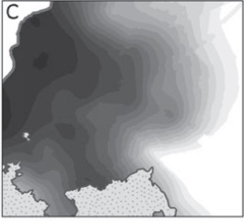
Review
Branches of spatial statistics
Continuous spatial analysis
Discrete spatial analysis
Spatial point processes
Sampled data
Rely upon spatially sampled measurement data
Global (i.e. model overall spatial autocorrelation in data)
Physical location of events in region
Global propensity to cluster or local spatial clusters of infection
Pullan et al (2012)

Slide 6
Review
Branches of spatial statistics
Continuous spatial analysis
Discrete spatial analysis
Spatial point processes
Sampled data
Point-level count data (prevalence/incidence)
Area-level count data (prevalence/incidence)
Point process data (event)

Slide 7
Terminology and overlap
Related to scale and sampling methods
Point-level data | Area data | Raster data | Point-process data
 | Areal data | Continuous data | Event data
 | Aggregate data | Grid data | Point data
Geostatistical data |  |  | Point-process data
Global |  |  | Local
Continuous variation |  |  | Point pattern
Clustering |  |  | Cluster detection
Spatial autocorrelation |  |  | Cluster analysis

Slide 8
Point-level vs Point-process data
 | Point-level data | Point process data
Measurement | Could in principle be measured anywhere, but typically come at a limited number of observation locations. | Corresponds to case-ascertainment.
Locations | Sampled locations usually based on “representativeness” or random sampling. | Usually event locations (i.e. incident case) over a given time frame and study region.
Analytic objectives | Pattern of observation locations itself usually not of primary interest – rather to infer aspects of the variable that have not been measured (i.e. prevalence over larger study area) | Determine whether the pattern of event locations contains clusters of events with increased risk of disease.
Outcome | Prevalence/Incidence (count) | Density

Slide 9
Content
  Overview of cluster analysis
    First- and second-order properties
    Stationary and Isotropy
  Global measures of clustering
    Moran’s I, Ripley’s K function
  Local measures of clustering
    Local Moran’s, scan statistics
  Theory of spatial point processes & hypothesis testing

Slide 10
Aims of cluster analysis
Are observed patterns ‘random’?
  point-processes define clustering as a departure from this randomness
What is the propensity for spatial clustering or locations of individual clusters (places with excess cases)?
  Surveillance systems
Where are areas with higher than expected risk?
  Target interventions to high risk areas; detect potential outbreaks
Over what scale does clustering occur?
  determine the optimal scale of interventions

Slide 11
Ways to define clustering
Global vs local clustering methods
  i.e. clustering vs cluster detection
Raw vs residual
  i.e. corrected for known risk factors
Scale
  Clustering likely to happen over multiple scales
  Clustering over larger spatial scales (and these tests of association) may mask more local clusters

Slide 12
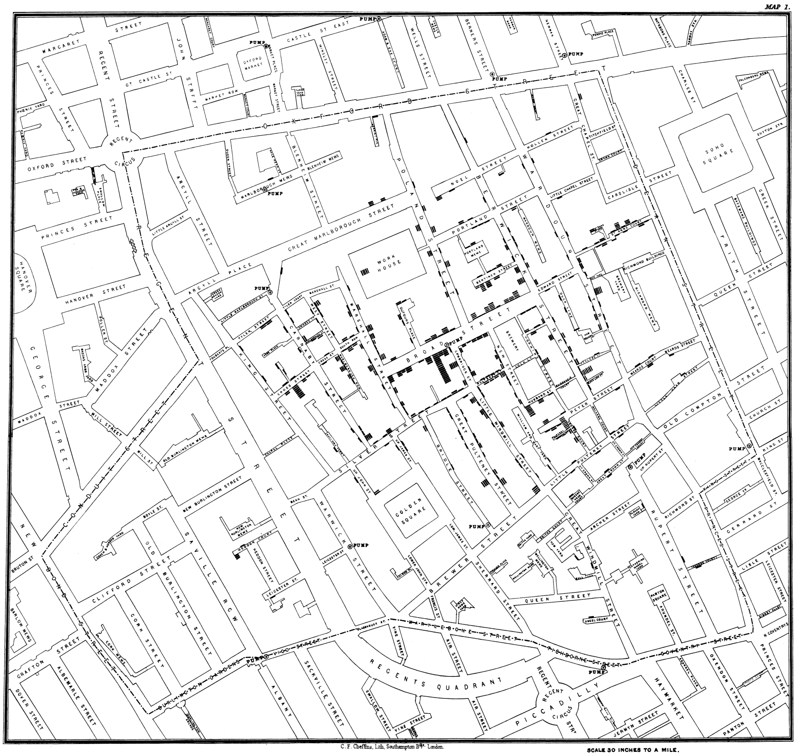
Broad Street Cholera Outbreak John Snow ~ 1854

Slide 13
Key statistical concepts
Spatial heterogeneity and dependence
  Stationary
  Isotropy
Variation amongst attribute values of a spatial process
  First-order spatial effects
  Second-order spatial effects

Slide 14
Stationary and Isotropy
A stationary process in one is which the relationship between two events depends only on their relative positions, not on the locations themselves
  (i.e. all properties of the process are invariant under translation)
Under the assumption of isotropy the relationship depends only on distance and not on direction/orientation to each other
  (e.g. invariant under rotation)

Slide 15
Variation amongst attribute values
(aka “first-order spatial effect”)
Variation in the mean
(aka “second-order spatial effect”
Residuals
Macro
Meso
Micro
Large scale trends
Geostatistical: mean of the outcome
Point process: mean intensity
Local dependence of spatial process & smaller scale interactions between neighbors
Geostatistical: autocorrelation
Point process: clusters

Slide 16
First-order characteristics (macro)
  Describe the way in which the expected value (mean or average) of the spatial point pattern varies across space (i.e., the density of the spatial point pattern)
  May be constant or spatially varying, but assumes that individual event locations are independent of one another (i.e. no spatial dependency).
  Measured by an intensity measure, e.g. quadrat estimation, kernel estimation
  Where do patterns appear to differ?

Slide 17
Second-order properties
(meso-/micro-)
  Inform on the interrelationship between events or spatial dependence.
  Measures by a dependence measure – e.g. nearest neighbor analysis, Ripley’s k-function
  Insight into global aspects of the point pattern, i.e. are there general patterns of clustering with respect to CSR or another pattern?

Slide 18
Aim of lecture
Determine whether disease clustering is statistically significant and worthy of further investigation
Later classes will focus on using some of the same concepts to produce smoothed risk maps or model spatial variation that is present (i.e. to model the mean risk or ensure standard errors are correct in the presence of spatial autocorrelation)

Slide 19
Main types of tests for spatial clusters
Global statistics
propensity for clustering anywhere in the study area, e.g. Ripley’s K-function, Cuzick & Edwards test for point data and Moran’s I for area data
Local statistics
cluster(s) in specific locations, e.g. Spatial scan statistic for point data and Getis and Ord’s local Gi(d) statistic for area data
Focused statistics
cluster(s) around a specific point source, e.g. Diggle’s method, Stone’s test, Bithell’s test

Slide 20
Data
Disease cluster investigations generally involve case data as either
  Case-control point data: point locations for each of a set of cases reported and a collection of non-cases (controls). “Marked point data”
    Malaria cases and population controls from Namibia
  Point-level & area-level data: reported counts of incident (newly diagnosed) or prevalent (existing) cases residing in particular areas within the study area
    Point prevalence of malaria in The Gambia

Slide 21
Global tests for spatial clustering using point-level and area data

Slide 22
Types of data & underlying assumptions
Autocorrelation statistics provide an estimate of the degree of spatial similarity observed among neighboring values of an attribute (i.e. disease prevalence) over a study area.
Requires:
  Definition of neighbors (distance-based or adjacency)
  Weights matrix (those close in space given greater weight)

Slide 23
Defining neighbors
Adjacency
first-order
Second-order
Distance-based
NB: may choose distance that allows each point/polygon at least one neighbor OR define spatial lags

Slide 24
Defining spatial weights
In order to calculate summary statistics, you have to assign spatial weights to each relationship
  Binary: used with fixed distance, K nearest neighbors, and contiguity spatial relationships. Neighbors =1, non-neighbors=0
  Variable: For inverse distance or inverse time spatial relationships, weights fall into a range from 0 to 1 with nearby neighbors getting larger weights than neighbors farther away.
Rule of thumb – stick to binary representation unless you know about the spatial process.
Default in R is “W” where the weights are standardized to sum to unit (aka row standardization).

Slide 25
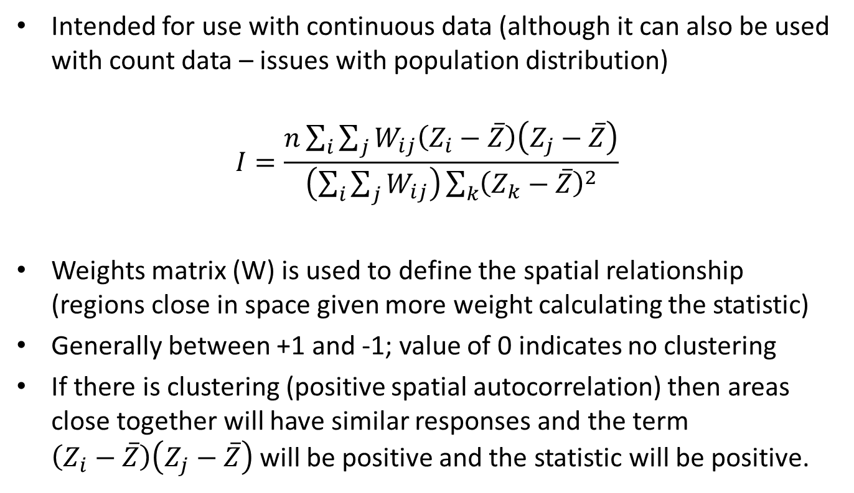
Moran’s I statistic
Intended for use with continuous data (although it can also be used with count data – issues with population distribution)
$$I=\frac{n\sum_{i}{\sum_{j}{W_{ij}\left(Z_{i}−\overline{Z}\right)\left(Z_{j}−\overline{Z}\right)}}}{\left(\sum_{i}{\sum_{j}{W_{ij}}}\right)\sum_{k}{{\left(Z_{k}−\overline{Z}\right)}^{2}}}$$
Weights matrix (W) is used to define the spatial relationship (regions close in space given more weight calculating the statistic)
Generally between +1 and -1; value of 0 indicates no clustering
If there is clustering (positive spatial autocorrelation) then areas close together will have similar responses and the term $\left(Z_{i}−\overline{Z}\right)\left(Z_{j}−\overline{Z}\right)$ will be positive and the statistic will be positive.

Slide 26
Correlogram of Moran’s I
Series of estimates of Moran’s I evaluated at increasing distances and plotted against one another – can help to determine where spatial autocorrelation is maximized.

Slide 27
Local tests for spatial clustering using point-level and area data

Slide 28
Local Indicators of Spatial Association (LISAs)
Global measures assume that the spatial process is stationary – if this is not true than tests can obscure local effects.
Particularly an issue with larger datasets because they summarize large amounts of potentially dissimilar information
LISAs scan the whole dataset but only measure dependence in limited portions of the study area
Detection of disease clusters……

Slide 29
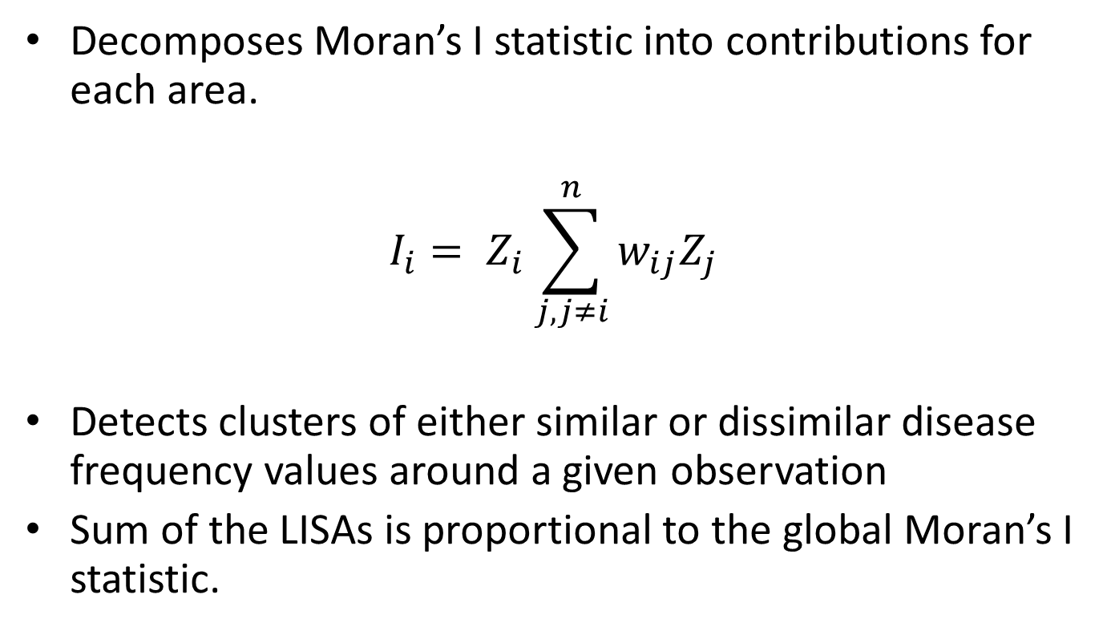
Local Moran’s
Decomposes Moran’s I statistic into contributions for each area.
$$I_{i}= Z_{i}\sum_{j, j≠i}^{n}{w_{ij}Z_{j}}$$
Detects clusters of either similar or dissimilar disease frequency values around a given observation
Sum of the LISAs is proportional to the global Moran’s I statistic.

Slide 30
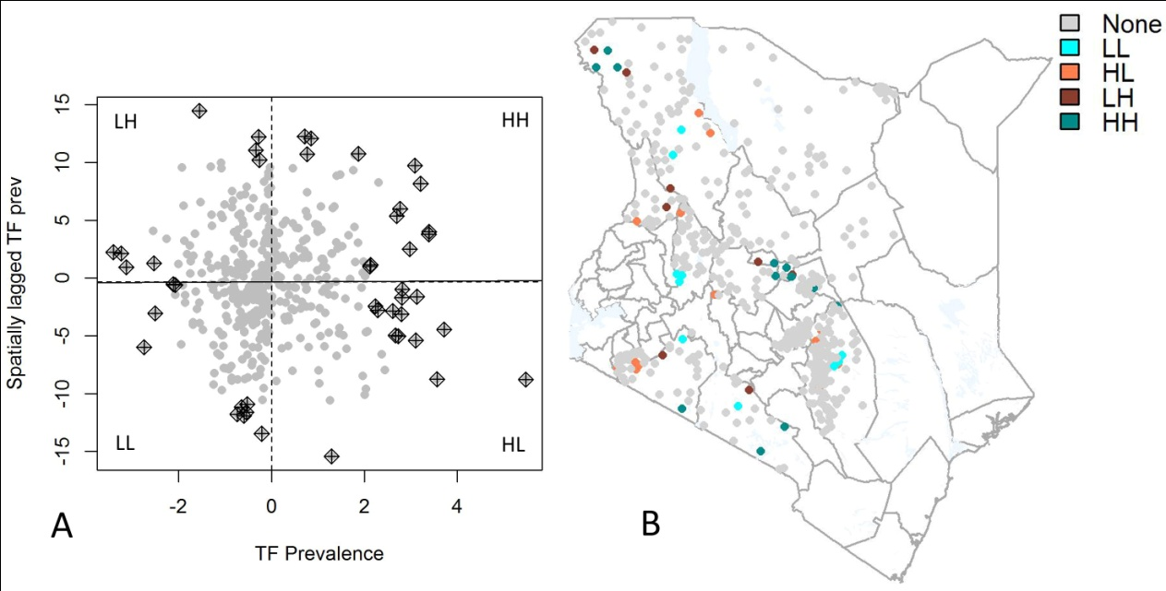

Slide 31
Hypothesis testing
Use simulation (Monte Carlo randomization) to assess the significance of clustering
  i.e. does the observed spatial pattern differ significantly from the null hypothesis of complete spatial randomness
Calculate the test statistic using the observed data and then re-calculating it using a specified number of simulated data sets (or permutations).
  Expected distribution of the test statistic under the null hypothesis
  Calculate the likelihood of obtaining the value for the test statistic derived from the observed data and expressed as the p-value = the proportion of the test statistic value (from the simulated data) that are greater than the value of the test statistic from the observed data.

Slide 32
Practical Part I: Methods for point-level data
Import point malaria prevalence data from the Gambia
Visualize data
Calculate global Moran’s I and a correlogram
Calculate local Moran’s I
**If you have time, carry out the global Moran’s I with the area-level data on Scottish lip cancer

Slide 33
Introduction to point processes

Slide 34
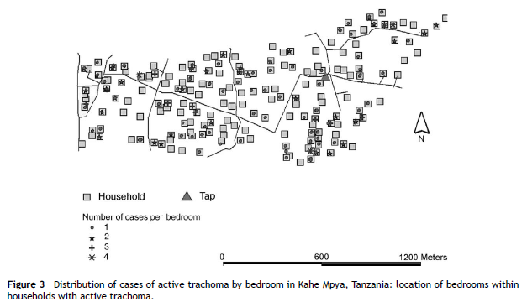
Properties of spatial point patterns
A point pattern is a set of locations
in a defined study region at which
events of interest have been
recorded
Key terms
Event – an occurrence of interest (e.g. incident case of disease)
Point – any location in the study area where an event could occur
(Event) Location – specific location where an event did occur
Data set – collection of observed event locations and a spatial domain of interest
Polack et al (2005)

Slide 35
General forms of point patterns
Random – a given point is equally likely to occur at any location and independent of other points
Regular – each point is as far from neighbour as possible
Clustered – some points clustered together, other areas contain no points

Slide 36
What is a point process?
An observed point pattern that can be described by a spatial stochastic process – probabilistic model defined by a collection of random variables (e.g. the amount of rainfall at a location), where each variable (X) represents the location of an event in space.
Any observed spatial point pattern can be considered an outcome (or a realisation) of a spatial stochastic process – i.e. a data set resulting from a particular model
Typically a Poisson process

Slide 37
Components of a point process
  First-order (mean) properties
    Describes the expected density of points through space.
    Quadrat and Kernel density estimation (next lecture)
  Second-order properties
    Informs on the interrelationship between events of the process
    Similar to variance and covariance
    Summarize spatial dependence between events over different spatial scales

Slide 38
Complete spatial randomness (CSR)
Homogeneous Poisson process (HPP)
Simplest theoretical model for a spatial point pattern (stationary; independence of points)
Events are distributed independently according to a uniform probability distribution over the region
Used as a benchmark for hypothesis testing – not useful if departure is obvious due to a priori heterogeneity (e.g. underlying population distribution)

Slide 39
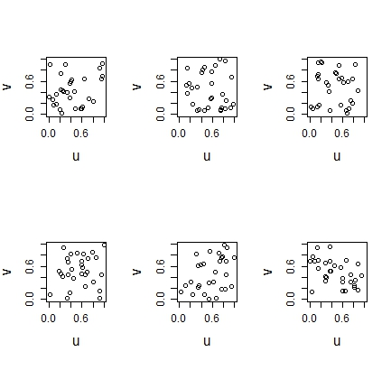
CSR II
Intensity of events is constant at all locations in the study area = homogenous
Realizations from the model can appear different

Slide 40
HPP vs IPP
Assumption of stationary is restrictive– the intensity is often not constant in the study area.
  We expect more cases in areas with more people at risk
  Risk may vary in space with other covariates
Heterogenous/inhomogenous Poisson process allows for spatially varying first-order (mean) property of the process.
No longer stationary
Allows for geographic variations in population size / other variation in risk

Slide 41
Edge effects
Boundaries of edges of an area may be incompatible (arbitrary), unavailable (another country) or non-existent (next to an ocean)
Points or area-units near edges will have fewer neighbors, which will be problematic when calculating mean intensity or test statistics for clustering.
Corrections usually use a weighting system to give less weight to observations at the edge

Slide 42
Global tests for spatial clustering using point (event) data

Slide 43
Ripley’s K function
Second-order analysis: Identifies the distance at which clustering occurs, based on the expected number of events within a distance, without regard to shape of study area and assuming no 1st order effects
Summarize spatial dependence between events at wide range of spatial scales
Number of events within a given spatial lag of a randomly chosen event
$$K \left(h\right)= \frac{E[number of events within h of a randomly chosen event]}{λ}$$

Slide 44
Observed spatial pattern
Expected random spatial pattern
Lower & upper confidence envelopes
K-function
Significant dispersion at larger distances
Significant dispersion at smaller distances
Distance
When observed K value is larger than the expected K value for a particular distance, the distribution is more clustered than a random distribution at that distance. When the observed K value is smaller than the expected K, the distribution is more dispersed than a random distribution at that distance. Statistical significance indicated by envelopes

Slide 45
Spatial clustering of malaria in Kenya
Comparison of clustering in differing valley systems in Kenya
U-shaped vs V-shaped
Cohorts of children aged 6-15 years
Geolocated households of participants
Wanjala, C. L., J. Waitumbi, et al. (2011). "Identification of malaria transmission and epidemic hotspots in the western Kenya highlands: its application to malaria epidemic prediction." Parasit Vectors 4: 81.

Slide 46
V-shaped valleys

Slide 47
U-shaped valleys

Slide 48
Limitations
K-function just for cases may not be useful due to variations in the spatial distribution of the population at risk
Can calculate the K-function for both cases and non-cases (controls) and estimate the difference in the two functions to represent a measures of the extra aggregation of cases above that observed in the general population.

Slide 49
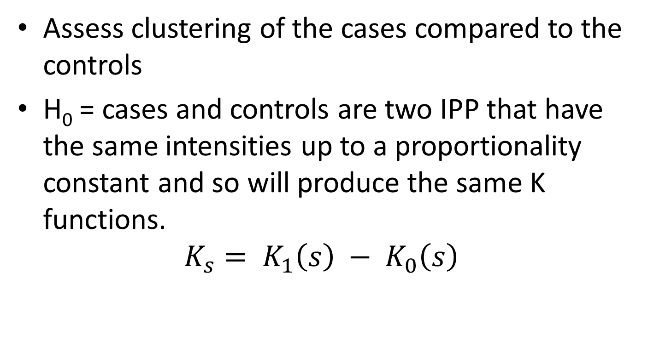
Difference in K-functions
Assess clustering of the cases compared to the controls
H₀ = cases and controls are two IPP that have the same intensities up to a proportionality constant and so will produce the same K functions.
$$K_{s}= K_{1}\left(s\right) − K_{0}\left(s\right)$$

Slide 50
Hypothesis testing
Monte Carlo randomization can be used to randomly permute the locations of cases and non-cases (controls)
Values of the difference function D(s) is computed for each permutation and then upper and lower bounds plotted.
Can use ClusterSeer or the splancs package in R

Slide 51
Practical Part IIa: Global cluster detection
Simulate point data within your study area that represent CSR
Visualize data
Use the case data in dataset 1 and Section 1 of the code in R use Ripley’s K to characterize clustering
  Is clustering present in the dataset?
  Over what scale is clustering present?
  What are the limitations of this approach
Estimate the difference in K-function for cases and controls

Slide 52
Local tests for spatial clustering using point process data

Slide 53
Spatial scan statistics
Calculations of intensity and K-functions not in many packages – other tests based on properties of heterogenous point process (i.e. number of events follows Poisson distribution)
Scan statistics – based on comparisons of local rate estimates
  Does the ratio of cases to controls (or cases per population at risk) appear “significantly” elevated in certain areas
  Similar to the comparison of intensity functions
  Goal is to detect specific clusters where the observed rate (or ratio) is inconsistent with the rate (or ratio) over the rest of the study area.

Slide 54
Kulldorff’s spatial scan statistic
This test detects spatial clusters based on a significant excess of cases within a moving cylindrical (or elliptical) window that systematically visits all spatial locations. Can be used for discrete (non-random and fixed locations) and continuous scan statistics (locations are random).
  Different types of probabilistic models for discrete scan statistics according to the underlying distribution of the population at risk.
  Poisson: number of events in a geographical location is poisson-distributed, according to a known underlying population at risk
  Bernoulli: 0/1 event data such as cases and controls
  Ordinal: Ordered categorical data
  Exponential: Survival time data
  Normal: Other types of continuous data

Slide 55
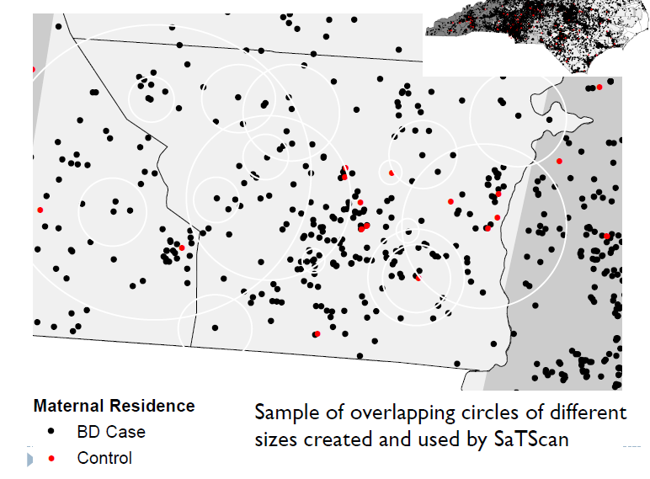
H₁ : there is an elevated risk within the window as compared to outside, for each location and size.
H₀: The risk of an event is the same within and outside the window
Create a grid of points (either as grid or population unit locations) throughout area
Creates an infinite number of circles of varying sizes around each point, maximum size = fixed proportion of pop.
Control
Malaria case

Slide 56
For each circle:
Obtain actual and expected number of events inside and outside the circle
Expected number of cases in each unit is proportional to the size of the population at risk
Calculate the likelihood function – likelihood of finding the observed number of events in each circle’
6/20 = 0.3
11/132 = 0.08
Household location
Control
Malaria case

Slide 57
Data input
Data can be either aggregated by administrative unit or other geographical level, or there may be unique coordinates for each observation.
SaTScan™ adjusts for the underlying spatial variation of a background population.
It can also adjust for any number of categorical covariates, as well as for temporal trends, known space-time clusters and missing data.

Slide 58
Common SatScan models
Poisson model: where the number of events in an area is Poisson distributed under the null hypothesis. Number of cases is compared to the background population data and the expected number of cases is proportional to the size of the population at risk in each circle.
Bernoulli model: with 0/1 event data such as cases and controls, where non-cases are taken to represent the background distribution population.

Slide 59
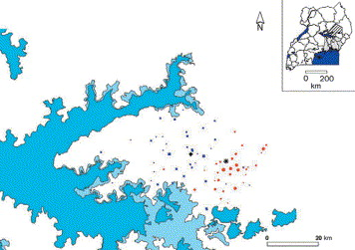
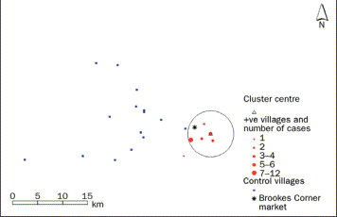
Epidemic of Trypanosoma brucei rhodesiense sleeping sickness in eastern Uganda
Spatial clustering of sleeping sickness around Brookes market, Soroti District, Uganda. The circle describes the area of the cluster (the triangle marks its centre) defined in the analysis, and includes 27 of 28 of the cases during the time period. Fevre et al. (2001). Lancet, 358: 625-628

Slide 60
Interpretation of spatial clusters
Possibility of false-positive clusters
  Inaccurate and non-standardised case definition
  Inadequate control of confounding variables
  Error in exposure measurement
  Influence of arbitrary assumptions, e.g. scanning window size and upper cluster size threshold
Rarely leads to aetiologically important insights as diseases always cluster (in space and time) and better to adopt traditional epidemiological hypothesis-driven investigation (Kenneth Rothman. Am J Epidemiol. 1990. 132 (supp1), S6-13)
For example, whilst numerous cancer clusters have been detected, none have been linked to an environmental pollutant or infectious agent (Alexander & Boyle, 2001)

Slide 61
Practical Part IIb: Cluster analysis with point process data
Export the case-control data required for SatScan as detailed at the end of Lab2_PointProcess.R
Run the analysis in SatScan
  What model will you be using?
Compare SatScan results using spscan.test in the “smacpod” library in R

