Slide 1
Biostat 200
Lecture 7

Slide 2
Outline for today
Hypothesis tests so far
  One mean, one proportion, 2 means, 2 proportions
Comparison of means of multiple independent samples (ANOVA)
Non parametric tests
  For paired data
  For 2 independent samples
  For multiple independent samples

Slide 3
Hypothesis tests so far
Dichotomous data
Test of one proportion:
  Null hypothesis p=p₀ (two-sided)
  Test statistic z = (p̂ - p₀) / √(p₀(1- p₀)/n)
Proportion test for two independent samples
  Null hypothesis p₁=p₂ (two-sided)
  Test statistic

Slide 4
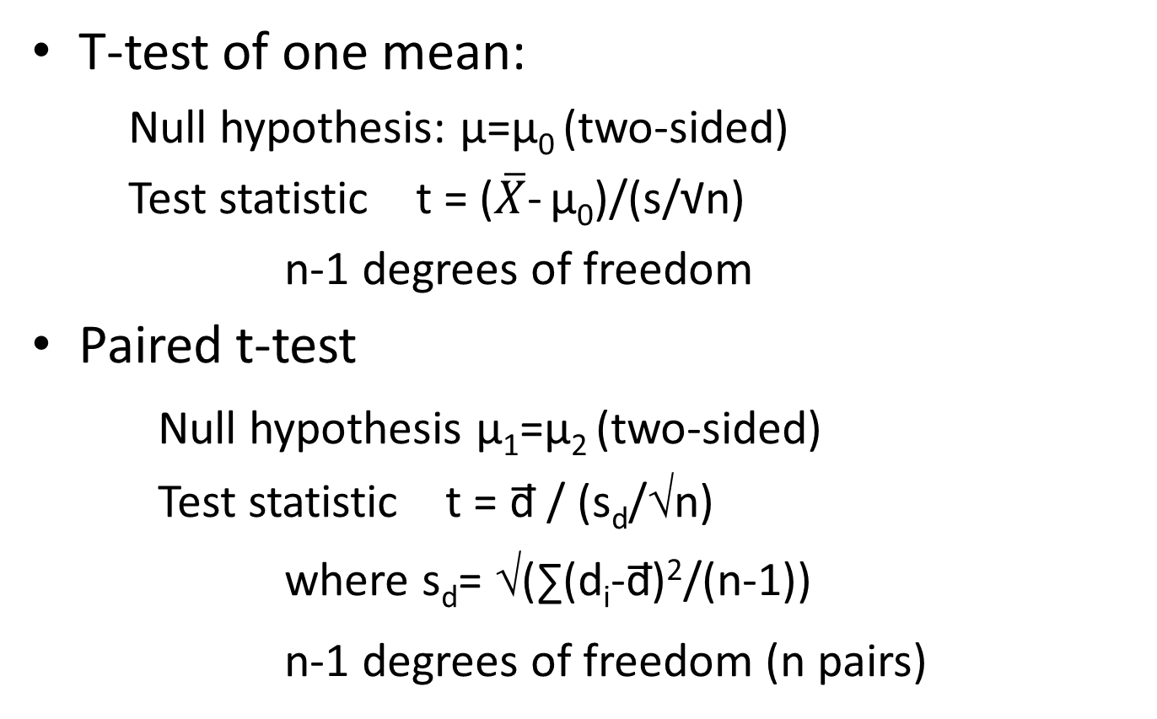
Hypothesis tests so far
Numerical data

Slide 5
Hypothesis tests so far
Numerical data
Independent samples t-test
  Null hypothesis µ₁=µ₂ (two-sided)
  Test statistic t = ( x̅₁ - x̅₂ ) / SE(diff between means)
  SE and degrees of freedom depend on assumption of equal or unequal variances

Slide 6
Comparing the t-tests
Example:
N1=20 s1²=3
N2=40 s2²=5
S_{p}²=(19*3+39*5)/58=4.34
T_{stat denominator} =
sqrt(4.34/20+4.34/40)
=0.571
Degrees of freedom = 58
T_{stat denom, unequal =}sqrt(3/20+5/40)
=0.524
Degrees of freedom =47.7

Slide 7
T-test: equal or unequal variance?
Why can’t we just do a test to see if the variances in the groups are equal, to decide which t-test to use?
  “It is generally unwise to decide whether to perform one statistical test on the basis of the outcome of another”
  The reason has to do with Type I error (multiple comparisons, discussed later)
  You are better off always assuming unequal variance if your data are approximately normal
Ruxton GD. Behavioral Ecology 2006

Slide 8
Statistical hypothesis tests
Data and comparison type | Alternative hypotheses | Test and Stata command
Numerical; One mean | H_{a}: μ≠ μ_{a} (two-sided) H_{a}: μ>μ_{a} or μ<μ_{a} (one-sided) | Z or t-test ttest var1==hypoth val.*
Numerical; Two means, paired data | H_{a}: μ₁ ≠ μ₂ (two-sided) H_{a}: μ₁ >μ₂ or μ<μ_{a} (one-sided) | Paired t-test ttest var1==var2*
Numerical; Two means, independent data | H_{a}: μ₁ ≠ μ₂ (two-sided) H_{a}: μ₁ >μ₂ or μ<μ_{a} (one-sided) | T-test (equal or unequal variance) ttest var1, by(byvar) unequal
Numerical; Two or more means, independent data
Dichotomous; One proportion | H_{a}: p≠ p_{a} (two-sided) H_{a}: p>p_{a} or p<p_{a} (one-sided) | Proportion test prtest var1==hypoth value* bitest var1=hypoth value
Dichotomous; two proportions | H_{a}: p₁≠ p₂ (two-sided) H_{a}: p₁ >p₂ (one-sided) | Proportion test (z-test) prtest var1, by(byvar)
Categorical by categorical (nxk)
Notes:
*Can be written =

Slide 9
Comparison of several means
The extension of the t-test to several independent groups is called analysis of variance or ANOVA
Why is it called analysis of variance?
  Even though your hypothesis is about the means, the test actually compares the variability between groups to the variability within groups

Slide 10
Analysis of variance
The null hypothesis is:
  H₀: all equal means μ₁=μ₂=μ₃=…
  The alternative H_{A} is that at least one of the means differs from the others

Slide 11
Analysis of variance
Why can’t we just do t-tests on the pairs of means?
  Multiple comparison problem
  What is the probability that you will incorrectly reject H₀ at least once when you run n independent tests (H₀ is true), when the probability of incorrectly rejecting the null on each test is 0.05?

Slide 12
Analysis of variance
This is P(X≥1) with p=0.05, n=number of tests
X=the number of times the null is incorrectly rejected
P(X≥1) = 1-P(X=0)
P(X=0)= (n choose 0) (.05)⁰(1-.05)^{n-0}
For n=4
  di 1-(1-.05)^4
  .18549375
Using the binomial
  di binomialtail(4,1,.05)
  .18549375
Notes:
So we do not do multiple tests because the probability of incorrectly rejecting the quickly becomes high.

Slide 13
Comparison of several means: analysis of variance
We calculate the ratio of:
  The between group variability
    The variability of the sample means around the overall (or grand) mean
  to the overall within group variability

Slide 14
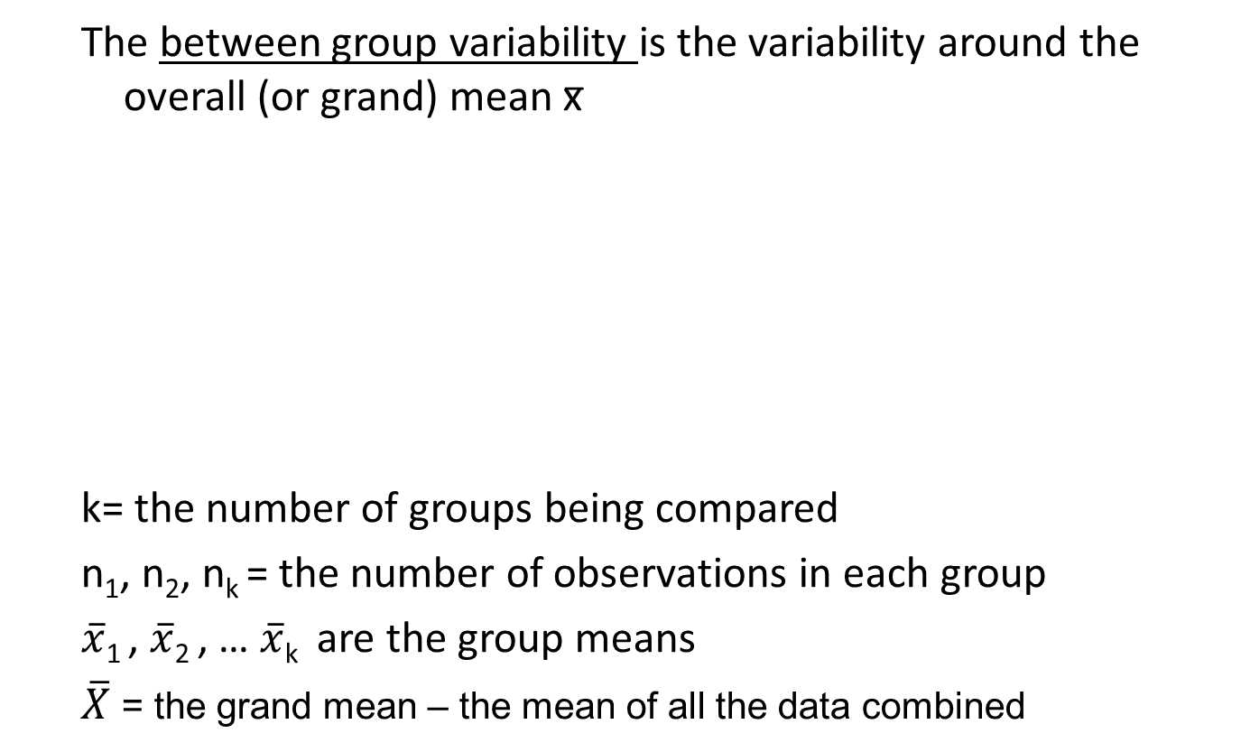
Between group variability

Slide 15
Within group variability
The within group variability is a weighted average of the sample variances within each group
  k= the number of groups being compared
  n₁, n₂, n_{k} = the number of observations in each group
  s₁² , s₂² , …, s_{k}² are the sample variances in each group

Slide 16
Comparison of several means: analysis of variance
The test statistic is
We compare the F statistic to the F-distribution, with k-1 and n-k degrees of freedom
  k=the number of groups being compared
  n=the total number of observations

Slide 17
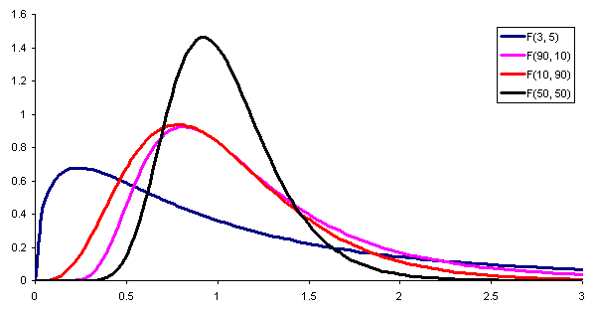
F-distribution
Notes:
Note that the distribution becomes more symmetric as the numerator degrees of freedom increases – i.e. as the number of groups increases.

Slide 18
ANOVA assumptions
The underlying data came from normally distributed populations
The observations are independent
The variance within each group over all groups (homoscedasticity)

Slide 19
ANOVA example
Does CD4 count at time of testing differ by drinking category?
*Using vct_baseline_biostat200_v1.dta **
hist cd4count, by(lastalc_3) percent fcolor(blue)

Slide 20
graph box cd4count, over(lastalc_3)

Slide 21
ANOVA example
tabstat cd4count, by(lastalc_3) s(n mean sd min median max)
Summary for variables: cd4count
by categories of: lastalc_3 (RECODE of lastalc (E1. Last time took alcohol))
lastalc_3 | N mean sd min p50 max
-----------------+------------------------------------------------------------
Never | 373 317.1475 253.4013 1 283 1601
>1 year ago | 180 305.3778 266.9453 2 248.5 1461
Within the past | 441 349.8662 273.9364 3 308 1932
year |
-----------------+------------------------------------------------------------
Total | 994 329.5322 265.5157 1 285 1932
------------------------------------------------------------------------------

Slide 22
ANOVA example
CD4 count, by alcohol consumption category
oneway var groupvar
. oneway cd4count lastalc_3
Analysis of Variance
Source SS df MS F Prob > F
------------------------------------------------------------------------
Between groups 344571.162 2 172285.581 2.45 0.0867
Within groups 69660550.3 991 70293.189
------------------------------------------------------------------------
Total 70005121.5 993 70498.6118
Bartlett's test for equal variances: chi2(2) = 2.4514 Prob>chi2 = 0.294
k=3 groups, n=994 total observations. n-k=991
. di Ftail(2,991,2.45)
.08681613
Notes:
SS stands for sum of squares
MS stands for mean squares
Bartlett’s test tests for non-equal variances and also departure from normality

Slide 23
ANOVA example
. oneway cd4count lastalc_3
Analysis of Variance
Source SS df MS F Prob > F
------------------------------------------------------------------------
Between groups 344571.162 2 172285.581 2.45 0.0867
Within groups 69660550.3 991 70293.189
------------------------------------------------------------------------
Total 70005121.5 993 70498.6118
Bartlett's test for equal variances: chi2(2) = 2.4514 Prob>chi2 = 0.294
This is the sample variance if you lumped all the CD4 counts together

Slide 24
ANOVA
Note that if you only have two groups, you will reach the same conclusion running an ANOVA as you would with a t-test
The test statistic F_{stat} will equal (t_{stat})²

Slide 25
T-test vs. F test (ANOVA) example
. oneway cd4count sex
Analysis of Variance
Source SS df MS F Prob > F
------------------------------------------------------------------------
Between groups 521674.035 1 521674.035 7.41 0.0066
Within groups 70155332.6 997 70366.4319
------------------------------------------------------------------------
Total 70677006.7 998 70818.6439
Bartlett's test for equal variances: chi2(1) = 0.0472 Prob>chi2 = 0.828

Slide 26
T-test vs. F test (ANOVA) example
. ttest cd4count, by(sex)
Two-sample t test with equal variances
------------------------------------------------------------------------------
Group | Obs Mean Std. Err. Std. Dev. [95% Conf. Interval]
---------+--------------------------------------------------------------------
1 | 374 299.6925 13.6301 263.5935 272.891 326.494
2 | 625 346.9104 10.65047 266.2618 325.9953 367.8255
---------+--------------------------------------------------------------------
combined | 999 329.2332 8.419592 266.1177 312.7111 345.7554
---------+--------------------------------------------------------------------
diff | -47.21789 17.34162 -81.24815 -13.18762
------------------------------------------------------------------------------
diff = mean(1) - mean(2) t = -2.7228
Ho: diff = 0 degrees of freedom = 997
Ha: diff < 0 Ha: diff != 0 Ha: diff > 0
Pr(T < t) = 0.0033 Pr(|T| > |t|) = 0.0066 Pr(T > t) = 0.9967
. di 2.7228^2
7.4136398

Slide 27
Multiple comparisons
If we reject H₀ , we might want to know which means differed from each other
But as noted before, if you test all combinations, you increase your chance of rejecting the null incorrectly
To be conservative, we reduce the level of α, that is we will reject the p-value at a level smaller than the original α

Slide 28
Bonferroni method for multiple comparisons
The Bonferroni methods divides α by the number of possible pairs of tests
Example: if you have 3 groups and you started with α=0.05 then α* = 0.05 / (3 choose 2)
= 0.05 / 3 = 0.01677
This means that you will only reject if p<0.017

Slide 29
Multiple comparisons with ANOVA
Use a t-test, but use the within group variance s_{w}² that weights over all the groups (not just the 2 being examined)
The test statistic for each pair of means is:
  and the degrees of freedom are n-k where n is the total number of observations and k is the total number of groups (note difference from regular t-test)
Reject if the p-value is <α*
  (Note: This is if you are doing the test by hand; if you use Stata option Bonferroni reject if p< α)

Slide 30
Multiple comparisons
. oneway cd4count lastalc_3, bonferroni
Analysis of Variance
Source SS df MS F Prob > F
------------------------------------------------------------------------
Between groups 344571.162 2 172285.581 2.45 0.0867
Within groups 69660550.3 991 70293.189
------------------------------------------------------------------------
Total 70005121.5 993 70498.6118
Bartlett's test for equal variances: chi2(2) = 2.4514 Prob>chi2 = 0.294
Comparison of CD4Count by RECODE of lastalc (E1. Last time took alcohol)
(Bonferroni)
Row Mean-|
Col Mean | Never >1 year
---------+----------------------
>1 year | -11.7697
| 1.000
|
Within t | 32.7188 44.4884
| 0.239 0.174
Difference between the 2 means
p-value for the difference, already adjusted for the fact that you are doing multiple comparisons (so reject if p<α)
Notes:
You could run: ttest cd4count if lastalc_3 != 0, by(lastalc_3) to get the ttest for only that one comparison. The p-value for that is 0.065. It is not the same because when you do the Bonferroni t-test, the SD estimate and the degrees of freedom differ from the t-test.

Slide 31
Statistical hypothesis tests
Data and comparison type | Alternative hypotheses | Test and Stata command
Numerical; One mean | H_{a}: μ≠ μ_{a} (two-sided) H_{a}: μ>μ_{a} or μ<μ_{a} (one-sided) | Z or t-test ttest var1=hypoth val.*
Numerical; Two means, paired data | H_{a}: μ₁ ≠ μ₂ (two-sided) H_{a}: μ₁ >μ₂ or μ<μ_{a} (one-sided) | Paired t-test ttest var1=var2*
Numerical; Two means, independent data | H_{a}: μ₁ ≠ μ₂ (two-sided) H_{a}: μ₁ >μ₂ or μ<μ_{a} (one-sided) | T-test (equal or unequal variance) ttest var1, by(byvar) unequal
Numerical, Two or more means, independent data | H_{a}: μ₁ ≠ μ₂ or μ₁ ≠ μ₃ or μ₂ ≠ μ₃ etc. | ANOVA oneway var1 byvar
Dichotomous; One proportion | H_{a}: p≠ p_{a} (two-sided) H_{a}: p>p_{a} or p<p_{a} (one-sided) | Proportion test prtest var1=hypoth value* bitest var1=hypoth value
Dichotomous; two proportions | H_{a}: p₁≠ p₂ (two-sided) H_{a}: p₁ >p₂ (one-sided) | Proportion test (z-test) prtest var1, by(byvar)
Categorical by categorical (nxk)
Notes:
*Can be written ==

Slide 32
Parametric hypothesis test assumptions
The hypothesis tests that use the z-statistic (i.e. when σ is known) assume that the underlying distribution of the parameter we are estimating (sample mean, sample proportion) is approximately normal.
  True under the CLT if n is large enough.
However, we usually do not know σ, and we use s² and compare our test statistic to the t-distribution. In theory, for this to work, the underlying distribution of the data must be normal, but in practicality, if n is fairly large and there are no extreme outliers, the t-test is valid.

Slide 33
Test assumptions
However, if the data are not normally distributed, the t-test is not the most powerful test to use. (Note: less powerful does not mean invalid)
  E.g. outliers will inflate the sample variance, decreasing the test statistic, thereby decreasing the chances of rejecting the null when it is false.
Non-parametric tests do not rely on assuming a distribution for the underlying data and therefore can help with this.
Note that the independence of your observations is more critical than normality.
  If your data points are not independent and you treat them as if they are, you will be acting like you have more data than you actually do (making you more likely to reject the null)

Slide 34
Differences log PEth (from 0-3 months)
* Using BREATH wide data.dta from Lecture 6 *
hist peth_diff, fcolor(blue) normal percent

Slide 35
Nonparametric tests for paired observations
The Sign test
  For paired or matched observations (analogous to the paired t-test)
  H₀ : median₁ = median₂
  Most useful when
    the sample size is small
    OR the distribution of differences is very skewed

Slide 36
Nonparametric tests for paired observations
The Sign test
  The differences between the pairs are given a sign:
    + if a positive difference
    – if a negative difference
    nothing if the difference=0
  Count the number of +s , denoted by D

Slide 37
Nonparametric tests for paired observations
Under H₀, ½ the differences will be +s and ½ will be –s
  That is, D/n= .5
This is equivalent to saying that the each difference is a Bernoulli random variable, that is, each is + or – with probability p=.5
Then the total number of +s (D) is a binomial random variable with p=0.5 and with n trials

Slide 38
Nonparametric tests for paired observations
So then the p-value for the hypothesis test is the probability of observing D + differences if the true distribution is binomial with parameters n and p=0.5
P(X=D) with n trials and p=0.5
You could use the binomialtail function
For a one-sided hypothesis:
    di binomialtail(n,D,.5)
For a two-sided hypothesis:
    di 2*binomialtail(n,D,.5)

Slide 39
PEth results on 2 interviews
list studyid peth0_log10 peth3_log10 peth_diff in 1/10
+-------------------------------------------+
| studyid peth0~10 peth3~10 peth_diff | sign
|-------------------------------------------|
1. | MBB2001 2.054766 1.950681 -.104085 | -
2. | MBB2002 .30103 .30103 0 | .
3. | MBB2006 .30103 .30103 0 | .
4. | MBB2007 .30103 .30103 0 | .
5. | MBB2008 1.388012 1.575477 .1874642 | +
|-------------------------------------------|
6. | MBB2011 .30103 .30103 0 | .
7. | MBB2013 .30103 .30103 0 | .
8. | MBB2016 2.122216 .30103 -1.821186 | -
9. | MBB2021 1.341533 1.348207 .0066741 | +
10. | MBB2022 .30103 1.111766 .8107364 | +
+-------------------------------------------+
** Using BREATH wide data.dta
** 1st 10 observations *

Slide 40
Sign test
. gen spd=sign(peth_diff)
. tab spd
spd | Freq. Percent Cum.
------------+-----------------------------------
-1 | 76 42.94 42.94
0 | 45 25.42 68.36
1 | 56 31.64 100.00
------------+-----------------------------------
Total | 177 100.00
D=76 negative differences
N=177-45=132 (don’t count the 45 ties)
Using binomial distribution
  . . di 2*binomialtail(132,76,.5)
  .09781221

Slide 41
In Stata
signtest var1=var2
. signtest peth3_log10=peth0_log10
Sign test
sign | observed expected
-------------+------------------------
positive | 56 66
negative | 76 66
zero | 45 45
-------------+------------------------
all | 177 177
One-sided tests:
Ho: median of peth3_l~10 - peth0_log10 = 0 vs.
Ha: median of peth3_l~10 - peth0_log10 > 0
Pr(#positive >= 56) =
Binomial(n = 132, x >= 56, p = 0.5) = 0.9664
Ho: median of peth3_l~10 - peth0_log10 = 0 vs.
Ha: median of peth3_l~10 - peth0_log10 < 0
Pr(#negative >= 76) =
Binomial(n = 132, x >= 76, p = 0.5) = 0.0489
Two-sided test:
Ho: median of peth3_l~10 - peth0_log10 = 0 vs.
Ha: median of peth3_l~10 - peth0_log10 != 0
Pr(#positive >= 76 or #negative >= 76) =
min(1, 2*Binomial(n = 132, x >= 76, p = 0.5)) = 0.0978
NOTE that there is only 1 = in the command!
Uses the larger of the number of positive or negative signed pairs
Notes:
Peth3_log10 and peth0_log10 are the 3 month and 0 month log(peth) values. You do not need to make a variable to represent the differences.

Slide 42
Nonparametric tests for paired observations
Note that the Sign test can be used for ordinal data
The sign test does not account for the magnitude of the difference in the outcome variable
Another test, the Wilcoxon Signed-Rank Test, ranks the differences in the pairs

Slide 43
Nonparametric tests for paired observations: Wilcoxon Signed-Rank Test
Null hypothesis :
  median₁ = median₂
The differences in the pairs are ranked
Ties are given the average rank of the tied observations
Each rank is assigned a sign (+/-) depending on whether the difference is positive or negative
The ranks for the positives and the negatives are added up separately; the absolute value of the smaller sum of the ranks is called T

Slide 44
Nonparametric tests for paired observations
  T follows a normal distribution with mean m_{T} and standard deviation σ_{T}
    m_{T} = n*(n+1)/4 (the rank sum if both medians were equal)
  The test statistic z_{T} = ( T- m_{T} )/ σ_{T}
  Compare to the standard normal distribution
  For n<12, use the exact distribution, table A.6

Slide 45
+------------------------------------------------------+
| uarto_id auditc~2 auditc~1 auditc~f rankdiff |
|------------------------------------------------------|
1. | MBA1007 0 0 0 10 |
2. | MBA1017 0 0 0 10 |
3. | MBA1041 2 0 2 25.5 |
4. | MBA1045 0 0 0 10 |
5. | MBA1053 0 0 0 10 |
|------------------------------------------------------|
6. | MBA1079 0 0 0 10 |
7. | MBA1121 1 0 1 21.5 |
8. | MBA1125 0 0 0 10 |
9. | MBA1135 0 0 0 10 |
10. | MBA1206 7 5 2 25.5 |
|------------------------------------------------------|
11. | MBA1233 0 0 0 10 |
12. | MBA1237 0 0 0 10 |
13. | MBA1256 0 0 0 10 |
14. | MBA1257 2 0 2 25.5 |
15. | MBA1317 0 0 0 10 |
|------------------------------------------------------|
16. | MBA1323 0 0 0 10 |
17. | MBA1429 0 0 0 10 |
18. | MBA1446 0 0 0 10 |
19. | MBA1494 0 0 0 10 |
20. | MBA1362 1 0 1 21.5 |
|------------------------------------------------------|
21. | MBA1128 1 0 1 21.5 |
22. | MBA1243 1 0 1 21.5 |
23. | MBA1312 1 . . . |
24. | MBA1280 3 3 0 10 |
25. | MBA1139 0 0 0 10 |
|------------------------------------------------------|
26. | MBA1303 3 . . . |
27. | MBA1339 4 4 0 10 |
28. | MBA1346 3 1 2 25.5 |
29. | MBA1217 0 0 0 10 |
30. | MBA1498 3 0 3 28 |
+------------------------------------------------------+
egen pethrank_diff=rank(peth_diff)
. list studyid peth3_log10 peth0_log10 peth_diff pethrank_diff in 1/20
+------------------------------------------------------+
| studyid peth3~10 peth0~10 peth_diff pethra~f |
|------------------------------------------------------|
1. | MBB2001 1.950681 2.054766 -.104085 65 |
2. | MBB2002 .30103 .30103 0 99 |
3. | MBB2006 .30103 .30103 0 99 |
4. | MBB2007 .30103 .30103 0 99 |
5. | MBB2008 1.575477 1.388012 .1874642 139 |
|------------------------------------------------------|
6. | MBB2011 .30103 .30103 0 99 |
7. | MBB2013 .30103 .30103 0 99 |
8. | MBB2016 .30103 2.122216 -1.821186 3 |
9. | MBB2021 1.348207 1.341533 .0066741 124 |
10. | MBB2022 1.111766 .30103 .8107364 170 |
|------------------------------------------------------|
11. | MBB2025 1.026124 2.054287 -1.028163 11 |
12. | MBB2026 1.717338 2.329398 -.6120603 26 |
13. | MBB2027 1.659488 .30103 1.358458 174 |
14. | MBB2029 .30103 .30103 0 99 |
15. | MBB2030 .30103 .30103 0 99 |
|------------------------------------------------------|
16. | MBB2032 .30103 .30103 0 99 |
17. | MBB2035 .30103 1.245883 -.9448526 16 |
18. | MBB2036 .30103 .30103 0 99 |
19. | MBB2040 1.650939 2.472025 -.821086 20 |
20. | MBB2041 2.856124 2.512551 .3435733 152 |
+------------------------------------------------------+
.

Slide 46
signrank var1 = var2
. signrank peth3_log10=peth0_log10
Wilcoxon signed-rank test
sign | obs sum ranks expected
-------------+---------------------------------
positive | 56 5882 7359
negative | 76 8836 7359
zero | 45 1035 1035
-------------+---------------------------------
all | 177 15753 15753
unadjusted variance 466026.25
adjustment for ties -0.13
adjustment for zeros -7848.75
----------
adjusted variance 458177.38
Ho: peth3_log10 = peth0_log10
z = -2.182
Prob > |z| = 0.0291
This is a two-sided p-value arrived at using
di 2*(normal(-2.182))
.02910953
If you wanted a one-sided test, use
. di normal(-2.182)
.01455477

Slide 47
Nonparametric tests for two independent samples (e.g. 2 arms of the study)
The Wilcoxon Rank Sum Test
  Also called the Mann-Whitney U test
Null hypothesis :
  median₁ = median₂
Samples from independent populations – analogous to the t-test
Assumes that the distributions of the 2 groups have the same shape
Notes:
Remember, the last 2 tests (the sign test and the signed rank test or Wilcoxon test) were for PAIRED data. Now we will look at further tests for independent samples.

Slide 48
Nonparametric tests for two independent samples
The entire sample (including the members of both groups) is ranked
Average rank is given to ties
Add up the ranks for each of the 2 samples – smaller sum is W
The test statistic z_{W} = ( W- m_{W} )/ σ_{W} is compared to the normal distribution (see P+G page 310 for the formula)
If the sample sizes are small (<10), exact distributions are needed – Table A.7

Slide 49
ranksum var, by(byvar)
. ranksum peth_log10, by(studyarm)
Two-sample Wilcoxon rank-sum (Mann-Whitney) test
studyarm | obs rank sum expected
-------------+---------------------------------
Cohort asses | 181 25643.5 26064
Min assessed | 106 15684.5 15264
-------------+---------------------------------
combined | 287 41328 41328
unadjusted variance 460464.00
adjustment for ties -20670.38
----------
adjusted variance 439793.62
Ho: peth_~10(studyarm==Cohort assessed) = peth_~10(studyarm==Min assessed)
z = -0.634
Prob > |z| = 0.5260
** Using BREATH cohort and comparisons_v2.dta **
This is a two-sided p-value arrived at using
di 2*normal(-0.634)
.52608082
If you wanted a one-sided test, use
.di normal(-0.634)
.26304041
Notes:
How does this compare to the t-test we ran last week?

Slide 50
. ttest peth_log10, by(studyarm)
Two-sample t test with equal variances
------------------------------------------------------------------------------
Group | Obs Mean Std. Err. Std. Dev. [95% Conf. Interval]
---------+--------------------------------------------------------------------
Cohort a | 181 1.406739 .0709392 .9543891 1.26676 1.546718
Min asse | 106 1.490502 .0897145 .9236671 1.312615 1.668389
---------+--------------------------------------------------------------------
combined | 287 1.437676 .0556285 .942407 1.328183 1.547169
---------+--------------------------------------------------------------------
diff | -.0837633 .1153577 -.3108244 .1432978
------------------------------------------------------------------------------
diff = mean(Cohort a) - mean(Min asse) t = -0.7261
Ho: diff = 0 degrees of freedom = 285
Ha: diff < 0 Ha: diff != 0 Ha: diff > 0
Pr(T < t) = 0.2342 Pr(|T| > |t|) = 0.4684 Pr(T > t) = 0.7658

Slide 51
Nonparametric tests for multiple independent samples
The Kruskal-Wallis test extends the Wilcoxon rank sum test to 2 or more independent samples
  You could use the Kruskal-Wallis with 2 independent samples and reach the same conclusion as if you had used the Wilcoxon
Analogous to one-way analysis of variance

Slide 52
Nonparametric tests for independent samples (Kruskal Wallis)
kwallis var , by(byvar)
. kwallis cd4count, by(lastalc_3)
Kruskal-Wallis equality-of-populations rank test
+----------------------------------------+
| lastalc_3 | Obs | Rank Sum |
|----------------------+-----+-----------|
| Never | 373 | 181395.00 |
| >1 year ago | 180 | 83338.00 |
| Within the past year | 441 | 229782.00 |
+----------------------------------------+
chi-squared = 6.134 with 2 d.f.
probability = 0.0466
chi-squared with ties = 6.134 with 2 d.f.
probability = 0.0466

Slide 53
. oneway cd4count lastalc_3
Analysis of Variance
Source SS df MS F Prob > F
------------------------------------------------------------------------
Between groups 344571.162 2 172285.581 2.45 0.0867
Within groups 69660550.3 991 70293.189
------------------------------------------------------------------------
Total 70005121.5 993 70498.6118
Bartlett's test for equal variances: chi2(2) = 2.4514 Prob>chi2 = 0.294

Slide 54
Parametric vs. non-parametric (distribution free) tests
Non parametric tests:
  No normality requirement
  Do require that the underlying distributions being compared have the same basic shape
  Ranks are less sensitive to outliers and to measurement error
If the underlying distributions are approximately normal, then the parametric tests are more powerful

Slide 55
Statistical hypothesis tests
Data and comparison type | Alternative hypotheses | Parametric test Stata command | Non-parametric test Stata command
Numerical; One mean | H_{a}: μ≠ μ_{a} (two-sided) H_{a}: μ>μ_{a} or μ<μ_{a} (one-sided) | Z or t-test ttest var1=hypoth val.*
Numerical; Two means, paired data | H_{a}: μ₁ ≠ μ₂ (two-sided) H_{a}: μ₁ >μ₂ or μ<μ_{a} (one-sided) | Paired t-test ttest var1=var2* | Sign test signtest var1=var2 Wilcoxon Signed-Rank • signrank var1=var2
Numerical; Two means, independent data | H_{a}: μ₁ ≠ μ₂ (two-sided) H_{a}: μ₁ >μ₂ or μ<μ_{a} (one-sided) | T-test (equal or unequal variance) ttest var1, by(byvar) unequal | Wilcoxon rank-sum test or Mann-Whitney U test ranksum var1, by(byvar)
Numerical, Two or more means, independent data | H_{a}: μ₁ ≠ μ₂ or μ₁ ≠ μ₃ or μ₂ ≠ μ₃ etc. | ANOVA oneway var1 byvar | Kruskal Wallis test kwallis var1, by(byvar)
Dichotomous; One proportion | H_{a}: p≠ p_{a} (two-sided) H_{a}: p>p_{a} or p<p_{a} (one-sided) | Proportion test prtest var1=hypoth value* bitest var1=hypoth value
Dichotomous; two proportions | H_{a}: p₁≠ p₂ (two-sided) H_{a}: p₁ >p₂ (one-sided) | Proportion test (z-test) prtest var1, by(byvar)
Categorical by categorical (nxk) | H_{a} : The rows not independent of the columns
Notes:
*Can be written ==

Slide 56
For next time
Read Pagano and Gauvreau
  Pagano and Gauvreau Chapters 12-13 (review)
  Pagano and Gauvreau Chapter 15

