Slide 1
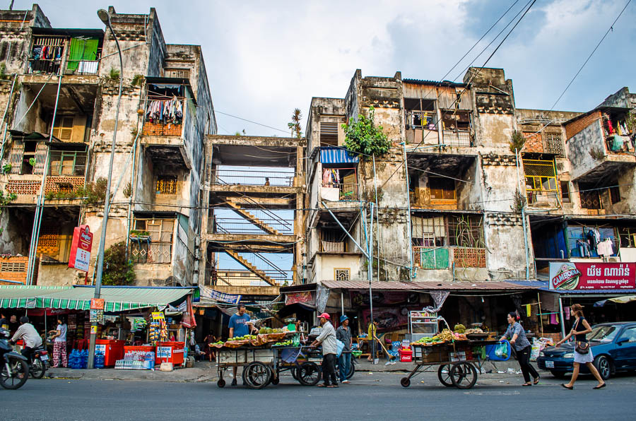
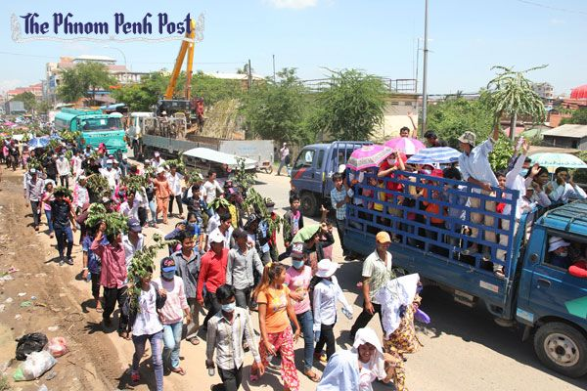
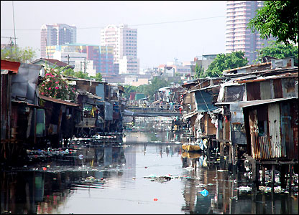
Urban Demography
Emily Treleaven, MPH
UCSF Department of Social and Behavioral Sciences
October 26, 2015

Slide 2
Outline
Definitions
Trends & projections for urbanization
Why is the world urbanizing?
Consequences of urban residence for health

Slide 3
Definitions
Urban: Spatial concentration of people whose lives are organized around non-agricultural activities; function of:
    Population size
    Land area
    Ratio of population to space (density)
    Economic and social organization
Urbanization: Process of social change and reorganization into cities and towns from rural areas, marked by shifts away from agriculture, and changes in social institutions and values
    % of population living in urban areas
    Rate of urbanization: Growth rate of level of urbanization
Urban transition: Predominantly rural predominantly urban
Notes:
Urban transition closely tied to migration
In most countries, a large part of the urban population actually lives in relatively small towns and villages. The urban population may also be thought of more as nonagricultural than urban in the way that we in SF or other major cities in the US or other developed countries would think of it
The urban transition represents the reorganization of human society from being predominantly rural and agricultural to being predominantly urban and non- agricultural (Firebaugh 1979)
Source: Weeks, Montgomery

Slide 4
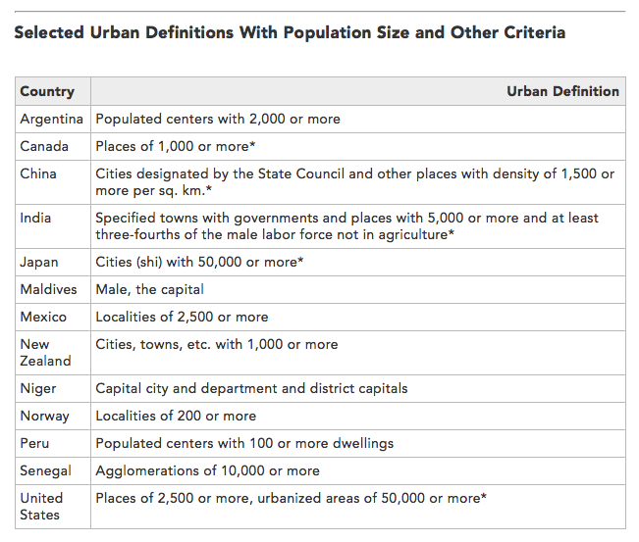
Notes:
A key consideration in examining urbanization is the wide variation in definitions of what is urban, which varies by countries
Source: Population Reference Bureau
http://www.prb.org/Publications/Articles/2009/urbanization.aspx

Slide 5
Definitions
Urban agglomeration categories:
  10 million or more (megacities)
  5–10 million
  1–5 million
  500,000 to 1 million
  Less than 500,000
Primate city: Disproportionately large leading city holding a central place in the economy of a country
Suburbanize: Growth in outlying areas of cities (peri-urban)
Notes:
Definitions of city size are standardized
Another term for this is the peri-urban region—the periphery of the urban zone that looks rural to the naked eye but houses people who are essentially urban. “The peri- urban region is a distinctive zone that spans the landscape between contiguous urban development and the rural countryside” (Ford 1999:298).
exurbs—the suburbs of the suburbs.

Slide 6
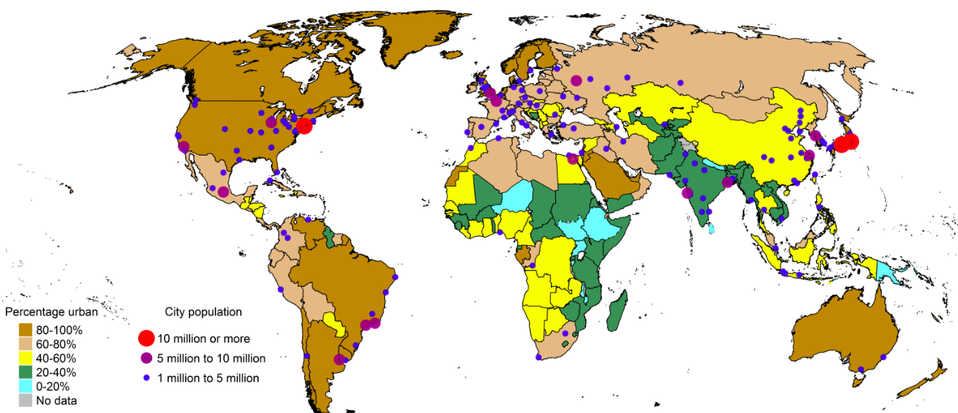
1970: % urban, urban agglomeration by size
Source: UN World Urbanization Prospects, 2014 Revision
Notes:
Not long ago, the vast majority of the world’s population was rural
1850 = 2%
1900 = 6%
1950 = 16%
In 1970s, most of the Americas, Europe already predominantly urban, with many over 80% urban

Slide 7
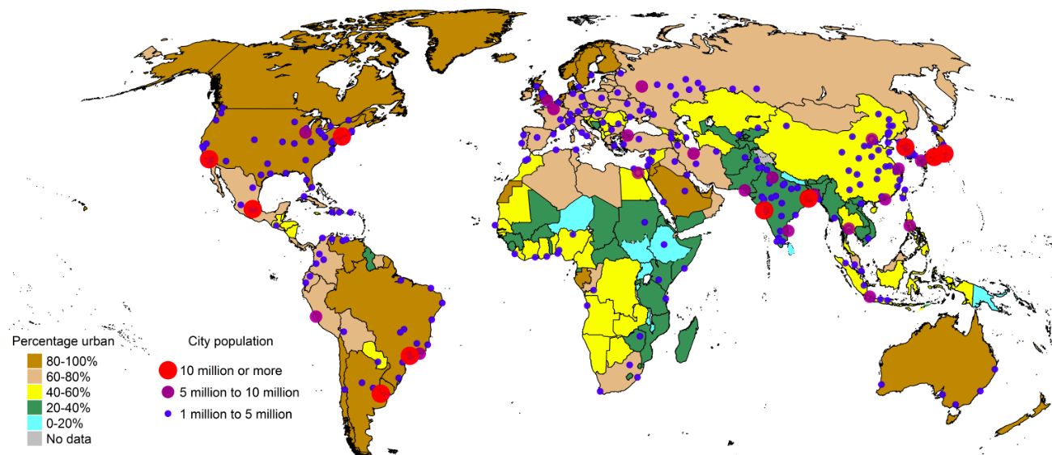
1990
Source: UN World Urbanization Prospects, 2014 Revision

Slide 8
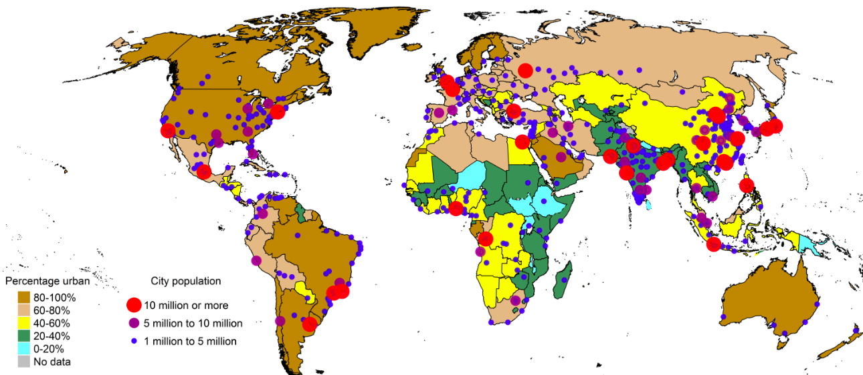
2014
Source: UN World Urbanization Prospects, 2014 Revision

Slide 9
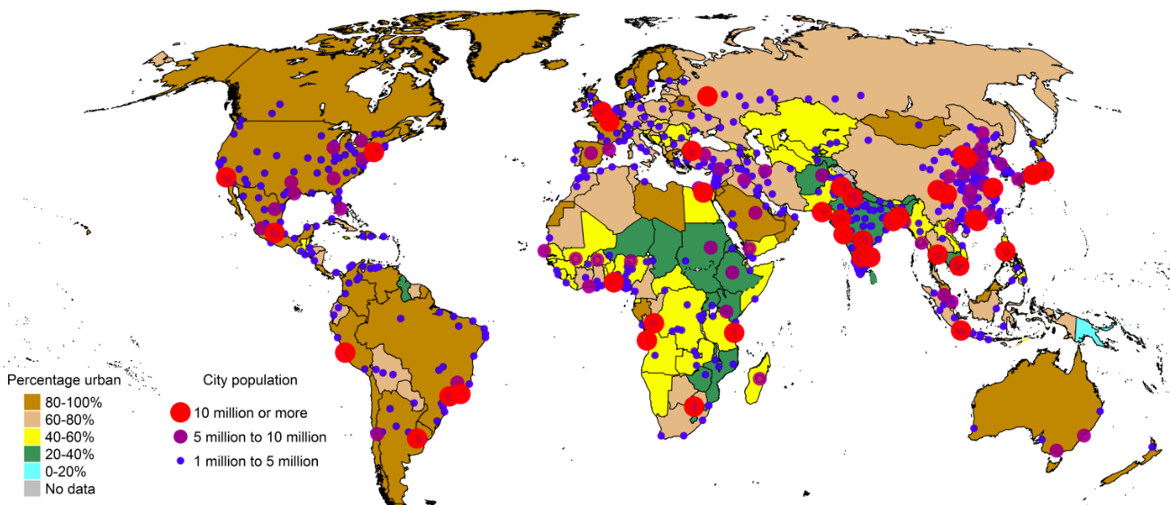
2030
Source: UN World Urbanization Prospects, 2014 Revision

Slide 10
Global trends in urbanization
More people live in urban than rural areas (54% of world population)
North America, Latin America, Europe most urbanized
Africa, Asia least urbanized
    Fastest urbanization rates
Rural population peaking, urban population growing
Almost half of urban residents live in cities <500,000 population
Largest cities now concentrated in Global South
Source: UN World Urbanization Prospects, 2014 Revision

Slide 11
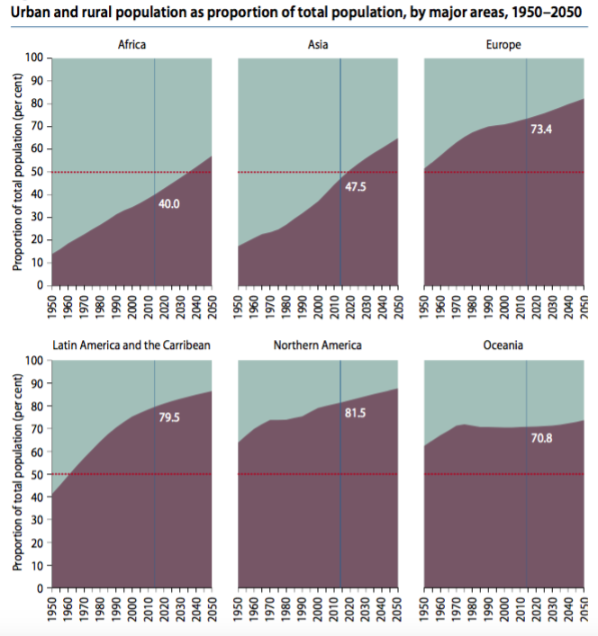

Source: UN World Urbanization Prospects, 2014 Revision

Slide 12
Population processes urbanization
1. Natural population increase
    Fertility
    Mortality
2. Migration
    Rural to urban internal migration
    Rural to urban international migration
3. Reclassification
Notes:
Natural increase = excess of births over death, so for urban areas, the population increase that occurs due to higher fertility than mortality among urbanites
City populations also increase through migration, as new residents move from rural areas to urban areas. This might be internal or international
Important from a heath policy perspective to understand what is driving population growth (or decline) in a specific urban area – ie, if migration is the major cause of growth, that might drive different planning than if it’s primarily through natural growth
- for example, distribution of population within the city will be different, so may need to allocate health services differently, and migrants may have specific health needs
- also means different age structure of population
Early cities had to be constantly replenished by migrants from the hinterlands, because they had higher death rates and lower birth rates than the countryside did, which usually resulted in an annual excess of deaths over births. The economically self-sustaining character of modern urban areas began with the transformation of economies based on agriculture (produced in the countryside) to those based on manufactured goods (produced in the city) and has expanded to those based on servicing the rest of the economy (and often located in the suburbs). Control of the economy made it far easier for cities to dominate rural areas politically and thus ensure their own continued existence in economic terms. (Weeks)
Industrial Revolution created demand for higher population in urban areas
In OECD countries in the 1800s, urban growth due to in-migration (excess mortality in cities; pre-demographic transition globally – high fertility and high mortality in both urban, rural areas)
As urbanization increased in LMICs in last few decades, natural increase was a major factor – in 1990s, accounted for 50-70% of growth in Africa, Asia & LAC
More recently, migration is playing a bigger role, as is reclassification (hard to compare over time and across countries due to changing definitions of urban)
Migration increased in these regions, esp. internal
Generally, better access to contraceptives and with higher cost of living, lower fertility in urban areas compared to rural, so migration plays a larger role in growth
Reclassification: annexation

Slide 13
Urban growth rate
Growth rate =
Rate of natural increase +
net migration rate
Notes:
Respective contribution of each component depends on the demographic and socioeconomic context

Slide 14
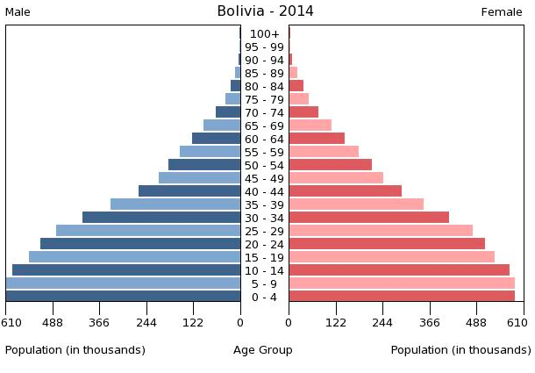
Example: Population growth in Bolivia
Notes:
EX population growth driven by natural population increase (fertility), low migration (medium mortality)

Slide 15
Natural population growth: Urban areas
Fertility decline in urban areas vs. rural: earlier, faster
    Higher availability of contraception
    Education, income, media exposure
    Changes in marriage patterns
Notes:
In developing countries, fertility decline usually has occurred earlier and faster in urban areas than in rural areas, for a variety of reasons, and in particular because of wider availability of modern contraception. Urban areas are also associated with higher levels of income, higher levels of education, and better access to mass media (Rustein, 2002; Westoff et al., 2011).
Source: Garenne, Michel. DHS Analytical Study 42, Trends in Marriage and Contraception in sub-saharan Africa: a Longitudinal perspective on factors of fertility decline

Slide 16
Natural population growth: Urban areas
Mortality decline in urban areas
    SES
    Access to knowledge and technology
    Access to health services
        Preventive
        Curative
        Emergency
Notes:
As I’ll talk about later, mortality doesn’t necessarily decline in urban areas; in many cases, the causes become different. But on the whole, there are some factors that predict mortality decline in urban areas compared to rural

Slide 17
Rural-to-urban migration
Often driven by economic opportunity
Tend to be concentrated in younger ages
    Gendered nature of work (male vs. female migrants)
        Men: Tend international
        Women: Tend internal
    Other selectivity factors (education)

Slide 18
Rural to urban migration
After first demographic transition, migration critical for urban growth
    Age structure impacted by children/parents left behind
If primarily young adults in-migrating:
    Inflated natural increase: higher urban birth rate (reproductive age); lower death rate
Notes:
See Vries 1990, Lerch 2014

Slide 19
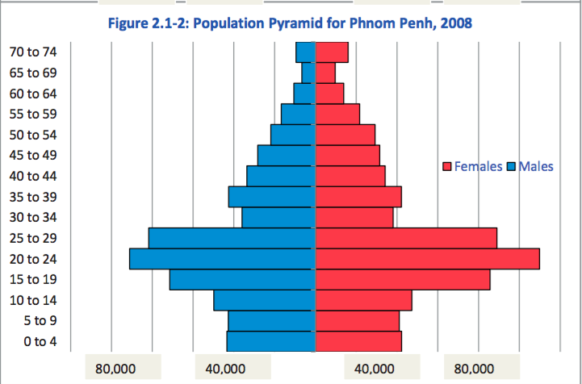
Example: Population growth in Cambodia
Notes:
Population growth driven by migration

Slide 20
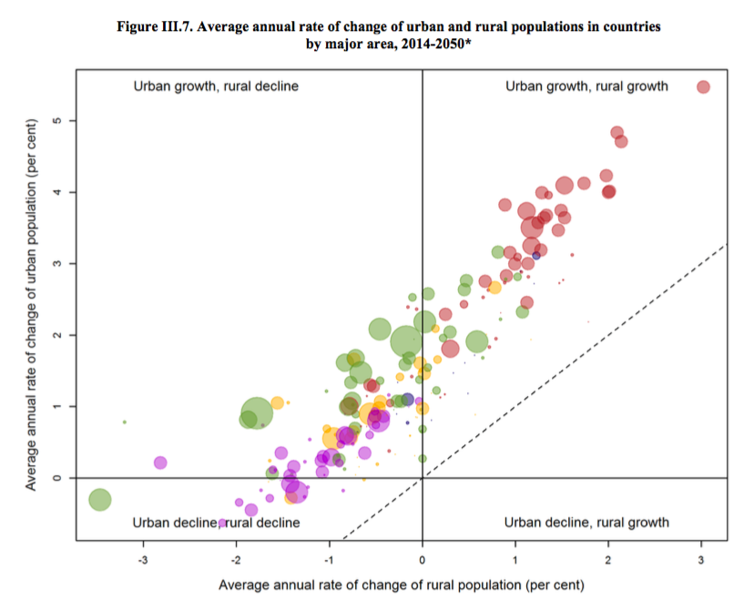
Notes:
Note NO urban decline, rural growth – everyone is urbanizing!
Some developed countries, esp. Europe and Japan are experiencing overall population decline due to below replacement fertility
Asia we see generally movement towards urban areas, and growth in those populations
Africa growth in both urban, rural
Red = Africa
Green = Asia
Yellow = LAC
Purple = North America, Europe
Source: UN World Urbanization Prospects, 2014 Revision

Slide 21
Urban population growth (closed population)
Phase 1: An inflow of migrants compensates for high urban mortality rates
    Population stable
Phase 2: As sanitation improves, death rates decline
    Urban growth is sustained by natural increase
Phase 3: Urban death rates decline to below the rural death rates
    Higher urban than rural natural increase (assuming similar birth rates)
    Urbanization
Notes:
Vries’ (1990) model decomposed the population growth of a closed country (i.e., without international migration) in its urban and rural sector. He distinguished three phases in the historical process of urbanization according to the relative importance in urban growth of rural-to-urban migration and urban natural increase (Dyson 2011; Vries 1990).
See Mathias Lerch 2014, Demography
Vries, J. D. (1990). Problems in the measurement, description, and analysis of historical urbanization. In A. V. D. Woude, A. Hayami, & J. De Vries (Eds.), Urbanization in history: A process of dynamic interaction (pp. 43–60). New York, NY: Oxford University Press.

Slide 22
How do cities shape health?
Urban crowding
Transmission dynamics
Exposures
Built environment
Availability or lack of health services
Differences from rural areas
    Economy (cash)
    Social networks
    Diet & physical activity
Notes:
The increase from 300 million urban inhabitants in developing countries in 1950 to 2.6 billion in 2010 (United Nations 2012) has outpaced the absorption capacity of labor markets and the develop- ment of infrastructure and social services, undermining public health and exacerbating the risks of environmental hazards (Lerch).
BUILT ENVIRONMENT: the physical transformation of the physical and natural environment that humans undertake in order to create a place where they can live. It includes the infrastruc- ture for piped water and sewerage, electricity and other types of energy, roads, buildings, parks, and everything else that physically represents what we think of as a city. These neighborhoods represent the context in which much of life will be played out for its residents, and this is an interactive process in which the people help to shape the social and physical fabric of a neighborhood and, at the same time, the na- ture of the neighborhood promotes or constrains the options that people have in life.
. Asia in particular is urbanizing quickly, and is expected to be almost two-thirds urban by 2050 (United Nations Department of Economic and Social Affairs, Population Division 2014). Rather than in megacities, much of this growth is expected to take place in small and medium size cities. These cities and towns tend have higher rates of poverty than large cities, often face shortages of health workers, and lack the physical and health infrastructure to accommodate large population growth (Montgomery 2009; Montgomery and Ezeh 2005a).
PLANNING AND POLICY CHALLENGE!
Crowding, for example, tends to promote the transmission of infec- tious diseases like pneumonia, diarrhea, and tuberculosis (Unger and Riley 2007), and neighbors’ open defecation is negatively associated with child height (Spears 2013).

Slide 23
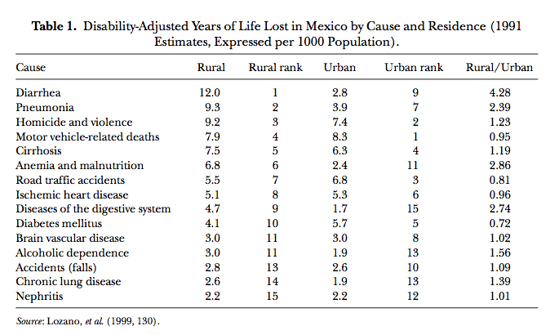
Urban vs. rural mortality causes
Notes:
Source: Montgomery & Ezeh 2005 in Handbook of Urban Health

Slide 24
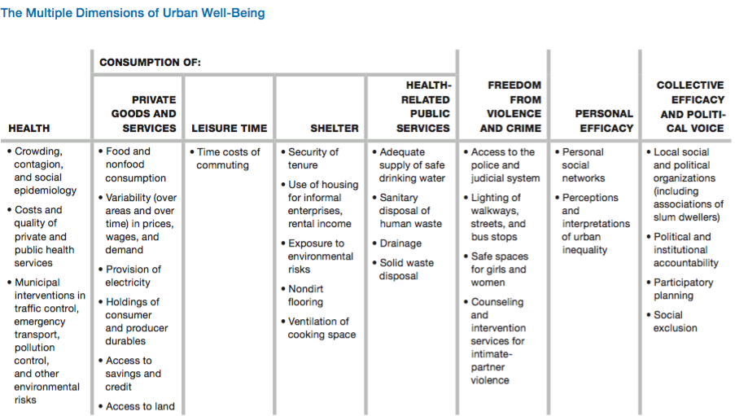
Montgomery’s framework for urban well-being
Source: Montgomery, Mark. 2009. Urban poverty and health in developing countries.
Notes:
Framework for holistic well-being
Housing characteristics, such as building materials, ventilation, security and tenure, and exposure to environmental risks shape residents’ risk of communicable diseases and other diseases. Personal efficacy, as measured by one’s social networks and perceptions of inequality, shapes access to resources needed to navigate the urban health system and acquire health knowledge. Collective efficacy, as demonstrated by the presence of organizations, political voice, and political and institutional accountability, can serve to protect residents’ health as people work together to achieve collective needs. Montgomery posits that different combinations of these physical and social inputs are associated with health outcomes, and a holistic consideration of these factors is critical in understanding urban health access, outcomes, and disparities.

Slide 25
Urban advantage vs. penalty
Urban advantage: Lower mortality in urban areas compared to rural
Urban penalty: Excess urban mortality compared to rural areas
Historically, urban penalty in developed countries
Currently, urban advantage in developing countries
Notes:
Historical evidence from Europe and North America shows that urban areas were characterized by an “urban penalty” (Kearns 1988) with mortality rates substantially higher in cities compared to rural areas, particularly for infants and children (Preston and Haines 1991; Gould 1998). These higher urban mortality rates were associated with the spread of communicable diseases due to high density, overcrowding and unsanitary conditions in cities, despite the greater availability of health facilities and higher overall incomes compared to rural areas (Gould 1998). By the 20 century this urban mortality
penalty had been transformed into an urban advantage, due largely to improvements in public health and sanitation (Preston and Haines 1991; Haines 1995).

Slide 26
Intra-urban inequality
Important to compare within urban inequalities to urban-rural inequalities
Greater variation in SES and education in urban areas
    Important predictors of access to care
Ex: Translates to greater variations in child health outcomes among urban children vs. rural
    Greater SES inequality in child mortality and malnutrition status in urban areas
    The urban poor often disadvantaged compared to rural children (vaccination, nutritional status)

Slide 27
Intra-urban health inequalities
Majority of urban growth projected to be in small & midsize cities…but,
Small or midsize cities do not enjoy the same quantity or quality of services available in the largest cities

Slide 28
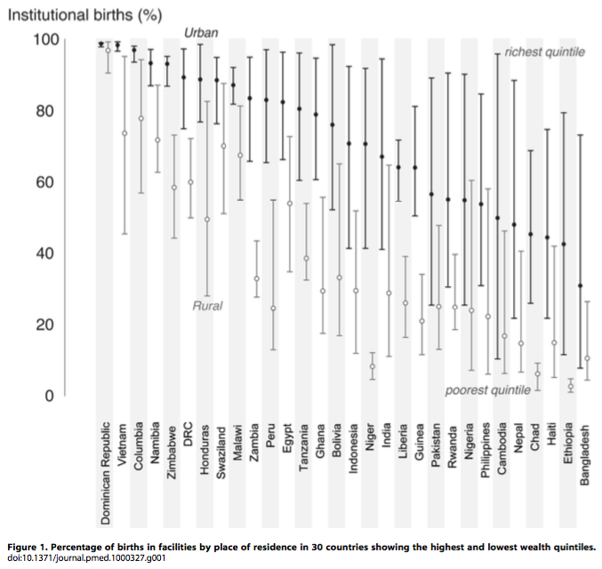
Intra-urban health inequality
Notes:
Examining the “Urban Advantage” in Maternal Health Care in Developing Countries, Mathews et al 2010 PLoS One

Slide 29
Segregation
Tendency for groups to cluster geographically by:
    Race or ethnicity (including immigrants)
    Social class
As a result of:
Concentration in particular occupations
Ability to participate in cultural organizations
Discrimination
Social mobility (lack thereof)
Notes:
The segregation of people into different neighborhoods on the basis of different social characteristics (such as ethnicity, occupation, or income) is a fairly common feature of human society (Bobo et al. 2000; Zlaff 1973). However, in the United States residential segregation by race is much more intense than segregation by any other measurable category. Residential segregation of blacks in the United States has been called an “American apartheid system” (Massey and Denton 1993), and the maintenance of this pattern until fairly recently has been explained by Farley and Frey (1994) as being due especially to the following factors: (1) Mortgage lending policies were discriminatory; (2) African Americans who sought housing in white areas faced intimidation and violence similar to that occurring during World War I; (3) After World War II, suburbs developed strategies for keeping African Americans out; and (4) Federally sponsored public housing encouraged segregation in many cities.
It is not clear whether these trends have eased over time, or whether patterns of residential segregation have simply changed.

Slide 30
Assess segregation by
Evenness: How evenly are groups spread across the city
Exposure: Probability of sharing a census tract with another group (isolation vs. interaction)
Centralization: To what degree is a group living near the center of a city
Concentration: Relative amount of area occupied by minority groups (density)
Clustering: Degree of segregation among groups (contiguousness)
Notes:
Evenness: “How many people would have to move in order to make each census tract have the same distribution as the city as a whole?”
Exposure: Inverse of the probability that a person of one ethnic group shares a census tract with a person of a particular other ethnic group
Generally assessed by race/ethnicity, but some work starting to be done on SES, assessing spatial concentration of poverty
Source: https://geodacenter.asu.edu/%5Btermalias-raw%5D/diversity-and-s-0; see Massey & Denton 1988

Slide 31
Neighborhood effects
Aggregated area or community-level factors associated with an area of residence that impact health access, outcomes, or well-being
    Education
    SES
    Social networks and social cohesion
    Social comparison
    Knowledge, attitudes, or practices
Notes:
Neighborhood poverty and neighborhood affluence associate with health (Montgomery and Ezeh 2005a).
Social comparison plays an important role in psycho-social health, and includes relative SES; where the urban poor face repeated exposure to social inequalities, this may be internalized to their detriment (Montgomery and Ezeh 2005b; Pickett and Wilkinson 2015) .
Urban poor do not always live in poor neighborhoods

Slide 32
Slums
Lacks at least one of the following (UN-HABITAT):
    Access to potable water
    Access to piped sewerage
    Housing of adequate space
    Housing of adequate durability
    Security of tenure
Other characteristics: Social exclusion; exposure to environmental hazards; poor access to health services (quality); lack of government regulation; lack of institutional support
Notes:
Slums are a clear manifestation of a poorly planned and managed urban sector and, in particular, a malfunctioning housing sector.
Concentrated urban poverty and deprivation are often characterized by residential crowding, exposure to environmental hazards, and social fragmentation and exclusion (Wratten 1995)—a cluster of conditions frequently referred to with the catch-all term of “slum-dwelling.” (Nolan)
These health problems are exacerbated by the illegality and social ex- clusion that tend to characterize slum settlements (de Snyder et al. 2011; Subbaraman et al. 2012), by poorly regulated and ineffective health services (Agarwal et al. 2007), by exposure to environmental hazards (Unger and Riley 2007), and, in the Indian case, by uncertainty regarding which level of government is responsible for protecting and promoting the health of the poorest urban residents (Nolan et al. 2014).
HOWEVER: multiple studies show that slum residents are not always poorest poor in terms of income; in megacities with large slum areas such as Mumbai and Nairobi, slum residents may include people classified as middle income
Often have thriving micro-economies

Slide 33
Slums & children’s health
Proportion of children residing in slums in Africa has decreased over time, but absolute numbers have increased (Cotton 2013)
Children in slums have outcomes equivalent to rural children after adjusting for SES, education, and access to services (Fink et al 2014)
Child mortality is significantly higher in slum than non-slum areas, but lower than rural areas (Gunther & Harttgen 2012)
Compared to urban non-slum dwelling children, children in slums have higher rates of malnutrition, diarrhea, and measles; lower rates of vaccination and vitamin A supplementation (Ferduous et al 2014)
Notes:
Cotton, Cassandra. 2013. Growing Up on the Edge: The Well-Being of Children and Youth in the Slums of Sub-Saharan Africa. Montreal: Institute for the Study of International Development. Retrieved October 26, 2015 (http://www.researchgate.net/profile/Cassandra_Cotton/publication/261358342_Growing_Up_on_the_Edge_The_Well-Being_of_Children_and_Youth_in_the_Slums_of_Sub-Saharan_Africa/links/00463533edf3fda49d000000.pdf).
Ferdous, Farzana et al. 2014. “Diarrhoea in Slum Children: Observation from a Large Diarrhoeal Disease Hospital in Dhaka, Bangladesh.” Tropical Medicine & International Health 19(10):1170–76.
Fink, Günther, Isabel Günther, and Kenneth Hill. 2014. “Slum Residence and Child Health in Developing Countries.” Demography 51(4):1175–97.
Günther, Isabel and Kenneth Harttgen. 2012. “Deadly Cities? Spatial Inequalities in Mortality in Sub-Saharan Africa.” Population and Development Review 38(3):469–86.

Slide 34
References
Astone, Nan. 2009. “Urban Demography.” Retrieved (http://ocw.jhsph.edu/courses/PrinciplesPopulationChange/PDFs/PopChange-sec8_Astone.pdf).
Haub, Carl. 2009. “What Is a City? What Is Urbanization?” Population Reference Bureau. Retrieved (http://www.prb.org/Publications/Articles/2009/urbanization.aspx).
Fink, Günther, Isabel Günther, and Kenneth Hill. 2014. “Slum Residence and Child Health in Developing Countries.” Demography 51(4):1175–97.
Massey, Douglas S. and Nancy A. Denton. 1988. “The Dimensions of Residential Segregation.” Social Forces 67(2):281.
Matthews, Zoë et al. 2010. “Examining the ‘Urban Advantage’ in Maternal Health Care in Developing Countries.” PLoS Medicine 7(9):e1000327.
Montgomery, Mark R. 2009. Urban Poverty and Health in Developing Countries. Population Reference Bureau Washington, DC. Retrieved August 28, 2015 (http://www.prb.org/pdf09/64.2urbanization.pdf).
Montgomery, Mark R. and Alex C. Ezeh. 2005. “Urban Health in Developing Countries.” Pp. 317–60 in Handbook of Urban Health, edited by S. Galea and D. Vlahov. Springer US. Retrieved August 28, 2015 (http://link.springer.com.ucsf.idm.oclc.org/chapter/10.1007/0-387-25822-1_17).
Nolan, Laura B. 2015. “Slum Definitions in Urban India: Implications for the Measurement of Health Inequalities.” Population and Development Review 41(1):59–84.
United Nations Department of Economic and Social Affairs, Population Division. 2014. World Urbanization Prospects: The 2014 Revision : Highlights. United Nations. Retrieved (http://esa.un.org/unpd/wup/Highlights/WUP2014-Highlights.pdf).
Weeks, John R. 2008. Population: An Introduction to Concepts and Issues. 10th ed. Belmont, CA: Thompson-Wadsworth.

