Slide 1
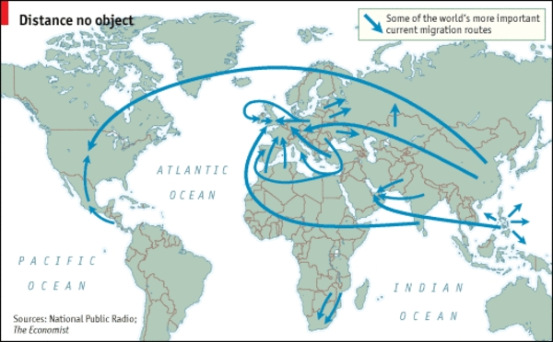
Migration and Health
May Sudhinaraset

Slide 2
Ice Breaker
How many of you are migrants? If so, what kind?
How did you/your parents come to be in the US?

Slide 3
Learning Objectives
Define migration and types of migrants
Describe global migration patterns and trends
Describe assimilation/acculturation theory
Apply concepts to population

Slide 4
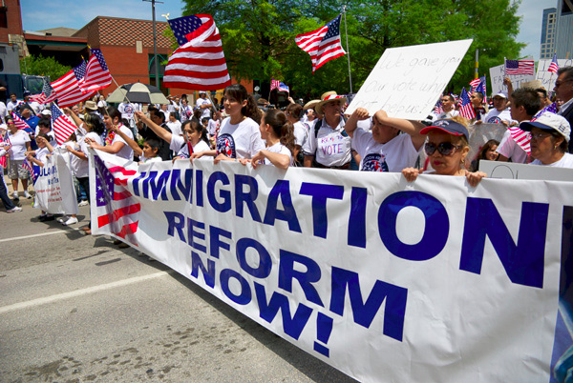
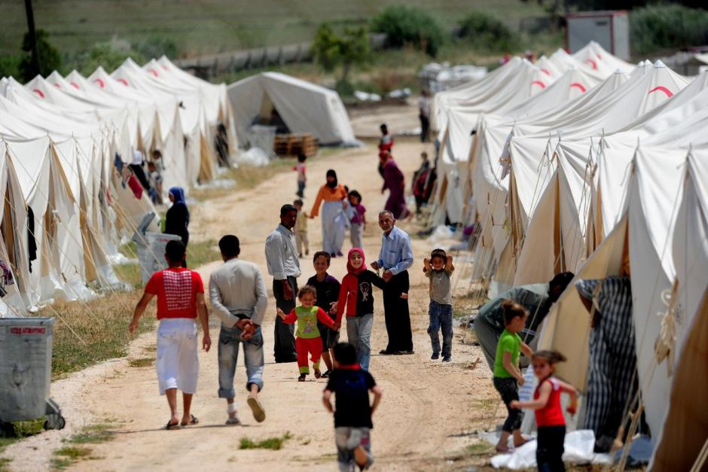
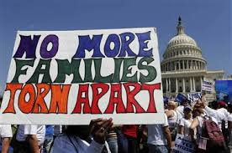
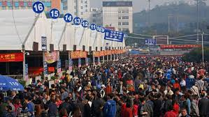
Notes:
Importance of migration
https://www.iom.int/world-migration

Slide 5
Migration and Demography:
Why is this relevant for public health practitioners and epidemiologists?
Rapidly changing demographic and macro-economic environment leads policy makers to:
  Revisit population projections and question the demographic assumptions on which existing economic, welfare, and migration policies are based
  Adapt key policy areas to fundamental changes in global and regional population trends
  Explore the potential of migration in bridging the gaps between youthful and aging societies and in promoting development
            (Munz, 2015 MPI)
Notes:
Increasing life spans and slowing birth rates

Slide 6
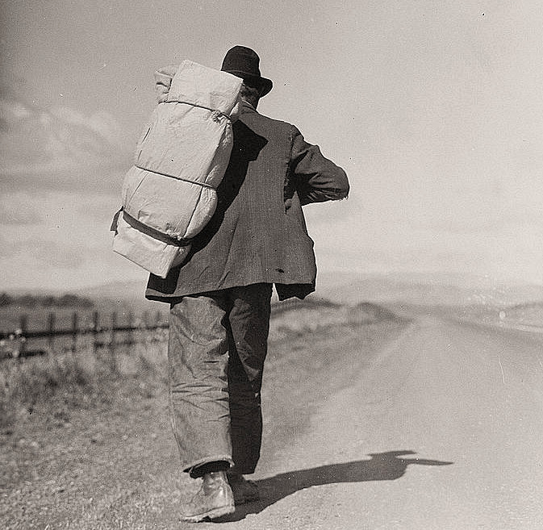
Definitions
Migration
  Movement of individuals from one place to another, crossing geographical boundary
  Defined as any permanent change in residence
    UN defines permanent as lasting more than one year
    The Movement of people across a specified boundary, national (i.e. internal) or international, to establish a new permanent place of residence

Slide 7
Types of Migration
Internal migration: movement within same country
International migration: movement across national boundaries
Chain migration: process that occurs after a small number of pioneering groups lead the way somewhere else and others from the same community follow. Chain migration results in migration fields –the clustering of people from a specific region into certain neighborhoods or small towns
Commuter: crossing boundary lines for work daily

Slide 8
Types of Migration
Forced migration: involuntary forum of migration related to environmental and human factors.
  Refugees: a person who can’t return home because of fear of persecution for reasons of race, religion, nationality, political association, social grouping, fleeing from war, armed conflict, civil war, disasters, famine, etc.
  Internally displaced persons: forced to leave his or her home region because of unfavorable (political, social, environmental), but does not cross any boundaries
  Asylum seekers: people who claim to be refugees. Usually have to undergo legal procedure in which host country decides whether they qualify for refugee status

Slide 9
Trends in Migration

Slide 10
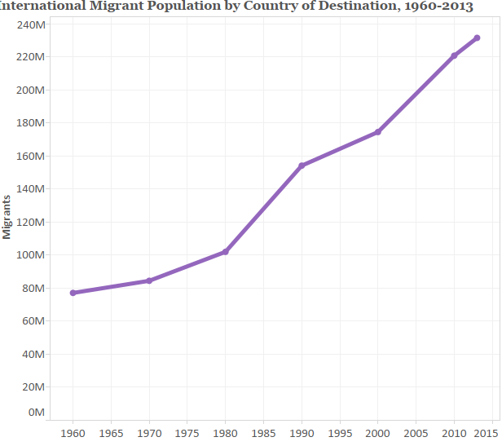

Slide 11
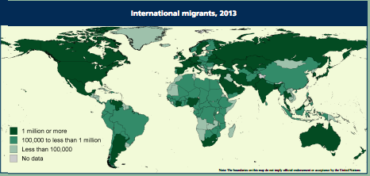
United Nations, 2013

Slide 12
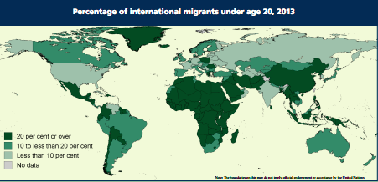
United Nations, 2013

Slide 13
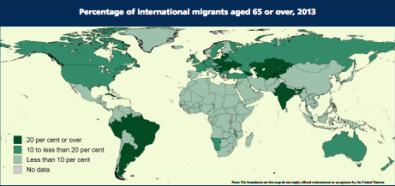

Slide 14
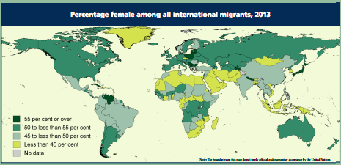

Slide 15
Theories Migration and Health

Slide 16
Acculturation
Acculturation definition
    Group level or individual level process of change that occurs when two cultures are in sustained contact with each other (Berry, 1994)
Enculturation
  Process of retaining or learning one’s own culture

Slide 17
Berry’s 2007 Model of Acculturation
Culture A
Changes in one or both culture
Psychological acculturation
Contact
Culture B
Adaptation

Slide 18
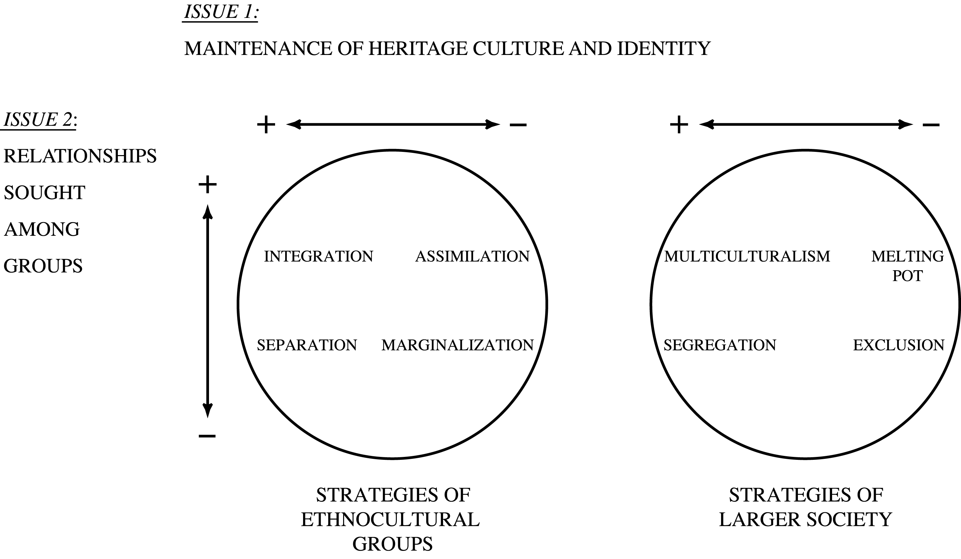
Acculturation Strategies Framework (Berry, 2007)
Notes:
On the left are the strategies of ethnocultural individuals and groups.
On the right are those of the larger society.
Integration/Multiculturalism are defined by holding a positive orientation to both issues.
Assimilation/Melting Pot exist when there is negative
orientation to first, and a positive one to second.
Separation/Segregation exist when there is a positive orientation to first, and a negative one to second.
Marginalisation/Exclusion exist when there are negative orientations to both issues.

Slide 19
Healthy Migrant Effect (Fennelly)
Epidemiologic Paradox: First-generation immigrants to the US are healthier than people of similar ethnic backgrounds who were born in this country
  Hummer, 2007: first-hour, first-day, first-week mortality rates among infants born in US to immigrant women 10% lower than infants to non-Hispanic, white US-born
Over time, newcomer’s health advantages diminish over time
Rumbaut “Paradox of assimilation”
Why do you think this is?

Slide 20
Convergence Effect
Poverty
Living in substandard housing
Not having access to medical care
Adoption of an American diet
Smoking and substance abuse

Slide 21
Critiquing migration research: Applications to asian and pacific islanders

Slide 22
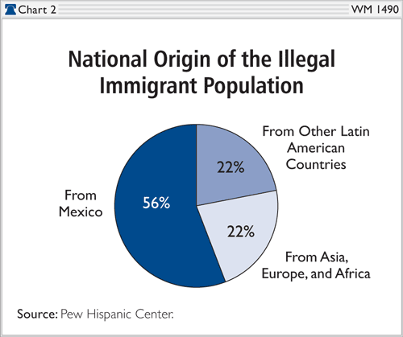
What’s wrong with this graph?

Slide 23
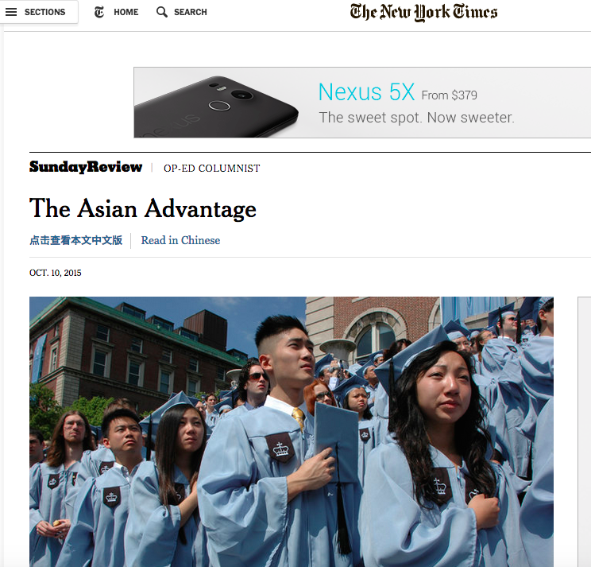
Nick Kristof
New York Times
October 10, 2015

Slide 24
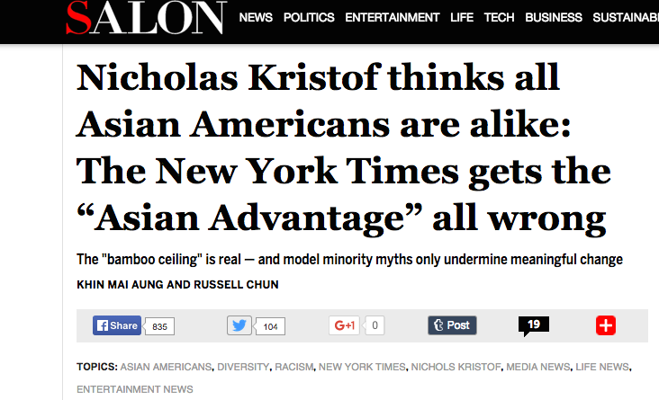
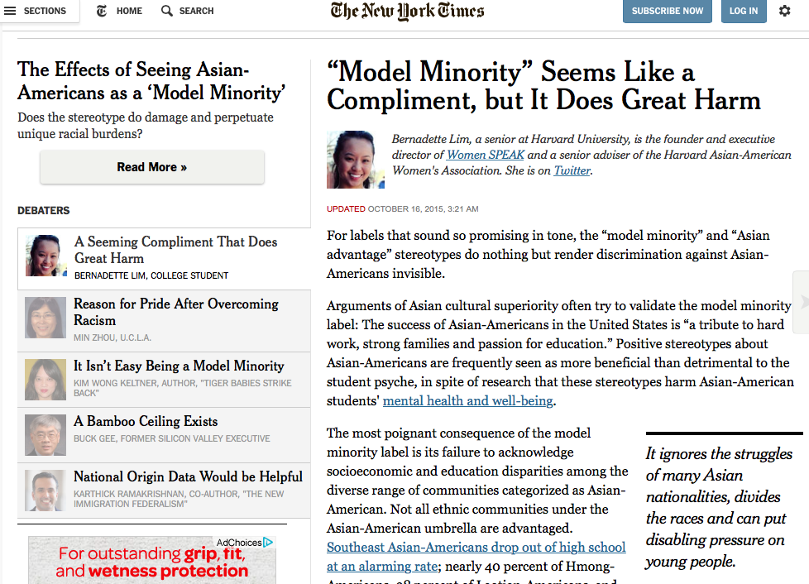

Slide 25
Nick Kristof
An Awkward Question: “Why are Asian Americans so successful in America”?
I wrote a series of columns last year, “When Whites Just Don’t Get It,” about racial inequity, and one of the most common responses from angry whites was along these lines: This stuff about white privilege is nonsense, and if blacks lag, the reason lies in the black community itself. Just look at Asian-Americans. Those Koreans and Chinese make it in America because they work hard. All people can succeed here if they just stop whining and start working.

Slide 26
“Asian-Americans are disproportionately stars in American schools, and even in American society as a whole.”

Slide 27
“Asian-Americans are disproportionately stars in American schools, and even in American society as a whole.”
33 percent of Laotian Americans and 37 percent of Cambodian Americans fail to complete high school, according to the White House Initiative on Asian Americans and Pacific Islanders.
AAPIs are fastest-growing populations in poverty. Nationally increase of 27%; among AA 37% and PIs 60%
1 in 3 AAPIs confronts a language barrier
Pacific Islanders have among the highest unemployment rates of all groups

Slide 28
They say Asian-Americans work hard to succeed in areas with clear metrics like math and science in part as a protection against bias — and in any case, many Asians still perceive a “bamboo ceiling” that is hard to break through.

Slide 29
They say Asian-Americans work hard to succeed in areas with clear metrics like math and science in part as a protection against bias — and in any case, many Asians still perceive a “bamboo ceiling” that is hard to break through.
Asians constitute only 1.5% of Fortune 500 CEOs despite making up 5% of population

Slide 30
Governor Brown vetoed Assembly Bill AB-176 that required California’s publicly-funded universities and community colleges and state Departments to disaggregate API data
Better Data → Better Policy → Better Public Discourse!

Slide 31
Immigration and Health Policies
Undocumented in the US

Slide 32
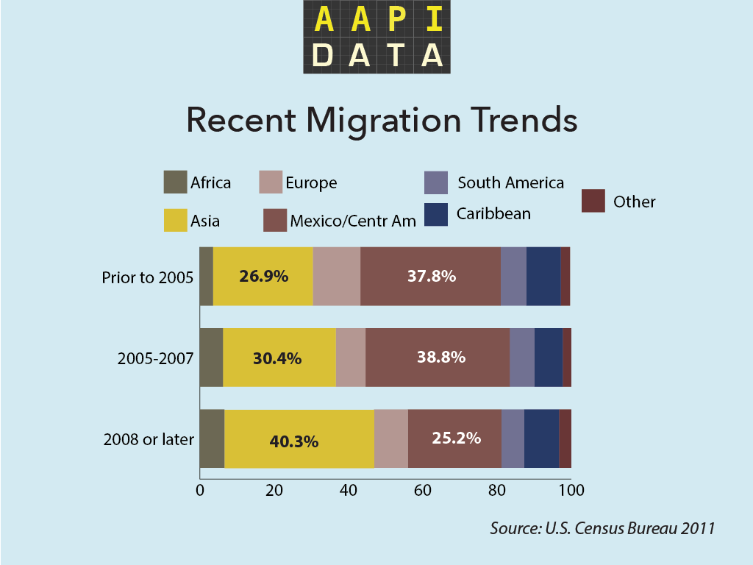

Slide 33
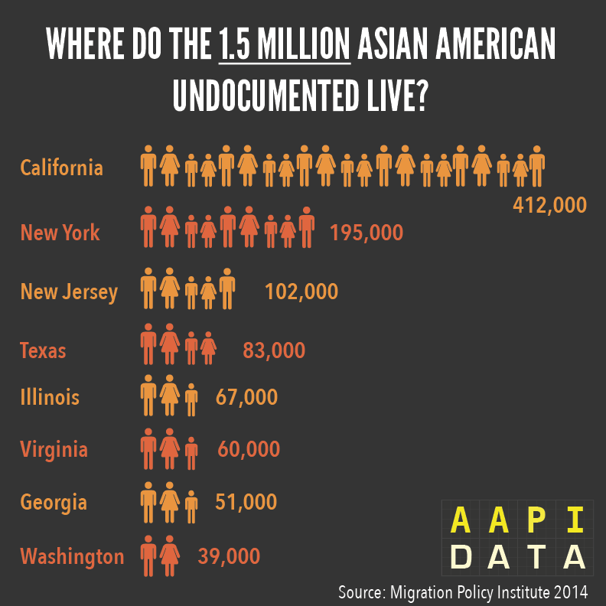

Slide 34
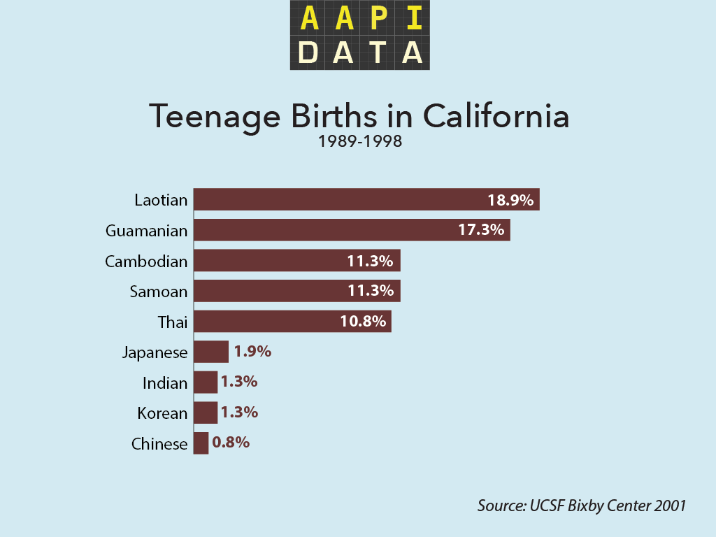

Slide 35
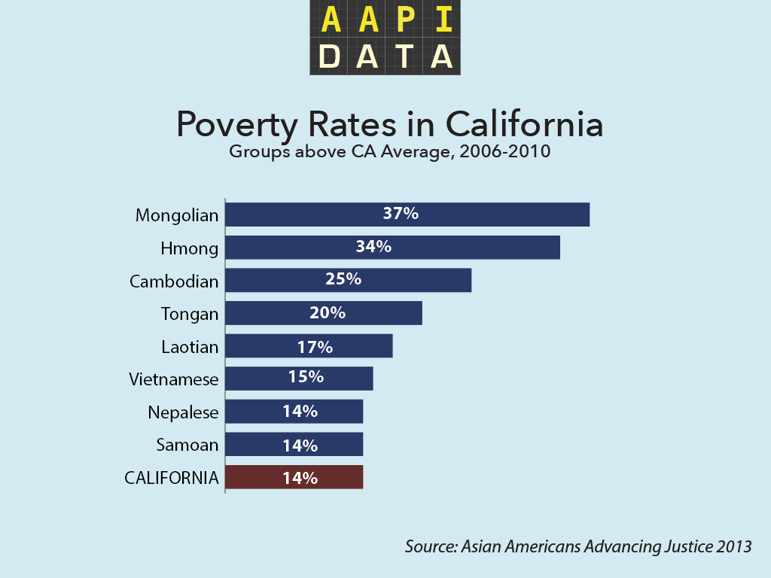

Slide 36
Immigration and Health Policies
The Development, Relief, and Education for Alien Minors Act | Consideration of Deferred Action for Childhood Arrivals | The Patient Protection and Affordable Care Act
DREAM | DACA | ACA
NOT Passed Proposed process for undocumented immigrants to gain conditional residency, followed by permanent residency. Eligibility Criteria: Conditional: enter U.S. before 16, reside 5+ years, high school diploma or GED, moral character, pass criminal background check Permanent: College or Military | Allows temporary (2 years) work authorization and relief from deportation for those who qualify. Eligibility Criteria: enter U.S. before 16, resided since 2007, present but undocumented in 2012, high school diploma or GED, or enrolled in school, or honorably discharged pass criminal background check College not required. | Passed (but with major restrictions for some immigrant groups) As of August 28th, 2012, DACAs were excluded from eligibility.
BACKGROUND

Slide 37

The BRAVE Study: API Voices

Slide 38
