Slide 1
Demography of aging

Slide 2
What is demography of aging
Demographic study of older populations
  Their size and composition
  Their mortality and morbidity
  The causes of demographic change among older populations
  The consequences of demographic change among older populations

Slide 3
Population aging : The process of growth in the number and percent of older persons within a population
Percent 60 and older

Slide 4
Global Average Annual Growth Rates

Slide 5
But, There is Great Variation by Age

Slide 6
Population aging
Older persons are continually making up a larger proportion of the population
This is occurring in every world region and in nearly every country

Slide 8
Why is the population aging?

Slide 9
History of world population
Population explosion
Industrial revolution
Agricultural revolution

Slide 10
Calculating population size
Today, the world is increasing population at a rate of about 1% per year.
If the world started with 2 people 5,000 years ago and we had a constant 1% growth rate throughout time , the population on the earth today would be:
P₂ = P₁ X e^{rt}
P₂ = 2 X e ^{(.01)(5000)}
P₂ =1,036,940,000,000,000,000,000
So, why are there not more people around today?
a. Growth rates throughout history were not as high as 1%.
b. High growth is a very recent thing.
c. A growth rate of what we experience today is not sustainable.

Slide 11
Population size and structure determined by three demographic processes:
1. Fertility/ births / birth rate
2. Mortality/ deaths/ death rate
3. Migration/ migration rate
For a population to remain stable, these factors must be balanced.
Assuming no migration, births and deaths must equal out.

Slide 12
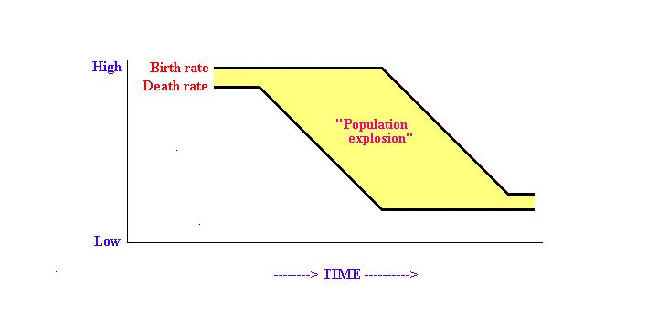
Demographic transition
Mortality decline makes the population younger. This is because more young people survive and percent young rises relative to other age groups.
Pre-transition, population remains stable
In time, birth rates start to decline.
Epidemiological transition results in decreasing death rates.
Population size stabilizes again.
Rapid population growth when birth rates are higher than death rates.

Slide 13
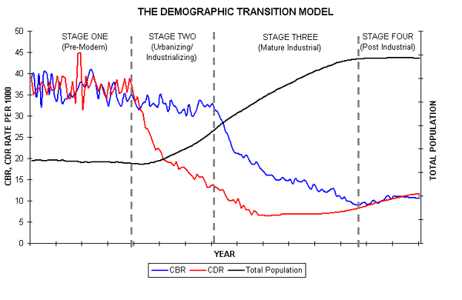
Example Sweden

Slide 14
Example Vietnam

Slide 15
Epidemiological transition
A change in cause of death from communicable to degenerative.
Communicable: Diseases transmitted from person to person or from some species to person. For example, smallpox, cholera, malaria, typhoid.
For most of human history, people were most likely to die of communicable diseases.
Communicable diseases kill young people.
When most people die of communicable diseases population size remains stable

Slide 16
Fertility and infant mortality rates for China
Total Fertility Rate
Deaths to infants before age 1 per 1,000

Slide 17
These transitions influence age structure
T1
T2
T3
= Grandparent
= Parent
= Child

Slide 18
Example: China 1950
Women
Men
15 %
10 %
5 %
5 %
10 %
15 %

Slide 19
Example: China 1975
Women
Men
15 %
10 %
5 %
5 %
10 %
15 %

Slide 20
China, 2000
Men
Women
15 %
10 %
5 %
5 %
10 %
15 %

Slide 21
China 2025
Men
Women
15 %
10 %
5 %
5 %
10 %
15 %

Slide 22
China, 2050
Men
Women
15 %
10 %
5 %
5 %
10 %
15 %

Slide 23
As fertility declines, the percent old increases
Total Fertility Rate
Percent 60 and older

Slide 24
Remember Vietnam
Epidemiological change in the past

Slide 25
Age distribution for Viet Nam

Slide 26
Age distribution for Viet Nam

Slide 27
Age distribution for Viet Nam

Slide 28
Age distribution for Viet Nam

Slide 29
Age distribution for Viet Nam

Slide 30
Age distribution for Viet Nam

Slide 31
Age distribution for Viet Nam

Slide 32
Age distribution for Viet Nam

Slide 33
Age distribution for Viet Nam

Slide 34
Age distribution for Viet Nam

Slide 35
Age distribution for Viet Nam

Slide 36
Age distribution for Viet Nam

Slide 37
Age distribution for Viet Nam

Slide 38
Viet Nam
Total Fertility Rate
Assuming stable fertility into the future.
Percent 60 and older

Slide 39
Possible implications of global population aging for public health
RETOOLING HEALTH CARE SYSTEMS
In most of the world, health care systems have been designed around a particular set of needs, e.g.:
child and maternal health
infectious and communicable disease
An aging world requires a change in health care philosophy toward
degenerative disease
long-term care

Slide 40
COST OF HEALTH CARE
Expenditure studies show costs of health care in old age to be significantly greater than costs at any other age.

Slide 41
DETERMINING HOW TO SPEND HEALTH CARE DOLLARS
 | Health expenditures per capita, 2011
U.S. | $8,508
Norway | $5,669
Canada | $4,522
Nigeria | $128
Ethiopia | $50
Congo | $26

Slide 42
Population aging versus human aging
Life span is the potential length of time a species can live.
Longevity is the length of time a species tends to live.

Slide 43
LONGEVITY

Slide 44
Life expectancy at birth for females in five countries, 1950 to 2015

Slide 45
LIFE SPAN

Slide 46
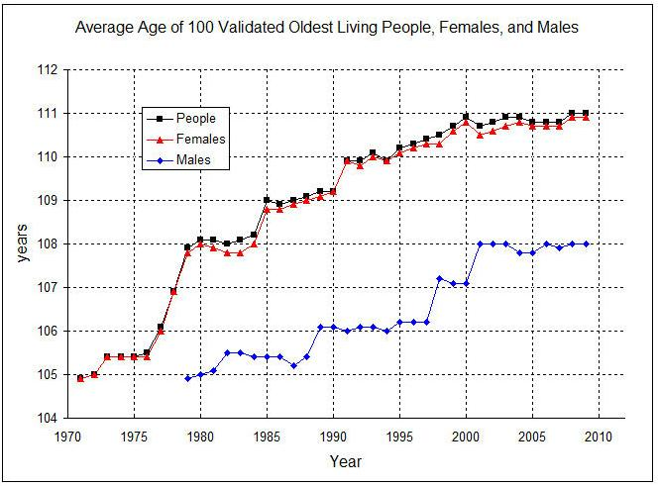
Average age of centenarians

Slide 47
Implications for public health
- Goal of medical science to reduce the gap between life span and longevity.
- Increasing one may not mean increasing the other.
- Rectangularization of mortality: Life span remains
the same but variation in age at death declines.

Slide 48
Rectangularization of mortality
0
55
110

Slide 49
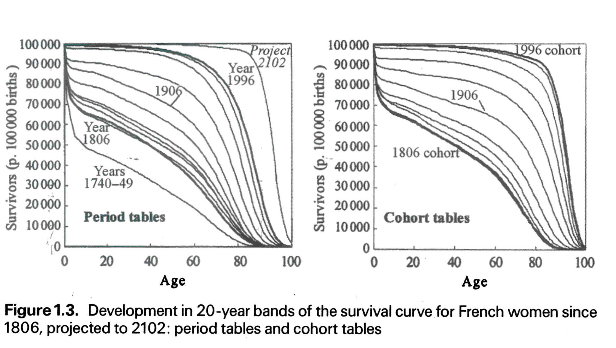
Rectangularization is evident in places where data is available
Page 21 fig 1.3

Slide 50
QUANTITY VERSUS QUALITY OF LIFE
Are the extra years of life healthy years, or are we extending our years lived in poor health?
.
Optimistic view: There has been a compression of morbidity into the final years of life.
Pessimistic view: Modern medicine extends life but it does so by saving people from dying without giving them years of healthy life.

Slide 51
Standardized survival, disability, and morbidity curves
Proportion surviving
Surviving healthy
Surviving
unhealthy

Slide 52
Standardized survival, disability, and morbidity curves
Proportion surviving

Slide 53
Expansion of morbidity – longer life worsening health
Proportion surviving
Surviving healthy
Surviving
unhealthy

Slide 54
Compression of morbidity – longer life better health
Proportion surviving
Surviving healthy
Surviving
unhealthy

Slide 55
Dynamic equilibrium – healthy years to increase proportionately to total years
Proportion surviving
Surviving
unhealthy
Surviving healthy

Slide 56
Conclusion
Global population aging is likely to be the most important demographic phenomenon influencing health and welfare policies globally over the next half century.

Slide 57


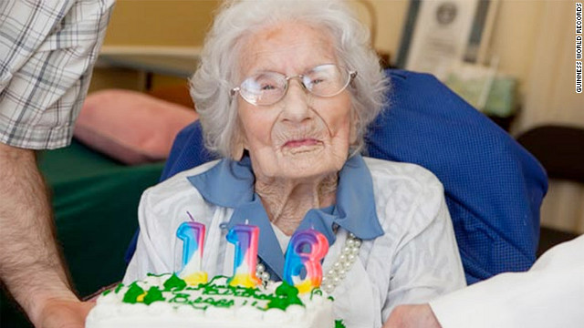
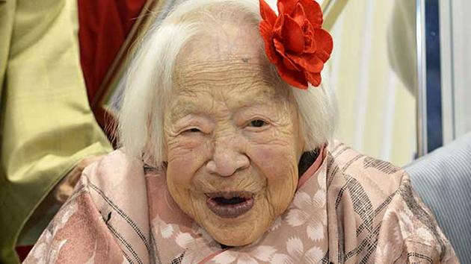
114
115
116
117

