Slide 1
Multi-State Life Tables
Amal Harrati, PhD
Stanford University School of Medicine

Slide 2
Agenda
Review of Basic Life tables
Introduction to a Multi-state life table: concepts and notation
Some applications in disability and work
Other applications

Slide 3
Life Tables
The life table records the passage of a cohort from birth to extinction, or when the last member has died, according to a set of fixed age specific probabilities of death/failure
As age increases, the number of survivors of the original group declines
Life Tables looks at the likelihood of an event occurring in the next time period (day, week, year) given survival to the beginning of the time period

Slide 4
Why do we use life tables?
Any question that concerns the probability of an event
To analyze any measurable process that involves a time pattern of exit from or entry into a particular state (e.g., births and deaths)
Estimate age/time specific risks
Examine changes in rates
Population growth and change (generate projections of the size and characteristics of future populations based on some initial base population.)
Compare health levels across two populations or one population over time

Slide 5
Not just life and death!
Mortality/Survival (people, cars, appliances)
Recidivism
Disability (Active Life Expectancy)
Marriage/cohabitation
Working Life (retirement, unemployment)
Contraceptive Use (effectiveness, discontinuation, switching)
Fertility (1st and higher order births, spacing, time to first sex)
Breastfeeding
Cancer survival

Slide 6
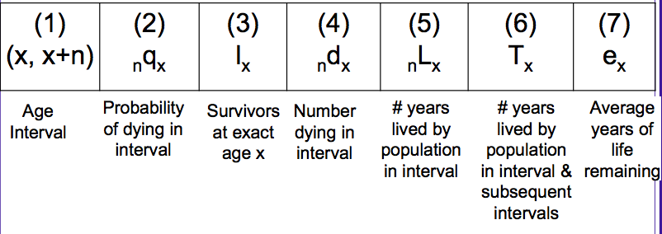
Analytical Pieces to a Life table

Slide 7
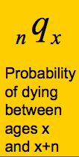
Life table notation:
The subscript before a symbol defines the width of the interval
The subscript after the symbol defines the starting point of the interval
lx, Tx and ex never have a left subscript as they refer to exact age x

Slide 8
Where does _{n}q_{x} come from?
Cohort Analysis: from actual, lived experience
Period Analysis: from current, age-specific rates (model tables) (historical data, UN Pop Division, CDC, etc.)

Slide 9
Single vs. Multi – state life tables
2 states: Alive and Dead
1 “absorbing” state: Death
Alive
Dead

Slide 10
Single vs. Multi – state life tables
Multiple states
Still need one “absorbing” state: Death
Called Multiple Decrement Table
Single
Married
Divorced
Widowed
Dead

Slide 11
Starting Point is still “nqx” , but more complex
q_{ij} (t, t+u) = d_{ij}(t, t+u) / n_{i}(t)
i= state 1
j = state 2
t= time period
“Prevalence rate”

Slide 12
Single vs. Multi – state life tables
Multiple states
Still need one “absorbing” state: Death
q_{ij}
q_{ij}
Single
Married
Divorced
q_{ij}
q_{ij}
q_{ij}
Widowed
q_{ij}
Dead
q_{ij}

Slide 13
Analytical Pieces to a MSLT: Everything is in matrix form

Slide 14
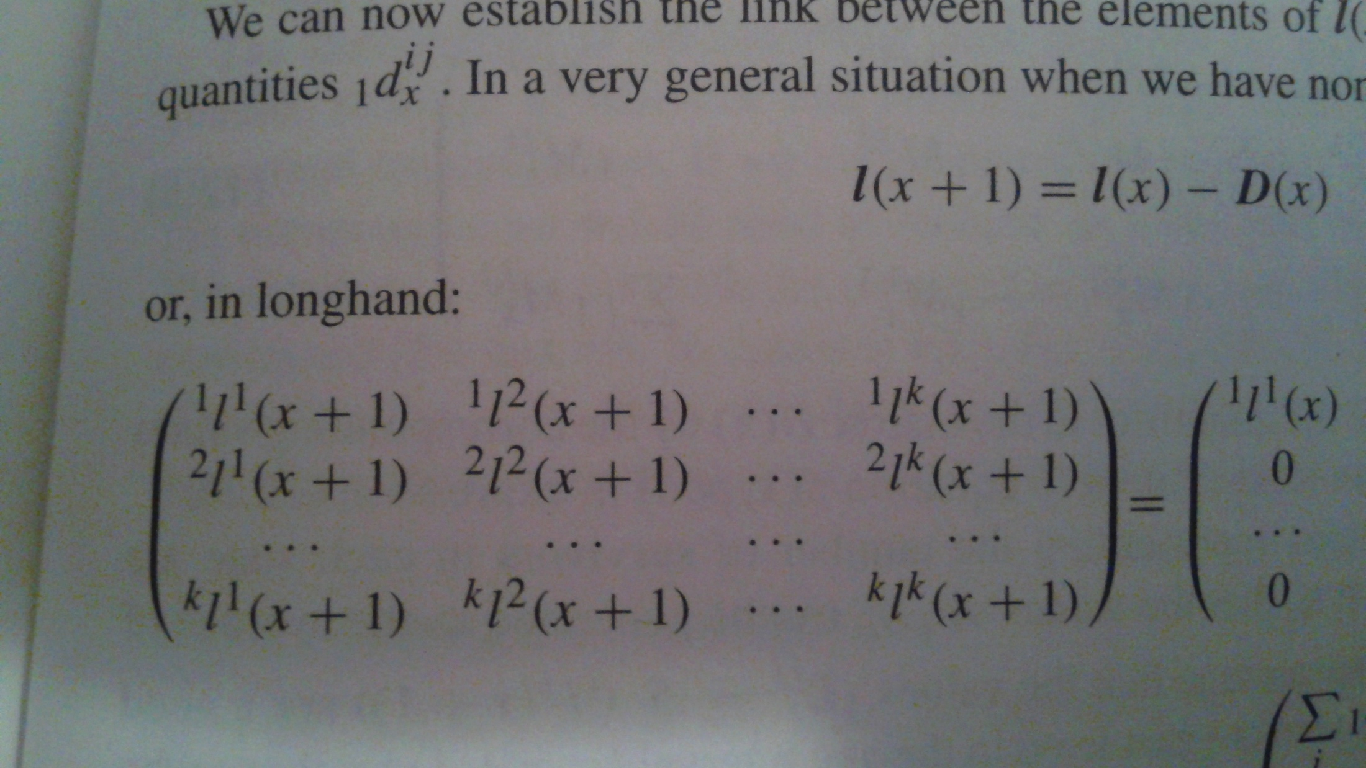
Analytical Pieces to a MSLT: Everything is in matrix form
l(x+1) = l(x) – D (x)

Slide 15
Complexities of a Multi-State life table
Censoring:
  Right-censoring: have we observed them at the beginning of their “lives”?
  Left-censoring: do we observe them until “death?”
Calculating transition probabilities
  Logit models with predicted probabilities
  Markov simulations
  SPACE (Hayward et al., 2009), etc

Slide 16
Questions one can ask with MSLT
Probabilities of Moving States: What is the probability that a cohort of women who began with a specific method (at Month 1) will be using other methods (or no methods) at the end of 6, 12, or 24 months, or that they will be pregnant unintentionally at these time points?
Duration in State: What is the expected length of time that women who began with a specific method will use it versus each of the other methods (or non-use), or be in the state of unintended pregnancy, during the first 24 months?
Movement of State Switching: What is the expected number of switches that women who began with a specific method will make to other contraceptive methods (or nonuse) or to unintended pregnancy during the first 24 months?

Slide 17
Application from my work: Multi-state model of transitions from work to STD, LTD and out of the workforce.
Aims
Model average time spent in various states of work and disability across a working life span.
Characterize common trajectories between work and disability in this working cohort.
Identify differences in trajectories across a number of socio-demographic and health states.
Develop a model to assess the determinants of adverse outcome at each stage of the work trajectory.

Slide 18
Single vs. Multi – state life tables
STD
Multiple states
Still need one “absorbing” state: Death
Work
LTD
WC
Leave Work

Slide 19
While the majority of workers remain in healthy work, the probabilities of transitioning to disability are non-negligible
 | Regular Work | Short Term Disability | Long Term Disability | Worker's Compensation | On Leave
Regular Work | 99.5450% | 8.6572% | 0.3076% | 2.4215% | 2.7153%
Short Term Disability | 0.2308% | 89.9785% | 0.0198% | 0.1181% | 0.1450%
Long Term Disability | 0.0002% | 0.0896% | 99.0077% | 0.0443% | 0.0585%
Worker's Compensation | 0.0049% | 0.0065% | 0.0000% | 96.9433% | 0.0280%
Leave | 0.0399% | 0.9401% | 0.4366% | 0.1921% | 96.8001%
Out of Alcoa | 0.1793% | 0.3281% | 0.2282% | 0.2807% | 0.2531%

Slide 20
Multi-state life tables show expected years of work and disability for each additional year of tenure
Tenure | Regular Work | STD | LTD | Worker's Comp | On Leave
1 | 6.990 | 0.163 | 0.018 | 0.015 | 0.130
2 | 6.121 | 0.157 | 0.017 | 0.014 | 0.123
3 | 5.451 | 0.146 | 0.017 | 0.013 | 0.110
4 | 4.889 | 0.136 | 0.017 | 0.012 | 0.099
5 | 4.396 | 0.126 | 0.016 | 0.010 | 0.088
6 | 3.949 | 0.116 | 0.016 | 0.010 | 0.078
7 | 3.534 | 0.105 | 0.015 | 0.009 | 0.068
8 | 3.145 | 0.094 | 0.014 | 0.008 | 0.059
9 | 2.775 | 0.083 | 0.012 | 0.008 | 0.051
10 | 2.422 | 0.072 | 0.011 | 0.007 | 0.043
11 | 2.082 | 0.060 | 0.009 | 0.007 | 0.036
12 | 1.754 | 0.049 | 0.007 | 0.006 | 0.029
13 | 1.436 | 0.039 | 0.006 | 0.005 | 0.023
14 | 1.129 | 0.029 | 0.005 | 0.005 | 0.018
15 | 0.831 | 0.020 | 0.003 | 0.004 | 0.013
16 | 0.543 | 0.012 | 0.002 | 0.003 | 0.008
17 | 0.266 | 0.006 | 0.001 | 0.002 | 0.004

Slide 21
Highlights from MSLT
An average employee can expect to spend 6.99 years in regular work, nearly 2 months in STD, and nearly 2 months in LTD or on leave.
The proportions of working life spent in each state do not change based on tenure. In other words, workers are not at higher risk of disability if they have been working longer.
Short-term disability episodes represent a longer total amount of time in disability than either long-term disability or worker’s compensation.

Slide 22
Characterizing common trajectories of work and disability
What are the most common trajectories of work and disability? How, if at all, do demographics differ across the individuals in these different trajectories?
Sequence analysis using “K-grams” with Jacquard distance measures.
68.8% (N=11,111) of the sample stays continuously employed (and/or leave Alcoa for other reasons) through sample period.

Slide 23
Episodes of STD are sometimes temporary in nature…
WORK
STD
WORK
( 24.12% )
WORK
STD
WORK
LEAVE
WORK
( 19.37% )
WORK
STD
WORK
STD
WORK
( 10.34% )

Slide 24
…and sometimes far more complex
WK
STD
WK
STD
WK
STD
WK
STD
WK
( 9.59% )
WK
STD
LTD
WK
STD
WK
STD
WK
( 12.57% )
WK
STD
WK
STD
LTD
WK
STD
WK
LEAVE
WORK
( 12.46% )

Slide 25
Trajectories from LTD typically follow more straight-forward pathways
WORK
LTD
WORK
( 6.33% )
WORK
LTD
WORK
LEAVE
WORK
( 5.26% )

Slide 26
Demographics differ across trajectory groups
Cluster Medoids | Continously Employed | Employed then left
N | 5185 | 5926
% Sample | 32.11% | 36.70%
Age (January 2007) | 35 | 35
Tenure (January 2007) | 5 | 4
Hourly | 69.5% | 69.7%
Male | 84.8% | 80.8%
Ethnicity
White | 42% | 53%
African American | 0% | 2%
Asian-Pacific | 2% | 4%
Hispanic | 2% | 4%
Native American | 1% | 2%
Unknown/Multi | 10% | 11%
NA | 43% | 24%
Risk Score
Average Max Risk | 1.00 | 0.84
Average Min Risk | 0.46 | 0.53
Proportion Risk Match | 0.84 | 0.67

Slide 27
Demographics differ across trajectory groups: LTD
Cluster Medoids | WK-LTD-WK | WK-LTD-WK-LEAVE
N | 5185 | 265
% Sample | 32.11% | 1.64%
Age (January 2007) | 41 | 40
Tenure (January 2007) | 8 | 7
Hourly | 89.4% | 81.8%
Male | 86.8% | 81.5%
Ethnicity
White | 60% | 57%
African American | 1% | 1%
Asian-Pacific | 8% | 14%
Hispanic | 2% | 7%
Native American | 2% | 2%
Unknown/Multi | 27% | 18%
NA | 0% | 0%
Risk Score
Average Max Risk | 1.23 | 1.42
Average Min Risk | 0.43 | 0.63
Proportion Risk Match | 86.04% | 76.49%

Slide 28
Demographics differ across trajectory groups: STD
CLUSTERS | W-S-W | W-S-W-L | W-S-W-S-W | W-S-W-S-W-S-W-S-W | W-S-L-W-S-W-S-W | W-S-W-S-L-W-S-W-L
N | 1215 | 974 | 521 | 483 | 633 | 627
% Sample | 7.52% | 6.03% | 3.23% | 2.99% | 3.92% | 3.88%
Age (January 2007) | 37 | 38 | 39 | 40 | 41 | 40
Tenure (January 2007) | 4 | 5 | 4 | 5 | 7 | 7
Hourly | 89.6% | 82.8% | 94.0% | 96.3% | 94.8% | 90.4%
Male | 84.8% | 78.5% | 85.4% | 75.4% | 78.4% | 75.1%
Ethnicity
White | 58% | 60% | 70% | 68% | 74% | 70%
African American | 0% | 1% | 0% | 0% | 0% | 2%
Asian-Pacific | 2% | 3% | 1% | 1% | 3% | 3%
Hispanic | 0% | 2% | 0% | 0% | 0% | 3%
Native American | 1% | 2% | 0% | 1% | 1% | 2%
Unknown/Multi | 14% | 18% | 16% | 22% | 22% | 20%
NA | 24% | 14% | 13% | 7% | 0% | 1%
Risk Score
Average Max Risk | 1.75 | 2.12 | 2.23 | 2.99 | 2.74 | 2.77
Average Min Risk | 0.54 | 0.74 | 0.51 | 0.67 | 0.64 | 0.82
Proportion Risk Match | 97.70% | 90.55% | 99.42% | 99.38% | 98.42% | 88.68%

Slide 29
Next steps
Understand specific health conditions associated with episodes of disability and to what extent they differ across trajectories.
Calculate time components to length of stay in disability and/work.
Develop a model to assess the determinants of adverse outcome at each stage of the work trajectory.

Slide 30
References
Samuel, Preston, Patrick Heuveline, and Michel Guillot. "Demography: Measuring and modeling population processes." Malden, MA: Blackwell Publishers (2001).
Wachter, Kenneth W. Essential demographic methods. Harvard University Press, 2014.

Slide 31
Questions?
Thank you!
aharrati@stanford.edu

