Slide 1
Patient Perspectives on Experts’ Recommendations for Hospital CPR Discussions
Cimino JW, Anderson WG, Lo B
International Conference on Communication in Healthcare
September 30, 2013
Notes:
10 min 12 sec

Slide 2
Disclosures
Project Funding:
Kornfeld Program in Bioethics and Patient Care, administered by the Greenwall Foundation
National Center for Advancing Translational Sciences, National Institutes of Health, through UCSF-CTSI Grant Number KL2TR000143
Notes:
Move through quickly

Slide 3
Background
Many concerns about CPR discussions
  Patients confused, overestimate effectiveness
  Clinicians unaware of patient wishes
Experts endorse models for improvement
  Values-based discussion model
  Information-focused discussion model
Little information about patients’ perspectives on these models
Notes:
Move through quickly

Slide 4
Objective
To describe seriously ill hospitalized patients’ perspectives on how hospital doctors should discuss CPR
Notes:
In this talk, I’m only going to present data on how respondents would feel about having a similar discussion with a hospital doctor

Slide 5
Methods
Qualitative study
Created videos depicting values-based and information-focused CPR discussions
Seriously ill hospitalized patients viewed and commented on videos
  Asked patients how they would feel having a similar discussion
Notes:
Add “at an academic hospital”?

Slide 6
Discussion Models
Values-based
Information-focused
Make decision together
Patient decides
Prognosis and goals of care
CPR procedural information
Gives recommendation
Asks
for decision
Notes:
References?
Derived models from literature review, refined scripts with input from national experts to ensure that they were realistic and consistent with the two models
Termed them “values-based” and “information-focused”
In the values-based model, the doctor introduces the discussion about CPR as a decision they will make together. The doctor frames the discussion in the patient’s prognosis and goals of care, and then provides a recommendation based on these factors.
In the information-focused model, the doctor emphasizes that whether or not the patient receives CPR is his decision. The doctor provides information about the procedure of CPR and then asks the patient for his decision.

Slide 7
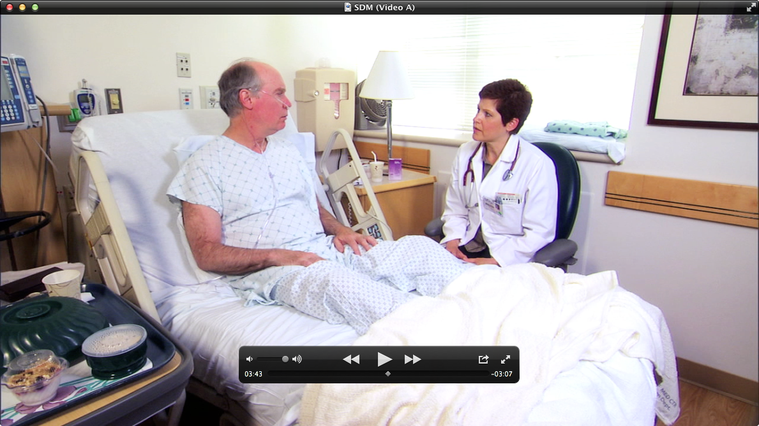
Notes:
This is what the videos looked like

Slide 8
Participant Characteristics
31 eligible patients; 23 (74%) consented
Characteristic | n=20 (%)
Age, mean (range) | 59 (41-82)
Male gender | 11 (55%)
Non-Hispanic Caucasian Asian African American Hispanic or Latino Native American | 9 (45%) 3 (15%) 3 (15%) 3 (15%) 3 (15%)
Cancer as life-limiting diagnosis | 9 (45%)
Previously discussed CPR | 8 (40%)
Advance directive | 11 (55%)
Notes:
SAY: Completed interviews for 20 patients, 3 patients agreed to participate but couldn’t complete interview before hospital discharge

Slide 9
Overall Reactions to Videos
Most felt both discussion models would help them decide about CPR (75-80%)
Most would feel comfortable with a similar discussion (60-65%)
Preference between videos:
  50% no preference (half liked both; remaining were apathetic)
  35% information-focused
  15% values-based
Notes:
Preference
Comfort
Majority would find both videos helpful (75-80%) and most would feel comfortable with (60-65)

Slide 10
Discussion Models
Values-based
Information-focused
Make decision together
Patient decides
Prognosis and goals of care
CPR procedural information
Gives recommendation
Asks
for decision
Notes:
Say: Recall that there were different components – we wanted to know reactions to components within discussions.
In qualitative analysis, identified benefits and harms associated with all components.
Main point: Majority comfortable with all components except recommendation

Slide 11
Reactions to CPR Recommendation
Discussion Component | Would feel comfortable n=20 (%)
Values-based video
Gives recommendation about CPR | 8 (40%)*
Information-focused video
Elicits CPR preference without recommendation | 13 (65%)*
*p=0.03 (statistically significant)
Notes:
Main point: Only 40% felt comfortable with a recommendation about CPR (ie. most felt uncomfortable with the recommendation); whereas 65% felt comfortable when the doctor elicits the patient’s preference without giving a recommendation

Slide 12
Benefits of MD Recommendation
Can show understanding of patient
Appreciate doctor’s candor about opinion
Helpful if patient can’t decide

Slide 13
Benefit of Recommendation
“I liked the [values-based video] better where…she made the recommendation. Because [it] looked a little more detailed. She made a recommendation then said why.”
  - 81-year-old man with metastatic prostate cancer
Notes:
Benefit was that the recommendation clarified the physician’s perspective
One short quote for each (1 benefit and 1 harm of recommendation)

Slide 14
Harms of MD Recommendation
Patients may feel reluctant to say “no” to doctor
Doctor could make the wrong decision for the patient
  Even if tried to base recommendation on patient’s stated goals and values
Takes away decision from the patient

Slide 15
Harm of Recommendation
“[The recommendation] is going to complicate matters because the patient is going to go, ‘Whoa! This is a cardiologist,’ She knows a helluva lot more than I do.’”
  - 42-year-old man with HIV and end stage liver disease
Notes:
Some participants worried that patients would have trouble saying no to a doctor

Slide 16
Conclusions
Participants’ reactions to the discussion models and components varied
Benefits and harms identified for all components
A majority of participants felt comfortable with all components except the doctor’s recommendation

Slide 17
Implications
One discussion model unlikely to work for all patients
Many patients might prefer a hybrid model
Need to tailor discussions to individual patients’ preferences

Slide 18
Acknowledgements
Patient participants, clinicians, and experts who reviewed scripts
Christian Burke from the UCSF Office of Educational Technology
Bernie Miller from the UCSF Kanbar Center for Simulation, Clinical Skills and Telemedicine Education
Actors Lisa-Marie Newton and David Usner; and videographer Daniel Murphy

Slide 19
Back-up Slides

Slide 20
Setting and Participants
Study conducted on the medicine service at a university hospital
Inclusion criteria:
  English speaking
  Hospital doctor “would not be surprised by their death or ICU admission within next year”
Exclusion criteria:
  Altered mental status
  Inability to provide informed consent
Notes:
Patient who would have these discussions with hospital doctors
*Use as backup slide only

Slide 21
Reactions to Discussion Components
Discussion Component | Would find helpful n=20 (%) | Would feel comfortable n=20 (%)
Values-based video
Elicits patient’s understanding of health | 13 (65%) | 12 (60%)
Goals and values | 12 (60%) | 13 (65%)
Recommendation about CPR | 11 (55%) | 8 (40%)*
Information-focused video
CPR is patient’s choice; doctor’s role to give information | 17 (85%) | 12 (60%)
Elicits CPR preference without recommendation | 14 (70%) | 13 (65%)*
*p=0.03.
Notes:
Main point: Most felt comfortable with all components except recommendation
*Use as back-up slide for Q&A

Slide 22
Interview Protocol and Analysis
Each participant viewed both videos
Semi-structured interview protocol:
  Overall preference for 2 discussion models
  Helpfulness, comfort of overall discussion models and components
  Qualitative interviewing to explore reactions
Thematic analysis: Benefits and harms of discussion models
Notes:
Say that alternated the order
1-hr, conducted in hospital room, audio-recorded and transcribed
Identified benefits and harms

