Slide 1
Spatial Regression part 2

Slide 2



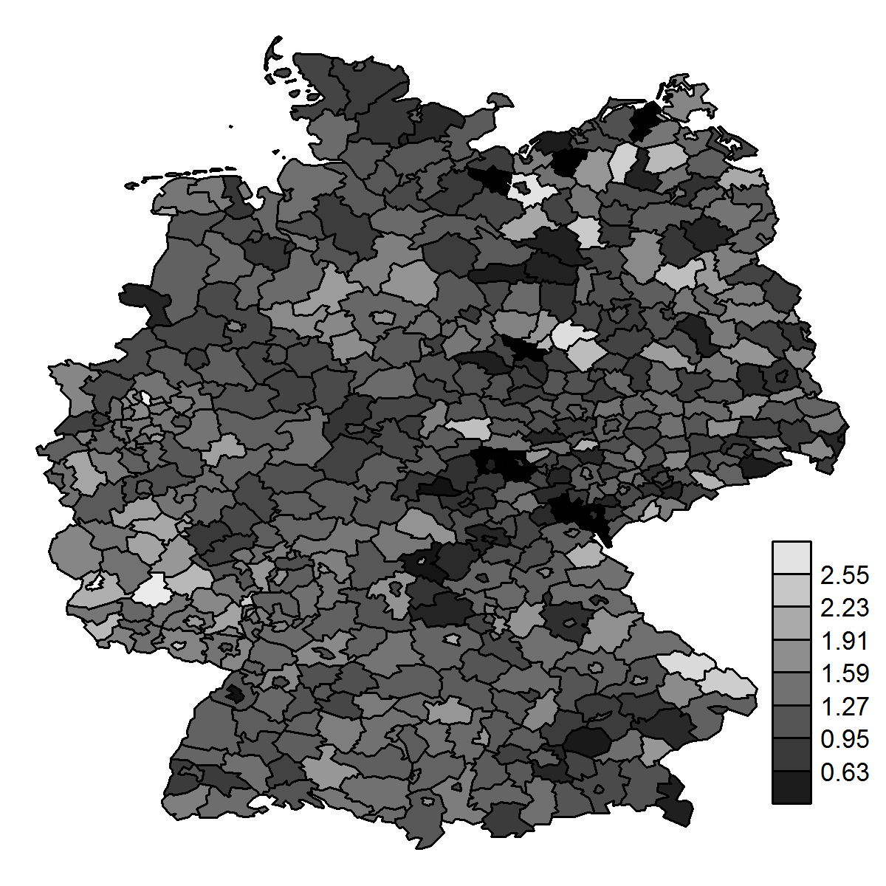
Areal data
SMR
Areal or lattice data arise when the region of interest is partitioned into a finite number of subregions at which outcomes are aggregated
Example: number of larynx cancer cases in the districts of Germany
We want to obtain the disease risk within the geographic units

Slide 3

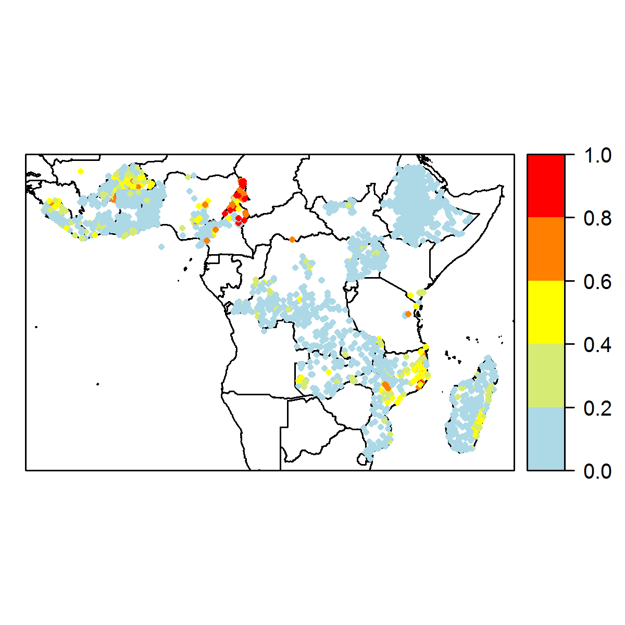

Geostatistical data
The disease risk is a spatially continuous phenomenon but it is measured only at particular sites
Example: lymphatic filariasis prevalence obtained from surveys conducted at several villages
We want to predict the disease risk at unobserved locations and construct a spatially continuous risk surface

Slide 4
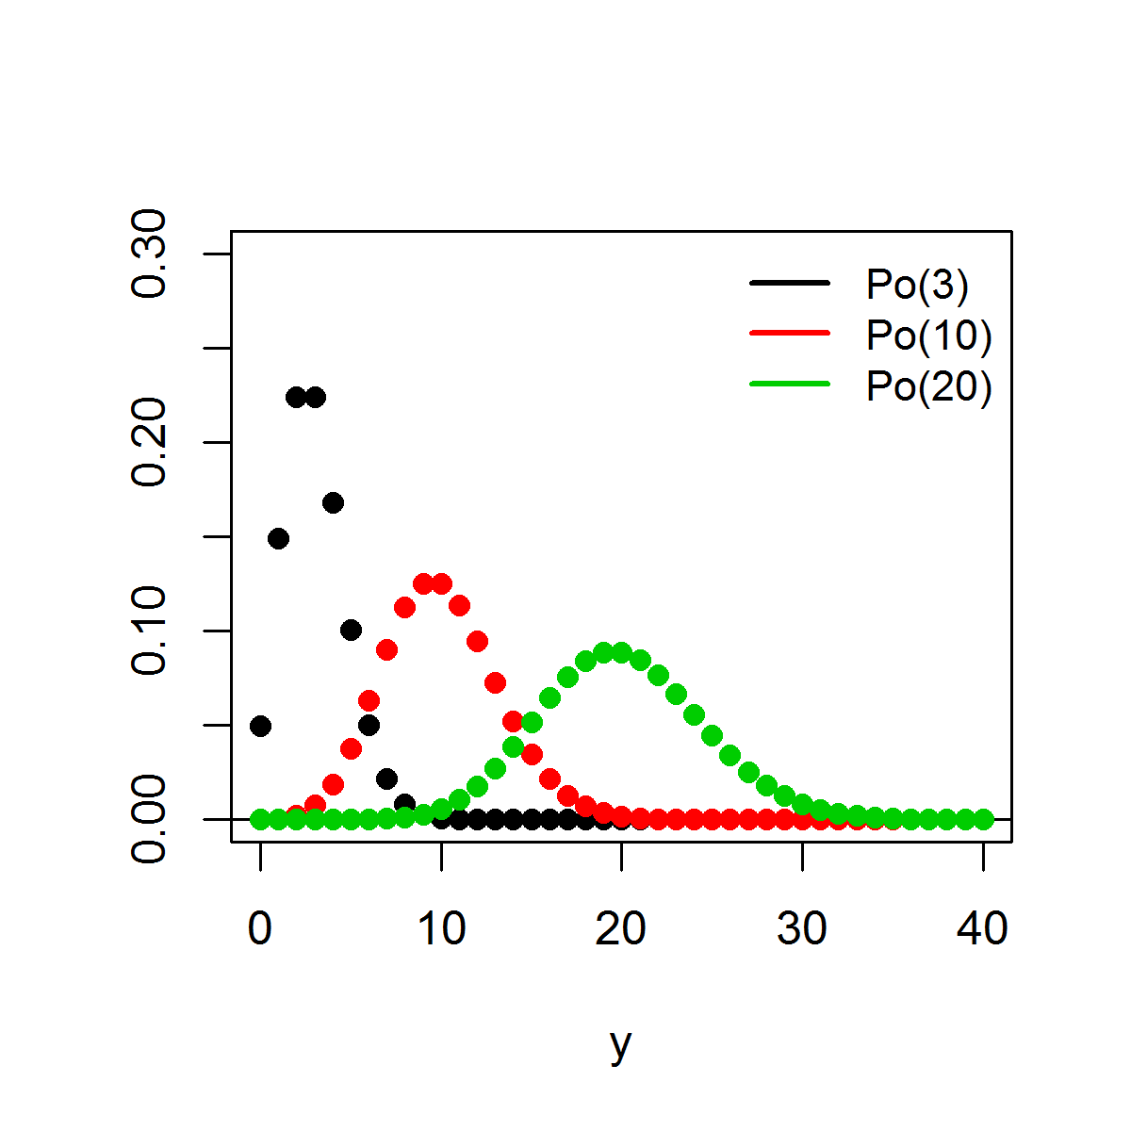
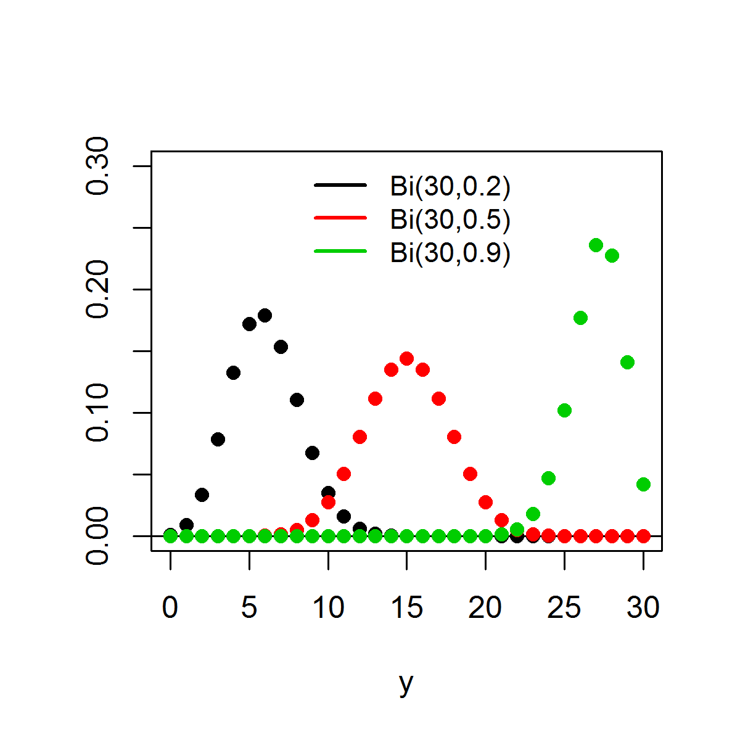
Distributions
Poisson distribution
Y ∼ Poisson(µ) y = 0, 1, 2, . . .
expected number of occurrences µ > 0
Binomial distribution Y ∼ Binomial (n, π) y = 0, 1, . . . , n
number of trials n ∈ {1, 2, . . .}, probability of success π ∈ [0, 1]
p(y|µ) =
e
−µ_{µ}y
n y (n−y )
y !
p(y|n, π) = π (1 − π)
y
E (Y ) = µ, Var (Y ) = µ
E (Y ) = nπ, Var (Y ) = nπ(1 − π)

Slide 5









Regression models
Log-linear model
Logistic model
Y_{i} ∼ Po(µ_{i} ), i = 1, . . . , n
log(µ_{i} ) = α + βx_{i}
For a one unit increase in x , the mean increases by a factor of exp(β) (holding all other covariates constant)
Y_{i} ∼ Binomial (n_{i} , π_{i} ), i = 1, . . . , n
logit(π_{i} ) = α + βx_{i}
log-odds: logit(π_{i} ) = log ^{( πi \}
1−π_{i}
π_{i} = logit⁻¹(α + βx_{i} ) =
exp(α+βx_{i} )
1+exp(α+βx_{i} )
β is the change in the log-odds associated with one-unit increase in the x covariate (holding all other covariates constant)
exp(β) is the odds ratio
π
OR =
1−π
|x =1
π
_{1−π} |x =0
For a one unit increase in x , the odds increase by a factor of exp(β) (holding all other covariates constant)

Slide 6






Standardized Mortality Ratio
Disease risk is often estimated by the standardized mortality ratio:
Y E
SMR =
Y number of observed cases
E number of expected cases if the study population has the same disease rate as the standard population (indirect standardization)
E = ^{},m}
_{r} (s)
n_{i}
i =1 i
_{r} (s)
rate in strata (age group) i in the standard population (usually
i
the national population)
_{r} (s)
number of events divided by number of individuals at risk
i
n_{i} population in stratum i of the observed population
SMR > 1 indicates more cases observed than expected from the standard population

Slide 7



Disease mapping
SMRs are often misleading and insufficiently reliable for reporting in areas with small populations
In contrast, model-based approaches enable to incorporate covariates and borrow information from neighboring areas to improve local estimates, resulting in the smoothing of extreme rates based on small sample sizes
Such approaches are often expressed as hierarchical Bayesian disease mapping models

Slide 8





Disease mapping models
Bayesian disease mapping models treat the disease risks θ_{i} , in small areas indexed by i , as random variables and specify a distribution for them
Y_{i} ∼ Po(E_{i} × θ_{i} ), i = 1, . . . , n
log (θ_{i} ) ∼ p(·|φ)
φ ∼ π(·)
Y_{i} and E_{i} are respectively the observed and expected number of cases of disease in area i
θ_{i} is the relative risk in area i
p(·|φ) is an appropriate prior distribution for the {θ_{i} }
φ are hyperparameters with hyperprior distributions π(·)

Slide 9



Disease mapping models
log(θ_{i} ) = α + CH + UH
CH is the correlated heterogeneity. It accounts for the spatial dependence between the relative risks
UH is an unstructured exchangeable component included to increase flexibility. It models uncorrelated noise
These hierarchical models allow straightforward extensions to estimate covariate effects, predict missing data and handle spatio-temporal data and multiple diseases

Slide 10






Conditional autoregressive (CAR) model
To model CH, a Gaussian Markov random field prior distribution is most commonly used in disease mapping
These models are usually specified by a set of area-specific spatially correlated Gaussian random effects u_{i} , i = 1, . . . , n where n is the number of areas in the study region
v
u_{i} |u_{−i} ∼ N(u¯_{δi} , _{n} )
δ_{i}
_{j∈δi} u_{j} , and δ_{i} denotes the set of labels of the neighbours
u =
₁ },
δ
n
i
δ
i
of area i
u_{i} has a normal distribution with conditional mean given the average of the neighbouring u_{j} ’s, and conditional variance inversely proportional to the number of neighbours

Slide 11
Scottish Lip Cancer data

Slide 12
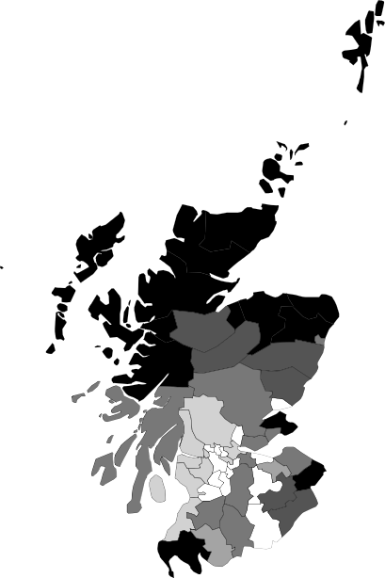
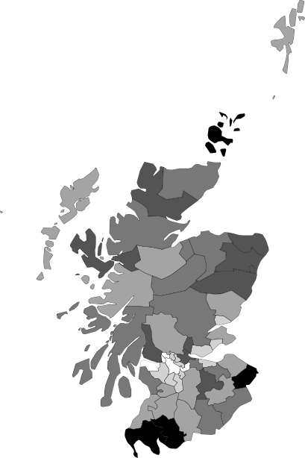
Dataset: Scottish lip cancer data
100
-1
-10 0 100
-1 0 -1
-01 0 -10
0 0 -1
1 0 -01
5 0 0
10 0 1
- 0 5
10
0 0 -
N
10
0
10 -10 0 Mle
a) SMR_{i} = 100Y_{i}/E_{i}, standardized mortality ratio for lip cancer in I = 56 districts, 1975–1980
R and WinBUGS Examples – p. 22/27

Slide 13
Dataset: Scottish lip cancer data
100
-1
-10 0 100
-1 0 -1
-01 0 -10
0 0 -1
1 0 -01
5 0 0
10 0 1
- 0 5
10
0 0 -
N
10
0
10 -10 0 Mle
SMR_{i} = 100Y_{i}/E_{i}, standardized mortality ratio for lip cancer in I = 56 districts, 1975–1980
one covariate, x_{i} = percentage of the population engaged in agriculture, fishing or forestry (AFF)
R and WinBUGS Examples – p. 22/27

Slide 14






Frequentist vs. Bayesian paradigms
Frequentist
Objective view of probability
Limit of the relative frequency of an outcome of an experiment over repeated runs of the experiment
Data y are random
Model parameters θ are fixed There is a fixed, true value of θ
Inference performed via maximum likelihood L(θ|y ) = p(y|θ)
Find θ such that likelihood p(y|θ) is maximized
Bayesian
Subjective view of probability
Quantity describing the individual’s degree of belief in the event
Current data y are fixed
Model parameters θ are random
We assign θ a probability distribution
Inference performed via the posterior distribution of θ, p(θ|y )
We have a prior belief about θ, p(θ). We combine this with the information provided by the observed data y , p(y|θ), to obtain the posterior distribution of θ, p(θ|y )

Slide 15




Frequentist vs. Bayesian paradigms
Frequentist
We estimate θ and make assumptions to generate measures of uncertainty about the estimate (standard errors, confidence intervals)
We cannot make probability statements about parameters (fixed) P(θ ∈ 95% CI ), P(θ > 3) are 0 or 1
We can only make statements about performance of estimators over repeated sampling
95% confidence interval:
95% of the time, θ is in the 95% interval that is estimated each time
Bayesian
All statistical inferences (point and interval estimates, hypothesis tests) follow from the posterior distribution
Posterior means yield point estimates of θ, quantiles yield credible intervals
We can make probability statements about parameters (random)
95% credible interval:
P(θ ∈ 95% CI ) = 0.95
Can handle complex models that are difficult to fit using classical methods (e.g. repeated measures, missing data, multivariate data)

Slide 16



Bayesian inference
Bayes’ Theorem
p(y |θ)p(θ) p(y )
p(θ|y ) =
p(θ|y ) posterior distribution of the parameter of interest θ
p(y|θ) likelihood function
p(θ) prior distribution. Reflects prior knowledge about θ. If there is not prior knowledge, use uninformative priors
Inference usually performed ignoring the normalizing constant p(y )
p(θ|y ) ∝ p(y|θ)p(θ)

Slide 17




Model-based geostatistics
Geostatistics is that part of spatial statistics which deals with data obtained by spatially discrete sampling of a spatially continuous process S (·) = {S (x ) : x ∈ A ⊂ R²}
Data consist of measurements Y₁, . . . , Y_{n} taken at locations
x₁, . . . , x_{n} sampled within A, and Y_{i} is a noisy version of S (x_{i} )
Model-based geostatistics is the application of general principles of statistical modelling and inference to geostatistical problems
Prediction problems are based on explicitly declared statistical models for the data. Likelihood-based methods of inference are applied to fit the model and the fitted model is used to make predictions

Slide 18




Prediction problem
Survey data
Sample of individuals in each of a number of villages Test results for a given disease
Explanatory variables
environmental and socio-economic data (elevation, vegetation, temperature, age,...) Objective
Predict local disease prevalence throughout the study region Compute local exceedance probabilities P(prevalence > cutoff)
Formulate a model describing the variability in the response variable as a function of the explanatory variables and a spatial effect to account for the residual spatial autocorrelation that enables spatial prediction in unsampled locations

Slide 19



Model
Distribution for the number of positive results Y_{i} out of N_{i} people sampled conditional on the true prevalence P(x_{i} ) at locations x_{i} ,
Y_{i} |P(x_{i} ) ∼ Binomial(N_{i} , P(x_{i} )),
logit(P(x_{i} )) = z_{i} β + S (x_{i} )
z_{i} = (1, z_{i 1}, . . . , z_{ip} ) vector of the intercept and covariates
β = (β₀, β₁, . . . , β_{p} )^{t} coefficient vector
Fixed effects quantify the effects of the covariates on the disease
S (·) is a zero-mean Gaussian process with
Var [S (x )] = σ² and ρ(u) = Corr [S (x_{i} ), S (x_{j} )], u = ||x_{i} − x_{j} ||
Correlation functions: Mat´ern, Powered exponential, Spherical families
Random effects represent residual spatial variation which is not
explained by the available covariates

Slide 20
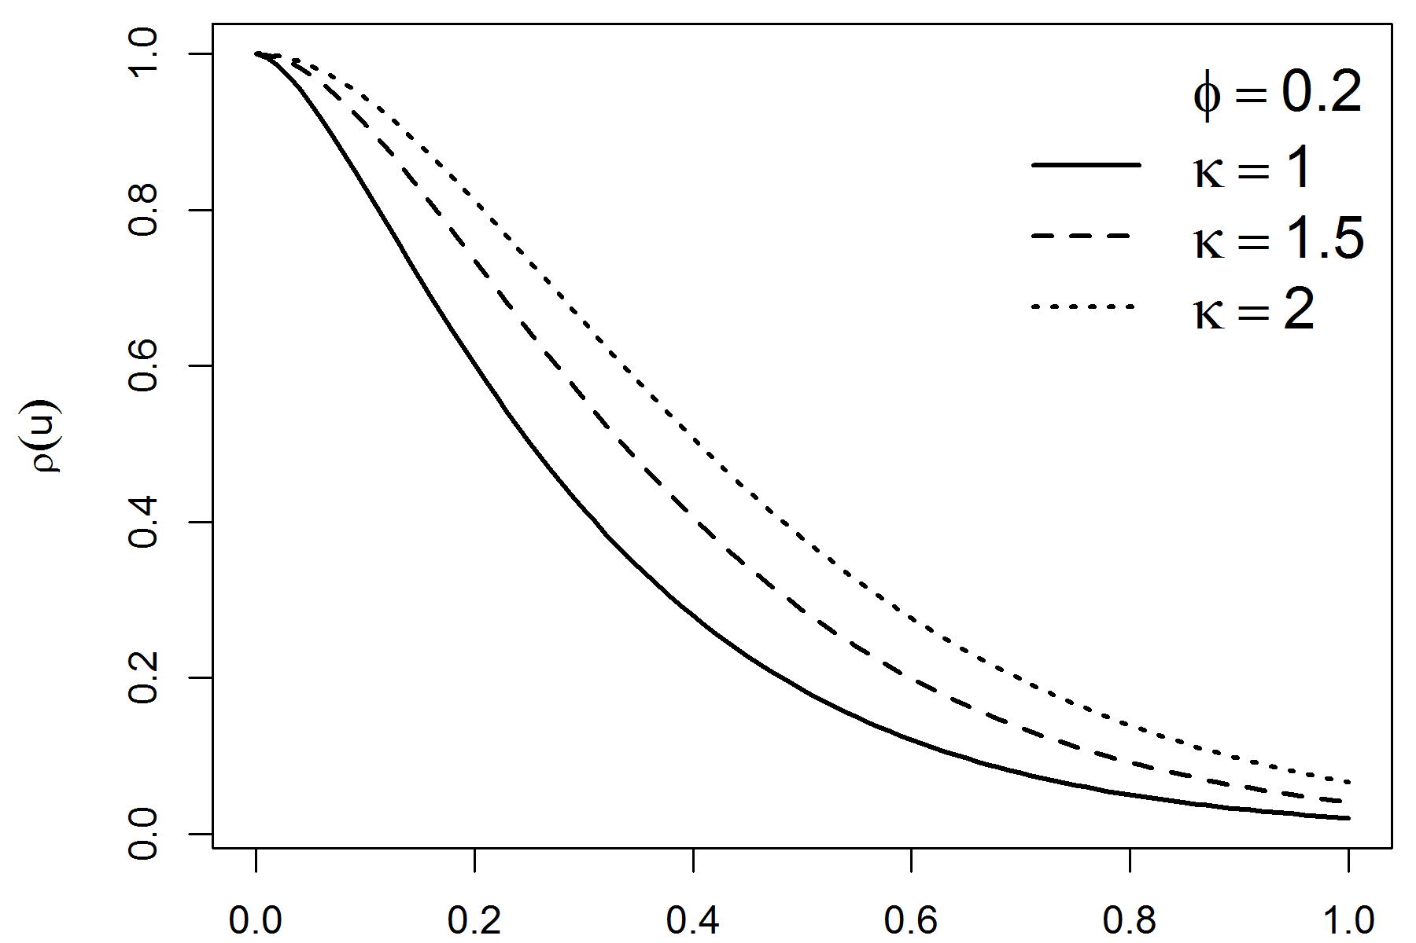
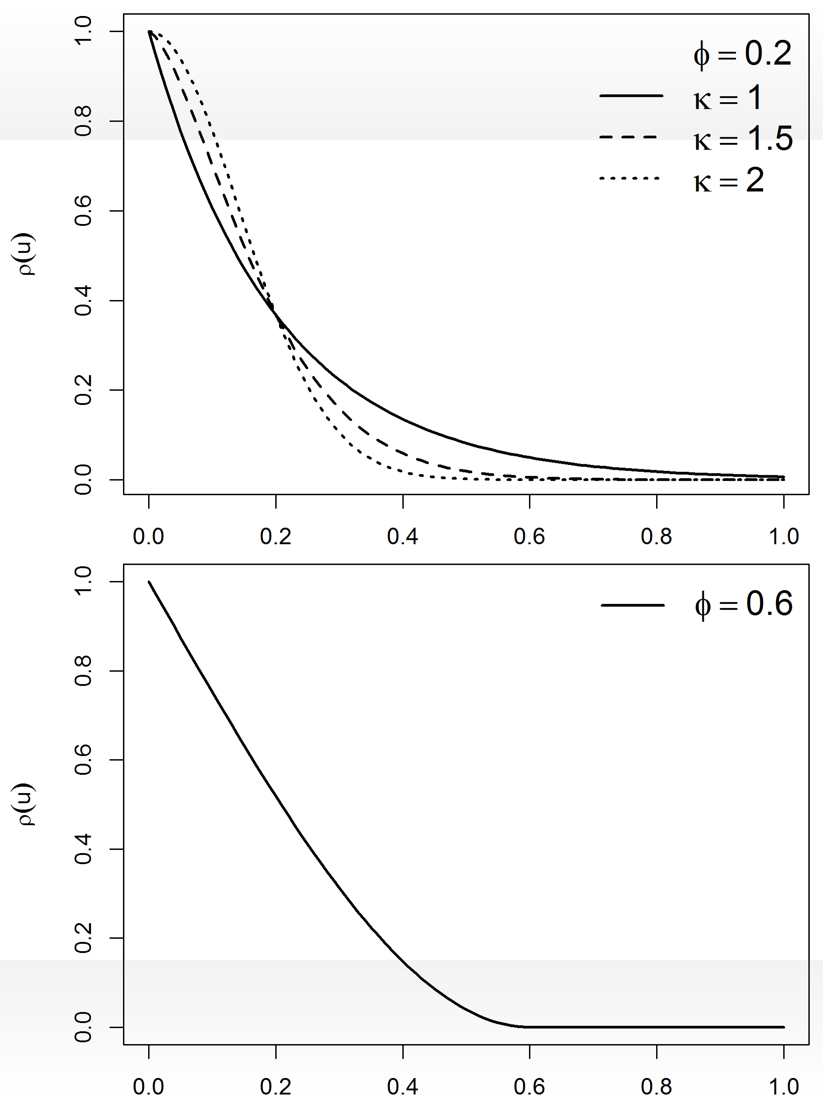

Correlation functions
Mat´ern family
1
ρ(u) = (u/φ)^{κ} Kκ (u/φ)
2^{κ−1} Γ(κ)
φ > 0 scale, κ > 0 order, Kκ (·) modified Bessel function of order κ
Exponential: ρ(u) = exp(−u/φ) (κ = 0.5)
Gaussian: ρ(u) = exp (−(u/φ)² ) (κ → ∞)
S (·) is Iκ − 1 times mean-square differentiable
Powered exponential family
ρ(u) = exp ⁽− (u/φ)^{κ )}
φ > 0 scale, 0 < κ ≤ 2 shape
if κ < 2, S (·) mean-square continuous but not mean-square differentiable if κ = 2, S (·) infinitely mean-square differentiable
Spherical family
⁽ 1 − ³ (u/φ) + ¹ (u/φ)³ : 0 ≤ u ≤ φ
ρ(u) =
2 2
0 : u > φ
φ > 0 single parameter
It has finite range, i.e. ρ(u) = 0 for sufficiently large u, namely u > φ ρ(u) is only once differentiable at u = φ

Slide 21



Example: Model
Conditional on the true prevalence P(x_{i} ) at location x_{i} , i = 1, . . . , n, the number of positive results Y_{i} out of N_{i} people sampled at x_{i} follows a binomial distribution,
Y_{i} |P(x_{i} ) ∼ Binomial(N_{i} , P(x_{i} )) logit(P(x_{i} )) = z_{i} β + S (x_{i} )
z_{i} = (1, z_{i 1}, . . . , z_{ip} ) vector of the intercept and the p covariates
β = (β₀, β₁, . . . , β_{p} )^{t} coefficient vector
S (x_{i} ) spatially structured random effect
S (x_{i} ) zero-mean Gaussian process with covariance function

Slide 22


Example: The Beta-Binomial model
Let Y be the number of successes in n independent trials
Y ∼ Binomial (n, π)
We wish to estimate π
Prior distribution for π:
p(π) = Beta(α, β) Posterior distribution for π:
p(π|y ) ∝ p(y|π)p(π)
= Binomial (n, π) × Beta(α, β)
= Beta(α + y, β + n − y )

Slide 23






Model selection
Bayesian models may be assessed via the Deviance Information Criterion (DIC)
DIC is based on a trade-off between the fit of the data to the model, and the complexity of the model
DIC = D¯ + p_{D}
Deviance D(θ) = −2 log(p(y|θ)), p(y|θ) likelihood function
D¯ = E [D(θ)] is a measure of how well the model fits the data.
The larger this is the worse the fit
p_{D} = D¯ − D(θ¯) is the effective number of parameters.
The larger p_{D} is, the easier it is for the model to fit the data and so the deviance needs to be penalised
Models with smaller DIC are preferred to models with larger DIC

Slide 24





Bayesian inference
One principal difficulty in applying Bayesian methods is the calculation of the posterior p(θ|y ), which usually involves high-dimensional integration that is generally not tractable in closed form
Thus, even when the likelihood and the prior distribution have closed-form expressions, the posterior distribution may not
Methods for solving this problem:
Markov chain Monte Carlo methods (MCMC)
Approximate Bayesian inference for latent Gaussian models by using Integrated Nested Laplace approximations (INLA)

Slide 25




Markov chain Monte Carlo (MCMC)
A Markov chain is a stochastic process (θ⁽⁰⁾, θ⁽¹⁾, θ⁽²⁾, . . .) that satisfies the Markov property:
_{p(θ}(t+1)_{|θ}(t)_{, θ}(t−1)_{, . . . , θ}(1)_{) = p(θ}(t+1)_{|θ}(t)₎
Consider a draw of θ^{(t)} at iteration t. The next draw θ^{(t+1)} at iteration t + 1 is dependent only on the current draw θ^{(t)}, and not on any past draws
The objective is to build a Markov chain that converges to the desired target distribution p(θ|y )
Then we can run this chain to get draws that are approximately from
p(θ|y ) once the chain has converged
MCMC algorithms: Gibbs sampling, Metropolis-Hastings algorithm,... Software: WinBUGS, OpenBUGS, JAGS,...

Slide 26
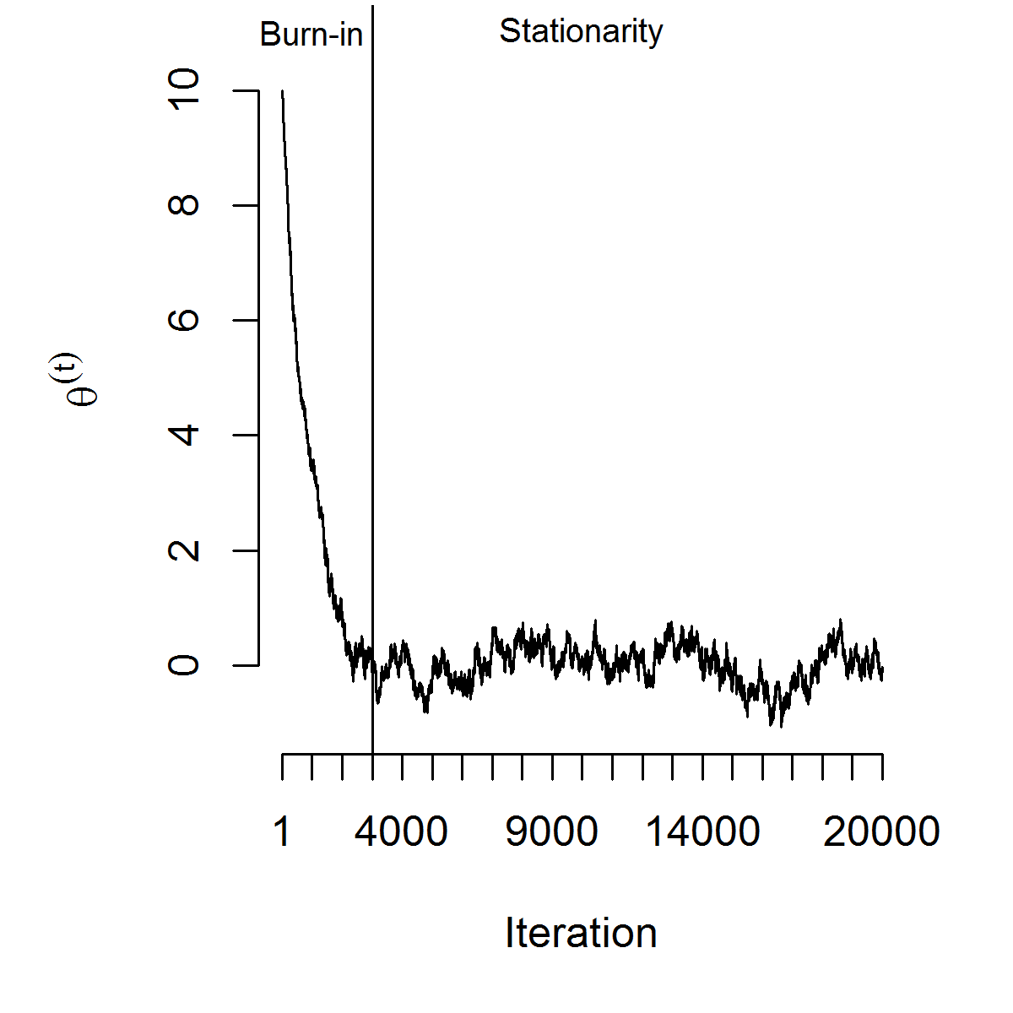
Burn-in
The chain will reach the stationary distribution eventually. The number of iterations it takes to converge varies depending on the starting point. We remove the first values, the burn-in

Slide 27
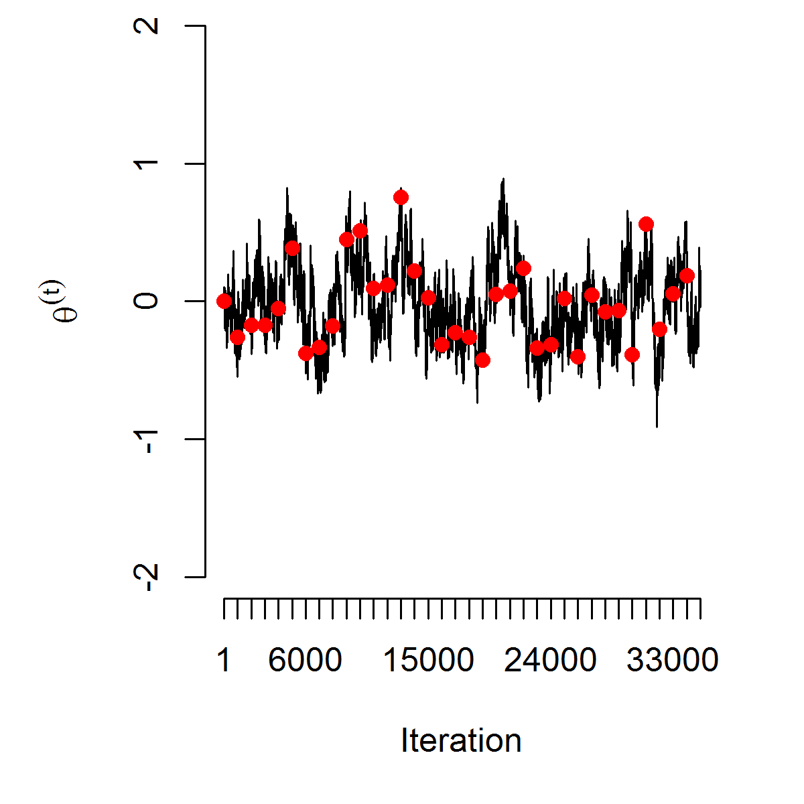
Thinning the chain
To reach converge the chain is run for a long time. We thin the chain by taking draws at every d th iteration. This saves memory and reduces the autocorrelation between draws

Slide 28




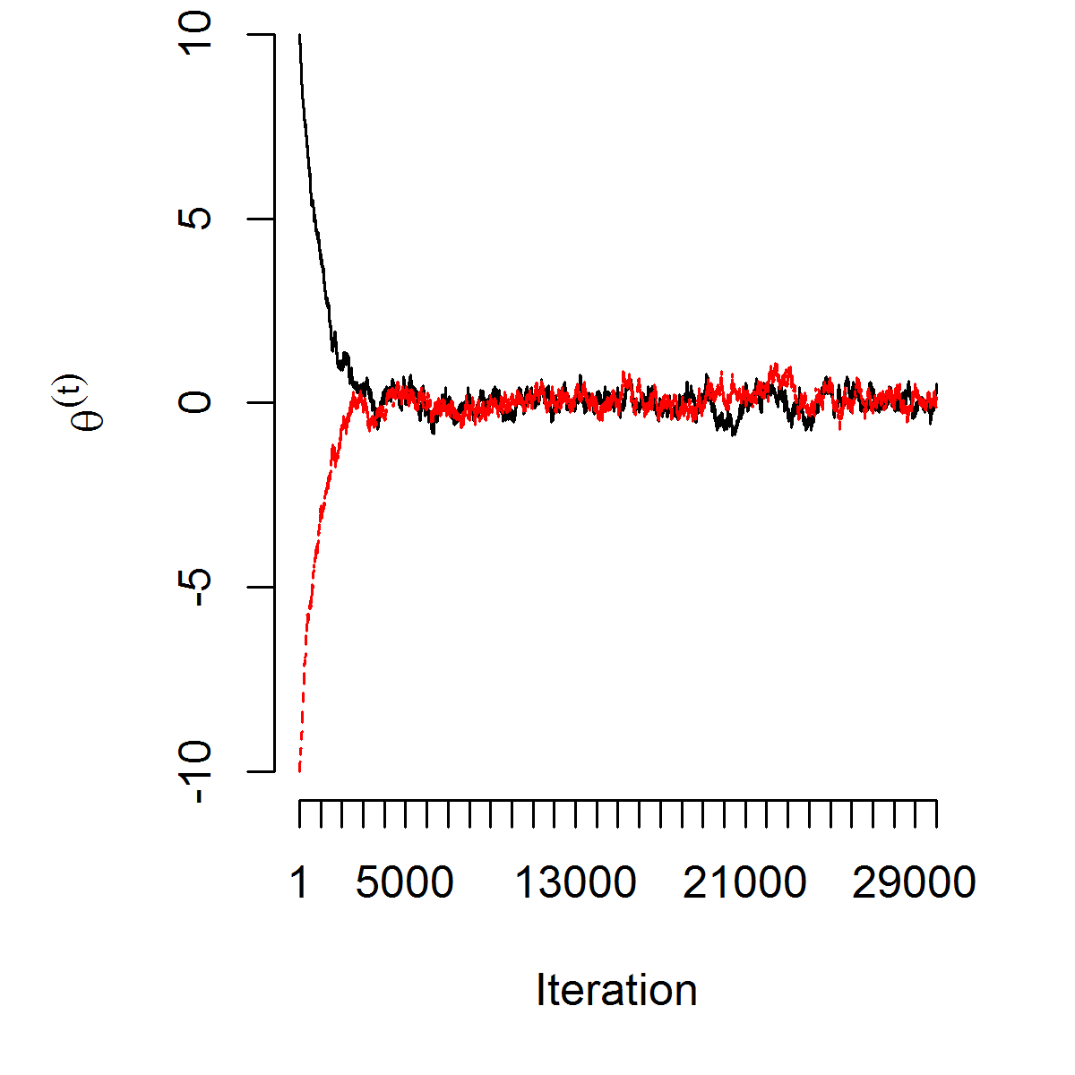
Convergence diagnostics
Traceplot of the chain should show good mixing
Auto-correlation function (ACF) measures the correlation of values h lags apart ρ(h) = cor (θ^{(t)}, θ^{(t+h)}). Slow decay of ACF indicates slow convergence and bad mixing
Run multiple chains
Gelman-Rubin-Brooks test. Run multiple chains. Once convergence is reached, variation within the chains and variation between the chains should coincide

Slide 29
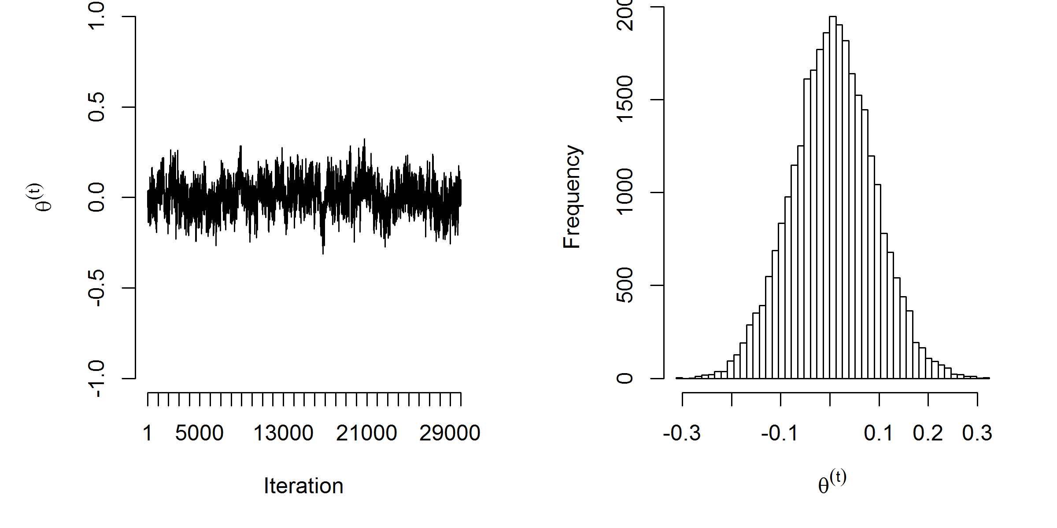
Monte Carlo Integration on the Markov chain
Once the Markov chain has converged to the stationary distribution, the draws in the chain are approximately draws from the posterior p(θ|y ).
Monte Carlo Integration methods can be used on those draws to get quantities of interest

Slide 30
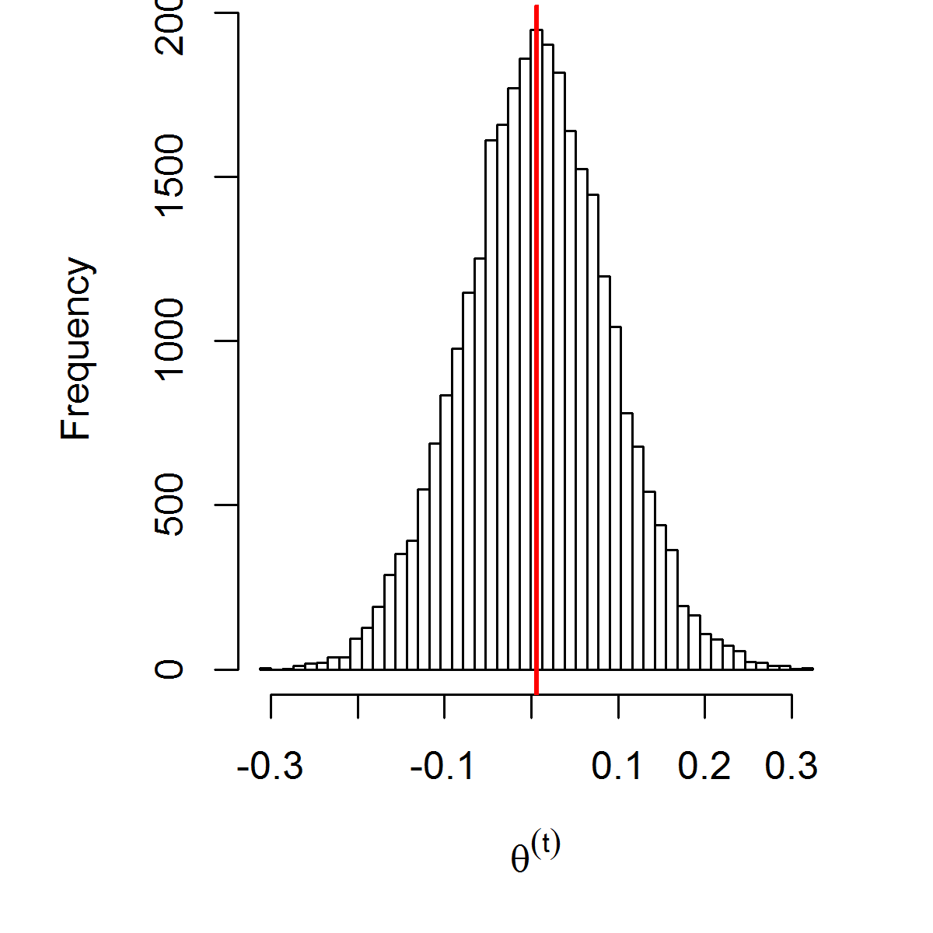
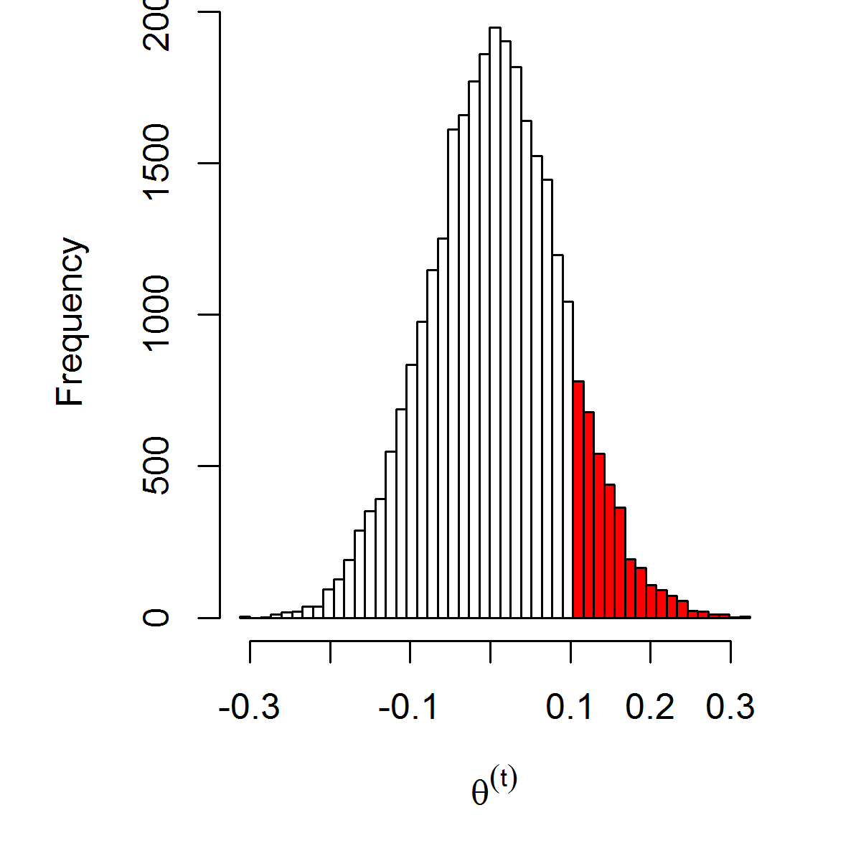
Monte Carlo Integration on the Markov chain
Given a sample (θ⁽¹⁾, . . . , θ^{(M)}) from p(θ|y ):
E (θ|y ) ≈
1
M
},
M
i =1
θ^{(i )} = 0.006
P(θ > 0.1
|y ) ≈
1
M
},
M
i =1
I (θ^{(i )} > 0.1) = 0.13

Slide 31





Approximate Bayesian inference for latent Gaussian models by using integrated nested Laplace approximations (INLA)
Integrated nested Laplace approximations (INLA) are an alternative to inference via MCMC in latent Gaussian models
The main advantage of INLA is the huge improvement of speed compared to MCMC alternatives
Laplace approximations to obtain posterior marginals Numerical algorithms for sparse matrices
Parallel computing
INLA can be easily applied thanks to the R package R-INLA

