Slide 1
Lectures
Assuming that you are in town and physically able to attend, which do you prefer?
Attending Live Lectures - A
Watching Recorded Lectures - B
Notes:
1

Slide 2
Alternative activities
If all lectures were only recorded and we eliminated live lectures, how interested would you instead be in attending weekly open format discussion (question-and-answer) sessions about the lecture topics?
Very interested - C
Not interested - A
Somewhat interested- B
Notes:
2

Slide 3
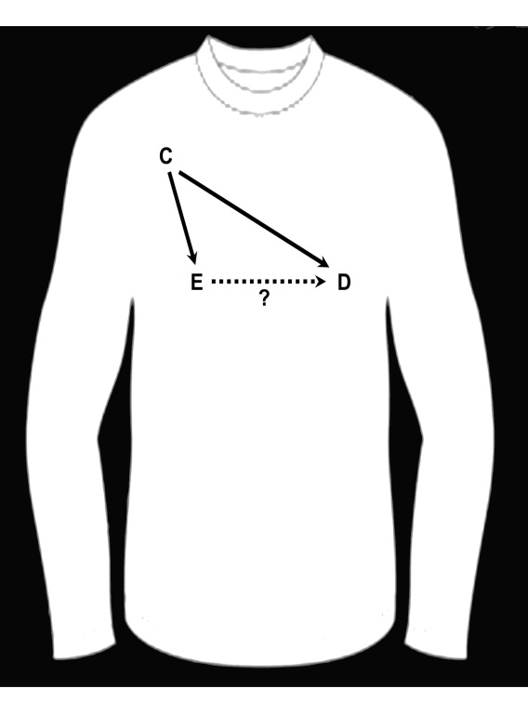
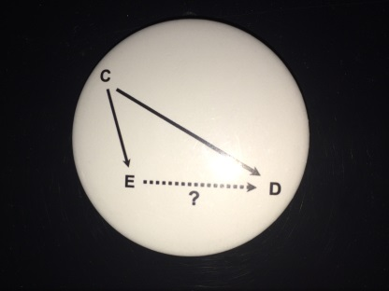
Prize Winners
Systematic Performance
  Highest % score on Problem Sets
    Xiao Wei
    Jonathan Lee
Chance
  Pick name out of a hat
    Michelle Roh (who also had a very high % !!)
Runners up: everyone else
Notes:
This year’s prize winners. The first prize is for systematic performance to the course participant who had the highest % score on the Problem Sets.
Sometimes it is just as good to be lucky as it is to be good and to show you that we respect the role of chance, we also are awarding a prize on the basis of chance. We picked a name out of hat and drew < > who also happened to have a very high % on the Problem Sets.

Slide 4
Experimental design is actually NOT the place that needs the most help…
Notes:
In the Optional Reading for this week, we have included recently published guidelines for reporting observational research. Who has heard of the CONSORT statement for reporting randomized trials, shown here?
Interestingly, it is not the trials researchers who really need these guidelines. The beauty of the randomized study design is typically very robust to making mistakes.

Slide 5
Instead, where more help is needed is in the wild west of observational studies.
Notes:
Instead, where more help is needed is in the wild wild west of observational studies. Who remembers our first Journal Club?

Slide 6
Optional Reading for this week
Notes:
To tame the massive heterogeneity that is currently the case in observational research, the new STROBE guidelines for reporting observational studies were published a few years ago. These are slowly catching on and will likely become the standard within the next 5 to 10 years.

Slide 7
What Kinds of Questions Does Epidemiology Answer?
What have we learned?
Description
  What are the most frequent and serious conditions/diseases?
Causation
  The science of establishing causal relationships among biological, behavioral, environmental (etc.) factors among humans
  Does X cause Y?
Attribution
  What fraction of disease can be eliminated if a causal exposure is eliminated?
Mediation
  Understanding the mechanisms of causation
  How does X cause Y?
Interaction
  When and for whom does X cause Y?
Prediction
  Do A, B, and C predict occurrence of Y? (e.g., diagnosis or prognosis)
How often does Y occur?
Notes:
As we draw to a close, we want to remind and congratulate everyone on what and how much you have learned. Who remembers this slide from our Introductory Comments? It lists the different types of questions that epidemiology answers. In our course, we have covered description, causation, attribution, and interaction (and we are sure that interaction is fresh in everyone’s minds today).
We have mentioned mediation although we really did not cover it in any depth. Finally, we did not cover prediction.

Slide 8

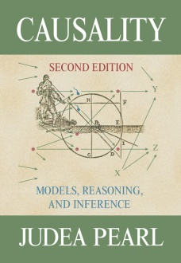
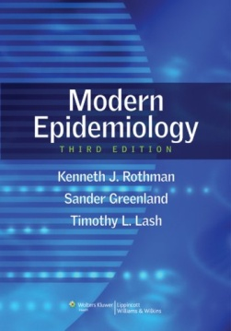


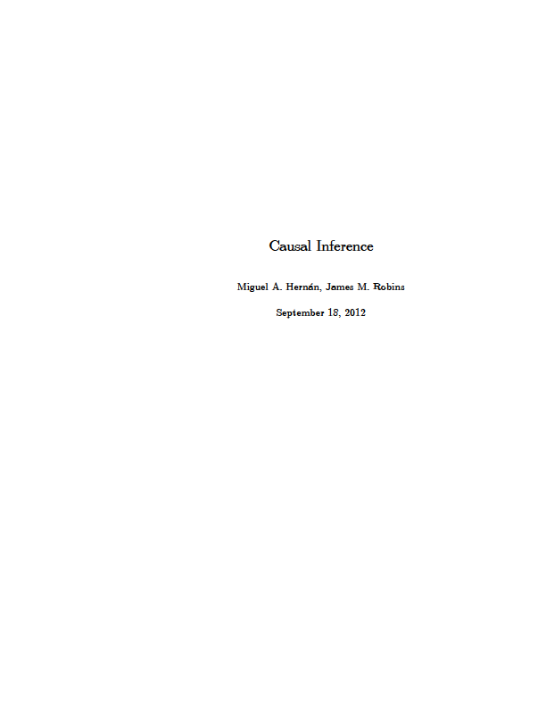
Where We Stand on the Ladder of Methodologic Sophistication
Causal Inference
Hernan & Robins
End of EPI 203
Beginning of EPI 203
Notes:
Where does this course leave you in your methodologic knowledge? This is what we call the ladder of methodological sophistication. It begins with introductory textbooks like the one by Gordis. It then goes to intermediate level, and as a reminder, we do view this course as an intermediate level course in epidemiologic methods. Our primary text, by Szklo and Nieto, is indeed pitched as such and distinguishes itself from other introductory texts, like that by Gordis, the prototype. As an intermediate level course, we had a lot to cover and everyone should feel a great sense of accomplishment for getting this far. We did want to mention to everyone, however, that there is a world beyond our text and course in the form of advanced specialized material. Our discussion of DAG’s, interaction, and non-conditioning approaches for confounding adjustment, for example, began to take us a bit into this world. You can see what the world is like in the Rothman, Greenland, and Lash text (the blue text) as well as the soon-to-be-released text on causal inference by the Harvard faculty. Finally, because there is always something at the top of the ladder, there is a very sophisticated text on causality by Judea Pearl.

Slide 9
Epidemiologic Methods II
Winter Quarter
Course Director: Lydia Zablotska
Notes:
For those of you who want more formal instruction, we encourage you to take our Epi Methods II course in the Winter quarter.

Slide 10
Observational Research
Getting it right can be a challenge
Replete with uncertainty
  Unknown selection forces
  Unknown degree of misclassification
  Unmeasured confounders
  Unbeknownst colliders
We need the most skillful researchers performing observational research
Notes:
I am sure that we have convinced you that observational research is not simple. Getting it right can be a challenge. It is replete with uncertainty from unknown forces of differential selection, unknown degree of misclassification, unmeasured confounders, and unbeknownst colliders.
Given this degree of difficulty and degree of uncertainty, we hope that we have convinced you that we need the most skillful and most knowledgeable people to be doing observational research.

Slide 11
  1:30 to 3:00 pm: Last Section
    Web-based course evaluation
    Bring laptop
  Distribute Final Exam (on website)
    Exam due next week by 4 pm Tuesday (Dec. 15) (for North/South American students) or 9 pm Wednesday (Dec. 16) (for African students)
    Upload your file on the CLE (Moodle) website (the syllabus site). Label file with your name.
    Upload a .pdf to preserve all of your formatting
    Contact Olivia (olivia@epi.ucsf.edu) if problems
    Please work independently
    The hard work for this has already been done!
Notes:
Here is the rest of the day’s schedule.
Unlike many courses where you relax all term and cram at the end to do a project or take an exam, for virtually all of you, the hard work for our course has already been done. The active learning that all of you have done each week during the term means that you have already done the hard work for this exam. So, again, congratulations to everyone for learning all of this important material.

