Slide 1
Introduction to Research with Diverse Populations
Kirsten Bibbins-Domingo, MD PhD
Christine Dehlendorf, MD MAS

Slide 2
Course Logistics
Homework and reading to be assigned every week, to be done before class
Post responses to homework questions on the class forum
Recorded lectures available on line
Optional on-line section Wednesday 1:15-3:15
One unit vs. two unit course

Slide 3
Course Objectives
Identify the meaning and measurement of race/ethnicity, SES, and other core concepts
Understand a multi-level and longitudinal framework for the etiologies of differences in health by race/ethnicity and SES
Describe the essential role of community engagement
Incorporate a rigorous approach to measurement and apply analytic methods to research in diverse populations

Slide 4
Course Objectives
Understand the application of different study designs to health disparities research
Incorporate an understanding of how to do strategic science in health disparities research
Recognize leading debates and areas of uncertainty, as well as priority areas of research, in health disparities research

Slide 5
Why is it important to think about race/ethnicity and SES when doing research?

Slide 6
Infant Mortality
Rates per 1,000 Live Births by Detailed Race & Hispanic Origin of Mother: U.S.,
2005
Source: CDC, NCHS, Health, United States, 2008, Table 18 http://www.cdc.gov/nchs/data/hus/hus08.pdf

Slide 7
Diabetes
Age-Adjusted Death Rates per 100,000 Persons by Race & Hispanic Origin: U.S.,
2005
Source: CDC, NCHS, Health, United States, 2008,

Slide 8
Breast Cancer
Age-Adjusted Death Rates per 100,000 Persons by Race & Hispanic Origin: U.S.,
2005

Slide 9
Tuberculosis (TB) Case Rates
Age-Adjusted Case Rates Per 100,000 Persons by Race & Ethnicity: U.S.,
2007
Source: CDC, MMWR, March 21, 2008 / 57(11);281-285, Trends in TB, US, 2007, Table: http://www.cdc.gov/mmwr/preview/mmwrhtml/mm5711a2.htm

Slide 10
Understanding patterns of health and disease
Economic & Social
Opportunities and Resources
Living & Working Conditions
in Homes and Communities
Behaviors
Medical Care
Interaction with genetic/other biological factors
HEALTH
Adapted from Braveman et al., for RWJ Foundation
Commission to Build a Healthier America | www.commissiononhealth.org

Slide 11
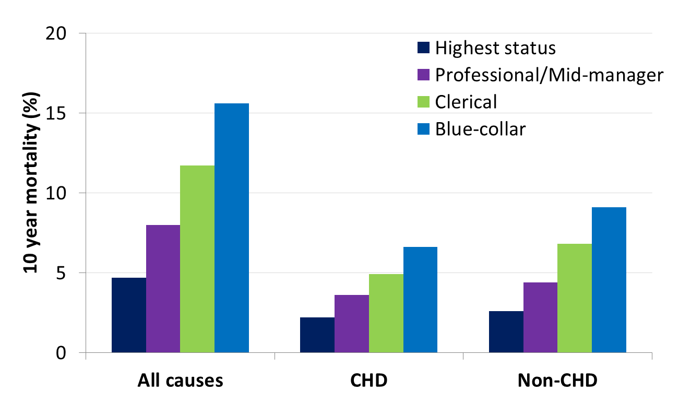
Higher-Status Job, Longer Life
UK Whitehall Study
Source: Marmot, M. G., et al (1984). "Inequalities in death--specific explanations of a general pattern?" Lancet 1(8384): 1003-1006.

Slide 12
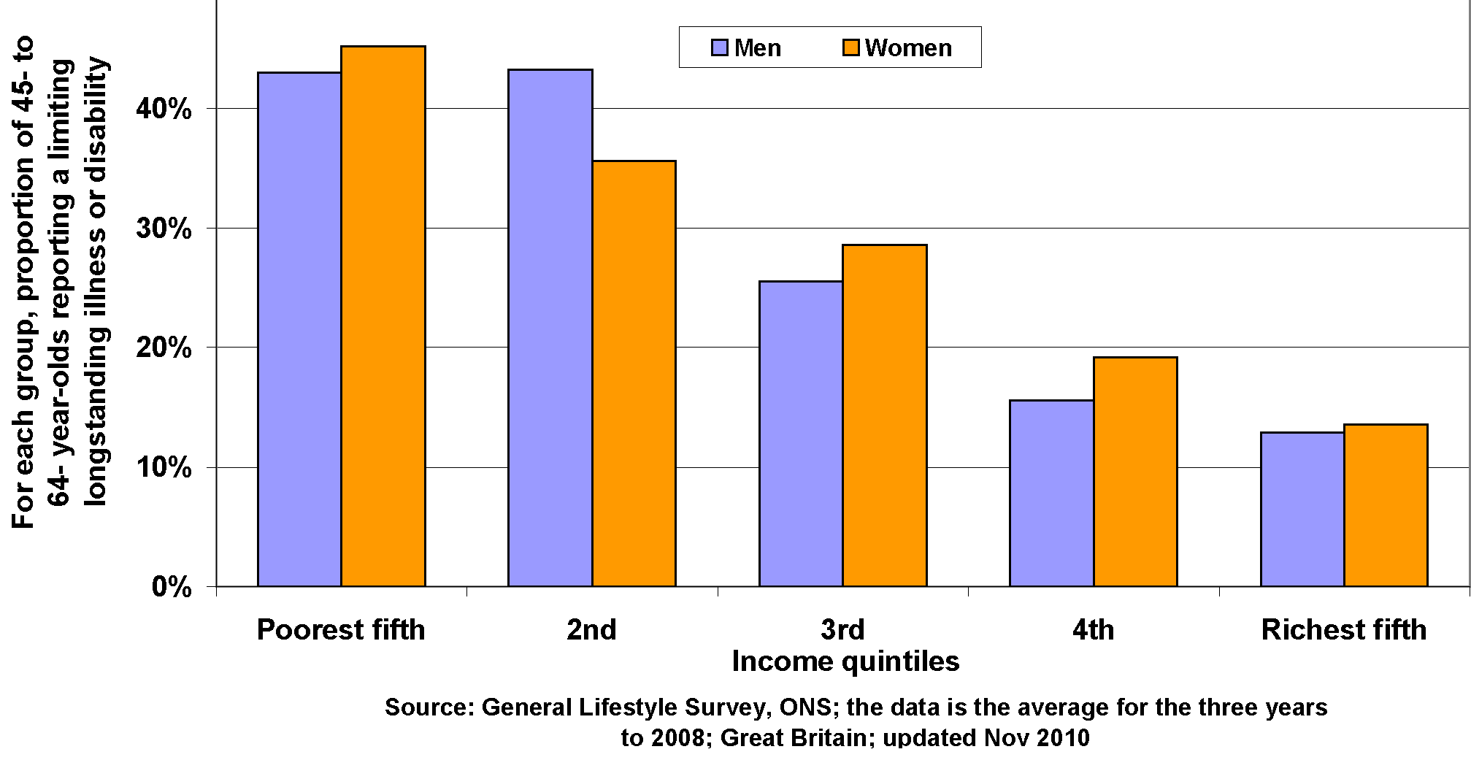
Illness or Disability by Income

Slide 13
Self-Reported Health
Braveman et al. analyses of NHIS 2001-2005.
Age-Adjusted.
Braveman et al. analyses of NHIS 2001-2005.
Age-Adjusted.

Slide 14
Diabetes-related mortality by Federal Poverty Level (FPL)
Age adjusted to the 2000 U.S. standard population
Rates per 100,000 person years
National Health Interview Survey

Slide 15
What are Health Disparities?
“A particular type of health difference that is closely linked with economic, social, or environmental disadvantage. Health disparities adversely affect groups of people who have systematically experienced greater social or economic obstacles to health based on their racial or ethnic group, religion, socioeconomic status, gender, age, or mental health; cognitive, sensory, or physical disability; sexual orientation or gender identity; geographic location; or other characteristics historically linked to discrimination or exclusion.”
Healthy People 2020 (HealthyPeople.gov)

Slide 16
Why is it important to think about race/ethnicity and SES when doing research?
Research designed to describe, understand, and ameliorate differences in health outcomes negatively impacting disadvantaged groups (i.e. health disparities research)
Patterning of health along sociodemographic characteristics has implications for all research

Slide 17

Principles for Research in Diverse Populations
Appropriately measure sociodemographic characteristics
Ensure diversity in recruitment and retention of study participants
Incorporate a socioecological perspective

Slide 18
Measurement of Race
Social construct?
Biological construct?

Slide 19
Definition of Race
Societal constructed taxonomy that reflects intersection of particular historical conditions with economic, political, legal, social and cultural factors, as well as racism.
David Williams, PhD, 1994
Notes:
1

Slide 20
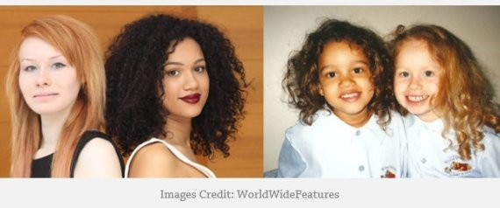
Race as a Social Category
Greater differences within groups than between groups
Racial definitions depend on cultural and social circumstances
  One-drop rule (1/16th Black = Black)
  South Africa, Brazil
  American Indian Tribal membership
  Mixed race

Slide 21
What about Ethnicity?
Ethnicity refers to self-identity with group defined by racial admixture, geographic origin, culture, religion and/or language
Characterized by sharing non-phenotypic characteristics (language, etc.)

Slide 22
Approach to measuring Race/Ethnicity
Self-identification is the gold standard
  Preferred NIH approach, as administrative data has limitations with up to 30% misclassification
  May depend on research question and whether external assessment is relevant
Specify reason for measuring/including race/ethnicity
Kaplan and Bennett, JAMA, 2003
Krieger, AJPH, 2005

Slide 23
Measurement of Race/Ethnicity in Clinical Research
Office of Management and Budget (OMB) Directive 15 sets guidelines for the collection of racial and ethnic categories to “provide for the collection and use of compatible, non-duplicated, exchangeable racial and ethnic data by Federal agencies.”
Separate race and ethnicity question

Slide 24
OMB Standards set in 2000
Allow for reporting 2 or more race categories––multi-racial
Separate Asian/Pacific Islander into 2 categories: Asian and Native Hawaiian or Other Pacific Islander
Change to Hispanic or Latino
Change to black or African American
Strongly endorse self-identification

Slide 25
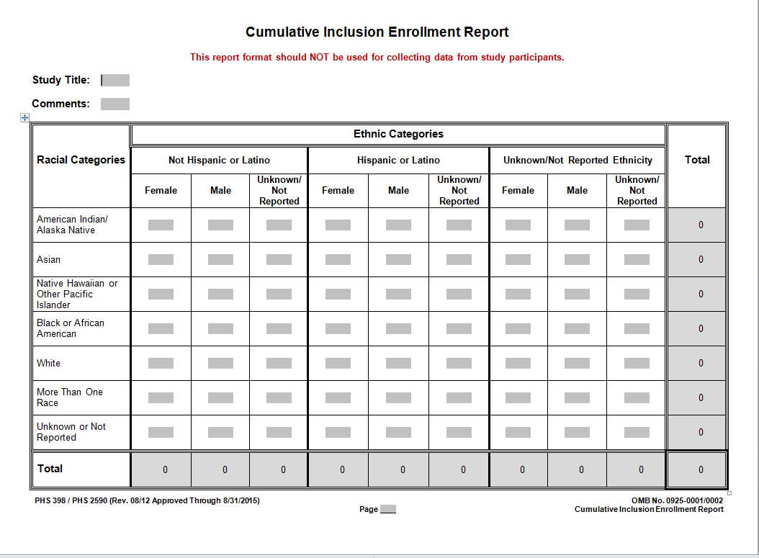
NIH Required Categories

Slide 26
2010 U.S. Census Questions
Ethnicity question:
Is this person Spanish/Hispanic Latino?
Ethnicity response options:
No, not Spanish/Hispanic/Latino
Yes, Mexican, Mexican-Am, Chicano
Yes, Puerto Rican
Yes, Cuban
Yes, other Spanish/Hispanic/Latino

Slide 27
2010 US Census Latinos by Race
Race Category | Percent National
White | 53 76.2
Black | 2.5 14.6
American Indian | 1.4 0.9
Asian | 0.4 5.6
Pacific Islander | 0.1 0.2
Some Other Race | 36.7 0.2
Mixed Race | 6 2.3

Slide 28
Ancestral Informative Markers
On average two humans have 99.9% identical DNA
Genetic mapping studies have suggested that genetic variation, although minimal, can be used as marker of “ancestry”
  This variation is may be useful for discovery science (pathophysiology, response to therapies, etc).
Study of AIMs is complicated by confounding by social factors

Slide 29
Genetic Origins of 2 Latino Groups
100%
3.0%
90%
15%
80%
70%
52%
24%
African
Percent
60%
Native American
Ancestral
50%
European
Contribution
Admixture
40%
30%
61%
20%
45%
10%
0%
Mexican
Puerto Rican
American

Slide 30
Ancestry Informative Markers in Mexican Latinos

Slide 31
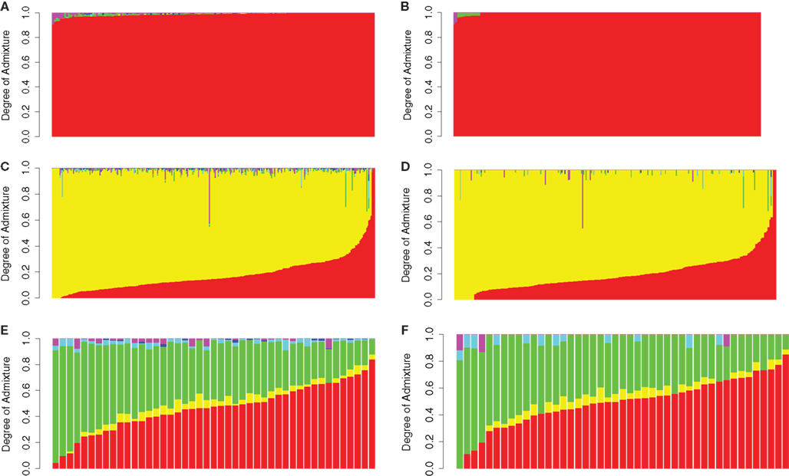
Admixture in White, Black and Hispanics

Slide 32
Race as social construct or biological construct?
Variations in biology have been important for discovery science
But conflating genetic markers (AIMs) with race/ethnic patterns of health and disease is problematic.

Slide 33
Understanding patterns of health and disease
Economic & Social
Opportunities and Resources
Living & Working Conditions
in Homes and Communities
Behaviors
Medical Care
Interaction with genetic/other biological factors
HEALTH
Adapted from Braveman et al., for RWJ Foundation
Commission to Build a Healthier America | www.commissiononhealth.org

Slide 34
What About Socioeconomic Status?

Slide 35
Measures of SES
Education – years of formal or establish ordinal categories
Income defined in terms of annual household and factor number of dependents. Frequently decline to report or inaccurate
Occupation– laborer, technical, professional, business

Slide 36
Additional SES Measures
Wealth
Class measure over the life course––childhood exposure
Parental occupation and education
Self-perceived ‘standing’ on a ladder ranging from 1 to 10

Slide 37
Race/Ethnicity and SES
Explain often independent variance in outcomes
Strong association between the two constructs
Gradient of health exists across all levels of social class

Slide 38
Measurement of SES
Think about measures that have most relevance to your research question
  May need multiple measures
Use validated question
Consider life course perspective
Always think about both race/ethnicity and SES

Slide 39
Principles for Research in Diverse Populations
Appropriately measure sociodemographic characteristics
Ensure diversity in recruitment and retention of study participants
Incorporate a socioecological perspective

Slide 40
NIH Mandate to Recruit Minorities
1993 NIH Revitalization Act: Women and minorities must be included in clinical research supported by NIH
Sufficient numbers to allow valid evaluation of ethnic differences for major ethnic groups

Slide 41
Why is this important?
Participation of diverse participants ensures that:
  Research findings are generalizable
  Research findings can be translated into diverse communities
  The benefits of clinical research are broadly distributed
  Disparities can be investigated and understood

Slide 42
Dismal Representation
Jan 2013 review of NCI-sponsored trials
  < 100/10,000 cancer trials focused on racial/ethnic minorities
Of participants in cancer research , only 10% are minorities, while they make up almost 40% of U.S. population
Overall, blacks and Hispanics make up 5% and 1% of clinical trial participants
Chen M. Cancer 2014; 120(7 supple):109-6
www2.mdanderson.org/cancerwise/2010/03/minority-participation-in-clinical-trials.html

Slide 43
Barriers to Participation in Research
Inconvenience
Lack of transportation
Caregiver obligations
Distrust of doctors, researchers, institutions
Lack of information
Lack of outreach

Slide 44
Differences in Willingness to Participate in Research

Slide 45
Perceived Risk with Research

Slide 46
Lack of Access to and Information about Trials
Clinical trials often not available at safety net institutions or publicized in low income/minority areas
Differential recruitment by study staff
Overly rigid exclusion criteria

Slide 47
How Do We Address Barriers?
Need to budget time and effort
Engage with the community
  Enhance relevance of research
  Develop trust
  Disseminate information
Make research accessible

Slide 48
How Do We Address Barriers?
Provide adequate financial incentives
Multiple methods of recruitment are higher yield
Use personal contacts
Employ culturally sensitive methods
Feed results back to the community

Slide 49
Latinos – South Texas
RCT of 3 methods targeting Latinos:
  Traditional intro letter/packet
  Trad + culturally tailored magazine
  Combo (Trad + magazine + f/u call)
  Ramirez A, et al. Community Genetics 2008;11:215-223.

Slide 50
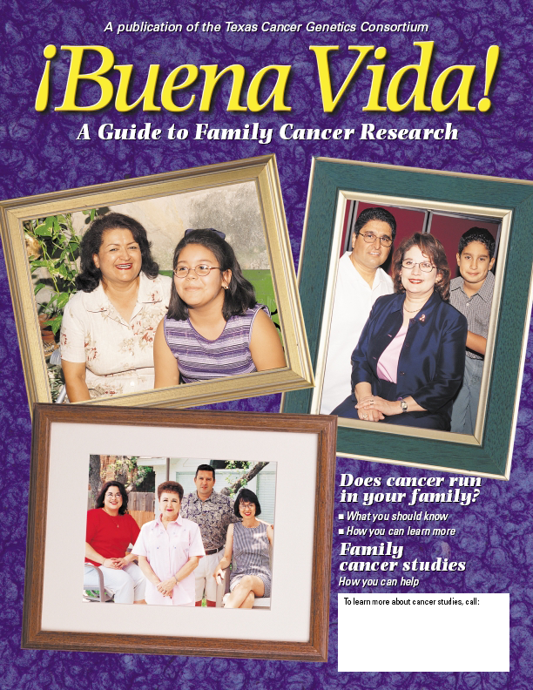
Culturally Tailored Magazine

Slide 51
Results
Traditional only: (31%)
Traditional + mag: (30%)
Combo (trad+mag+ph call) did best (43% response rate)
28% of combo group indicated they would not have joined without the call

Slide 52
Considerations for Recruitment
Is sampling frame likely to yield representative sample of targeted subgroups?
Does initial contact method account for literacy, culture, education, language, familiarity with and acceptance of research?
Are messages appealing to targeted audience?
Are there pre-recruitment strategies that might help (e.g., endorsements, outreach)?

Slide 53
Practical Recruitment Steps
Budget for varied recruitment strategies
Pretest recruitment messages and strategies
  ethnically tailored flyers, contact letters, envelopes, logos
Monitor recruitment and relationships; adjust as necessary
MAKE IT PERSONAL!

Slide 54
Considerations for Retention
Is the initial respondent burden reasonable (transportation, poor health)?
Are there tangible benefits to participating?
Are setting, approach, personnel welcoming?
Is research relevant and interesting?
How can I feed back interim and final results to participants and the communities involved?

Slide 55
Conclusions
Recruitment and retention of diverse groups is an equity and scientific issue
Planning and awareness of potential barriers can help ensure diversity in research participants

Slide 56
Principles for Research in Diverse Populations
Appropriately measure sociodemographic characteristics
Ensure diversity in recruitment and retention of study participants
Incorporate a socioecological perspective

Slide 57
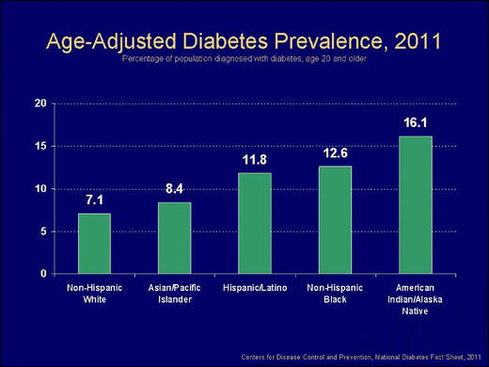

Slide 58
What causes these disparities?
Behavioral factors?
  Diet
  Sedentary lifestyle
  Obesity
Genetics?
Sharma, Ethn Dis, 2004

Slide 59
Chronic Disease Epidemiology
Diabetes
Behavioral Factors
Genetic Factors
Kurian, Ethn Dis, 2007

Slide 60
Chronic Disease Epidemiology
Diabetes
Behavioral Factors
Environmental Factors
Genetic Factors
Kurian, Ethn Dis, 2007

Slide 61
Paradigms of Epidemiology
Miasma: Sanitary statistics
Germ theory: Infectious disease epidemiology
Black box: Chronic disease epidemiology
  Emphasis on individual behavior change theories
Susser and Susser, AJPH, 1996

Slide 62
Shortcomings of Current Paradigm
Focus only on proximate risk factors
Singular attention to individual-level variables
Limited in time horizon
No recognition of interconnections
Isn’t getting us very far

Slide 63
Avoiding the Prison of the Proximate
1960s - Social epidemiology defined as a discipline
  Investigation of social factors as etiologies for disease
Development of theories to explain relationships

Slide 64
Theory of Fundamental Causes
1995 Link and Phelan addressed persistence of SES disparities in health despite changes in context and conditions
  19th century: Infectious disease
  20th and 21rst centuries: Cancer, cardiovascular disease

Slide 65
Theory of Fundamental Causes
SES is a fundamental cause of poor health:
  Regardless of disease or context, high SES individuals and groups can flexibly deploy resources to avoid risks and mitigate effects of poor health
Resources include:
  Money
  Power
  Knowledge
  Prestige
  Social connections

Slide 66
Theory of Fundamental Causes
Infectious diseases:
  Avoid areas that carry risk of contamination
  Limit entry of potential infectious individuals
Cardiovascular diseases:
  Access healthy food
  Live in communities that facilitate healthy choices
All contexts:
  Access quality medical care

Slide 67
Evidence to Support Theory of Fundamental Causes
SES gradients in mortality are more pronounced with preventable conditions
Advances in treatment increases disparities in outcomes
Specific examples:
  Statins: Use reversed income/cholesterol gradient
  Smoking: No SES gradient until evidence of cancer risk released in 1950s

Slide 68
Race as a Fundamental Cause
Initially, theory of fundamental causes focused only on SES
Racial/ethnic disparities considered as collinear with SES
Paper by Link and Phelan in 2015 argued for race/ethnicity as a fundamental cause:
  Predictive of SES
  Independently through racism

Slide 69
Upstream Theories:
Not the Whole Story
Important in encouraging a broader perspective
  Encourage structural approaches to disparities
BUT - Neglect the “downstream” mechanisms by which social conditions are mediated
  Both perspectives are needed
Example of decline in infectious mortality:
  Economic growth -> improved nutrition
  Public health efforts such as sanitation, antibiotics

Slide 70
Thinking Ecologically
Move toward ecological approach rooted in work in social science disciplines in 20th century
The ecological model is "a model of health that emphasizes the linkages and relationships among multiple factors (or determinants) affecting health.” – Institute of Medicine
  Allows for intervention at multiple levels

Slide 71
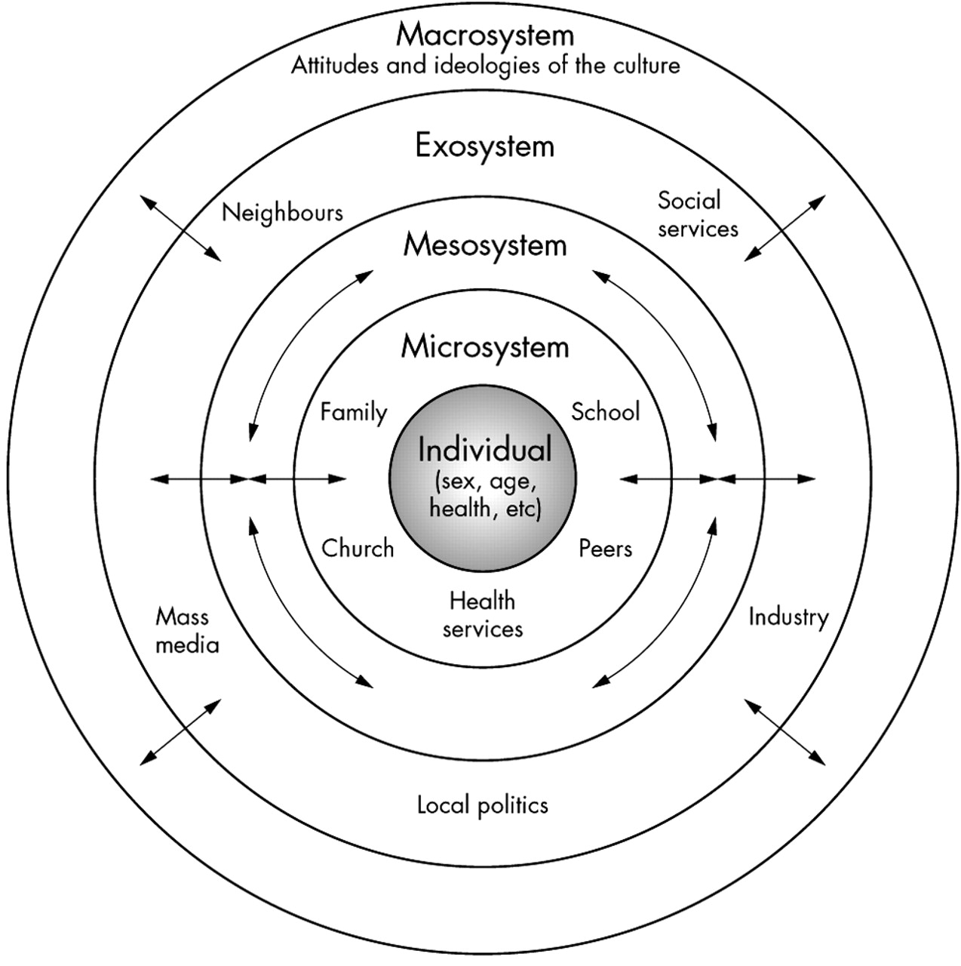

Brofenbrenner’s Ecological Theory of Development
McLaren L , and Hawe P J Epidemiol Community Health 2005;59:6-14
©2005 by BMJ Publishing Group Ltd

Slide 72
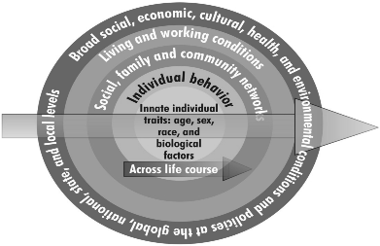
Institute of Medicine Ecological Model

Slide 73
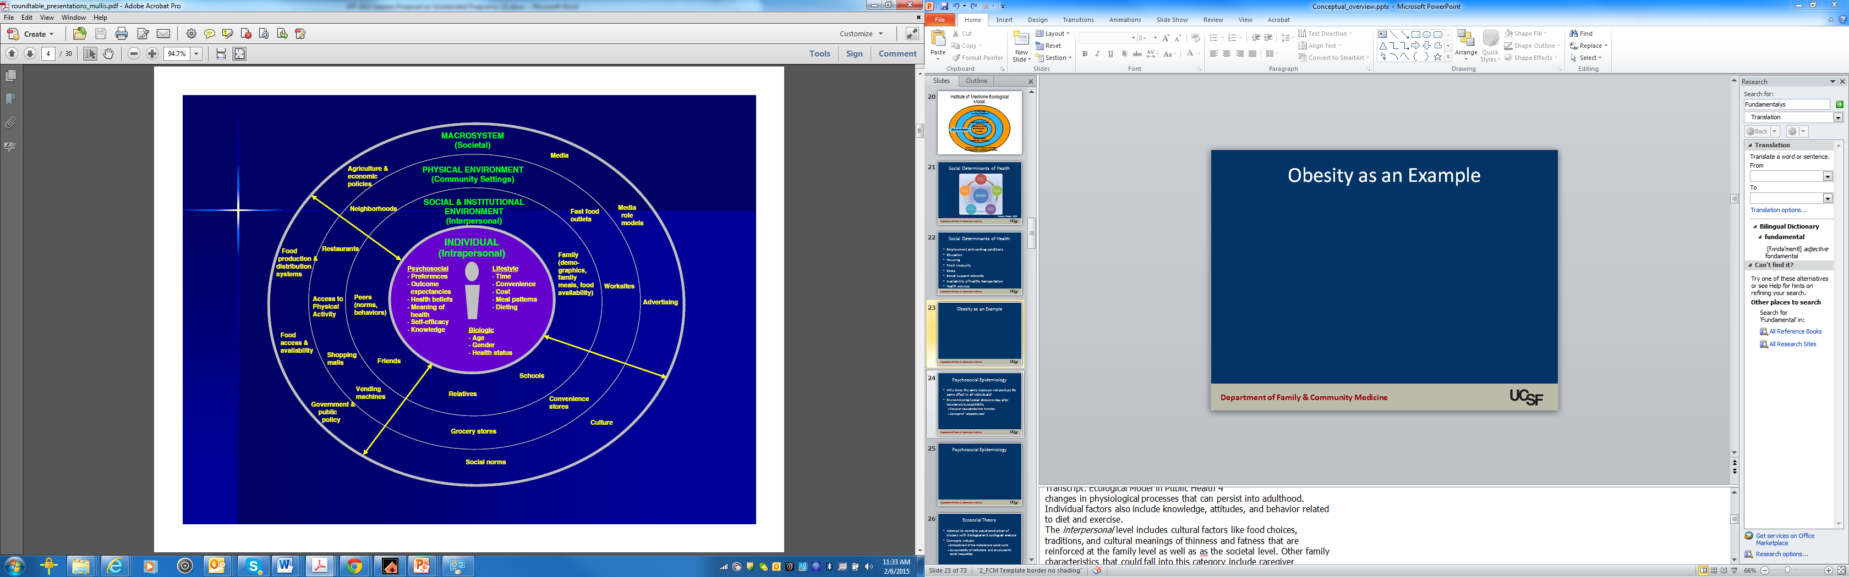
Obesity as an Example
Mullis, An ecological approach to childhood obesity. USDA, 2009

Slide 74
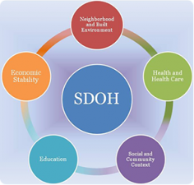
Social Determinants of Health
Healthy People 2020

Slide 75
A Different Approach to the Ecological Model
Economic & Social
Opportunities and Resources
Living & Working Conditions
in Homes and Communities
Behaviors
Medical Care
Interaction with genetic/other biological factors
HEALTH
Adapted from Braveman et al., for RWJ Foundation
Commission to Build a Healthier America | www.commissiononhealth.org

Slide 76
Understanding Diabetes Disparities
Focus in literature on behavior and genetics
  Women’s Health Initiative:
  “ Despite large racial/ethnic differences in diabetes incidence, most variability could be attributed to lifestyle factors.”
But what causes differences in healthy behaviors?
What do we know about unconfounded relationship with genetics?

Slide 77
Understanding Diabetes Disparities
Boston Area Community Study
  Biogeographical ancestry (measured using ancestry informative markers) has minimal independent association with diabetes
  Socioeconomic factors (income, education, occupation) explain > 50% of racial/ethnic disparities
Piccolo, Ann Epi, 2014

Slide 78
Diabetes Disparities
Poor quality retail food environments associated with obesity
Insulin resistance found to be associated with:
  Experiences of racism
  Internalized racism
Perceived discrimination associated with poor dietary habits

Slide 79
Life Course Considerations
Ecological thinking needs to take into account contextual factors over time
Timing and persistence of exposures may influence their impact
  Understanding disparities requires attention to different exposures at different time points

Slide 80
Framework: Socioeconomic Status Over the Life course and Health
Socioeconomic Position
Intrauterine
conditions
Education,
environment
Work conditions,
income
Income,
assets
Birth
Childhood
Adulthood
Old Age
Low birth weight
Growth retardation
Smoking,
diet, exercise
Inadequate
medical care
Job stress
Atherosclerosis
CVD
Reduced
function
Lynch J and Kaplan G, Social Epidemiology,
Oxford, 2000 (Ch 2, p. 28)

Slide 81
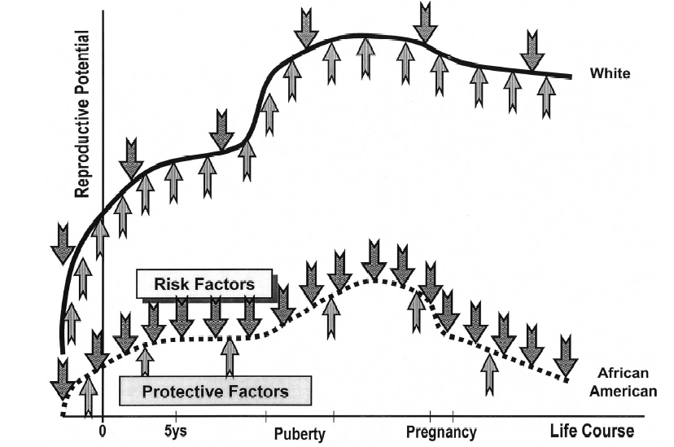
Life Course Perspective
Lu MC, Halfon N. Racial and ethnic disparities in birth outcomes: a life-course perspective.
Matern Child Health J. 2003;7:13-30.

Slide 82
Overwhelmed?
What if you just want to do clinical research?
Do conceptual models really need to take into account all these different levels?
It is really possible to influence structural determinants of disease anyway?

Slide 83
Why Ecology Matters
Ensure research is grounded in contextual understanding
  Collect necessary data
  Use appropriate analytic techniques
  Provide nuanced interpretation of results

Slide 84
Perils of Ignoring Ecology, Part 1
Not collecting/analyzing adequate data on relevant social determinants
  “When income was used to “adjust for SES,” Mexican Americans appeared to be at significantly increased risk of fair or poor health compared with non-Hispanic whites; however, risks appeared significantly lower when both poverty and educational levels were included.” Braveman, JAMA, 2005
  Important whether goal is measurement of disparities or unconfounded estimate of association between other predictor and outcome

Slide 85
Perils of Ignoring Ecology, Part 2
Not considering race and SES separately and in combination in analytic models
  “Both neighborhood and individual SES are associated with survival after breast cancer diagnosis, but these relationships vary by race/ethnicity.”
  Shariff-Marco S, Cancer Epidemiol Biomarkers Prev, 2014

Slide 86
Perils of Ignoring Ecology, Part 3
Risk of misinterpreting data from multivariate models
  Individualistic fallacy
  Biologic fallacy
Implications of results may depend on context

Slide 87
Biologic Fallacy
The presumption that differences that cannot be explained by identified non-biologic factors must be due to biologic differences.
  “High rates of ESRD among blacks is not fully explained by racial differences in age, socioeconomic status, or access to health care…. suggest[ing] an inheritable genetic predisposition.“ – Controlled for percent of individuals with college education in zip code

Slide 88
Individualistic Fallacy
The fallacy of assuming that individual-level outcomes can be explained exclusively in terms of individual-level characteristics
  “Living in a low SES neighborhood confers additional mortality risk beyond individual SES.”
  “The odds of violence for African Americans was 2.7 times greater than the odds of violence for Whites… when neighborhood disadvantage was added to the logistic regression equation, the significant effect of race was eliminated.”
Winkleby, J Epi Comm Health, 2003
Silver, Law Hum Behav, 2000

Slide 89
Interpretation of Results
Example of my fellowship research in reproductive health

Slide 90
Unintended Pregnancy Rates by Income and Race/Ethnicity, 2006-2008
Finer et al. Contraception, 2011

Slide 91
Disparities in Unintended Pregnancy
IUDs are most effective method of contraception
Are used less often by women of color
Are women of color counseled differently about IUDs?
Performed RCT using videos of standardized patients presenting for contraceptive advice
  Shown to participants at national meetings of ACOG and AAFP
Dehlendorf, AJOG, 2010

Slide 92
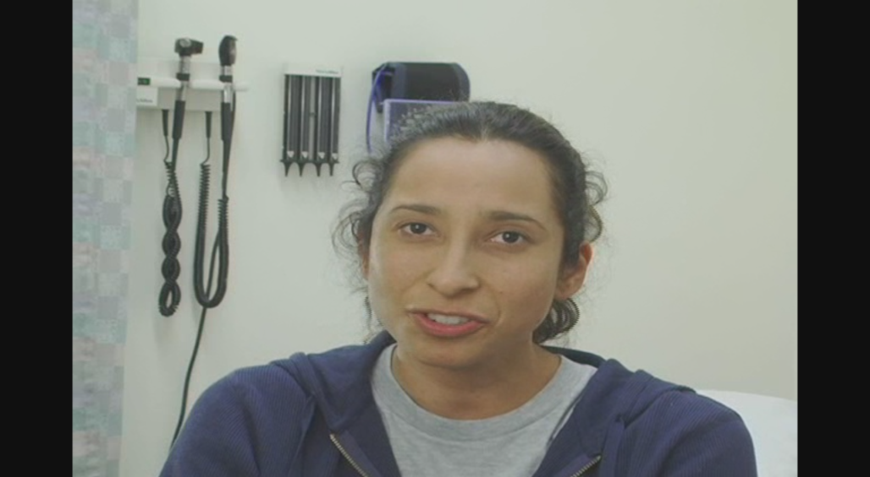
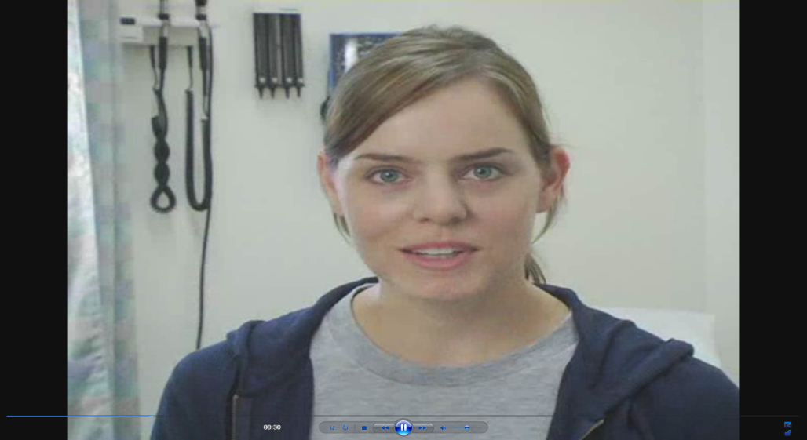
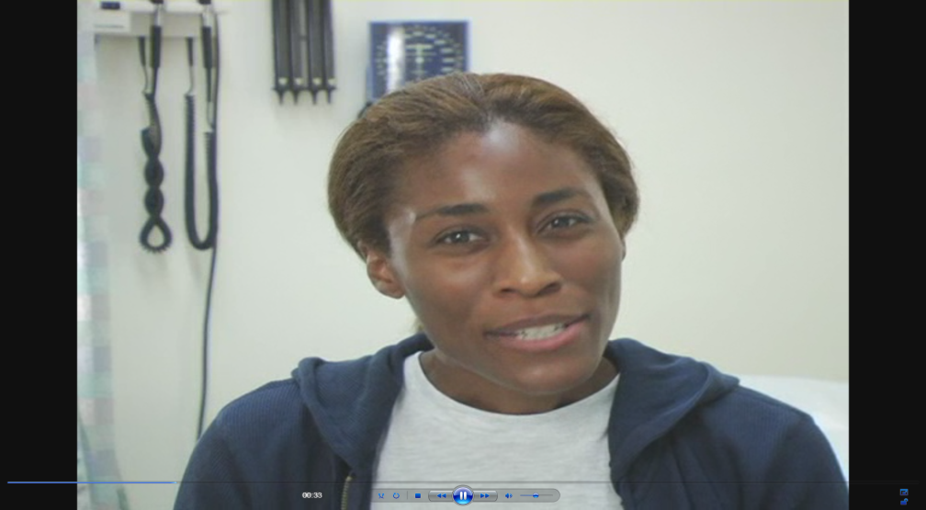
The “Patients”

Slide 93
P<0.05
Dehlendorf, et al. AJOG, 2010

Slide 94
What does this mean?
Are women of color getting better care?
Complex history of coercion
  Differential counseling towards provider controlled method potentially problematic
Context essential to understand nuance of data and its implications

Slide 95
Why Ecology Matters, Part 2
Provide broader and more accurate insight into possible approaches to address health disparities
Women’s Health Initiative:
  “ Despite large racial/ethnic differences in diabetes incidence, most variability could be attributed to lifestyle factors. Our findings show that the majority of diabetes cases are preventable, and risk reduction strategies can be effectively applied to all racial/ethnic groups.”

Slide 96
Solutions to Health Disparities
Food availability
Social norms
  Barbershop interventions for hypertension
Housing
Health coaches

Slide 97
Application to Specific Research Questions
Interconnections and variables of interest depend on research question
Specifying relationships:
  Ensures that ecologic thinking is incorporated into research question and design
  Provides clarity into pathways being investigated and how they relate to other influences

Slide 98
Obesity as an Example
Mullis, An ecological approach to childhood obesity. USDA, 2009

Slide 99
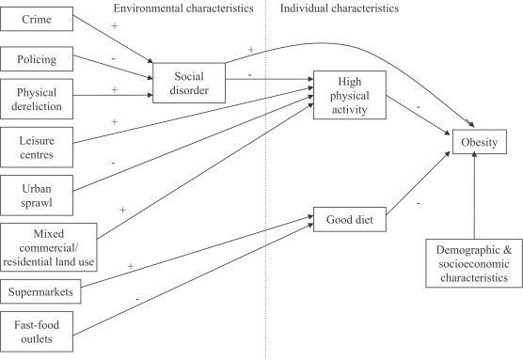
Theoretical model linking social and physical environmental characteristics to obesity
Pathways to obesity: Identifying local, modifiable determinants of physical activity and diet
Mai Stafford , Steven Cummins , Anne Ellaway , Amanda Sacker , Richard D. Wiggins , Sally Macintyre
Social Science &amp; Medicine, Volume 65, Issue 9, 2007, 1882 - 1897

Slide 100

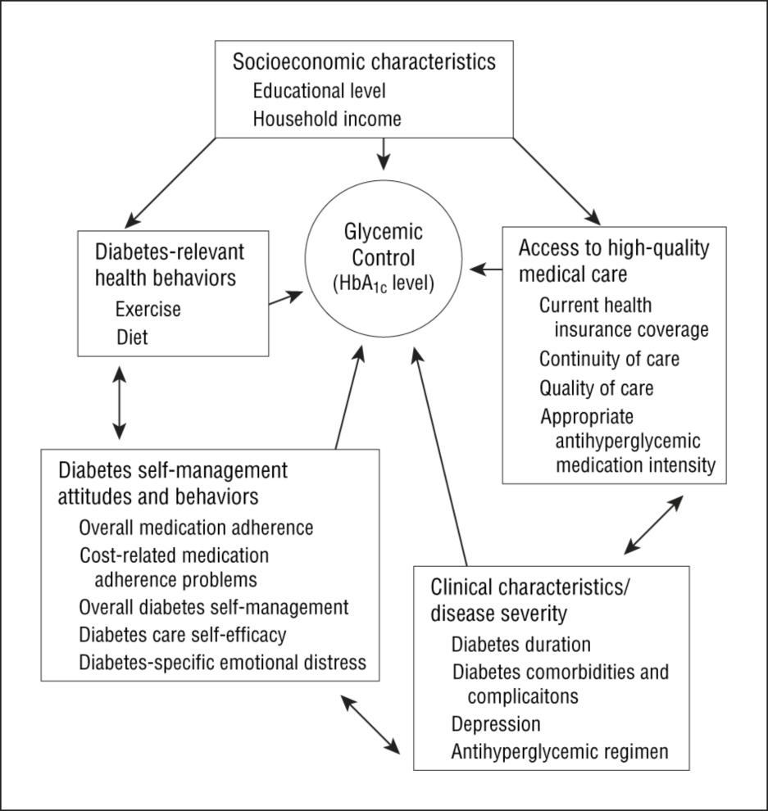
From: Mechanisms for Racial and Ethnic Disparities in Glycemic Control in Middle-aged and Older Americans in the Health and Retirement Study
Arch Intern Med. 2007;167(17):1853-1860. doi:10.1001/archinte.167.17.1853
Figure Legend:
Hypothesized mechanisms for racial/ethnic disparities in glycemic control. HbA_{1c} indicates hemoglobin A_{1c}.
Date of download: 2/9/2015
Copyright © 2015 American Medical Association. All rights reserved.

Slide 101
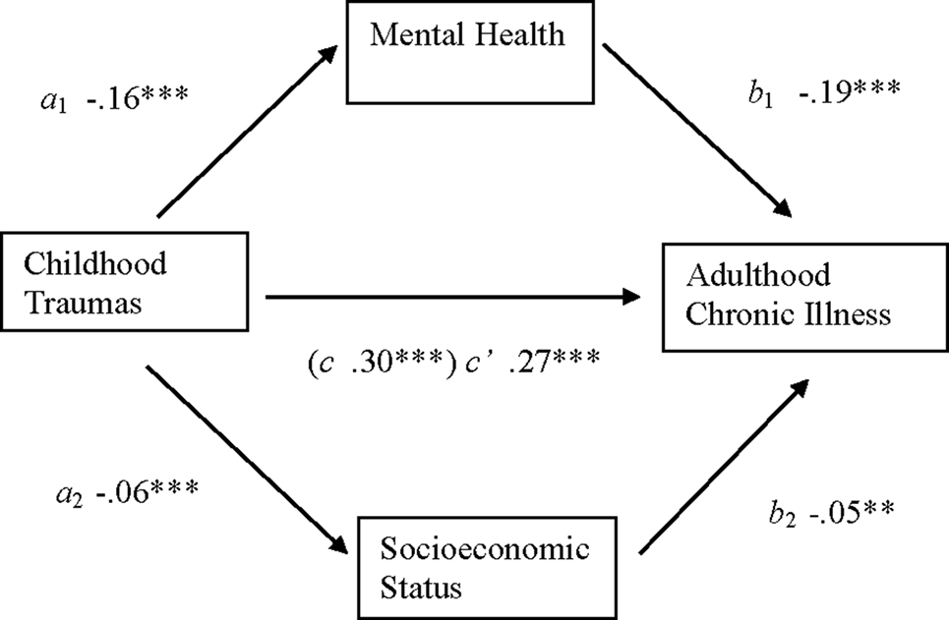
Childhood Trauma and Chronic Illness in Adulthood

Slide 102
Overview of Next 4 Weeks
Week 2: Social determinants
Week 3: Behavioral determinants
Week 4: Health systems and health care determinants
Week 5: Biological determinants

Slide 103
Map of Next Four Weeks
Week 2
Week 4
Economic & Social
Opportunities and Resources
Week 3
Living & Working Conditions
in Homes and Communities
Week 5
Behaviors
Medical Care
Interaction with genetic/other biological factors
HEALTH
Adapted from Braveman et al., for RWJ Foundation
Commission to Build a Healthier America | www.commissiononhealth.org

Slide 104
Questions?

Slide 105
Discussion
Think about health outcome of interest to you
Take 5 minutes and sketch conceptual model for this outcome (as you currently understand it)
Identify where your area of research or area of interest connects to the model
Identify:
  Greatest areas of uncertainty in model, and/or
  Areas with greatest potential for intervention

