Slide 1
The Health Policy Process
Andy Bindman, MD
Epi 249
January 7, 2016

Slide 2


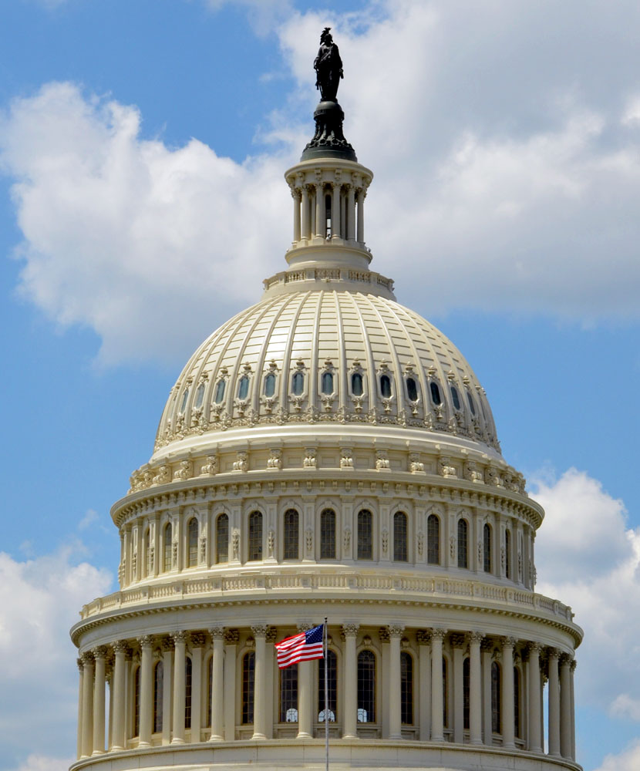
Andy Bindman
Primary care physician
Health services researcher
RWJ Health Policy Fellow in Congress during ACA
Part-time senior advisor at HHS/CMS since 2011

Slide 3
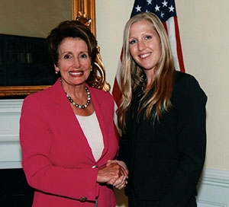
Brooke Hollister, PhD
Assistant Professor in School of Nursing
Policy research on long-term care
Fellow in Congress working with Minority Leader, Representative Nancy Pelosi

Slide 4
Format of the Class
Flipped classroom
Done at Home
  Watch video documentaries
  Do readings for upcoming class
  Prepare and submit homework draft to “before class box”
Done in the Classroom
  Discussion of video and reading
  Workshop homework assignments in small groups
After Class
  24 hours to submit final homework to UC box

Slide 5

CLE

Slide 6


Slide 7
Grading and Class Credit
Based on homework assignments and class participation
You must resubmit either original or an updated version of homework within 24 hours
Homework is designed to relate to your area of research
Cannot miss more than 1 class and receive credit

Slide 8

Health Policy

Slide 9
What is Health Policy
Government decisions that are discretionary, unstructured, and consequential
Reflected in things policymakers choose to do
Reflected in things they choose not to do

Slide 10
Major Health Policy Content Areas
Financing health care:
  Coverage, benefits, provider payment
Public health:
  Infectious disease control, drug safety
Research:
  Basic science, clinical and health system
Workforce/Health professions education:
  Physicians, nurses, dentists, allied health

Slide 11
What is Not Health Policy
The impact of adopting screening guidelines on your clinical practice
The impact of adopting an IT system on your health system
The adherence to Choosing Wisely in your specialty
… but these topics could be connected to policy

Slide 12
How to Be Health Policy Relevant
Developing screening guidelines for your clinical practice
  USPSTF ratings of A or B must be a free covered benefit of private plans
  How has coverage policy affected outcomes and costs?
Implementing an IT system
  Medicare and Medicaid providers are eligible for payments for adopting IT systems which meet meaningful use
  How have the costs of IT adoption been offset by savings due to improvements in communication or reductions in errors?
Choosing Wisely
  Payment policy shifting toward value based payments
  How does adherence to Choosing Wisely recommendations affect health care spending and outcomes?

Slide 13
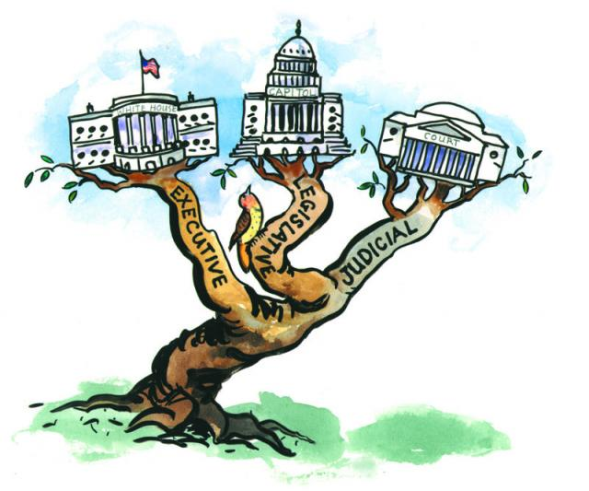
Who Makes Health Policy
Legislative branch passes laws
Executive branch writes regulations to implement laws
Courts render decisions on legality of laws

Slide 14

Federal Health Care Reform
Congress passed law 2010
Executive branch wrote regulations covering the more than 700 cases where ACA said “Secretary shall…”
Supreme Court upheld law but made Medicaid expansion optional

Slide 15
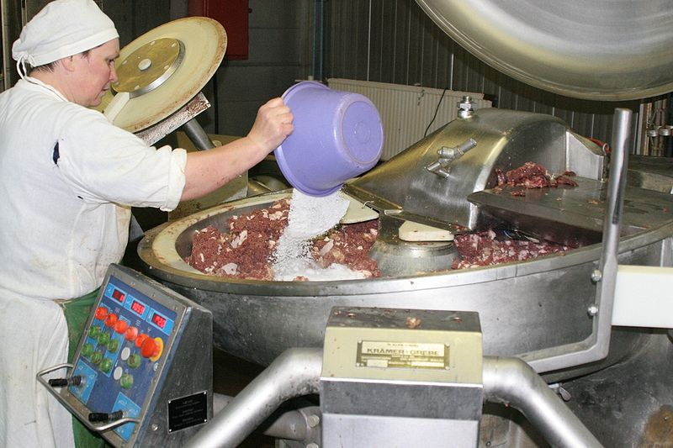
Making a Law
Notes:
15

Slide 16
Legislative Process
Typically legislation evolves through subcommittees and full committees of jurisdiction before full chamber level votes
“Hearings” and “Mark-ups”
If multiple committees of jurisdiction then bills must be merged before chamber votes
House and Senate must pass the same version of bill and President must sign to become law

Slide 17
Behind the Scenes of the ACA
Iron Triangle: Congress, WH, Stakeholders
Small team of leaders in WH, Senate and House set budget targets and high level policy
Staff develops legislative language
CBO estimates federal budget impact
Provisions added, dropped, and adjusted to meet budget targets or to acquire necessary votes
Stakeholders remain active throughout process – lobbying, communicating and brokering

Slide 18
Inertia in the Policy Process
Stakeholders tend to focus on preserving status quo and promoting their narrow interest
They express this through words and financial contributions
Consensus for votes typically results in incremental change rather than ideal solution
Laws can be rendered ineffectual by authorizing but not appropriating funding
Downstream actions by executive branch, state or local governments can slow effects of a law

Slide 19

Role of Research in the Policy Process
To identify problems in need of a solution
To provide evidence regarding policy options
To monitor/evaluate the anticipated and unanticipated impacts of a policy

Slide 20
Who Defines Health Policy Agenda
Policymakers own special interest
Constituents/Personal Stories
Journalists
Stakeholder/Interest Groups
Researchers
Alignment of these makes issue rise on agenda

Slide 21

How Do Policymakers Weigh Evidence
Little primary assessment of research
Information filtered via media, stakeholders, think tanks, and experts
Selective rather than systematic use of evidence

Slide 22
What Limits Research Impact on Policy
Findings often related but not exactly aligned with policy question
Data are often old by the time research is published
Policymakers often don’t know about it

Slide 23
Translating Research into Policy
Requires a good understanding of policymakers questions
  Need to move from general to the specific
Requires capacity to act quickly
  Need up to date information and rapid analytic capacity
Requires ability to get findings in hands of policymakers
  Akin to effective clinical referrals

Slide 24
Effective Clinical Referrals
Select appropriate consultant
Begun the work up
Provide a summary of the case
Make clear what asking consultant to do

Slide 25
Health Policy Counterparts of Referral
Clinical
Type of consultant
Have begun work up
Summarize the case
Explain what asking consultant to do
Health Policy
• Who in the government
• Homework on policy context
• Summarize research and its
relevance for policy
•The Ask

Slide 26
Your Relationship with Policy
For most:
  Aligning research to inform policy
  Want to know how to effectively translate research into policy
For some:
  On-going advisory role with policy decision-makers
  Requires some understanding of the policy process
For few:
  Direct role as a policy decision-maker
  Requires a detailed knowledge of the policy process
Relationship may evolve over time

Slide 27
Your Research and Policy Goals
State in 2 minutes or less
  What is your area of research
  What is an important policy questions in your area of research
  Who is your policy target- level/branch of government

Slide 28
For Example
I am interested in evaluating Medicaid patients’ access to care
I do this through physician surveys of whether they are accepting Medi-Cal patients in California
One important policy question related to this issue is whether the Medicaid payment rate is adequate to support access to physicians
My work is targeted primarily toward the state government in California which is responsible for setting Medi-Cal payment rates.

