Slide 1
Epi 213 Decision and Cost-Effectiveness Analysis (DCEA)
Introduction & Overview
7 Jan 2016

Slide 2
Today
Introductions (15 min)
  Course staff
  Students
Course overview (30 min)
Lecture - Decision Trees (60 min)
Discussion (15 min)

Slide 3
DCEA 2016 Staff
Course Director: | James G. Kahn, MD, MPH UCSF – IHPS, DEB, GHS
Section Leaders: | James G. Kahn, MD, MPH Elliot Marseille, DrPH, MPA Health Strategies International
Additional faculty: | Dhruv S. Kazi, MD, MSc, MS, UCSF Cardiology, SFGH
Teaching Assistants | Jennifer Kaplan, general surgery Sara Moassesfar, pediatric endocrinology

Slide 4
James G. Kahn, MD, MPH
Home
  UCSF - Institute for Health Policy Studies, Dept of Epidemiology and Biostatistics, Global Health Sciences.
Mission
  How can we best spend health care dollars to improve health?
  Thus – projects on efficiency in intervention choice & service delivery

Slide 5
Cost-effectiveness of Male Circumcision for HIV Prevention in South Africa

Slide 7
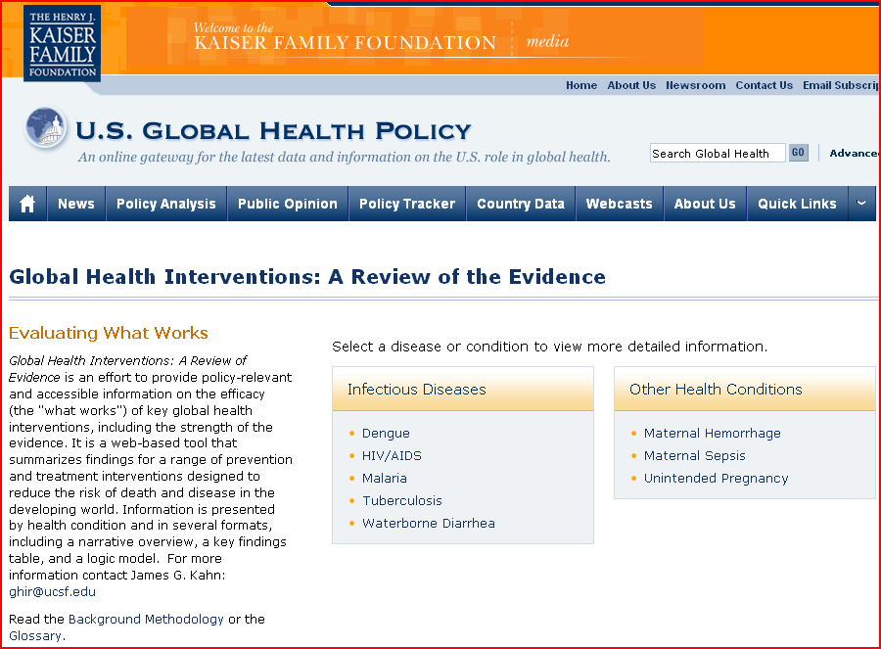
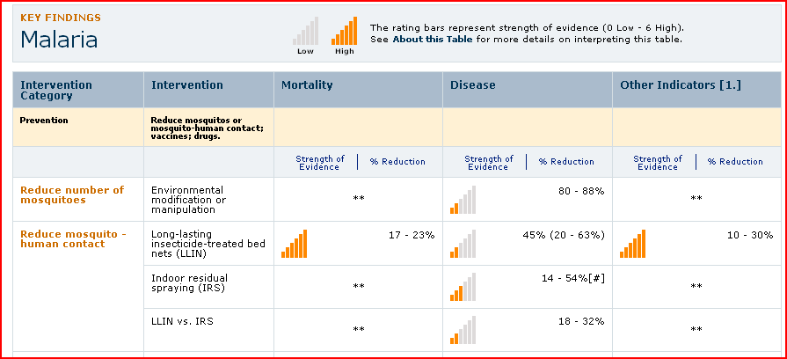

Slide 8
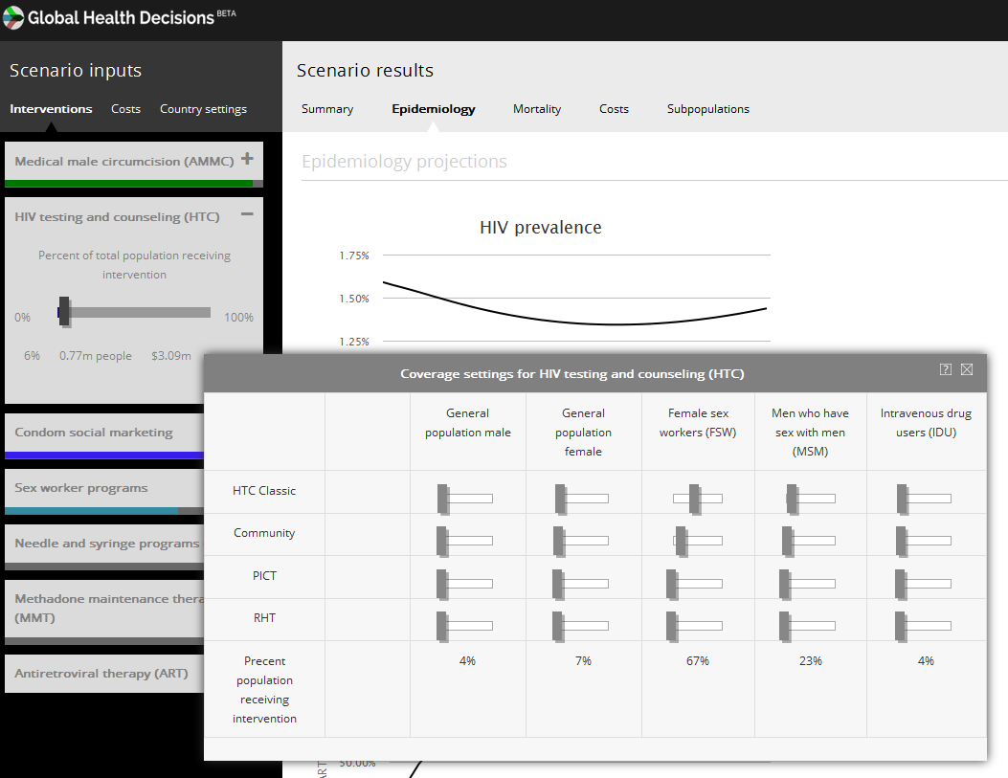
GHD – web-based resource allocation tool

Slide 9
CAPE – Coalition for the Assessment of Prevention Economics
UCSF, SFDPH, UC Berkeley, Stanford, others – 39 co-investigators
Cooperative agreement with CDC, 5 years
Economic analyses (incl CEA) for HIV, hepatitis, TB, STI, school health

Slide 10
Other DCEA team introductions

Slide 11
DCEA students
TICR – MCR / ATCR – 14
Global Health Masters – 15
Other (PhD, fellows, MTM) - 8
… and quick introductions

Slide 12
DCEA structure
Six cycles of lecture + section:
  Decision trees
  Valuing health: QALYs/DALYs
  Adding costs: Cost-effectiveness
  Markov disease-state modeling
  Data inputs
  Sensitivity analyses
Sections:
  Review HW (10 min)
  Review student projects – ~10 min each - structured summary / critique / discussion
Special topics:
  Excel tutorial – 15 Jan (TreeAge – prn with Kazi)
  HIV, HCV, ?CV
  Behavioral economics
  Iron CEA America!

Slide 13
DCEA student work & grading
Readings – prioritize Lecture Notes over articles
Own project – DA / CEA
  Design & implement simple CEA.
  Start with Excel templates, or TreeAge
  Each cycle, add new element (and update), feedback from mentor
  Ongoing development of structured summary (~800 words)
  By end, have complete simple DA/CEA & structured summary
  Typically solo; can work in pairs if prefer
  Given preliminary score and chance to refine
  Value: 50 points
Homework / problem sets (5)
  Mainly on mammography
  First is open-ended, then 3 programmed (excel)
  One on CEA article review
  Skip cycle 5 (data inputs)
  Value: 50 points (10 each) – late downgraded.
Final exam
  Optional, if needed due to missed HW(s)

Slide 14
DCEA Mentors
Mentor | Area(s) of focus
JGK | HIV, hepatitis, diabetes, & varied other
EAM | HIV, TB, diabetes, hepatitis
Dhruv Kazi | Cardiovascular disease
Joanne Spetz | MTM students; Labor economics
Harsha Thirumurthy | HIV, varied
Marc Pechevis | Varied
Wendy Max | Tobacco, global health
Others as approp. | Repro. health, ortho, global health, etc.

