Slide 1

Announcements

Slide 2
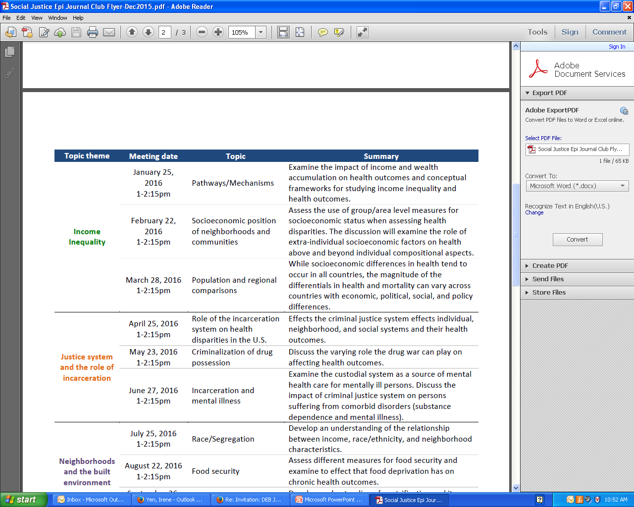
Social Justice Epidemiology
Journal Club

Slide 3
Multi-level Etiologies of Health Disparities:
Pt 1. social determinants
Irene Yen, PhD, MPH
Associate Professor

Slide 4
Housekeeping - units
1 or 2 units:
students to decide how many units will be completed before the 3rd week of term.
If the decision gets made later, a Study List Change petition needs to be submitted ($5 fee).
change period ends in the 7th week of the term.

Slide 5


Housekeeping – week #11
The final assignment will be a 5-7 minute presentation accompanied by a 1-2 page summary (of the presentation (turned in before the last class), bringing the course content to bear on a topic or area of interest to the student

Slide 6

Importance of social factors
in any research

Slide 7
Objectives
Review multi-level conceptual approach
Social determinants – multiple examples
  Socioeconomic status, socioeconomic position
  Race / ethnicity, racism
  Neighborhood and place
How to study

Slide 8
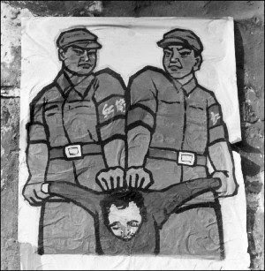

Slide 9
Improving health & reducing disparities by addressing the role of social factors
Economic & Social
Opportunities and Resources
Living & Working Conditions
in Homes and Communities
Behaviors
Medical Care
Interaction with genetic/other biological factors
HEALTH
Adapted from Braveman et al., for Robert Wood Johnson Foundation Commission to Build a Healthier America | www.commissiononhealth.org
Notes:
Map social factors onto these 2 levels (in the box)

Slide 11
Fundamental Cause
Influences multiple disease outcomes;
Affects disease thru multiple risk factors;
Involves access to resources that can assist in minimizing risk once the disease occurs;
Reproduced over time

Slide 12
Theory of Fundamental Causes
SES is a fundamental cause of poor health:
Resources include:
  Money
  Power
  Knowledge
  Prestige
  Social connections

Slide 13
Social Determinants of Health I
Socioeconomic status
  Income
  Employment and working conditions
  Education
Socioeconomic position
Race / ethnicity – unfair treatment
Notes:
Social stratification can be in there

Slide 14
Improving health & reducing disparities by addressing the role of social factors
Economic & Social
Opportunities and Resources
Living & Working Conditions
in Homes and Communities
Behaviors
Medical Care
Interaction with genetic/other biological factors
HEALTH
Adapted from Braveman et al., for Robert Wood Johnson Foundation Commission to Build a Healthier America | www.commissiononhealth.org

Slide 15
Social Determinants of Health II
Stressors / Stress
Housing
Neighborhood
Transportation
Incarceration
Notes:
Map to the socioecologic model

Slide 16



Socioeconomic status
From the American Psychological Association:
Socioeconomic status is commonly conceptualized as the social standing or class of an individual or group. It is often measured as a combination of education, income and occupation.
Resource-based measures

Slide 17
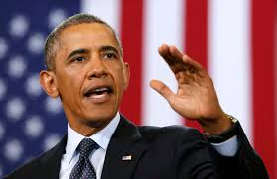


Social status
“the relative rank that an individual holds, with attendant rights, duties, and lifestyle, in a social hierarchy based upon honor or prestige.”
www.brittannica.com
“relations of ownership or control over productive resources (i.e. physical, financial and organizational).”
WHO Social Determinants of Health

Slide 18
Socioeconomic position

Slide 19
SES Across The Lifecourse:
Adult income
Latency/critical period model:
Exposure during sensitive window puts one at risk for development of disease later in life. Exposures encountered after the critical window closes do not influence risk. Focus on early life experiences that do not have a cumulative effect.
Older Age Health
Education
Cognitive
experiences
Knowledge
Credential
Social ties
Adult occupation

Slide 20
SES Across The Lifecourse:
Trajectory
Stability
Wealth
Adult income
Social trajectory model:
Social disadvantage increases risk of future disadvantage later in life. The initial insult does not necessarily have a harmful effect on the outcome – but the first exposure leads to subsequent exposures that then directly cause the outcome.
Old Age Health
Education
Adult occupation
Class
Prestige
Job content

Slide 21
Childhood SES is associated with adult health
Nurses Health Study:
Parental education is associated with the self-rated health of their adult children, after taking into consideration current SES (highest year of schooling, total household income, total net worth)
[Moody-Ayers, et al. 2007]
Health and Retirement Survey:
Parental occupation is associated with cardiovascular disease in middle age, after taking into consideration current SES (highest year of schooling)
[Gliksman et al. 1995]

Slide 22
Childhood SES is associated with adult health
Regression models – physical functioning
Beta coefficients
Model 1 | + father’s SES | + adult SES | + father’s SES, adult SES
Two parents 6.48*
Age started working -4.89* | * | *** | *
Perception importance educ 6.48*** | ** | ** | **
Extracurr Activities HS
Adult discourage -1.06* | * | * | *
* P <0.05; ** p < 0.01; *** p <0.0001

Slide 23
Results - summary
Raised by two parents, perception of importance of education are positively associated with perceived health and physical functioning
Age began working is negatively associated with perceived health and physical functioning
Discouragement by adults is negatively associated with physical functioning
Associations remain after adjustment for parental and adult SES (except for two parents)

Slide 24

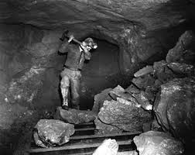
Employment and working conditions
Occupational classification
  Current
  Longest lasting
Employed vs. not

Slide 25
Higher-status job, longer life.
Male civil servants, UK Whitehall Study I
Age-adjusted, age 40-64
Source: Marmot, M. G., et al (1984). "Inequalities in death--specific explanations of a general pattern?" Lancet 1(8384): 1003-1006.

Slide 26
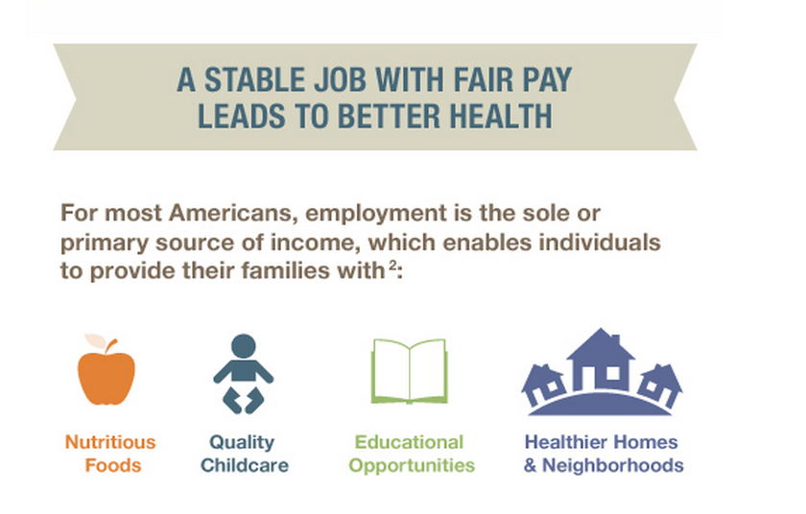

Slide 27
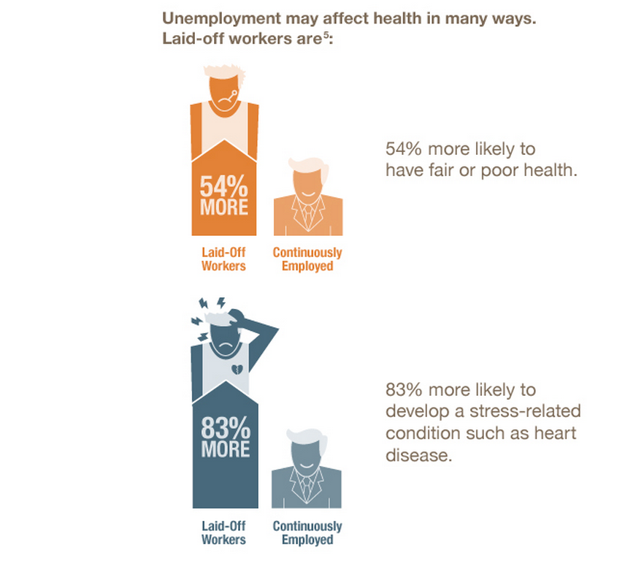

Slide 28
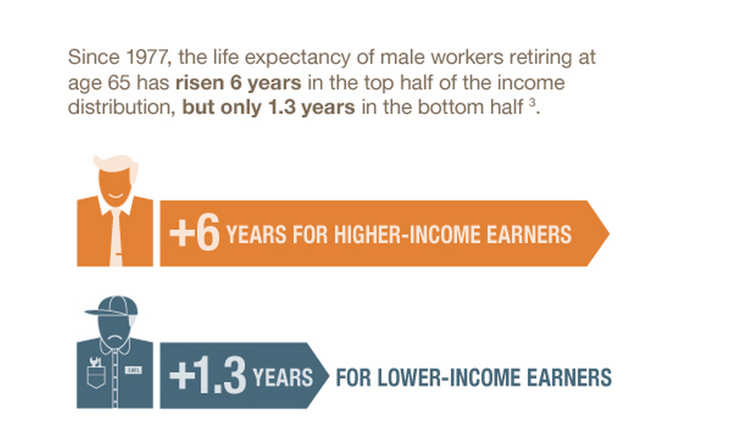

Slide 29

Education
# of years of schooling
Credentials

Slide 30
Higher income (or education), longer life:
Life expectancy at age 25
Source: National Longitudinal Mortality Study, 1988-98.

Slide 31
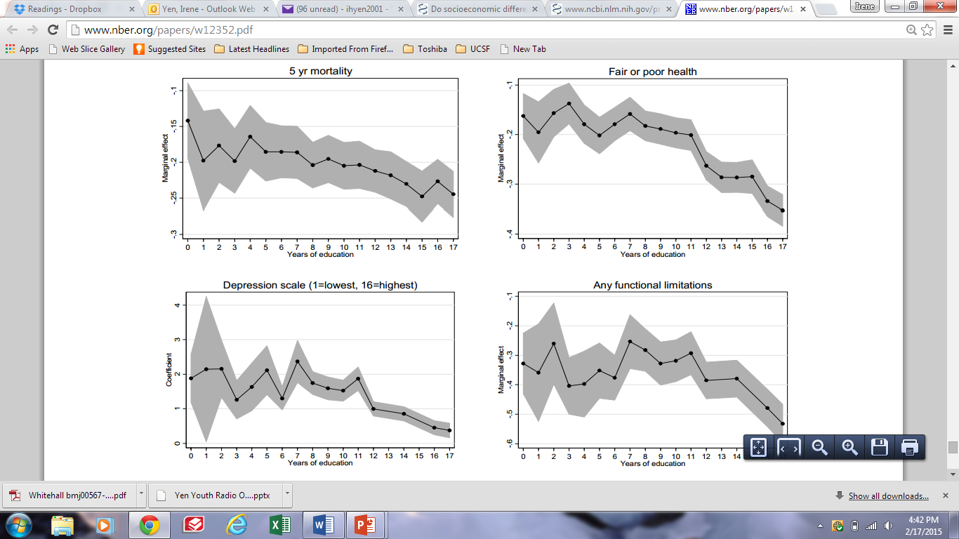

Slide 32
Race / Ethnicity
  Social?
  Biological?

Slide 33
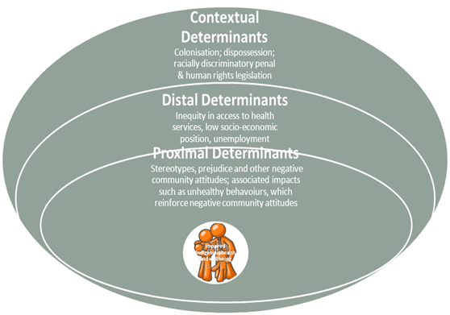

Slide 34
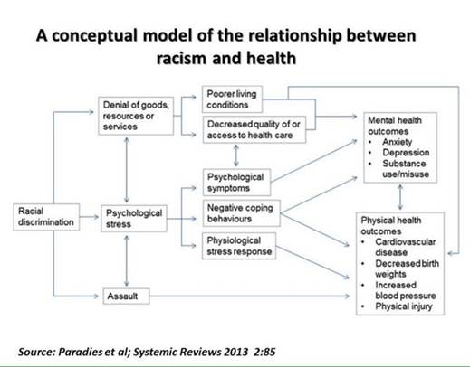

Slide 35
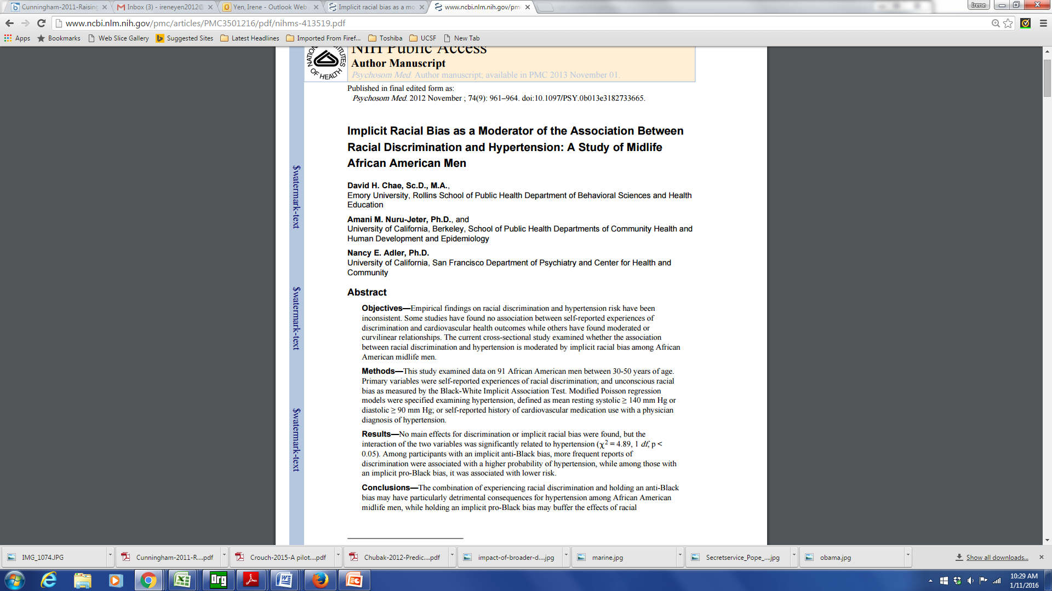
Internalized Racism

Slide 36
Internalized Racism
Implicit association test used to measure implicit (unconscious) racial bias
Among black men with anti-black bias, experiences of discrimination associated with hypertension
  Those with a pro-black bias had lower dx of hypertension

Slide 37
Race / Ethnicity
Unfair treatment
Discrimination
In your day-to-day life, how often do any of the following things happen to you?
1. You are treated with less courtesy than other people are.
You are treated with less respect than other people are.
You receive poorer service than other people at restaurants or stores.
People act as if they think you are not smart.
People act as if they are afraid of you.
Have you ever been unfairly treated in the following six domains (Yes/No):
fired or denied a promotion
not hired for a job
treated unfairly by the police
discouraged by a teacher from continuing education
prevented from moving into a neighborhood
neighbors have made their life difficult.

Slide 38
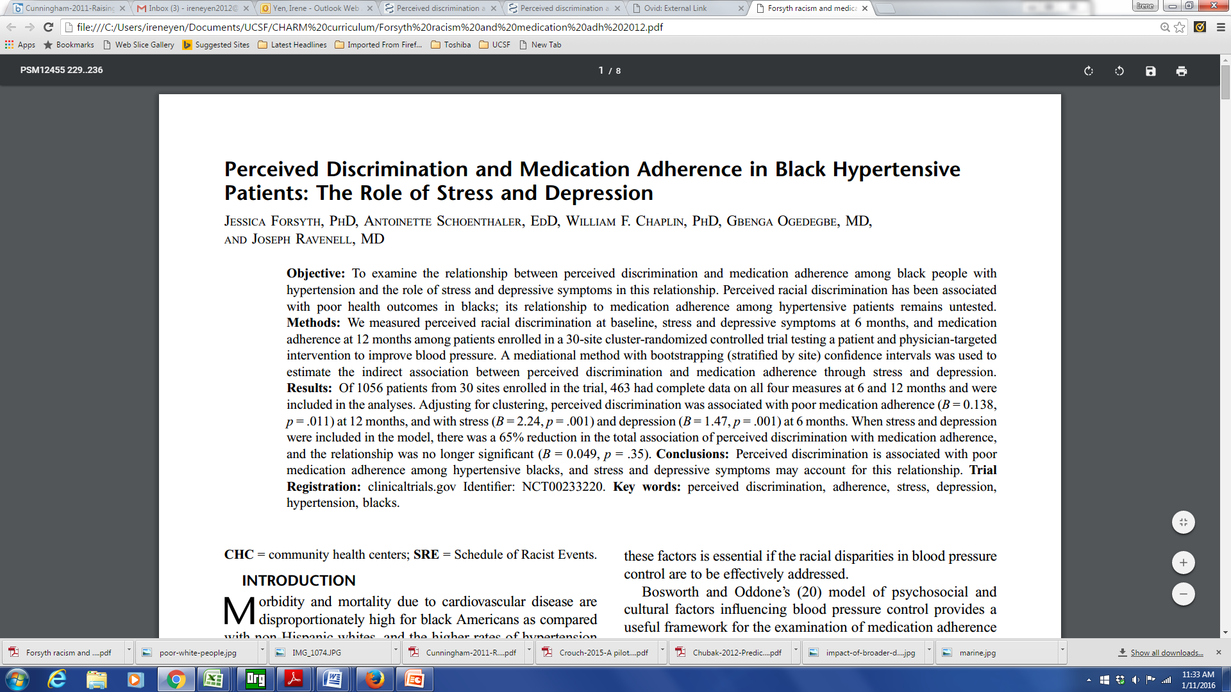
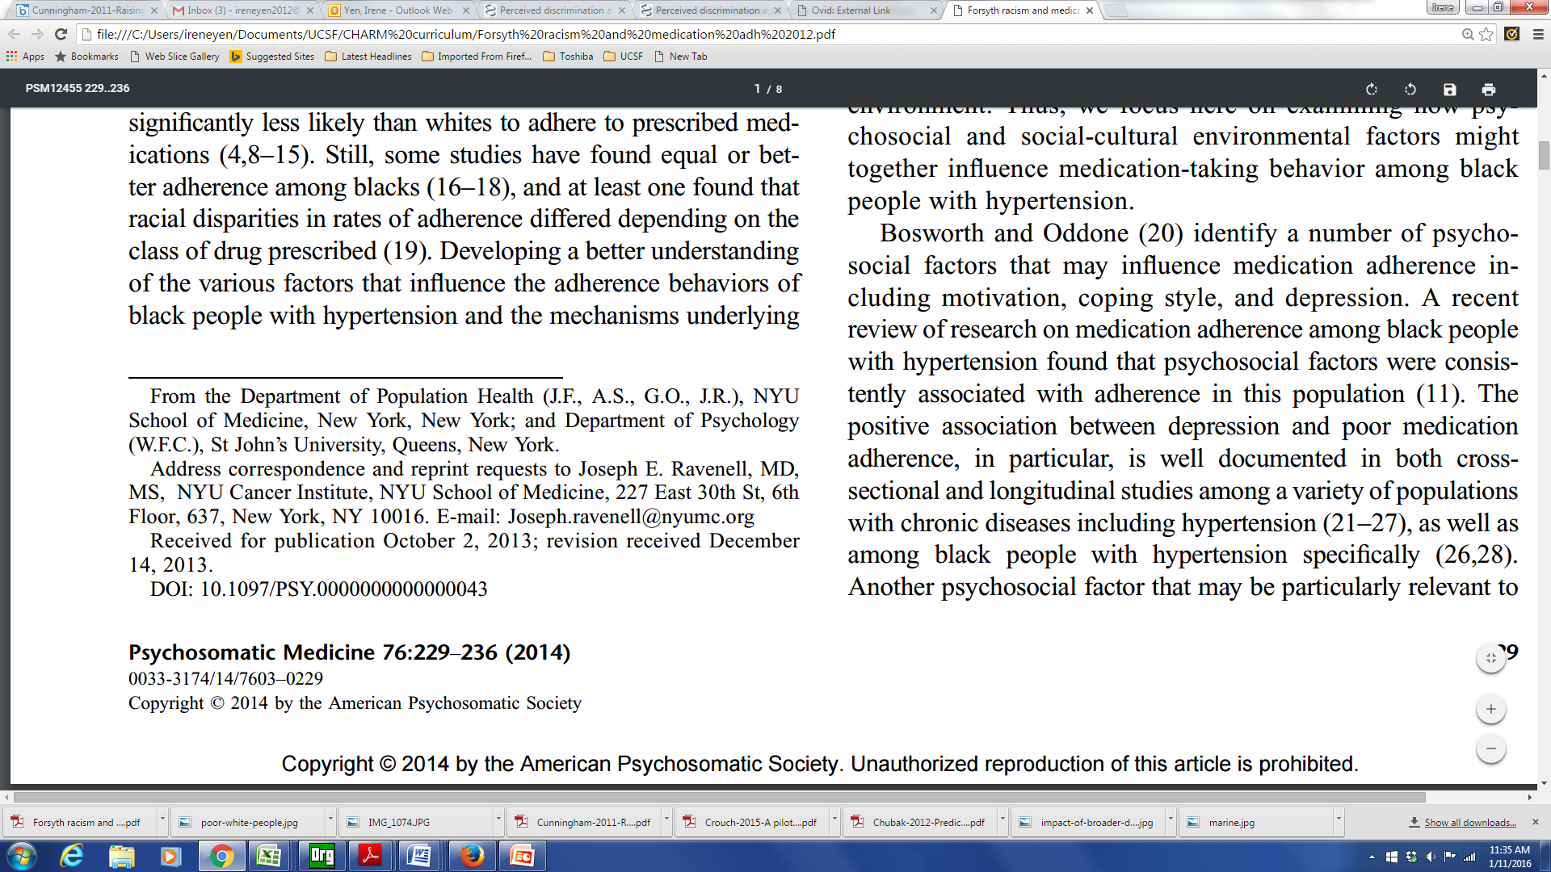

Slide 39
Racism and Medication Adherence
Perceived racial discrimination measured among patients enrolled in a 30-site cluster-randomized controlled trial
A mediational method was used to estimate the indirect association between perceived discrimination and medication adherence through stress and depression
Perceived discrimination was associated with poor medication adherence, and was mediated by stress and depression

Slide 40
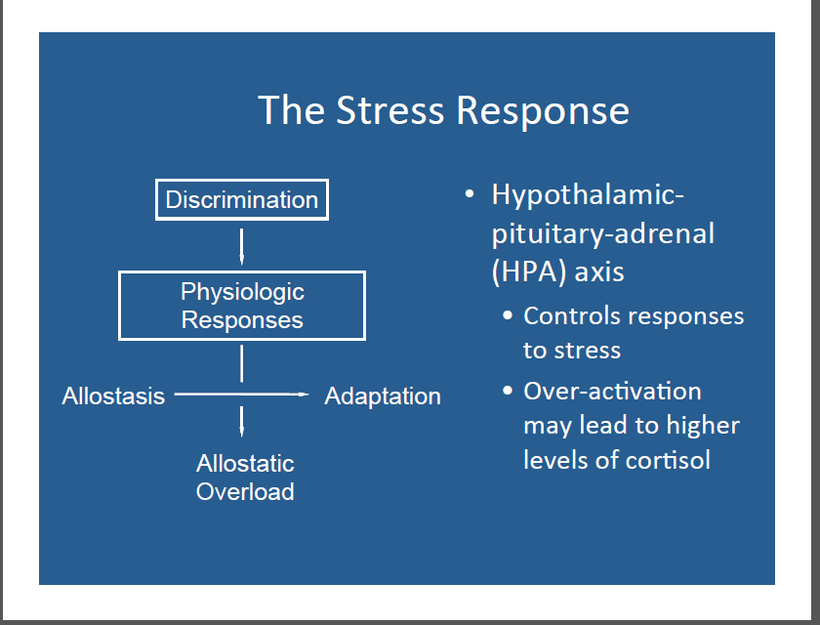

Slide 41
Hypersegregation
Segregation highest for African Americans
Characterized by not only by racial segregation
But also socioeconomic segregation
Socioeconomic segregation does not account for racial/ethnic segregation
Related to discrimination in housing/ mortgage markets

Slide 42
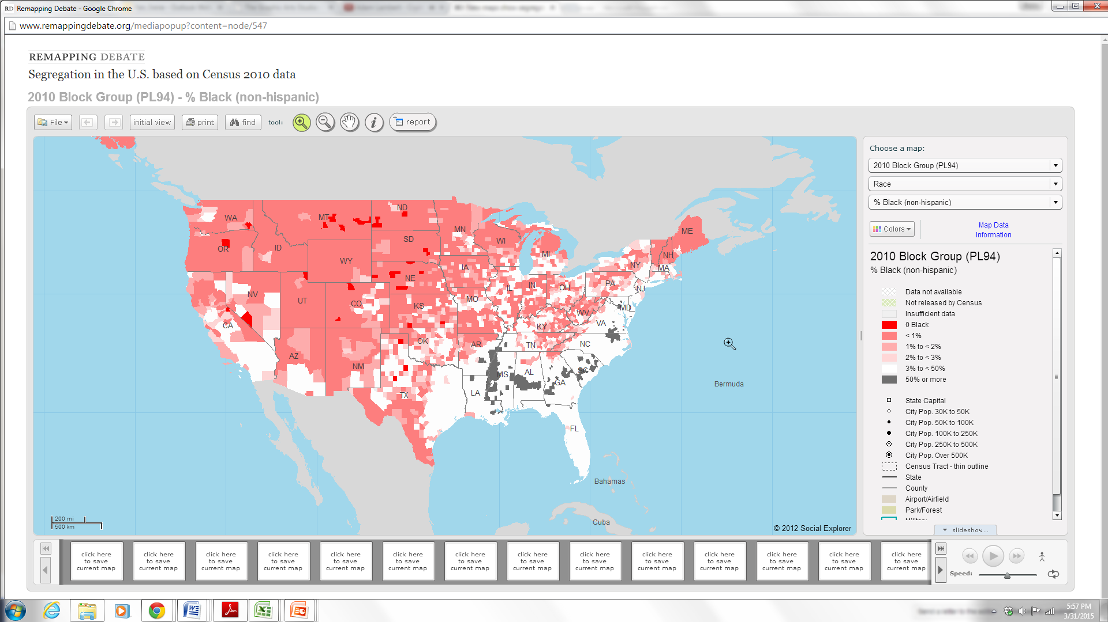

Slide 43
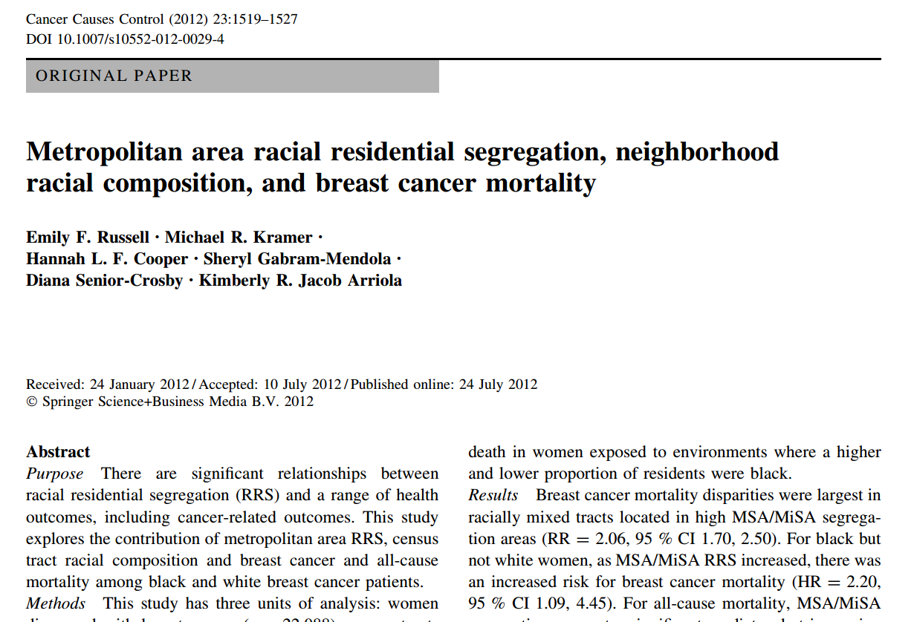

Slide 44
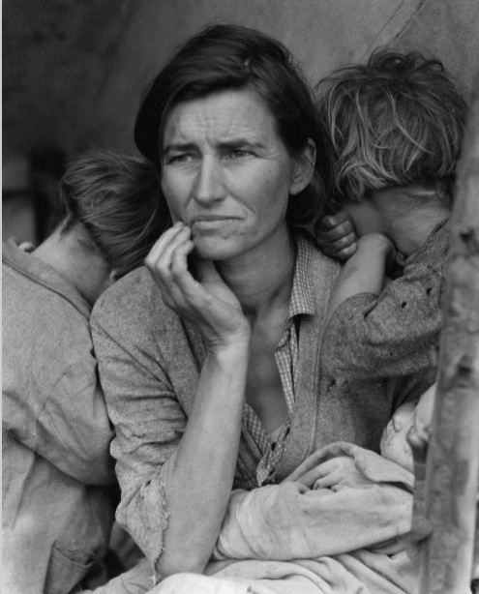

Slide 45
Racial/ethnic differences do not explain
differences in adult health by income
Analyses by Braveman et al., UCSF.
Data source: NHIS 2001-2005. Age-adjusted.

Slide 46
Racial/ethnic differences do not explain adult health differences by education
Braveman, Egerter et al., 2009.
Data source: BRFSS. Age-adjusted.

Slide 47
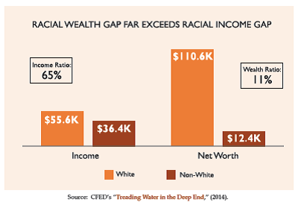

Slide 48
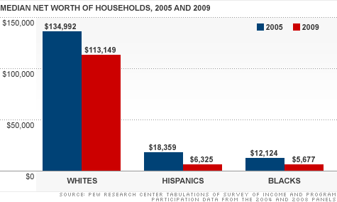

Slide 49
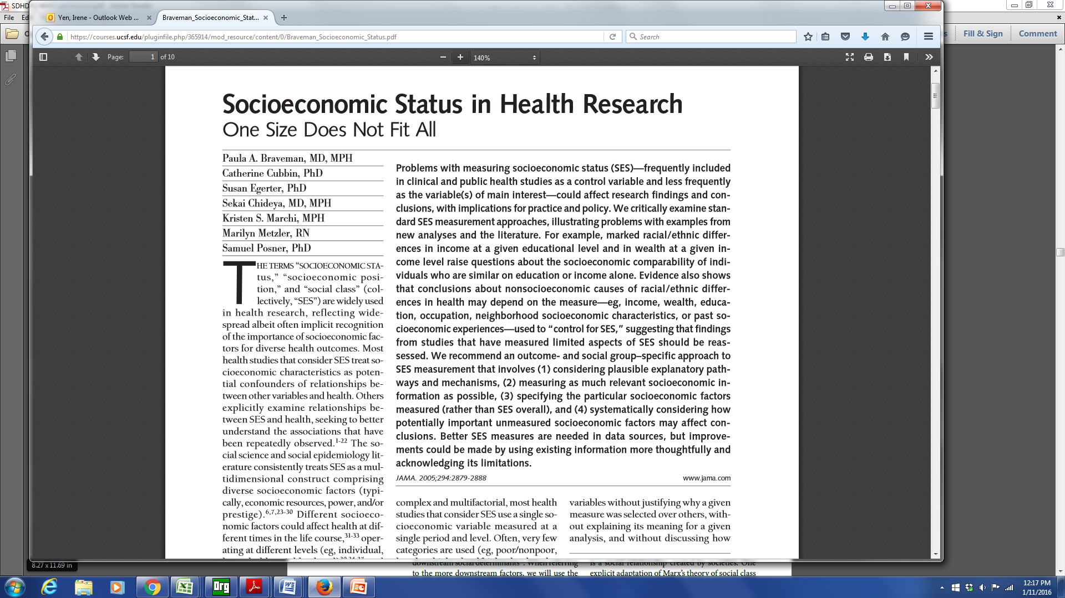

Slide 50
Braveman et al article –
a few of the take home points
Education and income not interchangeable – earnings can vary at similar educ levels.
income not a proxy for wealth
Importance of past socioeconomic experiences

Slide 51
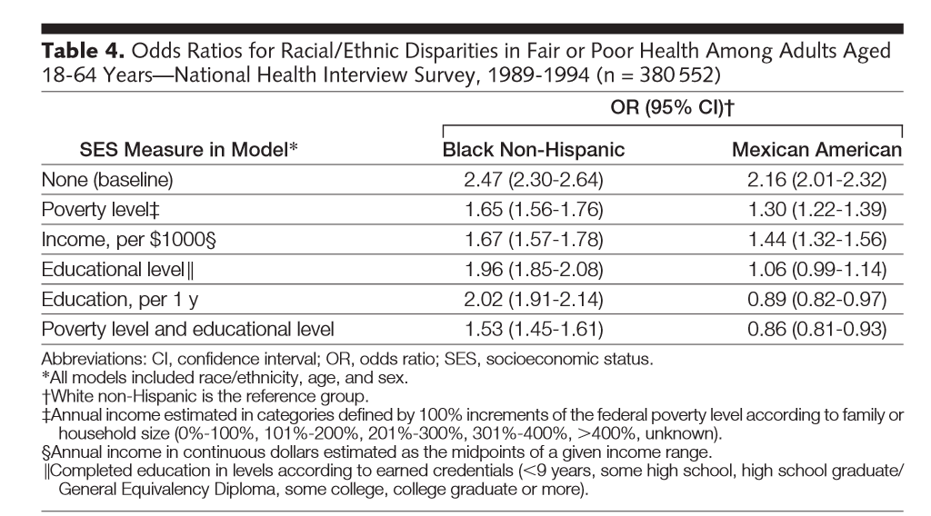

Slide 52
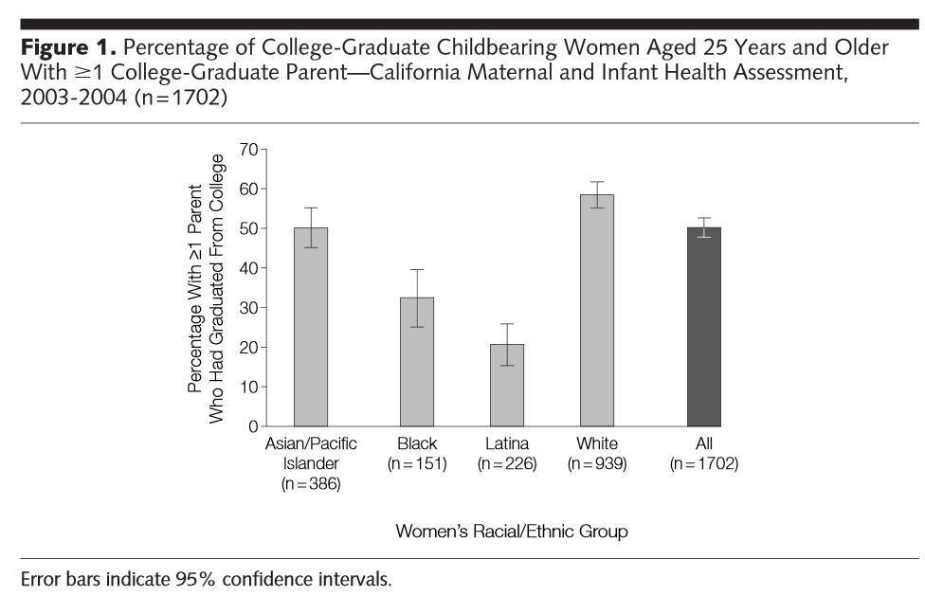

Slide 53
Social Determinants of Health II
Stressors / Stress
Housing
Neighborhood
Transportation
Incarceration

Slide 54
Stressors
Food insecurity
Job insecurity
High demands / Low control

Slide 55
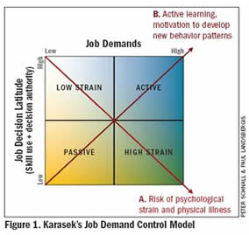
High Demands / Low control = job strain
Notes:
Note that this started in norway, began to notice childhood effects

Slide 56
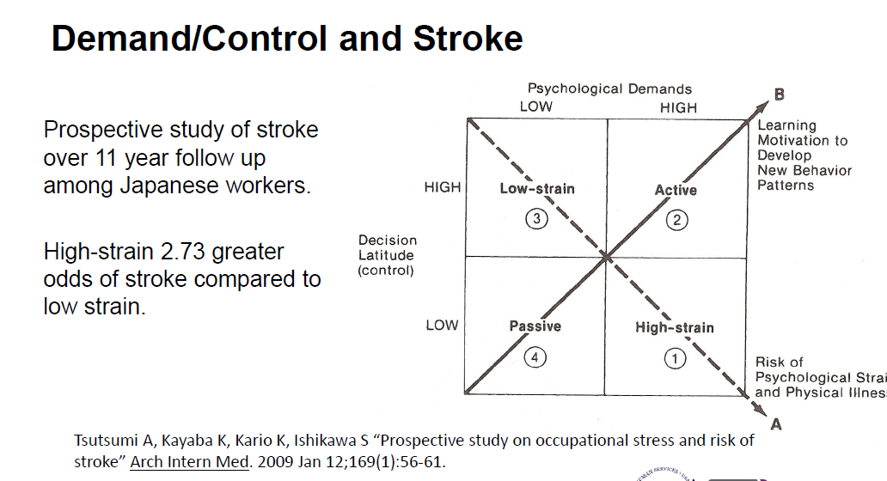

Slide 57
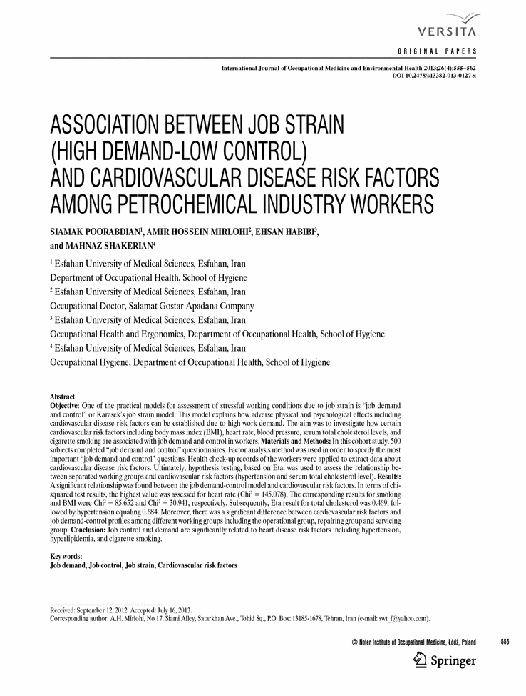

Slide 58
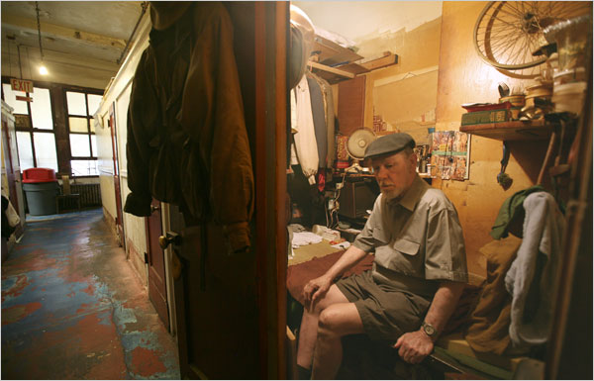
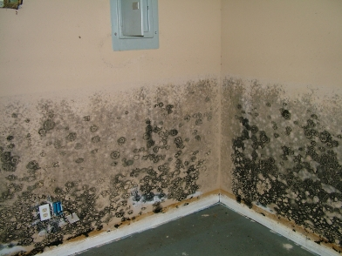
Housing
Own vs. rent
Cost / income proportion

Slide 59
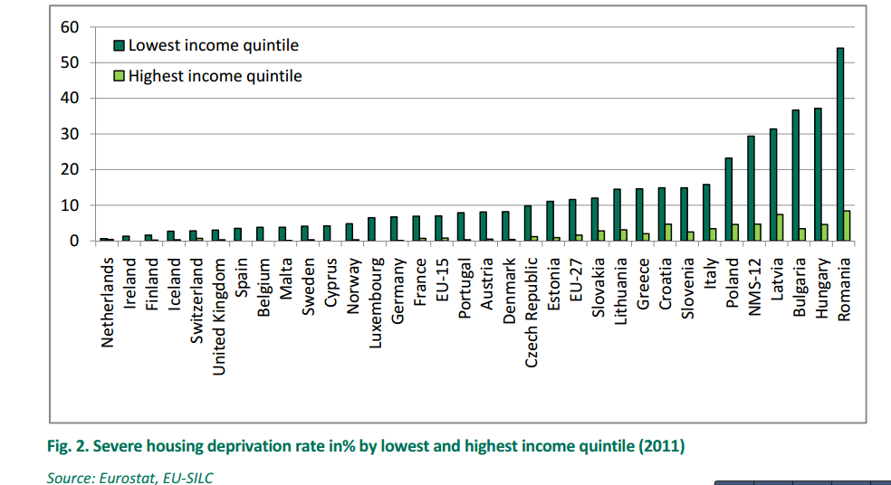
Housing Deprivation

Slide 60
Neighborhood
Pubmed Articles “Neighborhood” in title: 1970 - 2012
60

Slide 61
Neighborhood / Place research concepts and methods
definitions of neighborhood / geographic unit (scale)
  census block group
  census tract
  zip code
  buffers
measure to characterize the place
  composition
  context
types of measures
  census data
  counts
  density
  distance to
  time / space

Slide 62
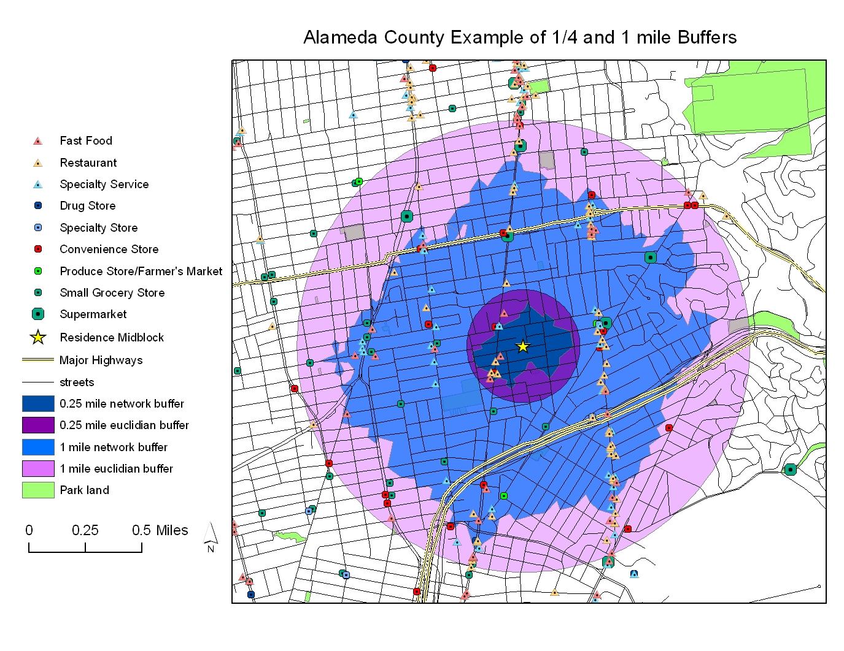

Slide 63
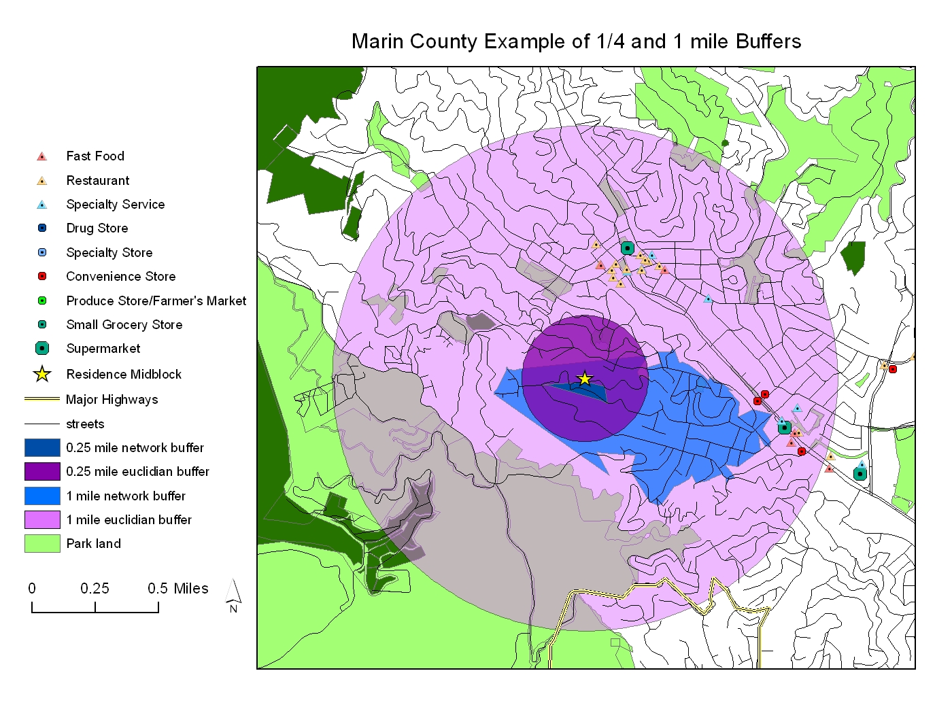

Slide 64
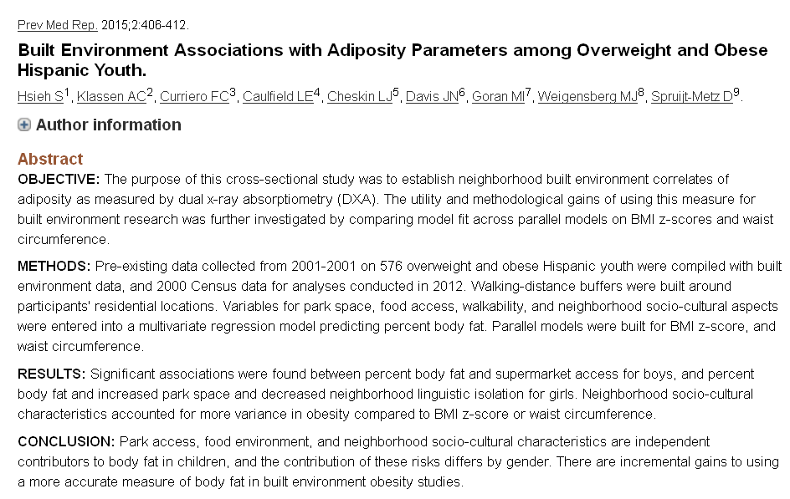

Slide 65
Moving to Opportunity
1994 – 4600 families with children living in public housing – RCT to move to lower poverty neigh
  Vouchers
  Section 8
  control
2008-2010 – evaluation studies

Slide 66
Moving to Opportunity - adults
adults offered housing vouchers have a lower prevalence of severe obesity and diabetes compared to controls
Adults offered housing vouchers report fewer physical limitations
self-reported health status and rates of hypertension and health-related risk behaviors are similar across groups.
improved mental health in areas such as depression and psychological distress

Slide 67
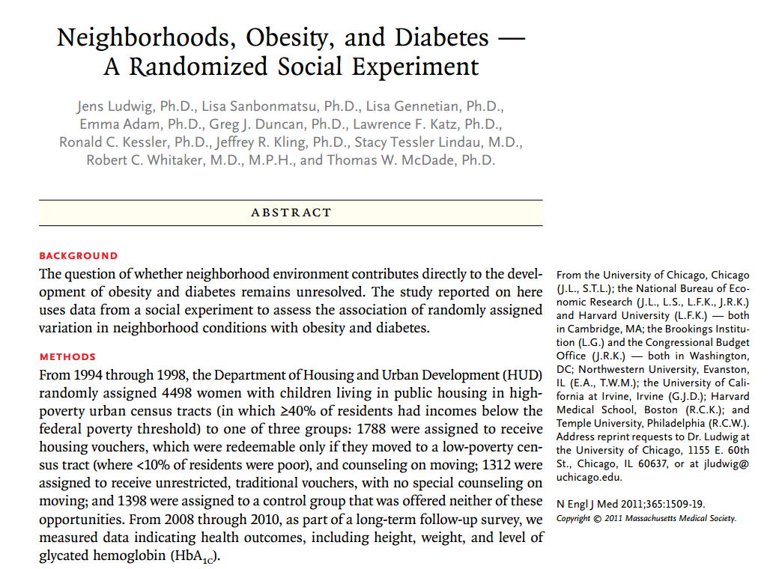

Slide 68
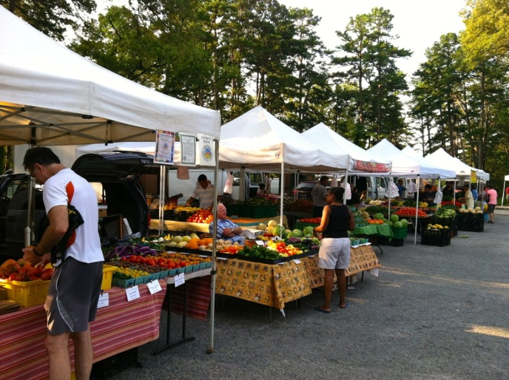


Food
Healthy People 2020

Slide 69
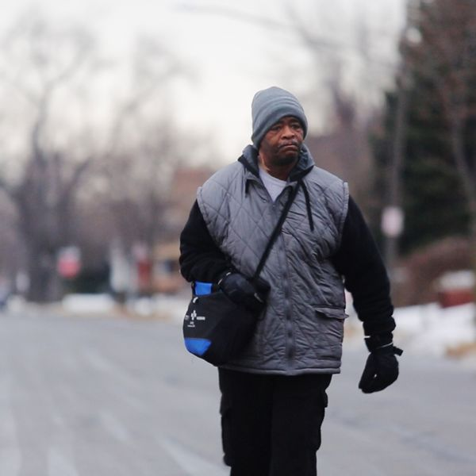
Transportation

Slide 70
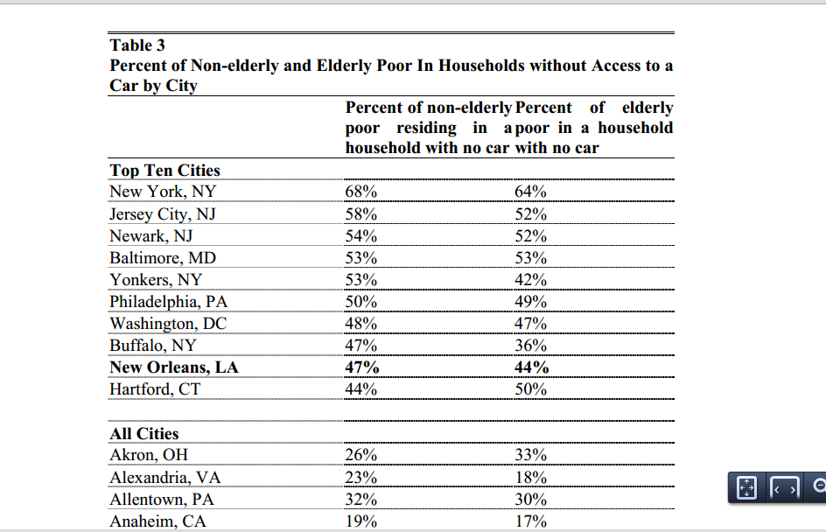

Slide 71
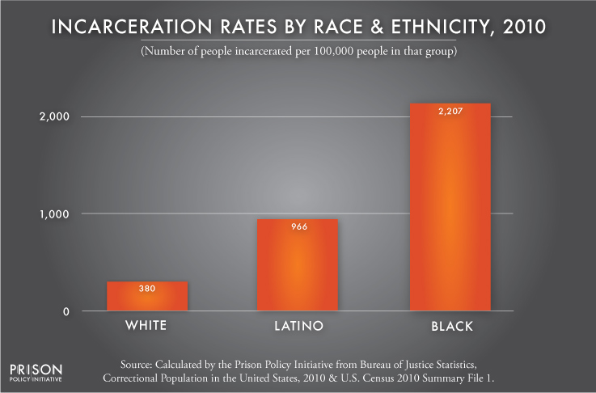
Incarceration

Slide 72
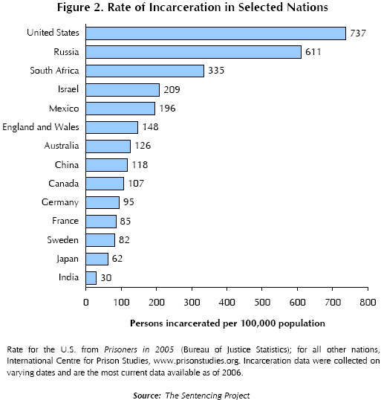
Incarceration

Slide 73
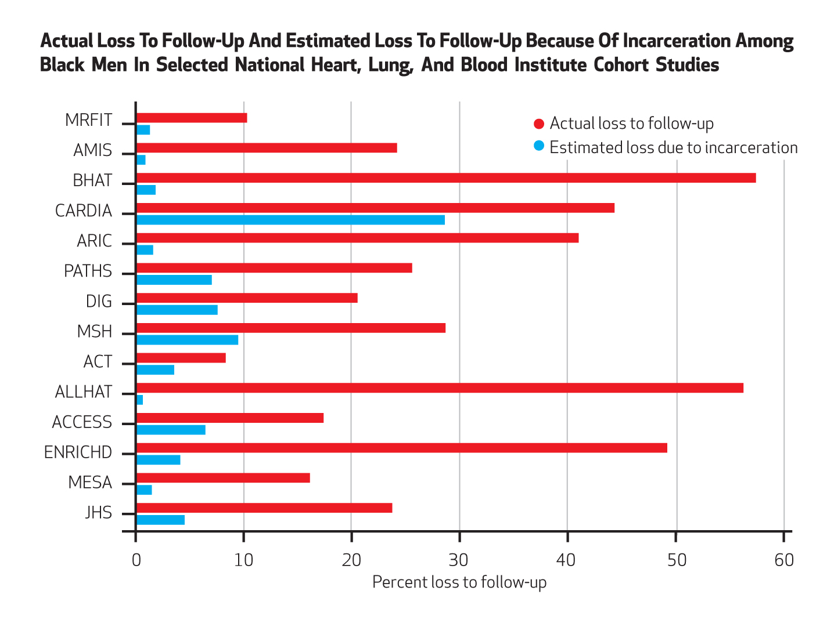
Incarceration
Notes:
Health Affairs 2014

Slide 74
Incarceration
As of 2004, there were approximately six times more inmates and ex-inmates than in the mid-1970s.
Presently, there are more than 16 million felons and ex-felons in the United States (Uggen et al. 2006)

Slide 75
Incarceration
The lifetime cumulative risk (measured to age 34) of imprisonment for all African American males > 20 % (Pettit & Western 2004).
African American males without a high school diploma, the lifetime risk of incarceration is 59 % (5x the rates of comparable whites.)
correctional policies have caused the emergence of a new ‘‘felon class’’ in society.
  8 % of the adult population,
  22% of the black adult population
  33% percent of the black adult male population

Slide 76
What produces health disparities across the life course and across generations?
SOCIETY
Reducing social
inequality
INDIVIDUAL
Social position, e.g. by race & class
Social
Context
1. Social inequality
2. Differential exposure
Reducing harmful exposures
Specific exposure
3. Differential vulnerability
Reducing vulnerability
Disease
4. Differential consequences
Preventing unequal
consequences
Policy
Context
5. More social inequality
Social consequences
of ill health
Adapted from Diderichsen, U. Copenhagen

Slide 77
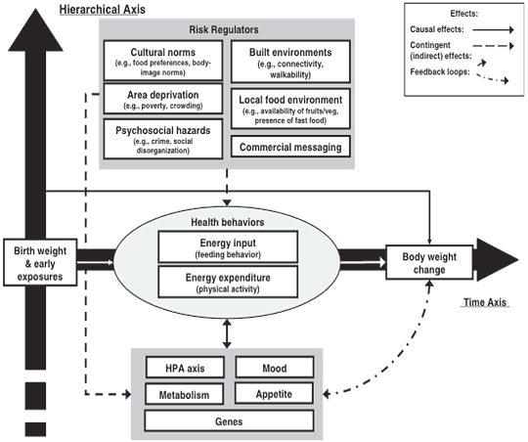
CDC Multilevel Model for Obesity
Notes:
http://www.cdc.gov/pcd/issues/2009/jul/09_0013.htm

Slide 78
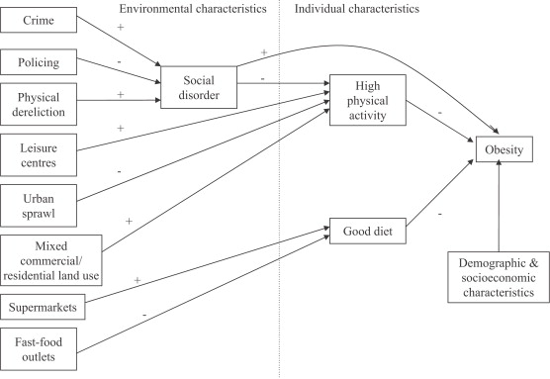
Theoretical model linking social and physical environmental characteristics to obesity
Pathways to obesity: Identifying local, modifiable determinants of physical activity and diet
Mai Stafford , Steven Cummins , Anne Ellaway , Amanda Sacker , Richard D. Wiggins , Sally Macintyre
Social Science &amp; Medicine, Volume 65, Issue 9, 2007, 1882 - 1897

Slide 79
Notes:
So what do we do about this? How do we factor this in when we do research?
Think carefully about what we control for
How do we measure race

Slide 80
Improving health & reducing disparities by addressing the role of social factors
Economic & Social
Opportunities and Resources
Living & Working Conditions
in Homes and Communities
Behaviors
Medical Care
Interaction with genetic/other biological factors
HEALTH
Adapted from Braveman et al., for Robert Wood Johnson Foundation Commission to Build a Healthier America | www.commissiononhealth.org
Notes:
Forecast future lectures – biological & behavior. [focus on 1st 5]

