Slide 1
Tobacco
Cancer Epidemiology
EPI 252
January 27, 2016

Slide 2
The Problem
Tobacco use is largest single cause of human cancer in Western countries
30% of all cancer deaths in U.S. and 16% worldwide
Causes even more deaths from cardiovascular disease
With current trends could account for 10 million deaths annually worldwide

Slide 3
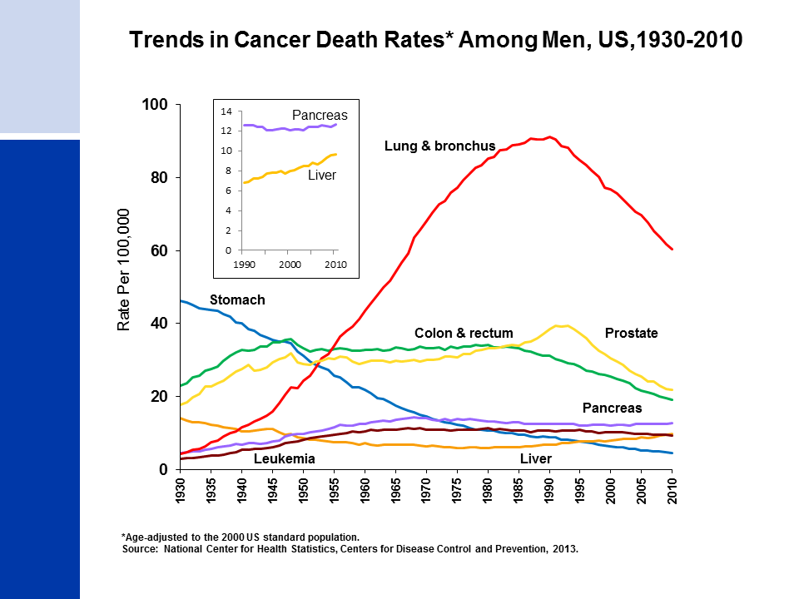
Notes:
Most of the increase in overall cancer death rates for men prior to 1990 was attributable to the rapid increase in lung cancer deaths due to the tobacco epidemic. However, since 1990, the lung cancer death rate in men has been decreasing; this decline has accounted for over 40% of the overall decrease in cancer death rates in men since 1990. The death rate for stomach cancer, which was the leading cause of cancer death among men early in the 20th century, has decreased by 90% since 1930. Death rates for prostate and colorectal cancers have been declining since the early 1990s and 1980s, respectively. In contrast to declining death rates for most cancer types, liver cancer death rates increased by more than 2% per year during the past decade of data (2001 to 2010). Death rates for pancreatic cancer have also been increasing slightly.

Slide 4
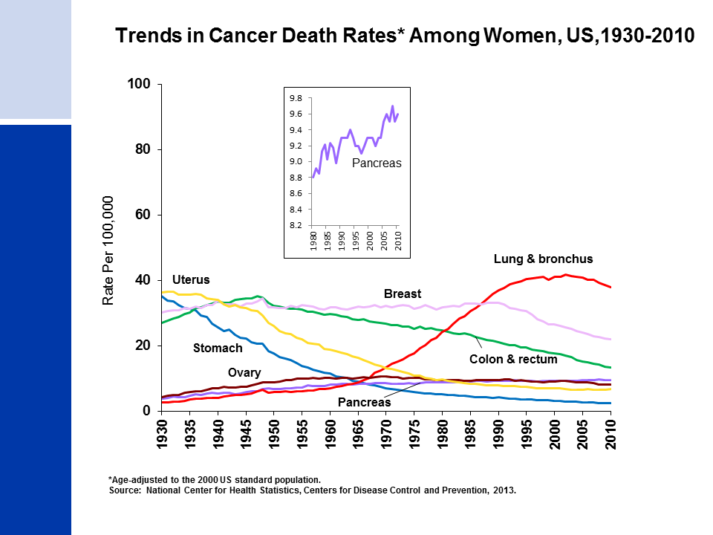
Notes:
The lung cancer death rate in women began declining in the early 2000s after increasing for the previous 70 years. The lag in the decline in lung cancer in women compared to men reflects differences in smoking patterns; smoking rates peaked about two decades later in women than in men and women lagged behind men in quitting smoking in large numbers. In comparison, breast cancer death rates changed little between 1930 and 1990, but decreased 34% between the peak year (1989) and 2010. Since 1930, the death rate for stomach cancer has decreased by more than 90%. The death rate for uterine cancer (uterine cervix and uterine corpus combined), which was the leading cause of cancer death in the early 20th century, declined 80% from 1930 to 1997, but has since been fairly stable. Colorectal cancer death rates have been decreasing for more than 60 years. Similar to men, pancreatic cancer death rates have been increasing slightly, from 8.8 (per 100,000 women) in 1980 to 9.6 in 2010.

Slide 5
Not Just Lung Cancer
Annual Attributable Deaths, U.S.
Lip, oral cavity, pharynx 5,200
Esophagus 7,900
Stomach 2,800
Pancreas 6,500
Larynx 3,100
Trachea, lung, bronchus 124,800
Cervix 500
Bladder 4,800
Kidney & other UT 3,000
Acuter myeloid leukemia 1,100

Slide 8
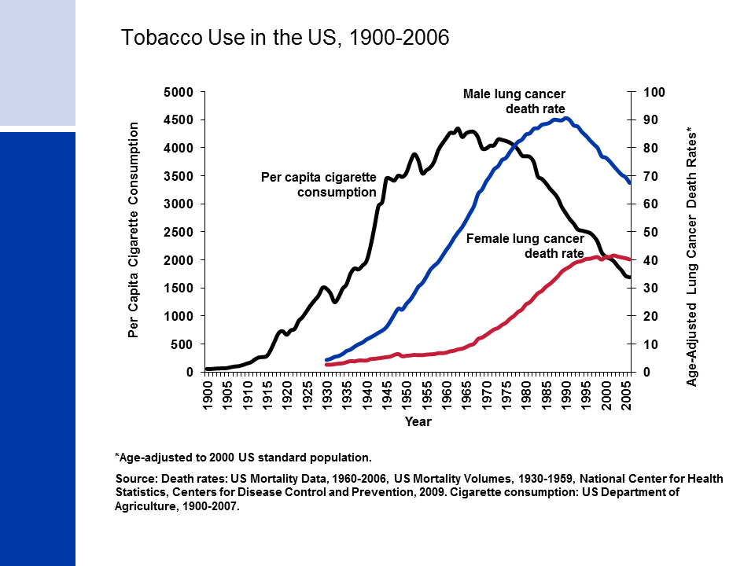

Slide 16
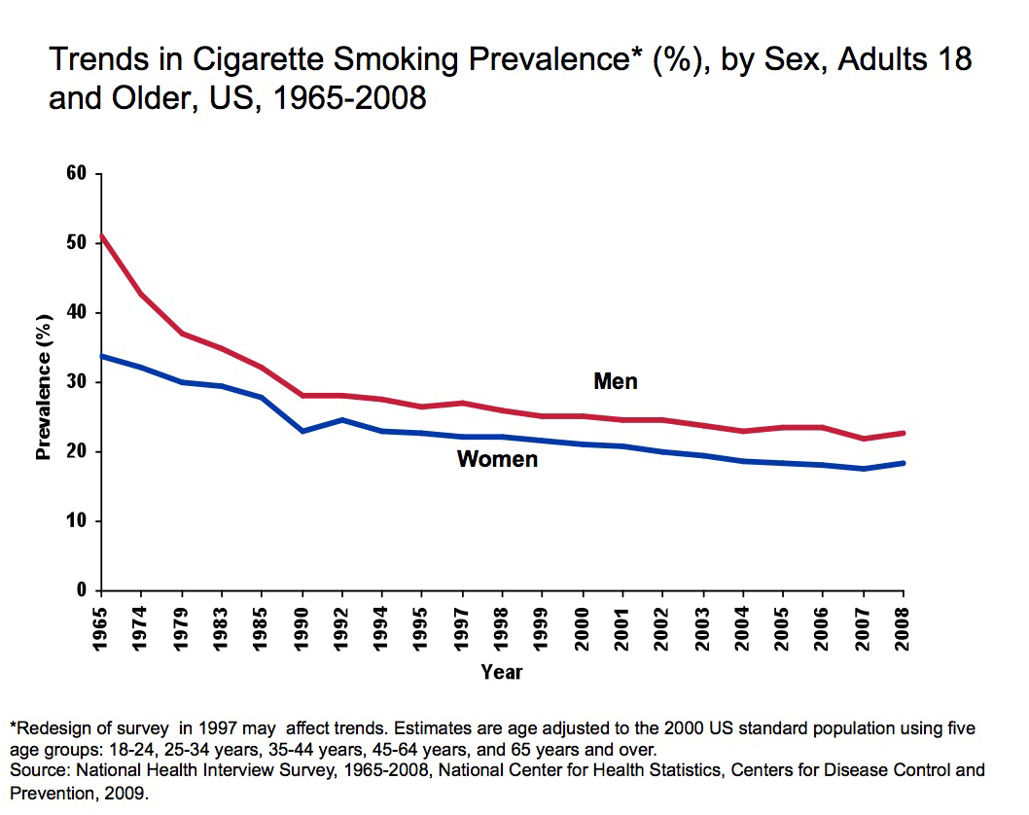
Notes:
The reduction in cigarette consumption has been associated with a decrease in adult smoking prevalence in both men and women since 1965. The difference in cigarette smoking across gender narrowed from 1965 to 1985, a result of smoking becoming more popular among women and higher rates of quitting among male smokers following the Surgeon General’s Report.
Between 1997 and 2004, the percentage of adults who smoke decreased significantly. Between 2004 and 2008, age-adjusted smoking rates were steady between 2004 and 2006, declined in 2007, and remained unchanged between 2007 and 2008 (men: 22.8%, women: 18.5%).

Slide 17
The “Controversy”
An epidemic of lung cancer observed
Cause was unclear- road tar, pollution, etc.
Doll and Hill in UK and Wynder and Graham in US published almost together in 1956 using case-control designs – but recall bias??
Doll and Hill cohort study of UK physicians
Hill’s Causal Criteria

Slide 18
Measurement
Current smoker = daily or some days
# cigarettes per day or years of smoking are the best measures for self-report
Duration is a better predictor than # of cigs/d
Questionnaires – underestimate pop level consumption vs. cig sales by 20-30%
Biomarkers – cotinine 17hr half life, useful for last 2-3 days
Self-report vs. cotinine – 87% sen, 89% spec
Pack-years and ex-smoker not as accurate.

Slide 19
Prevention
First – individual one-on-one efforts in clinic
Second – group health education and community efforts at behavioral change
Third – Non-smoking aids – nicotine gum and patches with or without counseling
Finally – Policy interventions – clean indoor air laws, bans on advertising/marketing, price/tax increases, and countermarketing.

Slide 20
Current Controversies and Challenges
Breast cancer and tobacco
E-cigarettes and “harm reduction” strategies
Tobacco use in youth
Alternative forms of tobacco use – spit, hookah, flavored cigarettes
Tobacco use in marginal populations (e.g., prisoners, mentally ill, substance abusers)

