Slide 1
Advanced Methods in Pharmacoepidemiology
Fei Xue, MD, ScD
Center for Observational Research, Amgen
Feb 5, 2015

Slide 2
Topics
Assess bias and confounding in observational studies
  Causal diagram
Methods to address confounding by indication:
  Propensity score analyses
  Marginal structural models
  Instrumental variables
  External covariate adjustment
Handling changing exposure over time
Validity studies

Slide 3
Determining whether an association is causal
An observed association must be due to chance, bias or causation
Statistical tests quantify probability of an association is due to chance
Knowing potential sources of bias allows one to assess whether results are likely to be affected by bias
Additional considerations in assessing causality:
  Biologic plausibility, temporal sequence, strength of association, dose-response, specificity, consistency
Notes:
Observation bias
Selection bias
Confounding

Slide 4
Clinical Trial vs. Observational Studies
  Randomized trials are sometimes described as the “gold standard” of biomedical research, in contrast to epidemiologic (“observational”) studies. But randomized trials, like all epidemiologic studies, are subject to biases and random error, and are imperfect.
  The big advantage of trials of randomization requires comparing the randomized groups (ITT analysis), but ITT is biased toward the null because of non-adherence. Such bias is tolerated in efficacy studies but should not be acceptable in safety studies.
  But comparing those adhering to treatment with those who did not receive or stick with treatment amounts to a non-randomized study. For studies evaluating drug safety, trials may offer little advantage (depending on levels of adherence) over nonexperimental studies.
Slide adapted from Kenneth Roth, RTI

Slide 5
Several biases are often important in pharmacoepidemiology studies
“Healthy user” (adherence) bias
  Patients more adherent to long-term preventive drug therapy are more health seeking (Ray, 2000)
Survivor bias
  Prevalent users may have disproportionately more subjects at lower risk of adverse outcomes
Channeling bias
  Physicians may not prescribe certain treatments to patients perceived to be at greater risk of side effects
  Inadequate control for this bias may make certain drugs appear safer in observational studies of specific outcomes
Immortal time bias:
  Inclusion of a period of follow-up during which, by design, death or the study outcome cannot occur (e.g., waiting for a prescription to be dispensed after discharge from hospital when the discharge date represents the start of follow-up )
  Biases the results in favor of the treatment under study by conferring a spurious survival advantage to the treated group

Slide 6
Confounding by indication (CBI) for treatment is one of the more important biases to consider
Confounding factor
Disease severity
+
C
+
?
X
Y
Exposure
Drug therapy
Outcome
Event of interest
Exposure and outcome association confounded by patient factors reflecting need for treatment
Patients with more severe disease have greater need for treatment and potentially greater risk of the event of interest
Without control for confounding, effects of disease severity on outcome may be mistakenly attributed to exposure
Notes:
Confounding by indication for treatment or by disease severity (channeling)
Treatment decisions at time of prescribing may depend upon available prognostic data
If variables used to inform prescribing decisions are independently related to the outcome, they are confounders
Failure to properly account for such variables can bias estimates of treatment effects

Slide 7
Causal Diagram (1)
Directed acyclic graphs (DAGs)
  Equivalent to G-computation¹⁻³ A compact graphic and algebraic formulation of assumptions and results
  A visual tool to identify variables that must be measured and controlled for to obtain un-confounded effect estimates
  Complements statistical modeling by
    Displaying a web of causation that are not conventionally captured
    Build a basis to test the validity of assumptions with reasonable variations
1. Robins J Chron Dis 1987; 2. Robins Biometrika 1995; 3. Robins Latent Variable Modeling with Application s to Causality 1997

Slide 8
Causal Diagram (2)
U
Unmeasured confounder
Parent of E and C; Ancestor of D
Node
A
B
C
E
D
Adjacent to A and C
Edge
Child of E,C and B; Descent of A

Slide 9
Causal Diagram (3)
Directed path includes
  Direct effect of X on Y: X→Y
  Indirect effect of X on Y based on known information: X→Z→Y
Backdoor path from X to Y: X←Y
Collider X: Y→X←Z
A blocked path: A path with one or more colliders
An unblocked path (association): A path with no collider
  Directed path (causal effect): X→Z→Y
  Backdoor path (confounding): X←Z→Y

Slide 10
Causal Diagram (4)
Blocked or unblocked?
A
B
A→E→D:
A→C→B:
A→E→C:
E→A→C→D:
C
E
D

Slide 11
Causal Diagram (5)
Blocked or unblocked?
A
B
A→E→D: unblocked direct path from D to A
A→C→B: blocked by collider C
A→E→C: blocked by collider E
E→A→C→D: unblocked backdoor path (E to A) and direct path (A to C to D)
C
E
D

Slide 12
Causal Diagram (6)
Conditioning on a collider X→Z←Y generates a spurious association between X and Y within a stratum of Z
A
B
A: It rains
B: Sprinkler is on
C: Lawn is wet
C
Given that the lawn is wet, and it did not rain …

Slide 13
Causal Diagram (6)
Conditioning on a collider X→Z←Y generates a spurious association between X and Y within a stratum of Z
A
B
A: It rains
B: Sprinkler is on
C: Lawn is wet
C
Given that the lawn is wet, and it did not rain, it is more likely that the sprinkler is on!!

Slide 14
Causal Diagram (7)
Another example: Selection bias due to stratification by uterine bleeding
E
D
E: Estrogen
D: Endometrial cancer
C: Uterine bleeding
C

Slide 15
How does confounding differ from other epidemiologic concepts
Mediator: A factor that’s on the causal pathway from exposure to outcome
Effect Modifier: A factor that modifies the association between exposure and outcome.
Collider: A factor that is a common effect of exposure and outcome
Example of Mediator
E
C
D
Example of Collider
E
D
E
D
C
U
C

Slide 16
Conventional Methods to Identify Confounding Factors
Automatic variable selection procedures, such as step-wise model selection based on P-value
  Assumes predictors of outcomes are confounding variables
Comparison of adjusted and unadjusted effect estimates
  Assumes that variables associated with substantial change of the exposure-outcome association are confounding variables
Checking criteria for confounding variable
  Whether the variable is associated with exposure in the population
  Whether the variable is associated with the outcome conditioning on exposure (among the unexposed)
  Whether the variable is not in the causal pathway between exposure and outcome

Slide 17
Conventional Methods to Identify Confounding Factors (2)
Inadequacy of conventional methods when solely based on statistical analysis
  Confounding criteria is based on causal relationship with exposure and with outcome
  Causal relationships with exposure or outcome cannot be ascertained from statistical analysis
Example1¹:
  Population: Slone Epidemiology Unit Birth Defect Study, infants born from 1992 to 1997
  Design: Case-control
  E: Supplementation with folic acid (E=1) vs. No Supplementation (E=0)
  D: Neural tube birth defects (D=1) vs. Birth defects unrelated to folic acid (D=0)
  C: Identity withheld
1. Hernan et al, American Journal of Epidemiology, 2002

Slide 18
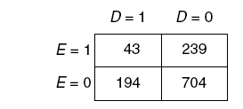
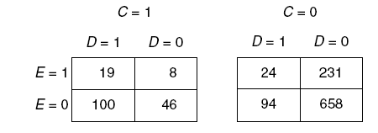
Example (continued)
Automatic forward variable selection: P for C<0.001
Relative change in effect estimate: (0.80 – 0.65)/0.80=19%
Standard criteria for confounding
  OR_{CE|D=0} =0.50 (95%CI 0.23 – 1.07)
  OR_{CD|E} =15.22 (95% CI 10.09 – 22.95)
  C is not on the causal pathway from E to D
OR_{ED} (95% CI)= 0.65 (0.45 – 0.94)
OR_{ED|C} (95% CI)= 0.80 (0.53 – 1.20)

Slide 19
Example (continued)
Automatic forward variable selection: P for C<0.001
Relative change in effect estimate: (0.80 – 0.65)/0.80=19%
Standard criteria for confounding
  OR_{CE|D=0} =0.50 (95%CI 0.23 – 1.07)
  OR_{CD|E} =15.22 (95% CI 10.09 – 22.95)
  C is not on the causal pathway from E to D
OR_{ED} (95% CI)= 0.65 (0.45 – 0.94)
OR_{ED|C} (95% CI)= 0.80 (0.53 – 1.20)
C satisfies all conventional confounder criteria and yet is NOT a confounder!

Slide 20
Example (continued)
Unveiled C: Pregnancy ending in still birth or therapeutic abortion
What is the possible causal diagram?
U₂
E
D
C
E
D
C
U
U₁
C is downstream of E and D in the causal structure and thus is not eligible as a confounding factor.

Slide 21
Detection of Confounding In DAG (1)
Algorithm¹:
  Delete all single-headed arrows from the exposure
  In the new graph without exposure effects, see whether there is any unblocked path from exposure to disease
Conventional criteria¹:
  The variable is an ancestor of the outcome
  The variable is associated with exposure
  The variable is not a descendant of either exposure or outcome
1. Greenland et al, Epidemiology, 1999

Slide 22
Detection of Confounding In DAG (2)
U
A
B
C
E
D

Slide 23
Detection of Confounding In DAG (3)
A
B
Backdoor paths?
C
E
D

Slide 24
Detection of Confounding In DAG (4)
A
B
Backdoor paths?
E←A→C→D
E←C←B→D
E←C→D
C
E
D

Slide 25
Detection of Confounding In DAG (5)
A
B
Backdoor paths:
E←A→C→D
E←C←B→D
E←C→D
C
E
D
Which variable(s) need to be adjusted for to completed block all the backdoor paths and thus adjust for all confounding effects?

Slide 26
Detection of Confounding In DAG (6)
A
B
Backdoor paths:
E←A→C→D
E←C←B→D
E←C→D
C
E
D
Which variable(s) need to be adjusted for to completed block all the backdoor paths and thus adjust for all confounding effects?

Slide 27
Detection of Confounding In DAG (7)
A
B
Backdoor paths:
E←A→C→D
E←C←B→D
E←C→D
C
E
D
Which variable(s) need to be adjusted for to completed block all the backdoor paths and thus adjust for all confounding effects?
C and (A or B)!

Slide 28
Strategies to Reduce Confounding When Confounders are Measured
Measured Confounders
Design
- Restriction
- Matching
Analysis
- Standardization
- Stratification
- Regression
- Marginal
Structural Models
Propensity Scores
Figure adapted from a presentation made by Sebastian Schneeweiss, ICPE, Chicago 2011

Slide 29
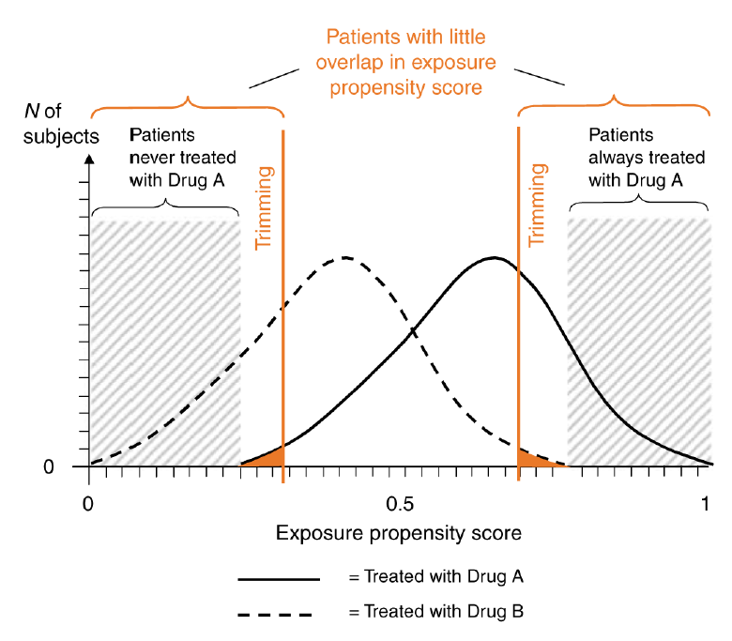
Propensity Scores (PS)
A propensity score is the conditional probability of receiving treatment given the covariates
PS usually estimated using logistic regression (other approaches are also possible)
Combines many patient characteristics/determinants of treatment into a single score
Regions of overlap in PS distributions represent clinical equipoise between two therapeutic
options
Can be used in analysis through:
  Matching
  Stratification
  Regression
  Combination of above methods
Figure taken from Schneeweis S, Clin Pharmacol Ther 2007;82(2):143-56.

Slide 30
Propensity Score Analysis – When?
Amenable to Propensity Techniques
Slide by S. Schneeweiss, Brigham and Women’s Hospital

Slide 31
Motivation
Assume matching when comparing 2 treatments:
  For every drug user with given characteristics
  Find a comparator with identical characteristics
Example: Male, age 45, smoker, with HTN…
Matching fails:
  Age (10 categories) x
  Sex (2 categories) x
  Prior diagnoses (5 @ 2 categories each)
  Prior drug therapy (5 @ 2 categories each)
  Preceding cost of care (5 categories)
  ↓102,400 potential matching groups
Thanks to J. Seeger

Slide 32
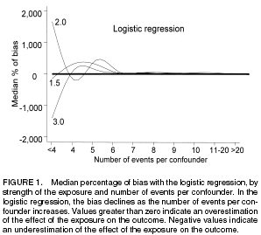
Motivation (2)
More than 8 events per covariate leads to unbiased estimates
So propensity score favored when:
Many more persons exposed to drug of interest than study outcomes
  Common exposure
  Rare outcome
Allows for richer model (more predictors) of exposure than outcome
  Alternative hypotheses
Cepeda S, et al. Am J Epidemiol 2003;158:280-287.

Slide 33
How to calculate it?
To do this, you run a regression (probit or logit) that has the probability of receiving treatment on the left hand side, and the covariates that determine selection into the treatment on the right hand side:
I_{i}^{treat} = β₀+ β₁ X_{i1} + β₂ X_{i2} +… (+γ ₁ X_{i1}² + γ ₂ X_{i2}²…) + ε_{i}
The propensity score is just the predicted value Î_{i}^{treat} that you get from this regression.

Slide 34
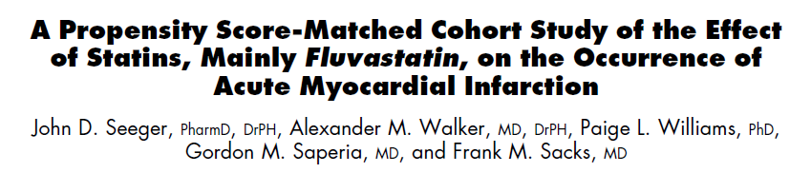
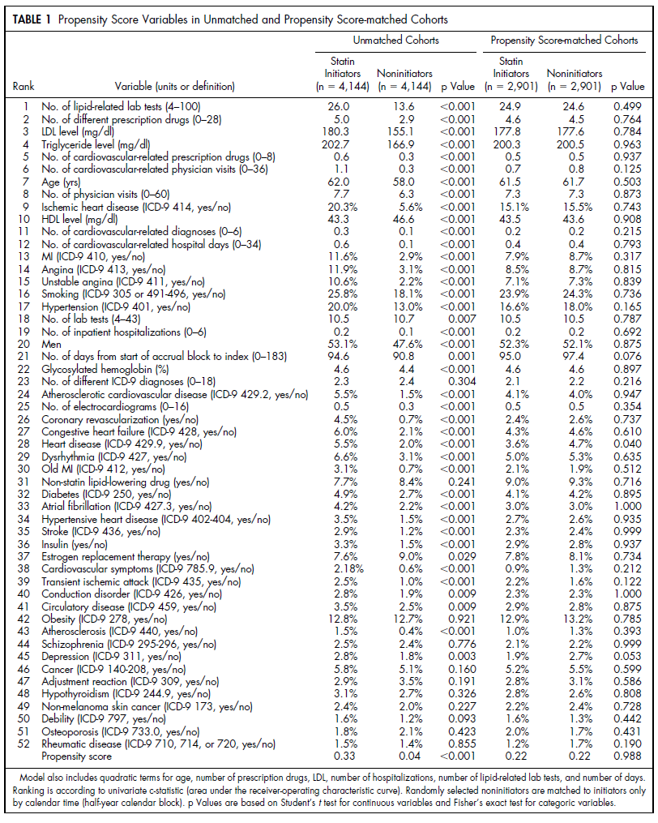
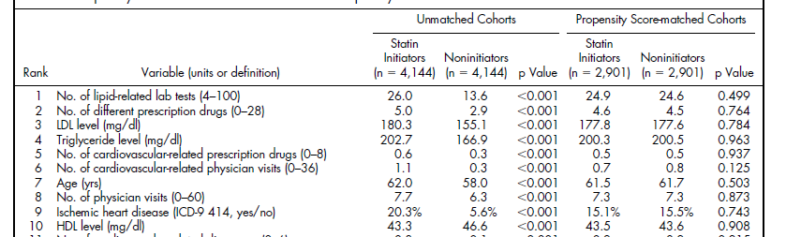
Seeger et al, Am J Cardiol 2003;92:1447-51.

Slide 35
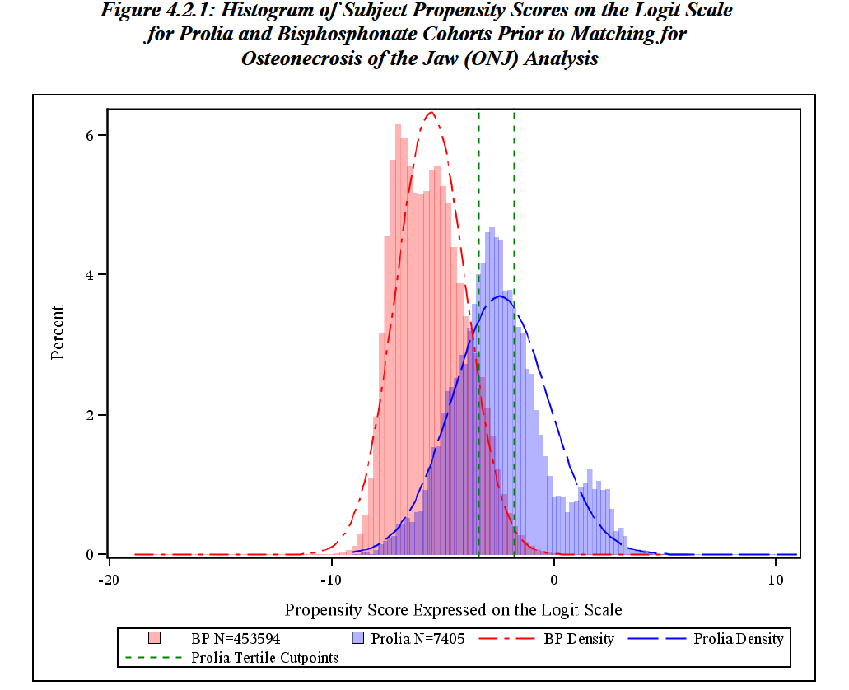
Analysis based on MarketScan health insurance database

Slide 36
Table 1. Comparison of patient characteristics between Prolia cohort and bisphosphonate cohort prior to matching
 | Bisphosphonates N=440825 |  | Prolia N=7405 |  | Comparisons
Covariatesª | Mean | Standard deviation | Mean | Standard deviation | Two-sample t-statistic | Standardized Difference Percentage
DEMOGRAPHIC AND OTHER PATIENT CHARACTERISTICS
Age on the exposure cohort index date (years) | 67.68 | 10.05 | 70.41 | 10.56 | -22.11** | -26.53
Fragility fracture history | 0.03 | 0.17 | 0.08 | 0.26 | -14.31** | -19.72
Charlson co-morbidity index score
0 | 0.77 | 0.42 | 0.68 | 0.47 | 16.29** | 19.99
1 to 2 | 0.17 | 0.37 | 0.19 | 0.40 | -6.09** | -7.34
>= 3 | 0.07 | 0.25 | 0.13 | 0.33 | -15.62** | -20.66
USAGE OF HEALTHCARE FACILITIES^{c}
Number of physician office /outpatient visits per patient | 7.42 | 6.54 | 10.86 | 8.48 | -34.76** | -45.47
Number of emergency room visits per patient | 0.34 | 1.10 | 0.52 | 1.51 | -10.24** | -13.65
Days of hospitalization per patient | 0.54 | 3.03 | 0.84 | 3.84 | -6.53** | -8.46
Number of ICU visits | 0.04 | 1.21 | 0.05 | 0.76 | -1.30 | -1.16
ENROLLMENT FACTORS
Calendar year of meeting PMO eligibility criteria
2010 | 0.60 | 0.49 | 0.34 | 0.47 | 46.67** | 53.68
2011 | 0.30 | 0.46 | 0.35 | 0.48 | -8.20** | -9.77
RISK FACTORS FOR ONJ
CHRONIC DISEASES
Diabetes | 0.12 | 0.33 | 0.14 | 0.35 | -4.46** | -5.37
Type 1 diabetes | 0.02 | 0.12 | 0.02 | 0.15 | -4.64** | -5.97
Type 2 diabetes | 0.11 | 0.31 | 0.12 | 0.32 | -2.69** | -3.21
Poorly controlled diabetes | 0.03 | 0.18 | 0.05 | 0.22 | -7.24** | -9.31
CONCOMITANT MEDICATIONS
Corticosteriods | 0.28 | 0.45 | 0.36 | 0.48 | -14.15** | -17.12
Baseline bisphosphonate use (yes/no) | 0.75 | 0.44 | 0.34 | 0.48 | 72.38** | 88.28
Baseline cumulative BP dose^{d} | 1845.77 | 1357.92 | 659.37 | 1121.39 | 89.94** | 95.27
Duration of BP (days) | 188.15 | 136.78 | 66.47 | 112.86 | 91.65** | 97.04
Anti-diabetic medication | 0.10 | 0.29 | 0.08 | 0.27 | 5.27** | 5.92
Immunosuppressant drugs | 0.02 | 0.13 | 0.02 | 0.14 | -0.99 | -1.18
* 0.01<P≤0.05
** P≤0.01

Slide 37
Table 2. Comparison of patient characteristics between Prolia cohort and the bisphosphonate cohort after matching on key measured confounding variables
 | Bisphosphonates N=7401 |  | Prolia N=7401 |  | Comparisons
Covariatesª | Mean | Standard deviation | Mean | Standard deviation | Two-sample t-statistic | Stantardized Difference Percentage
DEMOGRAPHIC AND OTHER PATIENT CHARACTERISTICS
Age on the exposure cohort index date (years) | 70.2 | 10.4 | 70.4 | 10.6 | -1.47 | -2.4
Fragility fracture history | 0.05 | 0.21 | 0.07 | 0.26 | -7.08** | -11.6
Charlson co-morbidity index score
0 | 0.71 | 0.45 | 0.68 | 0.47 | 4.15** | 6.81
1 to 2 | 0.19 | 0.39 | 0.19 | 0.39 | -0.44 | -0.72
>= 3 | 0.10 | 0.30 | 0.13 | 0.33 | -5.49** | -9.02
USAGE OF HEALTHCARE FACILITIES^{c}
Number of physician office /outpatient visits per patient | 8.3 | 7.1 | 10.9 | 8.5 | -19.9** | -32.7
Number of emergency room visits per patient | 0.48 | 1.38 | 0.52 | 1.51 | -1.62 | -2.66
Days of hospitalization per patient | 0.81 | 4.40 | 0.84 | 3.84 | -0.46 | -0.75
Number of ICU visits | 0.08 | 3.18 | 0.05 | 0.76 | 0.71 | 1.16
ENROLLMENT FACTORS
Calendar year of meeting PMO eligibility criteria
2010 | 0.34 | 0.47 | 0.34 | 0.47 | 0.00 | 0.00
2011 | 0.35 | 0.48 | 0.35 | 0.48 | 0.00 | 0.00
RISK FACTORS FOR ONJ
CHRONIC DISEASES
Diabetes | 0.15 | 0.36 | 0.14 | 0.34 | 2.04* | 3.35
Type 1 diabetes | 0.02 | 0.13 | 0.02 | 0.15 | -2.47* | -4.07
Type 2 diabetes | 0.13 | 0.34 | 0.12 | 0.32 | 3.12** | 5.13
Poorly controlled diabetes | 0.05 | 0.22 | 0.05 | 0.22 | 0.00 | 0.00
CONCOMITANT MEDICATIONS
Corticosteriods | 0.36 | 0.48 | 0.36 | 0.48 | 0.00 | 0.00
Baseline bisphosphonate use (yes/no) | 0.34 | 0.47 | 0.34 | 0.47 | 0.00 | 0.00
Baseline cumulative BP dose^{d} | 674.7 | 1,125.6 | 659.2 | 1,121.6 | 0.84 | 1.4
Anti-diabetic medication | 0.11 | 0.32 | 0.08 | 0.27 | 7.44** | 12.24
Immunosuppressant drugs | 0.02 | 0.14 | 0.02 | 0.14 | 0.66 | 1.08
* 0.01<P≤0.05
** P≤0.01

Slide 38
Table 7. Comparison of patient characteristics between the Prolia cohort and the bisphosphonate cohort after matching on key confounders and HDPS tertiles
 | Bisphosphonates N=7318 |  | Prolia N=7405 |  | Comparisons
Covariatesª | Mean | Standard deviation | Mean | Standard deviation | Two-sample t-statistic | Stantardized Difference Percentage
DEMOGRAPHIC AND OTHER PATIENT CHARACTERISTICS
Age on the exposure cohort index date (years) | 70.25 | 10.65 | 70.41 | 10.56 | -0.93 | -1.53
Fragility fracture history | 0.07 | 0.26 | 0.08 | 0.26 | -0.14 | -0.23
Charlson co-morbidity index score
0 | 0.68 | 0.47 | 0.68 | 0.47 | 0.30 | 0.50
1 to 2 | 0.20 | 0.40 | 0.19 | 0.40 | 0.39 | 0.65
>= 3 | 0.12 | 0.33 | 0.13 | 0.33 | -0.90 | -1.49
USAGE OF HEALTHCARE FACILITIES^{c}
Number of physician office /outpatient visits per patient | 10.55 | 9.35 | 10.86 | 8.48 | -2.11* | -3.48
Number of emergency room visits per patient | 0.53 | 1.38 | 0.52 | 1.51 | 0.29 | 0.48
Days of hospitalization per patient | 0.87 | 3.01 | 0.84 | 3.84 | 0.54 | 0.89
Number of ICU visits | 0.05 | 0.82 | 0.05 | 0.76 | -0.41 | -0.67
ENROLLMENT FACTORS
Calendar year of meeting PMO eligibility criteria
2010 | 0.33 | 0.47 | 0.34 | 0.47 | -0.59 | -0.98
2011 | 0.35 | 0.48 | 0.35 | 0.48 | 0.41 | 0.67
RISK FACTORS FOR ONJ
CHRONIC DISEASES
Diabetes | 0.14 | 0.35 | 0.14 | 0.35 | 0.29 | 0.48
Type 1 diabetes | 0.02 | 0.14 | 0.02 | 0.15 | -0.85 | -1.40
Type 2 diabetes | 0.12 | 0.32 | 0.12 | 0.32 | 0.67 | 1.11
Poorly controlled diabetes | 0.05 | 0.22 | 0.05 | 0.22 | -0.55 | -0.90
CONCOMITANT MEDICATIONS
Corticosteriods | 0.36 | 0.48 | 0.36 | 0.48 | 0.26 | 0.43
Baseline bisphosphonate use (yes/no) | 0.34 | 0.47 | 0.34 | 0.48 | -0.39 | -0.64
Baseline cumulative BP dose^{d} | 666.48 | 1125.68 | 659.37 | 1121.39 | 0.38 | 0.63
Duration of BP (days) | 67.81 | 113.93 | 66.47 | 112.86 | 0.72 | 1.18
Anti-diabetic medication | 0.09 | 0.28 | 0.08 | 0.27 | 2.12* | 3.50
Immunosuppressant drugs | 0.02 | 0.14 | 0.02 | 0.14 | 0.16 | 0.26
* 0.01<P≤0.05
** P≤0.01

Slide 39
Strategies to Reduce Confounding By Indication When Confounders are Measured
Measured Confounders
Design
- Restriction
- Matching
Analysis
- Standardization
- Stratification
- Regression
- Marginal
Structural Models
Propensity Scores
Figure adapted from a presentation made by Sebastian Schneeweiss, ICPE, Chicago 2011

Slide 40
Marginal Structural Models in Point-Treatment Studies
Assuming no unmeasured confounders given measured confounders L₀, unbiased causal estimates can be estimated by performing a weighted analysis.
w_{i} = 1/pr[A₀ = a_{0i}|L₀ = l_{0i}]
which can be estimated from data in a logistic regression of A₀ on L₀
logit pr[A₀ = a_{0i}|L₀ = l₀]=α₀ + α₁l₀
where A₀ is a dichotomous variable, e.g., treatment and L₀ is a column vector of measured confounders
With the presence of unmeasured confounders, unbiased estimation is impossible.

Slide 41
Marginal Structural Models in Point-Treatment Studies
Assuming no unmeasured confounders, confounding by L₀ is can be controlled for through crude analysis in a psudopopulation where each patient is weighted by w_{i}
Features of weighted psudopopulation
  A₀ is unconfounded by measured confounders L₀
  pr(Ya0=1 = 1) and pr(Ya0=0 = 1) in the pseudopopulation are the same as in the true study population so that the causal RD, RR, and OR are the same in both populations.

Slide 42
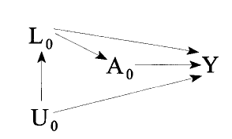
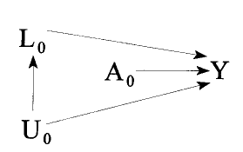
Marginal Structural Models in Point-Treatment Studies (8)
Causal diagram view of the effect by inversed probability weighting (IPTW)
No Confounding by L₀ in the psudopopulation and thus crude analysis in the psudopopulation generates unbiased effect estimate for A₀
Original study population
Weighted psudopopulation

Slide 43
Marginal Structural Models in Time-Dependent Treatments
Time-varying confounding by fragility fracture for the association between sequential osteoporosis treatment and the risk of serious infection
OP Treatment 1
Fragility Fracture
OP Treatment 2
Serious Infections
Unmeasured Confounders
Issue 1: Open the back-door path:
Treatment 1 → Fragility Fracture → Unmeasured confounders → Serious Infection
Issue 2: Blocked causal path:
Treatment 1→ Fragility Fracture → Treatment 2 → Serious Infection

Slide 44
Time-varying confounding by fragility fracture for the association between sequential osteoporosis treatment and the risk of serious infection
OP Treatment 1
Fragility Fracture
OP Treatment 2
Serious Infections
Unmeasured Confounders
MSM weights each patients by the stabilized weight (SW_{i}) of treatment and creates a “pseudopopulation”, where measured confounders are not predictive of treatment assignment and thus, crude analysis will generate unbiased effect estimate

Slide 45





Marginal Structural Models in Time-Dependent Treatments (6)
Pooled logistic regression model that treats each person-day as an observation can be used to estimate SW_{i}
  Denominator:
  Numerator:
  Output the estimated and
  for each patient.

Slide 46
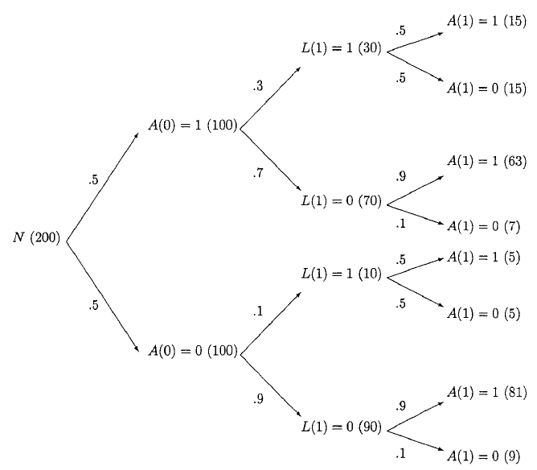
Marginal Structural Models in Time-Dependent Treatments (8)
[A(0), L(1), A(1)] | No | W | N_{W} | f[A(1)|A(0), L(1)} weighted by N_{W} | f[A(1)|A(0)] f [A(0)] | SW | N_{SW} | f[A(1)|A(0), L(1)} weighted by N_{SW}
(1,1,1) | 15 | 1/(0.5*0.5)=4 | 15 | 50% | 0.78*0.5=0.39 | 1.56 | 23.4 | 78%
(1,1,0) | 15 | 1/(0.5*0.5)=4 | 15 |  | 0.22*0.5=0.11 | 0.44 | 6.6
(1, 0,1) | 63 | 1/(0.5*0.9)=2.2 | 35 | 50% | 0.78*0.5=0.39 | 0.87 | 54.6 | 78%
(1, 0,0) | 7 | 1/(0.5*0.1)=20 | 35 |  | 0.22*0.5=0.11 | 2.2 | 15.4
(0,1,1) | 5 | 1/(0.5*0.5)=4 | 5 | 50% | 0.86*0.5=0.43 | 1.72 | 8.6 | 86%
(0,1,0) | 5 | 1/(0.5*0.5)=4 | 5 |  | 0.14*0.5=0.07 | 0.28 | 1.4
(0, 0,1) | 81 | 1/0.5*0.9)=2.22 | 45 | 50% | 0.86*0.5=0.43 | 0.95 | 77.4 | 86%
(0, 0,0) | 9 | 1/(0.5*0.1)=20 | 45 |  | 0.14*0.5=0.07 | 1.4 | 12.6
*W=1/{f[A(1)|L(1), A(0)]f[A(0)]}, SW={f[A(1)|A(0)]f[A(0)]} /{f[A(1)|L(1), A(0)]f[A(0)]}

Slide 47
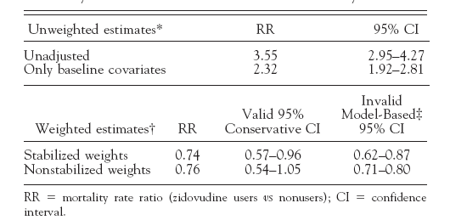
Example: Hernan et al, Epidemiology, 2000
Marginal structural Cox proportional hazards model was used to estimate the causal effect of zidovudine on the mortality of HIV-positive men
CD4 lymphocyte count is both a time-dependent confounder of the causal effect of zidovudine on mortality and is affected by past zidovudine treatment.

Slide 48
References:
Hernán M, Brumback B, Robins JM. (2000). Marginal structural models to estimate the causal effect of zidovudine on the survival of HIV-positive men. Epidemiology, 11(5):561-570.
Robins JM, Hernán M, Brumback B. (2000). Marginal structural models and causal inference in epidemiology. Epidemiology, 11(5):550-560.
Robins JM. (1999). Marginal Structural Models versus Structural Nested Models as Tools for Causal Inference. Statistical Models in Epidemiology: The Environment and Clinical Trials. M.E. Halloran and D. Berry, Editors, IMA Volume 116, NY: Springer-Verlag, pp. 95-134.
Robins JM. (1998). Marginal structural models. 1997 Proceedings of the American Statistical Association. Section on Bayesian Statistical Science, pp. 1-10. Reproduced courtesy of the American Statistical Association.
Dr. James Robins’ Research webpage: http://www.biostat.harvard.edu/~robins/research.html

Slide 49
Strategies to Reduce Confounding When Confounders are Unmeasured
Unmeasured Confounders
Measurable in sub-study
- 2-stage sample
- External adjustment
- Imputation
Unmeasurable
- Cross-over analysis
- Instrumental variables
- Etc
Figure adapted from a presentation made by Sebastian Schneeweiss, ICPE, Chicago 2011

Slide 50



Defining a Preference-Based Instrumental Variable
Low GI Risk
Moderate GI Risk
High GI Risk
“Marginal Patient”
NS NSAID
COXIB
COXIB
COX-2 Preferring Physician
NS NSAID
NS NSAID
COXIB
NS NSAID Preferring Physician
Slide Courtesy of Alan Brookhart, UNC

Slide 51
Preference-Based Instrumental Variable
Treatment
Treatment = ?
Index Patient’s IV is
Previous Patient’s Treatment
Previous Patient
Treated with NSAIDs
Index Patient
Time
Slide Courtesy of Alan Brookhart, UNC

Slide 52
Characteristics of An Instrumental Variable
Example: Physician Preference (e.g., last patient’s prescription)
Unrelated to index pt’s risk factors
Instrument
Last patient’s treatment
Confounders
Z
C
Correlated with index pt’s treatment
Related to outcome
only through association
with treatment
X
Y
Treatment
Outcome

Slide 53
IV Analysis Methods
X is received treatment
Y is outcome
Z is IV
IV estimate (α_{iv}) is the intent-to-treat estimate of the effect of IV (numerator), weighted by the strength of IV in predicting received treatment (denominator)
Notes:
Numerator is the intention to treat (ITT) estimate of the risk difference
Denominator is estimate of the effect of the instrument on treatment
on the risk difference scale

Slide 54
Constructing an IV from a Database
Patient (PATID)
Index Date
Physician (DEA)
Prior fill date
Prior fill date
Prior fill date
Prior fill date
Index Date
IV: Rx on the fill date prior to index date

Slide 55
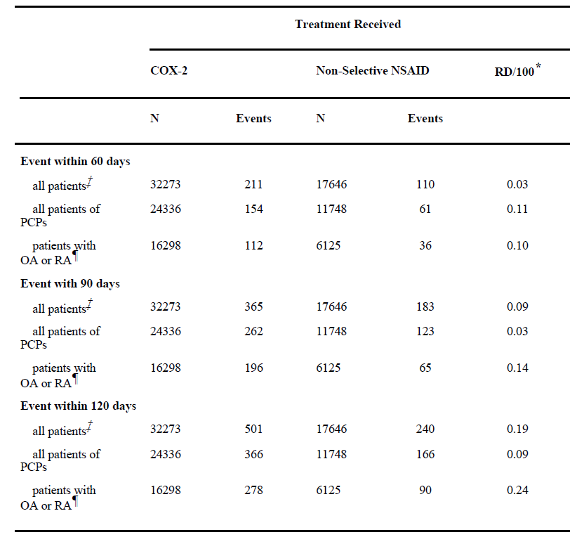
Use of COX-2 inhibitors vs. non-selective NSAIDS and risk of GI toxicity: An example of confounding by indication (CBI)
*risk of outcome per 100 patients treated with a COX-2 minus risk of outcome per 100 patients treated with a non-selective NSAID
Brookhart et al, Epidemiology 2006 ;17(3):268-75.

Slide 56
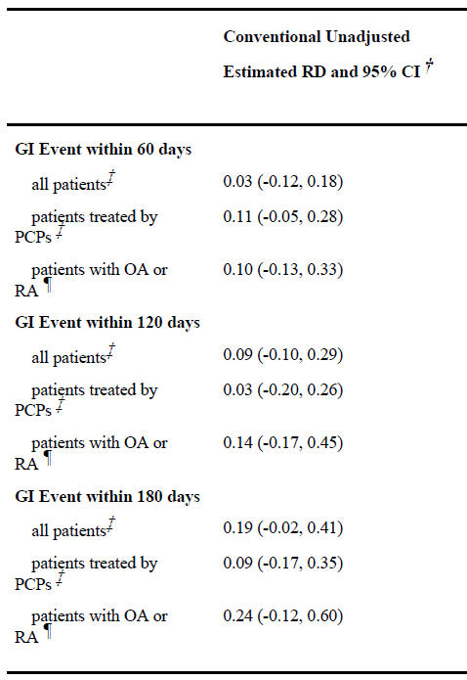
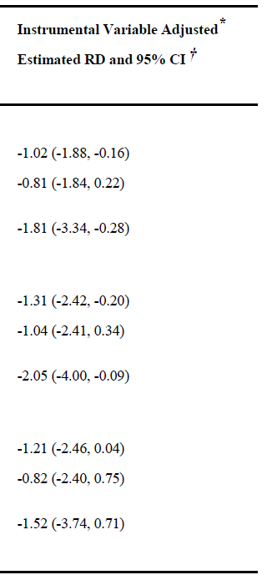
Use of COX-2 inhibitors vs. non-selective NSAIDS and risk of GI toxicity: After adjusting for confounding by indication
*risk of outcome per 100 patients treated with a COX-2 minus risk of outcome per 100 patients treated with a non-selective NSAID
Brookhart et al, Epidemiology 2006 ;17(3):268-75.

Slide 57
Strategies to Reduce Confounding When Confounders are Unmeasured
Unmeasured Confounders
Measurable in sub-study
- 2-stage sample
- External adjustment
- Imputation
Unmeasurable
- Cross-over analysis
- Instrumental variables
- Etc
Figure adapted from a presentation made by Sebastian Schneeweiss, ICPE, Chicago 2011

Slide 58
Incident User Cohort Design – Overview
Alternatively called “new user design”, “initiator cohort design”, “intent-to-treat analysis”, etc
Identify all patients in a defined population who start a course of treatment with the study drugs.
  Restricted to patients with a minimum period of nonuse (washout) prior to the start of treatment (index date)
Covariates evaluated during the washout period
Follow up for endpoints starting from the initiation of the treatment until censoring by disenrollment, death or occurrence of the endpoint (if incident case is of interest)
Analysis of data is similar to the way for clinical trials
  The index date is randomization

Slide 59
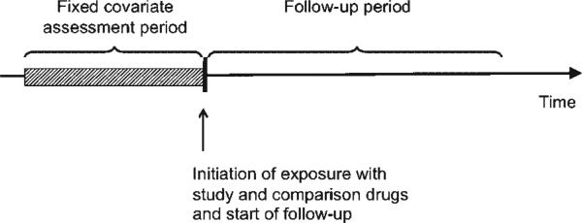
Incident User Cohort Design – Overview

Slide 60
Incident User Cohort Design – Advantages
Patients in the study cohort and comparator cohort(s) were equally evaluated and likely similar in characteristics
Clear temporal sequence of confounder adjustment before treatment initiation avoids adjustment for mediators
Identifying two active treatment groups reduces the chances of immortal time bias associated due to inclusion of “non-user” comparison group
Well-defined starting point of initiation cohorts makes it possible to assess whether and how incidence vary over time.
Avoid comparing a population predominantly composed of first-time users of a new drug with a population predominantly composed of prevalent users of an old drug.

Slide 61
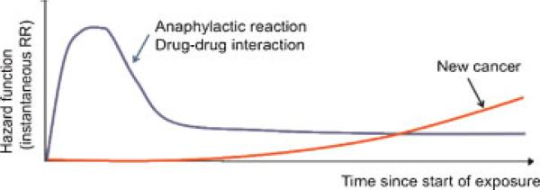
Incident User Cohort Design – Advantages

Slide 62
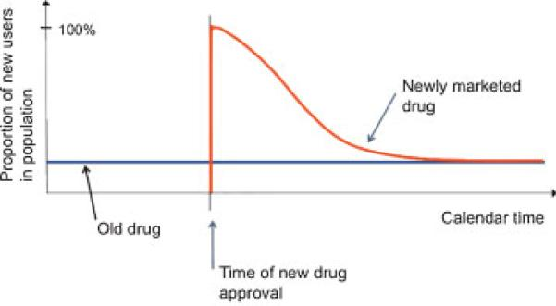
Incident User Cohort Design – Potential Advantage

Slide 63
Incident User Cohort Design – Potential Limitation
Misclassification of exposure due to switched treatment during follow-up
Exclusion of prevalent users reduces study sample size
For studies of second-line treatments in chronic conditions, only patients who switch from one drug to another can be studied due to small number of treatment-naïve patients
  Switching likely determined by disease progression and treatment failure or side effects
  Fair treatment comparison can still be achieved by comparing new switchers to study drug and those to comparison drug
  Example: Among methotrexate uses, compare new switchers to two biological disease modifying (BDM) anti-rheumatic drugs

Slide 64
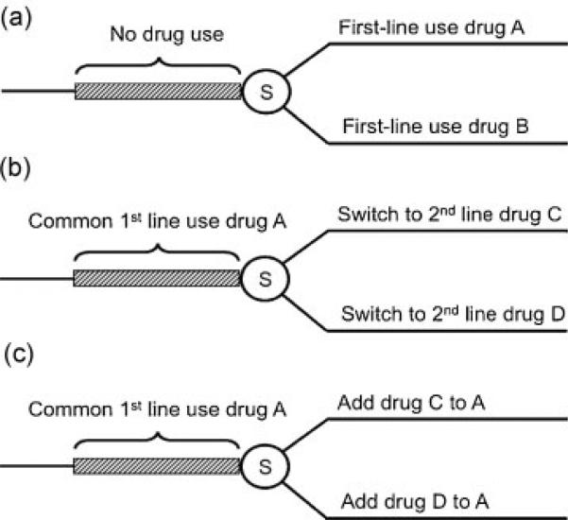
Incident User Cohort Design – Potential Limitation

Slide 65
Incident User Cohort Design – Exposure Risk window
The exposure risk window depends on pharmacokinetics and pharmacodynamics of the drug and study outcome
Exposure risk window can be varied to assess the most likely underlying risk window

Slide 66
Incident User Cohort Design – Balancing Patient Characteristics
Propensity score methods (matching, adjustment, stratification, weighting) can be used to balance large numbers of baseline covariates efficiently
Similar to randomization, propensity score matching creates two study cohorts balanced with regard to measured confounders.
In case of substantial to full separation of comparison cohorts, propensity score matching serves as an important diagnostic as to whether a specific comparison can be validly made.

Slide 67
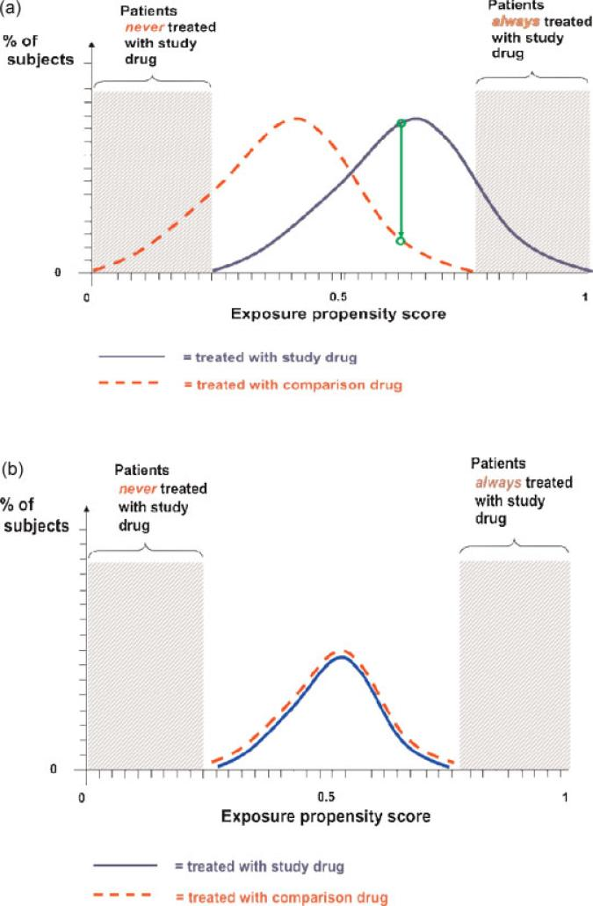
Incident User Cohort Design – Balancing Patient Characteristics 2

Slide 68
Incident User Cohort Design – Statistical Analysis
Propensity score matched study can be analyzed as RCTs
  2 x 2 tables
  Kaplan-Meier plots and log rank tests
  Multivariate adjusted regression model
Sensitivity analysis
  Vary time assumptions
    length of wash-out period
    length of exposure risk window
  Assess potential for exposure misclassification
    as-treated analysis allowing exposure status to vary over time

Slide 69
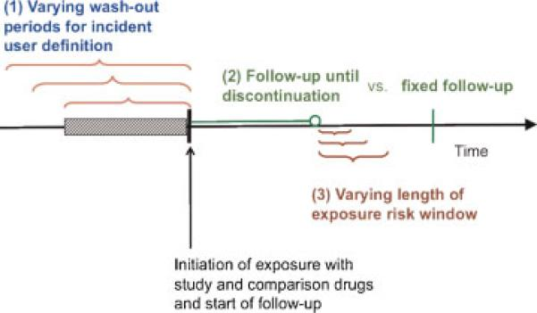
Incident User Cohort Design – Statistical Analysis

Slide 70
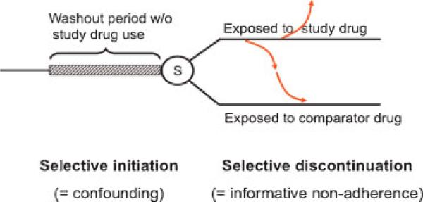
Misclassification of Exposure Status due to Treatment Switching

Slide 71
Alternatively, As-treated Analysis Based on Switched Treatment Status
Days supplied
30 days
1-year
Treatment B
End of follow-up
On-treatment period
Post-treatment period
Days supplied
30 days
1-year
Treatment A
End of follow-up
On-treatment period
Post-treatment period
Time at risk following no Treatment
Time at risk following A only
Time at risk following A and B
Time at risk following B
As-treatment Analysis is Limited in Control for Confounding because factors associated with treatment switching may not be completely adjusted for

Slide 72
Supplemental Data Collection Complements Existing Databases
Pros: Readily Available and Inexpensive
Cons: Data collected for administrative purposes rather than research → Limited validity
Healthcare Insurance Claims databases
Electronic Medical Records databases
National Healthcare Registries
Project-Specific Data Collection
Medical Record Review
Linkage to Disease Registries
Patient/
Physician survey
National Death Index Search, etc.
Notes:
Clinical research relying on readily available, inexpensive data originally collected for administrative or billing purposes or both has increased exponentially. Yet the inherent limitations of these administrative databases should not be ignored. Large administrative data sets are assembled from data originally intended for billing purposes. Not surprisingly, many diagnostic procedures are systematically underreported because there is no financial incentive to document them. On the other hand, diagnoses codes representing rule/out diagnosis may also be reflected in claims data if they are associated with reimbursement.
Although systematic undercoding of certain diagnostic procedures poses a major problem, all studies may not be affected to the same degree. High-revenue invasive diagnostic procedures (ie, cardiac catheterization, gastrointestinal endoscopy) are well captured in billing data and likely yield valid research studies.⁵ However, less-costly, noninvasive studies (ie, computed tomographic scans, electrocardiography, and ultrasound) are rarely, if ever, captured. Furthermore, the validity of the diagnosis may also be affected by the setting in which medical care was provided. For instance, inpatient diagnosis may carry higher reliability than outpatient daignosis.
Although imperfect, administrative data play an important role in health services research. Yet the data need to be better. Rather than abandon the use of administrative data or mandate the collection of additional data such that administrative data more closely resemble the electronic health record, researchers can leverage electronic health records to supplement administrative data with more detailed clinical information, as is currently done with the Surveillance, Epidemiology, and End Results (SEER) cancer registry and Medicare claims file data. Researchers and policy makers should transparently acknowledge the inherent limitations of administrative data and explore how those limitations may influence the inferences they make.

Slide 73
Coded Medical Data are Susceptible to Errors
Final common issue:
Coding
Diagnostic accuracy
Careful documentation
Clinical trial adverse event form
  Investigator verbatim term → Coded term
Medical encounter
Medical record
Billing record
Coded terms
Non-medical reporter
Postmarketing adverse event form
  Narrative text → Event terms identified → Coded terms
Fidelity of reporting
adverse events
Accuracy of verbatim terms
Extent of billing
Accuracy
Correct identification of medical terms in narrative
Slide adapted from Gerald Dal Pan

Slide 74
Challenges in Medical Event Identification from Existing Databases
A clinical event might not be recognized or diagnosed accurately
A clinical event might not be recorded in the medical record
A clinical event might not be reported as an adverse event (not relevant for claims data)
A clinical event might not be captured in billing data
An unconfirmed clinical event could be captured in billing data (“Rule out…”)
Coding serves many purposes
Balancing tradeoffs:
  Code-based outcome definitions that increase sensitivity typically do so at the expense of positive predictive value
  Code-based outcome definitions that increase positive predictive value typically do so at the expense of sensitivity
Slide adapted from Gerald Dal Pan

Slide 75
Performance of Outcome Identification Algorithms based on Existing Databases Varies
Adverse Events of Special Interest | Data System | Overall PPV
Fracture healing complications | Danish national registries | 72%
 | Swedish national registries | 60%
 | Norwegian national registries | 57%
Hypocalcemia leading to hospitalization or ER visit | United Healthcare | 40% overall
 |  | 82% for cases leading to ER visit
Dermatologic adverse events leading to hospitalization | United HealthCare | 70%
 | Danish national registries | 86%
 | Norwegian national registries | 33%
 | Swedish national registries | 15%
Hypersensitivity leading to hospitalization or ER visit | US Medicare | 76%
 | Danish national registries | 14%
 | Swedish national registries | 17%
 | Norwegian national registries | 0%
Osteonecrosis of the Jaw | US Medicare | 7%
 | Danish national registries | 33%
 | Swedish national registries | 8%
ER = emergency room; PPV = positive predictive value; US = United States
Supplemental Data Collection is Sometimes Necessary to Ensure Study Validity

Slide 76
Identification of Potential ONJ Events
ICD-9 codes | Description |  | ICD-10 codes | Description
526.4 | Inflammatory conditions of jaw |  | K046x | Periapical abscess with sinus
522.7 | Periapical abscess with sinus |  | K102x | Inflammatory conditions of jaws, including osteitis of jaws; osteomyelitis of jaws; periostitis of jaws; sequestrum of jaw bone
526.5 | Alveolitis of jaw |  | K103x | Alveolitis of jaws
733.45 | Aseptic necrosis of bone, jaw (introduced Oct 2007) |  | M87.0 | Idiopathic aseptic necrosis of bone
 |  |  | M87.1 | Osteonecrosis due to drugs
 |  |  | M87.2 | Osteonecrosis due to previous trauma
 |  |  | M87.3 | Other secondary osteonecrosis
 |  |  | M87.8 | Other osteonecrosis
 |  |  | M87.9 | Osteonecrosis, unspecified

Slide 77
Medical Chart Abstraction
Who will do it? | Study investigator or a 3rd party abstractor contracted with the investigator
From whom? | Healthcare providers who have made a diagnosis of ONJ as recorded in a claims or EMR database and who are likely to have medical records related to the ONJ diagnosis. Preferred providers may include inpatient hospitals specialists physicians providing long-term and/or frequent medical services
What time frame? | All requested medical records over a period from 3 months before the purported diagnosis date to the later of 3 months after the diagnosis date or end of hospitalization
What is to be collected? | Hospital admission note and discharge summary Emergency room report Outpatient physician visit note Critical care consult note Specialist consult note Laboratory test report Radiographic report Medication administration record
How? | Abstractor will contact providers requesting photocopies of relevant medical records in Medicare and abstract key medical information related to ONJ using standardized forms in Scandinavian National registries

Slide 78
An Example of Medical Record Abstraction from a Potential ONJ Case …
Identification of claims with ICD-9 733.45 (Aseptic necrosis of bone, jaw) on July 5, 2011, July 10, 2011 and August 21, 2011
Review of claims history: claim on July 10, 2011 refers to an inpatient hospitalization to Hospital A and is the most relevant for chart abstraction
Investigator send contact information of Hospital A to contracted abstractors
Medical records may include:
Outpatient visit note
X-ray report
Lab test results
Referral note
Outpatient specialist consulting note
Outpatient medical procedures and drug prescriptions
Hospital admission summary
Inpatient Medical procedures and drug prescriptions
Surgery notes and summary
Inpatient specialist consulting notes
Discharge summary …
Abstractor contacts the Hospital A and collects photocopies of all relevant medical record from April 10 until Oct 10, 2010
Abstract sends all photocopies of medical records or completed abstraction form to coordinating center
Abstractor abstracts key information related to ONJ diagnosis according to the standardized form

Slide 79
Ascertainment of Exposure in Electronic Healthcare Databases
Relies on coding systems which are often based on health insurance claims
  National Drug Classification (NDC) Codes
    Oral medications and non-oral medications dispensed at the pharmacy
    10-digit unique numeric code assigned to each medication
  Healthcare Common Procedure Coding System (HCPCS)
    Non-oral medications administered by the provider
    Identifies a category of products (e.g., chemotherapy) and not specific brand/trade names

Slide 80
Challenges in Ascertainment of Injectable Agents
Agents billed using miscellaneous codes
  Newly approved agents
  Agents not meeting requirements for assignment of a permanent HCPCS code
  NDC code may or may not be included on the same claim line as the HCPCS/CPT code to identify a specific brand/trade name
Product-specific codes may be shared by different dosages or formulations of the same drug
Issues
  Misclassification of exposure
  Challenges in assessing medication utilization (e.g., off-label use)

Slide 81
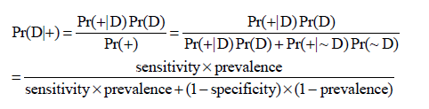
Outcome misclassification
High specificity translates into high PPV
Is PPV important?

Slide 82
Example
Cohort study:
  100 exposed give rise to 40 cases (risk=0.4)
  200 unexposed give rise to 20 cases (risk=0.1)
  Risk ratio = 0.4/0.1 = 4
  Risk difference = 0.4-0.1 = 0.3
Outcome measured with high specificity (100%), limited sensitivity (70%)
  Exposed cases = 0.7*40 = 28, risk = 0.28
  Unexposed cases = 0.7*20 = 14, risk = 0.07
  Risk ratio = 0.28/0.07 = 4
    Note, RR is unbiased
  Risk difference = 0.28-0.07 = 0.21
    Note, this is risk difference*sensitivity (0.7*0.3)
No Bias

Slide 83
Same Example, Different Test
Cohort study:
  100 exposed give rise to 40 cases (risk=0.4)
  200 unexposed give rise to 20 cases (risk=0.1)
  Risk ratio = 0.4/0.1 = 4
  Risk difference = 0.4-0.1 = 0.3
Outcome measured with high sensitivity (100%), limited specificity (80%)
  Exposed cases = 40+ (1-0.8)(100-40) = 52, risk = 0.52
  Unexposed cases = 20+(1-0.8)(200-20) = 56, risk = 0.28
  RR = 0.52/0.28 = 1.9
  Risk difference = 0.52-0.28 = 0.24
    Note this is risk difference*specificity (0.3*0.8)
Bias
Low sensitivity but not low specificity is OK for RR determination

Slide 84
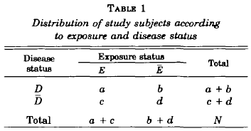
Assess Effect of PPV on Outcome
Assumes
Non-differential misclassification of outcome
  Independent of individual exposure status
Also
  No exposure misclassification
  No confounding
  No selection bias
  No heterogeneity
Green et al, American Journal of Epidemiology 1983, Vol 117, No. 1

Slide 85
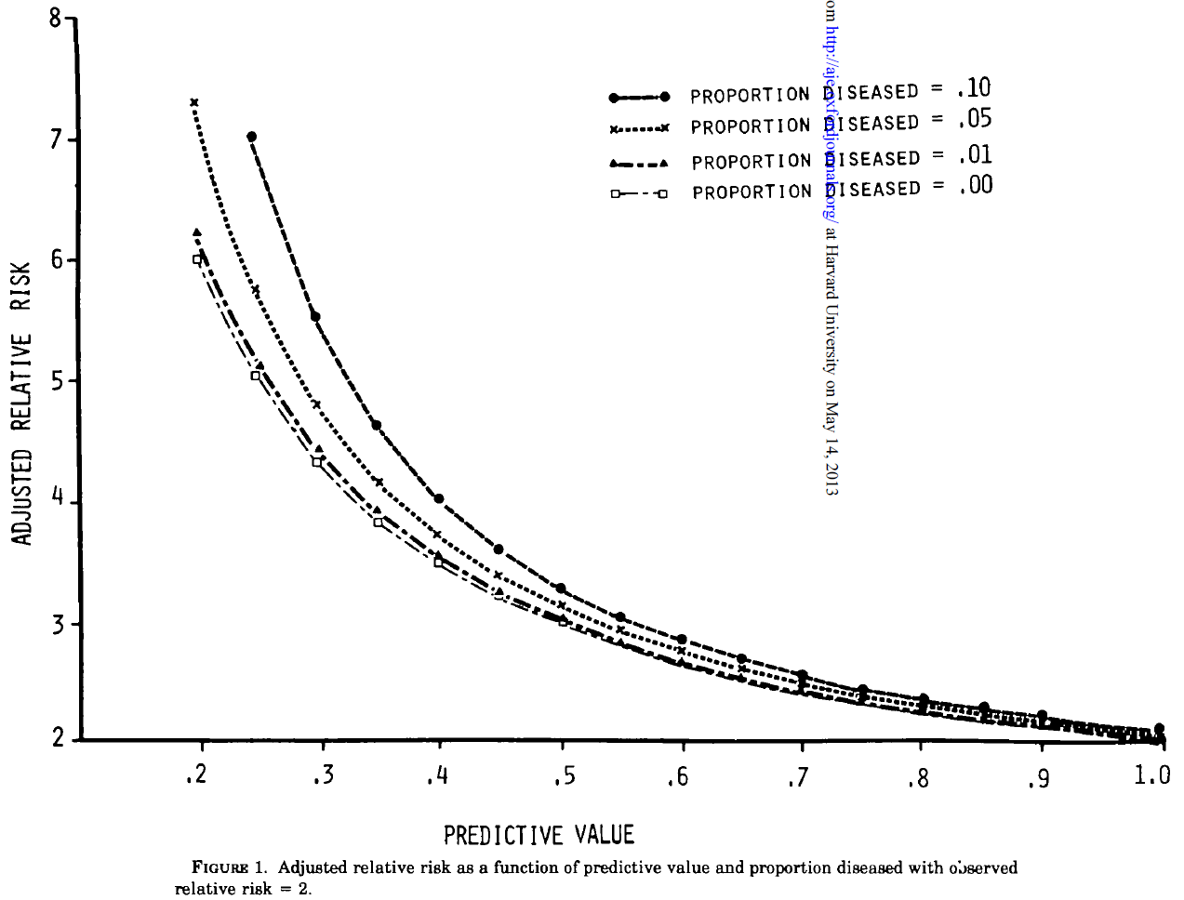
DDDD
D
D
D
D

Slide 86
Seek high specificity in outcome ascertainment, which leads to unbiased RR
Slide adapted from John Seeger

Slide 87
Summary
Causal diagram is a useful method to identify potential confounders that need to be adjusted for in pharmacoepidemiologic studies
Various study designs and statistical methods can be leveraged to address measured and unmeasured confounding
Some of the challenges related to data availability can be addressed by supplemental data collection or algorithms developed based on available information
Quality and validity of a study is ultimately decided by the quality and availability of data.

Slide 88
Thank you!
Questions?

Slide 89
backup

Slide 90
External Covariate Adjustment - Overview
Claims data studies is limited by incomplete capture of potential confounders
  Markers of disease severity
  BMI
  Smoking status
  Functional status
  Lab values, etc
When additional information is available through survey or medical chart review, external adjustment can be performed to estimate the strength of unmeasured confounding.

Slide 91
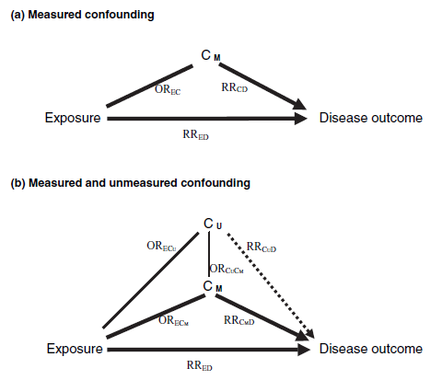
External Covariate Adjustment – Measured vs. Unmeasured Confounding
Confounding exists only if OR_{EC} ≠ 1 and RR_{CD} ≠ 1

Slide 92
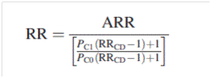
External Covariate Adjustment – Array Approach (1)
To estimate the true or fully adjusted RR assuming an apparent relative risk (ARR), a prevalence of unmeasured confounder in the unexposed (P_{C0}) and exposed (P_{C1}), and the association between unmeasured confounder and outcome (RR_{CD}).
  C₀, C₁ and RR_{CD} are assessed through medical record review or patient survey
  It has been proved that

Slide 93
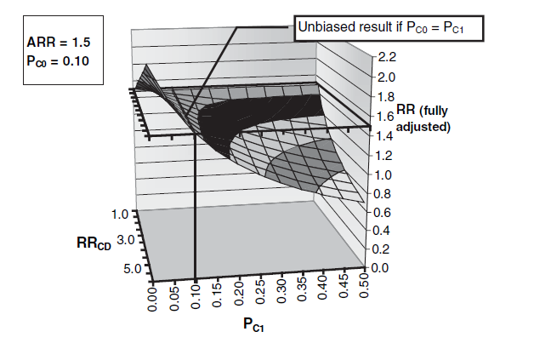
External Covariate Adjustment – Array Approach (2)

Slide 94
External Covariate Adjustment – Other Methods and Resources
Algebraic solution for single binary confounders
Multiple confounders of various distributions
Simulation-based sensitivity analysis
For array approach, rule out approach and algebraic solution, spread-sheets with example data can be downloaded at htttp:www.drugepi.org

Slide 95
Confounding
Conventional criteria for confounding factor¹
  The variable is a cause of outcome
  The variable is associated with exposure
  The variable is not an effect of exposure or outcome
C
E
D
1. Greenland et al, Epidemiology 1999

Slide 96
Confounding
Conventional criteria for confounding factor¹
  The variable is a cause of outcome
  The variable is associated with exposure
  The variable is not an effect of exposure or outcome
C
E
D
1. Greenland et al, Epidemiology 1999

Slide 97
Confounding
Conventional criteria for confounding factor¹
  The variable is a cause of outcome
  The variable is associated with exposure
  The variable is not an effect of exposure or outcome
U
C
E
D
1. Greenland et al, Epidemiology 1999

Slide 98
Control for Confounding Factor
Stratification, Matching or Weighting by Confounding Factors
U
C
E
D
Adjustment of Confounding Factor in Modeling
U
C
E
D
RR_{ED|C} is a valid estimator of the causal effect of E on D

Slide 99
Control for Collider
Stratification, Matching, or Weighing by or Adjusting for a Collider
E
D
U
C
RR_{ED|C} includes a spurious effect (non-causal) between of E on D by opening a back-door path from E to D

Slide 100
Control for Mediator (1)
Stratification, Matching or Weighing by Mediating Factors
E
C
D
Adjustment of Mediating Factor in Modeling
E
C
D
RR_{ED|C} underestimates the overall causal effect of E on D by excluding effect mediated by C

Slide 101
Control for Mediator (2)
Stratification, Matching, or Weighing by or Adjusting for Mediating Factors, which is also Confounded by Unmeasured Factors
U
E
C
D
RR_{ED|C} includes a spurious effect (non-causal) between E and D by adjusting for a collider

Slide 102
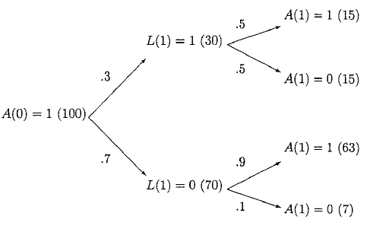
Marginal Structural Models in Point-Treatment Studies (7)
[L(1), A(1)] | No | W | N_{W} | f[A(1)|L(1)] weighted by N_{W} | f[A(1)] | SW | N_{SW} | f[A(1)|L(1)] weighted by N_{SW}
(1,1) | 15 | 1/0.5=2 | 15 | 50% | 0.78 | 1.56 | 23.4 | 78%
(1,0) | 15 | 1/0.5=2 | 15 |  | 0.22 | 0.44 | 6.6
(0,1) | 63 | 1/0.9=1.11 | 35 | 50% | 0.78 | 0.87 | 54.6 | 78%
(0,0) | 7 | 1/0.1=10 | 35 |  | 0.22 | 2.2 | 15.4
*W=1/f[A(1)|L(1)], SW=1/{f[A(1)]/f[A(1)|L(1)]}

Slide 103
Change Treatment Exposure Over Time Poses Challenges for Comparative Effectiveness/Safety Studies
  Switching pattern more likely to be BP ⇒ Prolia
  Duration of BP effect unknown and may be irreversible
  Carry-over effects impact assessment of treatment effects (impacts events of long latency)
Notes:
Carry-over effects impact assessment of treatment effects
Unbalanced switching pattern may introduce bias
A more serious problem for AESI with long latency
Proposed analytical approaches
Cox regression with time dependent exposures and covariates
Stratification by previously received treatment

Slide 104
ONJ Validation in Sweden: Preliminary Results
Positive predictive value (PPV) and 95% confidence interval (CI) for ICD codes
ONJ related diagnoses in Patient Register | Potential cases | Cases confirmed by medical record review
 | Number | Number | PPV (%) | 95% CI
Any ONJ related diagnosis | 83* | 15 | 18 | 10-28
Periapical abscess with sinus (ICD-10 K04.6) | 20 | 0 | 0 | 0 - 17
Inflammatory conditions of jaws (ICD-10 K10.2) | 43 | 7 | 16 | 7-31
Alveolitis of jaws (ICD-10 K10.3) | 7 | 0 | 0 | 0 - 41
Idiopathic aseptic necrosis of bone (ICD-10 M87.0) | 0 | - | - | -
Osteonecrosis due to drugs (ICD-10 M87.1) | 6 | 5 | 83 | 36 - 100
Osteonecrosis due to previous trauma (ICD-10 M87.2) | 0 | - | - | -
Other secondary osteonecrosis (ICD-10 M87.3) | 0 | - | - | -
Other osteonecrosis (ICD-10 M87.8) | 3 | 0 | 0 | 0 - 71
Osteonecrosis, unspecified (ICD-10 M87.9) | 0 | - | - | -
Mixed groups
Inflammatory conditions of jaws (ICD-10 K10.2) + Osteonecrosis due to drugs (ICD-10 M87.1) | 3 | 3 | 100 | 29 - 100
Inflammatory conditions of jaws (ICD-10 K10.2) + Other osteonecrosis (ICD-10 M87.8) | 1 | 0 | 0 | 0 - 98
*Medical records for 83 (95%) of 87 identified potential cases in Sweden were obtained.
Notes:
The preliminary data from Denmark indicated that out of 40 potential cases,13 (PPV=0.325, 95% CI: 0.186-0.491) was confirmed through medical chart review.

Slide 105
ONJ Validation in US Medicare: Preliminary Results
 | Requested (n) | Obtained (n) | Retrieved (%) | Confirmed Cases | Confirmed (%)
Potential ONJ cases | 304 | 84 | 27.7 | 6 | 7.1
Periapical abscess with sinus (ICD-9 522.7) | 17 | <11 | - | 0 | 0
Inflammatory conditions of jaw (ICD-9 526.4) | 162 | 40 | 24.7 | 5 | 12.5
Alveolitis of jaw (ICD-9 526.5) | <11 | <11 | - | 0 | 0
Jaw pain, NOS (ICD-9 526.9) | 112 | 38 | 33.9 | 0 | 0
Aseptic necrosis of bone, jaw (ICD-9 733.45) | <11 | 4 | - | 1 | 25
Question: How to address the issue with low chart retrieval rate?
How to address the issue with low case confirmation rate?

Slide 106
Lessons Learned
Bone disorder diagnosis and treatment codes increase accuracy of densoumab-specific HCPCS codes, even in the absence of a denosumab 60 mg NDC code
Restriction to administration claims with cost reflecting the price of denosumab 60 mg increases the accuracy of non-specific HCPCS codes in identifying denosumab 60 mg use in conjunction with bone disorder diagnosis and treatment codes

