Slide 1
Course Schedule
Date | Instructor | Topic
01/07 | M. Kelsh | Class logistics, Intro History of Pharmacoepidemiology
01/14 | M. Kelsh | Study Design in Pharmacoepidemiology
01/21 | D. Kim | Pharmacoepidemiology: Data sources
01/28 | M. Sprafka | Pharmacoepidemiology and Drug Safety
02/04 | F. Xue | Advanced Methods/Analytical Approaches
02/11 | F. Callaghan M. Kelsh | Advanced Methods (cont.): Quantitative Bias Analyses, MetaAnalysis
02/18 | M. Smith M. Pinco | Benefit-Risk Analyses: A Primer for Pharmacoepidemiology Safety Data Systems
02/25 | M. Woolley | Health Economics
03/03 | D. Cher | Medical Devices, Pharmacoepidemiology and Regulatory Processes
03/10 | A. Liede M. Kelsh | Ethics in Pharmacoepidemiologic Research Class Summary

Slide 2
Take Home Quizes/Class Paper - Schedule
Date
Topic
Thursday February 11
Thursday February 11
Monday February 15
Thursday March 10
Wednesday March 16
Friday March 18
Midterm take-home Quiz
Paper Topics submitted
Turn in Midterm Quiz
Final take-home Quiz
Turn in Final Quiz
Paper due

Slide 3
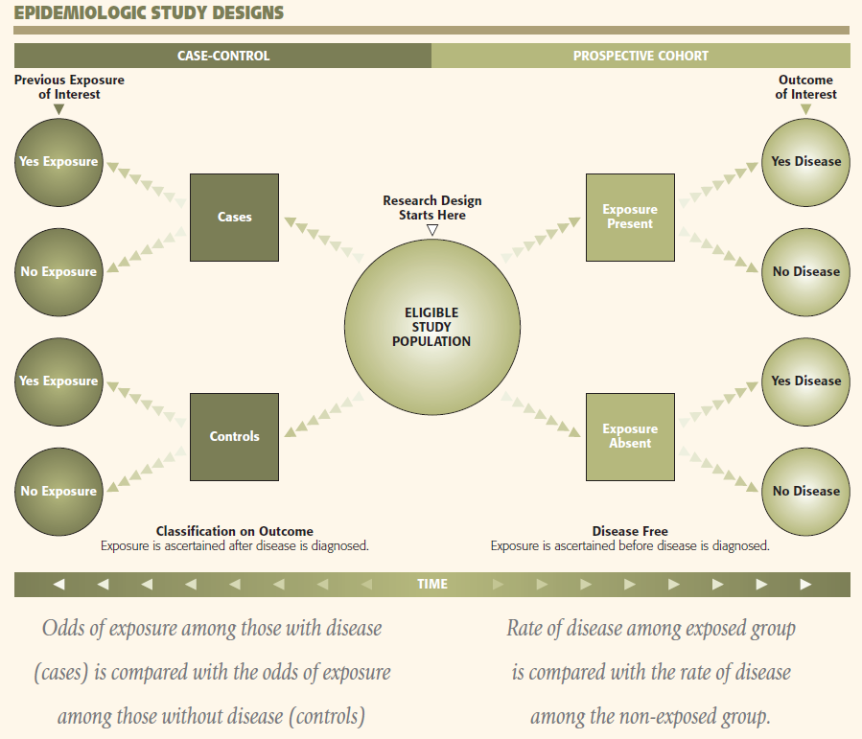

Slide 4
Risk Measures
Ratio of observed events to expected events
Ratio of disease rate in exposed group compared to disease rate in unexposed group
Many names:
  Odds ratio
  Rate ratio
  Risk ratio
  SMR, SIR
  PMR, PIR
  Prevalence ratio, incidence ratio
Difference measures:
  Absolute risk
  Risk difference
  Attributable risk

Slide 5
Multiple sources of systematic error (bias) in pharmacoepi studies
Selection Bias
  Referral Bias
  Self-Selection Bias
  Prevalence Bias
  Protopathic Bias
Misclassification
  Recall bias
  Detection bias
  Immortal time bias
Confounding
  By indication
  By co-medication

Slide 6
EPI 262:
Immortal Time Bias – Further Comments
Course Director: Michael A. Kelsh, MPH, PhD
Center for Observational Research, Amgen, Inc.
Department of Epidemiology and Biostatistics, UCSF

Slide 7
Important Bias in PE Studies:
Immortal Person Time Bias
“Span of cohort follow-up or observation time, which because of exposure definition, the study outcome or death cannot occur” – (Suissa 2008)
“Immortal time” – a period of follow-up during which by design, death or study outcome cannot occur (Levesque 2010)
In pharmacoepidemiology – happens when individual’s treatment status involves a delay or wait period (e.g. waiting for prescription after discharge)
Can be quite common in cohort studies of drug effects (Suissa, 2008)

Slide 8
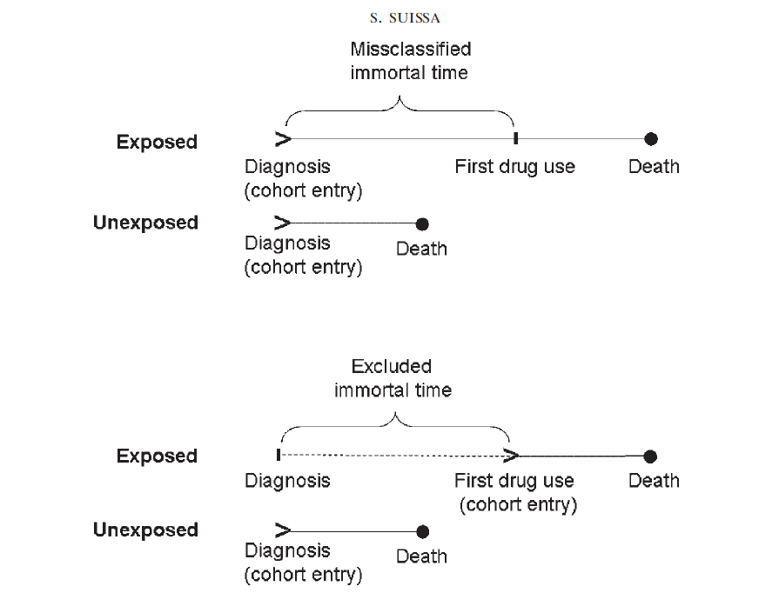

Slide 9
Immortal Person Time Bias
A misclassification bias when classifying the immortal time as treatment follow-up time – inflates the denominator – biases risk estimate towards the null
A selection bias when excluded immortal time leads to excluding individuals who do not receive treatment – bias could go in either direction
The amount of bias on the effect measures (e.g. HR) – will be dependent on the amount of immortal time misclassified
  Less impact on acute events

Slide 10
Identifying Immortal Time Bias (Levesque 2010)
Was treatment status determined after the start of follow-up, or defined using follow-up time?
Was the start of follow-up different for treated and untreated (comparator) groups?
Were treatment groups identified hierarchically (one group before the other)?
Were subjects excluded on the bases of treatement identified during follow-up
Was a fixed time analysis used?
  Fixed time refers to classifying exposed and unexposed time only in one group, cannot change over time

Slide 11
Immortal Time Bias – Examples
Statin use and reduction of the risk of diabetes progression (Levesque, 2010)
  Looked at time between statin use and initiation of insulin treatment
Use of corticosteriods to prevent mortality due to COPD compared with use of bronchodilators
  More time between diagnosis of COPD and corticosteriod use than diagnosis of COPD and bronchodilator use.
  Also – hierarchal example - corticosteriod use often followed bronchodilator use, from time of diagnosis, there is immortal time for corticosteriod use
Survival of heart transplant patients vs non-transplant patients
  similarly hematopoietic stem cell transplant patients

Slide 12
Analytical and Design Methods to Deal with Immortal Time Bias
Time Dependent analyses:
  Classify treatment time accurately
  Cox regression
  Other statistical techniques – Mantel Byar
Time-matched nested case-control studies within a cohort

Slide 13
