Slide 1
Directed Acyclic Graphs (DAGs) and
Causal Structures of Systematic Biases
Cindy Leung, ScD, MPH
Center for Health and Community
February 5, 2016

Slide 2
Agenda*
Introduction to causal inference
DAGs and confounding
1
2
3
4
Causal DAGs
DAGs and selection bias
*Material derived from Causal Inference chapters and lecture materials from Dr. Miguel Hernan

Slide 3

Revisiting Causal Effects
Neo takes the red pill
  Five minutes later, he dies
Had Neo not taken the red pill (and all other things being equal)
  Five minutes later, he would have been alive
Did the red pill have a causal effect?

Slide 4
Revisiting Causal Effects
Trinity takes the blue pill
  Five minutes later, she was alive
Had Trinity not taken the blue pill (and all other things being equal)
  Five minutes later, she would have been alive
Did the blue pill have a causal effect?

Slide 5
Revisiting Causal Effects
We compare…
  The outcome when the exposure is present
  The outcome when the exposure is absent
  Assuming all other conditions are equal
If these two outcomes differ, we say that the exposure had a causal effect on the outcome

Slide 6
Notation
For observed/actual data:
  Y=1 if participant died
  Y=0 if participant was alive
  A=1 if participant took the red pill
  A=0 if participant did not take the red pill
For ideal/counterfactual data:
  Y^{a=0}=1 if participant had not taken the red pill, he would have died
  Y^{a=1}=1 if participant had taken the red pill, he would have died
ID | A | Y^{a=0} | Y^{a=1}
Neo | 1 | 0 | 1
Trinity | 0 | 0 | 0

Slide 7
Counterfactual Outcomes
The potential outcomes that would have been observed under each possible treatment value
Or to put it another way…
The outcomes that would have been observed under a treatment value that the subject did not experience

Slide 8
Individual Causal Effects
ID | A | Y^{a=0} | Y^{a=1}
Neo | 1 | 0 | 1
Trinity | 0 | 0 | 0
Exposure had a causal effect if their outcome, had they been exposed, differs from their outcome, had they been unexposed
  Y_{i}^{a=1} ≠ Y_{i}^{a=0}
Generally cannot be determined

Slide 9


Exceptions…
Notes:
Exceptions: cross-over studies
Treatment is of short duration
Outcome is of abrupt onset and resolves by the next period
All prognostic factors remain the same

Slide 10
Average Causal Effects
Exposure had a causal effect if the average risk of the outcome had everyone been exposed, differs from the average risk of the outcome, had no everyone been unexposed
  Pr[Y^{a=1}] ≠ Pr[Y^{a=0}]
Can be determined in ideal randomized studies and in observational studies under strong assumptions

Slide 11
“Association is not causation”
Association: different risk in two disjoint subsets of the population determined by the subjects’ actual exposure value
  Pr[Y=1|A=1] is the risk of Y among those who were exposed (A=1)
  Pr[Y=1|A=0] is the risk of Y among those who were unexposed (A=0)
Causation: different risk in the entire population under two exposure values
  Pr[Y^{a=1}=1] is the risk of Y had the entire study population been exposed (a=1)
  Pr[Y^{a=0}=1] is the risk of Y had the entire study population been unexposed (a=0)

Slide 12
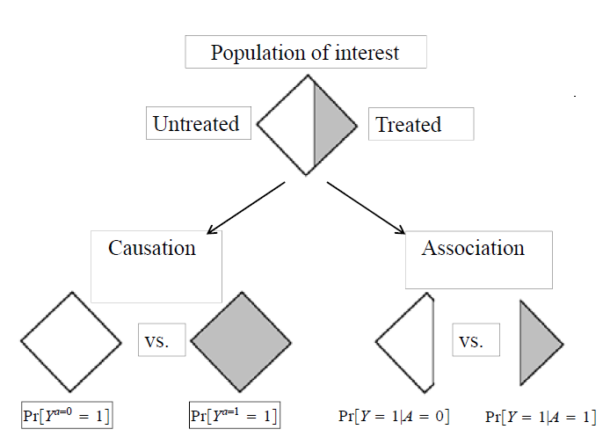
Notes:
Association compares 2 observed outcomes: the risk of the outcome among the exposed and the risk of the outcome among the unexposed
Causation compares 2 counterfactual outcomes: the risk of the outcome if everyone had been exposed and the risk of the outcome if everyone had been unexposed
Most observational studies are subject to confounding, biases, random error, which prevents us from determining counterfactual outcomes because the exposed and unexposed are not exchangeable
Strong assumptions needed to infer causation from measured association

Slide 13
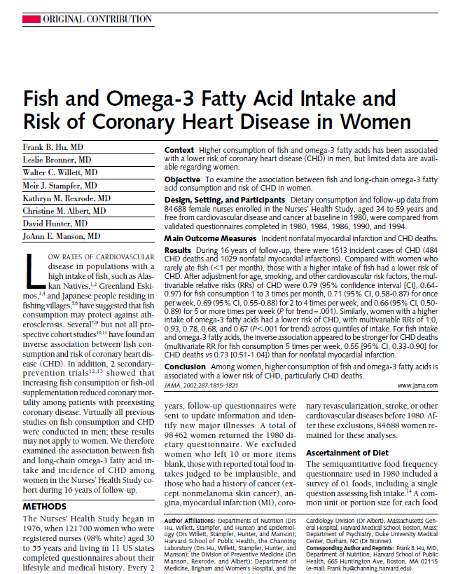

Slide 14
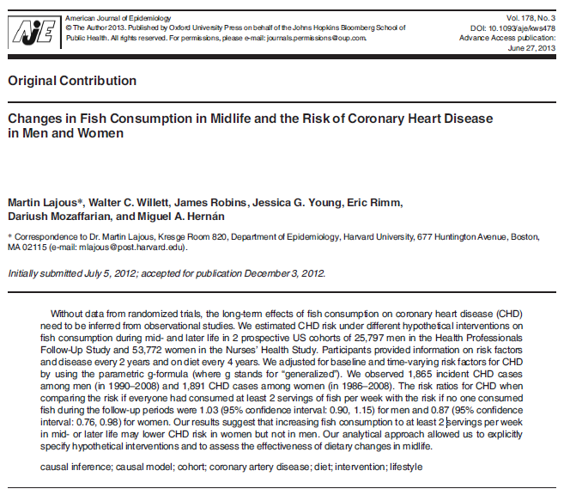

Slide 15
Assumptions for causal inference
Exchangeability
Positivity
Consistency (well-defined intervention)
No model misspecification

Slide 16
Exchangeability
The risk of the outcome in the exposed would have been the same as the risk of the outcome in the unexposed, had they been exposed
  And vice versa
The counterfactual outcome is independent of the exposure

Slide 17
Positivity
The probability of being exposed must be positive (>0)
  Pr[A=a|L=l] >0 when Pr[L=l] >0

Slide 18
Consistency
For each subject, their observed outcome is consistent with one of their counterfactual outcomes
More specifically, when the exposure is well-defined, the counterfactual outcome is well-defined.
  When the exposure is not well-defined, the counterfactual outcome is dependent on the exposure manipulation.
Notes:
Some examples:
Aspirin and heart attack
High sugar diet and diabetes
Gender and job discrimination
Smoking and lung cancer
BMI and mortality
Social status and general health

Slide 19


Consistency – some examples
Aspirin and heart attack
High sugar diet and diabetes
Gender and job discrimination
Smoking and lung cancer
High blood pressure and mortality
Social status and general health

Slide 20
In practice…
 | RCTs | Observational
Exchangeability | Expected to hold if randomization “works” and large sample size | Requires assumptions
Positivity | Expected to hold | Expected to hold/ Verifiable
Well-defined intervention | Expected to hold | Requires assumptions
Notes:
Exchangeability – no unmeasured confounders, same underlying population
Consistency – treatment and counterfactual outcomes are well-defined

Slide 21
Agenda
Introduction to causal inference
DAGs and confounding
1
2
3
4
Causal DAGs
DAGs and selection bias

Slide 22

Causal DAGs
D: Directed
A: Acyclic
G: Graphs
DAGs are used to:
  Think conceptually about causal inference
  Identify sources of bias in a study
  Identify approaches to study design and analysis to eliminate systematic bias and to help identify average causal effects
Notes:
Directed = arrows imply a direction of causation
Acylic = no cycles. The future cannot cause the past.

Slide 23
Examples of causal DAGs
Marginally randomized experiment
A Y
Conditionally randomized experiment
L A Y

Slide 24

Drawing causal DAGs
Identify all random variables of interest/ common causes of exposure and outcome
  A DAG is causal only if all common causes are shown
  Variables not common causes do not need to be shown
Variables drawn in temporal order
Draw arrows in direction of causation
Complete DAGs do not make any assumptions
Missing arrows convey expert knowledge about the association of interest

Slide 25
Two variables are associated if…
1) Direct causal effect
A Y A B Y
  A: high red meat intake Y: colorectal cancer
  B: heme iron

Slide 26
Two variables are associated if…
2) Shared common causes
L A Y
  A: A1 sauce Y: colorectal cancer
  L: high red meat intake

Slide 27
Two variables are associated if…
3) Conditioning on a common effect
  Sometimes called “collider bias”
A Y C
  A: raining Y: sprinkler turned on
  C: wet grass

Slide 28
Two variables are associated if…
3.1) Conditioning on the descendent of a common effect
A Y C L
  A: raining Y: sprinkler turned on
  C: wet grass L: slipped on the grass

Slide 29
d-separation terminology
Set of graphical rules to decide whether two variables are:
  Independent (d-separated)
  Associated (d-connected)
Path is any arrow-based route between two variables in the graph (regardless of arrow direction)
  Paths can be blocked or open according to a specific set of rules

Slide 30

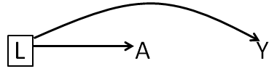

d-separation rules
A path is blocked:
  If there is a collider
  When conditioning on a non-collider

Slide 31

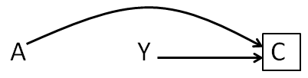
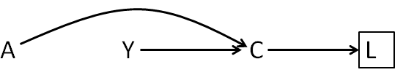
d-separation rules
A path is open:
  When no non-colliders have been conditioned
  When conditioning on a collider
  When conditioning on a descendent of a collider

Slide 32
In-Class Exercise
A Y
What do you conclude about A and Y?
D-SEPARATED/ INDEPENDENT

Slide 33
In-Class Exercise
What do you conclude about A and Y?
D-CONNECTED/ ASSOCIATED

Slide 34
In-Class Exercise
What do you conclude about A and Y?
D-SEPARATED/ INDEPENDENT

Slide 35
In-Class Exercise
U
What do you conclude about A and Y?
D-CONNECTED/ ASSOCIATED

Slide 36
In-Class Exercise
U₂
L A Y
U₁
What do you conclude about A and Y?
D-CONNECTED/ ASSOCIATED

Slide 37
In-Class Exercise
A B Y
What do you conclude about A and Y?
D-CONNECTED/ ASSOCIATED

Slide 38
In-Class Exercise
A B Y
What do you conclude about A and Y?
D-SEPARATED/ INDEPENDENT

Slide 39
In-Class Exercise
A Y L
What do you conclude about A and Y?
D-SEPARATED/ INDEPENDENT

Slide 40
In-Class Exercise
A Y L
What do you conclude about A and Y?
D-CONNECTED/ ASSOCIATED

Slide 41
In-Class Exercise
A
B
C
F
D
E
What do you conclude about A and F?
D-SEPARATED/ INDEPENDENT

Slide 42
In-Class Exercise
A
B
C
F
D
E
What do you conclude about A and F conditional on C?
D-SEPARATED/ INDEPENDENT

Slide 43
In-Class Exercise
A
B
C
F
D
E
What do you conclude about A and F conditional on B?
D-SEPARATED/ INDEPENDENT

Slide 44
In-Class Exercise
A
B
C
F
D
E
What do you conclude about A and F conditional on D?
D-CONNECTED/ ASSOCIATED

Slide 45
In-Class Exercise
A
B
C
F
D
E
What do you conclude about A and F conditional on E?
D-CONNECTED/ ASSOCIATED

Slide 46
In-Class Exercise
A
B
C
F
D
E
What do you conclude about A and F conditional on B and D?
D-SEPARATED/ INDEPENDENT

Slide 47
In-Class Exercise
A
B
C
F
D
E
What do you conclude about A and E?
D-CONNECTED/ ASSOCIATED

Slide 48
In-Class Exercise
A
B
C
F
D
E
What do you conclude about A and E conditional on D?
D-SEPARATED/ INDEPENDENT

Slide 49
In-Class Exercise
A
B
C
F
D
E
What do you conclude about A and (E and D) conditional on (B and C)?
D-SEPARATED/ INDEPENDENT

Slide 50
Agenda
DAGs and confounding
Introduction to causal inference
1
2
3
4
Causal DAGs
DAGs and selection bias

Slide 51
Confounders
Standard definition
  L is associated with A
  L is associated with Y independent of A
  L is not on the causal pathway between A and Y
Collapsibility definition
  L is a confounder if conditional on L, the association between A and Y is different from the unconditional association
Causal definition
  A variable that can be used to block a backdoor path
Notes:
Collapsibility definition – difference between conditional and unconditional measure may exist in the absence of common causes. Not all measures are collapsible. Or conditioning on common effects.
Causal definition – confounder label is relative to other variables being considered

Slide 52
Confounding
Bias due to common causes
  The exposed and unexposed are not exchangeable

Slide 53
Confounder?
U L A Y

Slide 54
Confounder?
U L A Y

Slide 55
So what?
We need expert knowledge to determine if we should adjust for a variable
  Statistical criteria are insufficient
Causal DAGs allow us to integrate expert knowledge into an analysis to identify true confounders

Slide 56
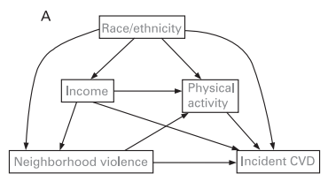
Neighborhood violence and CVD
X
X
X
Fleischer NL, Diez Roux AV. Using directed acylic graphs to guide analyses of neighbourhood effects: an introduction. JECH 2009.
Notes:
Simple DAG showing relationship between neighborhood violence and CVD.
Physical activity is an intermediate on the indirect causal pathway.
How does race/ethnicity affect neighborhood violence? CVD?
How does income affect neighborhood violence? CVD?
Which variables are necessary to control for confounding of the effect of neighborhood violence on risk of CVD?

Slide 57
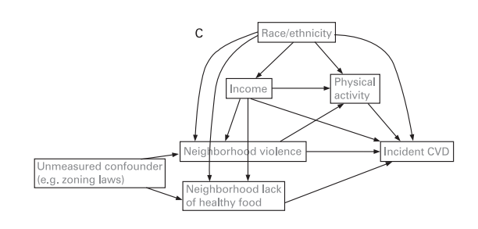
Neighborhood violence and CVD
Fleischer NL, Diez Roux AV. Using directed acylic graphs to guide analyses of neighbourhood effects: an introduction. JECH 2009.
Notes:
Variation of the same DAG showing an unmeasured confounder (zoning laws) as a common cause of neighborhood violence and neighborhood lack of healthy food.
Which variables are necessary to control for confounding of the effect of neighborhood violence on risk of CVD?

Slide 58
Control of confounding
In the design phase:
  Randomization
  Restriction
  Matching
In the analytic phase:
  Stratification
  IPW

Slide 59
Agenda
Introduction to causal inference
DAGs and confounding
1
2
3
4
Causal DAGs
DAGs and selection bias

Slide 60
Selection bias
Systematic bias due to the selection of subjects into the study or the analysis
  Conditioning on a common effect
    Survival
    Diagnosis with disease
    Selection into a study
    Complete data

Slide 61
Differential loss to Follow-Up
  L A C Y
U
A: Antiretroviral therapy
Y: AIDS
C: Lost during follow-up
L: CD4 count
U: Immunologic status
Notes:
Can happen in RCTs, cohort studies

Slide 62
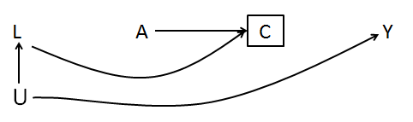
Volunteer/ self-selection
A: Smoking
Y: Heart disease
C: Volunteer to participate
L: Awareness of heart disease
U: Family history of heart disease
Notes:
Cannot occur in a randomized study because participants are randomized to treatment AFTER agreeing to participate

Slide 63
Control of selection bias
In the design phase:
  Sample controls in a manner that ensure that they represent the exposure distribution in the population
In the analytic phase:
  Stratification
  IPW

Slide 64
Confounding or Selection Bias?
L
C A Y
U
A: Physical Activity
Y: Heart disease
C: Being a firefighter
L: Parental SES
U: Attraction to activities that involve physical activity
Notes:
Confounding? No
Selection bias? Yes
Should you adjust for L?

Slide 65
Confounding or Selection Bias?
A₀ L₁ A₁ Y₂
U
A: Aspirin use
Y: Stroke
L: Gastrointestinal bleeding
U: Underlying health status
Notes:
Conditioning on the confounder not only creates selection bias but also prevents identification of the total effect of exposure
In general, stratification by intermediate variables to identify direct effects is dangerous

Slide 66
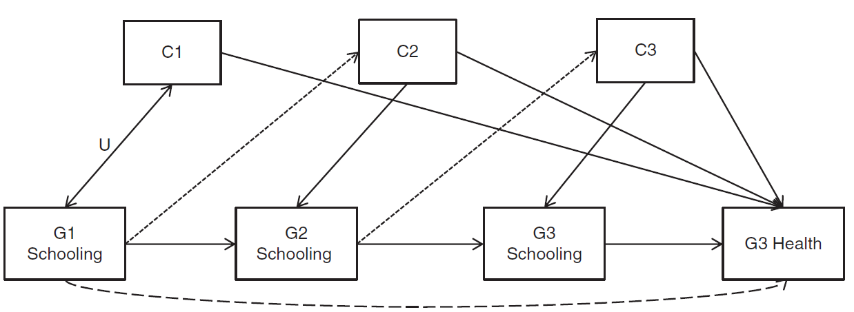
Example from HW
Which path is of greatest interest to the authors?
Notes:
C1: participant’s age, sex, household status, lived in same state as grandparent
C2: parental report of poverty in childhood, parents’ years of birth
C3: unmarried or teen mother at birth, childhood poverty, childhood health.

Slide 67
Example from HW
Identify any common effects.

Slide 68
Example from HW
What happens by conditioning on G2 and G3?

Slide 69
Importance of DAGs
Two distinct causal structures that lead to systematic bias:
  Confounding (common causes)
  Selection bias (conditioning on common effects)
Drawing DAGs help to provide a clear picture of the various biases that may be present in a study

Slide 70
Your turn!
You are part of a team evaluating the effects of a mindful eating intervention on excessive gestational weight gain. Women were not randomized though the intervention and control group differed only on parity.
Your PI suggests excluding women who developed gestational diabetes (measured at 24 weeks gestation) from the main analysis, even though they had complete follow-up through delivery.
1. Use a DAG to guide your decisions on which variables should be included in the main analysis of intervention effect on gestational weight gain.
2. Should cases of gestational diabetes be excluded from the analysis? Why/why not?

Slide 71
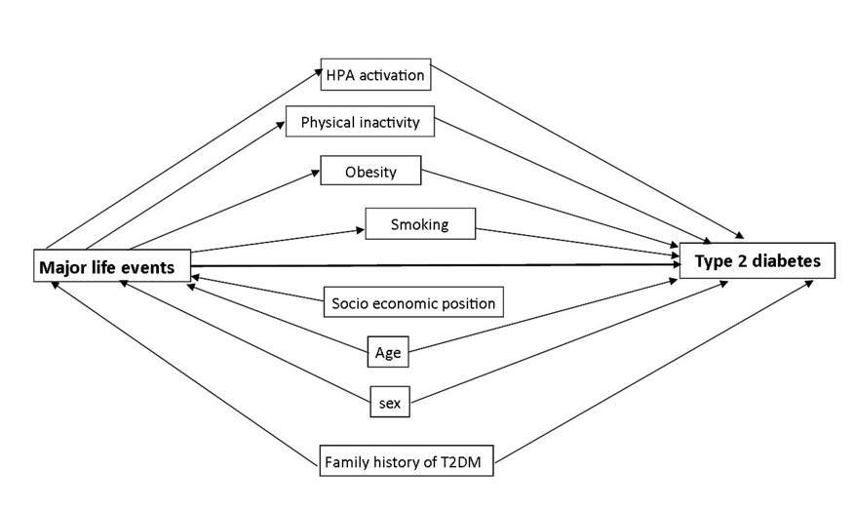
“Confounders were identified based on a prior knowledge and according to the directed acyclic graph method.”
Pedersen JM et al. Accumulation of major life events in childhood and adult life and risk of type 2 diabetes mellitus. PLoS One. 2015.
Notes:
Copenhagen City Heart Study (CCHS). 14,000 men and women.
Childhood MLE: long-term illness in parents, being placed in care outside of the home, serious family conflicts, parents’ long-term unemployment, and parent’s serious economic problems.
Adult MLE: serious or long-term illness in children, long-term illness or serious accident, having children with educational problems, serious conflicts with adult children, marital problems, death or long-term illness in a close family member, and serious economic problems.
Work MLE: job loss, serious conflicts with colleagues, serious conflicts with supervisors, serious conflicts with employees, not being promoted, and not achieving educational goals.

Slide 72
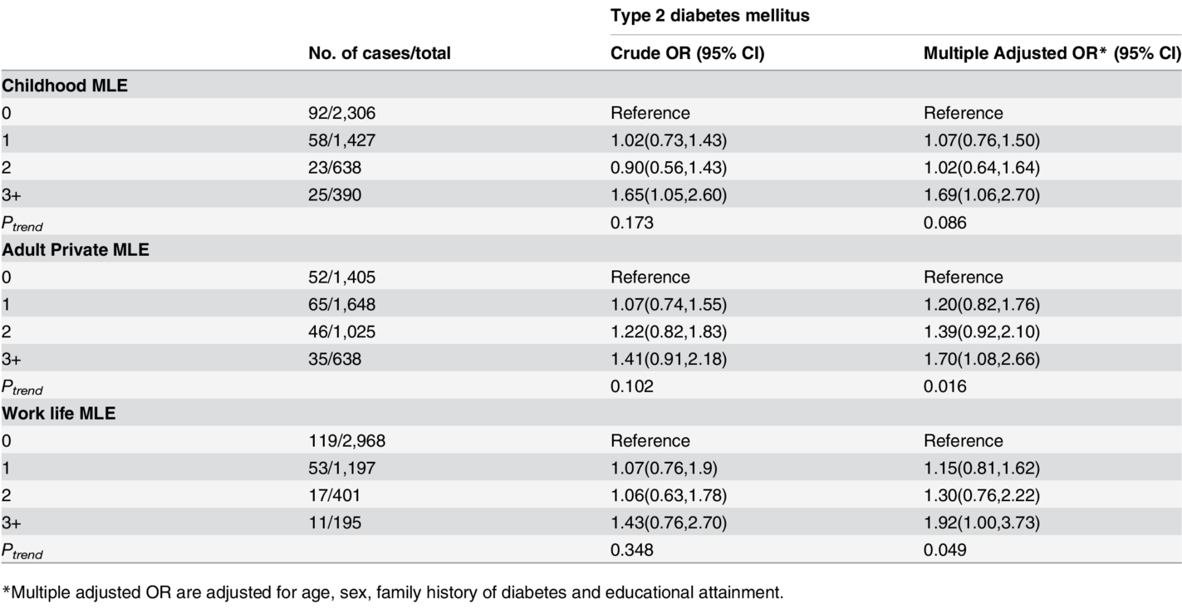
Pedersen JM et al. Accumulation of major life events in childhood and adult life and risk of type 2 diabetes mellitus. PLoS One. 2015.

Slide 73
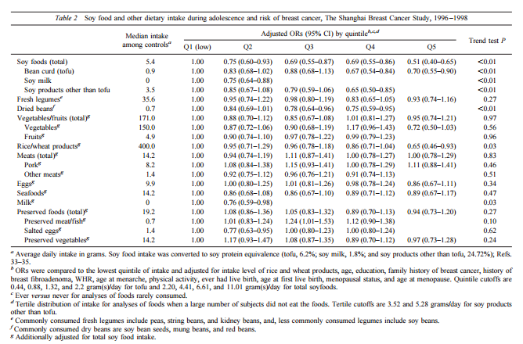
Shu XO et al. Soyfood intake during adolescence and subsequent risk of breast cancer among Chinese Women. Cancer Epidemiol Biomarkers Prev. 2001.

Slide 74
Putting it all together
Estimation of average causal effects requires strong assumptions
Causal DAGs can be used to identify approaches to study design and analysis to eliminate systematic bias
Confounding is a bias of common causes
  Causal DAGs allow us to integrate expert knowledge into an analysis to identify true confounders
Selection bias is a bias of common effects
  Causal DAGS allow us to identify the structure of selection bias and methods to “adjust” for bias

