Slide 1
Precision Medicine:
A Case Study (Part 2)
Ida Sim, MD, PhD
February 16, 2016
Division of General Internal Medicine, and
Graduate Group in Biological and Medical Informatics
UCSF
Copyright Ida Sim, 2016. All federal and state rights reserved for all original material presented in this course through any medium, including lecture or print.
Notes:
prospects for ehealth and ePCRN
if all data were “free” could ad hoc construct performance metrics as post-processing, not wired into data acquisition phase
http://content.nejm.org/cgi/content/full/NEJMsa0802005
OpenMRS
Medicine 2.0; n of 1? evidence farming
Health commons
20 percent of physician groups in Arizona are uninstalling HIT software, according to a June survey by HealthLeaders-InterStudy. In Britain, a $20 billion program to digitalize medicine across the National Health Service is five years behind schedule and heavily over budget.

Slide 2
Last Class
Precision Medicine and Learning Health(care) System are “big” ideas
PMI Cohort Program
  recruiting 1 million: many digital divides
  e-enrollment platforms available
  open question what data can/should be collected
  privacy is more than just yes/no

Slide 3
This Class
PMI Cohort Program (Part 2)
  collecting and combining data
  de-identification is more than just yes/no
  developing and evaluating PMI mobile apps
  participant engagement / just-in-time interventions
N-of-1 studies
Learning Health(care) System
Class summary

Slide 4
Obtaining Sensor Data: APIs
API = Applications Programming Interface
  a piece of software that sets of requirements on how one application can talk to another
Data repositories can expose their data via APIs
  some EHRs are just starting to offer APIs
Modern Internet APIs are usually RESTful and use JSON (but not always)
  no, Meaningful Use CCD is not a modern API
Many companies offer APIs for other systems to access their data
  e.g., 23&Me, Jawbone, FitBit, GoogleFit, Apple HealthKit

Slide 5
Example API: GoogleFit
Your machine has to connect to the GoogleFit cloud
You have to let it know who you are (identification), prove that you are who you are (authentication) and be given appropriate access (authorization)
  this is usually done using OAuth 2.0
https://developers.google.com/fit/rest/v1/reference/parameters lists a bunch of commands you can now issue to get at data, e.g.,
  GET https://www.googleapis.com/fitness/v1/users/userId/dataSources/dataSourceId

Slide 6
Obtaining the Data: Schemas
  e.g., https://www.googleapis.com/fitness/v1/users/"me"/dataSources/dataSourceId
You can get data about instantaneous or aggregated readings using their schemas (or data models)
  e.g., com.google.heart_rate.bpm
    bpm (float—bpm)
  com.google.heart_rate.summary
    average (float—bpm)
    max (float—bpm)
    min (float—bpm)

Slide 7
AHA Physical Activity Recommendation
"At least 30 minutes of moderate-intensity aerobic activity at least 5 days per week for a total of 150"
http://www.heart.org/HEARTORG/GettingHealthy/PhysicalActivity/FitnessBasics/American-Heart-Association-Recommendations-for-Physical-Activity-in-Adults_UCM_307976_Article.jsp

Slide 8
GoogleFit Activity Data
com.google.activity.summary
  activity (int—enum)
  duration (int—ms)
  num_segments (int—count)
Notes:
Enumerated list of types of activity.

Slide 9
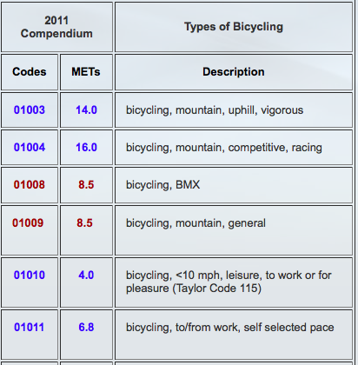
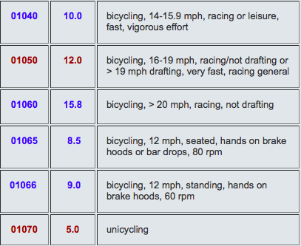
Minutes of Moderate Activity
Device | Data Element Name | Data Type/Value List
FitBit | Fairly active minutes | Number
GoogleFit | Activity | Aerobics, badminton, baseball, jogging, running, road biking, etc
 | Duration | Integer (milliseconds)
infer METS by type of activity, add up minutes at 3-6 METS
2011 Compendium of Physical Activities
Notes:
What about Google? Google Fit provides activity type and duration, so we could infer the METS by looking up the type of activity in for example the 2011 Compendium of Physical Activities. But road biking is anywhere from 4 METS if you're cycling leisurely at under 10 mph to over 15 METS if you're racing over 20 mph, and not drafting, or it's 5 METS if you're unicycling at any speed. So just knowing you're road biking isn't enough.
~~~~~~~~~~~~
Android FIT has Distance delta, Distance covered since the last reading, in meters

Slide 10
Minutes of Moderate Activity
Device | Data Element Name | Data Type/Value List
FitBit | Fairly active minutes | Number
GoogleFit | Activity | Aerobics, badminton, baseball, jogging, running, road biking, etc
 | Duration | Integer (milliseconds)
Health Kit | Workout Activity Type | Elliptical, running, hiking, walking, cycling, etc.
 | startDate | Number (a time value relative to an absolute reference date—the first instant of 1 January 2001, GMT)
 | endDate | Number (a time value relative to an absolute reference date—the first instant of 1 January 2001, GMT)
 | Total Distance (m, in, ft, or mi) | Number
Can convert duration and distance to METS (ml/kg/min) and add up minutes at 3-6 METS
Notes:
And HealthKit from Apple? We can calculate the duration of a workout using their definitions of start and endDate, and use known equations to calculate METS and add up the minutes at 3-6 METS. I've presented here a simplified story to make the point that something seemingly easy like getting at minutes of moderate activity isn't at all, and we're haven't gotten into more challenging data blood glucose (is it random, fasting or after a meal), or complicated variables to self-report and standardize like mood, or stress.
Birth of the Apple Universe

Slide 11
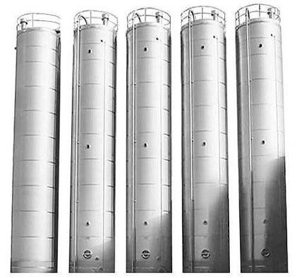
Déjà Vu
SNOMED
RxNORM
CPT
ICD-10
LOINC
ICD-9
Notes:
This is looking like déjà vu all over again. Silos, standards, headache!

Slide 12
Why Can't Health Data Work Like an ATM?
Banking
ISO 8583 standard has 128 data items, <80 used
No ambiguities in meaning (e.g., a dollar)
Only about 10 standard tasks (e.g., deposit)
20 years for ATMs to interoperate widely
Health care
ICD10 has 68,000 codes
Concepts (e.g., diseases) not well understood
Many complex, varying tasks
Each “customer” is different, many “tellers”

Slide 13

Need mHealth Data Standards
1
Open source data schemas: a common way to express e.g., minutes of moderate activity
2
Building upon clinical data standards (e.g., SNOMED-CT) and integrating with EHR standards
3
Evolving and adapting to new fields and new methods in mobile health
Open mHealth
a non-profit technology start-up
Estrin D, Sim I. Science 2010; 330:759-760
Notes:
Need data standards for mHealth. 3 years ago cofounded OmH, read about it in our Science paper.
Working with industry on open source schemas…

Slide 14
This Class
PMI Cohort Program (Part 2)
  collecting and combining data
  de-identification is more than just yes/no
  developing and evaluating PMI mobile apps
  participant engagement / just-in-time interventions
N-of-1
Learning Health(care) System
Class summary

Slide 15
HIPAA Protection of PHI
Can be disclosed only with explicit agreement of subject or as a “limited data set,” with zip codes, dates of admission, ages, but without
names;
street addresses (other than town, city, state and zip code);
telephone numbers;
fax numbers;
e-mail addresses;
Social Security numbers;
medical records numbers;
health plan beneficiary numbers;
account numbers;
certificate license numbers;
vehicle identifiers and serial numbers, including license plates;
device identifiers and serial numbers;
URLs;
IP address numbers;
biometric identifiers (including finger and voice prints); and
full face photos (or comparable images)
Notes:
No one sees my RunKeeper log (private). Everyone sees my RunKeeper log but they don't know it's me. My RunKeeper log is

Slide 16
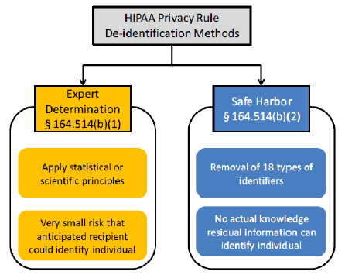
HIPAA and De-Identified Data
De-identified data is not PHI and can disclosed without restriction
UC ReX, PMI, MRCT clinical trial data sharing Platform all aim for de-identified data
must use documented, generally accepted methods to ensure a "very small risk…”
no dates, zip codes, ages!
Notes:
No one sees my RunKeeper log (private). Everyone sees my RunKeeper log but they don't know it's me. My RunKeeper log is

Slide 17
De-Identification
HIPAA implied allowed risk of re-identification is about 5-7%
  for information used alone or in combination with other reasonably available information by an anticipated recipient
    e.g., using 1990 census data: 87 percent of U.S. population can be identified by just a ZIP code, date of birth, and gender (c.f., L. Sweeney and Governor Kennedy ID from voter and DMV database)
    e.g., data from African HIV trial "de-identified" but recipient knows which villages participated in this trial
  now there’s very personal digital traces on us everywhere
De-identification is never 100% foolproof!
Risk of re-identification must be balanced against costs of de-identification
Notes:
No one sees my RunKeeper log (private). Everyone sees my RunKeeper log but they don't know it's me. My RunKeeper log is

Slide 18
Ways to De-id
Executable file
Notes:
No one sees my RunKeeper log (private). Everyone sees my RunKeeper log but they don't know it's me. My RunKeeper log is

Slide 19
This Class
PMI Cohort Program (Part 2)
  collecting and combining data
  de-identification is more than just yes/no
  developing and evaluating PMI mobile apps
  participant engagement / just-in-time interventions
N-of-1
Learning Health(care) System
Class summary

Slide 20
Mismatched "Metabolic Rate" of Technology and Evaluation
Riley et al. Clinical and Translational Medicine 2013, 2:10

Slide 21
Compare and Contrast
Develop idea and prototype on your own
Get it programmed
Pilot test on a small group of patients
Run an RCT
Years later, results are negative, technology is far advanced, and/or "everything's changed"
Participatory design
  develop idea and prototype with users and programmers
Mock up and test iteratively
Evaluate with increasing rigor
  qualitative
  observational
  interventional
Never stop developing, never stop testing, never stop evaluating

Slide 22
So you wanna build an app?
An app is not a uni-dimensional therapeutic like a drug
  multi-modal (e.g., attention focus, education, information)
  reminders (e.g., text prompts, notifications, calendar)
  rewards (e.g, leaderboard, badges, in-app purchases)
Different platforms yield different experiences
Many digital health interventions are behavioral (diet, exercise, stress, etc)
  life context (social network, work, physical environment) is very important and very variable

Slide 23
Development Decisions
The “specs” (specifications)
  what is your system supposed to do? for whom? who will pay for/sustain it in the long run?
  what specific functions will it have?
  do use case scenarios (step-by-step, storyboards, etc)
Basic technical choices
  “form factor”: kiosk, desktop, laptop, notebook, tablet, phone…
  operating system (e.g., Mac vs PC, or Android vs iPhone vs mobile web)
    check browser and platform usage statistics
Find a developer
  external: contact Aenor Sawyer at Center for Digital Health Innovation for referrals and standard contracts
  internal: UCSF Mobile Services or Telemedicine
  see http://drupal.ucsf.edu/ for website development

Slide 24
User Interaction Design
Thanks to Apple, consumers expect beautiful software
Prioritize the explicit design of interactive digital experiences
  more than user interface, is the whole user experience, i.e., how iPhone feels different than Android
User interaction design expertise
  e.g., http://www.coroflot.com/ search for "user interaction"
  contact Beth Berrean BerreanB@MEDSCH.UCSF.EDU, UCSF Mobile Services
Participatory design
  involve your users in design right from the beginning

Slide 25
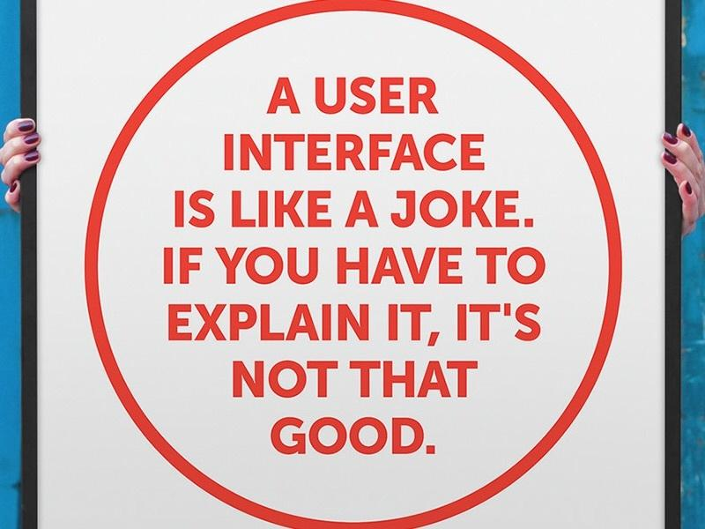

Slide 26
Participatory Development and
Evaluation Cycle
Requirements & Specifications
Storyboards & Wireframes
Alpha Prototype
Beta Prototype
Released Version
Informaticist/Developer/Ethnographer
User Interaction Designer/Developer
Developer/UX Designer/Ethnographer
Usability Testing
A/B testing
Focus groups
Talk Aloud Protocols
Field pilot
Video observations
Interventional study

Slide 27
Agile Rapid Cycle Field Testing
Qualitative tests
  surveys, interviews, video recordings, “talk-aloud protocols”
Quantitative tests
  user analytics
    track app launches, clicks, dwells, scrolls, links to web and back…e.g., Flurry.com
  A/B testing
    Google launched 450 search engine improvements in 2007, each one tested rigorously through real-time user analytics

Slide 28
A/B testing example
Identify part of the system for testing (e.g., video vs. text for explaining PMI)
Randomly assign each person landing on the screen to video or text
Test for comprehension with a short survey
Compare % correct answers, set “stopping rule,” run study until answer clear or test is over
Can run multiple embedded user interaction RCTs to optimize design features in parallel, e.g.,
  different motivational wording
  different reward levels

Slide 29
Participatory Development and
Evaluation Cycle
Requirements & Specifications
Storyboards & Wireframes
Alpha Prototype
Beta Prototype
Released Version
Informaticist/Developer/Ethnographer
User Interaction Designer/Developer
Developer/UX Designer/Ethnographer
Usability Testing
A/B testing
Focus groups
Talk Aloud Protocols
Field pilot
Video observations
Interventional study

Slide 30
This Class
PMI Cohort Program (Part 2)
  collecting and combining data
  de-identification is more than just yes/no
  developing and evaluating PMI mobile apps
  participant engagement / just-in-time interventions
N-of-1
Learning Health(care) System
Class summary

Slide 31
Engagement and Retention
Annual drop-out rate is 10-15% for longitudinal e-cohorts
  marketing techniques: interest, rewards, social influence, meaning
Individualized strategies
  responsiveness to social networks, to financial incentives, to gain vs. loss, rewards for referring friends or continuing
Personal insights
  “On days when you sleep more, you get more exercise"
Social norming
  “Your daily activity level is higher than 42% of PMI participants”
Results return
  “Your data has been used in 16 studies and has helped to discover…”
Notes:
customer acquisition costs

Slide 32
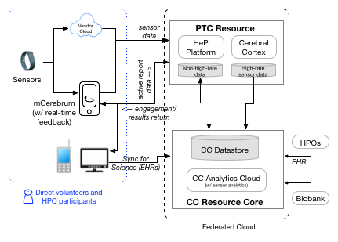
PMI Data Architecture

Slide 33
mCerebrum
MD2K mobile sensor data platform (Android only)
  collects high-rate sensor data from phone and sensors (via ANT and bluetooth)
  can run analytics on that data to detect digital biomarkers (e.g., stress, smoking event) in real-time
  can trigger EMAs or interventions based on data
    if stress high, EMA “what is your smoking urge level?”
    if stress high, administer stress reduction exercise
Can be used for just-in-time adaptive interventions (JITAI)

Slide 34
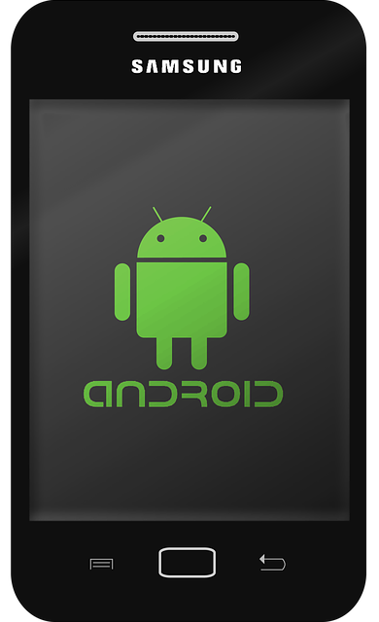

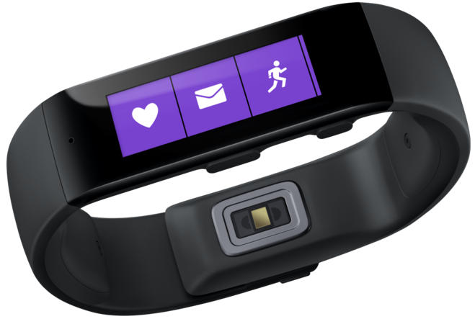
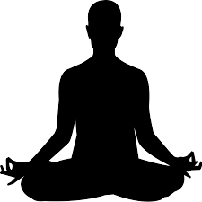
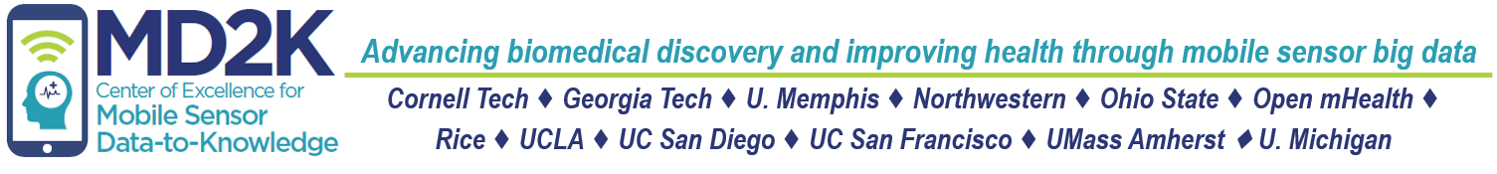
Staying Quit – A JITAI Study
Detect stress
adaptive microrandomization
Detect smoking
geolocation
stress
activity
individualized smoking urge model
individualized efficacy model
MD2K Spark cloud platform
Notes:
To do this study, we must be able to detect stress in real time. We're doing that using a chest band that infers stress from HR, HRV, and respiratory rate and pattern. If stress is detected, the person gets a buzz on their MS Band wristband, and they go to their phone and are microrandomized to a stress reduction exercise – could be music, guided imagery, or meditation. They are then monitored for whether they smoke again, through a wrist sensor to monitor arm and wrist movement correlated with a deep inhalation.
Our real-time computational platform crunches all this real-time data to build individualized models of smoking urge and to drive adaptive randomization through an individualized efficacy model. Remember just 10 hours of this monitoring is 3 Shakespeare's worth of data.
https://methodology.psu.edu/media/techreports/14-126.pdf

Slide 35
mCerebrum for PMI Engagement
Individualized strategies
  randomize participants to different engagement strategies, test for effectiveness, then individualize
    e.g., social influencing in older participants
Derive meaningful digital biomarkers
  “When your commute is especially long, your stress level stays high for hours and your sleep is disrupted for 3 nights"
Use machine learning to predict risk of dis-engagement
To improve data quality
  detect real-time loss of data to prompt user to reattach sensor, change battery, etc.
Notes:
customer acquisition costs

Slide 36
PMI Cohort Program Summary
recruiting 1 million: many digital divides
e-enrollment platforms available
open question what data can/should be collected
  mCerebrum and MD2K cloud optimized for deriving digital biomarkers from sensor data
will need APIs and careful data schemas
privacy is more than just yes/no
de-identification is more than just yes/no
engagement and retention need to be individualized
  randomized real-time individualized testing and interventions can be done using mCerebrum
Notes:
customer acquisition costs

Slide 37
This Class
PMI Cohort Program (Part 2)
  collecting and combining data
  de-identification is more than just yes/no
  developing and evaluating PMI mobile apps
  participant engagement / just-in-time interventions
Learning Health(care) System
  workflow integration
  novel study designs (N-of-1, PROMPT)
Class summary

Slide 38
This Class
PMI Cohort Program (Part 2)
  collecting and combining data
  de-identification is more than just yes/no
  developing and evaluating PMI mobile apps
  participant engagement / just-in-time interventions
N-of-1 studies
Learning Health(care) System
Class summary

Slide 39
How can mobile and digital health data be usable in clinical practice in a meaningful, effective way?
Notes:
So the question of the day is: How can digital health data be usable in clinical practice in a meaningful, effective way? Before we treat the problem, let’s diagnose it a bit further.

Slide 40
Diagnosis
2. Treatment
3. Monitoring
better characterize disease phenotype and the exposome
24/7 personal tech to improve health behaviors, disease management
how am I doing? what's working? what's not?
Notes:
mHealth technologies address 3 crucial tasks of clinical care: diagnosis, treatment, and monitoring.
By being eyes and ears beyond the walls of our clinics and hospitals, they can help us better characterize…
By being able to text you, buzz you, and reward, mHealth technologies can improve…
And by being able to monitor how you're doing, and giving you feedback, these technologies help us close the loop on what's working and what's not.

Slide 41
Other “Big” Data
+
Notes:
So mHealth technology can lead to better outcomes in 2 ways: through interventions that directly support better self care, such as behavior change and self-management of chronic diseases, and through mHealth data that provide feedback and data driven insight.

Slide 42
Other “Big” Data
+
> 100,000 apps many addressing only a single disease
will often need to bring together our own unique combinations of data, outside of any one app
Notes:
Ανδ τηισ δατα ωιλλ βε χαπτυρεδ τηρουγη πασσιϖε σενσορσ ανδ τηρουγη αχτιϖε σελφ ρεπορτ, υσινγ αν αππ το ρεπορτ παιν φορ εξαμπλε.
Τηε προβλεμ ισ τηατ οφ τηε 100,000 ηεαλτη αππσ, μανψ αδδρεσσ ονλψ α σινγλε δισεασε, βυτ 1 ουτ οφ 4 Αμεριχανσ ηαϖε 2 ορ μορε χηρονιχ δισεασεσ, ανδ βεχαυσε ηεαλτη ισ σο χομπλεξ, ανδ σο ινδιϖιδυαλιζεδ ωε∋λλ αλλ βε νεεδινγ το βρινγ τογετηερ ουρ οων υνιθυε χομβινατιον οφ δατα, ουτσιδε οφ ανψ ονε αππ.

Slide 43
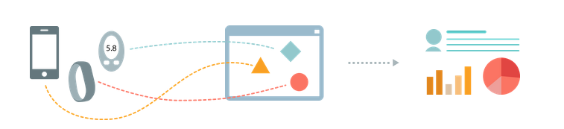
Combine different data regardless of sensor or app
Build smart-sensemaking
Personalized, clinical insights
sleep, physical activity, blood pressure?
pain, anxiety, ambient noise, caloric intake?
Notes:
For example, it might make sense for you to monitor your sleep, activity and blood pressure. Maybe I would want to look at pain, anxiety, caloric intake.
We need to be able to combine different data, regardless of what sensor or app they come from, to build smart sense-making to generate personalized, clinical insights, that can be used by patients and doctors together to prevent and manage disease.

Slide 44
data integration and data analytics is at the heart of the digital health promise; major barriers to implementation include
data – data standards, API, etc
workflow --
Notes:
So the flow from data to better outcomes now looks like this. Device-agnostic data capture, driving insight for both the clinician and patient, supporting behavior change and better disease management leading to better health outcomes.
It's data integration and data analytics that is at the heart of the digital health promise. But making good on this promise will require addressing 3 major barriers: data, workflow, and the patient-doctor user experience.

Slide 45
EHR
Clinical Care
Database
Workflow Tool
Notes:
The general idea seems to be this: Let's get mHealth data into the EHR for use in clinical care. And I'd say: that's the wrong question.
The EHR is two quite different things: it's a database, and a workflow tool. The EHR is the dominant workflow tool for today's clinicians, so yes, to the extent we want to get mHealth into clinical care, we need integrate with the EHR, but the precise question isn't getting mHealth into the EHR, but "how do we integrate mHealth data into the clinical workflow?" and if that workflow is on an EHR, how do we integrate with that.
I don't see an inherent reason for pouring all mHealth data into an EHR database. We've heard multiple times already today about how EHRs are silos, so why put the data there unless there's a compelling reason.

Slide 46
prescribing data, not apps
e.g., Linq (in pilot testing at Stanford)
Open mHealth
Notes:
At Open mHealth, we've put these ideas into play with a product called Linq.

Slide 47
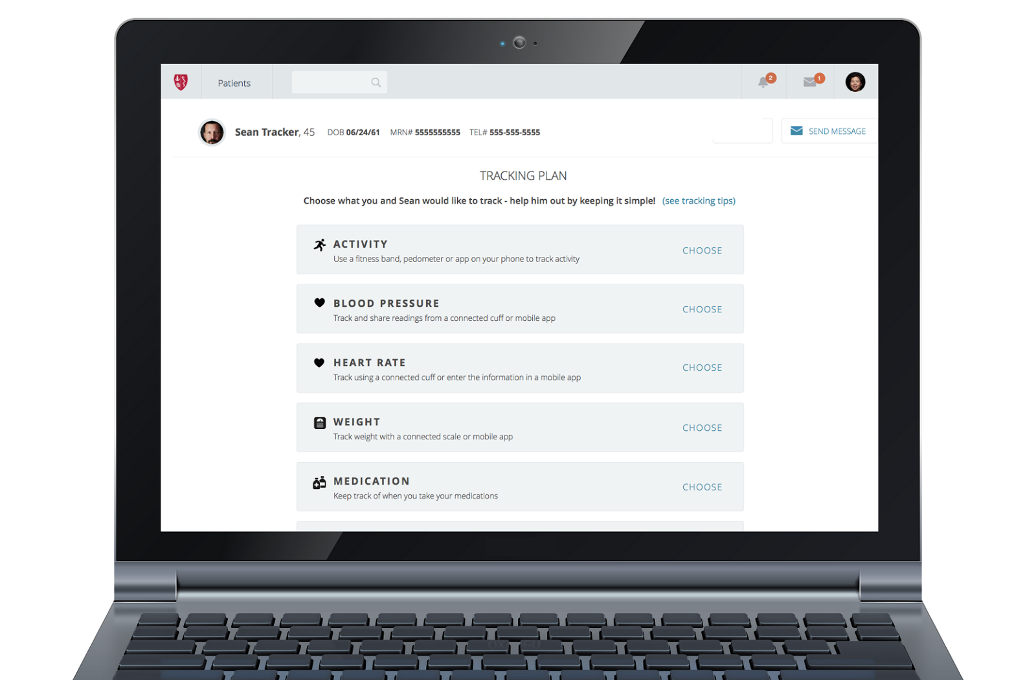
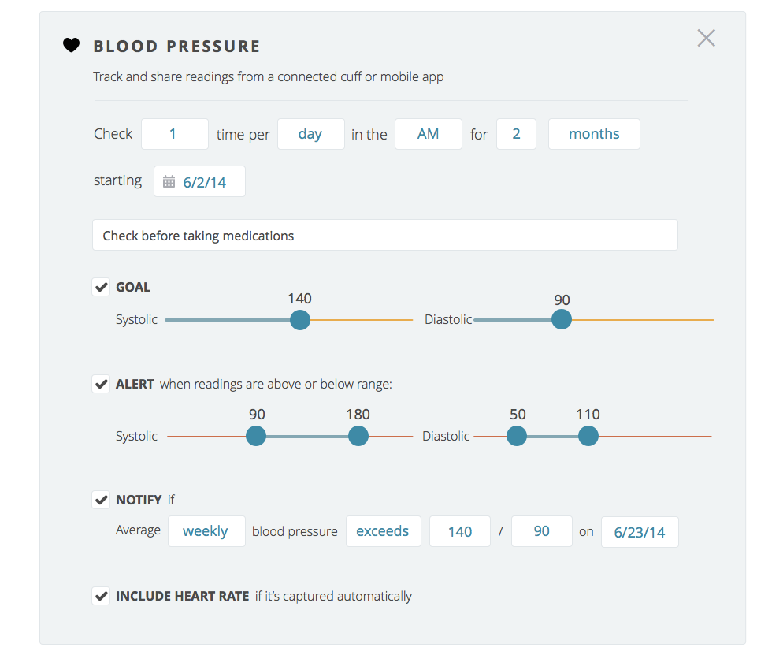
a "data prescription" with automated notification
Notes:
With Linq, I can prescribe BP data collection

Slide 48
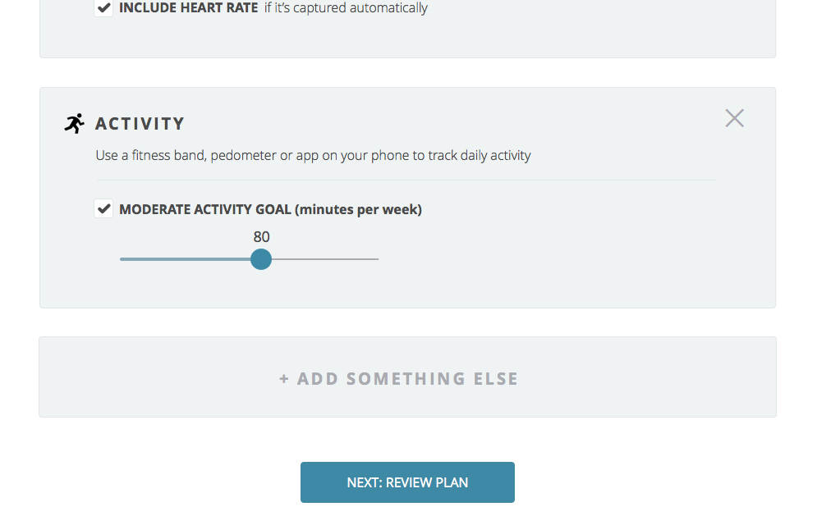
Notes:
Sean really wants to minimize meds, so now he’s doubly interested in improving his physical activity. The good news is that Sean’s employer recently gave him a coupon for a FitBit, and we agree that it would be interesting to track his activity. The American Heart Association recommends 150 mins of ‘moderate activity’ every week but when I explain what it would take to reach this target, Sean tells me that there’s no way he can do that. He thinks maybe 80 minutes total, four 20 mins episodes a week, is a more reasonable goal, so we go with that.

Slide 49
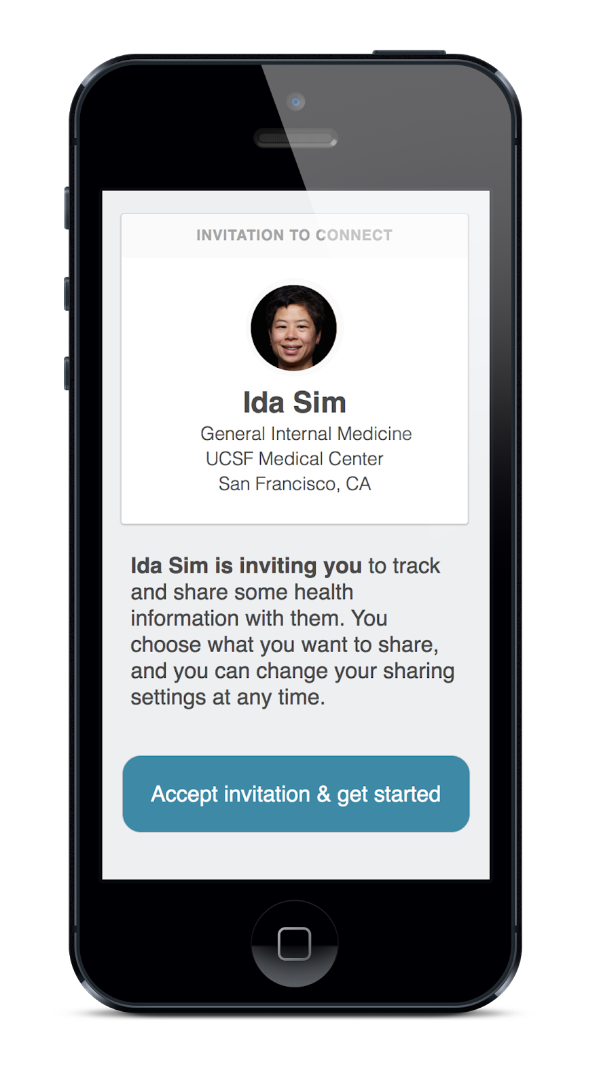
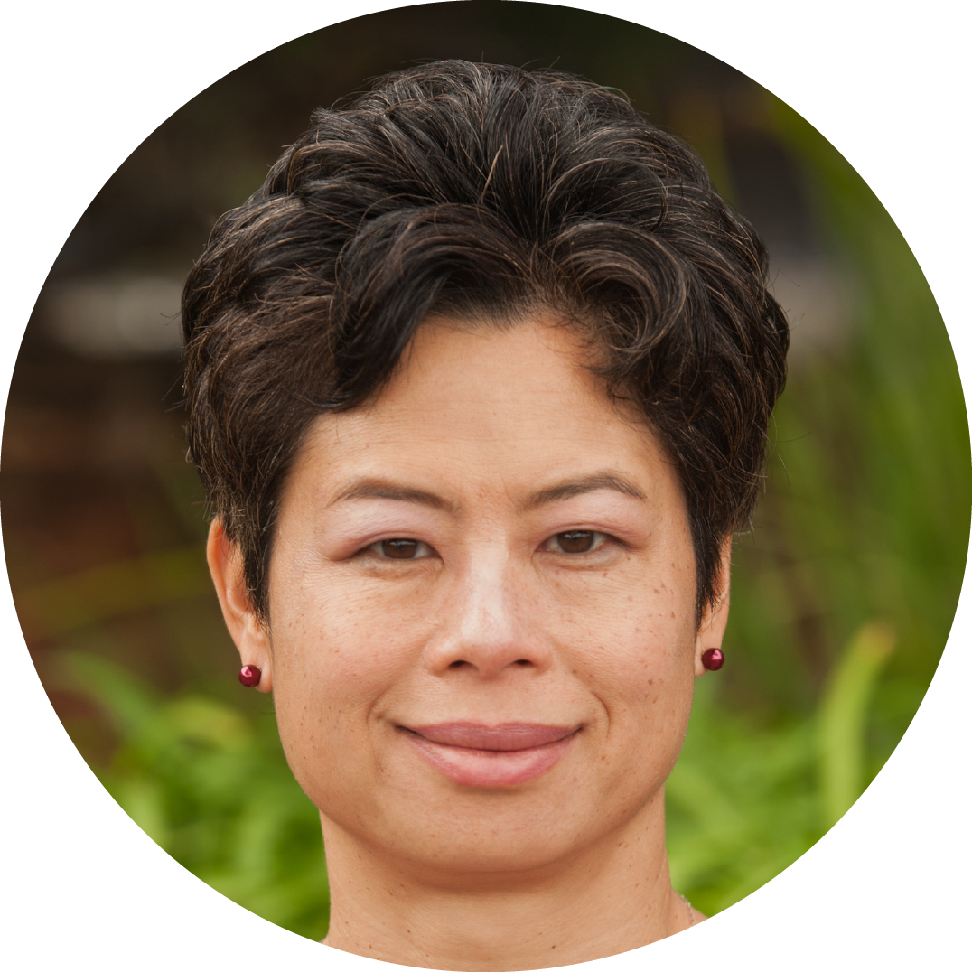
a patient-facing mobile app
available on iOS and Android
Notes:
When I saved the tracking plan, Sean was sent an email inviting him to download the Linq app. He downloads it, logs in and accepts the invitation

Slide 50
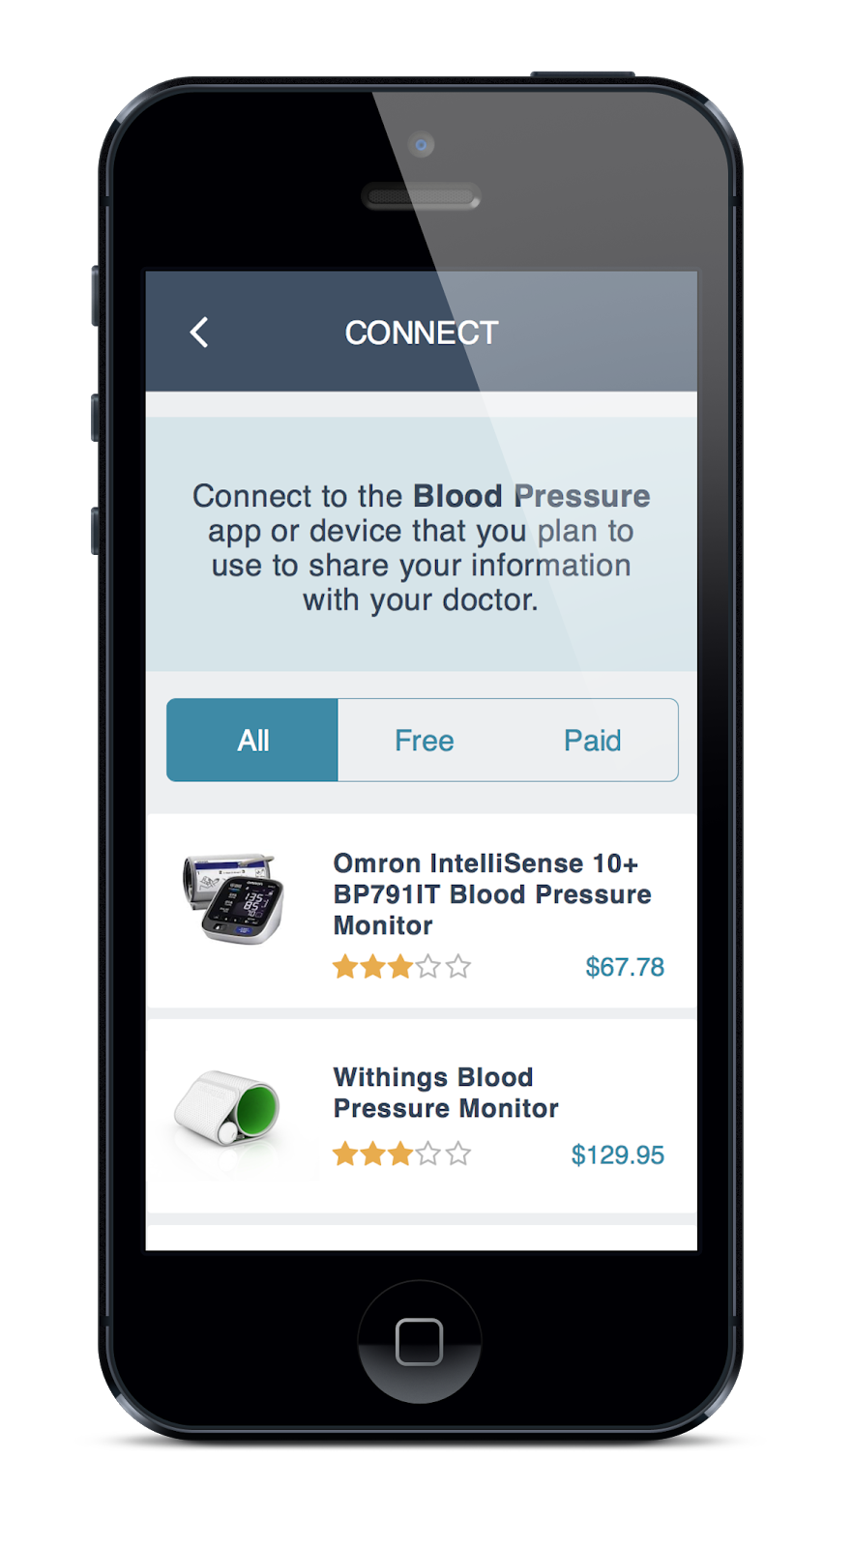
patient gets help getting "on boarded" with apps/sensors
Notes:
and he is able to “bring his own app” to fulfill the tracking plan. Linq provides some advice on devices, and Sean chooses to buy a Withings blood pressure cuff, a FitBit, and he sort of went on a spending spree and got an Aria wireless scale too. He selects and connects all these up to his Linq account.

Slide 51
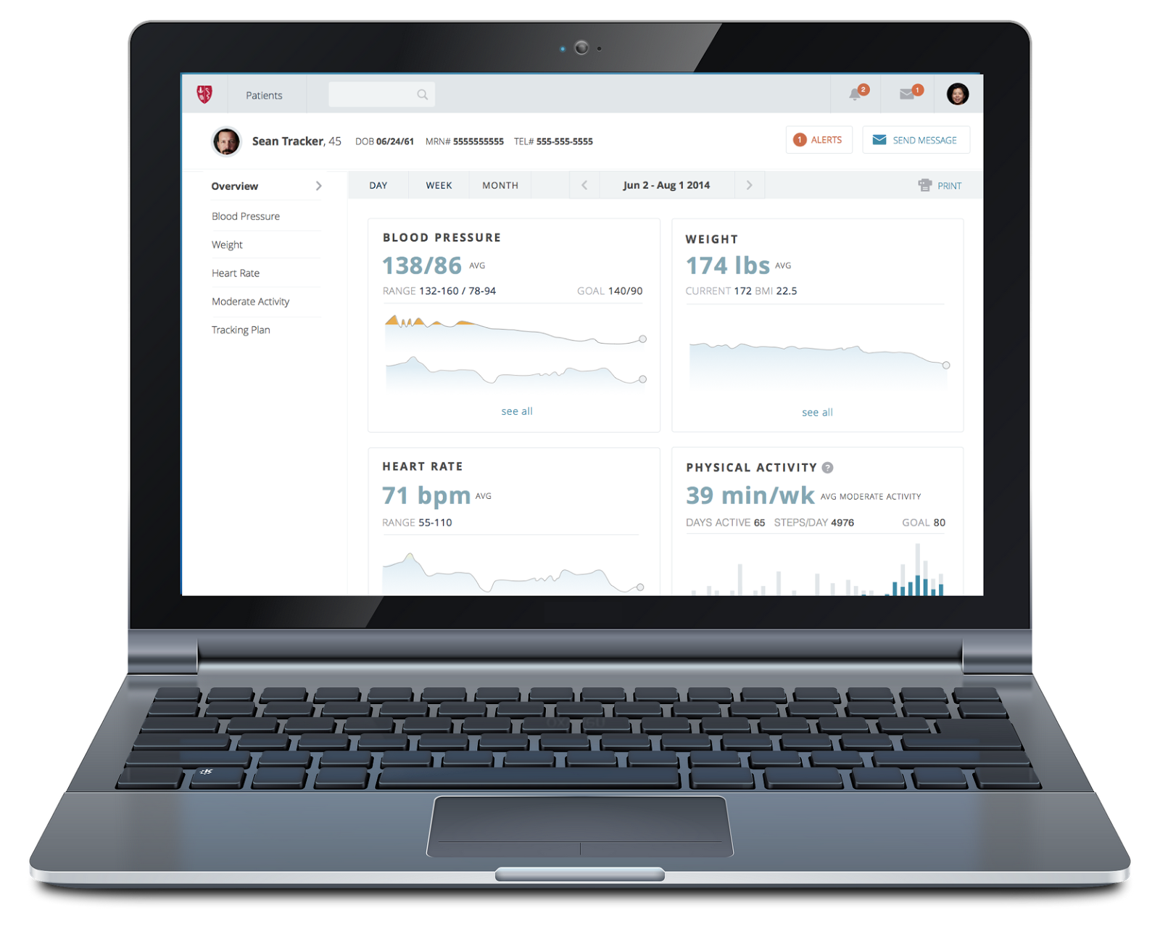
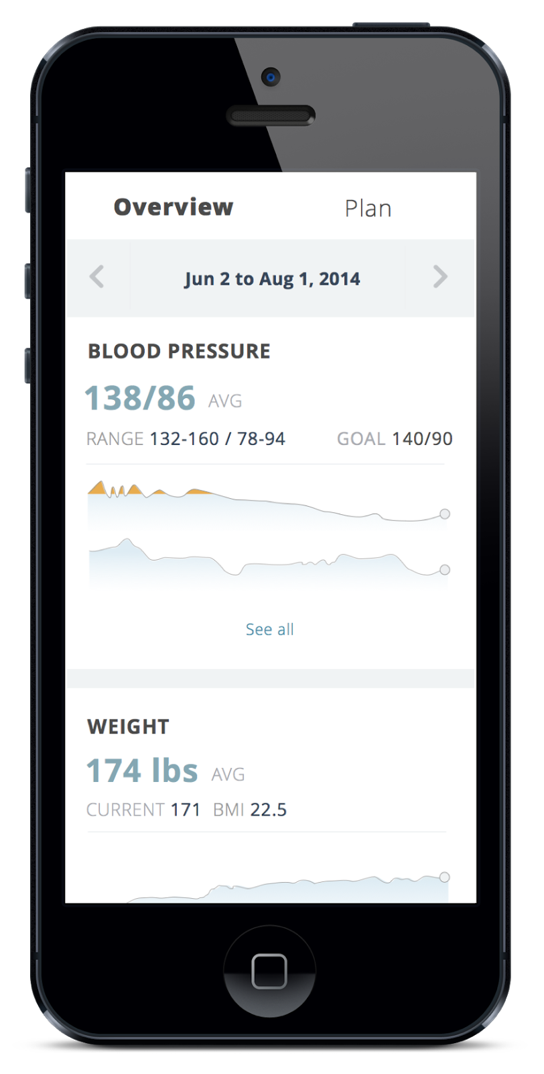
both doc and patient get data displays
Notes:
So as Sean starts tracking, his data is automatically pulled into his Linq app, and if I want, I can go take a look at it too in my clinician view, where I can see minutes of moderate activity in a simple number, whether it's from FitBit or Jawbone or whatnot.

Slide 52
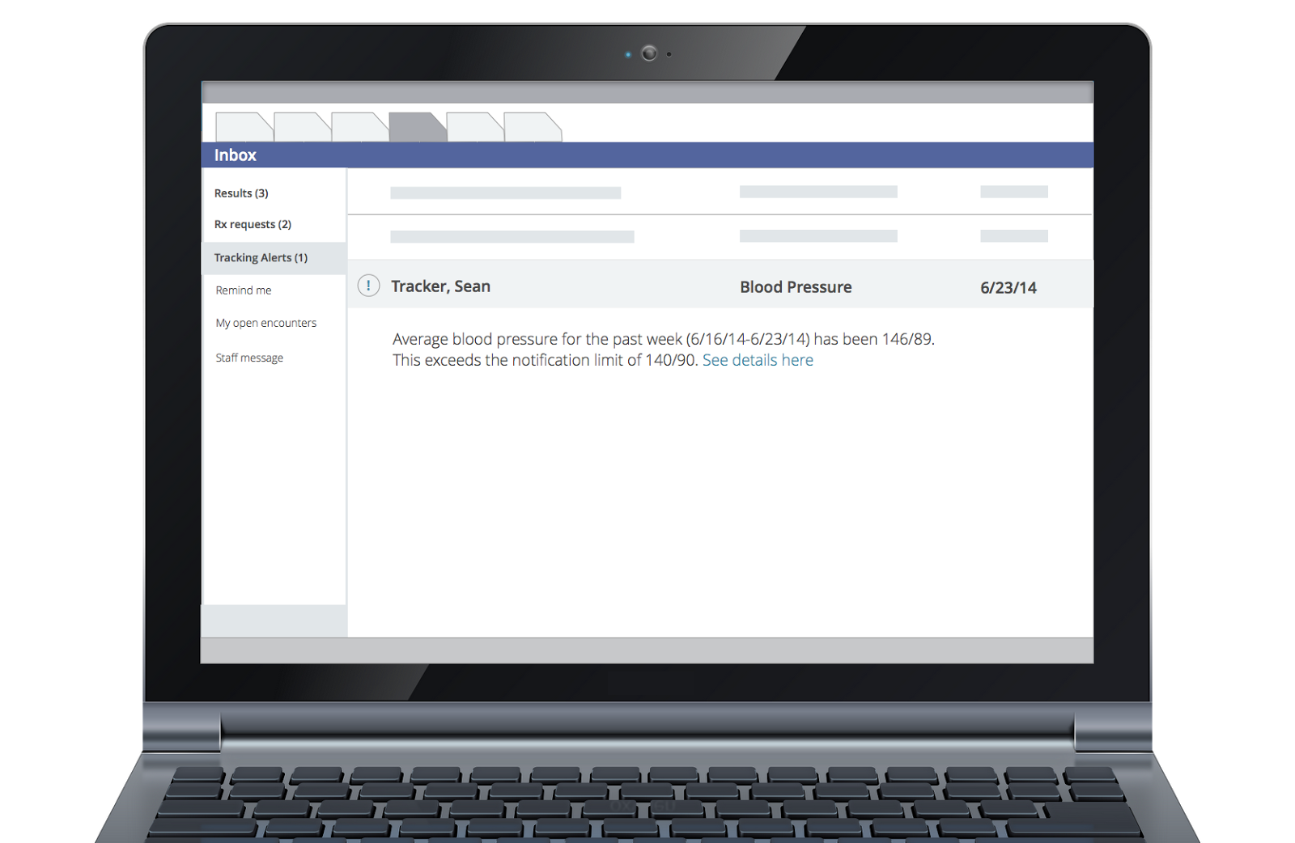
alerts go to docs via their EHR in-box
Notes:
After 3 weeks, I get a message in my medical record’s “In Box” that Sean’s average blood pressure is still over our goal of 140/90. This In Box is where I do all my clinical work, so this digital health data is coming to me just like any other test I order, which is what I need if I’m to use this type of data routinely.

Slide 53
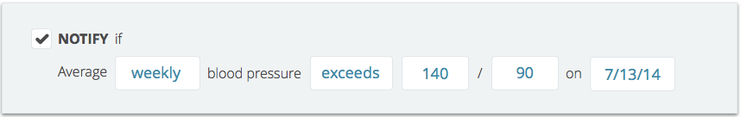
easily reset data prescription and notification parameters
Notes:
And I set Linq to notify me with his blood pressures in another 3 weeks.

Slide 54
Prescribe Data, Not Apps
Notes:
Here's a way then to have mHealth be used in real-time front line care.
Set up an order tab to order data not apps.
Let patients bring their own devices
Support device-agnostic data capture through open standards, store the data outside of the EHR
Allow 3rd parties to use that data for visualizations, predictive modeling, etc. that touch clinician workflow through the in box and through windows that float over encounters during face to face visits.
This will allow doctors to use mHealth data for treatment and monitoring in real-time frontline care, with mHealth data being nothing special, and allow patients to partner with their doctors in deciding what to track and why, and to improve their self-care and health outcomes. Thank you.

Slide 55
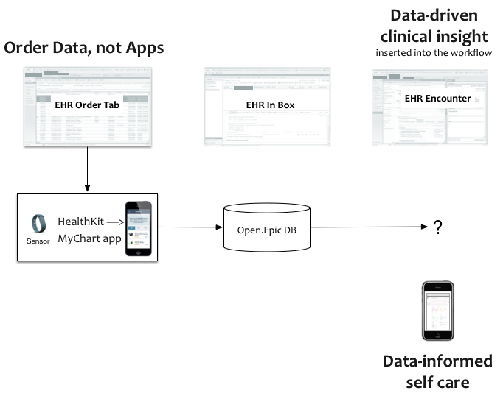
Epic Data Prescription
Notes:
Here's a way then to have mHealth be used in real-time front line care.
Set up an order tab to order data not apps.
Let patients bring their own devices
Support device-agnostic data capture through open standards, store the data outside of the EHR
Allow 3rd parties to use that data for visualizations, predictive modeling, etc. that touch clinician workflow through the in box and through windows that float over encounters during face to face visits.
This will allow doctors to use mHealth data for treatment and monitoring in real-time frontline care, with mHealth data being nothing special, and allow patients to partner with their doctors in deciding what to track and why, and to improve their self-care and health outcomes. Thank you.

Slide 56
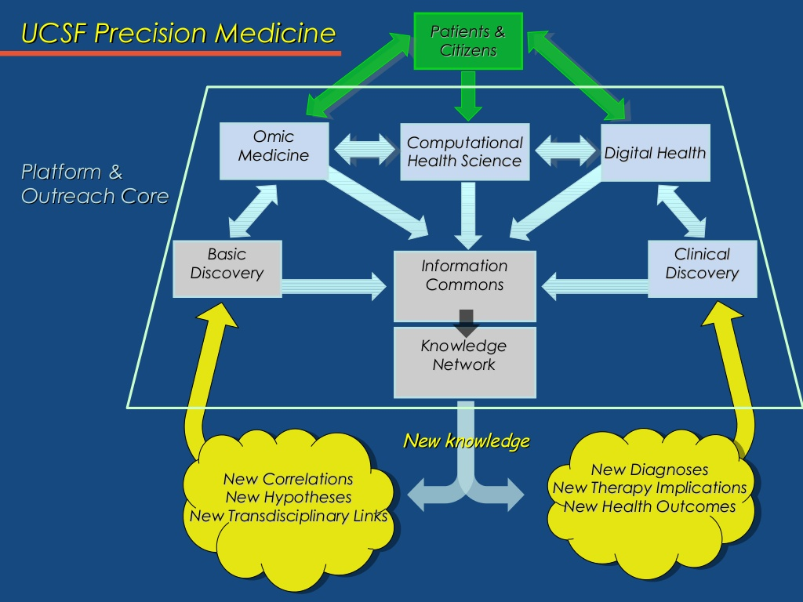
Notes:
UCSF Precision Medicine vision

Slide 57
Point-of-care Care/Research
How can we use technology to learn at the point-of-care?
Observational / Big Data
  machine learning of EHR, mobile, population, public health data
    e.g., refine predictive model of asthma triggers based on genomics, inflammatory markers, sensed PEFR, PM 2.5, smoking exposure, etc.
Embed traditional RCTs in care
  e.g., CTSI Learning Health System CFP to use APEX to screen, recruit, randomize, capture outcomes
    RCT of algorithm-driven real-time alert vs usual care for high risk of inpatient hypoglycemia
    RCT of guildeline-based COPD order set vs no order set
Less traditional designs, e.g.,
  N-of-1 studies
  Prompted Optional Randomization Trial (PORT)

Slide 58
rephrasing ‘does it work?’
(Complexes of) Exposures
Outcome
strength of association?
anti-depressant
mood
individual
population
Notes:
Statistically, this is asking about the strength of association between being "exposed" to oxycodone or percocet, say, and some outcome we care about, like pain relief.
We can ask whether oxycodone works at the population level or whether it works for an individual (does it work for me).

Slide 59
which works better: Zoloft or Prozac?
Zoloft
Mood, social activity
100 people
50 people
Effexor
Mood, social activity
50 people
population
tells us on average whether Zoloft or Effexor is better at improving mood, depression
Notes:
59
The standard thing to do would be to run an RCT, and we will see on average if oxycodone works better than say Percocet.
The problem though is that none of us are average.

Slide 60
none of us are average
Zoloft better
Effexor better
Notes:
60
The standard thing to do would be to run an RCT, and we will see on average if oxycodone works better than say Percocet.
The problem though is that none of us are average.

Slide 61
Consider…
8-week remission rate¹
e.g., for the last 200 patients "like you" in APEX
  60 Effexor patients, 30 remitted (50%)
  140 Zoloft patients, 88 remitted (63%)
Which should you take?
 | Effexor | Zoloft | p value
Mehtonen, et al. 2000 | 68 | 45 | 0.008
Sir, et al. 2005 | 54.4 | 59.5 | 0.47
¹http://www.effectivehealthcare.ahrq.gov/repFiles/Antidepressants_Final_Report.pdf

Slide 62

which works better for you?
N-of-1 study design: testing both in you for the outcomes that matter to you
Zoloft
Effexor
Zoloft
You
Effexor
Mood
Zoloft
Mood
Effexor
individual
http://effectivehealthcare.ahrq.gov/index.cfm/search-for-guides-reviews-and-reports/?productid=1844&pageaction=displayproduct
Notes:
62
The only formal method for answering "does it work for me" is the N-of-1 study design.
In which there's only 1 person, 1 "n" in the study. So I would be randomized first to PTSD Coach, then usual care, and back and forth a few cycles, assessing my depression symptoms along the way.
This method is not widely known and is statistically complicated, but offers the kind of personal evidence we need to drive systematic but personalized learning across mHealth

Slide 63
there you are!
Zoloft better
Prozac better
Notes:
63
The standard thing to do would be to run an RCT, and we will see on average if oxycodone works better than say Percocet.
The problem though is that none of us are average.

Slide 64
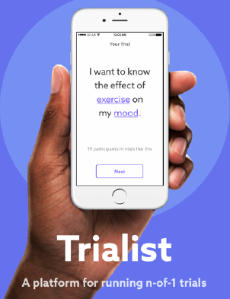
Trialist App
Generalizable platform for n-of-1 studies
v 1.0 being used for chronic pain med use (PREEMPT), n = 200+
v 2.0 for-profit spin-off from Open mHealth
  for WNYC, n = up to 6000

Slide 65
n = 1
Notes:
Ιν σελφ−εξπεριμεντατιον, ν, τηε νυμβερ οφ παρτιχιπαντσ, ισ 1. Τηε εξπεριμεντ μαψ βε θυιτε χασυαλ, ορ λιτ μαψ βε μορε σοπηιστιχατεδ ιν μετηοδολογψ λικε Ιαν ανδ Μιχηαελ ηαϖε δεσχριβεδ,

Slide 66
(n = 1).^{N}
Notes:
Scaling self-experimentation means having more people do it, to the power of a much much bigger n, still with strong methoology so we can learn more and advance health more broadly.

Slide 67
(n = 1).^{N}
Σ
Notes:
But even better, we should sum the experiences of all of those experiments to achieve real scale. The question of course, is how.

Slide 68
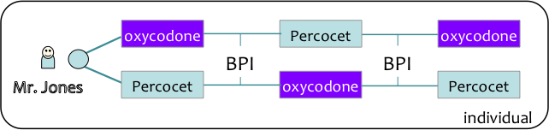
flip direction of research inference
population
Notes:
68
Once we get individual evidence, can aggregate to population level evidence – VA/DoD should help build the evidence base for better care.

Slide 69
“the ultimate study design for precision medicine”
(n ≥ 1).^{N}
Σ
Notes:
The real excitement is aggregating findings from many self-experiments. For that, we must first make the findings comparable. We are building libraries of standard measures, and working on way to index variables and results to standard vocabularies.

Slide 70
Randomization
Experimental randomized studies most powerful for causal inference
But randomization is
  expensive, logistically challenging to implement
    e.g., screening, enrolling, consenting, randomizing hundreds of patients to diabetes drug A vs. B
  requires yielding treatment decision to chance
  assumes clinical equipoise

Slide 71
Prompted Optional Randomized Trial
If enough docs switch when prompted, known and unknown confounders are washed out
  i.e., lower precision can be overcome with larger sample size
Prompt is an instrumental variable
  quite strongly associated with treatment assignment
  not directly associated with outcome of interest
  not associated with potential confounding variables
Flory, Karlawish. Am J Public Health.
2012;102:e8–e10. doi:10.
2105/AJPH.2012.301036

Slide 72
New Picture of Health(care)
WELLNESS
PATIENT CARE
RESEARCH
. .
. .
Virtual Patient
Care and Research Transactions
Raw data
Medical knowledge
Clinical research transactions
Raw research data
. .
. .
Doctor
. .
Decision support
. .
. .
Medical logic
. .
. .
. .
Patient Transactions
. .
. .
Citizen
Scientists
Patient
Big (Open) Data
Interaction design, workflow modeling and support, cognitive support, policies and mechanisms for sharing, privacy

Slide 73
Summary
Informatics necessary for making sense of data into information and knowledge
Today's health IT focuses very heavily on supporting doctor-driven transactions (bottom left quarter)
Need brand new technologies for other 3/4 of Big Picture
  systems to support learning health care system, deep decision support, patient and community self-care
Key informatics points to keep in mind
  data representation and standards vital for ensuring meaning
  it's about more than the data…. to get to information and knowledge, need blend of EBM and big data methods
  technology must be designed for humans to use and engage with
  some of the hardest challenges are sociotechnical: privacy, organizational change, digital divide

Slide 74
Take Home Message
At the cusp of something transformative
  be open to partnering with computer scientists, patients, companies, etc.
To guard against hype and to maximize value
  stay grounded in what is clinically useful and important
  know as much as possible of the underlying informatics
  don't forget to apply epi/biostats
  help develop new methods for evaluation, bring clinical research science to the digital age
Course evaluation
  https://ucsf.co1.qualtrics.com/jfe/preview/SV_e3etXta0KuUQHgV

