Slide 1
EPI 262:
Meta-Analysis Case Studies
Course Director: Michael A. Kelsh, MPH, PhD
Center for Observational Research, Amgen, Inc.
Department of Epidemiology and Biostatistics, UCSF
* Acknowledgement – Charles Poole, UNC

Slide 2
Meta-Analysis – Promise and Concern
"Meta-analysis is the wave of the future...It’s going to revolutionize how sciences, especially medicine, handle data. And it’s going to be the way many arguments are ended.”
Thomas Chalmers (1990)
"Meta-analysis is a boon for policy-makers who find themselves faced with a mountain of studies... That’s what everybody likes about it, and that’s also what everyone is so worried about.”
Kay Dickersin (1990)

Slide 3
Meta-Analysis Atitudinal Scale
| 0 | 1 | 2 | 3 | 4 | 5 | 6 | 7 | 8 | 9 | 10 |
Always
aggregate
“We understand meta-analysis as being the use of statistical techniques to combine the results of studies addressing the same question into a summary measure.”
Villar et al. (2001)
“Meta-analysis is a quantitative method of aggregation.”
Olkin (1994)

Slide 4
Meta-analysis attitude scale
| 0 | 1 | 2 | 3 | 4 | 5 | 6 | 7 | 8 | 9 | 10 |
Never
aggregate
"There are still too many epidemiologists who are willing to equate aggregation with truth.“
Shapiro (1994)
“I would like to reinforce that meta-analysis is not solely a synonym for the statistical procedures that produce a combined effect size.”
Olkin (1995)

Slide 5
Measure of Risk: Poole’s letter on Coffee and MI
Before 1st cup of coffee – reads case-control study about MI and coffee consumption OR=1.5
Hummm – what is the Risk Difference
Need to obtain baseline risk data for MI
Found information in Framingham Study ~ 10% risk across 10 year time period
Translates to 1/million risk in next hour, so 50% increase (from 1 to 2/million) or extra heart attack per 2,000,000 cups of coffee
Always consider the absolute risk

Slide 6
Indirect Comparison of Meta-Analysis Findings on Adverse Treatment Outcomes: Impact of Trial Heterogeneity and Effect Measure Selection
Case Study

Slide 7
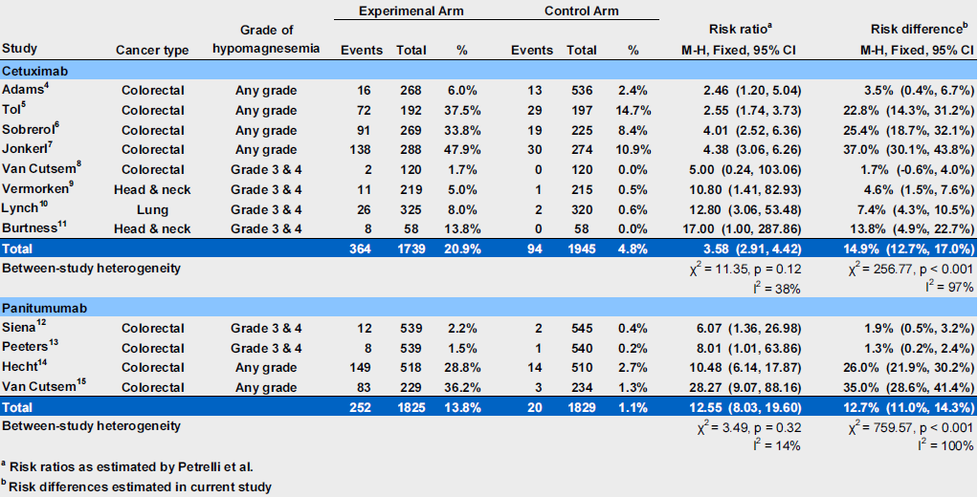
Table 1. Risk of hypomagnesemia associated with cetuximab and panitumumab as reported in Petrelli et al. with corresponding risk differences estimated in the present study

Slide 8
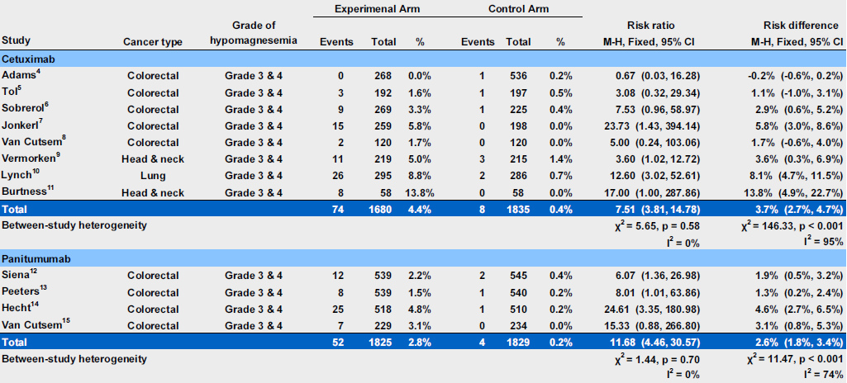
Table 2. Risk of hypomagnesemia associated with cetuximab and panitumumab: a subgroup analysis restricting to grade 3 & 4 events

Slide 9
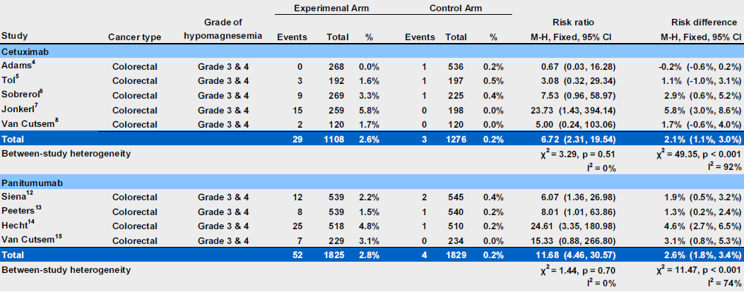
Table 3. Risk of hypomagnesemia associated with cetuximab and panitumumab: a subgroup analysis restricting to grade 3 & 4 events in colorectal cancer trials

Slide 10
MetaAnalysis – A Transparent Quantitative Summary of Epidemiologic Data? – Think Again: A Case Study of Hair Dye Use and Bladder Cancer

Slide 11
Conflicting Meta-Analysis Conclusions:
Personal Hair Dye Use and Bladder Cancer
Huncharek and Kupelnick 2005 (Public Health Reports):
  “The available epidemiological data suggest an association between personal hair dye use products and increased risk of bladder cancer”
Takkouch et al 2005 (JAMA):
  “..pooled relative risk for ever users of hair dyes was 1.01 (95% CI 0.89-1.14) for bladder cancer (10 studies). No effect was observed for use of permanent dyes or for extensive use..”

Slide 12
Personal Hair Dyes and Bladder Cancer
Bladder cancer – significant public health issue ~ 50,000 new cases diagnosed per year
Widespread hair dye use
  > 33% usage among women > 40 yrs old
  ~10% usage among men > 40 yrs old
Aromatic amine in hair dyes – potential to be absorbed percutaneously
Potential occupational risk among hair dressers

Slide 13
Conflicting Meta-Analysis Conclusions
Huncharek and Kupelnick 2005 (Pub Health Reports):
  “Initially combining homogeneous data from six case-control and one cohort study yielded a non-significant RR of 1.01 (95% CI 0.92-1.11), suggesting no association between hair dye use and bladder cancer”
  “Sensitivity Analysis examining the influence of hair dye type, color, and study design… showed that uncontrolled confounding and design limitations contributed to a spurious non-significant summary of RR.” Sensitivity summary RRs ranged from 1.22 (1.11-.51) to 1.50 (1.30-1.98).

Slide 14
Meta-Analysis Study Objectives
Compare, update and expand previous meta-analysis on hair dye use
Updated meta-analysis would include:
  Heterogeneity, sensitivity & influence analyses
  Two recently published studies
  Analyses of regular and permanent hair dye use
  Analyze aspects of exposure – duration, frequency, dark hair dyes
Assess potential methodological differences of previous meta-analyses

Slide 15
Personal Hair Dye Use and Bladder Cancer – Individual Study Results

Slide 16
Comparison of Meta-Analysis of Personal Hair Dye Use
Study Factor | Huncharek & Kupelnick 2005 | Takkouche et al., 2005 | Kelsh et al., 2008
Number of studies | 7 6 case-control 1 cohort | 10 9 case-control 1 cohort | 12 11 case-control 1 cohort
Number of studies permanent hair dye | Did not report | 3 | 5
Years of publication of studies | 1980-2001 | 1977-2004 | 1977-2006
Gender | No | No | Yes
Other exposure metrics | No | Intensive exposure | -Duration -Lifetime frequency -Dark color
Findings | 1.01 (0.92-1.11) | 1.01 (0.89-1.14) | 0.97 (0.87–1.08) M+F 1.01 (0.89-1.14) W 0.82 (0.60-1.14) M

Slide 17
Meta-Analysis of Personal Hair Dye Use and Bladder Cancer – Sex Differences?
Study | # Exposed Cases | Women | Men | Women and Men
Gago-Dominguez et al. 2001ª | 82 (women) 13 (men) | 1.8 (1.01-3.3) | 0.8 (0.4-2.0) | 1.4 (0.9-2.2)
Henley & Thun 2001 | 92 (women) | 1.08 (0.84-1.38) | Not reported | Not reported
Andrew et al. 2004 | 32 (women) 7 (men) | 1.5 (0.8-2.7) | 0.6 (0.2-1.5) | 1.15 (0.7-1.88)^{b}
Lin et al. 2006 | 77 (women) 23 (men) | 0.90 (0.41-1.96) | 0.68 (0.36-1.29) | 0.81 (0.50-1.30)
Kogevinas et al. 2006 | 60 (women) | 0.8 (0.5-1.5) | Not reported | Not reported
Meta Relative Risk |  | 1.15 (0.91-1.46) | 0.69 (0.44-1.08) | 1.06 (0.89-1.27)*
P-value for Heterogeneity |  | 0.311 | 0.909 | 0.464

Slide 18
Meta-Analysis – By Usage Characteristics
Summary RR Factor | Duration | Lifetime Frequency | Dark Hair Dye Use
Any Hair Dye Use | 1.00 (0.85 – 1.19) 0.397* | 1.12 (0.72 – 1.72) 0.093* | 0.94 (0.74 – 1.19) 0.893*
Permanent Hair Dye Use | 1.31 (0.78 – 2.19) 0.130* | 1.59 (0.69 – 3.64) 0.118* | NA
20+ Years Hair Dye Use | 1.06 (0.79 – 1.40) 0.203* | NA | NA
Comments | Categories of duration: 6 - 33 years. 5 of 7 studies 20+ years | # of applications 5 studies | *p-value for heterogeneity Black, Brown, Red hair dyes

Slide 19
Why Different Conclusions?
Huncharek sensitivity analysis – appeared to be ad-hoc and subjective
  Small studies excluded, mortality studies excluded – re-combined studies in inconsistent ways
Three new studies (all reporting no association) – not included in first meta-analysis
Data not fully explored in earlier meta-analyses

Slide 20
Limitations of Individual Studies
Reliance on self report of hair dye use – likely exposure misclassification
Small numbers of exposed cases
Different types of bladder cancer not evaluated, may have different risk factors
Limited characterization of exposure information

Slide 21
Other Observations Across the different
Meta-Analysis
Inclusion criteria varied slightly (e.g. letters to editor not included in one meta-analysis)
Data abstracted not always the same set
Sensitivity analysis, subset analyses varied across the different studies
Limitations of underlying studies – interpreted differently
  Lead to bias towards null – so association exists
  Do not allow for conclusion of association

Slide 22
What Can Meta-Analyses Tell Us?
Reduces statistical error/uncertainty
Cannot eliminate systematic error in underlying individual studies
Identify characterize heterogeneity across studies, influential groups of studies
Depending on how data are reported – can provide insight on exposure response
Don’t necessarily address other criteria for evaluating causality
  Biological plausibility

Slide 23
Research Funding
This research was funded by L’Oreal USA, a manufacturer of hair dyes and other beauty care products
L’Oreal staff had no role in the design, interpretation of these data, or writing of the scientific manuscript
Manuscript was not subject to approval by any staff or representative of L’Oreal

Slide 24
Historical Comparator Studies: Strengths, Limitations, and Analytical Considerations in Using Historical Pooled Clinical Data for Evaluating Efficacy and Safety of New Therapies
International Conference on Pharmacoepidemiology and Therapeutic Risk Management
August 25, 2015

Slide 25
Regulatory guidance on the use of historical controls
Comparisons to historical controls can be “notoriously unreliable” due to selection bias
Untreated historical control groups tend to have worse outcomes than an apparently similarly chosen control group in a randomized study due to selection bias
Need careful consideration of the design of the control selection and potential biases

Slide 26
Historical Comparator Studies Defined
Basically a pooled analysis of clinical data for a specific disease indication from one or multiple sites:
  External controls/comparison data
  Individual patient level data available for analysis
  Apply inclusion/exclusion criteria to improve comparability
  Data harmonization/analytical approaches to improve comparability
  Although labeled “historical” – external comparator information could be collected concurrently as well
Not including:
  Meta-Analysis, Comprehensive literature review

Slide 27
When Controlled Trials May Not Be Feasible, External Controls as Alternative
Rare disease – recruitment, achieving sufficient sample size are challenging
Unmet medical need - poor disease prognosis
Limited or no treatment options – would be unethical to allocate patients to “standard of care”
Clinicians unwilling to participate in these trials
New therapy – might offer hope, initial promise
Some control data better than no information, rapidness of data collection
Design challenges with clinical trials:
  Subject retention
  Cross-over

Slide 28
Absent Contemporaneous Controls: Options for Comparator Data
Expert clinical opinion
Literature review
Clinical data derived from a specific site
Meta-analysis of published data
Pooled analysis of individual level patient data (Historical Comparator or External Controls)

Slide 29
Case Study: Adult Relapsed/Refractory Acute Lymphoblastic Leukemia: Study Rationale and Design, Analytical Considerations and Lessons Learned
Dr Victoria Chia

Slide 30
Historical Comparator Case Study Setting: ALL Disease Background
Adult acute lymphoblastic leukemia (ALL):
  Rare disease (~ 1-2/100,000 age-adjusted incidence rate among adults)
  Large percentage of adult patients relapse after initial treatment
  Very poor prognosis (1 year survival ~ 15% among relapsed/refractory (R/R) patients)
Prognosis of R/R ALL is strongly impacted by:
  Time to relapse (or duration of remission)
  Number of previous relapses and salvage treatments
  History of HSCT

Slide 31
Historical Comparator Case Study Setting: Potential Data Sources/ Data Availability
Several studies* reported data on clinical outcomes among adult patients with R/R ALL:
  Helped to identify potential data sources and research collaborators
  Appeared data were available and could be assembled into a larger study relatively quickly
Summarizing the literature was limited because of significant variation on how data were reported:
  Differences in treatment histories (e.g. # of prior salvage therapies)
  Differences in patient subgroup categories: time to relapse, age etc.
*Fielding et al Blood 2007; Gokbuget et al Blood 2012; O’Brien et al Cancer 2008; Oriol et al Haematologica 2010; Tavernier et al Leukemia 2007

Slide 32
Adult R/R ALL Historical Comparator Study:
Study Schema
Investigator Databases
Analysis Sets/
Planned analysis
Study Endpoints
Primary/Secondary Analyses
EU
N=8
Pooled Historical Comparator
Database
Primary:
- CR
Secondary:
- OS
- Duration of CR
- Rate of HSCT
Ph- Difficult to Treat Analysis Set
Subgroup Analysis
Stratum-Adjusted Analysis
Review Data
Harmonize Data
Create Variables
Exploratory Analyses
US
N=3
Ph- Late First Relapse Analysis Set
Subgroup Analysis
Ph + Analysis Set
Subgroup Analysis

Slide 33
Key Study Design Characteristics
Characteristic | Description
Design | Pooled analysis of historical clinical data
Study Collaborators | 11 study groups in the US and EU
Patient population | Inclusion criteria: Patients with Ph- B-precursor relapsed or refractory ALL Age ≥ 18 years at relapse Initial ALL diagnosis in 1990 or later Experienced early relapse*, were refractory to prior treatments, or were in 2nd or greater salvage
Study Endpoints | Complete Remission (CR) Overall Survival (OS)

Slide 34
What is the best way to analyze historical comparator data in order to put clinical trial results into context?
Options for analysis:
  Direct comparison of endpoints
    Overall
    By subgroups
  Weighting endpoints on key characteristics to the clinical trial population
  Multivariable modeling
  Propensity score analyses

Slide 35
Other Analytical Considerations
Choosing the appropriate salvage treatment for comparison of endpoints
  Full treatment history in historical comparator population
  Patients may enter clinical trials at varying stages of disease progression
Options for choosing the appropriate salvage treatment:
  Fixed for each patient (e.g. first or last treatment)
  Random selection
Date of diagnosis
Front-line treatment
1st salvage
2nd salvage
3rd salvage

Slide 36
Complete Remission as Defined by the Study Group (CRsg)
Stratum | Age at Treatment | Prior lines of Treatment | n/N | Stratum % Observed | Stratum % Observed in Trial | CRsg Proportion (95% CI)
1 | <35 | alloHSCT | 14/48 | 6.9% | 21.2% | 0.29 (0.17, 0.44)
2 | <35 | In 1st salvage | 52/119 | 17.2% | 5.3% | 0.44 (0.35, 0.53)
3 | <35 | In 2nd+ salvage | 27/150 | 21.6% | 21.2% | 0.18 (0.12, 0.25)
4 | >=35 | alloHSCT | 11/41 | 5.9% | 12.7% | 0.27 (0.14, 0.43)
5 | >=35 | In 1st salvage | 57/187 | 27.0% | 10.1% | 0.30 (0.24, 0.38)
6 | >=35 | In 2nd+ salvage | 25/149 | 21.5% | 29.6% | 0.17 (0.11, 0.24)
Weighted estimate for historical data |  |  |  |  |  | 0.24 (0.20, 0.27)
Clinical trial data* |  |  |  |  |  | 0.43 (0.36, 0.50)¹ 0.33 (0.27, 0.41)²
n = number of patients achieving CRsg, N = number of patients evaluated for CRsg
Topp et al. Lancet Oncology 2015;16:57-66.
1. CR/CRh* 2. CR
Notes:
For manuscript, drop stratum column; drop Nna col; add Historical comparator stratum %

Slide 37
Median Overall Survival
Stratum | Age at Treatment | Prior lines of Treatment | N | Stratum % Observed | Stratum % Observed in Trial | Median OS (95% CI)
1 | <35 | alloHSCT | 108 | 9.7% | 21.2% | 3.8 ( 2.9, 4.5)
2 | <35 | In 1st salvage | 258 | 23.2% | 5.3% | 5.7 ( 4.9, 6.3)
3 | <35 | In 2nd+ salvage | 161 | 14.5% | 21.2% | 2.9 ( 2.3, 4.0)
4 | >=35 | alloHSCT | 79 | 7.1% | 12.7% | 4.0 ( 2.8, 4.7)
5 | >=35 | In 1st salvage | 341 | 30.7% | 10.1% | 3.7 ( 3.2, 4.4)
6 | >=35 | In 2nd+ salvage | 165 | 14.8% | 29.6% | 2.2 ( 1.7, 2.9)
Weighted estimate of historical data |  |  |  |  |  | 3.3 ( 2.8, 3.6)
Clinical trial data* |  |  |  |  |  | 6.1 (4.2, 7.5)
* Topp et al. Lancet Oncology 2015;16:57-66.
Notes:
For manuscript, drop stratum column, drop nna, add stratum %, add 6 month, 12 month and 36 month (?) OS to this table.

Slide 38
Propensity Score Analysis
Aim to create balance in baseline covariates between patients treated with blinatumomab and patients treated with standard of care (historical comparator)
Covariates:
  Age (years)
  Sex (male, female)
  Duration between most recent treatment and initial diagnosis
  Region (USA, Europe)
  Prior HSCT (yes, no)
  Number of salvage therapies (1, 2, 3, and 4+)
  Primary refractory and in/entering first salvage (yes, no)
  Refractory to last salvage therapy (yes, no)

Slide 39
Propensity Score Analysis – Methods
Propensity scores derived from logistic regression models considering available covariates
Odds ratio (OR) for complete remission estimated from logistic regression models, using stabilized inverse probability treatment weighting (sIPTW)
Hazard ratio (HR) for death estimated from Cox models, using inverse probability treatment weighting (IPTW)
Sensitivity analysis conducted by:
  Alternating weighting factors
  Time period
  Further model adjustments

Slide 40
Covariate balance before and after propensity score (PS) adjustments
Before PS adjustments
After PS adjustments
 | Historical comparator | Blinatumomab | p-value | Historical comparator | Blinatumomab | p-value
Age, Mean (SD) | 38 (14) | 41 (17) | 0.0018 | 38 (14) | 36 (16) | 0.35
Female, % | 44% | 37% | 0.09 | 44% | 38% | 0.48
Duration since initial diagnosis in months, mean (SD) | 11 (12) | 24 (23) | <0.0001 | 14 (17) | 17 (17) | 0.34
Region – Europe, % | 83% | 50% | <0.0001 | 77% | 77% | 0.93
Prior alloHSCT, % | 21% | 34% | 0.0003 | 23% | 21% | 0.61
Number of salvage therapies, mean (SD) | 1.5 (0.8) | 2.3 (1.0) | <0.0001 | 1.6 (0.9) | 1.7 (0.9) | 0.96
Primary refractory, % | 6% | 2% | 0.0395 | 5% | 11% | 0.41
Refractory to last salvage, % | 21% | 52% | <0.0001 | 27% | 25% | 0.75

Slide 41
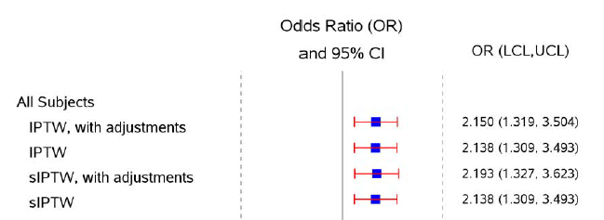

Forest Plot of Odds Ratios for Analyses of Complete Remission
IPTW=Inverse probability of treatment weighting. sIPTW=Stabilized inverse probability of treatment weighting.

Slide 42
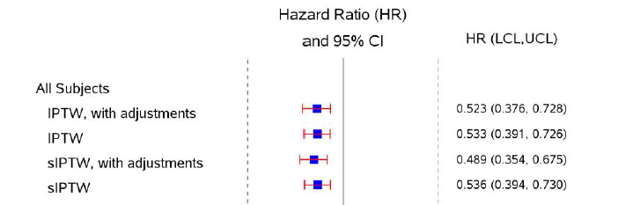

Forest Plot of Hazard Ratios for Analyses of Overall Survival
IPTW=Inverse probability of treatment weighting. sIPTW=Stabilized inverse probability of treatment weighting.

Slide 43
Efforts to Minimize Bias
At data collection stage – requested sites to provide all patients with R/R ALL – rather than having sites apply selection criteria
Inclusion/exclusion criteria applied centrally across all data sets
Study sites reflected centers of excellence for treatment of ALL
Weighting, stratified, and propensity score analyses to make endpoints more comparable
Variety of sensitivity analyses conducted in order to address assumptions

Slide 44
Challenges with External Historical Controls
Availability of and access to external control data
Data definitions – outcomes, exposure, covariates
Study biases:
  Selection
  Confounding
  Immortal Time
Treatment differences: across time, geographic regions
Heterogeneity

