Slide 1
Lecture 7 –
Drug Development Clinical Informatics e-Clinical Systems
Meir Pinco, Ph.D

Slide 2
Agenda
e-Clinical Systems
Clinical Data Standards
Computer System Validation
Observational Medical Outcomes Partnership (OMOP)

Slide 3
Data is critical for the clinical development process and clinical data is one of the most valuable assets to a pharmaceutical company. Clinical data is utilized as a basis for submission, approval, labeling and marketing of a drug.
The value of a new drug crucially depends on the quality of the data that should be well organized, easily accessible, thoroughly documented data out of well-designed clinical trials.

Slide 4
Drug Clinical Development
Regulatory
Agencies
Care
Givers
Drug Safety
Epidemiology
Data Management
Clinical Operations
Commercial
Project Management
Statistics
Drug
Study
Patient
Disease
Partners
Sponsors

Slide 5
e-Clinical Solutions
Safety Systems
Signal Detection
Clinical Trial Management System
Clinical Electronic Data Capture
Coding Tools
Reports Generators
Statistical & Analytical Tools
Electronic Trial Master File

Slide 6
Drug Safety
Adverse Events Reporting
Adverse Events
Clinical Trials
Call Centers
Literature Searches
Spontaneous Reports
Specialty Pharmacies
Expedited
Report
Aggregate
Report

Slide 7
AE Case Processing Workflow
Case Source
Case
Intake
Case Processing
Case
Output
Aggregate
Output
Output
Analysis
Safety Call Center
Reported Cases
Case Intake
Medical input/Review/Final Triage
Individual Case Reporting
Aggregate Data Review
Periodic
Reports
Clinical Trials SAEs
Safety Data
Processing
Safety Systems
Support
Signal
Analysis
Spontaneous Reports
Triage
Data
Entry
Query
Process
QC
Case
Close
Risk Benefit
Assessment
and Mitigation
Literature Search
Cases
Notes:
Starts with safety information coming from a variety of sources, such as clinical trials data, safety call centers, spontaneous reports, and literature searches.
Within the pv department each case is processed, causality is assessed to the product.
Cases are reported either as an expedited report or as part of an aggregate report, based upon pv policies, regulations, and guidance documents, to the regulatory authorities and other stakeholders.
Aggregate data are systematically analyzed for safety issues and assessed for benefit versus risk, and periodic safety update reports (PSURs) are submitted to the regulatory authorities as additional safety information is collected. This continues throughout the product’s life cycle.
Safety issues are addressed in order to mitigate risk. This may include changes in proposed labeling, change to a clinical trial design, implementation of a risk mitigation plan or discontinuation of development or use of a marketed product.

Slide 8
Drug Safety Database
Clinical & Post Marketing Safety System
Automated Case Processing
E2B Intake and Submission
Reporting
Periodic Reporting
Notes:
To effectively manage the complexity of safety and risk management, companies large and small are investing heavily in robust and compliant pharmacovigilance enterprise system.

Slide 9
What is a Safety Signal?
Safety signal is an information that arises from one or multiple sources which suggests a new, potentially causal association, or a new aspect of a known association between an intervention and an event or set of related events, either adverse or beneficial, that is judged to be of sufficient likelihood to justify verificatory action.
From the Council for International Organizations of Medical Sciences (CIOMS)

Slide 10
Detecting Safety Signals
Company Safety Database
FDA AERS
VigiBase WHO
Signal Strength Quantified
Signal Changes Monitored Over Time
Signal Record Created
Safety Signal Detected
Notes:
Pharmaceutical companies safety database- contained spontaneous AEs are collected from patients, health care providers, lawyers, health authorities, the medical literature, and other sources.
FDA Adverse Event Reporting System (AERS) database- support the FDA’s post-approval safety surveillance program. AERS contains data for all approved medicines and therapeutic biologic products.
VigiBase WHO global database which contains Individual Safety Case Reports submitted from 80 member countries in the WHO Programme for International Drug Monitoring from the start 1968 until today. VigiBase is maintained and developed on behalf of WHO by the Uppsala Monitoring Centre (UMC), situated in Uppsala, Sweden.
Detecting Safety Signals
System mines drug safety data for signals of adverse events that may be occurring more often than expected in corporate and public databases like FDA AERS or WHO VigiBase.
Once identified, signal strength is quantified on a numerical scale and depicted graphically
Changes in signals can be monitored as they develop over time
Allows create records of signals and other safety related topics of interest.
Designed for use in a 21 CFR Part 11-compliant environment.

Slide 11
Methods to Identify Safety Signals
Hands-on review of spontaneous cases and other safety information by trained medical personnel.
Signal of disproportionate reporting- applying statistical algorithms to large safety databases to determine whether certain adverse events (AEs) are being reported for a drug with a greater frequency than expected in on a statistical model.
Other methods include regression analysis, clustering, link analysis, deviation detection, and neural networks.

Slide 12
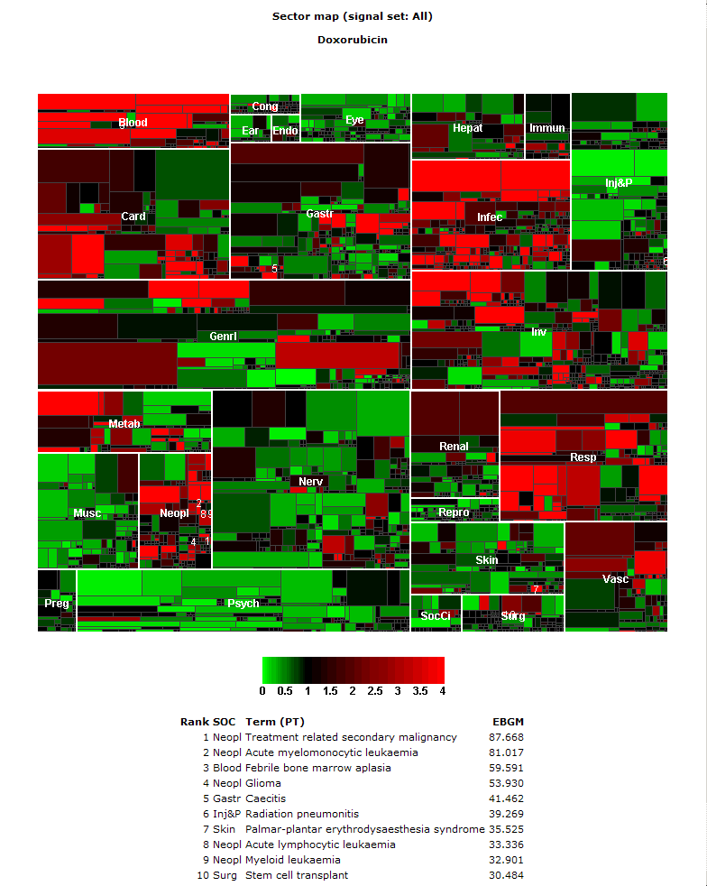
Empirica Signal - Sector Maps
Display disproportionality analysis in a sector map which allows visual assessment of signal strength
Large tiles are the MedDRA System Organ Class (SOC)
Smaller tiles are the Preferred Terms (PT)
Colors represent the strength of the signal – bright red indicates the AE’s occurring significantly higher than expected with the drug – bright green indicates significantly less occurrences than expected, or potential indications.

Slide 13
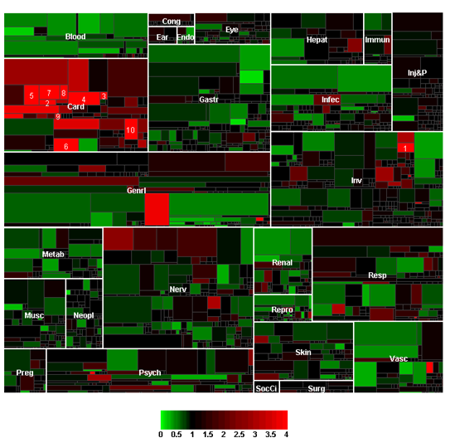
In this map, you can clearly see the large number of AE’s in the Cardiac SOC as represented by the bright red color.
This led to the 1998 market withdrawal of Seldane
Notes:
Seldane is an antihistamine. Antihistamines prevent sneezing, runny nose, itching and watering of the eyes, and other allergic symptoms. It was brought to market by Hoechst Marion Roussel (now Sanofi-Aventis). Seldane was withdrawn from the U.S. market in 1998.

Slide 14
Clinical Data Management
Clinical Data Management
CRF Design, Build & Manage
Database Design & Program
Validation
Medical Coding
Ex. Data Load, Integrate & Reconcile
Data Entry, Cleaning & Locking
Reports
Statistical Programming & Analysis

Slide 15

Clinical Electronic Data Capture (EDC)
Designed for clinical data collection, clinical EDC enables sponsors and CROs to streamline study setup and efficiently manage the execution of complex clinical trials, improving staff and site productivity, operational effectiveness, and IT efficiency.

Slide 16
Clinical Trials Management Systems (CTMS)
CTMS
Patient Management & Recruitment
Project Management
Budgeting & Financials
Investigator Management
Monitoring and Regulatory Compliance

Slide 17
Clinical Data Interchange Standards
Consortium (CDISC)
In the late 1990’s a consortium of industry companies collaborated and defined global standards aimed to streamline clinical research.
CDISC has spent the past decade developing and establishing standards that facilitate the collection, exchange, reporting and submission of clinical data along with the underlying standard terminology
CDISC standards have become accepted as the global standard for the development and implementation of EDC from trial planning to regulatory submission.

Slide 18
CDISC Components
SDTM
Study Data Tabulation Model
ADaM
Analysis Data Model
CDASH
Clinical Data Acquisition Standards Harmonization
LAB
ODM
Laboratory Data Model
SEND
Standard for Exchange of Nonclinical Data
Operational Data Model
Notes:
SDTM - Defines a standard structure for study data tabulations (datasets) that are to be submitted to a regulatory authority such as the FDA. Allows reviewers to develop a repository of all submitted studies and create stand alone tools to access, manipulate and view the study data.
ADam - Provides a framework that enables analysis of the data. ADaM enables reviewers and other recipients of the data to have a clear understanding of the data’s lineage from collection to analysis to results. he design of analysis data sets is generally driven by the scientific and medical objectives of the clinical trial.
SEND - is an implementation of the CDISC Standard Data Tabulation Model (SDTM) for nonclinical studies, which specifies a way to present nonclinical data in a consistent format. These types of studies are related to animal testing conducted during drug development.
CDASH- describes the basic recommended data collection fields for 18 domains, including demographics, adverse events, and other common domains that are common to most therapeutic areas and phases of clinical research.
LAB – vendor-independent format used to store and interchange lab data between clinical lab vendors and sponsor companies.
ODM - is designed to facilitate the regulatory-compliant acquisition, archive and interchange of metadata and data for clinical research studies.

Slide 19
Medical Coding
Medical coding is the process of assigning codes to clinical and safety data.
Storing clinical data in a controlled, consistent and reproducible manner for data retrieval and analysis is a essential to protect the patient’s safety, for success of the clinical study and for regulatory compliance.
Coding adverse events, serious adverse event, medical history (MedDRA) and concomitant medications (WHODRUG) is mandate in any given clinical trial.

Slide 20
Medical Dictionary for Regulatory Activities (MedDRA)
Term Level Definition
MedDRA is a medical coding dictionary developed by Maintenance and Support Services Organization (MSSO). Is supported by International Conference on Harmonization (ICH) on for registration of Pharmaceuticals for human use
SOC
Highest level of the terminology (26)
HLGT
Highest Level Group Term (333)
HLT
High Level Group Term (1,721)
PT
LLT
Preferred Term (21,345)
Lowest Level Term (74,229)
Representing anatomical or physiological system, etiology, or purpose
Superordinate 1 or more HTLs
Superordinate 1 or more PTs
Represents a single medical concept
Relate to single PT
Have identical LLT
SMQs
Standard MedDRA Queries (214)
Grouping of terms that relate to a defined medical condition or area of interest
MedDRA version18
Notes:
Standardised MedDRA Queries (SMQs) are tools developed to facilitate retrieval of MedDRA-coded data as a first step in investigating drug safety issues in pharmacovigilance and clinical development. SMQs are validated, pre-determined sets of MedDRA terms grouped together after extensive review, testing, analysis, and expert discussion. SMQs are a unique feature of MedDRA and provide a strong tool to support safety analysis and reporting. The SMQ topics are intended to address the important pharmacovigilance topics needed by regulatory and industry users. SMQs have been developed with the CIOMS Working Group on Standardised MedDRA Queries that provides pharmacovigilance expertise and validation of SMQs. The SMQs are maintained with each release of MedDRA by the MSSO.

Slide 21
LLT to SOC
Respiratory, thoracic and mediastinal disorders (SOC)
Respiratory tract infections (HLGT)
Influenza (PT)
Flu symptoms (LLT)
Influenza (epidemic) (LLT)
Influenza B virus infection (LLT)
Flu (LLT
Nasal herpes
Neonatal respiratory disorders
Viral lower respiratory tract infections
Viral upper respiratory tract infections (HLT)

Slide 22
Example of SMQs Available
Anaphylactic reaction
Cerebrovascular disorders
Convulsions
Depression and suicide/self-injury
Drug abuse, dependence and withdrawal

Slide 23
World Health Organization Drug Dictionary (WHODRUG)
WHODRUG is maintained and updated by Uppsala Monitoring Centre (UMC).
As of December 1, 2015 the WHO Drug Dictionary Enhanced contains:
  348,793 Unique Names
  2,510,297 different Medicinal Products and Trade Names, including, for example, form and strength information.
  13,543 different ingredients mentioned in these products
  Entries from over 134 countries

Slide 24
Medical Coding Methods
Hybrid
Auto-Encoders
Manual
Coding Conventions
Notes:
Autoencoders- A programmatically assisted process for matching a reported term to a dictionary term.
Manual Coding- A person selects an appropriate dictionary entry
Hybrid Approaches- Autoencoder are first automatically code reported terms that match a dictionary term or that match a term that has previously been coded (synonym list). The terms that are not auto-encoded are then manually coded.
To ensure coding uniformity and consistency, a coding convention document should be established for each clinical program and marketed product. Coding convention should include-
How to handle terms listed as both individual signs, symptoms and diagnosis.
For example: chest pain, elevated cardiac enzymes, myocardial infraction. Should these terms lumped together and coded to only one term(Myocardial Infraction) or should terms split?
The approaches to be followed for handling vague and non-medical terms
What MedDRA version to use and how to handle coding revisions based on the version selected.
The process need to be followed for QC and consistency check.

Slide 25
Dictionaries Change Management
MSSO releases updated MedDRA versions twice a year - in March and September. The March release is the main annual release and contains changes at the HLT level and above along with LLT and PT changes. The September release typically contains changes only at the LLT and PT level.
Dictionary version control is critical since dictionaries updated versions occasionally change pathways to body systems or organ classes.
Dictionary updates can have a substantial effect on conclusions regarding a product’s effects and may have an impact the labeling of the product.

Slide 26
FDA Guidelines on General Principles of Process Validation (1987)
Establishing documented evidence which provides a high degree of assurance that a specific process will consistently produce a product meeting its predetermined specifications and quality attributes.
Notes:
Computer system validation (CSV) is the process of establishing documented evidence that a computerized system will consistently perform as intended in its operational environment.

Slide 27
Why is Validation Needed
Reduces risk and legal liability
Having the objective evidence that computer systems are operating to their intended use.
Software is constantly evolving to keep up with the increasingly complex needs of the people that use it and the regulatory requirements.

Slide 28
Validation Process
Validation Plan
Project Plan
Installation Qualification
IQ
Performance Qualification
OQ
Operational Qualifications
OQ
Validation Summary Report

Slide 29
Specification and Qualification Relationships
User Requirement Specification
PQ
Verifies
Functional Specification
OQ
Verifies
Design Specification
IQ
Verifies
System Build

Slide 30
Observational Medical Outcomes Partnership (OMOP)
In partnership with PhRMA (Pharmaceutical Research and Manufacturers of America) and the FDA, the Foundation for the National Institutes of Health (FNIH) launched in 2008 the OMOP to identifying the most reliable methods for analyzing huge volumes of data drawn from heterogeneous sources.

Slide 31
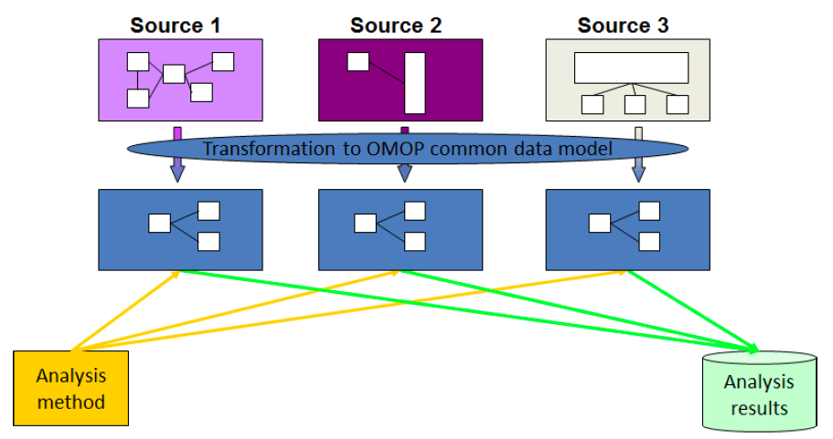
OMOP Common Data Model (CDM)
CDM allows for the systematic analysis of disparate observational databases.
The transform data contained within disparate databases into a common format, and then perform systematic analyses using a library of standard analytic methods applied on the common format.

Slide 32
OMOP Challenge
OMOP worked to design experiments testing a variety of analytical methodologies in a range of data types to look for drug impacts that are already well known.
OMOP research yielded some confidence that particular methods used with particular data types could potentially identify reliable correlations between individual medical interventions and specific health outcomes.

Slide 33
OMOP Work
Built a research lab (RL) that include a common data model (CDM),
Medical dictionary to enable the mapping of the source data to standard terminology and classification schemes
88 million patient records from clinical and administrative sources in a centralized database,
Access to additional patient records through its distributed data partners
Multiple analytical tools
Shared methods library and a scalable infrastructure.
OMOP Web RL available in the public domain.

Slide 34

Questions?

Slide 35
Signal Disproportionality Analysis
A score can be generated for a particular AE-medicine combination (e.g., frequency of bleeding disorder with Drug X)
Score compared with the score for all medicines in the database (i.e., frequency of bleeding disorder across all medicines).
Depending on the clinical context, when the AE-Drug X score is greater than the AE-all medicine score, a safety signal may have been detected.

Slide 36
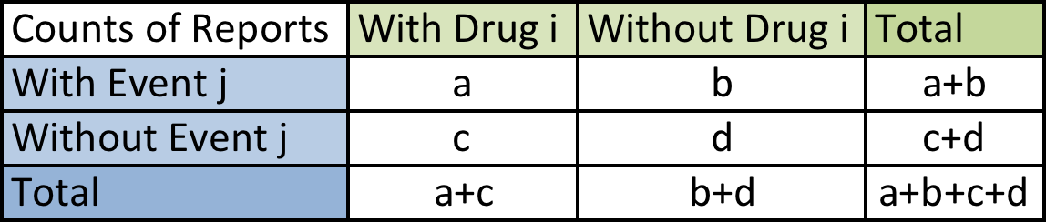
Measures of Disproportionality
Relative Reporting Ratio (RRR)
The overall proportion of reports having event j is (a+b)/(a+b+c+d)
If there are (a+c) reports involving drug i, the expected number of reports (e) of drug i with event j would be (assuming no association of report I with the event j)
e=(a+c)(a+b)/(a+b+c+d)
The Relative Reporting Ratio “RRR”
= a/e = [a/(a+b)(a+c)/(a+b+c+d)]

Slide 37
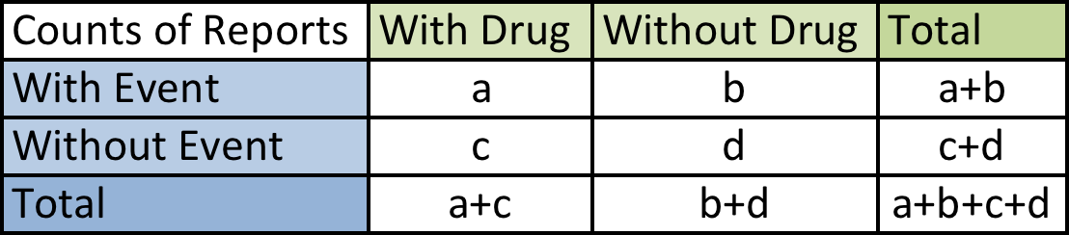
Measures of Disproportionality
Proportional Reporting Ratio(PRR)
PRR = [a/(a+c)]/[b/(b+d)]
Reporting Odds Ratio (ROR)
ROR = (a/c)/(b/d)=ad/bc

Slide 38
Limitations of Spontaneous Reports
Spontaneous report system data do not inherently include true “denominators,” a word used to describe the entire population of patients who have taken a drug.
Biases -
  Drug-competition bias - reports of well-established drug-event associations may mask alerts that arise from other drugs.
  Event-competition bias - known events may mask an association with new events for a given drug or drug class.
  Notoriety bias- Change in event reporting that is a result of an increase of increased recognition of the effect of the drug and not with an increased incidence.

