Slide 1
Non-Mendelian Genetics
Epidemiology 217: Lecture 9
Eric Jorgenson, PhD
March 1st, 2016
Kaiser Permanente Research

Slide 2
Outline
Epigenetics: DNA Methylation and Histone Modification
Parent-of-origin Effects
Mitochondrial DNA
De Novo Variation

Slide 3
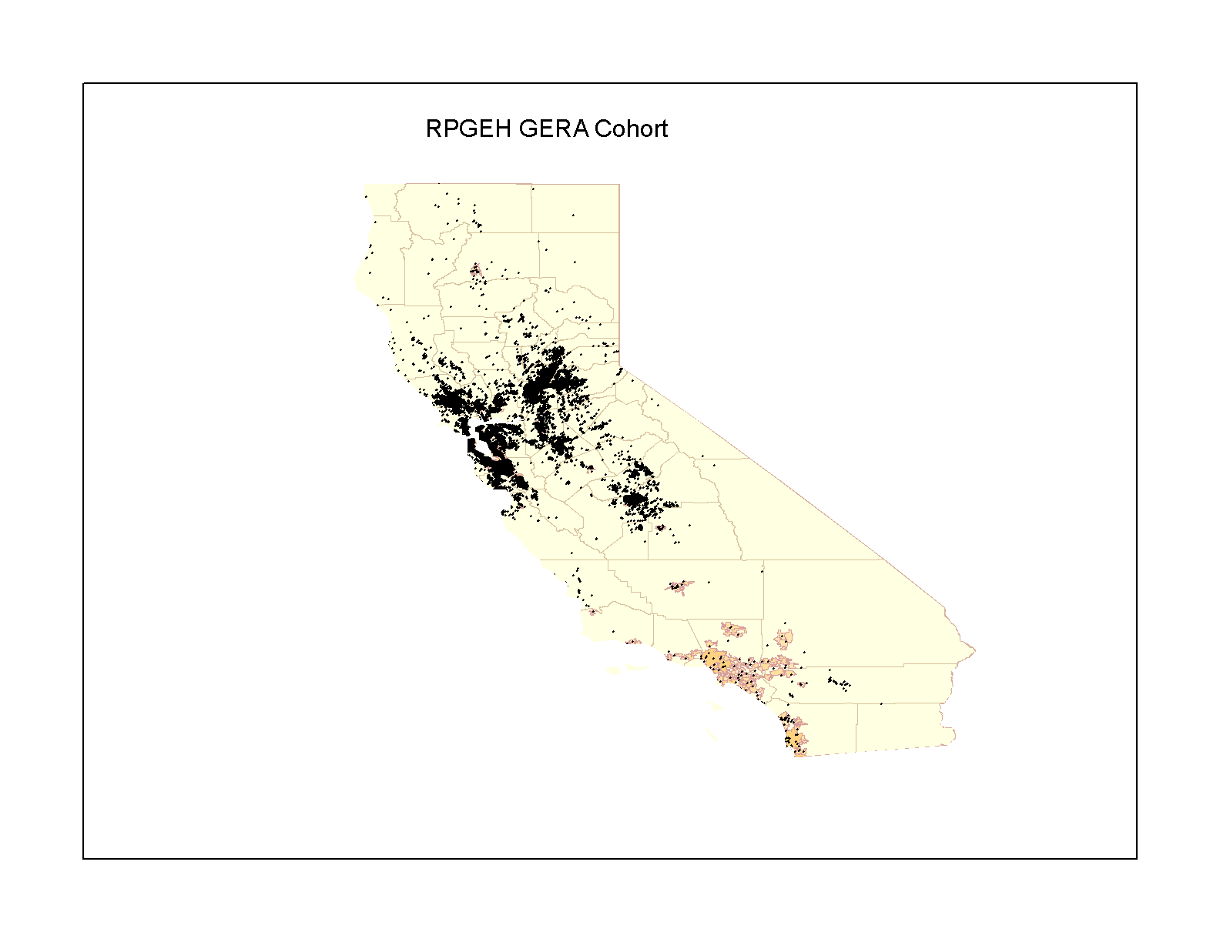
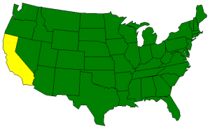
Kaiser Permanente Northern California Members
3
Notes:
GERA participants live in Northern California

Slide 4
Research Program on Genes, Environment, and Health
430,000 Adult Members of Kaiser Permanente Northern California Provided Informed Consent
Behavioral and
Demographic Data
from Surveys
Kaiser Permanente
Electronic
Health Records
RPGEH Resource
For Research
Genetic Data
from Biospecimens
Environmental
Exposure Data
Research Studies
Co-directors: Catherine Schaefer and Neil Risch
Notes:
A resource for studies of the genetic and environmental influences
on health, disease, and aging (2007)
RPGEH developed by Cathy and Neil
Build a resource
430K
Combines…
Initially funded by:
The Robert Wood Johnson Foundation
The Wayne and Gladys Valley Foundation
The Ellison Medical Foundation
Kaiser Permanente’s Community Benefit Program

Slide 5
RPGEH Survey Respondents, Biospecimens, and GERA
430,000 Survey Respondents
190,000 Biospecimens
110,266 GERA Cohort
Notes:
In total, 430K, >190K,
GERA includes 110,266

Slide 6
GERA Cohort Characteristics
 | Number of Subjects | %
Age at Specimen Donation
18-39 | 7,025 | 6.3
40-59 | 33,344 | 30.2
60-79 | 57,856 | 52.4
80+ | 12,041 | 10.9
Sex
Women | 63,883 | 57.9
Men | 46,383 | 42.1
Race/Ethnicity
African American | 3,765 | 3.4
Asian | 8,512 | 7.7
Hispanic | 7,917 | 7.2
Non-Hispanic White | 89,259 | 81.0
Total | 110,266 | 100.0
Notes:
Baseline characteristics
More women than men
Broad age range: average 62
Diverse

Slide 7
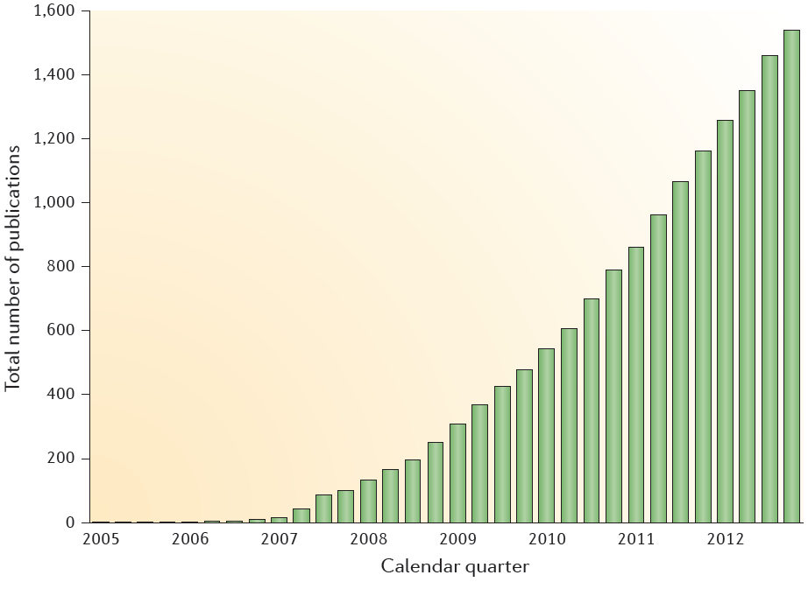
2,111 Published Genome-Wide Association Studies
http://www.genome.gov/gwastudies/

Slide 8
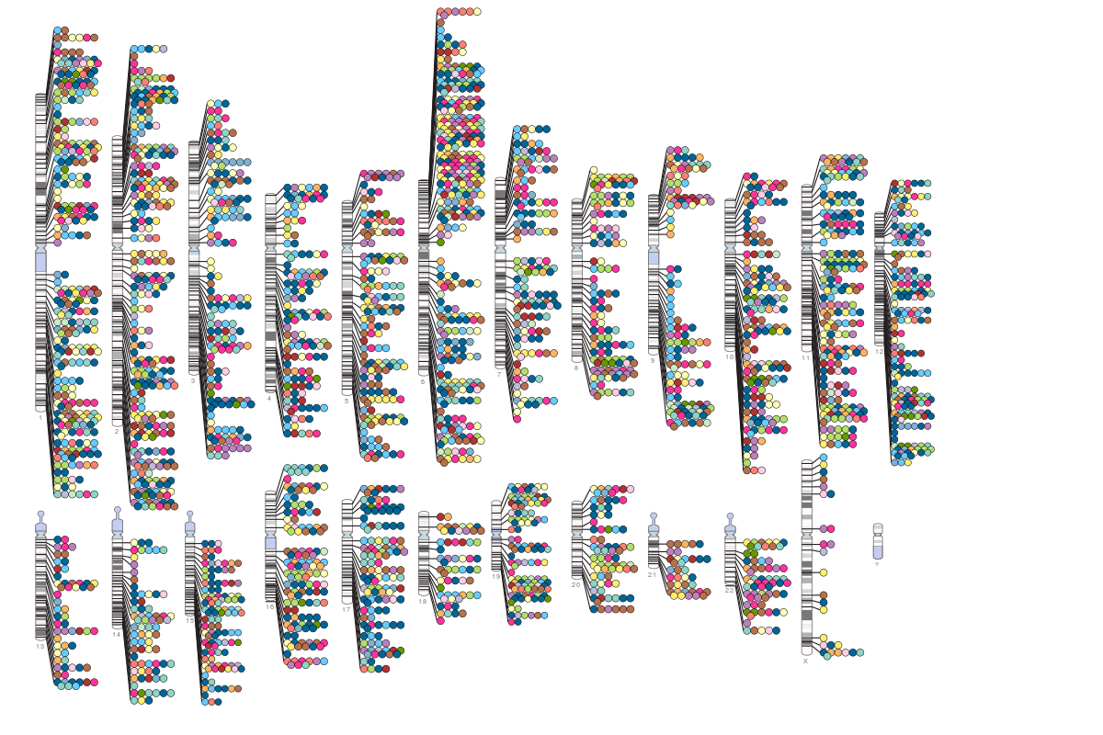
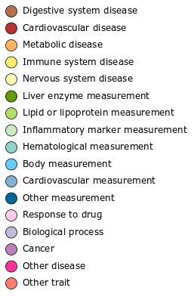
15,396 SNPs Associated in GWAS
http://www.genome.gov/gwastudies/

Slide 9
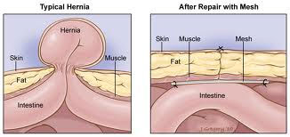
Hernia: A Condition with No GWAS Studies
Hernia Repair Surgery

Slide 10
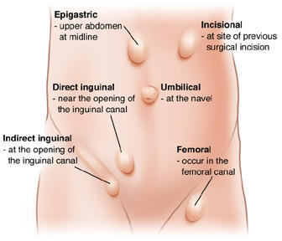
Hernias Are Classified by Anatomical Site
Hernia Repair Surgery

Slide 11
Inguinal Hernias Are Common in GERA
Hernia Repair Surgery
GERA Cohort | Inguinal Hernia Cases |  |  |  |  |  | Controls
Non-Hispanic whites | All (n=5,295) |  | Direct (n=2,335) |  | Indirect (n=2,647) |  | (n=67,510)
Men | 4,746 | 89.6% | 2,193 | 93.9% | 2,408 | 91.0% | 25,011 | 37.1%
Women | 549 | 10.4% | 142 | 6.1% | 239 | 9.0% | 42,499 | 63.0%
Jorgenson et al. Nature Communications 2015
Notes:
Hernia Type
ICD9 Diagnosis Codes
ICD9 Procedure Codes
CPT4 Codes
Inguinal Hernia
550.x
17.x, 53.0x, 53.1x
49491, 49492, 49495, 49496, 49500, 49501, 49505, 49507, 49520, 49521, 49525, 49650, 49651, 49659
Direct Inguinal
17.11, 17.21, 17.23, 53.01, 53.03, 53.11, 53.14, 53.13, 53.16, 53.17
Indirect Inguinal
17.12, 17.22, 17.23, 53.02, 53.04, 53.12, 53.15, 53.13, 53.16, 53.17

Slide 12
GWAS Can Identify Loci, not Genes
Hernia Phenotype Development
Genetic Analysis of Hernia Risk
Hernia Genetic Risk Loci
Hernia Risk Alleles

Slide 13
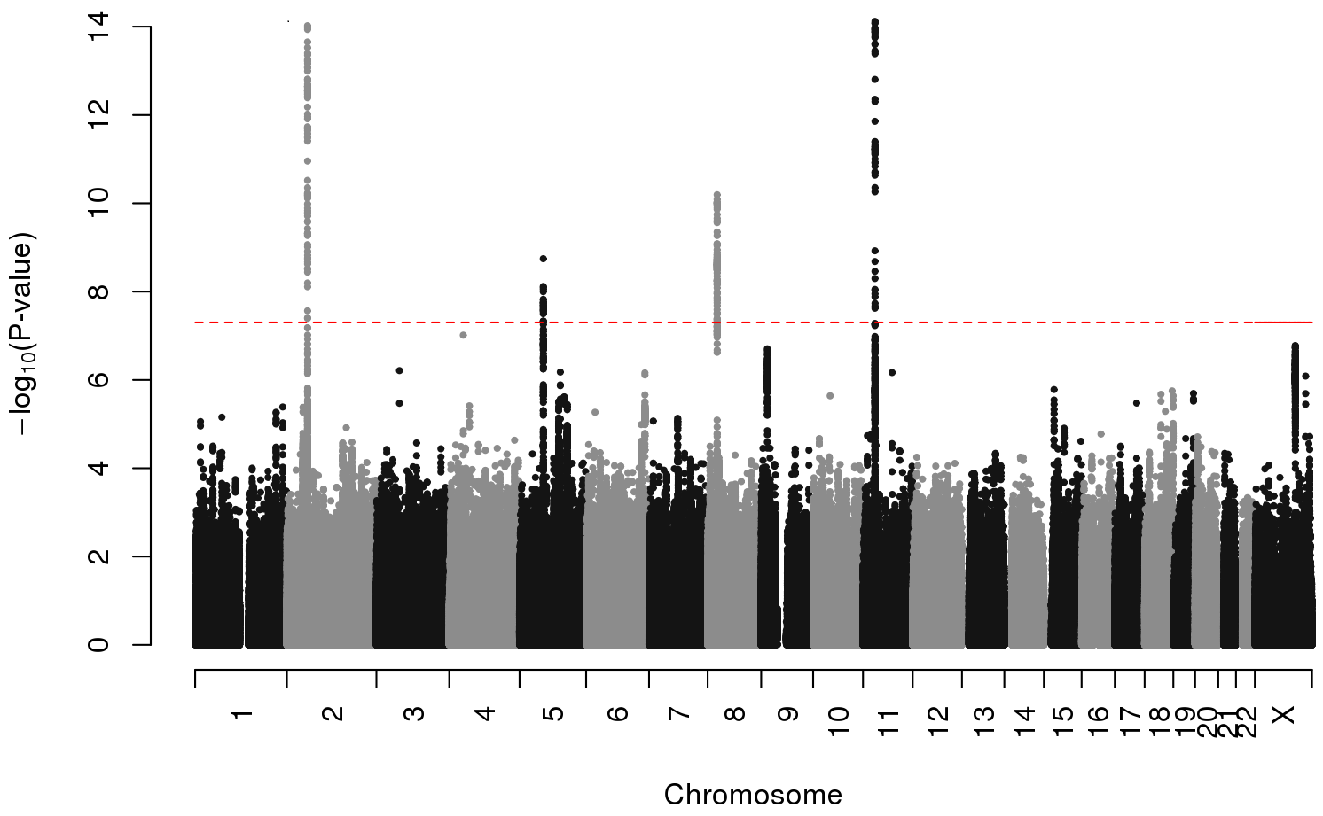
Manhattan Plot of Inguinal Hernia GWAS Results
EFEMP1
WT1
EBF2
ADAMTS6
Jorgenson et al. Nature Communications 2015
Notes:
Figure 1. Manhattan plot of GWAS findings in the GERA discovery cohort. Four novel inguinal hernia risk loci with genome-wide significant associations were identified in the regions of EFEMP1 (chromosome 2), ADAMTS6 (chromosome 5), EBF2 (chromosome 8), and WT1 (chromosome 11). The dotted red line represents a significance threshold of P=5.0x10⁻⁸.

Slide 14
Hernia Repair Replication Sample: 23&Me Subjects
“Have you ever had any of the following gastrointestinal surgeries (Hernia repair)?”
23&Me Subjects | Hernia Repair Cases (n=9,701) |  | Controls (n=82,743)
Men | 6,812 | 70.2% | 41,611 | 50.2%
<30 | 246 | 3.6% | 5,147 | 12.4%
31-45 | 1,087 | 16.0% | 14,109 | 33.9%
46-60 | 1,605 | 23.6% | 10,259 | 24.7%
>60 | 3,874 | 56.9% | 12.096 | 29.1%
Women | 1,889 | 29.8% | 41,132 | 49.8%
<30 | 63 | 3.3% | 4,252 | 10.3%
31-45 | 317 | 16.8% | 11,099 | 27.0%
46-60 | 603 | 31.9% | 11,431 | 27.8%
>60 | 906 | 48.0% | 14,350 | 34.9%
Jorgenson et al. Nature Communications 2015
Notes:
“Have you ever had any of the following gastrointestinal surgeries (Hernia repair)?”

Slide 15
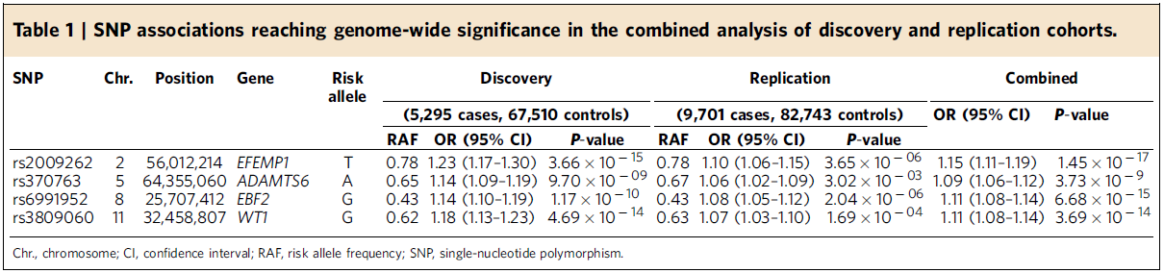
Replication of Inguinal Hernia Significant Associations
Jorgenson et al. Nature Communications 2015
Notes:
Top associated SNPs at four loci replicate in an independent sample

Slide 16
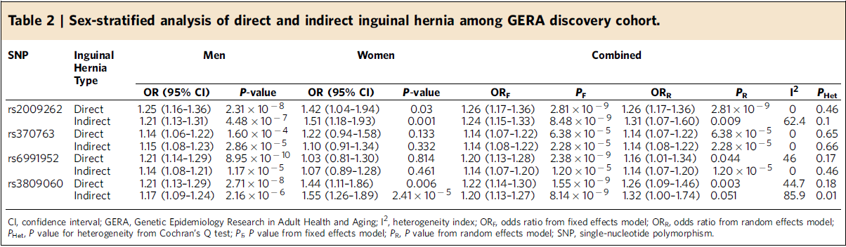
Clinical Subtyping of Inguinal Hernia Risk SNPs
Jorgenson et al. Nature Communications 2015
Notes:
Anatomical differences could lead to different effects in men and women and across inguinal hernia subtypes.
We do not see evidence of that in the discovery cohort.

Slide 17
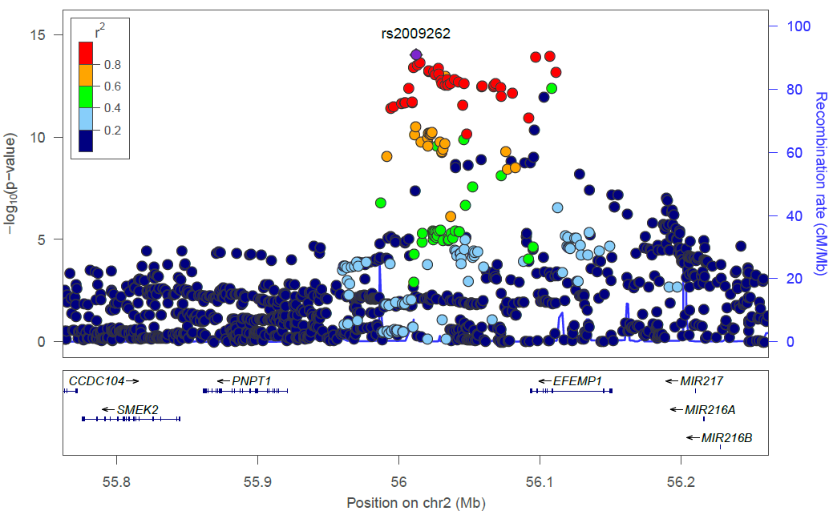
What Is in an Inguinal Hernia Risk Locus?
Jorgenson et al. Nature Communications 2015
Notes:
Supplementary Figure 1: (A-D) Locus Zoom plots of the top four loci associated with inguinal hernia in the GERA discovery cohort. Plots show association results of SNPs in the GWAS of the GERA cohort samples and recombination rates. Each circle represents the -log₁₀ P value (y axes) and chromosomal position (x axes) of SNPs tested for association. The top associated SNP in each region is identified by its rsID. The color of each circle reflects the extent of LD with the top SNP. Physical positions are based on NCBI build 37 of the human genome. The relative position of genes and transcripts are displayed below the association plot.

Slide 18
Are Genes in Risk Loci Expressed in Relevant Tissue?
Hernia Phenotype Development
Genetic Analysis of Hernia Risk
Hernia Genetic Risk Loci
Hernia Risk Alleles
qRT-PCR and RNA-seq of Genes in Hernia Risk Loci
Tissue Specific Expression of Putative Risk Genes
Notes:
Now that we have identified genetic risk loci, we want to demonstrate
tissue specific expression of genes in these loci

Slide 19
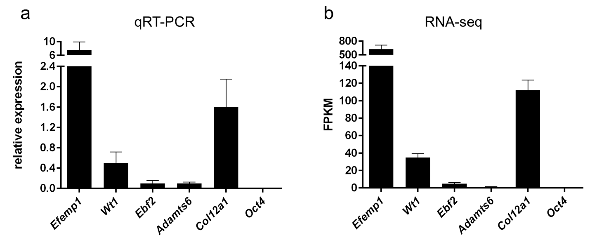
Genes at Inguinal Hernia Risk Loci are Expressed in Mouse Connective Tissue
Jorgenson et al. Nature Communications 2015
Notes:
Note that it is not proven that these are the causal genes

Slide 20
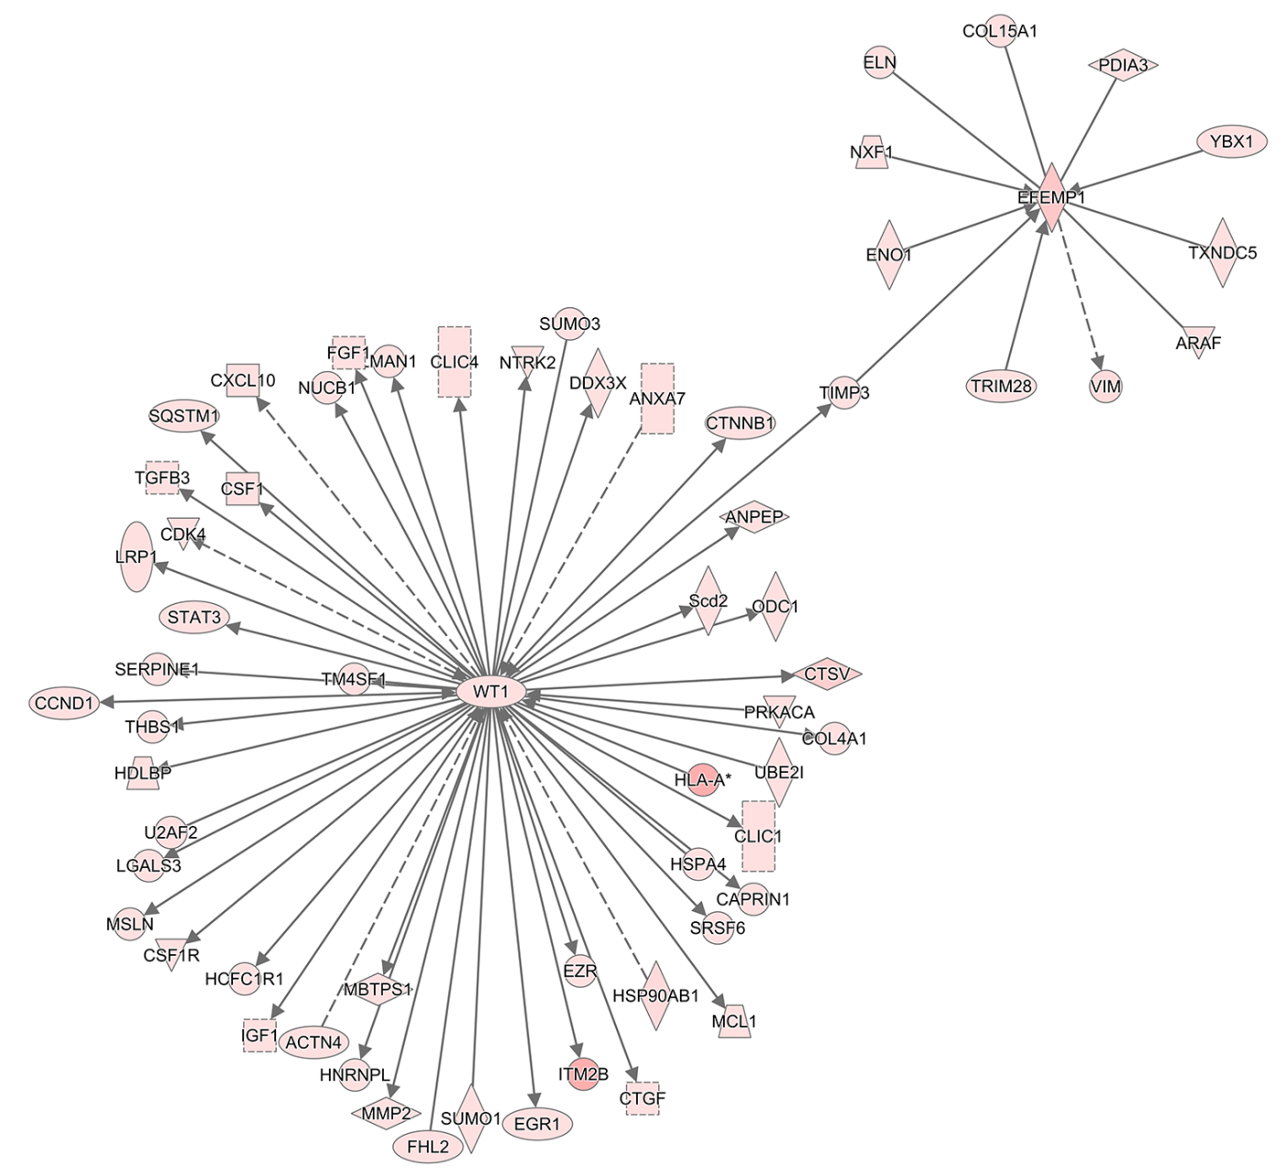
Expression Network Analysis Identifies a Pathway
Jorgenson et al. Nature Communications 2015
Notes:
TIMP3 is an inhibitor of matrix metalloproteinases
Arbitrary cut off:
Fragments per kilobase of 30: 2,059 genes

Slide 21
What Have We Learned about Inguinal Hernia Genetics?
4 Inguinal Hernia Risk Loci
  Confirmed through replication in an independent cohort
  Genes in the loci are expressed in equivalent mouse tissue
Hernia Loci Show Evidence of Pleiotropy
  EFEMP1: Height, Forced Vital Capacity, Multiple Cancers
  WT1: Wilms’ Tumor, Tuberculosis
  EBF2: Prostate Cancer (different area in the gene)
  ADAMTS6: Central Corneal Thickness, Osteosarcoma
Moving Toward Mechanism
  Collagen homeostasis
  Matrix metalloproteinases and their inhibitors (WT1 and ADAMTS6)
  Elastin and chronic obstructive pulmonary disease (EFEMP1)

Slide 22
What Have We Learned about Inguinal Hernia Genetics?
4 Inguinal Hernia Risk Loci
  Confirmed through replication in an independent cohort
  Genes in the loci are expressed in equivalent mouse tissue
Hernia Loci Show Evidence of Pleiotropy
  EFEMP1: Height, Forced Vital Capacity, Multiple Cancers
  WT1: Wilms’ Tumor, Tuberculosis
  EBF2: Prostate Cancer (different area in the gene)
  ADAMTS6: Central Corneal Thickness, Osteosarcoma
Moving Toward Mechanism
  Collagen homeostasis
  Matrix metalloproteinases and their inhibitors (WT1 and ADAMTS6)
  Elastin and chronic obstructive pulmonary disease (EFEMP1)

Slide 23
What Have We Learned about Inguinal Hernia Genetics?
4 Inguinal Hernia Risk Loci
  Confirmed through replication in an independent cohort
  Genes in the loci are expressed in equivalent mouse tissue
Hernia Loci Show Evidence of Pleiotropy
  EFEMP1: Height, Forced Vital Capacity, Multiple Cancers
  WT1: Wilms’ Tumor, Tuberculosis
  EBF2: Prostate Cancer (different area in the gene)
  ADAMTS6: Central Corneal Thickness, Osteosarcoma
Moving Toward Mechanism
  Collagen homeostasis
  Matrix metalloproteinases and their inhibitors
  Elastin and chronic obstructive pulmonary disease

Slide 24
What Do We Still Need to Learn about Hernia Genetics?

Slide 25
What Do We Still Need to Learn about Hernia Genetics?
Where are the Regulatory Elements in Hernia Risk Loci?
Which Variants Disrupt the Function of These Elements?

Slide 26

Genes Are Like Lightbulbs
Genes

Slide 27


Genes Are Like Lightbulbs
Genes
Promoters

Slide 28
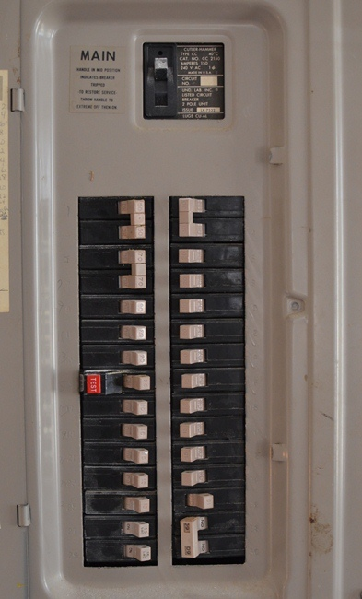
Genes Are Like Lightbulbs
Genes
Enhancer
Promoters

Slide 29
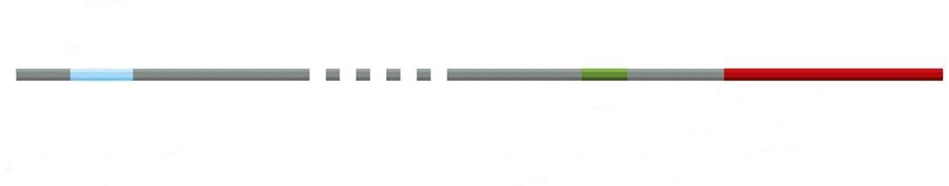
Proteins Bind Regulatory Elements
Enhancer Promoter Gene

Slide 30
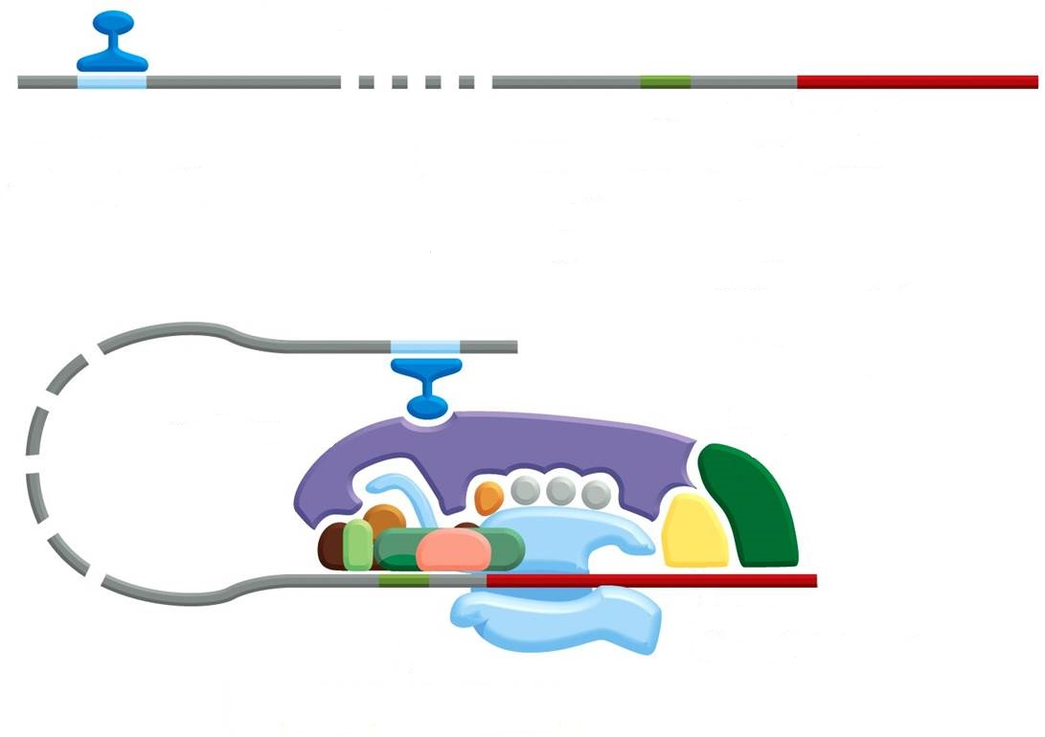
Proteins Bind Regulatory Elements
Activator
Enhancer Promoter Gene

Slide 31
Proteins Bind Regulatory Elements
Activator
Enhancer Promoter Gene

Slide 32
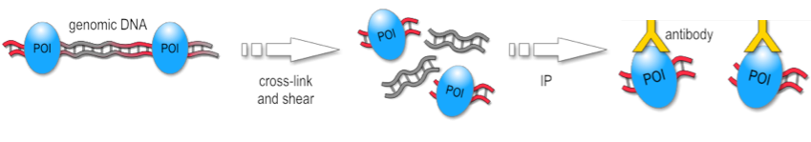
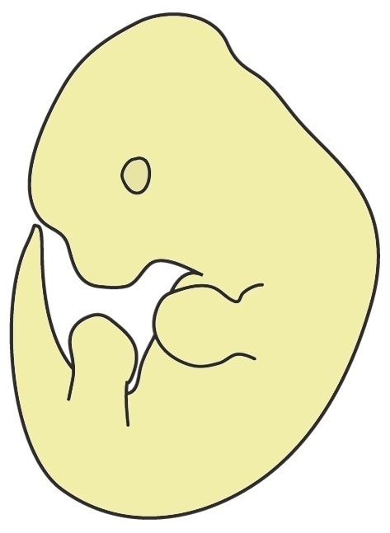
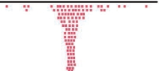
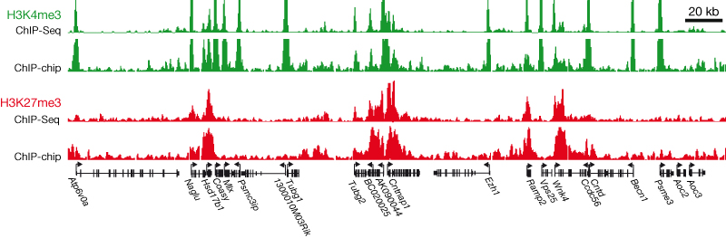
ChIP-seq Can Identify Regulatory Elements
Cross-link DNA and Proteins
Shear DNA
Isolate Tissue
Immunoprecipitate
Reverse Cross-link
Sequence and Map Reads
Determine Location

Slide 33
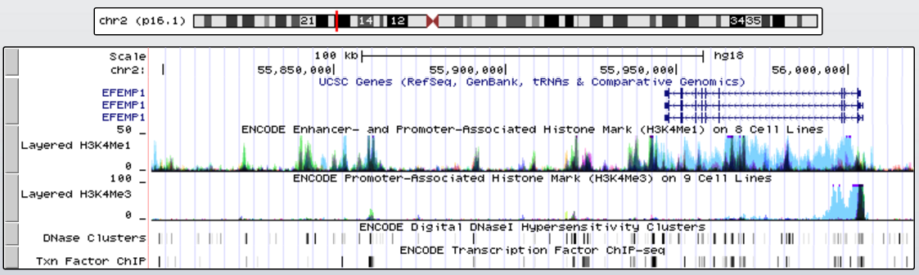
ChIP-seq for the EFEMP1 Region from ENCODE

Slide 34
What Do We Still Need to Learn about Hernia Genetics?
Where are the Regulatory Elements in Hernia Risk Loci?
Which Variants Disrupt the Function of These Elements?

Slide 35
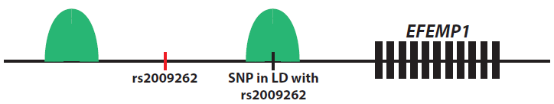
Identify SNPs in Regulatory Elements
Notes:
Supplementary Figure 1: (A-D) Locus Zoom plots of the top four loci associated with inguinal hernia in the GERA discovery cohort. Plots show association results of SNPs in the GWAS of the GERA cohort samples and recombination rates. Each circle represents the -log₁₀ P value (y axes) and chromosomal position (x axes) of SNPs tested for association. The top associated SNP in each region is identified by its rsID. The color of each circle reflects the extent of LD with the top SNP. Physical positions are based on NCBI build 37 of the human genome. The relative position of genes and transcripts are displayed below the association plot.

Slide 36
SNPs in the EFEMP1 Locus Might Affect Binding
SNP | Chromosome | Position | RegulomeDB Score
rs11888023 | 2 | 56,006,984 | 2b
rs6739641 | 2 | 56,020,961 | 2b
rs3791679 | 2 | 56,096,891 | 2b
rs1367228 | 2 | 56,112,439 | 3a
rs78857879 | 2 | 56,135,098 | 3a
rs3762515 | 2 | 56,150,863 | 3a
rs6704991 | 2 | 56,179,758 | 3a
rs11893573 | 2 | 56,007,033 | 4
rs1346782 | 2 | 56,037,093 | 4
rs11680015 | 2 | 56,090,238 | 4
rs4672080 | 2 | 56,188,552 | 4
rs1432561 | 2 | 56,188,647 | 4
rs6747490 | 2 | 56,193,417 | 4
rs13431149 | 2 | 56,193,664 | 4
rs1432563 | 2 | 56,193,908 | 4
…and 132 other SNPs
Jorgenson et al. Nature Communications 2015
Notes:
Supplementary Table 4: SNPs classified as likely to affect binding according to RegulomeDB in the four inguinal hernia risk loci

Slide 37
Identifying Causal Variants
Hernia Phenotype Development
Genetic Analysis of Hernia Risk
Hernia Genetic Risk Loci
Hernia Risk Alleles
qRT-PCR and RNA-seq of Genes in Hernia Risk Loci
ChIP-seq and Differential Enhancer Assays
CRISPR/Cas9 of
Associated Alleles
Tissue Specific Expression of Putative Risk Genes
Regulatory Elements in Hernia Risk Loci
Alterations in Regulatory Elements Influence Risk
Notes:
CRISPR/Cas9

Slide 38
Outline
Epigenetics: DNA Methylation and Histone Modification
Parent-of-origin Effects
Mitochondrial DNA
De Novo Variation

Slide 39
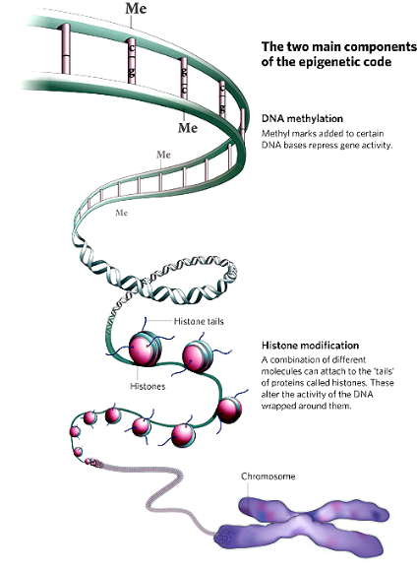
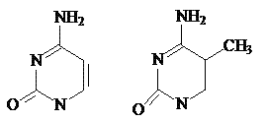
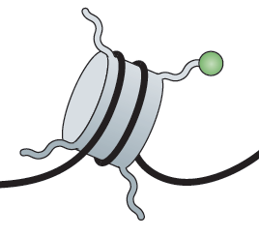
The Two Main Components of the Epigenetic Code
DNA methylation
Histone modification
Notes:
DNA Methylation occurs predominantly at CpG dinucleotides in mammals
Different molecules can attach to the tails of proteins called “histones”

Slide 40
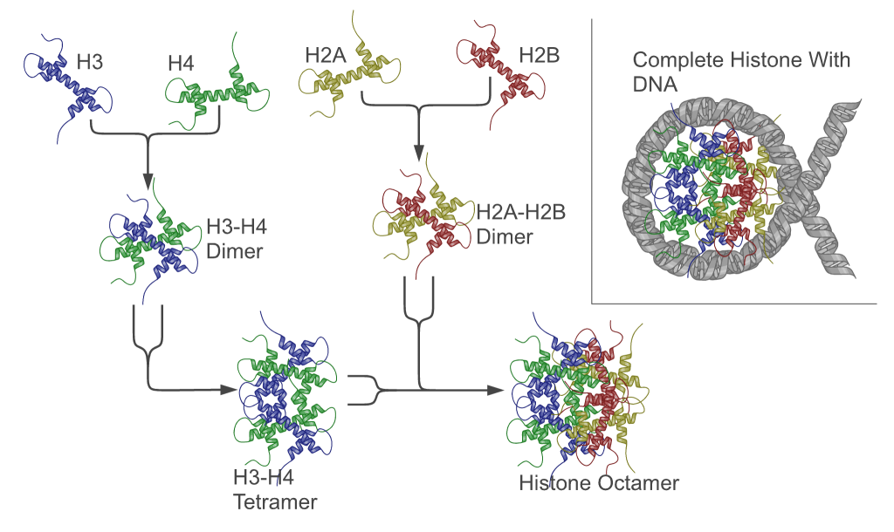
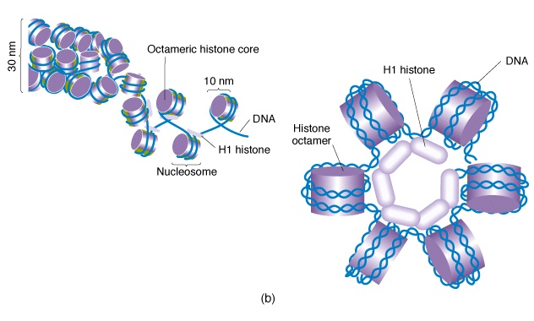
Chromatin: Histones Provide Structure to DNA
Chromatin
Notes:
Histones are proteins; they combine to form an octamer (8 subunits)
DNA wraps around the histone octamer twice to form a nucleosome
The resulting structured DNA and protein complex is called chromatin
Changes in chromatin lead to changes in gene regulation
in eukaryotes
80bp DNA = 1 turn
DNA wraps two times and 145bp DNA associates with each core
Linker DNA = 55bp
Human nucleus = 15-30 x 10⁶ nucleosomes

Slide 41
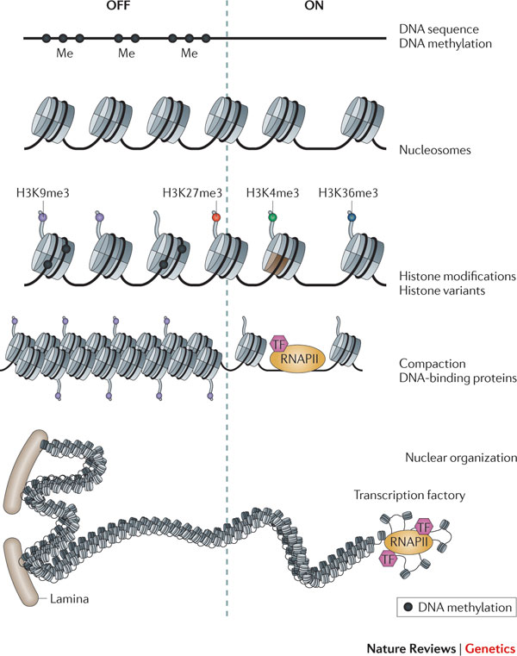
Chromatin Structure is Determined by
DNA Methylation and Histone Modifications
Notes:
Chromatin structure altered directly
Inhibit binding of repressive factors
Recruit activating factors

Slide 42
Histone Modifications
Nucleosome
Histone tails
Chemical modification
DNA (147 bp)
Modification | Role in transcription | Histone-modified sites
Acetylation | Activation | H3 (K9,K14,K18,K56)
 |  | H4 (K5,K8,K12,K16)
 |  | H2B (K6,K7,K16,K17)
Phosphorylation | Activation | H3 (S10)
Methylation | Activation | H3 (K4,K36,K79)
 | Repression | H3 (K9,K27)
 |  | H4 (K20)
Notes:
Residues of histone tails can be covalently modified. There are at least 150 different modifications that define the histone code

Slide 43
Histone Acetylation and Deacetylation
AC
ON
HAT
activator
Upstream activator sequence
HAT= Histone acetyltransferase
AC
HDAC
OFF
repressor
Upstream repressive sequence
HDAC= Histone deacetylase

Slide 44
Acetylation Reduces Histone Binding to DNA
AC
Transcription factor
Transcription ON
Closed
Open
Notes:
Neutralization of positively charged lysines by acetylation reduces the strength of binding of the histones to the negatively charged DNA and thus opens DNA binding sites.

Slide 45
Histone Methylation
Occurs at either lysines or arginines
Activates or represses gene transcription depending on the position within the histone tail
Multiple possible methylation states on each residue (-mono, -di or –tri methylated).

Slide 46
DNA Methylation
Unmethylated
de novo
methylation
Dnmt3a
Dnmt3b
Methyl CpG
Methylated
DNA
replication
Maintenance
Methylation
Dnmt1
Hemimethylated
Notes:
Cytosine methylation occurs predominantly in CpG dinucleotides in mammalian cells.
DNA methylation is established and maintained by DNA methyltransferases.
So far Dnmt1 and Dnmt3a and Dnmt3b have been shown to have methylase activity on CpG DNA.

Slide 47
DNA Methylation Affects Gene Expression in Two Ways
Model 1
The presence of the methyl groups interferes with the binding of transcription factors that activate transcription from a specific gene.
Transcription factor
Model 2
Repressing proteins are attracted by methylated DNA.
Repressive factor

Slide 48
Using Bisulfite Sequencing to Study DNA Methylation
Treatment with sodium bisufite converts all cytosines (C) in uracils (U)
unless they are methylated (C^{m}).
m
CTGTCGAGTCGT
GACAGCTCAGCA
m
m
UTGTCGAGTUGT
GAUAGCTUAGUA
m
m
TTGTCGAGTTGTAT
AACAGCTCAACATA
Bisulfite
treatment
PCR
Sequencing
Notes:
After PCR the uracils are substitute with thymines (T). Sequencing allows to determine is a sequence is mainly methylated (>CG) or hypomethylated (>TG).

Slide 49
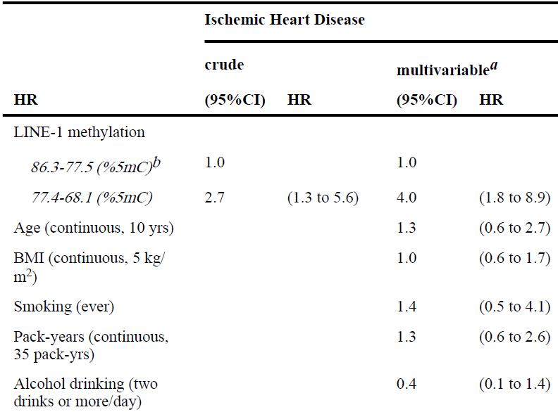
DNA Methylation and Heart Disease: Incidence
Baccarelli et al. Epidemiology 2010
Notes:
Long Interspersed Nucleotide Elements
Repetitive, highly methylated sequences
Demethylation of LINE-1 increases their activity as transposable elements
That leads to genomic alteration and deregulates gene transcription

Slide 50
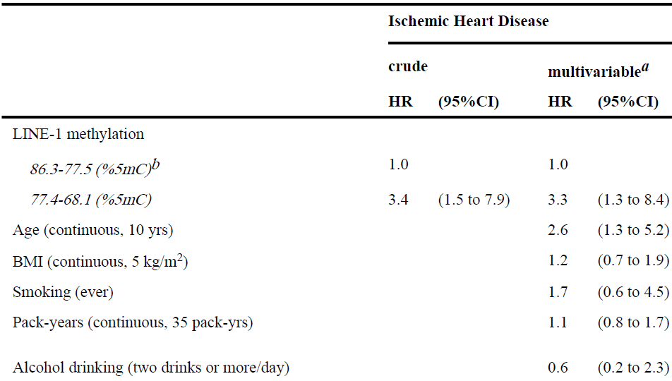
DNA Methylation and Heart Disease: Mortality
Baccarelli et al. Epidemiology 2010

Slide 51
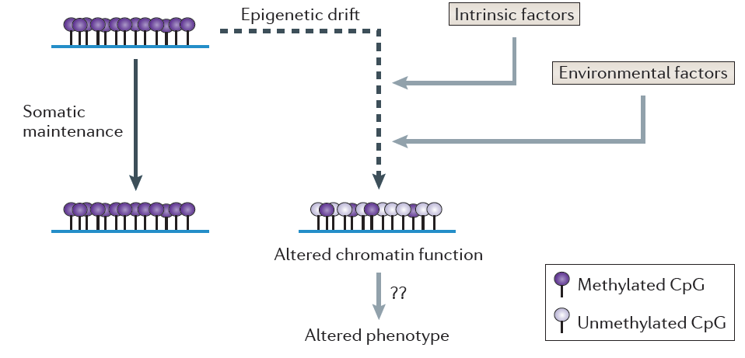
The Environment Can Affect Methylation
Feil and Fraga, 2012 Nature Reviews Genetics

Slide 52
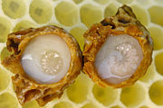
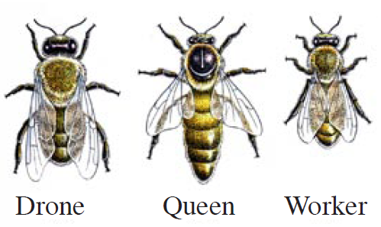
Environment and Epigenetics
Royal Jelly
Unmethylated
DNMT3 silencing
Methylated
Kucharski, R., Maleszka, J., Foret, S. & Maleszka, R.. Science 2008
Lyko, F. et al. PLoS Biology 2010
Notes:
Only larvae that are fed royal jelly develop into queens.
Silencing DNMT3 prevents methylation and produces queens.
Fertile queens and sterile workers are alternative forms of the adult female honeybee that develop from genetically identical larvae following differential feeding with royal jelly. Silencing the expression of DNA methyltransferase Dnmt3, a key driver of epigenetic global reprogramming, in newly hatched larvae led to a royal jelly-like effect on the larval developmental trajectory; the majority of Dnmt3 small interfering RNA-treated individuals emerged as queens with fully developed ovaries. Our results suggest that DNA methylation in Apis is used for storing epigenetic information, that the use of that information can be differentially altered by nutritional input, and that the flexibility of epigenetic modifications underpins, profound shifts in developmental fates, with massive implications for reproductive and behavioral status.

Slide 53
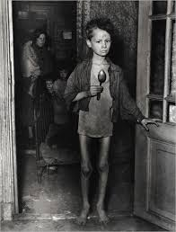
Development and Epigenetics
The Dutch famine of 1944 took place in the German-occupied part of the Netherlands near the end of World War II. About 4.5 million were affected.
Famine exposure in the periconceptional period led to an increased risk of metabolic and psychiatric disorders.
Notes:
Epigenetic alterations that arise around the time of conception, or during early embryogenesis, are amplified during development by cell division and somatic maintenance, and thus affect a high proportion of cells in the fully grown organism.
Fetal metabolic adjustments to nutritionally unfavorable conditions can affect growth and development, and may substantially alter the risk of chronic disorders later in life.

Slide 54
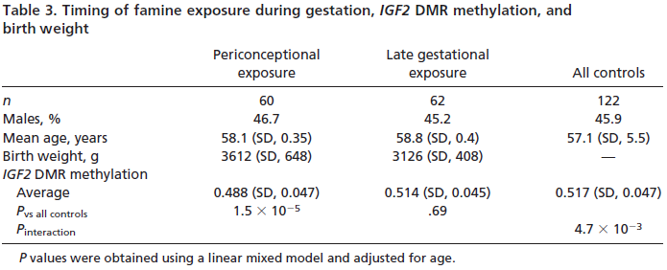
Development and Epigenetics
Heijmans et al., PNAS 2008
Notes:
Differences in DNA methylation were detected by different studies and affected genes involved in growth and metabolic disease.
Famine exposure later during gestation had no significant effects on DNA methylation

Slide 55
Outline
Epigenetics: DNA Methylation and Histone Modification
Parent-of-origin Effects
Mitochondrial DNA
De Novo Variation

Slide 56
Parent-of-Origin Effects
Imprinting
  Genes expressed only from one parent
  DNA Methylation
  <1% of genes
In utero effects
  Mother’s genotype can affect environment

Slide 57
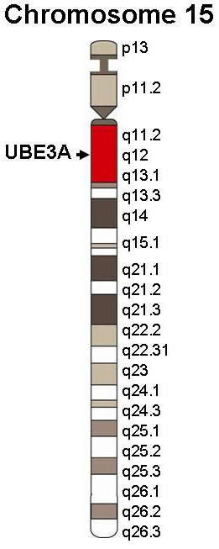
Diseases of Imprinting: Prader-Willi and Angelman
Paternal loss = Prader-Willi (gene SNRPN, Necdin gene, clusters of snoRNAs)
PWS/AS region
Maternal loss = Angelman (gene UBE3A)
Paternal allele silenced in hippocampus and cerebellum
Notes:
Prader-Willi: hypotonia, short stature, hyperphagia, obesity, behavioral issues (specifically OCD-like behaviors), small hands and feet, hypogonadism, and mild mental retardation
Mother’s copy is imprinted (off)
Angelman: Developmental delay, speech impairment, ataxia, behavioral uniqueness (happy demeanor, frequent laughter/smiling)
Father’s copy is imprinted (off)

Slide 58
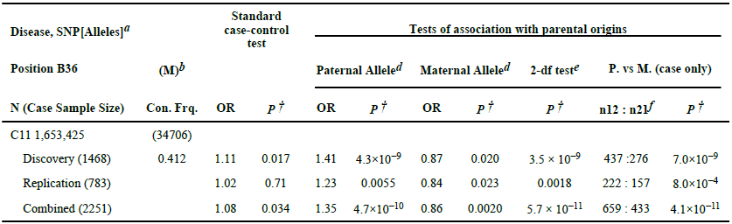
Parent-of-Origin Effects in Type 2 Diabetes
Kong et al. Nature 2009
Notes:
T2D

Slide 59
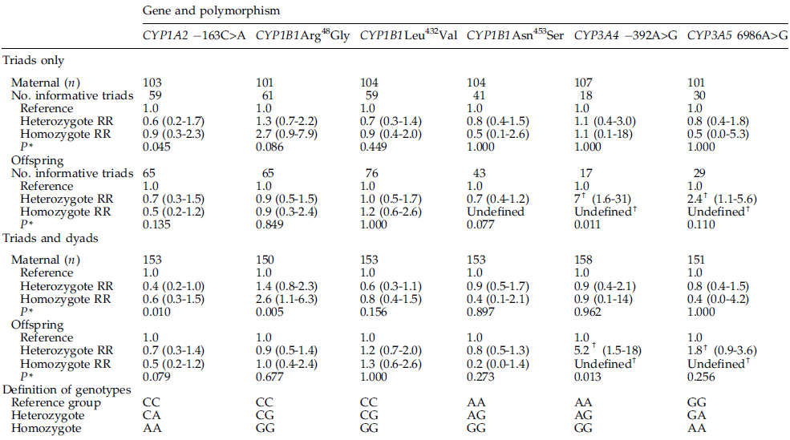
Testicular Germ Cell Tumors and Maternal Genotype
Starr et al. CEBP 2005

Slide 60
Outline
Epigenetics: DNA Methylation and Histone Modification
Parent-of-origin Effects
Mitochondrial DNA
De Novo Variation

Slide 61
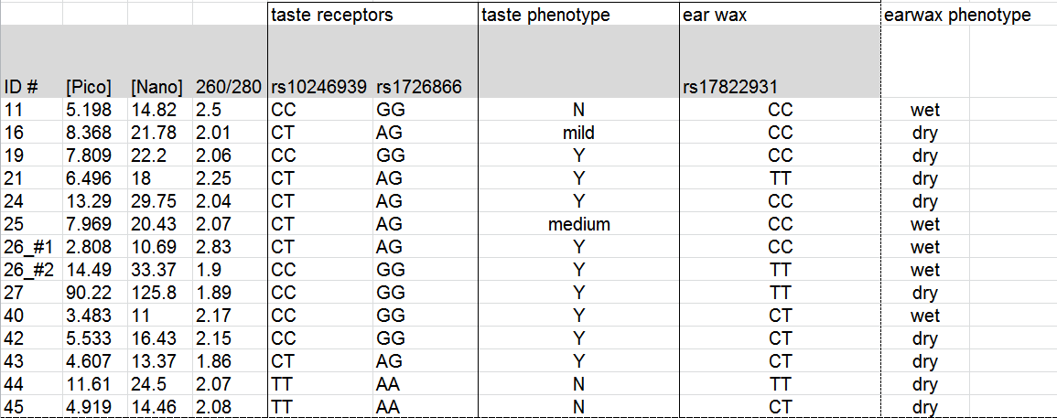
Joe’s Class Demo

Slide 62
PTC Taste Perception
ID # | rs10246939 | rs1726866 | Taster Status
19 | CC | GG | Y
26_#2 | CC | GG | Y
27 | CC | GG | Y
40 | CC | GG | Y
42 | CC | GG | Y
11 | CC | GG | N
21 | CT | AG | Y
24 | CT | AG | Y
26_#1 | CT | AG | Y
43 | CT | AG | Y
25 | CT | AG | medium
16 | CT | AG | mild
44 | TT | AA | N
45 | TT | AA | N

Slide 63
Earwax Type
ID # | rs17822931 | Earwax Type
11 | CC | wet
25 | CC | wet
26_#1 | CC | wet
16 | CC | dry
19 | CC | dry
24 | CC | dry
40 | CT | wet
42 | CT | dry
43 | CT | dry
45 | CT | dry
26_#2 | TT | wet
21 | TT | dry
27 | TT | dry
44 | TT | dry

Slide 64
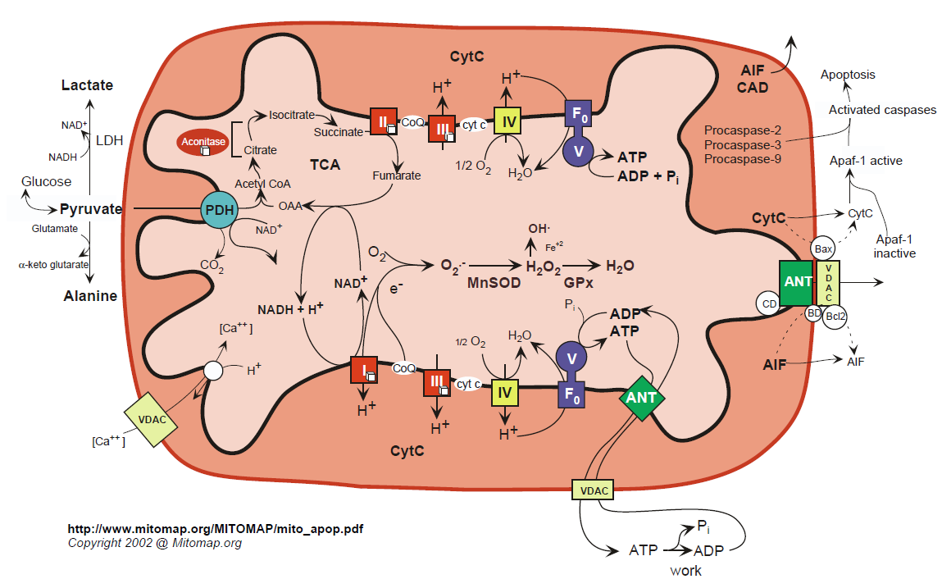
Mitochondrial Energetics
Notes:
Single mitochondrion in one celled organisms
1-2,000 in human liver cells

Slide 65
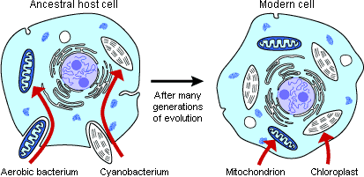
Origin of Mitochondria
Notes:
Mitochondria appear to have entered the eukaryote lineage as a singular event .

Slide 66
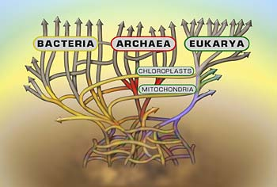
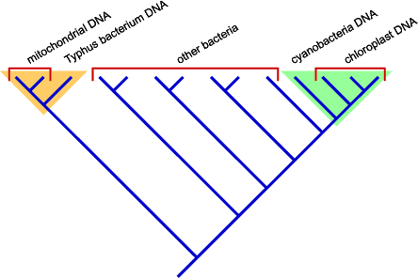
Origin of Mitochondria
Notes:
DNA sequence analysis suggests that the proto-mitochondrion was related to a aerobic alpha-proteobacterium like Typhus.

Slide 67
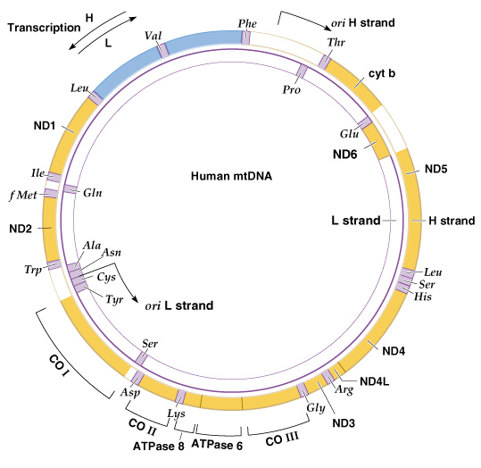
Human mtDNA (16,569 bp)
Notes:
Mitochondrial genomes are generally circular, double stranded, supercoiled, and small (less than 20 Kb in length in animals)
linear mitochondrial genomes are also found in some protozoa and fungi
In most animals the two strands of mtDNA have different densities, so they are called the H (heavy) and L (light) strands

Slide 68
Mitochondrial Genes
  tRNAs
  rRNAs
  Protein subunits:
    cytochrome oxidase
    NADH dehydrogenase
    ATPase

Slide 69
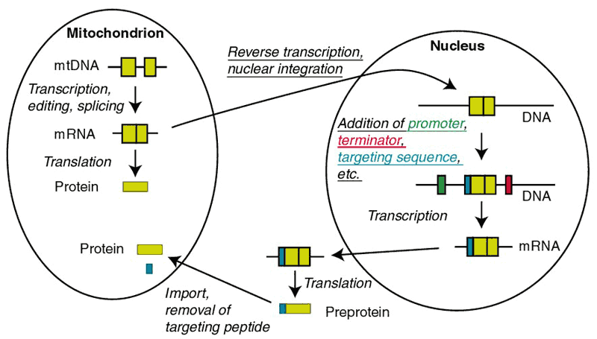
mtDNA Products Act Inside and Outside the Mitochondrion

Slide 70
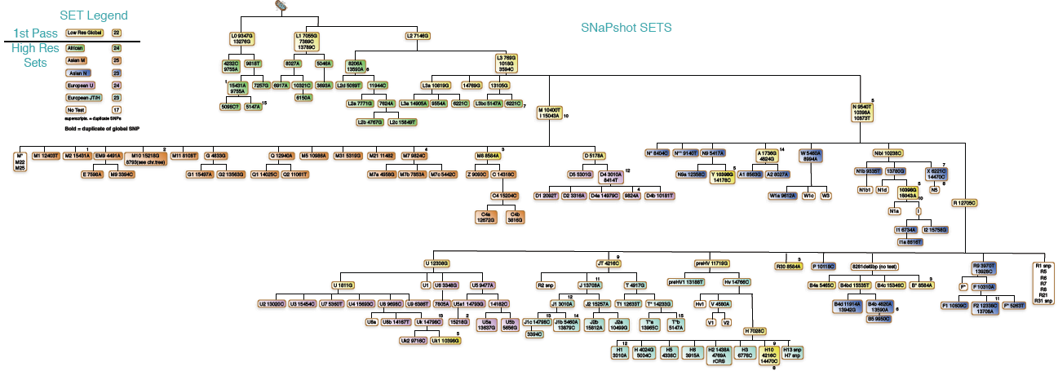
Human mtDNA Lineages

Slide 71
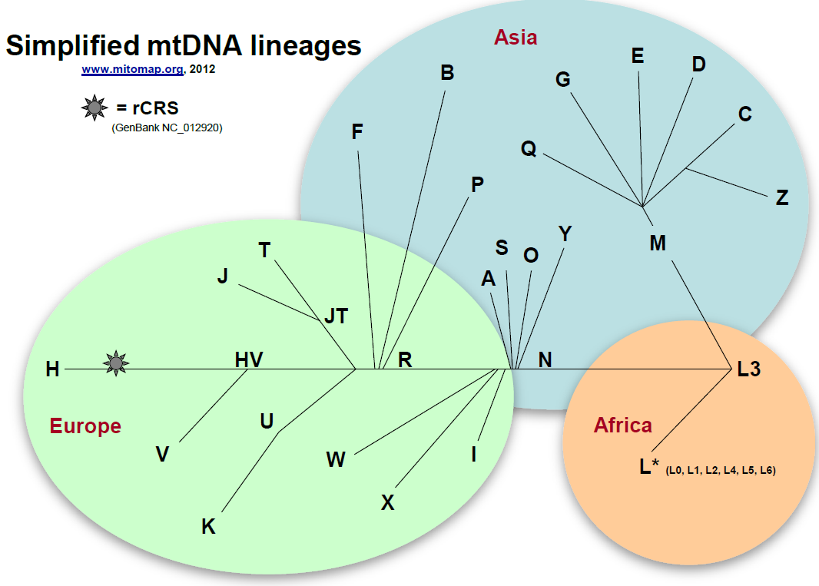
mtDNA Lineages (Simplified)

Slide 72
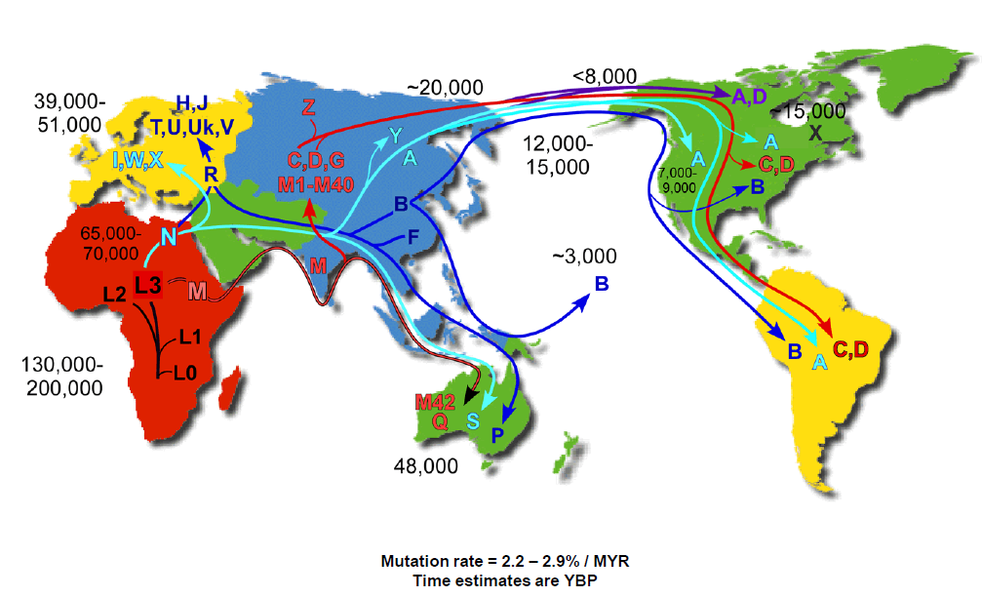
Human mtDNA Migrations

Slide 73
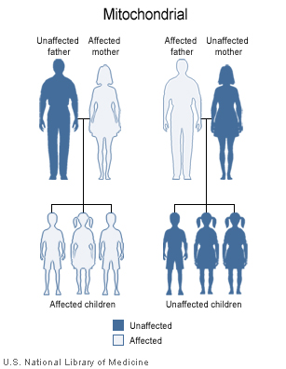
Mitochondrial Inheritance

Slide 74
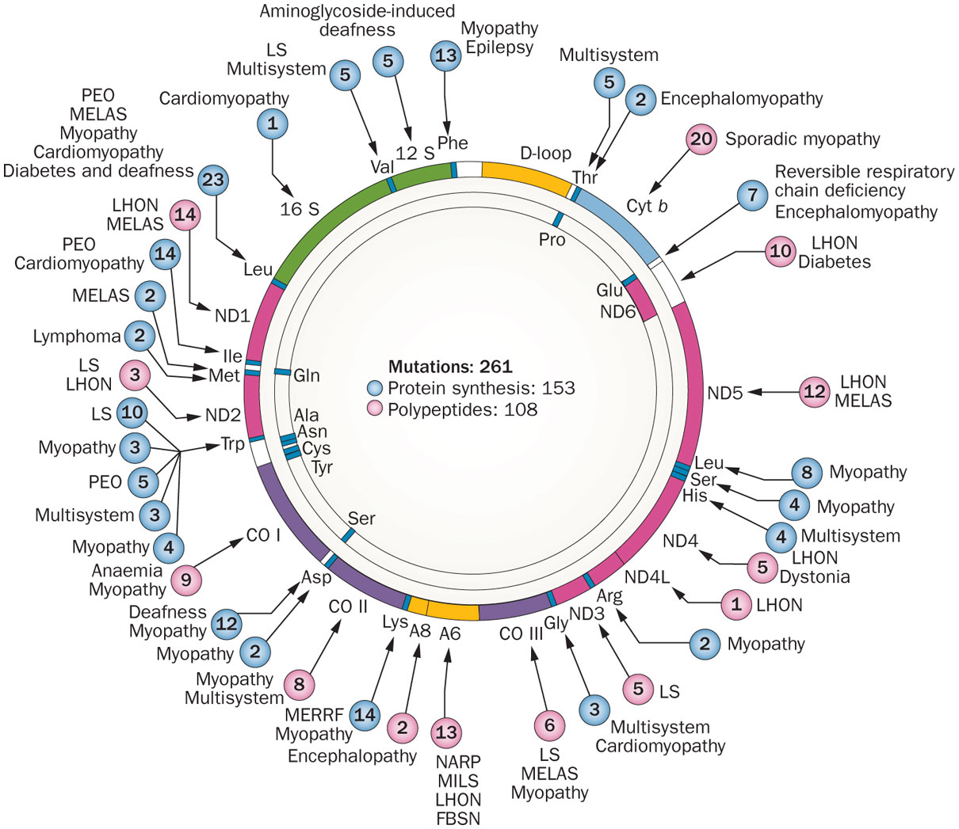
Morbidity Map of mtDNA
DiMauro, S. et al. Nat. Rev. Neurol. 2013
Notes:
Affects mid-life adults resulting in complete or partial blindness from optic nerve degeneration
Several mutations in mitochondrial electron transport chain enzyme complexes have been identified
LHON results from defects in the enzymes of oxidative phosphorylation: without ATP production, the optic nerve dies

Slide 75


Normal Vision Compared to Vision with Glaucoma
Normal Vision
Glaucoma

Slide 76

High Concentration of Mitochondria at Optic Disc
Notes:
Leber’s Hereditary Optic Neuropathy

Slide 77
Primary Open Angle Glaucoma Case and Control Definitions
Cases
  35 or older
  KPNC members from 2008-2014
  One or more diagnoses of primary open angle glaucoma (POAG)
    ICD-9 Codes: 365.01, 365.05, 365.1, 365.10, 365.11, and 365.15
  No diagnosis of any other type of glaucoma
Controls
  35 or older
  KPNC members from 2008-2014
  No glaucoma diagnosis of any kind
  No documented IOP measures above 22 mmHg in either eye
  No documented Cup-to-Disc ratio difference of more than 0.2 between eyes

Slide 78
Primary Open Angle Glaucoma in GERA
 | Cases |  | Controls
 | n=4,580 |  | n=75,766
Age (years) | n | % | n | %
35-44 | 30 | 0.66 | 6,283 | 8.29
45-54 | 164 | 3.58 | 13,288 | 17.54
55-64 | 743 | 16.22 | 23,075 | 30.46
65-74 | 1,450 | 31.66 | 20,022 | 26.23
75-84 | 1,676 | 36.59 | 10,837 | 14.30
85+ | 517 | 11.29 | 2,261 | 2.98
Mean (SD) | 72.89 | (9.94) | 62.45 | (12.13)
Sex
Women | 2,324 | 50.74 | 43,537 | 57.48
Men | 2,256 | 49.26 | 32,219 | 42.52
Race
Non-Hispanic white | 3,607 | 78.76 | 62,393 | 82.35
Latino | 371 | 8.10 | 6,154 | 8.12
East Asian | 313 | 6.83 | 5,167 | 6.82
African American | 289 | 6.31 | 2,052 | 2.71

Slide 79
Association Results in GERA Non-Hispanic Whites
-log₁₀(P-value)
Position on mitochondrial genome

Slide 80
mtSNPs Associated with POAG in Non-Hispanics Whites
SNP | Position in mtDNA (bp) | Minor Allele Frequency |  | OR | P-value | Haplogroups
 |  | Control | Case
rs28357981 | T4977C | 0.0014 | 0.0046 | 4.04 | 6.39*10⁻⁷ | B2, L4, N10
rs1029294 | C6473T | 0.0020 | 0.0055 | 3.05 | 8.32*10⁻⁶ | B2, M1
rs3928312 | A2833G | 0.0001 | 0.0012 | 12.36 | 1.50*10⁻⁴ | R5, M38, M67
rs3134801 | T9950C | 0.0026 | 0.0055 | 2.45 | 3.26*10⁻⁴ | B2, B5, HV4, L0, L3, M11, W1

Slide 81

Mitochondrial Lineages Cluster by Continent
B2

Slide 82

Mitochondrial Migrations
B2

Slide 83

Ancestry of Latinos in GERA
European
Native
American
African

Slide 84
The Effect of Ancestry on B2 and mtSNP Associations
Haplogroup/SNP | Unadjusted |  | Adjusted
 | OR | P-value | OR | P-value
non-Hispanic white
B2 | 2.95 | 3.88*10⁻⁵ | 3.34 | 1.54*10⁻⁵
rs28358586 | 1.71 | 1.93*10⁻² | 2.08 | 2.40*10⁻³
rs28357981 | 3.59 | 8.37*10⁻⁷ | 4.35 | 1.05*10⁻⁷
rs1029294 | 2.96 | 4.49*10⁻⁶ | 3.15 | 5.04*10⁻⁶
rs3134801 | 2.20 | 7.04*10⁻⁴ | 2.50 | 2.00*10⁻⁴
Latino
B2 | 1.34 | 0.031 | 1.19 | 0.220
rs28358586 | 1.33 | 0.038 | 1.20 | 0.206
rs28357981 | 1.38 | 0.016 | 1.24 | 0.133
rs1029294 | 1.34 | 0.031 | 1.19 | 0.229
rs3134801 | 1.32 | 0.039 | 1.19 | 0.235

Slide 85
Outline
Epigenetics: DNA Methylation and Histone Modification
Parent-of-origin Effects
Mitochondrial DNA
De Novo Variation

Slide 86

Your De Novo Mutations
74 new SNPs
2 new Indels
Rarely a CNV

Slide 87
De Novo Mutation Methods
Family Design
  Trios
Exome Sequencing
  Coding Variants
Array CGH
  CNVs
Bioinformatics
  Filter artifacts
Sanger Sequencing
  Confirmatory

Slide 88
Sporadic Autism Exome Study and De Novo Mutations
209 Families, 677 Individuals
  Trios
  Unaffected Siblings
Exome Sequencing
248 De Novo Events
  225 SNVs (single nucleotide variants)
  17 Indels
  6 CNVs
181 nonsynonymous changes
  120 severe
O’Roak et al. Nature 2012

Slide 89

De Novo Mutations and Autism Spectrum Disorder
O’Roak et al. Nature 2012
Notes:
a Haplotype phasing using informative markers shows a strong parent-of-origin bias with
41/51 de novo events occurring on the paternally inherited haplotype.
b, The paternal estimated age at conception versus the
number of observed de novo point mutations (0, n = 53; 1, n = 65; 2, n = 44; 3+, n = 27).
c, Decreased nonverbal IQ is significantly associated with an increasing number of “extreme”
mutation events (0, n = 138; 1, n = 41; 2+, n = 10), both with and without CNVs

Slide 90
Next Week
Next generation sequencing

