Slide 1

Pharmacokinetics and Pharmacodynamics
Allison Komirenko, PharmD
University of California, San Francisco
March 2016
Adapted from slides by Stephanie Hsia, PharmD
and Ryan Beechinor, PharmD
Reviewed by: Tina Brock, EdD

Slide 2

A little bit about me…
Chicago “transplant”
BM in Vocal Performance from Northwestern University
UCSF Pharmaceutical Sciences Pathway
Clinical Sciences Fellow at Achaogen
Volunteer Faculty at UCSF
Interest in pharmacology and pathophysiology

Slide 3
What you (should) already know
  Renal, hepatic, exercise, and endocrine physiology
  Drug actions at the receptor level
What we will discuss today
  Difference between pharmacokinetics (PK) and pharmacodynamics (PD)
  ADME (absorption, distribution, metabolism, elimination)
  Effects of physical therapy (PT) on ADME
  Types of PD effects
  PK- and PD-based drug-drug interactions (DDIs)
  How PK and PD concepts inform pharmacists’ clinical practice
  Implications of PK and PD concepts for physical therapy (PT) clinical practice
What you should be able to do after this lecture
  Recognize abbreviations of common routes of administration
  List and describe the important PK parameters (ADME)
  Explain the concept of steady state
  Predict effects of various PT treatments on a patient’s PK and a medication’s PD effects based on available data
  Distinguish between PK- and PD-based DDIs
  Describe how pharmacists use PK and PD concepts in clinical practice
  Propose an example of how a PK and/or PD principle could be useful for patient care in your clinicals

Slide 4
Why Should I Care?
Notes:
Exercise, application of physical agents, and massage can influence ‘normal’ pharmacokinetics (PK)
Physiological changes with physical activity that affect drug PK?
Redistribution of blood flow
Increase in skin temperature
Increase in skin hydration
Increase in cardiac output
Decrease bowel transit time
Loss of water from plasma into tissues
Increase metabolic enzyme activity
Increase respiratory rate
Increase tidal volume
Single bout of exercise vs. chronic exercise? Resulting level of fitness/physical conditioning? Type of physical activity – aerobic vs. strength-training? During exercise period vs. resting/recovery period? Healthy vs. sick individuals? Impact of disease state?
PK evidence, mechanistic rationales/hypotheses, and degree of clinical evidence to assess clinical impact and validate theories
Managing chronic conditions such as hypertension, dyslipidemia, and diabetes through increased physical activity in addition to drug therapy is a recommendation from each of these condition’s treatment guidelines.
Reference: Lenz TL. The effects of high physical activity on pharmacokinetic drug interactions. Expert opinion on drug metabolism & toxicology. 2011;7(3):257-266.

Slide 5

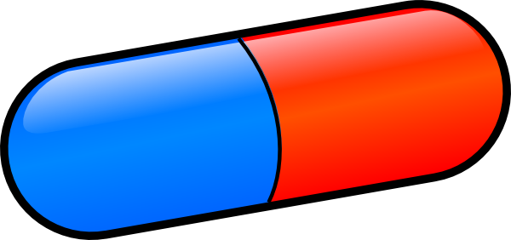
Pharmacokinetics (PK) vs. Pharmacodynamics (PD)
PK: What your body does to the drug
  ADME
  Example: The liver breaks down acetaminophen
PD: What the drug does to your body
  Example: Acetaminophen relieves pain
PK
PD
Notes:
Pharmacokinetics denotes the effects of biologic systems on drugs. It deals with the processes of absorption, distribution, and elimination and makes possible the calculation of loading and maintenance doses.
Pharmacodynamics deals with the effects of drugs on biologic systems. The principles of pharmacodynamics apply to all biologic systems, from isolated receptors in the test tube to patients with specific diseases.
Reference: Trevor AJ, Katzung BG, and Masters SB. Katzung and Trevor’s Pharmacology. 7th ed. 2005.

Slide 6
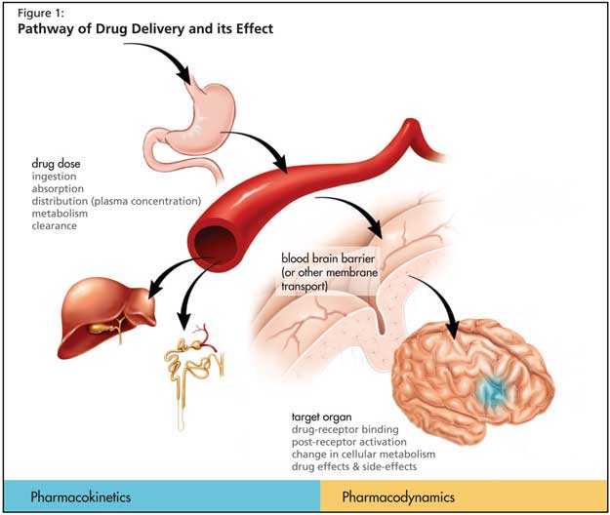
Pharmacokinetics vs. Pharmacodynamics

Slide 7
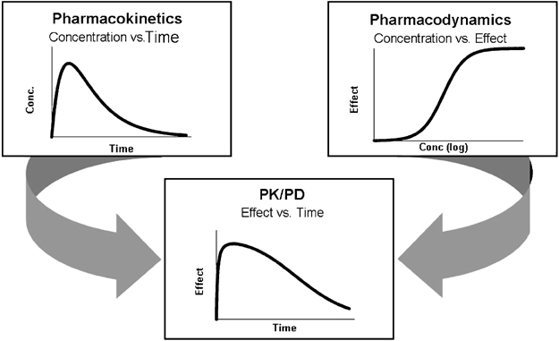
Pharmacokinetics vs. Pharmacodynamics
Notes:
The relationship between dose and effect can be separated into pharmacokinetic (dose-concentration) and pharmacodynamics (concentration-effect) components.
Concentration provides the link between pharmacokinetics and pharmacodyncamis and is he focus of the target concentration approach to rational dosing.
Reference: Katzung BG, Masters SB, and Trevor AJ. Basic & Clinical Pharmacology. 2012. 12th ed.

Slide 8
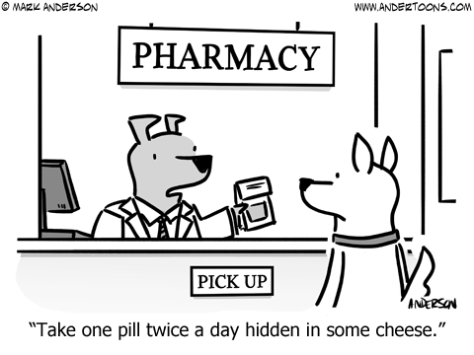
Pharmacokinetics
What the body does to the drug
Notes:
For example, some medications are given with food to improve absorption. One example is atovaquone, a component of an anti-malarial drug called Malarone. Atovaquone is a highly lipophilic compound with low aqueous solubility. Dietary fat taken with atovaquone increases the rate and extent of absorption, increasing exposure (area under the curve) and peak drug levels (Cmax) by 2-3 times and 5 times, respectively, compared with fasting conditions.
The absolute bioavailability of the tablet formulation when taken with food is 23%. Patients are counseled that Malarone tablets should be taken with food or a milky drink.
Reference: Malarone Prescribing Information. 2010 March. http://dailymed.nlm.nih.gov/dailymed/drugInfo.cfm?setid=fc22e8d8-3bfb-4f70-a599-dd81262a4887. Accessed 29 Feb 2016.
Reference: https://www.andertoons.com/pharmacy/cartoon/7435/take-one-pill-twice-a-day-hidden-in-some-cheese. Accessed 29 Feb 2016.

Slide 9
Pharmacokinetics
Absorption
Elimination
Drug
Plasma
(Blood)
Liver
Metabolism
Kidneys
Excretion
Distribution
Organs,
Site of
action
Absorption: Passage of drug from site of administration into the blood
Distribution: Movement of drug from blood into tissues, other compartments, or site of action
Metabolism: Breakdown of drug into metabolites
Excretion: Drugs and their metabolites are removed from the body
Notes:
After drug gets to organs, site of action, what happens? Pharmacologic effect and clinical response, which can include effectiveness and toxicity. These will be discussed in the second half of the lecture when we review pharmacodynamics.
Note: disposition or biodisposition are often used as a synonym for pharmacokinetics.
Reference: Trevor AJ, Katzung BG, and Masters SB. Katzung and Trevor’s Pharmacology. 7th ed. 2005.

Slide 10
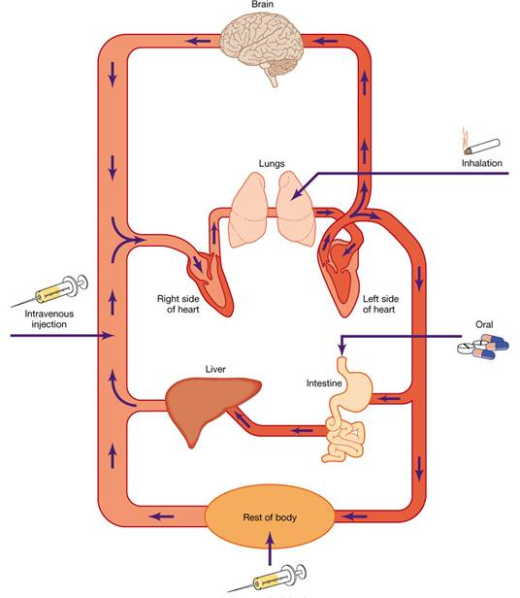
Routes of Administration
First pass
Notes:
Multiple ways that a drug can get into your system
See any routes not listed here?
Topical
Nasal
Intravitreal
Instillation into ear/eye
Intracerebroventricular (Cook AM et al. Pharmacotherapy. 2009;29(7):832-45. PMID: 19558257.)
Rectal, vaginal
Intracardiac
Intrarticular (joints)
Intrasynovial (jointfluid)
Oral meds go through what we call first pass metabolism
Means meds go through the liver before reaching the systemic circulation
Oral dose is absorbed through gut wall -> portal vein -> liver -> systemic circulation
So the drug dose resulting after this first pass metabolism is what is truly bioavailable (i.e. reaches the systemic circulation)
First-pass effect (e.g., presystemic elimination): The elimination of drug that occurs after administration but before it reaches the systemic circulation (e.g., during passage through the gut wall, portal blood, and liver for an orally administered drug).
Reference: Trevor AJ, Katzung BG, and Masters SB. Katzung and Trevor’s Pharmacology. 7th ed. 2005.
Quiz question: Do the following go through first-pass metabolism?
Buccal? No, completely avoids first pass metabolism. Goes straight into bloodstream.
Sublingual? No, completely avoids first pass metabolism. Goes straight into bloodstream.
Transdermal? No, completely avoids first pass metabolism. Goes straight into bloodstream.

Slide 11
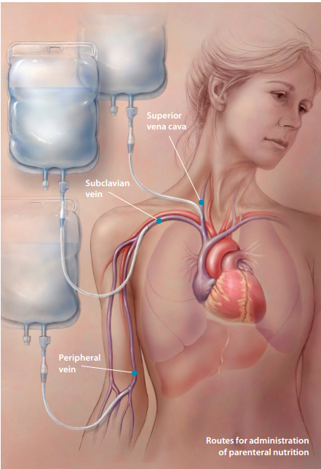
Vocab Lesson!
Parenteral
  Para = “beside”
  enteron = “intestine”
  Parenteral = beside intestine (a.k.a. bypasses the intestine)
  Means any route that doesn’t pass through the intestine
Image: Tilton J. Oncology Nurse Advisor. July/August 2011.
Notes:
Parenteral: any medication route other than the alimentary canal
Image: Tilton J. Benefits and risks of parenteral nutrition in patients with cancer. Oncology Nurse Advisor. July/August 2011. Available at: http://media.oncologynurseadvisor.com/documents/26/ona_feature-pn0811_6351.pdf Accessed 21 Feb 2016.

Slide 12
Routes of Administration
Enteral
  Oral (PO)
  Rectal (PR)
  Through feeding tube
Transdermal
Topical
Parenteral
  Inhaled
  Intravenous (IV)
  Sublingual (SL)
  Buccal
  Intramuscular (IM)
  Subcutaneous (subcut)
  Intrathecal (IT)
SC, SQ, and sub q are on the
ISMP’s Error-Prone Abbreviation list
https://www.ismp.org/tools/errorproneabbreviations.pdf
Notes:
‘SC’, ‘SQ’, and ‘sub q’ are on the ISMP’s Error-Prone Abbreviation list (https://www.ismp.org/tools/errorproneabbreviations.pdf): SC mistaken as SL (sublingual); SQ mistaken as “5 every;” the “q” in “sub q” has been mistaken as “every” (e.g., a heparin dose ordered “sub q 2 hours before surgery” misunderstood as every 2 hours before surgery). Recommended to use ‘subcut’ or write out (‘subcutaneously’)

Slide 13
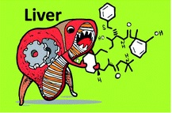
Absorption
Many factors affect absorption
Solubility: aqueous vs. lipophilic
Acid: stable vs. labile
Molecular size: large vs. small
Proteins
First pass metabolism
A DME
Notes:
Lenz et al 2011, after reviewing several pharmacokinetic-exercise interaction studies, makes the following conclusion: “Although the results of these studies are conflicting, the rate of absorption of medications through the gastrointestinal tract may, in part, be affected by the duration and intensity of activity. The studies demonstrating an increase in gastrointestinal absorption involved an exercise period that was at least 60 min long and was of more vigorous activity. By contrast, the study which showed decreased drug absorption while exercising involved an exercise period that was only 20 min in duration at 50% maximum capacity during a non-weight bearing activity.”
Perhaps with more work, other ‘covariates’ in the exercise-absorption relationship will be elucidated and further clarify this interaction

Slide 14
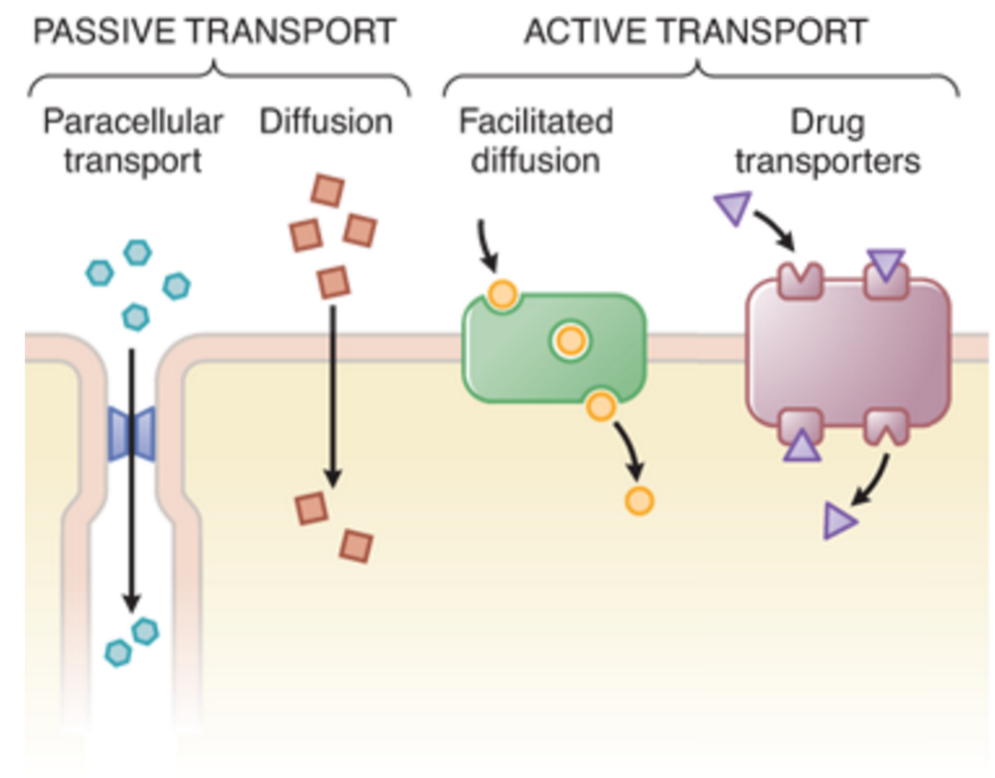
Absorption
Goodman & Gilman’s: The Pharmacological Basis of Therapeutics, 12ed. Figure 2-2.
A DME
Notes:
The variety of ways drugs move across cellular barriers in their passage throughout the body (permeation).
Aqueous diffusion: the movement of molecules through the watery extracellular and intracellular spaces. Passive process governed by Fick’s law.
Lipid diffusion: movement of molecules through membranes and other lipid structures. Passive process governed by Fick’s law.
Transport by special carriers: drugs may be transported across barriers by mechanisms that carry similar endogenous substances (e.g. ,amino acid carriers in the blood-brain barrier and the weak acid carriers in the renal tubule). Capacity-limited. Selective inhibitors for these carriers or transporters can have clinical value, such as probenecid which inhibits transport of uric acid, penicillin, and other weak acids, is used to increase the excretion of uric acid in gout.
Also, endocytosis and pinocytosis: occurs through binding to receptors with subsequent internalization by infolding of that area of the membrane. Permits very large or very lipid-insoluble chemicals to enter cells.
For example, since levodopa, a component in Sinemet, a medication for Parkinson’s Disease, competes with certain amino acids for transport across the gut wall, the absorption of levodopa may be impaired in some patients on a high protein diet.
As another example, the endogenous substance cortisol moves into cells by passing freely through the plasma membrane (lipophilic). This also relates to its mechanism of action – cortisol has to get inside of cells in order to bind the glucocorticoid receptor: Heat shock protein (HSP) disassociates and ligand-bound glucocorticoid-receptor moves into the nucleus.
Reference: Physiology I Reader (P121; Mitrovic)
Reference: Brunton LL, Chabner BA, Knollmann BC. Goodman & Gilman’s: The Pharmacological Basis of Therapeutics, 12ed. Figure 2-2. www.accesspharmacy.com
Reference: Sinemet prescribing information: http://www.accessdata.fda.gov/drugsatfda_docs/label/2014/017555s056s068s071lbl.pdf Accessed 20 Feb 2016.
Reference: Trevor AJ, Katzung BG, and Masters SB. Katzung and Trevor’s Pharmacology. 7th ed. 2005.

Slide 15
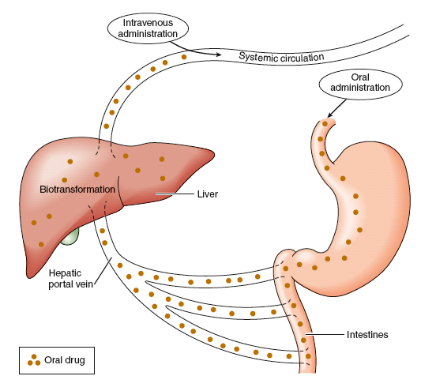
Bioavailability (F)
“The fraction or percentage of active medication that reaches the systemic circulation following administration from any route”
A DME
Notes:
Bioavailability is the fraction (or percentage) of the administered dose of a drug that reaches the systemic circulation
For example, a commonly used quinolone antibiotic, levofloxacin, is rapidly and essentially completely absorbed after oral administration, with a bioavailability of approximately 99%.
Levofloxacin also comes as an IV formulation, which by definition, has a bioavailability of 100%. So this enables a 1:1 dose conversion between PO and IV formulations (e.g., what is absorbed from a 500 mg tablet is equivalent to a 500 mg IV dose).
Reference: Levofloxacin prescribing information. http://www.accessdata.fda.gov/drugsatfda_docs/label/2014/020634s066,020635s072,021721s033lbl.pdf Accessed 20 Feb 2016.
Reference: Trevor AJ, Katzung BG, and Masters SB. Katzung and Trevor’s Pharmacology. 7th ed. 2005.

Slide 16
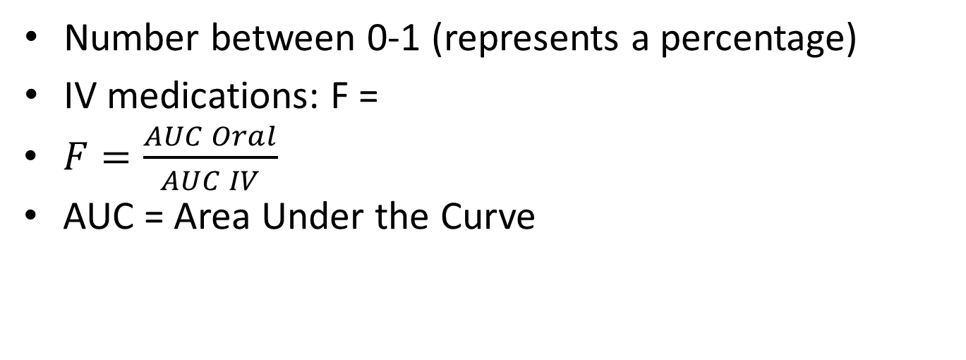
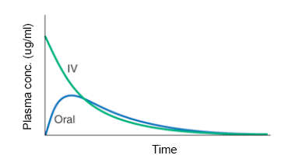
Bioavailability (F)
Number between 0-1 (represents a percentage)
IV medications: F =
$F=\frac{AUC Oral}{AUC IV}$
AUC = Area Under the Curve
1
A DME
Kasper DL et al. Harrison’s Principles of Internal Medicine, 19th ed. Figure 5-2.
Notes:
If drug has bioavailability of 0.5, means 50% gets absorbed.
Idealized time-plasma concentration curves after a single dose of drug. A. The time course of drug concentration after an instantaneous IV bolus or an oral dose in the one-compartment model shown. The area under the time-concentration curve is clearly less with the oral drug than the IV, indicating incomplete bioavailability. Note that despite this incomplete bioavailability, concentration after the oral dose can be higher than after the IV dose at some time points.
Reference: Kasper DL, Fauci AS, Hauser SL, Longo DL, Jameson JL, and Loscalzo J. Harrison’s Principles of Internal Medicine, 19th Edition. Figure 5-2. www.accessmedicine.com

Slide 17
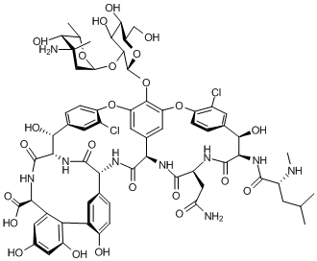
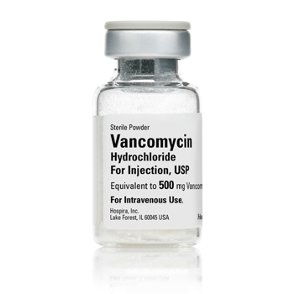
Example: PO Vancomycin
Image: Koteva K et al. Nature Chemical Biology. 2010;6:327-329.
Image: Hospira website
If F<0.05, what’s the rationale for PO vancomycin?
Kelly CP, Pothoulakis C, Lamont JT. N Engl J Med. 1994;330(4):257-62.
A DME
Notes:
Vancomycin at low concentrations (<5 μg per milliliter) destroys C. difficile, and its pharmacokinetic properties are ideal for the treatment of C. difficile colitis, since the drug is not appreciably absorbed or metabolized but is excreted unchanged in the stool. Metronidazole, in contrast, is readily absorbed in the upper gastrointestinal tract, and systemic side effects can occur, notably nausea, a metallic taste, and a reaction to alcohol like the one patients have with disulfiram.
Reference: Kelly CP, Pothoulakis C, Lamont JT. Clostridium difficile colitis. N Engl J Med. 1994;330(4):257-62. [PMID: 8043060].
Oral vancomycin is not appreciably absorbed or metabolized, but is excreted in the stool unchanged, which is ideal for the treatment of C difficile infection. Intravenous vancomycin should not be used, however, since bactericidal concentrations are not achieved in the colon.^{[1-3,6]} For vancomycin, oral doses of either 125 mg four times daily or 500 mg four times daily in adults are recommended. Both regimens have provided the same clinical outcome.^{[14-15]} The use of a rectal vancomycin enema (500 mg diluted in 1000 mL of 0.9% sodium chloride injection) is an alternative as described in several anecdotal reports.
Reference: http://www.medscape.com/viewarticle/410904_5 Accessed 21 Feb 2016.
Vancomycin capsules: $1273.20 vs. Vancomycin IV formulation compounded as oral solution: $52.31.
Reference: Drekonja DM, Butler M, Macdonald R, et al. Comparative effectiveness of Clostridium difficile treatments: a systematic review. Ann Intern Med. 2011;155(12):839-47. [PMID: 22184691].
Vancomycin vial image: http://www.hospira.com/en/products_and_services/drugs/VANCOMYCIN_HYDROCHLORIDE Accessed 21 Feb 2016.
Vancomycin chemical structure: http://www.nature.com/nchembio/journal/v6/n5/compound/nchembio.350_comp1.html Accessed 21 Feb 2016. (Koteva K, Hong HJ, Wang XD, et al. A vancomycin photoprobe identifies the histidine kinase VanSsc as a vancomycin receptor. Nat Chem Biol. 2010;6(5):327-9. [PMID: 20383152].)

Slide 18

Test Your Understanding
If F of oral oxycodone is 0.70 how many mg of an oxycodone 10 mg tablet would you expect to reach the patient’s blood?
0.70 X 10 mg = 7 mg
A DME

Slide 19
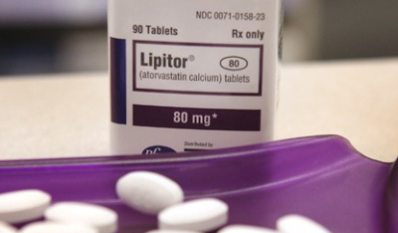
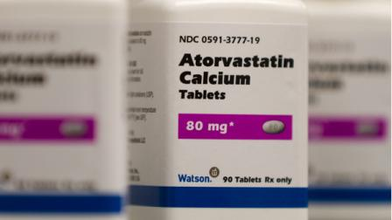
What about generic drugs?
Must demonstrate bioequivalence to the original, brand-name drug
Ensures that the generic version delivers the same active ingredient by the same route of administration at the same rate and to the same extent
Image: Forbes website
Image: ABC News website
A DME
Notes:
Measure the time it takes the generic drug to reach the bloodstream and its concentration in the bloodstream in 24 to 36 healthy, normal volunteers
Ensures that the generic version delivers the same amount of active ingredients into a patient’s bloodstream in the same amount of time as the original, brand-name drug
Reference: http://www.fda.gov/Drugs/EmergencyPreparedness/BioterrorismandDrugPreparedness/ucm134444.htm. Accessed 21 Feb 2016.
Images:
Lipitor: http://www.forbes.com/sites/matthewherper/2011/03/16/how-bargain-lipitor-could-raise-health-costs/#5a4e14a8a9f2. Accessed 21 Feb 2016.
Atorvastatin: http://a.abclocal.go.com/wpvi/6at4/story?section=news/national_world&id=8889287. Accessed 21 Feb 2016.
More In-Depth Explanation:
Generics are not required to replicate the extensive clinical trials that have already been used in the development of the original, brand-name drug. These tests usually involve a few hundred to a few thousand patients. Since the safety and efficacy of the brand-name product has already been well established in clinical testing and frequently many years of patient use, it is scientifically unnecessary, and would be unethical, to require that such extensive testing be repeated in human subjects for each generic drug that a firm wishes to market. Instead, generic applicants must scientifically demonstrate that their product is bioequivalent (i.e., performs in the same manner) to the pioneer drug.
One way scientists demonstrate bioequivalence is to measure the time it takes the generic drug to reach the bloodstream and its concentration in the bloodstream in 24 to 36 healthy, normal volunteers. This gives them the rate and extent of absorption-or bioavailability-of the generic drug, which they then compare to that of the pioneer drug. The generic version must deliver the same amount of active ingredients into a patient's bloodstream in the same amount of time as the pioneer drug.
Using bioequivalence as the basis for approving generic copies of drug products was established by the Drug Price Competition and Patent Term Restoration Act of 1984, also known as the Hatch-Waxman Act. Brand-name drugs are subject to the same bioequivalency tests as generics when their manufacturers reformulate them.

Slide 20
Effects of Physical Therapy on Absorption
PO medications
  Variable (can increase or decrease plasma levels)
  During exercise, blood is directed away from the gut which can decrease absorption
  Exercise can also increase blood flow which can increase absorption
SQ or IM medications
  Exercise can increase absorption of drug injected near actively exercising muscles by increasing diffusion and blood flow
  Massaging the injection site can also increase absorption
  Exercise can decrease absorption if drug is injected into non-exercising tissues by decreasing blood flow
  Example: insulin
A DME
Lenz TL. Expert opinion on drug metabolism & toxicology. 2011;7(3):257-266.
Notes:
Several physiological changes take place as a result of exercise such as a redistribution of blood flow, increases
in skin temperature and hydration, loss of water in the plasma, and others that can alter the pharmacokinetics of some medications.
Example: The absorption of subcutaneously injected insulin can be increased if the injections is in a location of the body
which is about to be involved in exercise (e.g., thigh injection prior to cycling exercise).
Although conflicting reports have been published with regard to insulin absorption and exercise, the majority of the literature shows that insulin is absorbed faster if it is subcutaneously injected into an area of the body that is about to experience increased blood flow with exercise.
In addition, there is clinical evidence to show that blood glucose levels are less consistent when injecting insulin into the thigh compared with the abdomen or shoulder prior to riding a bicycle.
It would be good practice for healthcare providers to inform all patients with diabetes about this drug--exercise interaction to increase awareness and prevent adverse events. Patients should be advised to administer insulin injections into the shoulder or abdomen if lower body and/or weight bearing physical activity are planned.
Reference: Lenz TL. The effects of high physical activity on pharmacokinetic drug interactions. Expert opinion on drug metabolism & toxicology. 2011;7(3):257-266.

Slide 21
Effects of Physical Therapy on Absorption
Transdermal medications
  Exercise usually increases absorption by increasing skin temperature and sweating
  Certain physical therapy treatments (whirlpool, heating pad) involving heat could increase absorption
Inhaled medications
  Exercise can increase absorption by increasing pulmonary blood flow
A DME
Lenz TL. Expert opinion on drug metabolism & toxicology. 2011;7(3):257-266.
Notes:
Example: The absorption of drugs that are administered via transdermal patch, especially nitroglycerin and nicotine, are increased while exercising as a result of increased subcutaneous blood flow and skin hydration.
For transdermal patch, special attention should be paid to patients who may be at particularly high risk for drug absorption changes resulting from physical activity: long duration sporting events such as marathon or ultra-marathon running – vulnerable to changes in skin temperature, hydration and blood flow, and increased drug absorption for long periods of time.
Reference: Lenz TL. The effects of high physical activity on pharmacokinetic drug interactions. Expert opinion on drug metabolism & toxicology. 2011;7(3):257-266.

Slide 22
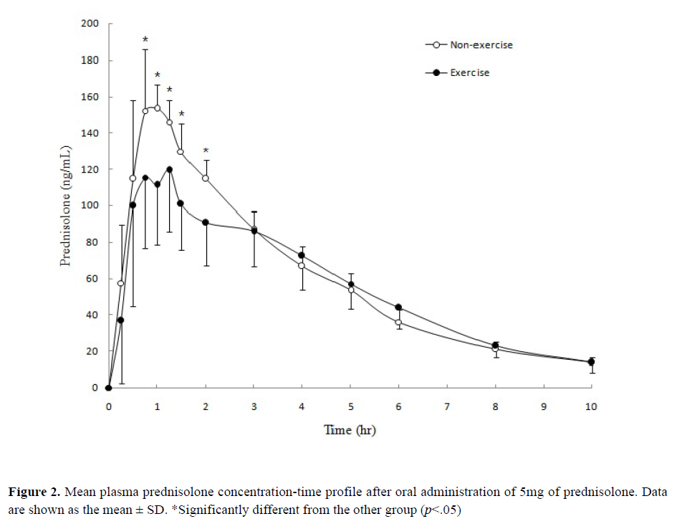
Example: Prednisolone 5 mg PO
Non-Exercise Arm: Remained seated for duration of experiment
Hypotheses:
Exercise shunted blood flow away from viscera towards muscles
Exercise reduced stomach-emptying rate
Exercise Arm: Cycled at 70% VO_{2max} intensity until exhaustion;
Gave rise to a significantly lower C_{max} (p<0.05)
PK blood sampling pre-dose
A DME
Chien KY et al. J Pharm Pharmaceut Sci. 2010;13(1):58-66.
Notes:
Background: Prednisolone used commonly due to its relatively short pituitary inhibition (PD effect) and its moderate potency. Exercise is a non-pharmacological intervention for glucocorticoid-induced osteoporosis. What was previously unknown is effects of exercise on prednisolone PK.
Note: Prednisone (inactive) is rapidly metabolized to prednisolone by 11-beta-hydroxydehydrogenase, which is believed to be the active form of the drug. (Gambertoglio et al 1980).
Methods: Randomized, cross-over study design. Two trials: Non-exercise (NE) and exercise (E) trials. After pre-dose blood sample, subjects were administered prednisolone 5 mg PO with 100 mL water then rested 30 minutes. E trial: subjects cycled at 70% VO2max intensity until exhaustion. NE trial: remained seated for duration of experiment.
PK Sampling at pre-dose, then 0.25, 0.5, 0.75, 1, 1.25, 1.5, 2, 3, 4, 5, , 8, 10, and 12 hours after prednisolone administration (“Dense Sampling” vs. “Sparse Sampling”)
Analytical method: Prednisolone and cortisol concentrations were analysed with a validated HPLC (“high performance liquid chromatographic”) method.
Results: Cmax of the E trial was significantly lower than the NE trial (p<0.05). However, the AUC, half-life, time-averaged total body clearance, and apparent volume of distribution showed no significant difference between two trials.
PD effect: The mean percentage change of cortisol of E trial was significantly higher than NE trial (p<0.05).
Conclusion: The results suggest that sub-maximal exercise altered the prednisolone absorption pattern with an accompanying change in PD. We’ll talk about PD in the second half of the lecture!
Discussion: Likely first human clinical trial investigating effect of exercise on PK of prednisolone.
Major finding is that sub-maximal exercise (referring to 70% VO2max) decreased prednisolone Cmax compared with non-exercise part of the study.
Prednisolone disposition: Prednisolone PO is almost completely absorbed by the intestine. It is recognized that (1) stomach-emptying rate, (2) gastric intestinal mobility, and (3) blood flow to the absorption site all affect the rate and extent of drug absorption.
(1) Intuitively, exercise may have effects on drug absorption. Ref 23 shows that exercise intensity above 70% VO2max reduced stomach-emptying rate, which probably delayed drug absorption.
(3) Blood flow is important for carrying absorbed drugs via systemic circulation. During exercise, blood is shunted away from viscera (e.g., stomach, liver, etc.) towards muscles during moderate exercise. Since Cmax was significantly lower in E vs. NE in this study, possible reason could be that exercise reduced gastric emptying rate and shunted blood flow away from the intestine.
Also! Note the different shape or absorption patterns.
Reference: Chien KY et al. Sub-maximal exercise alters the prednisolone absorption pattern. J Pharm Pharmaceut Sci. 2010;13(1):58-66.
Reference: Gambertoglio JG et al. Pharmacokinetics and bioavailability of prednisone and prednisolone in healthy volunteers and patients: a review. Journal of pharmacokinetics and biopharmaceutics. 1980;8(1):1-52. PMID: 6991663. (Two of the authors, including Dr. Leslie Benet, are/were affiliated with UCSF!)

Slide 23
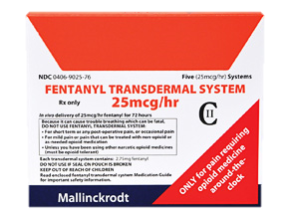
Example: Fentanyl Patch
Exposing the patch to heat, either from an external source, increased exertion, or possibly high fever, could increase release of the drug, which might lead to an overdose and fatal respiratory depression
Image: Kaiser Permanente>Drugs & natural medicines website
In brief: heat and transdermal fentanyl. Med Lett Drugs Ther. 2009;51(1318):64.
New York Times Story – Doctors and Nurses, Still Learning. April 29, 2009.
A DME
Notes:
My patient was a young woman struggling with aggressive lymphoma who needed around-the-clock pain control. Because of her youth, and the hope that she might be cured, the attending physician was thinking of her future. He worried a patient-controlled analgesia pump could lead to a psychological dependence on narcotics..
For my part, it was hard to watch her struggle against the pain. “What about a fentanyl patch?” I suggested to the doctor, a “fellow’’ who was second in command to the attending physician. Fentanyl patches are the pain-control version of nicotine patches for smokers, and they’re a great way to treat chronic pain in cancer patients. It seemed like a good idea. A patch would give the patient more consistent pain relief and would obviate the doctor’s concerns about overuse.
The fellow looked at me. “That’s a terrible idea,” he said, “to put a fentanyl patch on a patient who is having fevers.” He didn’t say it aggressively, or meanly. But he was very clear, and he was right. My idea was really, really terrible, even dangerous.
The doctor was referring to the fact that heat can interfere with the patch’s slow-release mechanism, causing it to “dump” a large dose of fentanyl all at once. Some patients wearing the patches have died, and some of those deaths were likely caused by a patient applying a heating pad, or because a patient had a fever.
Reference: Brown, T. Doctors and Nurses, Still Learning. New York Times. April 29, 2009. Available at: http://well.blogs.nytimes.com/2009/04/29/doctors-and-nurses-still-learning/?_r=0 Accessed 21 Feb 2016.
Image: https://healthy.kaiserpermanente.org/health/care/consumer/health-wellness/drugs-and-natural-medicines/drug-encyclopedia/medicine-information/!ut/p/a1/fc5BT4MwFMDxz7IDR-mDDtZ561jEgjDMiGIvhs2uI2GUdN3Ivr2AeDBR360vv_7zEEcF4k15rWRpKtWU9fDm_nsObLNaORTAYR6wLCLpmhAXAoxeUYS4rNVuxG9HY9p7Cyz40Bcpmv3trlXa1MJYgPiwY2tUuK5PwBs4bXaYSMS1OAgttH3RfWVonMdI13W2VErWwt6rU5_45ctRnQ0qfsr-Kv7_4TCBh2j7BTbzJQGWBI8BS2OAcDGBjAIjCXgOUOwD83McL5LUgXA-AcDseSyEmQ-9jfP4ZRljAPcb_DEUUHsiN1xfnw5bVjE6m30Chy2ybg!!/dl5/d5/L2dBISEvZ0FBIS9nQSEh/#Photos by medication strength Accessed 21 Feb 2016.

Slide 24
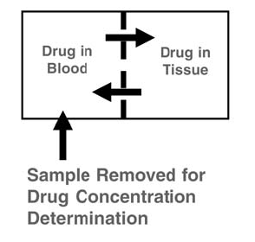
Distribution
How much of the drug distributes into the tissues
Factors that affect distribution
  Water/lipid solubility
  Drug size
  Protein binding
Equilibrium between circulation and tissue
A D ME
Notes:
Factors affecting drug distribution in the body include the molecule size, water/lipid solubility, and protein binding.
Small, water-soluble molecules such as ethanol will distribute into total body water (0.6 L/kg), whereas larger water-soluble molecules such as gentamicin are distributed to the extracellular water only (0.2 L/kg).
A drug that is strongly plasma protein-bound and very large such as heparin distributes to the blood (0.08 L/kg) and plasma (0.04 L/kg).
In contrast, a highly lipid-soluble molecule such as DDT distributes to the fat (0.2-0.35 L/kg) and has a much larger volume of distribution.
Reference: Katzung BG, Masters SB, and Trevor AJ. Basic & Clinical Pharmacology. 2012. 12th ed.

Slide 25
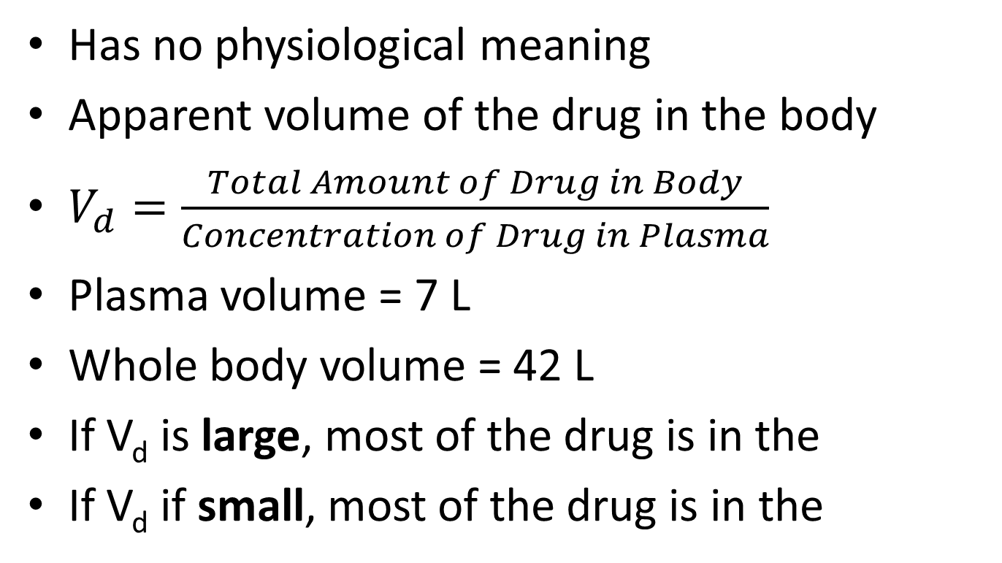
Volume of Distribution
Has no physiological meaning
Apparent volume of the drug in the body
$V_{d}=\frac{Total Amount of Drug in Body}{Concentration of Drug in Plasma}$
Plasma volume = 7 L
Whole body volume = 42 L
If V_{d} is large, most of the drug is in the
If V_{d} if small, most of the drug is in the
tissues
blood
A D ME
Notes:
Volume of distribution relates the amount of drug in the body to the concentration of drug in blood or plasma
Volume of distribution can vastly exceed any physical volume in the body because it is the volume apparently necessary to contain the amount of drug homogenously at the concentration found in the blood or plasma.
Drugs with very high volumes of distribution have much higher concentrations in extravascular tissue than in the vascular compartment (i.e., they are not homogenously distributed.)
Drugs that are completely retained within the vascular compartment, on the other hand, have a minimum possible volume of distribution equal to the blood component in which they are distributed (e.g., 0.04 L/kg body weight or 2.8 L for a 70 kg person for a drug that is restricted to the plasma component).
Reference: Katzung BG, Masters SB, and Trevor AJ. Basic & Clinical Pharmacology. 2012. 12th ed.

Slide 26
Test Your Understanding
Phenytoin has a volume of distribution ~49 L. Where is most of the drug?
In the tissues!
V_{d} > whole body volume
A D ME
Notes:
Phenytoin is the oldest nonsedative antiseizure drug, introduced in 1938. It has two phenyl rings (greasy; a more soluble prodrug form, fosphenytoin, is available for parenteral use) and is highly bound to plasma proteins.
Reference: Katzung BG, Masters SB, and Trevor AJ. Basic & Clinical Pharmacology. 2012. 12th ed.

Slide 27
Test Your Understanding
Chloroquine has a volume of distribution
~100 L/kg. Where is most of the drug?
In the tissues!
V_{d} > whole body volume
A D ME
Notes:
Chloroquine distribution: Widely in body tissues including eyes, heart, kidneys, liver, leukocytes, and lungs where retention is prolonged
Reference: Krishna S and White NJ. Pharmacokinetics of quinine, chloroquine, and amodiaquine. Clinical implications. Clin Pharmcokinet. 1996;30(4):263-99.

Slide 28
Effects of Physical Therapy on Distribution
Exercise can decrease the V_{d} of certain medications (verapamil, propranolol, caffeine)
  Less of the drug reaches the target tissues
  Can lead to decreased effect
Exercise can increase the V_{d} of certain medications (digoxin)
  Digoxin binds to cell membrane of skeletal muscle
  Can increase effect and lead to possible toxicity
Clinical effects are unclear
A D ME
Lenz TL. Expert opinion on drug metabolism & toxicology. 2011;7(3):257-266.
Notes:
Exercise is thought to lead to increased plasma protein concentrations due to loss of water from the plasma into the tissues. Could be due to increased osmolality in the active tissues, plus increased hydrostatic pressure and fluid loss (in the form of sweat)
Example: The distribution of digoxin is altered during exercise as digoxin has been shown to bind to actively working muscles, thus decreasing serum digoxin levels. How did this study study digoxin skeletal muscle concentration? Muscle biopsy of the quadriceps femoris.
Warfarin: some literature observes an inverse relationship between physical activity and INR (i.e., increased physical activity associated with lower INR, which takes less time to clot and is interpreted as less anticoagulated). Further research is needed for confirm observations and elucidate potential reasons for this. It is thought that increased physical activity may increase the amount of warfarin bound to serum albumin, which decreases free warfarin concentrations and results in a decreased INR. One advantage of warfarin is that its PD effect can be measured through measurement of INR.
Reference: Lenz TL. The effects of high physical activity on pharmacokinetic drug interactions. Expert opinion on drug metabolism & toxicology. 2011;7(3):257-266.

Slide 29
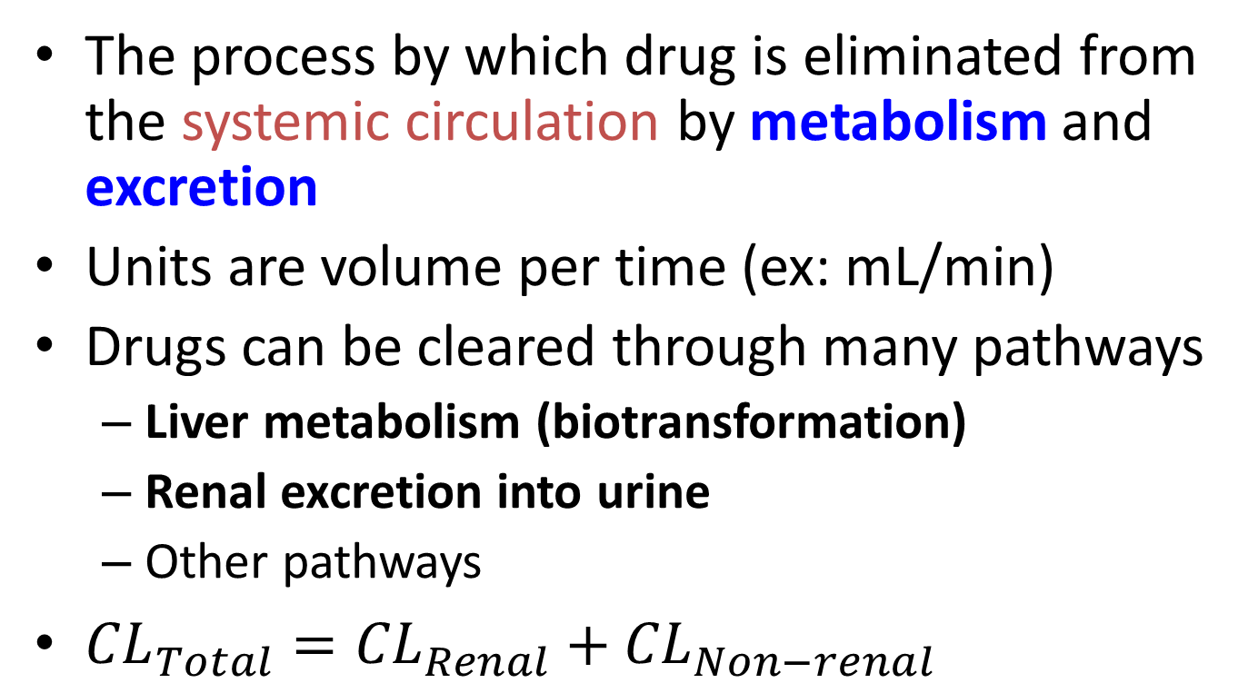
Clearance
The process by which drug is eliminated from the systemic circulation by metabolism and excretion
Units are volume per time (ex: mL/min)
Drugs can be cleared through many pathways
  Liver metabolism (biotransformation)
  Renal excretion into urine
  Other pathways
${CL}_{Total}={CL}_{Renal}+{CL}_{Non−renal}$
AD ME
Notes:
CL(total) = CL(renal) + CL(non-renal)
CL(renal) is the net effect of glomerular filtration, tubular secretion, and tubular reabsorption. Glomerular filtration rates have been shown to decrease by as much as 30% during physical activity. (The greater the exercise intensity, the lesser the renal blood flow, and therefore the lower the glomerular filtration rate.)
CL(non-renal): Elimination of drug from circulation can occur through urine, bile, sweat, expired air, breast milk or seminal fluid.
Reference: Lenz TL. The effects of high physical activity on pharmacokinetic drug interactions. Expert opinion on drug metabolism & toxicology. 2011;7(3):257-266.

Slide 30
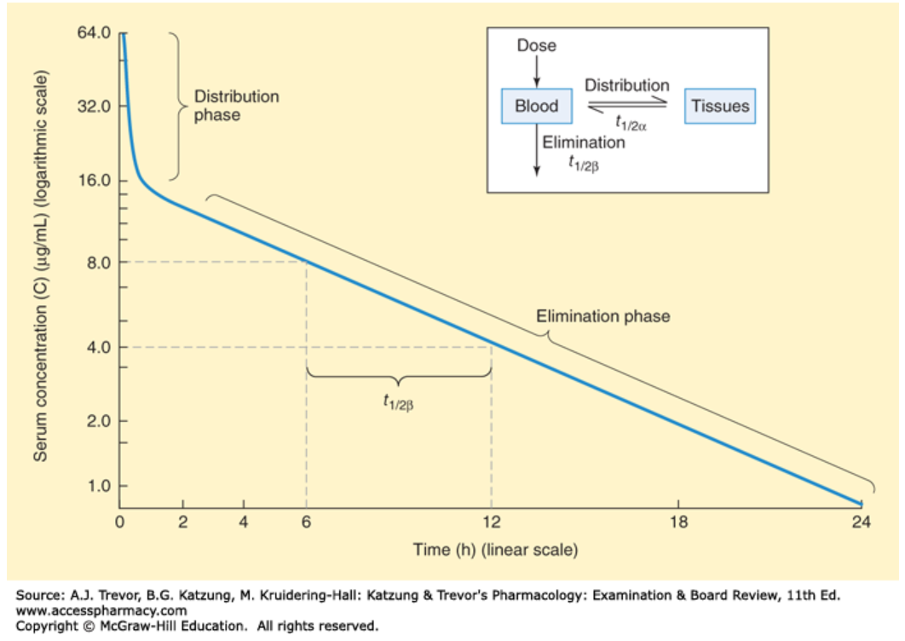
Half-life
The amount of time it takes to go from one concentration to half of that concentration
Depends on the clearance and V_{d}
Longer half-life = drug stays in body longer
AD ME
Katzung and Trevor’s Pharmacology, 11e. Figure 1-4.
Notes:
Half-life: the time it takes for the amount or concentration of a drug to fall to 50% of an earlier measurement.
For drugs eliminated by first-order kinetics (the great majority of drugs), this number is a constant regardless of concentration.
Half-life is not a constant and therefore not particularly useful for drugs eliminated by zero-order kinetics (e.g., ethanol).
Reference: Trevor AJ, Katzung BG, and Masters SB. Katzung and Trevor’s Pharmacology. 7th ed. 2005.
Serum concentration-time curve after administration of a drug as an intravenous bolus.
This drug follows first-order kinetics and appears to occupy two compartments.
The initial curvilinear portion of the data represents the distribution phase, with drug equilibrating between the blood compartment and the tissue compartment.
The linear portion of the curve represents drug elimination. The elimination half-life (t_{1/2β}) can be extracted graphically as shown by measuring the time between any two plasma concentration points on the elimination phase that differ by twofold.
Reference: Trevor AJ, Katzung BG, and Masters SB. Katzung and Trevor’s Pharmacology: Examination & Board Review, 11e. Figure 1-4.

Slide 31
Metabolism
Process of increasing the water solubility of a drug to increase renal excretion in the urine
Often happens in the liver
Not all drugs are metabolized
May result in active or inactive metabolites
CYP450 enzymes (CYPs) metabolize drugs
  Many different enzymes metabolize different drugs
Patient with liver failure have decreased metabolism, typically leading to decreased clearance
AD M E
Lenz TL. Expert opinion on drug metabolism & toxicology. 2011;7(3):257-266.
Notes:
Drug metabolism can occur in many different organs, however, the liver is the principal organ responsible for drug metabolism in the body
Reference: Lenz TL. Expert opinion on drug metabolism & toxicology. 2011;7(3):257-266.

Slide 32
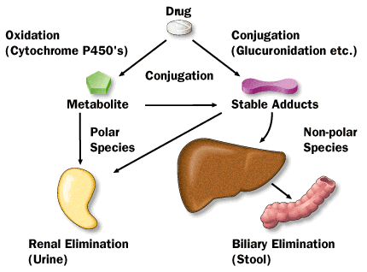
Metabolism
AD M E
Notes:
Conceptual: All organisms are exposed to foreign chemical compounds in the air, water, and food. To ensure elimination of pharmacologically active foreign chemicals as well as to terminate the action of many endogenous substances, metabolic pathways are available to alter their activity and their susceptibility to excretion.
The action of many drugs (e.g., sympathomimetics, phenothiazines) is terminated before they are excreted because they are metabolized to biologically inactive derivatives. Conversion to a metabolite is a form of elimination.
Example from physiology of an endogenous compound is metabolism of (endogenous) cortisol: Like most steroids, cortisol is metabolized in the liver. It has a half-life in the circulation of 60-90 minutes. Most of the cortisol is reduced to dihydrocortisol and then to tetrahydrocortisol, which is conjugated to glucuronic acid. Some cortisol is converted to cortisone. Note that cortisone is an inactive glucocorticoid and only formed in the liver, or kidney, not in the adrenal. Cortisone is reduced and conjugated to form tetrahydrocortisone glucuronide. The tetrahydroglucuronide derivatives of cortisol and cortisone are water soluble and are excreted in the urine.
Note! Some drugs (e.g., lithium) are not modified by the body; they continue to act until they are excreted.
Reference: Physiology I Reader (P121; Mitrovic)
Reference: Trevor AJ, Katzung BG, and Masters SB. Katzung and Trevor’s Pharmacology. 7th ed. 2005.

Slide 33
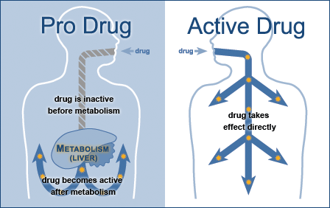
Pro-drugs
Drugs that need to be metabolized by the liver to their active form
Example: clopidogrel (Plavix)
AD M E
Notes:
Many drugs are active as administered and can have active metabolites as well (e.g., some benzodiazepines).
However, for prodrugs, drug metabolism functions as a mechanism of drug activation: prodrugs are inactive as administered and must be metabolized in the body to become active.
The effectiveness of clopidogrel bisulfate is dependent on its activation to an active metabolite by the cytochrome P450 (CYP) system, principally CYP2C19.
Black Box Warning: Clopidogrel bisulfate at recommended doses forms less of that metabolite and has a smaller effect on platelet function in patients who are CYP2C19 poor metabolizers. Poor metabolizers with acute coronary syndrome or undergoing percutaneous coronary intervention treated with clopidogrel bisulfate at recommended doses exhibit higher cardiovascular event rates than do patients with normal CYP2C19 function. Tests are available to identify a patient's CYP2C19 genotype; these tests can be used as an aid in determining therapeutic strategy. Consider alternative treatment or treatment strategies in patients identified as CYP2C19 poor metabolizers.
Reference: Clopidogrel prescribing information. http://dailymed.nlm.nih.gov/dailymed/drugInfo.cfm?setid=edae8df1-caf9-ff72-1304-5ae8b355f8e7. Accessed 29 Feb 2016.
Reference: Trevor AJ, Katzung BG, and Masters SB. Katzung and Trevor’s Pharmacology. 7th ed. 2005.

Slide 34
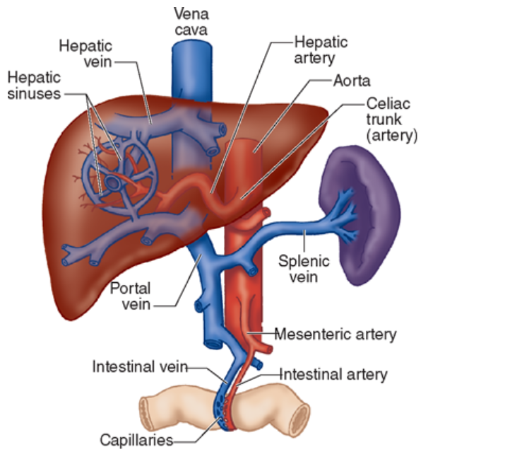
Effects of Physical Therapy on Metabolism
Exercise decreases blood flow to the liver, which decreases the amount of drug that can reach the liver and decreases clearance
Clinical effects are unclear
Morgan & Mikhail’s Clinical Anesthesiology, 5e. Figure 32-2.
Lenz TL. Expert opinion on drug metabolism & toxicology. 2011;7(3):257-266.
AD M E
Notes:
Affinity of drugs for extraction by the liver determines whether liver blood flow affects degree of metabolism.
High extraction ratio drugs (e.g., propranolol, verapamil) have metabolism significantly dependent upon liver blood flow and tend to be less available to the systemic circulation.
During exercise, changes in liver blood flow can affect metabolism of these drugs. In contrast, liver blood flow doesn’t significantly affect low extraction ratio drugs (e.g., digoxin, warfarin, theophylline, insulin, carvedilol).
Reference: Lenz TL. Expert opinion on drug metabolism & toxicology. 2011;7(3):257-266.
Reference: Morgan & Mikhail’s Clinical Anesthesiology. 5th ed. Figure 32-2. AccessMedicine.

Slide 35
Excretion
Removal of drug from the body mostly through urine
Can also be removed through bile, sweat, tears, feces, breast milk, and exhaled air
Many drugs are excreted renally
Dose must be adjusted based on the patient’s kidney function
Example: gentamicin
ADM E

Slide 36
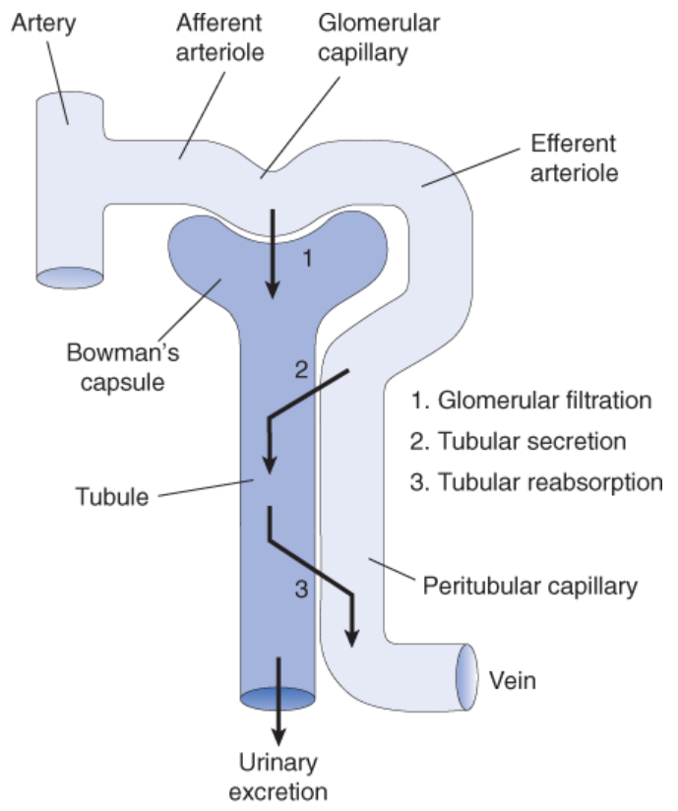
Renal Excretion
ADM E
Vander’s Renal Physiology, 8e. Figure 1-7.
Notes:
Example: Transport of Cortisol in Plasma – Approximately 75% of the cortisol in the circulation is bound to a plasma protein named transcortin or corticosteroid binding globulin (CBG). Another 15% is bound to albumin, and the remaining 10% is unbound or “free”. Only free or unbound cortisol is biologically active and can permeate the plasma membrane to then bind to its cognate receptor – the nuclear hormone glucocorticoid receptor (GR).
Free cortisol is controlled by the amount of transcortin. Transcortin is produced by the liver and is regulated by estrogens. Therefore plasma transcortin levels increase during pregnancy. As a result, free cortisol concentrations decrease and stimulate ACTH secretion, which stimulates increased cortisol production and free cortisol concentration returns to normal. For this reason, pregnant women have elevated blood cortisol levels but do not have symptoms of glucocorticoid excess.
Only free drug can be excreted
Reference: Physiology I Reader (P121; Mitrovic)
Reference: Vander’s Renal Physiology. 8th ed. Figure 1-7.

Slide 37
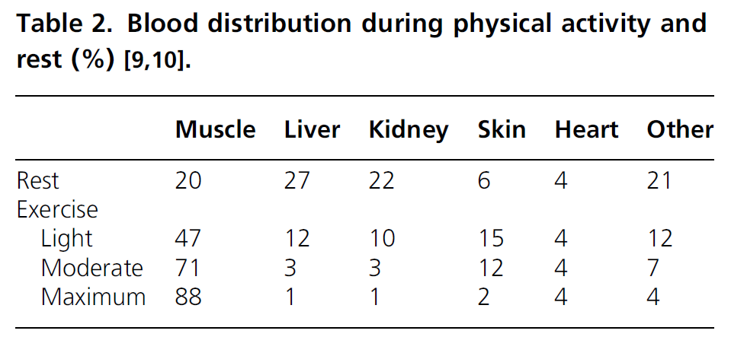
Effects of Physical Therapy on Excretion
Exercise can decrease renal blood flow, which decreases renal excretion and clearance
Clinical effects are unclear
Lenz TL. Expert opinion on drug metabolism & toxicology. 2011;7(3):257-266.
Notes:
Glomerular filtration rates have been shown to decrease by as much as 30% during physical activity. The greater the exercise intensity, the lesser the renal blood flow, and therefore the lower glomerular filtration rate.
The elimination PK of drugs that are most likely affected by exercise are those that are primarily eliminated unchanged in the urine or whose elimination is dependent on renal function.
Example: atenolol is eliminated 90%+ unchanged in the urine – one study found 1.7 fold increase in atenolol plasma concentrations during exercise compared with pre-exercise condition.
Interesting to think about the effect of exercise during hemodialysis on solute removal – one study found that exercise increased the efficiency of dialysis by reducing the rebound of solutes due to increased perfusion of the skeletal muscles. PMID: 10570099.
Reference: Lenz TL. Expert opinion on drug metabolism & toxicology. 2011;7(3):257-266.

Slide 38
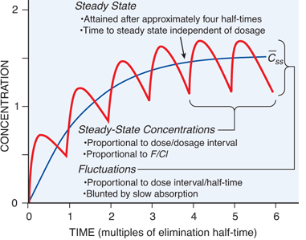
Steady State
Goodman & Gilman’s: The Pharmacological Basis of Therapeutics, 12ed. Figure 2-5.
Notes:
Steady state: when drug reaches therapeutic level
Longer the half-life of drug, longer it takes to get to steady state
Steady-state: the condition in which the average total amount of drug in the body does not change over multiple dosing intervals (i.e., the rate of drug input equals the rate of elimination).
Figure - Fundamental pharmacokinetic relationships for repeated administration of drugs. The blue line is the pattern of drug accumulation during repeated administration of a drug at intervals equal to its elimination half-time when drug absorption is 10 times as rapid as elimination. As the rate of absorption increases, the concentration maxima approach 2 and the minima approach 1 during the steady state. The black line depicts the pattern during administration of equivalent dosage by continuous intravenous infusion. Curves are based on the one-compartment model.
Reference: Brunton LL, Chabner BA, Knollmann BC. Goodman & Gilman’s: The Pharmacological Basis of Therapeutics, 12ed. Figure 2-5. www.accesspharmacy.com
Reference: Trevor AJ, Katzung BG, and Masters SB. Katzung and Trevor’s Pharmacology. 7th ed. 2005.

Slide 39
Pharmacokinetics Summary
What the body does to the drug
Absorption: Drugs can be administered many different ways and have varying degrees of absorption (bioavailability)
Distribution: Drugs can distribute into tissues, depending on their volume of distribution (high V_{d} means the drug goes into tissues)
Clearance depends on the metabolism of the drug by the liver and the excretion of the drug by the kidney
Exercise can have different effects on ADME; however, effects of PT on absorption are the only one that have demonstrated clinical effect
Notes:
http://sepia.unil.ch/pharmacology/index.php?id=100

Slide 40
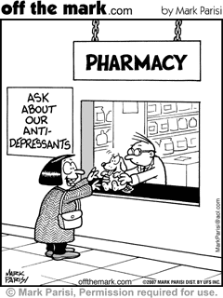
Pharmacodynamics
What the drug does to the body
Notes:
Encompasses a broad range of things:
Receptors, effectors
Dose-response curves
Agonists, partial agonists, antagonists, inverse agonists
Signaling mechanisms
Receptor regulation
Reference: Trevor AJ, Katzung BG, and Masters SB. Katzung and Trevor’s Pharmacology. 7th ed. 2005.

Slide 41
Pharmacodynamics
Two main types of effects
  Agonist
    Drug activates the receptor and elicits the normal physiologic response
    Full vs. partial agonist
    Example: albuterol is a short acting beta-2 agonist
  Antagonist
    Antagonize = against
    Drug binds the receptor and prevents receptor activation
    Competitive vs. irreversible (non-competitive) inhibitor
    Example: propranolol is a beta-1 antagonist
Trevor AJ, Katzung BG, and Masters SB. Katzung and Trevor’s Pharmacology, 7e.
Notes:
Agonist: a drug that activates its receptor upon binding
Antagonist: a drug that binds without activating its receptor and thereby prevents activation by an agonist (results in constitutive activity only)
Competitive antagonist: can be overcome by increasing the concentration of agonist
Irreversible (non-competitive) antagonist: cannot be overcome by increasing agonist concentration
Reference: Trevor AJ, Katzung BG, and Masters SB. Katzung and Trevor’s Pharmacology. 7th ed. 2005.

Slide 42
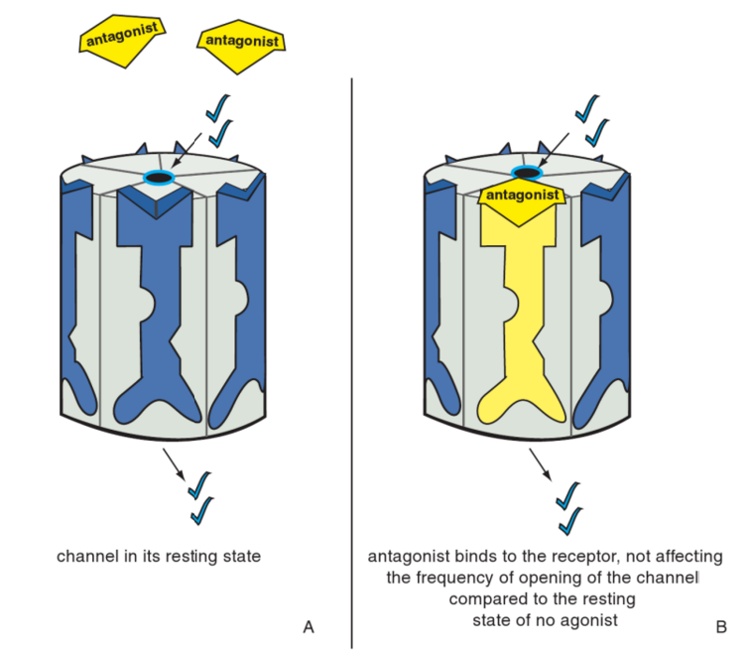
Antagonist:
Constitutive activity only
When the antagonist occupies the site normally occupied by the agonist on the ligand-gated ion channel, there is no consequence to this. There is no effect on the degree or frequency of opening of the channel compared to the resting state.
Stahl SM. Stahl’s Essential Psychopharmacology, 4e. Figure 3-5.

Slide 43
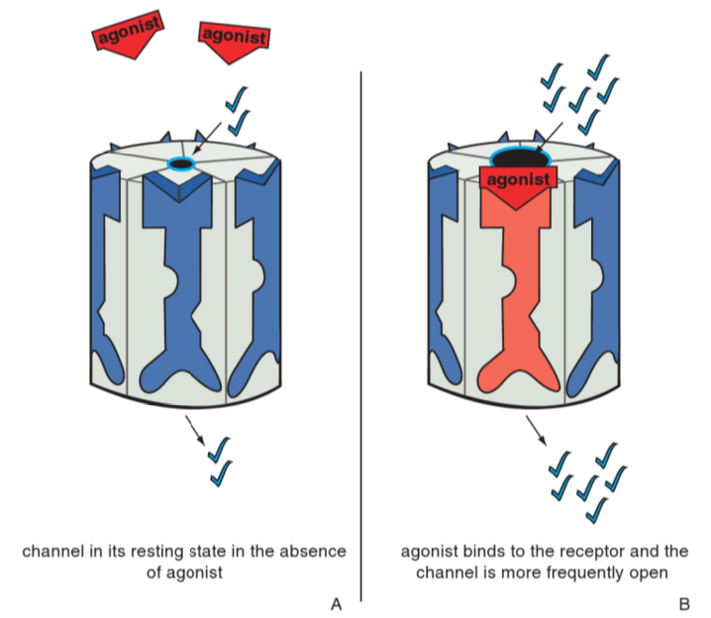
Agonist:
Increased channel opening frequency
In its resting state, the ion channel opens infrequently (constitutive activity). When the agonist occupies its binding site on the ligand-gated ion channel, it increases the frequency at which the channel opens.
Stahl SM. Stahl’s Essential Psychopharmacology, 4e. Figure 3-5.
Notes:
Agonist: a drug that activates its receptor upon binding
Partial agonist: a drug that binds to its receptor but produces a smaller effect (Emax) at full dosage than a full agonist
Inverse agonist: a drug that binds to the non-active state of receptor molecuels and decreases constitutive activity
Constitutive activity: activity of a receptor-effector system in the absence of an agonist ligand
Allosteric agonist or antagonist: a drug that binds to a receptor molecule without interfering with normal agonist binding but alters the response ot the normal agonist
Reference: Trevor AJ, Katzung BG, and Masters SB. Katzung and Trevor’s Pharmacology. 7th ed. 2005.

Slide 44
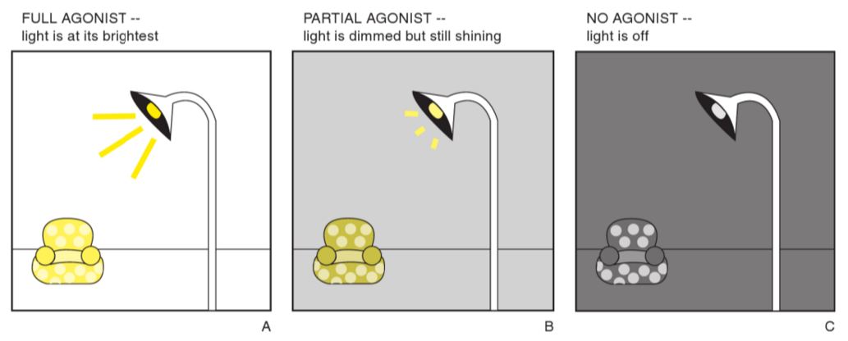
Agonist Spectrum Analogy
A useful analogy for the agonist spectrum is a light controlled by a rheostat (“dimmer”):
If the light is already on, a partial agonist will “dim” the lights, thus acting as a net antagonist.
Stahl SM. Stahl’s Essential Psychopharmacology, 4e. Figure 2-8.
Notes:
The light will be brightest after a full agonist turns the light switch full on.
A partial agonist will also act as a net agonist and turn the light on, but only partially, according to the level preset in the partial agonist’s rheostat.
When no full or partial agonist is present, the situation is analogous to the light being switched off.

Slide 45
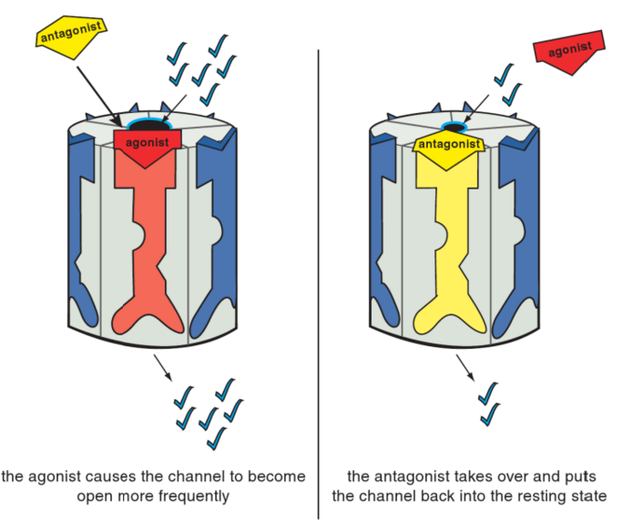
Antagonist in presence of Agonist:
Constitutive activity only
In the presence of an agonist, the antagonist shoves the agonist off the binding site, reversing the agonist’s actions and restoring the resting state. Thus, the ion channel has returned to its status before the agonist acted.
Stahl SM. Stahl’s Essential Psychopharmacology, 4e. Figure 3-5.
Notes:
Competitive antagonist: can be overcome by increasing the concentration of agonist
Irreversible (non-competitive) antagonist: cannot be overcome by increasing agonist concentration
Reference: Trevor AJ, Katzung BG, and Masters SB. Katzung and Trevor’s Pharmacology. 7th ed. 2005.

Slide 46
Pharmacodynamic Effects
Therapeutic effect
  What you want the drug to do
  Example: morphine relieves pain
Side effects
  “Off-target” effects (can range from mild to severe)
  Idiosyncratic: unpredictable
    Ex: Steven-Johnsons Syndrome
  Paradoxical: opposite of what you’d expect
    Ex: Benzodiazepines
  Iatrogenic: caused by medical treatment
    Ex: Chemotherapy drugs
Notes:
Iatrogenic: alkylators cause cancer themselves

Slide 47
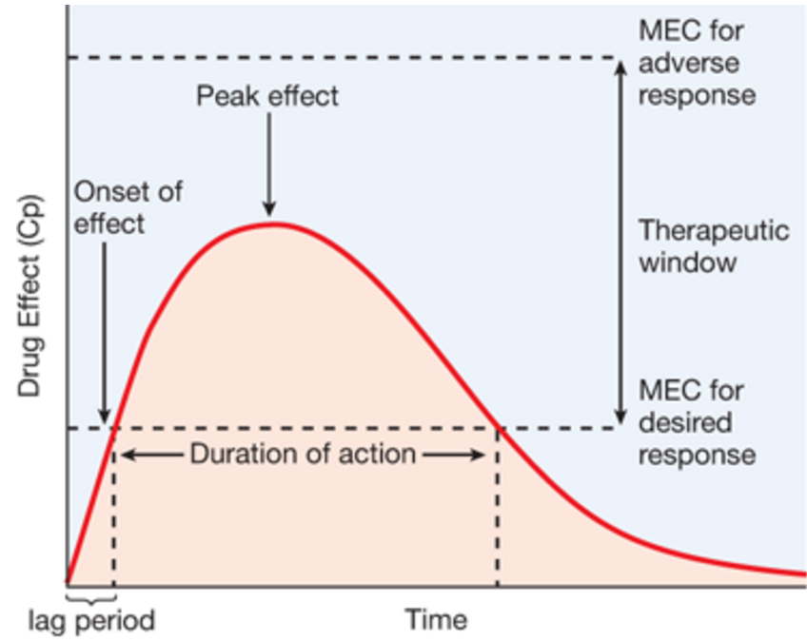
How Do We Relate Pharmacokinetics to Pharmacodynamics?
Goodman & Gilman’s: The Pharmacological Basis of Therapeutics, 12e. Figure 2-6.
Notes:
Oral vs. IV
MEC: Minimum Effective Concentration
MTC: Maximum Toxic Concentration
Therapeutic Range = therapeutic window (warfarin and digoxin have narrow therapeutic window)
Temporal characteristics of drug effect and relationship to the therapeutic window (e.g., single dose, oral administration). A lag period is present before the plasma drug concentration (Cp) exceeds the minimum effective concentration (MEC) for the desired effect. Following onset of the response, the intensity of the effect increases as the drug continues to be absorbed and distributed. This reaches a peak, after which drug elimination results in a decline in Cp and in the effect's intensity. Effect disappears when the drug concentration falls below the MEC. Accordingly, the duration of a drug's action is determined by the time period over which concentrations exceed the MEC. An MEC exists for each adverse response, and if drug concentration exceeds this, toxicity will result. The therapeutic goal is to obtain and maintain concentrations within the therapeutic window for the desired response with a minimum of toxicity. Drug response below the MEC for the desired effect will be subtherapeutic; above the MEC for an adverse effect, the probability of toxicity will increase. Increasing or decreasing drug dosage shifts the response curve up or down the intensity scale and is used to modulate the drug's effect. Increasing the dose also prolongs a drug's duration of action but at the risk of increasing the likelihood of adverse effects. Unless the drug is nontoxic (e.g., penicillins), increasing the dose is not a useful strategy for extending the duration of action. Instead, another dose of drug should be given, timed to maintain concentrations within the therapeutic window. The area under the blood concentration-time curve (area under the curve, or AUC, shaded in gray) can be used to calculate the clearance (Equation 2–6) for first-order elimination. The AUC is also used as a measure of bioavailability (defined as 100% for an intravenously administered drug). Bioavailability will be <100% for orally administered drugs, due mainly to incomplete absorption and first-pass metabolism and elimination.
Reference: Brunton LL, Chabner BA, Knollmann BC. Goodman & Gilman’s: The Pharmacological Basis of Therapeutics, 12ed. Figure 2-6. AccessMedicine.

Slide 48
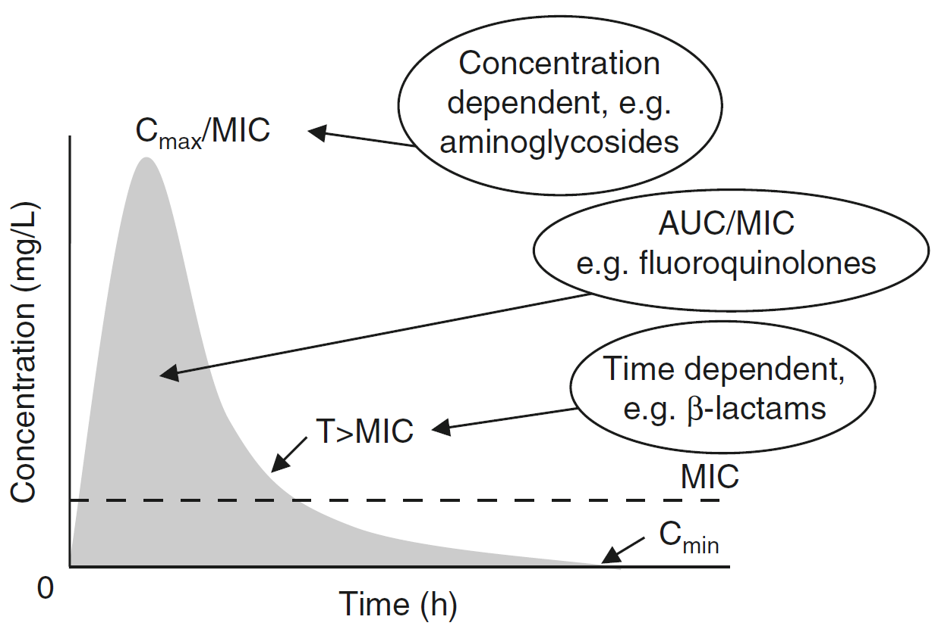
How Do We Relate Pharmacokinetics to Pharmacodynamics?
MIC=minimum inhibitory concentration
Roberts JA and Lipman J. Clin Pharmacokinet. 2006;45(8):755-773.
Notes:
MIC=minimum inhibitory concentration
Figure from Roberts JA and Lipman J. Antibacterial dosing in intensive care – pharmacokinetics, degree of disease and pharmacodynamics of sepsis. Clin Pharmacokinet. 2006;45(8):755-773.

Slide 49
Effects of Physical Therapy on Pharmacodynamics
Physical therapy sessions can work in conjunction with pharmacodynamics of medications
Example: Patient who has shoulder tendonitis can take ibuprofen to reduce his shoulder pain while also attending physical therapy to increase his range of motion and further decrease his pain
Lenz TL. Expert opinion on drug metabolism & toxicology. 2011;7(3):257-266.
Notes:
There are two ways to address the interactions that are believed to exist between physical activity and drug therapy. Drug--exercise interactions can be examined from the perspective of the effects that medications have on the ability to perform physical activity. The other is to examine the effect that physical activity has to the ability of the drug to work as it is designed.
Reference: Lenz TL. The effects of high physical activity on pharmacokinetic drug interactions. Expert opinion on drug metabolism & toxicology. 2011;7(3):257-266.

Slide 50
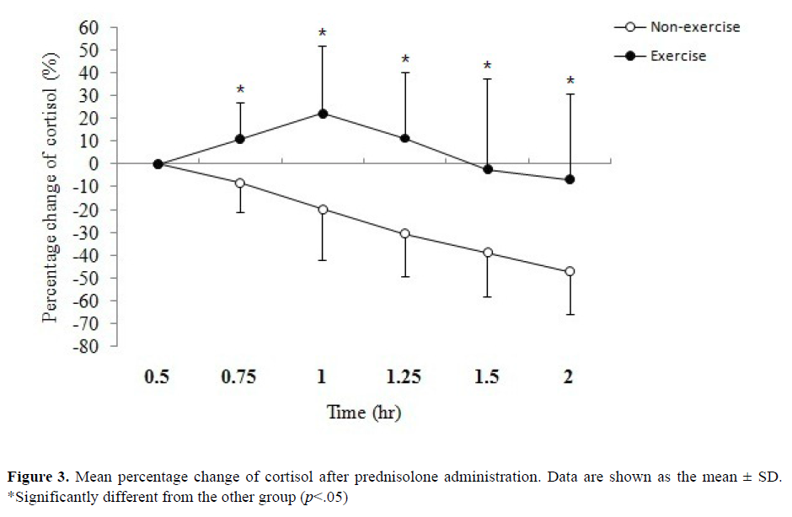
Back to our Prednisolone Example
Exercise of appropriate intensity is a potent stimulus for GH and cortisol secretion.
Diurnal cortisol variation
Exercise Arm: Cycled at 70% VO_{2max} intensity until exhaustion; significantly lower C_{max} (p<0.05)
Non-Exercise Arm: Remained seated for duration of experiment
Chien KY et al. J Pharm Pharmaceut Sci. 2010;13(1):58-66.
Kanaley JA. The Journal of Clinical Endocrinology & Metabolism. 2001;86(6):2881-2889.
Notes:
Remember from earlier in the lecture that exercise resulted in a significantly lower Cmax than NE, and that the absorption patterns were slightly different. Does this PD result make sense in that context?
Result: The mean percentage change of cortisol was significantly different between the E and NE trials during the period of 0.75 to 2 hr and E trial was significantly higher than NE trial (p<0.05).
Reference: Kanaley JA. Cortisol and Growth Hormone Responses to Exercise at Different Times of Day. The Journal of Clinical Endocrinology & Metabolism. 2001;86(6):2881-2889. Available at: http://press.endocrine.org/doi/citedby/10.1210/jcem.86.6.7566. Accessed 23 Feb 2016.
- Diurnal cortisol secretion pattern - was time of day controlled?
Reference: Physiology I Reader (P121; Mitrovic)
How cortisol works: Once in the nucleus, GR is able to bind a specific glucocorticoid receptor response element on DNA or the promoter region controlling certain gene transcription. This results in enhanced transcription, and protein synthesis. In Figure 5, one sees why GR inhibit the inflammatory response. 1. GR promotes an increase in IkB – IkB binds to NFkB, which is normally needed to mount an inflammatory response. 2. GR also binds directly to NFkB, which is needed for mounting an inflammatory response. 3. GR also negatively regulates NFkB when it is bound to DNA.
Reference: Physiology I Reader (P121; Mitrovic)

Slide 51
Pharmacodynamics Summary
What the drug does to the body
Drugs can either act as agonists (stimulate receptors) or antagonists (block receptors)
Drugs can exert their therapeutic effect, but may also cause side effects
Scientists relate PK to PD through curves, which help to determine doses and dosing intervals

Slide 52


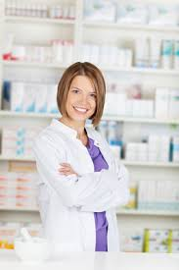


Time to put on your pharmacist hat (or coat!)

Slide 53
How Pharmacists Use PK & PD
Drug-drug interactions
Therapeutic Drug Monitoring
Calculate doses
Adjust doses for special populations
Renal dose adjustments
Clinical research
Preclinical research
Notes:
Special populations: obesity, pediatrics, renal replacement therapy, elderly, renal/hepatic impairment, burn patients

Slide 54
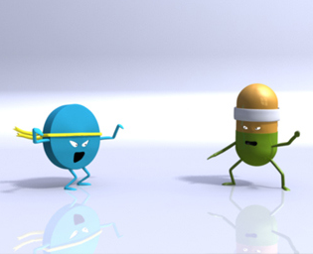
Drug-Drug Interactions (DDIs)
Big part of a pharmacist’s job
Some drugs notorious for having DDIs (HIV drugs, warfarin)
Can be PK or PD in nature
Some are only theoretical whereas others have clinical effects
DDI databases exist to provide guidance on how to manage DDIs (you’ll learn about these next week!)

Slide 55
DDI Example #1
Propofol and Lorazepam
Both of these medications work by activating GABA receptors and causing CNS depression. The administration of these two together can result in decreased respiratory drive, bradycardia, and death.
PK or PD?
Lexicomp Online® , Lexi-Drugs® , Hudson, Ohio: Lexi-Comp, Inc.; February 21, 2016.

Slide 56
DDI Example #2
Ketoconazole and Quetiapine
Quetiapine is an antipsychotic that can cause QT prolongation. Ketoconazole is an inhibitor of the CYP450 enyzmes responsible for metabolizing quetiapine. Administration of the two together can cause prolonged QT interval and death.
PK or PD?
Lexicomp Online® , Lexi-Drugs® , Hudson, Ohio: Lexi-Comp, Inc.; February 21, 2016.

Slide 57
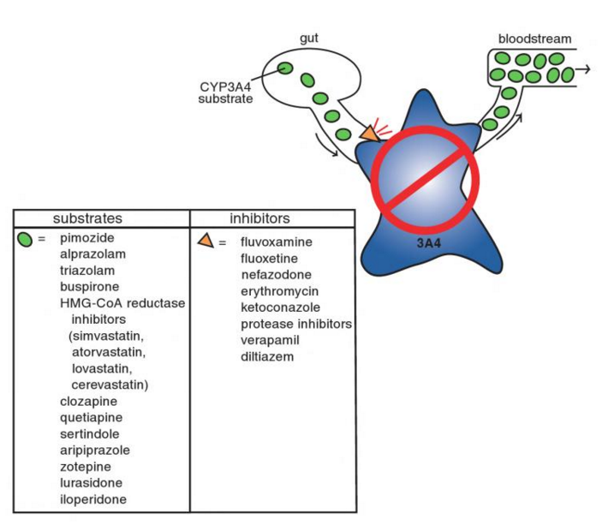
DDI Example #2
Stahl SM. Stahl’s Essential Psychopharmacology. 4th ed. Figure 2-20.
Notes:
The antipsychotic pimozide, the benzodiazepines alprazolam and triazolam, the anxiolytic buspirone, HMG-CoA reductase inhibitors (statins), and multiple antipsychotics are all substrates for CYP3A4.
Fluvoxamine, fluoxetine, and nefazodone are moderate CYP3A4 inhibitors, as are some nonpsychotropic agents.

Slide 58
DDI Example #3
Fluoxetine and Tramadol
Fluoxetine is a Selective Serotonin Reuptake Inhibitor (SSRI) and works by increasing serotonin levels in the CNS. Tramadol is a pain medication which binds to opiate receptors and inhibits reuptake of serotonin and norepinephrine. Administration of the two together can lead to “serotonin syndrome,” resulting in mental status changes, diaphoresis, tachycardia, and death.
PK or PD?
Lexicomp Online® , Lexi-Drugs® , Hudson, Ohio: Lexi-Comp, Inc.; February 21, 2016.

Slide 59
DDI Example #4
Clopidogrel and Omeprazole
Clopidogrel is a pro-drug that prevents platelets from aggregating and reduces thrombosis risk in cardiac stent patients. Omeprazole inhibits the P450 enzyme that metabolizes clopidogrel. Administration of the two together can lead to reduced anti-platelet effect and stent thrombosis.
PK or PD?
Lexicomp Online® , Lexi-Drugs® , Hudson, Ohio: Lexi-Comp, Inc.; February 21, 2016.

Slide 60
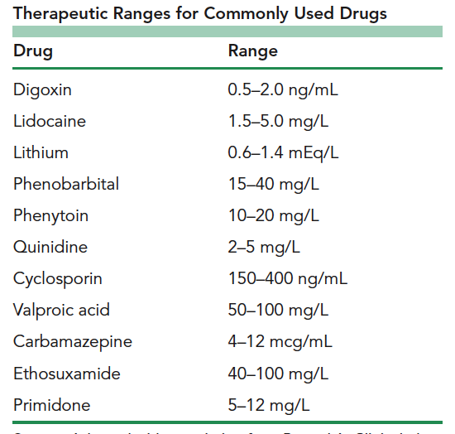
Therapeutic Drug Monitoring
Very important for drugs with narrow therapeutic window and certain antibiotics (vancomycin)
Measuring concentration of drug in the blood
Making dose adjustments based on the level and the patient’s pharmacokinetics (clearance and volume)
Ensuring the concentration stays in the therapeutic range

Slide 61
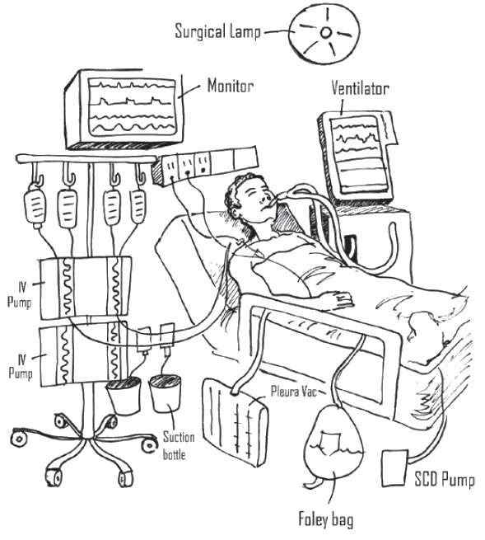
PK in Critically Ill Patients
Leaky capillaries can lead to increased V_{d} for water-soluble drugs
  Fluid shifts from intravascular compartment to interstitial space
Increased cardiac index can lead to increased CL
  Inotropic agents often prescribed for hypotension
End-organ dysfunction can lead to decreased CL
Image: UCSF Medical Center. A Family Guide to the ICU.
Roberts JA and Lipman J. Clin Pharmacokinet. 2006;45(8):755-773.
Notes:
Important concept: recommended dosages are obtained from healthy volunteers and possibly (ward) “sick” patients
“Deranged PK” – difficult to predict. Obviously, the first two bullet points would result in lower drug concentrations vs. last bullet point could result in higher drug concentrations. Also, note the dynamic nature of PK in a critically ill patient – things can progress rapidly.
Endotoxins, such as lipopolysaccharides (Gram-negative bacteria), lipoteichoic acid (Gram-positive bacteria), or mannan (fungi) stimulate the production of various endogenous mediators, such as cytokines, interleukins, platelet activating factor, eicosanoids, complement components, and kinins -> direct or indirect effect on vascular endothelium -> either vasoconstriction or vasodilatation with maldistribution of blood flow, endothelial damage, and increased capillary permeability.
Capillary leak syndrome results in fluid shifts from the intravascular compartment to the interstitial space, which is known as “third-spacing”. (Increases Vd of water-soluble drugs.)
Cardiac index is equal to cardiac output over body surface area. Cardiac output = stroke volume x heart rate. CI=CO/BSA=(SV*HR)/BSA. Increased cardiac index can lead to increased renal blood flow.
As sepsis progresses, significant myocardial depression can occur, which leads to a decrease in organ perfusion. Myocardial insufficiency and abnormalities of the macrovascular circulation are compounded by failure of the microcirculation. This induces end-organ microvascular alterations, which may progress to multiple organ dysfunction syndrome.
2016 Consensus Definitions for Sepsis and Septic Shock -> http://sites.jamanetwork.com/sepsis/ (PMID: 26903338).
Image: UCSF Medical Center. A Family Guide to the Intensive Care Unit (ICU). http://campuslifeservices.ucsf.edu/dmx/PatientEd/SDICU0005.pdf
Reference: Roberts JA and Lipman J. Antibacterial dosing in intensive care: pharmacokinetics, degree of disease and pharmacodynamics of sepsis. Clin Pharmacokinet. 2006; 45(8):755-773.
Additional recommended reference: Lipman J. Pharmacokinetics in the critically ill. http://www.slideshare.net/oliflower/1200-j-lipman-38900607. Accessed 20 Feb 2016.

Slide 62
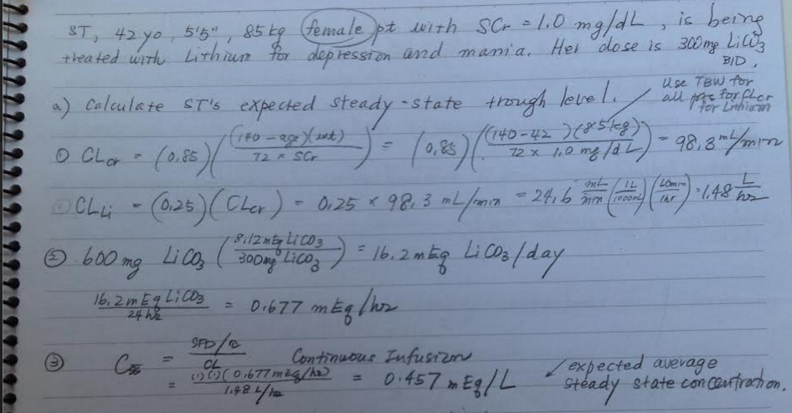
PK Calculations!
Cockcroft and Gault equation: estimates a patient’s renal function
Notes:
There is one equation on here that comes up a lot: the Cockcroft and Gault equation, which is used to estimate a patient’s renal function. Often, this value in mL/min is used to determine a patient’s dose based on their renal function.
This particular calculation has to do with lithium, which was on the list of medications for which therapeutic drug monitoring is sometimes used since it has a narrow therapeutic range (NRT) and a known blood level correlates with its efficacy and toxicity.

Slide 63
In Summary…
PK and PD concepts are important for designing an optimally safe and efficacious therapeutic regimen
Physical therapy treatments can affect how the body handles the drug (PK) and the patient’s treatment outcome (PD)
PK and PK/PD relationships can involve a lot of math, but understanding the underlying fundamental concepts is most important!
Notes:
As Lenz et al conclude, it is clear the physical activity can and dose have an interaction with some medications, particularly those with a narrow therapeutic range, and vice versa.
Exercise-PD interactions that affect exercise performance are more easily understood and measured than exercise-PK interactions.
‘Research in this area has been conducted since the 1960s yet most healthcare providers are unaware that such interactions exist. Perhaps the reason for this is the fact that little clinical data can be tied to even the PK parameter changes that prove to be statistically significant.’
‘With the information that is available to date, the practical emphasis of drug--exercise pharmacokinetic interactions should be focused on three areas: insulin injection site and timing relative to a bout of physical activity, medications that have a narrow therapeutic range and medications that are administered via transdermal patch drug delivery system, especially when coupled with activities that are of long duration.’
Three major groups of medications talked about today: insulin, narrow therapeutic range drugs, and transdermal patch drug delivery system.
Digoxin, theophylline, and warfarin are all considered to have a narrow therapeutic range. Blood levels outside the therapeutic range for these medications can have serious consequences when they are both toxic and sub-therapeutic. Monitoring of both PK and clinical variables of these medications in a person who is physically active may be particularly important. Healthcare professionals – educate the patient about signs and symptoms of drug toxicity with these medications in case of adverse reaction developing as a result of increased physical activity. For warfarin, more frequent INR measurements may be warranted for patients involved in physical therapy or a training program.
Reference: Lenz TL. The effects of high physical activity on pharmacokinetic drug interactions. Expert opinion on drug metabolism & toxicology. 2011;7(3):257-266.

Slide 64
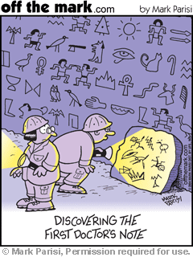
Questions?

Slide 65
Major References
Hsia S. Pharmacokinetics and Pharmacodynamics. March 2015.
Beechinor R. Pharmacokinetics and Pharmacodynamics. March 2014.
Ciccone CD. Basic pharmacokinetics and the potential effect of physical therapy interventions on pharmacokinetic variables. Phys Ther. 1995; 75: 343-351.
Lenz TL. The effects of high physical activity on pharmacokinetic drug interactions. Expert opinion on drug metabolism & toxicology. 2011;7(3):257-266.
Winters M. Basic Clinical Pharmacokinetics. 5th ed. LWW, 2009.
Katzung B. Basic and Clinical Pharmacology. 11th ed. McGraw Hill Medical, 2009.
Brunton LL, Chabner BA, Knollmann BC. Goodman & Gilman’s: The Pharmacological Basis of Therapeutics, 12ed.
Lexicomp Online® , Lexi-Drugs® , Hudson, Ohio: Lexi-Comp, Inc.; February 21, 2016.
Roberts JA and Lipman J. Antibacterial dosing in intensive care – pharmacokinetics, degree of disease and pharmacodynamics of sepsis. Clin Pharmacokinet. 2006;45(8):755-773.
Stahl SM. Stahl’s Essential Psychopharmacology: Neuroscientific basis and practical applications. Fourth edition. 2013.

Slide 66
Appendix I: PD CONCEPTS
Ion Channels: Full Agonists, Partial Agonists, Antagonists

Slide 67
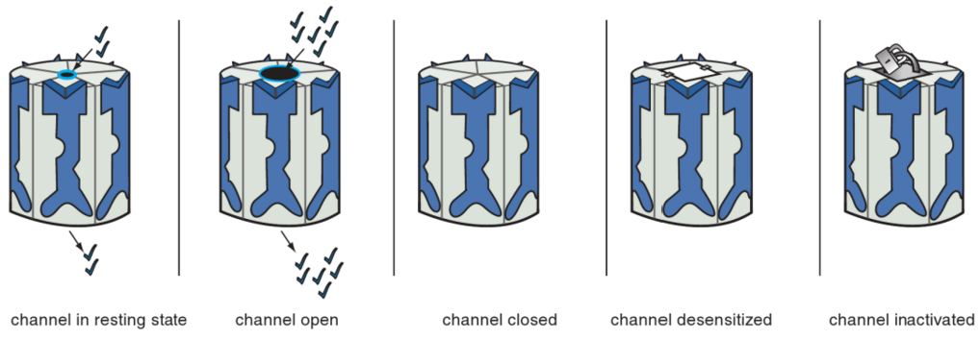
Five States of Ligand-Gated Ion Channels
Resting state: channel opens infrequently; constitutive activity that may or may not lead to detectable signal transduction
Open state: channel opens to allow ion conductance through the channel, leading to signal transduction
Closed state: no ion flow, signal transduction is reduced to even less than is produced in the resting state
Stahl SM. Stahl’s Essential Psychopharmacology. 4th ed. Figure 3-14.

Slide 68
Five States of Ligand-Gated Ion Channels, continued
Channel desensitization: an adaptive state in which the receptor stops responding to agonist even if it is still bound
Channel inactivation: state in which a closed ion channel over time becomes stabilized in an inactive conformation
Stahl SM. Stahl’s Essential Psychopharmacology. 4th ed. Figure 3-14.

Slide 69
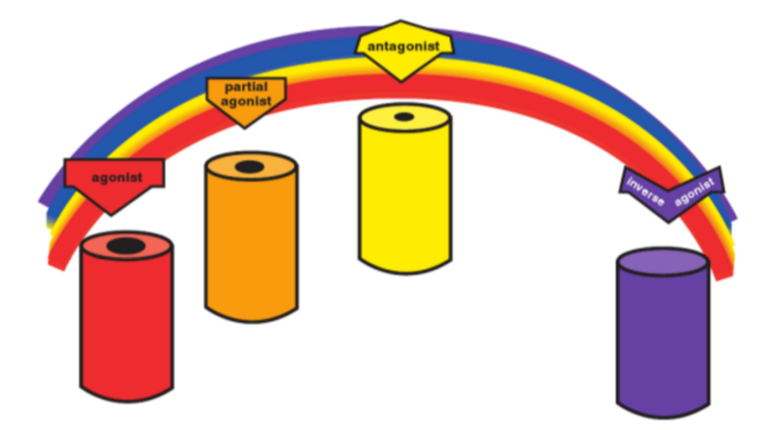
The Agonist Spectrum
Agonists: Open channel the maximum amount and frequency allowed by that binding site
Partial Agonist: Increase the degree and frequency of channel opening compared to the resting state, but not as much as a full agonist
Inverse Agonists: Put the ion channel in a closed and inactive state
Stahl SM. Stahl’s Essential Psychopharmacology. 4th ed. Figure 3-4.
Notes:
Antagonists: retain the resting state with infrequent opening of the channel
Inverse Agonists: put the ion channel in a closed and inactive state

Slide 70
The Agonist Spectrum, continued
Antagonists: Retain the resting state with infrequent opening of the channel. Can block anything in the agonist spectrum, returning the ion channel to the resting state in each instance.
Stahl SM. Stahl’s Essential Psychopharmacology. 4th ed. Figure 3-4.

Slide 71
Agonist:
Increased channel opening frequency
In its resting state, the ion channel opens infrequently (constitutive activity). When the agonist occupies its binding site on the ligand-gated ion channel, it increases the frequency at which the channel opens.
Stahl SM. Stahl’s Essential Psychopharmacology. 4th ed. Figure 3-5.

Slide 72
Antagonist:
Constitutive activity only
When the antagonist occupies the site normally occupied by the agonist on the ligand-gated ion channel, there is no consequence to this. There is no effect on the degree or frequency of opening of the channel compared to the resting state.
Stahl SM. Stahl’s Essential Psychopharmacology. 4th ed. Figure 3-5.

Slide 73
Antagonist in presence of Agonist:
Constitutive activity only
In the presence of an agonist, the antagonist shoves the agonist off the binding site, reversing the agonist’s actions and restoring the resting state. Thus, the ion channel has returned to its status before the agonist acted.
Stahl SM. Stahl’s Essential Psychopharmacology. 4th ed. Figure 3-5.

Slide 74
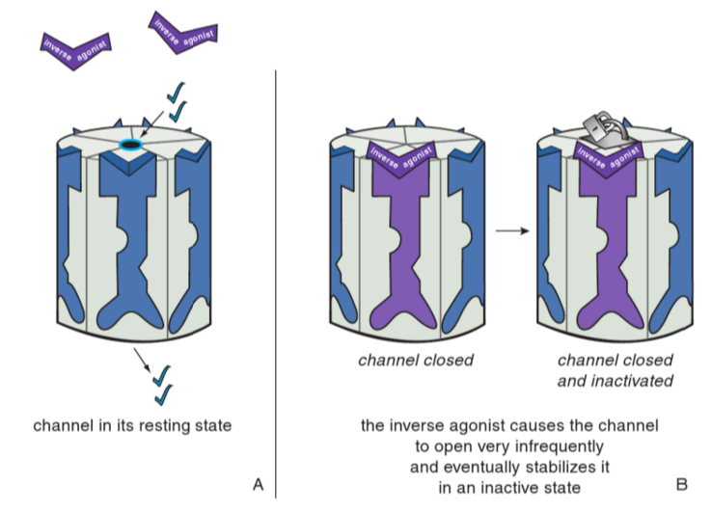
Inverse Antagonist:
Closes and Inactivates Channel
When the inverse agonist occupies the binding site on the ligand-gated ion channel, this causes it to close. This is the opposite of what an agonist does! Eventually, the inverse agonist stabilizes the ion channel in an inactive state (represented by the padlock).
Stahl SM. Stahl’s Essential Psychopharmacology. 4th ed. Figure 3-5.

Slide 75
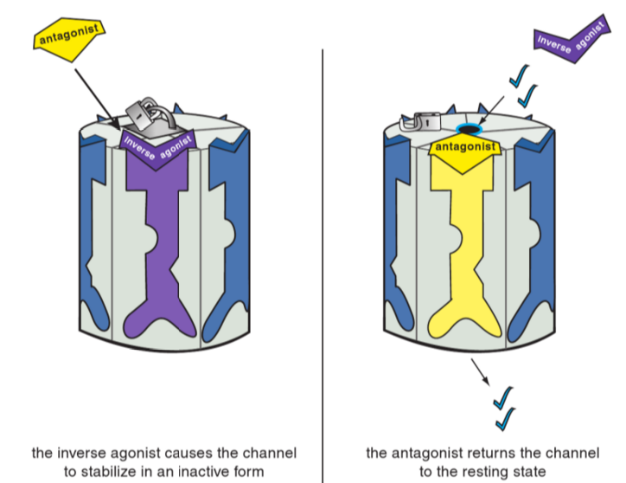
Antagonist in presence of Inverse Agonist: Constitutive activity only
In the presence of an inverse agonist, the antagonist prevails and shoves the inverse agonist off the binding site, returning the ion channel to its resting state. An antagonist reverses the actions of either an agonist or inverse agonist despite the fact that it does nothing on its own.
Stahl SM. Stahl’s Essential Psychopharmacology. 4th ed. Figure 3-5.

Slide 76
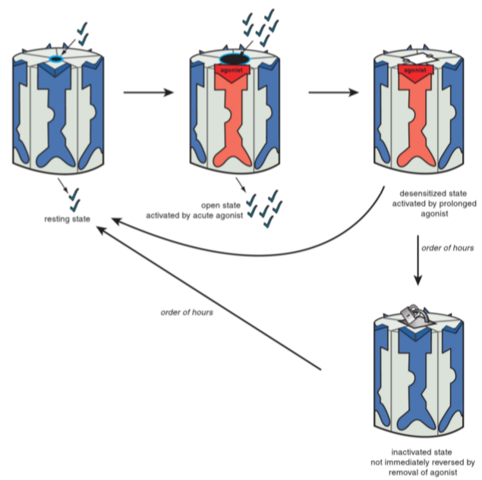
Opening, desensitizing, and inactivating by agonists
Prolonged exposure to agonists can cause a ligand-gated ion channel to enter a desensitized state in which it no longer responds to the agonist even if it is still bound.
  Prompt removal of the agonist can reverse this state fairly quickly.
However, if the agonist stays longer, it can cause a conformational change that leads to inactivation of the ion channel.
  This state is not immediately reversed when the agonist is removed.
Stahl SM. Stahl’s Essential Psychopharmacology. 4th ed. Figure 3-15.

Slide 77
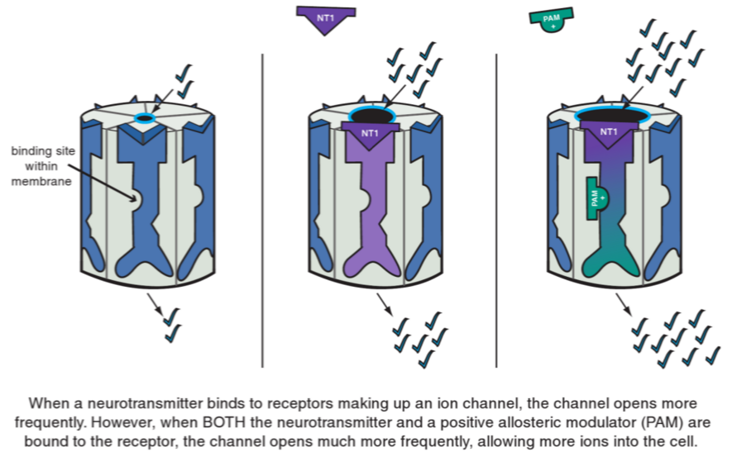
Allosteric Modulation: Enhance or block actions of neurotransmitters
Allosteric modulators bind to sites other than the neurotransmitter site on an ion-channel-linked receptor.
Allosteric modulators have no activity on their own – they enhance (positive allosteric modulators) or block (negative allosteric modulators) the actions of neurotransmitters.
Stahl SM. Stahl’s Essential Psychopharmacology. 4th ed. Figure 3-16.
Notes:
When a positive allosteric modulator binds to its site while an agonist is also bound, the channel opens more frequently than when only the agonist is bound, therefore allowing more ions into the cell.

Slide 78
Appendix II: PD CONCEPTS
GPCRs: Full Agonists, Partial Agonists, Antagonists

Slide 79
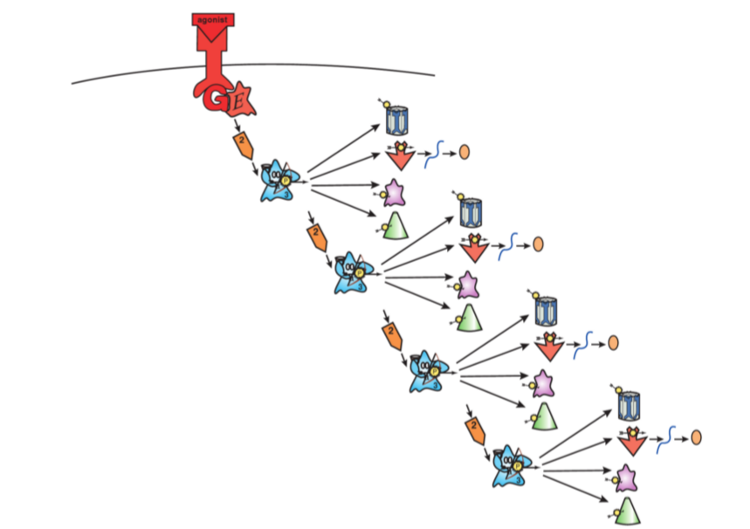
Full Agonist:
Maximum Signal Transduction
When a full agonist binds to GPCRs, it causes conformational changes that lead to maximum signal transduction. Thus, all the downstream effects of signal transduction, such as phosphorylation of proteins and gene activation, are maximized.
Stahl SM. Stahl’s Essential Psychopharmacology. 4th ed. Figure 2-5.
Notes:
GPCR: G-protein coupled receptor

Slide 80
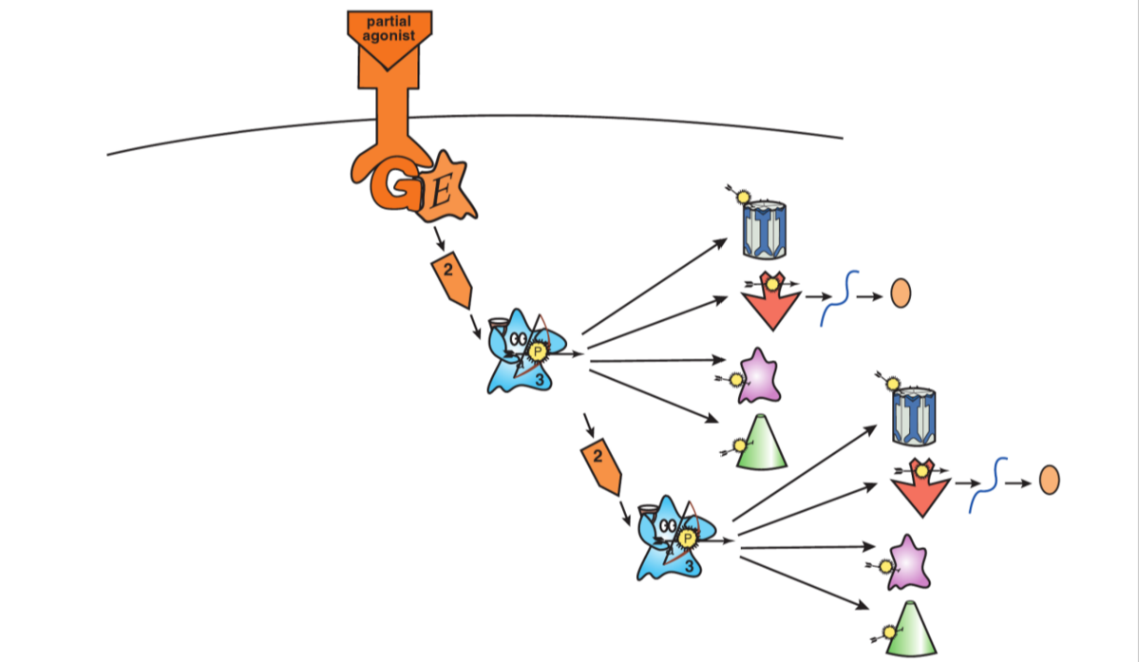
Partial Agonist:
Partially Enhanced Signal Transduction
What happens in the presence of a full agonist?
Partial agonists stimulate GPCRs to enhance signal transduction but do not lead to maximum signal transduction the way full agonists do. Thus, in the absence of a full agonist, partial agonists increase signal transduction.
Stahl SM. Stahl’s Essential Psychopharmacology. 4th ed. Figure 2-7.
Notes:
In the presence of a full agonist, the partial agonist will actually turn down the strength of various downstream signals. For this reason, especially in psychopharmacology, partial agonists are sometimes referred to as stabilizers.

Slide 81

Antagonist:
Constitutive Activity Only
An antagonist blocks agonists (both full and partial) from binding to GPCRs, thus preventing agonists from causing maximum signal transduction and instead changing the receptor’s conformation back to the same state as exists when no agonist is present.
Stahl SM. Stahl’s Essential Psychopharmacology. 4th ed. Figure 2-6.
Notes:
Antagonists also reverse the effects of inverse agonists, again by blocking the inverse agonists from binding and then returning the receptor conformation to the baseline state.
Antagonists do not have any impact on signal transduction in the absence of an agonist.

Slide 82
Appendix III:
IONTOPHORESIS PHARMCOKINETICS
PK Playing a Role in Validating a PT Intervention

Slide 83

A DME
Rigby JH et al. J Orthop Sports Phys Ther. 2015;45(3):190-7. PMID: 25679344.
Notes:
Background: In humans, real-time information of Dex-P transdermal delivery during iontophoresis is unknown.
Objective: To determine the time course of dexamethasone sodium phosphate (Dex-P) during iontophoresis to underlying tissues using microdialysis.

Slide 84


Effects of Physical Therapy on Absorption
64 healthy male participants randomized to six groups:
1-mA current, 1-mm probe depth
1-mA current, 4-mm probe depth
2-mA current, 1-mm probe depth
2-mA current, 4-mm probe depth
In vivo retrodialysis
Skin perfusion flowmetry
A DME

Slide 85

A DME
Notes:
Results: There was no difference in Dex-total between current intensities (p=0.99), but a greater amount of Dex-total was recovered superficially at 1mm compared to the 4-mm depth (p<0.0001).
Peak concentrations mean +/- SD for the 1- and 2-mA currents at 1 mm were 10.8 +/- 8.1 and 7.7 +/- 5.5 ug/mL, and at 4 mm were 2.0 +/- 0.8 and 1.3 +/- 1.9 ug/mL, respectively.
Peak skin perfusion was 741.4$ +/- 408.7% and 711.6% +/- 260.8% at baseline for 1- and 2-mA intensities, respectively.
Skin perfusion returned to baseline levels earlier during 1-mA intensity at 110 mA-min dose within the treatment, compared to 2 mA at 60 minutes posttreatment.
Conclusion: Transdermal delivery of Dex-P during iontophoresis was successfully measured in vivo through human skin.
Measurable concentrations of Dex-total were found regardless of current intensity.
Although current-induced vasodilation occurred, it did not significantly affect the tissue accumulation of Dex-total.

