Slide 1
Next Generation Sequencing
Epidemiology 217: Lecture 10
Eric Jorgenson, PhD
March 8th, 2016
Kaiser Permanente Research

Slide 2
Outline
Overview
Examples of Next Generation Sequencing Studies: Whole Genome, Exome, Families (IBD), Cancer
PTC Taste Sensitivity
Implications

Slide 3
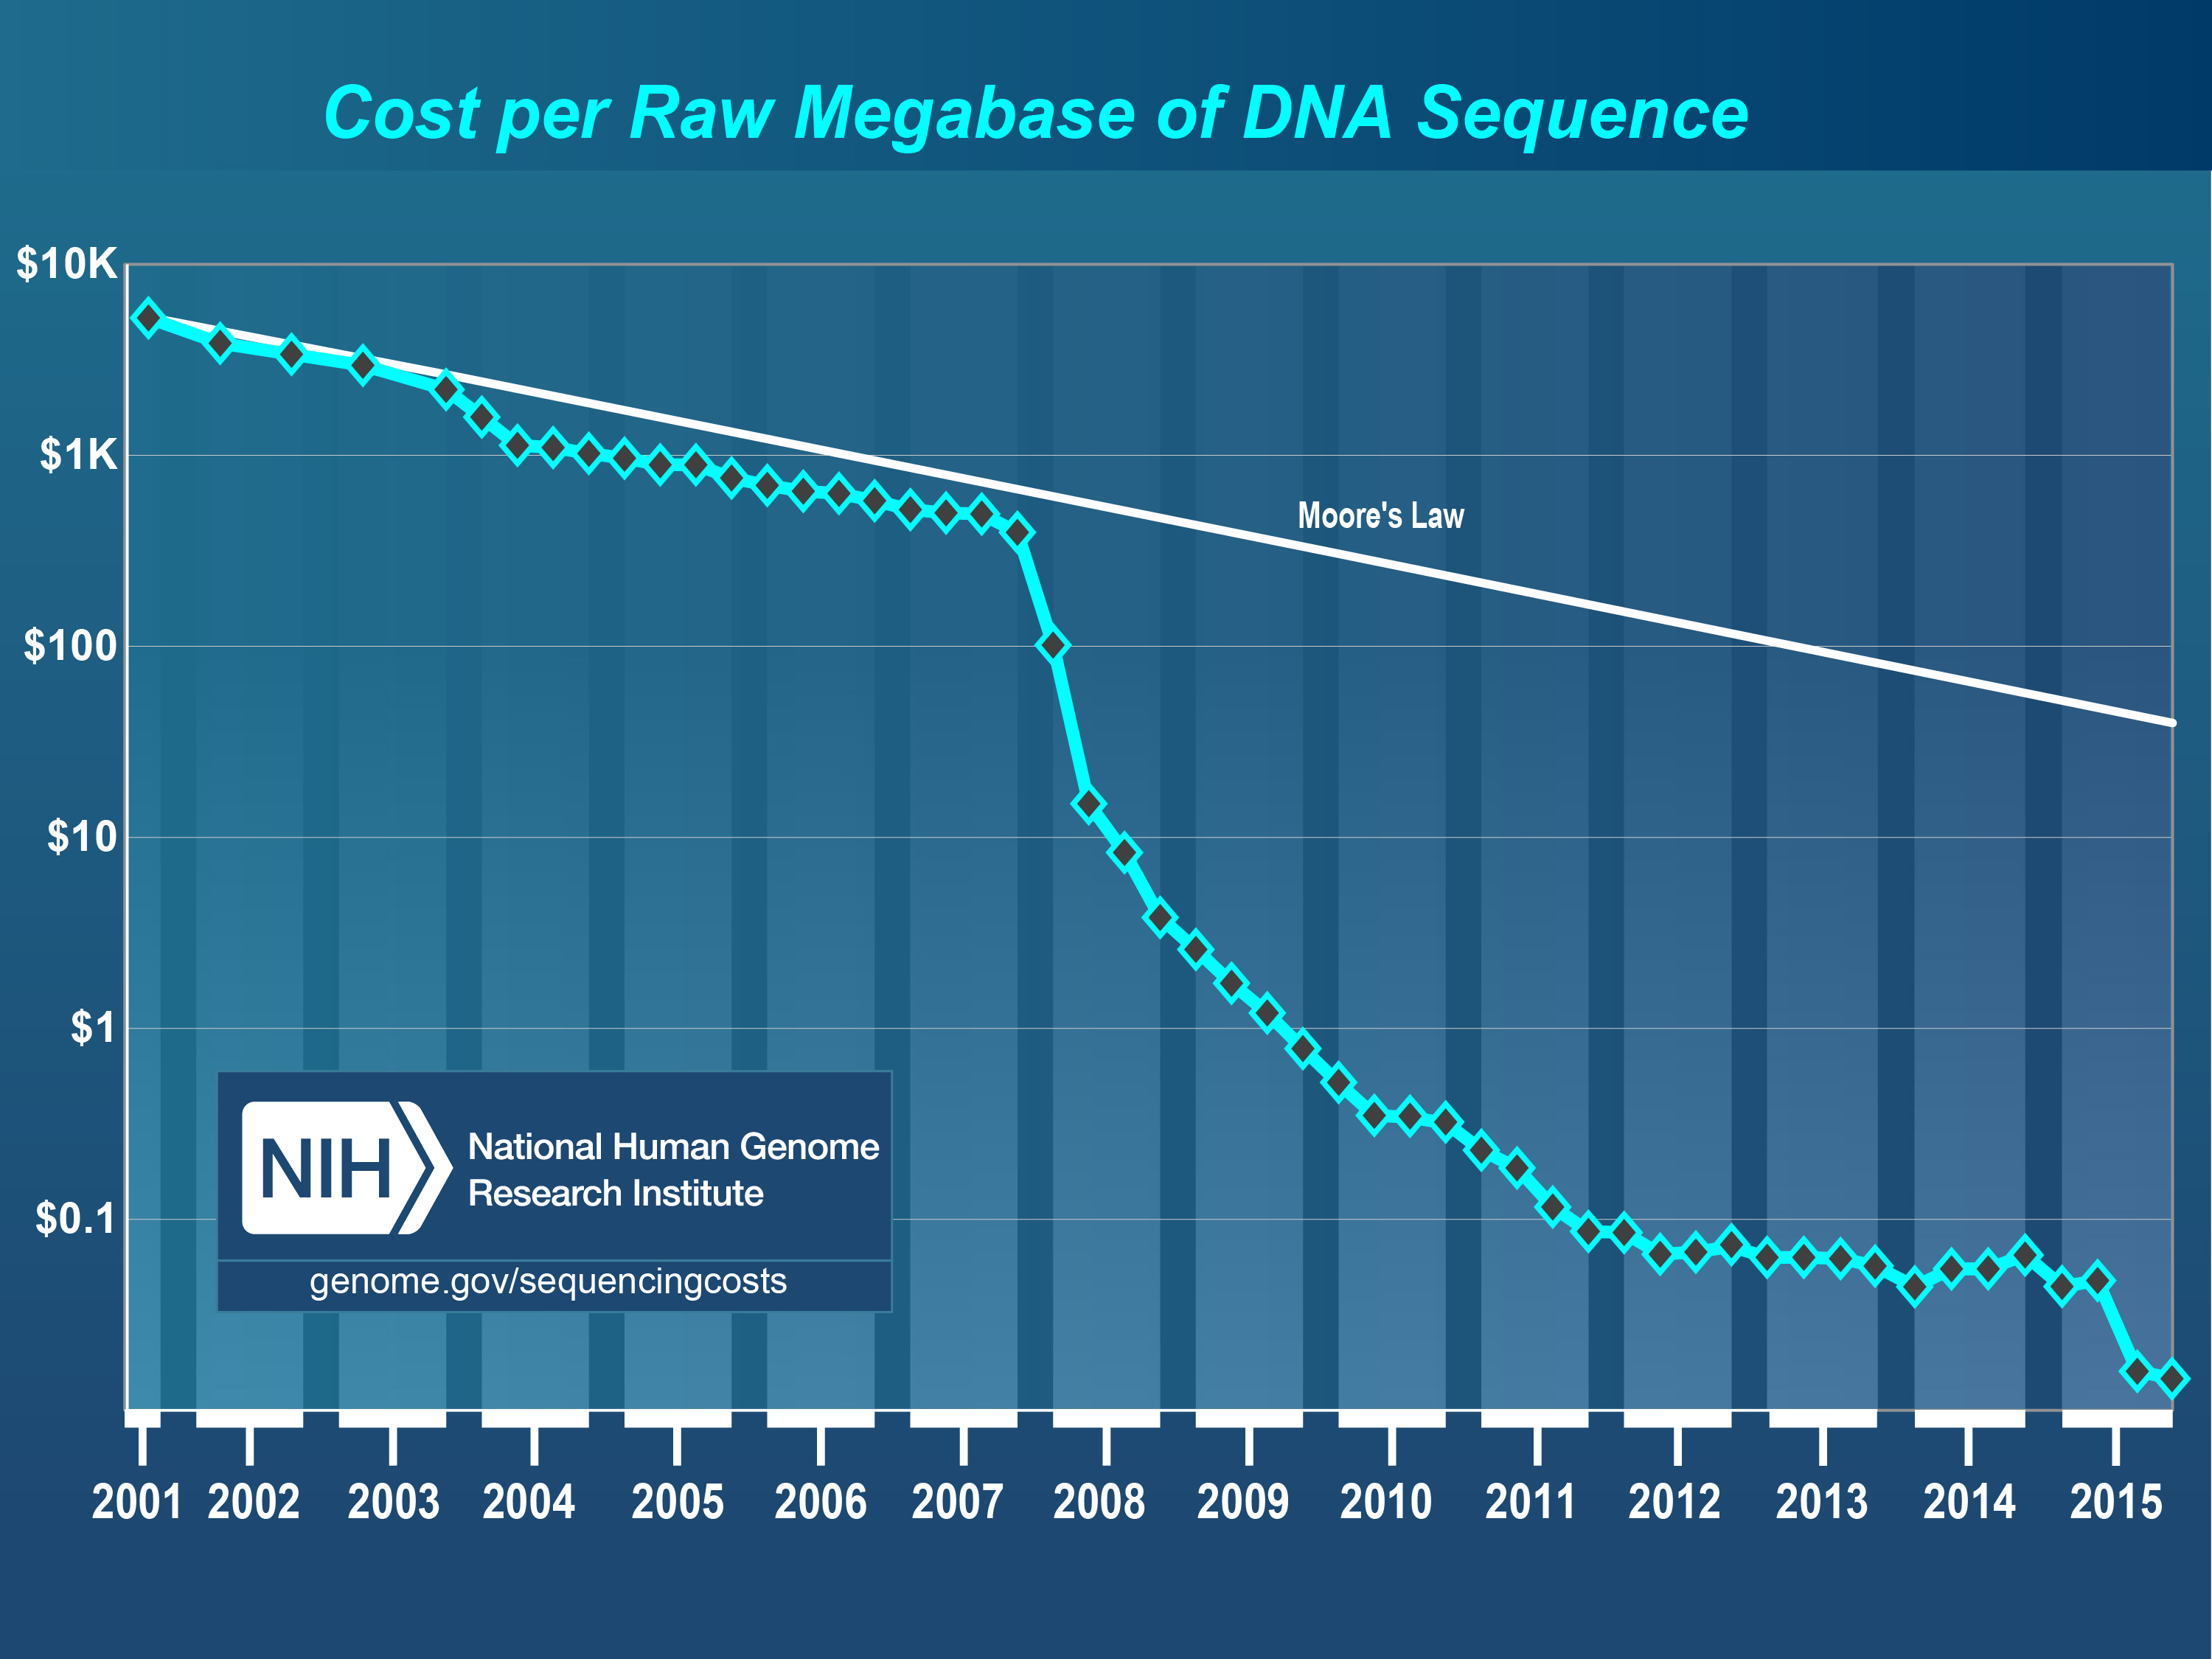
Sequencing Cost Have Fallen

Slide 4
Number of Genetic Markers Needed for Genetic Studies
Genome-wide Linkage Studies
300-400 Microsatellite Markers
Genome-wide Association Studies
100,000-2,500,000 SNPs
Exome Sequencing Studies
30,000,000 Basepairs
Exome Array Studies
>240,000 exonic variants
Whole Genome Sequencing Studies
3,200,000,000 Basepairs

Slide 5
Links to Sequencing Projects
1000 Genomes:
http://browser.1000genomes.org/Homo_sapiens/Info/Index
Exome Sequencing Project:
https://esp.gs.washington.edu/drupal/
Exome Array Design:
http://genome.sph.umich.edu/wiki/Exome_Chip_Design#Second_Generation_Arrays

Slide 6
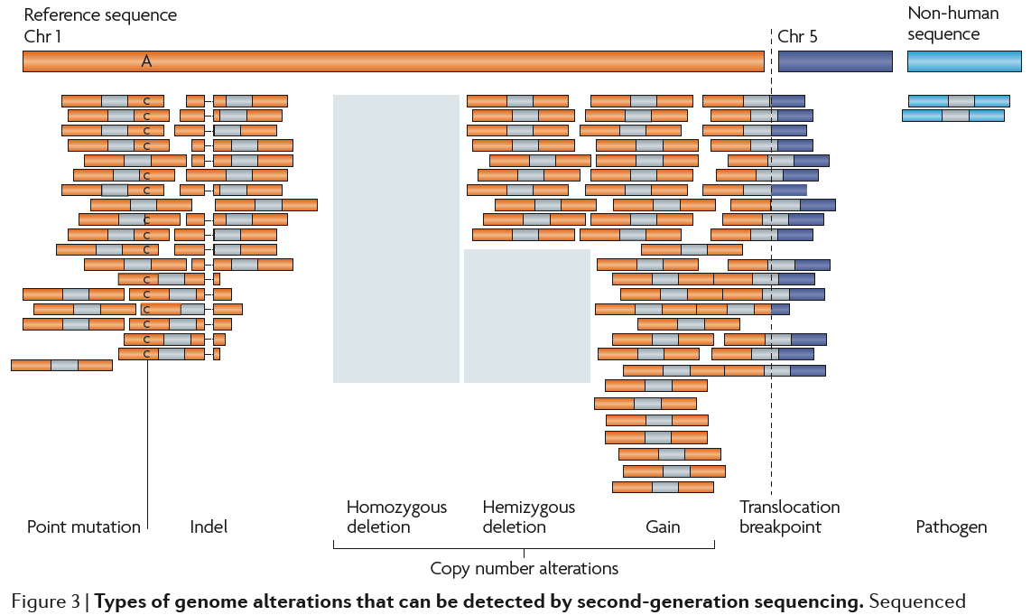
Variant Detection through Next Generation Sequencing
Meyerson et al. NRG 2010

Slide 7
Outline
Overview
Examples of Next Generation Sequencing Studies: Whole Genome, Exome, Families (IBD), Cancer
PTC Taste Sensitivity
Implications

Slide 8
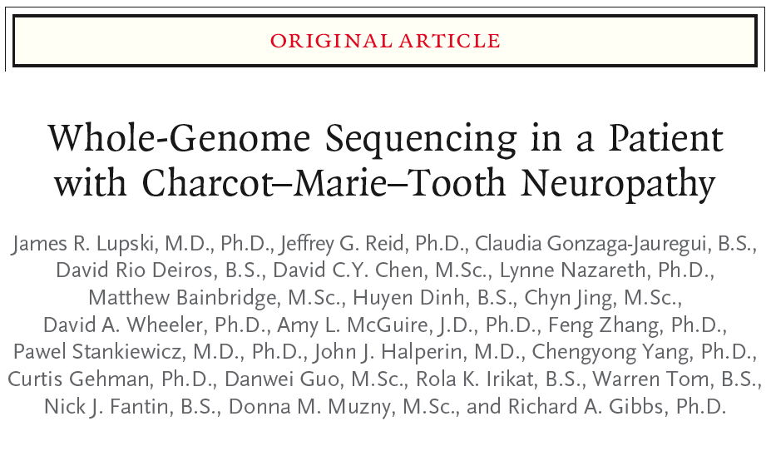
Sequencing of a Single Individual with Family Data
Lupski et al. NEJM 2010

Slide 9
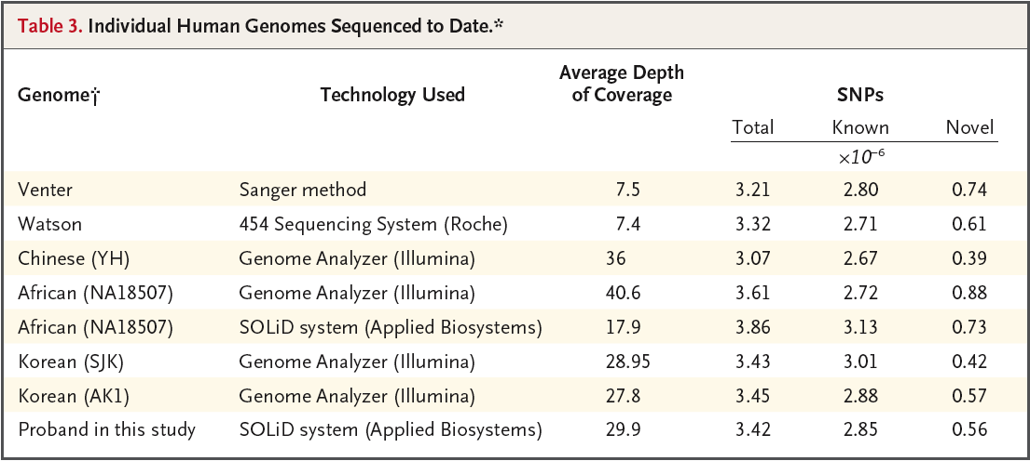
The First 8 Human Genomes
Lupski et al. NEJM 2010

Slide 10
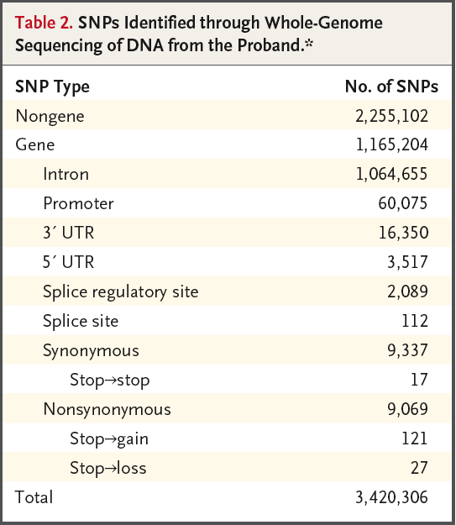
SNP Distribution in Proband
Lupski et al. NEJM 2010

Slide 11
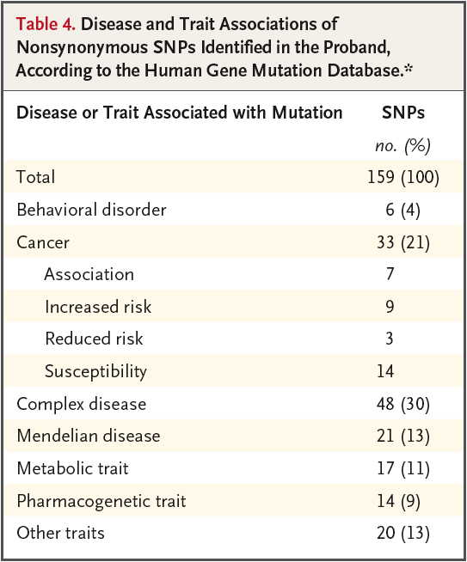
Nonsynonymous SNPs in Known Disease Genes
Lupski et al. NEJM 2010

Slide 12
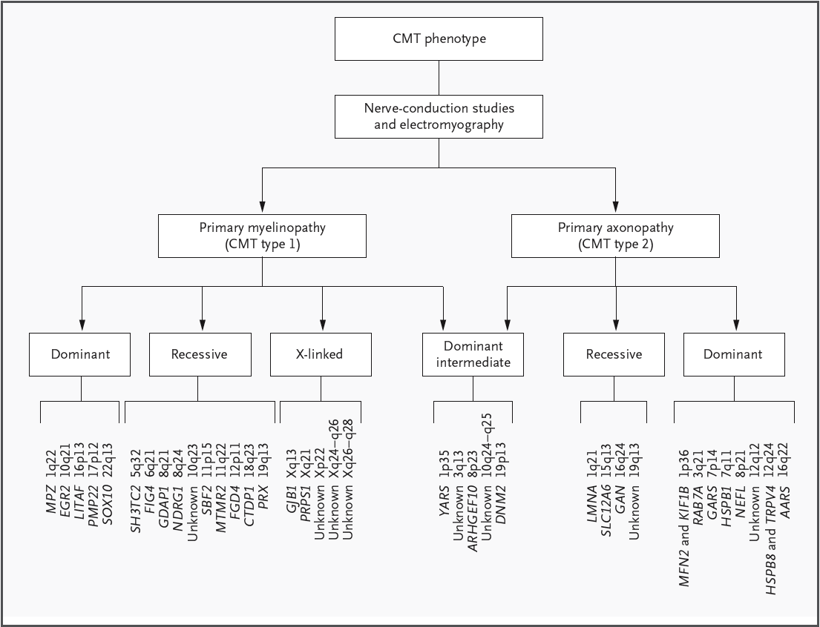
CMT Subtypes: Many Genes
Lupski et al. NEJM 2010

Slide 13
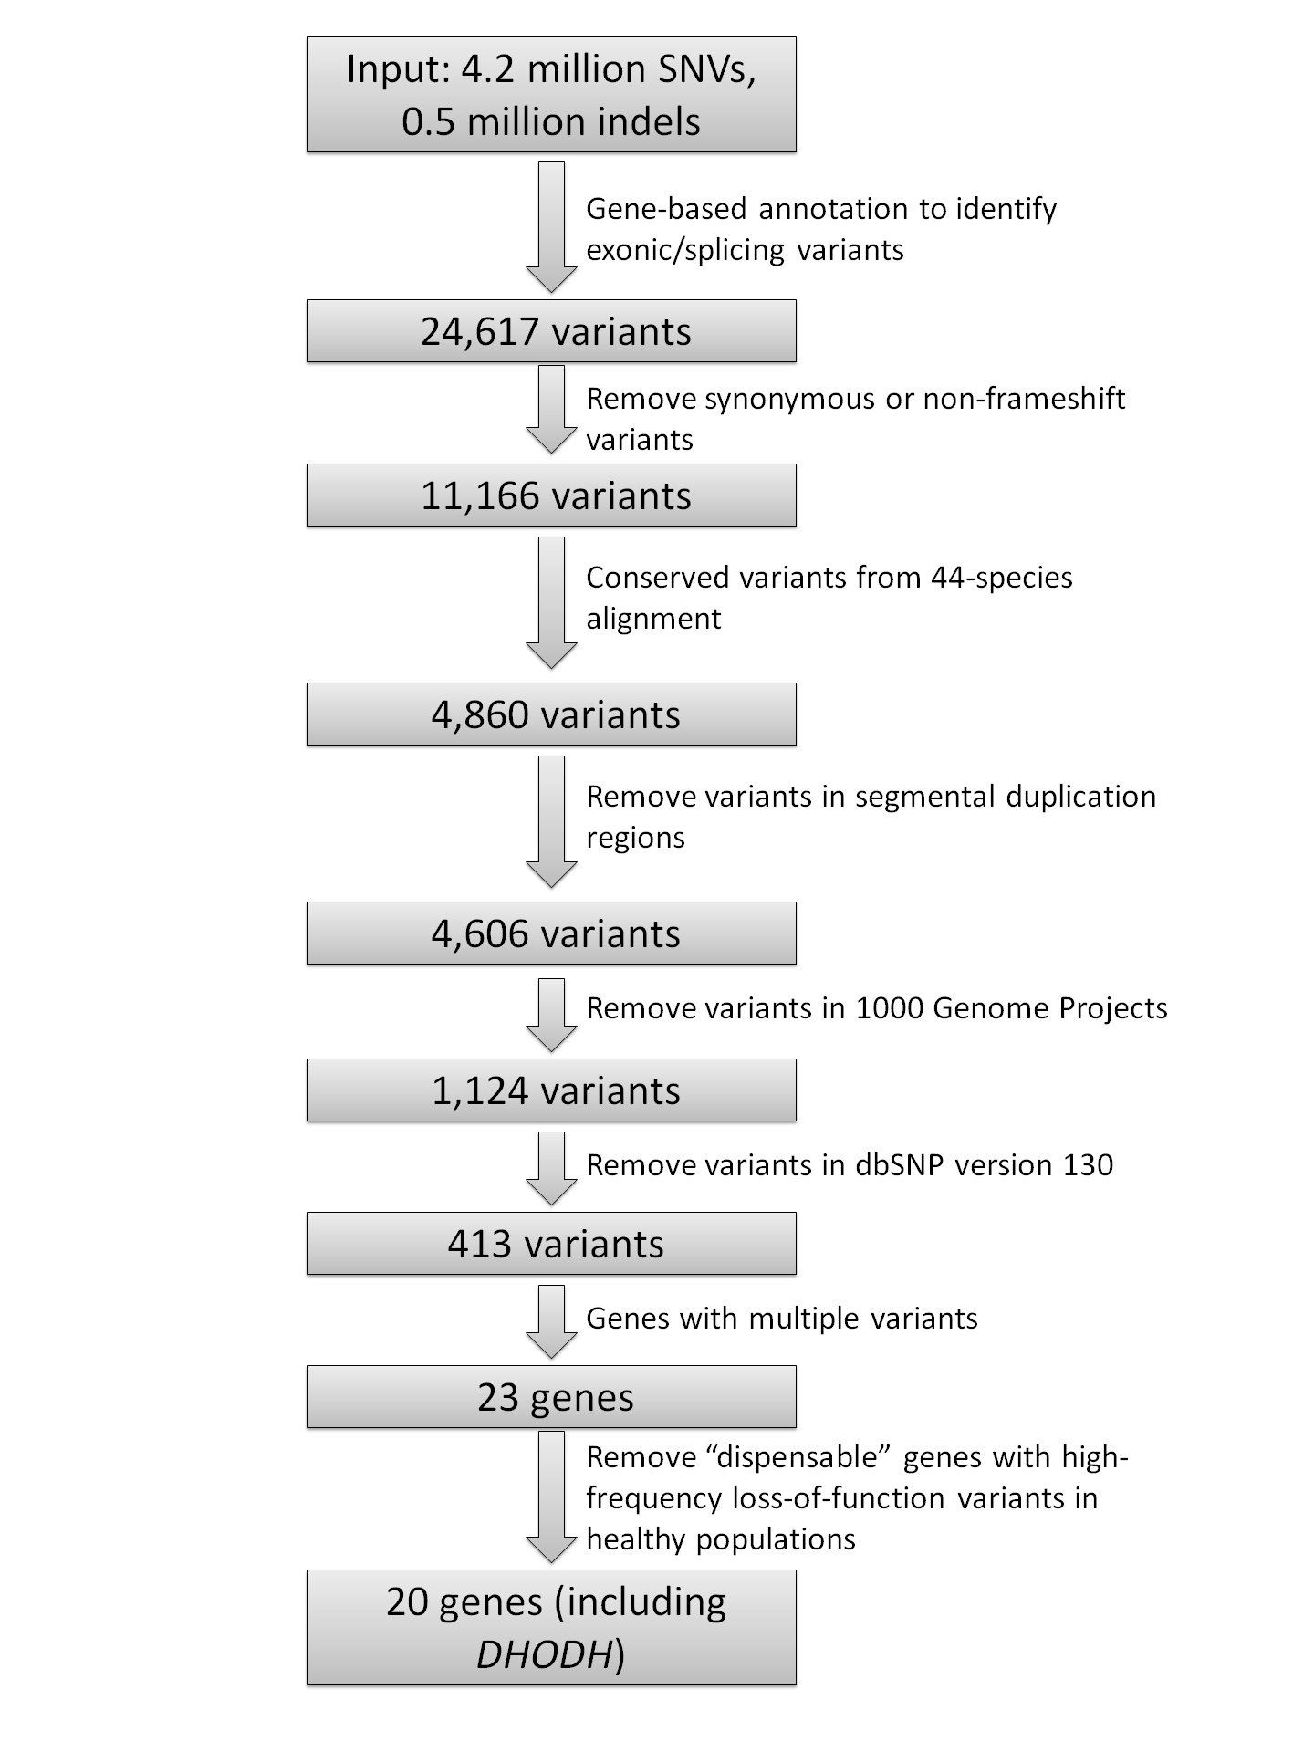
ANNOVAR: Using Annotation to Narrow the Search Space
openbioinformatics.org/annovar

Slide 14
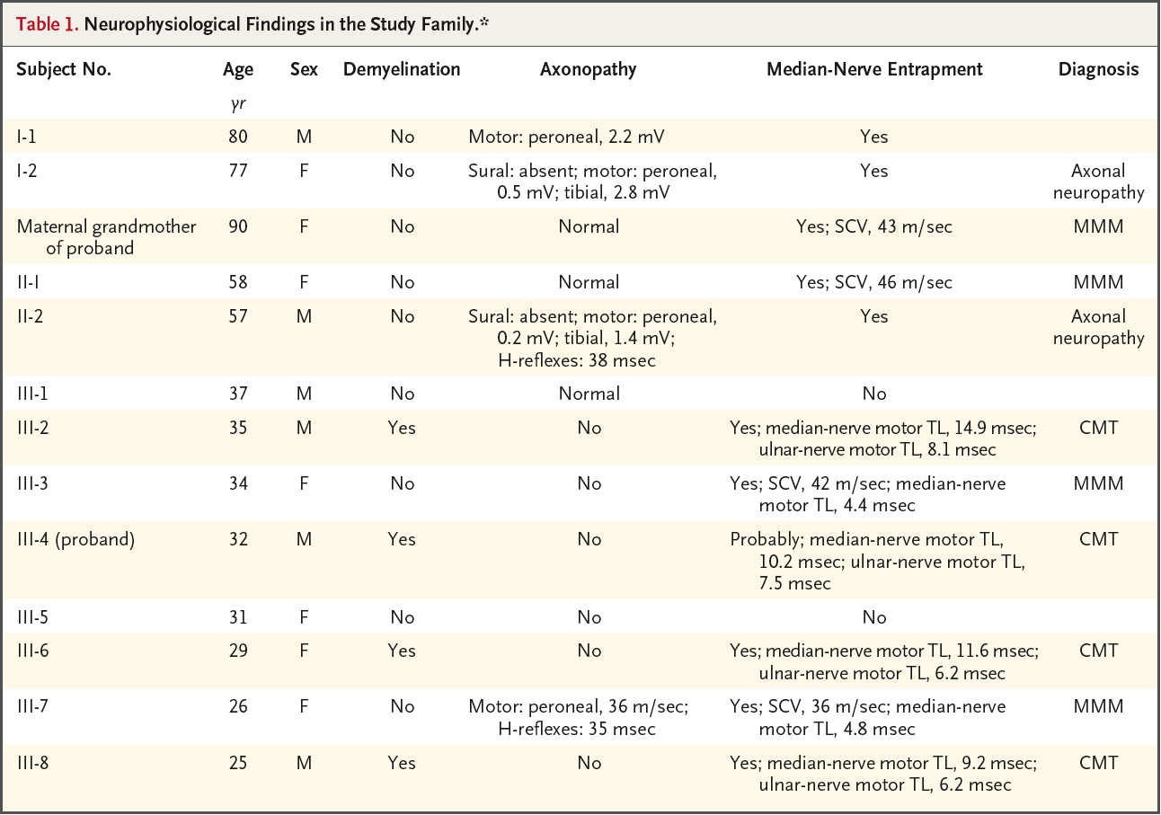
Phenotypes in Unseqeunced Family Members
Lupski et al. NEJM 2010

Slide 15
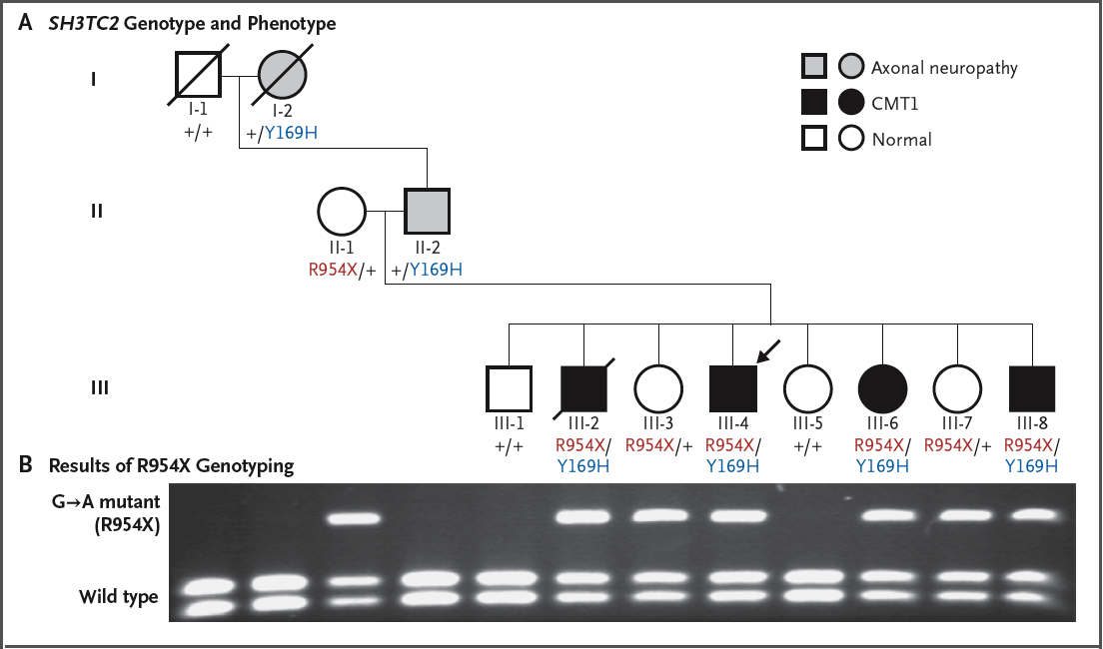
Family Pedigree
Lupski et al. NEJM 2010

Slide 16
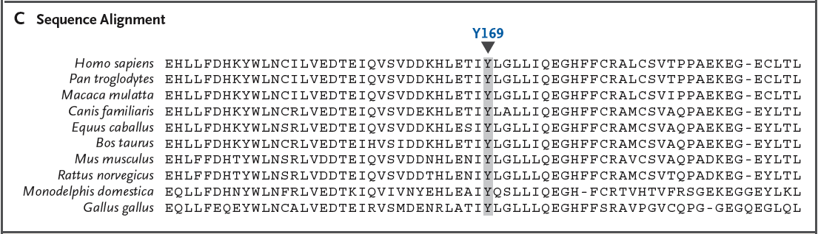
Putative Causal Variant at a Conserved Amino Acid
Lupski et al. NEJM 2010

Slide 17
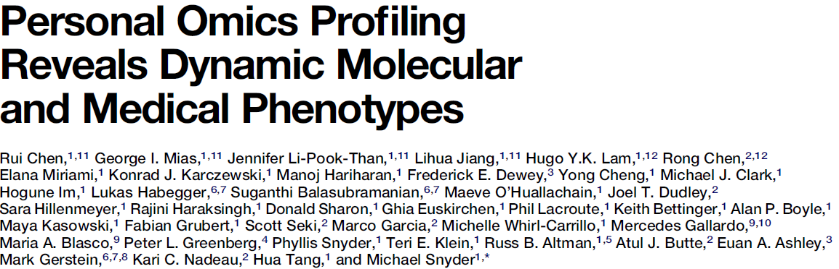
Narcissome
Chen et al. Cell 2012

Slide 18
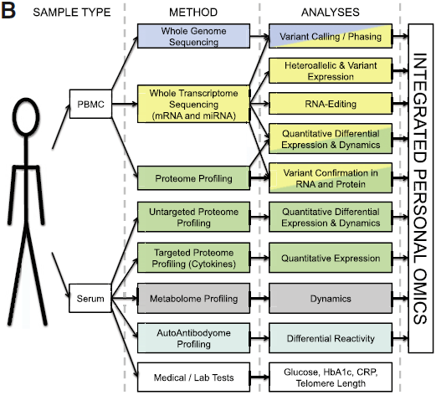
Narcissome
Chen et al. Cell 2012

Slide 19
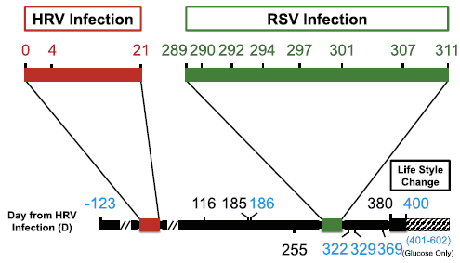
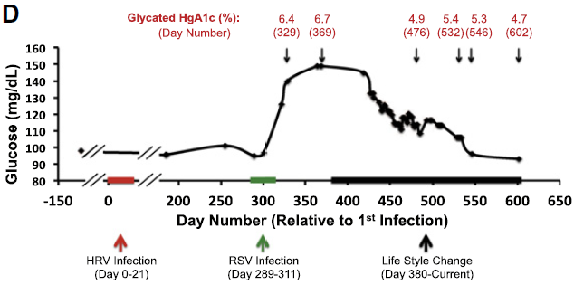
Narcissome
Chen et al. Cell 2012

Slide 20
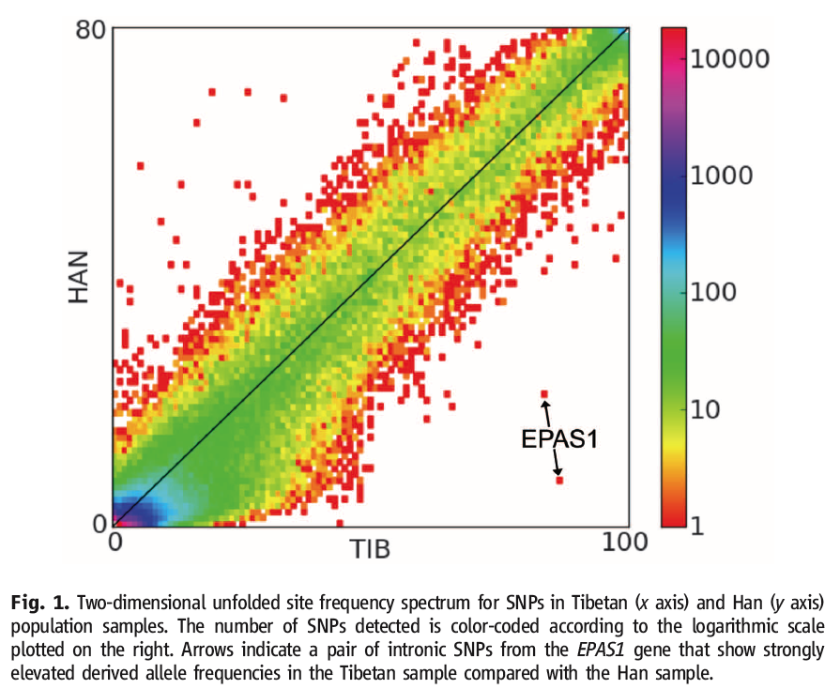
Exome Sequencing Identifies a Tibetan Adaptation
Yi et al. Science 2010

Slide 21
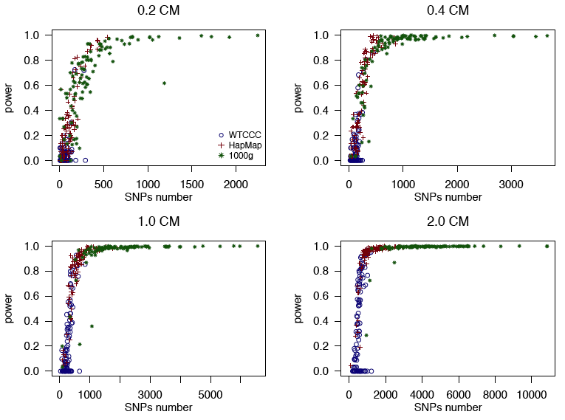
Sequence Data Improves Identity by Descent Resolution
Su and Jorgenson 2012

Slide 22
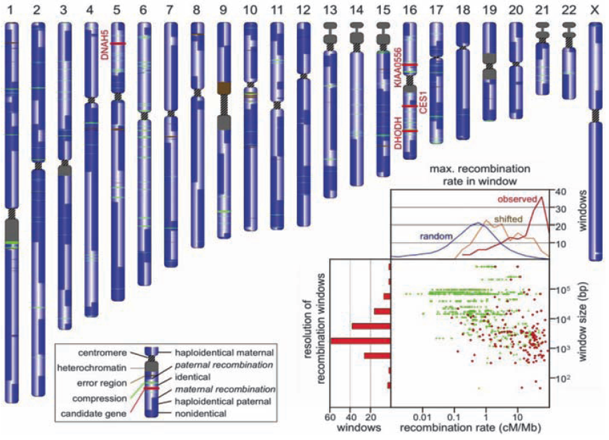
Family Sequencing for Rare Diseases
Roach et al. Science 2010

Slide 23
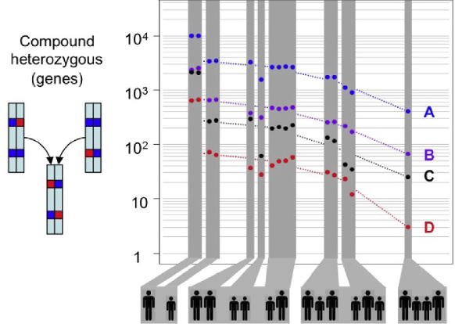
Families Can Reduce Error Rate
Roach et al. Science 2010

Slide 24
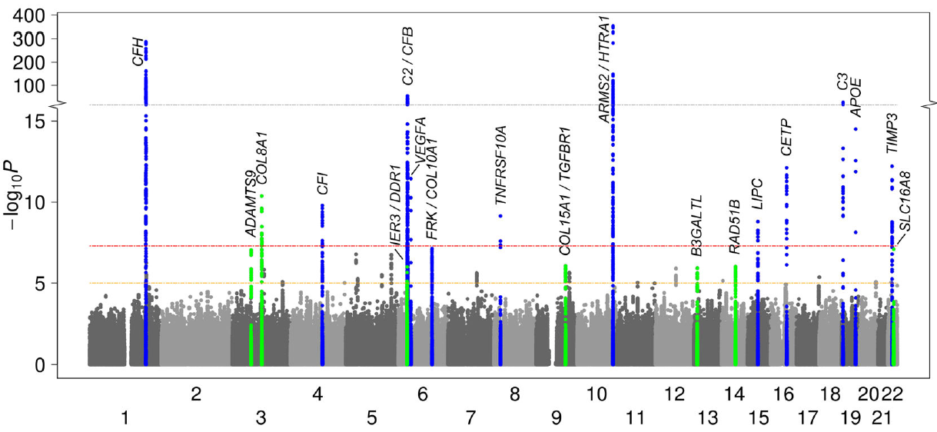
AMD GWAS Findings, 2013
Notes:
Explain Manhattan plot here if this is the first instance.

Slide 25
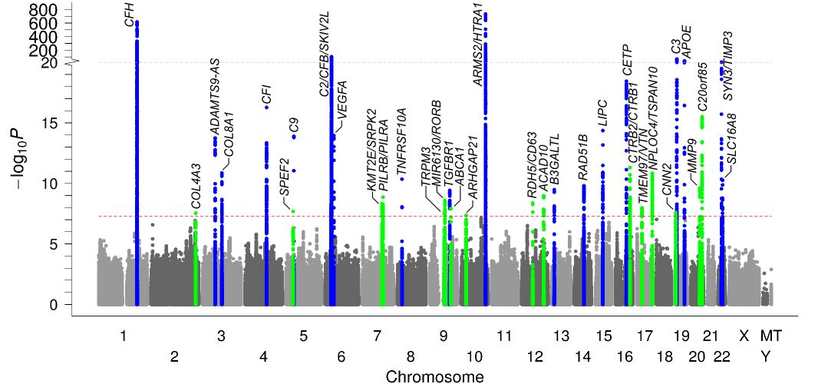
AMD GWAS Findings, 2015
Notes:
Explain Manhattan plot here if this is the first instance.

Slide 26
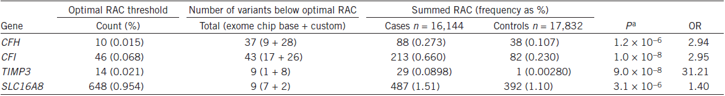
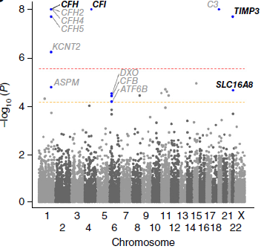
AMD Rare Variant Findings, 2015
Notes:
We computed a gene-based burden test of rare protein-altering variants comparing 16,144 advanced AMD cases and 17,832 controls. Shown are P values from the
variable-threshold test (from up to 100 million permutations) and odds ratios from the collapsed burden test, both adjusted for the other variants identified in each locus
(locus-wide conditioning). Four genes (among the 703 genes in the 34 AMD locus regions) showed a significant (P < 0.05/703 = 7.1 × 10−5) burden.

Slide 27
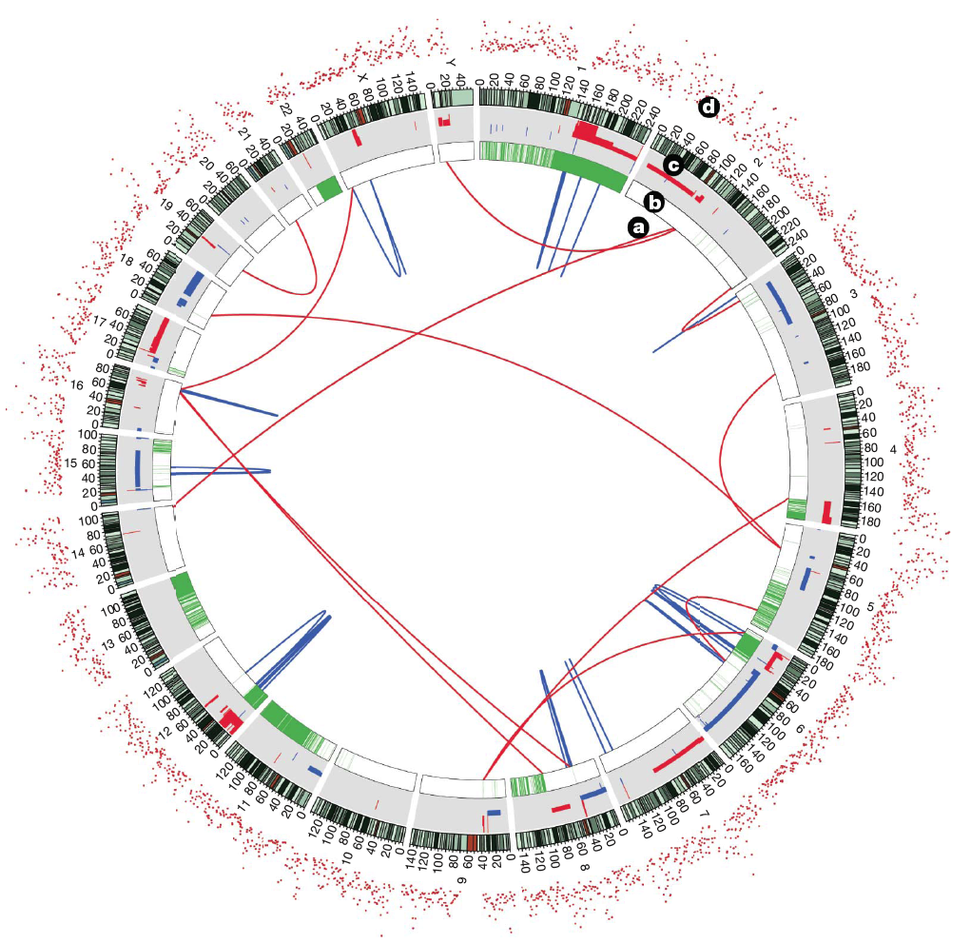
Cancer: Tumor vs. Normal
Lee et al. Nature 2010

Slide 28
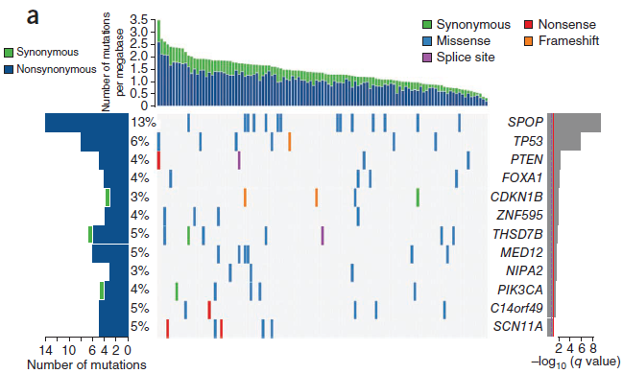
Exome Sequencing in Prostate Cancer
Barbieri et al. Nature Genetics 2012

Slide 29
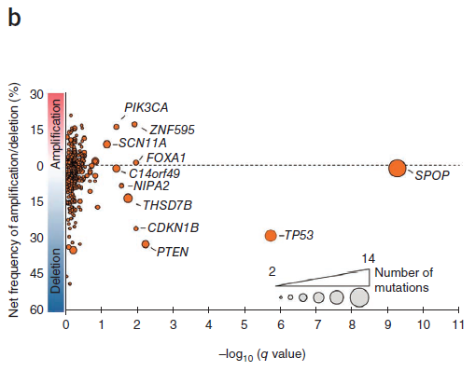
Exome Sequencing in Prostate Cancer
Barbieri et al. Nature Genetics 2012

Slide 30
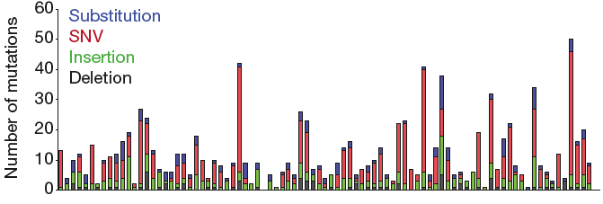
Nonsynonymous Somatic Mutations in Neuroblastoma
Molenaar et al. Nature 2012

Slide 31
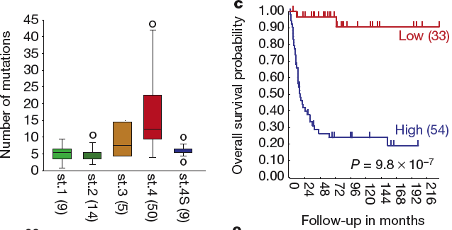
Mutation Count Associated with Age, Stage, and Survival
Molenaar et al. Nature 2012

Slide 32
Outline
Overview
Examples of Next Generation Sequencing Studies: Whole Genome, Exome, Families (IBD), Cancer
PTC Taste Sensitivity
Implications

Slide 33
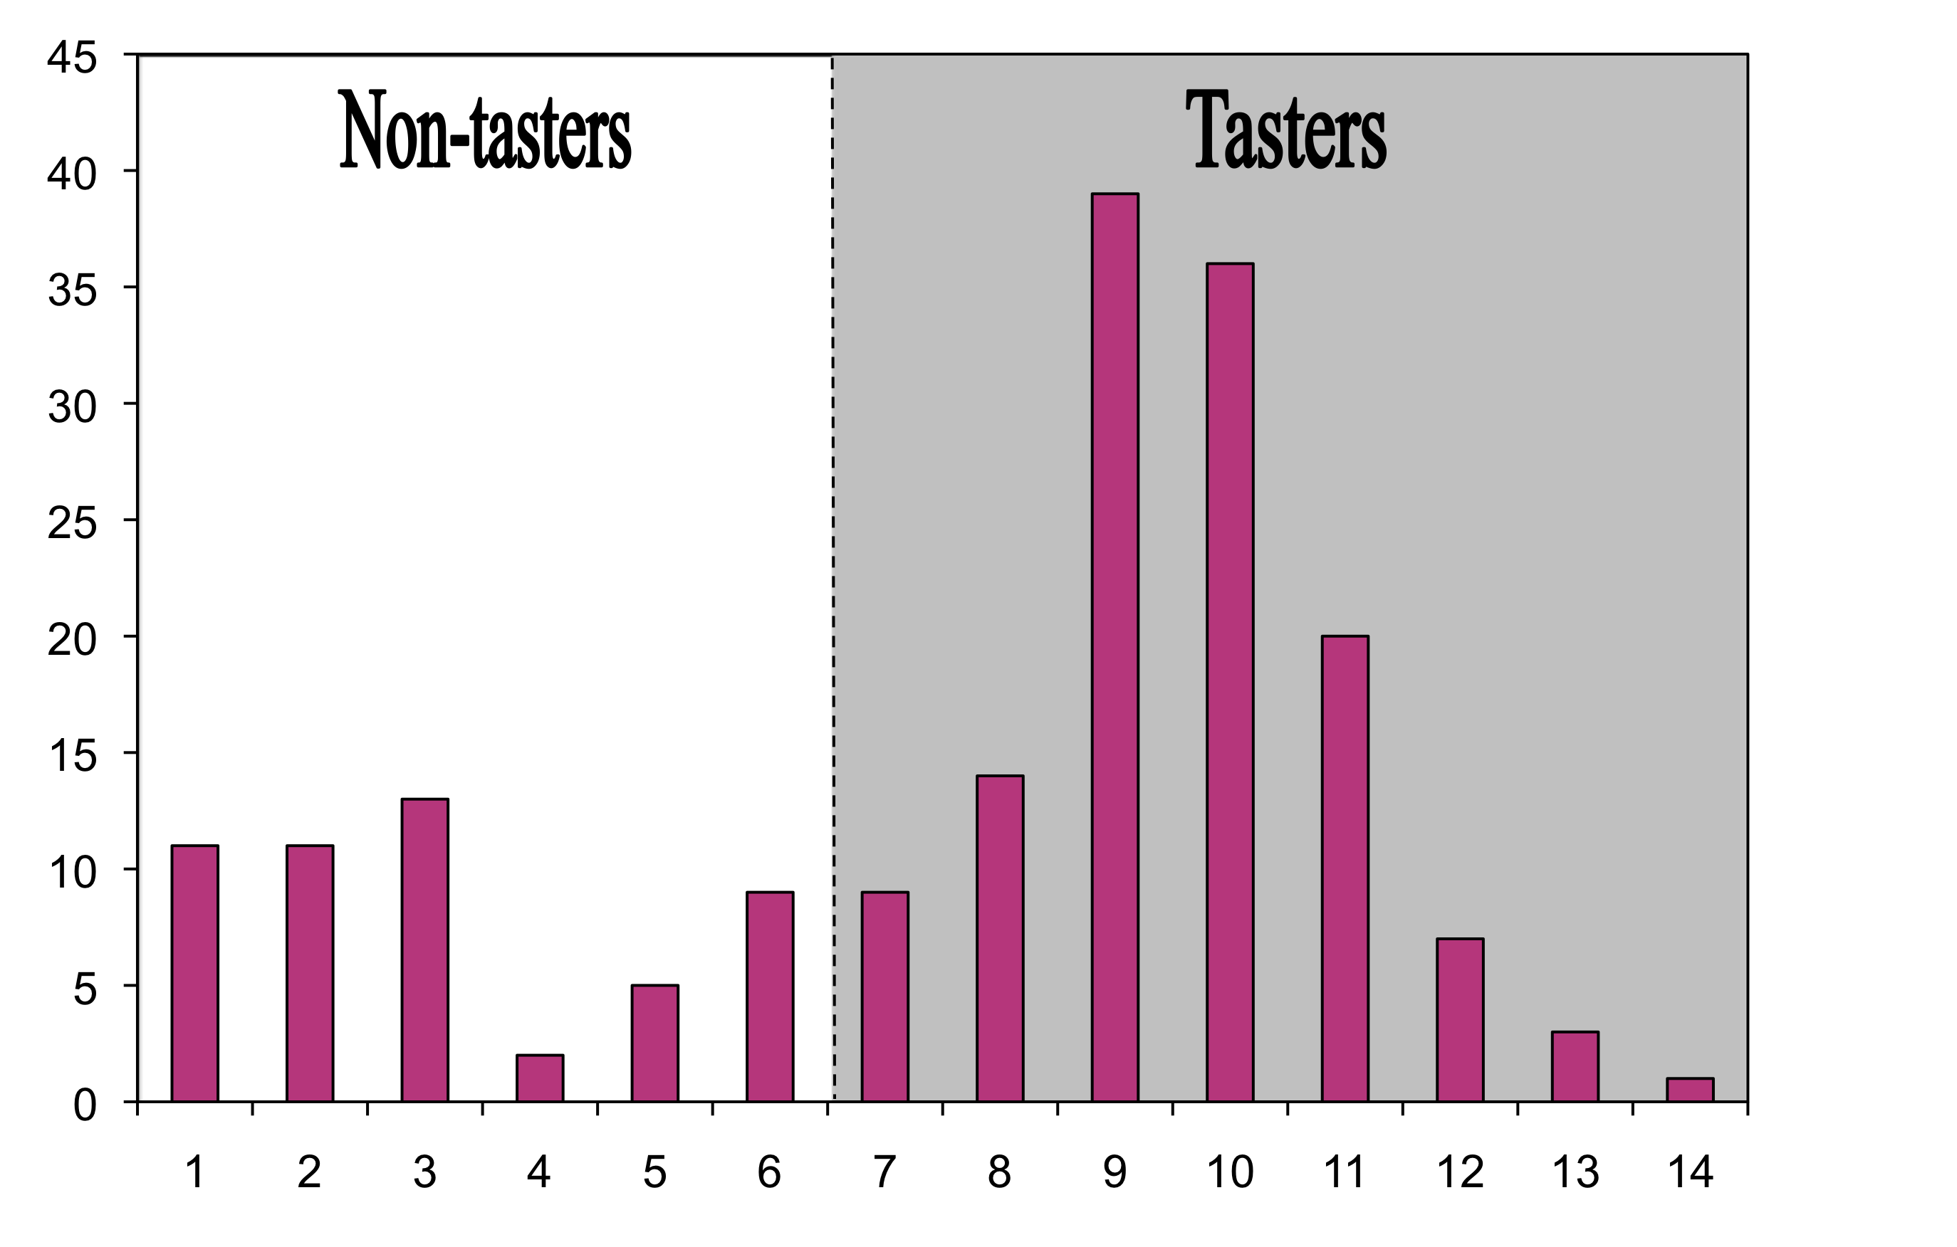
Distribution of the PTC Phenotype
Number of Subjects
PTC Score

Slide 34
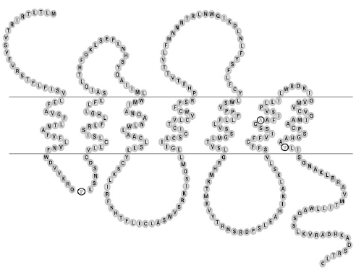
TAS2R38 Receptor Structure
rs1726866
rs10246939
rs713598
Kim et al. J Dent Res 2004

Slide 35
3 SNPs Form 3 Haplotypes
Taster
P A V
Non-taster
A V I
Rare
A A V
Notes:
3rd haplotype is the result of recombination.
A of non-taster
AV of taster
Allows us to compare the effect of the 1st SNP vs. the 2nd and 3rd.
Rare-not in all combinations

Slide 36
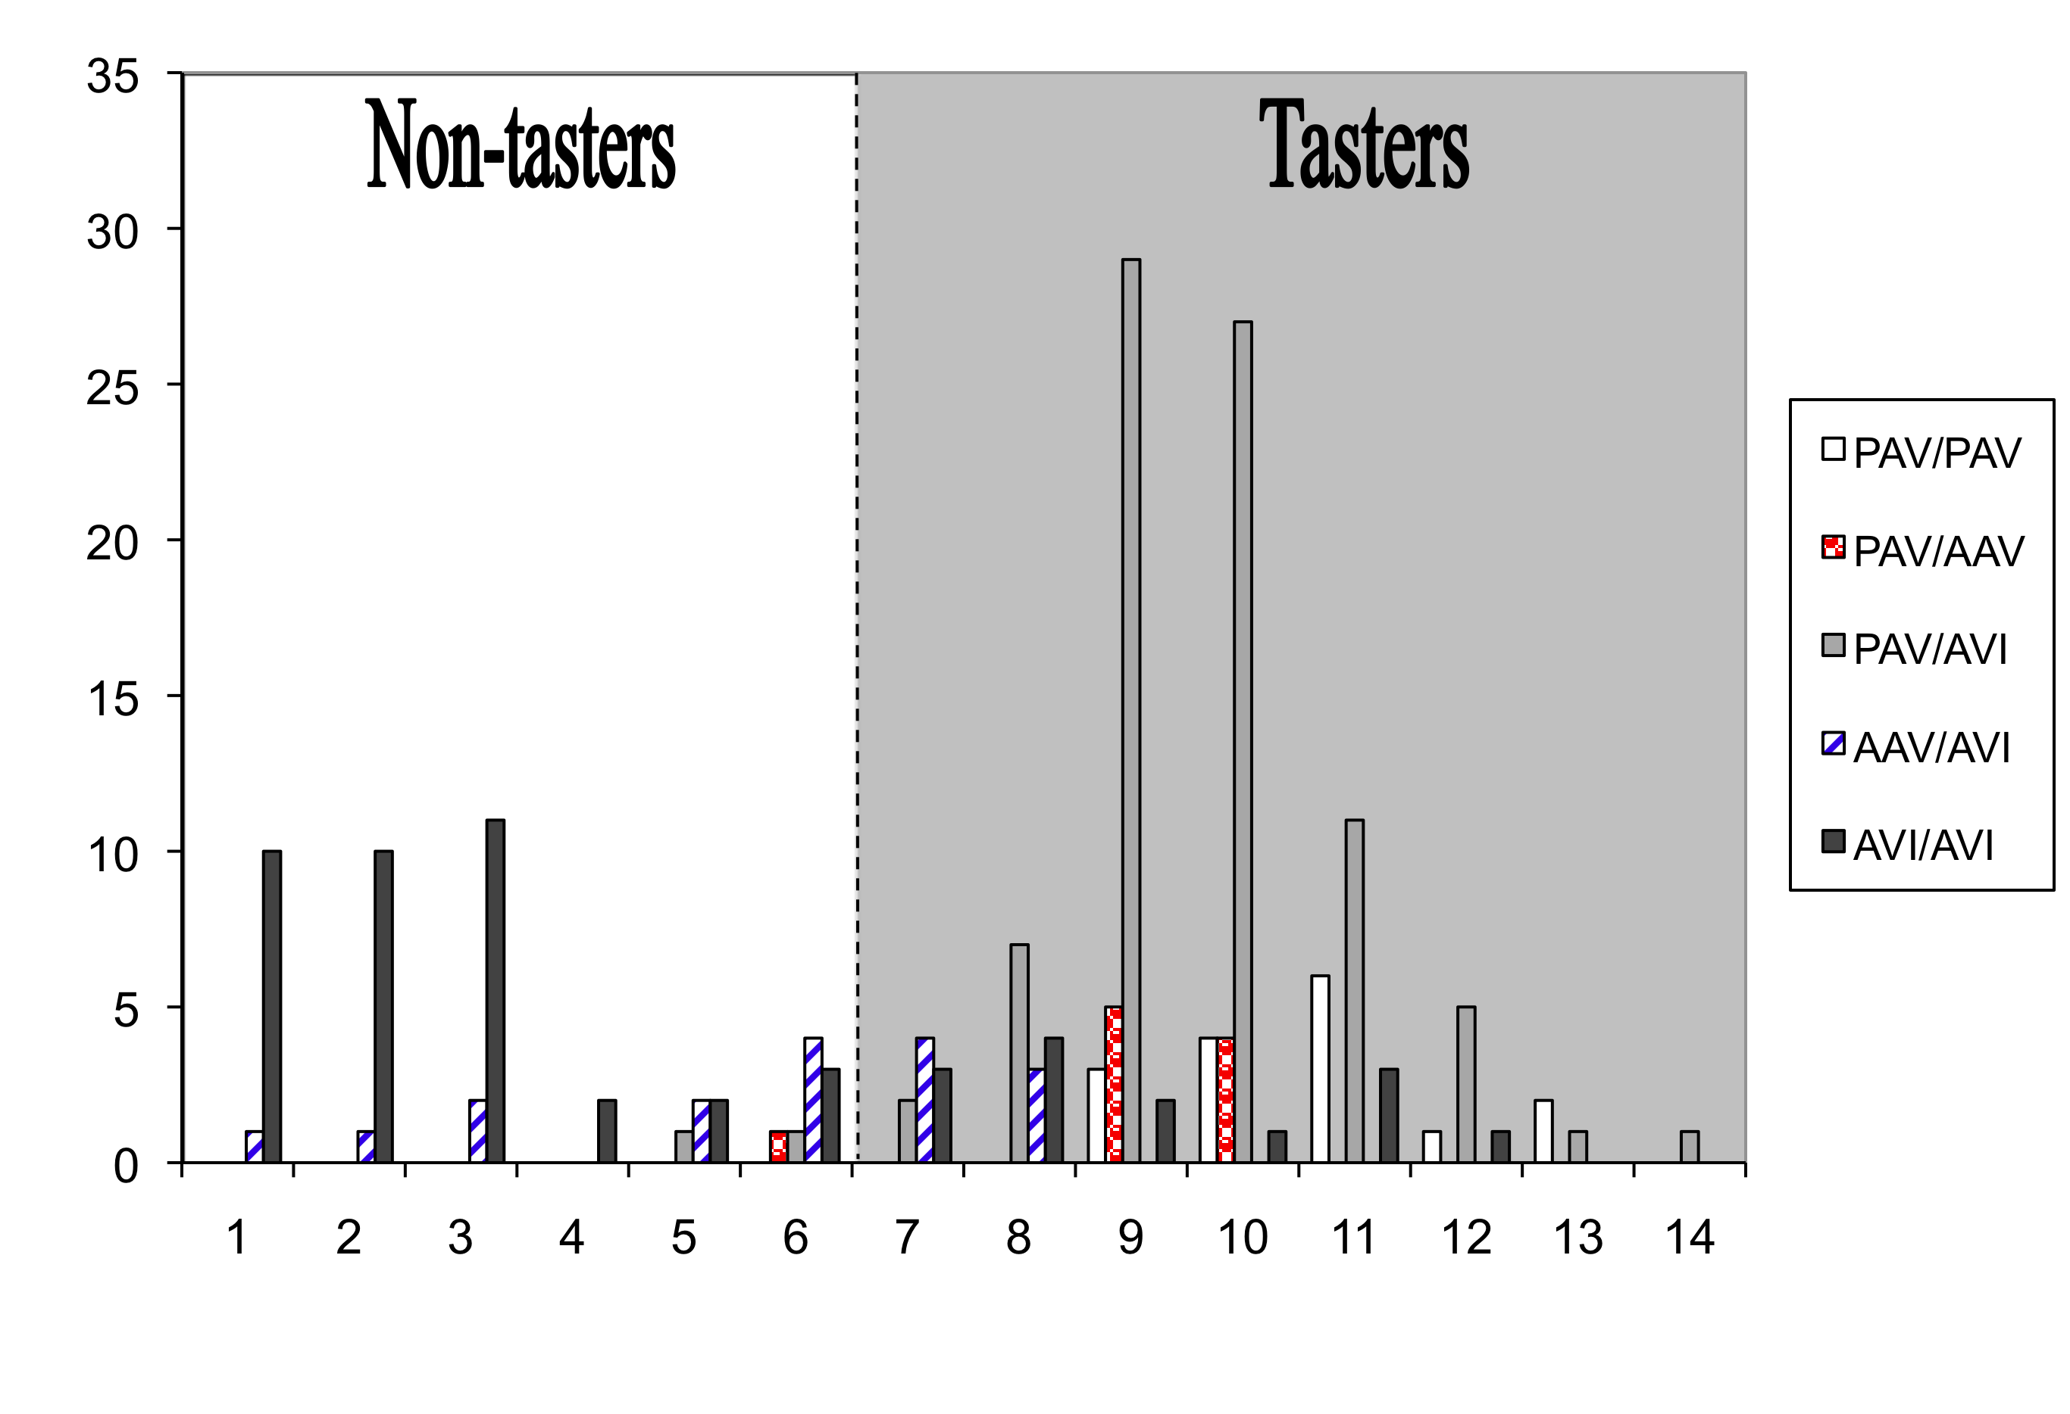
PTC Phenotype by TAS2R38 Diplotype
Number of Subjects
PTC Score

Slide 37
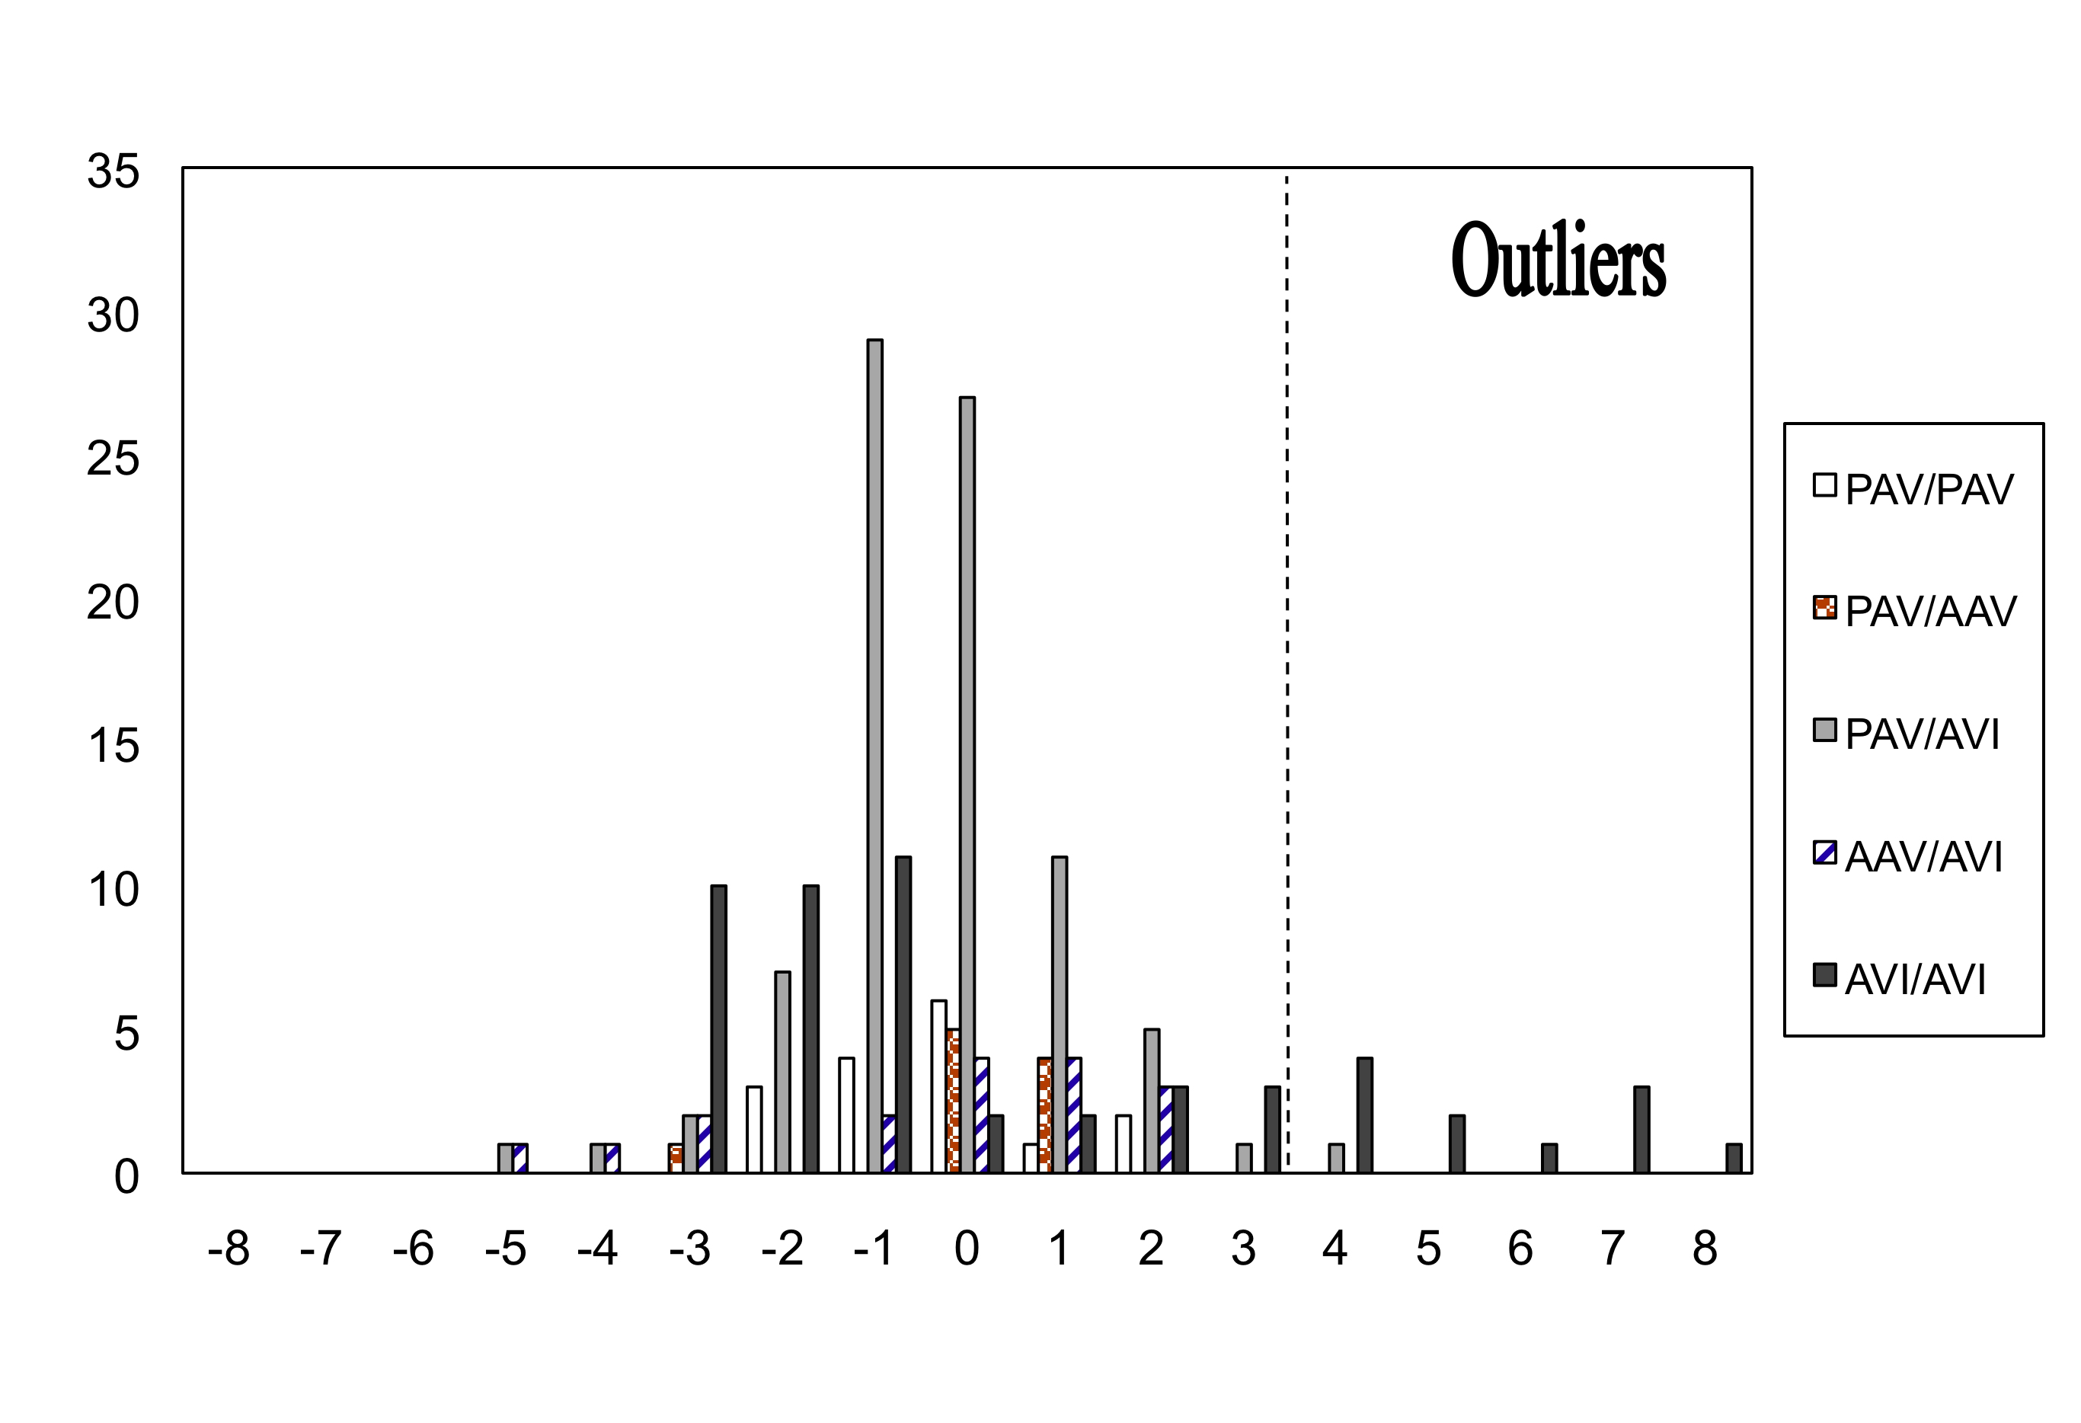
Outliers after Adjusting for TAS2R38 Diplotype
Number of Subjects
PTC Score

Slide 38
Unusual PTC Phenotypes (AVI Homozygotes in Green)
11
8
9
3
8
10
12
9
9
9

Slide 39
Unusual PTC Phenotypes (AVI Homozygotes in Green)
11
14
10
10
9
2
4
11
11

Slide 40
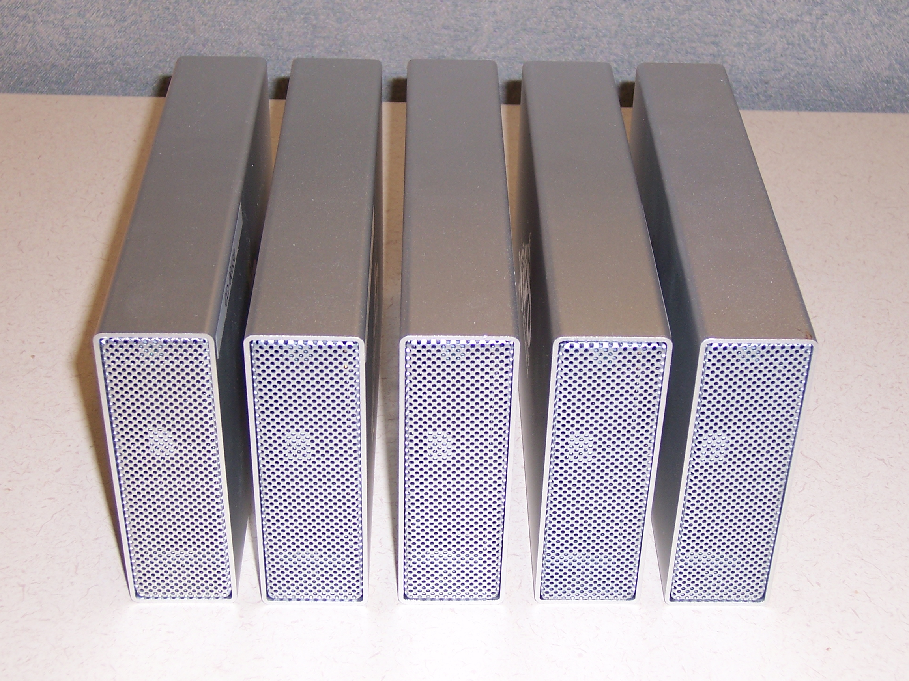
10 Genomes, 5 Hard Drivers

Slide 41
Summary of Variation
 | Sample 1 | Sample 2 | Sample 3 | Sample 4 | Sample 5
Gender | Female | Female | Male | Female | Female
Total Sequence (Gb) | 214 | 220 | 218 | 243 | 219
Percent fully called | 0.95 | 0.96 | 0.96 | 0.97 | 0.96
Coverage (X fold) | 53 | 55 | 53 | 63 | 54
SNPs | 3,270,920 | 3,269,487 | 3,278,557 | 3,355,266 | 3,341,154
Insertions | 184,763 | 190,633 | 197,830 | 210,805 | 206,120
Deletions | 195,419 | 200,495 | 208,031 | 221,532 | 216,578
Synonymous SNPs | 9,666 | 9,547 | 9,808 | 10,004 | 9,981
Missense SNPs | 9,253 | 9,135 | 9,350 | 9,486 | 9,581
Nonsense SNPs | 90 | 97 | 82 | 88 | 92
Frameshift Insertions | 103 | 102 | 97 | 112 | 127
Frameshift Deletions | 99 | 101 | 91 | 108 | 116
Novel SNPs | 0.04 | 0.04 | 0.04 | 0.04 | 0.04
Novel Insertions | 0.18 | 0.18 | 0.19 | 0.20 | 0.19
Novel Deltions | 0.22 | 0.22 | 0.23 | 0.23 | 0.23

Slide 42
Quality Control: 99.8% Concordance
Sample 1 | Genotyping
Sequencing | Homozygous Reference | Heterozygous | Homozygous Variant
Homozygous Reference | 479,773 | 429 | 422
Heterozygous | 426 | 234,156 | 293
Homozygous Variant | 65 | 168 | 172,479

Slide 43
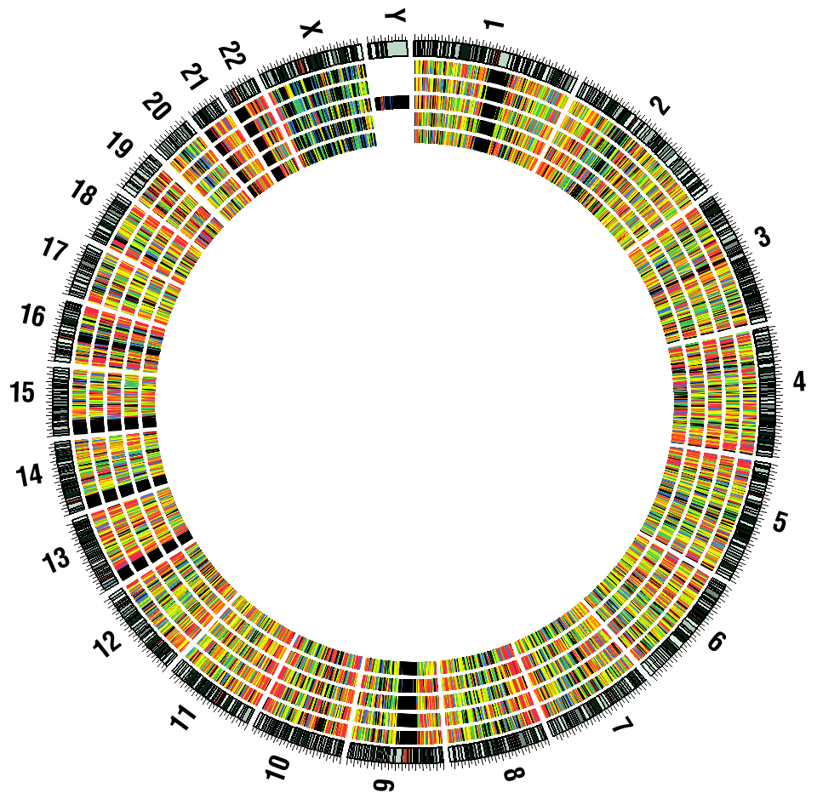
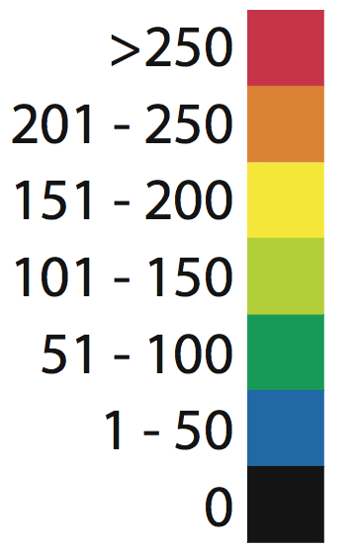
Variant Distribution in PTC Subjects

Slide 44
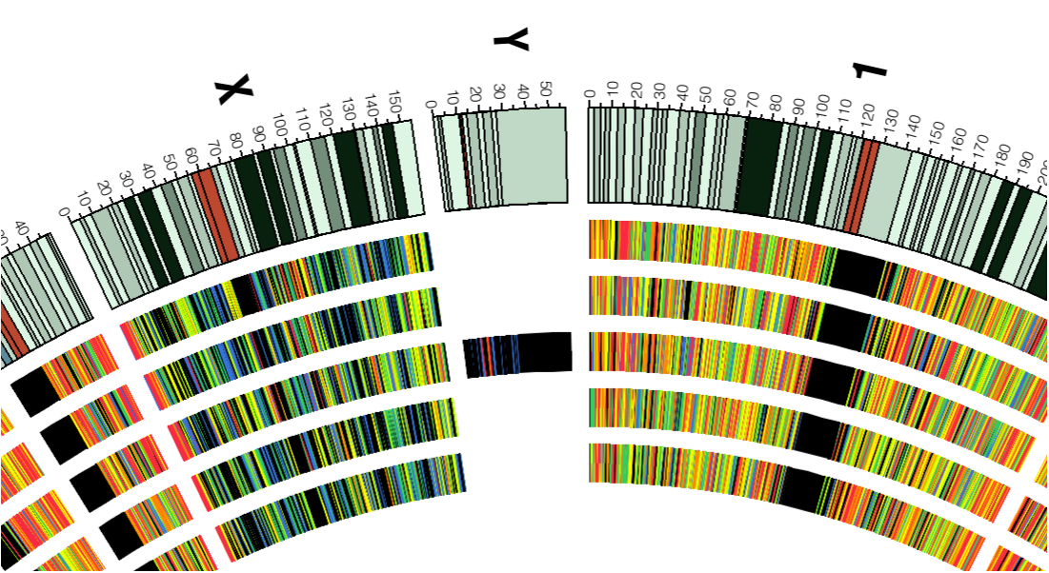
Variant Distribution in PTC Subjects

Slide 45
Using Relatedness
11
8
9
3
8
10
12
9
9
9

Slide 46
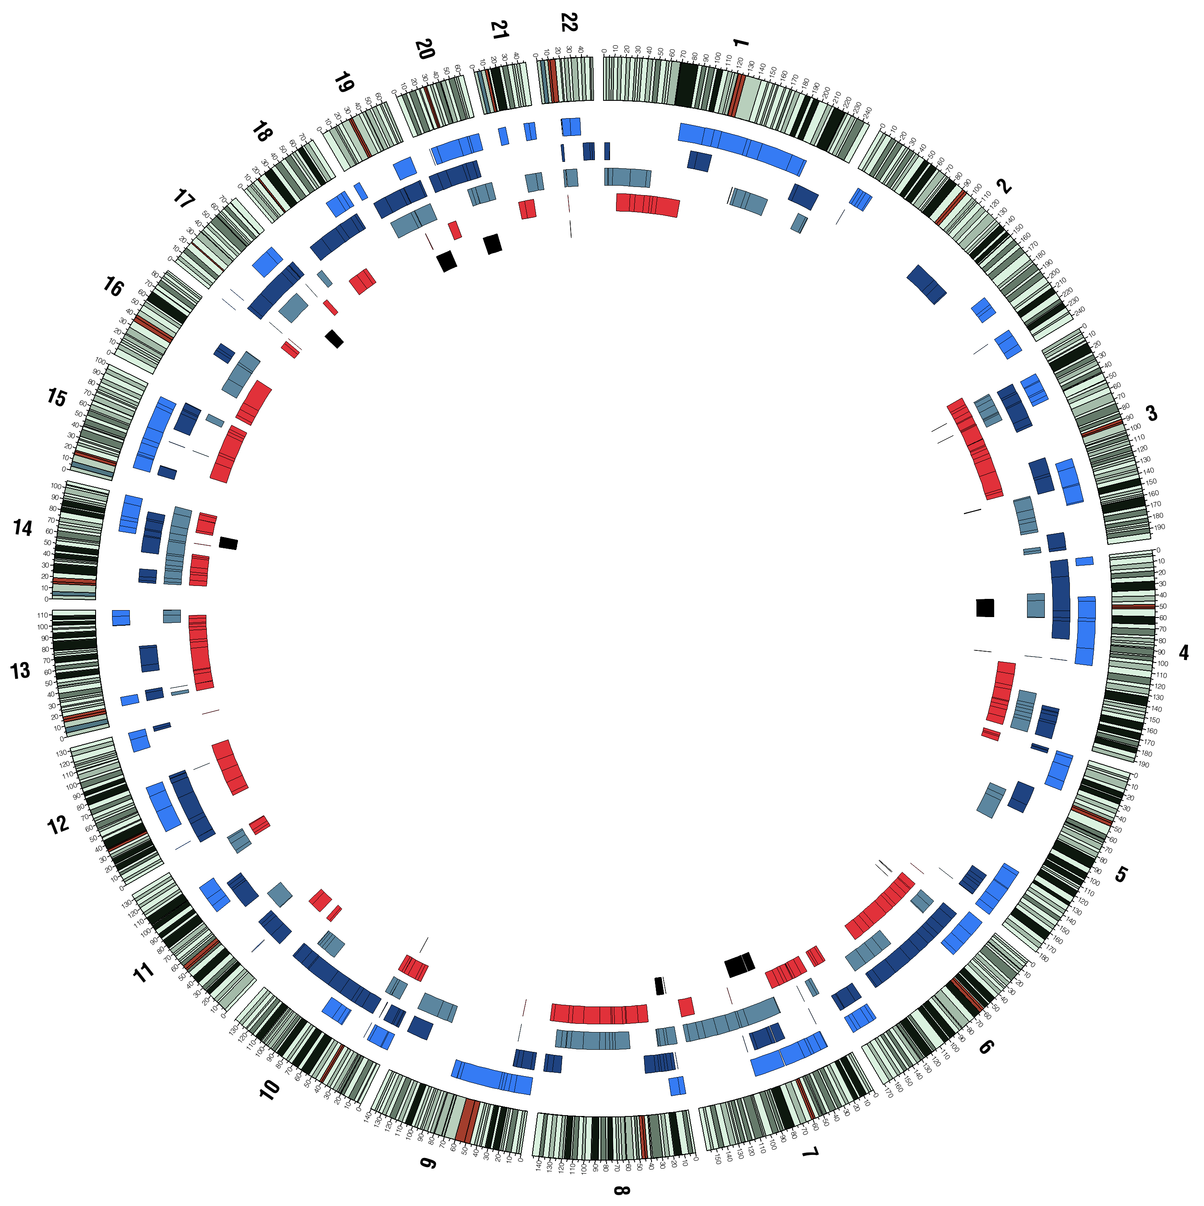
Identity by Descent

Slide 47
Identity by Descent

Slide 48
Nonsynonymous Variants

Slide 49
Outline
Overview
Examples of Next Generation Sequencing Studies: Whole Genome, Exome, Families (IBD), Cancer
PTC Taste Sensitivity
Implications

Slide 50
How Can Whole Genome Sequencing Influence Treatment?
Identify Genes with Protein Altering Mutations
Determine Variation in Specific Genes

Slide 51
Genes with Protein Altering Variants
Notes:
51

Slide 52
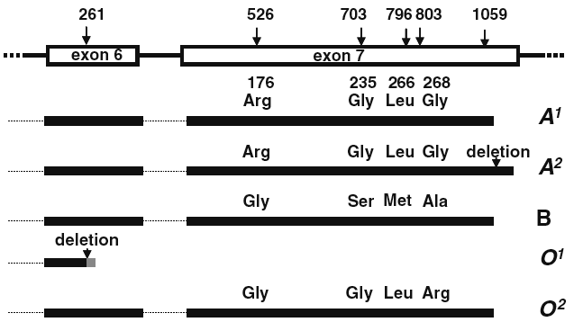
Genetic Variation Determines ABO Blood Type

Slide 53
Determination of ABO Blood Type

Slide 54
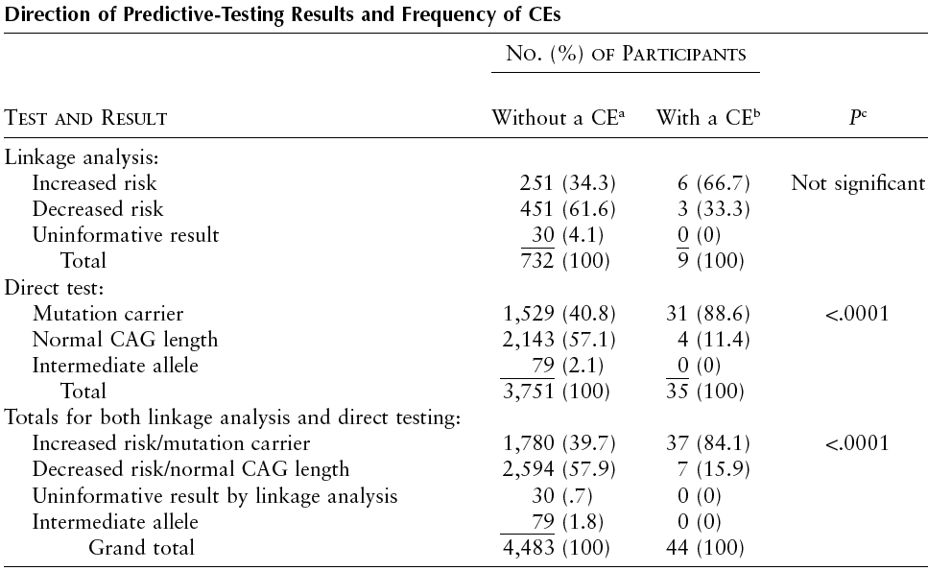
Huntington’s Disease Testing Has Conseqeunces
Almqvist AJHG 1999

Slide 55
Links to Videos and Articles on Seqeuncing
http://topics.bloomberg.com/the-dna-conundrum/
http://www.bloomberg.com/video/84364498-genetic-counselor-charts-reporter-s-family-history.html/
http://www.bloomberg.com/video/86406762-bloomberg-news-reporter-learns-genome-results.html/
http://www.bloomberg.com/video/bloomberg-reporter-gets-second-opinion-on-dna-test-a~bxIq0BTPyoD_iEV2EcwA.html/

Slide 56
Next Week
Putting it all Together: Incorporating Molecular and Genetic Measures into Your Research

