Slide 1
Ethics and Conflict of Interest in the Pharmaceutical Industry
Alexander Liede, PhD
Amgen Inc.
Pharmacoepidemiology Course
UCSF School of Public Health
March 10, 2016

Slide 2
Opening Questions
What is ethics?
What does it mean to be ethical?
Notes:
It is a shared, reflective examination of ethical issues

Slide 3
Ethics and Conflict of Interest in the Pharmaceutical Industry
Equipoise
Authorship (esp. ghostwriting, author shifting)
Conflict of interest
Show me the money!
Thomas Kuhn on objectivity
Why focus on financial interests?
Does the focus on financial interests detract from scientific evaluation?
How best to deal with conflicts

Slide 4
Equipoise
The state of being balanced or in equilibrium
Randomized clinical trials should only be considered when there is genuine uncertainty about which treatment would benefit patients’ most
Many gray areas
    Definition of genuine uncertainty
    Research involving “standard of care”
    Research in lesser developed countries

Slide 5
Ghostwriting
How I was asked to “author”
a ghostwritten research paper
By Adriane Fugh-Berman
Thursday April 21, 2005
The Guardian Newspaper
Recently, the House of Commons health select committee looked at the submission of ghostwritten articles to medical journals. Witnesses from two pharmaceutical groups, GlaxoSmithKline and AstraZeneca, "strongly denied that ghostwriting was practised in their respective companies". But such work can be hired out. Last summer, I was asked by RxComms, a British medical communication company, to author a review of interactions between herbs and warfarin (a generic anticoagulant prescribed to prevent strokes or blood clots). Well, not "author", exactly. The usual practice is for a complete article to be supplied; all I would have to do was review it and sign it off.

Slide 6
Author Shifting
Shifting is more problematic than ghostwriting
Solutions:
  Develop an explicit publication process that includes following ICMJE uniform guidelines
  Gain agreement on order of authorship early in project
  Work only with trusted academic colleagues who have a publication clause in their contracts

Slide 7
International Committee of Medical Journal Editors (ICJME) Guidelines
Authorship credit should be based on:
  Substantial contributions to conception and design, acquisition of data, or analysis and interpretation of data;
  Drafting the article or revising it critically for important intellectual content; and
  Final approval of the version to be published
  Agreement to be accountable for all aspects of the work in ensuring that questions related to the accuracy or integrity of any part of the work are appropriately investigated and resolved
Acquisition of funding, collection of data, or general supervision of the research group alone does not constitute authorship
Ref: Defining the Role of Authors and Contributors – ICJME

Slide 8
Case Study: Authorship Credit
Samuel, a 2nd year graduate student at Miskatonic University was outraged when he discovered that his name had been left off the penultimate draft of a journal article which he had worked hard at for the last year.
He helped design the experimental approach and even collected some of the initial data. “I was promised the 2nd author slot,” complained Samuel. “I don’t know what happened. Maybe Professor Honest forgot, or something, but I barely made it on as fourth author after I complained.”
Samuel knew of other grad students that were collaborating with Prof. Honest on the project, but two of the co-authors listed on the final draft were added at the last minute. One was a graduate student just finishing up her degree. She was given 2nd authorship. She was also expected to go on the job market in the coming year. The other was a professor who Samuel suspects did nothing except provide reagents for the experiment.
Ref: http://155.97.32.9/~bbenham/Phil%207570%20Website/pdfs-Authorship/csAuthorship-Fall08.pdf
Notes:
Anne to present

Slide 9
Case Study: Authorship Credit Discussion Questions
Is Samuel justified in being upset about his place in the list of authors? What legitimate reasons might Prof. Honest have for demoting Samuel from second to fourth author?
If Samuel’s suspicions about the graduate student and the professor added to the paper are true, is this an appropriate use of authorship? Whose responsibility is it to determine authorship on this paper?
Did Samuel do the right thing in complaining to Prof. Honest? How would you have handled it if you were in the same position as Samuel?
Imagine that Samuel is himself about to graduate and plans to go on the job market in the next year. Does this change your assessment of the fairness of this situation? Should it?
Notes:
Anne to present

Slide 10
Conflict of Interest
Show me the money!
Thomas Kuhn on objectivity
Why focus on financial interests?
Does the focus on financial interests detract from scientific evaluation?
How best to deal with conflicts?

Slide 11
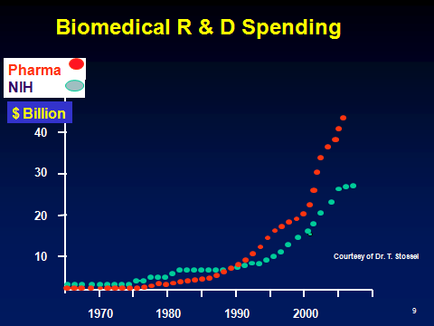
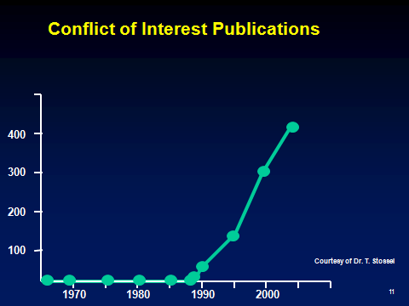
Show Me the Money!

Slide 12
Thomas Kuhn: The Challenge of Scientific Objectivity
A scientist’s worldview influences what he or she researches and how results are interpreted
Our comprehension of science can never rely wholly upon "objectivity" alone.
Science must account for subjective perspectives as well, since all objective conclusions are ultimately founded upon the subjective conditioning/worldview of its researchers and participants.

Slide 13
Interests
Financial
  Personal reward
  Research funding
Sociopolitical & ideological
  Environmentalism
Professional
  Status
Ref: Horton R. Conflicts of interest in clinical research: opprobrium or obsession. Lancet 1997; 349:1112-3.

Slide 14
The Three Fallacies
Scientific writing can be free from biases
Financial conflicts cause the most concern
Disclosure heals the wound inflicted by a financial conflict
Ref: Horton R. Conflicts of interest in clinical research: opprobrium or obsession. Lancet 1997; 349:1112-3.

Slide 15
Why focus on financial conflicts of interest?
“Conflict-of-interest rules usually focus on financial gain, not because it is more pernicious than other secondary interests, but because it is more objective and more fungible.… Just because we cannot do much about other secondary interests, it does not follow that we should do little about financial gain”
Environmental and social activism are popular special interests; financial interests are not.
Questions: Since epidemiology is a science, shouldn’t all interests be treated as critically as possible? Is it true that we can’t do much about other secondary interests?
Ref: Thompson DF. NEJM 1993;329:573-6

Slide 16
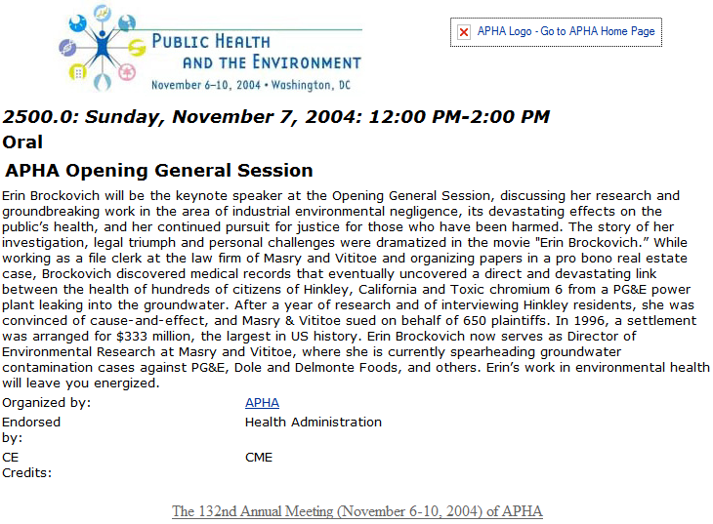
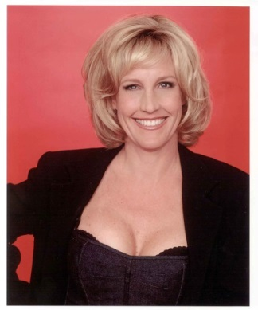
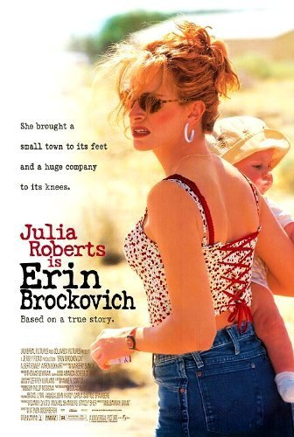
Conflict of Interest: Concerns expressed about at APHA 2004
American Public Health Association Keynote Address

Slide 17
“Sex, Not Science, Featured at Public Health Meeting”
“I was just appalled to learn that Erin Brockowich has been named the keynote speaker for the upcoming convention. This is like making the guy who advertises for malpractice business the keynote for the AMA convention… This lady is an anti-public health uneducated "researcher" who does nothing but work for a tort lawyer. Whether the case goes for the plaintiff or the defense (including the one that the movie is based on), there is no scientific merit to the claim.… She routinely puts down and tries to prevent pertinent epidemiologic investigation. If she speaks, it means that APHA espouses anti-epidemiology.”
Tom Mack
Department of Preventive Medicine
University of Southern California

Slide 18
Preference
The state of being preferred
The act, fact, or principle of giving advantages to some over others
Ref: Merriam-Webster Online Dictionary. www.m-w.com

Slide 19
Does the focus on financial conflicts hinder scientific evaluation?
“We, like many others, give most credence to papers published in reputable journals by academics working in ‘Institutes of Excellence’. The credibility rating goes down when a project is funded by a drug company that has an interest in its outcome.”
Ref: Raveendran R, Gitanjali B. Letter to the Editor. Lancet 1997:349:1173-4.

Slide 20
Are we developing a caste system in clinical epidemiology research?
“Under the new Policy, ASCO will not accept an abstract or paper describing company-funded original research if the first, last, or corresponding author has been the Company’s employee, investor, or paid speaker during the previous 2 years.”
ASCO 2013. American Society of Clinical Oncology Policy for Relationships with Companies: Background and Rationale. J Clin Oncol Published Ahead of Print on April 22, 2013 as 10.1200/JCO.2013.49.4997

Slide 21
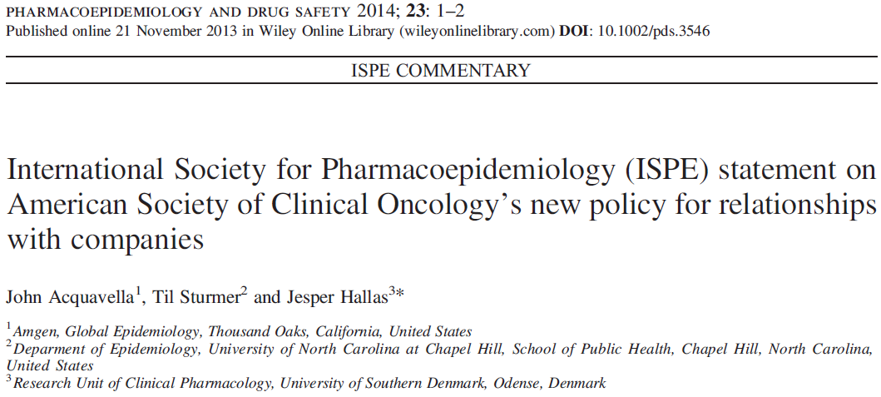

Slide 22
ASCO Reconsiders its Policy
“ASCO leadership has carefully considered the concerns expressed by the biomedical community regarding the author restrictions in the 2013 COI policy and has decided to suspend enforcement of these restrictions for a period of at least 3 years.”
ASCO 2014. The Changing Landscape of Conflict of Interest Supports Further Study of American Society of Clinical Oncology Authorship Restrictions for Research Studies J Clin Oncol: Published Ahead of Print on February 10, 2014 as 10.1200/JCO.2014.55.4006

Slide 23
“Conflict of interest. The New McCarthyism in Science”
“The objectivity of the [scientific] process depends on each contribution receiving its due regard, whatever the motivations for bringing it. It depends on judging a work on its merits, rather than on the inferred state of mind of the author.”
Ken J. Rothman
Ref: Rothman KJ. JAMA 1993; 269:2782-4, p 2783

Slide 24
When You Are Looking for Jobs… Ask the Right Questions
How do you limit commercial influence on epidemiologic research? Specifically, does research get published regardless of outcome?
Do you have any examples of early career epidemiologists as first authors on published papers?

Slide 25
Beware of your own biases, Lead by example
Judge on merit, not on presumed conflict of interest
Advocate a more balanced perspective on conflict of interest
Engage financial and other interests to live up to highest standards of our profession
Help clean up irregularities that exist (e.g., ghostwriting, author shifting)

Slide 26
Beware of Scientific vs Sponsor Interests
All sponsors have an interest in the outcome
Beware that you can be influenced
Only get involved in projects where the scientific issue is clear and can be pre-specified in a protocol. Consider sponsor input at protocol stage.
Be clear with the sponsor on the strengths and limitations of the proposed research
Insist on appropriate publication language in contracts
Consider sponsor suggestions and accept only those that make scientific sense

Slide 27
Top Ten Misbehaviors by Scientists (1)
Falsifying or ‘cooking’ research data.
Ignoring major aspects of human-subject requirements.
Not properly disclosing involvement in firms whose products are based on one’s own research.
Relationships with students, research subjects or clients that may be interpreted as questionable.
Using another’s ideas without obtaining permission or giving due credit.
Ref: Martinson, Anderson, & deVries, 2005, p. 737
Notes:
Anne to present

Slide 28
Top Ten Misbehaviors by Scientists (2)
Unauthorized use of confidential information in connection with one’s own research.
Failing to present data that contradict one’s own previous research.
Circumventing certain minor aspects of human-subject requirements.
Overlooking others’ use of flawed data or questionable interpretation of data.
Changing the design, methodology or results of a study in response to pressure from a funding source.
Ref: Martinson, Anderson, & deVries, 2005, p. 737
Notes:
Anne to present

Slide 29
Other Questionable Behaviors
Publishing the same data or results in two or more publications
Inappropriately assigning authorship credit
Withholding details of methodology or results in papers or proposals
Using inadequate or inappropriate research designs
Dropping observations or data points from analyses based on a gut feeling that they were inaccurate
Inadequate record keeping related to research projects
Ref: Inzana, T. Presentation entitled “Research Misconduct”
Notes:
Anne to present

Slide 30
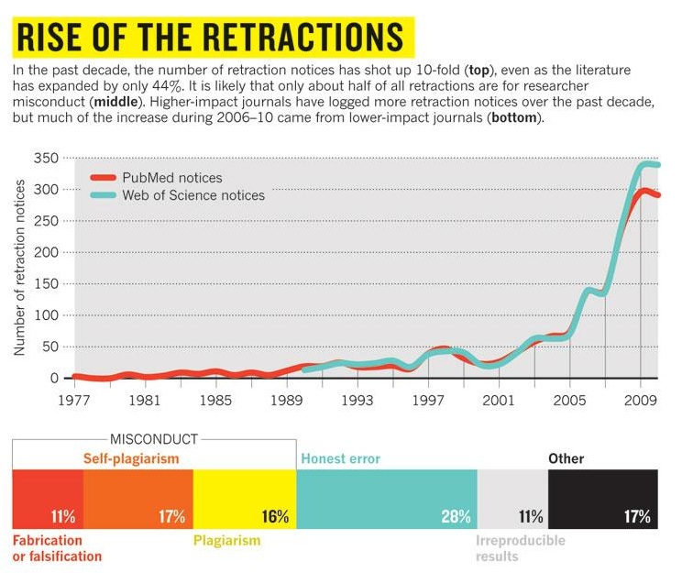
Ref: Van Noorden, R. (2011). Science publishing: The trouble with retractions. Nature, 478:26-8.
Notes:
Anne to present

Slide 31
Potential Causes of Scientist Misconduct
Pressure for professional advancement
  Pressure to gain promotion and tenure
Ease of intentionally reporting inaccurate, incomplete, or more positive results
Failure to engage in rigorous academic research
Rationalization that everyone else does it
Belief that no one will ever find out about it
Claim that an unintentional or careless error was made rather than misconduct
Ref: Lumpkin, A from the University of Kansas. Presentation entitled “Responsible Conduct in Research — Standards and Expectations for Ethical Conduct .”
Notes:
Anne to present

Slide 32
Case Study: Outliers
A scientist developed a new and promising theoretical model representing economic phenomena of interest, but needed empirical evidence to support the formulation. The data set needed to do this may exist.
However, upon initial estimation of model parameters, the researcher discovers that the data do not provide parameter estimates consistent with a thorough and rigorously developed model specification.
Further analysis traces the problem to one or two outliers in the data set, and removal of these outliers provides parameter estimates that, while perhaps not perfect, are largely consistent with the theoretical arguments
Adapted from: Debertin, Luzar and Chambers, 1995. J of Ag and Resource Econ. 20(1):82-95.
Notes:
Anne to present

Slide 33
Case Study: Outliers Discussion Questions
What are the researcher’s options?
What should the researcher publish and why?
Notes:
Anne to present

Slide 34
Perspectives in Bioethics
Notes:
Anne to present

Slide 35
Perspectives in Bioethics
Historical Context: Protection of human subjects
Ethics at Amgen
From the Headlines: Case studies
Ethical Dilemmas in the Digital Age: New technologies posing new challenges
Notes:
Anne to present

Slide 36
Laws to Protect Human Subjects: The Nuremberg Code
A Turning Point in Bioethics
1947 – Nuremberg Code established as part of the Nuremberg trials after World War II, specifically related to the violation of rights of human subjects as part of medical experiments during Nazi Germany
First document to specify ethical principles that should guide medical staff engaged in human research
Set the standard for the protection of human subjects in medical research
Did not have the strength of law, it was created post hoc, and it applied to only non-therapeutic human subjects research
Notes:
Anne to present

Slide 37
The Declaration of Helsinki (1964)
A set of ethical principles regarding human experimentation developed for the medical community by the World Medical Association (WMA).
  The Declaration more specifically addressed clinical research. A notable change from the Nuremberg Code was a relaxation of the conditions of consent, which was 'absolutely essential' under Nuremberg. Now researchers are to obtain consent 'if at all possible' and research was allowed without consent where a proxy consent, such as a legal guardian, was available.
  Document set the stage for the implementation of the Institutional Review Board (IRB) process.
“Biomedical research cannot be legitimately carried out unless the importance and objective is in proportion to the inherent risk to the subject.”
  Widely regarded as the cornerstone document of human research ethics, and continually revised, 6th revision cycle 2007-2008
Notes:
Anne to present

Slide 38
Different Codes and Guidelines
  Each country may also have local regulations – e.g., Tri-Council Policy Statement in Canada, or international guidelines such as CIOMS, Nuffield Council (UK) and UNESCO.
  1991: Common Rule in the U.S. – In addition to the requirements of the FDA and Office for Human Research Protections (OHRP):
  “…No investigator may involve a human being as a subject in research… unless the investigator has obtained the legally effective informed consent of the subject.”
There are a number of available tools which compare these
  e.g., "Comparison of Common Rule with the Declaration of Helsinki and Good Clinical Practice". 2012.
Notes:
Anne to present

Slide 39
Good Clinical Practice, an international standard
  2008 – FDA issued a final decision on April 28, 2008 to replace the Declaration of Helsinki with Good Clinical Practice (GCP) effective October 2008
  GCP is an international quality standard that is provided by International Conference on Harmonisation (ICH), an international body that defines standards, which governments can transpose into regulations for clinical trials involving human subjects
  Today, the GCP are used in clinical trials throughout the globe with the main aim of protecting and preserving human rights
Notes:
Anne to present

Slide 40
ISPE-Professional Certification Commission (PCC) Code of Ethics
Our professional society, the International Society for Pharmacoepidemiology, has a certification that defines a set of principles for the professional conduct expects from its certificants and candidates.
The Code of Ethics works together with the Standards of Professional Conduct which provides guidance for certificants and candidates regarding ethical and fair professional practices. The Certificants and candidates shall:
Hold paramount the health, welfare and safety of the public, customers, colleagues and employers and protect the environment and property in the performance of the certificants professional duties.
Act with objectivity, competence, and in an ethical manner with colleagues in the pharmaceutical and related industries, the public, employers, clients and prospective clients worldwide.
Maintain all relationships with the highest standards of integrity and honesty.
Take reasonable steps to ensure the privacy and safekeeping of confidential and proprietary information concerning the business affairs and technical processes of any former or present employer or client or public body for which they serve.
Refrain from receiving or offering gratuities or inducements that may compromise professional standards or independent judgment.
Ref: http://www.ispe.org/certified-pharmaceutical-industry-professional/code-of-ethics
Notes:
Anne to present

Slide 41
What is Bioethics?
The study of ethics or ethical implications of biological research and its applications, especially in medicine.
It is a shared, reflective examination of ethical issues in healthcare, health science, and health policy.
Ethics is the systematic study of moral choices.
Ethical debate ensues with technological advances.
Ethical decision-making requires respect for individual rights, neutrality, and concern for the consequences of intended actions.
The moral basis for choices in biomedical research relies on the four guiding principles of bioethics: autonomy, justice, beneficence, and nonmaleficence.
Notes:
Anne to present

Slide 42
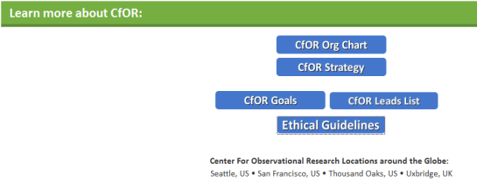
Ethical Guidelines at Amgen
At Amgen, we learn about the importance of ethical conduct in clinical research
  History
  GCP standard
  “Do the right thing” training
Specific ethical guidelines for observational researchers can be derived from the 4 guiding principles of bioethics:
  Autonomy: Requires that the patient have autonomy of thought, intention, and action when making decisions regarding health care procedures
  Justice: The idea that the burdens and benefits of new or experimental treatments must be distributed equally among all groups in society
  Beneficence: Requires that the procedure be provided with the intent of doing good for the patient involved
  Non-malificence: Requires that a procedure does not harm the patient involved or others in society
Center for Observational Research
Notes:
Anne to present

Slide 43
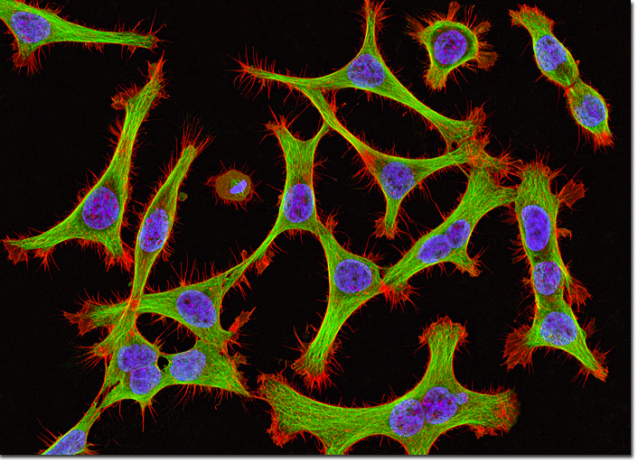
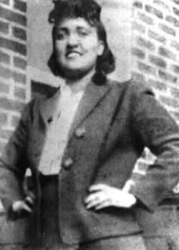
Case Study: HeLa (1)
Henrietta Lacks 1920-1951
Ref: Ruiz J and Bell K. Presentation entitled “Research Ethics and Research Involving Humans”
Notes:
Anne to present
How many people have seen these cells??
Has anyone used them in research or class labs etc.?
How many people know the story behind them?
Henrietta Lacks was born into a black working class family in 1920 in Virginia. She had 5 children.
Story recently popularized with the publication of The Immortal Life of Henrietta Lacks by Rebecca Skloot

Slide 44
Case Study: HeLa (2)
Standard diagnostic test reveals cervical cancer (1951)
Cancer cells are removed for research purposes without consent
George Gey created the first immortal cell line, and they were widely shared
Creation of the cell line generated an increase in medical and biological research, including a vaccine for polio, cancer research, AIDS research, among others
The identity of Henrietta Lacks remained confidential until the 1970s
After her identity was known, the family found out for the first time that Henrietta Lack’s cells were still “alive.”
The family was approached to give blood for research
The Lacks family did not have access to health care
Ref: Ruiz J and Bell K. Presentation entitled “Research Ethics and Research Involving Humans”
Notes:
Anne to present
-Discuss the issue of confidentiality and how the taking of the HeLa samples affected her family etc…
-tell story about the families experience with the researcher who took their blood and left them to believe that they were getting a diagnostic test for cancer.

Slide 45
Case Study: HeLa Discussion Questions
What are the ethical issues?
Consent
Individual benefit versus societal benefit
Confidentiality
Commercialization
Notes:
Anne to present
-Consent – common practice in the 1950s to take tissue samples for research without consent (still common but there is regulatory oversight that governs this)
-Do you think that it was “wrong” to take the cancer cells without consent. Would this same situation bother you.
-Individual rights versus Public benefit
-What benefits did society get - research and development, advances in healthcare (From R. Skloot without tissue research “we would have no tests for diseases like hepatitis and HIV; no vaccines for rabies, smallpox, measles; none of the promising new drugs for leukemia, breast cancer, colon cancer.” The list goes on….
-What benefits did Henrietta Lacks – What could have the benefits been: contributing to research
-Confidentiality: George Gey strongly believed in confidentiality so Henrietta Lack’s identity did not come out until after he died. Impact on the family once it did come out.
-Money – Henrietta Lack’s family cannot even access healthcare? Not sharing in the benefits of the research. Who should benefit?
Rebecca Skloot The Immortal Like of Henrietta Lacks

Slide 46
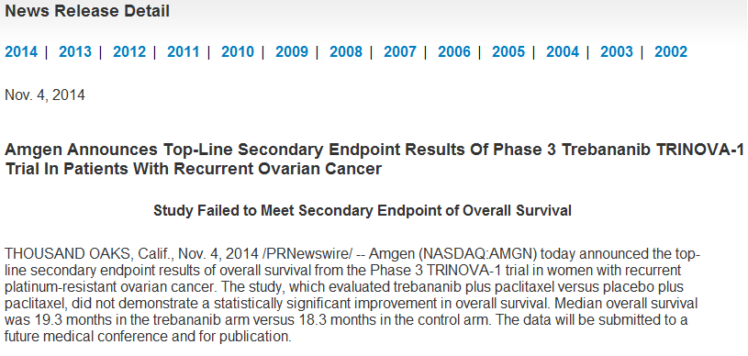
Sometimes Priorities Change
Ongoing epidemiology studies in ovarian cancer
Ethical commitment to complete work, often represent academic collaborations (publication)

Slide 47
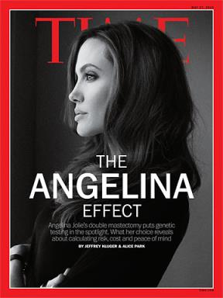
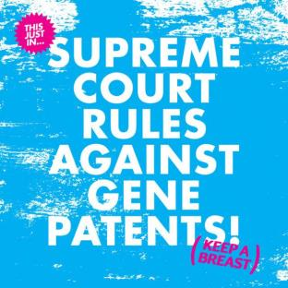
Case Studies: Events in 2013 Re-Ignited Interest in Genetic Testing and BRCA1/2

Slide 48

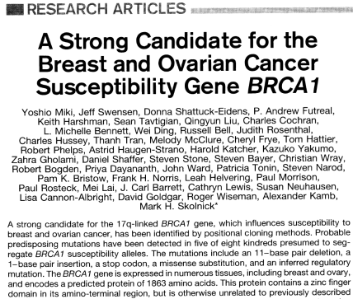
Association for Molecular Pathology v. Myriad Genetics
1994 - BRCA1 cloned by Myriad Genetics and published by 40 collaborators in Science
BRCA1 patent filed; Myriad develops process and laboratory to perform high throughput sequencing
1995 - BRCA2 patent filed
2010 – Myriad’s patents on the BRCA1 and BRCA2 genes ruled invalid on March 29, 2010 in the U.S. District Court for the Southern District of New York
Approximate costs before Supreme Court ruling:
  $3000 for full BRCA1/2 testing
  $415 for 3 Jewish founder mutations
  $350 for single site analysis
Science 7 October 1994

Slide 49
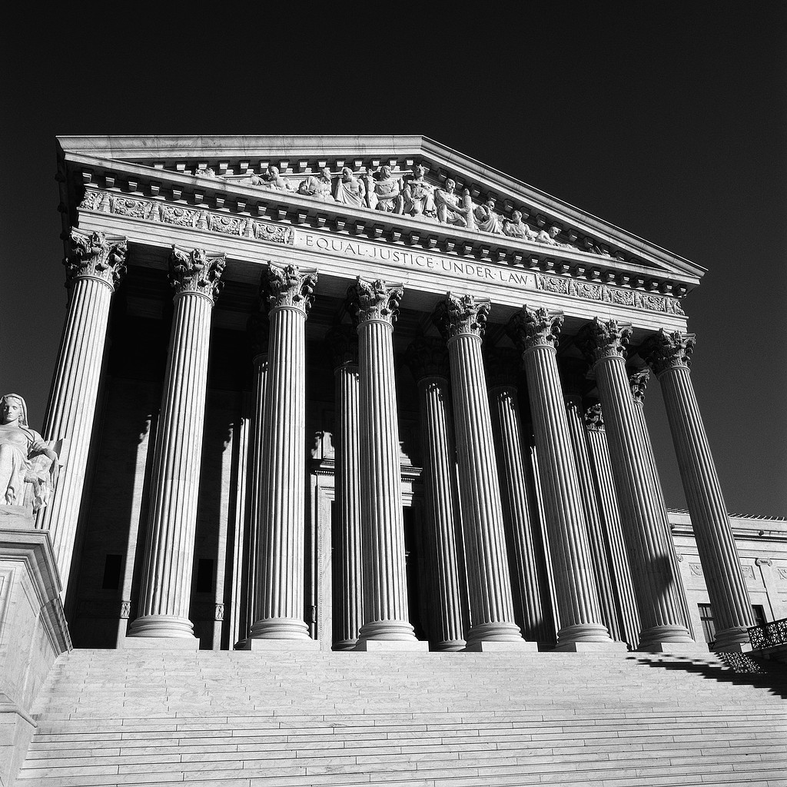
Supreme Court Ruling on Gene Patents
June 13, 2013 - Association for Molecular Pathology v. Myriad Genetics (No. 12-398)
U.S. Supreme Court unanimously ruled that, "A naturally occurring DNA segment is a product of nature and not patent eligible merely because it has been isolated," invalidating Myriad's patents on the BRCA1 and BRCA2 genes
More competition, low cost, more access to genetic testing

Slide 50

  Are the proper standards in place?
Genetic testing is cheaper and easier than ever

Slide 51

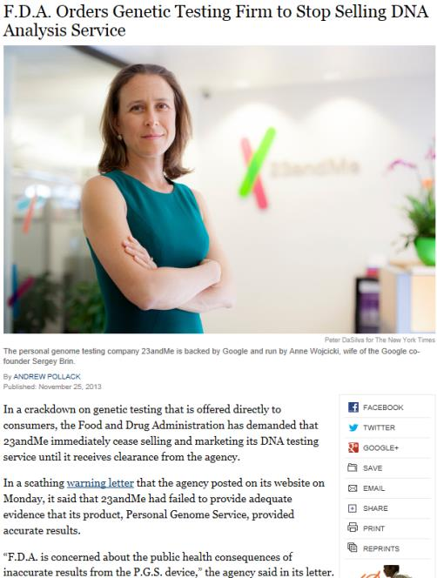
FDA vs 23andMe
November 25, 2013
FDA issued a warning letter about the accuracy and standards of test results from the Personal Genome Service
Of greatest concern was testing for mutations in genes linked to hereditary breast and ovarian cancer, stating that a false positive could lead to an unnecessary preventive mastectomy
  Genetic testing for breast cancer risk is one example where guidance from doctors and genetic counselors is warranted, and offering these results directly to consumers is of concern
Class-action suit followed

Slide 52
More Controversy
“1 step forward, 23 steps back”
  Debate ensues around 23andMe balancing the right to know vs. the right not to know for families tested
    Close Relatives check box led to a patient discovering that his parents were not his biological parents by selecting to learn more about his ancestry by linking to family members who were tested
  Company to hire Chief Privacy Officer to ensure informed, conscious decisions made by customers about whether and how to receive potentially overwhelming information
Headline: Expansion to UK sparks privacy concerns
  Will my data be sold to Google?
Ethical problem: patient autonomy, right not to know

Slide 53
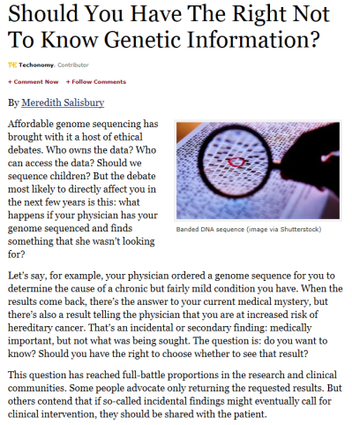
Patient Autonomy and the Right Not to Know
November 5, 2013
American College of Medical Genetics and Genomics (ACMG) recommendation that 57 genes should be evaluated any time a physician orders a genetic test
  Genes related to diseases such as Alzheimer’s or Huntington’s, with no known medical treatment, are not on the list
  Genes linked to hereditary breast and ovarian cancer are among the selected 57
This “duty to hunt” was surprising—caused heated debate at a recent American Society of Human Genetics (ASHG) meeting because part of the recommendation said these findings should be shared even with patients who expressly do not want to know the results
Forbes.com 11/05/2013
Ethical problem: patient autonomy, right not to know

Slide 54
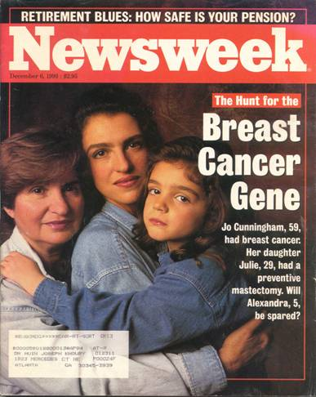
Case Study: Hereditary Breast-Ovarian Cancer (HBOC)
1866 - Hereditary breast cancer syndrome first described by Paul Broca, in the form of a large pedigree with 10 breast cancer cases
Late 1960s - Henry Lynch (Lynch syndromes I and II) started to describe families showing autosomal dominant inheritance patterns for breast cancer
1990 - Mary-Claire King provided first convincing linkage data in early-onset breast cancer families which mapped the susceptibility gene, thereafter named BRCA1 for Breast Cancer 1, to the long arm of chromosome 17
Notes:
Relative to last year, the SRE market growth is flat or -1%. Another milestone was over 100,000 patients treated with XGEVA by 2013. However, the brand team plan anticipated about a 30% growth in SRE market and now CfOR and GHE are working to help provide a better understanding of the proportion of bone mets patients that remain untreated. To better understand the drivers and barriers of prescribing bone modifying agents to prevent skeletal complications.

Slide 55
BRCA1: Highly Penetrant Gene and the Single Greatest Risk Factor for an Individual
Breast Cancer Risk to Age 70
Up To 10-Fold Higher Risk^{a-c}
Prospective Data on Unaffected BRCA1 Mutation Carriers Confirm High Risk
Risks to Age 70
Breast cancer risk (prospective):
60% U.K.¹
61% Norway²
55% Poland³
69% North America (shown)³
BRCA1
Up to
87%
Up to
60%
Breast Cancer Incidence: 2-4% Per Year¹⁻⁴
Cumulative risk (%)
BRCA1
Cumulative incidence of breast cancer (%)
BRCA1
8%
<2%
General population⁵
mean age of breast ca 42.6 yrs (n=3,985 with BC among 10,017 BRCA1 mutation carriers)^{d}
Easton et al. Am J Hum Genet. 1995;56:265-71.
Ford et al. Lancet. 1994;343:692-695
Struewing et al. N Engl J Med. 1997;336:1401-8
Hereditary BC Study Group (BRCA1/2 Registry n=13,584 per S. Narod), n=3,985 BC among 10,017 (2013 not published)
Mavaddat et al. JNCI 2013 105(11):812-22. av. 1.8% (1.3-2.6%) per year; range 1.7% to 3.6% (30 to 59 yrs).
Moller et al. Clin Genet. 2013 Jan;83(1):88-91. av. 2.0% (95% CI 1.7–2.5%) per year.
Lubinski et al. Int J Cancer 2012 131(1):229-34
Liede et al. JCO 2002 20(6):1570-7. n=213, mean 7.2 yrs f/u among BRCA; 2.1% per year BC
American Cancer Society. Cancer Facts & Figures 2013.

Slide 56
Genetic Testing for BRCA1 Begins with Affected Family Member
Exception: individuals from ethnic groups with higher prevalence (e.g., Ashkenazi Jewish)
Genetic counseling: 2-3 appointments
“female cancers”
Br 43
Major Phenotypic Features
Autosomal dominant inheritance pattern
Number of cancers, multiple generations
  3+ relatives w/ breast ca at any age
  2+ relatives w/ breast ca, one <50 yrs
Age of onset
  Breast cancer <50 yrs
Type of cancer
  Ovarian cancer at any age
  Male breast cancer
  Triple –ve breast cancer
  Pancreatic cancer w/ breast or ovarian ca
Bilateral or multiple primaries
  2 Primary breast cancers
  Breast and ovarian ca in one individual
Ethnicity, founder effects
Br 49
Ov 56
Ov 60
Br 42
Br 39
BRCA1 Ashkenazi Jewish family modified from Liede et al. J Clin Oncol 2002 20(6):1570-7

Slide 57
Case Study: Genetic Counseling Issues (Family)
Family involvement
  For accurate risk assessment or testing
  Communicating results
Confirmation of a “cancer gene” in family
Insurance concerns
Expectations of family members
  Family members may or may not wish to have testing or share results
  Strategy to inform relatives
What about the right not to know?
Genetic guilt
Ethical concern: patient autonomy, right not to know
BRCA2 family from the Philippines in De Leon Matsuda et al. Intl J Cancer 2002 98:596-603

Slide 58
Motivations for genetic testing...
Doctor’s recommendation ranks low
Ref: Liede et al. Am J. Human Genetics 2000 67:1494-1504

Slide 59
Risk Management Strategies
Early detection/screening
Prophylactic surgery
Chemoprevention

Slide 60

What Options do Women With a BRCA1 Mutation Choose?
Angelina Jolie, 37, underwent prophylactic bilateral mastectomy
Mother, Marcheline Bertrand, died of ovarian cancer age 56 (French Canadian with a strong family history of HBOC)
In 2015, underwent prophylactic bilateral salpingo oophorectomy to reduce her risk of ovarian cancer
Women with a sister or mother with breast or ovarian cancer are significantly more likely to have prophylactic surgical procedures¹
Only 11% of Jewish women who underwent population genetic testing in Canada had bilateral mastectomy within 2 years, and 90% had oophorectomy³
Risk reducing options chosen by 2,677 BRCA1/2 mutation carriers (2,051 BRCA1)²
Option | Israel | Norway | Poland | Italy | Austria | Canada | France | Netherlands | US
Mastectomy* | 4% | 4% | 3% | 10% | 20% | 22% | 25% | 33% | 36%
Oophorectomy | 67% | 74% | 35% | 50% | 52% | 57% | 71% | 64% | 71%
Tamoxifen or raloxifene* | 11% | 0% | 6% | 0% | 5% | 10% | 0% | 0% | 12%
Any risk-reducing measure (above)* | 57% | 68% | 26% | 40% | 40% | 59% | 75% | 56% | 72%
Mammography | 96% | 93% | 66% | 100% | 100% | 97% | 100% | 100% | 98%
MRI | 2% | 14% | 7% | 72% | 65% | 48% | 67% | 95% | 24%
*among women without breast cancer
Metcalfe et al. Clin Genet. 2008;73(5):474-9.
Metcalfe et al. Int J Cancer. 2008; 122(9):2017–22.
Metcalfe et al. Breast Cancer Res Treat. 2012;133(2):735-40. n=19, mean age 46 yrs (28–67 yrs).
Notes:
Relative to last year, the SRE market growth is flat or -1%. Another milestone was over 100,000 patients treated with XGEVA by 2013. However, the brand team plan anticipated about a 30% growth in SRE market and now CfOR and GHE are working to help provide a better understanding of the proportion of bone mets patients that remain untreated. To better understand the drivers and barriers of prescribing bone modifying agents to prevent skeletal complications.

Slide 61

Gilda Radner Ovarian Cancer Detection Program
Women at risk of ovarian cancer in Los Angeles (n>1,600); family history
Followed at Cedars-Sinai for 10 years (1991-2001)
  Free surveillance with CA125, TVS, color Doppler
8 incident ovarian cancers
Study cohort:
  Ashkenazi Jewish; 290 eligibile
  Informed consent obtained and genetic counseling; n=213 (73.4%) tested in 1998
Results: 16% BRCA-positive
  31 BRCA1
  2 BRCA2 mutation carriers
Ref: Liede et al. J Clin Oncol 2002 20(6):1570-1577
Notes:
From the follow-up of ten years available on this cohort of women, I was able to calculated the cumulative risk of cancer for BRCA1 mutation carriers versus non-carriers. You may recall that all these women were “healthy” at the start of the program. Women were censored if they were diagnosed with cancer, died, or at the date of their last appointment or date of oophorectomy for Kaplan-Meier survival analysis.
43 women had prophylactic oophorectomy.
Because we tested 100% of women who developed cancer and only 72% of women who did not develop cancer. We reduced or adjusted our estimates by 24%.

Slide 62
Ethical Debate: Decision to Disband Program
Bottom Line: Screening failed to detect early-stage ovarian cancers
All women who developed ovarian cancers were stage IIIc, and were BRCA1 185delAG mutation carriers
  One stage Ic ovarian cancer identified, in a non-carrier
  Risk of cancer in non-carriers <3% in ten years
Program redesigned to focus on BRCA1/2 mutation carriers 2002
BRCA1 carriers
Cumulative risk at 10 years:
28% ovarian cancer
21% (adjusted)
P < 10⁻⁶
Non-carriers
Time since entry to program (years)
Ref: Liede et al. J Clin Oncol 2002 20(6):1570-1577
Notes:
The Gilda Radner Program allowed us to conduct the first prospective study on BRCA1 or BRCA2 mutation carriers.
We observed that….
Implications for surgical prevention of ovarian cancer - how do we reduce the risk of peritoneal cancer in carriers.

Slide 63
Health Insurance Portability and Accountability Act (HIPAA) of 1996
Protects health insurance coverage for workers and their families when they change or lose their jobs.
Administrative Simplification (AS) provision requires the establishment of national standards for electronic health care transactions and national identifiers for providers, health insurance plans, and employers.
Right to privacy to individuals from age 12-18.
  The provider must have a signed disclosure from the affected before giving out any information on provided health care to anyone, including parents.
  Research can be exempt from HIPAA’s Privacy Rule; HIPAA’s Privacy Rule only applies to personal health information (PHI) gathered by or from covered entities

Slide 64

HIPAA and Privacy Challenge: Much of the EMR Data Remains Untapped
EMR research to date
Structured data
(e.g., demographics, stage, diagnosis)
There’s more to EMR
Unstructured data
(e.g., pathology, stage, biomarkers, physician notes)

Slide 65


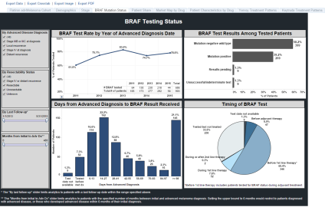
Is our Personal Health Information Protected?
How do we go from here?
(site of care)
To here?
(electronic data)
To here?
(research use)
Electronic Database
Notes:
I also had to ask myself “Why are we doing a physician survey”
Well, to measure knowledge… but isn’t the real goal to ensure safe use of our products.
So how do we get from the product label safety language to → the survey → to ensuring safe use in practice

Slide 66
Case Study: Electronic Health Records (EHR) in Research
Linkable Patient ID
EHR Onc Database
1M Cancer
Patients
Clearing House Medical Claims (1 out of 2)
Pharmacy Prescriptions
(3 out of 4)
HIPAA-compliant data de-identification and encryption in storage and in transit
Tumor Registry
Hospital charge master
(400 hospitals)
Death Records (Experian)
PharMetrics Plus Claims
Adapted from: Quach et al (2013) presented at 29th international conference on Pharmacoepidemiology and Therapeutic Risk Management, Montreal, Canada, August 25-28, 2013.

Slide 67
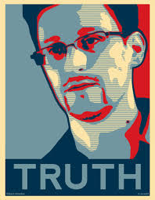
Big Data Poses New Challenges
Big Data: An all-encompassing term for any collection of data sets so large and complex that it becomes difficult to process using on-hand data management tools or traditional data processing applications.
From Wikipedia, accessed 8/22/14

Slide 68
In Scandinavia, Patient SSN can be used to Link Across National Databases
specimens
Linking gastric cancer specimens,
MET analysis, and mortality outcomes

Slide 69
Each Country may have its own regulation
In Denmark, access to patient-level data is governed by the Danish Data Protection Agency: http://www.datatilsynet.dk/english/
  Getting approval from this agency is the first step for each study.
  To access patient medical records (as opposed to registry records), one needs informed consent of patients.
  The procedure is more or less similar in other Nordic countries.
In Germany, data access governed by laws: http://www.gesetze-im-internet.de/sgb_10/BJNR114690980.html
EU Data Protection Directive 95/46/EC is relevant: http://eur-lex.europa.eu/LexUriServ/LexUriServ.do?uri=CELEX:31995L0046:en:HTML

Slide 70
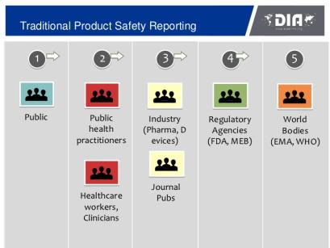
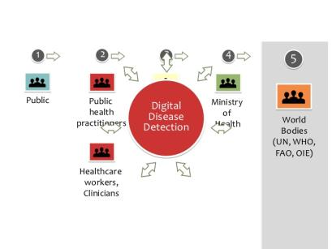
Where Social Media Holds Promise…
169M US adults (72% of all adults) went online to research a health question in 2010, compared with 63M in 2002
80% of serious AEs are reported by pharmaceutical companies

Slide 71
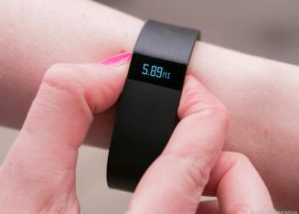
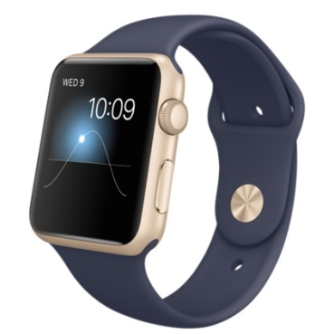
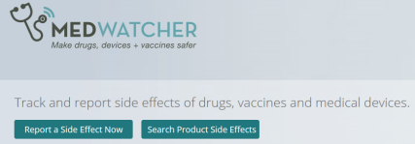
Ethical debate will follow Big Data and the integration of new sources of health data
Big Data refers to very large super-sets of data that include RWD and data from other sources
  social media (Twitter, Facebook)
  consumer data (purchasing habits)
  health technologies (Fitbit)
  non-health behaviors
Big Data is also a conceptualization in which all of these RWD sources may be integrated and used for healthcare decision-making
Technological advances are being made to help FDA monitor social media to identify safety signals/adverse events
ICPE 2013 Plenary Session: “How the FDA Uses Mobile Apps and Social Media Monitoring to Identify AEs” (Nabarun Dasgupta)
MedWatcher.org and app allow individuals
to report adverse events

Slide 72
  Physician As Research Participants
  Ensuring the rights of participants while encouraging research enrollment
  Law and regulations in place to prevent:
Coercion
  Incentives to participate
Undue Influences
  Payment
Pressures
  Manipulation and Persuasion
Exploitation
Conflict of interest
  Increases the likelihood of the other ethical concerns
Physician surveys as part of mandated PV to measure prescribers’ understanding of risks associated with drug
  Ethical concern: How to protect confidentiality with “test results” provided to regulatory agency
ICC/ESOMAR Code on Market and Social Research: http://www.esomar.org/knowledge-and-standards/codes-and-guidelines.php

Slide 73
Conclusions
Research integrity and research ethics characterize responsible conduct of research
Responsible conduct applies to all aspects of research, and researchers must strictly conform to federal, institutional, and professional requirements
Every researcher must accept responsibility to call to the attention of appropriate individuals any concerns about possible research misconduct
Engaging in research misconduct has and should have serious consequences
Ethics is a shared, reflective examination of ethical issues—issues that are continuously changing and challenging our assumptions of what may be considered ethical
Ref: Lumpkin, A from the University of Kansas. Presentation entitled “Responsible Conduct in Research — Standards and Expectations for Ethical Conduct .”

Slide 74
Thank you

