Slide 1
Epidemiology 245 – Introduction to the Course for Spring 2016
Elvin Geng

Slide 2
Course Objectives
Understand the motivations for a science of implementation;
Describe distinctive characteristics of implementation science;
Understand how to analyze barriers to implementation and how to propose solutions to overcome those barriers;
  Apply theory from implementation science, as well as from social sciences more broadly, to implementation problems in health.
Understand conceptual and practical challenges with designing and carrying out implementation science – including sampling, measurements and analytic issues

Slide 3
Course Overview - Processes
Lectures
  Synthesis of key areas
  Guest speakers
  Material posted on course website
  Draw on examples from HIV
  Dialogue
Readings
  One or two required per week
  More available on website
Homework
  Write parts of a grant proposal
  Students to post to course website
  Comment on other students’ writing
  Final proposal presentation
Discussion section
  Discuss assignment
  Open forum
Journal club
  Content evolving
Content evolving…
Grade
  Posting assignment
  Commenting on others
  Final presentation

Slide 4
Week 1:
Mon
Tues
Wed
Thur
Fri
Lecture 1 - “Motivation for a Science of Implementation”
Assignment 1 given out - “Describe a gap between knowledge and practice”
Week 2:
Mon
Tues
Wed
Thur
Fri
Students post assignment 1 – “Describe a gap between knowledge and practice” to course website
Each student comments on two of classmates content before coming Thursday
Elvin / Elizabeth and Roya also comment
Lecture 2 – “Understanding Reasons for the Gap”
Assignment 2 given out – “Gap analysis”
Small group – discuss Assignment 1 - “Describe a gap between knowledge and practice”

Slide 5
Assumptions
Assume you have expertise in three things…
  The course is a conversation
Clinical knowledge – explicit knowledge in clinical or public health
  Medical school, boards, subspecialty training
  You know what needs to be done
Practical experience – implicit knowledge in professional training or practice
  Wards, residency, clinical rotations, etc.
  You know (some? many?) of the problems with getting it done
Thinking causally
  Draw on your experiences and interests

Slide 6
Week 1: Why a Science of Implementation?
Epidemiology 245 - Spring 2016
Elvin Geng, MD MPH
Associate Professor
Department of Medicine

Slide 7
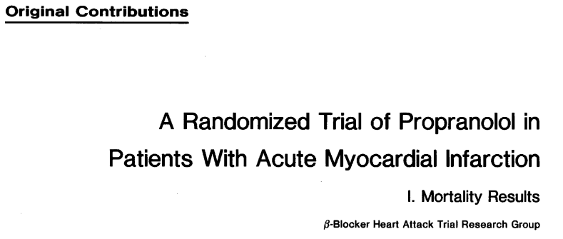

Slow Translation of Evidence to Practice: a Case Study
Beta-blocker heart attack trial (BHAT)
Population
  30-69 years with acute MI
  Not very highly selected population (already on beta blocker, living too far from study site, 18% because of perceived contraindications)
Years of study: 1978 – 1980
2827 total individuals randomized
180 to 240 mg daily of propranolol vs. placebo
Notes:
In 1982, a randomized trial was done to evaluate the effect of beta-blockers on mortality after MI’s
There were half a dozen or so studies – some observational that beta blockers had a role after MI
Some as early as 1977

Slide 8
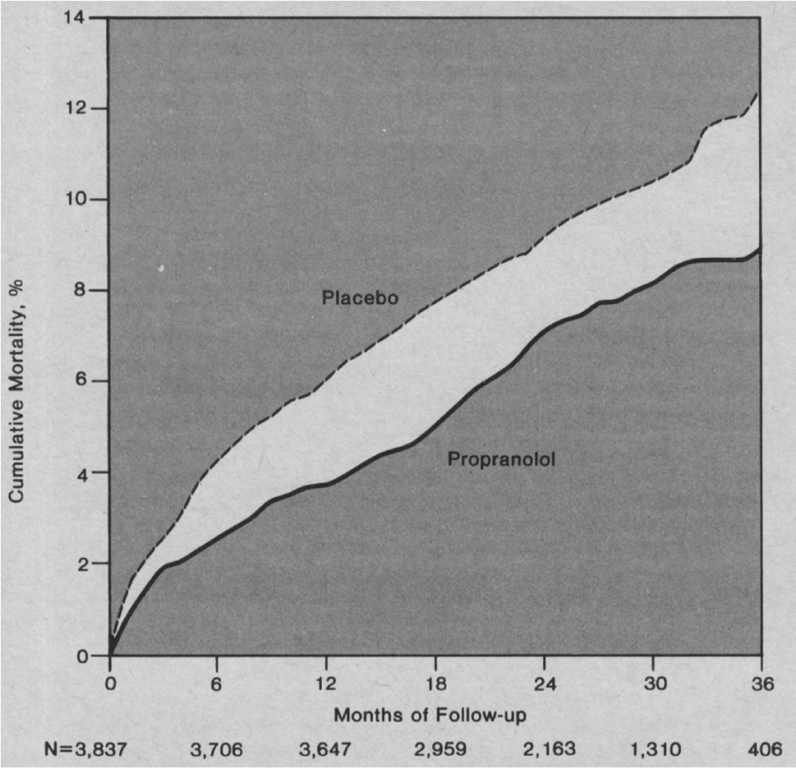
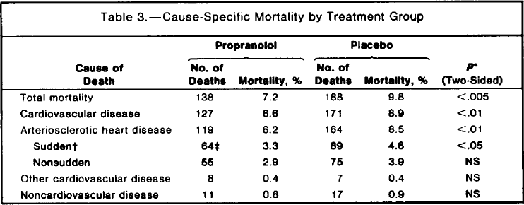
Results: Beta-blocker Reduces Mortality
Notes:
2.6 total mortality
2.3 in cardiovascular disease

Slide 9

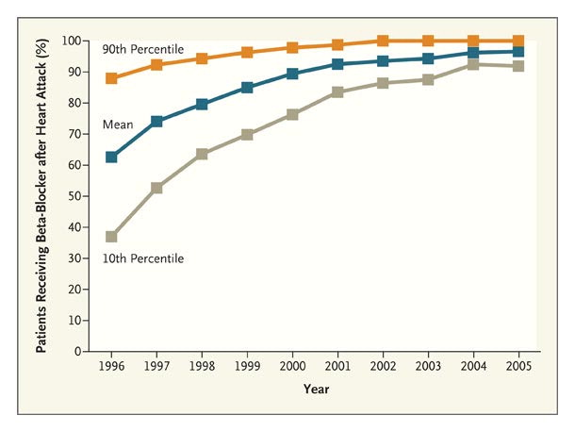
Inadequate Use in Routine Practice
“Eulogy for a Quality Measure”
Lee, NEJM 2007
1997 NEJM publication
Nationwide observational study of 201,752 individuals with MI’s (ICD-9 – 410) from Medicare records
34% discharged with beta blocker
Beta blocker reduced mortality by 40% when prescribed, adjusted for other characteristics
Effect similar across subgroups
ACC/AHA 1996 guidelines
1997 Joint commission quality indicator
1996 HEDIS (Health Plan Employer Data and Information Set) indicator
Incentives
Quality improvement
Notes:
About 15 years later, however, a large observational study in the NEJM using national Medicare data suggested that only 34% of persons admitted with an MI received a BB on discharge
Predictors of receipt: healthier, younger, shorter hospital stay, lower creatinine, more likely to have gotten thrombolytics
Momentum built, however, over the next 10 years – and guidelines, incentives, quality improvement activities often focused on this issue
In 2007, Thomas Lee, wrote a commentary when the National Committee for Quality Assurance retied this indicator – discharged after MI with prescription for BB

Slide 10
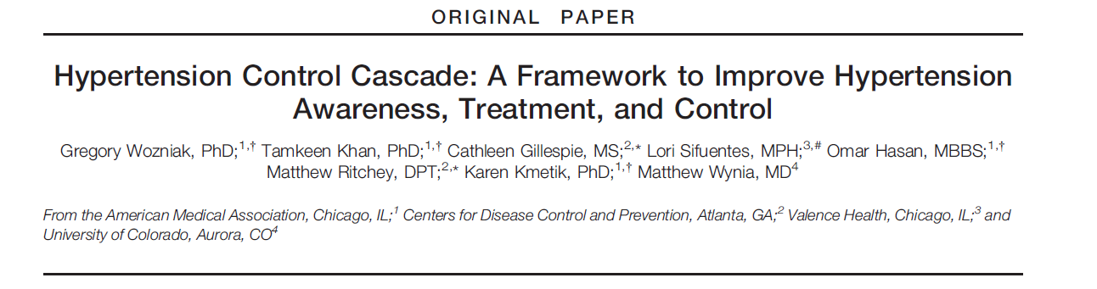
Hypertension Cascade: United States
30% of American adults have hypertension (70 million persons)
Contributes to approximately 360,000 deaths in America each year
Used NHANES to estimate the hypertension cascade (2007-12)
Sample size: 17,788
Wozniack J Clin Hypertens (Greenwich). 2015:1–8.
Notes:
While d/c with a prescription is an important step, let’s look in a little more depth at the set of events that have to occur for a medical condition to be adequately addressed
Hypertension in a very prevalent condition
The presence of hypertension was > 140/90 and control was < 140/90

Slide 11
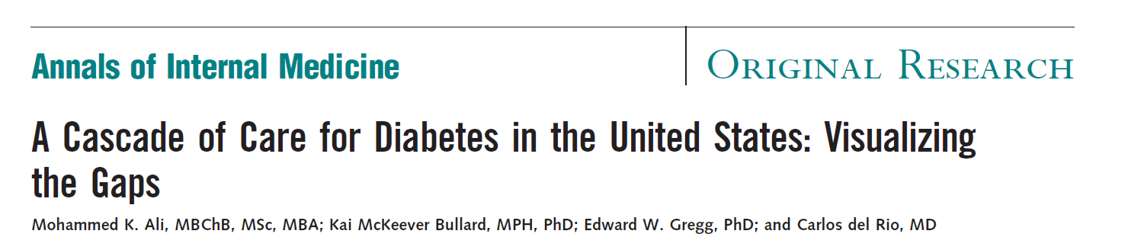
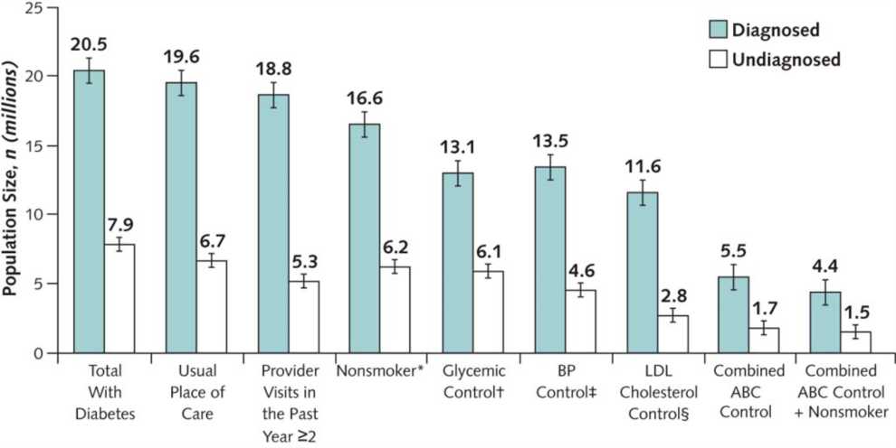
Diabetes Cascade: United States
Ann Intern Med. 2014;161(10):681-689. doi:10.7326/M14-0019
Diabetes prevalence in US adults 11.8% (28.4 million persons)
Diabetes is seventh leading cause of death in the US
NHANES - with HbA1c
72% of diabetics aware of diagnosis
92% of diabetics in some kind of care
64% of patients who are diagnosed have controlled glucose levels
ABC = combined control of hemoglobin A_{1c} level, BP, and LDL cholesterol level; BP = blood pressure; LDL = low-density lipoprotein. NHANES = National Health and Nutrition Examination Survey.

Slide 12
Pervasive Gap Between Knowledge and Routine Use
Variable | No. Indicators | No. Eligible | No. Times Indicator Eligibility | Percentage of Recommended Care Received
Overall care | 439 | 6712 | 98,649 | 54.9 (54.3–55.5)
Type of care
Preventive | 38 | 6711 | 55,268 | 54.9 (54.2–55.6)
Acute | 153 | 2318 | 19,815 | 53.5 (52.0–55.0)
Chronic | 248 | 3387 | 23,566 | 56.1 (55.0–57.3)
Function
Screening | 41 | 6711 | 39,486 | 52.2 (51.3–53.2)
Diagnosis | 178 | 6217 | 29,679 | 55.7 (54.5–56.8)
Treatment | 173 | 6707 | 23,019 | 57.5 (56.5–58.4)
Follow-up | 47 | 2413 | 6,465 | 58.5 (56.6–60.4)
McGlynn NEJM 348;26, 2003
Notes:
Approximately 6700 patients from 12 metropolitan areas

Slide 13
Global Implementation Gap: HIV Treatment
Clinical Advancement and Investments
The Global HIV Treatment Cascade
10
5
Billions of dollars
1990
2000
94%
96%
Transmission reduction with ART
Cohen NEJM2011; 365:493-505
Of normal lifespan expected with ART
Helleberg CID 2013 Mar;56(5):727-34.
95%
Reduction in vertical
Mofeson MMWR 2013 Mar;56(5):727-34.
Notes:
Globally these problems are not well documented but often far worse
In most countries in Africa, for example, there are no primary health care systems that are widely available and so many chronic diseases go untreated
HIV is an exception to this – in the med 2000 when it was prevalence was 15 to 30%, life expectancies
In 1995 life expectance in Botswana was 65 years
In 2005 it was 35 years
PEPFAR…

Slide 14
Science to Address the Gap
Each year, billions of U.S. tax dollars are spent on research and hundreds of billions are spent on service delivery and community health programs. However, relatively little is spent on, or known about, how best to ensure that the lessons learned from research are relevant to, and, inform and improve the quality of health, delivery of services and the utilization and sustainability of evidence-based tools and approaches.
…it is essential that health care providers, patients, families, caregivers, communities and healthcare settings are equipped with empirically-supported strategies to integrate scientific knowledge and effective interventions into everyday use.
The National Institutes of Health has recognized that closing the gap between research discovery and clinical and community practice through scientific inquiry is both a complex challenge and an absolute necessity if we are to ensure that all populations benefit from the Nation’s investments in scientific discoveries
http://grants.nih.gov/grants/guide/pa-files/PAR-13-056.html
Notes:
Tinkle, Mindy, et al. "Dissemination and implementation research funded by the US National Institutes of Health, 2005–2012." Nursing research and practice 2013 (2013).

Slide 15
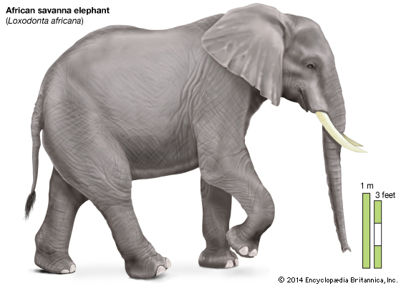
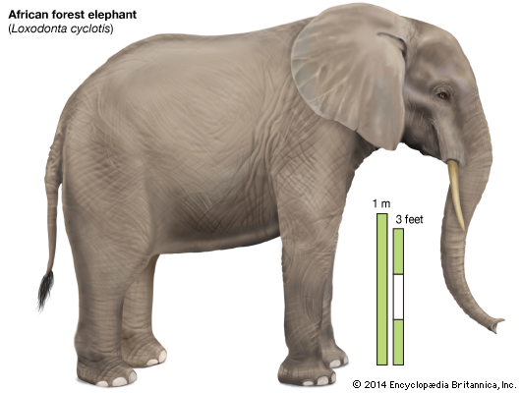
Implementation Science: A New Elephant?
Clear consensus that a need for research to optimize use of proven clinical interventions is clear
What is this area of research? What is the scope, bounds, nature?
How is it different from other areas of research?
  “implementation science” or “implementation research” or “operations research” or “knowledge translation” or “delivery science” or “program science” or “outcomes research” or
  “community participatory research?”
How is it related to the social sciences?
  Marketing? Economics? Sociology? Psychology?
What methods are distinctive in this area of research?
Defining it crystalizes its needs, allows us to talk about progress and an create cohesive discourse and attention – and funding…
Notes:
Science to address this gap – implementation science – is it new?
Behavior of individuals
Behavior of organizations
Behavior of systems
Behavior of governments
Is it a new elephant and if so what are it’s defining characteristics?

Slide 16
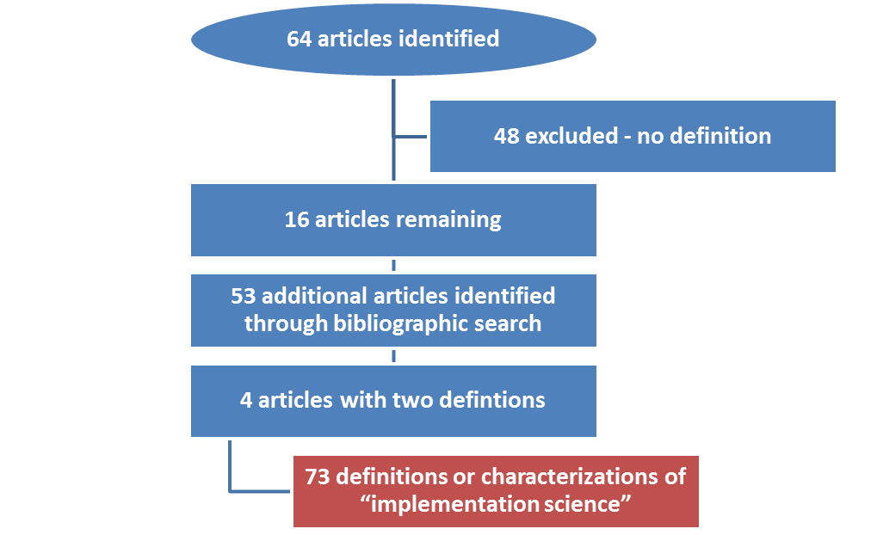
Defining Implementation Research: A Review
2014 Strategic Use of Antiretroviral Therapy
  WHO HIV Department
Definitions
  PubMed search in April 2014 to identify articles containing using the terms “delivery science”, “implementation science”, “implementation research”, “dissemination research”, “dissemination science” and “knowledge translation” with Medical Subject Headings terms “HIV” and “AIDS”.
Measurements
  Extracted key characteristics of definitions (eg, publication year, author) and references
Analysis
  Tabulated characteristics of definitions
  Network graph of definitions linked by their chain of references
  Coded content themes
  Offer an empiric “synthetic” working definition of implementation science
Odeny Lancet HIV 2015

Slide 17
Characteristics of Identified Definitions
Terms | Implementation Research | 40
 | Implementation Science | 25
 | Dissemination Research | 4
 | Dissemination Science | 4
Categories | Definitions | 36
 | Characterizations | 23
 | Both | 14
Sources | Academic journals | 54
 | Government or agency documents | 5
 | Reports/white papers | 10
 | NGO websites | 2

Slide 18
Publication Dates of Identified Definitions (N=73)
Date of Publication

Slide 19
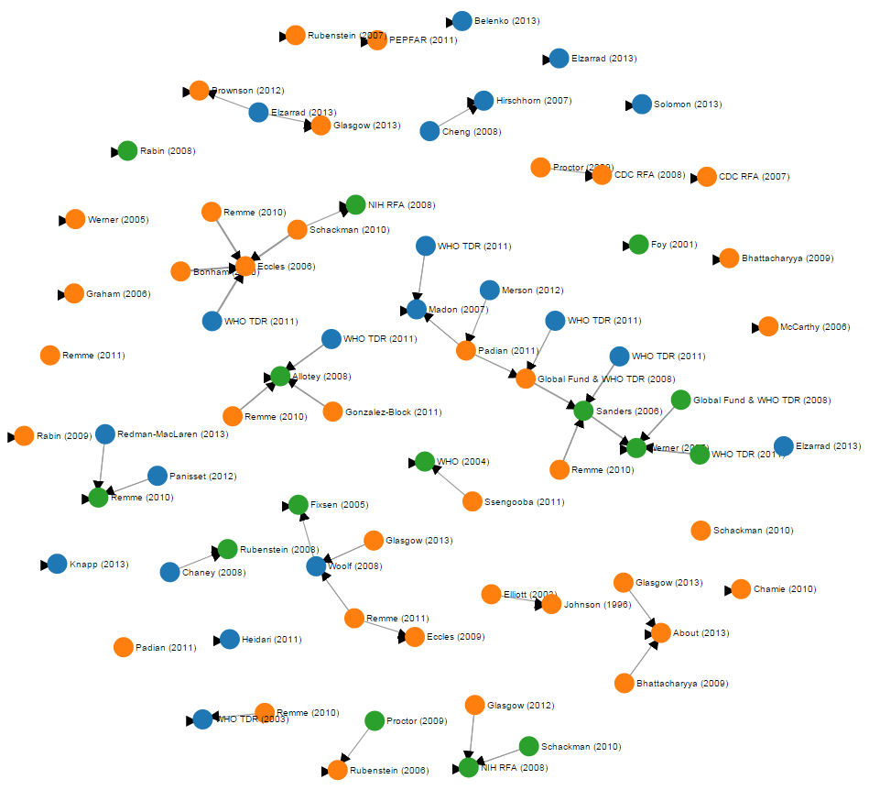
Network Map of Definitions
5 was maximum cluster size
41% definitions were index definitions that cited no other references
67% of these index definitions were not were cited by any other definition.

Slide 20
Understand the Nature of the Gap
Practiced, realized, concrete
Broad agreement that implementation science seeks to understand the gap between something theoretical (knowledge, evidence) and something practical and concrete (practice, delivery)
Theoretical
“Evidence”
“Knowledge”
“Research findings”
“Use”
“Delivery”
“Practice”
“Uptake”
GAP
Notes:
Understand nature of the gap
Generalizable
“Getting evidence into practice”
Generalizable understanding of how to do his

Slide 21
Magnitude of the Gap between Clinical Evidence and Routine Practice
Research to quantify this gap was mentioned by 14% of definitions
Sanders and Haines (PLoS Medicine) offer as an example of implementation research a study showing that full use of existing interventions could cut child deaths globally by more than 60%.

Slide 22
Understand Reasons for the Gap
Research to identify reasons for this gap was mentioned by 26% of definitions
  “…the study of the processes and variables which determine/influence the adoption of health promotion and disease prevention-related knowledge.”
                Eliot 2003 http://heb.sagepub.com/content/30/3/267.short
  “…implementation researchers focus on understanding… why health care providers do what they do….”
    Rubenstein 2006
    http://onlinelibrary.wiley.com/doi/10.1111/j.1525- 1497.2006.00364.x/full

Slide 23
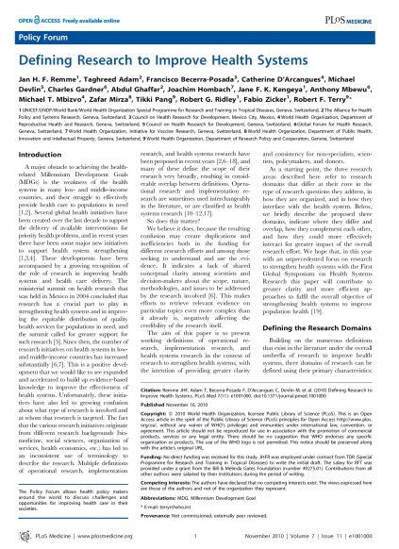
Identify Interventions to Close the Gap
Identifying interventions to close this gap was mentioned by 80% of definitions.
  Implementation science aims to “…develop strategies for available or new health interventions in order to improve access to and use of these interventions.”
            Remme, PLoS Medicine http://journals.plos.org/plosmedicine/article?id=10.1371/journal.pmed.1001000
  “Implementation research is the scientific study of methods to promote the systematic uptake of research findings and other evidence-based practices into routine practice, and, hence, to improve the quality and effectiveness of health services.”
            Eccles, Implementation Science, 2007 http://implementationscience.biomedcentral.com/articles/10.1186/1748-5908-1-1

Slide 24
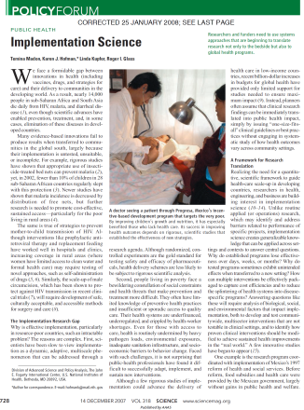

Tension between Generalizability…
Generalizable findings was an objective mentioned by 51% of definitions
  “Implementation science creates generalizable knowledge that can be applied across settings and contexts to answer central questions.”
                Madon, Science 2007
                http://science.sciencemag.org/content/318/5857/1728
  “Although related to operations research, implementation research differs in that it aims to produce generalizable knowledge that can be applied across settings and contexts”
                David Peters, World Health Organization and Health Alliance
                http://who.int/alliance-hpsr/alliancehpsr_irpguide.pdf
Notes:
51%

Slide 25
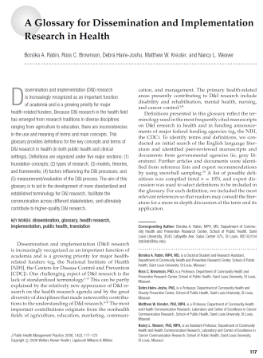
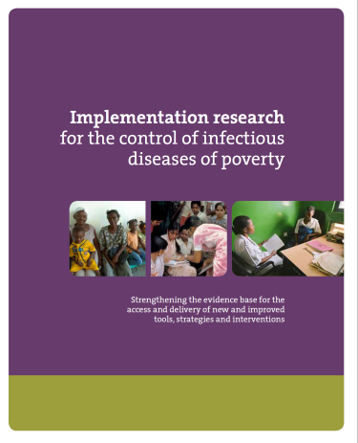
…and Adaptation
Adaptation to specific locations, populations or contexts was mentioned in 81% of definitions
  “Implementation Research …[is] concerned with the adaptation of the implemented intervention to local context.”
                Rabin 2008
                http://www.ncbi.nlm.nih.gov/pubmed/18287916
  “Implementation research does not isolate the effects from the context – rather it focuses precisely on the interaction between the intervention and the context”
                Allotey TDR 2011
                http://www.who.int/tdr/publications/documents/access_report.pdf?ua=1

Slide 26
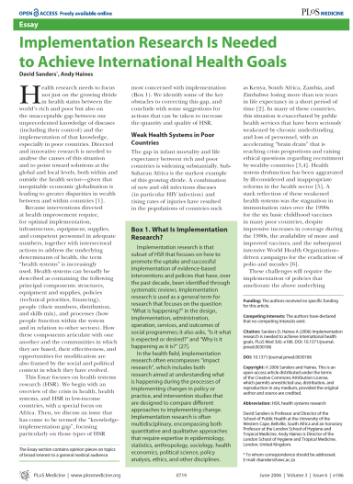
The Approach: Interdisciplinary
“Implementation research is often multidisciplinary, encompassing both quantitative and qualitative approaches that require expertise in epidemiology, statistics, anthropology, sociology, health economics, political science, policy analysis, ethics, and other disciplines
              Saunders PLoS Med
              http://journals.plos.org/plosmedicine/article/asset?id=10.1371%2Fjournal.pmed.0030186.PDF
“Implementation science is an inherently interdisciplinary research area”
              Implementation Science Journal (Editors Statement 2013)

Slide 27
Insights?
Rising number of definitions
  Emerging recognition that a bounded, named, systematic inquiry into optimization of the use of efficacious interventions is an urgent need
Poorly linked in a network map - discourse is not fully mature.
Agreement on motivating problem (i.e., closing the gap between evidence and practice),
Tension between generalizable knowledge across contexts and knowledge adapted to specific contexts
Summary of definitions is also notable for what is absent (e.g., Consolidated Framework for Implementation Research)
Synthetic definition?
  Implementation science is a multidisciplinary specialty that seeks generalizable knowledge about the behavior of stakeholders, organizations, communities, and individuals in order to understand the scale of, reasons for, and strategies to close the gap between evidence and routine practice for health in real world contexts.

Slide 28
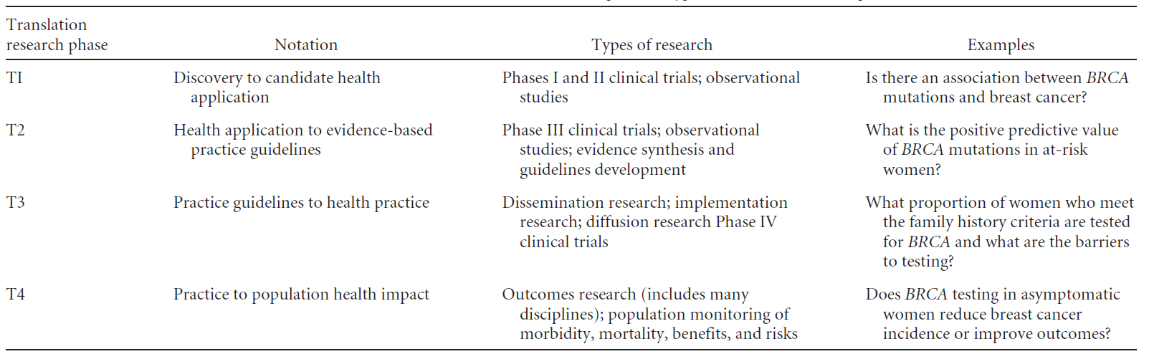
“Translational” Research: T2 and Beyond
3%
Genetics in Medicine (2007) 9, 665–674;

Slide 29
The “Four P’s” of Implementation Research
Making research relevant in real world
Pedantic
Pragmatic
Generalizable / Transportable
  Use findings in one setting to infer about effects in another?
Accumulatable
  Findings be formally (meta analysis) or informally synthesized with other research?
Implementable
  Can other people carry it out?
Impactful
  Is the intervention likely to have a big effect in diverse settings?
Internal validity
Purile
Populist
Relevance
Adapted from David Aron
Notes:
Although define the magnitude and understanding reasons is important, we focus on interventions to day.
David Aron – used a heuristic to define the kind of research that we want implementation science to be through two axes - internal validity and relevance →
Example
Pedantic – DOT
Populist – CAGs
Desirable qualities of impactful, pragmatic implementation research
Generalizable
Accumulatable
Transport
Robustly impactful
All of this enhances scale up.

Slide 30
The “Four P’s” of Implementation Research
Making real world evaluations
more rigorous
Pragmatic
Pedantic
Counterfactual without giving up real world-ness
Measure where you are not doing anything
Understanding diversity of program activities
Address flaws in real world data
Internal validity
Purile
Populist
Relevance
Adapted from David Aron

Slide 31
Candidate Interventions for ART Uptake in Africa
PEPFAR 2004 – Global enterprise to treat HIV
Doubts about success and uptake of treatment
  Adherence, retention and resistance?
  Doubts
    Distance and opportunity costs
    Health care workforce
    “African’s don’t understand time” – Andrew Natsios (BMJ 2004)
    Weak primary care infrastructure, supply chain
    Stigma
Strategies to promote use of HIV treatment?

Slide 32
Public Health Impact: REAIM
RE-AIM ELEMENT | Definition | Questions
REACH | Reach is an individual-level measure (e.g., patient or employee) of participation. | Can the practice attract large and representative percent of target population / communities?
EFFICACY | Magnitude of effect among those successfully treated | Does the practice produce large effects ?
ADOPTION | The proportion and representativeness of settings that adopt a given policy or program. | Is the practice feasible for majority of real-world settings (costs, expertise, time, resources, etc.)?
IMPLEMENTATION | The extent to which a program is delivered as intended. | Can the program be consistently implemented across program elements, different staff, time, etc.?
MAINTENANCE | Sustainability in a given governance, policy, economic and funding context | Can the settings sustain the program over time without added resources and leadership?
Glasgow AJPH 1998
Notes:
http://www.ncbi.nlm.nih.gov/pmc/articles/PMC1508772/pdf/amjph00009-0018.pdf
One way to understand impact, or generalized impact

Slide 33
Public Health Impact: REAIM
RE-AIM ELEMENT | DOT | Home based care | CAG | SMS
REACH | Low-1 | Low-medium-2 | Medium-high-4 | High-3
EFFICACY | High-5 | High-5 | Medium-high-4 | Low-2
ADOPTION | Low - 1 | Low -1 | Medium-high-4 | Medium-3
IMPLEMENTATION | Low-1 | Low-medium-2 | Medium-3 | High-5
MAINTENANCE | Low-1 | Low-1 | Medium-high-4 | High-5
Total | 9 | 11 | 19 | 19
Glasgow AJPH 1998
Notes:
Heuristic
Exercise
Highly efficacious but of little impact - DOT

Slide 34
Impactful: Testing the Right Intervention and Asking the Right Question
RCT of full service, home based care
Pragmatic RCT of
community ART groups
Observational study of community ART groups
Internal validity
Case series of DOT
Relevance
Notes:
HIV treatment to be rolled out in Africa
Bush administration the President’s Emergency Fund for AIDS Relief
3 RCT of DOT but no RCT or CAG (until now)

Slide 35
Conclusions
Implementation science
  Emerging
  Unique tensions between internal and external validity
  Interdisciplinary
Directions
  Explore different perspectives on analysis of this gap
  Identify interventions to targets
  Understand challenges of doing research in this space

