Slide 1
Meta-Analysis and Evidence-Based Medicine
Why EBM? All Were Partly Right and All Were Totally Wrong!

Slide 2
Background – How much do you know?
Who ‘invented’ meta-analysis & in what discipline?
Why is meta-analysis easier to explain to non-statisticians than ANOVA or mixed models?
How long does a meta-analysis take?
Why do we perform a meta-analysis?
What is the hierarchy of evidence?
How do I choose an outcome?
What are the different types of meta-analysis?
How do I validate my model?
What are the major issues/controversies?

Slide 3
Background – How much do you know?
Earliest use of meta-analysis was in Education by Gene Glass:
Glass, G. V (1976). Primary, secondary, and meta-analysis of research. Educational Researcher.

Slide 4
Background – How much do you know?
Analysis of Variance vs. Meta-analysis
ANOVA is used with individual patient data to understand differences between trials or subgroups within a trial. Meta-analysis is used to find the overall effect, synthesizing similar outcomes either on a study (publication) basis or using individual data.

Slide 5
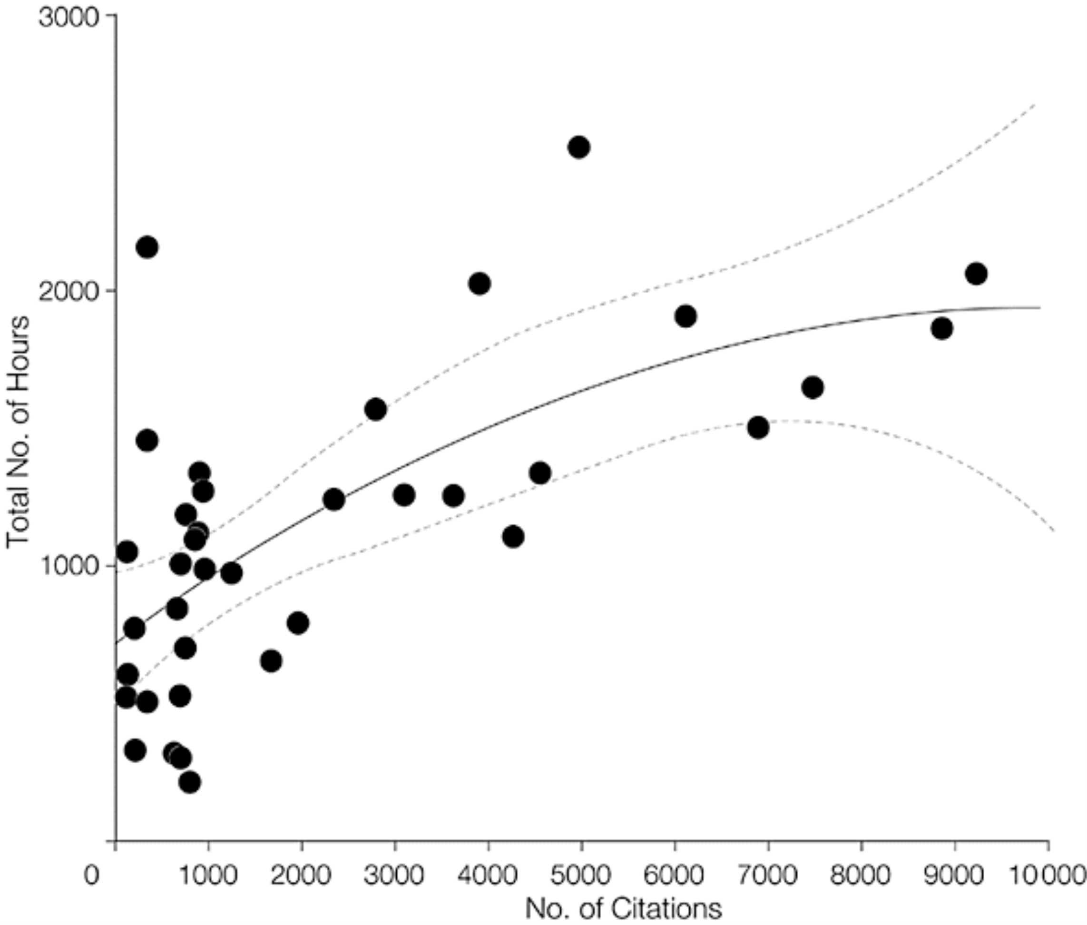
Background – How much do you know?
How long does a meta-analysis take?
Mean total number of hours = 1139 Median = 1110, Range =216 to 2518
Allen & Olkin, JAMA. 1999;282(7):634-635. doi:10-1001/pubs.JAMA-ISSN-0098-7484-282-7-jbk0818

Slide 6
Background – How much do you know?
Why do we perform a meta-analysis?
All our trials are too small
We’re applying for a new indication
We want to make a marketing claim or rebut a marketing claim from a competitor
We want to show superiority of our treatment
Concisely communicate findings/great background for grants
Identifies areas for future study

Slide 7
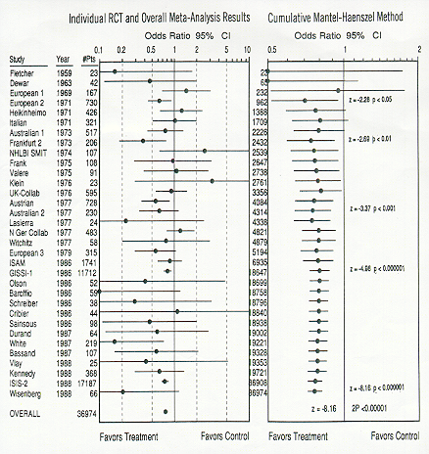
The Meta-Analysis that started EBM
Lau, Chalmers et al. NEJM 1992; 327:250
Streptokinase was finally approved by the FDA in 1988

Slide 8
Background – How much do you know?
What are the important steps?
How do you report a meta-analysis?
Do you think you can do a meta-analysis?

Slide 9
Simple Example
Subject | Credits | Grade
English | 3 | 4.0
Chemistry | 5 | 3.0
Genetics | 2 | 3.8
Subject | Credits | Grade
English | 3 | 4.0 | 12.0
Chemistry | 5 | 3.0 | 15.0
Genetics | 2 | 3.8 | 7.6
 | 10 |  | 34.6
Summary Grade = 34.6 / 10 = 3.46

Slide 10
Subject | Credits | Grade
English | 3 | 4.0 | 12
Chemistry | 5 | 3.0 | 15
Genetics | 2 | 3.8 | 7.6
 | 10 |  | 34.6
Weighted Average =

Slide 11
The basic statistical procedures are feasible and intuitive.
You can do this.

Slide 12
Hierarchy of Evidence*
1. Meta-analysis with original data
2. Randomized controlled trials with meta-analyses
3. Simple randomized control trials
4. Series with historical controls
5. Case control series
6. Computer database analysis
7. Case series with literature controls
8. Uncontrolled case series
9. Case reports, expert opinions
*Cook DJ, Guyatt GH, Laupacis A, Sackett DL, Goldberg RJ. Clinical recommendations using levels of evidence for antithrombotic agents. Chest 1995 Oct; 108(4 Suppl):227S-230S.

Slide 13
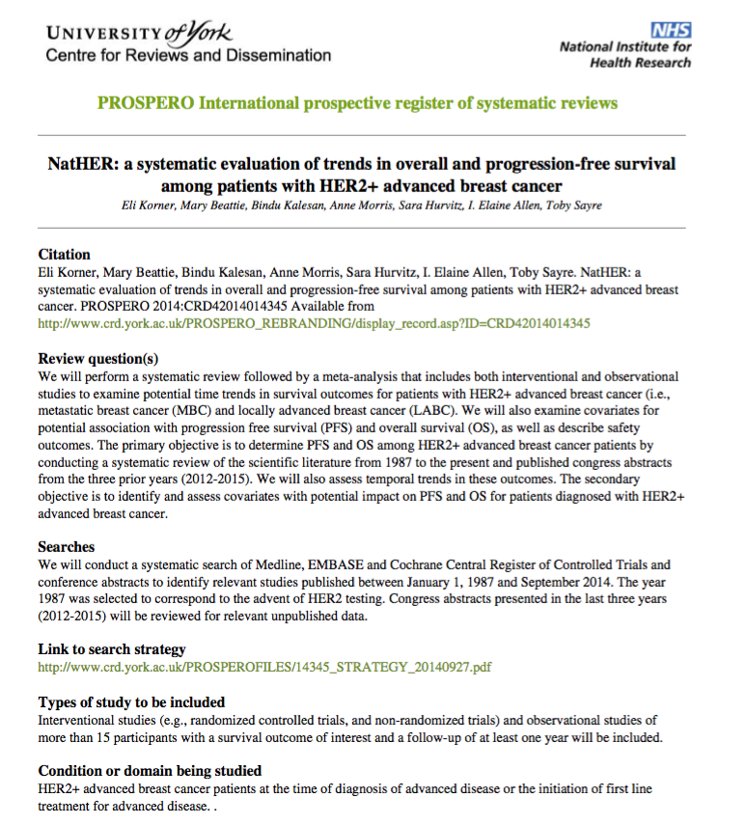
PROSPERO registration for the Herceptin Project*
*Systematic evaluation of trends in survival among patients with HER2-positive advanced breast cancer

Slide 14
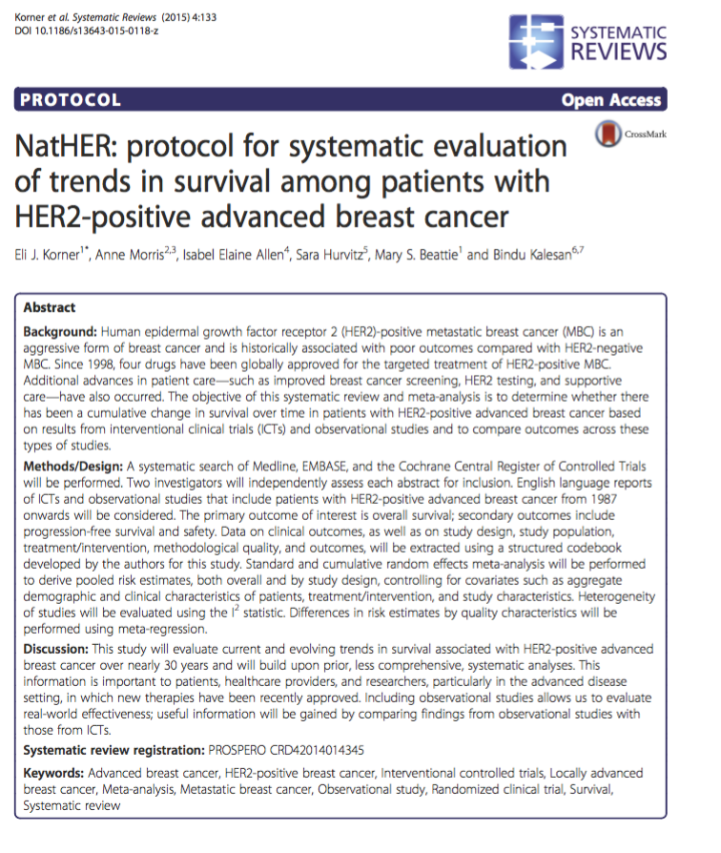
Systematic Reviews paper on the methods for the Herceptin Project*
*Systematic evaluation of trends in survival among patients with HER2-positive advanced breast cancer

Slide 15
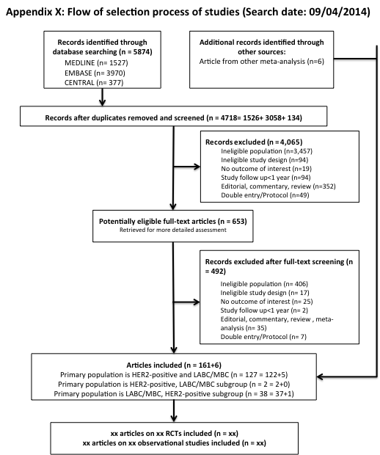
PRISMA flowchart for the Herceptin Project*
*Systematic evaluation of trends in survival among patients with HER2-positive advanced breast cancer

Slide 16
The Basics
Three questions to keep in mind:
  Is there a real effect? [level, bias, probability]
  Is the size of the effect clinically important? [quality, clinically useful difference]
  Is the evidence relevant to practice? [statistical precision]
Primary objective:
  Synthetic goal (estimation of summary effect)
    vs.
  Analytic goal (estimation of differences)

Slide 17
Principal issues in choosing an outcome measure
Communication, i.e., a straightforward and clinically useful interpretation
Consistency of the statistic across different studies
Reasonable mathematical properties

Slide 18
The Basics
Outcomes
  Discrete: Odds Ratio, Risk Ratio, Risk Difference, NNT
  Continuous: Mean Difference, Standardized Mean Difference
  Single arm trials
  Diagnostic data: Sensitivity & Specificity
  Transition Probabilities
  Adjusted/scaled/re-parametrized data
  Bayesian/Network Meta-analysis

Slide 19
Outcome
Discrete
(event)
Continuous
(measured)
Mean Standardized
Difference Mean Difference
(MD) (SMD)
Odds Relative Risk
Ratio Risk Difference
(OR) (RR) (RD)
(Basic Data)
(Basic Data)
Overall Estimate
Overall Estimate

Slide 20
Effect Measures: Discrete Data*
P1 = event rate in experimental group
P2 = event rate in control group
OR = Odds Ratio = P1/(1-P1)/[P2/(1-P2)]
RR = Relative Risk = P1/P2
RD = Risk Difference = P2 - P1
NNT = Number Needed to Treat = 1 / (P2-P1)
*or log OR or arcsin p_{t} - arcsin p_{c}

Slide 21
Why NNT is popular – Odds Ratios and NNTs in Statin vs. Placebo for Clinical Outcomes
Outcomes K OR (95% CI) NNT
All Mortality 14 0.76 (0.67, 0.86) 67
Fatal MI 14 0.61 (0.48, 0.78) 166
Fatal Stroke 10 0.77 (0.57, 1.04) 500
Non-Fatal MI 13 0.66 (0.57, 0.77) 43
Non-Fatal Stroke 7 0.69 (0.54, 0.88) 143
Angina 12 0.70 (0.65, 0.76) 24
K = # of studies
Ross, Allen et al. Arch Intern Med. 1999;159:1793-1802

Slide 22
When to Use OR / RR / RD
OR vs. RR
OR ≈ RR if event occurs infrequently
OR > RR if event occurs frequently
RD vs. RR
When interpretation in terms of absolute difference is better than in relative terms (e.g., Interest in absolute reduction in adverse events)
Statistically - the variance of the RD is not defined and must be approximated

Slide 23
What’s wrong with Odds Ratios?
ORs are difficult to deal with and explain in clinical terms.
ORs may differ from relative risk ratios (RRRs) and ORs may overestimate risks.
It is difficult to move from ORs to number needed to treat (NNTs) or to patient event risk ratios (PEERs).
Sackett, D. in Evidence-Based Medicine, September/October, 1996.

Slide 24
Effect Measures: Continuous Data
Number Mean Standard Deviation
Experimental n_{e} s_{e}
Control n_{c} X_{c} s_{c}
-
X_{e}
-
-
-
X_{e}
X_{c}
Effect size = MD = - or
Effect size = SMD = ( - )/S,
where S² is the pooled variance estimate from the two treatment groups
-
-
X_{e}
X_{c}

Slide 25
Continuous Effect Measures*
Means are most appropriate when
  all unit increases in the outcome are equivalent
  distributions are symmetric
  assumes an underlying Normal distribution
Data required for experimental and control groups
  mean
  standard deviation (SD) or p-value
  standard error (SE) and sample size (N)
Standardizing effect measures to the same metric can also be useful
*Also correlation coefficients but they have limited power in analyses

Slide 26
The Basics
Models
  Fixed Effects Models
  Random Effects Models
  Survival Data
  Single Arm Trials
  Diagnostic Studies - ROC Curves
  Network Meta-Analyses & Indirect Effects
  Markov Transition Models
  NOT Vote Counting
  NOT synthesis of p-values

Slide 27
Fixed-effects model
Random-effects model
Fixed-effects meta-analysis assumes that the intervention has a single true effect.
Random-effects meta-analysis assumes that the effect of the intervention varies across studies.

Slide 28
Fixed-effects model
Random-effects model
OR
Which should I choose?
  Good news – most software produces both
  Both theoretical and practical reasons for choosing
    Generalizability
      What is the focus of this meta-analysis?
      Can I assume this is the whole population?
    Heterogeneity
      How different are these studies?

Slide 29
Random-Effects Model
Assume true effect estimates really vary across studies
Two sources of variation:
  within studies (between patients)
  between studies (heterogeneity)
What the software does:
  revises weights to take into account both components of variation:
Weight =
When heterogeneity exists we get
  a different pooled estimate (but maybe not) a different interpretation
  a wider confidence interval
  a larger p-value
1
Variance + heterogeneity

Slide 30
Simple Dataset (Wang, et al 2016)
STATA code:
gen AB_no_pass = AB_sample - AB_passed
gen placebo_no_pass = placeob_sample - placebo_passed
metan AB_passed AB_no_pass placebo_passed placebo_no_pass, rr lcols(Author Year Stone_Size) random

Slide 32
Validation: You have your results, everything looks promising…what now?
Sensitivity analyses & validation!
Yes, fitting the model is just the tip of the iceberg

Slide 33
Heterogeneity is your friend!
  Clinical diversity
  Methodological diversity
  Statistical heterogeneity
    I² Statistics or Cochran’s Q
    Bias testing or adjustment
    Study sponsorship adjustment
    Meta-regression
    Individual or grouped Jackknife
    Subgroup analyses
    Funnel plots
    NNT
    Fail safe number

Slide 34
Sources of Heterogeneity
Differences in design (patient selection or treatment schedule)
Heterogeneity at study level (patient mix or quality of the trial)
Heterogeneity at the patient level (prognostic factors)
Heterogeneity of outcomes (chance results)
…it is common in meta-analysis, get used to it.
Remember the mantra….

Slide 35


Do you want Apples & Oranges or Fruit Salad?
OR

Slide 36
How to Handle Heterogeneity & Bias
Fixed effects model can measure it
Random effects model controls for it (but does not explain it)
Always test for it (Cochran’s Q & I²), Begg’s & Egger’s tests
Stratify and explore reasons for it (Jackknife, funnel)
Regress important covariates to examine their effect
Don’t omit outlier studies
Use the information to design better studies

Slide 37
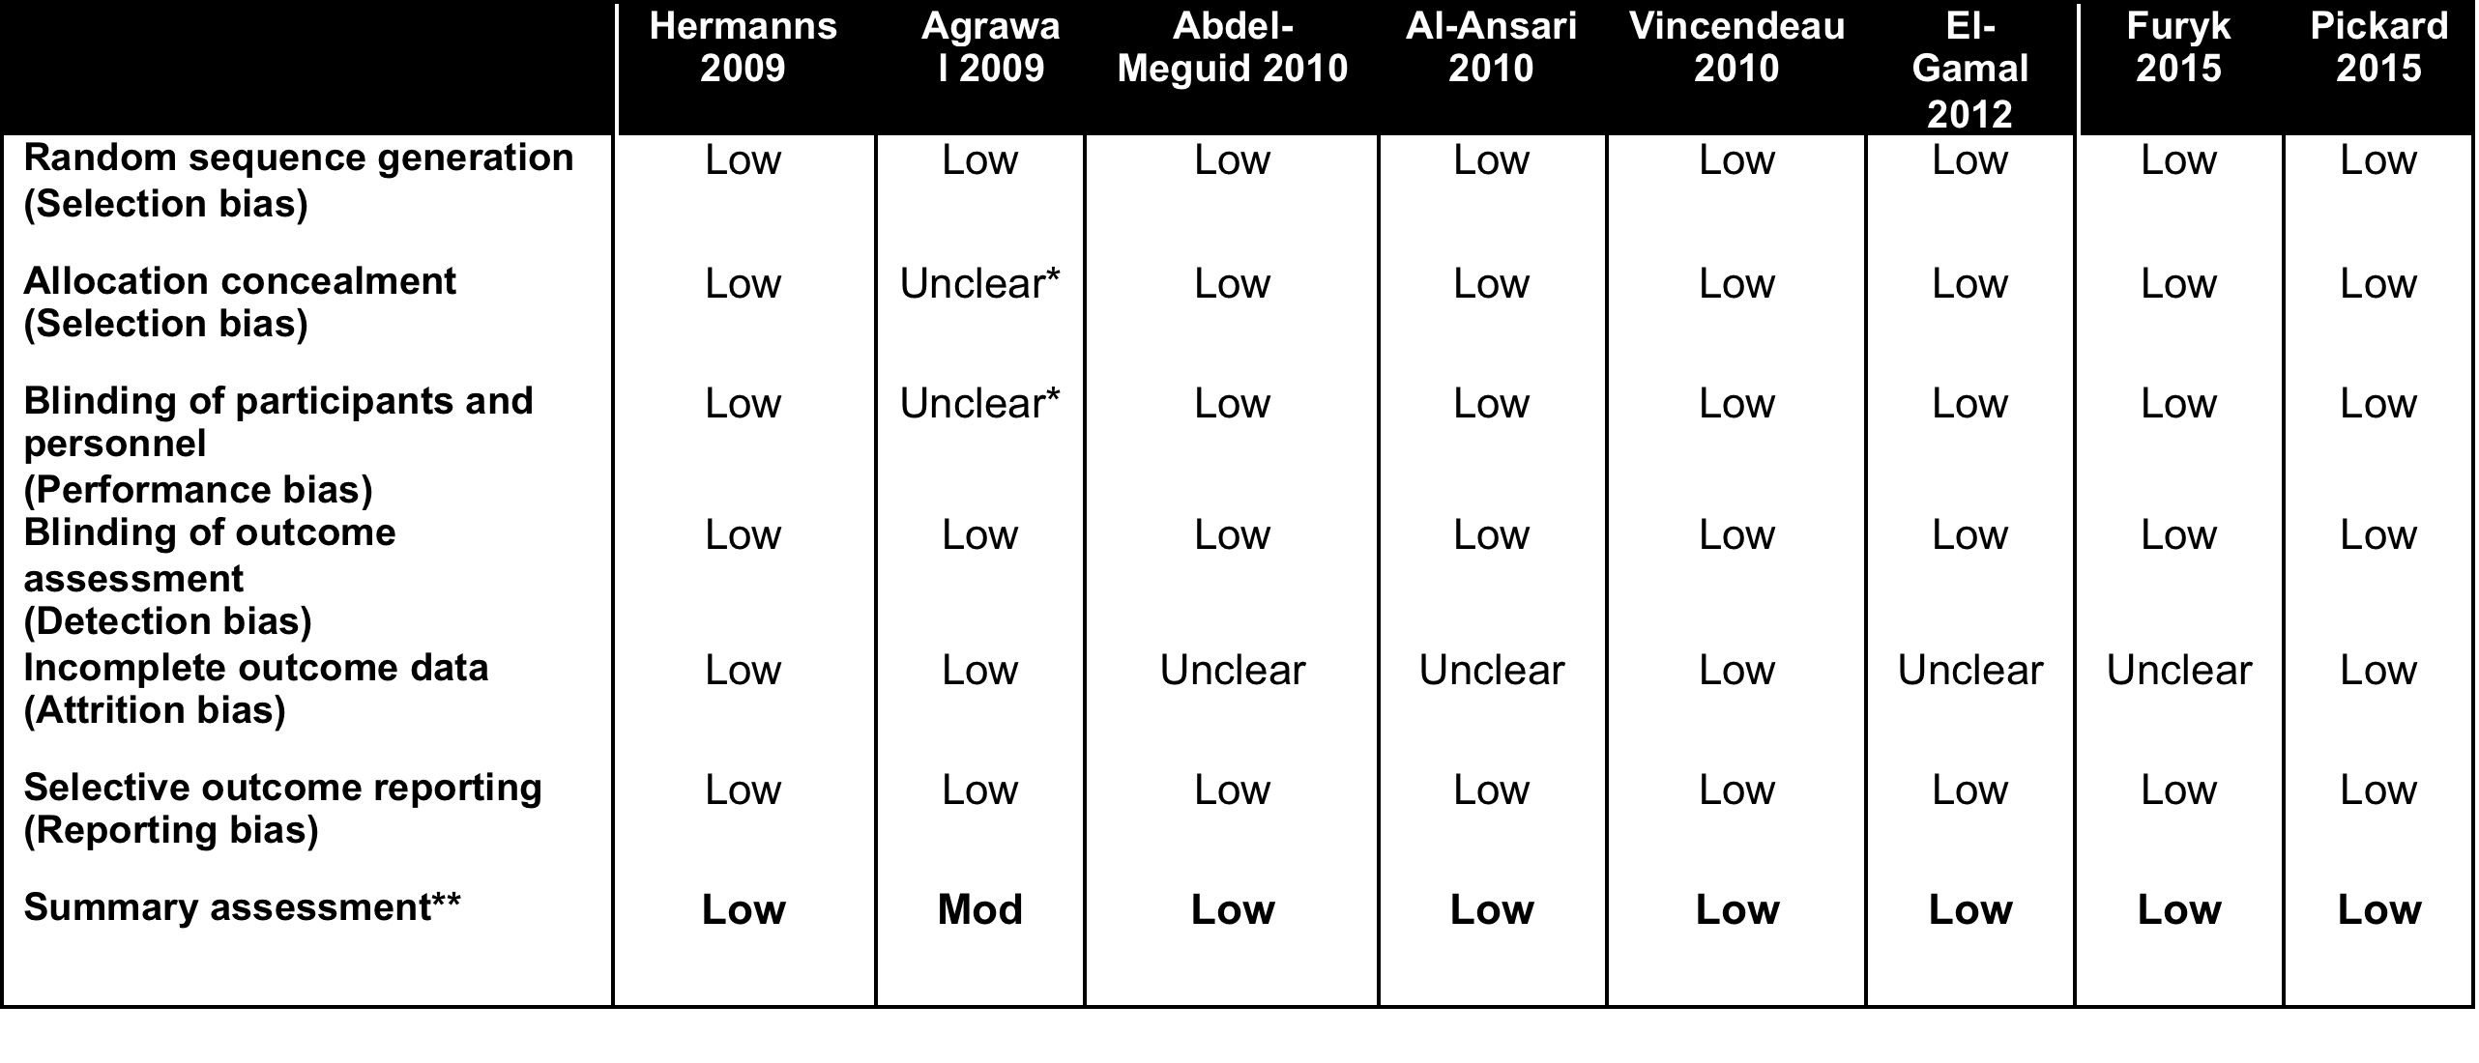
Wang: Risk of Bias Assessment

Slide 38
Example of a Funnel Plot
Log(Sample Size)
Log(Effect Size)

Slide 39
Back to Ralph’s data: Test for bias: Begg’s or Egger’s tests & funnel plot
STATA CODE:
metabias logrr _selogES, begg
metabias logrr _selogES, egger
metafunnel logrr _selogES, xtitle(Log Relative Risk) ytitle(Standard error of Log Relative Risk) xlab(0.01 0.1 1) xscale(log)

Slide 40
Back to Ralph’s data: Test for bias: Begg’s or Egger’s tests, funnel plot

Slide 41
Meta-Regression
Subgroup analyses
Examining the control rate
Identification of important covariates
Control for baseline differences
Control for quality score or sponsorship
Caveat: Need sufficient studies to use this

Slide 42
STATA CODE:
metareg logrr Stone_Size, wsse(_selogES) ef

Slide 43
Guidelines for Reporting Meta-Analyses and Critiquing Studies for Inclusion in your Analyses
http://www.consort-statement.org/ - reporting guidelines for reporting RCT’s
http://www.prisma-statement.org/ - reporting guidelines for meta-analyses
http://www.emgo.nl/kc/analysis/statement/quorum%20review%20lancet%201991.pdf – reporting guidelines for meta-analyses of RCT’s
http://www.stard-statement.org/ - reporting guidelines for diagnostic studies
http://www.emgo.nl/kc/analysis/statements/MOOSE.pdf - reporting guidelines for meta-analyses of observation studies in Epidemiology

Slide 44
Look Fred, This seems to be the
same thing…SUMMARIZED

Slide 45
My Favorite Meta-analyses
Meta-analysis and the law
Unique Applications
Future Directions – the advanced class in 2 weeks

Slide 46
Using Meta-Analysis as a Primary Evidence Tool*
Aredia – Zometa Deutsch v. Novartis Pharm. (E.D.N.Y. 2011)
Avandia In re Avandia Marketing (E.D. Pa. 2011)
Baycol In re Baycol Prods. (D. Minn. 2007)
Benzodiazepine Vinitski v. Adler, (PhilaCt. Common Pleas 2004)
Celebrex – Bextra In re Bextra & Celebrex Marketing (2007)
E5 (anti-endotoxin monoclonal antibody for sepsis) (1996)
Fenfluramine, Phentermine In re Diet Drugs Prod. (E.D.Pa. 2000)
Fosamax In re Fosamax Prods. Liab. Litig., (S.D.N.Y. 2009)
Gadolinium In re Gadolinium-Based Contrast Agents (N.D. Ohio 2010)
Hydroxycut In Bechler v. MuscleTech (2003 & 2006)
Neurontin In re Neurontin Marketing, Sales Practices (D. Mass. 2009)
Paxil (SSRI) In Tucker v. Smithkline Beecham Corp (S.D.Ind. 2010)
Procrit In Amgen v. OrthoBiotech (2009)
Prozac (SSRI) In Rimberg v. Eli Lilly & Co. (2009)
(RIAA) In A&M Records, Inc. v. Napster, Inc., 239 F.3d 1004 (2001, 2007)
Seroquel In re Seroquel Products Liab. (M.D. Fla. 2009)
Thimerosal – Vaccine Salmond v. Sec’y Dep’t of HHS, (Fed.Cl. 1999)
Trasylol In re Trasylol Prods. Liab. Litig.,(S.D. Fla. 2010)
Ultra Dawn In Proctor & Gamble class action suit (2002)
Vioxx Merck & Co v. Ernst, (Tex. Ct. App. 2009) (Tex. 2011)
X-Ray Contrast Media Bracco v. Amersham (D.N.J. 2009, 2012, 2014)
Zoloft (SSRI) Miller v. Pfizer, Inc.,(10th Cir. 2004)
Zymar Senju Pharmaceutical Co. Ltd. v. Apotex Inc. (D.Del. 2011)
Zyprexa In re Zyprexa Products Liab. (E.D.N.Y. 2007)
*Cases I worked on

Slide 47
Does Ultra Dawn Live Up to Its Name?
Consumer Reports that Ultra Dawn may not be a ‘significant’ improvement over regular Dawn
  CR policy is that it does not release its experimental results or design or the tests it performs
  What does ‘significant’ mean?
Law firm in California files a class action suit to reimburse users of Ultra Dawn for the difference in price
Proctor & Gamble law firm hires MetaWorks to reproduce P&G’s analysis and also produce a meta-analysis of all the (internal) trials comparing Ultra Dawn to regular Dawn
Exhaustive internal protocol of analyses but only select pertinent information given to Ingram Olkin from Stanford, who will testify for P&G

Slide 48
Overall Summary Provided to Ingram & to P&G
All the experiments carried out by Procter & Gamble comparing Ultra Dawn to Standard Dawn were reviewed. The test procedures and statistical methodologies used to establish the superiority of Ultra Dawn vs. Standard Dawn were statistically rigorous.
All the statistical analyses were replicated with increase in fat dissolved as the primary outcome.
Meta-analyses performed of the experiments conducted by Procter & Gamble comparing Ultra Dawn with Standard Dawn.
Meta-analysis showed the superiority of Ultra Dawn vs. Standard Dawn.
Effect Size 95% Confidence Interval Significance Level
0.85& [0.65 to 1.06] p < 0.001
What type of meta-analysis model is appropriate? What was the outcome of the lawsuit?
*Ultra Dawn **Regular Dawn &in favor of Ultra Dawn

Slide 49
Safety of Ephedrine Weight Loss Supplements
Class action suits after deaths linked to ephedrine and FDA issuing new regulations for the supplement
Objective: Quantify selected efficacy and safety outcomes of Hydroxycut™ when used as indicated as a dietary supplement, with or without caloric restriction and exercise, in overweight healthy adults
  Efficacy in Weight Loss
  Safety in no excessive increase in BP or pulse
Hydroxycut was marketed by MuscleTech, a Canadian company, for several years, and was tested for selected efficacy and safety outcomes in 6 randomized controlled trials (RCTs) sponsored by MuscleTech since 1999
What meta-analysis model is appropriate here?

Slide 50
Modest Weight Loss Overall - (at 8 weeks or LOCF)

Slide 51
Safety Analyses
 | k | n | Baseline |  | 8 Weeks |  | Effect size for MD (95%CI) |  | MD (95% CI)*
 |  |  | Control | Intervention | Control | Intervention
Average SBP (mmHg)
LOCF | 6 | 150 | 122.1 | 122.1 | 120.2 | 121.8 | 0.90 (-.35, 2.15) p = 0.156 |  | -1.95 (-5.05, 1.14)
Completers | 6 | 124 | 122.7 | 122.5 | 119.2 | 122.5 | -0.15 (-1.66, 1.36) p = 0.845 |  | -3.07 (-6.71, 0.57)
Average DBP (mmHg)
LOCF | 6 | 150 | 78.5 | 77.8 | 75.6 | 75.7 | 0.75 (-1.01, 2.25) p = 0.400 |  | -0.53 (-3.65, 2.58)
Completers | 6 | 124 | 74.9 | 76.8 | 74.9 | 76.7 | 1.46 (-0.26, 3.18) p = 0.097 |  | -1.28 (-4.97, 1.06)
Average Pulse (bpm)
LOCF | 5 | 132 | 77.6 | 76.5 | 74.1 | 76.0 | 0.11 (-1.32, 1.55) p=0.880 |  | -2.21 (-5.76, 1.34)
Completers | 5 | 107 | 77.3 | 77 | 73.7 | 76.0 | 0.46 (-0.14, 1.06) p=0.129 |  | -3.13 (-6.97, 1.34)
k = number of studies
n = total number of subjects in group
SBP = systolic blood pressure
DBP = diastolic blood pressure
mmHg = millimeters of mercury
bpm = beats per minute
LOCF = last observation carried forward (includes all subjects who started for whom any follow-up data were available)
Completers = only subjects completing at least 8 weeks on study
MD = mean difference
CI = confidence interval
* Mean difference of test change - control change (kg)
FDA & Trial Outcomes?

Slide 52
Clinical Trial Feasibility: Asthma
Question: Will a planned multicenter phase 4 trial ($10 million estimate) succeed in proving that drug P is better than drug Z?
EBMI tool: Meta-analysis of all sponsor’s trials of drug P vs. SBA drug Z.

Slide 53
Drug P or Z Vs. Placebo: All Outcomes
#Study/
Outcome Treatment Arms #Pts
FEV 1 Z₁ 3 1042
FEV 1 P₁ 4 805
AM PEFR Z 3 1042
AM PEFR P₁ 4 805
PM PEFR Z₁ 3 1042
PM PEFR P₁ 4 2805
β agonist Z 3 1042
β agonist P₁ 4 805
Odds Ratio and 95% C.I.
-6
-4
-2
0
2
4
6
Favors Placebo
Favors Treatment
Random Effects Model
Notes:
7

Slide 54
Sample Size:
Estimated Clinical Trial Sample Size
Outcome A B Required Sample Size
per Group**
FEV1
Overall 0.069 0.068 27,000
Recommended Dose* 0.066 0.077 7,000
Morning PEFR
Overall 0.054 0.062 1,700
Recommended Dose* 0.053 0.055 10,500
Evening PEFR
Overall 0.051 0.039 3,700
Recommended Dose* 0.051 0.036 2,500
Beta-Agonist Use
Overall 0.299 0.245 2,000
Recommended Dose* 0.321 0.250 2,300
** α = 0.05, 1-β = 0.80
Notes:
11

Slide 55
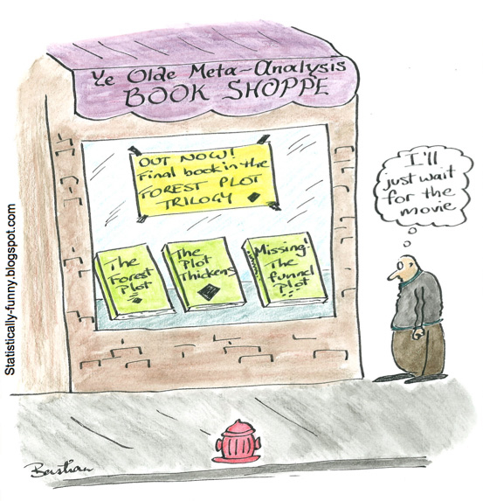
Thank you.
Any Questions?
https://www.youtube.com/watch?v=QUW0Q8tXVUc

