Slide 1
Analyses with Clustered Data and Lifecourse Models

Slide 2
Outline
Sources of clustering
Conceptual questions about clustered data
Consequences of ignoring clustering
Basic mixed model for clustered data without ordering
Growth curves with mixed models
Lifecourse timing

Slide 3
Incorrect SEs and Loss of efficiency
  Ignoring clustered data generally leads to SEs that are too small
    Variance of estimate of mean value of Y=variance of Y/N
    But in clustered data effective N<actual N
  Same problem if you draw a clustered sample, people within a cluster are not independent and you do not learn as much new information from each person.
    You must correct your standard errors for this phenomenon.
    You must anticipate this correction in study design and inflate the sample you need.
    The ratio of the clustered sample size needed to the simple random sample size is the design effect.
  How does clustering affect the sample size you must draw, compared to a simple random sample?
  Conversely, how much does ignoring clustering affect your SEs?

Slide 4
Variance “cost” of clustering a function of rho/ICC and # of people/cluster
Rho = a measure of homogeneity that behaves like a correlation coefficient. It is the correlation between all possible pairs of elements within a cluster on a particular characteristic (Sudman, 1976)
ICC=rho= s²_{between-cluster}/(s²_{between-cluster} + s²_{within-cluster})
Rho of 1 indicates extreme homogeneity (e.g., household income of all of 6 children in one household).
Rho of -1 indicates extreme heterogeneity (e.g., gender w/in a 2 person heterosexual household cluster).
Small Rho of 0.05 or less common for many characteristics in neighborhoods and schools
If you cluster randomize, everyone in the cluster has the same value of the random assignment variable, so rho for that variable is 1.

Slide 5
Calculation of rho/ICC
Denominator=total variance
Numerator=variance of mean at the cluster level
Can ask about conditional or unconditional ICC
Dubowitz, et al Am J Clin nutr

Slide 6
Approximate design effect formula for estimation of the mean
DE = s²_{cluster}/s²_{SRS} = 1 + rho_{X}(m_{avg}- 1)
DE = the ratio of the variance from a clustered sample
design to the variance of a SRS of the same size
m_{avg} = average number of units drawn from a cluster
s² = V= sample variance of the parameter estimate
  Works if clusters are about the same size.
  Assumes a small proportion of all possible clusters have been sampled.
Increases if rho goes up.
Increases if m goes up.
What if m=1? (i.e., 1 person in a cluster)
What if rho=1? (i.e., everyone in cluster identical)
Notes:
This is the design effect for estimating the population mean

Slide 7
3 Situations
Substantive question is level 2 exposure (greenspace)
Substantive question is level 1 exposure, level 1 exposure is not clustered (male)
Substantive question is level 1 exposure, level 1 exposure is clustered (BMI)
set obs 200
gen nbhd=_n
gen greenspace=uniform()>.3
gen U_nbd=uniform()>.5
expand 25
sort nbhd
by nbhd: gen id=_n
gen male=uniform()<.4
gen BMI=invnorm(uniform())+1*U_nbd * this induces clustering and confounding
gen U_ind=uniform()<.5
gen sbp=.3*greenspace+1*U_nbd+.2*male+.2*BMI+.1*U_ind+invnorm(uniform())

Slide 8
3 Situations
Substantive question is level 2 exposure (greenspace)
Substantive question is level 1 exposure, level 1 exposure is not clustered (male)
Substantive question is level 1 exposure, level 1 exposure is clustered (BMI)
set obs 200
gen nbhd=_n
gen greenspace=uniform()>.3
gen U_nbd=uniform()>.5
expand 25
sort nbhd
by nbhd: gen id=_n
gen male=uniform()<.4
gen BMI=invnorm(uniform())+1*U_nbd * this induces clustering and confounding
gen U_ind=uniform()<.5
gen sbp=.3*greenspace+1*U_nbd+.2*male+.2*BMI+.1*U_ind+invnorm(uniform())

Slide 9
3 Situations

Slide 10
3 Situations

Slide 11
3 Situations
In naïve model:
Underestimated SEs for neighborhood characteristic (you do not have 5000 independent observations).
Biased estimate for BMI (nbhd confounding)
Overestimated SEs for unclustered individual level characteristic, male (conditioning out neighborhood predictors of SBP reduces unexplained variance)

Slide 12
3 Situations

Slide 13
Inefficient estimators
Alternatives to mixed models or GEE
  Do men average higher SBP than women?
    Take the average value of SBP for each person over all repeated measures
    Treat as a single outcome measure and regress on sex
    Choose one observation and use that
  Do residents of neighborhoods with greenspace average lower SBP?
    Average SBP for all individuals in each neighborhood
    Treat n=# of neighborhoods
    Inefficient with unbalanced data

Slide 14
GEE uses most efficient weighting of correlated observations
The optimal weights for combining the responses of individuals from clusters of size k are: 1/(1+(k-1)*R), where R=correlation of pairs of observations from the same cluster
i.e., Downweight individuals from large clusters, in proportion to the intracluster correlation.

Slide 15
Wide vs Tall Data sets
Wide
id X_time1 X_time2 X_time3
1 27 32 45
2 18 17 20
3 41 44 46
Tall
id time X
1 1 27 1 2 32
1 3 45
2 1 18 2 2 17 2 3 20
3 1 41 3 2 44 3 3 46

Slide 16
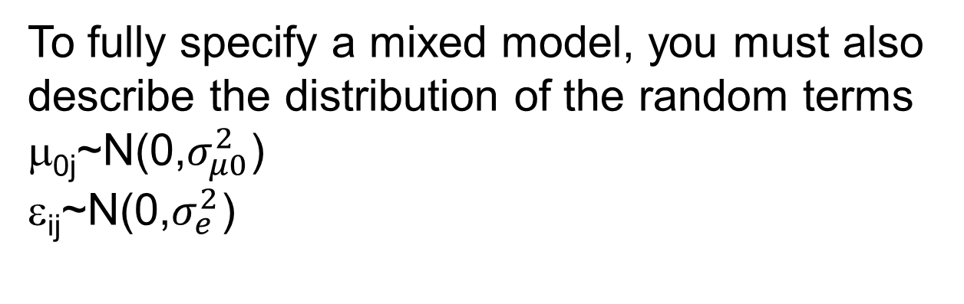
Basic mixed model for clustered data without ordering
Two level random intercepts model for person i in place j:
To fully specify a mixed model, you must also describe the distribution of the random terms
μ_{0j}~N(0,$σ_{μ0}^{2}$)
ε_{ij}~N(0,$σ_{e}^{2}$)

Slide 17
Random slopes model
Two level random slopes model (implicitly, assume you have a random intercept as well):

Slide 18
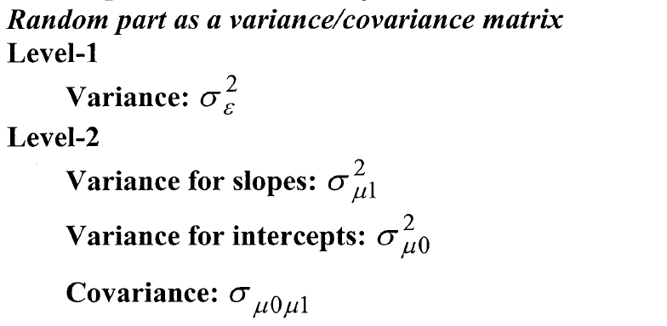
Random slopes model

Slide 19
When the unit of clustering is a person
We are usually interested in determinants of within person change, thus the descriptor “growth curves”
Typically motivated by specifying change term using a time dimension (conceptually, age) and examining interactions with the time term
Can be a time-constant modifier: Sex*age
Or a time-varying modifier: depressive symptoms*age

Slide 20
Questions potentially of interest: repeated measures of a person
Growth curve models are specified as interactions between time and (usually) a person-level variable (sometimes time-varying variable)
Person level exposure → time-specific outcome
  Does SBP change more quickly for men than for women: measure sex at person level and time at the occasion level.
  Addresses whether sex of the person modifies the rate of change over time.
  Major challenge is choosing the time dimension: age vs time from enrollment vs time from some other milestone (e.g., death, diagnosis)

Slide 21
Classic growth curve: Willis et al Pmed S2: trajectories of SBP
SBP_{ij}= β₀ + μ_{0i} + (β₁ + μ_{1i}) age_{ij} + (β₂ + μ_{2i}) age²_{ij} + (β₃ + μ_{3i}) age³_{ij} + ε_{ij}
Where SBP_{ij} is the systolic blood pressure for individual i at observation time j.
β₀ and β₁ are the fixed intercept and slope, μ_{0i} to μ_{3i} are the random intercept and slope coefficients for each individual i, and ε_{ij} is the residual error term for individual i, at time j.
Covariance between the random coefficients was allowed . Age was centred at the baseline age in each cohort .

Slide 22
Classic growth curve: Willis et al Pmed S2: trajectories of SBP
SBP_{ij}= β₀ + μ_{0i} + (β₁ + μ_{1i}) age_{ij} + (β₂ + μ_{2i}) age²_{ij} + (β₃ + μ_{3i}) age³_{ij}
+ γ₁ zBMI_{ij} + γ₂ (age_{ij} zBMI_{ij}) + γ₃ (age²_{ij} zBMI_{ij}) + δ₁ zbHT_{i}
+ δ₂ (zbHT_{i} age_{ij}) + δ₃ (zbHT_{i} age²_{ij}) + δ₄ (zbHT_{i} age³_{ij})+ ε_{ij}
zBMI_{ij} is the BMI z-score externally referenced to the UK 1990 sex and age-specific growth charts for subject i at observation time j.
γ₁ represents the cross sectional association between BMI and SBP
γ₂ and γ₃ allow the association between current BMI and SBP to vary by chronological age.
zbHT_{i} represents the height z-score at baseline referenced to the UK 1990 sex and age-specific growth charts for subject i.
δ_{1,} δ₂ and δ₃ thus allow baseline height to affect the SBP intercept and slope.
Non significant γ’s and δ’s were removed from the final model.

Slide 23
What’s the best time dimension?
Age is conceptually natural (?)
  But using age as the time-dimension conflates between person differences and within person changes
  For studies of old people, cohort effects can bias age-based growth curves
  Especially problematic if exposure of interest is highly correlated with age
Using “time from baseline” and adjusting for baseline age eliminates cohort problems, but introduces potential period and practice effect problems
Best practice: estimate separately (baseline age + time from baseline) and understand why they diverge (Fitzmaurice, Laird, and Ware, pg 420)

Slide 24
It’s possible to estimate an age slope with cross-sectional data
Age | Y_born 1930 | Y_born 1940 | Y_born 1950 | Y_born 1960
30 | 100 | 100 | 100 | 100
40 | 90 | 90 | 90 | 90
50 | 80 | 80 | 80 | 80
60 | 70 | 70 | 70 | 70
70 | 60 | 60 | 60 | 60
80 | 50 | 50 | 50 | 50

Slide 25
It’s possible to estimate an age slope with cross-sectional data
Age | Y_born 1930 | Y_born 1940 | Y_born 1950 | Y_born 1960
30
40
50 |  |  |  | 80
60 |  |  | 70
70 |  | 60
80 | 50
Age

Slide 26
But the XS data conflates age, period , and cohort differences
Age | Y_born 1930 | Y_born 1940 | Y_born 1950 | Y_born 1960
30 | 100 | 110 | 120 | 130
40 | 90 | 100 | 110 | 120
50 | 80 | 90 | 100 | 110
60 | 70 | 80 | 90 | 100
70 | 60 | 70 | 80 | 90
80 | 50 | 60 | 70 | 80
Imagine a large cohort effect (10 points higher for every decade later birth), but identical age slopes
Regressing Y on age in a cross-sectional data set leads to a flattened age slope
Age

Slide 27
But the XS data conflates age, period , and cohort differences
Age | Y_born 1930 | Y_born 1940 | Y_born 1950 | Y_born 1960
30 | 100 | 110 | 120 | 130
40 | 90 | 100 | 110 | 120
50 | 80 | 90 | 100 | 110
60 | 70 | 80 | 90 | 100
70 | 60 | 70 | 80 | 90
80 | 50 | 60 | 70 | 80
Imagine a large cohort effect, but identical age slopes
Regressing Y on age in a cross-sectional data set leads to a flattened age slope

Slide 28
But the XS data conflates age, period , and cohort differences
Age | Y_born 1930 | Y_born 1940 | Y_born 1950 | Y_born 1960
30 | 100 | 101 | 102 | 103
40 | 110 | 91 | 92 | 93
50 | 80 | 101 | 82 | 83
60 | 70 | 71 | 92 | 73
70 | 60 | 61 | 62 | 83
80 | 50 | 51 | 52 | 53
Imagine almost no cohort effects, but large period effect (added 20 points in 1970)
Fitting a straight line to age in a single birth cohort will lead to a much flatter age-slope estimate

Slide 29
But the XS data conflates age, period , and cohort differences
Age | Y_born 1930 | Y_born 1940 | Y_born 1950 | Y_born 1960
30 | 100 | 101 | 102 | 103
40 | 110 | 91 | 92 | 93
50 | 80 | 101 | 82 | 83
60 | 70 | 71 | 92 | 73
70 | 60 | 61 | 62 | 83
80 | 50 | 51 | 52 | 53
Imagine almost no cohort effects, but large period effect (added 20 points in 1970)
Fitting a straight line to age in a single birth cohort will lead to a much flatter age-slope estimate- XS data could actually get the right estimate

Slide 30
What’s the best time dimension?
Best practice: estimate separately (baseline age + time from baseline) and understand why they diverge
    (Fitzmaurice, Laird, and Ware, pg 420)
Y_{ij}=β₀₀+β₁*age_base+β₂*(age_now - age_base)+μ_{i}+ε_{ij}
β₁ ~=β₂ ? If so, then okay to use:
Y_{ij}=β₀₀+β₁*age_now+ μ_{i}+ ε_{ij}
If not, why?
Can examine practice, period, etc, e.g., :
Y_{ij}=β₀₀+β₁*age_base+β₂*(age_now - age_base)+β₃*(1st wave)+μ_{i}+ε_{ij}

Slide 31
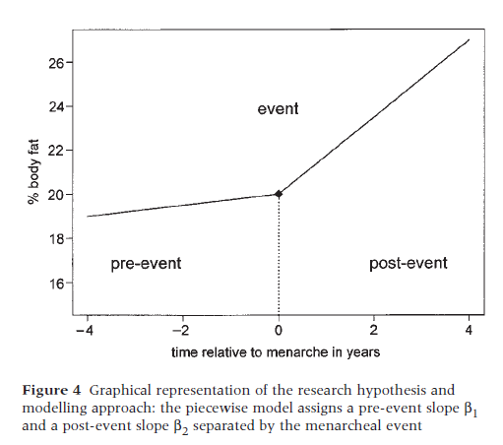
Alternative time dimensions
Choose a time-dimension:
Age
Time before or after a major event
Secular time
Specify a model with time as a linear predictor
How does body fat change per year of age?
Add a factor that modifies the rate of change with time
Is the rate of change different before (δ=1) or after (δ=0) menarche?

Slide 32

First the model for before menarche (δ=1)
Choose a time-dimension:
Age
Time before or after a major event
Secular time
Specify a model with time as a linear predictor
How does body fat change per year of age?
Add a factor that modifies the rate of change with time
Is the rate of change different before (δ=1) or after (δ=0) menarche?

Slide 33

Then the model for after menarche (δ=0)
Choose a time-dimension:
Age
Time before or after a major event
Secular time
Specify a model with time as a linear predictor
How does body fat change per year of age?
Add a factor that modifies the rate of change with time
Is the rate of change different before (δ=1) or after (δ=0) menarche?

Slide 34

Then the combined model
Choose a time-dimension:
Age
Time before or after a major event
Secular time
Specify a model with time as a linear predictor
How does body fat change per year of age?
Add a factor that modifies the rate of change with time
Is the rate of change different before (δ=1) or after (δ=0) menarche?

Slide 35
Provides a flexible test of multiple questions
Does rate of change differ before or after menarche?
Does rate of change differ after menarche depend on parental obesity (v_{i})?
Y_{ij}=β₀+β₁t_{ij}δ_{ij}+β₂t_{ij}(1-δ_{ij})+β₃v_{i}+ β₄t_{ij}(1-δ_{ij})v_{i}+ε_{ij}
This equation estimates a slope for pre-menarche and post-menarche, but lets the post-menarche slope differ by parental obesity

Slide 36
Outline
Sources of clustering
Conceptual questions about clustered data
Consequences of ignoring clustering
Basic mixed model for clustered data without ordering
Growth curves with mixed models
Lifecourse timing

Slide 37
Lifecourse timing
Alternative models: DAGs and statistical claims corresponding with the DAGs
How you could distinguish and why you would bother
Conventional approaches and limitations of those approaches

Slide 38
Etiologic Model: Immediate Risk
After the exposure is removed, the risk starts to decline.
Early Adult SEP (SEP₂)
Midlife
SEP
(SEP₃)
Childhood SEP (SEP₁)
Health

Slide 39
Etiologic Models: Immediate Risk + Social Trajectory
After the exposure is removed, the risk starts to decline.
Social conditions at each moment set the stage for the next period: the trajectory is sticky. The initial insult does not directly harm later health – but the first exposure leads to subsequent exposures that then directly affect health.
Consistent with chain of risk model
Early Adult SEP (SEP₂)
Midlife
SEP
(SEP₃)
Childhood SEP (SEP₁)
Health
39

Slide 40
Critical Period/Latency
(+ Social Trajectory)
Exposure in one period makes all the difference: subsequent exposures do not influence health.
Also called programming models
Example: fetal origins of disease
Critical periods may occur in adulthood/old age, may be social, rather than biological
Early Adult SEP (SEP₂)
Midlife
SEP
(SEP₃)
Childhood SEP (SEP₁)
Health
40

Slide 41
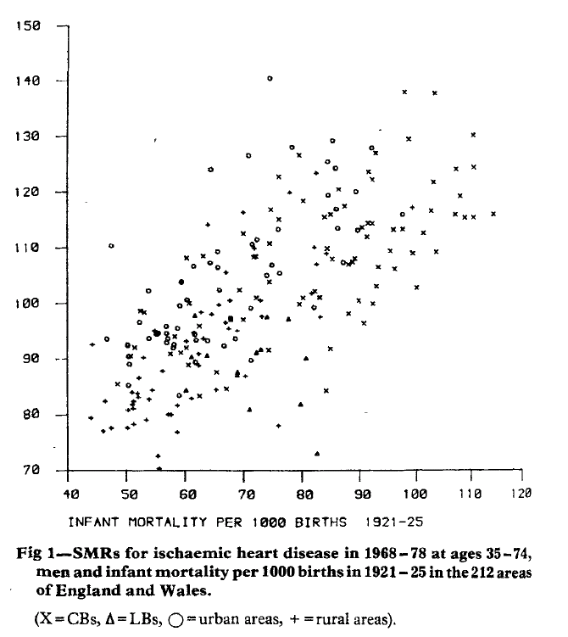
Fetal Origins of Disease
Barker Lancet 1986 – launched many more rigorous studies
“poor nutrition in early life increasessusceptibility to the effects of an affluent diet.”
“humans are plastic during their development, and adverse influences can permanently change body structure and function; a phenomenon known as ‘programming’”

Slide 42
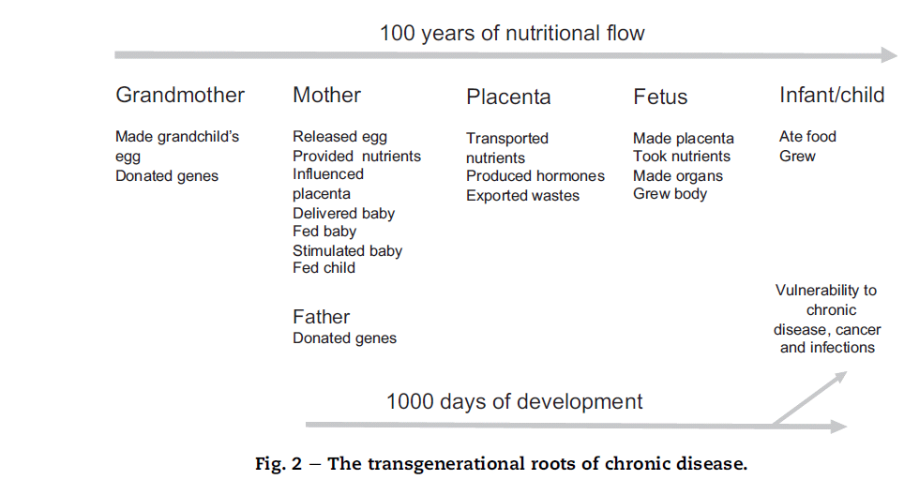
Fetal Origins of Disease
During development, there are critical periods during which a system or organ has to mature. These periods are brief, they occur at different times for different systems, and they occur in utero for most systems. After birth, only the brain; liver and immune system remain plastic. Much of human development is completed during the first 1000 days after conception (i.e. during intra-uterine life and infancy).- Barker 2012, Doll lecture

Slide 43
Etiologic Models: Cumulative Risk
Each exposure period has an independent effect on risk.
Also consistent with chain of risk model
Example: allostatic load
Early Adult SEP (SEP₂)
Midlife
SEP
(SEP₃)
Childhood SEP (SEP₁)
Health
43

Slide 44
Physiological Effects of Trajectory/Change
Change itself, rather than level of SEP, influences health.
SEP Change, Child to Early Adult
(Δ SES₁)
Early Adult SEP (SEP₂)
Midlife
SEP
(SEP₃)
Childhood SEP (SEP₁)
Health
SEP Change, Early Adult to Midlife
(Δ SES₂)
44

Slide 45
Etiologic Models: All Confounding
Social conditions have no effect on adult health.
The association between social conditions and adult health is entirely attributable to confounding by unmeasured characteristics such as genetic background.
Family Genetics
Early Adult SEP (SEP₂)
Midlife
SEP
(SEP₃)
Childhood SEP (SEP₁)
Health
45

Slide 46
Implications of Alternatives
All confounding: no effect of SES on adult health.
Immediate risk: childhood SES does not affect adult health
Social trajectory: childhood SES has no direct effect on adult health other than that mediated by adult SES
Latency: adult SES has no effect on adult health, but the association between adult SES and adult health may be confounded by childhood SES
Cumulative: childhood SES indirectly affects adult health, via adult SES, and directly affects adult health, via pathways not mediated by adult SES.

Slide 47
Implications for Prioritizing Resources
Under all but the “immediate risk” and “all confounding” model, intervening to change childhood SEP would improve adult health outcomes
Under the latency and cumulative risk model, it is not possible to completely remediate the harm from childhood disadvantage in adulthood: action must be taken in childhood.
Under the latency/critical childhood period model, intervening to improve adult SES doesn’t even improve adult health.

Slide 48
Lifecourse Models Guide
Intervention Design/ Policy Priorities
Policy/financial tradeoffs between:
  Timing of educational investments (pre-school, secondary school completion, university attendance, adult training, continuing education)
  Timing of financial security programs: pregnancy, early childhood, old age
  Housing policies: moves away from concentrated poverty areas to low/mixed poverty communities

Slide 49
Lifecourse Models Guide
Intervention Design/ Policy Priorities
“In contrast to the documentation of significant long-term effects from model preschool interventions, later remediation efforts have been shown to be considerably less effective ... Similarly, public job training programs, adult literacy services, prisoner rehabilitation programs, and education programs for disadvantaged adults have yielded low economic returns, with the returns for males often being negative (19).” Knudson, et al. 2006

Slide 50
Lifecourse Models Have Inconsistent Empirical Predictions
So you can provide evidence on which is most plausible for each outcome

Slide 51
Conventional Approach: Total Effect of Child SES on Adult Health
  To distinguish latency and cumulative from immediate risk:
  E(health2)=b0+b1*SES1
  If you have some measured confounders (common causes or factors on a common cause pathway):
  E(health2)=b0+b1*SES1+b2*Age+b3*Birth Regn

Slide 52
Conventional Approach: Total Effect of Child SES on Adult Health
  E(health2)=b0+b1*SES1
  E(health2)=b0+b1*SES1+b2*Age+b3*Birth Regns
  Important: to estimate the effect of an exposure on an outcome, do not adjust for things that are affected by the exposure!
  Especially do not adjust for mediators on the pathway between the exposure and the outcome!

Slide 53
Conventional Approach: Direct Effect of Child SES on Adult Health
  E(health2)=a0+a1*SES1+a2*SES2
  Challenge: should not adjust for mediators of childhood SES but most measured variables are not temporally prior to early life SES

Slide 54
Conventional Approach: Indirect Effect of Child SES on Adult Health
  Indirect Effect=Total Effect-Direct Effect
    Indirect Effect=b1-a1
  This decomposition assumes:
    Indirect Effect + Direct Effect = 1

Slide 55
Conventional Approach:
Cumulative vs Latency
  Does adult SES predict health conditional on child SES:
    E(health2)=a0+a1*SES1+a2*Age+a3*SES2
  Does a “cumulative” indicator, such as a sum of times in life “disadvantaged” predict health?
    E(health2)=a0+a1*(SES1+SES2+SES3)

Slide 56
When The Classic Approach Works
There are no unmeasured confounders of childhood SES and no unmeasured confounders of adult SES
When the sample is not conditioned (restricted, weighted) on any factor affected by childhood SES, adult SES (or, it follows, adult health).
When childhood and adult SES are measured perfectly
Linear models
Adult SES doesn’t modify the effect of childhood SES
There are no confounders of adult SES that are affected by childhood SES

Slide 57
Difficult to Assess Empirically
There are no unmeasured confounders of childhood SES and no unmeasured confounders of adult SES
    Impossible to prove in observational data.
57

Slide 58
When The Classic Approach Works
  2. When the sample is not conditioned (restricted, weighted) on any factor affected by childhood SES, adult SES (or, it follows, adult health).
    Most studies start in adulthood (or old age)
    Who survives to adulthood?

Slide 59
Critical Period/Latency
& Survivor Bias
Exposure in one period makes all the difference: subsequent exposures do not influence health.
Early Adult SEP (SEP₂)
Midlife
SEP
(SEP₃)
Childhood SEP (SEP₁)
Health
Survive to Old Age
Healthy Genes
59

Slide 60
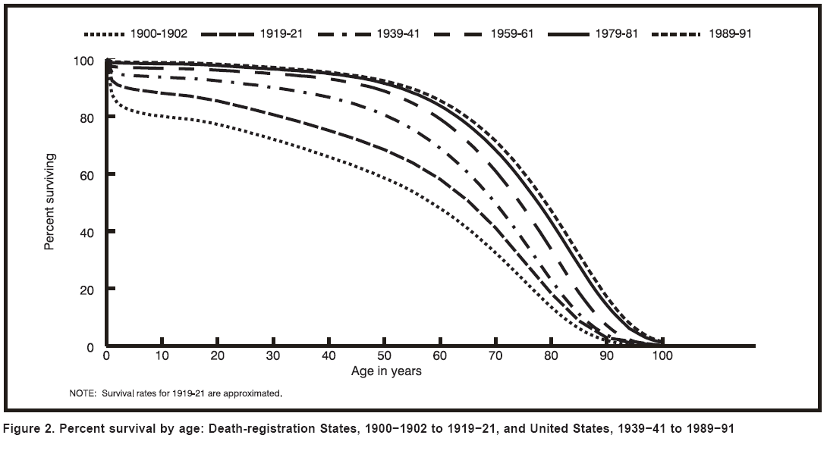
Who survived to be old?
Notes:
60
Another way to think about the old is to consider birth cohorts. People who turn 70 years old in 2010 were born around 1940. If early life experiences affect people’s health, then their early life experiences were defined by what was happening in the years immediately surrounding 1940.
Suppose you started a study of “the old’ today, What percent of the 1940 birth cohort even survived to be in your study?
For every hundred babies born in the US in 1940, roughly 60 of them survived to celebrate their 65th birthdays.
Similarly, we can ask about the 1920 birth cohort: today’s 90 year olds. Well, about 9 of them survived to be 85.
Because survival is increasing, this problem was even more acute for earlier studies. If you started a study in 1985 (e.g. the EPESE study),
Only about 51% of the 1920 birth cohort lived to turn 65 in 1985. Only about 6 of the 1900 birth cohort survived to age 85.

Slide 61
Survivor Bias in Lifecourse Studies
If the study enrolls adults, it is by design conditioned on factors that influence survival to adulthood.
Early childhood adversity is very likely to influence survival
Survivor Bias is not just a generalizability problem: it can obscure (or inflate) causal effects
Very similar issue if you are examining a patient population: by definition they are selected into having the disease. Relevant for obesity paradox.

Slide 62
Problems with Conventional Approach: Measurement Error
3. When childhood and adult SES are measured perfectly: but what is the causal factor?
    What level? Individual? Family? Neighborhood? State? Region?
    What time period? Infancy? Early childhood? Age 13?
    What domain? Education? Income? Status? Psychological traumas?
    How to measure? Retrospective? Linking outside data sets?
    The effect of adjusting for a mediator attenuates as the square of the correlation between the measured value and the true value of the mediator.
62

Slide 63
Distinguishing Etiologic Models: Testing for Latency or Cumulative vs Immediate Risk
Early Adult SEP (SEP₁)
Midlife
SEP (SEP₂)
Health
Educational Attainment
Occupational Class
To test for a direct effect of SEP₁ on Health, we would compare the regression of Health on Education with and without adjustment for occupational class.
63

Slide 64
Distinguishing Etiologic Models: Testing for Latency or Cumulative vs Immediate Risk
Early Adult SEP (SEP₁)
Midlife
SEP (SEP₂)
Health
Educational Attainment
Occupational Class
Even if there were no direct effect of SEP₁ on health, educational attainment would predict health independently of adult occupational class, due to measurement error.
64

Slide 65
Distinguishing Etiologic Models: Testing for Latency or Cumulative vs Immediate Risk
Early Adult SEP (SEP₁)
Midlife
SEP (SEP₂)
Health
Educational Attainment
Occupational Class
Even if there were no effect of SEP₂ on health, occupational class would predict health independently of education, because occupational class is a correlate of the latent variable, SEP₁.
65

Slide 66
Alternative Sources of Evidence
Some types of randomization
Natural experiments/policy changes influencing childhood or adult SES
Biological studies/animal models
Better regression models
    Better measurement of SES
    Better measurement of confounders
    Modeling modification of direct pathways by mediators
    Weighting to deal with measured confounders
    of adult SES that are mediators of child SES effects

Slide 67
Alternative Sources of Evidence
Some types of randomization
  A few formal trials that should be compared to observational studies to see how many of the “potential” biases are serious problems.
Moving To Opportunity
  Subgroup analyses to understand mechanisms
  Analyses by age of randomization
Romanian Orphans’ Study
  Evidence for differential specificity of timing for specific cognitive/behavioral outcomes

Slide 68
Alternative Sources of Evidence
Natural experiments/policy changes influencing childhood or adult SES
  Migration studies: where you’re born strongly influences lifecourse trajectory (research limited by data availability)
Instrumental variables
  Policy changes: school policies, health care access policies, income support policies, racial segregation policies (research limited by data availability)
  Institutional quirks: age of enrollment cutoff for primary school
  Mendelian Randomization studies: genotypes control phenotypes, use genotypes as natural experiments (not clear what phenotypes of interest are genetically controlled)

Slide 69
Alternative Sources of Evidence
Better regression models
    Better measurement of exposures
    Better measurement of confounders
    Subgroup assessments with improved quality
    Modeling modification of direct pathways by mediators
    Modern mediation tools, appropriately handling confounded mediators

Slide 70
Alternative Sources of Evidence
  Better measurement of exposures:
    Improvements in ideas, data, and analysis
    important to recognize when we are looking under the lamppost and try to move out.
  Lifecourse epi has been dominated by data availability
  A place where innovative data linkages have made everything possible, but also constrained the questions

Slide 71
Old notes on interactions

Slide 72
Basic logistic model
If you test interaction terms, you are testing deviations from multiplicative relationships
This issue comes up again when you consider marginal versus conditional models
  What happens to MY risk if I’m exposed?
  What happens to the population’s risk if the population is exposed?

Slide 73
Effect Measure Modification
Effect measure modification: is the effect measure the same in different strata?
  Is the relative risk of stroke associated with obesity the same in men and women? Is it the same in blacks and whites?
  Is the risk difference for stroke associated with obesity the same in men and women? Is it the same in blacks and whites?
If there is a main effect (e.g. obesity predicts stroke and race also predicts stroke), usually no more than one effect measure will show no modification.
  If the RRs are the same for blacks and whites, but blacks have a higher overall rate of stroke than whites, the RDs must be different.
Notes:
73

Slide 74
Effect Modification vs Interaction
If the RRs are the same for men and women, but men have a higher overall rate of stroke than women, the RDs must be different.
Suppose:
  Obesity is associated with an RR of 1.5 in both men and women.
  Non-obese women have an absolute risk of stroke of 2 per 1,000, so obese women have a risk of 3/1000
  Non-obese men have an absolute risk of stroke of 4 per 1,000, so obese men have a risk of 6/1000.
  RD for women=1/1000. RD for men=2/1000.
Notes:
74

Slide 75
Scale Dependence of Effect Modification
If there is a main effect (e.g. obesity predicts stroke and race also predicts stroke), usually no more than one effect measure (e.g. RR, OR, RD) will show no modification.
If one of the exposures doesn’t predict at all, then there shouldn’t be effect measure modification
  E(Y|X=x,M=1)-E(Y|X=x’,M=1) ≠ E(Y|X=x,M=0)-E(Y|X=x’,M=0)
  Implies:
  E(Y|X=x,M=1) ≠E(Y|X=x,M=0)
  Which means:
  E(Y|M=1) ≠E(Y|M=0)
Notes:
75

Slide 76
Scale Dependence of Effect Modification
If there is a main effect (e.g. obesity predicts stroke and race also predicts stroke), usually no more than one effect measure (e.g. RR, OR, RD) will show no modification.
If one of the exposures doesn’t predict at all, then there shouldn’t be effect measure modification
There could be effect measure modification on many scales (e.g. subgroup differences in both additive effects and also multiplicative effects).
Notes:
76

Slide 77
Effect Modification vs Interaction
The scale dependence of interaction is essential to recognize when interpreting disparities, and especially trends in disparities.
Relative effect measures will tend to be closer to the null in groups with higher baseline risk.
  RRs in young routinely more extreme than RRs in old.
  RRs tend to become more extreme over time if there is progress in reducing the p0pulation risk of a disease
Which is more important: relative or absolute changes?
Notes:
77

Slide 78
Relative vs Absolute Measures
Some claims that depend on comparing risk factor coefficients:
The black-white disparity in infant mortality changed little during the 20th century, despite the advances in civil rights.
Although the medical system may not work ideally for younger African-Americans, these problems are ameliorated among the elderly.
After age 70, the role of socioeconomic factors in determining morbidity and mortality declines, and genetic risks predominate.
From 1968-1996, Alabama made greater strides in reducing stroke mortality than Oregon.

Slide 79
Some Rules
Don’t drop the lower order variables (the variables used to create the interaction tern) when you have an interaction term in the model.
Don’t test all possible interactions in your data set: use theory guiding what you’ll test.
  You’ll get tired
  You’ll definitely find something (unless it’s your dissertation, in which case you will defy the laws of probability and never find a p<.05 even after examining 5 million possible interactions).
But remember: theory is only as good as … well, it’s often not very good.

Slide 80
Some Rules
It’s easy to mess up the interpretation
Categorizing variables simplifies.
  Start with stratification
  Pool and examine dichotomized versions for one or both of your variables unless you really have a strong reason not too.
  Steve says: always categorize one of your variables if you possibly can
  I say: always start by looking at categorized versions, and then consider which story you want to tell.
A plot can go a very long way to understanding what is happening for yourself and readers.
Remember - interactions go both ways

Slide 81
Common Questions
What’s the difference between evaluating confounding and effect modification?
A
Y
X
A
XA
Y
X
Both will result in a change in the estimated association between X and Y when conditioning on a specific value of A.
A
X(A=1)
Y
X
X(A=0)
Notes:
Take eqn 1 and suppose we say, NO, b1 estimate is biased because women have higher LE than men and also have a higher spouse edn than men so the result is a biased (upwards) estimate of b1, but just because of misspecification.

Slide 82
Common Questions
Do two variables have to be correlated to interact?
NO

Slide 83
Common Questions
Does Z have to be associated with X to confound the relation between X and Y?
Yes

Slide 84
Common Questions
Which do I test for first, confounding or interactions?
Think about what we need to adjust (i.e., control) for and then look at interactions.
If you have a very firm theory and need to stratify than you do the first step in the two separate (stratified) models.

