Slide 1

Homework #2; Section A: Meta-analysis of Count Data
From a visual inspection of the data provided in the table, do the measures of
outcome (i.e., relative risks) appear consistent across studies (just provide a
qualitative/descriptive answer based on the data shown in the table above)?
Author/year | # of infections/ # on antibiotics | # of infections/ # on placebo | Antibiotic | RR (95% CI)
Krohn 1981 | 6 / 104 (6%) | 11 / 106 (10%) | Tinidazole | 0.56 (0.21, 1.45)
Sonne-Holm 1981 | 14 / 254 (6%) | 26 / 239 (11%) | Penicillin and Pivampicillin | 0.51(0.27, 0.95)
Westrom 1981 | 10 / 102 (10%) | 17 / 110 (15%) | Tinidazole | 0.63 (0.30, 1.32)
Heisterberg 1985 | 2 / 51 (4%) | 10 / 49 (20%) | Metronidazole | 0.19 (0.04, 0.83)
Darj 1987 | 8/386 (2%) | 24/383 (6%) | Doxycycline | 0.33 (0.15, 0.73)
Heisterberg 1984 | 25/269 (9%) | 25/263 (10%) | Lymecycline | 0.98 (0.58, 1.66)
Heisterberg 1987 | 7 / 64 (11%) | 7 / 54 (13%) | Metronidazole | 0.84 (0.32, 2.26)
Heisterberg 1988 | 2 / 24 (8%) | 7 / 31 (23%) | Lymecycline | 0.37 (0.08, 1.62)
Levallois 1988 | 3 / 535 (1%) | 26 / 539 (5%) | Doxycycline | 0.12 (0.04, 0.38)
Sørensen 1992 | 20 / 189 (11%) | 30 / 189 (16%) | Erythromycin | 0.67 (0.39, 1.13)
Larsson 1992 | 3 / 84 (4%) | 11 / 90 (12%) | Metronidazole | 0.29 (0.08, 1.01)
Neilsen 1993 | 55 / 525 (10%) | 73 / 548 (13%) | Ofloxacin | 0.79 (0.57, 1.09)

Slide 2
Homework #2; Section A: Meta-analysis of Count Data
#2 What is the summary estimate and 95% confidence interval?
The summary estimate is 0.59 (95% CI 0.49-0.71)..

Slide 3
Homework #2; Section A: Meta-analysis of Count Data
#3 Which study is weighted the most heavily ?
how does the point estimate for this study compare to the overall summary estimate?

Slide 4
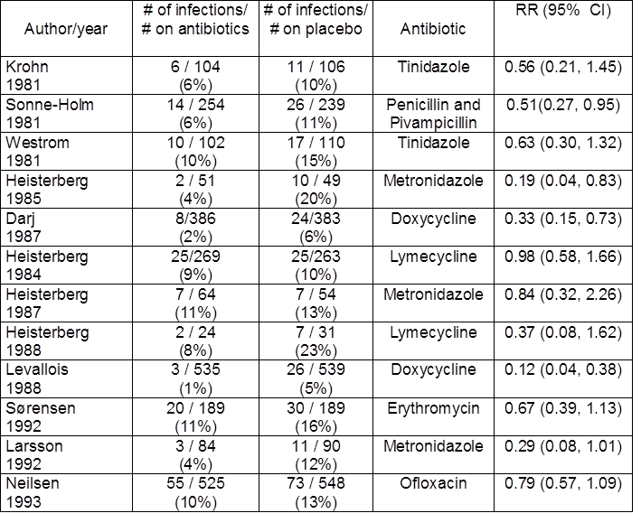

Homework #2; Section A: Meta-analysis of Count Data
#3 Why aren't the studies by Levallois and Neilsen, which have similar sample sizes, weighted the same (hint: look at the 2x2 tables on page 3)?
But the issue is here number of outcomes.
Levallois – very small number of outcomes,
Therefore variance higher – weighted less.
In FE analysis, all things being equal – higher
Variances (larger CI’s) - lower weights

Slide 5
Homework #2; Section A: Meta-analysis of Count Data
#3 Why aren't the studies by Levallois and Neilsen, which have similar sample sizes, weighted the same (hint: look at the 2x2 tables on page 3)?
Under FE model:
Effect sizes for all studies are identical
And reason variation occurs is because of sampling error (error in estimating effect sizes)
FE ignores from smaller studies since we have.
Better information on effect sizes from large studies
Weights in FE is 1/variance
Under RE model
  Goal is not to estimate one TRUE Effect but to estimate the distribution
  Of effects.
  Each study provides a different Effect size –want to make sure all
  Effect sizes are represented in the Summary estimates
  Therefore RE does not discount the small study by giving it a small
  weight
  Even if you are a small study and imprecise – can’t ignore it.
  Same with large studies can’t give it too much weight.
  Weights in RE model ; 1/variance + τ² (or D ); D = Q –df/ (C);
  Q= ∑_{i=1-k} W_{i} (Y_{i}-M)²; C= ∑ W_{i} - ∑ W_{i} ²/ ∑ W_{i}

Slide 6
Homework #2; Section A: Meta-analysis of Count Data
#5. How would you interpret the results?
These results indicate that prophylactic antibiotics at the time of therapeutic abortion significantly reduce the risk of PID about 40%.

Slide 7
Homework #2; Section A: Meta-analysis of Count Data
In Stata, Q is labelled “Heterogeneity chi-squared.”
6. Are the results homogeneous? Support your conclusions based on the STATA output.

Slide 8
Homework #2; Section A: Meta-analysis of Count Data
In Stata, Q is labelled “Heterogeneity chi-squared.”
7. What is heterogeneity and what factors can account for heterogeneity?
.
Heterogeneity in effect sizes – means variation in the true effect size.
This incorporates both (true) heterogeneity and also random error
Even if All studies – same effect size
True effect size varies between studies
True heterogeneity is zero
Effect sizes will not be identical
Rather, because of within study error – each to fall within some range of the common effect.
Here, observed effects vary from one another for two reasons
  Real heterogeneity in effect size
  Within study error

Slide 9
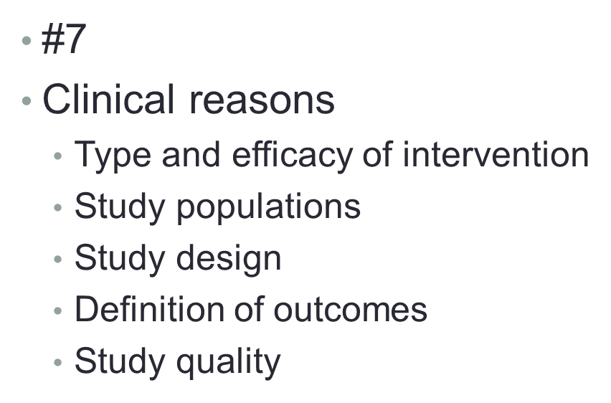
Homework #2; Section A: Meta-analysis of Count Data
7. What is heterogeneity and what factors can account for heterogeneity?

Slide 10
Homework #2; Section A: Meta-analysis of Count Data
In Stata, Q is labelled “Heterogeneity chi-squared.”
7. What is heterogeneity and what factors can account for heterogeneity?
.
If we want to quantify the heterogeneity – partition the observed variation into true heterogeneity and the within-study error - and then we focus on the true heterogeneity.
Five ways of measuring dispersion
Q, p, T^{2,} T,I²
Q and its p – depends on the number of studies; not sensitive to the metric of the effect size index
T² and T – depends on scale
I^{2 –}does not depend on either; a type of S:N ratio.

Slide 11
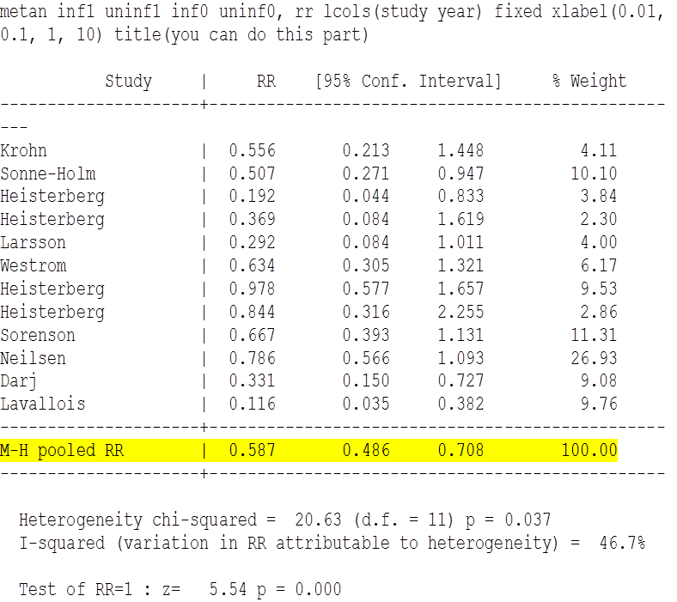
Homework #2; Section A: Meta-analysis of Count Data
8. Which study do you suspect contributes the most to heterogeneity in this analysis ? Why
#8Levallois
W_{i} is the study weight (1/V_{i}), Y_{i} is the study effect size, and M is the summary effect and k is the number of studies.
We compute the deviation of each effect size from the mean, square it, weight this by the inverse variance for that study and sum these values over all studies to yield WSS or Q
7.1/20.6 or 34.6% of Q.
The point estimate for the study by Levallois is very different from the summary estimate and the study has a modest weight, both contribute to increasing Q

Slide 12
Homework #2; Section A: Meta-analysis of Count Data
Question #9:Does exclusion of this study “fix” the heterogeneity? Support your conclusions based on the STATA output.
Excluding the study by Levallois from the meta-analysis will result in a homogeneous result, Q= 12.3, P= 0.27.
However, it is not acceptable to simply eliminate the finding of a study from a meta-analysis because it causes statistical heterogeneity. The idea is to explain or account for the heterogeneity

Slide 13
Homework #2; Section A: Meta-analysis of Count Data
Perform a subgroup analysis to examine the effect of antibiotics in the subgroup of studies
with a low prevalence of PID and the subgroup of studies with high prevalence of PID. To
do this, calculate the summary estimates for studies that with relatively low risks of PID
and studies with relatively high risks of PID. Studies with a prevalence in the placebo
group less than 7% will be considered "low risk"; studies with a prevalence in the
placebo group greater than 7% will be considered "high risk."You will want to create a
variable for risk group. The following will work: generate riskgp = inf0/n0 > 0.07
10. What are the summary estimates for each group?
The summary relative risk for the two
studies in which the prevalence of PID
is 5-6% is 0. 22 (95% CI 0.12-0.42).
The summary relative risk for studies with a prevalence of 10% to 23% is 0.67 (95% CI 0.55-0.82).

Slide 14
Homework #2; Section A: Meta-analysis of Count Data
Do the summary estimates differ from 2? How would you interpret the difference
or lack of difference? Are the results homogeneous for each group?
The summary estimate for the overall analysis is 0.59 (95% CI 0.49-0.71).
Steve’s Point:
Differences in the prevalence of PID among the control group, i.e. risk for the outcome or method of defining the outcome, may account for the heterogeneity among the studies.
Heterogeneity may also be eliminated or reduced by simply by reducing power (i.e., confining the analysis to a smaller group of studies).
The summary estimate for studies with 10% to 23% “high” prevalence of PID is 0.67 (95% CI 0.55-0.82)
Still demonstrates an overall reduction in PID risk when antibiotics are administered, i.e. the direction and magnitude of the two summary estimates are similar. The results are homogeneous with Q= 9.14, P = 0.42.
The summary estimate for studies with lower prevalence of disease is much lower (0.22, 95% CI 0.12-0.42) than the overall summary estimate and is also homogeneous, Q= 2.14, P= 0.14.

Slide 15
Homework #2; Section A: Meta-analysis of Count Data
Policies !
Do the summary estimate and 95%
confidence interval differ from the fixed effects model? What is the difference?
13. Are the results homogeneous?
The results are still heterogeneous, Q=20.63, p=0.037).
The summary relative risk is 0.55 (95% CI 0.40-0.74) which is similar, but not exactly the same, as the summary relative risk calculated using a FE model (0.59, 95% CI 0.49-0.71).

Slide 16
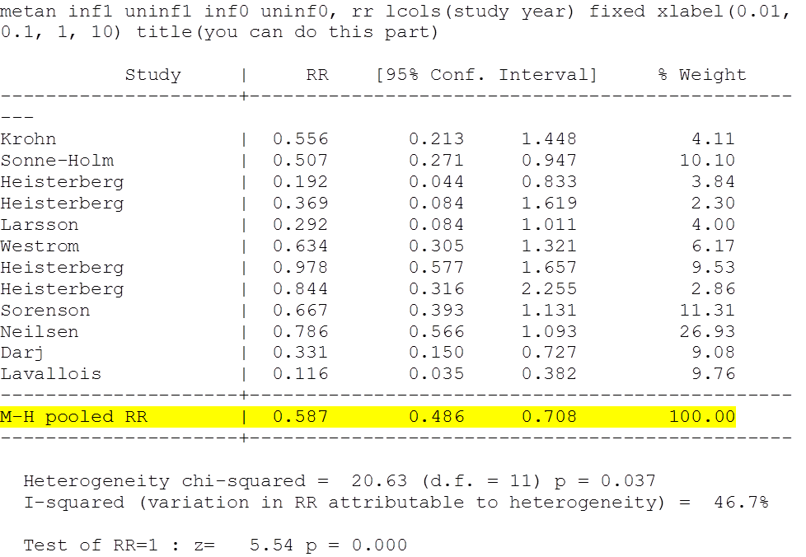
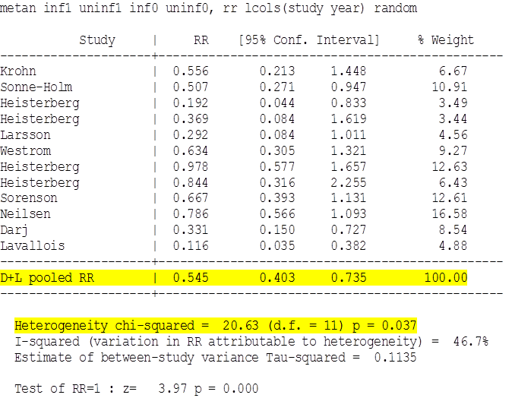
Compare the relative weights of the studies in the fixed effects model
with their weights in the random effects model. Discuss how the relative weights
affect the summary estimates and 95% confidence intervals.
Homework #2; Section A: Meta-analysis of Count Data
Fixed effects model
Random Effects model

Slide 17
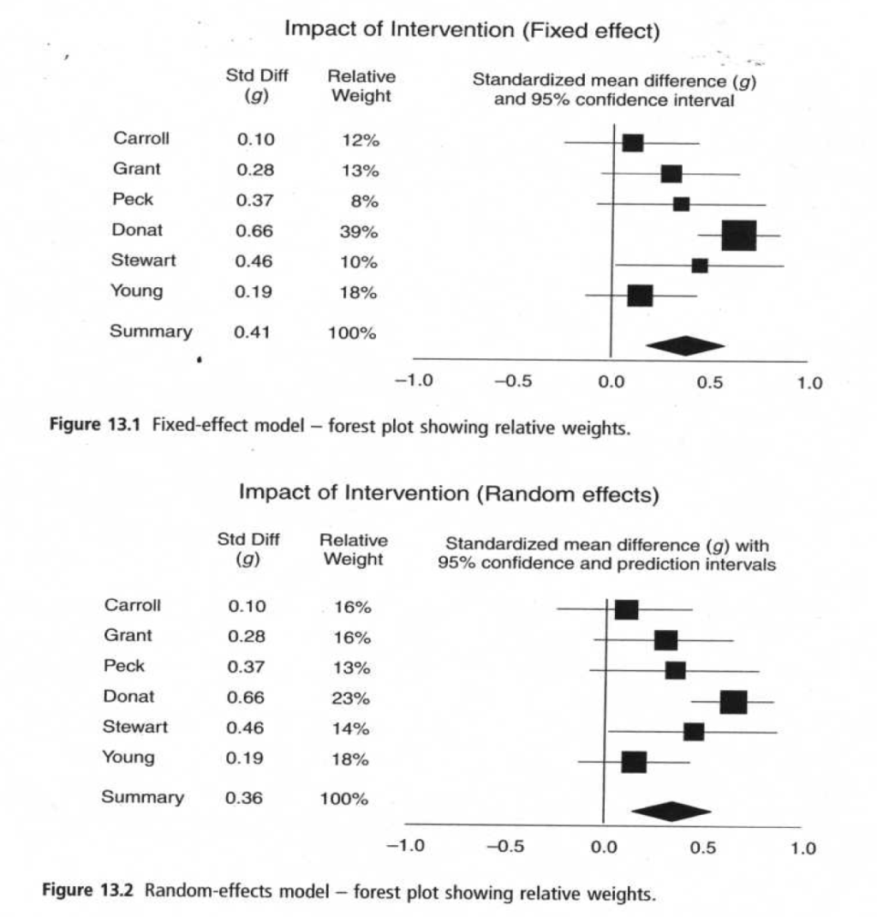
Homework #2; Section A: Meta-analysis of Count Data
Compare the relative weights of the studies in the fixed effects model
with their weights in the random effects model. Discuss how the relative weights
affect the summary estimates and 95% confidence intervals.
FE – true effect size for all studies is identical. When assigning weights – we ignore information from smaller studies since we have better information about the same effect size in larger studies
RE – goal is not to estimate one true effect; BUT mean of distribution of effects. Since each study provides information about a different effect size – want to make sure all effect sizes are represented in summary estimate. Therefore, can’t discount a small study by giving it a small weight.
Introduction to Meta-Analysis. M. Borenstein et al.

Slide 18
Question # 14
Homework #2; Section A: Meta-analysis of Count Data
Steve’s Points:
1) The random effects model does not solve the problem of heterogeneity. When heterogeneity is present, it is inappropriate to combine results using any model.
2) When heterogeneity is present, the summary estimate calculated using the random effects model might differ from that calculated using the fixed effects model.
3) When between study variance is large, large and small studies have similar weights in the random effects model, i.e. larger studies are weighted less relative to their weight in the fixed effects model.
4) Since the random effects model takes into account within and between study variance, the 95% confidence interval around the summary estimate is larger than the confidence interval around the summary estimate for the fixed effects model.

Slide 19
Homework #2; Section A: Meta-analysis of Count Data
  The original search found a randomized controlled trial the investigators decided to exclude because no placebo was used in the control group. The relative risk for this study was 0.20 (95% CI 0.04 - 0.90) with 10 cases of PID among 274 in the placebo group and 2 cases among 275 in the treated group. Perform a sensitivity analysis by combining this study with the full set of studies (n=12) using the fixed effect model for crude data.
Does the summary estimate and 95% confidence interval change?
Support your conclusions by including STATA output.
The summary relative risk is 0.57 (95% CI 0.48-0.69) which is very similar to the summary relative risk calculated in #2 (0.59 (95% CI 0.49-0.71)).

Slide 20
Homework #2; Section A: Meta-analysis of Count Data
Given the results of this sensitivity analysis, would you conclude the summary
estimate you computed in problem 2 is robust?
This sensitivity analysis indicates that the overall summary relative risk is stable and not greatly influenced by excluding a study that did not meet the stringent inclusion criteria.
Steve’s Point: A sensitivity analysis is important to convince the reader of the robustness of the overall summary estimate and should be a part of all meta-analyses.
Sensitivity analyses are performed to examine whether the methods used in conducting the meta-analysis influenced the overall summary estimate. Such methods include 1) the criteria for including or excluding studies, 2) type of model used (fixed vs. random effects), 3) type of data (published vs unpublished), and 4) quality of the studies.

Slide 21
Homework #2; Section A: Meta-analysis of Count Data
Does the funnel plot show evidence of publication bias?
Cut and paste the funnel plot in your homework
Publication bias - form of selection bias and occurs when published studies are not representative of all studies that have been done, usually because statistically significant results tend to be submitted and published more often than non-significant results.(“In-drawer manuscript”)
The funnel plot shows there is evidence of publication bias.

Slide 22
PUBLICATION BIAS
MODEL- generally used has certain assumptions
  Large studies – published
  Moderate – risk of getting lost
  Small – greatest risk of getting lost.
Traditionally – funnel plots had effect size on x axis and the sample size or variance on Y axis. Large studies at top and generally clustered around mean. Smaller studies at bottom (more sampling error variation in effect sizes). Resembles a funnel
Use of standard error (rather than sample size or variance) – spreads out the points on the bottom half of the scale where small studies are plotted. Makes it easier to identify asymmetry.

Slide 23
PUBLICATION BIAS
Is the entire effect an artifact of bias ?
Rosenthal’s fail-safe N
Orwin’s fail-safe N
Duval and Tweedie’s trim and fill
  Pitfalls
    Depends strongly on the assumptions of the model of why studies are missing
    Algorithm for detecting asymmetry can be influenced by one or two aberrant studies.

Slide 24
Homework #2; Section A: Meta-analysis of Count Data
18. Do the statistical tests suggest evidence of publication bias?
Support your conclusions with STATA output.
Kendall’s Tau is -0.32, P= 0.03.
The statistically significant value for Kendall’s Tau indicates publication bias may exist due to the absence of small negative studies.
The significant p-value for the Egger’s test also suggests there may be publication bias.

Slide 25
Homework #2; Section B : Meta-analysis of Effect Sizes
What is the relative risk of endometrial cancer comparing all estrogen
users to controls (fixed effects model)?
The summary odds ratio for the fixed effects model is 2.19 (95% CI 1.84-2.59) and for the random effects model 2.59 (95% CI 1.71-3.93).
These results show a significant increase in endometrial cancer risk among estrogen users for both the fixed effects and random effects model. The between study variance in the random effects model results in wider confidence intervals around the summary point estimate.
Steve’s Point: This is a good example of a meta-analysis of observational data to address an important research question that could not be answered by a randomized controlled trial because it would not be feasible to conduct such a trial.

Slide 26
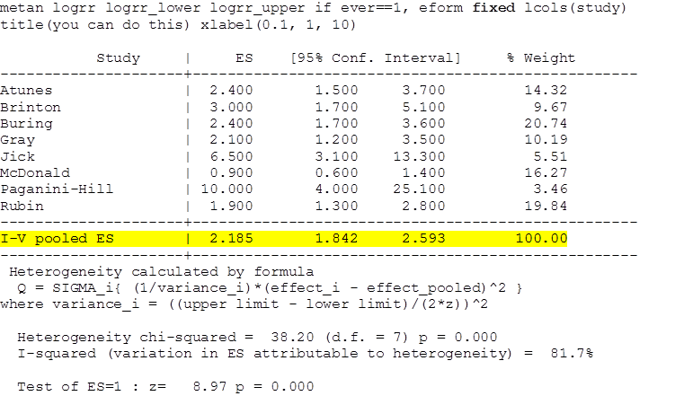
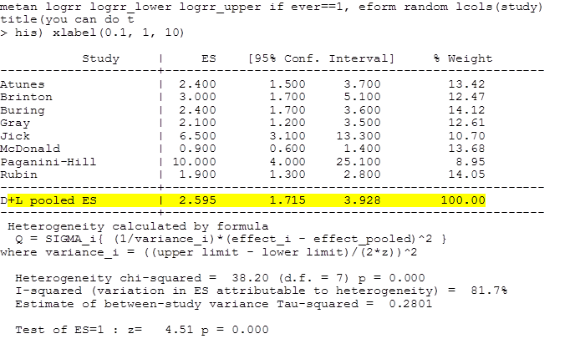
Homework #2; Section B : Meta-analysis of Effect Sizes
Are the results homogeneous? If the studies are not homogenous, what
issues related to observational studies may account for the heterogeneity?
The results are not homogeneous
The summary odds ratio is heterogeneous with Q= 38.20, P < 0.001.
The point estimates for ever-users of estrogen range from 0.9 to 10.0.
The study by McDonald contributes the most to Q with a point estimate that is markedly different from the summary estimate. However, there is no obvious reason why this study should have found a much different odds ratio than the others.
In reviewing Table 1, it appears that duration of use and dose of estrogen influence degree of risk of endometrial cancer

Slide 27
Q. 2 Are the results homogeneous? If the studies are not homogenous, what issues related to observational studies may account for the heterogeneity?
Steve’s Point:
When heterogeneity is present, the results of a meta-analysis need to be interpreted with caution. If heterogeneity is present consider one or all of the following:
1) don't combine results,
2) search for the problem causing the variability focusing on differences in study design, definition of outcomes, definition of intervention, etc.,
3) use the results to plan for subsequent studies, and
4) consider whether heterogeneity invalidates the findings, i.e. are the effect sizes in the individual studies and summary estimate in the same direction and of similar magnitude.

Slide 28
Homework #2; Section B : Meta-analysis of Effect Sizes
Are the results in each of these subgroups (low, medium, high-dose users)
homogeneous? Show the results for each subgroup.
The summary odds ratio is 3.40
(95% CI 2.05-5.64) for those who took
0.625mg of estrogen:
The summary odds ratio is 3.85 (95% CI 1.50-9.84)
for women who took 0.325mg of estrogen:
The summary odds ratio is 5.1 (95% CI 3.72-6.92) f
or those who took >1.25mg or more of estrogen:
The results are homogeneous for all three summary estimates

Slide 29
Homework #2; Section B : Meta-analysis of Effect Sizes
4. Based on these results, what is your conclusion about the data?
It appears that risk for endometrial cancer may be higher at the highest doses of estrogen than at lower doses
Point: Differences in the dose of estrogen among ever users may account for the heterogeneity among the studies.

