Slide 1
Using Meta-Analyses for Decision-Making
“... the outlook for thrombolysis in unstable angina has dimmed considerably. The ballgame is in late innings and the home team is losing badly. Soon the meta-analysts will arrive, like sportscasters, to announce the final score.”
David Waters and Jules Lam, Circulation 86: 1642-1644, 1992

Slide 2
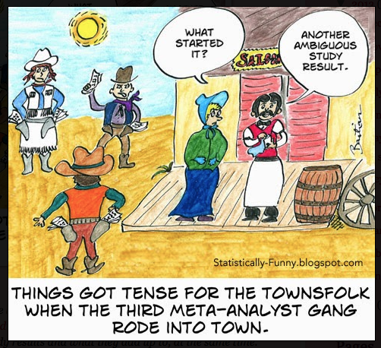

Slide 3
Advanced Techniques for Meta-Analysis
Single arm Meta-Analysis
Meta-Regression
Survival Analysis
Diagnostic Tests & ROC curves
Indirect/Network Meta-Analyses

Slide 4
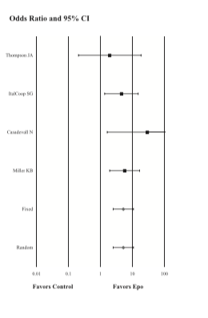
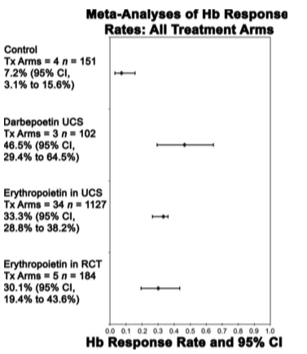
Meta Analysis of Rates
Efficacy and Safety of Erythropoiesis-Stimulating Proteins in Myelodysplastic Syndrome: A Systematic Review and Meta-Analysis Susan D. Ross, I. Elaine Allen, Corey A. Probst, Brian Sercus, Sheila M. Crean and Gayatri Ranganathan Oncologist 2007;12;1264-1273

Slide 5
SINGLE ARM META-ANALYSIS in STATA: Diagnostic performance of two-phase and four-dimensional computed tomography for parathyroid localization; a systematic review and meta-analysis
Wouter Kluijfhout, MD, Endocrine Surgery, UCSF, to appear in Radiology
35 arms from 30 studies from 2000-2016
Only outcomes from one type of contrast per study
Sample of the data

Slide 6
SINGLE ARM META-ANALYSIS: STATA Metaprop command:
. metaprop TP SensDenom, random cimethod(exact) label(namevar=Author, yearvar=Year)

Slide 7
. metaprop TP SensDenom, random cimethod(exact) by(Phase) label(namevar=Author, yearvar=Year)
Separating by contrast phase does not help
What’s next?

Slide 8
Cumulative Meta-Analysis: STATA
. metacum TP SensDenom, random label(namevar=Author, yearvar=Year)
Cumulative Meta-Analysis?
Not much help here.

Slide 9
Meta-Regression
Subgroup analyses
Examining the control rate
Identification of important covariates
Control for baseline differences
Control for bias or sponsorship
Control for heterogeneity
STATA command does not work for single-arm analyses

Slide 10
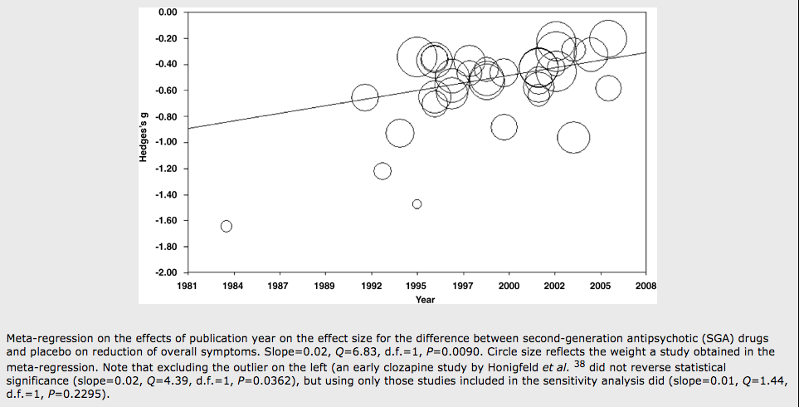
Meta-Regression
Only appropriate in meta-analyses of 10 or more studies
The outcome is the effect estimate
Predictors are characteristics of study design
How effective are second-generation antipsychotic drugs? A meta-analysis of placebo-controlled trials S Leucht, D Arbter, R R Engel, W Kissling & J M Davis, Molelar Psychiatry , 2008

Slide 11
Meta-Regression STATA example
Meta-analysis comparing CABG to PCI*
23 studies
Slight benefit to CABG
I² ⁼ 86%
Ashok Krishnaswami, MD; Anne C H Goh, MD; Alan S Go, MD; Robert J Lundstrom, MD; Jonathan Zaroff, MD; James J Jang, MD; Elaine Allen, PhD, Journal of Cardiology, to appear 2016

Slide 12
STATA: metareg _ES yrpublished, wsse(_selogES) graph
Meta-Regression
Notice that you have new variables after your meta-analysis:
_SS _ES _selogES _LCI _UCI _WT
25 .75 1.154701 .0780151 7.210147 .0681302
1.06 .2371708 .6701138 1.697887 1.475598
^{Meta-regression}
REML estimate of between-study variance
% residual variation due to heterogeneity Proportion of between-study variance explained With Knapp-Hartung modification
^{Number of obs = 22}
^{tau2 = .01639}
^{I-squared_res = 78.80%}
^{Adj R-squared = -25.32%}
_ES Coef. Std. Err. t P>t [95% Conf. Interval]
yrpublished -.0015316 .0071283 -0.21 0.832 -.0164008 .0133377
_cons 4.02446 14.30124 0.28 0.781 -25.80741 33.85633

Slide 13
PUBLICATION YEAR – heterogeneity still 80%

Slide 14
STATA: metareg _ES hypertension, wsse(_selogES) graph
HYPERTENSION – reduces heterogeneity to 50%

Slide 15
Survival Analyses
Reconstruct actuarial life tables
- impute interim timepoints
Reconstruct log rank statistics
- need p-values
Deconstruct survival curves
- using a ruler, ‘graph mapping software’
Combine into meta-analysis of median survival time

Slide 16
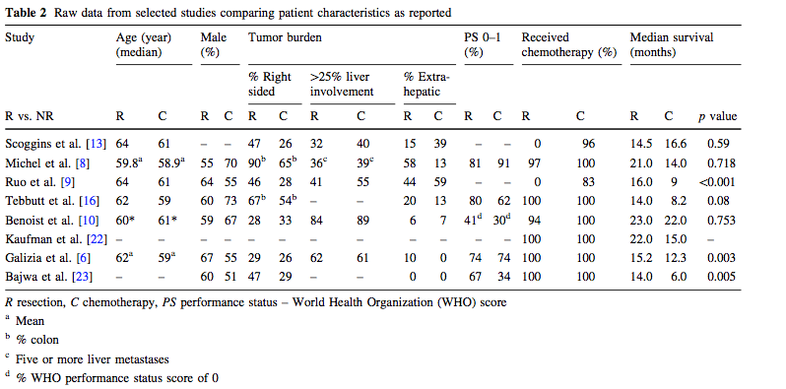
Survival Analyses
Meta-Analysis of Survival of Patients with Stage IV Colorectal Cancer Managed with Surgical Resection Versus Chemotherapy Alone P. Stillwell • P. G. Buettner • Y-H. Ho World J Surg (2010) 34:797–807

Slide 17
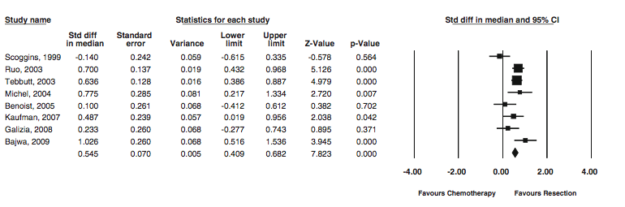
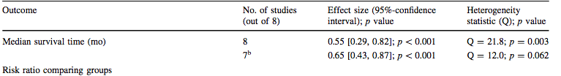
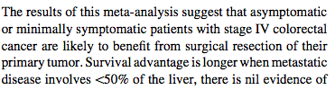
Survival Analyses
Sensitivity Analysis of Heterogeneity

Slide 18
Diagnostic Studies
Objective may be diagnosis, imaging modalities,
evaluation vs. a gold standard
Studies may use different thresholds
- compute 2 x 2 tables for each study
Compare areas under the ROC curve using logit models

Slide 19
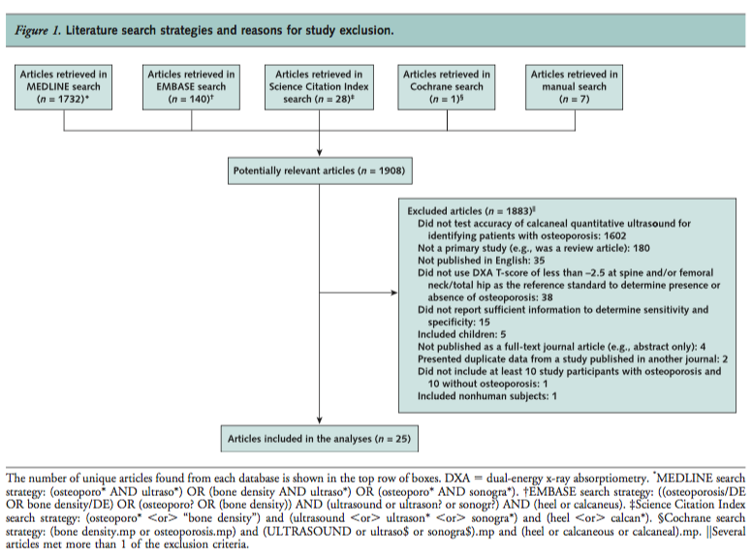
Diagnostic Studies
Meta-Analysis: Accuracy of Quantitative Ultrasound for Identifying Patients with Osteoporosis Smita Nayak, MD; Ingram Olkin, PhD; Hau Liu, MD, MPH, MBA; Michael Grabe, PhD; Michael K. Gould, MD, MS; I. Elaine Allen, PhD; Douglas K. Owens, MD, MS; and Dena M. Bravata, MD, MS
6 June 2006 Annals of Internal Medicine Volume 144 • Number 11

Slide 20

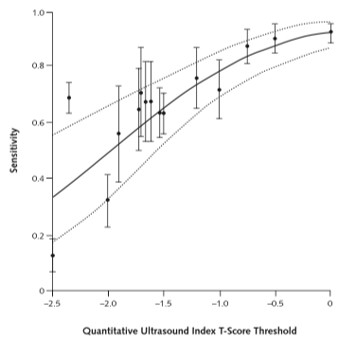
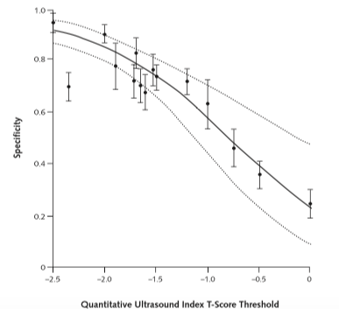
Diagnostic Studies

Slide 21
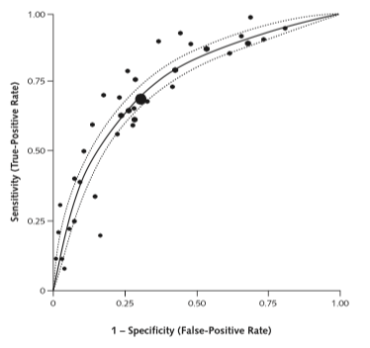
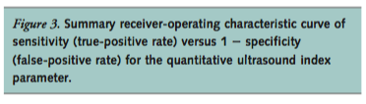
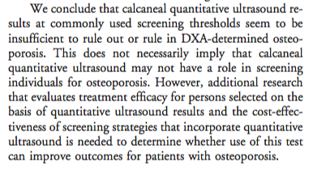
Diagnostic Studies

Slide 22
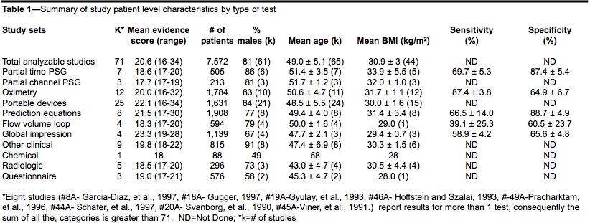
STATA example: Diagnostic Studies
Systematic Review and Meta-analysis of the Literature Regarding the Diagnosis of Sleep Apnea Susan D. Ross MD, FRCPC, Iris A. Sheinhait MA, Katherine J. Harrison BA,Marion Kvasz MD, MPH, Janet E. Connelly BS, Steven A. Shea PhD, and I. Elaine Allen PhD SLEEP, Vol. 23, No. 4, 2000

Slide 23
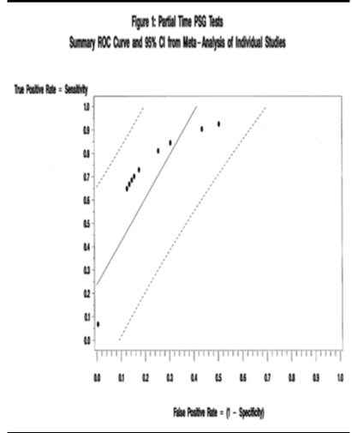
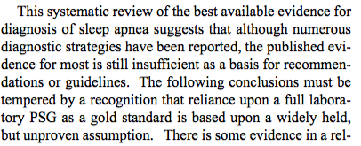
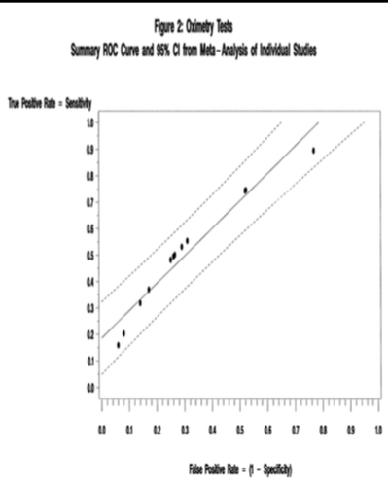
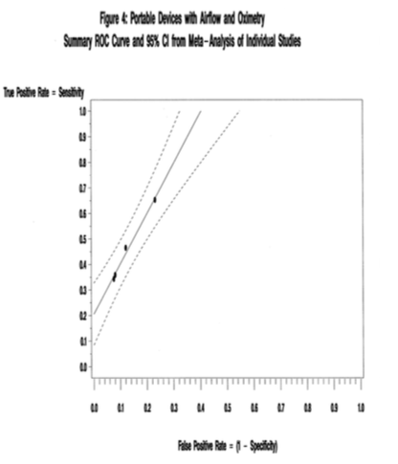
Diagnostic Studies
Much easier now in STATA with the metandi command

Slide 24
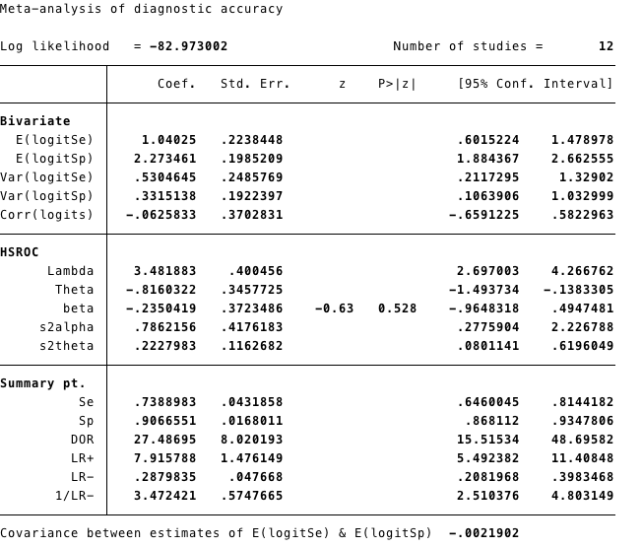
STATA: metandi TP FP FN TN

Slide 25
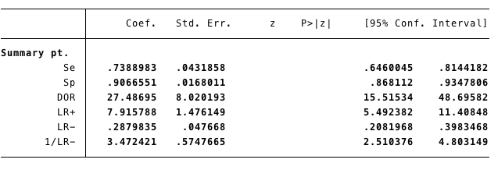
metandi TP FP FN TN, nobivariate nohsroc plot

Slide 26
metandi TP FP FN TN, nobivariate nohsroc plot
Easy to use
Results can be used in other models
Can get prediction plots

Slide 27
Evaluating Indirect Effects
Evidence includes studies of two treatments:
  comparing one to the other
  comparing each to a placebo
  comparing each to a third comparator
  or any combination of these

Slide 28
Evaluating Indirect Effects
Estimating Missing Effect Sizes
TYPE OF INTERVENTION
Standard Type1 Type2 Type3
Region
A X X X
E X X X
T X X

Slide 29
Testing Treatment Differences in Placebo Controlled Studies
Evaluating Indirect Effects
Outcomes at 30 Days Composite (Death or MI)
Study Drug # of Patients # Studies Odds Ratio 95% CI
Drug A 9,606 5 0.45 (0.37, 0.55)
Drug E 5,834 4 0.82 (0.69, 0.98)
Drug T 3,634 3 0.73 (0.57, 0.92)

Slide 30
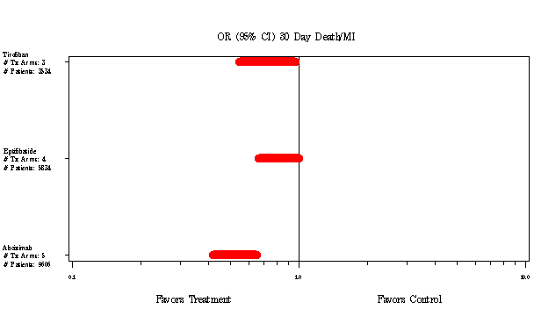
Evaluating Indirect Effects
Testing Treatment Differences in Placebo Controlled Studies
One-way ANOVA comparing treatments:
Drug A vs. Drug E p < 0.001
Drug A vs. Drug T p < 0.01
Drug E vs. Drug T p > 0.05

Slide 31
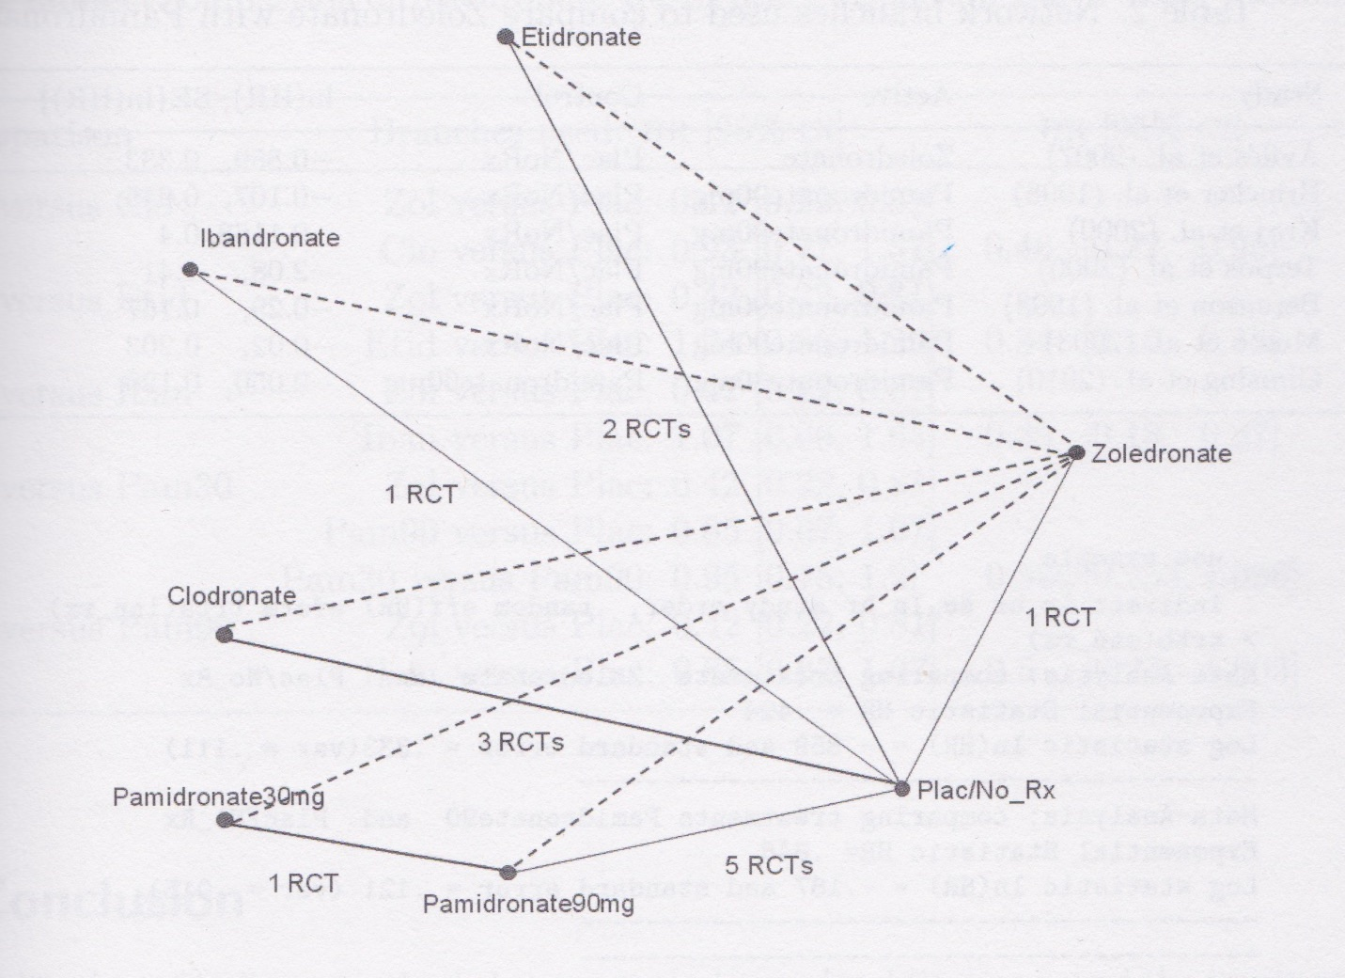
Beyond ANOVA: Evaluating Indirect Effects
And Network Analyses

Slide 32
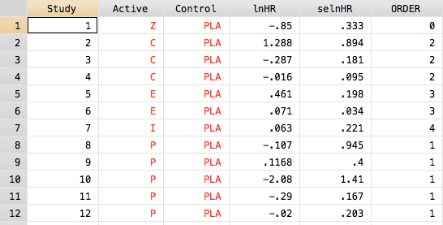
Raw data
Evaluating Indirect Effects
STATA: indirect lnHR selnHR Study ORDER, random eff(HR) eform trta(Active) trtb(Control)

Slide 33
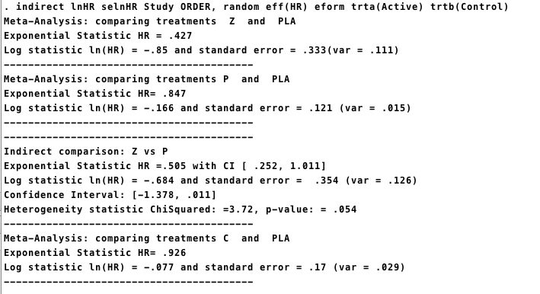
Evaluating Indirect Effects

Slide 34
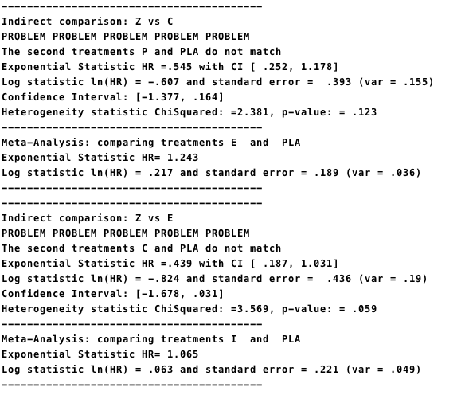
Evaluating Indirect Effects
Why no I vs. Z?

Slide 35
Raw data
Evaluating Indirect Effects
STATA: indirect lnHR selnHR Study ORDER, random eff(HR) eform trta(Active) trtb(Control)

Slide 36
Special Issues in Meta-Analysis
Meta Meta Meta Analyses
Meta-Analysis of transition probabilities
Pharmocoeconomic Meta-Analysis
Meta-Analysis of zero events

Slide 37
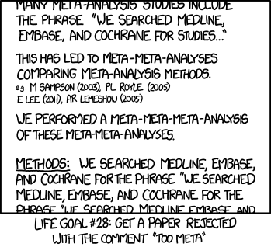
Meta Meta Meta Analyses
*xkcd

Slide 38
Markov Chain Meta-Analyses
Where is it being applied?
Policy analyses in mental health
-modeling transition probabilities within a mental health system
-probability of transition to outpatient or readmission
Genome analyses
-modeling likelihood of gene pairings

Slide 39
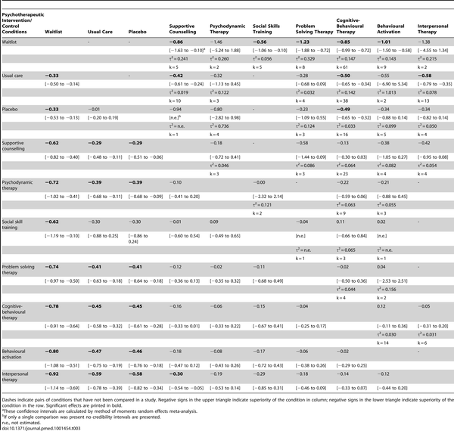
Markov Chain Meta-Analyses
Relative effect sizes (and 95% credibility intervals)
of psychotherapeutic interventions
Barth J, Munder T, Gerger H, Nüesch E, et al. (2013) Comparative Efficacy of Seven Psychotherapeutic Interventions for Patients with Depression: A Network Meta-Analysis. PLoS Med 10(5): e1001454. doi:10.1371/journal.pmed.1001454
http://www.plosmedicine.org/article/info:doi/10.1371/journal.pmed.1001454

Slide 40
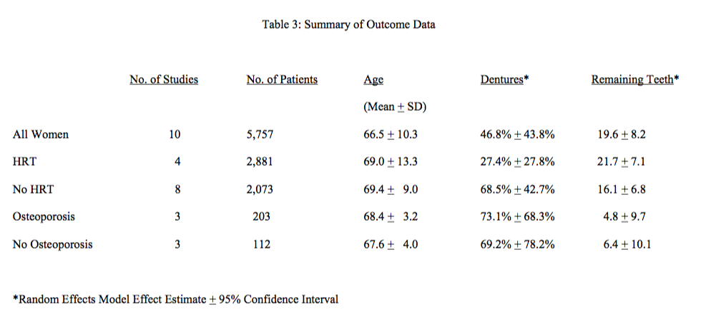
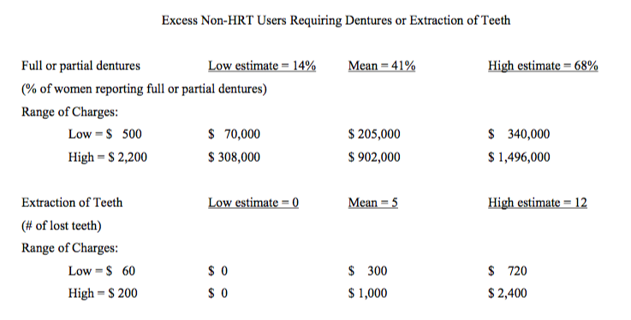
Pharmacoeconomic Meta-Analysis
Effect of postmenopausal hormone replacement therapy on dental outcomes: systematic review of the literature and pharmacoeconomic analysis.
Allen IE, Monroe M, Connelly J, Cintron R, Ross SD. Managed Care Interface, 2000
Overall, the annualized excess cost associated with these two dental outcomes in non-HRT users is estimated to be between $ 14,000 and $ 300,000 with a mean of $ 100,000 per thousand untreated postmenopausal women per year.

Slide 41
What to do with zero events?
Bracco v. Amersham (X-Ray Contrast Media)
Dueling Marketing Claims each based on a meta-analysis
Re-analysis of both meta-analyses by each company
Most fun: Teaching the judge (she was an English major) about statistics, odds ratios, meta-analyses, and Bayes
STATA has two fixes here
  Easy – adds 0.5 to each outcome
  Hard – imputes the missing data

Slide 42
What to do with zero events?
Renal Safety of Iodixanol(IOCM) v. Iopamidol (LOCM) on the incidence of Contrast Induced Nephropathy
Fixed effects models
Per protocol analysis
Omits 6 studies with zero outcomes

Slide 43
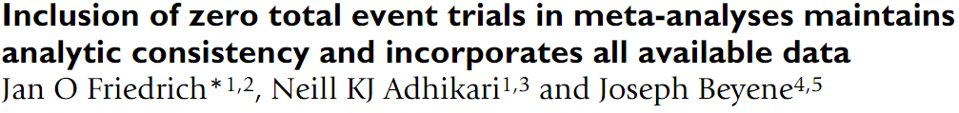
What to do with zero events?
Reanalysis using all the studies, intent-to-treat population, and random-effects models

Slide 44

When working on meta-analyses in the future, you can certainly find me if you have questions:
Isabel.allen@ucsf.edu 2nd Floor Mission Hall

