Slide 1
Implementation Strategies
Epidemiology 245
Spring 2016

Slide 2
Overview
Describe distinctive challenges to conceptualization of implementation interventions and strategies
Describe a framework for understanding implementation interventions and strategies
  Proctor framework
Illustrate use of this framework to dissect interventions and strategies
Describe consequences of inadequate conceptualization of implementation interventions

Slide 3
What are Implementation Interventions / Strategies?
“Implementation strategies…constitute the ‘how to’ component of changing healthcare practice”
“…the specific means or methods for adopting and sustaining interventions…”
Something done to close the gap between evidence and practice

Slide 4
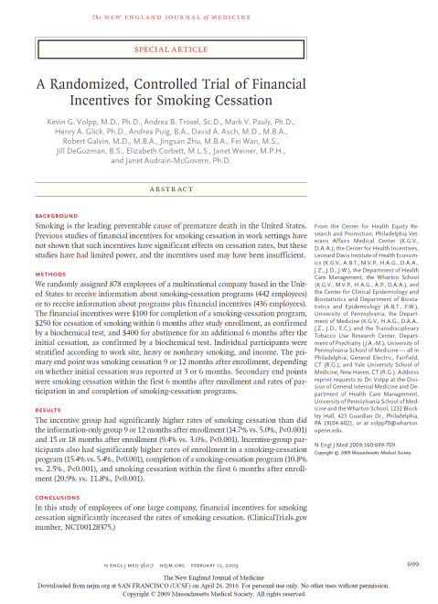
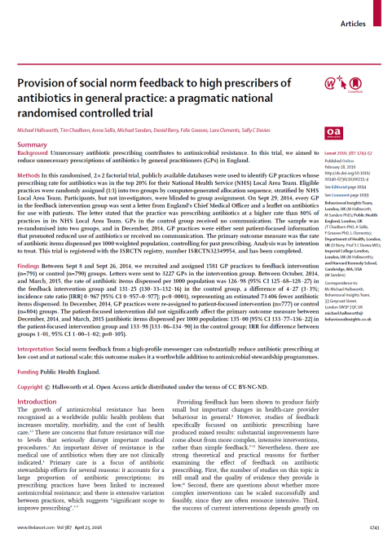


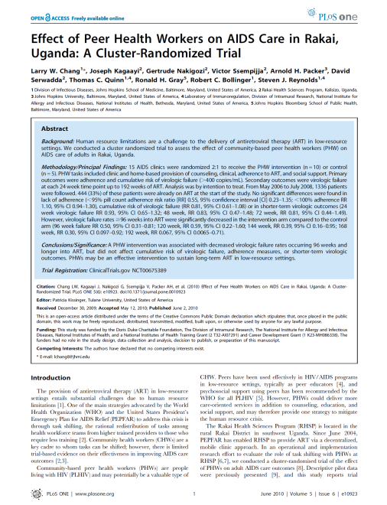
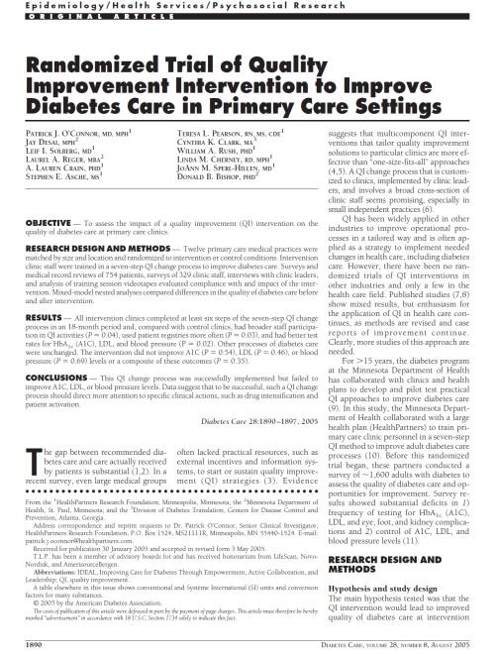


Implementation Strategies and Interventions: Examples…
Incentives
Social Networks
Quality Improvement
Notes:
Of course not all RCT’s

Slide 5
Implementation vs. Clinical Interventions
Traditional Clinical Intervention
(often a pharmacologic intervention)
Implementation Strategy
(often a behavioral intervention)
Bench and animal research : identify a
compound; understand mechanism
Draw from existing practices to design an intervention
Settle on a precise formulation: dose, frequency, monitoring requirements
Phase 1 and 2 trials: determine safety, dosage, side effects…
Use the intervention as designed in a study (or in practice) – including adaptive ones
Use the drug in a clinical trial (selected population; controlled measurements)
Intervention as delivered in that study
Intervention as delivered in that trial (adherence)
Intervention effects - efficacy
Intervention effects – effectiveness; unintended effects (i.e., side effects)
Notes:
In drug development – there is a lot that goes into understanding the intervention before you can use it in people. They are working with a firmer grasp of underlying mechanisms.

Slide 6
Distinctive Challenges for Implementation Interventions
Implementation interventions are not fully conceptualized nor specified
  Dose, frequency, intensity are not prerequisites
How implementation interventions work is less understood
  “Mechanism” of effect incompletely known a priori
Difference between interventions as (originally) designed and as delivered
  Sometimes that is good - adaptivity
  Sometimes not good - fidelity
There is more uncertainty about effects
  intended and unintended effects

Slide 7
From Gap, to Gap Analysis, to Implementation Intervention
We have identified a gap and
analyzed the reasons for it…
You want to change the behavior
of the health system, organization,
health care worker, patient or community to close that gap
Still has ACE
Leadership wants ACE
Ever successfully started
ACE
Hospital that serves elderly
An approach to conceptualize the interventions or strategies to close this gap?

Slide 8
Conceptualizing and specifying implementation interventions
Still has ACE
Leadership wants ACE
Ever successfully started
ACE
Hospital that serves elderly
(Or gap)
Proctor et al. Implémentation Science 2013, 8:139

Slide 9
 | Socio-ecologic level government: Leveraging contracting and financing mechanisms to enhance ART coverage | Socio-ecological level HCW: Enhance doctor offer and prescription of PrEP | Socio-ecological level: Patient
Actor | The Global Fund for HIV, TB and Malaria in Geneva (Government, civil society, private, community partnership) | Peer opinion leader | Counselor trained in motivational interviewing
Action | Offering governments in LMIC a choice between a lump sum for public health services rather than fee reimbursement | Training, engaging and motivating HCW | Explore though counseling patient experiences with PrEP
Dose | Once yearly | CME once and detailing quarterly | Monthly
Action Target | Motivate ministries of health | Provider capability, motivation | “We targeted participant identification of adherence-related needs…what would make it easier to integrate product use into daily life …”
Behavioral target | Find efficiencies in public health delivery | Identify and offer PrEP | Promote discourse that touches on desire, ability, reason, or need for product use
Cascade target | Identify more HIV infected individuals through HIV testing | PrEP initiation | Greater adherence to PrEP

Slide 10
Actor
Generalizable characterization of “actor”
Socio-demographics
Training, education (e.g., nurse)
Position (e.g., middle manager)
Identity (e.g., peer)
Sociometrically (e.g., opinion leader)
Knowledge / motivation gap: Leadership does not know or care about ACE – “actor” might be an advocacy organization or a branch of an advocacy organization (AARP).
Technical gap: Leadership wants it but doesn't know how to get it done – “actor” could be a professional with X training who occupies a new “seconded” position (e.g., QI for HIV - HRSA)
Hospital that
serves elderly
Leadership
wants ACE
Ever successfully
started ACE
Still has ACE
Notes:
Describe the actor in general terms.
The actor depends on your gap analysis.

Slide 11
Action
“An active verb statements to specify the specific actions, steps, or processes that need to be enacted” (e.g., train, educate, persuade, motivate) (BCW)
Knowledge / motivation gap: Leadership does not know or care about ACE – “actor” might be an advocacy organization or a branch of an advocacy organization (AARP) which seeks to persuade through petition letters and reputational incentive (website that shows facilities with and without ACE)
Technical gap: Leadership wants it but doesn't know how to get it done – “actor” could be a professional with X training who occupies a new “seconded” position (e.g., QI for HIV - HRSA seconds) which seeks to engage, motivate and train colleagues on a committee
Hospital that
serves elderly
Leadership
wants ACE
Ever successfully
started ACE
Still has ACE
Notes:
QI for HIV services in Africa as an example
Gap A: inadequate capacity at the level of the national leadership to develop a program
Actor A: QI expert secunded to the ministry by USAID
Actoin A: Engaged, train, and motivate leadership to institutionalize QI practices
Gap B: Facility take up is poor because there is no buy in from the in charges and weak managerial links because facilities are geographically remote
Actor B: District health officers
Action B: text messages What about prep among reproductive health specialists...
Action... What is the actor suppose to do? The seconded person changes the capability and motivation of the organization through leading, convening a committee, engaging decision makers, maybe that is how you envision their role?

Slide 12
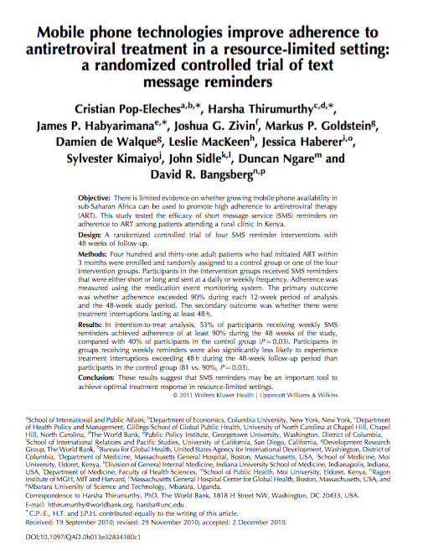
Dose and Temporality
Knowledge / motivation gap: Leadership does not know or care about ACE – “actor” might be an advocacy organization or a branch of an advocacy organization (AARP) which seeks to persuade through petition letters and reputational incentive (website that shows facilities with and without ACE) (which are delivered monthly and available continuously, respectively)
Technical gap: Leadership wants it but doesn't know how to get it done – “actor” could be a professional with X training who occupies a new “seconded” position (e.g., QI for HIV - HRSA seconds) which seeks to engage, motivate and train colleagues on a committee - delivered at weekly meetings and prn as opportunities arise
Notes:
A QI coach who makes 2-hour, weekly visits to a clinic in order to train health care workers
The AARP ACE campaign unit sends letters with petitions to hospital CMO’s once monthly to show growing support
A teaching campaign using opinion leaders to give talks at free dinners about PrEP – seeks to target each provider only once.
It matters for Amoxicillin, prednisone and ibuprofen, does dose matter for behavioral interventions?
Weekly SMS enhances adherence, daily does not – even if message content is the same
Incentives

Slide 13
Action Target
The determinant of behavior
Mediates between intervention actions and behaviors
One schema: capability, opportunity, motivation (COMB)
Examples:
  A QI coach makes 2-hour visits each week to a clinic in order to train and thereby enhance capabilities of health care workers
  The AARP ACE campaign unit sends petitions monthly to motivate hospital CMO’s
  A state offered tax relief each year for the next five years to incentivize facilities to create new analytic capabilities through database tools

Slide 14
Behavioral Target (Implementation Outcomes)
Behavior that you seek to change
Necessary component but usually insufficient cause of closing cascade step
Proctor offers acceptability, sustainability, adoptability, etc.
Examples:
  A QI coach makes 2-hour visits each week to a clinic in order to train and thereby enhance capabilities of health care workers to operate a quality committee
  The AARP ACE campaign unit sends petitions monthly to motivate hospital CMO’s to allocate an FTE to leading an ACE scale up
  A state offered tax relief each year for the next five years to incentivize facilities to create analytic database tools that systematically reports incident kidney dysfunction

Slide 15
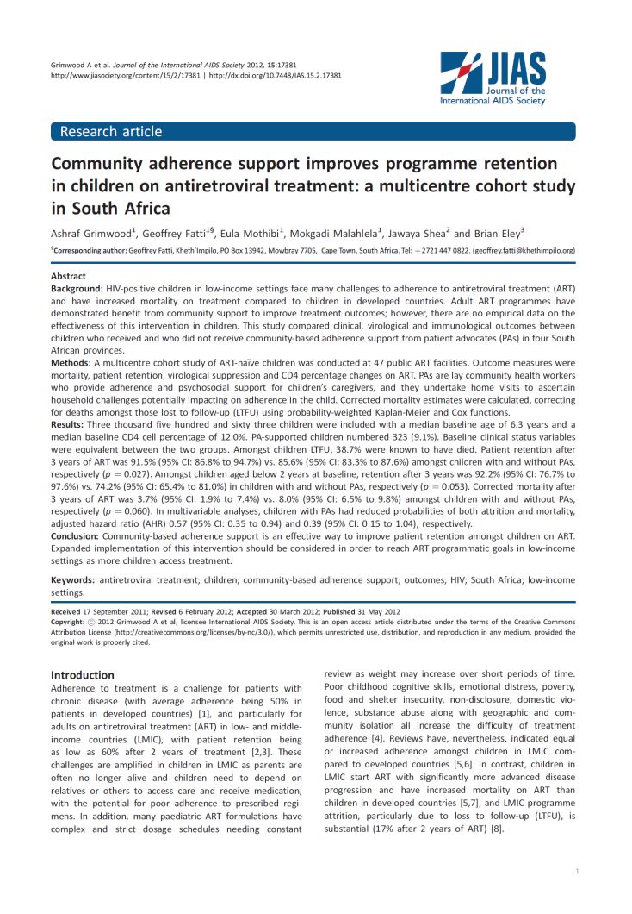
Action Specification: Repeatability
Effect of “patient advocates” on pediatric HIV retention (Grimwood JIAS 2012)
Cascade step: reduced attrition (AHR) 0.57 (95% CI: 0.35 to 0.94)
Actors
  “patient advocates” carried out selection, education, training
Actions
  clinical assessments, counseling and concrete care activities
Temporality, dose, frequency, duration, of contact unspecified
Notes:
And dose matters
Network meta-analyses for indirect comparisons across common SOC –
Couples counseling increases uptake of pMTCT (Becker 2009)
Act through patient knowledge, beliefs and attitudes or through facilitated disclosure?
If you measure the extent to which the effect is mediated by disclosure, you can infer more accurately about the effect of the interventino in settings with different levels of disclosure, different drivers of disclosure and in environments where disclosure may be effect modified by something else

Slide 16
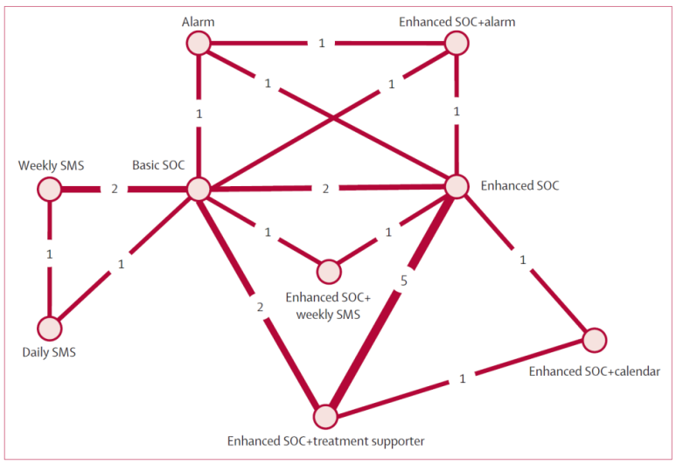
Actors and Actions: Accumulatability
Meta-analyses seek to combine studies to synthesize research findings
Network meta-analysis offer synthetic “comparative effectiveness”
Effects synthesis without adequate intervention specification?
“Peer support”
  Clinic assigned or self selected?
  Meets in facility or community?
  Monthly vs. weekly vs. as needed (i.e. prn?)
Mills Lancet HIV 2014
Notes:
Network meta-analysis of interventios to support adherence to HIV treatment (Mills Lancet HIV 2014)
“Comparative effectiveness”
Estimate A vs. C even if A never studied against C
Via common comparison against B

Slide 17
Generalizability: Transportability vs. Robustness
Generalizability - Transportability
  The ability to use results in one setting to infer about another
  A function of what you have measured in the initial setting and what you know about the new settings
  Age standardization
  More complex when interventions have an effect on mediators of effects
Generalizability – Robustness
  Stability of effects across different settings
  Generalizability is the way you study the intervention
Both depend on understanding mechanism

Slide 18
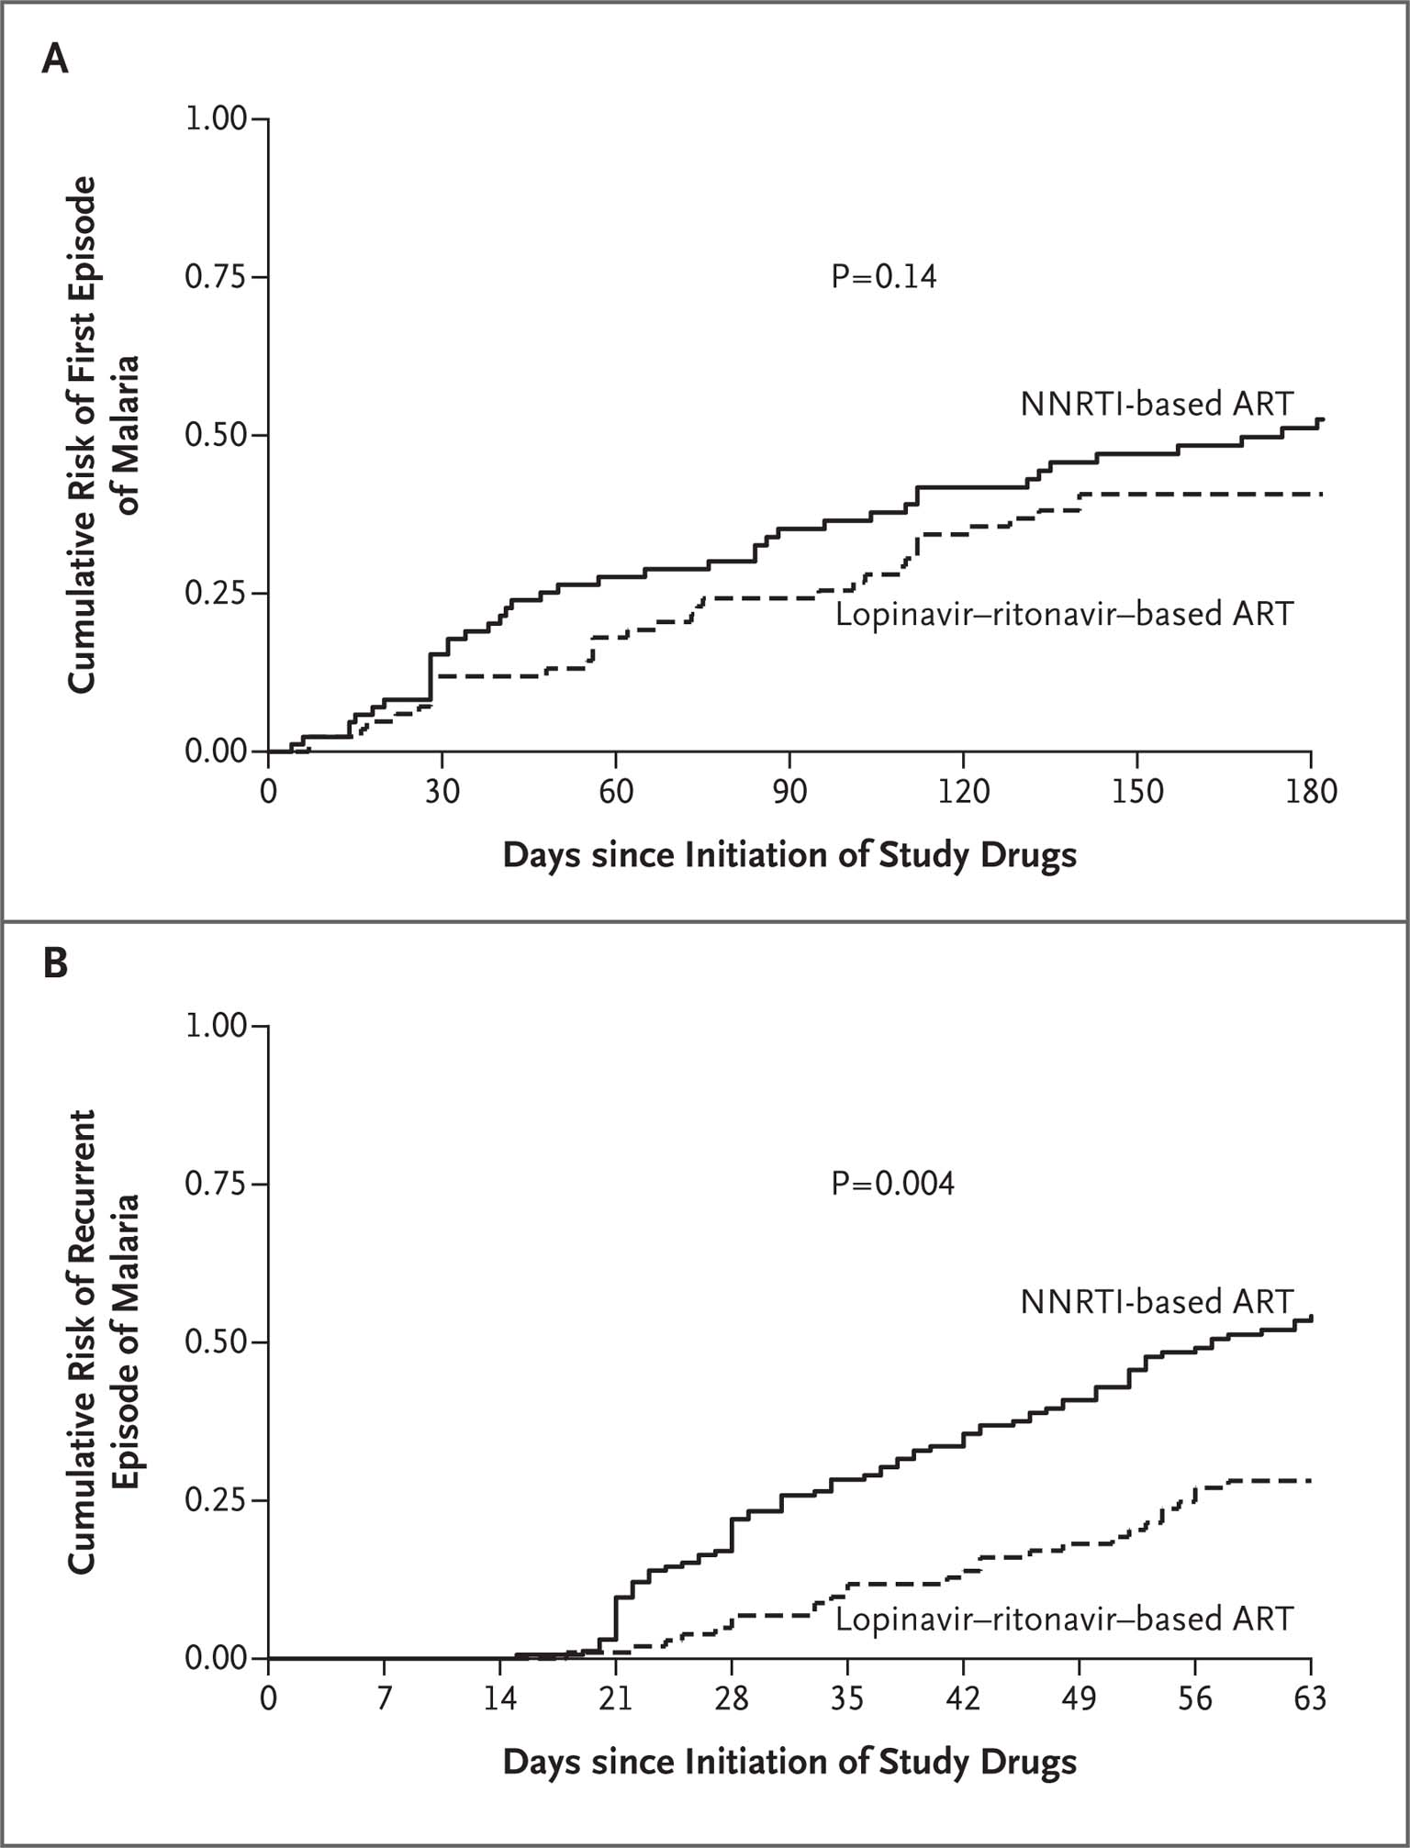
Mechanisms Inform Transportability: Infer about Effects Elsewhere
Understanding action target (s) enables inference about results in one setting in another
Illustration from clinical medicine
  Protease inhibitors have anti p. falciparum effect
  Protease inhibitors alter kinetic of anti-malarial drugs
Mechanism informs generalizability
  Direct anti-plasmodium effect → can expect the same effect in low prevalence areas
  Boosting coartem → not transportable to low prevalence settings
First episode of malaria
Recurrent malaria
Achan NEJM 2012;367:2110-8.
Notes:
In this 2012 NEJM paper the investigators sought to test the effect of PI vs. NNRTI in the treatment of HIV infected children in Uganda on malaria.
Use of PI’s was motivated by the observation that PI’s have a direct effect on p falciparum. At the same time PI’s influence the . The investigators stored samples every 12 weeks
176 children between 2 and 5 were randomized
In the intervention condition, malaria incidence went from 2.3 to 1.3 episodes per person year with a incidence rate ratio of 0.59 – p value that is 0.04
When they examined the “mechanism” of the effect, the found no evidence of a direct anti-malarial effect, but rather a marked change in the levels of coartem after an initial episdoe, and indeed overall the effect of PI was seen only in on recurrent episdoes

Slide 19
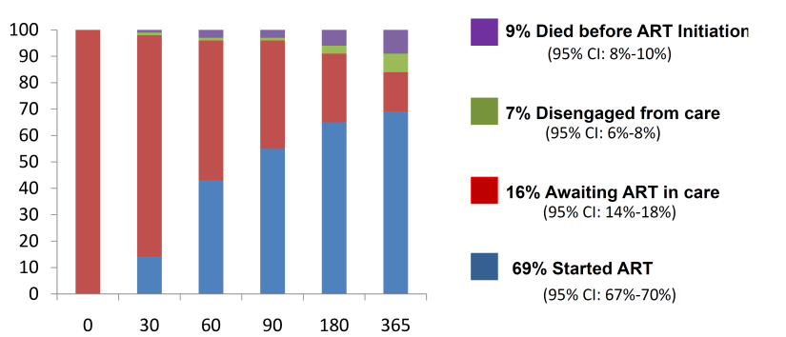
Delays in ART Initiation among ART Eligible Patients
East Africa IeDEA Consortium
Reasons:
Structural
  Overnight processing of CD4 testing
    Failure to return for second visit
Organizational
  One size fits all counseling
    “treatment supporter” and three pre-ART adherence visit requirements
Providers
  Slow diffusion of new clinical research findings
    Unaware of new data suggesting timing matters (Zolopa 2009, Havlir 2011)
    “ART is not an emergency”
Days since ART eligibility

Slide 21
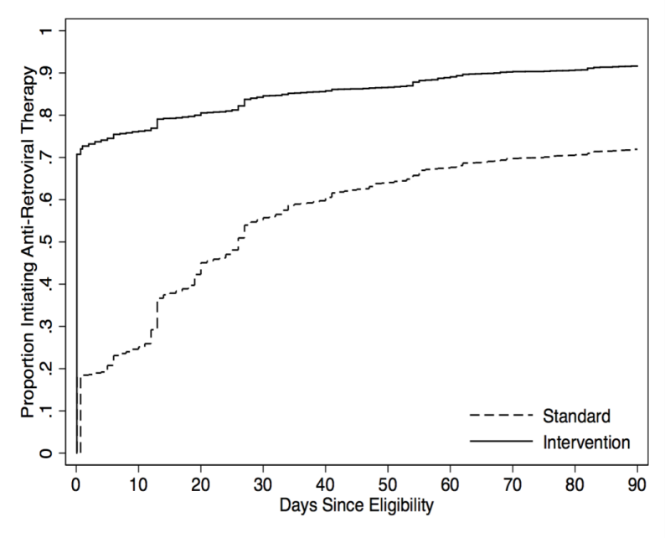
Primary outcome: ART initiation by 14 days after ART eligibility (N=12,024)
Cumulative Incidence of ART Initiation
Notes:
Among 12,024 treatment eligible patients 79.6% met the primary outcome of ART initiation two weeks after eligibility in the intervention condition vs. 37.7% in the control condition (risk ratio of 2.11 (95% CI of 2.03 to 2.20) and a risk difference of 41.9%, (95% CI: 40.1%-43.8%). The p value was less than 0.0001
Subgroup analysis found this effect to be consistent across sex, age, although an attenuation in effect over each intervention wave was observed.
The full distribution of ART initiation times shows that the probability of initiation on the same day as eligibility rose from 18.30% to 70.80%, for a risk ratio of 3.87 (95% CI: 3.64 - 4.11, P < 0.0001).
At 90 days, 70.40% had started in the control condition and 89.70% in the intervention condition, for a risk ratio of 1.27 (1.25 - 1.30), p value <0.0001
The cumulative incidence was estimated with the Aalen-Johansen competing risk method

Slide 24
Implementation Strategies Targeting HIV Treatment Cascade in LMIC: a Systematic Review
Systematic search for studies of interventions targeting HIV treatment cascade in LMIC in published literature
  Quantitative, comparator group
Characterized “intervention types”
  Functional archetypes recognizable by public health implementers.
Grouped “intervention types” into a broader “intervention approaches” using principle components analysis
N=106 studies
Characteristic |  | %
Region
 | Africa | 83
 | Asia | 10
 | Americas | 5
 | Eastern Europe | 1
Design
 | Individual RCT | 15
 | Cluster RCT | 14
 | Observational | 71
Level of effect
 | Clinic/health facility | 23
 | Community | 10
 | Health care system | 16
 | Health care worker | 0.4
 | Patient | 45
 | Patient and family | 4
Study size – med (IQR) |  | 1034 (432 to 7333)
Notes:
For example, Franke¹² reported on an “accompaniment” intervention in Rwanda where a community health worker made daily visits to the patient home in which social support, adverse event evaluation, directly observed therapy, and dispensed food supplementation were all provided. The intervention types therefore included: “counseling,” “social support (non-peer),” “directly observed therapy” and “food supplementation” and “incentive.” As a point of contrast, Igumbor¹³ studied a “patient advocate” intervention in South Africa which facility based staff made home visits, assessed of barriers to adherence, counseled about adherence and plan adherence support services. Therefore the intervention types included, “counseling,” and “peer support (community based)”, but would not include “DOT” since this was not carried out or “food supplementation.”

Slide 25
Intervention Types (N=491)
Intervention Type | Count
Counseling | 34
Point of care | 27
Integration | 25
Peer support (community-based) | 25
Decentralization | 23
mHealth | 23
Peer support (facility-based) | 23
Mobile testing | 22
Task shifting | 22
Home based care | 21
Incentives | 19
Service expansion | 19
Social support non-peer based | 18
Outreach | 17
Community mobilization | 16
Guidelines | 16
Intervention Type | Count
Management | 16
Navigator | 16
Quality improvement | 15
Male involvement | 14
Reminder | 12
Food supplementation | 11
Health worker training | 11
Data management | 10
Community based care | 9
Patient skills development | 8
Adjunctive services | 7
Directly observed therapy | 6
Technology | 5
Behavioral economics (other) | 4
Health campaign | 2
Leadership | 2
Mass marketing | 1
Notes:
491 instances of intervention types – this implies that each intervention is characterized by more than one intervention type.
Any given intervention could be composed of more than one intervention type – so for example, counseling with peers would counted as counseling as well as peer support while counseling with
Behavioral economcis not – opt out
Industrial engineering – Sheer - Systems Analysis and Improvement to Optimize pMTCT: A Cluster Randomized Trial
Leadership - mobilization of province wide PMTCT team to improve key PMTCT indicators in the 11 districts of KZN province (ias)
Mass communications: adolescents and theater Communication on sexual rights and health: participation of adolescents in reformatories

Slide 26
Intervention Approaches | n | % | Intervention Type | n | %
Service delivery architecture: above facility | 42 | 40% | Task shifting | 19 | 18%
 |  |  | Decentralization | 15 | 14%
 |  |  | Service expansion | 7 | 7%
 |  |  | Integration | 6 | 6%
 |  |  | Peer support (facility-based) | 5 | 5%
Counseling/Skills Development | 31 | 29% | Counseling | 29 | 27%
 |  |  | Patient skills development | 12 | 11%
Community Interventions | 25 | 24% | Outreach | 22 | 21%
 |  |  | Peer support (community-based) | 10 | 9%
 |  |  | Community mobilization | 5 | 5%
 |  |  | Home-based care | 4 | 4%
Technology | 20 | 19% | Reminder | 16 | 15%
 |  |  | Technology | 10 | 9%
 |  |  | mHealth | 9 | 8%
Organizational Process Improvement | 18 | 17% | Guidelines | 9 | 8%
 |  |  | Health worker training | 7 | 7%
 |  |  | Management | 5 | 5%
 |  |  | Leadership | 2 | 2%
 |  |  | QI | 1 | 1%
Non-Peer Social Support | 16 | 15% | Social support (non-peer) | 14 | 13%
 |  |  | Directly observed therapy | 6 | 6%
 |  |  | Male involvement | 1 | 1%
Service delivery architecture: within facility | 14 | 13% | Mobile testing | 8 | 8%
 |  |  | Point-of-care | 7 | 7%
 |  |  | Data management | 1 | 1%
Additional Services | 13 | 12% | Incentives | 9 | 8%
 |  |  | Food supplementation | 6 | 6%
 |  |  | Navigator | 3 | 3%
 |  |  | Adjunctive services | 2 | 2%
Service Promotion | 3 | 3% | Demand creation | 2 | 2%
 |  |  | Marketing/mass communication | 2 | 2%

Slide 27
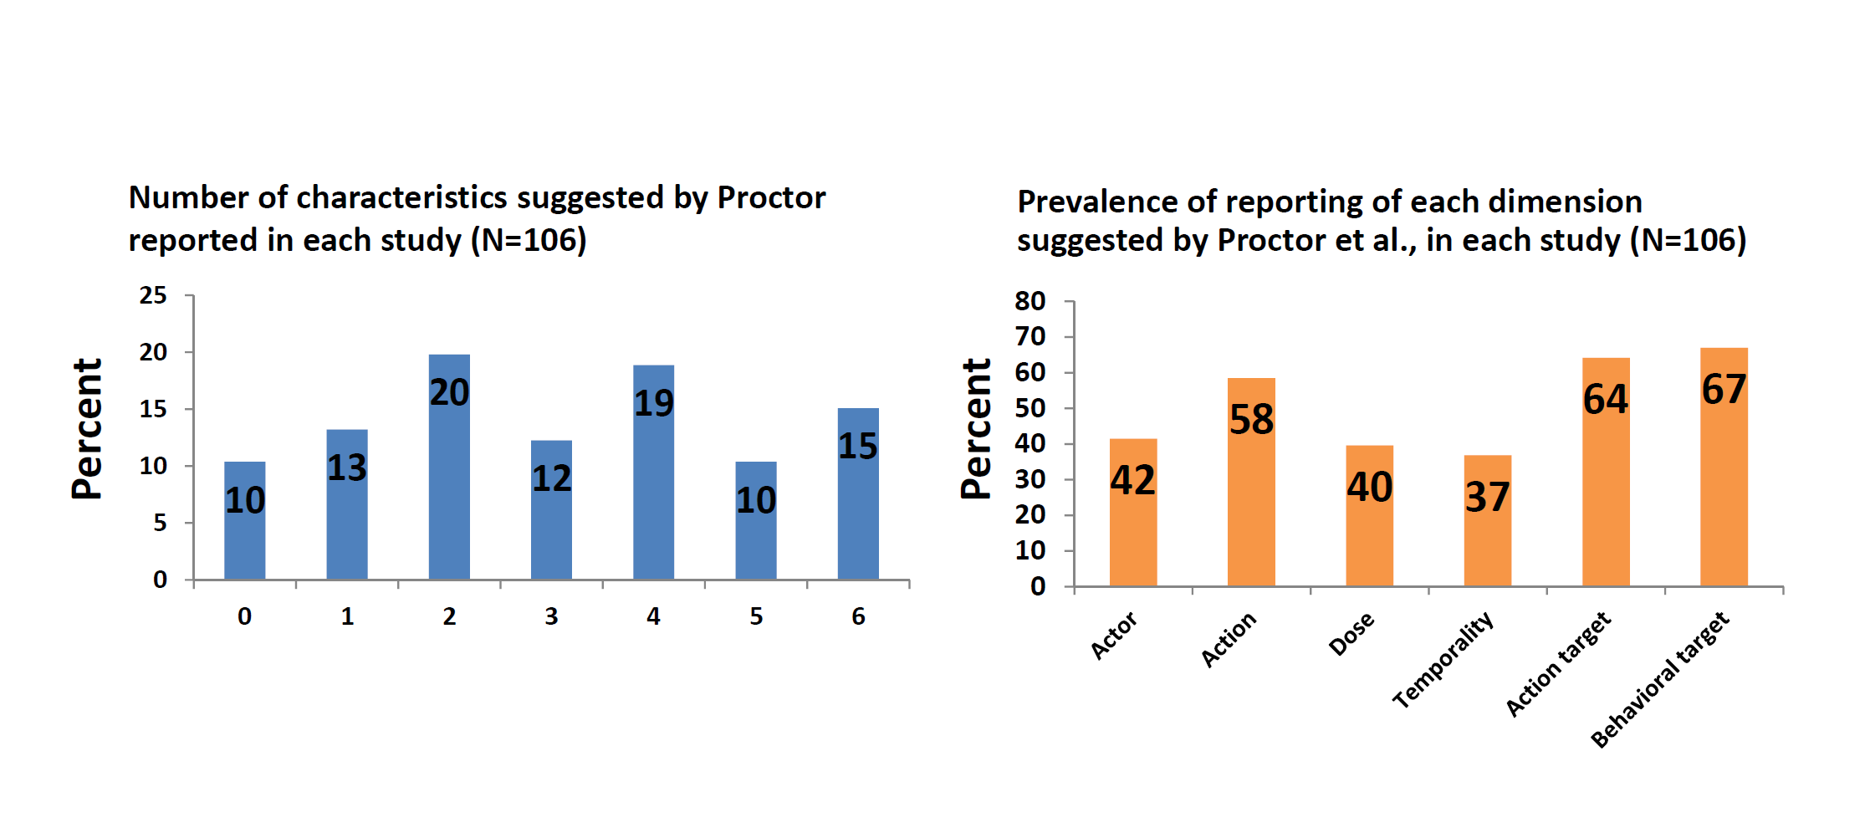

Slide 28
Intervention Specification: Intervention Approaches (N=106)
 | Facility-based Service Delivery Architecture | Incentives/Additional Services | Non-Peer Social Support | Community Interventions | Service Promotion/Marketing | Organizational Process Improvement | Counseling/Skills Development | Health Care Worker Improvement | Technology | Non-facility based Delivery Architecture | Average
Actor | 0.29 | 0.23 | 0.25 | 0.60 | 0.33 | 0.80 | 0.55 | 0.62 | 0.55 | 0.71 | 0.49
Action | 0.38 | 0.62 | 0.69 | 0.68 | 0.67 | 0.60 | 0.77 | 0.54 | 0.80 | 0.86 | 0.66
Dose | 0.29 | 0.46 | 0.38 | 0.32 | 0.33 | 0.20 | 0.35 | 0.46 | 0.70 | 0.57 | 0.41
Temporality | 0.33 | 0.15 | 0.38 | 0.28 | 0.33 | 0.60 | 0.39 | 0.46 | 0.60 | 0.57 | 0.41
Average | 0.32 | 0.37 | 0.43 | 0.47 | 0.42 | 0.55 | 0.52 | 0.52 | 0.66 | 0.68

Slide 29
Intervention Specification: Cascade Targets (N=106)
 | Testing | Linkage | Staging | Initiation | Pre-ART retention | Retention on ART | Adherence | Row Average
Actor | 0.55 | 0.56 | 0.63 | 0.58 | 0.56 | 0.44 | 0.43 | 0.42
Action | 0.70 | 0.67 | 0.75 | 0.58 | 0.67 | 0.44 | 0.73 | 0.58
Dose | 0.35 | 0.44 | 0.63 | 0.42 | 0.67 | 0.26 | 0.57 | 0.40
Temporality | 0.35 | 0.56 | 0.88 | 0.58 | 0.67 | 0.33 | 0.41 | 0.37
Average | 0.49 | 0.56 | 0.72 | 0.54 | 0.64 | 0.37 | 0.54

Slide 30
Mechanism Specification: Intervention Approaches (N=106)
 | Facility-based Service Delivery Architecture | Incentives/Additional Services | Non-Peer Social Support | Community Interventions | Service Promotion/Marketing | Organizational Process Improvement | Counseling/Skills Development | Health Care Worker Improvement | Technology | Non-facility based Delivery Architecture | Average
Action target | 0.64 | 0.77 | 0.56 | 0.60 | 0.67 | 0.60 | 0.68 | 0.77 | 0.80 | 0.79 | 0.69
Behavioral target | 0.48 | 0.77 | 0.81 | 0.64 | 1.00 | 0.60 | 0.77 | 1.00 | 0.65 | 0.93 | 0.77
Average | 0.56 | 0.77 | 0.69 | 0.62 | 0.84 | 0.60 | 0.73 | 0.89 | 0.73 | 0.86

Slide 31
Mechanism Specification: Cascade Targets (N=106)
 | Testing | Linkage | Staging | Initiation | Pre-ART retention | Retention on ART | Adherence
Action target | 0.65 | 0.67 | 0.75 | 0.68 | 0.56 | 0.54 | 0.73 | 0.65
Behavioral target | 0.95 | 0.89 | 0.88 | 0.89 | 0.78 | 0.38 | 0.73 | 0.79
 | 0.80 | 0.78 | 0.82 | 0.79 | 0.67 | 0.46 | 0.73

Slide 32
Association between Implementation Approach and Specification
Implementation Approach | Coefficient | 95% CI |  |  | p-value
Non-Facility-Based Service Delivery | 2.28 | 1.14 | - | 3.43 | <0.0001
Technology | 1.41 | 0.49 | - | 2.33 | 0.003
Health Care Worker Improvement | 1.57 | 0.49 | - | 2.65 | 0.005
Counseling/Skills Development | 0.91 | 0.03 | - | 1.80 | 0.043
Organizational Process Improvement | 0.64 | -0.97 | - | 2.24 | 0.433
Service Promotion/Marketing | 0.96 | -1.29 | - | 3.21 | 0.399
Community Interventions | -0.08 | -0.94 | - | 0.78 | 0.853
Non-Peer Social Support | 0.02 | -0.98 | - | 1.02 | 0.968
Incentives/Additional Services | 0.31 | -0.91 | - | 1.52 | 0.617
Facility-Based Service Delivery Systems | -0.29 | -1.13 | - | 0.55 | 0.498

Slide 33
Association between Cascade Step and Specification
Cascade step | Coefficient | 95% CI |  |  | p-value
Testing | 0.97 | -0.14 | - | 2.1 | 0.086
Linkage to Care | 0.38 | -0.97 | - | 1.7 | 0.58
Staging | 1.1 | -0.41 | - | 2.6 | 0.15
ART Initiation | 0.41 | -0.71 | - | 1.5 | 0.47
Pre-ART Retention in Care | 1.2 | -0.21 | - | 2.6 | 0.094
Retention in Care on ART | -0.38 | -1.2 | - | 0.50 | 0.40
Adherence to ART | 1.3 | 0.36 | - | 2.2 | 0.007

Slide 34

Understand Studies where “No Effect” is Observed
Actor does not do what the actor is supposed to do
Specification of the design (intended actor, action, dose, etc.) enables measurement of implementation (fidelity)
  Distinguish between a no effect and indeterminate study
If the target is reached but no behavior change is observed then there is a problem with the

Slide 35
The “Four P’s” of Implementation Research
Making research more relevant
Pedantic
Pragmatic
Internal validity
Purile
Populist
Relevance
Adapted from David Aron
Notes:
Implementation strategies are methods to influence the behavior
The goal of implementation research is to be both internally valid and highly relevant
In the academy, this conversation is mostly about how to make valid research more relevant – outside the academy it’s mostly about how to make real world data practices more rigorous, but I want to focus today’s discussion on the x-axis – on how to make research more relevant

Slide 36
Repeatability
Can other people carry it out either in program practice or research?
Transportable
Can we infer about effects in another setting even if population characteristics differ?
Accumulatable
Can findings be synthesized with other research findings?
Pragmatic
Robust
Is the intervention likely to have a big effect in diverse settings?
Rapid
Are findings disseminated in a timely way?
Notes:
There are many dimensions to

