Slide 1
Epi 245 section 4/5
Evaluating implementation

Slide 2
Specifying implementation strategies (Proctor)
Assessing implementation outcomes
Health Belief Model
Journal Club articles

Slide 3
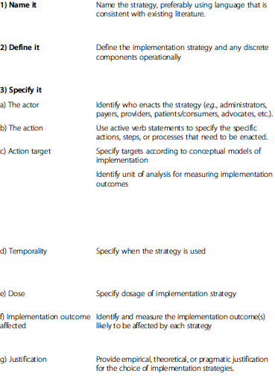
Implementation strategy guidelines
Proctor et al, 2013

Slide 4
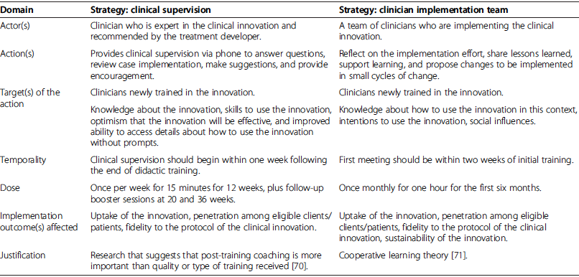
Specifying implementation strategies
Proctor et al, 2013

Slide 5
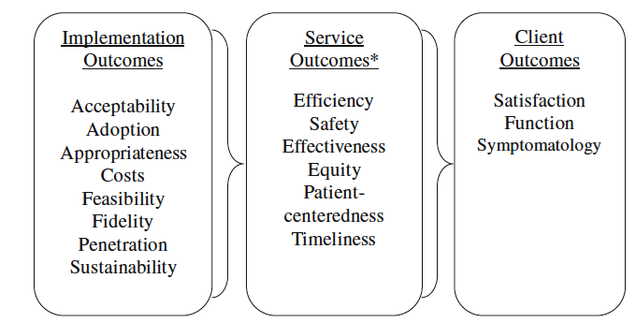
Implementation outcomes
From Proctor et al, 2011

Slide 6
Assessing implementation outcomes: RE-AIM framework
Reach
Effectiveness
Adoption
Implementation
Maintenance

Slide 7
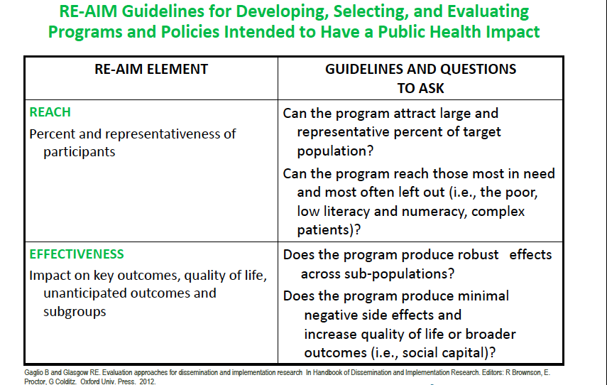

Slide 8
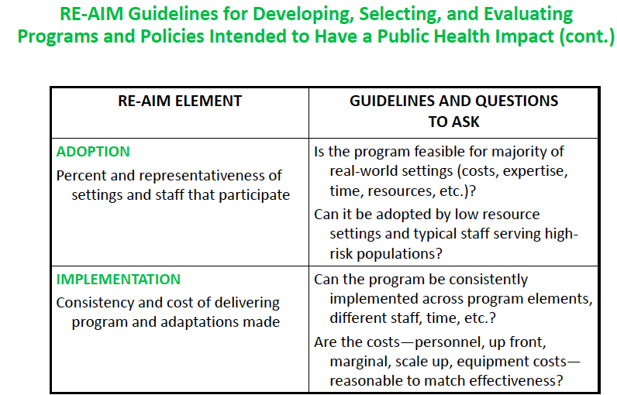

Slide 9
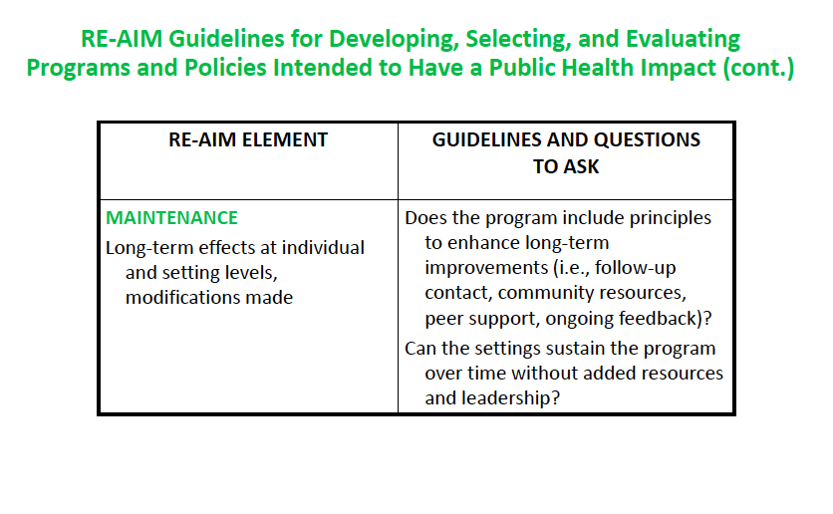
http://www.re-aim.org/forms/re-aim_framework_constructs_checklist.pdf

Slide 10
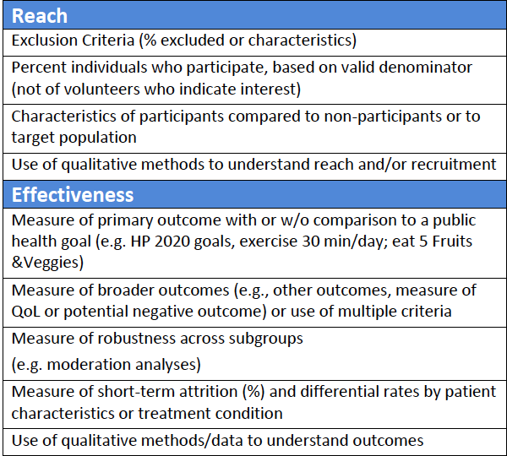
Reach & Effectiveness

Slide 11
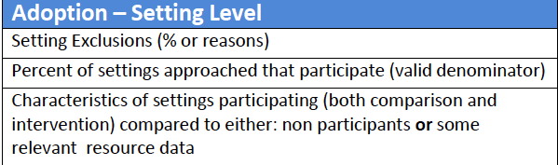
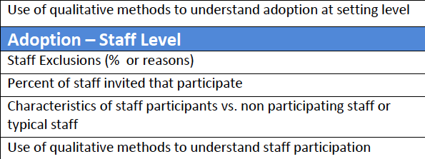
Adoption

Slide 12
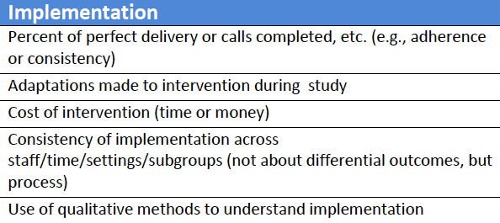
Implementation

Slide 13
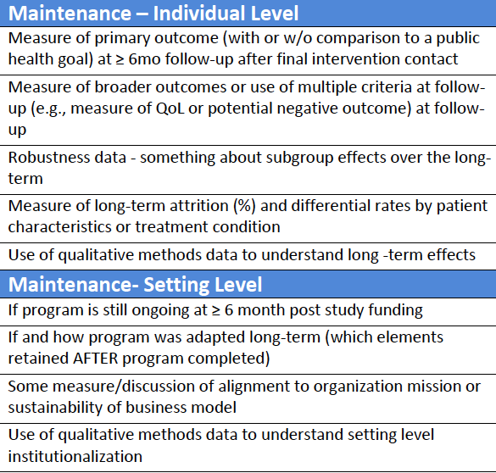
Maintenance

Slide 14
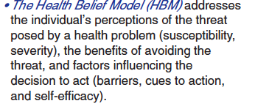
Health Belief Model

Slide 15
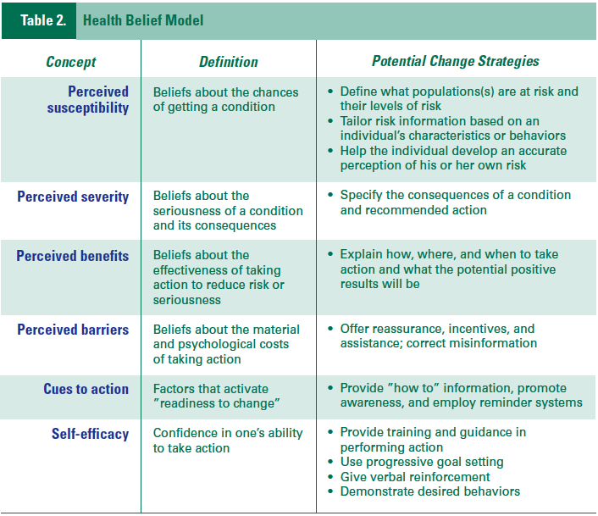
From Theory at a Glance

