Slide 1
Behavioral Economics
Part 1: Overview of concepts
James G Kahn, MD, MPH

Slide 2
Concepts
Neo-classical economic theory
Expected utility theory
Behavioral economics
  Prospect theory
    Judgment
    Choice
  Intertemporal choice
2
Notes:
The field of micro-economics is dominated by the neo-classical approach.
Because they didn’t know how to incorporate them into the formal theory - hard to measure
2

Slide 3
1. Neo-classical theory assumptions
People have rational preferences among outcomes that can be identified and associated with a value. These are stable.
Individuals maximize utility* and firms maximize profits.
People act independently on the basis of full and relevant information.
* utility is the satisfaction gained from consuming a good or service.
3
Notes:
The field of micro-economics is dominated by the neo-classical approach.
Because they didn’t know how to incorporate them into the formal theory - hard to measure
3

Slide 4
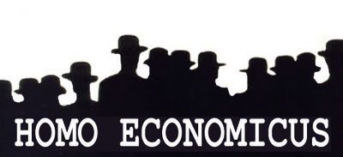
The Economic Human
maximizes utility as a consumer and economic profit as a producer.
"It is not from the benevolence of the butcher, the brewer, or the baker that we expect our dinner, but from their regard to their own interest.”
Smith, Adam. “On the Division of Labour,” The Wealth of Nations, 1776
Notes:
Assumption that the human acts rationally.

Slide 5
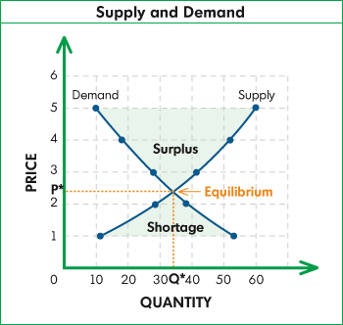
Supply and Demand Curve: Price mediates
At low price, there is a shortage:
supply < demand.
At high price, there is a surplus:
supply > demand.
At the equilibrium price (P*), supply = demand (Q*).
Assumes perfect information, rationality, utility maximizing.
Supply
Demand
Notes:
This is the classic supply and demand curve. By tradition, price is on the Y axis and quantity on the X axis.
As price rises, demand falls (moves left) because fewer people are willing to pay higher prices. However, potential supply grows (moves right), because more suppliers are willing to produce and sell.
Thus at a high price, there is a surplus – more supply than demand. At low price, there is a shortage – more demand than supply.
In the classic market, with perfect information and rational behavior, the mismatch between supply and demand exerts a corrective force on price. At just the right price, there is equilibrium: supply = demand.

Slide 6
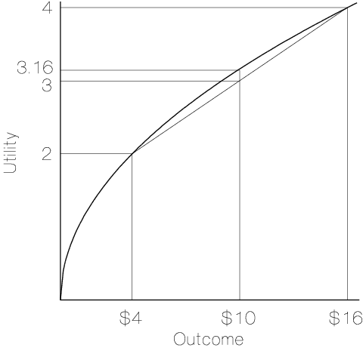
2. Expected Utility Theory
Early adjustments to neo-classical theory
Bernouilli (1738) rejected the idea that that expected value of an outcome is equal to its payoff times its probability
Utility increases incrementally with wealth, but at a declining rate (Esterlin; see Kahn JG, Time Mag. 2013)
Example: we gain more utility from each dollar if personal income is $20,000 compared to $200,000
6
Notes:
6

Slide 7
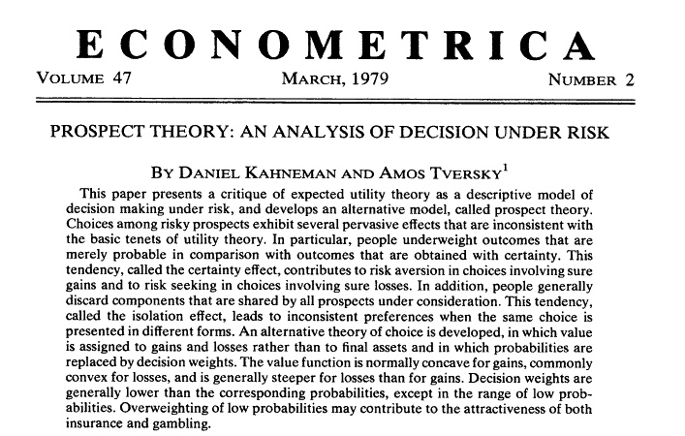

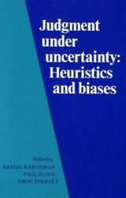
3. The cognitive revolution
In the 1970s, Kahneman and Tversky invented “behavioral economics” -- theories & evidence that applied psychology to economics
7
Notes:
Kahneman developed Prospect Theory to explain divergences from neo-classical theory
Prospect Theory is a descriptive model that explains how decisions are made between alternatives that involve risk
7

Slide 8
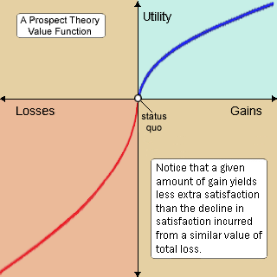
Prospect Theory (1979)
Risk averse:
prefer a sure small gain over the chance of a larger gain
Risk seeking:
will risk a big loss to avoid a certain smaller loss
8
Notes:
8
“We suffer more... when we fall from a better to a worse situation, than we ever enjoy when we rise from a worse to a better.” - Adam Smith
8

Slide 9
A key basis for Prospect Theory:
The Endowment Effect
We value what we have more than what we don’t.
Coffee mug example
Notes:
From Camerer: A seminal demonstration of an "endowment effect" in buying and selling prices was conducted by Kahneman et al (1990). They endowed half of the subjects in a group with coffee mugs. Those who had mugs were asked the lowest price at which they would sell. Those who did not get mugs were asked how much they would pay. There should be essentially no difference between selling and buying prices. In fact, the median selling price was $5.79 and the median buying price was $2.25, a ratio of more than two: one which has been repeatedly replicated. Although calibrationally entirely implausible, some economists were concerned that the results could be driven by “wealth effects”—those given mugs are wealthier than those not given mugs, and this might make them value mugs more and money less. But in a different study reported in the same paper, the selling prices of one group were compared to the "choosing" prices of another: For a series of money amounts, subjects chose whether they would prefer to have a mug or money. The median choosing price was half the median selling price ($3.50 versus $7.00). Choosers are in precisely the same wealth position as sellers—they choose between a mug or money. The only difference is that sellers are "giving up" a mug they "own," whereas choosers are merely giving up the right to have a mug. Any difference between the two groups cannot be attributed to wealth effects.

Slide 10
Judgment and Choice - preview
Judgment: what processes do we use to estimate probabilities?
  Availability heuristic
  Representativeness heuristic
  Anchoring and adjustment
Choice: what processes do we use to make decisions, given our judgments?
  Framing

Slide 11
Judgment: Heuristic techniques - Overview
Neoclassical approach: Use statistical sampling and Bayes’ rule (updating probabilities with new evidence). This is cognitively unrealistic because it:
  Requires a prior sample
  Requires separation between previously judged probabilities and evaluation of new information
  Can separate probability judgment and utilities
Behavioral approach: Use heuristics, experience-based (often irrational) techniques to make judgments (“rule of thumb” / intuition)
11

Slide 12
Judgment: Heuristic techniques …
Availability heuristic: people judge the probabilities of future events based on how easy those events are to imagine or to retrieve from memory (“hindsight bias”)
  “smoking isn’t unhealthy! my grandfather smoked 3 packs of cigarettes per day and lived to 100”
  Which is greater: Risk of death by homicide or stomach cancer?
  If people imagine an outcome, it will become more likely (imagining you have a side-effect from medication)
12
Notes:
(see Camerer & Loewenstein book chapter)
Stomach cancer is 5 times as likely!

Slide 13
Judgment: Heuristic techniques…
Representativeness heuristic: people judge probabilities by how well the example under consideration appears to represent the class
  Example of the conjunction fallacy:
  Mary is studious, controlling, and judgmental toward others. She is passionate about women’s rights. Mary is most likely:
    A librarian
    A librarian and active in women’s liberation group
13
Notes:
13
(see Camerer & Loewenstein book chapter)
Most people will choose librarian and active in women’s liberation group because its more descriptive even though probability is less likely. (85% chose the 2nd option). Option 2 seems more “Representative” of her although #1 is more likely mathematically speaking.

Slide 14
Judgment: Heuristic techniques…
Anchoring and adjustment: we make judgments and choices where we over-rely on an “anchor” or cognitive baseline, adjusting incrementally to reach an estimate.
Example: students presented with a product and asked whether they would buy it for roughly a price equal to the last two digits of their social security number.
After answering yes/no, then asked “would you pay $79?” Demonstrated those with higher social security numbers were willing to pay more.
14

Slide 15
Choice: Framing
15
Framing is the collection of stereotypes and anecdotes that people use to make decisions and sense of the world (the “frame” or way a question / statement is posed influences its outcome)
Example: A disease threatens 600 citizens.
  Frame I: (a) save 200 lives for sure, or (b) 1/3 chance of saving 600 lives with 2/3 of saving no one.
  Frame II: (c) 400 people die for sure, or (d) 2/3 chance of 600 dying, and 1/3 chance no one dying.
Notes:
Most choose (a) over (b), but (d) over (c). Why? The way the choice is stated (framed) – risk averse for gains (frame I) and risk seeking for losses (frame II)

Slide 16
Intertemporal choice
Hyperbolic discounting (Ainslie 1975): the tendency to give much greater value to rewards as they move towards the “now”
"Hyperbolic time discounting implies that people will make relatively far-sighted decisions when planning in advance when all costs and benefits will occur in the future but will make relatively short-sighted decisions when some costs or benefits are immediate.”
Examples:
  Drug-dependence
  Gamblers
  Binge-eating
  Paying for bednets
16
Notes:
16
Timing is important in ways not incorporated by classical economics. Time, steady discount rate.
"Hyperbolic time discounting implies that people will make relatively far-sighted decisions when planning in advance when all costs and benefits will occur in the future but will make relatively short-sighted decisions when some costs or benefits are immediate. The systematic changes in decisions produced by hyperbolic time discounting create a time-inconsistency in intertemporal choice not present in the exponential model. An agent who discounts utilities exponentially would, if faced with the same choice and the same information, make the same decision prospectively as he would when the time for a decision actually arrives. In contrast, somebody with time-inconsistent hyperbolic discounting will wish prospectively that in the future he will take far-sighted actions; but when the future arrives he will behave against his earlier wishes, pursuing immediate gratification rather than long-run well-being."
Rational model - person thinks I will maximize my utility if I have a small piece of cake (and can fit into jeans later) because
Inappropriately high discount rate (because it goes against own utility maximizing)
Overcome by the impulses of the present and the value of the future recedes
Neoclassical model:
Trade-off present and future at fixed discount rate (e.g. 3%).
Thus: Indifferent between $1 today and $1.03 in one year and $1.06 in two years.
Quasi-hyperbolic discounting:
Tradeoffs same as neoclassical (so $1.03 in one year still valued same as $1.06 in two years).
But immediate gratification gets extra value. (biological cause?)
So to give up $1 today would need say $1.30 next year (instead of $1.03 in neoclassical model).
Theory for binge eating, postponing tobacco quits to tomorrow, underuse preventive care such as vaccines, etc.
Negative time discounting
Greater preference for future rewards
Postpone activities with the most gratification
Causality is not known. High-rate discounting rats consume more alcohol and cocaine.
Neo-classical model treats time preferences as stable– actual behaviors suggest that people discount hyperbolically – more at first than later

Slide 17
Key Vocabulary
Neo-classical economics, homo-economicus, expected utility theory, prospect theory, intertemporal choice, hyperbolic discounting, availability heuristic, representativeness heuristic, anchoring and adjustment heuristic, framing, risk aversion, risk seeking
17
Notes:
17
Most choose A over B, but D over C. Why? The way its said.
JGK – good, fun exercise, but take it slower. People are (certain) loss averse

