Slide 1
Sample Size Calculations, Power Analysis and Stata
Biftu Mengesha MD
Biostat 212: Summer 2016
Mini-lecture

Slide 2
Definitions
Sample size: How many subjects to sample or study for a particular research question
Power: Probability of detecting a difference between groups given the effect is real
Power analysis: Evaluating statistical power at a given effect size for a fixed sample size and level of significance
Notes:
Let’s start with some very basic definitions – a sample size is essentially an estimate of how many subjects you will need in your study to answer a particular research question.
You will go through this more in your DCR course in the next few weeks I’m sure, but just as a teaser the way a sample size is calculated depends on a few things – the type of variable your predictors and outcomes are (like if they are continuous, categorical, etc), the variance or proportions in each group and what difference you are trying to prove or compare between the groups in your study (or the “effect size”). Generally, the higher the difference or effect size between groups the smaller the sample size and the more feasible a study will be to do.
Power is the probability of detecting an effect or difference between groups given the effect is really there and power analysis using different levels of power to determine sample size estimates at varying levels of power. The higher your power, the higher the sample size needed. A typical power used by many researchers is 0.8 or 80% power, although some use higher power depending on their studies. Power analysis can also be helpful for you to know how much power you have retrospectively with an already existing number of patients and effect size at a prespecified level of significance, which is commonly 0.05.
Sample size planning and power analysis are a mathematical way of making a ballpark estimate of what you need. It helps you know if your study design and research question is feasible, or if you may need different predictors and outcomes if not feasible.

Slide 3
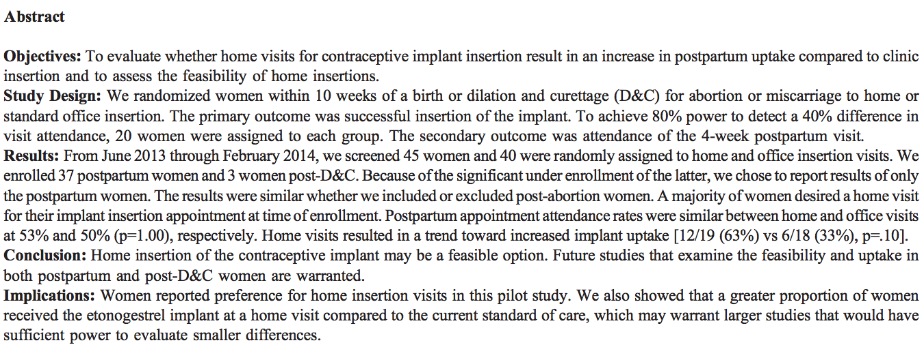
Abstract Example
Not included in abstract: proportion of office implant insertion at baseline is 50%
Notes:
So we will use an example from current literature to work through sample size calculation and power analysis using stata.
This is an abstract from a randomized controlled trial done comparing home versus office insertion of a hormonal implant. Their primary outcome was successful insertion of the implant and their predictor was place of insertion. They estimated their effect size to be a 40% difference between groups.

Slide 4
What’s Needed to Do These
We’ll focus on calculating sample size for a difference in 2 proportions
Information needed
  Proportion of group 1
  Proportion of group 2
  Effect size (proportion group 2 – proportion group 1)
  Level of statistical significance (alpha)
  Power (1-beta)
Notes:
The exact way in which a sample size is calculated depends on the nature of your data – whether it’s continuous or categorical. For simplicity sake, we will focus on calculating a sample size and conducting power analysis for a difference in 2 proportions.
The information needed to calculate a sample size for a difference in 2 proportions is…

Slide 5
Stata Command for Sample Size
power twoproportions p1 p2 [, power(#) options]
p1 = control group proportion
p2 = experimental group proportion
Default power 0.8
Default significance 0.05
Notes:
Here is the stata command for calculating a sample size for a difference in 2 proportions.
P1 is the control group proportion, P2 is the experimental group proportion, and this command if left without the stuff in the brackets operates with a default power of 0.8 and default significance of 0.05.

Slide 6
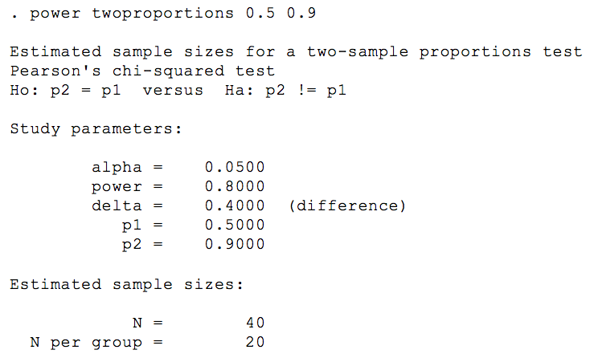
Stata Output
From our abstract example
  p1 = 50%, p2 = 90%, effect size = 40%
Notes:
So if we use the data from our abstract, which told us the proportion of implant users in the control group was 50%, the proportion in the experimental group was 90% and the effect size if 40% we can calculate our sample size
This is the stata output for this calculation
This is the command here, and here are the study parameters that we told the command to have – the default power and alpha, the delta or the effect size or difference between groups, and the different proportions in each group
It then at the end gives you the calculated sample size, total and then the number per group, which is exactly what the authors of the abstract had set to use.

Slide 7
Alternative Stata Commands and Options
power twoproportions p1, diff(#)
diff = p2-p1
power twoproportions p1 p2 , power(#)
power twoproportions p1 p2, alpha(#)
Options:
test(test)- specify statistical test to use, default is chi2
alpha(#) – specify alpha (if different from 0.05)
power(#) – specify power (if different from 0.8)
Notes:
Here are some different variations of the stata command for calculating a sample size for two proportions.
In the first one, you can just put the proportion of group 1 and the effect size or the difference between group 2 and group 1 proportions by using the notation “diff”
In these next 2, you can change your power and your alpha to be different than the default
And here is a list of a couple of the common options that you may want to use with the command. There is a long list of many other options, but these are the most relevant for an introductory lesson. We just covered the alpha and power – the a and p are underlined because these are shortcuts in the stata code where you don’t have to write out the entire word “alpha”, you can just put “a” instead
The other useful one is if you want to specify the statistical test to use in comparing the 2 proportions. The default is to use a chi2 test, but you can specify for other tests like the likelihood ratio test or a fisher’s exact test. That is the beyond the scope of this exercise.

Slide 8
Sample Size
Can also evaluate power at varying p2 proportion at a fixed p1 and total sample size graphically
Example
  p1 = 0.5, total n=40
  Varying p2 from 0.6 – 0.9 by increments of 0.1 (0.6, 0.7, 0.8, 0.9)
  power twoproportions 0.5 (0.6(0.1)0.9), n(40) graph
Notes:
We can also see what level of power we can achieve at different proportions of group 2 based on a fixed proportion of group 1 and total sample size
Let’s use our same proportions from the abstract, and evaluate varying proportions from 0.6 to 0.9 in increments of 0.1
Here is the stata code for that, and we can write the code for the varying proportions like this – start with the lower number (0.6), the increment in parentheses that you want to increase by (0.1) and the higher number as your endpoint for proportions.

Slide 9
Graphical Representation
  power twoproportions 0.5 (0.6(0.1)0.9), n(40) graph
Notes:
Here is what this looks like on the graph and you can see the varying proportions for group 2 on the x axis and how the power changes on the y axis.
And here is our example with a proportion of 0.9 and with a power of 0.8.

Slide 10
Power Analysis
power twoproportions p1 p2 , n(#) [options]
p1 = control group proportion
p2 = experimental group proportion
n = total sample size
Notes:
We can also calculate the power we would have based on our proportions in both groups at a fixed sample size, and this is the stata code to do that.
Again P1 and P2 are the proportions for the control and experimental groups respectively, and n is the total sample size

Slide 11
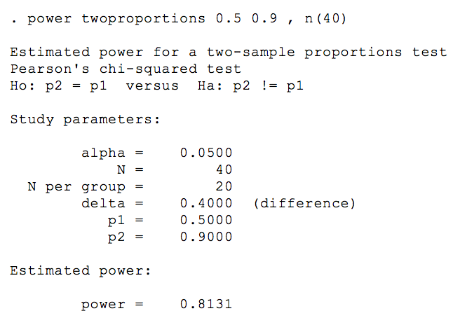
Stata Output
From our abstract example
  p1 = 50%, p2 = 90%, total n = 40
Notes:
So here is the stata output using the information from our abstract example. Remember our p1 and p2 were 0.5 and 0.9 respectively, and the total sample size is 40.
Here is the stata code specifying this information
Here are the study parameters that we identified in this code, and again this uses the default alpha of 0.05
And here is the estimated power of about 0.81 with these parameters

Slide 12
Power Analysis
Can also evaluate level of power at varying sample sizes based on proportions in a graph
Example
  p1 = 0.5, p2 = 0.9
  Total n increasing by increments of 5 from 30-50 (n=30, n=35, n=40, n=45, n=50)
power twoproportions 0.5 0.9 , n(30(5)50) graph
Notes:
Similarly to what we did for the proportions for group 2, we can also see what level of power we can achieve at different sample sizes based on fixed proportions
Let’s use our same proportions from the abstract, and evaluate varying sample sizes from 30 to 50 in increments of 5
Here is the stata code for that, similar in structure to the last example of this but just changing the sample size notation - starting with the lower number (30), the increment in parentheses that you want to increase by (5) and the higher number as your endpoint for sample size.

Slide 13
Graphical Representation
power twoproportions 0.5 0.9 , n(30(5)50) graph
Notes:
Here is what this looks like on the graph and you can see the varying sample sizes on the x axis and how the power changes on the y axis.
And again here is our example with a total sample size at n=40 with a power of 0.8.

Slide 14
Other Related Commands
Power twomeans
Power onemean
Power pairedmeans
Power oneproportion
Power twoway
Power mcc
Power trend
Power cox
Power logrank
Notes:
Here are the other power commands for different types of comparisons that you may need depending on the data you have and the analyses you are doing. It would take too long to go through this, but these are here for your reference and you can use the stata manual to read more about the code and uses of these.

Slide 15
Additional Resources
Stata Resources
  www.stata.com/manuals14/pss.pdf
  Command line
    help power
Designing Clinical Research textbook
UCSF CTSI website
  http://www.sample-size.net/

Slide 16
Practice!
Sample Size Calculation
Want to do an RCT looking at continuation rates at 6 months of IUDs for women who have them placed immediately after placental delivery versus at 6 weeks postpartum
Estimated effect size = 0.4
Proportion of delayed group (p1) = 0.45
Power 0.8, significance 0.05
Notes:
So we are now going to do 2 mini-exercises on these concepts. The first will be using stata to calculate a sample size.
Let’s say we want to do an RCT looking at rates of IUD use at 6 months after placement comparing between women who have them placed in the delayed postpartum period, which is at 6 weeks and this is the control group, and for those who have them placed right birth, which will be the experimental group.
Our estimated proportion of use at 6 months for the control group is 0.45, and our estimated effect size is 0.4, meaning that the proportion of the immediate group is 0.85. We will use the standard power and significance levels.

Slide 17
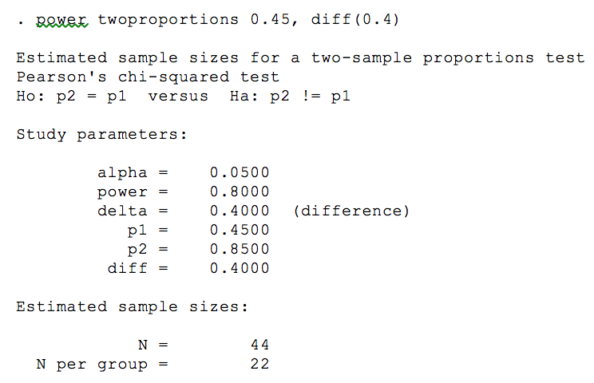
Answer
Total N = 44, 22 per group
Stata code
Alternative code:
power twoproportions 0.45 0.85
Notes:
So we see that the total sample size is 44, with 22 in each group
You can use 2 different stata codes for this one – one that uses the proportion of group one and the effect size. The other that just uses the proportions of both groups. Both will get you to the same answer.

Slide 18
Practice part 2!
Power Analysis
Doing a secondary analysis of RCT data on breastfeeding initiation rates for women who had an immediate postplacental IUD versus IUD at 6 weeks postpartum
Immediate Group
Delayed Group
32 women – 47%
27 women – 59%
Effect size = 12%
What is the level of power in this analysis?
Notes:
For our next and last practice problem, we are going to do a power analysis of some data we have from an RCT that we want to do a secondary analysis on. We want to see if 6 month breastfeeding rates are different between those women who have an IUD placed immediately after the placenta is delivered at the time of birth versus those women who have an IUD placed at the standard time of 6 weeks postpartum.
We have 32 women in the immediate group, with 47% of them initiating breastfeeding, and 27 women in the delayed group with 59% of them initiating breastfeeding, so this makes our effect size 12%.
So we want to know if we have the “power” at this sample size and effect size to reach statistical significance

Slide 19
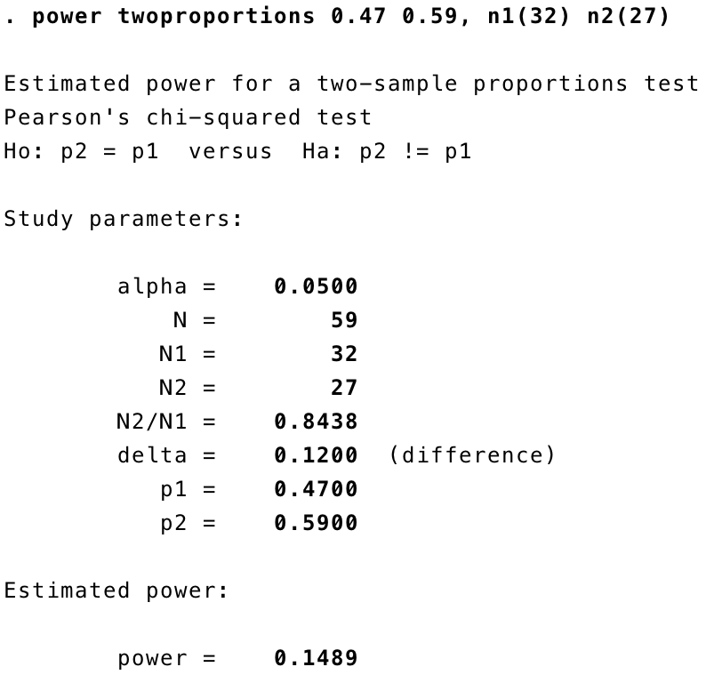
Answer
Power = 0.1489
Stata output
Notes:
This was a little tricky, because we have been assuming equal group sizes up until now, but the groups we outlined didn’t have equal group sizes, so this is the stata code you would use to identify different group sizes, and the power you get is 0.1489

Slide 20
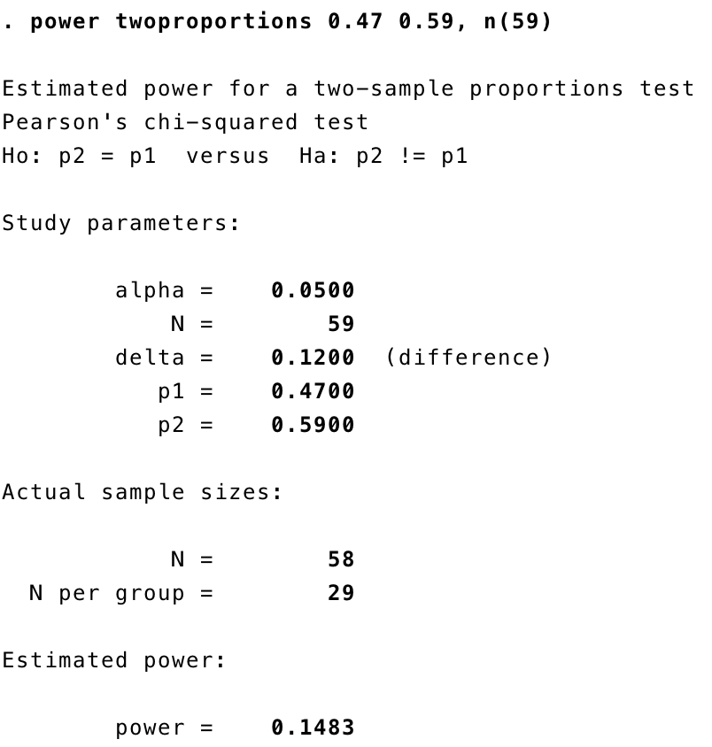
Alternative
Notes:
Turns out for this particular example, it doesn’t change the power much even if you entered in the information as a total sample size instead of the separate different group sizes because the differences between groups here is so small, but with larger differences and smaller sample sizes this may make a difference.

