Slide 1
QUIZ 1
Square Root of 457 di sqrt(457)= 21.377558
(10,875*456)/(7^2) di (10875*456)/(7^2) = 101204.08
Natural log of 342 di ln(342 = 5.8348107
Random Number between 1 and 20 _____
  display a + int((b-a+1)*runiform())
  di runiform(1,20)
Notes:
di sqrt(457)= 21.377558
di (10875*456)/(7^2) = 101204.08
. di ln(342 = 5.8348107
display 1 + int((20-1+1)*runiform()) = 7

Slide 2
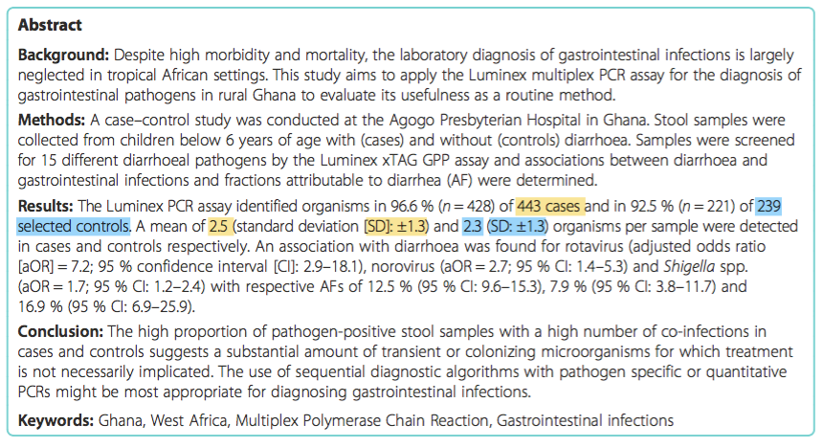
QUIZ 2
Calculate the 95% confidence interval around the mean number of diarrhea pathogens per stool sample in cases
cii 443 2.5 1.3
(2.378611, 2.621389)
Calculate the 95% confidence interval around the mean number of diarrhea pathogens per stool sample in controls
cii 239 2.3 1.3
(.134344, 2.465656)
    cii #observations #mean #standard deviation
Eibach D, Krumkamp R, Hahn A, et al. Application of a multiplex PCR assay for the detection of gastrointestinal pathogens in a rural African setting. BMC Infectious Diseases. 2016;16:150. doi:10.1186/s12879-016-1481-7.
Notes:
Number of different pathogens in children with and without diarrhea
Cases – with diarrhea
cii 443 2.5 1.3
(2.378611, 2.621389)
Controls – without diarrhea
cii 239 2.3 1.3
(2.134344, 2.465656)

