Slide 1
Observational
Study Designs
Kirsten Bibbins-Domingo, PhD, MD, MAS

Slide 2
Objectives
To understand the difference between descriptive and analytic observational studies
To identify the strengths and weakness of different designs and apply different study designs to the same research question

Slide 3
Descriptive vs. Analytic
Risk Factors
Heart Failure
Descriptive Questions
What proportion of patients in my clinic have heart failure?
What is the average age of patients with heart failure in my clinic?
Analytic Questions
Is race/ethnicity associated with heart failure among my patients?
Is excessive consumption of sugar-sweetened beverages associated with heart failure among my patients?

Slide 4
Analytic Studies
Attempt to establish a causal link between a predictor/risk factor and an outcome.
You are doing an analytic study if you have any of the following words in your research question:
  causes, leads to, compared with, more likely than, associated with, related to, similar to, correlated with, greater than, less than
Predictor
(risk factor)
Outcome
(disease)

Slide 5
Hierarchy of Study Types?
Descriptive
Case report
Case series
Survey
Analytic
Observational
Cross sectional
Case-control
Cohort studies
Experimental
Randomized
controlled trials
Strength of evidence for causality between a risk factor and outcome

Slide 6
Key elements of study design
Timing of the study
  Prospective
  Historical
Timing of variable occurrence & measurement
  When are predictors and outcomes measured?
How the subjects will be sample

Slide 7
Research Question
Among patients seen in General Medicine Clinic, who is at risk for heart failure?

Slide 8
Great idea, but how do you get started…
Observations in clinical practice
  Describing cases of heart failure in clinic
    Case report or Case series
  Describe characteristics of all heart failure patients (e.g. average age)
Moving from descriptive to analytic studies
  What are the risk factors associated with developing heart failure?

Slide 9
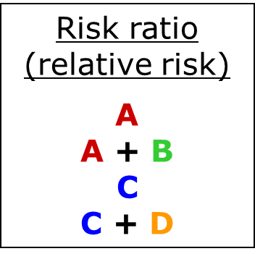
Measures of association
 |  | Disease
 |  | Yes | No
Risk Factor | Yes | A | B
 | No | C | D

Slide 10
Study Design #1
Cross-sectional study
National Health and Nutrition Exam Survey (NHANES)
Outcome: “have you been told by a doctor that you have heart failure?”
Multiple possible predictors (demographic, behavioral/lifestyle, other risk factors)
Research question: Is hypertension associated with heart failure risk?

Slide 11
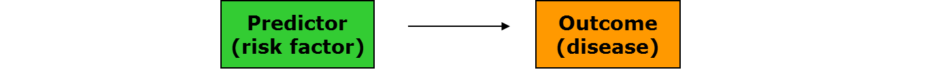
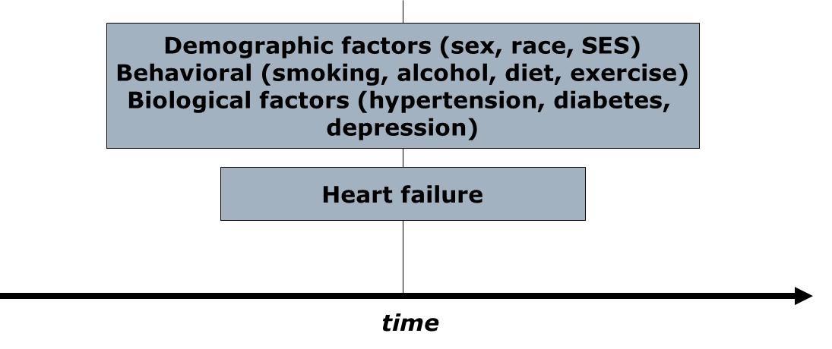
Cross-sectional study: structure

Slide 12
Cross-sectional Study: Pluses
+ Prevalence
+ Fast/Inexpensive - no waiting!
+ No loss to follow up
+ Associations can be studied
Many well-known cross-sectional studies
  NHANES
  California Health Interview Survey (NHIS, CHIS)
  Behavioral Risk Factor Surveillance Survey (BRFSS)

Slide 13
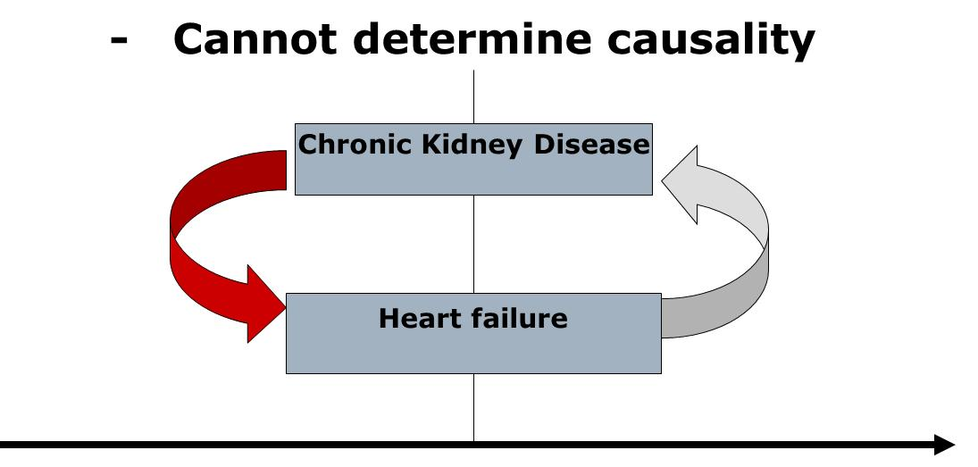
Cross-sectional study: minuses

Slide 14
Cross-sectional study: minuses
Cannot determine incidence
Cannot study rare outcomes

Slide 15
What if you are interested in the rare outcome?
Heart failure in adults before age 50
Heart failure in adults before age 30
Heart failure in children
ANSWER: A Case-Control study

Slide 16
Study Design #2
A case-control study
Cases: Adults with premature heart failure (18-50 years)
  General medicine vs. cardiology/ UCSF vs. community practice
Controls: Adults 18-50 without heart failure
  Who are the appropriate controls?
Potential predictors: Many – may be based on questionnaire
Hypothesis: Hypertension early in adulthood are more likely to have premature heart failure.

Slide 17
Case control studies
Investigator works “backward” (from outcome to predictor)
Sample chosen on the basis of outcome (cases), plus comparison group (controls)
Predictor
(risk factor)
Outcome
(disease)

Slide 18
Case-control study structure
present
CASES
Patients with heart failure before
Age 50
RISK FACTORS
Demographic
Behavioral
Biological
Genetic
CONTROLS
Patients without
Heart failure
time

Slide 19
Case control studies
Cannot yield estimates of incidence or prevalence of disease in the population (why?)
Odds Ratio is statistics

Slide 20
Measures of association
Odds ratio
A
B
C
D
Also…
A D
C B
 |  | Disease
 |  | Yes | No
Risk factor | Yes | A | B
 | No | C | D

Slide 21
Case-control Study: pluses
+ Rare outcome/Long latent period
+ Inexpensive and efficient: may be only feasible option
+ Establishes association (Odds ratio)
+ Useful for generating hypotheses (multiple risk factors can be explored)

Slide 22
Case-control study-minuses
Causality still difficult to establish
  Selection bias (appropriate controls)
    Caffeine and Pancreatic cancer in the GI clinic
  Recall bias: sampling (retrospective)
    Abortion and risk of breast cancer in Sweden

Slide 23
Case-control study--minuses
Incidence
  New cases of an outcome that occur
  Can measure in a cohort study
Prevalence
  Cases that exist at a given time
  Can measure in a cross-sectional study
Neither can be measured in a case-control study

Slide 24
Case-control - “the house red wine”
Rely tampons and toxic shock syndrome:
  High rates of toxic shock syndrome in menstruating women
  Suspected OCPs or meds for PMS
  Cases: 180 women with TSS in 6 geographic areas
  Controls: 180 female friends of these patients and 180 females in the same telephone code
  Tampon associated with TSS (OR = 29!)
  Super absorbency associated with TSS (OR 1.34 per gm increase in absorbency)
  Led to “RELY” brand tampons being taken off the market.

Slide 25
Where are we?
Cross-sectional studies and case-control studies are important for generating hypotheses about risk factors for heart failure.
What’s missing? - strengthening evidence for a causal link between risk factors and heart failure.
Use results from our previous studies to apply for funding for a prospective cohort study!

Slide 26
Study design #3
Prospective cohort study
CARDIA study:
  Prospective cohort study
  5000 (M/W, black/white, low/high SES)
  Age 18-30 at enrollment
  Followed 20 years
  Exam visits years 0, 2, 5, 7, 10, 15, 20
Outcome: Incident heart failure

Slide 27
Elements of a cohort study
Predictor
(risk factor)
Outcome
(disease)
Selection of sample from population
Measures predictor variables in sample
Follow population for period of time
Measure outcome variable
Famous cohort studies
  Framingham
  Nurses’ Health Study
  Physicians’ Health Study

Slide 28
Prospective cohort study structure
The present
The future
MI, CHF, stroke, ESRD, LEA
Everyone else
time

Slide 29
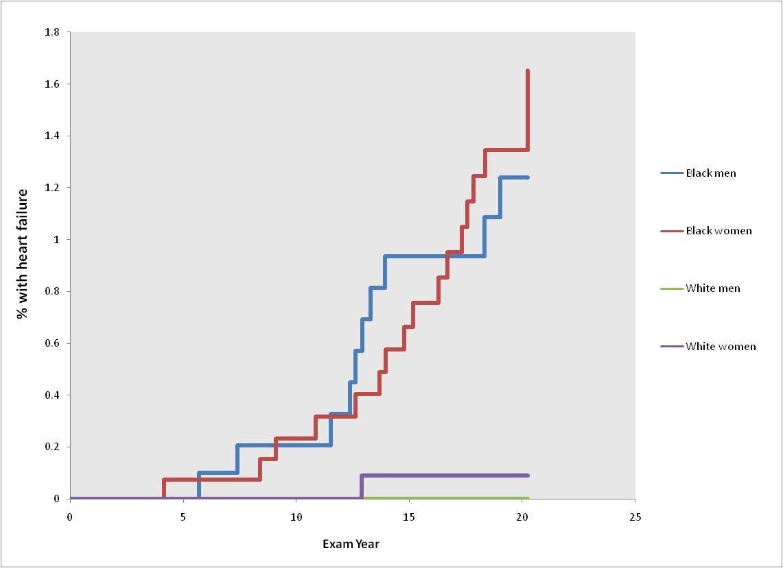
Incidence of heart failure before age 50 in black and white adults
Bibbins-Domingo et al. N Engl J Med 2009; 360:1179-1190

Slide 30
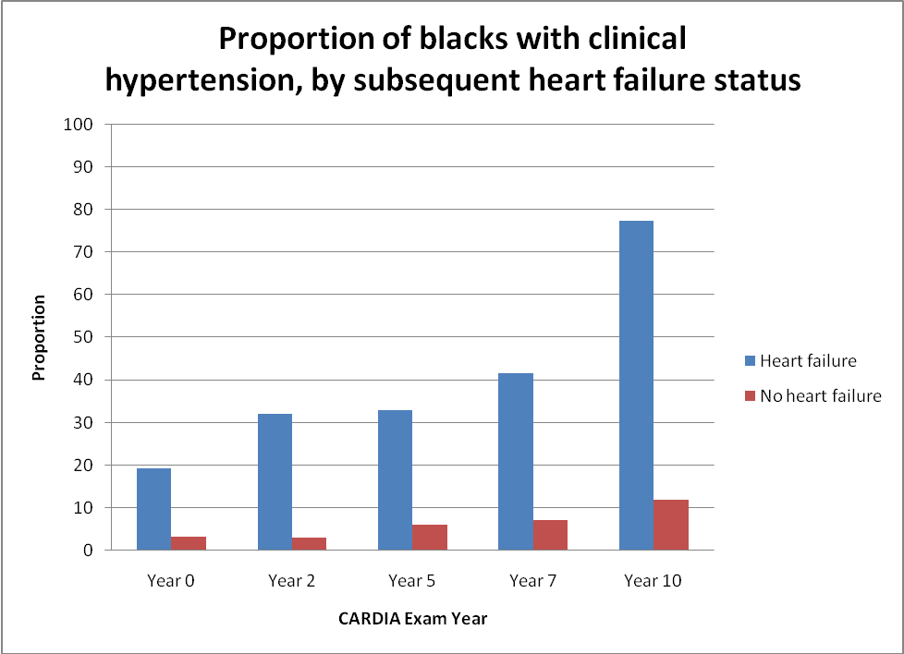
Hypertension early in life is a risk factor for heart failure before age 50 among blacks
Bibbins-Domingo et al. N Engl J Med 2009; 360:1179-1190

Slide 31
Strengths of cohort studies
Know that predictor variable was present before outcome variable occurred (some evidence of causality)
Directly measure incidence of a disease outcome
Can study multiple outcomes of a single exposure (RR is measure of association)

Slide 32
Weaknesses of cohort studies
Expensive and inefficient for studying rare outcomes
  HERS vs. WHI
Often need long follow-up period or a very large population
  CARDIA
Loss to follow-up can affect validity of findings
  Framingham

Slide 33
Other types of cohort studies
Retrospective cohort
  Identification of cohort, measurement of predictor variables, follow-up and measurement of outcomes have all occurred in the past
  Much less costly than prospective cohorts
  Investigator has minimal control over study design

Slide 34
A study type for every budget, purpose, and research question
Descriptive
Case report
Case series
Survey
Analytic
Observational
Cross sectional
Case-control
Cohort studies
Experimental
Randomized
controlled trials
A study type of every budget, purpose and research question

Slide 35
Plasma Natriuretic Peptide Levels and the Risk of Cardiovascular Events and Death
Thomas J. Wang, M.D., Martin G. Larson, Sc.D., Daniel Levy, M.D., Emelia J. Benjamin, M.D., Eric P. Leip, M.S., Torbjorn Omland, M.D., Philip A. Wolf, M.D., and Ramachandran S. Vasan, M.D.N Engl J Med 2004; 350:655-663
BACKGROUND: The natriuretic peptides are counterregulatory hormones involved in volume homeostasis and cardiovascular remodeling. The prognostic significance of plasma natriuretic peptide levels in apparently asymptomatic persons has not been established.
METHODS: _____________________3346 persons without heart failure. Using proportional-hazards regression, we examined the relations of plasma B-type natriuretic peptide and N-terminal pro–atrial natriuretic peptide to the risk of death from any cause, a first major cardiovascular event, heart failure, atrial fibrillation, stroke or transient ischemic attack, and coronary heart disease.
RESULTS: During a mean follow-up of 5.2 years, 119 participants died and 79 had a first cardiovascular event. After adjustment for cardiovascular risk factors, each increment of 1 SD in log B-type natriuretic peptide levels was associated with a 27 percent increase in the risk of death (P=0.009), a 28 percent increase in the risk of a first cardiovascular event (P=0.03), a 77 percent increase in the risk of heart failure (P<0.001), a 66 percent increase in the risk of atrial fibrillation (P<0.001), and a 53 percent increase in the risk of stroke or transient ischemic attack (P=0.002). Peptide levels were not significantly associated with the risk of coronary heart disease events. B-type natriuretic peptide values above the 80th percentile (20.0 pg per milliliter for men and 23.3 pg per milliliter for women) were associated with multivariable-adjusted hazard ratios of 1.62 for death (P=0.02), 1.76 for a first major cardiovascular event (P=0.03), 1.91 for atrial fibrillation (P=0.02), 1.99 for stroke or transient ischemic attack (P=0.02), and 3.07 for heart failure (P=0.002). Similar results were obtained for N-terminal pro–atrial natriuretic peptide.
CONCLUSIONS: In this community-based sample, plasma natriuretic peptide levels predicted the risk of death and cardiovascular events after adjustment for traditional risk factors. Excess risk was apparent at natriuretic peptide levels well below current thresholds used to diagnose heart failure.

Slide 36
Needlestick Injuries among Surgeons in Training
Martin A. Makary, M.D., M.P.H., Ali Al-Attar, M.D., Ph.D., Christine G. Holzmueller, B.A., J. Bryan Sexton, Ph.D., Dora Syin, B.S., Marta M. Gilson, Ph.D., Mark S. Sulkowski, M.D., and Peter J. Pronovost, M.D., Ph.D.
N Engl J Med 2007; 356:2693-2699
BACKGROUND: Surgeons in training are at high risk for needlestick injuries. The reporting of such injuries is a critical step in initiating early prophylaxis or treatment.
METHODS: We surveyed surgeons in training at 17 medical centers about previous needlestick injuries. Survey items inquired about whether the most recent injury was reported to an employee health service or involved a “high-risk” patient (i.e., one with a history of infection with human immunodeficiency virus, hepatitis B or hepatitis C, or injection-drug use); we also asked about the perceived cause of the injury and the surrounding circumstances.
RESULTS: The overall response rate was 95%. Of 699 respondents, 582 (83%) had had a needlestick injury during training; the mean number of needlestick injuries during residency increased according to the postgraduate year (PGY): PGY-1, 1.5 injuries; PGY-2, 3.7; PGY-3, 4.1; PGY-4, 5.3; and PGY-5, 7.7. By their final year of training, 99% of residents had had a needlestick injury; for 53%, the injury had involved a high-risk patient. Of the most recent injuries, 297 of 578 (51%) were not reported to an employee health service, and 15 of 91 of those involving high-risk patients (16%) were not reported. Lack of time was the most common reason given for not reporting such injuries among 126 of 297 respondents (42%). If someone other than the respondent knew about an unreported injury, that person was most frequently the attending physician (51%) and least frequently a “significant other” (13%).
CONCLUSIONS: Needlestick injuries are common among surgeons in training and are often not reported. Improved prevention and reporting strategies are needed to increase occupational safety for surgical providers.

Slide 37
First-Trimester Use of Selective Serotonin-Reuptake Inhibitors and the Risk of Birth Defects
Carol Louik, Sc.D., Angela E. Lin, M.D., Martha M. Werler, Sc.D., Sonia Hernández-Díaz, M.D., Sc.D., and Allen A. Mitchell, M.D. N Engl J Med 2007; 356:2675-2683
BACKGROUND: The risk of birth defects after antenatal exposure to selective serotonin-reuptake inhibitors (SSRIs) remains controversial.
METHODS: We assessed associations between first-trimester maternal use of SSRIs and the risk of birth defects among 9849 infants with and 5860 infants without birth defects participating in the Slone Epidemiology Center Birth Defects Study.
RESULTS: In analyses of defects previously associated with SSRI use (involving 42 comparisons), overall use of SSRIs was not associated with significantly increased risks of craniosynostosis (115 subjects, 2 exposed to SSRIs; odds ratio, 0.8; 95% confidence interval [CI], 0.2 to 3.5), omphalocele (127 subjects, 3 exposed; odds ratio, 1.4; 95% CI, 0.4 to 4.5), or heart defects overall (3724 subjects, 100 exposed; odds ratio, 1.2; 95% CI, 0.9 to 1.6). Analyses of the associations between individual SSRIs and specific defects showed significant associations between the use of sertraline and omphalocele (odds ratio, 5.7; 95% CI, 1.6 to 20.7; 3 exposed subjects) and between the use of paroxetine and right ventricular outflow tract obstruction defects (odds ratio, 3.3; 95% CI, 1.3 to 8.8; 6 exposed subjects). The risks were not appreciably or significantly increased for other defects or other SSRIs or non-SSRI antidepressants. Exploratory analyses involving 66 comparisons showed possible associations of paroxetine and sertraline with other specific defects.
CONCLUSIONS: Our findings do not show that there are significantly increased risks of craniosynostosis, omphalocele, or heart defects associated with SSRI use overall. They suggest that individual SSRIs may confer increased risks for some specific defects, but it should be recognized that the specific defects implicated are rare and the absolute risks are small.

Slide 38
The Role of Black and Hispanic Physicians in Providing Health Care for Underserved Populations
Miriam Komaromy, M.D., Kevin Grumbach, M.D., Michael Drake, M.D., Karen Vranizan, M.A., Nicole Lurie, M.D., M.S.P.H., Dennis Keane, M.P.H., and Andrew B. Bindman, M.D. N Engl J Med 1996; 334:1305-1310
BACKGROUND: Patients who are members of minority groups may be more likely than others to consult physicians of the same race or ethnic group, but little is known about the relation between patients' race or ethnic group and the supply of physicians or the likelihood that minority-group physicians will care for poor or black and Hispanic patients.
METHODS: We analyzed data on physicians' practice locations and the racial and ethnic makeup and socioeconomic status of communities in California in 1990. We also surveyed 718 primary care physicians from 51 California communities in 1993 to examine the relation between the physicians' race or ethnic group and the characteristics of the patients they served.
RESULTS: Communities with high proportions of black and Hispanic residents were four times as likely as others to have a shortage of physicians, regardless of community income. Black physicians practiced in areas where the percentage of black residents was nearly five times as high, on average, as in areas where other physicians practiced. Hispanic physicians practiced in areas where the percentage of Hispanic residents was twice as high as in areas where other physicians practiced. After we controlled for the racial and ethnic makeup of the community, black physicians cared for significantly more black patients (absolute difference, 25 percentage points; P<0.001) and Hispanic physicians for significantly more Hispanic patients (absolute difference, 21 percentage points; P<0.001) than did other physicians. Black physicians cared for more patients covered by Medicaid (P = 0.001) and Hispanic physicians for more uninsured patients (P = 0.03) than did other physicians.
CONCLUSIONS: Black and Hispanic physicians have a unique and important role in caring for poor, black, and Hispanic patients in California. Dismantling affirmative-action programs, as is currently proposed, may threaten health care for both poor people and members of minority groups.

Slide 39
Effect of Cigar Smoking on the Risk of Cardiovascular Disease, Chronic Obstructive Pulmonary Disease, and Cancer in Men Carlos Iribarren, M.D., M.P.H., Ph.D., Irene S. Tekawa, M.A., Stephen Sidney, M.D., M.P.H., and Gary D. Friedman, M.D. N Engl J Med 1999; 340:1773-1780
BACKGROUND: The sale of cigars in the United States has been increasing since 1993. Cigar smoking is a known risk factor for certain cancers and for chronic obstructive pulmonary disease (COPD). However, unlike the relation between cigarette smoking and cardiovascular disease, the association between cigar smoking and cardiovascular disease has not been clearly established.
METHODS: _______________study among 17,774 men 30 to 85 years of age at base line (from 1964 through 1973) who were enrolled in the Kaiser Permanente health plan and who reported that they had never smoked cigarettes and did not currently smoke a pipe. Those who smoked cigars (1546 men) and those who did not (16,228) were followed from 1971 through the end of 1995 for a first hospitalization for or death from a major cardiovascular disease or COPD, and through the end of 1996 for a diagnosis of cancer.
RESULTS: In multivariate analyses, cigar smokers, as compared with nonsmokers, were at higher risk for coronary heart disease (relative risk, 1.27; 95 percent confidence interval, 1.12 to 1.45), COPD (relative risk, 1.45; 95 percent confidence interval, 1.10 to 1.91), and cancers of the upper aerodigestive tract (relative risk, 2.02; 95 percent confidence interval, 1.01 to 4.06) and lung (relative risk, 2.14; 95 percent confidence interval, 1.12 to 4.11), with evidence of dose–response effects. There appeared to be a synergistic relation between cigar smoking and alcohol consumption with respect to the risk of oropharyngeal cancers and cancers of the upper aerodigestive tract.
CONCLUSIONS: Independently of other risk factors, regular cigar smoking can increase the risk of coronary heart disease, COPD, and cancers of the upper aerodigestive tract and lung.

Slide 40
Zika Virus Infection in Pregnant Women in Rio de Janeiro
Patrícia Brasil, M.D., Jose P. Pereira, Jr., M.D., Claudia Raja Gabaglia, M.D., Luana Damasceno, M.S., Mayumi Wakimoto, Ph.D., Rita M. Ribeiro Nogueira, M.D., Patrícia Carvalho de Sequeira, Ph.D., André Machado Siqueira, M.D., Liege M. Abreu de Carvalho, M.D., Denise Cotrim da Cunha, M.D., Guilherme A. Calvet, M.D., Elizabeth S. Neves, M.D., Maria E. Moreira, M.D., Ana E. Rodrigues Baião, M.D., Paulo R. Nassar de Carvalho, M.D., Carla Janzen, M.D., Stephanie G. Valderramos, M.D., James D. Cherry, M.D., Ana M. Bispo de Filippis, Ph.D., and Karin Nielsen-Saines, M.D. March 4, 2016
BACKGROUND
Coffee is one of the most widely consumed beverages, but the association between coffee consumption and the risk of death remains unclear.
Full Text of Background...
METHODS
We examined the association of coffee drinking with subsequent total and cause-specific mortality among 229,119 men and 173,141 women in the National Institutes of Health–AARP Diet and Health Study who were 50 to 71 years of age at baseline. Participants with cancer, heart disease, and stroke were excluded. Coffee consumption was assessed once at baseline.
Full Text of Methods...
RESULTS
During 5,148,760 person-years of follow-up between 1995 and 2008, a total of 33,731 men and 18,784 women died. In age-adjusted models, the risk of death was increased among coffee drinkers. However, coffee drinkers were also more likely to smoke, and, after adjustment for tobacco-smoking status and other potential confounders, there was a significant inverse association between coffee consumption and mortality. Adjusted hazard ratios for death among men who drank coffee as compared with those who did not were as follows: 0.99 (95% confidence interval [CI], 0.95 to 1.04) for drinking less than 1 cup per day, 0.94 (95% CI, 0.90 to 0.99) for 1 cup, 0.90 (95% CI, 0.86 to 0.93) for 2 or 3 cups, 0.88 (95% CI, 0.84 to 0.93) for 4 or 5 cups, and 0.90 (95% CI, 0.85 to 0.96) for 6 or more cups of coffee per day (P<0.001 for trend); the respective hazard ratios among women were 1.01 (95% CI, 0.96 to 1.07), 0.95 (95% CI, 0.90 to 1.01), 0.87 (95% CI, 0.83 to 0.92), 0.84 (95% CI, 0.79 to 0.90), and 0.85 (95% CI, 0.78 to 0.93) (P<0.001 for trend). Inverse associations were observed for deaths due to heart disease, respiratory disease, stroke, injuries and accidents, diabetes, and infections, but not for deaths due to cancer. Results were similar in subgroups, including persons who had never smoked and persons who reported very good to excellent health at baseline.
Full Text of Results...
CONCLUSIONS
In this large prospective study, coffee consumption was inversely associated with total and cause-specific mortality. Whether this was a causal or associational finding cannot be determined from our data
BACKGROUND: Zika virus (ZIKV) has been linked to neonatal microcephaly. To characterize the spectrum of ZIKV disease in pregnancy, we followed patients in Rio de Janeiro to describe clinical manifestations in mothers and repercussions of acute ZIKV infection in fetuses.
METHODS: _______________pregnant women in whom a rash had developed within the previous 5 days and tested blood and urine specimens for ZIKV by reverse-transcriptase–polymerase-chain-reaction assays. _____________________________________________
RESULTS: A total of 88 women were enrolled from September 2015 through February 2016; of these 88 women, 72 (82%) tested positive for ZIKV in blood, urine, or both. The timing of acute ZIKV infection ranged from 5 to 38 weeks of gestation. Predominant clinical features included pruritic descending macular or maculopapular rash, arthralgias, conjunctival injection, and headache; 28% had fever (short-term and low-grade). Women who were positive for ZIKV were more likely than those who were negative for the virus to have maculopapular rash (44% vs. 12%, P=0.02), conjunctival involvement (58% vs. 13%, P=0.002), and lymphadenopathy (40% vs. 7%, P=0.02). Fetal ultrasonography was performed in 42 ZIKV-positive women (58%) and in all ZIKV-negative women. Fetal abnormalities were detected by Doppler ultrasonography in 12 of the 42 ZIKV-positive women (29%) and in none of the 16 ZIKV-negative women. Adverse findings included fetal deaths at 36 and 38 weeks of gestation (2 fetuses), in utero growth restriction with or without microcephaly (5 fetuses), ventricular calcifications or other central nervous system (CNS) lesions (7 fetuses), and abnormal amniotic fluid volume or cerebral or umbilical artery flow (7 fetuses). To date, 8 of the 42 women in whom fetal ultrasonography was performed have delivered their babies, and the ultrasonographic findings have been confirmed.
CONCLUSIONS: Despite mild clinical symptoms, ZIKV infection during pregnancy appears to be associated with grave outcomes, including fetal death, placental insufficiency, fetal growth restriction, and CNS injury

Slide 41
Helicobacter pylori Infection and Gastric Lymphoma
Julie Parsonnet, Svein Hansen, Larissa Rodriguez, Arnold B. Gelb, Roger A. Warnke, Egil Jellum, Norman Orentreich, Joseph H. Vogelman, and Gary D. Friedman N Engl J Med 1994; 330:1267-1271
BACKGROUND: Helicobacter pylori infection is a risk factor for gastric adenocarcinoma. We examined whether this infection is also a risk factor for primary gastric non-Hodgkin's lymphoma.
METHODS: This _____________study involved ______________(230,593 participants). Serum had been collected from cohort members and stored, and all subjects were followed for cancer. Thirty-three patients with gastric non-Hodgkin's lymphoma were identified, and each was matched to four controls according to cohort, age, sex, and date of serum collection. For comparison, 31 patients with nongastric non-Hodgkin's lymphoma from one of the cohorts were evaluated, each of whom had been previously matched to 2 controls. Pathological reports and specimens were reviewed to confirm the histologic type of the tumor. Serum samples from all subjects were tested for H. pylori IgG by an enzyme-linked immunosorbent assay.
RESULTS: Thirty-three cases of gastric non-Hodgkin's lymphoma occurred a median of 14 years after serum collection. Patients with gastric lymphoma were significantly more likely than matched controls to have evidence of previous H. pylori infection (matched odds ratio, 6.3; 95 percent confidence interval, 2.0 to 19.9). The results were similar in both cohorts. Among the 31 patients with nongastric lymphoma, a median of six years had elapsed between serum collection and the development of disease. No association was found between nongastric non-Hodgkin's lymphoma and previous H. pylori infection (mathed odds ratio, 1.2; 95 percent confidence interval, 0.5 to 3.0).
CONCLUSIONS: Non-Hodgkin's lymphoma affecting the stomach, but not other sites, is associated with previous H. pylori infection. A causative role for the organism is plausible, but remains unproved.

Slide 42
Eastern Equine Encephalitis in Latin America
Jean-Paul Carrera, B.S., Naomi Forrester, Ph.D., Eryu Wang, M.D., Ph.D., Amy Y. Vittor, M.D., Ph.D., Andrew D. Haddow, Ph.D., Sandra López-Vergès, Ph.D., Ivan Abadía, M.D., Elizabeth Castaño, M.D., Nestor Sosa, M.D., Carmen Báez, M.D., Dora Estripeaut, M.D., Yamilka Díaz, B.S., Davis Beltrán, B.S., Julio Cisneros, Hector G. Cedeño, D.V.M., Amelia P. Travassos da Rosa, B.S., Humberto Hernandez, D.V.M., Alex O. Martínez-Torres, Ph.D., Robert B. Tesh, M.D., and Scott C. Weaver, Ph.D. N Engl J Med 2013; 369:732-744
BACKGROUND: The eastern equine encephalitis (EEE) and Venezuelan equine encephalitis (VEE) viruses are pathogens that infect humans and horses in the Americas. Outbreaks of neurologic disease in humans and horses were reported in Panama from May through early August 2010.
METHODS: We performed antibody assays and tests to detect viral RNA and isolate the viruses in serum samples from hospitalized patients. Additional cases were identified with enhanced surveillance.
RESULTS: A total of 19 patients were hospitalized for encephalitis. Among them, 7 had confirmed EEE, 3 had VEE, and 1 was infected with both viruses; 3 patients died, 1 of whom had confirmed VEE. The clinical findings for patients with EEE included brain lesions, seizures that evolved to status epilepticus, and neurologic sequelae. An additional 99 suspected or probable cases of alphavirus infection were detected during active surveillance. In total, 13 cases were confirmed as EEE, along with 11 cases of VEE and 1 case of dual infection. A total of 50 cases in horses were confirmed as EEE and 8 as VEE; mixed etiologic factors were associated with 11 cases in horses. Phylogenetic analyses of isolates from 2 cases of equine infection with the EEE virus and 1 case of human infection with the VEE virus indicated that the viruses were of enzootic lineages previously identified in Panama rather than new introductions.
CONCLUSIONS: Cases of EEE in humans in Latin America may be the result of ecologic changes that increased human contact with enzootic transmission cycles, genetic changes in EEE viral strains that resulted in increased human virulence, or an altered host range.

Slide 43
Clinical Presentation of Patients with Ebola Virus Disease in Conakry, Guinea
Elhadj Ibrahima Bah, M.D., Marie-Claire Lamah, M.D., Tom Fletcher, M.R.C.P., Shevin T. Jacob, M.D., M.P.H., David M. Brett-Major, M.D., M.P.H., Amadou Alpha Sall, Ph.D., Nahoko Shindo, M.D., Ph.D., William A. Fischer, M.D., Francois Lamontagne, M.D., Sow Mamadou Saliou, M.D., Daniel G. Bausch, M.D., M.P.H.&T.M., Barry Moumié, M.D., Tim Jagatic, M.D., Armand Sprecher, M.D., James V. Lawler, M.D., M.P.H., Thierry Mayet, M.D., Frederique A. Jacquerioz, M.D., María F. Méndez Baggi, M.D., Constanza Vallenas, M.D., Christophe Clement, M.D., Simon Mardel, M.D., Ousmane Faye, Ph.D., Oumar Faye, Ph.D., Baré Soropogui, Pharm.D., Nfaly Magassouba, D.V.M., Ph.D., Lamine Koivogui, Pharm.D., Ph.D., Ruxandra Pinto, Ph.D., and Robert A. Fowler, M.D.C.M. N Engl J Med 2015; 372:40-47
BACKGROUND: In March 2014, the World Health Organization was notified of an outbreak of Zaire ebolavirus in a remote area of Guinea. The outbreak then spread to the capital, Conakry, and to neighboring countries and has subsequently become the largest epidemic of Ebola virus disease (EVD) to date.
METHODS: From March 25 to April 26, 2014, we performed a study of all patients with laboratory-confirmed EVD in Conakry. Mortality was the primary outcome. Secondary outcomes included patient characteristics, complications, treatments, and comparisons between survivors and nonsurvivors.
RESULTS: Of 80 patients who presented with symptoms, 37 had laboratory-confirmed EVD. Among confirmed cases, the median age was 38 years (interquartile range, 28 to 46), 24 patients (65%) were men, and 14 (38%) were health care workers; among the health care workers, nosocomial transmission was implicated in 12 patients (32%). Patients with confirmed EVD presented to the hospital a median of 5 days (interquartile range, 3 to 7) after the onset of symptoms, most commonly with fever (in 84% of the patients; mean temperature, 38.6°C), fatigue (in 65%), diarrhea (in 62%), and tachycardia (mean heart rate, >93 beats per minute). Of these patients, 28 (76%) were treated with intravenous fluids and 37 (100%) with antibiotics. Sixteen patients (43%) died, with a median time from symptom onset to death of 8 days (interquartile range, 7 to 11). Patients who were 40 years of age or older, as compared with those under the age of 40 years, had a relative risk of death of 3.49 (95% confidence interval, 1.42 to 8.59; P=0.007).
CONCLUSIONS: Patients with EVD presented with evidence of dehydration associated with vomiting and severe diarrhea. Despite attempts at volume repletion, antimicrobial therapy, and limited laboratory services, the rate of death was 43%.

Slide 44
Association of Coffee Drinking with Total and Cause-Specific Mortality
Neal D. Freedman, Ph.D., Yikyung Park, Sc.D., Christian C. Abnet, Ph.D., Albert R. Hollenbeck, Ph.D., and Rashmi Sinha, Ph.D. N Engl J Med 2012; 366:1891-1904
BACKGROUND: Coffee is one of the most widely consumed beverages, but the association between coffee consumption and the risk of death remains unclear.
METHODS: We examined the association of coffee drinking with subsequent total and cause-specific mortality among 229,119 men and 173,141 women in the National Institutes of Health–AARP Diet and Health Study who were 50 to 71 years of age at baseline. Participants with cancer, heart disease, and stroke were excluded. Coffee consumption was assessed once at baseline.
RESULTS: During 5,148,760 person-years of follow-up between 1995 and 2008, a total of 33,731 men and 18,784 women died. In age-adjusted models, the risk of death was increased among coffee drinkers. However, coffee drinkers were also more likely to smoke, and, after adjustment for tobacco-smoking status and other potential confounders, there was a significant inverse association between coffee consumption and mortality. Adjusted hazard ratios for death among men who drank coffee as compared with those who did not were as follows: 0.99 (95% confidence interval [CI], 0.95 to 1.04) for drinking less than 1 cup per day, 0.94 (95% CI, 0.90 to 0.99) for 1 cup, 0.90 (95% CI, 0.86 to 0.93) for 2 or 3 cups, 0.88 (95% CI, 0.84 to 0.93) for 4 or 5 cups, and 0.90 (95% CI, 0.85 to 0.96) for 6 or more cups of coffee per day (P<0.001 for trend); the respective hazard ratios among women were 1.01 (95% CI, 0.96 to 1.07), 0.95 (95% CI, 0.90 to 1.01), 0.87 (95% CI, 0.83 to 0.92), 0.84 (95% CI, 0.79 to 0.90), and 0.85 (95% CI, 0.78 to 0.93) (P<0.001 for trend). Inverse associations were observed for deaths due to heart disease, respiratory disease, stroke, injuries and accidents, diabetes, and infections, but not for deaths due to cancer. Results were similar in subgroups, including persons who had never smoked and persons who reported very good to excellent health at baseline.
CONCLUSIONS: In this ___________study, coffee consumption was inversely associated with total and cause-specific mortality. Whether this was a causal or associational finding cannot be determined from our data

Slide 45
Adherence to a Mediterranean Diet and Survival in a Greek Population
Antonia Trichopoulou, M.D., Tina Costacou, Ph.D., Christina Bamia, Ph.D., and Dimitrios Trichopoulos, M.D. N Engl J Med 2003
BACKGROUND: Adherence to a Mediterranean diet may improve longevity, but relevant data are limited.
METHODS: We conducted a __________________________involving 22,043 adults in Greece who completed an extensive, validated, food-frequency questionnaire at base line. Adherence to the traditional Mediterranean diet was assessed by a 10-point Mediterranean-diet scale that incorporated the salient characteristics of this diet (range of scores, 0 to 9, with higher scores indicating greater adherence). We used proportional-hazards regression to assess the relation between adherence to the Mediterranean diet and total mortality, as well as mortality due to coronary heart disease and mortality due to cancer, with adjustment for age, sex, body-mass index, physical-activity level, and other potential confounders.
RESULTS: During a median of 44 months of follow-up, there were 275 deaths. A higher degree of adherence to the Mediterranean diet was associated with a reduction in total mortality (adjusted hazard ratio for death associated with a two-point increment in the Mediterranean-diet score, 0.75 [95 percent confidence interval, 0.64 to 0.87]). An inverse association with greater adherence to this diet was evident for both death due to coronary heart disease (adjusted hazard ratio, 0.67 [95 percent confidence interval, 0.47 to 0.94]) and death due to cancer (adjusted hazard ratio, 0.76 [95 percent confidence interval, 0.59 to 0.98]). Associations between individual food groups contributing to the Mediterranean-diet score and total mortality were generally not significant.
CONCLUSIONS: Greater adherence to the traditional Mediterranean diet is associated with a significant reduction in total mortality.

