Slide 1
Sample Size and Power
Steven R. Cummings, MD
Professor of Medicine, Epidemiology and Biostatistics
Director, S.F. Coordinating Center

Slide 2

The Key to Long Life?
Resveratrol
In the skin of red grapes
Makes mice
  Run faster
  Live longer

Slide 3
What I want to show
Consuming resveratrol prolongs healthy life

Slide 4
Ingredients for Estimating Sample Size
Testable hypothesis
Study design
  Type of variables and statistical test
Effect size
Power and alpha

Slide 5
My research question
Does consuming resveratrol lead to a long and healthy life?

Slide 6
What’s wrong?
Does consuming resveratrol lead to a long and healthy life?
Not testable
Vague
Needs to be measureable

Slide 7
“Consuming resveratrol”
Needs to be quantifiable
I could measure resveratrol intake in a cohort, then follow-up for survival free of disease…

Slide 8


An alternative to
“Consuming resveratrol”
A rigorous design: randomized placebo-controlled trial
A known quantity of resveratrol vs. placebo
Comparing red wine to placebo would be difficult
But resveratrol supplements are widely available

Slide 9
A specific, measured, predictor
Dose of resveratrol vs. placebo

Slide 10
I need a measureable endpoint
“Prolongs healthy life”
Not measurable
A measureable endpoint: mortality rate

Slide 11
The question is becoming a hypothesis
Do people randomized to get a resveratrol supplement have a lower mortality rate than those who get a placebo?

Slide 12
Specify the population
Do people randomized to get a resveratrol supplement have a lower mortality rate than those who get a placebo?

Slide 13
The study subjects
Elderly men and women (≥70 years)
  Because the question applies to both genders
  Because they have a relatively high mortality rate: enough ‘events’ within a feasible period of study

Slide 14
The research hypothesis
(AKA the‘alternative’ hypothesis)
Men and women > age 70 years randomized to get a resveratrol supplement have a lower mortality rate than those who get a placebo.
However, it cannot be tested statistically
Statistical tests only reject null hypothesis - that there is no effect

Slide 15
The Null Hypothesis
Men and women > age 70 years randomized to receive a resveratrol supplement do not have lower mortality rate than those who receive placebo
Can be rejected by statistical testing

Slide 16
Ingredients for Sample Size
 Testable hypothesis
Study design and type of variables

Slide 17
Descriptive studies
Only one variable
Sample size is based on the desired width of the confidence interval
What is the mean red wine intake of centenarians?
  Confidence interval for the mean
Covered in the textbook

Slide 18
Analytical studies
Predictor and outcome variable(s)
Comparisons
  For example:
  Compare the mean red wine intake in centenarians vs. 60-80 year olds
  People who get resveratrol have lower mortality than those who get placebo

Slide 19
Ingredients for Sample Size
 Testable hypothesis
Study design: analytical (RCT)
→Variables and statistical test

Slide 20
The class of statistical test depends on the types of variables
Simple but works for
most early study planning

Slide 21
The types of variables?
Men and women > age 70 years randomized to receive a resveratrol supplement do not have lower mortality rate than those who receive placebo
Dichotomous: resveratrol or placebo
Mortality “rate:”
  The cumulative proportion that have died
  Dichotomous

Slide 22
The types of variables?
Men and women > age 70 years randomized to receive a resveratrol supplement do not have lower mortality rate than those who receive placebo
Dichotomous: resveratrol or placebo
Mortality “rate:”
  Alternative: time to event (death)
  More complex. Consult a biostatistician.

Slide 23
The appropriate test for this trial for cumulative mortality

Slide 24
Ingredients for Sample Size
 Testable hypothesis
 Study design: analytical (RCT)
  Type of variables and statistical test
Effect size
Power and alpha

Slide 25
Estimating the effect size
For randomized trials,
Start with the expected rate in the placebo
Usually available from population or cohort studies
In this case, we know the proportion that dies by age:
3-4% per year*
A 3 year trial, cumulative proportion 10%

Slide 26
Effect size the hardest part
What should I assume for the effect of resveratrol on mortality?

Slide 27
Effect size the hardest part
Ways to choose an effect size:
What is likely, based on other data?
Do a pilot study
Estimate based on effect on biomarkers
What difference is important to detect?
  “We don’t want to miss a __%_ difference”
What can we afford?

Slide 28
The effect of resveratrol on mortality rate?
What is likely, based on other data?
  No data in humans!

Slide 29
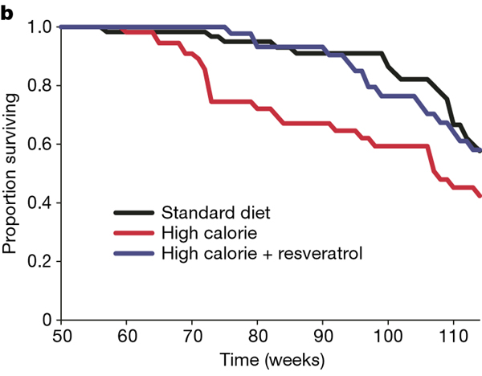
Resveratrol pronged survival of mice fed high calorie diet
~ 25%
Baur, Nature 2006

Slide 30
The effect of resveratrol on mortality rate?
What is likely, based on other data?
Pilot study??
  Small pilot studies generally produce unstable estimates of effects and variance

Slide 31
The effect of resveratrol on mortality rate?
What is likely, based on other data?
Do a pilot study
Estimate based on effect on biomarkers
  Biomarkers for mortality and effect of resveratrol?

Slide 32
The effect of resveratrol on mortality rate?
What is likely, based on other data?
Do a pilot study
Estimate based on effect on biomarkers
What difference is important to detect?
  I don’t want to miss a 1% decrease
  Absolute decrease: 10% vs. 9%

Slide 33
The effect of resveratrol on mortality rate?
What is likely, based on other data?
Do a pilot study
Estimate based on effect on biomarkers
What difference is important to detect?
  I don’t want to miss a 1% decrease
What can we afford?
  1%: the trial will be too big & expensive
  5%: the trial will be smaller and cheaper

Slide 34
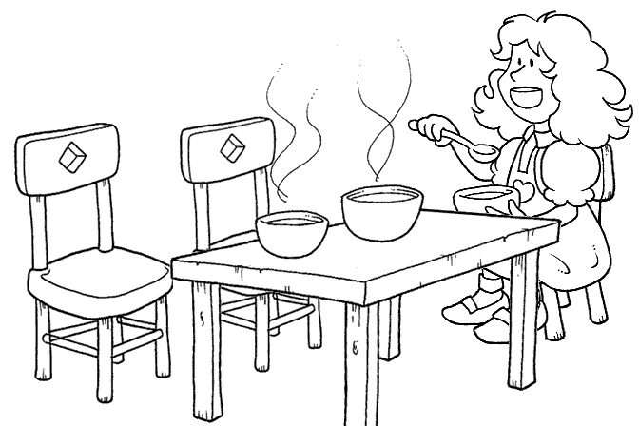
The Science of Effect Sizes
Too large! Too small! Just right!
It requires
good judgment,
balancing science
and feasibility
Smaller effect is important to health
Larger effect is important for your budget
2%
5%
1%

Slide 35
Effect size
Men and women > age 70 years randomized to receive a resveratrol supplement do not have lower mortality rate than those who receive placebo
Placebo rate: 10%
Resveratrol rate: 8%
It would be important to find (I don’t want to miss) a 2% difference
  (20% decreased relative risk)
2% difference

Slide 36
Ingredients for Sample Size
 Testable hypothesis
 Type of study: analytical (RCT)
 Study design
   Type of variables and statistical test
Effect size
→Power and alpha

Slide 37
α (alpha)
The probability of finding a ‘significant’result if there is no association
“Type 1 error”
P-value

Slide 38
To convince people that an effect is not due to chance
Customarily, a result is ‘statistically significant’ if P<0.05
In other words,
Probability of a type I error = 5%
α (alpha) = 0.05

Slide 39
If I need to convince skeptics reduce the chance of a false +
Very small chance that a positive result is an error
α (alpha) = 0.01
P<0.01
A smaller α means larger sample size

Slide 40
Two-sided vs. one-sided α
A 2-sided α assumes that the result could go either way
  Recognizes that you have two chances of finding something that isn’t really there
    Resveratrol decreases mortality
    Resveratrol increases mortality
A 1-sided hypothesis assumes that the result could, plausibly, go only one way

Slide 41
One-sided α
You may believe that your effect could only go one way!
  Resveratrol is‘natural.’ It could not increase mortality!
Be humble.
  The history of research is filled with results that contradicted expectations

Slide 42
One-sided α?
There is a universal consensus: vitamin D is good for muscle and bone!
Vitamin D trial (Sanders et al, JAMA 2010):
  ~1500 IU of vitamin D/d
  Significantly increased the risk of falls and fractures in elderly women and men
A 1-sided test is almost never the best choice

Slide 43
β (beta)
The probability of missing this effect if it is really true
AKA Type 2 error
Power (1- β)

Slide 44
Power (1- β)
The probability of finding this effect size is statistically significant if it is really true

Slide 45
If it’s true, I don’t want to miss it
The chance of missing the effect (β)
is “customarily” 20%
In other words
Probability of a type II error = 0.20
β (beta) = 0.20
Power = 1- β : 0.80
“80% power”

Slide 46
I really don’t want to miss it
β = .10
Power (1- β) = 0.90
Greater power requires a larger sample size

Slide 47
We have all of the ingredients
 Testable hypothesis
 Study design (RCT)
 Statistical test: Chi-squared
 Effect size 10% vs. 8%
 Power: 0.90; alpha: 2-sided 0.05

Slide 48
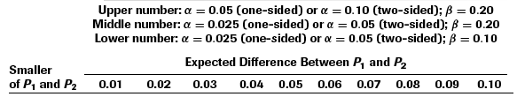
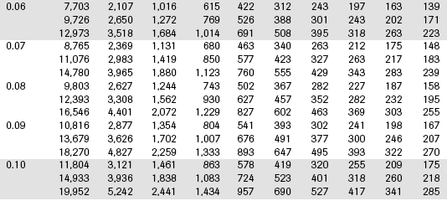
From Table 6B.2
Comparing two proportions
2-sided α = 0.05
Power = 0.90
Treatment
rate

Slide 49
From Table 6B.2
Sample size: 4,401
Per group!
Total: 8,802
Does not include drop-outs
  20% drop-out: 11,002 total sample size!

Slide 50
Appropriate responses
Shock
Depression
Consider alternative approaches

Slide 51
Alternatives
Tweak α: one-sided
  Almost never appropriate
Tweak the power: 0.80

Slide 52
From Table 6B.2
Comparing two proportions
2-sided α = 0.05
Power = 0.80
Treatment
rate

Slide 53
Alternatives
Tweak α: one-sided
  Almost never appropriate
Tweak the power: 0.80
  Modest effect: 3,308 (6,616 total)
  (not including loss to follow-up)

Slide 54
Alternatives
Increase the effect size
  10% vs. 6% (4% difference)
  Resveratrol reduces mortality by 40%!

Slide 55
From Table 6B.2
Comparing two proportions
Treatment
rate

Slide 56
Increasing the effect size
10% vs. 6%
Makes a big difference!
769 / group; 1,538 total (no dropouts)
However, still large (and not affordable)
Not believable

Slide 57
Alternatives: a new hypothesis
Change the outcome measure
  Continuous measurement
  A precise measurement
A‘surrogate’for mortality rate:
  Strongly associated with mortality rate
    and
  Influenced by resveratrol
Walking speed

Slide 58
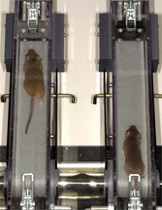
Mice on resveratrol
Mice fed resveratrol
  Live 25% longer
  Run faster
  Have greater endurance

Slide 59
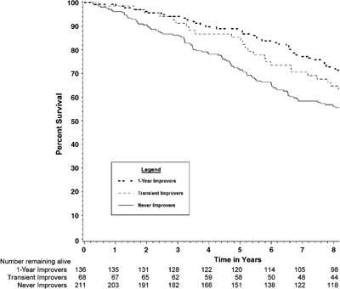
People who walk faster live longer
Faster by ≥0.1 m/s
Slower
~20% decreased
mortality rate

Slide 60
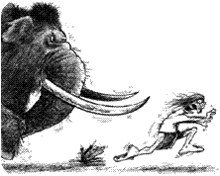
Fast walkers have lower mortality
An evolutionary perspective

Slide 61
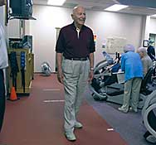
Walking speed
Easy and cheap!
Measure time over a 6 meter course

Slide 62
New endpoint needs a new hypothesis
Among 70 year old men and women, those randomized to resveratrol will not have a greater change in walking speed than those assigned to placebo.

Slide 63
The new ingredients
 New testable hypothesis
 Study design: analytical (RCT)
 Statistical test?
  Continuous variable
  Difference between means

Slide 64
Type of statistical tests
Depends on the types of variables

Slide 65
The new ingredients
 Testable hypothesis
 Study design (RCT)
 Statistical test: T-test
 Effect size ??
 Power: 0.90; alpha: 2-sided 0.05

Slide 66
The new ingredients
 Testable hypothesis
 Study design (RCT)
 Statistical test: T-test
→Effect size: ?

Slide 67
What effect size for an effect of resveratrol on walking speed
A continuous measurement that might indicate that resveratrol may influence
mortality

Slide 68
What we know about walking speed and mortality rate
Faster
Slower

Slide 69
What we know about walking speed and mortality rate
Faster by ≥0.1 m/s
Slower
~20% decreased
mortality rate

Slide 70
The new ingredients
 Testable hypothesis
 Study design (RCT)
 Statistical test: T-test
Effect size: 0.1 m/s
HOWEVER, Continuous variables, like gait speed, also need to consider variance (variability) in the measurement
Noisy measurements will need more subjects to find an effect

Slide 71
Standardized effect size: E/S
Sample size depends on the ratio of E/S
  E: Effect size (difference in means)
  S: Standard deviation for measurement
You need smaller sample size if
  There is a greater effect (E)
  More precise measurement: lower Standard Deviation (SD)

Slide 72
What we need to determine E/S for our trial
Effect size (E) for change in walking speed
+0.1 m/s
I need S: Standard deviation
Standard deviation of the change

Slide 73
S (Standard Deviation)
Standard deviation for the measurement
  Cross-sectional data: 0.25 m / sec
However, we are interested in change
Standard deviation of change in speed?
  From longitudinal studies: 0.2 m / sec

Slide 74
E/S
E: Effect size: 0.1 m/sec difference in change
S: Standard deviation: 0.2 m/sec
E/S = 0.5

Slide 75
The new ingredients
 New testable hypothesis
 Type of study: analytical (RCT)
 Statistical test: t-test
  Continuous variable
  Difference between means
Effect size: 0 vs. 0.1 m/sec change
  E/S = 0.5
 Power: 0.80; 2-sided alpha: 0.05

Slide 76
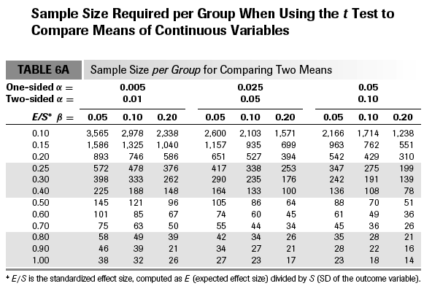

Slide 77
The new ingredients
 New testable hypothesis
 Type of study: analytical (RCT)
 T-test
 Effect size: E/S = 0.5
 Power: 0.80; alpha: 0.20
Sample size: 64 per group; 128 total
With 20% drop out: 160 total

Slide 78
The new ingredients
 New testable hypothesis
 Type of study: analytical (RCT)
 T-test
 Effect size: E/S = 0.5
 Power: 0.80; alpha: 0.20
Sample size: 64 per group; 128 total
With 20% drop out: 160 total
A trade-off: feasibility vs. clinical importance

Slide 79
Online Calculator
http://www.sample-size.net/
CTSI sample-size
No ads!

Slide 80
Summary
Estimate sample size early
Systematically collect the ingredients
Effect size is the most difficult and important judgment
Alternatives that reduce sample size
  Compromise power
  Increase effect size
  Use continuous outcomes

