Slide 1
Biostat 202: Opportunities and Challenges of “Big Data”.
Prediction Algorithms 2:
Classification
John Kornak
Division of Biostatistics
Department of Epidemiology and Biostatistics
08/18/2016

Slide 2
Overview
Classification
Model evaluation and training-test
Classification methods
Training-validation-test
Cross validation
More classification methods at a glance
IBM SPSS Data Modeler examples left for todays lab

Slide 3
Supervised vs. unsupervised
Machine Learning
Supervised
Regression (continuous outcome)
Classification (categorical outcome)
Unsupervised
Clustering
(grouping observations)
Data Reduction (transforming variables)

Slide 4
Supervised vs. unsupervised
Machine Learning
Supervised
Regression (continuous outcome)
Classification (categorical outcome)
Unsupervised
Clustering
(grouping observations)
Data Reduction (transforming variables)

Slide 5
Classification
Objective – given set of predictors and some training data, generate a rule (classifier) to predict which category a new instance/observation/subject belongs to
Training data with predictors and outcomes used to develop classifier
Classifier is applied to new data where the outcome (i.e. target group/class) is unknown
Let’s look at a toy example trying to classify 1st vs. 6th grade girls based on height and weight….

Slide 6
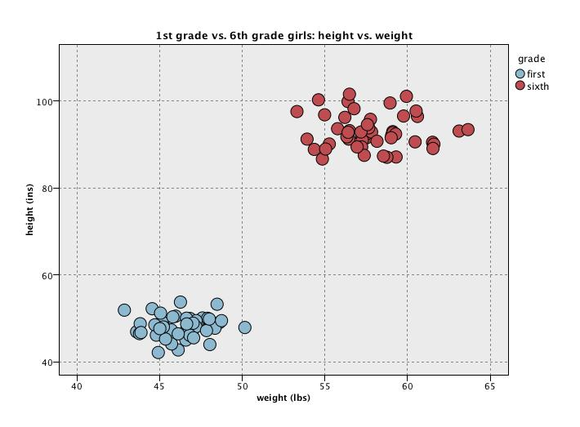
2D Classification example

Slide 7
2D Classification example

Slide 8
2D Classification example
Classification Rule is to predict new data points above the line to be 6th grade

Slide 9
2D Classification example

Slide 10
2D Classification example

Slide 11
But in real problems the separation is unlikely to be so neat
Consider 1st grade boys vs. 1st grade girls

Slide 12
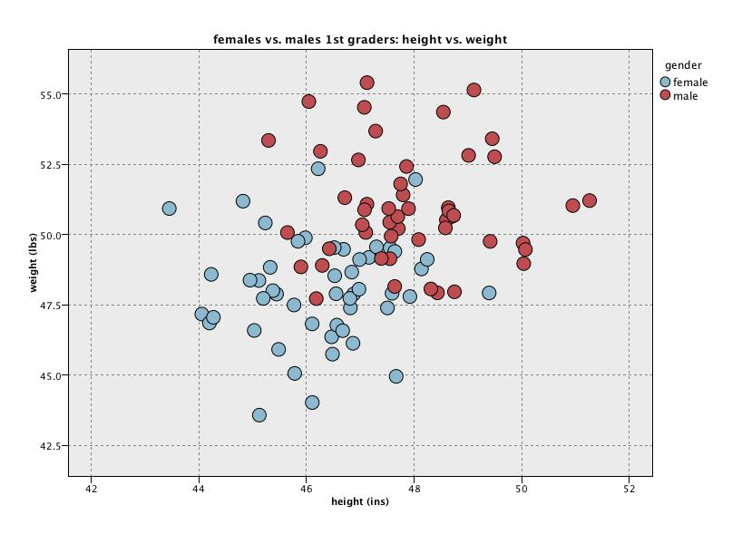
2D Classification example

Slide 13
2D Classification example
Tension: misclassifying many points

Slide 14
2D Classification example

Slide 15
2D Classification example
Tension: don’t believe real - overfitting

Slide 16
The trade-off
Want to find true predictive patterns in the data
But, want to avoid overfitting spurious detail: i.e. don’t want to make the model capture apparent patterns due to noise - we want results that are likely to be generalizable to future observations
Solution – independent testing – reserve some data that has not been used in model fitting for the purpose of model evaluation and comparison

Slide 17
Evaluation
Possible evaluation measures:
  Classification Accuracy – or conversely, the classification error rate = 1 – classification accuracy
  Total cost/benefit – different errors may have different costs
  Gini Index, cross-entropy (we’ll look at these later)
  ….
How reliable are the predicted results ?

Slide 18
Classifier error rate
Natural performance measure for classification problems: error rate
  Success: instance’s class is predicted correctly
  Error: instance’s class is predicted incorrectly
  Error rate: proportion of errors made over the whole set of instances
Training set error rate: is generally too optimistic!
  you can find patterns even in random data

Slide 19
When you have lots of “instances”
If many (>1000) instances are available, including >100 from each class
A simple evaluation training/test evaluation will work
  Randomly split data into training and test sets (often ~2/3 for train, 1/3 for test) – may want to stratify on outcome (have matching proportions of each class in each set)
Build a classifier using the training set and evaluate it using the test set
We will look at cross-validation later for when you do not have so many observations

Slide 20
When you have lots of “instances”
Results Known
+
Training set
+
-
-
Data
+
Testing set

Slide 21
When you have lots of “instances”
Results Known
+
Training set
+
-
-
Data
+
Model Builder
Testing set

Slide 22
When you have lots of “instances”
Results Known
+
Training set
+
-
-
Data
+
Model Builder
Evaluate
Predictions
+
-
+
-
Y
N
Testing set

Slide 23
Classification methods
Logistic regression
K-nearest neighbors
Classification trees
Support vector machines (SVMs)
Linear Discriminant Analysis (LDA)

Slide 24
Logistic Regression

Slide 25
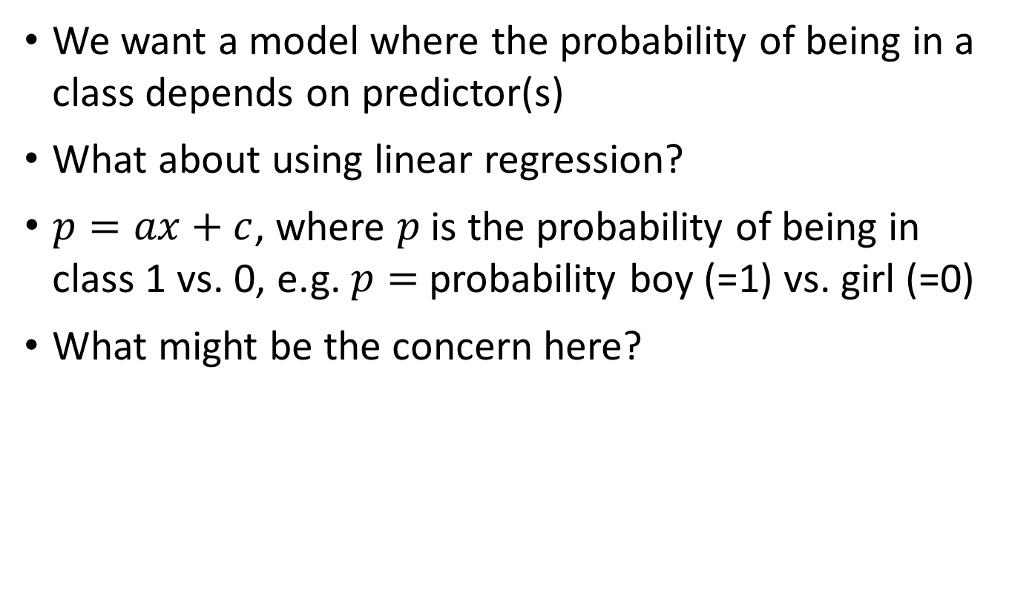
Binary/flag outcome regression modeling
We want a model where the probability of being in a class depends on predictor(s)
What about using linear regression?
$p=ax+c$, where $p$ is the probability of being in class 1 vs. 0, e.g. $p=$probability boy (=1) vs. girl (=0)
What might be the concern here?

Slide 26
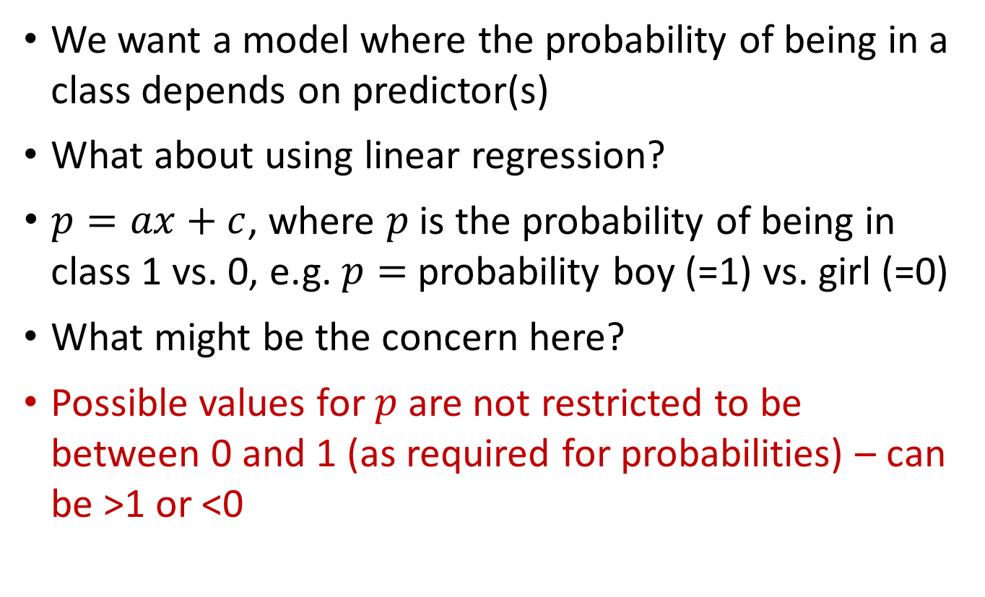
Binary/flag outcome regression modeling
We want a model where the probability of being in a class depends on predictor(s)
What about using linear regression?
$p=ax+c$, where $p$ is the probability of being in class 1 vs. 0, e.g. $p=$probability boy (=1) vs. girl (=0)
What might be the concern here?
Possible values for $p$ are not restricted to be between 0 and 1 (as required for probabilities) – can be >1 or <0

Slide 27

Linear regression?
$$p$$
1
0

Slide 28
Linear regression
Problem predictions – outside range 0 to 1
$$p$$
1
0

Slide 29
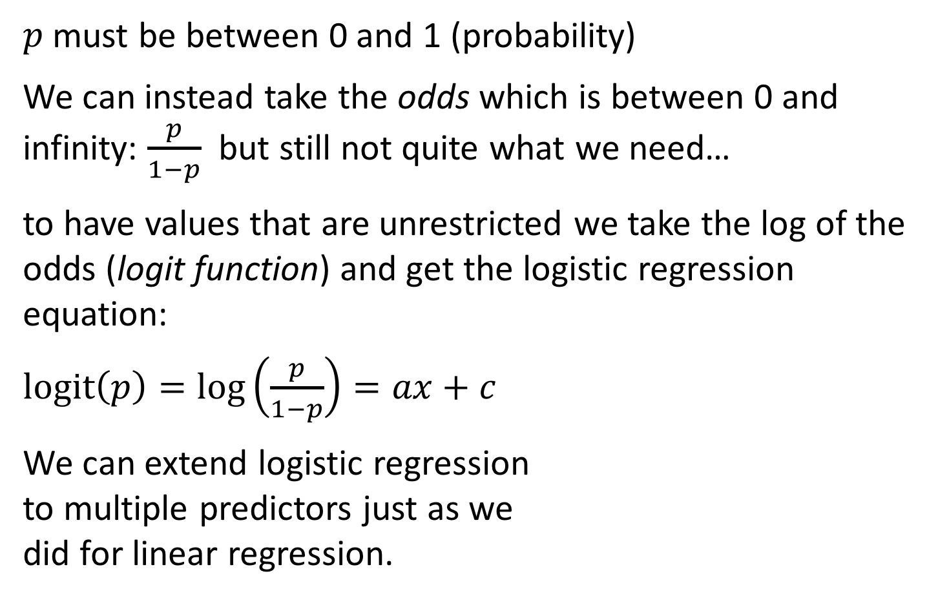
Logistic regression
$p$ must be between 0 and 1 (probability)
We can instead take the odds which is between 0 and infinity: $\frac{p}{1−p}$ but still not quite what we need…
to have values that are unrestricted we take the log of the odds (logit function) and get the logistic regression equation:
$logit\left(p\right)=\log\left(\frac{p}{1−p}\right)=ax+c$
We can extend logistic regression
to multiple predictors just as we
did for linear regression.

Slide 30
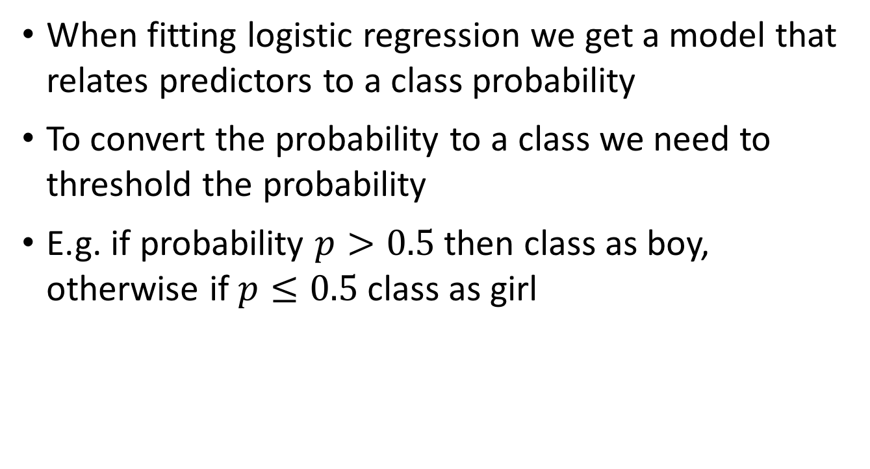
Logistic regression for classification
When fitting logistic regression we get a model that relates predictors to a class probability
To convert the probability to a class we need to threshold the probability
E.g. if probability $p>0.5$ then class as boy, otherwise if $p≤0.5$ class as girl

Slide 31
Logistic regression
A long history (relatively) – well known
Much statistical theory
Works well for many problems
Can be extended to multiple categories
Can use step-wise/subset selection techniques
Can provide interpretable models

Slide 32
K-nearest neighbors classification

Slide 33
K-nearest neighbors classification
Training data – 2 classes
and 2
predictors
height
weight

Slide 34
K-nearest neighbors classification
k=1 – blue wins
height
New point – need to predict class
weight

Slide 35
K-nearest neighbors classification
k=1 – blue wins
height
weight

Slide 36
K-nearest neighbors classification
k=3 – red wins
height
weight

Slide 37
K-nearest neighbors classification
k=3 – red wins
height
Any concerns?
weight

Slide 38
K-nearest neighbors classification
Common to standardize predictors to have mean 0 and standard deviation of 1 (subtract mean and divide by standard deviation)
Take majority vote among k-nearest neighbors
Ties are broken at random (e.g. 1 red neighbor and 1 blue neighbor when k=2 – choose red or blue at random).
Works for problems with more than 2 classes

Slide 39
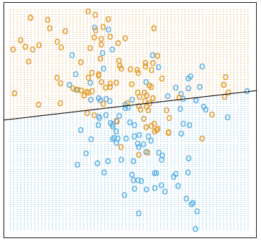
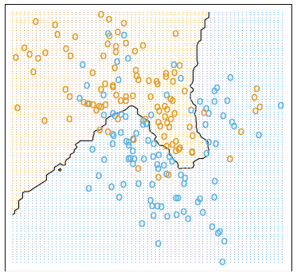
Choice of k
Example taken from Elements of Statistical Learning – Hastie et al. 2nd Ed. pp. 13-17
Linear decision boundary (LDA) 15 nearest-neighbor boundary

Slide 40
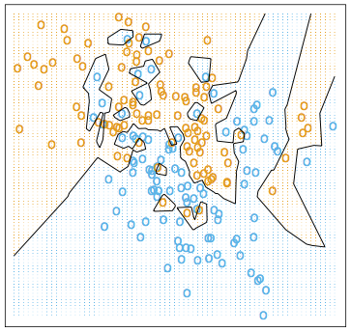
Choice of k
15 nearest-neighbor boundary 1-nearest neighbor boundary

Slide 41
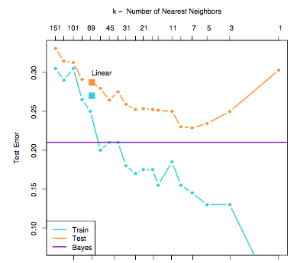
Choice of k
Fitting increased noise
Low to high complexity

Slide 42
Choice of k
Fitting increased noise
Low to high complexity
Training set error gets better with more complexity – fitting to noise helps

Slide 43
Choice of k
Fitting increased noise
Low to high complexity
Test error goes down then up again when overfitting
to training data
Training set error gets better with more complexity – fitting to noise helps

Slide 44
Choice of k
Best predictive
models
Fitting increased noise
Low to high complexity
Test error goes down then up again when overfitting
to training data
Training set error gets better with more complexity – fitting to noise helps

Slide 45
Choice of k
Best predictive
models
Theoretically best true predictive error level from this simulated data (Bayes classifier)

Slide 46
Choice of k
Best linear separating line
Best predictive
models
Theoretically best true predictive error level from this simulated data (Bayes classifier)

Slide 47
Nearest neighbors classifier
Simple technique
No modeling
Has been applied to many machine learning problems successfully

Slide 48
Parameter estimation
Many classifiers (and regression approaches) have inbuilt “tuning parameters” (like choosing k for nearest neighbors)
Some learning schemes operate in two stages:
  Stage 1: builds the basic structure
  Stage 2: optimizes parameter settings
The test data can’t be used for parameter tuning!
Proper procedure uses three sets: training data, validation data, and test data
  Validation data is used to optimize parameters
Once evaluation is complete, all the data can be used to build the final classifier

Slide 49
Train-validate-test
Do this for multiple values of the procedures parameter(s)
Results Known
+
Model
Builder
+
Training set
-
-
Data
+
Evaluate
Choose best parameter values based on validation set results
Model Builder
Predictions
+
-
+
-
Y
N
Validation set
+
-
+
-
Final Evaluation
Final Test Set
Final Model

Slide 50
Warning: IBM Modeler goes against convention here:
IBM = training/test/validate convention = training/validate/test
We will use convention in the slides but be careful to switch test and validate definitions when working in Modeler

Slide 51
But what if you don’t have enough data to split 2, let alone 3 ways?

Slide 52
Cross-validation
Cross-validation avoids overlapping test sets
  First step: data is split into k subsets of equal size
  Second step: each subset in turn is used for validation and the remainder for training
This is called k-fold cross-validation (10-fold is common choice, also 5-fold)
Often the subsets are stratified before the cross-validation is performed
The error estimates are averaged to yield an overall error estimate

Slide 53
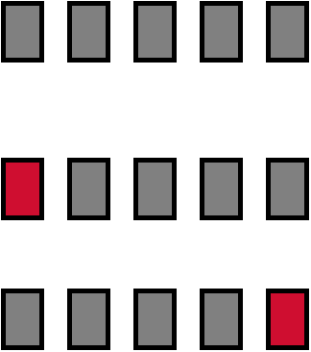
5-fold cross-validation
Break up data into groups of the same size
Hold aside one group for testing and use the rest to build model
Repeat
Test set

Slide 54
Another Warning:
IBM text book (Wendler and Gröttrup) wrongly considers cross-validation to be a simple train-test-validate analysis
(no rotation of dataset)
This flies in the face of the definition for cross-validation!

Slide 55
Recursive Partitioning
(Decision Trees)

Slide 56
Recursive Partitioning
Classification based on a series of binary decision cut-points e.g.,
  Is systolic blood pressure greater that 140?
  If yes, is LDL Cholesterol greater than 190?
  If no, exercise > 2 times per week
At the end of the series of questions a decision node is reached (note that the series of questions may not be the same for every subject – it depends which branch of the tree you go down)

Slide 57
Risk of heart problem
Systolic BP > 140?
No Yes
Exercise < 2 times per week
LDL > 190?
Alcohol > 2 units/day?
monitor
intervention
monitor
monitor
intervention

Slide 58
Risk of heart problem
Systolic BP > 140?
No Yes
Exercise < 2 times per week
LDL > 190?
Exercise < 3 times per week
Alcohol > 2 units/day?
monitor
intervention
monitor
intervention
monitor
intervention

Slide 59
Growing Trees
Greedy algorithmic approach
Start with first best split on a single variable (based on Gini Index)
  The Gini Index is related to classification error, but penalizes errors more as the proportion of observations in a node is further from 0.5 – favors pure nodes
  A pure node is a decision node where all of the observed data is of a single class
Then for each branch look for the best split on a single variable for the observations within that branch
Keep going untill each branch is pure or has less than e.g. 5 observations

Slide 60
Pruning Trees
Full tree after growing is too complex
Goal is to find the sub-tree (contained in the fully grown tree) that minimizes a cost-complexity criterion.
The cost-complexity criterion is a trade-off between the classification error rate and the complexity (size) of the tree
The best balance (weighting) for the trade-off is determined via cross-validation to minimize the classification error rate

Slide 61
Recursive Partitioning
Recursive partitioning methods are a very popular classification approach and come in many flavors: Classification and Regression Trees (CART), C5.0, Random Forests…
Partitioning on cut-points approach is very popular in medicine because mimics decision approach of clinicians

Slide 62
Support vector machines

Slide 63
Support vector machines
Idea is to generate a (non-linear) hyper-plane that optimally separates points from different classes
Developed in computer science community in 1990s

Slide 64
Maximizing margins

Slide 65
But usually we have overlapping data…

Slide 66
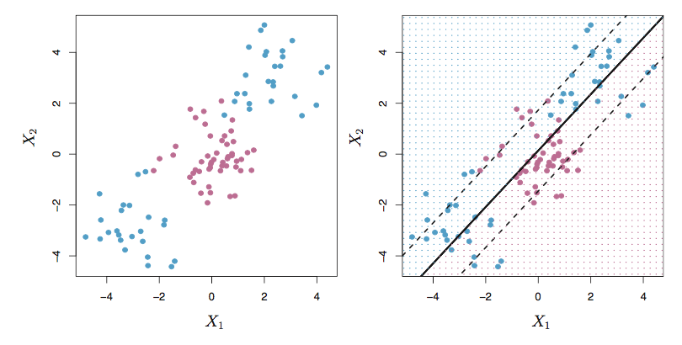
But linearity is limited
Example from ISLR

Slide 67
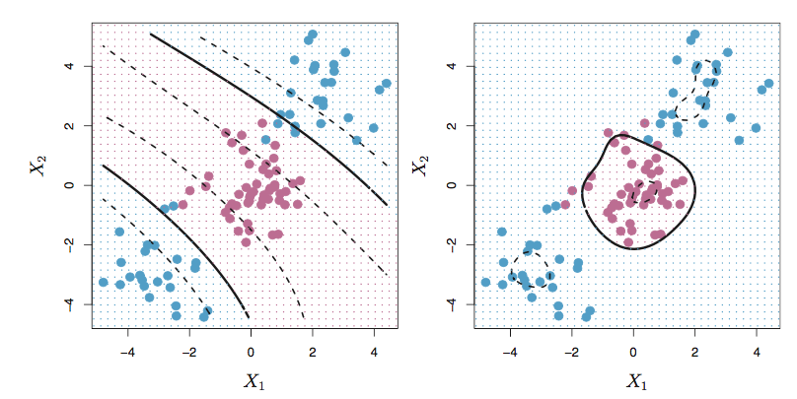
Non-linear decision boundary

Slide 68
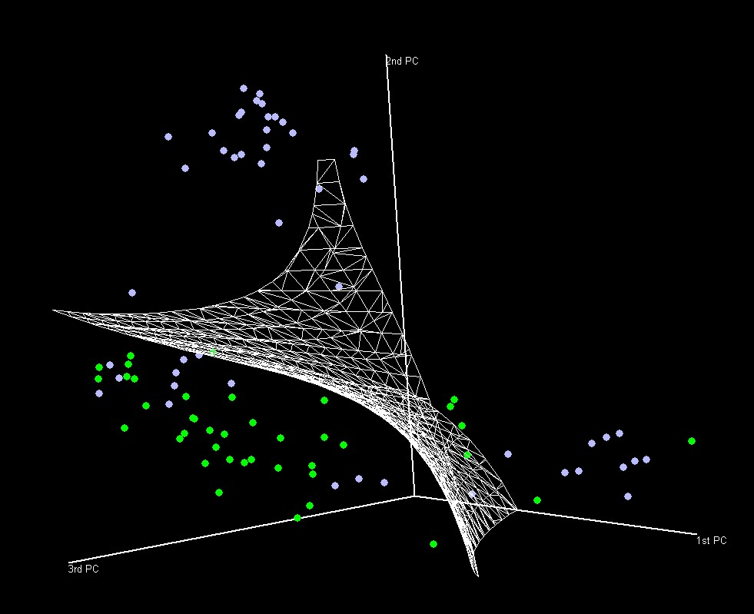
3 predictor - non-linear decision boundary

Slide 69
Support Vector Machine
Considered one of the best “out of the box” classifiers
Has gained massive popularity
Solved a lot of tough problems

Slide 70
Discriminant Analysis

Slide 71
Linear discriminant analysis (LDA)
Consider 2 or more classes with correct class known for each subject.
Objective: find a linear combination
of the variables that maximizes the ratio of the between-class to within-class variance – this is the first linear discriminant function.
The 2nd linear discriminant finds the best linear combination orthogonal (perpendicular) to the first to maximize the same ratio etc.

Slide 72
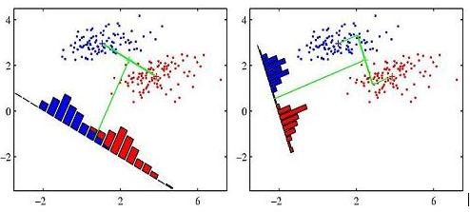
Discriminant analysis
Gaussian (normal) probability densities: linear discriminant analysis (LDA) based on assuming within-class covariances are equal
Provides the probability of belonging to each class, not just a classification.

Slide 73
Discriminant analysis
Long standing method (goes back to Ronald Fisher – see lab)
We are more interested in summary patterns of what is important in determining classification
Can extend to quadratic discriminant analysis (QDA) and more complex non-linear forms

Slide 74
Monday’s lecture – clustering and data reduction
Clustering
  K-means clustering
  Kohonen
Data reduction
  Principal components analysis (PCA)
Neural Networks (Neural Nets)
Bayesian Networks (Bayes Nets) – causal interpretation

Slide 75
Note: HW #4 will be up some time tomorrow
– due 11.55pm on Thursday August 25

Slide 76




