Slide 1
Anatomy of the Axilla
Technical Considerations in Breast Surgery
Schecter Conference
August 11th, 2016

Slide 2
Anatomy of the Axilla

Slide 3
Anatomy of the Axilla
Axilla Boundaries:
  Superior- Axillary Vein
  Inferior- 4th-5th Rib
  Medial- Serratus Anterior Muscle
  Posterolateral- Latissimus Dorsi Muscle
  Anterior- Pectoralis Muscle
Axillary lymph nodes receive 85% of lymphatic drainage from all quadrants of the breast. Remaining 15% of lymph drains to internal mammary, infraclavicular, and supraclavicular lymph nodes.

Slide 4
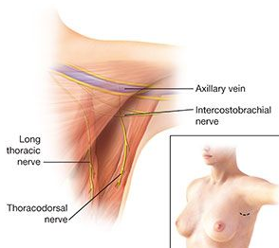

Slide 5
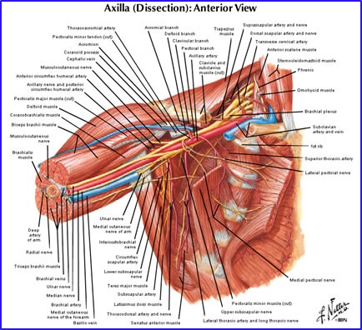

Slide 6
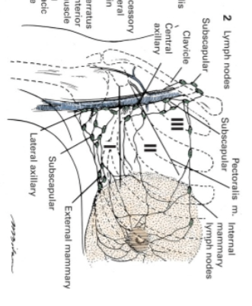

Slide 7
Technical Considerations

Slide 8
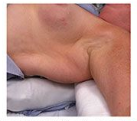
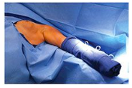
Patient Positioning
Notes:
Supine
Roll placed under ipsilateral shoulder as to elevate the latissimus dorsi muscle
All lines, cuffs, pulse ox should be placed on other extremities
Arm prepped circumferentially

Slide 9
Sentinel Lymph Node Biopsy
What do you want to achieve?
What do you want to avoid?
Notes:
Goal- accurately stage patient. SLNB has lower risk of arm morbidity, particularly lymphedema, sensory loss, and shoulder abduction deficits

Slide 10
Sentinel Lymph Node Biopsy
Radioactive Tracer and/or Blue Dye
  Surgeon Preference
  Use of both has been shown to be associated with higher identification and lower false negative rates
  However, in skin sparing mastectomy dye can make it more difficult to evaluate for skin ischemia/necrosis
Role of Lymphoscintigraphy
  Draining lymph patterns of breast are less variable than melanoma
  May be helpful in recurrent or new primary disease.

Slide 11
Sentinel Lymph Node Biopsy
When do you inject tracer and dye?
  Radiology, Preop, or OR
Where do you inject tracer and dye?
  Tracer: Peritumor, Intradermal, Periareolar
  Dye: Peritumor, Subareolar
What do you inject?
  Tracer: Technetium Tc 99m sulfur colloid
  Dye: Isosulfan Blue or Methylene Blue
    What are potential side effects?
Notes:
Preop- painful
Intradermal- in the skin over the location of the cancer
Periareolar- 4 injections around areola, which allows for lymphatic mapping of multiple tumors or those that are not easily identifiable
Isosulfan Blue- Associated with anaphylaxis (need to pretreat with steroids and benadryl) and expensive, but better able to visualize veins
Methylene Blue- Cheaper, Associated with skin necrosis, pulmonary edema, and serotonin syndrome in patient taking psychiatric meds
Both can give the patient blue breast

Slide 12
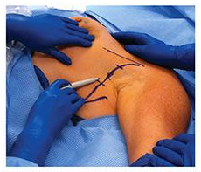
Incision
Notes:
Where?
Mark Borders - pectoralis and latissimus dorsi
Lazy S to allow for extension superior or inferior
Use gamma probe to identify area of maximal radioactivity

Slide 13
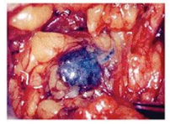
Identification of Sentinel Lymph Nodes
What is a sentinel lymph node?
Notes:
What is a sentinel lymph node?
Hottest node and any node with counts >10% ex vivo count of hottest node
All blue nodes and those nodes at end of blue channel
Palpable node regardless if not hot or not blue (tumor may be obstructing)
Stop at only 3 nodes?

Slide 14
Axillary Lymph Node Dissection
What do you want to achieve?
What do you want to avoid?
Notes:
Achieve- LN stations 1 and 2 en bloc
Avoid- damage to thoracodorsal and long thoracic nerves

Slide 15
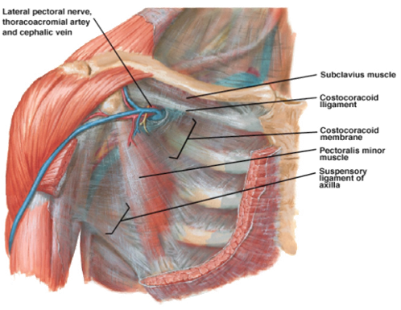
Axillary Lymph Node Dissection
To enter the axilla, incise the clavipectoral fascia along the edge of the pectoralis major muscle.

Slide 16
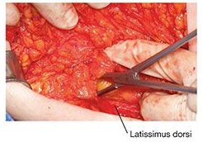
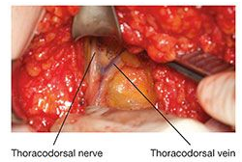
Axillary Lymph Node Dissection
Identify the thoracodorsal neuromuscular bundle by dissecting the latissimus dorsi towards axillary vein

Slide 17
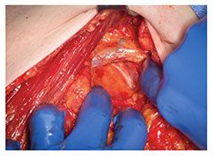
Axillary Lymph Node Dissection
Identify the axillary vein, then dissect level I nodes

Slide 18
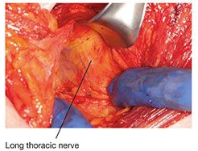
Axillary Lymph Node Dissection
Gain access to level II nodes by retracting pectorals muscles medially
Identity the long thoracic nerve
If injured, what is the resultant defect?
Notes:
When retracting be mindful of the medial pectoral bundle
Long thoracic nerve is superficial to serrates anterior fascia. Feels like spaghetti. Injury causes winged scapula.

Slide 19
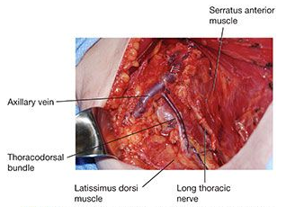
Axillary Lymph Node Dissection

Slide 20
Axillary Lymph Node Dissection
Closure
  Place drains deep and superficial to pectorals muscles to prevent serum formation
Postop Complications
  Seroma
  Lymphedema
  Nerve Injury
  Axillary Vein Thrombosis

Slide 21
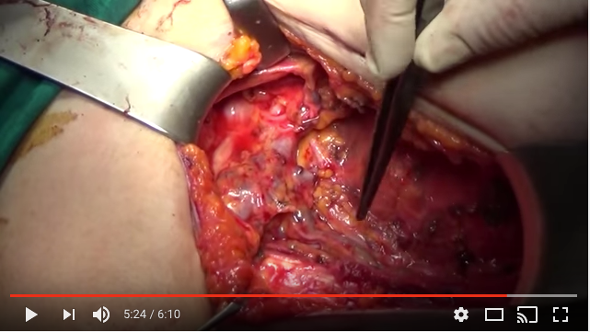
ALND Video
https://www.youtube.com/watch?v=708ShuXlDcM

