Slide 1


ABDOMINAL WALL RECONSTRUCTION
Oren Shaked
Expert Consultation: Jonathan Carter
7/27/16

Slide 2
Goals
Review of abdominal wall anatomy and vascular supply
Review various types of ventral abdominal hernias
Understand methods of repair
Review mesh options for repair, and utility of mesh in repair

Slide 3
CASE
EM 58 F h/o asthma and ECF as complication of prior mesh repair of VAH who is status post takedown of ECF, bilateral minimally invasive anterior component separation and vicryl underlay mesh
She presents with a 6 cm recurrent incisional hernia that causes discomfort.
BMI is 26.2, she is pre-diabetic, and had been on steroids for her asthma. She does not smoke

Slide 4
Epidemiology
Overall incidence of incisional hernias 10-15%
  Incidence can be as high as 23% in post operative wound infections.
Most (50-60%) occur in the first year following surgery
About a 2% incidence per year
In 2006, nearly 350,000 ventral hernia repairs
  Cost of over $3 Billion

Slide 5
Risk Factors
infection, obesity, smoking, medications (steroids, immunosuppressives, etc.), excessive wound tension, malnutrition, fractured sutures, poor technique, and connective tissue disorders, emergency surgery, ascites

Slide 6
Incisional hernias
Highest incidence is with midline incisions
Upper abdominal incisions have a higher incidence of herniation greater than lower abdominal incisions.
Technical decisions during surgery can have large impacts on hernia development

Slide 7
Preoperative Imaging
CT Scan is the imaging study of choice
  Allows assessment of size, number and relationship of abdominal wall defects and hernia sacs to the viscera and abdominal wall musculature
  Helps identify the position and size of previously placed prosthetic mesh(es) and any associated infection or sinus tracts
  Can be used to assess loss of domain by calculating the volume of the hernia as a percentage of the peritoneal cavity volume (more to come later)

Slide 8
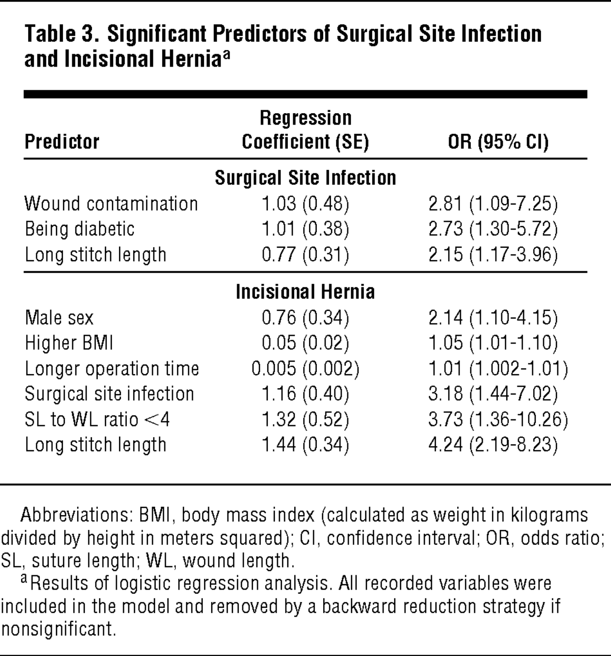
Notes:
Arch Surg. 2009 Nov;144(11):1056-9. doi: 10.1001/archsurg.2009.189.
Effect of stitch length on wound complications after closure of midline incisions: a randomized controlled trial.
Millbourn D¹, Cengiz Y, Israelsson LA.

Slide 9
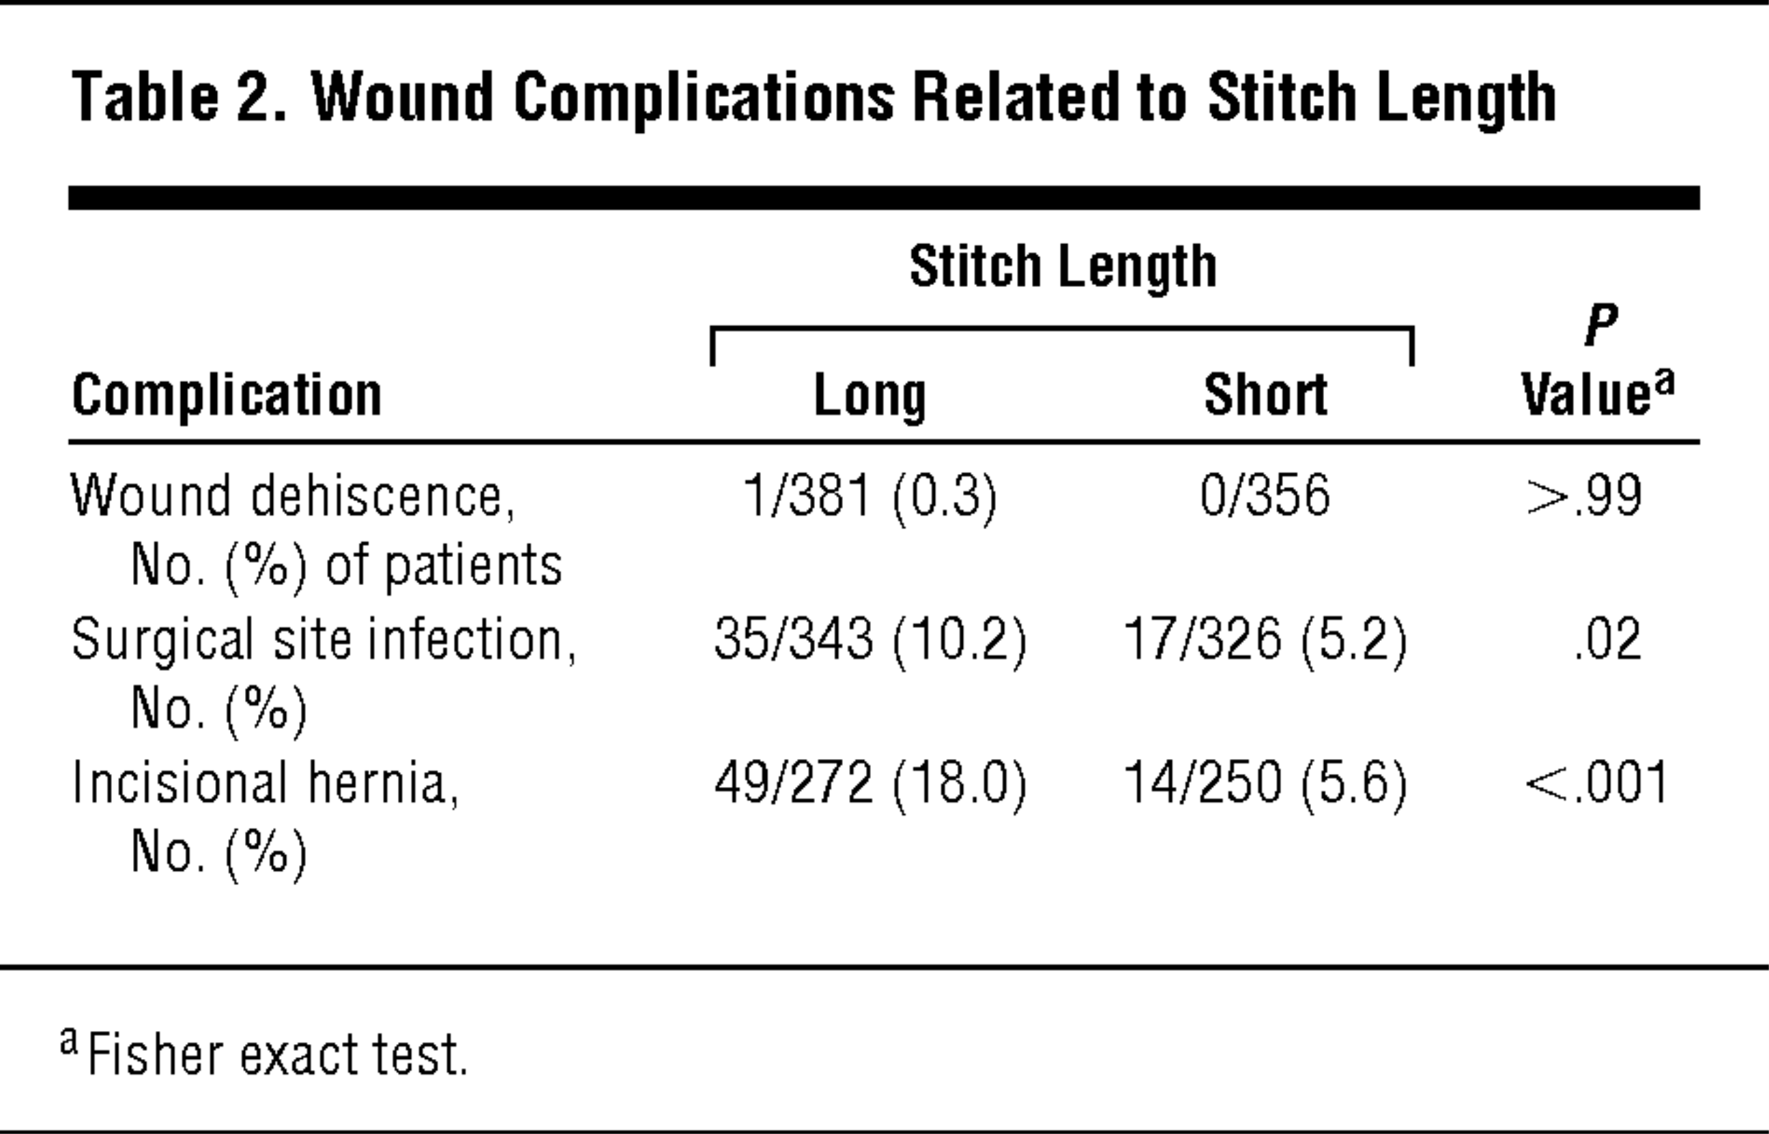
Notes:
Arch Surg. 2009 Nov;144(11):1056-9. doi: 10.1001/archsurg.2009.189.
Effect of stitch length on wound complications after closure of midline incisions: a randomized controlled trial.
Millbourn D¹, Cengiz Y, Israelsson LA.

Slide 10
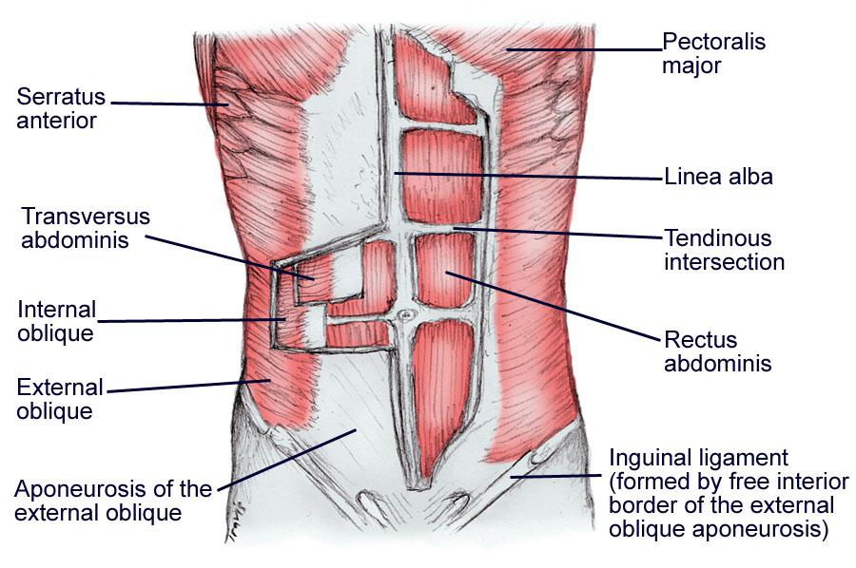
Abdominal Wall Anatomy
Notes:
The abdominal wall is composed of 5 paired muscles: 2 vertical muscles (the rectus abdominis and the pyramidalis) and 3 layered, flat muscles (the external abdominal oblique, the internal abdominal oblique, and the transversus abdominis muscles).
external abdominal oblique muscle arises from the lower 8 ribs and interdigitations of the serratus anterior muscle. It courses in an inferior medial direction. Inferiorly, the external abdominal oblique aponeurosis folds back on itself to form the inguinal ligament between the anterior superior iliac spine and the pubic tubercle before inserting onto the pubic tubercle and the anterior half of the iliac crest. Just medial to its insertion on the pubic tubercle, the aponeurosis divides and forms the superficial (or external) inguinal ring.
The internal abdominal oblique muscle originates broadly from the anterior portion of the iliac crest, lateral half of the inguinal ligament, and thoracolumbar fascia. It inserts on the inferior border of the 10th-12th ribs, the linea alba, and the pubic crest via the conjoint tendon, with its muscle fibers coursing upward in a superomedial orientation, perpendicular to the muscle fibers of the external abdominal oblique. Superior to the arcuate line (see the image below), the internal abdominal oblique aponeurosis splits anteriorly and posteriorly to enclose the rectus muscle and helps form the rectus sheath. However, inferior to the arcuate line, the internal abdominal oblique aponeurosis does not split and only passes anterior to the rectus muscle as part of the anterior rectus sheath. Inferior fibers of the internal oblique muscle course over the spermatic cord as the cremasteric muscles through the inguinal canal, and the medial fibers fuse with the aponeurosis of the transversus abdominis muscle to form the conjoint tendon.
Of note, all the neurovascular structures supplying the abdominal muscles run in the plane between the internal abdominal oblique muscle and the transversus abdominis muscle, except for the iliohypogastric and ilioinguinal nerves. Initially, they lie on the anterior surface of the quadratus lumborum, then pass laterally into the plane between the transversus abdominis and the internal abdominal oblique. Above the anterior superior iliac spine, they penetrate the internal abdominal oblique to run between this muscle and the aponeurosis of the external abdominal oblique muscle.
The transversus abdominis muscle originates on the internal surfaces of the 7th–12th costal cartilages, thoracolumbar fascia, anterior three fourths of the iliac crest, and lateral third of the inguinal ligament. Above the arcuate line, the transversus abdominis aponeurosis contributes to the posterior rectus sheath. Below the arcuate line, it is fused with the other flat muscles as the anterior rectus sheath. The muscle and aponeurotic fibers run in a transverse direction, except for the inferior most aponeurotic fibers, which curve in an inferomedial direction to unite with the aponeurosis of internal abdominal oblique to form the conjoint tendon. The conjoint tendon attaches onto the pubic crest and the pectineal (Cooper) ligament. The inferior aponeurotic fibers are fused to the underlying transversalis fascia, thus forming the posterior wall of the inguinal canal. A small triangular opening in this posterior wall forms the deep or internal inguinal ring.
The rectus abdominis muscles originate from the xiphoid process of the sternum and costal cartilage of the 5th-7th ribs and insert on the pubic symphysis. The rectus muscles have a dual blood supply. The superior epigastric artery and vein, which are direct continuations of the internal thoracic vessels, supply the superior half of the rectus muscles. The inferior epigastric artery and vein, which arise from the external iliac vessels just proximal to their passage under the inguinal ligament, supply the inferior portion of the rectus muscles and run superiorly until they anastomose with the superior epigastric vessels. In addition, there are numerous small, segmental contributions from the lower 6 intercostal vessels,
The pyramidalis muscle is a small, triangular muscle that lies anterior to the inferior aspect of the rectus abdominis muscles. It originates at the pubic symphysis and attaches superiorly at the linea alba. This muscle functions to tense the linea alba and aid in midline stabilization. The pyramidalis muscle is generally considered insignificant in humans and is, in fact, absent in about 20% of the population.

Slide 11
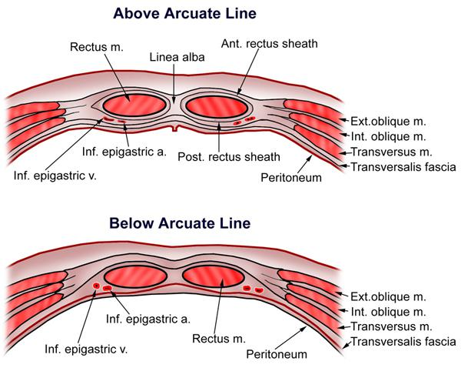
Notes:
The transversalis fascia is a thin layer of connective tissue lining most of the abdominal cavity between the posterior surface of the transversus abdominis and superficial to the extraperitoneal fat and peritoneum. Superiorly, this fascia continues with the inferior diaphragmatic fascia; inferiorly with the iliac and pelvic fascia; posteriorly with the thoracolumbar fascia; and laterally to the iliac crest. Above the arcuate line, the transversalis fascia contributes to the posterior sheath along with the posterior leaf of the internal abdominal oblique and the transversus abdominis muscles. Below the arcuate line, the transversalis fascia forms the posterior sheath alone. With attachments to the posterior margin of the inguinal ligament, it contributes to the formation of the femoral sheath, contributes the internal spermatic fascia, and becomes the only layer contributing to the inguinal floor. At the deep inguinal ring, the structures of the spermatic cord in males and, in females, the structures of the round ligament of the uterus pass through the transversalis fascia.

Slide 12
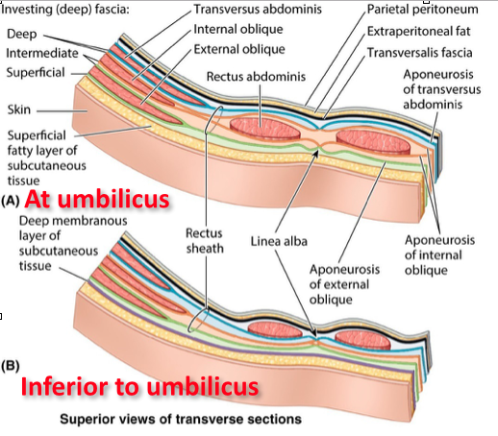

Slide 13
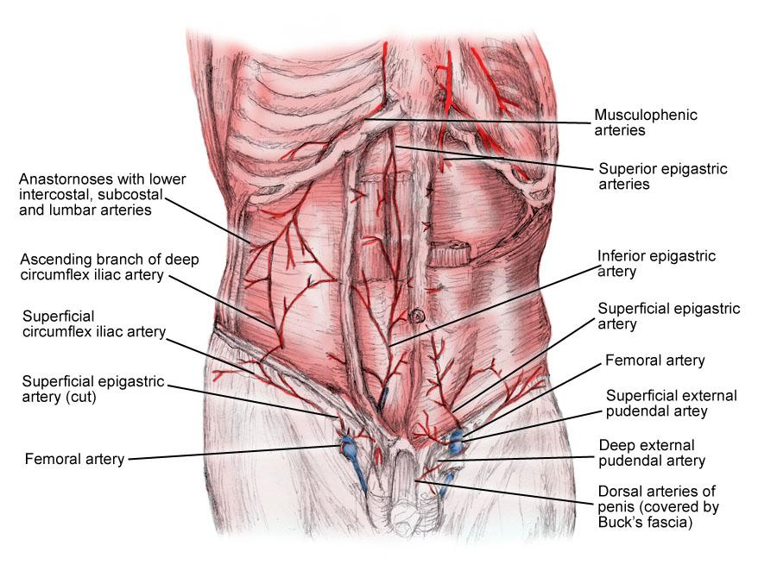
Blood supply of the abdominal wall

Slide 14
VENTRAL ABDOMINAL HERNIAS

Slide 15
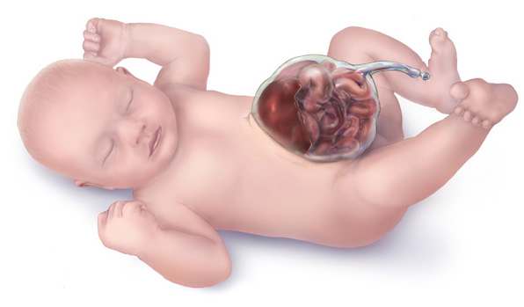
Omphalocele
Notes:
Source: Centers for Disease Control and Prevention, National Center on Birth Defects and Developmental Disabilities
Image taken from: http://en.wikipedia.org/wiki/File:Omphalocele-drawing.jpg

Slide 16
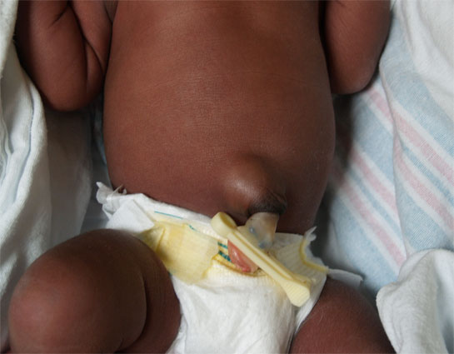
Infantile Umbilical Hernia
Notes:
Source: Stanford School of Medicine, Newborn nursery at LBCH
Image Taken From: http://newborns.stanford.edu/PhotoGallery/UmbHernia1.html

Slide 17
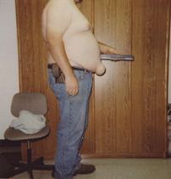
Adult Umbilical Hernia
Notes:
Source: Southern California Hernia Center
Image Taken From: http://www.google.com/imgres?sa=X&biw=1280&bih=815&tbm=isch&tbnid=5QL4nZ8ncSDymM:&imgrefurl=http://www.herniaonline.com/typesofhernias/umbilical.html&docid=TrowovygOcO6eM&imgurl=http://www.herniaonline.com/images/umbilical2.gif&w=202&h=211&ei=jUdZUvLTFtG-4AOthIEQ&zoom=1&iact=rc&dur=140&page=1&tbnh=157&tbnw=161&start=0&ndsp=35&ved=1t:429,r:1,s:0,i:84&tx=109&ty=22

Slide 18
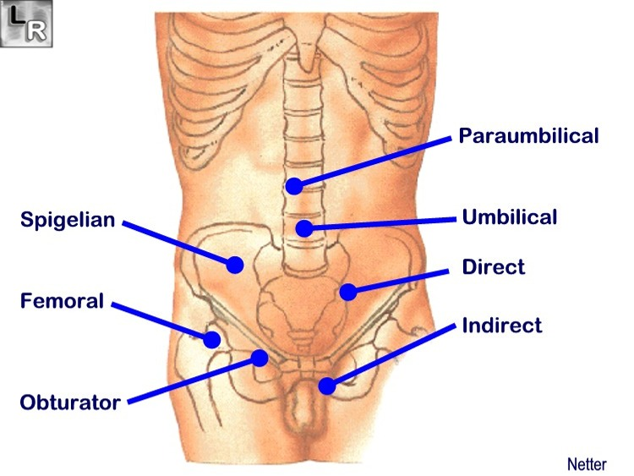
Paraumbilical Hernia
Notes:
Source: LearningRadiology.com
Image Taken From: http://www.learningradiology.com/archives2008/COW%20337-Umbilical%20hernia/umbilherniacorrect.htm

Slide 19
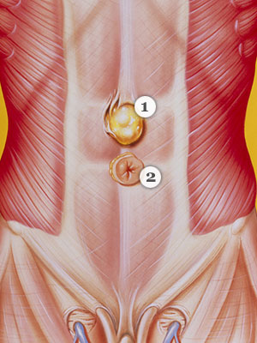
Epigastric/Hypogastric Hernia
Epigastric
Hypogastric
Notes:
Source: Hernia Signs and Symptoms
Image Taken From: http://www.everydayhealth.com/healthy-living-pictures/types-of-hernia.aspx#/slide-1

Slide 20
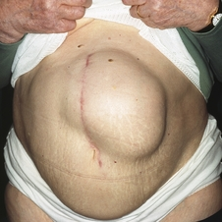
Incisional Hernia
Notes:
Source: Incisional hernia photos and a listing of clinical trials
Image Taken From: http://trialx.com/curebyte/2011/07/05/incisional-hernia-photos-and-a-listing-of-clinical-trials/

Slide 21
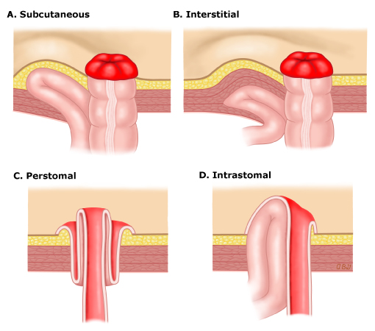
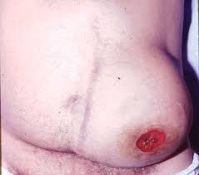
Parastomal Hernia
Notes:
Sources: UpToDate, Parastomal Hernia
Image Taken From: http://www.uptodate.com/contents/parastomal-hernia

Slide 22
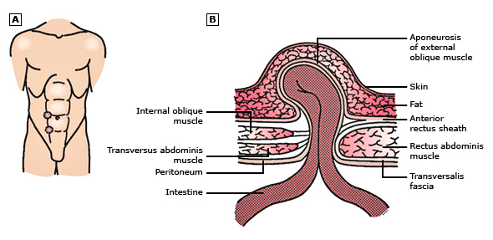
Spigelian Hernia
Notes:
Source: UpToDate, Abdominal Wall Hernias
Image Taken From: http://www.uptodate.com/contents/overview-of-abdominal-hernias?detectedLanguage=en&source=search_result&search=spigelian+hernia&selectedTitle=1%7E3&provider=noProvider#H29

Slide 23
What is a “massive” hernia?
>20cm in one dimension
Involves abdominal loss of domain
Ratio of hernia sac volume : abdominopelvic volume 0.50

Slide 24
What is “loss of domain?”
Multiple definitions:
  “Inability of abdominal cavity to accommodate viscera without high intraabdominal pressures (>15mmHg)”
  Hernias whose contents are held in place by adhesions without ability to be reduced

Slide 25
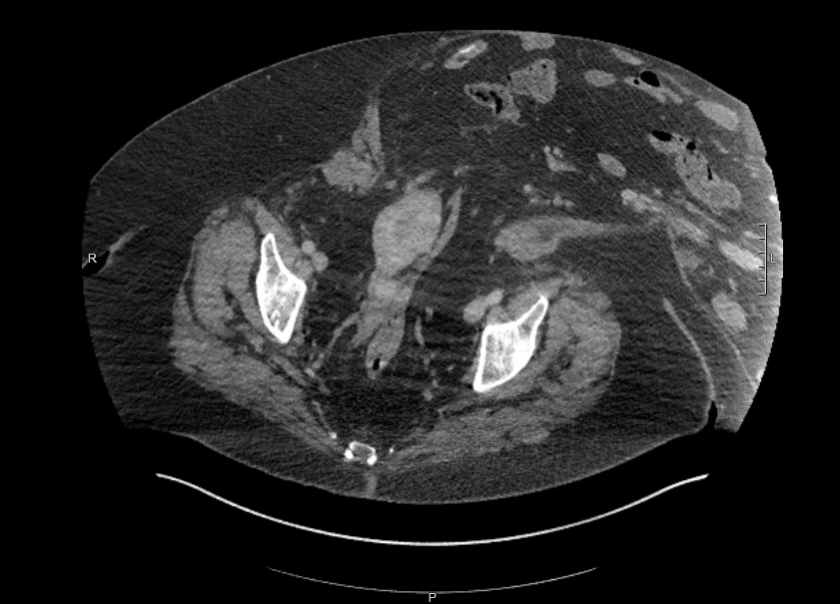
Example of Loss of Domain

Slide 26
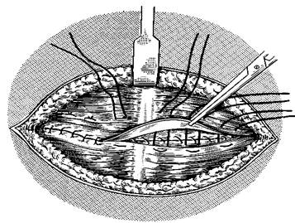
Simple Suture Repair
“Tension Free Approximation of clean, well-vascularlized wound edges.
Classically described as an adequate approach for hernias that are < 2 cm
  Need to make the above determination in OR with the patient fully relaxed.
Mayo Technique (overlying fascial edges)
Notes:
Mayo Technique doesn’t improve outcomes:
Farris JM, Smith GK, Beattie AS (1959) Umbilical hernia: an inquiry into the principle of imbrication and a note on the preservation of the umbilical dimple. Am J Surg 98: 236–9
Paul A, Korenkov M, Peters S, Köhler L, Fischer S, Troidl H (1998) Unacceptable results of the Mayo procedure for repair of abdominal incisional hernias. Eur J Surg 164: 361–7

Slide 27
Near and Far Suture Technique
A “tension-relieving” suture technique used for widely separated fascial edges
Alternate between small and large bites of sheath on opposite sides of the defect with a modified vertical mattress suture.
Advantage thought to be in contaminated/dirty wounds
Long term data shows recurrence rates >50%
Notes:
Korenkov M, Saurland S, Arndt M et al (2002) Randomised clinical trial of suture repair, polypropylene mesh or autodermal hernioplasty for incisional hernia. Br J Surg 89: 50–6
Flum DR, Horvath K, Koepsell T (2003) Have outcomes of incisional hernia repair improved with time? A population-based analysis. Ann Surg 237: 129–35

Slide 28
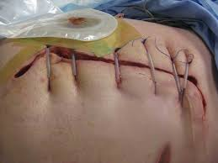
Deep Tension (retention) Sutures
Uses a series of interrupted, non-absorbable sutures passed through all layers of the anterior abdominal wall, 2-4 cm away from the wound edges
  Sutures then passed through short sections of drain tubing over the wound surface, and tied under tension
Used in extreme cases of burst abdomen, but has fallen out of favor given high failure rate, terrible skin scarring and pressure necrosis, and no evidence base.

Slide 29
Recurrence Free Survival: Primary vs Mesh Repair
Notes:
Burger JW et al. Long-term follow-up of a randomized controlled trial of suture versus mesh repair of incisional henria. Ann Surg 2004; 240(4): 578-83.

Slide 30
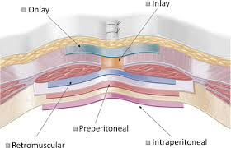
Mesh Placement Options

Slide 31
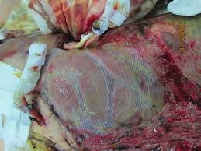
Mesh: Inlay Technique
Suturing of the mesh to the fascial edge without primary closure of the fascia
Bowel is directly exposed to mesh (higher rate of ECF)
High rate of failure compared to sublay and onlay
May be used as a temporary closure technique
Damage control vicryl inlay in trauma
Notes:
De Vries Reilingh TS, van Geldere D, Langenhorst BLAM et al (2004) Repair of large midline incisional hernias with polypropylene mesh: comparison of three operative techniques. Hernia 8: 56–9

Slide 32
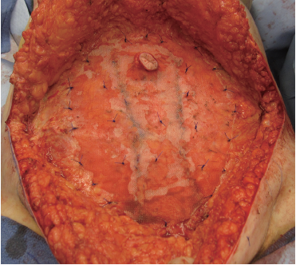
Mesh: Onlay Technique
Simple technique requiring exposure of the subcutaneous prefascial space with mesh anchored directly to the underlying fascia.
Initial trials showed no difference in recurrence rates, but increased incidence of seroma formation
More recent meta-analysis suggests high recurrence and infection rates compared to sublay technique
Example of mesh onlay with “quilting” to
prevent seroma
Notes:
Den Hartog D, Dur AH, Tuinebreijer WE, Kreis RW (2008) Open surgical procedures for incisional hernias. Cochrane Database Syst Rev 3: CD006438.pub2
Timmermans L, de Goede B, van Dijk SM, Kleinrensink GJ, Jeekel J, Lange JF (2014) Meta-analysis of sublay versus onlay mesh repair in incisional hernia surgery. Am J Surg 2007(6): 980–8

Slide 33
Mesh: Sublay Technique
(Rives-Stoppa-Wantz retrorectus repair)
Positioning of the mesh over the closed posterior rectus sheath and peritoneum with subsequent closure of the anterior sheath and reconstruction of the linea alba
Limited to the repair of predominantly midline hernias that are up to 10 cm.
Associated with a 10% recurrence rate.
Notes:
Bauer JJ (2002) Rives-Stoppa procedure for repair of large incisional hernias: experience with 57 patients. Hernia 6(3): 120–3
Yaghoobi Notash A, Yaghoobi Notash A Jr, Seied Farshi J, Ahmadi Amoli H, Salimi J, Mamarabadi M (2007) Outcomes of the Rives-Stoppa technique in incisional hernia repair: ten years of experience. Hernia 11(1): 25–9

Slide 34
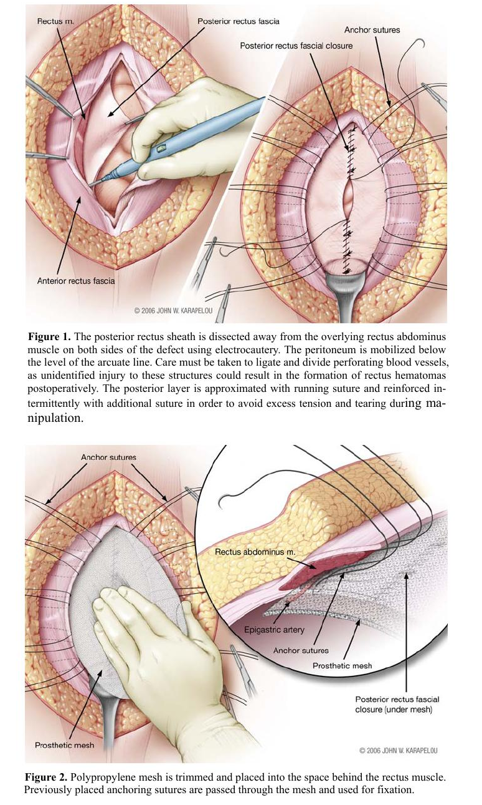

Slide 35
Another View of Rives-Stoppa, Part I

Slide 36
Rives-Stoppa, Part II

Slide 37
Rives-Stoppa, Part III

Slide 38
Rives-Stoppa, Part IV

Slide 39
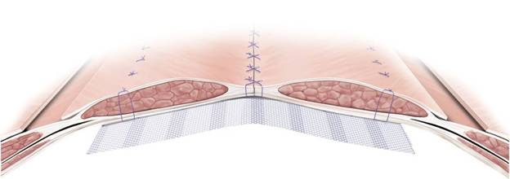
Mesh: Underlay Technique
While terminology can be confusing as often used interchangeably, here an underlay represents infraperitoneal mesh placement
Concern with this repair is for erosion of the mesh into bowel.
Overall recurrence with underlay/sublay, appears to be the lowest. Most ideal if some layer can be placed between mesh and bowel

Slide 40
Outcomes for Various Mesh Placement
Notes:
Helgstrand F, et al. Nationwide prospective study of outcomes after elective incisional hernia repair. J Am Coll Surg 2013; 216(2): 217-28

Slide 41
CONCEPS IN MESH SELECTION
Weight: light, medium, heavy
Dimensions: 2D vs 3D (knit, woven)
Pore size: microporous, macroporous, submicronic
  Pore > 75 um, <10 um, and adhesion-free composits, respectively
Cost
Outcomes

Slide 42
Types of Mesh
Currently, there are over 200 options for prosthetic materials available to the general surgeon for abdominal wall reconstruction, all with varying composition, weight, cost and indications for use
Permanent synthetic mesh
Absorbable synthetic mesh
Composite mesh
Biologic mesh
Generally speaking, the term mesh refers to all synthetic materials while graft refers to materials derived from animal (xenograft) and human (allograft) tissue.

Slide 43
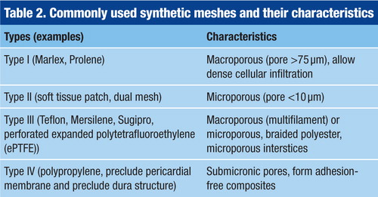
Permanent Synthetic Mesh
Notes:
Abid S, El-Hayek K. Which mesh or graft? Prosthetic devices for abdominal wall reconstruction. Br J Hosp Med 2016; 77(3): 157-8

Slide 44
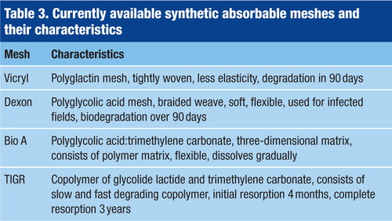
Absorbable Synthetic Mesh
Notes:
Abid S, El-Hayek K. Which mesh or graft? Prosthetic devices for abdominal wall reconstruction. Br J Hosp Med 2016; 77(3): 157-8

Slide 45
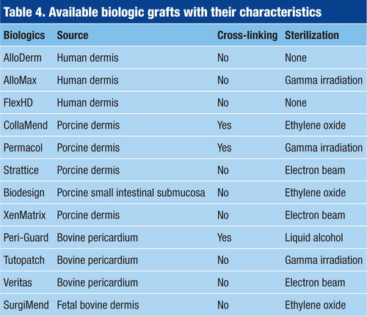
Biologic Mesh
Notes:
Abid S, El-Hayek K. Which mesh or graft? Prosthetic devices for abdominal wall reconstruction. Br J Hosp Med 2016; 77(3): 157-8

Slide 46
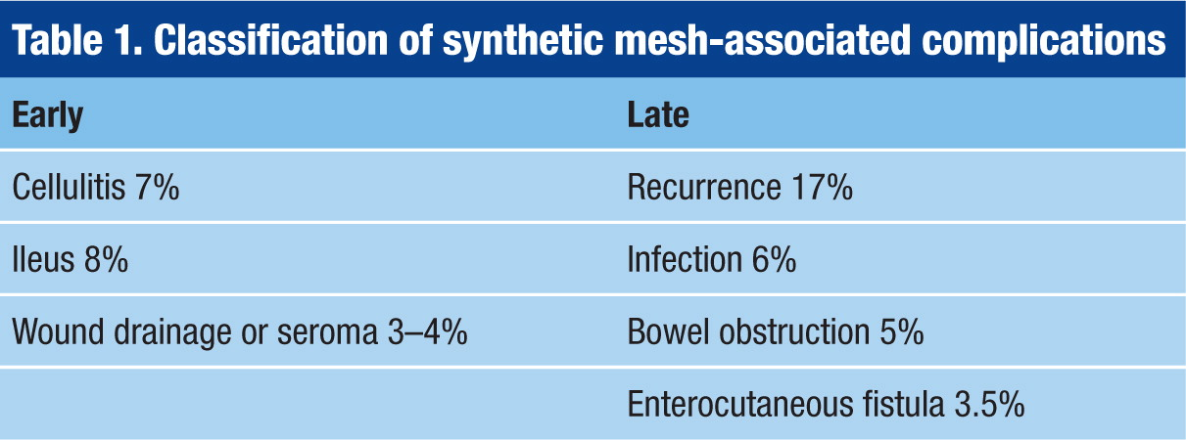
Mesh Related Complications: Permanent Synthetic
Notes:
Abid S, El-Hayek K. Which mesh or graft? Prosthetic devices for abdominal wall reconstruction. Br J Hosp Med 2016; 77(3): 157-8

Slide 47
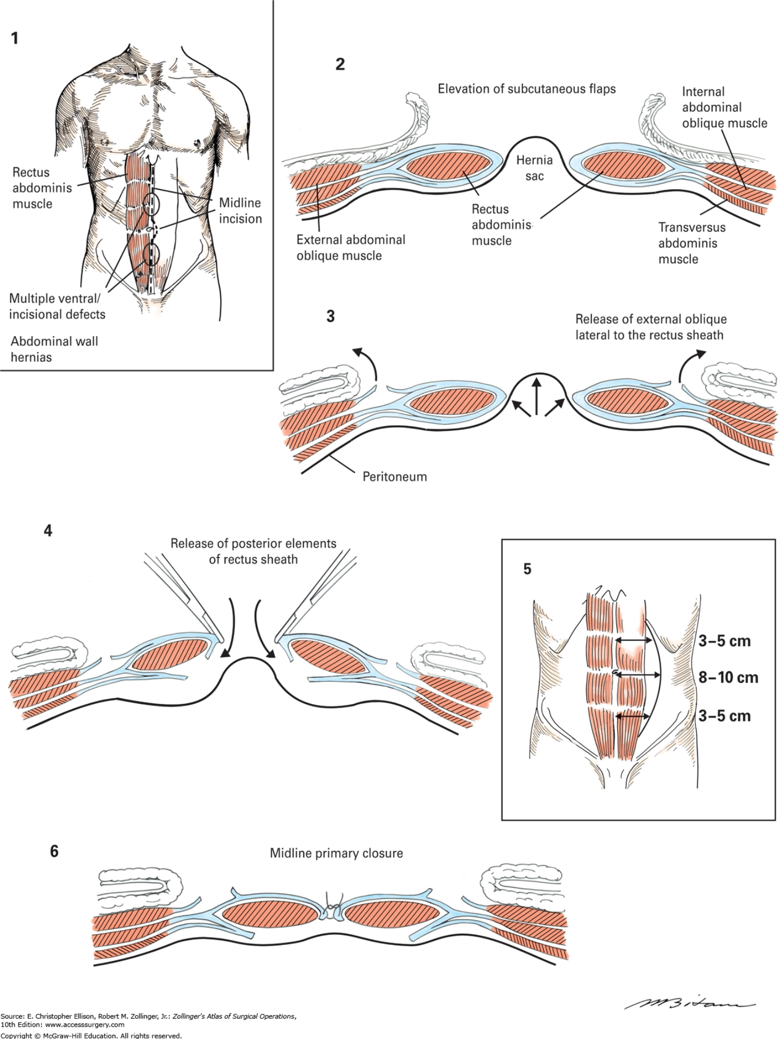
Component Separation

Slide 48
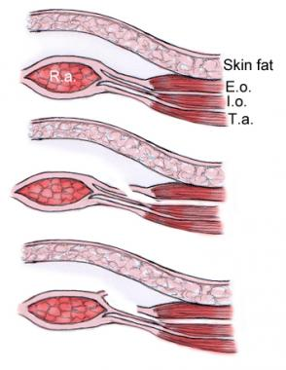
Anterior Component Separation: Ramirez
Fascial release of the rectus abdominis muscles via a fasciotomy of the external oblique aponeurosis at the lateral edge of the rectus muscle, with dissection of a plane between the external and internal oblique aponeuroses.
Allows for 10 cm of medial advancement on each side
Classically necessitates the creation of lipocutaneous flaps to expose the linea semilunaris.
  This maneuver divides the perforating blood vessels from the deep epigastric supplying the central abdominal skin, thus leading to skin necrosis complications
  Division of the perforating vessels can be avoided with minimally invasive release (aka: periumbilical perforator sparing (PUPS) repair) or laparoscopic release
Notes:
Clarke JM (2010) Incisional hernia repair by fascial component separation: results in 128 cases and evolution of technique. Am J Surg 200: 2–8
Cox TC, Pearl JP, Ritter EM (2010) Rives-Stoppa incisional hernia repair combined with laparoscopic separation of abdominal wall components: a novel approach to complex abdominal wall closure. Hernia 14: 561–7
De Vries Reilingh TS, van Geldere D, Langenhorst BLAM et al (2004) Repair of large midline incisional hernias with polypropylene mesh: comparison of three operative techniques. Hernia 8: 56–9

Slide 49
Skin Flap Necrosis

Slide 50
Anterior Component Separation: Minimally invasive approach, Part I

Slide 51
Anterior Component Separation: Minimally invasive approach, Part II

Slide 52
Posterior Component Separation and Transversus Abdominis Release
This operation starts as a Rives-Stoppa repair within the retrorectus space.
Enlarging this space can be achieved by extending the preperitoneal dissection, intramuscular plane formation, or transverse abdominis muscle release (TAR)
Takes advantage of retromuscular dissection plane, and avoids creation of lipcutaneous flaps
Associated with recurrence rates < 10%
Notes:
Pauli EM, Rosen MJ (2013) Open ventral hernia repair with component separation. Surg Clin N Am 93: 1111–33

Slide 53
Posterior Component Separation and TAR, Part I

Slide 54
Posterior Component Separation and TAR, Part II – Above Arcuate Line

Slide 55
Posterior Component Separation and TAR, Part III – Below Arcuate Line

Slide 56
Posterior Component Separation and TAR, Part IV

Slide 57
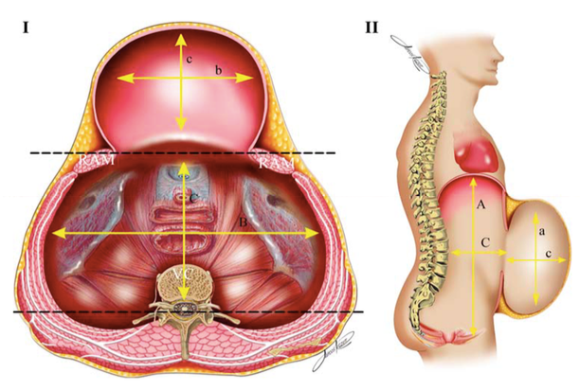
Progressive Pneumoperitoneum
Patients with a VR >25% were considered eligible for PPP
Hernia (2010): 14:63-9

Slide 58
Laparoscopic Repair
Currently performed for about ¼ of cases
Technique involves placing mesh in a retrorectal, preperitoneal, or intraperitoneal position with at least 5 cm of overlap with the fascia circumferentially to allow for mesh shrinkage.
About a 1-3% rate of enterotomy (higher compared to open), no restoration of midline apposition of muscle groups
Unclear effect on hospital stay or post operative pain compared to open
Seromas are common, although they often resolve spontaneously
Meta-analysis shows that overall recurrence is similar to open (3.4% vs 3.6%, respectively)
Notes:
Colavita PD, Tsirline VB, Belyansky I et al (2012) Prospective, long-term comparison of quality of life in laparoscopic versus open ventral hernia repair. Ann Surg 256: 714–23
Forbes SS, Eskicioglu C, McLeod RS et al (2009) Meta-analysis of randomised controlled trials comparing open and laparoscopic ventral hernia repair with mesh. Br J Surg 96: 851–8
LeBlanc KA, Eliason MJ, Corder JM III (2007) Enterotomy and mortality rates of laparoscopic incisional and ventral hernia repair: a review of the literature. JSLS 11: 408–14

Slide 59
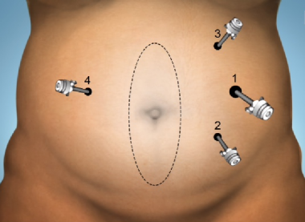
Triangulation

Slide 60
Technical Outcomes for Various Repairs
Notes:
Hawn et al. Long-term follow-up of technical outcomes for incisional hernia repair. J Am Coll Surg 2010; 210(5): 648-55.

