Slide 1
Biostat 202: Opportunities and Challenges of “Big Data”:
Clustering and data reduction
John Kornak
Division of Biostatistics
Department of Epidemiology and Biostatistics
08/22/2016

Slide 2
Overview
Clustering
  K-means clustering
  TwoWay and Kohonen
Data reduction
  Principal components analysis (PCA)
  Independent components analysis (ICA)
Return to Classification
  Neural Networks (Neural Nets)
  Bayesian Networks (Bayes Nets) – causal interpretation
Thursdays lab and HW #5 will reinforce these methods along with the classification and regression methods of last weeks lectures

Slide 3
Supervised vs. unsupervised
Machine Learning
Supervised
Regression (continuous outcome)
Classification (categorical outcome)
Unsupervised
Clustering
(grouping observations)
Data Reduction (transforming variables)

Slide 4
Supervised vs. unsupervised
Machine Learning
Supervised
Regression (continuous outcome)
Classification (categorical outcome)
Unsupervised
Clustering
(grouping observations)
Data Reduction (transforming variables)

Slide 5
Supervised vs unsupervised
Supervised Learning
Have data where you know outcome in order to train the model
Train the model to predict future outcomes from sets of predictors
Unsupervised Learning
No desired outcomes
Separate data points into groups with “similar” properties (clustering)
Or reduce data to fewer variables in some way that still captures important structure of the data
Prediction: Regression (continuous outcomes) and classification (categorical outcomes)
Clustering and data reduction

Slide 6
Clustering

Slide 7
Clustering problems
Determine whether there are distinct (unknown) subclasses of brain cancer based on symptomatic and tumor characteristics
Determine whether there are distinct patterns of gene expression within a patient population

Slide 8
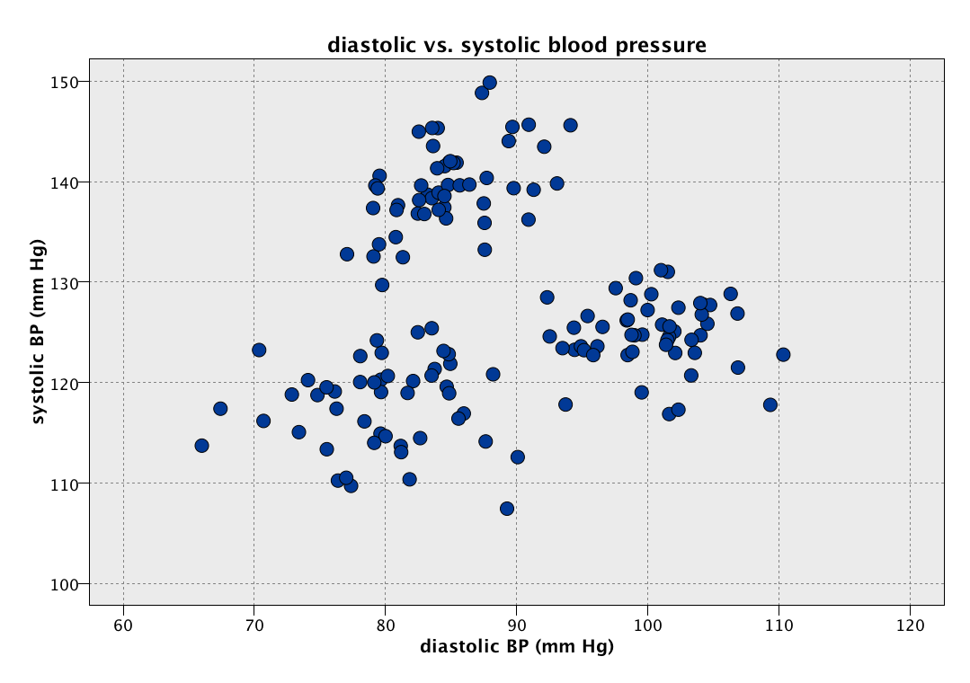
2D Clustering example
How many clusters?
Where are the clusters?

Slide 9
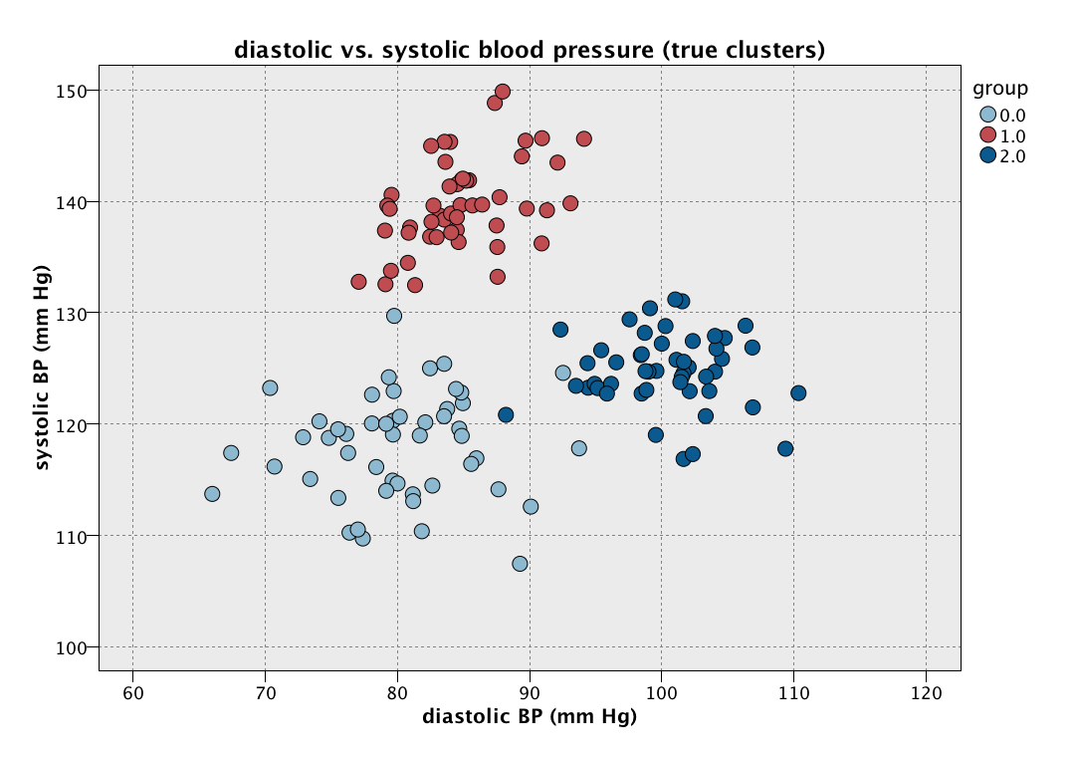
2D clustering example
The truth
Truth has 3 clusters
(kind of obvious)

Slide 10
Cluster Analysis (Data Segmentation)
Objective is to group (or segment) collection of objects into subsets (or clusters)
There is no “Target” in cluster analysis (Unsupervised)
Objects within a cluster are more similar (or less dissimilar) than objects in different clusters

Slide 11
2D clustering example
We want long green lines (large distance between cluster centers)
We want small ellipses (points within clusters grouped tightly together)
Maximize similarity within clusters and minimize similarity between clusters

Slide 12
Cluster Analysis (Data Segmentation)
Need to define similarity (or dissimilarity) and we need to be able to measure it
Want to maximize similarity (or minimize dissimilarity) within clusters and minimize similarity (maximize dissimilarity) between clusters

Slide 13
Measures of similarity/dissimilarity
Most common choice for dissimilarity between 2 instances is the squared difference summed over all attributes (higher values = more dissimilar)
x₂
Consider 2 observations with only 2 variables x₁ and x₂ –
dissimilarities could be
Square diff = a² + b²
Absolute diff = |a| + |b|
Can also differentially weight attributes e.g. ka² + mb²
a
b
x₁
Extension to 3D would be e.g. a² + b² + c², and so on for higher dimensions

Slide 14
Measures of similarity/dissimilarity
Generally need to “standardize variables”
Ordinal variables are treated the same as continuous variables
Nominal variable differences between groups need to be explicitly given. A common choice is difference 1 if the groups are the same and 0 if they are different. (This then needs to be standardized if any non-categorical variables are also considered.)
Remember, we want to maximize similarity (or minimize dissimilarity) within clusters and minimize similarity (maximize dissimilarity) between clusters

Slide 15
K-means clustering

Slide 16
K-means clustering overview
Algorithm to split set of observations into K clusters, where K can equal 2, 3, 4, …
K is pre-chosen (though often choose a set of different K’s to try
Uses square difference dissimilarity measure a² + b² + c² + …
Procedure: starts from a random cluster assignment of observations, and then iterates toward increased similarity (reduced dissimilarity) – estimating cluster centers on each iteration
Common practice to try a bunch of different values for K and use some kind of measure to determine the best K after the fact. Modeler uses the “Silhouette measure” for this purpose.

Slide 17
K-means algorithm
Algorithm proceeds as follows:
  Randomly assign a cluster number (between 1 and K) to each of the observations/instances in the dataset. These are the initial cluster assignments
  Iterate between the following until the cluster assignments no longer change:
    For each cluster determine the center (centroid) of the cluster
    Assign each observation to the cluster whose center is closest to them in terms of squared differences (i.e., the center that is the most similar to the observation)
The algorithm increases the within-cluster similarity relative to the between cluster similarity at every step

Slide 18
K-means algorithm
  The center of a cluster is simply the point associated with the mean of each of the attributes for the observations assigned to that cluster – e.g. in the Age direction the center would be located at the mean Age for all subjects in the cluster.
  Note that for different initial random assignments of observations to clusters, K-means may lead to different final clustering (it is a local not global minimizer of dissimilarity)
Local minimum
global minimum
Upshot - may not converge to best answer

Slide 19
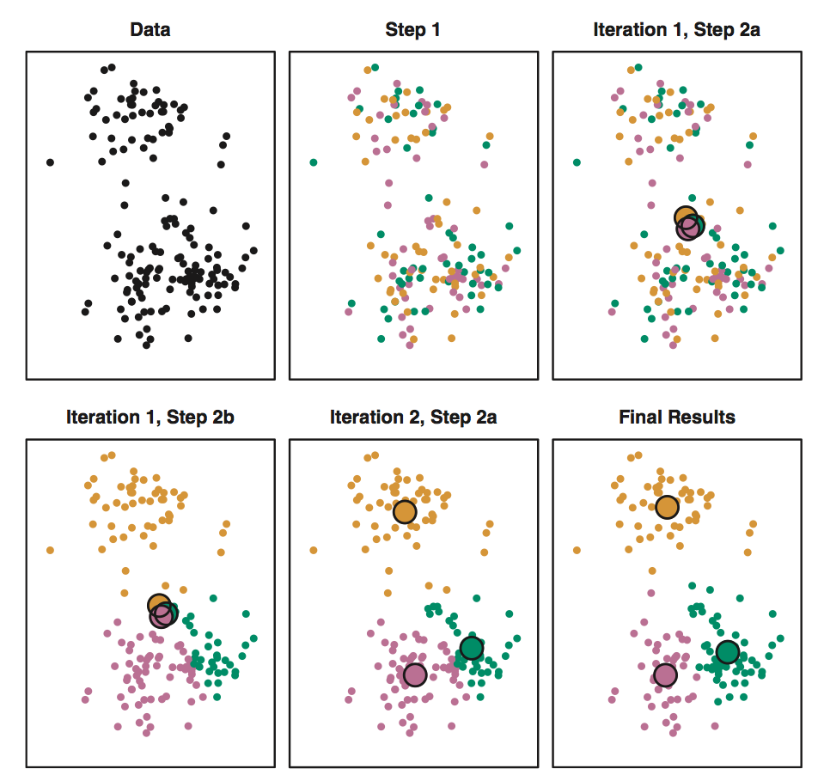
K-means algorithm
Taken from ISLR,
James et al., 2013
p. 389

Slide 20
K-means BP Modeler example

Slide 21
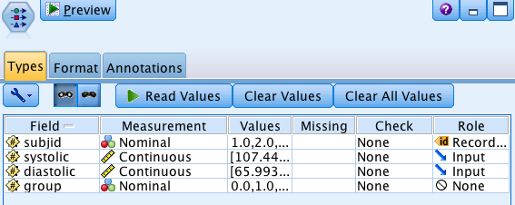
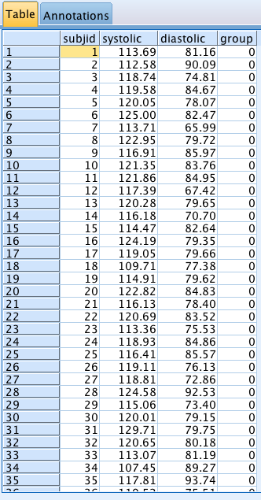
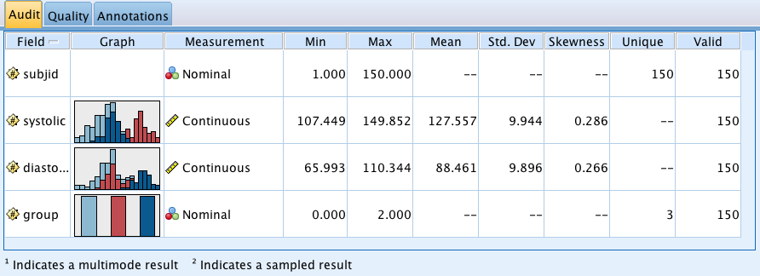
K-means BP Modeler example
Type Node
Table Node
Audit Node (include group as Target for visualization only)

Slide 22
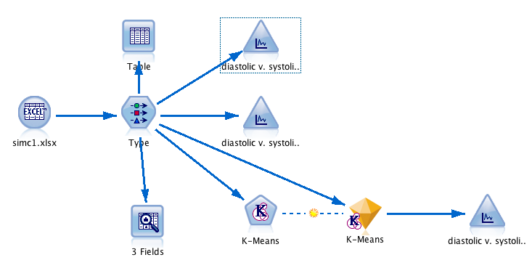
K-means BP Modeler example

Slide 23
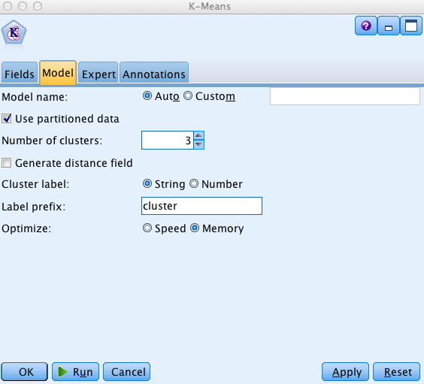

K-means Node
Pre-defined roles in Fields tab (all inputs) – systolic and diastolic are input variables
K-Means in IBM Modeler automatically normalized inputs using the following formula:
Use defaults in Expert tab

Slide 24
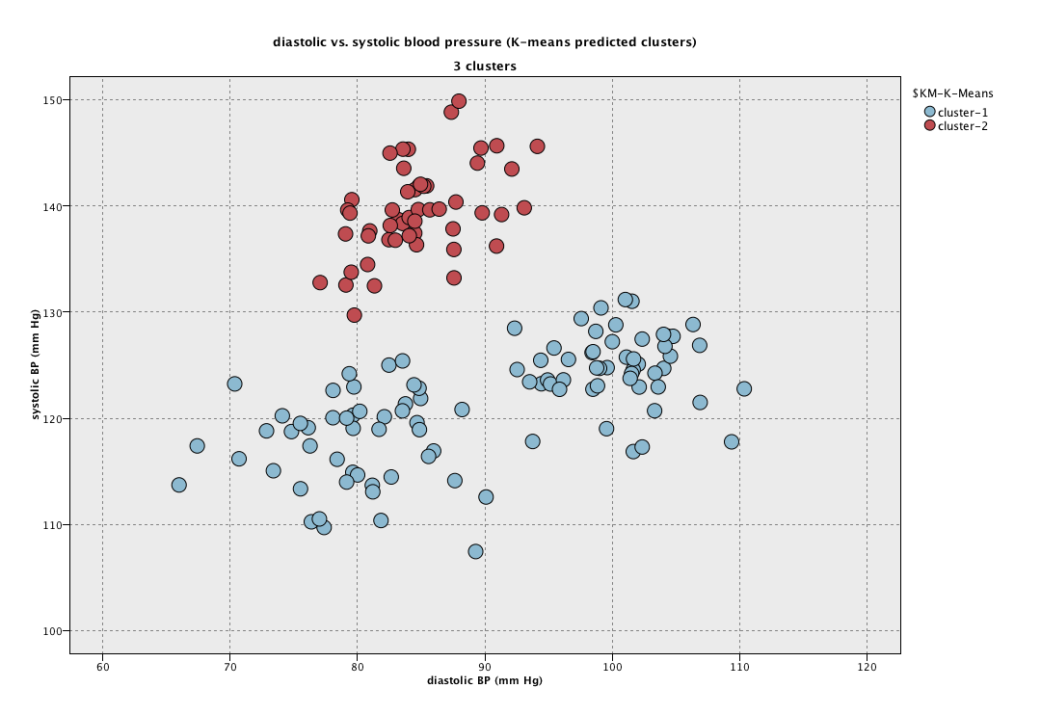
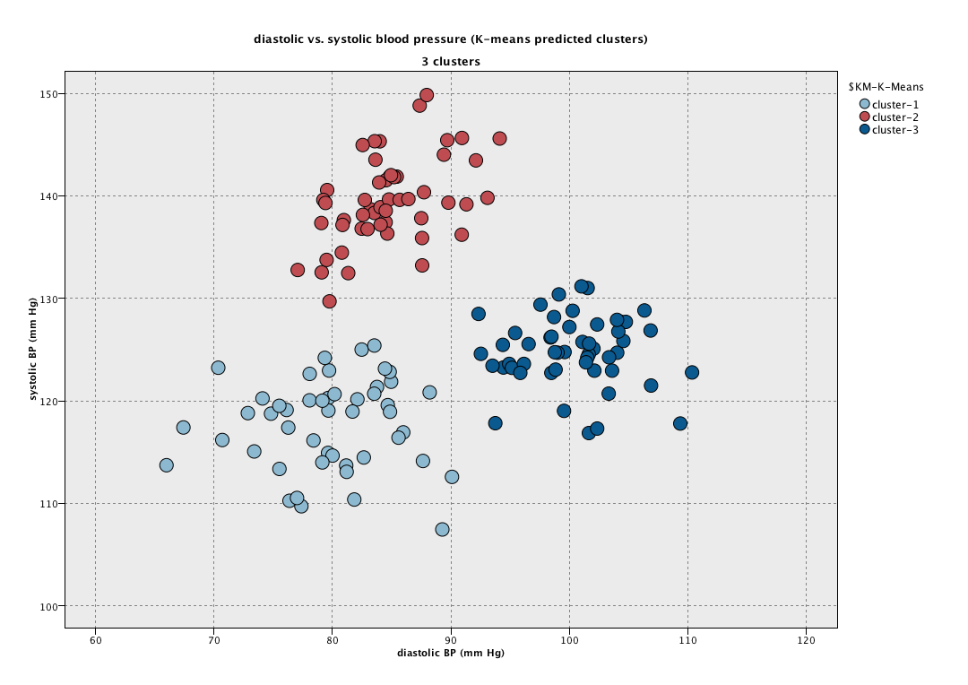
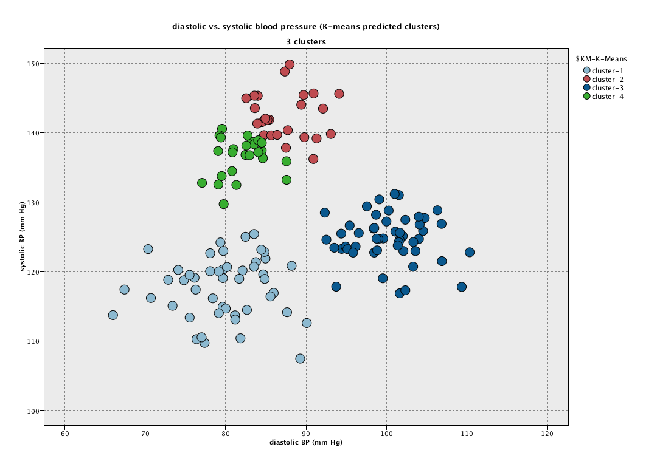
K-means results
K=2
K=3
K=4

Slide 25
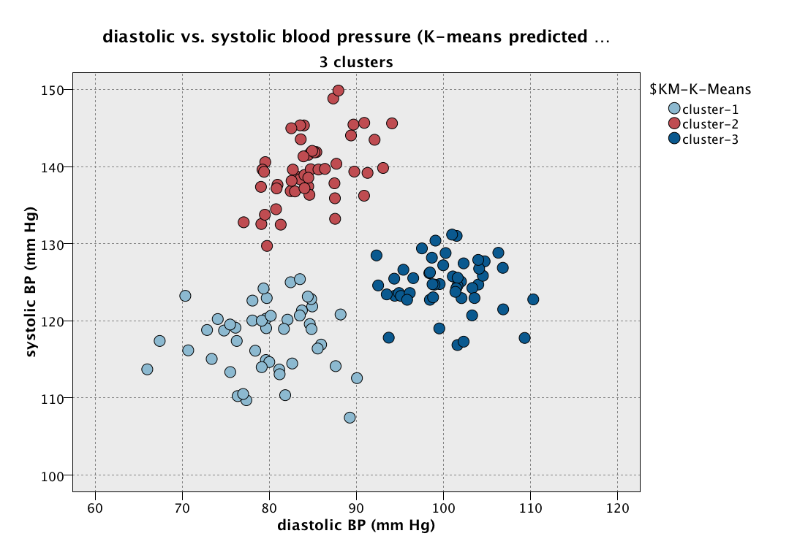
K-means example
The truth
K-means (K = 3)

Slide 26
K-means example
The truth
K-means (K = 3)

Slide 27
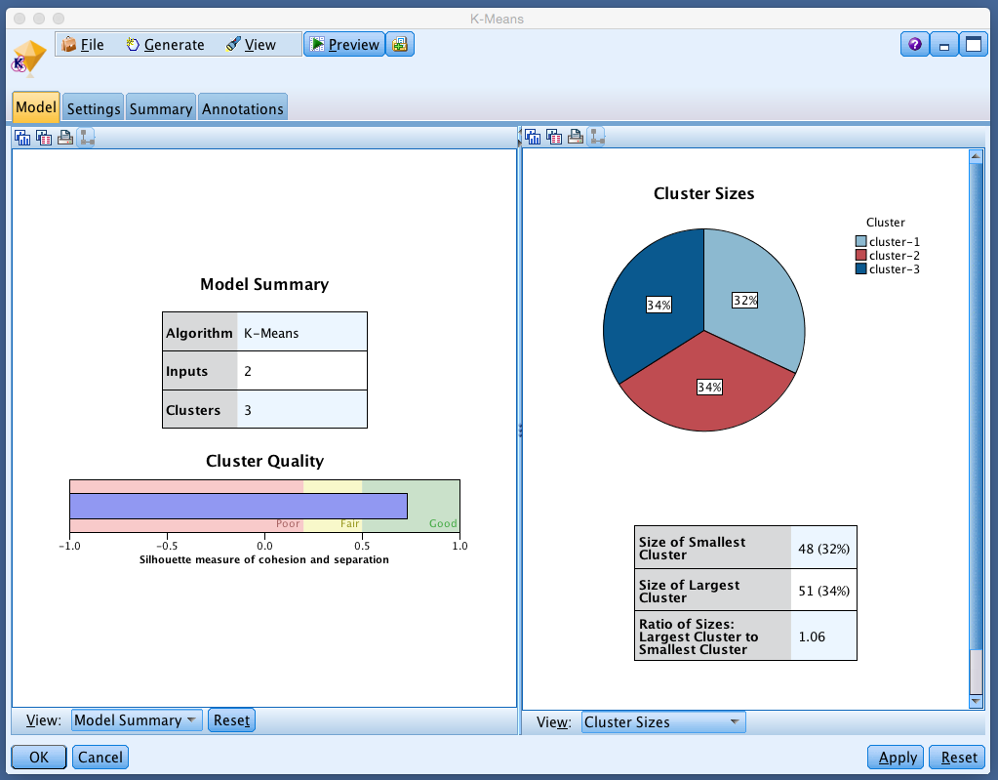
K-means example

Slide 28
K-means example
Silhouette measure – loosely how closely observations are matched within cluster compared to between cluster

Slide 29
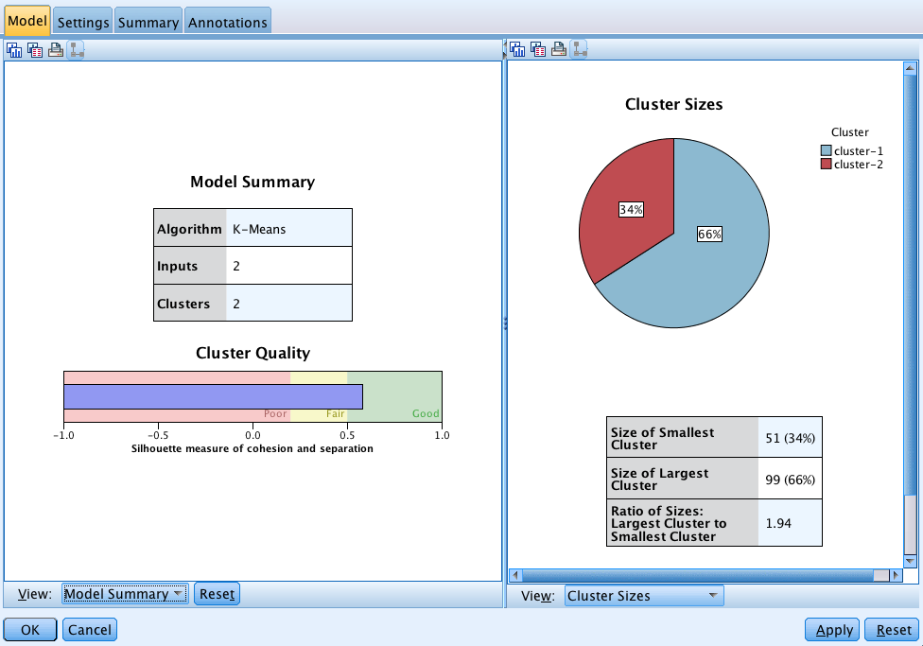
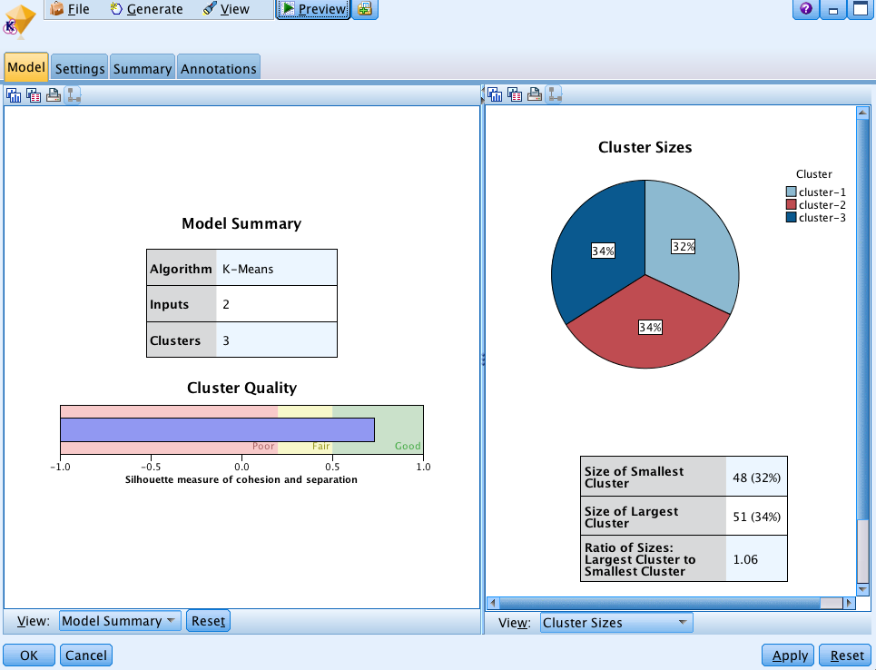
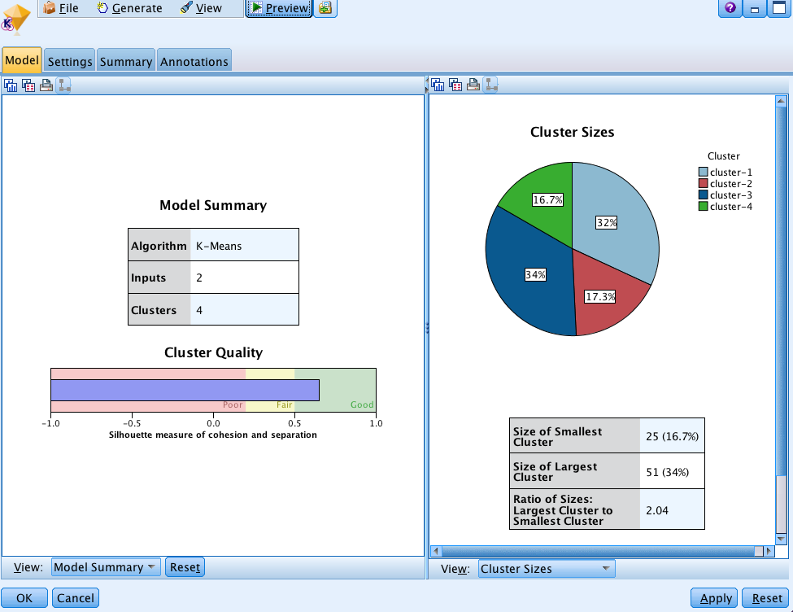
K-means example
K=2
K=3
K=4

Slide 30
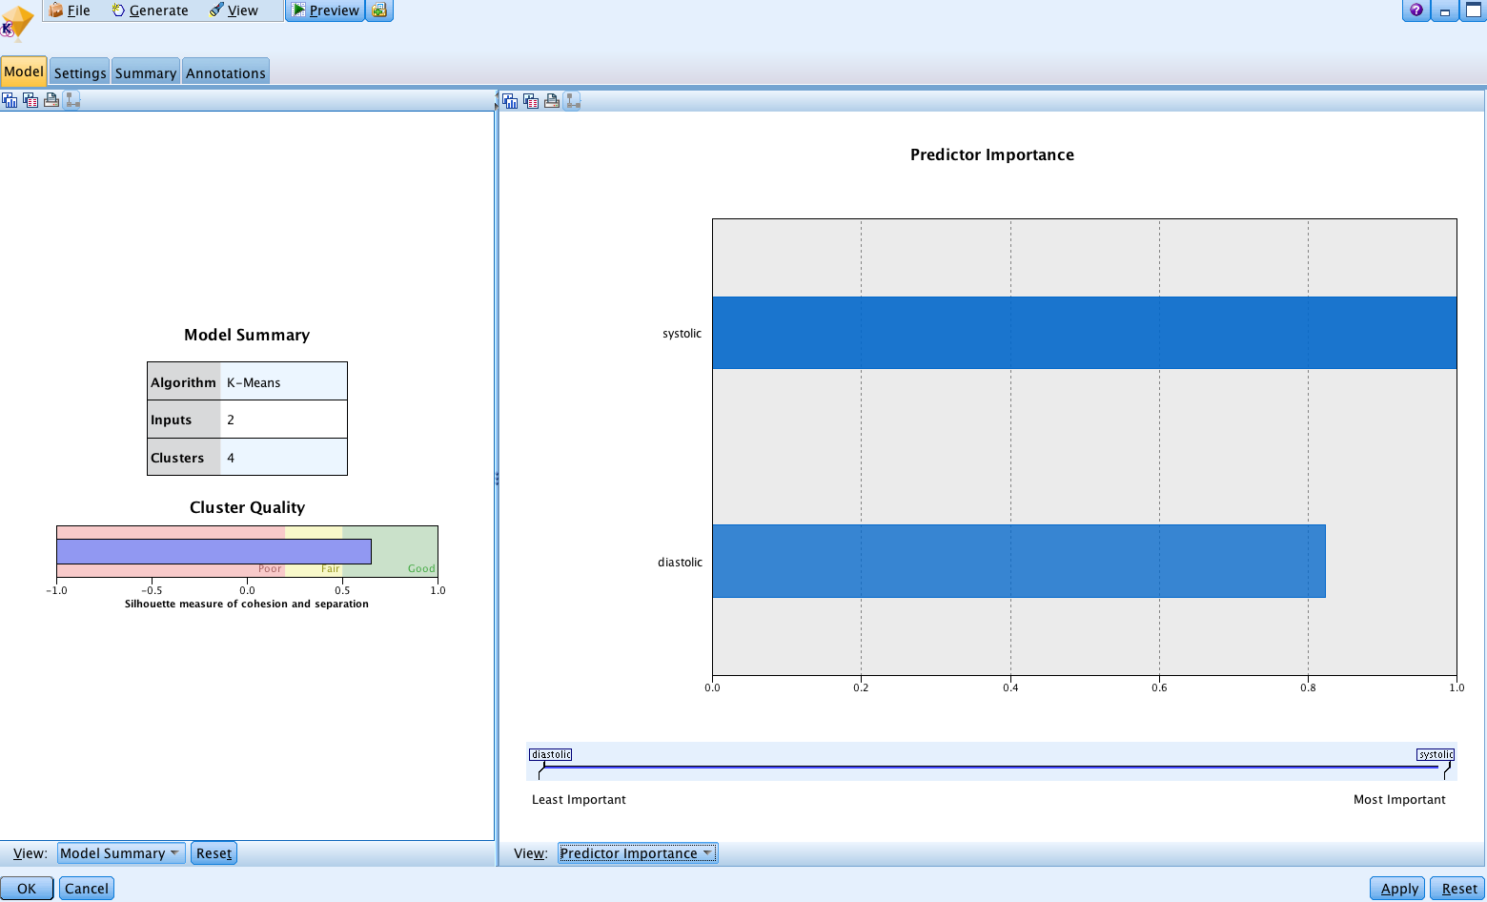
K-means example

Slide 31
K-means clustering
K-means is fast – good for big data – in particular with large number of variables/attributes
Number of clusters must be defined by user – only heuristic methods for choosing number of clusters (IBM Modeler gives “Silhouette measure”)
Local minimizer not global –different starts can lead to different results

Slide 32
Other Clustering Algorithms in IBM Modeler (in brief)

Slide 33


Two Step
Other Clustering Algorithms in IBM Modeler (in brief)
“Hierarchical clustering” method – successively splits data into increasing number of clusters (estimates optimal number of clusters – slower than K-means)
Kohonen
Based on Neural Networks (estimates optimal number of clusters – slower than K-means)

Slide 34
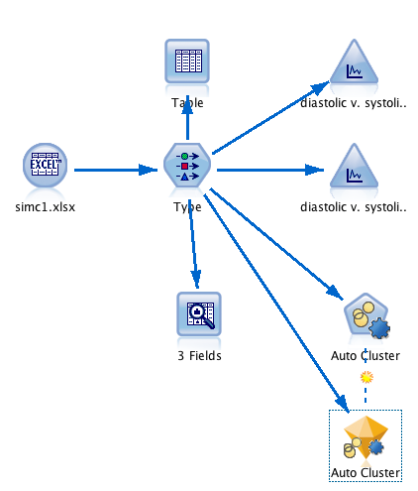

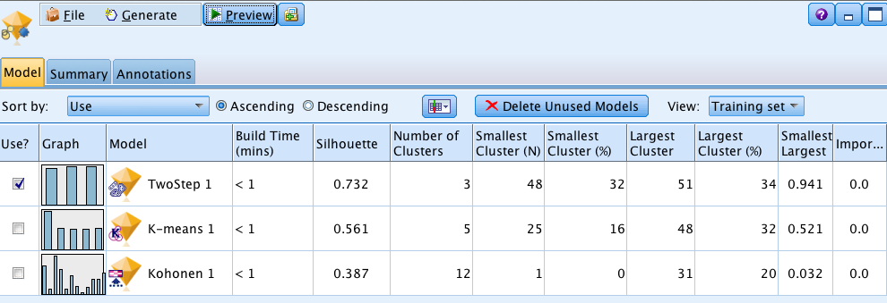
Auto-Cluster
Try all of Modelers methods and find “best”
Uses K-means, TwoStep and Kohonen
Looks like TwoStep did “best” on the BP data

Slide 35
Data Reduction Methods

Slide 36
PCA and ICA
Principal Components Analysis and Independent Components Analysis
Methods to succinctly summarize high-dimensional data sets (transform many variables to a few variables) – but not assigning observations to clusters
Many variables are summarized in terms of just a few new variables (the components)
We will focus on PCA

Slide 37
Principle components analysis (PCA)

Slide 38
PCA
Finds weighted sums of the variables (attributes) that maximally explain variability in the data
The first PC explains as much of the variability in the full data set as possible
The second PC explains as much variability as possible after the variability from the first (PC) has been removed
Constraint: each PC is a weighted sum (linear combination) of the original variables

Slide 39
Each PC is a weighted average of the original variables.
The data reduction goal is to closely represent the full data set in terms of just a few of these PCs
Sometimes it is also hoped that each of the PCs is meaningful

Slide 40
2D illustration
Var 1
Var 2

Slide 41
2D illustration
1st PC
Var 1
Var 2

Slide 42
2D illustration
Minimize sum of squares
1st PC
Var 1
Var 2

Slide 43
2D illustration
1st PC
Var 1
2nd PC
Var 2

Slide 44
2D illustration
Note: that there is also a potential issue of scaling – variables often normalized in advance
1st PC
Var 1
2nd PC
Var 2

Slide 45

PCA example – knee shape
Is the bone in ACL injured knees a different “shape” than a group of control knees?
May suggest that particular bone shapes predispose to ACL injury.

Slide 46
PCA example – knee shape
Identify a large number of specific locations on the knee bones (“landmarks”).
Measure the distance between all pairs of landmarks to quantify the shape.
Used >8,000 landmarks in the tibia and >11,000 in the femur.
All told there were >32,000,000 possible distances for the tibia and >62,000,000 for the femur to use as predictors to distinguish ACL vs non-ACL.
Need to reduce!
Notes:
How does distance between landmarks define shape? Think of height and “width” of a person to get a rough idea of a person’s shape.
Tibia: 8,120 chose 2 is 32,963,140. Femur: 11,222 chose 2 is 62,961,031.

Slide 47
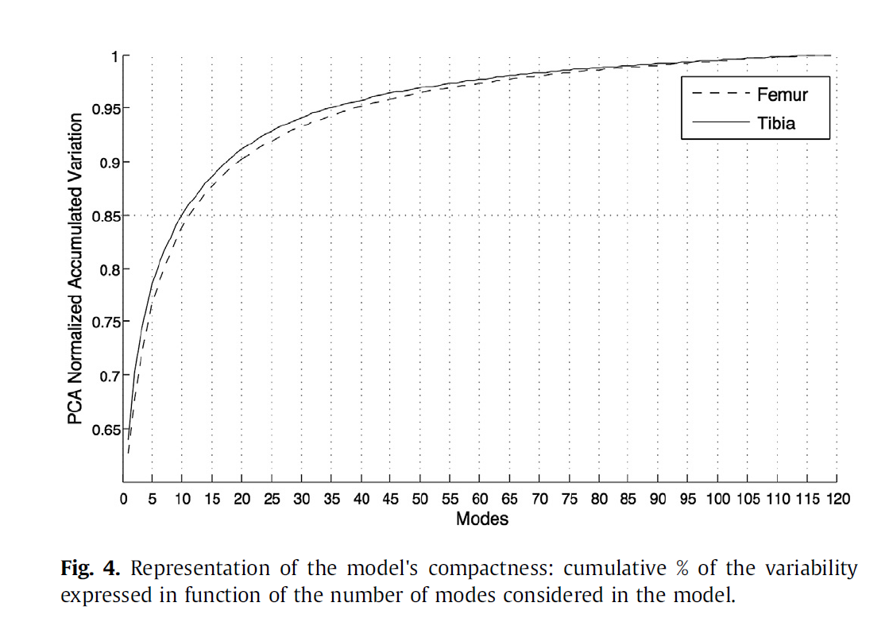
PCA illustration – knee shape
= PCs
For the femur, summarized 90% of the variation in 62 million variables using only about 20 principal components.

Slide 48
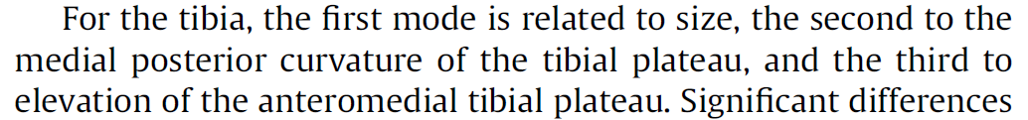
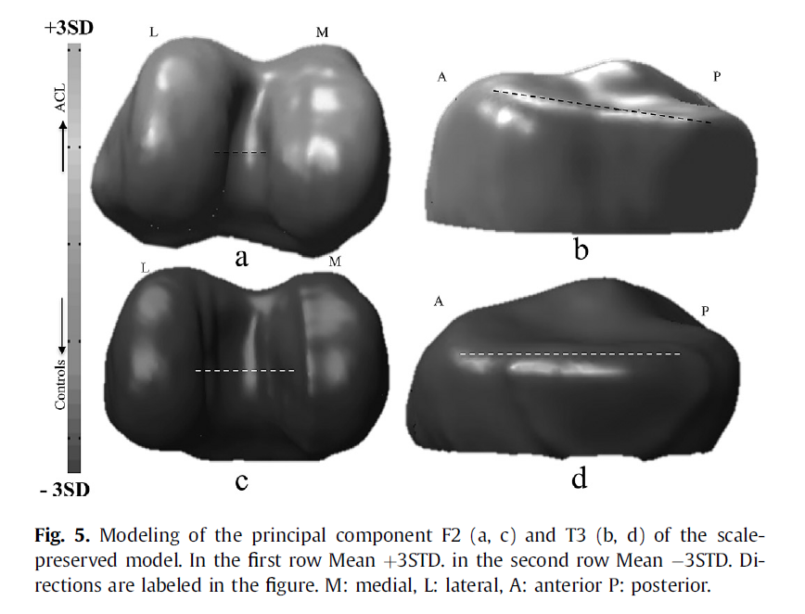
A number of the PCs (called modes here) had reasonable interpretations.
Though this is by no means a guarantee and is somewhat unusual.

Slide 49

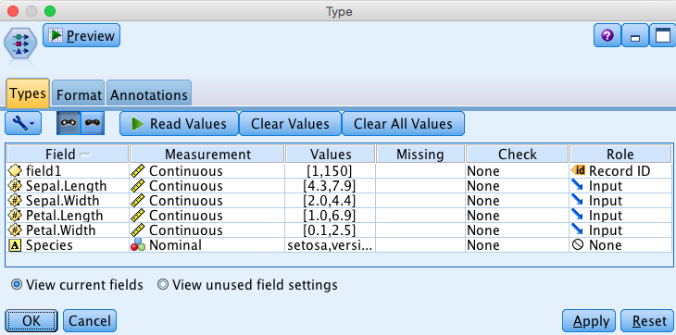
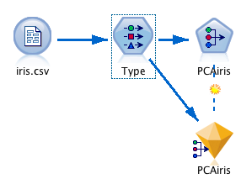
PCA in Modeler
Revisit iris data
Just consider 4 input variables – Sepal.Length, Sepal.Width, Petal.Length, and Petal.Width

Slide 50
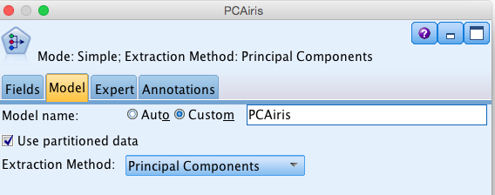
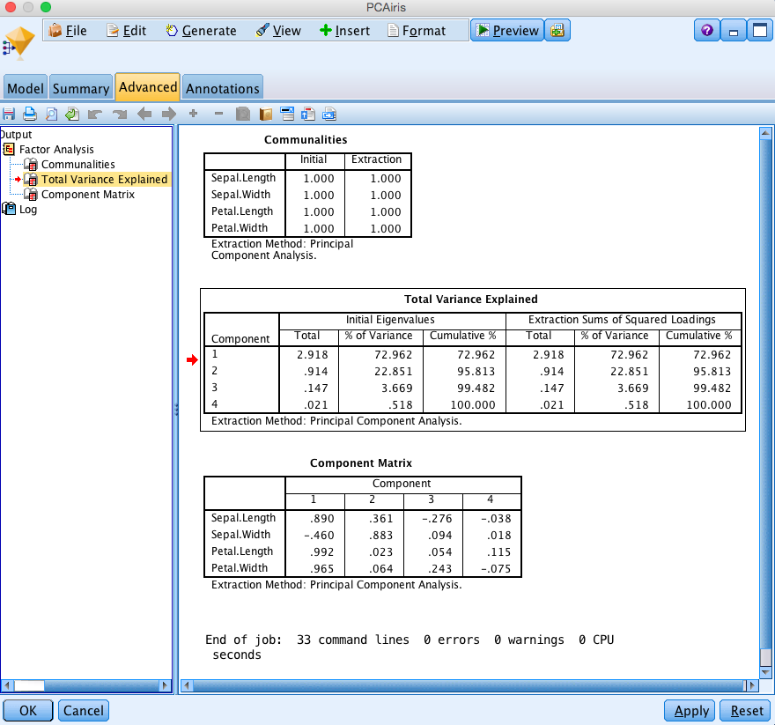
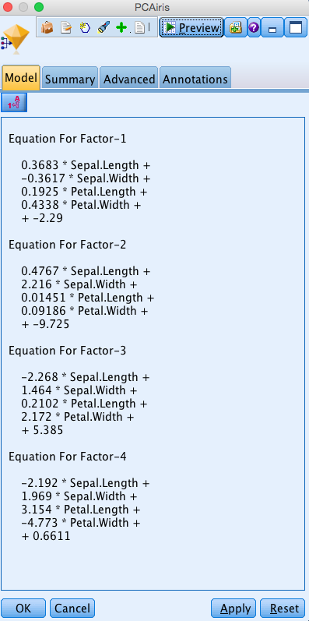
PCA in Modeler
Use first 2 or 3 PC’s to represent full data

Slide 51
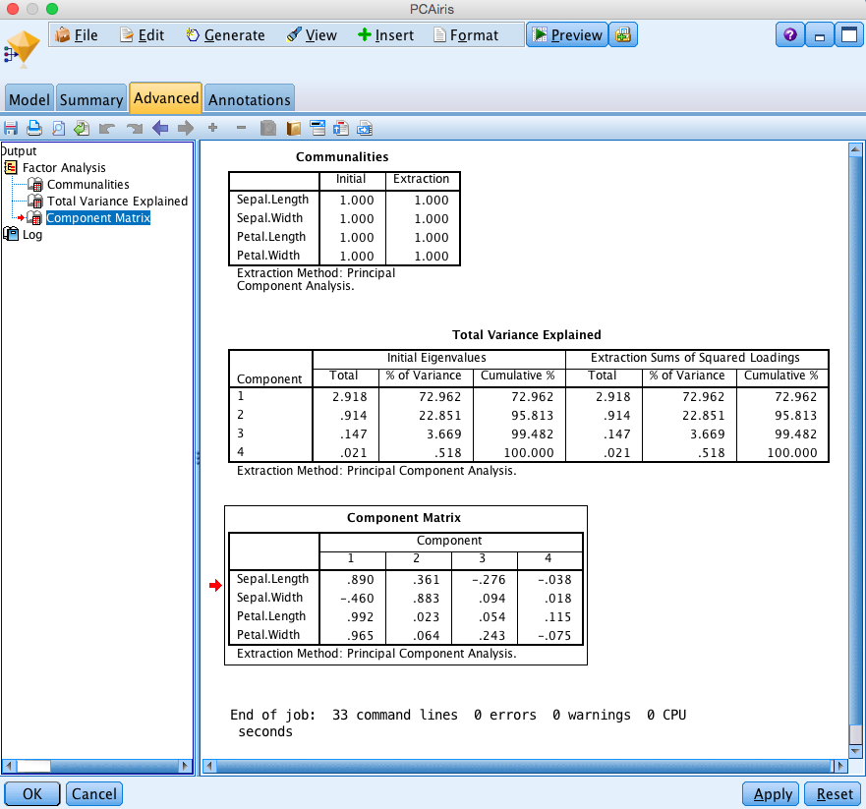
PCA in Modeler
Correlations of each predictor with each PC
Use first 2 or 3 PC’s to represent full data

Slide 52
Independent components analysis (ICA)

Slide 53
Independent Components Analysis (ICA)
ICA differs from PCA by focusing on maximizing independence between components rather than maximizing variance within components (for non-normal signals)
In PCA the PCs have to be uncorrelated – however, uncorrelated does not imply independent – independence is a stronger requirement

Slide 54
Uncorrelated but not independent
Var 1
Var 2

Slide 55
Uncorrelated but not independent
Var 1
Var 2

Slide 56
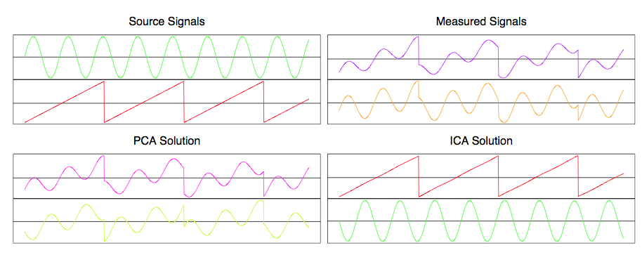
ICA illustration
Figure below from Elements of Statistical Learning (p. 561) – shows potential power of ICA in separating two mixed signals (example of the classical cocktail party problem). Different microphones pick up mixtures of different independent sources (music, speech from different speakers, etc.). ICA is able to perform blind source separation, by exploiting the independence and non-normality of the original sources.
(mixed signals)

Slide 57
ICA demands that the components are (maximally) independent of each other
It provides a different decomposition of the full data than does PCA (i.e. it gives a different set of weighted averages of the predictors – components)
ICA tends to do well at signal separation (e.g. separating overlaid recorded speech signals or different components of brain activation in fMRI)
ICA does not have an inherent ordering of components (unlike PCA that goes from largest to smallest variance explained)
Computationally expensive and not guaranteed to find global optimum (cf. K-means clustering)
Not available in Modeler, but is increasingly used for summarizing high dimensional biomedical data – can use “ica” or “fastICA” in R, or FastICA in Python, or PCA and ICA package in Matlab

Slide 58
Back to Classification

Slide 59
Choosing a classifier
Logistic Regression (also holds for Linear Discriminant Analysis)
  Nice probabilistic interpretation
  Not highly flexible
Kernel-bases classification
  No “model” required – don’t have to worry about outliers
  Easy to understand rules
  Not so good for interpretation
Decision Trees
  Easy to interpret and explain
  No “model” required -- don’t have to worry about outliers
  Restricted to recursive partitioning of data to form classes
Support Vector Machines
  Often have high accuracy
  Can deal with highly non-linear separation of features
  Requires effort tuning and difficult to interpret
However, if your primary goal is good prediction, then you can run multiple classifiers and combine them to get an even better one overall (ensemble techniques of boosting, bagging and stacking)

Slide 60
Neural networks (neural nets)
More properly called an ‘artificial’ neural network
“A computing system made up of a number of simple, highly interconnected processing elements, which process information by their dynamic state response to external inputs.”
A learning rule is developed to “learn by example” so that the weights of connections can be modified based on the observed data
At one time considered as a model for the brain…

Slide 61
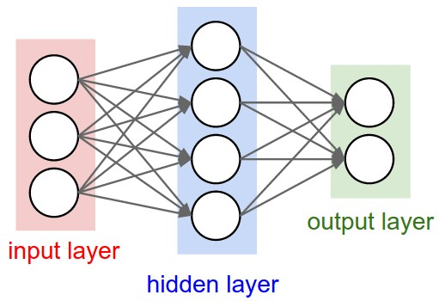
Neural networks (neural nets)
Connections
Nodes
Can have more than one output and outputs can be class variables or continuous
Underlying math is complex

Slide 62

Neural Networks
Complex models with many tuning parameters – many flavors – number of layers and nodes
Fitting neural networks is an iterative process
Stopping the iterations early gives a model that has reduced chance of being overfit (simpler network)
A very flexible way to capture non-linear classification, but needs experience to use effectively because of difficulty in optimally tuning parameters
Computationally intensive – especially for large networks with a large amount of data
No interpretation – “Black Box classifier”
Fitted in Modeler using the Neural Net node – we will explore this node in lab Thursday

Slide 63
Bayesian Networks
(Bayes Nets)

Slide 64
Bayesian Networks
Looks for pathways or complex relationships between variables
Unlike most classification methods, Bayes Nets actually has a “causal” interpretation
Bayesian networks do not have pre-defined outcomes/predictors, but determine order/structure among a set of variables

Slide 65
Components of Bayes Nets
Each node is a variable with an associated probability distribution
Each arc (arrow) denotes conditional dependence
Parent
Smoker
HA = event of Heart Attack
HA
Child

Slide 66
Small illustration
Smoker
P(Smoker)
BP
P(BP|Smoker)
HA
P(HA|BP,Smoker)

Slide 67
Small illustration
Smoker
P(Smoker)
BP
P(BP|Smoker)
MS
P(HA|BP,Smoker)

Slide 68
Conditional independence
Have determined risk of heart attack (HA) is conditionally independent of Smoker given BP
Smoker, BP, and HA are all related to each other, but once the value of BP is settled, Smoker and HA become independent of each other
Reduced model is simpler to estimate and interpret
Smoker
P(Smoker)
BP
P(BP|Smoker)
HA
P(HA|BP)

Slide 69
Learning Bayes Nets
Compute optimal network among a set of nodes
Requires a “score” of what is “good”
Full evaluation = “NP-hard” problem (i.e. computationally impossible for large problems)
Employ greedy type algorithms
Perhaps have multiple starts

Slide 70
Example Multiple Sclerosis – variable set
Categorical
Continuous
Treatment Y/N (Tx)
Gender (Gender)
Disease Type (Dz.Typ)
HLADRB1*1501 (drb1)
Disease Duration (Dz.Dur)
Age at Disease Onset (Age.Onset)
Baseline Glu GM (Glu.GM)
Baseline Glu WM (Glu.WM)
1 year change in NAA GM (diff.NAA.GM)
1 year change in NAA WM (diff.NAA.WM)
1 year change in EDSS (diff.EDSS)

Slide 71
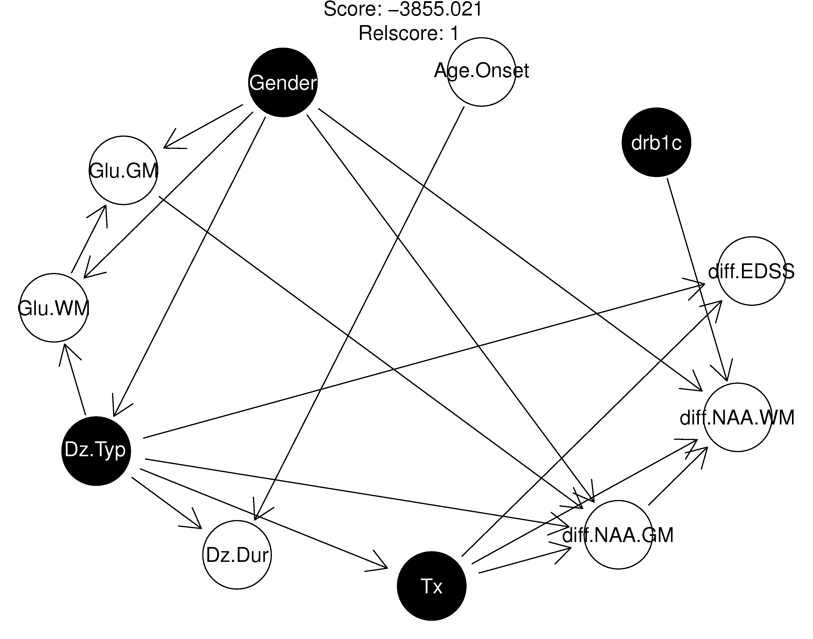
Fitted Bayes’ Net
Arrows can be interpreted as defining causal effects – see all the caveats in Dr. McCulloch’s lecture on Thursday when it comes to causal modeling

Slide 72
Glu Effect on NAA GM

Slide 73
Glu Effect on NAA GM

Slide 74
Glu Effect on NAA GM
x

Slide 75
Glu Effect on NAA GM

Slide 76

Bayesian networks
Can lead to complex insights into the relationships between variables
Have to be careful to not over-interpret estimated “causal” relationships – see Dr. McCulloch’s lecture Thursday
Computation can be expensive
We will explore Bayes Nets in Modeler during lab:

Slide 77
Machine Learning Computational Tools
We have focused on IBM Modeler but there are other tools/software/programming languages if you want to dig further. Here are some free ones
Weka -- http://www.cs.waikato.ac.nz/ml/weka/ - there is an associated book - Data Mining: Practical Machine Learning Tools and Techniques 3rd edition, Witten, Frank and Hall, 2011
R -- https://www.r-project.org/ -- R has many machine learning libraries and tools. They have a machine learning and statistical learning “Task View” page which much of what is available in R (including an R interface to the Weka package)
Python -- https://www.python.org/ -- if you want to go even further down the programming line – many numerical and scientific libraries – see e.g. http://www.southampton.ac.uk/~fangohr/training/python/pdfs/Python-for-Computational-Science-and-Engineering.pdf to get started

Slide 78


Another upcoming seminar of interest

Slide 79
Next Lecture - Thursday
Dr. McCulloch
“Causal Inference from Big Data”

