Slide 1
Surgical Management of Early and Metastatic Breast Cancer
Faculty: Rita Mukhtar MD
Presenter: Joey Bautista PGY-3
Schechter Conference
UCSF General Surgery
8/24/2016
Notes:
BACKGROUND INFO– We will not go over this in conference. These slides are for your reference and should be reviewed before we discuss the cases

Slide 2
Outline
Stratification
  Early-stage Breast Cancer
  Locally Advanced Breast Cancer
Special Considerations
  Fertility
  Older patients : Menopause, Multiple comorbidities
  Male patients
  Pregnancy
Prognosis
Post-treatment Surveillance
Breast Reconstruction
Metastatic Breast Cancer

Slide 3
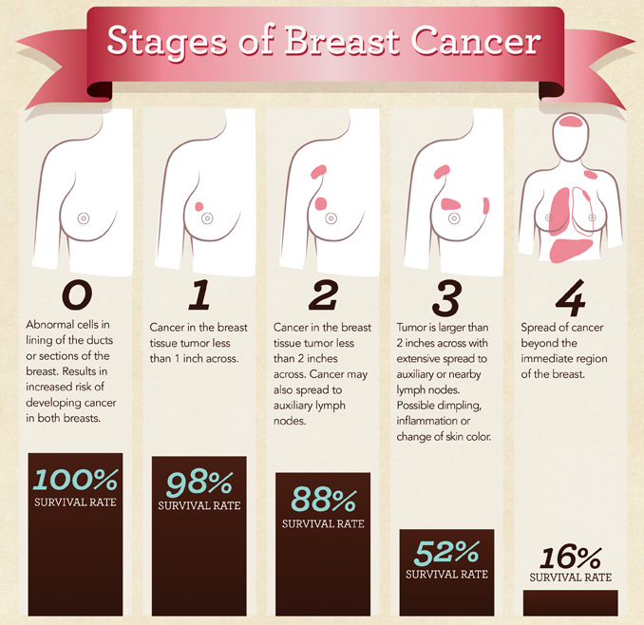
Notes:
A rough estimate of 5 year survival rates for breast cancer at each stage

Slide 4
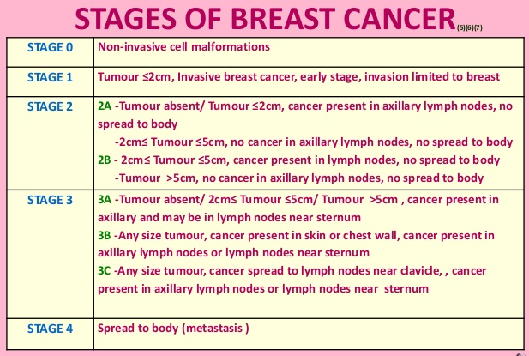
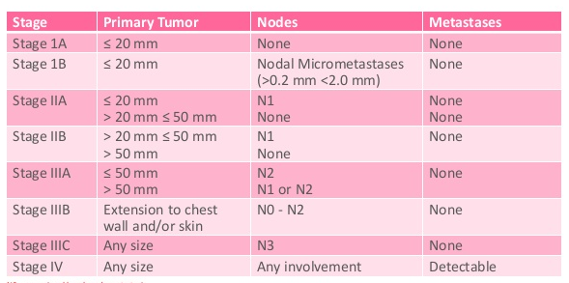
Notes:
Formal definition of each stage, correlated with TMN.
Stratification of patients to either early breast cancer or locally invasive breast cancer determines the initial treatment modality, namely immediate surgery for the former, and neoadjuvant chemo for downstaging, followed by surgery for the latter.

Slide 5
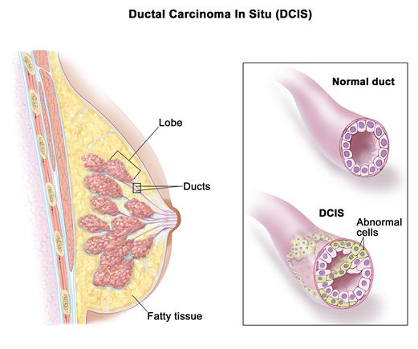
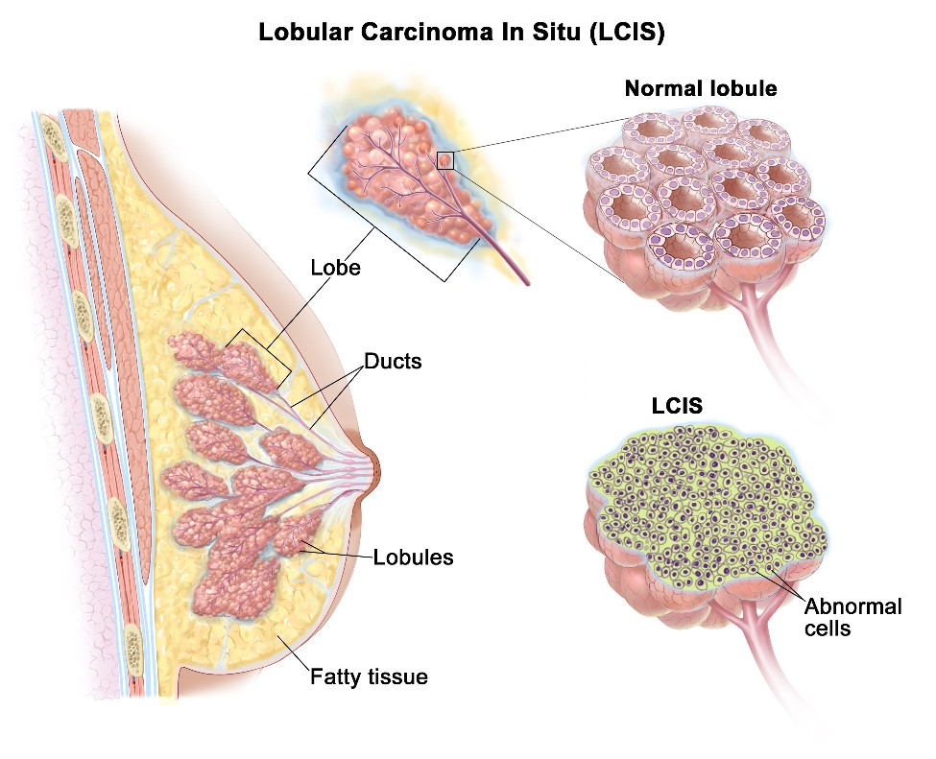
Non-invasive Lesions
Notes:
Illustration of DCIS vs LCIS.
1.) LCIS is covered by Juliet in a previous presentation. Current guidelines recommend wide excision with negative margins to rule out invasive cancer, followed by chemoprevention with SERM or AI.
Historically LCIS has been treated with prophylactic bilateral mastectomy. However, there are no randomized trials addressing the comparative efficacy of surveillance versus prophylactic mastectomy in a population of high-risk women. In a meta-analysis of published series that included 389 women with LCIS who were followed for a mean of 10.9 years, breast cancer-specific mortality was 2.8 percent among women who had initial excision followed by surveillance and mastectomy for recurrence; this value was not statistically significantly different from the 0.9 percent disease-specific mortality rate in women initially treated with mastectomy for LCIS
2.) Ductal carcinoma in situ (DCIS) of the breast represents a heterogeneous group of neoplastic lesions confined to the breast ducts. The goal of therapy for DCIS is to prevent the development of invasive breast cancer.
Therapeutic approaches include surgery, radiation therapy (RT), and adjuvant endocrine therapy.
The following are current recommendations per UptoDate:
●For patients who are candidates for BCT, we suggest BCT over mastectomy (Grade 2B). We recommend that most women undergoing BCT receive RT in addition to lumpectomy (Grade 1B).
●For patients with very small foci of low-grade DCIS, breast-conserving surgery only (ie, omission of RT) with widely negative margins (ideally 10 mm) is an option. However, prospective randomized evidence to support the omission of adjuvant radiation is limited, even in selected low-risk cases.
●For most patients with DCIS, we recommend not performing surgical evaluation of the axilla (Grade 1A). However, we suggest sentinel lymph node biopsy (SLNB) in patients who do not meet criteria for BCT and thus require mastectomy (Grade 2B).
●For women with estrogen receptor (ER)-positive DCIS treated with breast-conserving surgery with or without RT, we suggest endocrine therapy rather than observation (Grade 2B). For women who opt for treatment, the choice between anastrozole and tamoxifen should be individualized based on the side effect profile of each medication, menopausal status, and the preferences of the patient.
●In general, for women who underwent unilateral mastectomy for ER-positive DCIS, we suggest endocrine therapy rather than observation (Grade 2C). For these patients, the use of endocrine therapy should be considered "chemoprevention" and not treatment to prevent recurrence for this diagnosis. In other words, it would be given with the intent to prevent a new primary contralateral or ipsilateral breast cancer.
●We do not routinely utilize tamoxifen as chemoprevention for women with ER-negative DCIS given that the benefit of endocrine therapy does not reduce the risk of recurrence in this population. Some women may opt to take tamoxifen, however, to decrease the risk of developing a new endocrine receptor-positive DCIS or breast cancer.
●The treatment for a patient diagnosed with a recurrence following original treatment for DCIS is based upon whether the disease is purely in situ or has an invasive component, the disease extent, location, prior surgical approach (ie, mastectomy versus lumpectomy), and whether RT or endocrine therapy was previously administered.

Slide 6
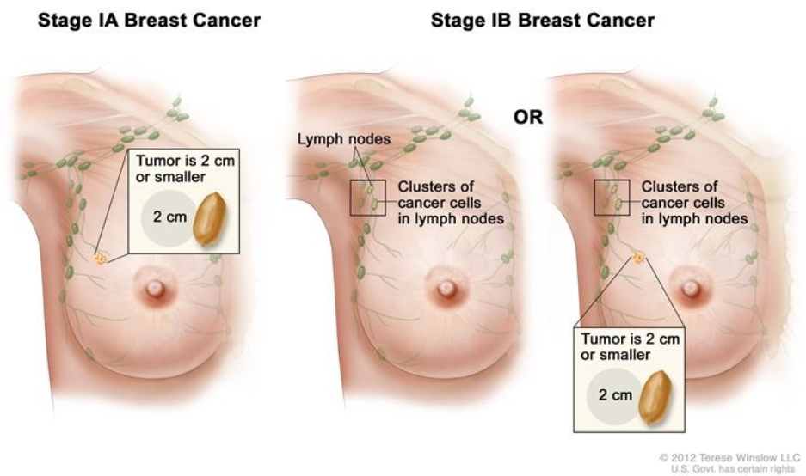
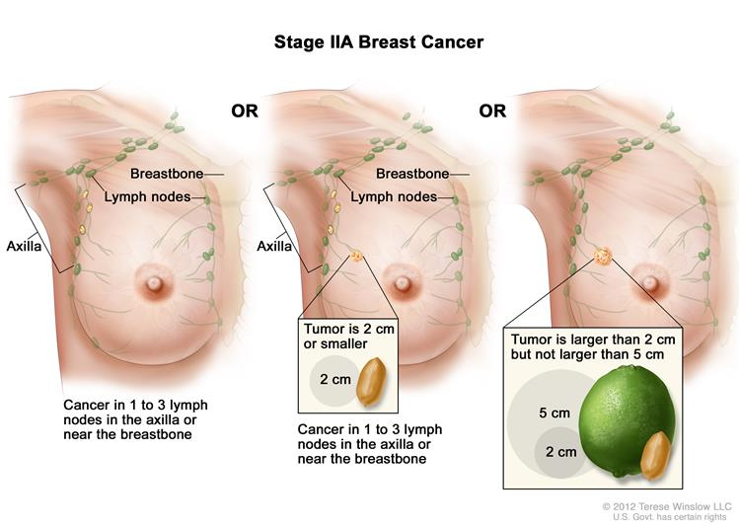
Early-stage Breast Cancer
Notes:
Illustrations of early stage breast cancer.
The common theme is 1-3 axillary nodes are positive associated with a tumor smaller than 5 cm, or node negative disease if the tumor is greater than 5 cm

Slide 7
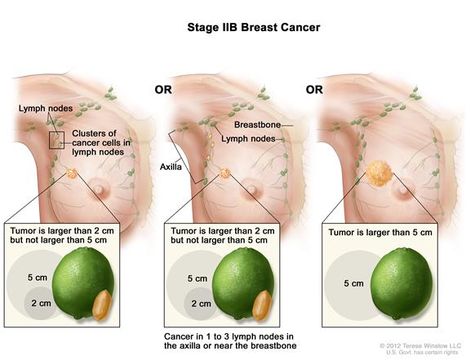
Early-stage
Locally advanced
Notes:
Any tumor larger than 5 cm, even when node negative, is considered locally advanced and warrants neoadjuvant chemotherapy

Slide 8
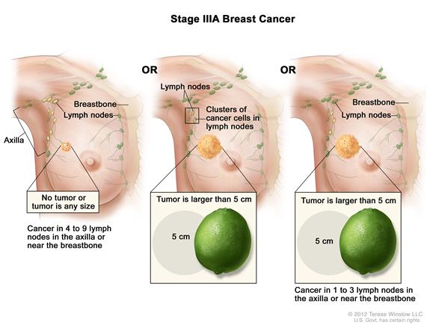
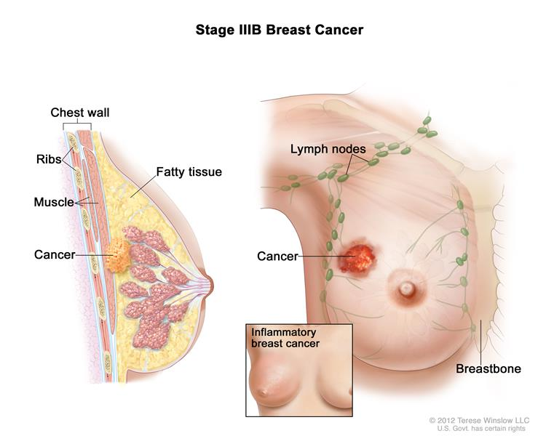
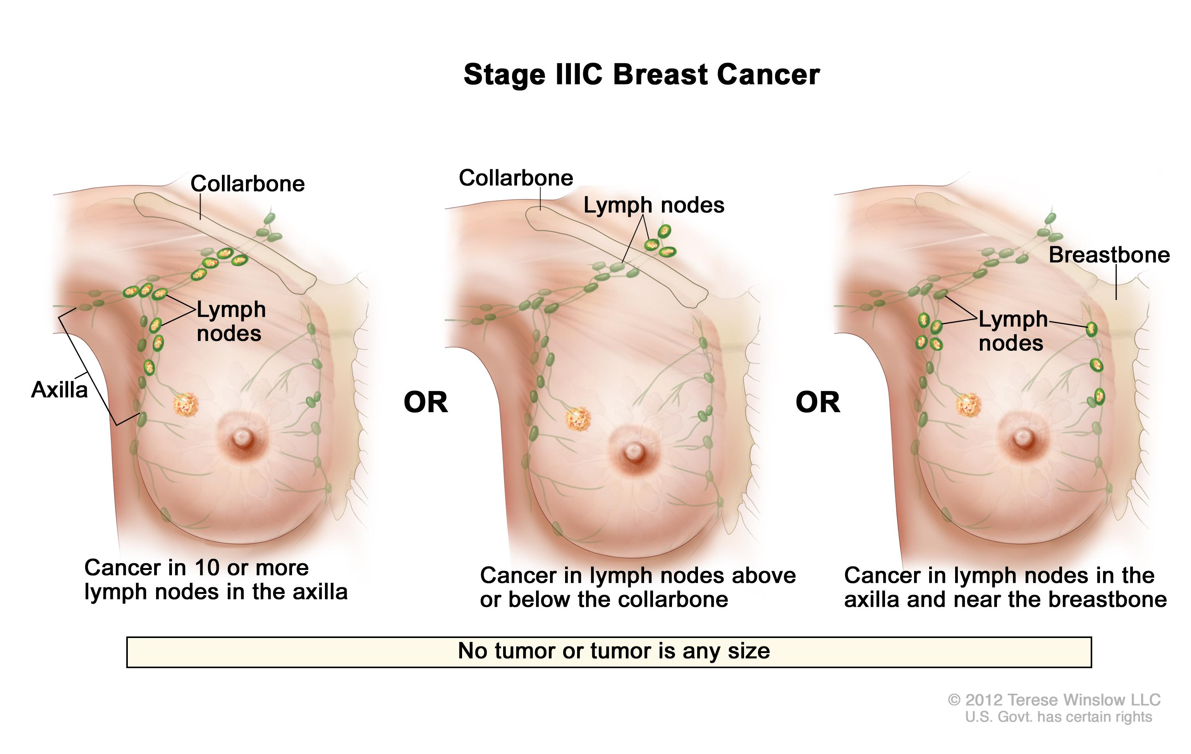
Locally Advanced Breast Cancer
Notes:
These are illustrations of locally invasive breast cancer.
There are greater than 4 positive nodes
The nodes are not only in the axilla but are crossing the collarbone or are found in near the sternum
The tumor has invaded the pectoralis major fascia or other nearby structures
Or the tumor is larger than 5 cm and there are 1-3 positive nodes

Slide 9
Treatment Overview
Breast Cancer
Early-stage
Locally advanced
Neoadjuvant chemo
Mastectomy
BCT:
Lumpectomy + RT
Adjuvant therapy
Multicentric disease
Large tumor relative to breast size
Diffuse malignant appearing calcifications on mammogram
Prior chest RT
Pregnancy
Triple-negative-- chemo eg. doxirubicin/cyclophosphamide → palitaxel
Her2-positive – chemo +/- trastuzumab
ER/PR-positive –- chemo +/- endocrine therapy (aromatase inhibitor vs SERM)
Yes
Positive margins?
No
Yes
High risk of
recurrence?
No
Notes:
Overview of treatments for non-metastatic breast cancer
Operability plays a role in the selection of patients for neoadjuvant treatment. While historically limited to patients with locally advanced breast cancer (in whom even a mastectomy may not be an option), it is frequently administered to women with operable breast cancer in an effort to improve cosmetic outcomes following surgery.

Slide 10
Neoadjuvant chemotherapy
The goal of treatment is to induce a tumor response before surgery and enable breast conservation.
Regimens for HER2-negative breast cancer
  TC (docetaxel plus cyclophosphamide)
  Dose-dense ACT (doxorubicin plus cyclophosphamide followed by paclitaxel)
  AC (doxorubicin plus cyclophosphamide)
  ACT (doxorubicin plus cyclophosphamide followed by weekly paclitaxel)
  TAC (docetaxel, doxorubicin, and cyclophosphamide)
  Oral CMF (oral cyclophosphamide plus methotrexate and fluorouracil)
  IV CMF (IV cyclophosphamide plus methotrexate and fluorouracil)
  FEC (fluorouracil, epirubicin, plus cyclophosphamide)
  FEC followed by weekly paclitaxel
  FEC followed by weekly docetaxel
Regimens for HER2-positive breast cancer
  Neoadjuvant pertuzumab, trastuzumab, and docetaxel followed by adjuvant FEC plus trastuzumab
  Neoadjuvant trastuzumab, pertuzumab, carboplatin, and docetaxel
  Neoadjuvant FEC followed by docetaxel, pertuzumab, and trastuzumab
  ACTH (doxorubicin plus cyclophosphamide followed by paclitaxel plus trastuzumab)
  Pertuzumab, trastuzumab, and docetaxel
Notes:
This slide is to point out that there are MANY regimens for neoadjuvant chemo, but the major distinction is HER2 positive vs negative tumors
Neoadjuvant therapy results in long-term distant disease-free survival and overall survival (OS) comparable to that achieved with primary surgery followed by adjuvant systemic therapy.
●For most patients with hormone receptor-positive disease, we recommend chemotherapy in the neoadjuvant setting rather than endocrine therapy. Chemotherapy is associated with higher response rates in a shorter time period.
●For patients with human epidermal growth factor receptor 2 (HER2)-positive breast cancer, a HER2-directed agent (eg, trastuzumab with or without pertuzumab) should be added to the chemotherapy regimen.
●We restrict endocrine therapy in the neoadjuvant setting to the treatment of postmenopausal patients with hormone receptor-positive disease who are not surgical candidates (regardless of tumor size) with a relative or absolute contraindication to chemotherapy (ie, significant medical comorbidities, advanced age, or poor performance status).

Slide 11
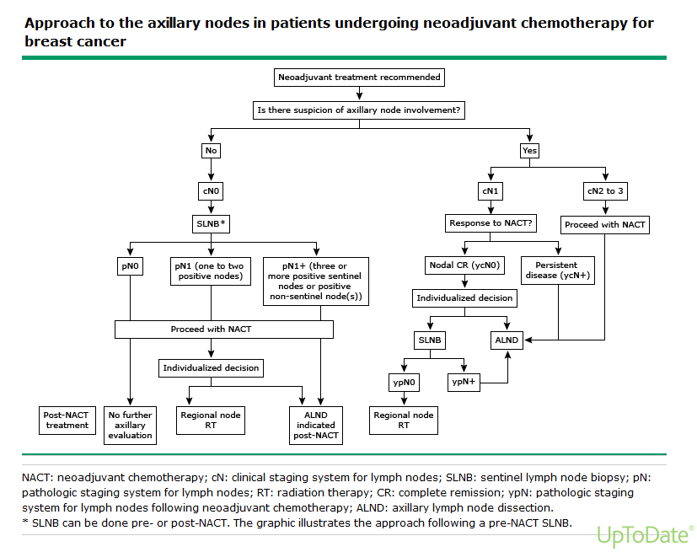
Notes:
How to manage axillary lymph nodes tends to depend on whether there is clinical suspicion for a positive node.

Slide 12
Special Considerations
Fertility
  Cryopreservation (oocytes, embryos, ovarian tissue + autotransplantation)
  GnRH agonists
Older patients
  Menopause
    SERM vs Aromatase inhibitors for ER/PR + cancer (see next slide)
  Comorbidities
    Life expectancy? →Palliative chemotherapy vs Surgery/RT
Male patients
  Less common than in women, presents at an older age, 80-90% abnormal mammography
  Work-up, treatment and survival is similar to women
Pregnancy
  Work-up–- attenuated to protect fetus
  Mastectomy vs BCT-– RT is not an option for most, unless it is feasible to delay it (w/ chemo) or delivery is imminent
  Chemotherapy– most agents are safe to use during pregnancy after the 1st trimester
Notes:
FERTILITY
Clinicians should discuss with patients the risk of infertility and possible interventions to preserve fertility prior to initiating potentially gonadotoxic therapy. This discussion should occur soon after diagnosis, since some interventions to preserve fertility take time and could delay the start of treatment.
*Cryopreservation of embryos is a proven effective technique for preserving reproductive capacity; cryopreserved thawed embryos are used in about 20 percent of all ART cycles. Cryopreservation of mature oocytes is also a proven technique, while cryopreservation of immature oocytes and ovarian tissue are promising approaches with reports of live births but remain investigational
*Data on the effect of GnRH agonist suppression of ovarian function on subsequent fertility in women undergoing chemotherapy for breast cancer have been conflicting, and methodologic flaws limit their interpretation. For example, several meta-analyses reported improved rates of menstrual function in women treated with a GnRH agonist and chemotherapy compared with those receiving chemotherapy alone, while others reported no difference in menstrual function between treatment and control groups. These disparate results may be explained by differences in inclusion criteria, tamoxifen use, and length of follow-up (12-month follow-up or longer) among the studies.
BREAST CANCER IN MEN
Breast cancer is much less common in men than in women. Men tend to present at an older age than women
●The most common clinical presentation is a painless, firm, subareolar mass.
●Mammography is abnormal in 80 to 90 percent of men ultimately diagnosed with breast cancer. It can usually differentiate breast cancer from gynecomastia.
GESTATIONAL BREAST CANCER
Importantly, all patients with gestational breast cancer should be evaluated for distant metastatic disease according to guidelines in nonpregnant patients with breast cancer. In order to protect the fetus, this can be attenuated to include: chest radiograph with fetal shielding, ultrasound of the liver, and magnetic resonance imaging (MRI) of the spine without contrast to evaluate for bone metastases
The same local treatment options that are available for nonpregnant patients should be considered in pregnant women, with the exception of radiation therapy (RT). As in nonpregnant women, surgery is the definitive local treatment for gestational breast cancer. Breast and axillary lymph node surgery during any trimester of pregnancy appears to be associated with minimal fetal risk.
*Mastectomy — Mastectomy may be chosen when the patient opts to continue the pregnancy, even for women with clinical stage I and II disease. An advantage of mastectomy may be the elimination of the need for breast RT. If breast reconstruction is desired, it should be delayed until after delivery.
*Breast-conserving surgery — The therapeutic equivalence of mastectomy and breast-conserving therapy (breast-conserving surgery [BCS] followed by RT) has been demonstrated in nonpregnant women; this is also true for the pregnant patient. BCS can be used effectively as RT can be delayed after the administration of adjuvant or neoadjuvant chemotherapy.
The data suggest it is safe to administer many agents used in the treatment of breast cancer during pregnancy when initiated after the first trimester, and that the majority of pregnancies result in live births with low related morbidity in the newborns. Although only limited case reports are available, chemotherapy given on a dose-dense schedule (ie, treatment every two weeks) does not appear to increase the risks of maternal or fetal complications compared with treatment administered every three weeks.

Slide 13
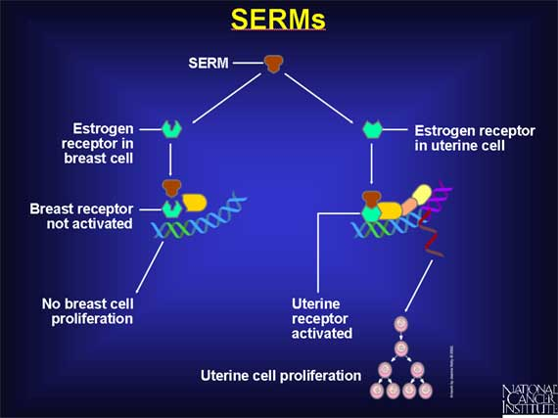
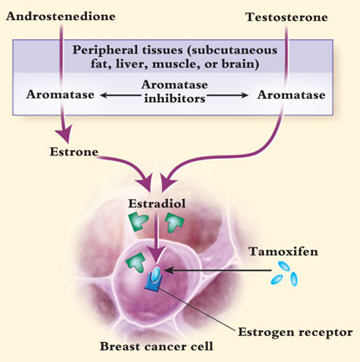
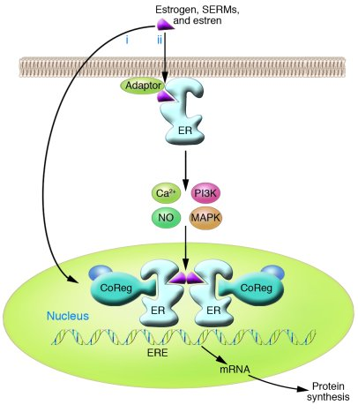
Selective estrogen receptor modulators
Aromatase inhibitors
Notes:
Recommendations from Uptodate:
For postmenopausal women, both selective estrogen receptor modulators (SERMs, tamoxifen or raloxifene) and the aromatase inhibitors (AIs, anastrozole or exemestane) are reasonable options. A choice among them should be individualized.
-For women who prefer a SERM, we suggest raloxifene if they are more concerned about uterine cancer and thromboembolic risks than their risk of breast cancer (Grade 2B). For women who are more concerned about breast cancer prevention, we suggest tamoxifen (Grade 2B).
-For women who desire breast cancer prevention but would rather not take a SERM for whatever reason, an AI is reasonable. In the absence of data suggesting there is a preferred AI, a choice between anastrozole or exemestane is based on individual preference.
•For premenopausal women at high risk of breast cancer, we suggest tamoxifen rather than observation (Grade 2B). These women are not candidates for an AI.

Slide 14
Prognosis
Patient characteristics
  Age: Worse for < 35 yo or > 65 yo
  Race: Black women have higher mortality despite lower incidence of breast cancer– likely a combination of socioeconomic disparities and tumor biology
Pathologic factors
  Tumor stage (TNM) is the most important prognostic indicator
  Tumor morphology: Tubular, papillary, mucinous, medullary, and adenoid cystic carcinoma are associated with a good prognosis; by contrast, micropapillary and metaplastic carcinomas appear to confer a worse prognosis
  Histologic grade: Based on the Elston-Ellis grading system. Has some prognostic value but no longer in use bc of high inter-observer variation
  Peritumoral lymphovascular invasion: Associated with worse prognosis, but unclear utility
Tissue markers
  Hormone receptors:
    ER-positive tumors tend to develop metastases in bone, soft tissue, or the reproductive/genital tracts; by contrast, ER-negative tumors more commonly metastasize to brain and liver, sites that are associated with shorter survival. They also tend to be histologically well differentiated, have a lower fraction of dividing cells, and are diploid. They are also less likely to be associated with mutations, loss, or amplification of breast cancer-related genes such as p53, HER2, or EGFR, all of which have been associated with a poorer prognosis.
    PR expression was independently predictive of disease-free survival (hazard ratio [HR] 1.94, 95% CI 1.32-2.85) and breast cancer-specific survival (HR 2.12, 95% CI 1.34-3.38)
  HER2 overexpression:
    Main benefit of HER2 testing is its predictive value for appropriate candidates who should receive HER2-directed agents. In the absence of systemic therapy, HER2 overexpression is a marker of poor prognosis in patients with pathologically node-positive and node-negative breast cancer.

Slide 15
Prognosis
Genomic profiles
  Luminal subtypes–- Refers to the similarity in gene expression tumors and the luminal epithelium of the breast. Tends to correlate with ER expression. Luminal A has better prognosis than Luminal B.
  HER2-enriched-- Tends to be ER/PR negative tumors
  ER-negative subtypes-- Triple-negative tumors
Gene expression profiles
  Oncotype Dx 21-gene recurrence score (RS)–- helps determine which ER+/HER2- node negative patients may benefit from endocrine therapy
  EndoPredict-- identifies a subgroup of patients with ER+HER2- tumors that have a very low risk of recurrence without adjuvant chemotherapy, as well as patients at low risk for a late recurrence
  Breast Cancer Index--accurate predictor of endocrine responsiveness among patients with ER+ breast CA, useful in predicting late recurrence (>5 years from diagnosis) as compared with RS and IHC4
  PAM50-- stratifies patients with ER+ disease into high, medium, and low recurrence subsets
Markers of proliferation
  Ki-67-- high Ki-67 levels were associated with a higher risk of relapse in both node-positive and node-negative disease as well as worse breast cancer survival in both node-positive and node-negative disease.
  Urokinase plasminogen activator-- High levels of uPA and uPAR, as well as the plasminogen activator inhibitor PAI-1, have been associated with shorter survival in women with breast cancer; by contrast, high levels of PAI-2 appear to be associated with better outcomes
  P53-- mutations in TP53 have a worse prognosis compared with other patients, independent of tumor size, node status, and hormone receptor status
Notes:
GENOMIC PROFILES:
Luminal subtypes: They typically express luminal cytokeratins 8 and 18.
●Luminal A tumors, which probably make up about 40 percent of all breast cancers, usually have high expression of ER-related genes, low expression of the HER2 cluster of genes, and low expression of proliferation-related genes. Luminal A tumors are the most common subtype and in general, carry the best prognosis of all breast cancer subtypes. Despite this, most breast cancer deaths are from ER-positive, HER2-negative disease, and racial disparity in outcome is particularly found in this subset.
●The less common (about 20 percent) luminal B tumors have relatively lower (although still present) expression of ER-related genes, variable expression of the HER2 cluster, and higher expression of the proliferation cluster. Luminal B tumors carry a worse prognosis than luminal A tumors. Most luminal B cancers have high recurrence scores as assessed by the 21-gene recurrence score assay and poor 70-gene prognostic signatures.
The HER2-enriched subtype (previously the HER2-positive/ER-negative subtype) makes up about 10 to 15 percent of breast cancers and is characterized by high expression of the HER2 and proliferation gene clusters and low expression of the luminal and basal clusters. For this reason, these tumors are most often negative for ER and PR, and positive for HER2. However, the HER2-enriched subtype is not synonymous with clinically HER2-positive breast cancer. While half of clinical HER2-positive breast cancers are HER2-enriched, the other half can include any molecular subtype but is mostly made up of HER2-positive luminal subtypes. About 30 percent of HER2-enriched tumors are clinically HER2-negative. While the impact of HER2 targeting in these tumors is being studied, it is possible that at least some represent HER2 mutations or other events in the HER2 signaling pathway producing a similar expression phenotype without HER2 amplification or protein overexpression.
The ER-negative genomic profile includes multiple subtypes, such as basal-like, claudin-low, and interferon-rich, among others. Most of these fall under the category of triple-negative breast cancers because they are also PR negative and HER2 negative.
Of these, the best described is the claudin-low subtype. The basal-like subtype, so called because of some similarity in gene expression to that of the basal epithelial cells of normal breast tissue, makes up about 15 to 20 percent of breast cancers. It is characterized by low expression of the luminal and HER2 gene clusters. For this reason, these tumors are typically ER negative, PR negative, and HER2 negative on clinical assays, which has prompted the nickname "triple-negative breast cancers" to describe them. However, while most triple-negative breast cancers are basal-like, and most basal-like tumors are triple-negative, there is significant discordance (up to 30 percent) between these two classification methods that must be kept in mind when evaluating studies focused upon basal-like breast cancer.
--------
GENE EXPRESSION PROFILES
Oncotype Dx 21-gene recurrence score (RS) is the best-validated prognostic assay and may identify patients who are most and least likely to derive benefit from adjuvant chemotherapy. At this time, it is indicated for women with node-negative, estrogen receptor (ER)-positive, human epidermal growth factor receptor 2 (HER2)-negative breast cancer to determine the prognosis in patients recommended to proceed with at least a five-year course of endocrine therapy. There is also limited support for use in patients with this biologic subtype and limited nodal involvement.
EndoPredict — Another prognostic assay is RNA-based and utilizes reverse transcriptase polymerase chain reaction (PCR) of 11 genes (including three reference genes) to calculate a prognostic score. Known as EndoPredict (EP), it was validated using the data from two Austrian Breast Cancer Study Group trials (ABCSG-6 and ABCSG-8), and its prognostic value was found to be independent of conventional prognostic factors. EP can be reliably run in routine molecular pathology laboratories using formalin-fixed, paraffin-embedded samples and can be performed with tissue from either the diagnostic core biopsies or final surgical specimens. However, the performance of EP as compared with other prognostic tests has not been evaluated.
The Breast Cancer Index (BCI) is a combination of two profiles, the HOXB13-to-IL17BR expression ratio (H:I ratio) and the Molecular Grade Index (MGI). Using genome-wide microarray analysis, three differentially expressed genes that were associated with an increased risk of progression among ER-positive patients treated with tamoxifen were: the antiapoptotic homeobox B13 (HOXB13, overexpressed in tamoxifen recurrent cases) and both interleukin 17B receptor (IL17BR) and EST AI240933 (both overexpressed in tamoxifen non-recurrent cases). Compared with clinical prognostic factors (eg, age, tumor size, tumor grade, and lymph node status), the H:I ratio was significantly and independently correlated with outcome (odds ratio [OR] 7.3, 95% CI 2.1-26)
The Predictor Analysis of Microarray 50 (PAM50, by Prosigna) is a 50-gene test that characterizes an individual tumor by intrinsic subtype. It was designed to determine the intrinsic subtype of a cancer using only 50 prespecified genes. Results from the PAM50 are used to generate the risk of recurrence (ROR) score, which can stratify patients with ER-positive disease into high, medium, and low subsets. The test can be performed on formalin-fixed, paraffin-embedded tissue with a high degree of analytical validity. The ROR was significantly predictive of prognosis among patients with node-negative breast cancer
MARKERS OF PROLIFERATION
Urokinase plasminogen activator system — Urokinase plasminogen activator (uPA) is a serine protease with an important role in cancer invasion and metastases. When bound to its receptor (uPAR), uPA converts plasminogen into plasmin and mediates degradation of the extracellular matrix during tumor cell invasion.

Slide 16
Post-treatment Surveillance
Cancer survivors who have completed treatment for breast cancer should undergo regular follow-up.
Annual mammography should also be performed in patients who underwent breast-conserving therapy (BCT).
The routine use of breast magnetic resonance imaging (MRI) or whole-breast ultrasound is not recommended for breast cancer survivors because of a lack of evidence to inform their role in this population.
In addition, laboratory tests and whole-body imaging in asymptomatic cancer survivors is not recommended.

Slide 17
Breast Reconstruction
There are two general types of reconstructive procedures: prosthetic devices (eg, tissue expanders, saline implants, silicone implants) and autologous tissue reconstruction, which involves the transfer of a flap of tissue from a donor site to the anterior chest wall.
The choice of the reconstructive option depends upon a variety of factors including body habitus, associated comorbidity (eg, obesity, history of diabetes, smoking), the size and configuration of the contralateral breast, prior surgical procedures, the quality of the chest wall skin, and patient choice.
Breast reconstruction is often performed immediately after mastectomy. The advantages of immediate reconstruction include streamlined care, reduced cost, superior cosmetic results, and psychosocial benefits. Immediate reconstruction may be considered in patients who are undergoing mastectomy for prophylaxis, ductal carcinoma in situ, or for invasive breast cancers less than 5 cm in size that are clinically axillary node-negative, and/or have a negative premastectomy sentinel node biopsy.
For women who are likely to need postmastectomy radiation therapy, delayed reconstruction may be considered. Autologous tissue is typically preferred rather than an implant following radiation treatments since this approach provides an acceptable outcome with fewer post-radiation complications.

Slide 18
Metastatic Breast Cancer
Is there a role for surgery?
  The median survival for patients with metastatic (stage IV) breast cancer is 18 to 24 months.
  Those who experience long-term survival tend to be young with an excellent performance status and limited metastatic disease. These patients benefit from an intensified multidisciplinary approach combining systemic therapies with local treatment (surgery, radiation, and regional chemotherapy).
Surgical options:
  Lung metastases — Isolated lung metastases occur in 10-25% of patients with metastatic breast cancer. Pulmonary resection or metastasectomy may be offered to highly select patients.
  Liver metastases — Hepatic metastases occur in over half of patients with metastatic breast cancer. They are most commonly a late development, associated with disseminated disease and a poorer prognosis than bone or soft tissue metastases. Only 5-12% of patients have isolated liver involvement. For the latter, hepatic resection may be considered.
Notes:
The mainstay of metastatic breast cancer is systemic chemotherapy, +/- endocrine or HER-2 directed therapies. But some patients, especially those who are young, active and have limited metastatic disease may benefit from aggressive local control of the tumors. The overall goal of treatment is prolongation of survival, alleviation of symptoms, and maintenance or improvement in quality of life, despite the toxicity associated with treatment.
-----
Pulmonary resection or metastasectomy offers an opportunity for long-term survival in highly selected patients with metastatic breast cancer, with cases series demonstrating five-year overall survival ranging from 30 to 80 percent and median survival duration ranging from 40 to 100 months. Patients most likely to experience long-term survival after mastectomy are those with solitary metastases and a disease-free interval greater than 36 months. Other prognostic factors may include hormone-receptor status, size of metastases, completeness of resection, and use of anatomic resection (as opposed to wedge resection). Other options are radiofrequency ablation (RFA), and stereotactic body RT.
Liver-directed therapy includes radiofrequency ablation (RFA), stereotactic body RT (SBRT), selective internal RT (SIRT), percutaneous ethanol injection, cryotherapy, hepatic arterial infusion chemotherapy, transhepatic arterial chemoembolization (TACE), and interstitial laser therapy. In general, there are fewer less data regarding the use of these techniques for metastatic breast cancer than there are for patients with colorectal cancer liver metastases or primary hepatocellular cancer. Furthermore, none of these methods has been directly compared to systemic chemotherapy in metastatic breast cancer.
●Radiofrequency ablation (RFA) can be used alone or in combination with resection. It is most effective with solitary lesions less than 3 cm in diameter.
RFA entails the local application of radiofrequency thermal energy to a lesion, in which a high frequency alternating current moves from the tip of an electrode into the tissue surrounding that electrode. As the ions within the tissue attempt to follow the change in the direction of the alternating current, their movement results in frictional heating of the tissue. As the temperature within the tissue becomes elevated beyond 60º C, cells begin to die, resulting in a region of necrosis surrounding the electrode.
●Selective internal RT (SIRT or targeted radiotherapy with Yttrium-90 microspheres [SIR-Spheres]) uses millions of microscopic beads injected into the liver to deliver internal radiation directly to the tumor.
●Interstitial laser therapy (ILT) causes local tumor destruction by the application of laser light, delivered through quartz diffusing laser fibers that can be percutaneously placed within tumors. This technique can be used to treat lesions that are up to 5 cm in diameter.
●Transarterial chemoembolization (TACE) is able to deliver chemotherapy directly to the tumor while blocking blood flow to the liver because the majority of the blood supply to liver tumors is from the hepatic artery rather than the portal vein. Experience with these techniques in patients with breast cancer is limited.
●Stereotactic Body Radiation Therapy (SBRT or fractionated radiosurgery) is a technique that delivers external beam radiation to the tumor using high-dose, precisely focused beams of radiation.

