Slide 1
Creativity and Innovation in Clinical Research
Steve Cummings, MD
SF Coordinating Center

Slide 2
How to be Creative
Over 9,000 books on ‘creativity’ on Amazon
Most common approach: techniques to stimulate free associations

Slide 3
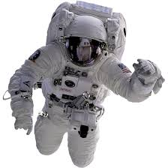


Typical Creativity Seminars

Slide 4
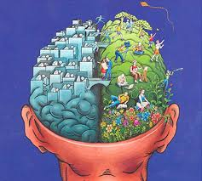

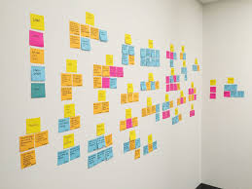

Free Association

Slide 5
Free Association
Stimulating creativity
Produces novel associations
If not grounded in a problem
  Does not apply deep expertise
Rarely leads to impactful or useful innovations

Slide 6
Innovation
Impactful discoveries and solutions to problems

Slide 7
Sources
Half a dozen books
Feedback from > 2 dozen seminars
Genentech and Stanford seminars on Innovation

Slide 8
Outline
The motive: problem, anomaly, passion, or crisis
Deep expertise
Cross-fertilize
Anomalies and outliers, and extremes
Skepticism
The creative personality
Rapid prototyping
Barriers to innovation

Slide 9
My background and examples
Generalist. Academic meandering
Diverse expertise
  Research methodology
  Osteoporosis
  Aging biology
Examples
  Risk factors for fracture, quantitative breast density, nitroglycern for hot flushes

Slide 10
Motives
Problems, crises…

Slide 11
Motives
Better prediction of mortality to prioritize liver transplantation
What causes hip fracture?
Why does maize have differently colored kernels?

Slide 12
Example: Hot flushes
Problem:
Estrogen was a very effective and standard treatment for hot flushes
WHI found that postmenopausal estrogen therapy has harmful effects
Women and physicians stopped using estrogen and needed effective alternatives

Slide 13
Deep Expertise

Slide 14
Expertise
Understand in depth and detail
  Recognize problems and solutions
Clinical experience
  Listen and observe without preconceptions
Systematic review
Learn from world’s experts

Slide 15
Hot flushes
Deb Grady
  World-class expert in estrogen therapy and hot flushes
  Hot flushes result from instability of vasodilation

Slide 16
Expertise in Osteoporosis
Read every article (about 600) that had been written about the topic
Interviewed and examined 100 patients with hip fractures; visited them at home
  Did not fit the current beliefs about causes
Engaged the two most expert epidemiologists about fractures
  Wrote reviews with them

Slide 17
A ‘feel’ for the problem
Visualization
Imagination

Slide 18
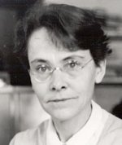
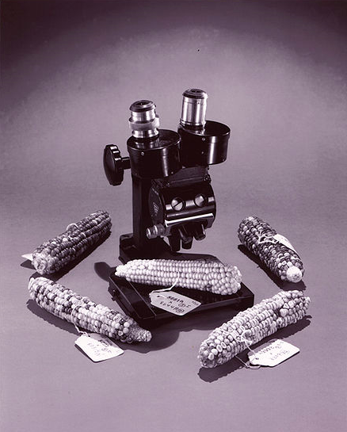
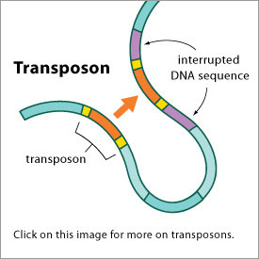
Barbara McClintock: deep expertise and imagination
Nobel prize for discovering genetic transposition (‘jumping genes’)
Why did maize have a variegated pattern?
Developed staining techniques to visualize maize chromosomes
Observed that segments could change position on the chromosome and, thereby, alter gene exp

Slide 19
Barbara McClintock: deep expertise and imagination
“I know my corn plants intimately…the more I worked with [the corn] the bigger [they] got, and I wasn’t outside, I was down there. I was part of the system….It surprised me because I felt as if I were right down there and these were my friends.”

Slide 20
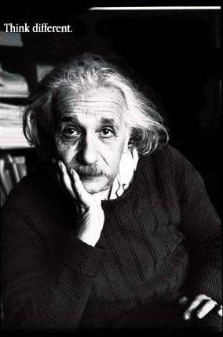
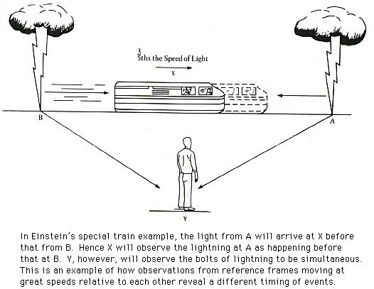

Slide 21
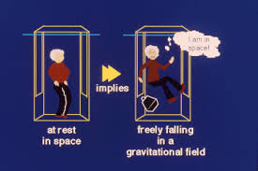

Slide 22
A Theory of Falls and Fractures
Me
How do falls cause fractures? Why do some result in hip while others result in wrist or skull fractures?

Slide 23
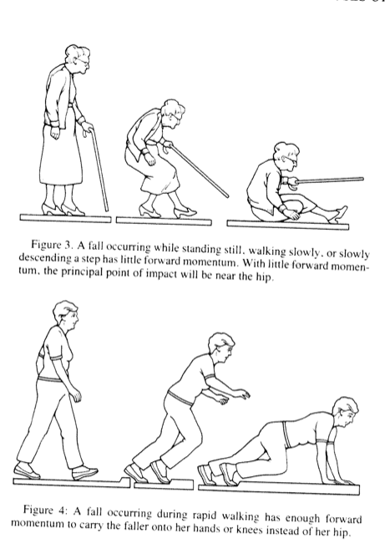
A Theory of Falls and Fractures
Me
Mats, video camera, and an artist in Millberry Gym (1988)
It is not whether but how you fall that determines whether and what type of fracture occurs
Mike

Slide 24
Lessons about fractures
Me
Hip fractures result from loss of balance and weak leg extension, walking slowly, and slow reflexes
Wrist fractures result from tripping while walking and quick reflexes
Mike

Slide 25
Lessons about fractures
Me
New tests in studies discovered new risk factors
  Can’t rise from a chair
  Poor “tandem balance”
  Slow gait-> hip fracture; fast gait -> wrist fracture
Mike

Slide 26
Focused Creativity

Slide 27
Cross-fertilization
Find new measurements

Slide 28
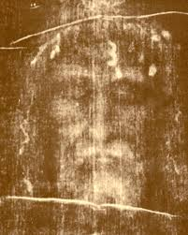
Cross-fertilizations
Alert to new technology:
The shroud of Turin in Time Magazine
“PCR”
Collected DNA in SOF in 1988

Slide 29
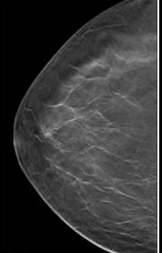
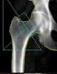
Cross-fertilization
+
=

Slide 30
Cross-fertilization
Automated, precise measurement of breast density
+
=

Slide 31
New tests from one discipline applied to new clinical problems
Jennifer Lai
How to prioritize patients for liver transplant?
MELD: the standard score focused on the liver: blilirubin, creatinine, and INR to prioritize patients for liver transplant.

Slide 32
New tests from one discipline applied to new clinical problems
Jennifer Lai
How to prioritize patients for liver transplant?
MELD: the standard score focused on the liver: blilirubin, creatinine, and INR to prioritize patients for liver transplant.
Applied physical measurements of frailty from geriatrics
  Index of frailty: Grip strength, timed chair stands and ‘30 sec balance test
Improved prediction of mortality ~21%

Slide 33
New measurements create careers
Mike Shlipak: Cystatin C
  New measurement in existing samples
  Predicts mortality, CHD, frailty
  Established as a more accurate measurement of renal function than estimated from serum creatinine

Slide 34
New measurements create careers
Katie Stone: technology to measure sleep in home and circadian activity rhythms
Features of sleep predict dementia
Included 24 hour data on circadian activity rhythms

Slide 35
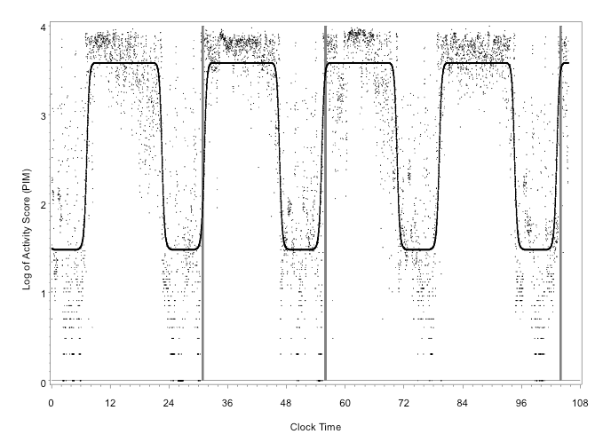
New measurements create careers
Decreased, delayed, or disorganized rhythm with aging predicts
  Mortality
  Dementia
  Diabetes
  Disability
  … and more
Major focus of our research
Normal
Old

Slide 36
Internet trials and consent
Problem: Trials with Susan Love’s online Army of Women
Expertise with details of clinical trials
Developed all of the methods to transfer trials to internet
  Interactive electronic consent with identity and quizzes to confirm

Slide 37
Hot flushes, estrogen and nitroglycerin
At the national bone meeting, wandered among posters and attended basic science sessions
Estrogen causes vasodilation that is blocked by L-Name – blocks NO synthesis
Estrogen’s effect on blood vessels is mediated by nitric oxide.

Slide 38
Purposeful cross-collaboration
Be alert to new measurements and concepts relevant to your problem
Attend science meetings outside of your ‘specialty’
Read a wide array of science journals
Look for opportunities to collaborate with experts in other areas
Become expert in novel applications of the new measurement technology or treatment to your problems

Slide 39
Anomalies and outliers

Slide 40
Anomalies and scientific discovery
‘Discovery commences with the awareness of anomaly…that nature has violated the paradigm-induced expectations.’
T. Kuhn Structure of Scientific Revolutions, Ch VI

Slide 41
Data

Slide 42
Data

Slide 43
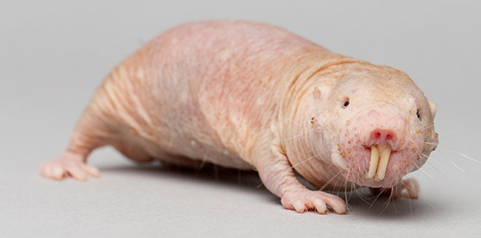

Slide 44
Naked mole rat

Slide 45
Naked mole rat
Live 30 years
Don’t get cancer
Feel no pain

Slide 46
Naked mole rat
Compared to other rodents
Lack substance P essential for pain
Greater expression of genes for DNA repair
Ribosomes produce more error-free proteins

Slide 47
What didn’t happen
Severe car crash
Multiple injuries
No fractures

Slide 48
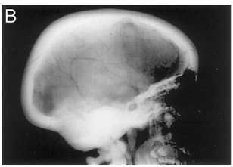
What didn’t happen
Severe car crash with many injuries
No fractures
Normal but thick bones
Genotyped the family
Discovered an LRP5 mutation, a new pathway and new drug treatments

Slide 49
Skepticism
Challenge current beliefs.
What if it isn’t true?

Slide 51
Barbara McClintock
“If you know you are on the right track, if you have this inner knowledge, then nobody can turn you off... no matter what they say.”

Slide 52
Barbara McClintock
“If you know you are on the right track, if you have this inner knowledge, then nobody can turn you off... no matter what they say.”
But criticisms caused her to stop publishing in 1953

Slide 53
Barbara McClintock
“If you know you are on the right track, if you have this inner knowledge, then nobody can turn you off... no matter what they say.”
But criticisms caused her to stop publishing in 1953

Slide 54
Type 1 and Type 2 Osteoporosis
Dominant paradigm before our study: Vertebral fractures in women <60 years are due to low estrogen. Hip fractures >age 65 are due to low vitamin D
Universal belief without evidence
Measured estradiol (E2) in SOF.
Low E2 a very strong predictor for hip fracture. Vitamin D not associated.

Slide 55
Personality and innovation
Can innovation be learned?

Slide 56
It helps to be crazy…
We tested whether polygenic risk scores for schizophrenia and bipolar disorder would predict creativity.
Higher scores were associated with artistic society membership or creative profession in both Icelandic (P = 5.2 × 10⁻⁶ and 3.8 × 10⁻⁶ for schizophrenia and bipolar disorder scores, respectively) and replication cohorts (P = 0.0021 and 0.00086).
Nature Neuroscience 18, 953–955 (2015)

Slide 57
Jeff and George
Jeff
  Good straight A - B student
  Completes homework as instructed
  Answers questions when he is certain
George
  Unruly challenging student
  Off-beat homework and different products
  Asks questions and takes chances

Slide 58
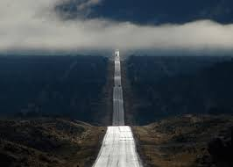
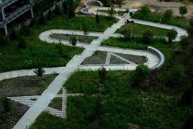
The life courses of Jeff and Geoge

Slide 59
Jeff and George
Jeff
  Good committed long-term employee
  Essential for implementation
George
  Moves from specialty to specialty and job to job
  A source of cross-fertilization and recasting problems

Slide 60
‘Rapid prototyping’
Fail smartly and quickly

Slide 61
Rapid prototyping
Mike S: small study of cystatin-c in existing specimens to predict mortality
  Many subsequent studies and NEJM review – cystatin-c is superior
Jennifer Lai: tried 3 measures of frailty in her own practice
  Confirmed in an NIH multisite trial
  Becoming the new standard

Slide 62
Internet trials
Start-up with minimal funding, mainly my wallet and a friend from Eli Lilly
Tested nutriceuticals for anxiety and insomnia
Worked beautifully – 380 in 6 weeks from 45 states.
>$10M trial of OAB funded by Pfizer under IND from FDA

Slide 63
Innovation, an example
Putting it together:
Hot flushes

Slide 64
The crisis
Estrogen is 90% effective for hot flushes
HERS and WHI found HRT to be harmful
Many women avoided estrogen and needed alternatives

Slide 65
A standard response
Find estrogen-like alternatives
Low doses
SERM + estrogen
Phytoestrogens

Slide 66
Deep expertise
Deb Grady
  Hot flushes
  Vasodilation
Steve C
  Nitroglycerin

Slide 67
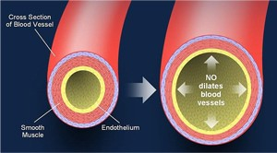
Reframing the problem
Forget about estrogen
Focus on vasodilation

Slide 68
Cross-fertilization
Steve C
  Short term nitroglycerin causes vasodilation
  Continuous nitroglycerin causes tachyphylaxis

Slide 69
The new paradigm and innovation
Continuous, 24 hour, nitroglycerin to induce tachyphylaxis
Prevent vasodilation
Prevent hot flushes?

Slide 70
Rapid prototyping
A few volunteers with severe hot flushes
Uncontrolled short-term study: ~75% decrease in moderate-severe hot flushes
  Women didn’t want to stop

Slide 71
Testing
NIH RO1: Randomized placebo-controlled trial
~200 women with >7 hot flushes/day
Several doses of 24 hour nitroglycerin patches

Slide 72
Barriers to innovation
(some are reasons why you are successful professionals!)

Slide 73
Barriers to innovation
Belief
  Master current beliefs and practices without skepticism

Slide 74
Barriers to innovation
Belief
  Master current beliefs and practices without skepticism
Fear of criticism, mistakes and failing
  Take chances!

Slide 75
Barriers to innovation
Belief
  Master current beliefs and practices without skepticism
Fear of criticism, mistakes and failing
  Take chances!
Too busy

Slide 76
Barriers to innovation
Belief
  Master current beliefs and practices without skepticism
Fear of criticism. mistakes and failure
  Take chances!
Too busy
Bad mentors
  Critical or disinterested in novel ideas
  Just want your help with their research

Slide 77
To have an impact on science and practice
Get deep expertise
Focused creativity
  Cross-fertilize
  Pay attention to anomalies
  Ask – what if it isn’t true?
Take chances
Rapidly test the new idea
Find great mentors – even beyond UCSF

Slide 78
Thank you

