Slide 1
Melanoma
Dr. Michael Alvarado
James Ross

Slide 2
Overview
Accounts for 75% of skin cancer deaths
Risk: sun exposure, family history, prior melanoma, blistering sunburn, fair complexion, dysplastic nevi.
  10% familial (CDKN2A and CDK4 muts)
Prognosis is excellent with early recognition

Slide 3
Pathophysiology
Clinically heterogeneous cancer derived from one of two neural crest-like stem cell populations in the skin (dermis, and hair follicles)
  Epithelium-Associated (Lentigo/desmoplastic, superficial spreading/spitzoid, mucosal, acral)
  Non epithelium-associated (uveal, visceral, blue nevi, congenital nevi)
Initial ‘radial’ growth phase, followed by ‘vertical growth phase’
  10-year survival decreases progressively with depth (96% for <0.5mm, 54% for 4-6mm)
Commonly spreads to regional nodes, then lung, brain, GI tract.
  Cutaneous mets may present between 1º lesion and nodes – ‘in transit’ dx

Slide 4
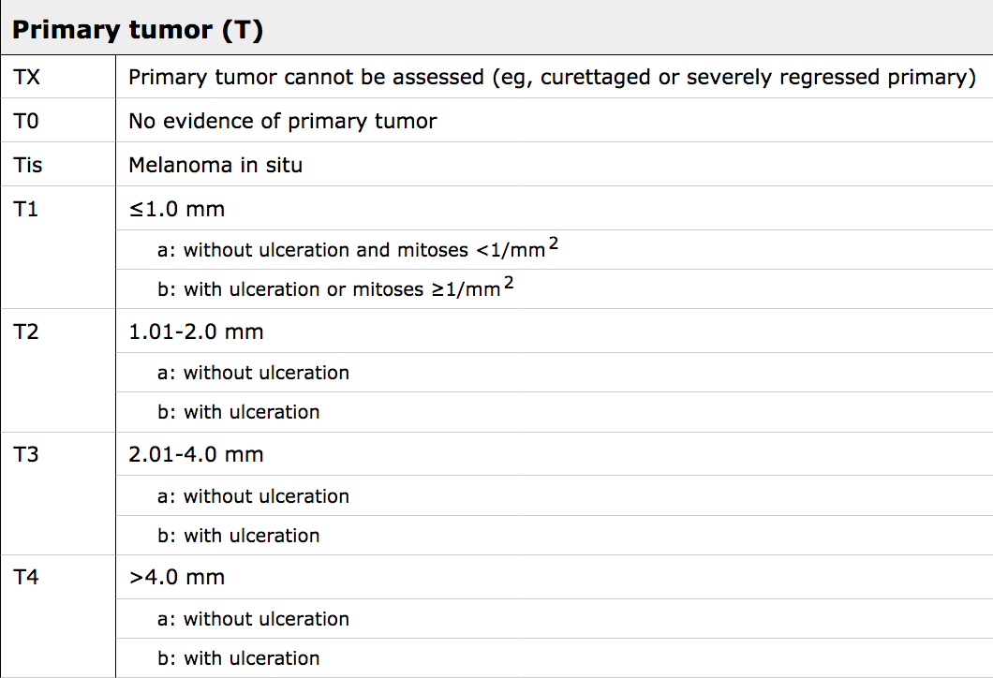
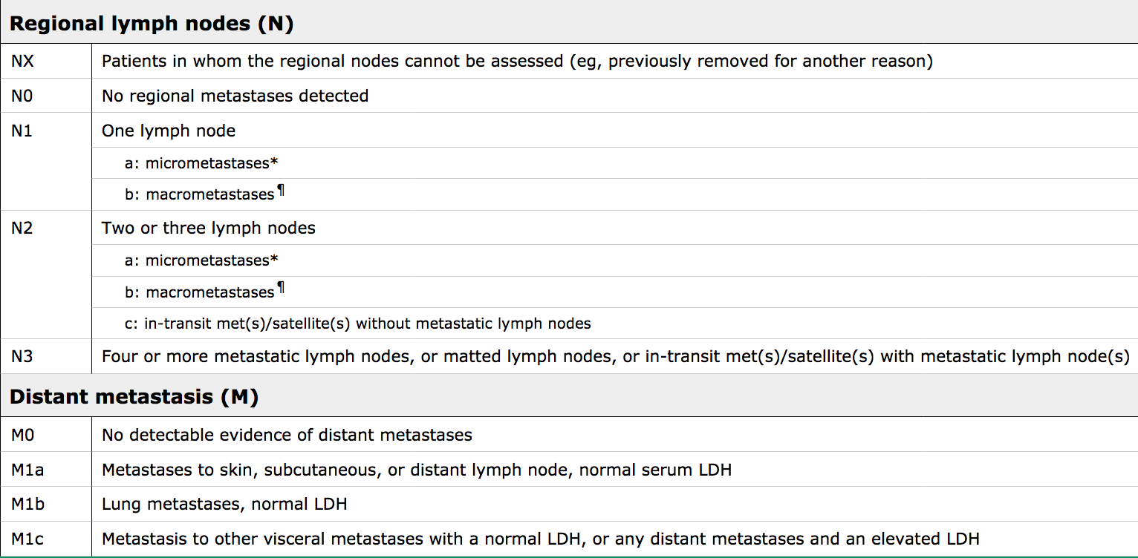
Staging
Stage 0-II based primarily on depth of invasion (modified by ulceration and mitotic rate)
Stage III Regional mets
Stage IV Distant mets
Notes:
Breslow (absolute depth)
Clark (by anatomic layers of skin)

Slide 5
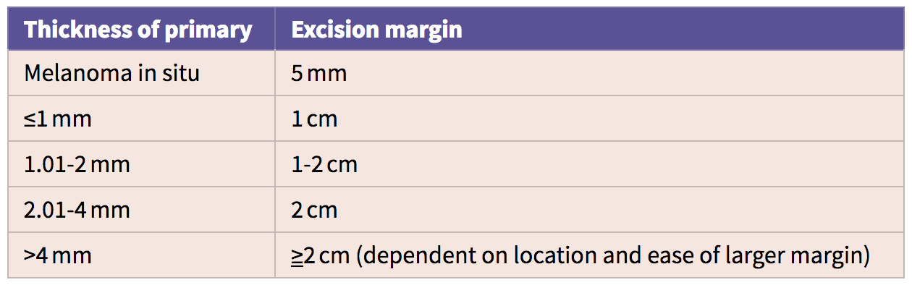
Overview of Management (1 of 2)
All Stage I-III melanomas require wide local excision of primary lesion.
Lesions >1mm deep require sentinel lymph node biopsy.
  SLN positive in 12-20% in 1-2mm, 28-33% in 2-4mm, 28-44% in >4mm.
  Consider SLNB in <1mm if pt: young, male, ulcerated lesion, regression of lesion, inadequate biopsy, mitotic rate >1, lymphovascular or perineural invasion.

Slide 6

Why rely on sentinel nodes?
“Final Trial Report of Sentinel-Node Biopsy versus Nodal Observation in Melanoma”
2001 pt randomized to observation or biopsy.
  Observation: WLE plus obs with US and delayed lymphadenectomy for nodal dx.
  Biopsy: WLE plus SLNB, with lymphadenectomy for positive sentinel node.
No difference in survival at 10 years.
Significant improvement in 10 yr disease-free survival in biopsy group for pt with melanoma >1.2mm and <3.5mm.
  As expected, positive SNLB was more common in thicker melanomas.
  SLNB correctly determined the path status of nodal basin in 96% of cases.
  SLNB identified clinically-occult nodal mets.

Slide 7
Overview of Management (2 of 2)
If positive sentinel node, evaluate for systemic dx.
  MRI brain, CT c/a/p, whole-body PET.
If SLN positive and no systemic disease, need completion lymphadenectomy.
  Cervical -> Neck dissection
  Arm -> Axillary levels I and II (+level III if +ve nodes, or palp at presentation)
  Leg -> Superficial inguinal dissection (+ deep inguinal if +ve nodes, or palp)
Following resection, patients require routine monitoring (Clinical exam, CXR, LDH) with CT or PET/CT if symptoms.

Slide 8
Management of Systemic Disease (1 of 2)
Chemotherapy and Immunotherapy
IL2 cures small subset, but no improvement in overall survival
  Use limited by severe toxicity
Immunotherapeutics prolong progression-free and overall survival
  Checkpoint inhibitors (pembrolizumab, nivolumab)
  Cytotoxic T lymphocyte associated protein inhibitors (ipilimumab)
Direct inhibitors of BRAF or MEK pathways (vemurafenib, dabrafenib).
  Useful in patients with known BRAF mutations
  Commonly relapse when treatment stopped

Slide 9
Management of Systemic Disease (2 of 2)
Metastectomy
Patients with isolated mets and good response to immunotherapy may be candidates for metastectomy
Pulmonary mets
  Complete resection of limited disease improves five-year survival.
Brain mets
  Limited role for resection in highly select candidates (good function, 1-2 mets, superficial and non-eloquent locations)
  Aim to relieve symptoms, not improve survival.
  After resection, 1 yr survival ~25%
GI Tract
  Only to treat acute bleed or obstruction

Slide 10
Summary
Staging and prognosis depends primarily on depth of invasion.
Stage I-III lesions (>1mm +/- regional node involvement) require wide local excision and sentinel node biopsy.
Positive sentinel nodes require completion lymphadenectomy (if no evidence of systemic disease).
Multiple immunotherapeutics are available for systemic disease.
Consider resecting isolated distant mets in select patients.

