Slide 1
What Kinds of Questions Does Epidemiology Answer?
Description
  How frequent/common are risk factors/exposures/conditions/diseases?
Causation
  The science of establishing causal relationships among biological, behavioral, environmental (etc.) factors among humans, including effects of interventions
  Does X cause (or prevent) Y?
Attribution
  What fraction of disease Y can be eliminated if causal exposure X is eliminated?
Mediation
  Understanding the mechanisms of causation
  How does X cause Y?
Interaction
  When and for whom does X cause Y?
Prediction
  Do A, B, and C predict presence/occurrence of Y? (e.g., diagnosis or prognosis)
How often does Y occur?
Notes:
Here is the framework we set forth in the Introductory Video about the kinds of questions that epidemiology can answer. In the next two lectures, we will be discussing description.

Slide 2
Disease Occurrence I
Main Points to be Covered
Incidence versus Prevalence
The 3 elements of measures of incidence
Cumulative incidence vs. person-time incidence
Concept of censoring
Methods (“estimators”) for calculating cumulative incidence
  Simple proportion
  Kaplan-Meier
  Life-table
  [next week] Aalen-Johansen
Underlying assumptions/warnings: losses unrelated to outcome; no (or independent) competing events; and secular trends
Notes:
This is the outline for today. In addition to the distinction between incidence and prevalence, introduced in class last week, we will be presenting the difference between two important and widely used ways to measure incidence called cumulative incidence and person-time incidence. The reading for this week emphasizes the 3 elements in measuring disease incidence. Understanding those 3 elements and focusing on how they are used (or not used) can eliminate confusion about the frequently erratic use of terminology in the clinical research/epidemiologic literature. We will go on to describe the concept of censoring and why this presents complications for us. The bulk of this week will be spent on methods for calculating cumulative incidence, with a focus on the first three methods and particularly on the Kaplan-Meier technique. Formally, we call this estimation and specific techniques are called estimators. Then, next week we will discuss the Aalen-Johansen estimator. Along the way we will discuss the various assumptions and warnings that are required when using these estimators to allow them to give meaningful answers.

Slide 3

How do our study designs describe their underlying cohort (fixed)?
= event = loss to follow-up CE = competing event
CE
CE
Cohort
“Forward in time”
Cross-sectional
Time
= Case-control
“Strategically (which limits description)”
“One point in time”
Notes:
As we begin to discuss measures of disease occurrence, it is helpful to review how our common study designs sample their underlying cohorts and hence are able to describe them. This is a graphic that summarizes the individual-level study designs that we covered in last week’s lecture. For studies with individuals as the unit of observation, we discussed 3 designs for between-subject studies: cohort, cross-sectional and case-control. We distinguished fixed (illustrated here) and dynamic cohorts. Cohort design follows and describes the entire cohort or a sample of as it moves forward in time. It is the most natural and unadulterated approach. Think of it as the “forward looking” approach. Cross-sectional design takes and describes a “snapshot” of the cohort at a single timepoint; it is less work and is more strategic than the forward-looking cohort approach but it also has more potential problems when it comes to analytic objectives. Case-control designs first identify incident cases and then sample the underlying cohort that gave rise to the cases. It is extremely strategic, efficient, and sophisticated. It turns out that it is so strategic that it is actually limited in terms of pure description of the underlying cohort, but instead its strengths are in analytic objectives. You really need to know what you are doing, however, with case-control designs; otherwise, you can make some big mistakes.
When it comes to measuring disease occurrence, the nature of the study design dictates the kind of measures the design can yield. Our lecture today starts to address this issue of measuring disease occurrence, or measuring the outcome of interest.

Slide 4
Measuring Disease Occurrence
Occurrence of disease is a fundamental measurement in epidemiology
Occurrence of disease is often a binary (yes/no; present/absent) outcome
  Note: Continuous changes in any entity, e.g., changes in blood pressure, are also relevant but are not the focus of this course
Occurrence of disease involves time
Note: we will talk in terms of “disease” but can refer to any event/condition (be it favorable or unfavorable)
Notes:
Given that epidemiology is all about studying health and disease, it follows that occurrence of disease is a fundamental measurement, or aspect, of epidemiology. In this course, we are going to focus on disease in a binary respect, meaning yes or no, present or absent. This is not the only way to characterize disease in that it can be characterized in multi-state categories, or even as a continuous (interval-scale) variables, but in our course, we are going to focus on disease as binary. Also, note that we will use the term disease in our examples but we can be referring to any event or condition, be it favorable or unfavorable.
Last week, with the overview of study design, we emphasized the importance of viewing each of the basic types of study design as occurring in the setting of a study base moving through time, either an explicit cohort or a hypothetical cohort. The central idea is that study design cannot be thought about correctly without including the element of time. Movement of persons through time is what defines a cohort. Turning now to how disease occurrence is measured, time will remain at the center. To understand the different measures of disease occurrence you must pay attention to how time enters into the picture.
Time plays a role even in the measure of prevalence when the distinction is made between point and period prevalence, a topic covered in the next few slides.

Slide 5
Prevalence versus Incidence
Prevalence counts existing disease diagnoses, usually at a single point in time
Incidence counts new disease diagnoses during a defined time period
Fundamental distinction in epidemiology
Notes:
The difference between incidence and prevalence is a fundamental distinction in epidemiology. As we noted last week, prevalent cases of a disease will over-represent those with longer duration or survival. This can potentially introduce significant bias into a study when the goal is to study why diseases occur (studies of disease etiology).
In some instances, prevalence may look numerically similar to incidence and in others the two measures will be very different. They are, however, very different entities. The amount of the difference between incidence and prevalence is related to the time period during which incidence is measured and the average length of duration of the disease condition.

Slide 6
Prevalence vs Incidence
Prevalence
  For public health
    burden of disease in a population & public health planning
  For science
    prioritization for research
Incidence
  For public health
    trends over time -> implications for disease control
  For scientific
    prioritization for research
    fundamental for studies of causality/etiology
      Exclude prevalent cases to focus on causes of disease, rather than causes of “survival with disease”
Notes:
Why are both prevalence and incidence important?
Prevalence is important from the public health perspective of examining the burden of a disease in a population. It tells the public health and medical systems what they need to prepare for and serve. For science, prevalence helps to prioritize what we should be studying in research.
Incidence is also important to public health in determining trends over time in controlling a disease, i.e., telling us how well our disease control efforts are doing. Like prevalence, the study of incidence also plays a role in prioritization in research in that the diseases that are more common and have a higher incidence of subsequent mortality deserve highest prioritization. However, the unique aspect of incidence is its fundamental role for studies of causality/etiology. Causality/etiology means the study of what causes various diseases. To understand disease etiology, it is necessary to distinguish between causes of the disease and causes of extending disease survival. Using only incident cases of a disease achieves this by removing any differences in survival time or duration of the disease. Studying prevalent cases of disease introduces differences in survival time which could be related to the factors being investigated as causes of disease per se. In other words, any study evaluating factors associated with prevalence of disease can be difficult to disentangle whether a factor is associated with the onset of the disease itself or with the survival after disease onset.

Slide 7
Two Types of Prevalence
Point prevalence - number of persons with a specific disease at one point in time divided by total number of persons in the population
Period prevalence - number of persons with disease in a time interval (e.g., one year) divided by number of persons in the population
  Prevalence at beginning of an interval plus any incident cases
Exposure (sometimes called “risk factor”) prevalence is also important
Notes:
This distinction is often not made because most prevalence estimates that you will encounter in the literature are point prevalence. Period prevalence has its uses, however. It is, for example, helpful for planning the delivery of health services to know how many persons in a given time period may need those services. A way to think about period prevalence is as the point prevalence at the beginning of a defined time interval plus whatever incident cases occur during that interval.
The concept of prevalence is not unique to disease outcome. The prevalence of a risk factor (or “exposure”, as we will generically refer to this throughout the course) is also important from a public health perspective. For example, a risk factor (exposure) may have a modest association with a disease outcome (say, a risk ratio less than 2), but it may be a very common exposure. In that instance, even a small risk ratio may have great public health importance if a large proportion of the population is exposed. A good example is the risk associated with second hand smoking. We will cover this subject in more detail later in the course when we discuss measures of disease association and attribution, but, in general, the size of the risk ratio of an exposure can be useful as a gauge of its potential role in etiology of a particular disease, but the prevalence of the exposure in the population will determine how large its attributable risk on the disease – and on public health - will be. We have also already discussed the concept of exposure prevalence last week when we mentioned assumptions for exposure prevalence in case-control designs.

Slide 8
Example of Point Prevalence
NHANES = National Health and Nutrition Examination Survey, a probability sample of all U.S. residents, conducted 1988 to 1994
During NHANES, blood samples drawn and tested for antibodies against HIV
  Prevalence of HIV infection = 0.18%
    McQuillan et al. JAIDS 1997
Notes:
NHANES III was carried out over a long time period, 6 years between 1988 and 1994, but each person’s blood was drawn at a single point in time, so this is an example of point prevalence. Of course, testing all of those blood samples together as if they were all drawn at a single point in time does make an assumption that the point prevalence wasn’t changing during the time it took to carry out the entire NHANES III study. This certainly would have been a poor assumption had NHANES III taken place in the early 1980’s when HIV was first introduced into the U.S. and was spreading rapidly. The concept illustrated is that point prevalence is not a function of the length of time it takes to conduct the study. It is a function of the time period in a given person’s life represented by the measurement. A single blood sample represents one point in time. Although it may take a while to gather all of the samples, most prevalence studies do not take 6 years (this was an extreme example), and the assumption of not much change in the prevalence being measured during the period of carrying out the study is usually reasonable. The prevalence of many common chronic conditions does not change rapidly in a population as large as the entire U.S.
Substantive note: this particular estimate of HIV prevalence was undoubtedly too low, as the authors acknowledged, because NHANES does not get a good sample of some of the groups at high risk for HIV infection, especially persons who inject drugs.

Slide 9
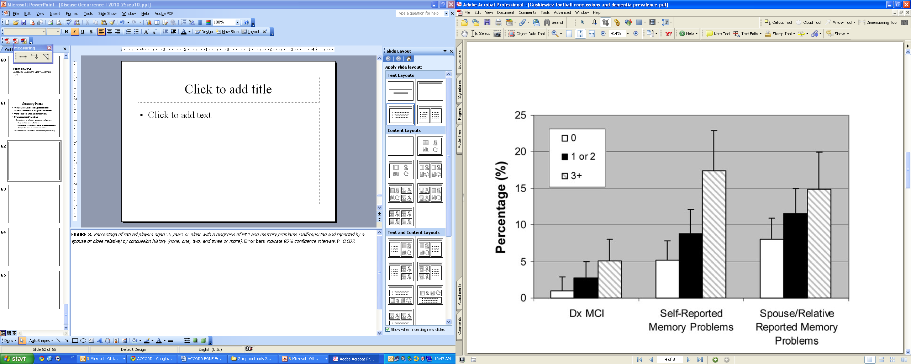
Point Prevalence: Concussion and Cognitive Impairment in Retired Football Players
No. of concussions
Diagnosis of Mild Cognitive Impairment
FIGURE 3. Percentage of retired players aged 50 years or older with a diagnosis of MCI and memory problems (self-reported and reported by a
spouse or close relative) by concussion history (none, one, two, and three or more). Error bars indicate 95% confidence intervals.
Guskiewicz et al. Neurosurgery 2005
Notes:
This is a general health questionnaire completed by 2552 retired professional football players. The participants had an average playing career of 6.6 years. Dx stands for diagnosis and MCI for mild cognitive impairment (MCI). Retired players with three or more reported concussions had a five-fold higher prevalence of MCI diagnosis and a three-fold higher prevalence of reported significant memory problems compared with retirees without a history of concussion.
This is an example of a study using point prevalence.

Slide 10
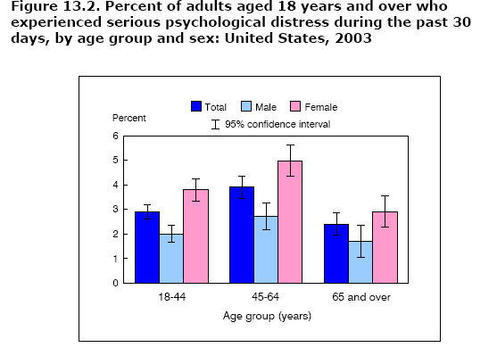
Period Prevalence: National Health Interview Survey (NHIS)
Notes:
The National Health Interview Survey is carried out every year (so it doesn’t take as long as the NHANES), but again the point is not how long it takes to conduct the NHIS but the time period the measurement represents in a given participant. In this case, the measurement of disease prevalence is for a specified time period, 30 days, so it is an example of period prevalence, albeit not a particularly long period. The same question might have been asked for the past six months and a different prevalence estimate would have been obtained. The point prevalence question would have been whether the person was experiencing serious psychological distress at the time the interview was conducted, a proportion that could not be greater and presumably would have been lower than reported for the 30-day period. Here period prevalence might have served a role in reducing bias if the study directors thought that persons experiencing serious psychological distress at the moment would be less likely to answer the question truthfully (or answer it at all).
One can begin to see how a very short-lived condition will have different prevalence depending on whether point or period prevalence is being examined and on the length of the time period if period prevalence is being examined.

Slide 11
How to report prevalence
Prevalence should always be stated as a number between 0 and 1 (e.g., 0.03) or as a percentage (e.g., 3%):
  “The prevalence of smoking was 15% (95% confidence interval: 12 to 18%) amongst teenagers in the U.S. in 2015.”
  “We found that 24% (95% CI: 20 to 28%) of adults had symptoms of fatigue at least once in the past 3 months”
Avoid statements such as:
  “Prevalence was 0.13 per 1000 persons”
  Easily confused with a report of incidence (i.e., a rate)
  Prefer: “Prevalence was 0.013% or 0.00013”
Notes:
Being able to clearly communicate findings from clinical/epidemiologic research to non-scientific audiences is a major task for a researcher. We will spend a lot of time on this in this class.
When describing prevalence, it is often useful to incorporate the word “prevalence”. It makes it unambiguous what is being referred to. When referring to period prevalence, however, it is often better to spell out exactly what was done; very few laypersons know what period prevalence is.

Slide 12
Proposing prevalence objectives in a grant
Descriptive objectives are often the lead off (first specific aim) in grant proposals
Level of language sophistication in a grant should typically be higher than when reporting results
  Reviewers will expect a certain amount of scientific terms and assess your language to evaluate your know-how
Yet, best to be sufficiently clear in a grant for a general reviewer to comprehend (best to know your audience!)
  “We will estimate the prevalence of cigarette or pipe smoking amongst teenagers in the U.S. in 2015.”
  “We will determine the period prevalence, over the prior year, of self-reported symptoms of fatigue amongst adults in Ohio.”
Notes:
Likewise, researchers often need to communication prevalence-related objectives in grant proposals. Descriptive objectives are often the initial specific aims (the lead off) in grant applications.

Slide 13
Incidence
Notes:
Prevalence is relatively straightforward, and thus we will spend most of our time focusing on a harder concept – incidence.

Slide 14
The Three Elements in Measures of Disease Incidence
E = an outcome event = a binary outcome
    (e.g., onset of disease)
N = number of at-risk persons in the population under study
T = time period during which the events are observed
Notes:
Turning now to incidence, understanding the 3 elements of incidence is essential to understanding the different measures we will be discussing. These elements are: 1) the outcome/disease event, 2) a number of persons at risk, and 3) a time period during which the outcome events are observed. If you always pay close attention to how these 3 elements are being used (or not used), you should have no trouble in understanding what kind of incidence measure is being presented. Again, the binary event we are generally examining is the occurrence of a disease (or perhaps death), but this framework applies to measuring incidence in any study with a binary outcome (such as successfully quitting smoking).
(Note that your reading (Tapia Granados 1997) presents a similar concept but defines “e” as population under study and “n” as outcome events.)
Not all reports of disease occurrence you encounter in the literature will explicitly identify these three elements for you. It is necessary in those cases to look closely at what is being reported and uncover any elements that are not made explicit. We will look at some examples in the slides that follow.

Slide 15
Two Measures of Incidence
Proportion of at-risk individuals who experience the event in a defined time period (E/N during some time T)
  = cumulative incidence
  = incidence proportion
  = risk
Number of events divided by the amount of at-risk person-time observed (E/NT)
= incidence rate
= incidence density
= rate
(Importantly, this is not a proportion)
Notes:
There are two different measures of incidence. Both are perfectly valid measures of incidence as both include E, N, and T. We will be exploring some of the properties of these two measures, the assumptions they make, and how they are used in research. Both measures account for the variation in time that participants are observed, but they do so in different ways.
The first measure is the proportion of individuals who experience an event in a defined time period. There are many terms for this, but we prefer “cumulative incidence” for this construct as it is the most descriptive. The terms “incidence proportion” and “risk” are also acceptable. Even our preferred term “cumulative incidence” has some ambiguity. The term has also been used by Breslow and Day (1980) to describe what is more commonly known as the cumulative hazard. Once again, the reader of any research needs to be very aware of what is being presented by the authors and not just assume a common interpretation of these terms for incidence.
The second measure describes the number of events that arise from some person-time of at-risk observation. The is E/NT. This is somewhat less intuitive to naïve observers. We prefer the term “incidence rate” to describe this construct but “incidence density” and “rate” are also fine. Please note that this is not a proportion.

Slide 16
Cumulative Incidence – Example
Definition: The proportion of at-risk individuals who experience the event in a defined time period (E/N during some time T) = cumulative incidence
Example: diabetic medications and bone fracture:
  “The cumulative incidence of a first fracture among women reached 15% at 5 years with rosiglitazone, 7.3% with metformin, and 7.7% with glyburide.”
Notes:
If the measure is a proportion of persons, it is unitless and it has to vary between 0 and 1. In other words, it is a probability. But because it is unitless, the time element T has to be explicitly added; for example, it might the proportion of persons diagnosed during a five-year period. This is a common error in the literature: the time period for cumulative incidence is often missing. If the time horizon is missing, the reader is left guessing: Is it 6 months, 1 year, 5 years, other?
In this example from the ADOPT trial, the investigators have calculated cumulative incidence over 5 years for first fracture in 3 different groups of the women participating in the trial: those assigned to rosiglitazone, metformin and glyburide. The incidence is reported as a proportion without units. This example is a randomized trial, but cumulative incidence can, of course, be reported in a similar fashion for any fixed cohort study. (Kahn et al. Diabetes Care 31:845-51. 2008 )

Slide 17
Incidence Rate – Example
Definition: The number of events divided by the amount of at-risk person-time observed (E/NT) = incidence rate or density (not a proportion)
Same example, diabetic medications and fracture, now presented as incidence rates:
  “The incidence of a first fracture among women was 2.74 per 100 person-years with rosiglitazone, 1.54 per 100 person-years with metformin, and 1.29 per 100 person-years with glyburide.”
Notes:
If the measure is a number of events divided by some collective at-risk period of time among individuals, it is not a proportion (not a probability) because the denominator multiplies persons by time (100 persons followed for 2 years gives the same denominator as 200 persons followed for 1 year). In other words, the denominator is not the number of discrete people. The value of the expression will change with the denominator and the units of the denominator are arbitrary. That is, if an incidence is presented as events per person-years, those person-years could be converted to person-months, or person-days, or even person-minutes with corresponding changes in the incidence rate (even though they all mean the same thing). And none of those fractions is constrained to be between 0 and 1—they can exceed 1. The concept of an incidence rate is not intuitive to everyone at first glance, but we will spend much more time on it later.
The example is from the same ADOPT trial, but now the fracture results are presented as incidence rates. The incidence rates includes units, in this case number of first fractures per 100 person-years. (Kahn et al. Diabetes Care 31:845-51. 2008 )

Slide 18
Counterintuitive Idea #2
The denominator for incidence does not have to be a count of individual persons
Incidence rate, with person-time in the denominator, is in fact the most fundamental measure of disease occurrence. More on this next week.
Notes:
We have just introduced the idea of a measure that uses the product of time and persons as the denominator, a concept called person-time. We will explore person-time rates in more depth next week, but, for now, it is sufficient to note that this at first seem a somewhat counterintuitive idea. As we will try to show later on, however, it is the most fundamental measure of disease occurrence.

Slide 19
Disease Occurrence Measures:
A Confusion of Terms
Terminology is not standardized and is used carelessly even by those who know better
Key to understanding measures is to pay attention to how the 3 elements of number of events (E), number of persons at risk (N), and time (T) are used
Even the basic difference between prevalence and incidence is often ignored
Notes:
We are presenting terms for the types of incidence that allow for precise and efficient communication amongst knowledgeable scientists, we will adhere to these terms for the rest of course. We think they make the distinctions that the best epidemiological writing on the subject make and that they should be preferred. Precise use of this terminology allows us to speak to each other succinctly and unambiguously, avoid misunderstandings, and get the right answers in our research projects. Unfortunately, we need to warn you that in reading the clinical and epidemiologic research literature you will often find these terms used in other ways and often used without making distinctions that we think are important. This extends all the way to ignoring the basic distinction between prevalence and incidence.

Slide 20
Incidence or Prevalence?
HIV/AIDS infection rates drop in Uganda
KAMPALA, Sept. 10 (Kyodo) - Infection rates of the HIV/AIDS epidemic among Ugandan men, women and children dropped to 6.1% this year from 6.8% a year earlier, an official report shows…
The report says the average rate of infection for urban areas fell from 10.9% to 8.7%. In rural areas, the average was 4.2%, not much different from the 4.3% average a year earlier.
Notes:
Use of the word “rate” should imply that incidence is being measured, but this is not always the case in practice. Reports like that cited above are common. What is reported as an infection rate is not, in fact, incidence but prevalence. It is not immediately clear that the figures of 6.1% and 6.8% are not incidence because it might be possible (although unlikely) to have one-year incidence rates (e.g., 6 to 10 per 100 person-years) of HIV infection that high in Africa. However, one would have to be an expert in this subject matter to know this.
In fact, all of the figures are prevalences.
Since this is a news service report, it isn’t clear whether the originating researchers used the language of infection rates or whether that was introduced by the reporters. In any case, you will commonly see this same inappropriate use of rate in clinical and epidemiologic research literature.

Slide 21
“Rate” should not be used to describe prevalence
Although you may encounter “prevalence rate,” including in our text, rate should be reserved for measuring incidence.
In general, a rate is a change in one measure with respect to change in a second
From Szklo & Nieto text:
Notes:
We want to re-iterate: Don’t use rate to describe prevalence. Unfortunately, you will see others do this, including the Szklo and Nieto text, but it is technically wrong and only serves to cause problems.
Rate is a mathematical concept that has broad application in many fields of science. Most generally, a rate is a change in one measure with respect to a change in a second measure. Although we are using rate for reporting the change in a measure of disease occurrence with respect to a change in time, it can be change in one measure with respect to a second measure which is not necessarily time. For example, traffic fatalities per passenger-mile traveled is a rate. Mathematically, a rate is the first derivative of a specific function, and it is usually called the hazard of a function.

Slide 22
Measures that are sometimes loosely called incidence
Count of the number of events (E) in a vague time period
  e.g., there were 84 traffic fatalities during the holidays in California
Count of the number of events during some specific time period (E/T)
  e.g., traffic accidents have averaged 50 per week during the past year in San Francisco
Neither explicitly includes the number of persons (N at risk) giving rise to the events
  Both would suffer if one had to make an intelligent comparison of them to another measure, say in another city or state.
Notes:
A comprehensive measure of incidence requires that we know how many events occurred (E) during what time period (T) among how many persons (N) at risk. Some other measures are sometimes loosely called incidence, but they fall short of being highly useful.
In the first example, the “holidays” may refer to a specific 3-day holiday weekend, thus giving the implied time period but this is not made explicit (maybe it also includes an extra day that many people took off work). Furthermore, we do not know exactly how many people were at risk.
Traffic accidents per week has a specific time element and also has an implied number of persons, but again we are not told what that number is. Making guesses about N and T can be reasonable depending upon the context, but the point we are making is that all three E, N, and T need to be accounted for, preferably explicitly, in order to have a true measure of incidence. Having all three would be necessary if we wanted to make an intelligent comparison of any of these measures to another city or state that had a different population size.

Slide 23
CDC: Chickenpox rates drop in four states as inoculations become common
SF Chronicle, Thursday, September 18, 2003
The number of chickenpox cases in four states dropped more than 75 percent as inoculations became more common in the last decade, according to a federal study released Thursday.
The total number of cases in Illinois, Michigan, Texas and West Virginia dropped from about 102,200 in 1990 to about 24,500 in 2001, the Centers for Disease Control and Prevention said. At the same time, the percentage of infants receiving chickenpox shots rose from less than 9 percent in 1996 to as much as 83 percent in 2001, the CDC said.
What additional data would provide more useful estimate of incidence?
Notes:
In this example, the number of events (E) is given, the time period (T) is described (two one-year periods – 1990 and 2001), and a geographic area is specified (four states). The story says that the number of cases dropped more than 75% and that is perfectly accurate, but the headline says that rates dropped. What is missing in order to compare rates between these two one-year time periods is the number of persons living in those four states in the two time periods. Since the two one-year incidence periods are 11 years apart, it is a reasonable bet that the population of the four states changed during 11 years. A demographer would know much child population changed and could do the necessary math him/herself but anyone else would not know how population changed (short of having to look it up on the internet). If the child population increased a lot, then the difference in incidence rates between the two years is even greater than the change in the number of cases.
So the press release is probably not qualitatively incorrect (unless those 4 states lost most of their population, which we know is not the case), but it would have been even more informative if incidence rates rather than the counts had been reported. This is information knowable from U.S. census data— and a good use of census data.
This type of reporting might be OK for newspapers, but it is not good enough for science.

Slide 24
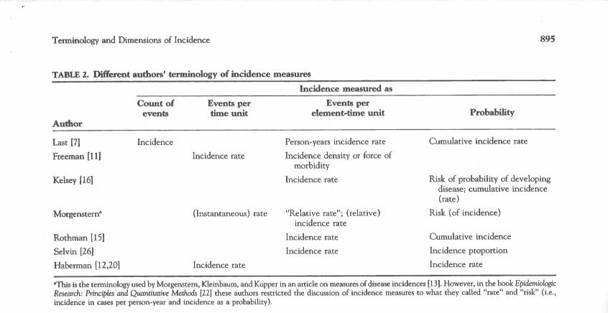
E
E/T
E/NT
E/N in time T
From Tapia Granados J Clin Epi 1997
Notes:
Here is an example of the confusion in terminology, which is modified from Tapia Granados (1997). We have added the E’s, N’s, and T’s to this table in order to give it some order and put it into the context we are using in class.
The two measures of incidence that include E, N and T are identified in the last two columns.
What is true is that E/NT is being referred to by most authors as a rate or density. We suspect that because a rate is a sophisticated concept anyone who can actually calculate it will be sophisticated enough to give it the correct name. On the other hand, the construct of E/N over time T is called many different things by authors including rate.
We favor the terminology used here by Rothman, who calls E/NT incidence rate and E/N cumulative incidence. These terms make the most sense in that they are aptly descriptive, which we will go on to explain. We are also fine with the term incidence proportion as being synonymous with cumulative incidence.

Slide 25
Two Measures of Incidence:
Our Preferred Terms
Cumulative incidence
Incidence rate
Notes:
Just, to be clear, we will be using these two terms.

Slide 26
Disease Incidence Key Concept
Numerator is always the number of new events (E) (aka “incident events”) in a time period in both incidence measures
Examine the denominator (persons or person-time) to determine the type of incidence measure
Notes:
In both measures of incidence, the numerator is E, the number of new events in the time period of interest. These new events are also termed “incident” events. To distinguish cumulative incidence from incidence rate, look at whether the denominator is a number of discrete persons or person-time. If the value is a cumulative incidence, the authors should have given the duration of time for which it was calculated (e.g., 43% at 3 years). If the estimate is described as events “per person-years” (or person-any time period), an incidence rate is being reported.

Slide 27
Cumulative Incidence
Perhaps most intuitive measure of incidence since it is just proportion of those observed who got the disease over a specific time period
Proportion=probability=risk
Estimated with 1 of 4 techniques
  directly, as a simple proportion
  or, more typically, using one of these estimators:
    Kaplan-Meier
    Life-table
    Aalen-Johansen [next week]
See Extra Slides for definition of “estimator”
Notes:
Both measures of incidence, cumulative incidence and incidence rate, are valid. They make some different assumptions and are associated with different analytic techniques, but both are very useful. Cumulative incidence is probably the most intuitive because it is just the proportion of persons who got the outcome in question in some specific time period. It is easy to understand but, again, it only has meaning when a time period is attached to it. For example, the probability of cancer in a one-year period is quite different from the lifetime probability of cancer.
Incidence based on a person-time denominator is a little less intuitive, but it is actually the more fundamental measure of disease occurrence. We will return to incidence rate using person-time next week. For now, we will spend the rest of this session on understanding the cumulative incidence measure and the methods used to estimate it.
Although cumulative incidence is a proportion, it is rarely the case we can calculate it directly by dividing one number by another. In practice, for reasons we will state in a moment, it is not often the case that we can calculate it just simply by a numerator divided by a denominator. In practice, there are 3 techniques which we use in our research studies to estimate cumulative incidence: the Kaplan-Meier estimator, the life-table estimator, and the Aalen-Johansen estimator.
Note that we are calling these entities estimators because we are estimating incidence in some study base (also called a target population) by working with a sample of people from the underlying population. See the Extra Slides for more on this.

Slide 28
Calculating Cumulative Incidence: Simple Proportion
With complete and equal follow-up of each subject, cumulative incidence is just number of events (E) divided by the number of persons (N) = E/N (i.e., a simple proportion) in a given time period
Prototypical example
  Outbreak investigations (e.g., of a gastrointestinal illness) with complete follow-up on a cohort of persons who were identified at the beginning of the epidemic
  (Unfortunately, this is often called an “attack rate”!)
Notes:
The simplest situation in which to calculate cumulative incidence is if all of the persons at risk for the outcome in question are followed for the same length of time. We call this complete and equal follow-up. In such instances, the cumulative incidence is simply the total number of events divided by the total number of persons. In long term cohort studies this virtually never happens for reasons we will explain. The prototypical example for this is an outbreak investigation, such as a CDC investigation of an outbreak of gastroenteritis, where time zero is identified in a fixed cohort and period of observation is short. It is so short that no one has a chance to become lost to follow-up or have a competing event.
Unfortunately and paradoxically, the term “attack rate” has traditionally been used to describe the proportion of persons who develop illness in these type of short term complete follow-up studies. As we have been arguing, this is an incorrect use of “rate,” since the denominator is just the number of persons investigated; it is not a rate. This is another example of how terminology in the literature can be confusing.

Slide 29
Calculating incidence with a simple proportion:
Fixed cohort with complete and equal follow-up
On June 24, 1996, the Livingston County (New York) Department of Health (LCDOH) was notified of a cluster of diarrheal illness following a party on June 22…. Plesiomonas shigelloides and Salmonella serotype Hartford were identified as the cause of the outbreak… 98 attendees were interviewed. 56 (57%) of 98 respondents developed illnesses meeting the case definition. MMWR, May 22, 1998
57% is a cumulative incidence
Optimal terminology: The cumulative incidence of diarrheal illness by XX days after party attendance was 57%.
Notes:
Here is an example of such a CDC outbreak investigation. What happened here was that a set of people developed diarrheal illness tightly bunched in time and it was soon determined that they all attended the same party. Thus, the cohort of all persons who attended the party was the study base when researchers from the CDC decided to study the problem; it is a fixed cohort. A total of 56 (57%) of 98 persons in this fixed cohort developed diarrheal illnesses meeting the case definition; 57% is a cumulative incidence.
Stated most optimally, the cumulative incidence of diarrheal illness by xx days following the party was 57% . No time period is explicitly mentioned, but we know from other sources this is cumulative incidence over a few days following the party. Complete follow-up is possible because the time period is very short.
A similar situation could be found in a clinical trial where all participants are followed for the same length of time and there are no losses to follow-up. A very well run clinical trial with relatively short follow-up time could achieve this.

Slide 30
Complete and equal follow-up in a cohort study
= event
Time (e.g., 7 days )
Notes:
This is what complete and equal follow-up looks like schematically.

Slide 31
Cumulative incidence with differing follow-up times
In most cohort studies (or trials), participants have different follow-up times -- for a variety of reasons.
Therefore, use of simple proportions to estimate incidence does not work
Next slides identify common reasons for differing follow-up times.
Notes:
31
Having complete and equal follow-up on all subjects is the exception to the norm.

Slide 32
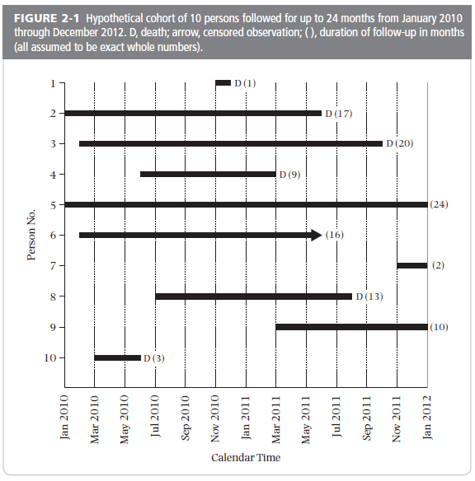
Follow-up times differ: Staggered entry
D = death
Notes:
This is the hypothetical example of a 10 person cohort study given in your text book. This illustrates one of the ways that follow-up time can differ among individual participants in a cohort study.
Having identical and complete follow-up on all subjects is the exception to the norm. A typical cohort study may take months to years to recruit all of the participants. Since many observational studies have a single ending date, subjects enrolled at the end of the recruiting process are going to have less follow-up time in the study than those enrolled at the beginning, even without considering that participants drop out or die when death is not the outcome (this a competing event).
In this particular example, all-cause mortality is the outcome so we are not concerned with competing events.
32

Slide 33
Follow-up times differ: Censoring (lost to follow-up and administrative)
= loss to follow-up
D = death
Notes:
This example also introduces the concept of censoring. Here the times persons enter and leave the cohort are being shown on a calendar time scale. The solid black bars represent the length of time each person was followed in the study. D = death, which is the event of interest. Of the participants who did not die during the follow-up time, participant #6 (in green) was lost to follow-up (or perhaps refused to participate further in the study). This person is identified with an arrow; this is called a “censored observation.” It is referred to as censoring because whatever happens after this date is suppressed from the investigator; the rest of the story on this participant is censored from the investigator’s view.
It is actually the case that all of those who did not die during follow-up are said to be censored. Thus, participants #5, #7, and #9 (in red) continued until the study was ended without the event, and they are defined as what is often called administrative censoring. Administrative means that the reason follow-up ended was that the study ended. In terms of the statistical handling of the data for analysis it doesn’t matter why a person is censored. Each person in a cohort is considered to either have the event or be censored. The reason for censoring will matter when considering threats to validity and possible bias in the study results.
33

Slide 34
Two Ways Censoring Occurs
Loss to follow-up
  Also known as “drop-out”
  Participants might inform investigators of intentions
    no longer interested in participating, or
    moving away and can no longer practically participate
  Or, they may not inform investigators
    Simply stop coming to study visits and cannot be found
  Although all above mechanisms are handled the same analytically, it is worth recording the mechanism
2) End of study (participant alive and hasn’t experienced outcome) = Administrative Censoring
Notes:
Therefore, there are two ways that censoring can occur.
The first is called lost to follow-up or drop-out. Participants might volitionally inform investigators of their intent to drop out or they may not.
The second is called administrative censoring. Follow-up ends with the period of study observation, and subjects who are still being followed at that time but have not been diagnosed with the outcome (or experienced a competing event if outcome isn’t mortality) are said to be administratively censored as of the last date of follow-up. They therefore contribute the entire amount of their time in the study to the disease free follow-up time. This time may not be exactly the same for all administratively censored subjects because they may not all have been enrolled on the same date. In the previous figure from the text book, there are actually 3 persons who are administratively censored, subjects 5, 7, and 9. Subject 7 only has 1 month of follow-up because he or she was enrolled late in the cohort, but because follow-up was ended only by the end of the study, that person was administratively censored, just as subject 5, who was enrolled at the earliest possible date, was administratively censored.
Thus, there are two ways of being censored: a) loss to follow-up (aka drop-out); and b) administrative censoring

Slide 35
Cumulative incidence with differing follow-up times
In most cohort studies, participants have different follow-up times because of at least one of these possible reasons:
Staggered entry with fixed ending time
Loss to follow-up (aka drop-out)
Competing events
Results in censoring
Notes:
35
To summarize, these are several ways that participants can have different follow-up times in a cohort study. Participants may start at different times in the accrual process of the study. If the end date for all participants is the same, those who start later will have less follow-up time. Or, some participants may have less follow-up time because they drop out before the end of the study. The final mechanism is the occurrence of a competing event, which we defined last week. Note that we do not have to consider competing events in this particular example study since our outcome is all-cause mortality, but in studies with another outcome, competing events can also contribute to differing follow-up times.

Slide 36
Follow-up times differ: Censoring (lost to follow-up and administrative)
= loss to follow-up
D = death
Can we use E/N to calculate cumulative incidence in this situation?
Notes:
We cannot use a simple proportion (E/N) to calculate incidence in this situation. This is because we do not know how to handle instances like person #6 or #7, others who did not have the event but also were not followed for the entire possible length of the study.
Later, we are going to discuss how to account for these different amounts of follow-up time when estimating incidence in a cohort study. These methods can account for different amounts of time followed, but the only way that these methods can give valid answers is if we assume that losses are random, i.e. not related to the outcome. In other words, we have to assume that the rate of the event under study in those who do not have complete follow-up is the same as the rate as those who stay in the study. These methods can’t overcome problems of bias when losses to follow-up are not random. Having individuals who are lost to follow-up is a major threat to the validity of conclusions about incidence. As we stressed last time, losses to follow-up are a primary problem threatening the validity of cohort studies. This includes the validity of randomized trials which can be viewed as cohort studies in which investigators have assigned exposure.
36

Slide 37
Example: Calculating Cumulative Incidence in Face of Differing Follow-up Times
Previous example: “The cumulative incidence of a first fracture reached 15.1% at 5 years with rosiglitazone, 7.3% with metformin, and 7.7% with glyburide.”
  There were different follow-up times and these %’s take this into account. We’ll see how to do this in the next slides
“Among the 1,840 women, 111 reported a first fracture: 60 (9.3%) of those treated with rosiglitazone, 30 (5.1%) of those treated with metformin, and 21 (3.5%) of those treated with glyburide.”
  60 fractures/645 women assigned to rosiglitazone = 9.3%. Avoid reporting a simple % if there are differing follow-up times; the % has no meaningful epidemiologic interpretation. No. of fractures (e.g., 60) is useful, but % is not.
Notes:
Returning to our example from the ADOPT trial, the cumulative incidence reported took into account the follow-up time for participants in the trial. We will talk about how to do this in a minute.
The second bullet is a description from the paper on the occurrence of fracture in each of the treatment groups. Providing the number of cases is informative, but adding the proportion (e.g., 9.3% of the rosiglitazone group) is not if follow-up is not complete and equal on everyone. The % has no meaningful epidemiologic interpretation unless we know the time horizon. Note that this proportion is different from the cumulative incidence (15.1%) for this treatment group. The raw proportion does not take follow-up time into account and hence can be very different than the true cumulative incidence, when calculated properly. Avoid reporting such raw %’s if there is differing follow-up times.

Slide 38
Cumulative incidence with differing follow-up times
With different follow-up time, use of simple proportions to estimate incidence does not work
That simple proportions cannot be used is the basis of the field called survival analysis
  Pertains not just to survival after a diagnosis but rather to the occurrence of any incident event
  We will learn the basics of survival analysis
Notes:
38
Having identical and complete follow-up on all subjects is the exception to the norm.
When follow-up times are different, other methods are needed and this is the basis of the field survival analysis. This is also sometimes called failure time analysis or time-to-event analysis. Time-to-event analysis is perhaps the best name because indeed this form of analysis is not just for survival after a disease diagnosis. It can be used for the occurrence of any discrete event, be it a favorable or unfavorable occurrence.

Slide 39
Calculating cumulative incidence with differing follow-up times (i.e., in the presence of censoring)
The Problem: Since rarely have equal follow-up on everyone, we can’t just divide number of events by the number who were initially at risk
The Solution: Kaplan-Meier and life table estimation are two common methods devised to calculate cumulative incidence among persons with differing amounts of follow-up time (i.e., censoring)
Notes:
Since cumulative incidence has to be defined as per some time period, it is incorrect to say, when follow-up times vary by individual, that the cumulative incidence in a cohort study that had up to, say, 3 years for the longest followed individual is simply the proportion with the diagnosis divided by the number enrolled in the study. So the problem is how to calculate cumulative incidence when persons are followed for different times.
The two most common methods of solving this problem of calculating the cumulative incidence for different amounts of follow-up are called the Kaplan-Meier and the life table method. The life table approach is much older but is uncommonly seen in the medical literature these days because the Kaplan-Meier method has become the standard. We will spend the majority of our discussion on the Kaplan-Meier method although for large datasets life tables give the same answer. The textbook illustration of life tables is a bit misleading because, for the sake of showing the computations, the authors use a small number of observations that results in quite different estimates from the Kaplan-Meier method. The main difference is that life tables use uniform time periods in which to estimate the proportion who experience the outcome whereas the Kaplan-Meier method looks at time periods defined by when an outcome event occurs in the study population. For sizable data sets, these two approaches give virtually identical answers.

Slide 40
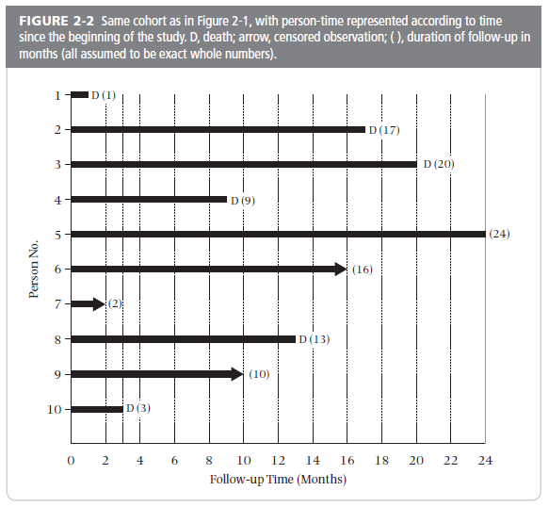
Change time scale to “follow-up” time
Notes:
To resolve the problem of different starting times, we start by “shifting all the starting time to the left.” For the analysis, each person is going to be started at the same time zero. This graph from your text shows how the data look when all of the different calendar starting times are reassigned the same follow-up starting time. Note that the time axis is now follow-up time rather than calendar time. This approach of shifting all starting time to the left, i.e., use of follow-up time as the scale, rather than calendar time, can be performed in both the Kaplan-Meier and life table methods.
By assigning everyone the same starting time you might be, depending upon the study, combining persons who started in very different calendar time periods. If the incidence of the outcome under study varies according to calendar time, this is called a “secular” trend. Whether or not it is a wise thing to be combining persons who are experiencing their observation in such different calendar time periods will depend upon the research question, but keep in mind that the final answer cannot be said to pertain to any individual in the cohort, from any calendar period. The final answer is simply an average of the different calendar time periods. The only way the answer you get pertains to all individuals is if you assume no secular trends.
40

Slide 41
Kaplan-Meier estimator of cumulative incidence
Also called “product limit estimator”. Original article is in the optional reading.
Key innovation: Calculates the cumulative probability of not having the event (i.e., of “survival”) across discrete periods of time
Analysis is performed by dividing the follow-up time into discrete periods
  calculate conditional probability of “survival” at each event time
Requires date that event (outcome) occurred on each individual or date last observed (i.e., date censored)
Notes:
The Kaplan-Meier (KM) estimator is also called the “product limit estimator.” It was first described in 1958. The original article is included in the optional reading for the course. It’s one of the most cited biomedical articles of all time. Kaplan EL, Meier P. Nonparametric estimation from incomplete observations. J Am Stat Assoc 1958;53:457-81.
The essence and key innovation of the KM method is breaking up the period of observation into little discrete pieces. The little pieces are defined by the dates in which the outcomes under study occurred. The proportion not developing the outcome (which is called “survival” in the parlance of survival analysis) is calculated for each discrete piece and the overall cumulative probability of not developing the outcome (i.e. “surviving the occurrence of the outcome”) at any point is calculated by multiplying together the individual probabilities of not developing the outcome. It seems like a simple concept now, but it was innovative in 1958 and became the most common method in human subject-based research to estimate disease incidence.
The process starts by assigning each subject a start time (a time zero, which we did in the last slide) and an end date, which can either be the date in which he/she developed the event of interest or the last known date he was without the event of interest (i.e., the date he was censored). Every member of the cohort needs to have these dates in order to be included in the analysis. Note: the date last seen without the event can simply be the end of the study, in the case of administrative censoring.

Slide 42
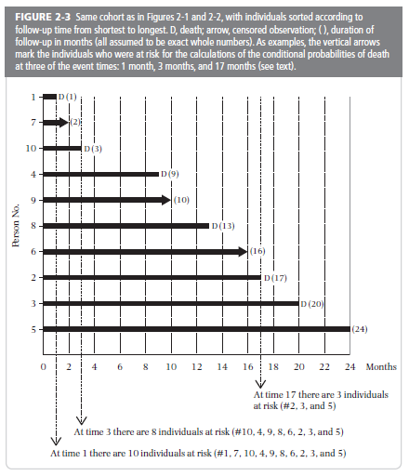
To start:
Sort the follow-up times from shortest to longest
Notes:
To perform the Kaplan-Meier estimation, conceptually think of ordering the previous table of participant experience, already “shifted to the left,” by order of follow-up time.
42

Slide 43
Calculating Cumulative Probability
Probability theory: Probability of 2 independent events occurring is the product of the probabilities for each occurring alone
  If event 1 occurs with probability 1/6 and event 2 with probability 1/2, then the probability of both event 1 and 2 occurring = 1/6 x 1/2 = 1/12
Kaplan-Meier estimator takes advantage of this theory to get what we want, which is cumulative incidence of an event:
  Achieves this by casting the problem as determining the probability of not having the event over a period of time
Notes:
In order to calculate cumulative incidence using the Kaplan-Meier estimator, you first need to understand or least accept on faith the following aspect of probability therapy. It is a fundamental theorem of probability that the cumulative probability of two independent events is the product of their individual probabilities. So the probability of flipping two heads in a row with a fair coin is ½ x ½ = ¼ . Or, if the probability of event 1 is 1/6 and the probability of event 2 is ½, then the probability of event 1 and 2 occurring jointly is 1/6 x ½ = 1/12.
How can we take advantage of this theory to get what we want, which is the cumulative incidence of some event? The Kaplan-Meier estimator does it by casting the incidence problem as determining the probability of not having the event over a period of time.

Slide 44
Calculating Cumulative Incidence with Kaplan-Meier Approach
Table 2-3. Calculation of Kaplan-Meier Survival Estimates
Time (mos) | Individuals at Risk | Number of Events | Conditional Probability of the Event | Conditional Probability of Survival | Cumulative Probability of Survival
 | n | d | q = d/n | p = 1-q | S(t)
1 | 10 | 1 | 1/10=0.10 | 0.90 | 0.90
Notes:
Let’s see how this use of cumulative probability is applied in the K-M technique. This uses the example in the Szklo and Nieto textbook. The key is keeping straight the event and the complement, not having the event. In our example, the event, deaths, occurred at 6 different times during follow-up, so there are 6 discrete pieces of time (remember, the event could be death or a disease diagnosis or some other binary outcome). The probability of the event is the number of deaths at each point in time (just 1 here, but it is possible to have more than 1 at the same time) divided by the number at risk in the cohort during the time interval in question. So between time 0 and 1 month of follow-up there was a death and at that time all 10 original members of the cohort were still in follow-up. The probability of death was 1/10 and the probability of not having the event, which is survival in the parlance of survival analysis, was 1 – 1/10 = 9/10.
44

Slide 45
Calculating Cumulative Incidence with Kaplan-Meier Approach
Table 2-3. Calculation of Kaplan-Meier Survival Estimates
Time (mos) | Individuals at Risk | Number of Events | Conditional Probability of the Event | Conditional Probability of Survival | Cumulative Probability of Survival
 | n | d | q = d/n | p = 1-q | S(t)
1 | 10 | 1 | 1/10=0.10 | 0.90 | 0.90
2 | 9 | 0 | 0/9=0 | 1 | 0.90
S(2) = 0.9 x 1 = 0.9
Notes:
This illustrates why it is not necessary to calculate a probability of survival when a person is censored, rather than experiencing an event. Here, 1 person was censored at 2 months. The probability of having the event during the interval is 0, and the probability of survival for the 9 individuals is 1. We calculate the cumulative probability of survival by multiplying the conditional probabilities of survival, and 0.9 x 1 still equals 0.9. In the next slides, we will only calculate conditional probabilities when an event occurs, ignoring the times when someone is censored.
45

Slide 46
Calculating Cumulative Incidence with Kaplan-Meier Approach
Table 2-3. Calculation of Kaplan-Meier Survival Estimates
Time (mos) | Individuals at Risk | Number of Events | Conditional Probability of the Event | Conditional Probability of Survival | Cumulative Probability of Survival
 | n | d | q = d/n | p = 1-q | S(t)
1 | 10 | 1 | 1/10=0.10 | 0.90 | 0.90
3 | 8 | 1 | 1/8=0.125 | 0.875 | 0.788
S(3) = 0.90 x 0.875 = 0.788
Notes:
When the second death occurs at 3 months of follow-up, only 8 persons are still in follow-up because 1 person was lost to follow-up at 2 months of follow-up. Therefore, the probability of death in the time period from the first event until the second event was 1/8=0.125, the probability of survival (not having the event) was 1-0.125 = 0.875, and the cumulative probability of survival (i.e. not having the event) through 3 months is the probability of not having the event in the first time period times the probability of not having the event in the second time period. It is 0.9 x 0.875 = 0.788.
46

Slide 47
Calculating Cumulative Incidence with Kaplan-Meier Approach
Table 2-3. Calculation of Kaplan-Meier Survival Estimates
Time (mos) | Individuals at Risk | Number of Events | Conditional Probability of the Event | Conditional Probability of Survival | Cumulative Probability of Survival
 | n | d | q = d/n | p = 1-q | S(t)
1 | 10 | 1 | 1/10=0.100 | 0.900 | 0.900
3 | 8 | 1 | 1/8=0.125 | 0.875 | 0.788
9 | 7 | 1 | 1/7 = 0.143 | 0.857 | 0.675
13 | 5 | 1 | 1/5 = 0.200 | 0.800 | 0.540
17 | 3 | 1 | 1/3 = 0.333 | 0.667 | 0.360
20 | 2 | 1 | 1/2 = 0.500 | 0.500 | 0.180
24 | 1 | 0 | 0 | 1 | 0.180
Cumulative probability of survival = S(24) = 0.9 x 0.875 x 0.857 x 0.8 x 0.667 x 0.500 x 1 = 0.180
But, we want cumulative incidence, the cumulative probability of the event = 1- S(24) = 1 – 0.180 = 0.820
Notes:
We continue this process, calculating conditional probability of event and of survival at each time an event occurs until we have included all events (6 in this example). The cumulative probability of survival (0.180) is the product of the individual conditional probabilities of survival, as shown on the slide.
Now, we have the cumulative probability of survival, but what we really want is the cumulative probability of the outcome. We obtain that by subtracting S(t) from 1. In this example, 1 – 0.180 = 0.820 is the cumulative probability of death by 24 months.
47

Slide 48
Kaplan-Meier:
Cumulative Incidence of the Outcome
Common error: Cannot calculate this by multiplying each event probability (that would be the probability of repeating the event)
  (in our example, 0.100 x 0.125 x 0.143 x 0.200 x 0.333 x 0.500 = 0.0000595)
It is a proportion, so time is not intrinsic to the units. Time period has to be specified for number to be interpretable.
In this example, 0.82 is the 2 year cumulative incidence.
Notes:
The cumulative probability of the event is calculated with the survival probabilities because it is only survival (not having the event) that can happen repeatedly. To use the probability of the event each time you would be calculating a probability of repeated diagnoses, which is not what you want. You don’t want to estimate the probability of repeatedly having death! This makes no sense. Instead, to get the cumulative probability of the event, do the following. At the end of multiplying together all of the individual survival probabilities to get the cumulative probability of 0.18, the cumulative probability of death can be obtained by subtracting from 1. 1 – 0.18 = 0.82.
Cumulative incidence cannot be interpreted without specifying the time period. The cumulative incidence of death for the whole U.S. population at 1 year is about 0.8% but at 100 years it is greater than 99.9%. For our example, the cumulative incidence of death by 2 years is 0.82 (or 82%).

Slide 49
The Key Probability Aspect of Kaplan-Meier
Probability theory: Probability of 2 independent events occurring is the product of the probabilities for each occurring alone
  If event 1 occurs with probability 1/6 and event 2 with probability 1/2, then the probability of both event 1 and 2 occurring = 1/6 x 1/2 = 1/12
Kaplan-Meier technique assumes independence in the sequences of probabilities of not experiencing the event in question:
  Probability of no event in time 2 given no event in time 1 (i.e. conditional on no event in time 1) is independent of the probability of no event in time 1
Notes:
Some learners sometimes balk at treating the two or more time period for a given person as independent. They say, “How can they be considered independent when it is many of the same persons in each time period”? The answer is that the probability in the second time period is conditional on a given person already having lived through the first time. In other words, in each time period, the clock is reset. So the probability of the outcome in the second period is the probability conditional on not having experienced the outcome up until that point in time. A similar mistake is made by gamblers who think that because a coin has come up tails four times in row the probability of heads on the next toss is better than ½. It isn’t.
An example closer to clinical experience: Risk for fracture in year 2 isn’t reduced for a patient who hasn’t experienced a fracture in year 1.

Slide 50
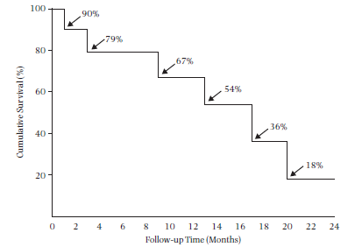
The Iconic “Kaplan-Meier Plot” (or “Curve”):
Typically shows cumulative survival
Step Function
Notes:
The results of these calculations for the textbook example can be displayed in what is known as a Kaplan-Meier plot or Kaplan-Meier curve. Everyone in biomedicine has surely seen such a plot, which is why we call it iconic. What we show here is probably the most typical plot, showing the cumulative survival (not having the event).
Note that the K-M plot is a step function. It is not correct to connect the dots with straight lines. K-M curves that appear smoother are, in fact, still step functions, just like this one, but with events occurring more frequently relative to the time scale so the curve appears smooth.
While classically K-M plots show survival (i.e., falling curve), they can just as easily show incidence (i.e., climbing curve). In fact, we prefer the climbing curves in that they are more intuitive to most observers. In other words, K-M natively estimates probability of no event but we are typically interested in probability of event, and we can estimate and plot either one.
50

Slide 51
Kaplan-Meier plot of cumulative incidence
Notes:
This is the complement of the Kaplan Meier survival plot in the previous slide. This is showing the same data but now presented as incidence (incidence of mortality in this example).
As noted before, we prefer the incident (“climbing”) curves since we are typically interested in the probability of the event. Historically, plotting of survival (not having the event) has been more common, probably because this is what is directly calculated in the Kaplan-Meier approach. In some fields, such as evaluation of death after cancer diagnosis, the concept of “survival” is directly relevant and plotting survival has become firmly entrenched. However, plotting of the cumulative probability of the incident event is becoming increasing popular in the literature, and we prefer it in most applications.
51

Slide 52
K-M curve:
Development of tolerance to cow’s milk
Suh et al. J Korean Med Sci 2011
Notes:
Excerpt from a study:
“This study was conducted to determine the natural course of cow’s milk allergy in Korean children with atopic dermatitis (AD) and analyzed prognostic factors that affected the outcome of cow’s milk allergy...Of the patients who visited the Samsung Medical Center Allergy Clinic between January 2000 and May 2008, 115 children, diagnosed with both AD and cow’s milk allergy within the first 24 months of birth, were included in this study… The average age at AD diagnosis was 3.1 ± 2.0 months and the average age at introduction of solid food was 6.6 ± 1.8 months. ” Children were followed for at least 24 months.
“The mean duration of follow-up was 47.0 ± 20.4 months (range 24-114 months).”
This is an example of a K-M survival curve, showing the proportion of children who continued to have cow’s milk allergy from birth to age ~70 months. Like other K-M curves, it has to remain the same or fall over time.
A few things to note for this example.
1) Many small steps during months 20-40 as many children have resolution of allergy. Larger steps in subsequent time period as fewer children are left to study.
2) The time scale on the x-axis is age, not time since study entry. Time since study entry is seen more commonly, but use of age as the time scale can also be effective in some contexts.

Slide 53
FIG. 1. Cumulative incidence of any fracture among 1,964 Rochester residents after first recognition of diabetes mellitus in 1970–1994
Melton et al. JBMR 2008
Notes:
This study was conducted at the Mayo Clinic in Rochester, Minnesota in the United States, using data from Olmsted County in Minnesota. The underlying population is a dynamic cohort that receives virtually all of their medical care through the Mayo Clinic and has been used for numerous research studies. Despite it being a dynamic cohort, the goal of this research question was to determine the incidence of fracture after onset of diabetes. Thus, all the individuals had their observation “shifted to the left” and analyzed as if they were a fixed cohort.
This is an example of a K-M cumulative incidence plot, showing cumulative incidence of fracture on the y-axis over up to 30 years of follow-up time. Follow-up time for fracture starts after first diagnosis of diabetes.

Slide 54
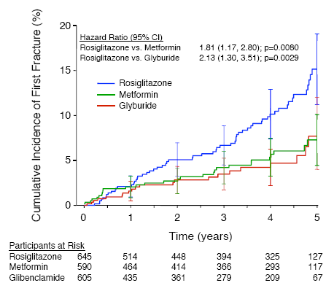
“The cumulative incidence of a first fracture reached 15.1% at 5 years with rosiglitazone, 7.3% with metformin, and 7.7% with glyburide.”
Standard error bars
Notes:
We now return to the earlier example of the incidence of fractures amongst participants with diabetes being treated with different anti-diabetes agents. This is a figure from the publication. It shows Kaplan-Meier estimates of the cumulative incidence of fractures at 5 years in women. Bars represent 95% CIs. (Kahn et al. 2008 Diabetes Care 31:348-51)
This Kaplan-Meier curve showing incidence of the outcome, rather than survival without the outcome. The cumulative incidence would have been calculated by first calculating “survival without fracture,” and determining the complement in order to show fracture incidence.
This plot includes standard error bars at each year. 95% confidence bands can also be calculated for Kaplan-Meier curves.
The numbers below the graph indicate the number of participants that were still being followed, by treatment group, at each of the time points. This gives the reader a better sense of the how many participants are contributing to the different estimates and hence the statistical precision of the estimates. However, with the standard error bars shown, there is no additional information provided by the number at risk. The standard error bars tell you all you need to know.

Slide 55
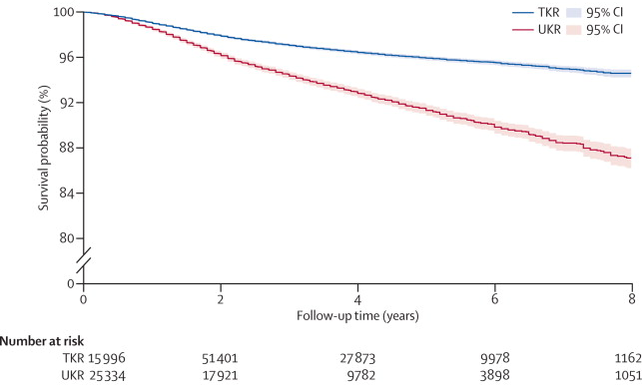
Need for Revision after Knee Replacement:
National Joint Registry for England and Wales
Figure 1. Kaplan-Meier curve of revision to 8 years in matched patients. UKR=unicompartmental knee replacement. TKR=total knee replacement.
Liddle et al. Lancet 2014
Notes:
This example of a K-M survival curve shows probability of not having a revision after total (TKR) or unicompartmental (UKR) knee replacement. A revision refers to another surgical replacement of the knee. Note the use of shaded bands to identify the 95% CI. The confidence bands are narrow because the sample size is very large, which can be seen in the “number at risk” at the bottom of the plot.
Note also the nice use of the break in the y axis. Although the y axis is a probability, there is no reason why you have to show the entire range of 0 to 100%.
Finally, note the slavish adherence to the term “survival probability” on the y axis. This is what generically gets printed by statistical software, but it should be modified to one’s specific context. In this case, it should be “Probability of not undergoing revision of knee replacement”.
We maintain that showing the complement of this, incidence of revision, is a more intuitive way of showing the data.

Slide 56
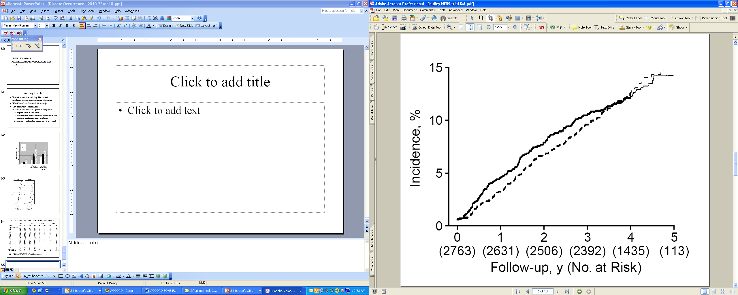
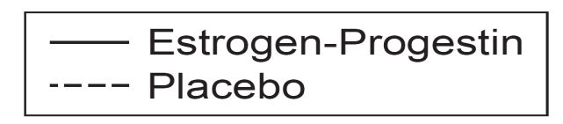
Cumulative incidence of primary coronary heart disease (CHD) events in the HERS trial
log rank P value = 0.91
The number of women observed at each year of follow-up and still free of an event are provided in parentheses, and the curves become fainter when this number drops below half of the cohort.
Hulley et al. JAMA 1998
Notes:
The plot shows Kaplan-Meier estimates of the cumulative incidence of primary coronary heart disease (CHD) events in the HERS trial which randomized women to estrogen-progestin replacement vs placebo. The number of women observed at each year of follow-up and still free of an event are provided in parentheses. The authors have also made the curves lighter at the point where less than half the cohort is still being followed; this is an interesting visual technique but not conventional.
This is an interesting example of how much can be learned from the KM curves. These two curves converge by the end of follow-up indicating no difference in the cumulative incidence of CHD events between the treated (estrogen-progestin) and placebo arms at 4 years. The p-value for the log rank test used to compare the two curves, something we’ll get into more in the Disease Association lectures, indicates that the curves do not differ overall. However, it looks like the treatment group has a higher cumulative incidence of the outcome at intermediate points. Indeed, if the trial had been stopped after one year, the results would have shown a negative effect of the treatment. Such a post hoc evaluation can only be “hypothesis generating” but this was one of the first clues that hormone therapy might have negative, rather than the assumed positive, effects on cardiovascular health in women.

Slide 57
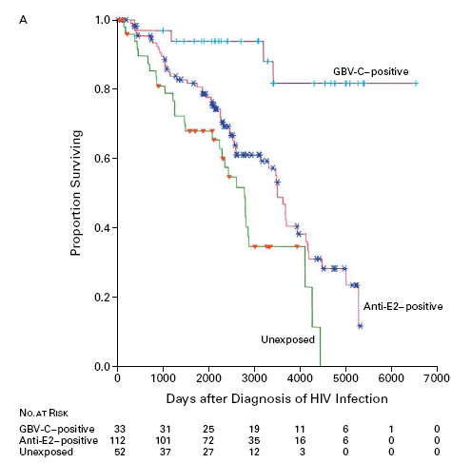
Cumulative survival after diagnosis of HIV infection in three groups of patients
“Tick mark” when participant is censored (lost to follow-up or administrative)
Large “steps” and low number at risk: Tail of curve less precise.
Tillmann et al. NEJM 2001
Notes:
Here is a graph showing a Kaplan-Meier analysis of cumulative survival after diagnosis of HIV infection in three groups of patients according a particular hepatitis virus: the top line represents patients positive on an assay for GBV-C RNA (evidence of active infection; GBV-C has also been designated hepatitis G virus); the middle group are positive on an assay for antibodies to a surface protein of GBV-C (designated E2; evidence of prior infection); and the third group was negative on both GBV-C assays (no evidence of infection).
As usual, notice that the lines have a step function. This is because there is a discrete jump in the cumulative incidence each time a death occurred. Very large steps occur when very small numbers are observed at risk, illustrated by the last three large downward steps of the unexposed group.
The numbers below the x-axis are useful as they show the reader how many persons were observed in each group as time progressed. Only 3 were left in the unexposed during that last portion of the K-M function, each drop representing 1 person dying. No confidence intervals are shown, but the small numbers at risk and large drops indicate that the survival estimate is quite imprecise for those time points. Hence, the tail of the curve does not give precise information. While the numbers at risk are nice to see a more direct way to show statistical precision would be to show confidence bands.
The tick marks on each survival curve represent times at which a person was censored, so they provide useful information on the amount and pattern of follow-up time in each group. They do not, however, necessarily represent drop outs or losses to follow-up as subjects started at different points in time and would have different follow-up times even if they all continued to the end of the study and had administrative censoring.
To read cumulative survival for a group from the graph, pick a time point, such as 3000 days, draw a line straight up to intersect the survival curve and then a horizontal line that intersects the y-axis. Where it intersects the y-axis is the estimate of the proportion surviving at that time of follow-up (about 60% in these data for the antibody positive group and less than 40% for the unexposed group).
If the cumulative incidence of death had been plotted instead of the cumulative incidence of survival (always an option), the graph would have started in the lower left-hand corner at 0 and moved up toward 1 (inverting the curve pictured).

Slide 58
K-M Plots of Cumulative Incidence
We have shown a variety of options to give you a sense of what you will encounter in the literature and how you might report your results.
Our preferences for K-M plot:
  Show cumulative incidence (i.e., of the event)
    Unless your field uniformly and sensibly shows survival
  Provide indication of sampling error (either confidence bands or pointwise confidence intervals)
  Number at risk table under the plot is a nice touch
    But not requisite

Slide 59
Time Element in Cumulative Incidence
KM plot shows cumulative incidence for every time point; this plot is full disclosure on incidence.
  “A picture is worth a thousand words”
However, if you cannot show a plot and you must say cumulative incidence in words (such as in an abstract), then YOU MUST ADD A TIME ELEMENT.
For example, “20% over 1 year” or “5% by 6 months”
Notes:
Failure to add a time element is one of the most common problems in reporting cumulative incidence.

Slide 60
Cumulative Incidence:
Underlying Assumption #1
For cumulative incidence to be unbiased (i.e. valid), censoring must be unrelated to the probability of experiencing the outcome.
  Censoring must be “non-informative”
i.e., the outcome experience of those who are censored (particularly those who are lost to follow-up/drop out) must be the same as those who remain in the study.
Notes:
This concept takes us back to the point made in the first lecture on study design about the threat to validity of a cohort study coming from losses to follow-up. (There are other threats to validity in a cohort such as measurement bias and confounding but losses to follow-up are a substantial concern). Those persons lost to follow-up are among those persons who are censored in the data analysis, so if the goal is to get an unbiased measure of incidence, those losses to follow-up cannot be related to the probability of the outcome. If members of the cohort who are leaving are either more or less likely to experience the outcome than those remaining, the resulting incidence estimate (which can only be calculated using the persons who remain) will be either too high or too low relative to the entire study population.

Slide 61
Informative vs Non-informative Censoring
When the goal is estimation of incidence (“descriptive”):
Informative censoring (aka “non-ignorable”) means that those censored have different incidence of the outcome than subjects who remain in the study, and therefore introduce bias in the incidence measure
Non-informative censoring (aka “ignorable”) means that those censored have the same incidence of the outcome as subjects who remain in the study, and therefore do not result in bias
Notes:
Statisticians and epidemiologists characterize censoring into the terms informative and non-informative censoring. Whether censoring is informative or non-informative depends upon several factors but, to start, it depends upon what you want to estimate. In cohort studies, you may wish to just measure incidence (i.e., a descriptive objective) or you may also wish to evaluate determinants of incidence (i.e., an analytic objective). So far in the class we are just discussing descriptive objectives. When the goal is estimation of incidence (i.e., descriptive), informative censoring means that those who are censored have a different incidence of the outcome under study than those who remain in the study. To lose these types of people from full observation is considered “informative” (i.e., you would want to know about their full follow-up, if you could) and you cannot ignore it (hence the term “non-ignorable). In other words, you have lost information and this leads to bias. Non-informative censoring means that those who are censored have the same incidence of the outcome as those who remain in the study. Not being able to observe these people does not introduce bias in the incidence estimates. You can ignore what happened after these people were censored (and hence the term “ignorable”). As noted earlier, however, even non-informative censoring does lead to a loss of statistical precision.
Although we won’t cover this now, it is the case that censoring that is informative in the context of incidence estimation may not be informative in analytic work. In other words, certain things we do in the analysis may negate the informativeness of the losses.

Slide 62
Follow-up times differ: Censoring (lost to follow-up and administrative)
= loss to follow-up
D = death
= loss to follow-up – may be informative
= Administrative – typically
non-informative
Notes:
Here is a slide we showed earlier, with a diagram from the textbook showing different follow-up times. In the previous slide we stated: “For cumulative incidence to be unbiased (i.e. valid), censoring must be unrelated to the probability of experiencing the outcome.” This assumption is usually reasonable for participants who are administratively censored. The reason for their reduced follow-up time is an administrative decision, not the participant’s choice. However, for those who are “lost to follow-up” (drop out) during the study, this assumption may not be met. Participants who decide to “drop out” of follow-up may be systematically different from those who remain in follow-up, and these differences may include a different incidence of the outcome of interest. Persons who are lost to follow-up may be informatively censored.
62

Slide 63
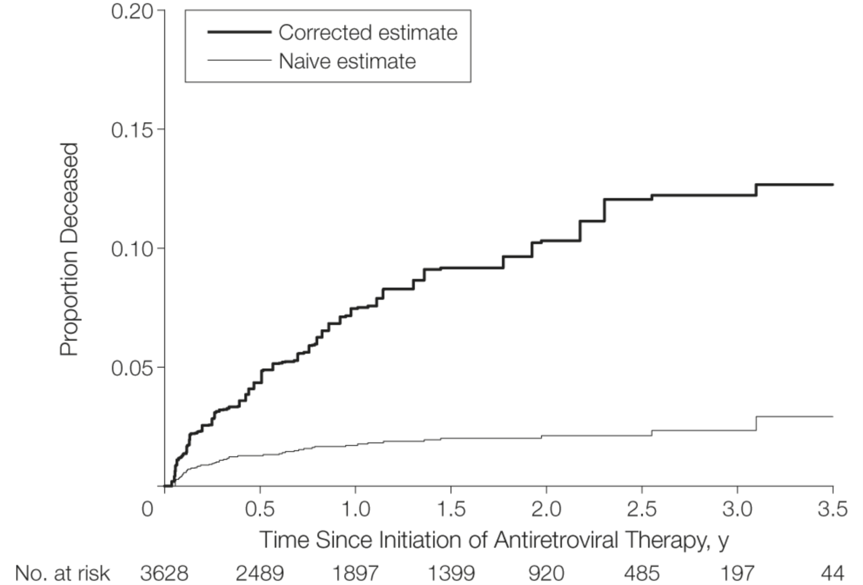
Mortality after initiation of antiretroviral therapy in resource-limited countries: Differences according to intensity of follow-up
Corrected estimate represents vital status outcomes in lost patients obtained by tracking down the lost in the community
Here, losses were informative
Naive estimate is determined using only deaths passively reported during routine clinical care. Blithely accepts the losses to follow-up and makes no attempt to decipher losses.
Geng et al. JAMA 2008
Notes:
This is an example of just how different results can be in some settings when losses to follow-up are not taken into account. In this study from Uganda, the proportion of HIV-infected patients initiating antiretroviral therapy who had died was 2.3% at 3 years by passive follow-up. We call this the naïve estimate because it just uses the readily available data. In other words, when patients stop showing up at clinic, they are called lost to follow-up and nothing else happens. It blithely accepts the presence of losses to follow-up and makes no attempt to decipher these losses.
There were a significant number of drop-outs in this study. A sample of these patients who were lost to follow-up was actively tracked to determine their vital status. The experience of this tracked group was used to correct the results for the full cohort. This is the basis of the corrected estimate. With correction based on the tracked patients, the investigators found that cumulative mortality after 3 years was 12.2%. The difference between 2% incidence of death and 12% is important. This is a situation where the losses to follow-up are informative.
Informative losses of follow-up are common, especially if the outcome is death and the sickest persons in the cohort are the least likely to return for study visits and the most likely to die. Whether these losses to follow-up would also bias a measure of association between an exposure variable and the outcome (an analytic objective) depends on whether those losses are also related to the exposure and other factors (such as other factors that might be controlled for). As we pointed out in the lecture on study design, bias in a measure of association only occurs when the losses are related to both the outcome and the exposure.

Slide 64
Informative or Non-informative Losses?
How do we know whether our losses to follow-up are informative or non-informative?
Without going after them (or a sample of them) to find out, you do not know. This is the problem.
It is a matter of opinion — between you and your reviewers — whether you believe the assumption of non-informative censoring, or, if you don't believe it, if you believe the violation of the non-informative censoring assumption is at least minimal.

Slide 65
Cannot distinguish “lost to follow-up” from “administratively censored” in KM plot
Cumulative survival after diagnosis of HIV infection
“Tick mark” when participant is censored (lost to follow-up or administrative)
Tillmann et al. NEJM 2001
Notes:
All this said, what studies really need to show is the incidence of drop out to give readers a sense of the potential problem. Conventional techniques of showing at risk tables and tick marks for censoring on KM plots do not fully disclose the problem because they also include staggered entry and administrative censor.
As we noted previously for this KM plot, the tick marks on each survival curve represent times at which a person was censored, so they provide some useful information on the amount and pattern of follow-up time in each group. They do not, however, necessarily represent just drop outs. They may also include as participants who started at later points in time and had administrative censoring at end of the study.

Slide 66
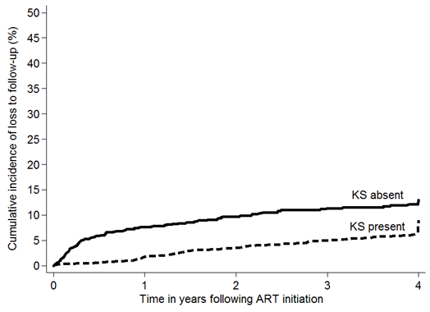
Reporting “lost to follow-up”
“Loss to follow-up” includes those who “dropped out” of the study. Does NOT include administratively censored.
Notes:
This slide shows a plot of “lost to follow-up” as an outcome. (From work conducted by Stephen Asiimwe and Jeff Martin.) In this example, only the “drop outs” are tallied and those who are administratively censored at the end of the study are not included. The plot reveals a slightly higher cumulative incidence of loss to follow-up in the “KS absent” group at nearly every time in the study.
This is the preferred approach for telling your readers the extent of loss to follow-up in your fixed cohort.

Slide 67
Cumulative Incidence Assumption #2
For K-M Estimation
No competing events; or
Independent competing events + a world in which you can envision preventing such competing events
Notes:
Another assumption we must make to get a valid and interpretable Kaplan-Meier estimate has to do with competing events. To get a valid K-M estimate, we must either have no competing events OR we must assume that there is a reality where competing events can be eliminated/prevented and that these competing events are independent of the outcome in question.

Slide 68
No Competing Events
True universally only for studies of all-cause mortality.
For all other studies, presence of competing events can be directly assessed by looking at the data
  e.g., study of adolescents for occurrence of diabetes
    In theory could have competing events (e.g., death from accident) but, in any given study, there might not be any
Notes:
Let’s take these scenarios one at a time. In the example we used earlier to calculate cumulative incidence using the Kaplan-Meier method, the outcome was all-cause mortality. In this situation, there are can be no competing events. If this occurs, then, of course, there are no complications from competing events and no assumptions to be made. For all other studies, it may also be the case that competing events are a theoretical possibility but that none occurred. For example, you might be studying a group of adolescents for an outcome of diabetes. Here, mortality (prior to diabetes) is a competing event, but it simply may not happen in your study. If this is the case, you don’t need to worry about competing events. In other words, in all other studies, you must directly assess whether competing events are occurring.

Slide 69
Can competing events be incorporated into K-M estimation?
Only way CE can be incorporated is by assuming a reality (a target population) where they can be eliminated and they are independent
  Only way to handle CE in routine K-M estimation is to censor them
  If you censor at CE, resulting K-M estimate is unbiased (i.e., valid) only if “CE is independent of outcome”. Independence of CE means:
    Those who leave the analysis because of the CE are destined to have the same rate of the primary event as those who remain
    If you prevented the CE, you would not alter underlying rate of the outcome of interest; it would be same as rate as those without the CE
    However, hard to believe -- in most scenarios -- that both of these points are true (e.g., exception: getting struck dead by lightening)
  Therefore, K-M is typically not recommended when CE are present
  Instead, other techniques, to be covered next week, are used
Notes:
However, if competing events do occur – and they usually do in studies other than of all-cause mortality – then you will need to make some decisions if you want to calculate incidence by the K-M technique. How can competing events by accommodated in Kaplan-Meier estimation? If you wish to calculate incidence by the K-M technique, this means the only thing you can do is to censor a person at the time of a competing event. If you do this, it means is that you wish to make a statement about what would happen if competing events did not occur (i.e., were prevented/eliminated). Censoring means that you, the investigator, don’t directly see what happens to the subject but that you realize that they do continue to march forward and have things happen to them. Many or most observers would believe this is it is ludicrous to consider a reality where competing events are eliminated. This is not reality as we know it. That is, we live in a world of competing events.
If you nonetheless still want to go ahead and do the K-M calculation, the only way to mechanically do this in routine Kaplan-Meier estimation is to censor observation after the competing event occurs. If you do this, the underlying assumption, for the KM estimate to be valid, is that the CE is independent of the outcome of interest. Or, in other words, what this means is that if you could prevent the competing events, the rate of the outcome of interest would not be affected. The assumption is that there are no factors which are both causing the competing event and the outcome of interest. Becoming dead by being struck by lightening is one such example of an independent competing event but most competing events are not obviously independent. In other words, this is an assumption that is not often realistic. The text makes this point on page 56 and Table 2-4 (first item in the Table) although they don’t use the term “competing event.”
In summary, to incorporate CE into KM, one needs to conduct an analysis in which you act like the CE is eliminated. To do so, one needs to:
--envision a target population in which the CE does not occur. If this target population does not exist, it hardly seems worthwhile to try to perform an analysis in which CE’s are eliminated
--assume that the occurrence of the CE and the outcome of interest are independent
--assume what you have to do to eliminate the CE does not change the underlying rate of the outcome of interest
Because it is difficult to justify these three things, KM is not recommended when there is any appreciable incidence of competing events. “Appreciable” means any number which is high enough to substantively change the point estimate depending upon whether you censored the CE’s or not. There are other methods available to estimate cumulative incidence in the presence of competing events, and we will cover those next week.

Slide 70
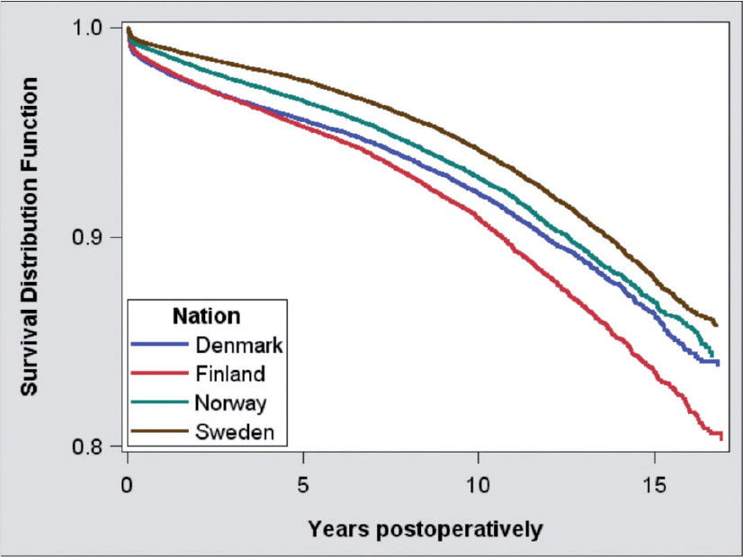
K-M often used despite competing events when looking at longevity of devices, implants, other surgical procedures
~1/3 were 75 years or older
Kaplan-Meier survival for all total hip replacements, by country.
Outcome is need to revise (i.e. fix) the hip replacement (for any reason).
Patients were censored at death.
Mäkelä et al. Acta Orthopaedica 2014
Notes:
The recommendation not to use conventional K-M estimation in the face of competing events does not stop researchers from doing it. Next week we will show data on just how often researchers get this wrong – usually because of ignorance of the topic -- but for this week we will concentrate on a research area where we suspect people are familiar with the other approaches but still nonetheless use the K-M technique. This is the area of devices (e.g., pacemakers), implants (e.g., heart valve replacements), and surgical procedures (e.g., coronary artery bypass graft placements). The research question in these areas is “what is the biological lifespan of the device, implant, procedure, assuming that the host patients never died”. It is a bioengineering question, and it seems like a reasonable question to ask, but there are difficulties when trying to use the K-M technique to answer it.
Indeed, this was the question addressed in this example where researchers sought to estimate how long hip replacements are lasting in 4 Scandinavian countries. As you would expect, this is an older population, and indeed we are told that about 1/3 were 75 years or older. Thus, we fully expect to see a lot of deaths, which would be competing events in this context. Nonetheless, the investigators censored patients at death and used the K-M technique to estimate the cumulative incidence of needing a revision after a total hip replacement (i.e., needing the original hip replacement to be fixed or replaced). Is K-M the right approach to use?

Slide 71
K-M often used despite competing events when looking at longevity of devices, implants, other surgical procedures
Is K-M with censoring at death the right approach?
  Hard to say, but we believe probably not
Censoring at death assumes that if those who died had not died they would have had the same rate of hip revision as those who did not die.
  Means that you think no factors are influencing both death and hip revision (no common causes of both)
  Believable if you think state of body is not influencing device lifespan (or physicians’ decisions to do revision procedures)
  If this is the case, you may as well get the answers in animals
Use of K-M with inverse probability weighting approaches in part gets around this. Very rarely used in practice. See optional reading.
One more problem: how are you going to create a world in which no one dies? Won’t this intervention also affect risk of hip revision?
Notes:
71
Is K-M the right approach to use? By censoring patients at death, the investigators are making the assumption that if those who died had not died they would have had the same rate of hip replacement revision (fixing or redoing the procedure) as those who did not die. Stated another way, they are assuming those who did not die and whose rate of hip revision can be observed are, in fact, representing all the patients who started in this analysis, including those who earlier died.
First, is this a reasonable question to ask? Yes, it is a bioengineering question; the focus is entirely on the device and not the human being. Note that it is slightly different than asking how long people would last without having a heart attack assuming they never died from any other competing risk (cancer). If it is a reasonable question to ask, is censoring at death with the K-M estimator the best way to do the analysis? The answer is hard to know, but we think probably not. Although we don’t have the direct data available to us here, it is likely not the case that hip revision and death are independent. We do not believe that those who are experiencing death would have the same rate of hip revision (if they had stayed alive or were “revived”) as those who are not dead. The only way death and hip revision could be independent is if they shared no factors which influenced them both (i.e., if they had no common causes). This includes physicians decisions to perform the hip revisions (physicians typically will not perform these procedures on patients who are perceived to have very short lifespans). In other words, you would have to believe that nothing about the human body is influencing the need for hip revision. If you believe this, you may as well get the answers in animals. We do not believe hip revision and death are independent.
There are, however, analytic techniques that get around some of these assumptions using the K-M approach, such as the use of inverse probability weighting to construct the population a bit differently to better reflect its risk for hip revision once the dead are revived. This is explained briefly in the optional reading (Grunkemeier et al 2007). This technique also requires some assumptions so it is not a magic bullet. In practice, the technique is rarely used (and we will not be describing it in the course).
There is yet one more problem and it is one which introduces more hypothetical quandaries. That is, exactly what is the intervention that you are going to need to keep everyone from experiencing death (the competing event)? If there are shared common causes of both death and need for hip revision, then it is quite likely that anything you do to prevent deaths is also going to alter the rate of hip revision both in those destined to die (and perhaps in those not destined to die). How much it will change incidence of hip revision is hard to know.
The bottomline is that attempting to accurately describe what the incidence of hip revision would be in a world where patients did not die (i.e., eliminating death) is hard to do. It is “make believe”. It is easy to do the math (just censor at the time of the CE) but you should not feel confident that you have right answer. Some people would say it is so hard to be sure the answer is correct that it is not worth doing, and instead other approaches, where we simply tolerate or accommodate competing events, is a better approach. We will discuss these approaches next week.

Slide 72
Cumulative Incidence:
Underlying “Warning” #3
To calculate cumulative incidence with different follow-up times, we “shifted everyone to the left” and used follow-up time as the time scale rather than calendar time.
If the probability of the outcome is changing over calendar time, (i.e., “secular/temporal trends” affect the outcome), then this combines persons of different eras/experiences.
If there are secular trends, you can still do the calculation and it is mathematically correct, but the result is loss of information and, typically, a less meaningful interpretation.
We note this as a warning while the text calls it an assumption.
  We don’t have to assume that secular trends are absent to do the analysis
  Rather, if secular trends present, interpretation must be altered.
Notes:
To perform this analysis in our example, we “shifted everyone in the left” and combined them into one group. That is, we used follow-up time rather than calendar time as the time scale. If the probability of the outcome is changing over calendar time (a construct that is called a secular or temporal trend), then shifting everyone to the left combines persons of different eras/experiences into one lumped summary. If there are secular trends, you can still do the calculation and it is mathematically correct, but the result is loss of information and, typically, a less meaningful interpretation. In this situation, you would be sweeping a lot of interesting information under the carpet by not showing the incidences for the periods separately. Your result also has a limited interpretation in that it does not apply to any single person in your study sample, and it certainly does not apply to the next patient who presents with the condition or question. Your answer is simply the average over disparate time periods. This average may be useful to some observers but remember that it represents neither of the time periods per se.
The text calls this issue an “assumption” in that you must assume that secular trends are not present in your population, but we think this is not the right characterization. Secular trends are not a threat to validity but, rather, can affect whether the resulting cumulative incidence calculation combines and averages widely differing experiences. Instead, we just view it is an issue that the investigator needs to be aware of.
Finally, “lack of secular trend” does not mean that the probability of the outcome is the same during all of the follow-up time (what we will later call a constant hazard). Moving everyone to the left has no impact on what happens with incidence over time in a given individual. Risk could either increase or decrease over time.

Slide 73
Text book example: Follow-up times differ
Notes:
73

Slide 74
Change time scale to “follow-up” time
Notes:
Just as was the case with Kaplan-Meier estimation, by assigning everyone the same starting time you are ignoring any calendar time trends that will affect your estimate of incidence. You have dropped calendar time, and hence trends associated with calendar time (often called “secular trends”), out of the analysis.
74

Slide 75
Reasons for underlying secular trends
True biological/clinical changes in incidence
  Rapid changes in HIV incidence at start of epidemic
  Changes in incidence of hip fracture
Changes in methods of diagnosis (measurement)
  Adding A1C to diagnostic criteria for diabetes
  Widespread use of mammography for breast cancer screening
More important in a study with longer follow-up time
Notes:
For many studies, it is reasonable to assume that incidence is not changing over calendar time of the study follow-up. For one thing, the difference in calendar time may be just a matter of months rather than years, so it would take a very rapidly changing trend to be important in a time frame of months. For some situations, though, this may be a dubious assumption. For example, if one were enrolling subjects to study a new infectious disease during its introductory epidemic period (HIV, SARS, Ebola, etc.), secular trends might affect incidence estimates significantly. Changes in methods of diagnosis can also cause a change in incidence that is essentially an artifact of the new diagnostic approach. For example, this may occur with estimates of diabetes incidence as new guidelines using A1C to diagnose are implemented. Improved screening can also cause an increase in incidence. All of these examples are known as period effects.

Slide 76
FIG. 1. Cumulative incidence of any fracture among 1,964 Rochester, MN, residents after first recognition of diabetes mellitus in 1970–1994
How long was the “baseline” period? i.e. How many years between the start of follow-up for first & last participants?
OK to shift everyone to the left to summarize with one estimate of fracture incidence?
Melton et al. JBMR 2008
Notes:
Here is a K-M plot that we showed earlier, for cumulative incidence of any fracture in those with diabetes.
Follow up time starts with diagnosis of diabetes.
In this study, participants were “left shifted” for a period of up to 24 years, the period 1970-1994.
Is there any problem introduced by shifting all of these patients to the left – for a 24-year period - and coming up with one estimate of fracture incidence? The answer depends on whether we think fracture incidence in those with diabetes was relatively stable over these years. Data on fracture incidence, by calendar time in this specific population (with diabetes), isn’t available. Interestingly, the issue was not discussed by the authors. We can, however, look at fracture incidence in other populations over a similar time period. The results on the next slide, taken from a Swedish population, suggests that this might be a concern.

Slide 77
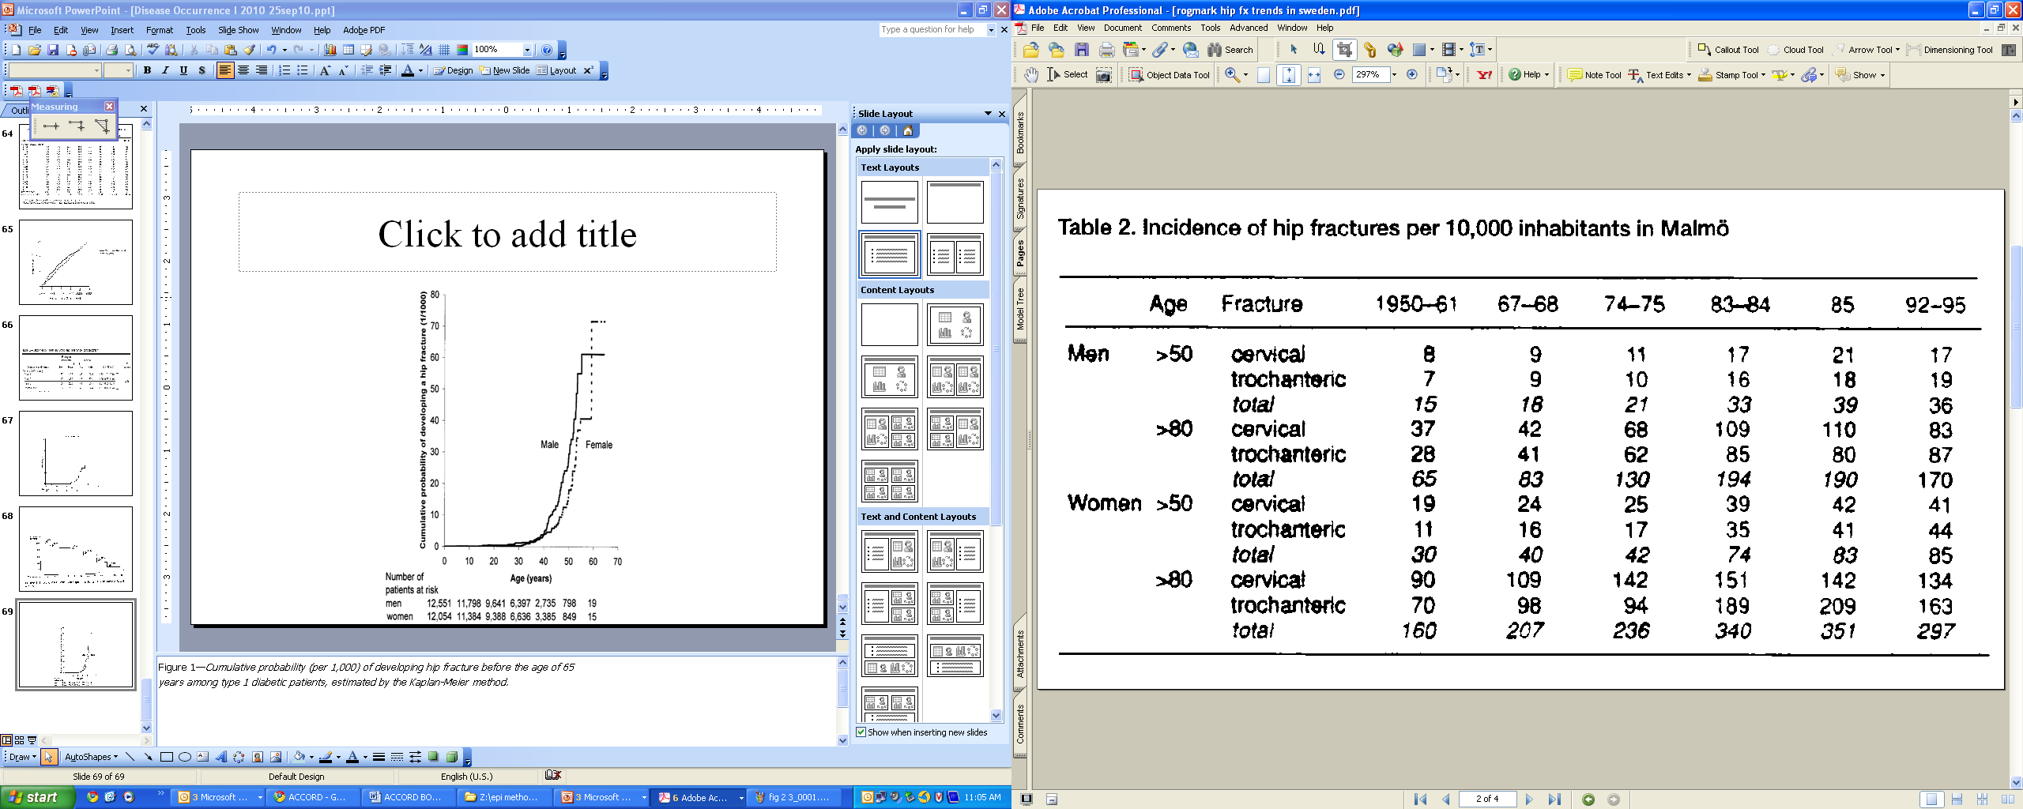
Hip fracture trends in Sweden
Rogmark et al. Acta Orthop Scand 1999
Notes:
These are results from a study of trends in hip fracture incidence during the last 60 years in Sweden. They have increased steadily with some leveling off in the 1990’s. Those results were taken from 1975 – 1998, similar to the period from the Rochester study in the prior slide. The changing rates over time can lead to a substantial loss of information and inaccurate conclusions about cumulative incidence if one simply lumps all of these time periods together. If we calculate cumulative incidence for the time period 1967-95, we would mix together periods with differing incidence of hip fracture. The resulting number would not really be representative of any of the individual years. In other words, a single number summarizing those years (1967-95) wouldn’t represent any single person.

Slide 78
Kaplan-Meier using Stata:
An Example
Cohort: Participants diagnosed with primary biliary cirrhosis in a large health maintenance organization
Goal: Determine the cumulative incidence of death (of any cause; “all cause”) — also called cumulative mortality — after diagnosis of primary biliary cirrhosis.
Dataset includes 184 patients with 96 deaths. Median follow-up time was 3.6 years.
Notes:
Let’s now turn to the computer implementation of the K-M technique. We illustrate the use of Stata to calculate cumulative incidence with the Kaplan-Meier method with an example. The dataset we are using is a collection of patients with primary biliary cirrhosis, an autoimmune disease of the liver. The dataset includes 184 patients. The outcome we are interested in is death due to any cause. 96 deaths occurred during follow-up. Median follow-up was 3.6 years. We will calculate the cumulative incidence of death, also called the cumulative mortality.

Slide 79
Biliary Cirrhosis Dataset
. use "M:\biliary cirrhosis dataset.dta", clear [THIS OPENS THE DATASET]
. describe
Contains data from M:\My Documents\ATCR - Teaching\Stata datasets\biliary cirrhosis dataset.dta
obs: 184 PBC
vars: 7 17 Mar 2002 23:36
size: 5,152
-------------------------------------------------------------------------------
storage display value
variable name type format label variable label
-------------------------------------------------------------------------------
id float %9.0g Subject identifier
time float %9.0g Follow-up time in years
d float %9.0g d Failure: 1=dead, 0=alive
treat float %9.0g treat Treatment
age float %9.0g Age at entry (years)
cirrhos float %9.0g cirrhos Cirrhosis at entry
bilirub float %9.0g Bilirubin at entry (mumol/l)
-------------------------------------------------------------------------------
Sorted by: id
Notes:
This is the dataset regarding death following a diagnosis of primary biliary cirrhosis.
This slide shows how to open a dataset and obtain a description of the contents, using the command line in Stata.

Slide 80
To calculate Kaplan-Meier estimator, we need:
A data set with one observation per person.
Knowledge of whether each person either experiences event (death in this example) or is censored (either drop-out or administrative). A variable must indicate this. In this dataset, this variable = d
A variable for the time from study entry to date of event or date of censoring. In this dataset, this variable = time
Notes:
80

Slide 81
Biliary Cirrhosis Dataset
First 9 observations
+--------------------+
| id time d |
1. | 51 1.582478 1 |
2. | 23 9.032169 0 |
3. | 40 2.286105 1 |
4. | 42 2.078029 1 |
5. | 45 5.31143 1 |
6. | 48 2.633812 0 |
7. | 50 3.931554 0 |
8. | 52 4.843258 0 |
9. | 54 2.105407 0 |
Variables required for Kaplan-Meier estimate
Notes:
To illustrate how survival data look in Stata, this slide shows the first 9 observations in the biliary cirrhosis dataset.
The 3 essential variables are Id (the unique patient identifier), follow-up time, and event (or outcome). In this study, the outcome is death.
Id = Participant identification number
Time = Follow-up time (in years)
d = death (1=dead, 0=alive)

Slide 82
Survival Analysis in Stata
Notes:
We already opened our dataset (biliary cirrhosis dataset.dta) with the use command.
Next we tell Stata that our dataset contains survival data. If you’re using the command line, use the stset variable.
Once Stata understands that the dataset contains survival data, Stata will then provide the user some summary information on the dataset.

Slide 83
Cumulative incidence of death at 11.64 years = 1 – 0.2375 = 0.7625
Notes:
sts list provides the survivor function at each time a participant fails or is censored (“net lost”). This is what we did with our small dataset in the example from the text, except we did not show the work for each time a participant was censored since the survivor function does not change.
Stata output shows the survivor function when a participant is censored, and we can see in this example that it does not change. The last line at time 11.64 indicates 1 participant censored and the survivor function remains the same (0.2375) as in the line just above at time 11.25.
Stata also provides 95% confidence intervals [95% CI] for the survivor function.
Note that 2 participants can fail at the same time, shown in the output on this slide.
This slide only shows the beginning and end of the actual output. To obtain the cumulative incidence at, say, 5 years, you could identify this from the sts list output, but those lines of output are not shown on this slide.
You will have a chance to calculate cumulative incidence using the Kaplan-Meier method in Stata in the Problem Set of this week.

Slide 84
Follow-up time (in years)
Notes:
The command for above graph that specifies the axis titles is : sts graph, ytitle (“proportion surviving”) xtitle (“Follow-up time (in years)”)

Slide 85
Follow-up time (in years)

Slide 86
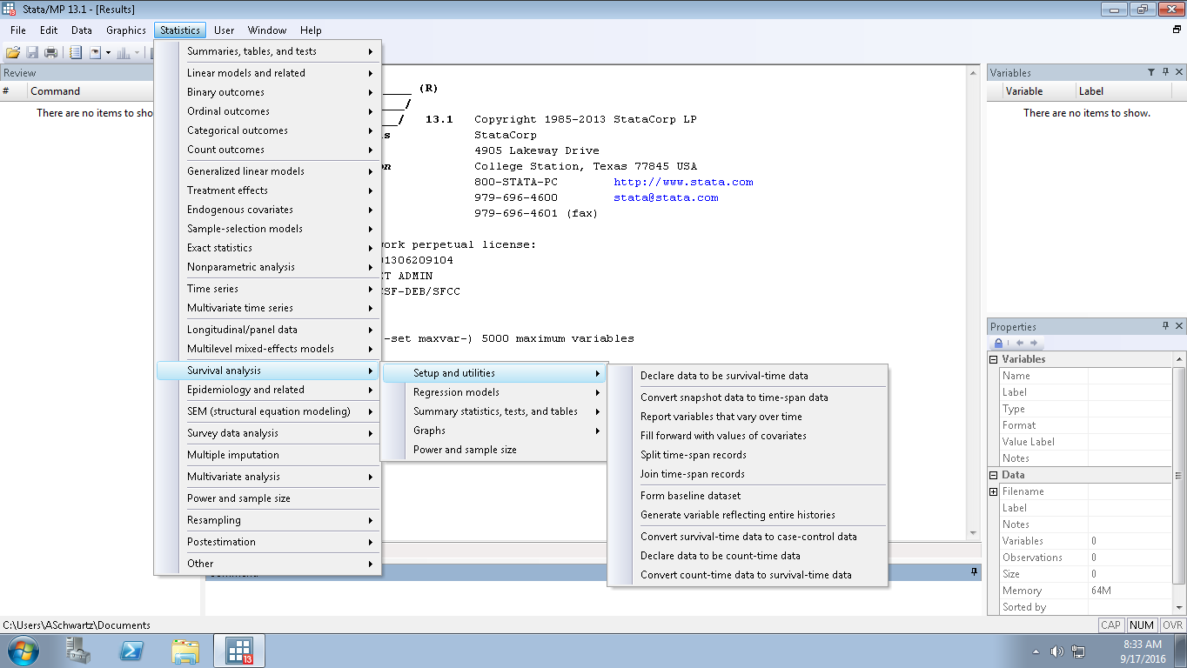
All of preceding can be done in Stata using
its drop-down menus And these lead to dialog
boxes showing many other options
Notes:
These are the menu pathways.
Statistics
Survival Analysis
Setup & Utilities
Use Declare data to be survival-time data
to identify time and censoring variables and specify value
that indicates failure (e.g., 1)
Statistics
Survival Analysis
Summary statistics, tests, & tables
Use List survivor and cumulative hazard functions to get
values of survival function
Use Graphs to get K-M graph

Slide 87
Life table method of estimating cumulative incidence
Key difference from Kaplan-Meier is that probabilities are calculated for fixed time intervals, not at the exact time of each event
Unlike Kaplan-Meier, don’t need to know exact date of each event (chief advantage of life table)
  e.g., acquisition of hepatitis C virus is typically clinically silent, only identified by repeated blood tests
For large data sets, the life table and the Kaplan-Meier methods produce nearly the same results
Notes:
Life tables, as the name implies, were first constructed to look at the cumulative survival (mortality) of large populations over a lifetime. They differ from a Kaplan-Meier estimation in that they don’t require knowing the exact time of each death (event); this is the chief advantage. A life table also precedes by dividing time up into discrete pieces, calculating survival probabilities for each piece, and obtaining a cumulative incidence by multiplying the individual probabilities of non-events together. But the time pieces are arbitrary, not determined by the time of each death (event). Hence, one does not need to know the exact time of each death (event). The time intervals are set by the investigator. For a lifetime life table they are typically 5-year intervals. For a cohort study where participants are typically followed for 5-10 years, 1-year or 6-month intervals might be more typical.
Historical note: Life tables go back to the 17th century. Their original use has been credited to Edmund Halley.
Halley, E. An estimate of the degrees of the mortality of mankind, drawn from curious tables of the births
and funerals at the city of Breslaw; with an attempt to ascertain the price of annuities upon lives. Philosophical
Transactions 17: 596–610, 1693.

Slide 88
For Life Table method:
Use follow-up time
Notes:
This is the same set of data that we used earlier to illustrate the calculation of cumulative incidence with the Kaplan-Meier method. We will use this same set of data to illustrate calculation of cumulative incidence using the life table method. As with the Kaplan Meier method, to resolve the problem of different starting times, the analyst “shifts all the starting time to the left.” For the analysis, each person is going to be started at the same time zero. Note that the time axis is now follow-up time rather than calendar time. When you do this, you need to be cognizant, as was the case with Kaplan-Meier estimation, that you combining the experience of persons who might have been in very different calendar time periods.
Life table calculations are based on distinct time periods after the starting point. In this example, we will divide this into 2 periods, each 12 months long, but it’s not necessary to have time periods of equal length. Periods should be chosen based on the assumption that events occur at a uniform rate during the interval. For this example, if we were concerned a priori that event rates might be different towards the beginning of follow-up, we could divide the follow-up time into the first 6 months and the second 18 months.
88

Slide 89
Calculating Cumulative Incidence with a Life Table
Time interval (mos) | Alive at start of interval | Effective number at risk during interval | Number of events | Conditional probability of the event | Conditional probability of survival | Cumulative probability of survival
 | n | n* | d | q = d/n* | p = 1-q | S(t)
1-12 | 10 | 9 | 3 | 3/9=0.33 | 0.67 | 0.67
13-24
Effective number at risk for 1st year (n*)
10 alive at start
2 were censored. Assume constant rate of censoring through the interval. This means that each censored person effectively contributes 0.5 of a person. Thus, effective number of persons at risk during interval:
  10-(1/2)(2) = 10-1 = 9
Notes:
89

Slide 90
Calculating Cumulative Incidence with a Life Table
Time interval (mos) | Alive at start of interval | Effective number at risk during interval | Number of events | Conditional probability of the event | Conditional probability of survival | Cumulative probability of survival
 | n | n* | d | q = d/n* | p = 1-q | S(t)
1-12 | 10 | 9 | 3 | 3/9=0.33 | 0.67 | 0.67
13-24 | 5 | 4.5 | 3 | 3/4.5=0.67 | 0.33
Effective number at risk for 2nd year:
5 alive at start
1 censored. Assume constant rate of censoring. Effective number at risk:
  5-(1/2)(1) = 5-0.5 = 4.5
Notes:
The same logic is used in the second interval of calculation from month 13 to 24.
90

Slide 91
Calculating Cumulative Incidence with a Life Table
Time interval (mos) | Alive at start of interval | Effective number at risk during interval | Number of events | Conditional probability of the event | Conditional probability of survival | Cumulative probability of survival
 | n | n* | d | q = d/n* | p = 1-q | S(t)
1-12 | 10 | 9 | 3 | 3/9=0.33 | 0.67 | 0.67
13-24 | 5 | 4.5 | 3 | 3/4.5=0.67 | 0.33 | 0.22
Cumulative probability of survival thru 24 months =
0.67 x 0.33 = 0.22
We want cumulative probability of event =
1-0.22 = 0.78 (over 2 years)
Recall that the K-M estimate was 0.82
Notes:
The cumulative probability of survival through 24 months is 0.67 x 0.33 = 0.22.
91

Slide 92
Life table in Stata
Using same dataset – mortality after diagnosis of primary biliary cirrhosis
. ltable time (d)
Beg. Std.
Interval Total Deaths Lost Survival Error [95% Conf. Int.]
-------------------------------------------------------------------------------
0 1 184 18 7 0.9003 0.0223 0.8464 0.9360
1 2 159 19 9 0.7896 0.0308 0.7214 0.8429
2 3 131 13 9 0.7084 0.0349 0.6337 0.7707
3 4 109 9 12 0.6465 0.0375 0.5679 0.7145
4 5 88 14 7 0.5394 0.0407 0.4563 0.6153
5 6 67 7 14 0.4765 0.0424 0.3915 0.5565
6 7 46 10 12 0.3574 0.0455 0.2694 0.4461
7 8 24 3 4 0.3086 0.0472 0.2193 0.4022
8 9 17 2 3 0.2688 0.0488 0.1786 0.3671
9 10 12 1 6 0.2389 0.0517 0.1458 0.3449
10 11 5 0 3 0.2389 0.0517 0.1458 0.3449
11 12 2 0 2 0.2389 0.0517 0.1458 0.3449
-------------------------------------------------------------------------------
How do we report cumulative incidence of death at 10 years from this output?
1-0.2389 = 0.7611
KM estimate was 0.7625
Notes:
This slide illustrates the life table method in Stata We are using the same dataset – survival after diagnosis of primary biliary cirrhosis - as we used before for the Kaplan-Meier calculation in Stata.
By default, Stata has assigned an interval of 1 time unit for the life table. Since our time variable is in years, this is a time interval of 1 year. A different interval (or intervals) can be specified.
How would we report cumulative incidence of death at 10 years from this output? The “survival” column gives us the cumulative survival (0.2389), but we want cumulative incidence of death (failure). That is 1-0.2389 = 0.7611. Compare this result with the estimate we obtained with the Kaplan-Meier method: cumulative incidence of 0.7625. You can see with this larger dataset that the K-M and life table estimates are very similar.
The graph produced with this command is shown on the next slide.

Slide 93
Life Table Estimator
Survival after diagnosis of primary biliary cirrhosis
Kaplan-Meier Estimator
Follow-up time (in years)
Follow-up time (in years)
Notes:
Here we see the life table and K-M survival curve for the same set of data (time to death after diagnosis of primary biliary cirrhosis). Note that the life table is not a step function. This is consistent with the underlying assumption that the rate is constant within each interval. The K-M plot is a step function although it is difficult to appreciate in this graph because there are many events. It’s easier to see this step function in the small n example from the text (Figure 2-3) that we showed earlier today.

Slide 94
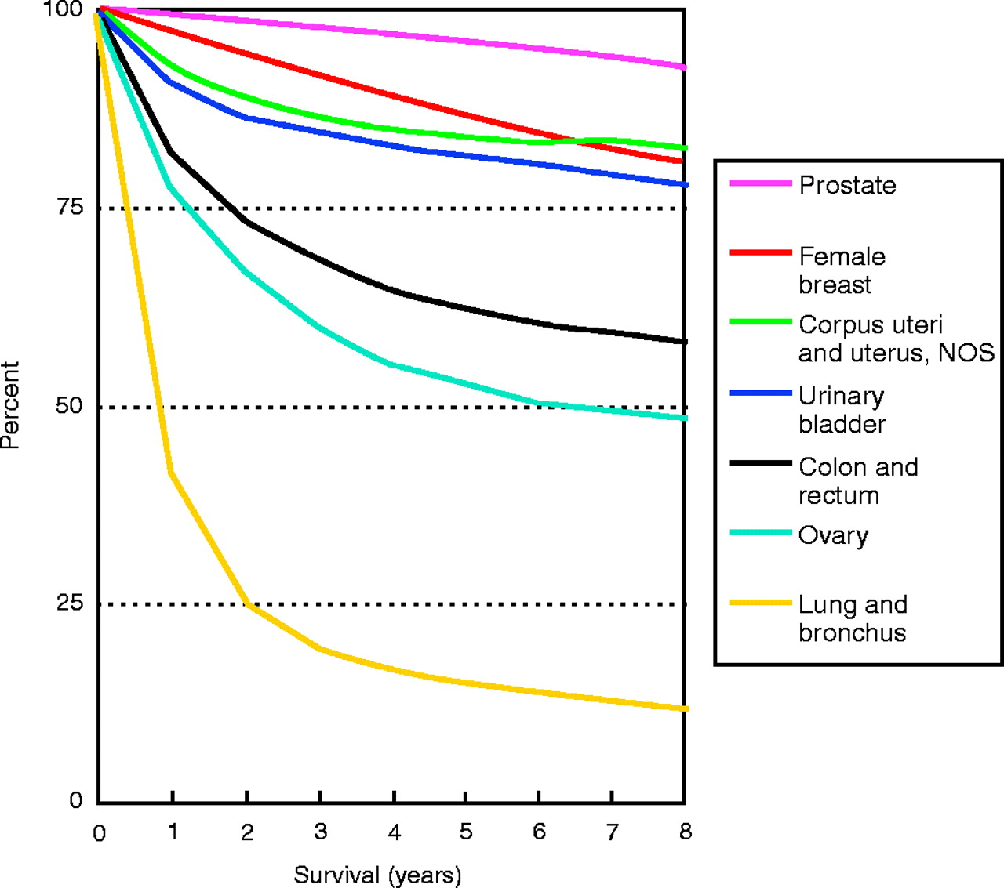
Life Table estimation: Survival by year from diagnosis by cancer site for cases diagnosed from 1990–1999
Gloeckler Ries et al. The Oncologist 2003
Notes:
Here is another example of life table estimation. It shows survival by year from diagnosis by cancer site for cases diagnosed from 1990–1999. Based on data from the Surveillance, Epidemiology, and End Results (SEER) registry, the NCI-funded population-based registry that aims to identify all new cancer diagnoses in designated areas and follow them for long-term outcomes. SEER registries do not cover the entire United States but they do aim to identify all new cancer diagnoses in specifically defined geographic areas.
Notice how there are not steps in the plot. This is characteristic of life tables.

Slide 95
K-M vs Life Table
 | Kaplan-Meier | Life Table
Calculation | Based on product of conditional probabilities of survival | Same
Interval | Defined by event | Defined by investigator depending upon context
Dating of event | Need date of event | Don’t need exact date of each event. Must place within time interval.
Assumptions:
Rate of censoring | No assumptions | Constant rate of censoring within each interval
Censoring | Unrelated to probability of outcome | Same
Competing events | No CE or independent | Same
Notes:
Here is a review of the similarities and differences in the Kaplan-Meier (KM) and Life Table approaches to estimation of cumulative incidence. The major difference is in the dating of the event. The exact date is known for Kaplan-Meier estimation, but for the life table the exact date is not needed. Instead, it is sufficient to simply know what interval of time the event occurred.
In practice, the Kaplan-Meier approach is used much more commonly, but knowledge of the life table approach is useful to reinforce the underlying principle behind both approaches, which is the way that cumulative probability of survival is calculated in the face of censoring.

Slide 96

Advanced Topics
Instead of “shifting everyone to the left” and using follow-up time, you can have different scales of time, such as age
Can also accommodate gaps in follow-up
For more, recommend:

Slide 97
Disease occurrence
Prevalence
Point
Period
Incidence
Cumulative incidence
Incidence rate
Simple proportion
Kaplan-Meier
Life-table
Aalen-Johansen
Average incidence rate
Instantaneous (hazard) rate
Notes:
Here’s a flowchart of the material covered in the lectures on Disease Occurrence, including topics that we covered today in red.

Slide 98
Summary Points 1
Prevalence counts existing disease and incidence counts new diagnoses of disease
  Point prevalence
  Period prevalence
Prevalence is a proportion
Terminology is not standardized
  “Rate” is often used incorrectly to describe prevalence
  You will need to examine details of what others have done rather than accept their nominal terminology

Slide 99
Summary Points 2
Incidence: consider E, N, and T
  Cumulative incidence: a proportion
  Incidence rate: based on person-time (next week)
Cumulative incidence:
  % of persons who have event within a specific time
  Estimated with simple proportion, Kaplan-Meier or life table
  Unequal follow-up times are the source of complications which are addressed with Kaplan-Meier and life table
  Assumptions of Kaplan-Meier and life table:
    losses unrelated to outcome (non-informative censoring)
    No (or independent) competing events
  Be aware of when observations spanning long calendar periods are combined and everyone is “shifted to the left”
Notes:
In the next lecture we will finish our discussion of cumulative incidence by presenting the Aalen-Johansen estimator that does not require the assumption of independent (or no) competing events. And, we will take up the measure of incidence based on person-time.

Slide 100
Extra Slides

Slide 101
A note on estimation
Because we are working with a sample of subjects (from the target population), we formally can only estimate any target population parameter
  e.g., In our study, we seek to estimate cumulative incidence.
Mathematical formulae/techniques which accomplish this estimation are often called “estimators”
  e.g., We used the Kaplan-Meier estimator.
The numerical result of the estimator is sometimes called an estimand.
Notes:
101

