Slide 1
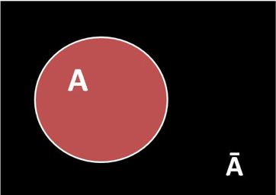
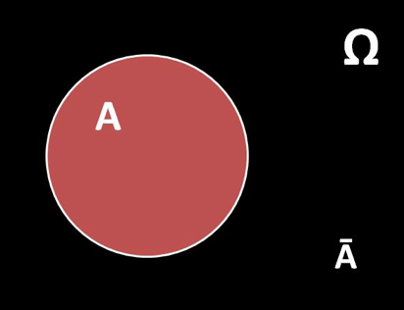
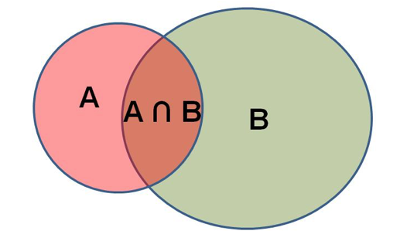
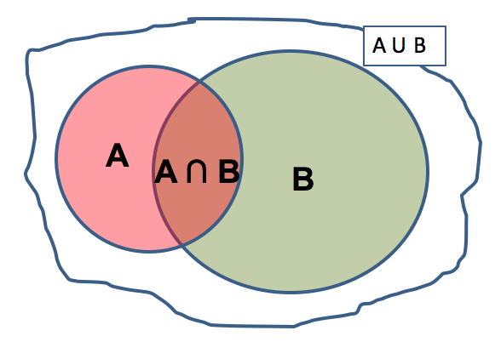
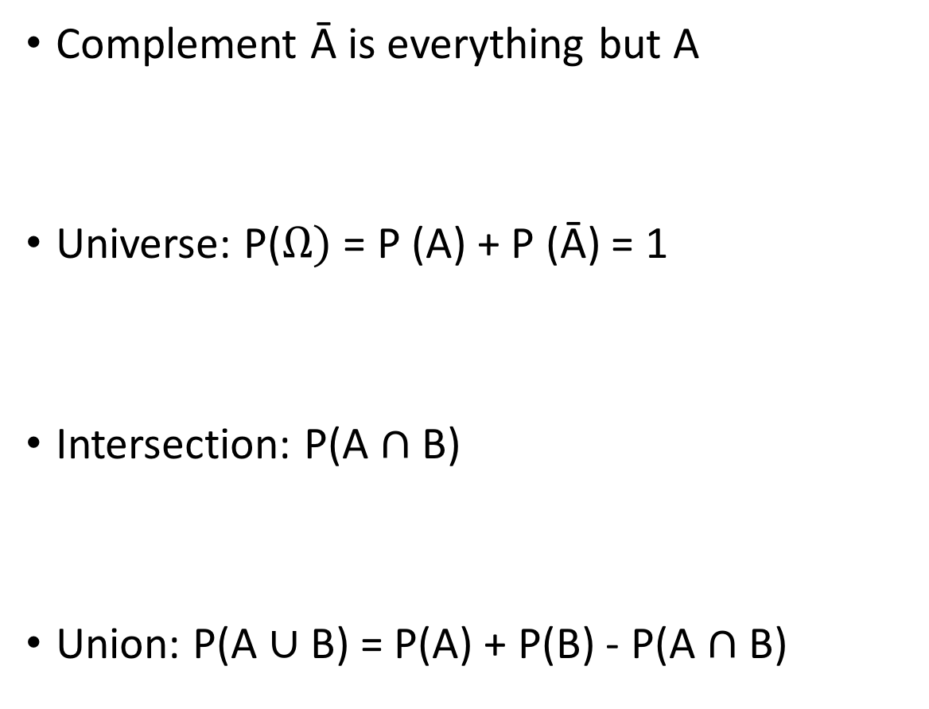
Summary of probabilities
Complement Ā is everything but A
Universe: P($Ω)$= P (A) + P (Ā) = 1
Intersection: P(A $∩$ B)
Union: P(A $∪$ B) = P(A) + P(B) - P(A $∩$ B)
Notes:
Universe is all the possible outcomes
Intersection is when both A and B occur together
Union is when either A, B, and both occur

Slide 2
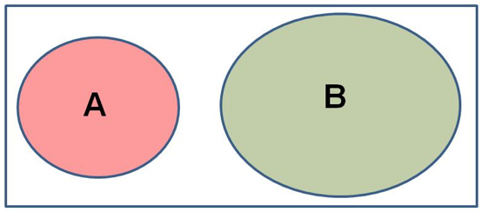
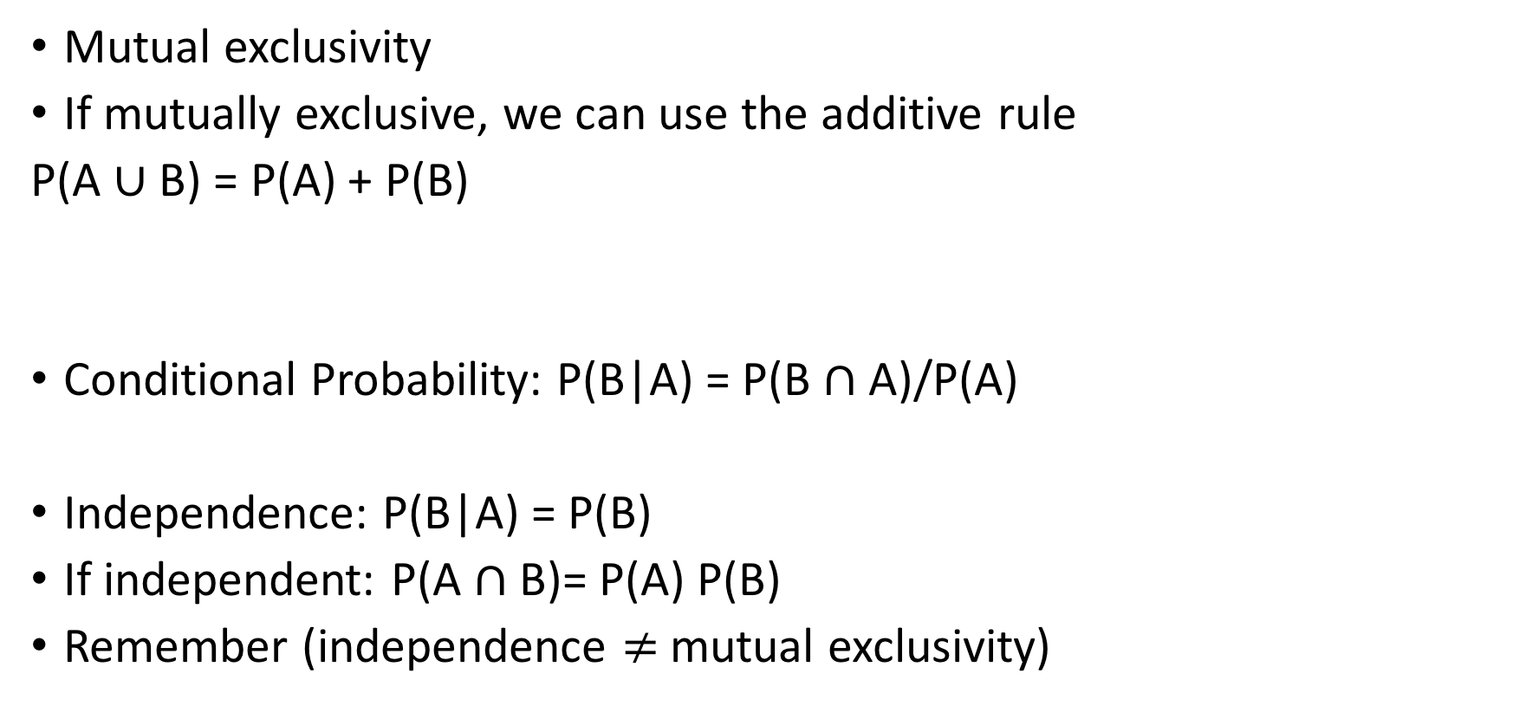
Mutual exclusivity
If mutually exclusive, we can use the additive rule
P(A $∪$ B) = P(A) + P(B)
Conditional Probability: P(B|A) = P(B $∩$ A)/P(A)
Independence: P(B|A) = P(B)
If independent: P(A $∩$ B)= P(A) P(B)
Remember (independence $≠$mutual exclusivity)
Notes:
Mutual exclusivity is when 2 events cannot occur together
The probability of an event B will occur given that an event A has occurred
When 2 probabilties do not depend on each other
The multiplicative rule of independence

Slide 3
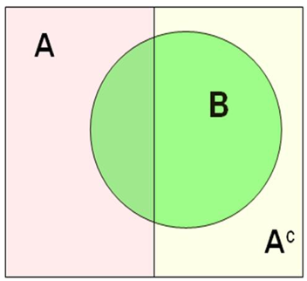
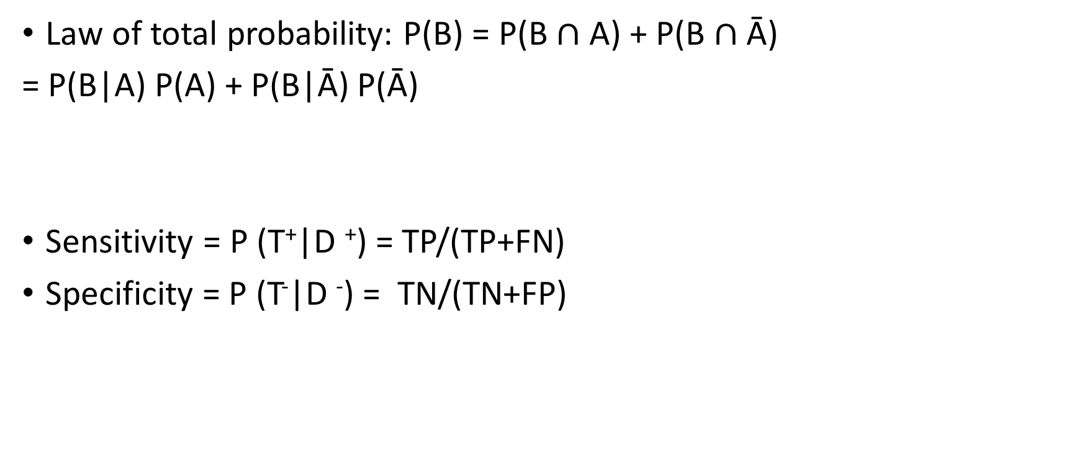
Law of total probability: P(B) = P(B $∩$ A) + P(B $∩$ Ā)
= P(B|A) P(A) + P(B|Ā) P(Ā)
Sensitivity = P (T⁺|D ⁺) = TP/(TP+FN)
Specificity = P (T⁻|D ⁻) = TN/(TN+FP)
Notes:
Remember that it is helpful when you cannot directly calculate a probability
Are based on experiments in which a test is compared “gold standered”

Slide 4
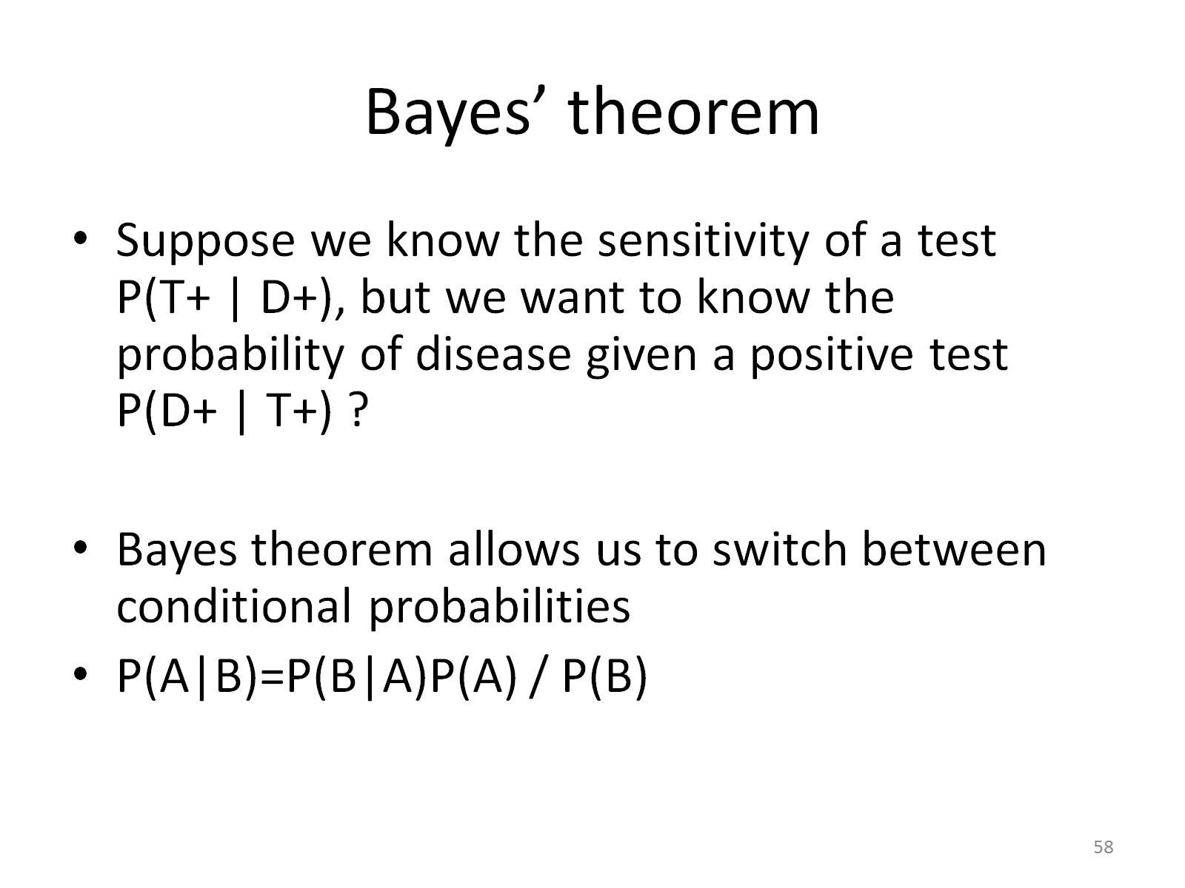
Bayes’ theorem

Slide 5
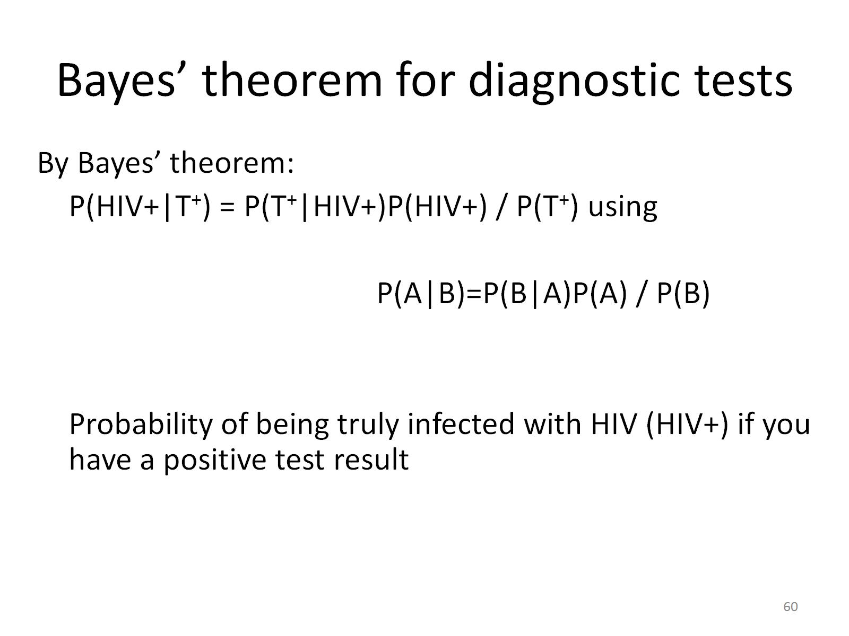
Bayes’ theorem for diagnostic tests

