Slide 1
Epidemiology of Aging
EPID 210
Overview
Context and Changing demographics

Slide 2
Aging: A Biological Definition
“A progressive, generalized impairment of function resulting in a loss of adaptive response to stress (loss of biological reserve) and in a growing risk of age-associated disease.“
After Kirkwood T, 1996

Slide 3
What is the epidemiology of aging?
One view: study of the distribution and determinants of risk factors and disease in older populations (aka: geriatric epidemiology)
Another view: study of the distribution and determinants of risk factors and disease in all populations across the life span (aka: life span epidemiology): developmental perspective

Slide 4
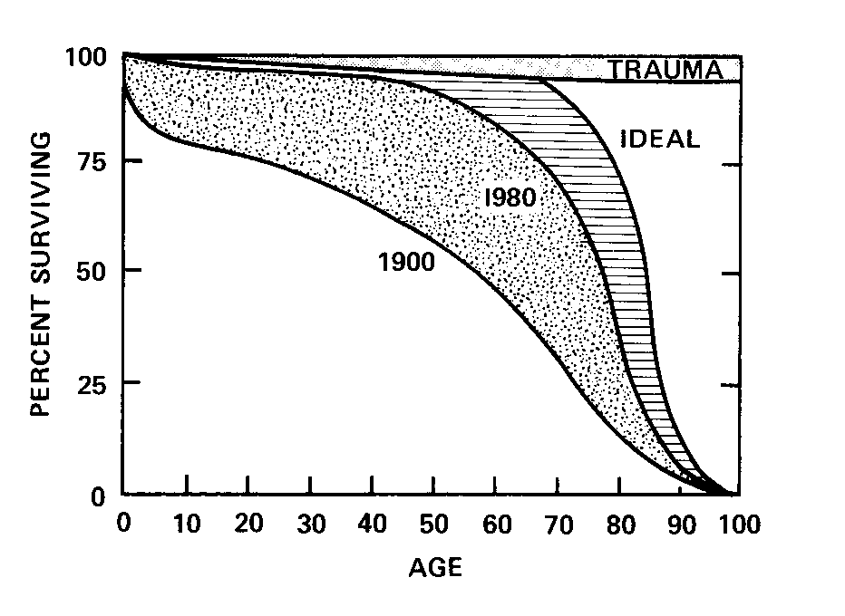
Squaring of the curve: ideal situation

Slide 5
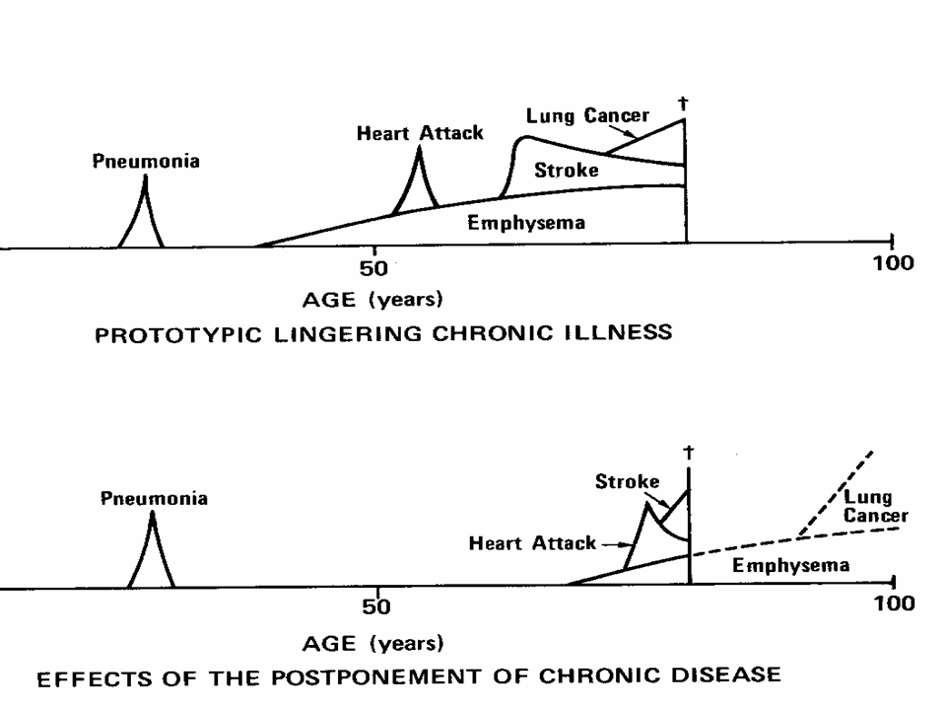

Slide 6

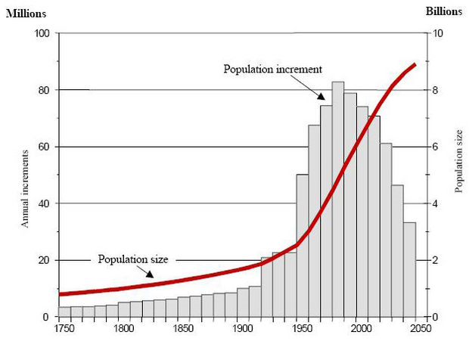
7 BILLION
Notes:
There can be no question that the world population is rapidly increasing. Economic growth, Public Health efforts and environmental improvements such as sanitation have lead to declining birth rates but improved survival. The total world population has grown from about 4 million in 1750 to 7 billion in 2011. We now face a predicted global population of over 8 billion by 2050. population growth of this order is unprecedented in the history of the world and is straining global resources everywhere.

Slide 7
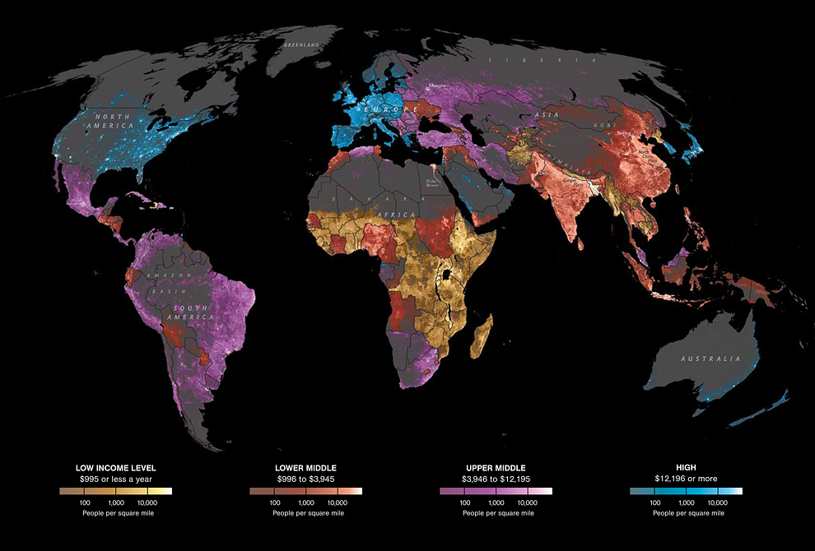
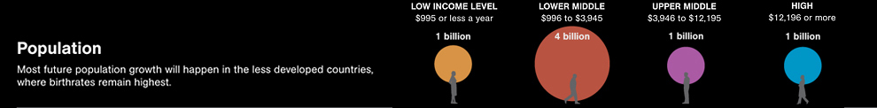
The world in 2011
Notes:
This map from National Geographic shows color coded income levels per country. Along with global aging, there are persistent and increasing health, economic and social disparities between developed and developing countries. Most future population growth will happen in less developed countries where birth rates remain highest. More than 70% of the world population – 5 billion people-- exists on less than $4000 a year.

Slide 8
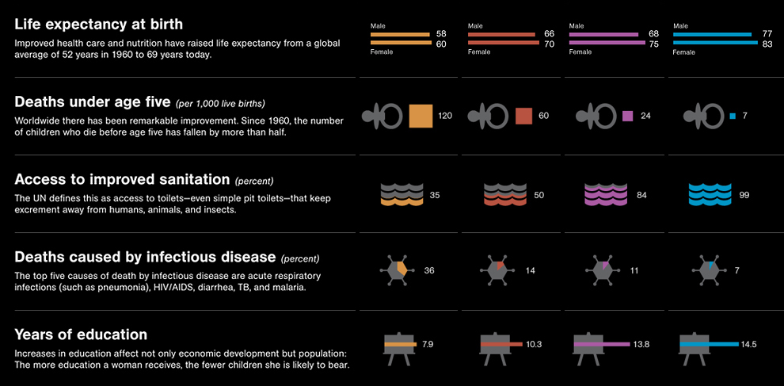
Notes:
This shows measures of country health color coded by income.. in low and lower middle income countries, life expectancy at birth has barely changed since 1950. Most deaths under age 5 occur in these countries. Access to sanitation is a fraction of what it is in upper middle and high income countries. Death by infectious diseases is five times higher. Education is half of what it is in high income countries. Literacy ranges from 99% in high income countries to less than 30% in Niger of Mali.

Slide 9
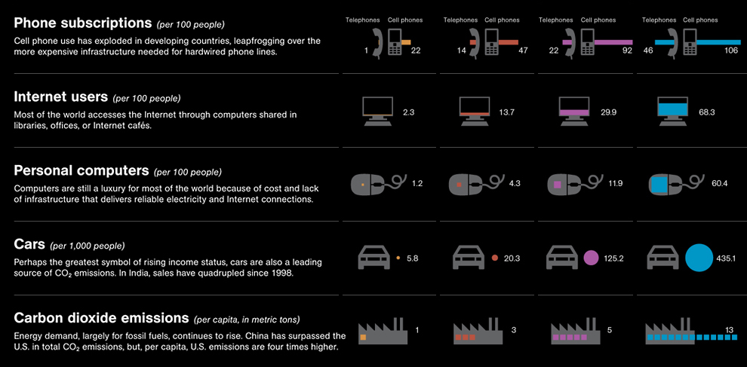

Notes:
There are widespread global disparities in access to modern technology that might aid people in developing countries to improve their economic conditions and their health. Internet access in low income countries is 30 times lower than in high income countries. Consumption of energy and materials such as cars, computers and petroleum, are vastly higher in high income countries relative to low income countries.

Slide 10
Global Aging is a priority for international health
United Nations Research Priorities for an aging world
Priority 1: population aging and socioeconomic development
Priority 2: Current practices and options for maintaining material security at older ages
Priority 3: Changes in family structures, intergenerational transfer systems and emergent patterns of family and institutional dynamics
Priority 4: Determinants of healthy aging
Priority 5: Basic biological mechanisms and age associated diseases
Priority 6: Quality of life and ageing in diverse cultural, socioeconomic and environmental situations

Slide 11
Population dynamics and economics influence population aging
Demographic factors
Lower Fertility rate
Lower Mortality rate
Longer Survival
Lead to:
Population decreases
Changes in the age structure of the population
Economics
Immigration from less developed countries to more developed countries
Employment of the older population
Changes in ‘dependency ratio’ (ratio of dependent population to working population)

Slide 12
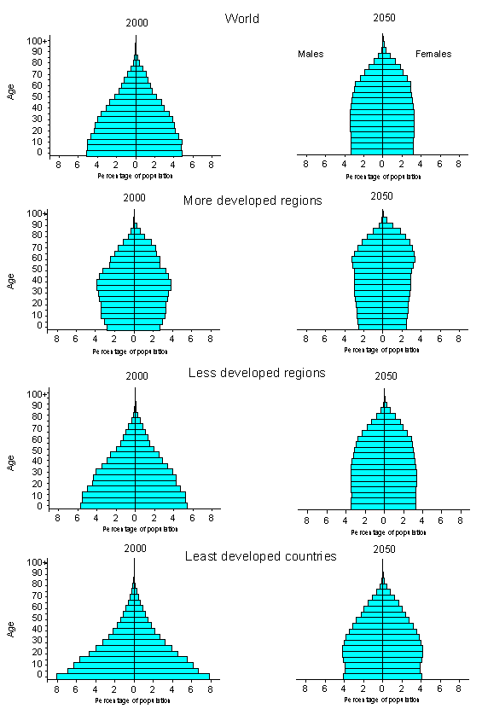
Projected ‘Pyramid’ of aging by world, region and development status

Slide 13
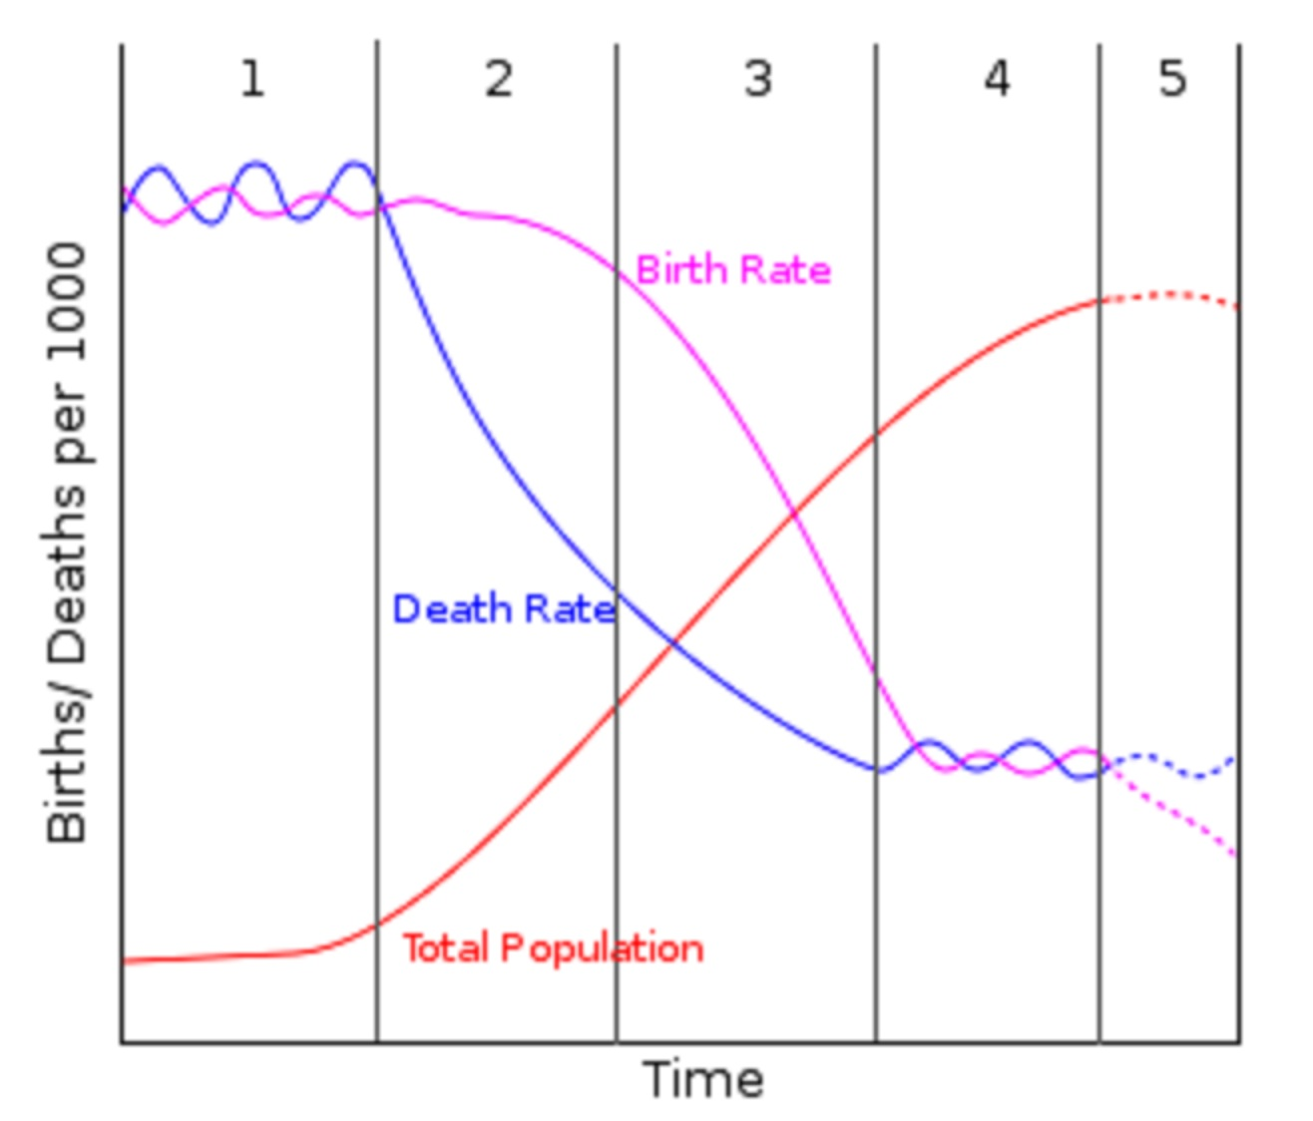
  Our world now stands on the threshold of a stunning demographic transition called global aging.
  This is caused by declining birth and death rate and decreases in population.
Notes:
Stages in demog transtion

Slide 14
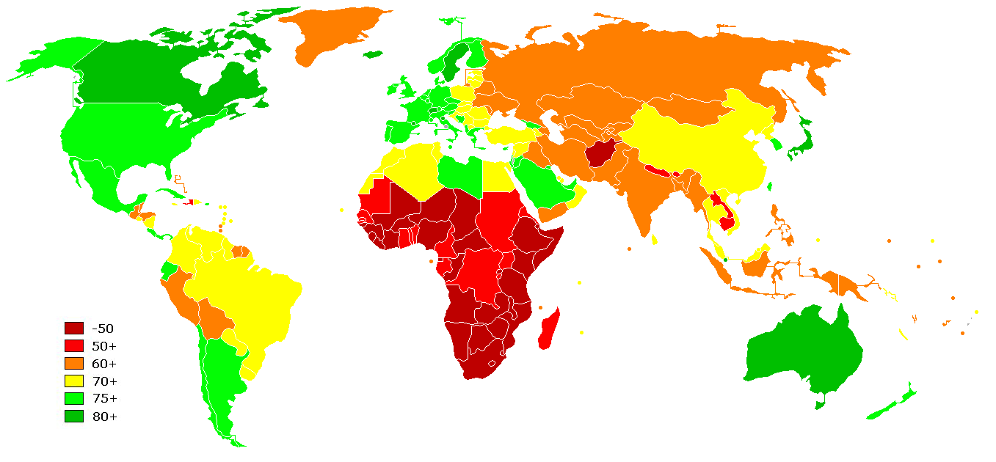
Global Life expectancy at birth by country

Slide 15
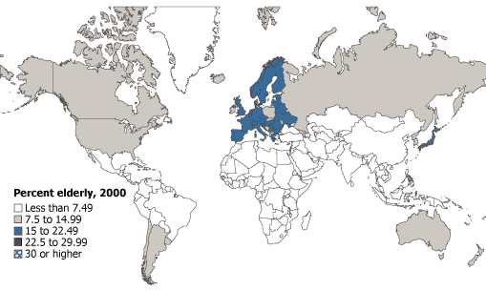
Aging ‘Epidemic’: 2000
Percent elderly aged 65+
Population reference bureau

Slide 16
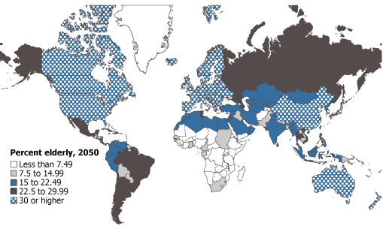
Aging ‘Epidemic’: 2050
Percent elderly aged 65+
Population reference bureau

Slide 17
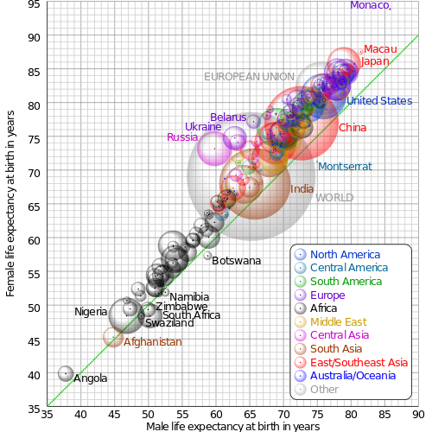
Comparison of gender life expectancy

Slide 18
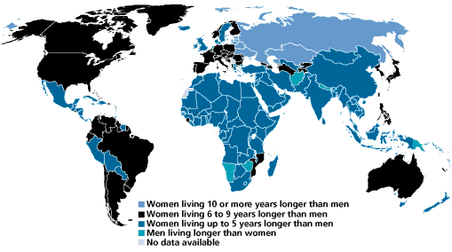
Even with gender inequality as a global phenomenon, in most places in the world, women live longer than men
Would women live even longer than men if there was less economic and social inequality?

Slide 19
The World’s 15 ‘Oldest’ Countries and the U.S.
Percent Age 65 or Older
Sources: Carl Haub, 2006 World Population Data Sheet.
Notes:
Except for Japan, the world’s 15 oldest countries are all in Europe.
The U.S. population is relatively “young” by European standards, with less than 13 percent age 65 or older, ranking as the 38th oldest country.
The aging of the baby-boom generation in the United States will push the proportion of older Americans to 20 percent by 2030; it will still be lower than in most Western European countries.
The older share of the population is expected to more than double between 2000 and 2030 in Asia and Latin America and the Caribbean. Aging is occurring more slowly in sub-Saharan Africa, where relatively high birth rates are keeping the population “young.”

Slide 20
Notes on the World’s 15 ‘Oldest’ Countries and the U.S.
Except for Japan, the world’s 15 oldest countries are all in Europe.
The U.S. population is relatively “young” by European standards, with less than 13 percent age 65 or older, ranking as the 38th oldest country.
The aging of the baby-boom generation in the United States will push the proportion of older Americans to 20 percent by 2030; it will still be lower than in most Western European countries.
The older share of the population is expected to more than double between 2000 and 2030 in Asia and Latin America and the Caribbean. Aging is occurring more slowly in sub-Saharan Africa, where relatively high birth rates are keeping the population “young.”

Slide 21
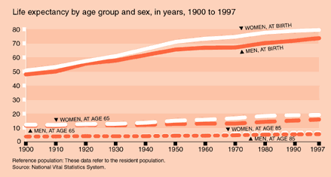
Life expectancy 1900 to 1997 USA
At birth (women): 60% increase: At 65: 100% increase
Notes:
LE at birth has increased by 60% from 50 years in 1900 to 80 years in 1997. LE at 65 has increased by 100% from 10 (women) in 1900 to about 20 in 1997.

Slide 22
Cities with the least and the most proportions of people aged 65+
United States (2000)
Least
Most

Slide 23
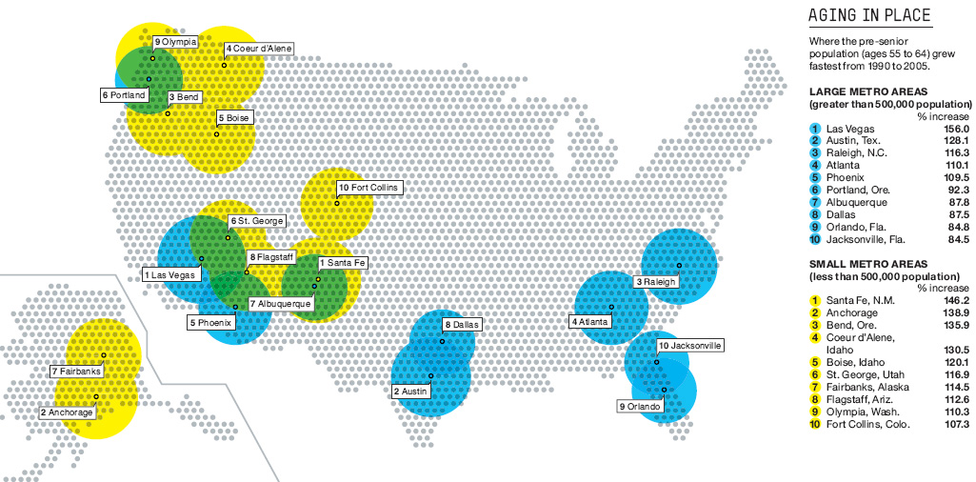
Areas with the fastest growth in ages 55-64 between 1990-2005 in USA

Slide 24
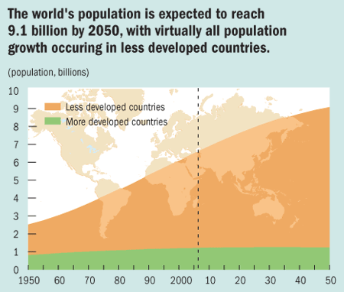

Slide 25
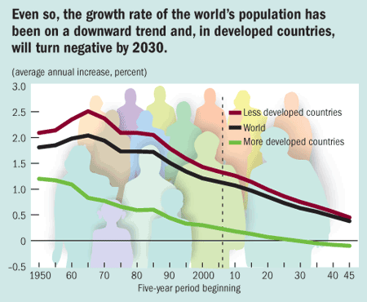

Slide 26
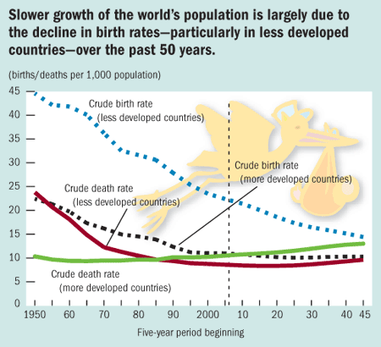

Slide 27
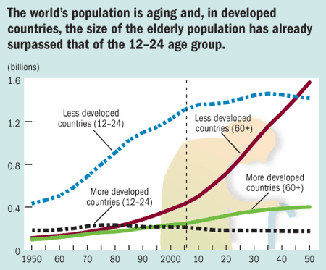

Slide 28
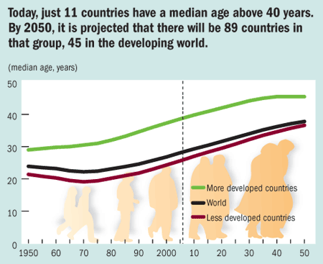

Slide 29
Example of Aging in China
Percent of Elderly (65+) in China’s Population, 1950-2050
Source: World Population Prospects: The 2004 Revision (2005).
Notes:
Due to vast improvements in health over the past five decades, life expectancy at birth has increased by two-thirds from 40.8 to 71.5 years between 1955 and 2005.
The percent of elderly in China is projected to triple from 8 percent to 24 percent between 2006 and 2050.
Because chronic health problems become more common in old age, China’s population aging has led to increases in the country’s prevalence of chronic disease and disability.

Slide 30
Notes on Aging in China
Due to vast improvements in health over the past five decades, life expectancy at birth in China has increased by two-thirds from 40.8 to 71.5 years between 1955 and 2005.
The percent of elderly in China is projected to triple from 8 percent to 24 percent between 2006 and 2050.
Because chronic health problems become more common in old age, China’s population aging has led to increases in the country’s prevalence of chronic disease and disability.

Slide 31
The rise of chronic disease and disabilities

Slide 32
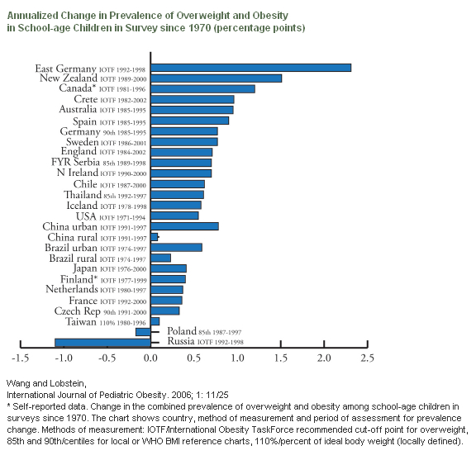
World wide trends in obesity since 1970
Notes:
Along with global aging we are seeing rapid increases in obesity at ever younger ages, even in less developed countries. These reflect increased urbanization, more sedentary lifestyles, lack of access to healthy food supplies.

Slide 33
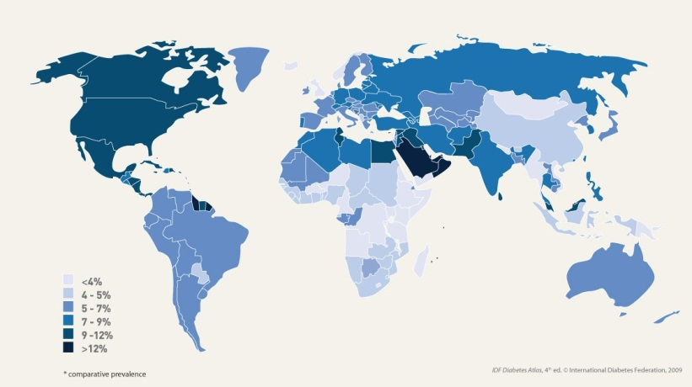
Prevalence of diabetes in 2010 by country
Notes:
Diabetes can be a devastating disease is linked to stroke, blindness, amputations, dementias and high death rates in ever younger populations. Today diabetes is highest in developed countries such as the US and Canada.

Slide 34
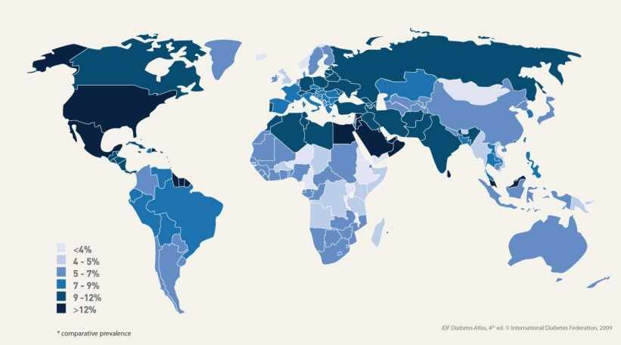
Prevalence of diabetes in 2030 by country
Notes:
By 2030, worldwide diabetes is projected to affect over 440 million people. The largest increase will be in Africa where prevalence will double -- affecting more than 47 million people. Effective treatments exist for diabetes but are out of reach of many living in LDCs.

Slide 35
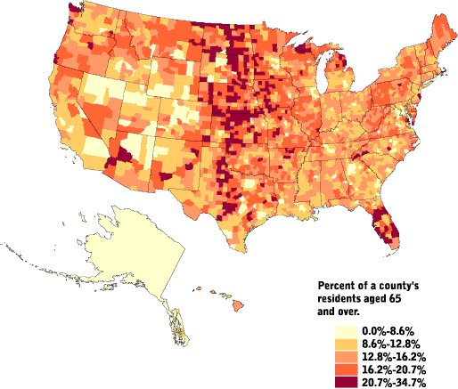
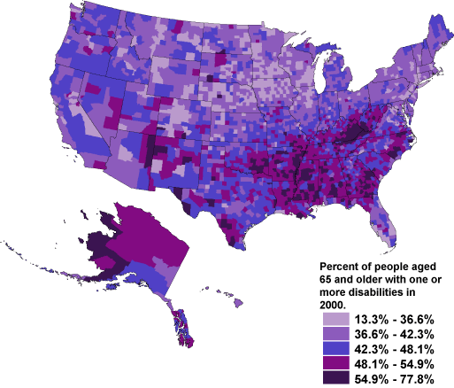
Aging populations in the United States and disabilities (Census 2000)
Age 65+
65+ with Disabilities

Slide 36
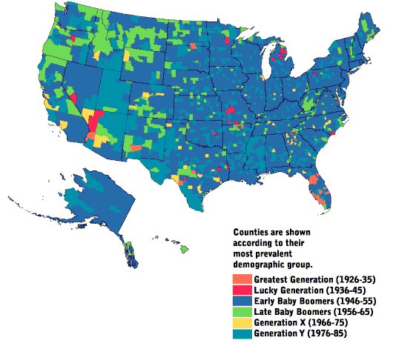
Generations* and aging, US census 2000
http://www.censusscope.org/us/map_generations.html
* Birth and period cohort effects: generational experience, HRS

Slide 37
Some terminology related to epidemiology and aging
Life expectancy: average, maximum, disability-free, active, healthy
Life span: average, maximum
Disability free life expectancy
Dependency Ratio
Comorbidity

Slide 38
‘Life expectancy’
The Life expectancy of a group of people at any given age is the average number of years that they have remaining to live. "Life expectancy at birth" (abbreviated as e₀) is also called average life span or mean life span. This is distinct from maximum life span. Life expectancy at birth should not be confused with median survival time (the time by which 50% of a cohort will have died).
Life expectancy calculations are extrapolated from age-specific death rates of people alive at the beginning of a given time-period, typically a given calendar year or group of years. Typical life expectancies for the current year reflect current age-specific death rates and are not predictions or projections about life expectancy or mortality in the future. The fact that an average is calculated over a subset of the population makes life expectancy a statistical measure.

Slide 39
Maximum life span
Maximum life span is a measure of the observed maximum number of years a member of a group has been observed to survive. Maximum life span corresponds to the age at which the oldest known member of a species or experimental group has died, or the current age of the oldest living member, if higher.
Maximum life span is contrasted to mean life span (average lifespan or life expectancy). Mean life span varies with susceptibility to disease, accident, suicide and homicide, whereas maximum life span is thought to be determined by a fundamental
"rate of aging".

Slide 40
What is healthy life expectancy? (World Health Organization)
Healthy life expectancy (HALE) is based on life expectancy, but is decremented for time spent in poor health.
This indicator measures the equivalent number of years in ‘full health’ that a person can expect to live based on the current mortality rates and prevalence distribution of health states in the population in which he or she resides.

Slide 41
WHO definition of chronic disease
Chronic diseases are diseases of long duration and generally slow progression. Chronic diseases, such as heart disease, hypertension, stroke, cancer, chronic respiratory diseases and diabetes, are by far the leading cause of mortality in the world, representing 60% of all deaths. Out of the 35 million people who died from chronic disease in 2005, half were over 70 and half were women.

Slide 42
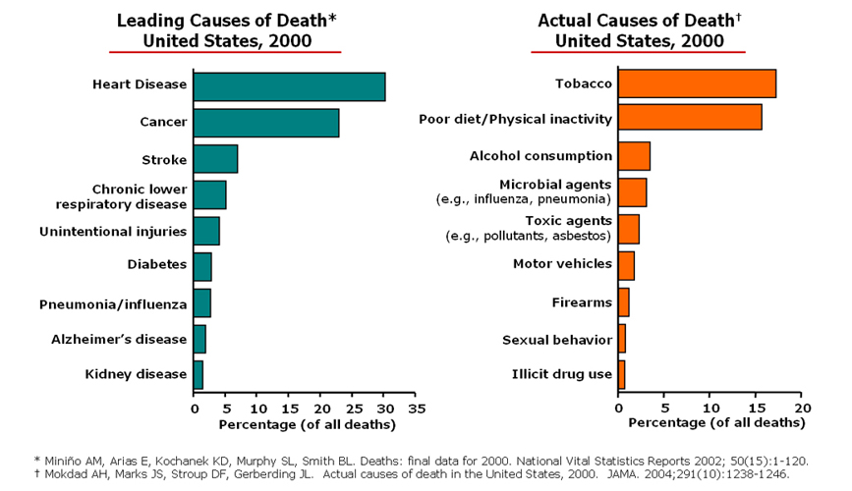

Slide 43
Ten most prevalent conditions in people aged 65+ in the US
Many of these co-exist in older people= ‘comorbidity’
What do most of these conditions have in common?

Slide 44
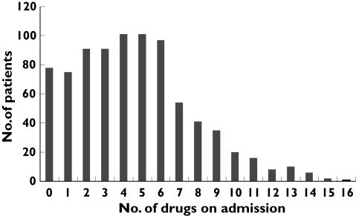
Figure 1 Polypharmacy:
Distribution of drug use on admission among 827 hospitalized patients
Br J Clin Pharmacol. 2007 February; 63(2): 187–195.

Slide 45
What is ‘comorbidity’?
Single disease vs.
multiple conditions, diagnoses, & drugs
Predictor of disability, death and
Institutionalization
Interactions between conditions and
treatments
Usual Measurement:
N of diseases
Severity of disease
on an additive rating scale
Rozzini, Age and Ageing 2002

Slide 46
Geriatric index of comorbidity
In computing the GIC, each of the 15 more prevalent
clinical conditions (ischemic or organic heart diseases,
primary arrhythmias, heart diseases with a nonischemic
or nonorganic origin, hypertension, stroke,
peripheral vascular diseases, diabetes mellitus, anemia, gastrointestinal diseases, hepatobiliary diseases, renal diseases, respiratory diseases, parkinsonism and nonvascular neurologic diseases, musculoskeletal disorders, and malignancies) is graded on a 0-4 disease severity scale AS:
0=absence of disease,
1=asymptomatic disease, 2=symptomatic disease
requiring medication but under satisfactory control,
3=symptomatic disease uncontrolled by therapy,
and 4=life-threatening or the most severe form of
the disease.
Four classes of increasing somatic comorbidity.
Class 1 includes patients who have one or more conditions with a disease severity grade equal to or lower than 1.
Class 2 includes patients who have one or more conditions with a disease severity grade of 2.
Class 3 includes patients who have one condition with a disease severity of 3, other conditions having a disease severity equal to or lower than 2.
Class 4 includes patients who have two or more conditions with a disease severity of 3 or one or more conditions with disease
severity of 4.

Slide 47
Common geriatric syndromes and conditions
Death
Falls→ disability, mortality, hospitalizations, high costs for families
Increasing comorbid conditions & diseases
Disability and frailty syndromes
Cognitive changes and dementias
Sensory loss: vision, hearing, smell
Nonfatal, disabling conditions: ie: prostate enlargement, cataracts, arthritis
Loss of social networks: bereavement, loss of friends through death, inability to participate in social functions
Loss of income due to retirement or ill health

Slide 48
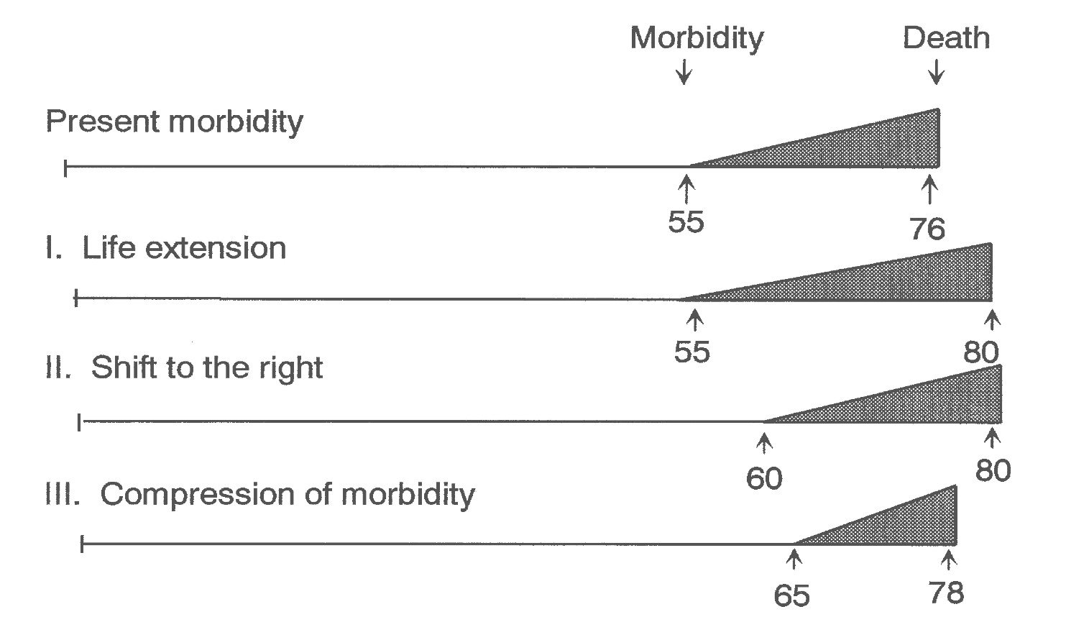
Compression of morbidity
Are people living longer but doing worse?
Key issues:
1- When does chronic disease begin?
2 – Is there a maximum life span?
3- Influence of changes in
treatment and prevention over
time on the difference between
onset of morbidity and death
Ideal: as people live longer, they will also be healthier, so the period
of morbidity will be the same or shorter.
OR: they are living longer with disease, the period of morbidity
will be longer

Slide 49
Example of
Okinawa study of aging

Slide 50
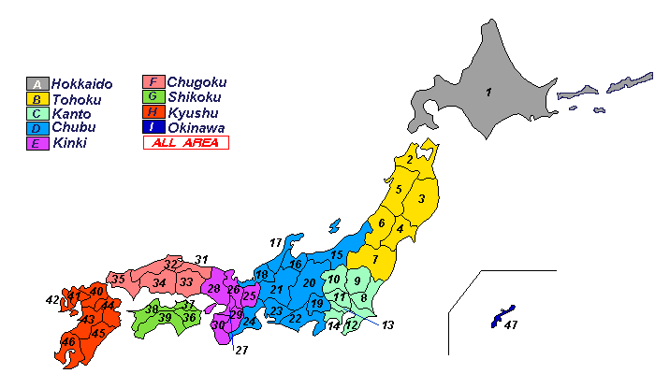
Japan
Okinawa

Slide 51
The dream of living forever….

Slide 52
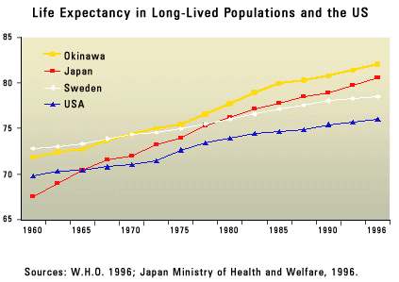
Life expectancy at birth in Okinawa…

Slide 53

Why do Okinawans live so long? Or do they?
Lifestyle factors cited by authors
Diet low in fat, high in vegetables
Low stress
Low obesity
Frequent exercise
Social connections
Non smoking
Low alcohol consumption
Lower blood pressure
Buddhists

Slide 54
http://www.youtube.com/watch?v=39ce8WA6mSM
Which factor(s) does the investigator suggest that might explain
longevity in Okinawa?

Slide 55
Complexity of aging and population health
Aging is an continuous underlying process that affects all living things
Aging is not a disease and disease pathology is not inevitably linked to aging
Environments at many levels (global, local, biological) influence the rates of aging and development of disease
Genetic factors that influence disease risk may act differently in older populations
Many conditions/syndromes common in aging populations are characterized by slow progression, nonfatal but debilitating limitations

Slide 56
Some ways that health in older populations is different from younger populations
Older populations are more selected (‘survivors’)
Symptoms and trajectory of conditions and diseases may be different than in young or middle aged people
Competing risk of mortality: higher death rates may reduce the effects of a risk factor on disease
Comorbidities may compete with each other or interact to affect risk
Targets of interventions may be different
Interventions used in younger populations may not work the same in older populations
Definition of ‘health’ may mean functionality rather than absence of disease

Slide 57
Are causes and patterns of disease different in older vs. younger populations?
Cause/Etiology and prevention
  New events (ie: a heart attack in someone who never had one)
  Recurrent events
  Change in functional status (disability, frailty)
  Change in cognitive status (memory, processing speed)
Most chronic diseases have a long initiation phase (latency) that has a preclinical/asymptomatic phase
Predictors of disease may change: ie: LDL, a predictor of heart disease in middle age, may only predict subclinical disease at older ages
In the elderly, sub-clinical disease may predict clinical events (precipitate events)

Slide 58
Life style interventions in old age
Should people over 70 be encouraged to exercise?
Will stopping smoking at age 70 have any benefits?
What about dietary changes?
Are aging processes modifiable?
Prevention of decline is a key

Slide 59
Why is aging important to public health programs and research?
Most chronic illness occurs in older age groups
Aging is a global issue
Cultural values and behaviors related to aging vary
Aging is often, but not always, accompanied by disability and illness
Disability and illness in old age can often be prevented
Impact on families of disability in older people
Policies related to aging:
  Retirement age
  Security in old age
  Health care use and costs
  Driving and independence
  Voting and memory loss
  Social security
  Long term care costs
  Hospice
  In home care costs
  Financial losses to families……….

Slide 60
Elements of population health and ageing
Interventions:Primary
prevention of risk factors
Secondary
and tertiary
interventions:
Medical care
Risk factors
*early life
*mid life
*old age
Diseases and conditions
Functioning
Population dynamics
*birth rate
*age specific mortality
Disability
Survival with disability
Institutionalization
Death

