Slide 1
EPI222
Lecture 6: Social Policies Contributing to and Alleviating Health Disparities
Notes:
Add more on disparities policies – eg lead.
Regression discontinuities

Slide 2
Where are we in the class?
Economic & Social
Opportunities and Resources
Policies to promote child
and youth development
and education, infancy
through college
Policies to promote economic development, reduce poverty,
and reduce racial segregation
Living & Working Conditions
in Homes and Communities
Policies to promote healthier
homes, neighborhoods,
schools and workplaces
Behaviors
Medical Care
Biology and interactions between biology & experiences
HEALTH
Adapted from Robert Wood Johnson Foundation Commission to Build a Healthier America | www.commissiononhealth.org

Slide 3
Policies and Health Disparities
Reasons to research policies
Types of policies that may affect health disparities
Rigorous empirical approaches to evaluating health effects of policies
  MTO: a randomized trial
  Regression discontinuity and related methods: hospital desegregation, educational policies
  Pseudo-randomization: juvenile judges
Distinguishing policy effects on average outcomes from effects on disparities: GI Bill
Major controversies or uncertainties

Slide 4
Policies and Health Disparities
Reasons to research policies
Types of policies that may affect health disparities
Rigorous empirical approaches to evaluating health effects of policies
Distinguishing policy effects on health from effects on health disparities: GI Bill
Major controversies or uncertainties

Slide 5
Why study social policies and health?
Policies themselves – at the federal, state, local, or organizational levels – may be the most powerful health interventions.
Evaluating the health impact of policies can contribute to arguments about the design and implementation of such policies.
Policies may also provide “natural experiments” to understand the origins of health disparities.
Evaluating policies as natural experiments can give new insight into whether social factors are causal.

Slide 6
Social Factors and Health: Hypothesized Pathways
Employment/ Occupation
Toxic/Dangerous Environments (Housing, work, infections, lead)
Education
Income
Wealth
Behaviors (diet, exercise, medical care, sex, violence)
Disease
Onset, Progression, and Consequences
Social Networks
Knowledge
Cognitive Skills (literacy, numeracy)
Psychological Experiences
(stress, shame)
Race/
Ethnicity
Self efficacy

Slide 7
Which Pathways Are Affected by Policies?
Employment/ Occupation
Toxic/Dangerous Environments (Housing, work, infections, lead)
Education
Income
Wealth
Behaviors (diet, exercise, medical care, sex, violence)
Disease
Onset, Progression, and Consequences
Social Networks
Knowledge
Cognitive Skills (literacy, numeracy)
Psychological Experiences
(stress, shame)
Race/
Ethnicity
Self efficacy

Slide 8
Which Pathways Are Affected by Policies?
Employment/ Occupation
Toxic/Dangerous Environments (Housing, work, infections, lead)
Education
Income
Wealth
Behaviors (diet, exercise, medical care, sex, violence)
Disease
Onset, Progression, and Consequences
Social Networks
Knowledge
Cognitive Skills (literacy, numeracy)
Psychological Experiences
(stress, shame)
Race/
Ethnicity
Self efficacy

Slide 9
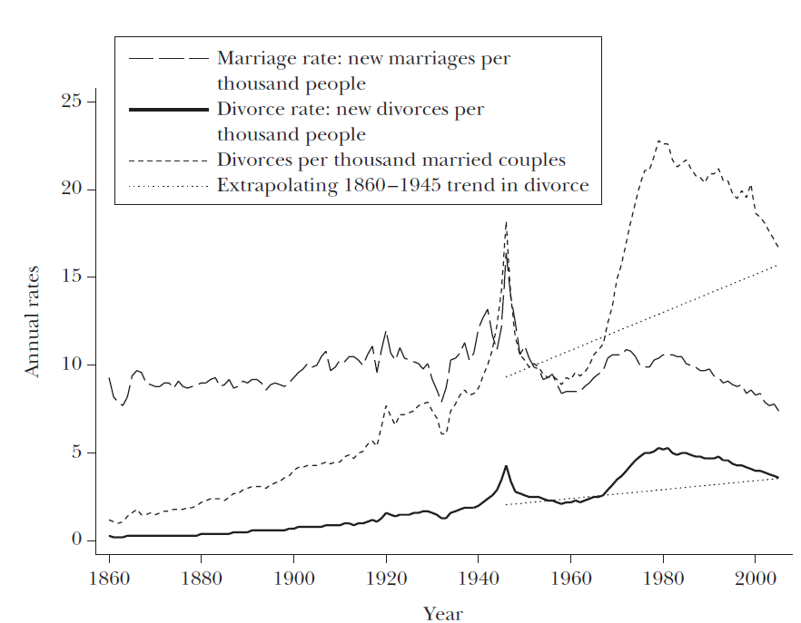
Even profoundly personal exposures are shaped by policies
Marriage and divorce rates US 1860-2005
Stevenson and Wolfers, JEP 2006
Notes:
Griswold head of planned parenthood – CT law made it illegal to use a drug, medicinal article, or instrument to prevent conception – decision applied right of privacy to marital relationships
Eisenstadt extended to unmarried couples
Gomez v Perez: overturned state laws exempting men from financial responsibility for out-of-wedlock kids

Slide 10
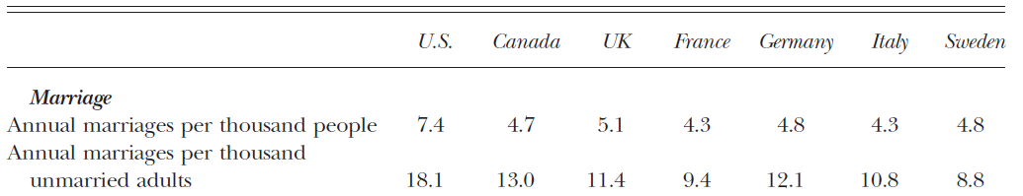
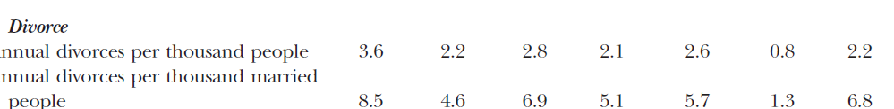
Even profoundly personal exposures are shaped by policies
Marriage and divorce rates internationally (circa 2003)
Stevenson and Wolfers, JEP 2006
Marriage and divorce rates to changed markedly across time and differ dramatically across countries.
Probably dynamic feedback between social policies and social norms
Notes:
Griswold head of planned parenthood – CT law made it illegal to use a drug, medicinal article, or instrument to prevent conception – decision applied right of privacy to marital relationships
Eisenstadt extended to unmarried couples
Gomez v Perez: overturned state laws exempting men from financial responsibility for out-of-wedlock kids

Slide 11
Even profoundly personal exposures are shaped by policies
Marriage, divorce, and children: core social networks
Birth control availability and legality
    Griswold v Connecticut (1965) birth control ok
    Eisenstadt v. Baird (1972) even for unmarried people
    Changed both marriage and fertility
Legal obligations to children
    Gomez v Perez (1973) Dads have to pay, even if unmarried
Marriage and divorce laws
    Loving v Virginia (1967) allowing interracial marriage
    “irreconcilable differences” as grounds for divorce (late 1960s, state by state)→ divorce at the request of either spouse, and “no fault” laws
    Unilateral divorce: short term effects on divorce rates but not large long-term effects; decreases in female suicide and domestic violence.(Stevenson and Wolfers 2006)
Notes:
Griswold head of planned parenthood – CT law made it illegal to use a drug, medicinal article, or instrument to prevent conception – decision applied right of privacy to marital relationships
Eisenstadt extended to unmarried couples
Gomez v Perez: overturned state laws exempting men from financial responsibility for out-of-wedlock kids
Point here is simply that something that seems fundamentally personal and individual level – who you love, have sex with, and marry – is deeply shaped by social policies. These factors (who you love, have sex with, and marry) in turn shape a whole host of downstream health risk factors – health behaviors, medical access, exposures.

Slide 12
Which Pathways Are Affected by Policies?
Employment/ Occupation
Toxic/Dangerous Environments (Housing, work, infections, lead)
Education
Income
Wealth
Behaviors (diet, exercise, medical care, sex, violence)
Disease
Onset, Progression, and Consequences
Social Networks
Knowledge
Cognitive Skills (literacy, numeracy)
Psychological Experiences
(stress, shame)
Race/
Ethnicity
Self efficacy

Slide 13
Policies and Health Disparities
Reasons to research policies
Types of policies that may affect health disparities
Rigorous empirical approaches to evaluating health effects of policies
Distinguishing policy effects on health from effects on health disparities: GI Bill
Major controversies or uncertainties

Slide 14

Policies regulating fundamental social causes lead to
social inequalities in health risk factors, which influence
social inequalities in morbidity and mortality
Education/Schooling
Availability
Quality
Content
Age of school attendance
Behaviors
Health Care Access
Environmental Justice
Toxic Environment
Housing
Occupational Health
Neighborhood Safety/Security
Stress
Social Networks /Integration
Social Norms
Mental Health
Financial Resources
Taxation
Welfare programs
Pensions
Workplace discrimination protection
Minimum wages
Employment security
Physical Health
Notes:
Figure 12-1. Policy mechanisms influencing social determinants of health and socially patterned risk factors. Some social policies directly influence “fundamental social determinants of health”, such as education and income, but many social policies also target inequalities in health risk factors. Policies that eliminate social inequalities in health risk factors, for example by guaranteeing healthy housing in safe neighborhoods, can also reduce social inequalities in health.
One way to organize thinking about categories of policies relevant to health.

Slide 15
Types of policies that may affect health disparities
Not carved in stone, but helpful to distinguish by “proximity” to health outcome
  Social determinants of health, level and inequalities
  Recognized health risk factors
  Receipt of high quality medical care
Can also consider where in disease process
  Primordial prevention: prevent development of risk factors
  Primary prevention: prevent disease incidence
  Secondary prevention: reduce the impact of disease that already occurred
  Tertiary prevention: Reduce long-term impact of ongoing illness
Notes:
Griswold head of planned parenthood – CT law made it illegal to use a drug, medicinal article, or instrument to prevent conception – decision applied right of privacy to marital relationships
Eisenstadt extended to unmarried couples
Gomez v Perez: overturned state laws exempting men from financial responsibility for out-of-wedlock kids
Point here is simply that something that seems fundamentally personal and individual level – who you love, have sex with, and marry – is deeply shaped by social policies. These factors (who you love, have sex with, and marry) in turn shape a whole host of downstream health risk factors – health behaviors, medical access, exposures.

Slide 16
Social Epidemiology Translation (SET) model
Interventions within the Medical Care System
Identify populations likely to be underdiagnosed to improve screening and preventive treatment
Identify vulnerable people and vulnerable periods to improve quality of care delivery systems
Identify modifiers of treatment effects/personalize treatment
Disease Risk Factors
Morbidity and Mortality
Disease Incidence
Disease Diagnosis
Disease Management
Prevent development of risk factors (e.g., unhealthy behaviors). Modify risk factors for disease incidence, e.g., smoking, lead exposure
Modifiable risk factors for non-adherence to treatment, e.g., low literacy, lack of transportation
Modifiable risk factors for poor outcomes even with good treatment adherence. e.g., psychological stressors
Interventions for Individual or Community/Environment
Patton & Glymour, Circ 2014
Notes:
Figure: Conceptual model for strategies to use social epidemiology research to reduce morbidity and mortality: the social epidemiology translation (SET) framework.

Slide 17
Policy Evaluation Relevant at Multiple Stages of Public Health
What are the causes of health and illness?
Theoretical understanding, including biology and social theory
How important are the various causes?
Heterogeneity/subgroup analyses
Population attributable fractions
How do we alter these health determinants?
Collaborations with experts in the “determinants of social determinants” to define interventions
Policy analyses
Simulation studies
Quasi- or natural-experiments
Implementation expertise
Observational epidemiology
Randomized trials
Evidence feedback: intervention results inform theoretical understanding of causal determinants of health.

Slide 18
Policies and Health Disparities
Reasons to research policies
Types of policies that may affect health disparities
How to study health effects of policies?
  MTO: a randomized trial
  Regression discontinuity and related methods: hospital desegregation, mandatory educational policy
  Pseudo-randomization: juvenile judges
Distinguishing policy effects on health from effects on health disparities: GI Bill
Major controversies or uncertainties

Slide 19
How do you study health effects of policies?
Randomize: generally preferable, but rare.
Some other possible sources of exogenous variation:
  Geography variations in policies
  Temporal variations in policies
  Institutional features with policy differences (banking policies, loan guarantees)
  Evidence on the effects of the target of the policy:
    Hypothesize: Policy→ “resource” → Health
    Prove “resource” affects health
Notes:
19

Slide 20
Policies and Health Disparities
Reasons to research policies
Types of policies that may affect health disparities
How to study health effects of policies?
  MTO: a randomized trial
  Regression discontinuity and related methods: hospital desegregation, mandatory educational policy
  Pseudo-randomization: juvenile judges
Distinguishing policy effects on health from effects on health disparities: GI Bill
Major controversies or uncertainties

Slide 21
Design
Families with children in urban public housing developments invited and randomized to:
  Control
  section 8, or
  “low poverty” section 8
Once randomized:
  60% of section 8 group moved
  47% of low poverty group moved.
Compare to Women’s Health Initiative:
  “At the time the trial was stopped, 54.0% of study participants assigned to receive CEE and 53.5% of those assigned to receive placebo had discontinued use of their study medication.” –Hsia 2006

Slide 22
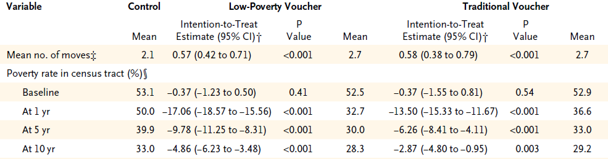
Did the trial affect neighborhood environment?
From Ludwig 2011

Slide 23
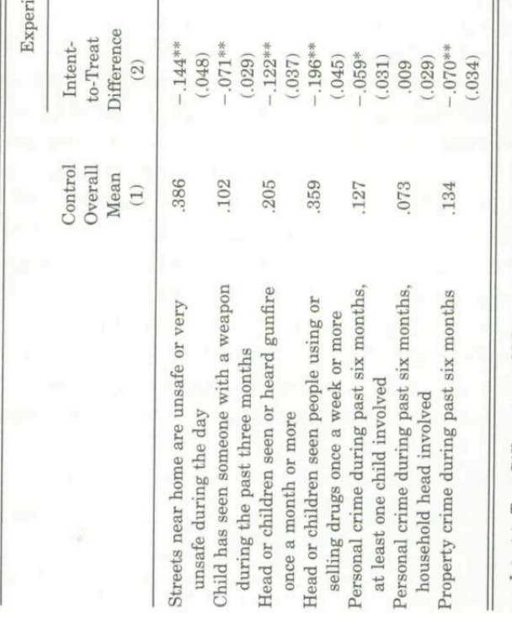
Did the trial affect neighborhood environment?
From Katz 2001

Slide 24
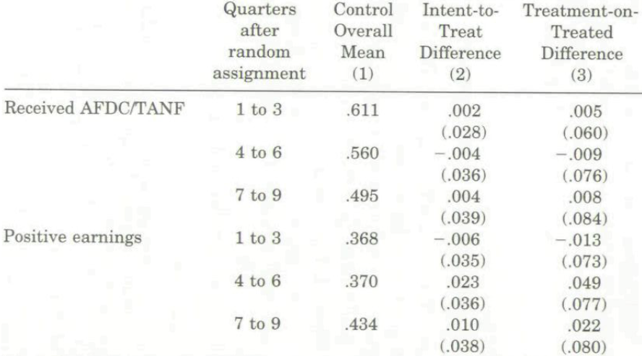
Early Results for Labor Market Outcomes (Boston, 2-Year)
No effect on employment, earnings, or welfare receipt. -Katz 2004

Slide 25
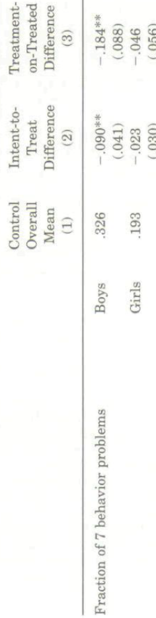
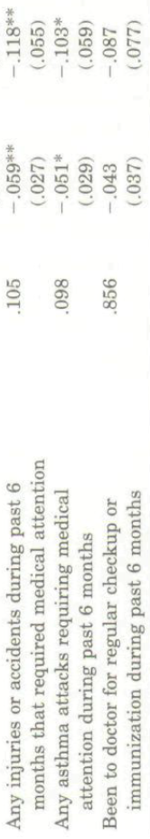
Early Results for Health,
Boston 2 Year Low Poverty

Slide 26
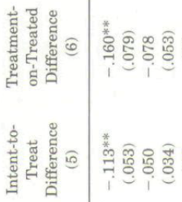
Early Results for Health,
Boston 2 Year Section 8

Slide 27
Mid-Term (5-7 year) Results for Health
No effects on adult economic self-sufficiency
Reduction in adult obesity
Improvements in adult mental health

Slide 28
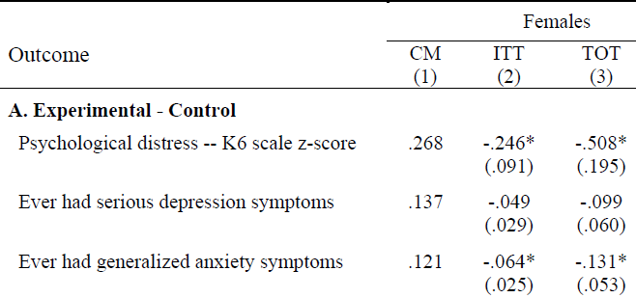
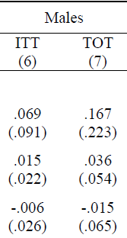

Mid-Term (5-7 year) Results for Children’s Mental Health

Slide 29
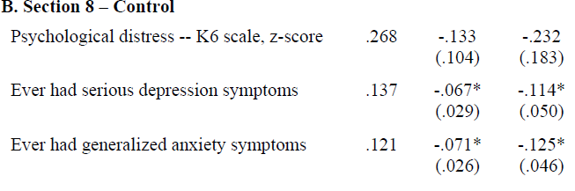
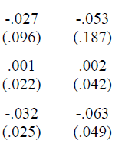
Mid-Term (5-7 year) Results for Children’s Mental Health
Girls ITT
Girls TOT
Boys ITT
Boys TOT

Slide 30
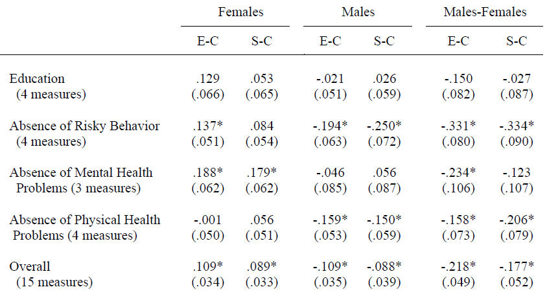
Mid-Term (5-7 year) Results for Children’s Mental Health

Slide 31
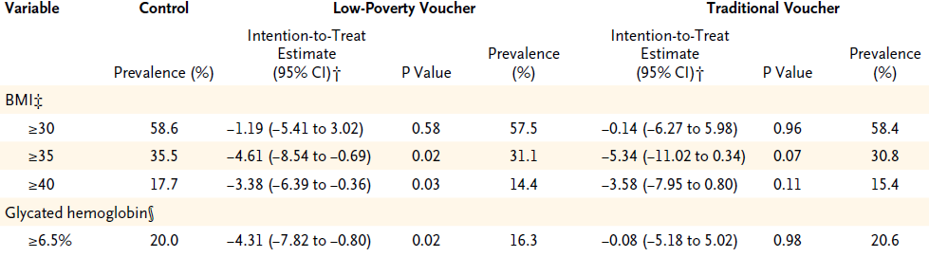
Long-Term (10 year) Results for Health, Adults

Slide 32
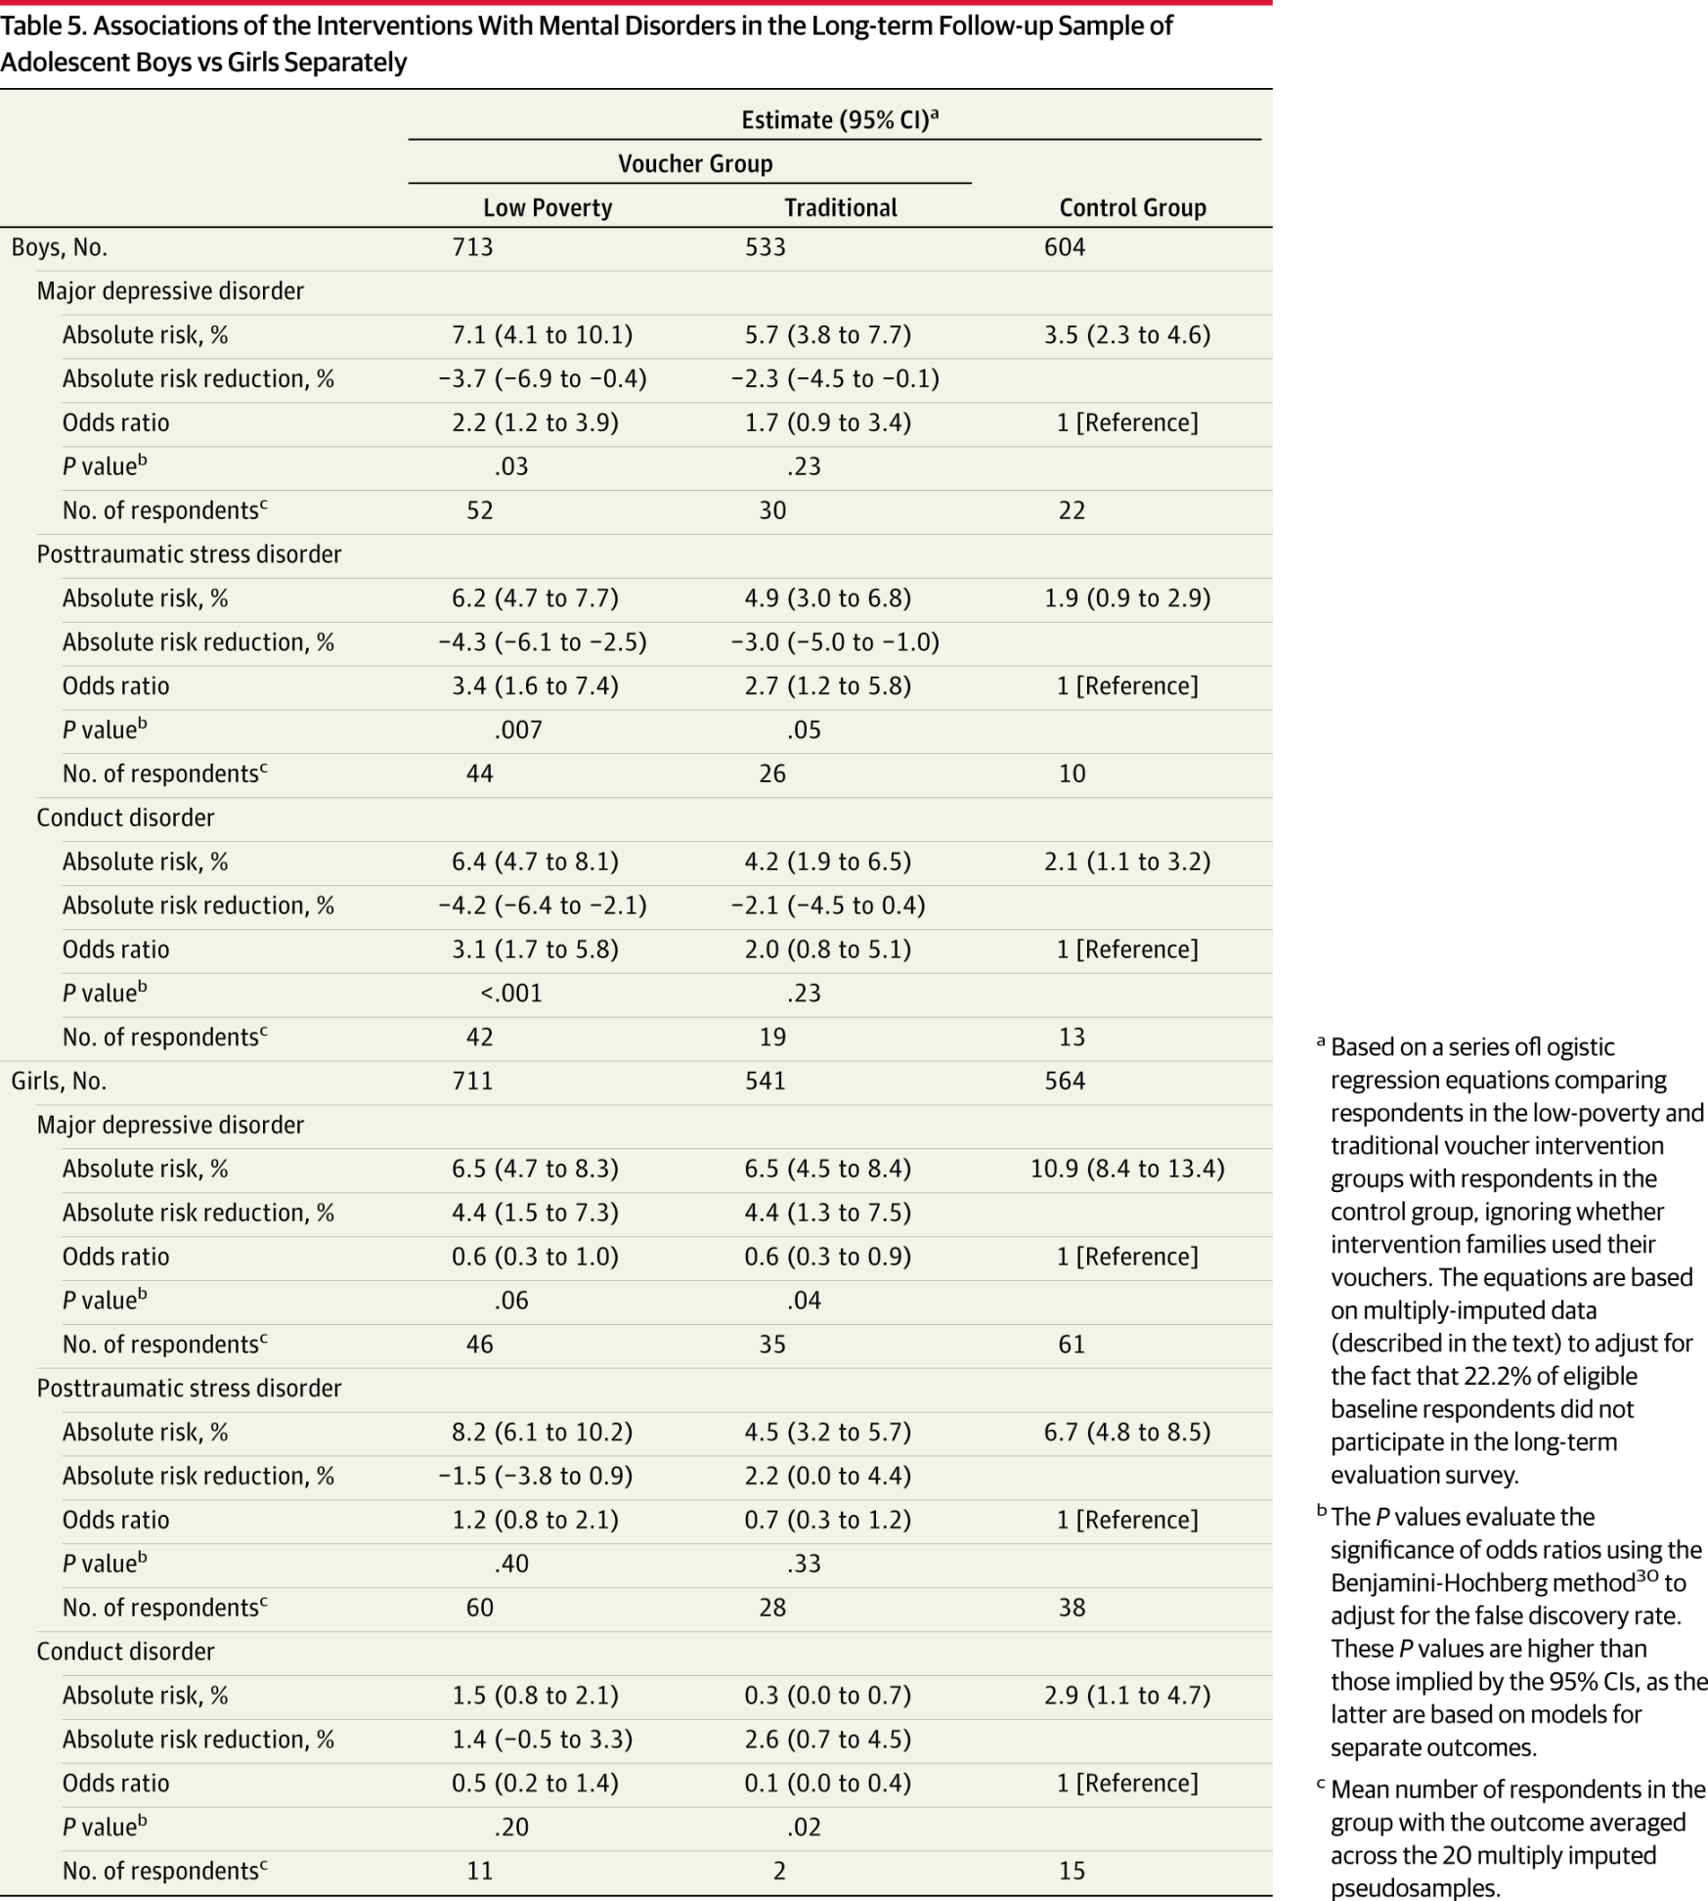
MTO: Harmful Effects on Boys, Aged 0-8 at Randomization
Follow-up ages 13-19
Date of download: 3/29/2015
From: Associations of Housing Mobility Interventions for Children in High-Poverty Neighborhoods With Subsequent Mental Disorders During Adolescence. JAMA 2014

Slide 33
Trial challenges
Mixed effects,
Small samples?
Heterogeneous Effects?
What was the salient component of the treatment?

Slide 34
New MTO results: Earlier exposure→ later benefits
Children whose families take up an experimental voucher to move to a lower-poverty area when they are <13 years old have an average annual income $3,477 (31%) higher relative to a mean of $11,270 in the control group in their mid-twenties.
In contrast, the same moves have, if anything, negative long-term impacts on children who are more than 13 years old when their families move, perhaps because of disruption effects
Chetty, Hendren, and Katz 2015
http://www.equality-of-opportunity.org/images/mto_paper.pdf

Slide 35
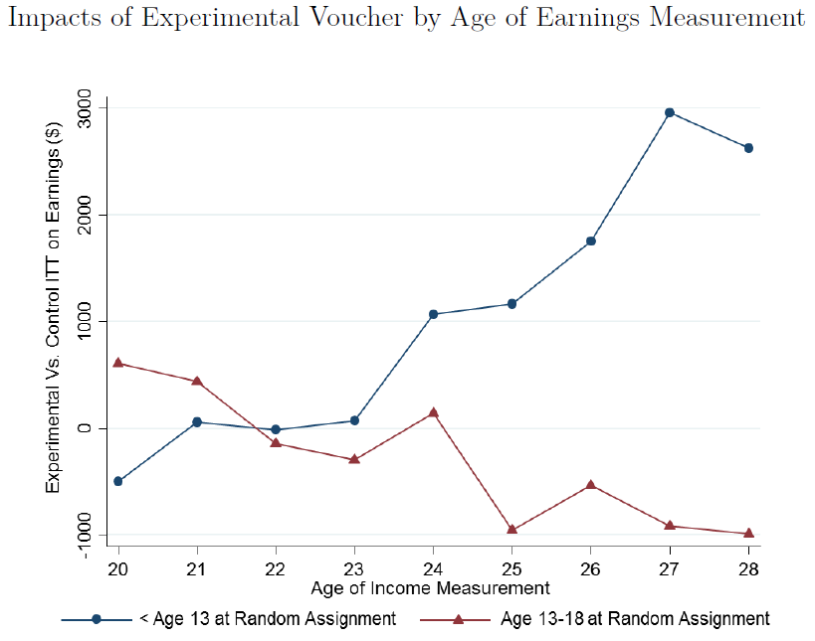
Benefits for kids randomized before age 13 on earnings age 24+
Chetty, Hendren, and Katz 2015
http://www.equality-of-opportunity.org/images/mto_paper.pdf

Slide 36
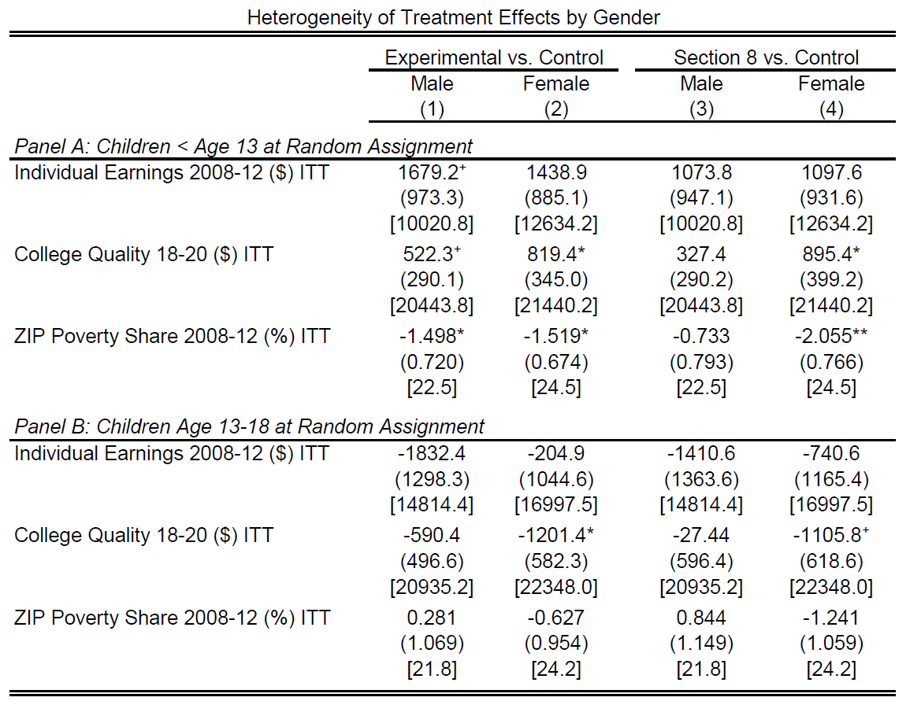
Benefits for kids randomized before age 13 on earnings age 24+
Chetty, Hendren, and Katz 2015
http://www.equality-of-opportunity.org/images/mto_paper.pdf

Slide 37
New Neighborhood Results: Compare Children by Age When Parents Move
Stated differently, the outcomes of children who move converge to the outcomes of permanent residents of the destination area at a rate of approximately 3-4% per year of exposure
We find analogous childhood exposure effects for several other outcomes, including college attendance, teenage employment, teenage birth, and marriage.
- Chetty and Hendren 2015

Slide 38
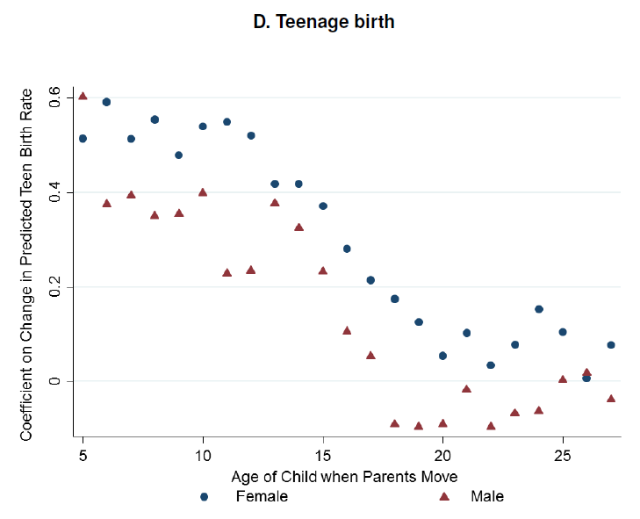
New Neighborhood Results: Compare Children by Age When Parents Move
N=~16,829,532, born 1980-1991
Chetty & Hendren, NBER 2015
http://www.equality-of-opportunity.org/

Slide 39
Policies and Health Disparities
Reasons to research policies
Types of policies that may affect health disparities
How to study health effects of policies?
  MTO: a randomized trial
  Regression discontinuity and related methods: hospital desegregation, mandatory educational policy
  Pseudo-randomization: juvenile judges
Distinguishing policy effects on health from effects on health disparities: GI Bill
Major controversies or uncertainties

Slide 40
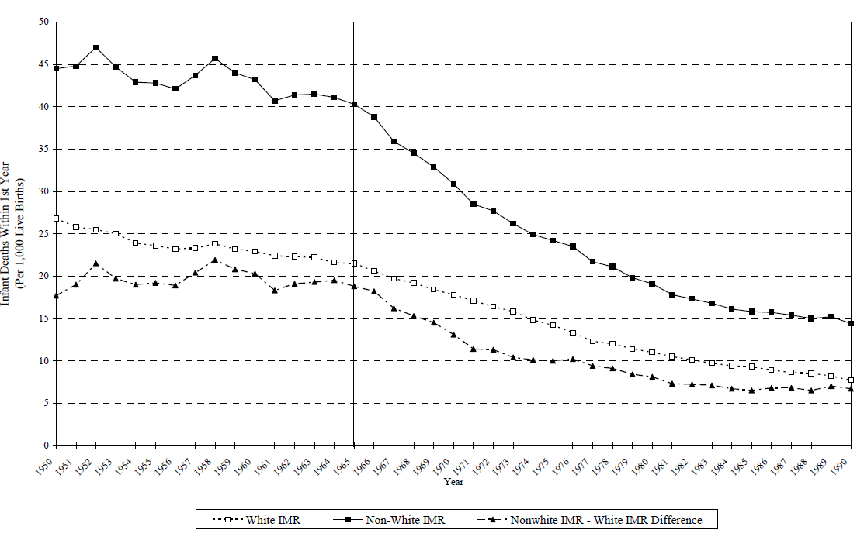
Trends in US Infant Mortality by Race: 1950-1990
Non-white IMR
White IMR
1965
Notes:
Note dramatic declines over time, with fairly persistent *relative* disparity but markedly narrowing absolute disparity.
Note sharpness of black IMR declines increases in 1965

Slide 41
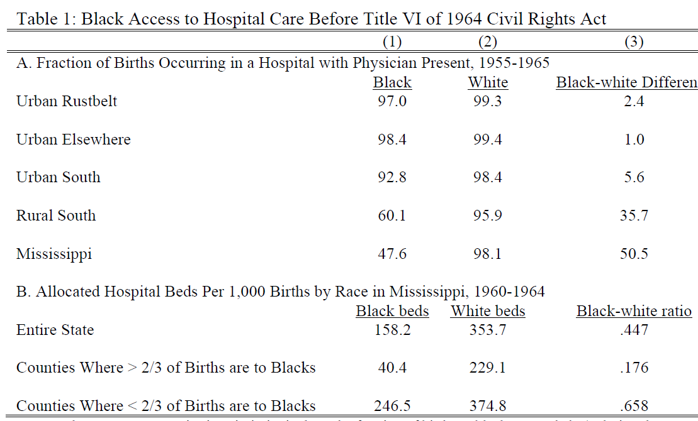
Pre-Civil Rights: Limited Access in Southern States
Notes:
Note dramatic declines over time, with fairly persistent *relative* disparity but markedly narrowing absolute disparity.
Note sharpness of black IMR declines increases in 1965

Slide 42
Did desegregation of hospitals reduce black infant mortality?
Almond, Chay and Greenstone make 4 predictions:
  Racial gap will decrease after 1965
  The gap will decrease more in areas of the country where segregation and inadequate supply were more pervasive prior to 1965
  The gap will decrease more among causes of death responsive to access to hospitals
  Among causes of death preventable with hospital access, the gap will fall promptly and persistently upon integration.
Data?
Notes:
Note dramatic declines over time, with fairly persistent *relative* disparity but markedly narrowing absolute disparity.
Note sharpness of black IMR declines increases in 1965

Slide 43
Did desegregation of hospitals reduce black infant mortality?
Data?
  Individual level mortality data for 1960-1975
  Natality data for each state by race and urban/rural
  Examine trends in mortality rates due to pneumonia and gasteroenteritis
  Separate analysis for Mississippi counties
Trend break in 1965
  Blacks in the rural south: -.705
  Whites in the rural south: -.076
  Blacks in the urban rustbelt: -.205
  Whites in the urban rustbelt: -.048
Notes:
Note dramatic declines over time, with fairly persistent *relative* disparity but markedly narrowing absolute disparity.
Note sharpness of black IMR declines increases in 1965

Slide 44
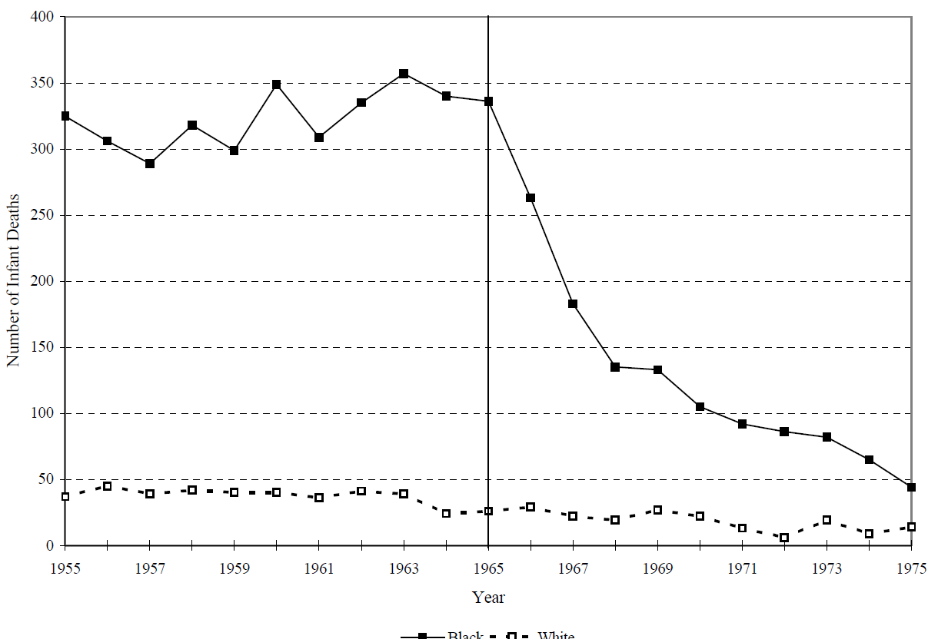
Post-neonatal infant deaths due to Diarrhea and Pneumonia in Mississippi, 1955-1975
Black Infants
White Infants
1965

Slide 45
What makes their evidence convincing?
This is basically a time trend – is the result credible?
A priori plausible
Specificity of population affected (black infants, not white infants)
Specificity of the outcome (amenable to the exposure targeted by the policy)
Specificity of the place (southern, segregated states)

Slide 46
Policies and Health Disparities
Reasons to research policies
Types of policies that may affect health disparities
How to study health effects of policies?
  MTO: a randomized trial
  Regression discontinuity and related methods: hospital desegregation, educational policy
  Pseudo-randomization: juvenile judges
Distinguishing policy effects on health from effects on health disparities: GI Bill
Major controversies or uncertainties

Slide 47
Research Question
Do increases in education (years completed) lead to reduced in old age dementia risk, measured with cognitive test scores?
Why education?
  Education is modifiable via individual or policy actions (unlike, say, the APOE gene)
  Likely few harmful side effects (?), possibly other benefits
  Generally politically accepted as a target of social policy
  Revolutionary changes in avg education in the US in the 20th century
  Effects of education supports the “use it or lose it” hypothesis, relevant for individual-level interventions and social policies on housing, work.
Challenge: Many factors influence educational attainment and also late life dementia risk
How to show that it was education itself that benefited kids?
Notes:
47

Slide 48
Early 20th Century Compulsory Schooling Law Changes in South Carolina
Birth Cohort affected, based on laws in force at ages 6 and 14

Slide 49
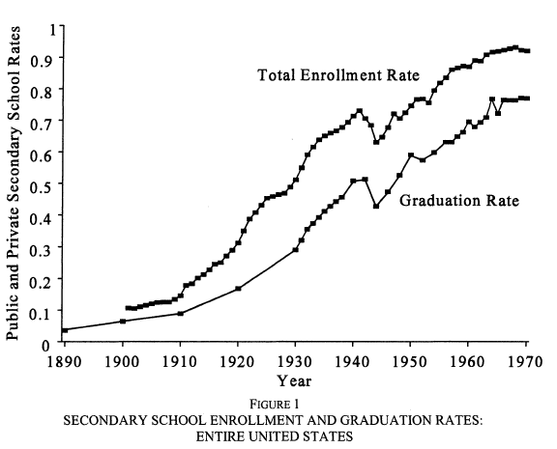
The High-School Revolution
From Goldin,
J Econ Hist 1998

Slide 50
Cohort Differences in Educational Attainment
Old people now and in the near future are better educated than ever before
If education is causally related to cognition/ dementia risk, this should improve population health
If parental education is causally related to cognitive outcomes in old age, this should continue to pay off for another generation
Educational access delayed for African-Americans, so the health dividend of improving education will pay out for a longer period of time
Notes:
Source: U.S. Census Bureau, Current Population Survey, 2009 Annual Social and Economic Supplement

Slide 51
IV Analyses using School Policy as a Natural Experiment
Sample: US born whites with <=12 years of school
State schooling policies
  Compulsory school to drop out (CSL) or receive a work-permit (CSL-W)
  Based on policy in state of birth when school-age
  Separate-Sample 2-stage least squares analysis
Exposure (endogenous) variable:
  Years of education (self-report)
Outcome: Memory score in later adulthood

Slide 52
Covariates
1
Unadjusted
Sex
Birthyear
State of birth indicators
State characteristics: age 6 % black, % urban, and % foreign born; age 14 manufacturing jobs per capita and wages per manufacturing job
2
3
4

Slide 53
HRS Sample

Slide 54
IV Estimates for Education: CSLs
Estimated effect of 1 year ed’n on cognitive test scores.
5. OLS estimates 0.09 (0.08, 0.10)
Notes:
These estimates are adjusted for birthyear, sex, race, hispanic ethnicity, and parental SES.

Slide 55
Schooling and racial disparities
Analyses on Compulsory schooling restricted to whites because evidence that mandatory schooling/minimum work permit age not enforced for black children
Major historical differences in school quality for black and white children
De jure desegregation fairly recent and de facto segregation persists– do we know if it affects health?
Surprisingly limited evidence

Slide 56
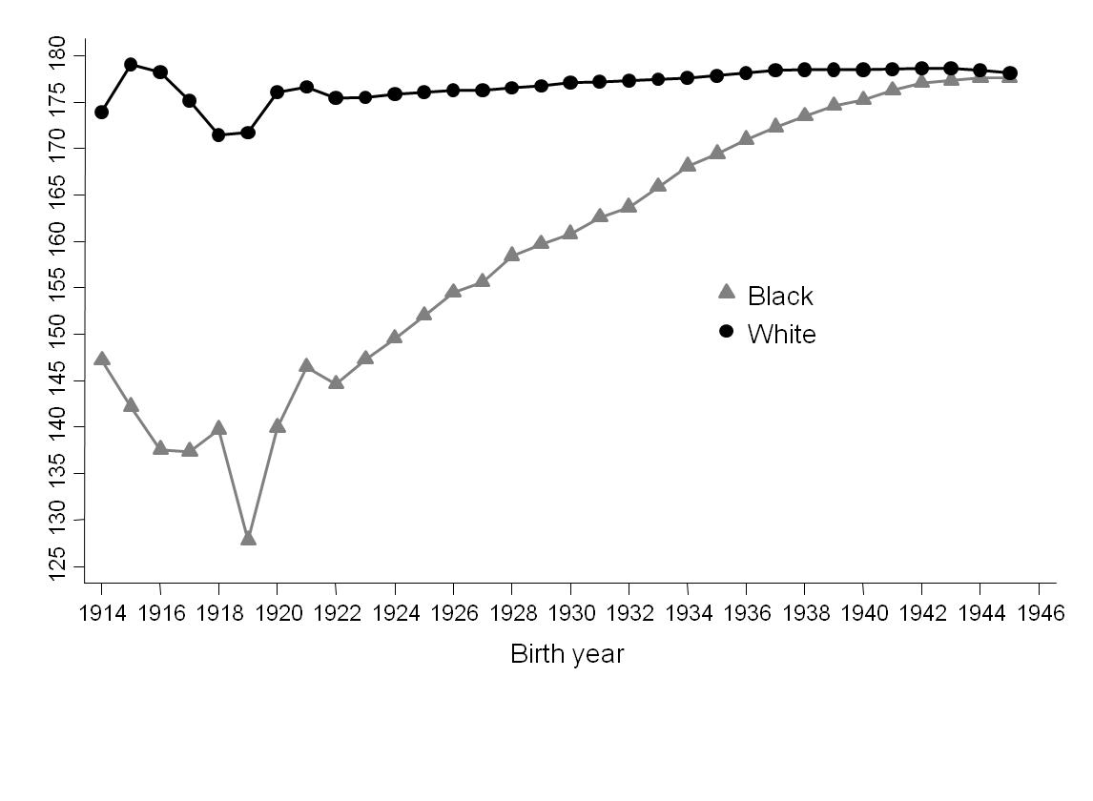
Major historical differences in school quality for black and white children
Average state-mandated school term length by birth cohort, based on state and year of birth, stratified by race, 2009-2011 ACS
S. Liu PLOS one 2015

Slide 57
Do these contribute to persistent disparities in adult health?
Effect of longer school term length (at the state level) on Systolic Blood Pressure
 | 10% Difference in school term length
 | Black |  | White
 | Female | Male | Female | Male
Systolic BP (mm/Hg) | -5.9 (-8.7, -3.0) | -2.4 (-6.1, 1.3) | -0.3 (-2.3, 3.0) | 1.6 (-0.8, 4.0)
PLOS one 2015

Slide 58
Does desegregation affect health outcomes?
Difference in Difference in Difference
(change in teen fertility) (among black versus white adolescents) (in cities that desegregated in the 1970s vs desegregated in the 60s or 80s)
- Sze Liu 2012 SSM

Slide 59
Desegregating Schools and Reductions in Teen Pregnancy
Difference in Difference in Difference
(change in teen fertility) (among black versus white adolescents) (in cities that desegregated in the 1970s vs desegregated in the 60s or 80s)
Y = β₀ + β₁Census1980 + β₂Desegregated1970s + β₃Black + β₄Census1980*Desegregated1970s + β₅Census1980*Black + β₆Desegregated1970s*Black + β₇Desegregated1970s*Census1980*Black + ε_{istr}
“School desegregation policy in the US in the 1970s was associated with a significant reduction of 3.2 percentage points in the prevalence of births among black female adolescents between 1970 and 1980.” - Sze Liu 2012 SSM

Slide 60
Conclusions re School Policy and Health
Mandatory schooling applicable in state of birth predicted years of education completed.
Estimated effect of education received because of mandatory schooling on Memory score were significant and larger than conventional estimates.
Other state characteristics are plausible confounders, but must change in tandem with mandatory schooling and affect only those with <13 years of education.
School quality differences → persistent racial disparities in blood pressure, but effects differ by sex
Desegregation → Reduced adolescent births

Slide 61
Policies and Health Disparities
Reasons to research policies
Types of policies that may affect health disparities
How to study health effects of policies?
  MTO: a randomized trial
  Regression discontinuity and related methods: hospital desegregation, mandatory educational policy
  Pseudo-randomization: juvenile judges
Distinguishing policy effects on health from effects on health disparities: GI Bill
Major controversies or uncertainties

Slide 62
What are the effects of juvenile incarceration?
35,000 children (avg=14) in Chicago juvenile court
Linked to public school and adult incarceration data
Assigned to 1 of 62 judges essentially randomly
  order entered into system & judge’s schedule
Judge decides whether the juvenile is:
  Placed on probation
  Detained (Cook County Juvenile Temporary Detention Center) and then placed on probation
  Average detention~42 days
Aizer and Doyle, QJE 2015

Slide 63
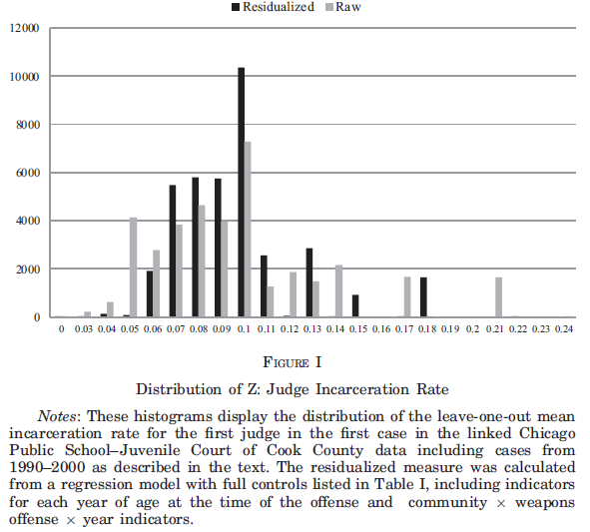
Chance of incarceration depends on judge assigned: 6% to 18%
Number of cases assigned
Probability Judge Chooses to Incarcerate (Based on Other Cases)
Black bars are adjusted for covariates such as child’s age.

Slide 64
Juvenile incarceration instead of probation due to differences in judge…
Decreased chance of high school graduation by ~13 percentage points
Decreased chance of entering an adult prison by age 25 by ~23 percentage points.
Decreased chance of adult prison for a violent crime by age 25 by ~15 percentage points
Effects largest for children ages 15-16
Estimates often very different than estimates from conventional regression
Note: not for all kids, this is among kids on the margin: who some judges thought should be incarcerated and others thought should not.
Health effects???????

Slide 65
Policies and Health Disparities
Reasons to research policies
Types of policies that may affect health disparities
How to study health effects of policies?
  MTO: a randomized trial
  Regression discontinuity and related methods: hospital desegregation, mandatory educational policy
  Pseudo-randomization: juvenile judges
Distinguishing policy effects on health from effects on health disparities: GI Bill
Major controversies or uncertainties

Slide 66
WW2 GI Bill
  Increase in % of blacks serving in WW2 due to (controversial) policy changes, but blacks still underrepresented in military
  GI Bill implemented in 1944 under Roosevelt
  Four primary components:
    Educational subsidy and stipend to cover college tuition
    Guarantees for loans for housing, small business initiatives
    Job placement assistance from the US Employment Service
    Unemployment compensation
  Eligibility: 90+ days of service, no dishonorable discharge
  De jure, race neutral
  Were the effects race neutral?

Slide 67
Job Placement
Assistance administered by local offices, mostly staffed by whites (in the south, southern whites)
“Describing the overall predicament that black former servicemen encountered when they went to USES offices, Harry Wright, a Southern Regional Council field agent and fellow black veteran wrote:
‘In trying to find a job he’d [the veteran] visit the local U.S. Employment Service Office, if he’ll accept some laborer’s job they’ll readily place him – if he knows some of the old –timey trades they can get him placed, but if he’s qualified in some of the new skills that Negros haven’t traditionally been doing – or has some kind of professional training, they just can’t find a place for him and he’ll be offered a job as a porter in the local hotel or the like. [sic]’”
Onkst, 2001 “First a negro” quoting NYTimes 8 april, 1946

Slide 68
GI Bill: Job placement
In MS in Oct 1945, NSES counselors filled 6,583 non-agricultural jobs
86% of professional, skilled, and semi-skilled positions went to whites
92% of the unskilled and service oriented jobs went to blacks
Men who did not take a job deemed “suitable” by the job counselor were refused unemployment compensation

Slide 69
GI Bill: Loan Guarantees
Administered by local banks
  Loans require collateral
Survey of 13 Mississippi cities in 1947
  3,229 loans guaranteed by the VA
  2 were for blacks
Unclear how widespread – very limited evidence, but strong suggestion loan guarantees were essentially unavailable to blacks

Slide 70
GI Bill: Education
At the end of WW2, blacks wanting to attend college in the south restricted to ~100 designated public and private institutions: small, under-resourced colleges
Southern black colleges turned away ~55% of veterans for lack of space
High school graduation rates lower among blacks, further reducing potential value of college tuition subsidy
How to estimate the effect of GI bill?
  Compare veterans to non-veterans?
Clearly biased, and biased differentially for blacks and whites because of different selection criteria for entry into the military (literacy, disability, discrimination)

Slide 71
Bound & Turner use birth cohort as a natural experiment
Don’t compare vets to non-vets
Equate birth cohort with chance of being a vet
Compare outcomes by birth cohorts

Slide 72
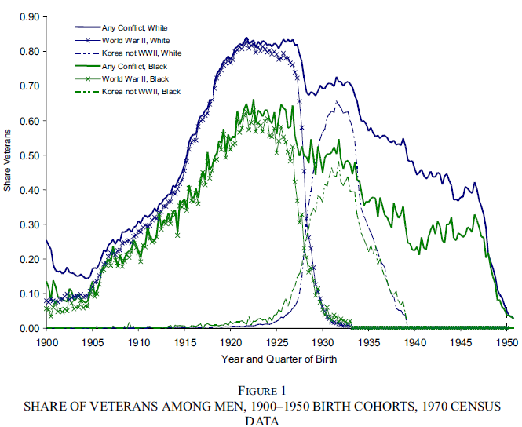
Due to age eligibility and draft rules, birth year → chance of military service

Slide 73
How to Estimate Disparate GI Bill Benefits?
Assume that the reasons military participation differed by birth cohort had nothing to do with characteristics of the men that would predict their education
Men in peak service cohorts were not smarter, did not have better high school training, did not have more money, were not less likely to have children etc.
Not quite credible, because there is a secular trend in college enrollment, even before the war.

Slide 74
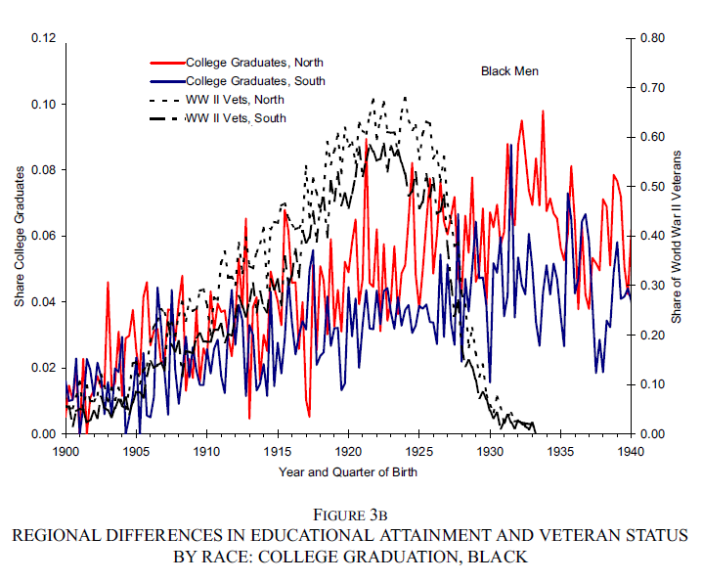
Secular Trend in College Attendance: Black Men

Slide 75
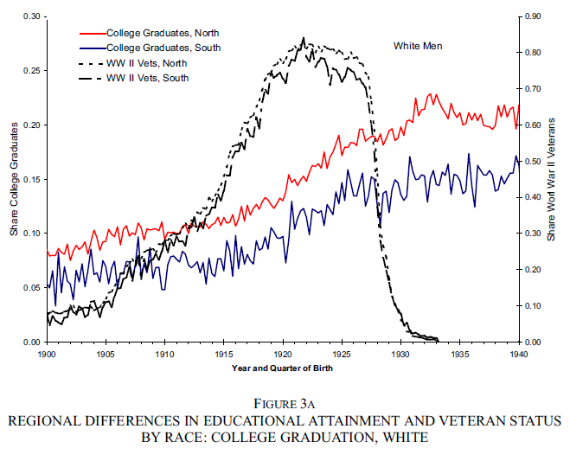
Secular Trend in College Attendance: White Men

Slide 76
Estimated Effect of GI Bill
At least 4 percentage point increase in college completion, probably 5-6 percentage points (college completion was unusual, so this is about a third)
Benefits for white men large and positive
Benefits for black men born in the south negligible
Benefits for black men outside the south positive (6-8 percentage points)
Health effects???

Slide 77
Untargeted Resources Can Exacerbate Inequalities
Key lesson from GI Bill:
  Making a resource generally available without special consideration for least advantaged can exacerbate disparities even while helping the “average”
  Advantaged are best able to use the new resource
  This is one prediction of fundamental cause theory: new information, technological advances, and similar general progress can exacerbate inequalities
Unclear how often this occurs, but clearly sometimes
May depend on how inequality is measured (more coming…)

Slide 78
Policies and Health Disparities
Reasons to research policies
Types of policies that may affect health disparities
How to study health effects of policies?
  MTO: a randomized trial
  Regression discontinuity and related methods: hospital desegregation, mandatory educational policy
  Pseudo-randomization: juvenile judges
Distinguishing policy effects on health from effects on health disparities: GI Bill
Major controversies or uncertainties

Slide 79
Uncertainties and Controversies
How much does the ‘Intervention’ delivered correspond with future flavors of the policy?
  Additional education at age 4 versus age 17? Additional high vs low quality of education?
  Education in the future similar to education in the past?
  MTO: section 8 housing similar effects as the voucher?
Results are often sensitive to model specification if relying on time trends, regression discontinuity approaches.
Insufficient power
Main problem: very little rigorous research. Major social policies simply never evaluated for health impact: social security, home ownership subsidies, school quality, transportation ….
Results are often not what we expect – things that seem obvious are not necessarily the case -- suggesting we need to do more not less research.

Slide 80
In groups
Identify a policy you think may have important health implications.
Describe why an evaluation of that policy is informative (primarily about the policy, or primarily a test of hypothesized mediators?)
Specify the outcomes and populations you think most responsive or least responsive to the policy.
Propose a study design to evaluate the policy
  Describe biggest challenge to implementing and drawing inferences

