Slide 1
Lecture 4 overview
Nelson Kalema

Slide 2
Sampling
Why sample? – feasibility and estimation
Does study point estimate=true population parameter?
Sampling variability and inherent population = samples not the same
How close to truth are we?
  Hypothesis testing (e.g. sample mean x ≠ u hypothesized population mean)
  Confidence intervals – if CI of sample contains true estimate
  Use probability to express confidence in our estimation of truth

Slide 3
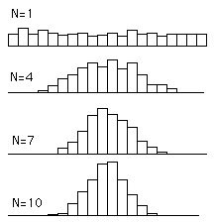
Central Limit theorem
Suppose we drew successive random samples of size n=4, 500 times (x1, x2, …x500)
Computed means 1…. 500 of a randomly distributed population variable for each sample and plotted frequency distribution of means
As n increases, n=4, n=10, n=1000 the distribution of their - the sampling distribution of the mean approximates a normal distribution
Distribution of averages/means tends to be normal even when the distribution from which the average is computed is non-normal

Slide 4
Probability distribution
Frequency distributions display each mean (outcome) and the number of times its present in data = adding up to 100% or 1.
x | P (X=x)
1 | 0.416
2 | 0.330
. | .
8+ | 0.004
Total | 1.00
Used to construct probability distribution random variable xr outcome (x=1….8+) plotted against its corresponding P (Xo = xr) Table 7.1 Pagano
Plot Relative frequency of occurrence of each outcome xr is its probability = Probability distributions: Each area under vertical bar histogram → P(X=x),
As n becomes large or possible values of x large → ∞, graph becomes smooth curve = probability density with AUC=1
Origin of idea of Area under curve = Probability of outcome
but it is not possible to calculate area associated with each value for continuous outcomes

Slide 5
AUC, intervals and Z-scores
In binomial or poisons distributions - random outcome variables take on discrete values – counts or integers P(X=1)
For random variables that are continuous, like serum cholesterol, P(X=215.6738…, 215.783247…) P(X=x) = 0
So we compute P (X=Interval between x1 and x2) = essentially area under the curve between interval x1 and x2
And standardize with Z-scores which represent fraction of area under the curve of the standard normal distribution curve with µ=0 and Ợ=1

Slide 6
99.7%
The sampling distribution of the mean roughly follows a (standard) normal distribution
95% of the time, an individual sample mean should lie within 2 (actually 1.96) standard deviations of the mean
95%
68%
f(x)
-3σ -2σ -1σ μ +1σ +2σ +3σ
P(Z>=2.0) = 0.0228 P(-2<=Z<=+2) = 1 – 2*0.0228 = 0.9544
P(Z>=1.96) = 0.025 P(-1.96<=Z<=+1.96) = 1 – 2*0.025 = 0.95

Slide 7
Confidence Intervals:
Degree of certainty of point estimate approximating true parameter
Computed using the Z-score corresponding to level of confidence and SEM
CLT Z follows normal distribution if n is large
Margin of error
In our estimate

Slide 8
t-distribution for confidence interval of means
When n is small or σ of population is not known
, the sample standard deviation is not a
reliable estimate of population σ
CLT Z follows normal distribution if n is large Not true
If X is normally distributed, for sample size n, t statistic follows a t-distribution, n-1 df

Slide 9
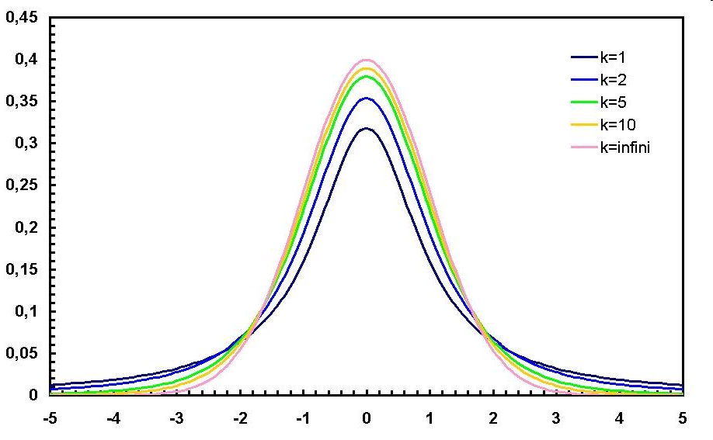
The t-distribution

Slide 10
Approximation to normal distribution
Student’s t-test
  Normal pop dist, unmodal, >30-40, no outliers
There are separate curves for each degree of freedom (df)
Stata: P(T≥t) is calculated using ttail
E.g., P(T>1.96) n=20
  display ttail(19,1.96)
  .03241449
To find the value of t for n=20, p=.025, P(T>t)=p use invttail(df,p)
  display invttail(19,.025)
  t=2.0930241, for n=20, p=.025
Binomial distribution approximates normal distribution as, n the number of trials increases
  n*p as the mean, variance= np(1-p)
  Sd=sqrt[np(1-p)]
When p=.5, required n is smaller
P(X>=30; n=50, p=.45)
    di binomialtail(50,30,.45)
    .02353582
Considered valid when np≥5 and n(1-p) ≥5

Slide 11
Confidence intervals for proportions
  Focuses on proportion p of successes, rather than the number of successes x
  is the true population mean, x=successes, n=#trials
  ~ N(0,1)
  So
Rearranging, we get
Sample size | n
Population proportion | p
Sample proportion | pˆ
Standard error of pˆ | SE(pˆ)=√p^(1−p^)/n
Upper C.I limit
Lower C.I limit

