Slide 1
Data quality and aging
Nadia Diamond-Smith, PhD, MSc

Slide 2
Common Sources of Demographic Data
Vital Registration/Statistics
Population Registers (provides info about life events and population at risk)
Census
Sample Surveys
Record linkage
Other sources of demographic data
  Administrative Data: Medical claims, Hospital
  Qualitative sources
  Geographic Information Systems (GIS)
  Historical sources

Slide 3
Vital Registration Systems
Data:
  Mortality
  Fertility
  Nuptuality (marriage/divorce)
  Migration
US Vital registration/statistics:
  Death registration since 1900s (not for black population until 1968)
  Births since 1915
  1933: National Vital Statistics System started
Problems:
  Changes in cause of death classification over time
  Missing Populations
  Incomplete in many countries

Slide 4
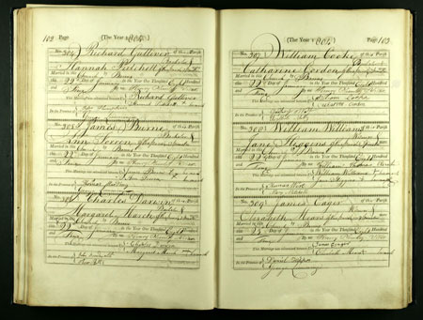
British Vital Registration:
Originally collected in church/parishes in Europe, then governments took over

Slide 5
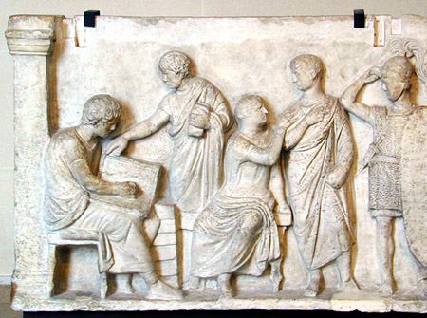
Censuses
Full count of a population at a certain point in time
  Age
  Sex
  Geographic locator
  Some have data on recent mortality
Pros: full country, most countries have them
  >90% of world population covered by census
  Cons: Only available at intervals, often 10 years

Slide 6
  Censuses: Types of errors
Sampling
Non-sampling
  Coverage
    Under enumeration; prone to missing data
      Recent births, migrants, homeless, hard to reach, minorities
      Ways to estimate using inter-censual projections
    Over enumeration: Kashmir and Jammu
  Content error:
    Prone to age-heaping
      Can use indirect estimation techniques to adjust for these
    Income notoriously hard to collet data on

Slide 7
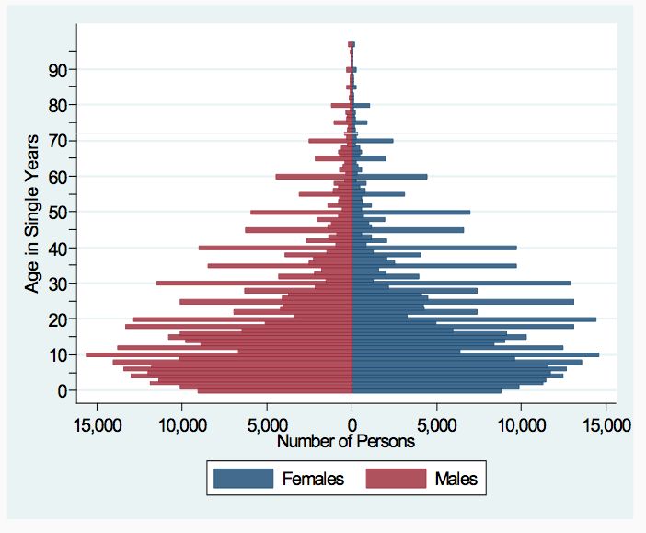
Ethiopia Census: 2007
Age attraction
Under reporting of children?

Slide 8
Sample Surveys
Used to validate vital statistics or Censuses, or provide information in inter-censual periods
Most focused on fertility and health
  Demographic and Health Surveys (International)
  Also general household surveys, labor force surveys, etc.
Pros
  Can be more in depth, ask different types of questions
  Can occur more frequently but still not continuous (compared to vital statistics)
Suffers from errors as well
  Sampling errors and biases: DHS and questionnaire length

Slide 9
Aging:
Demographic study of older populations
  Their size and composition
  Their mortality and morbidity
  The causes of demographic change among older populations
  The consequences of demographic change among older populations

Slide 10
Global Average Annual Growth Rates

Slide 11
But, There is Great Variation by Age

Slide 12
Population aging
Older persons are continually making up a larger proportion of the population
This is occurring in every world region and in nearly every country

Slide 14
Possible implications of global population aging for public health
RETOOLING HEALTH CARE SYSTEMS
In most of the world, health care systems have been designed around a particular set of needs, e.g.:
child and maternal health
infectious and communicable disease
An aging world requires a change in health care philosophy toward
degenerative disease
long-term care
Expenditure studies show costs of health care in old age to be significantly greater than costs at any other age.

Slide 15
DETERMINING HOW TO SPEND HEALTH CARE DOLLARS
 | Health expenditures per capita, 2011
U.S. | $8,508
Norway | $5,669
Canada | $4,522
Nigeria | $128
Ethiopia | $50
Congo | $26
Acknowledgement to Zachary Zimmer

Slide 16
Life expectancy at birth for females in five countries, 1950 to 2015

Slide 17
Implications for public health
- Goal of medical science to reduce the gap between life span and longevity.
- Increasing one may not mean increasing the other.
- Rectangularization of mortality: Life span remains
the same but variation in age at death declines.

Slide 18
Rectangularization of mortality
0
55
110

Slide 19
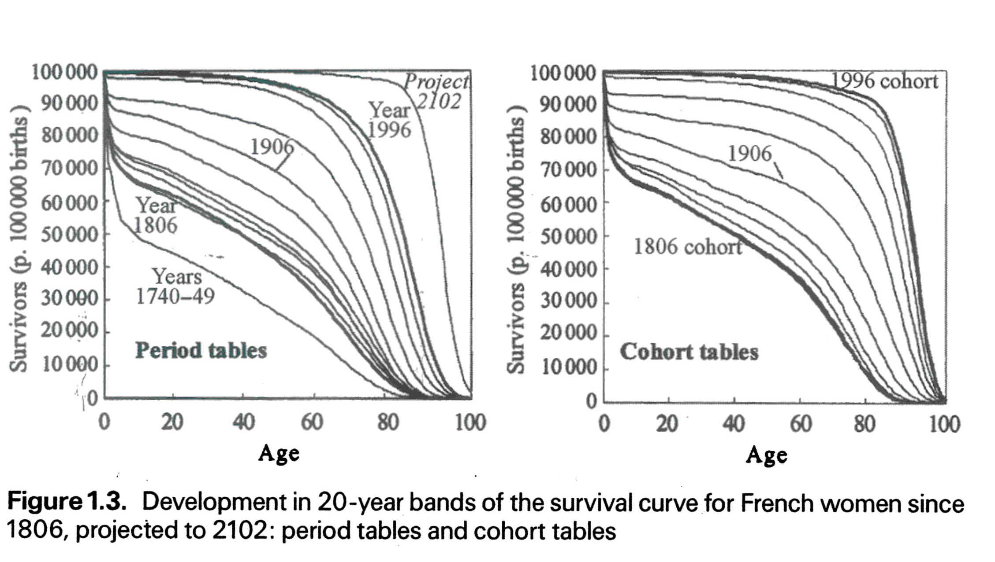
Rectangularization is evident in places where data is available
Page 21 fig 1.3

Slide 20
QUANTITY VERSUS QUALITY OF LIFE
Are the extra years of life healthy years, or are we extending our years lived in poor health?
.
Optimistic view: There has been a compression of morbidity into the final years of life.
Pessimistic view: Modern medicine extends life but it does so by saving people from dying without giving them years of healthy life.

Slide 21
Standardized survival, disability, and morbidity curves
Proportion surviving
Surviving healthy
Surviving
unhealthy

Slide 22
Standardized survival, disability, and morbidity curves
Proportion surviving

Slide 23
Expansion of morbidity – longer life worsening health
Proportion surviving
Surviving healthy
Surviving
unhealthy

Slide 24
Compression of morbidity – longer life better health
Proportion surviving
Surviving healthy
Surviving
unhealthy

Slide 25
Dynamic equilibrium – healthy years to increase proportionately to total years
Proportion surviving
Surviving
unhealthy
Surviving healthy

Slide 26
Conclusion
Global population aging is likely to be the most important demographic phenomenon influencing health and welfare policies globally over the next half century.

Slide 27
Dependency Ratio
Ratio describing the number of people of working age compared to older and/or younger people of non-working age in a population
Way to describe the burden of aging populations and/or growing populations on the working age population
  Burden in care giving, financial support, government resources
Can also calculate the youth and elderly dependency ratios on their own

Slide 28
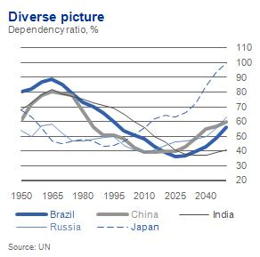
Dependency Ratios by Country

Slide 29
Demographic Dividend
A transitional period that countries go through while fertility is falling and mortality is falling
Idea that falling fertility will lead to a small youth population, while there is still a relatively small old age population
So the working aged population will grow more than the elderly or young population for a few years
Should lead to a time of increasing productivity because labor force population is growing more than the dependent population
A short period in time, lasts maybe 5 decades
  Then population aging begins
Much interest in capitalizing on the demographic dividend in Africa especially where fertility is just beginning to fall

Slide 30
Thank you!
Questions?
Notes:
Final boiler plate language: 2 versions
Through its singular focus on health, UCSF is leading revolutions in health.
UCSF is driven by the idea that great breakthroughs are achieved when the best research, the best education and the best patient care converge.

Slide 31
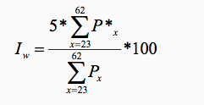

Detection and quantification of age attraction
Whipple’s Index (I_{w}):
Where Px is the population aged x, and P*x is the population of an age x ending in “0” or “5”

Slide 32

Other methods
Compare age ratios
  Ages in one 5 year group should be fairly similar (or smoothly related to) the ones before and after
Compare sex ratios
  Only works for some countries
UN: Age-sex accuracy index
Intercensal cohort comparisons

