Slide 1
Biostat 200
Lecture 5

Slide 2
Where are we?
Week 1: Variables, tables, graphs
Week 2: Probability:
Independence → multiplicative rule
Mutual exclusivity → additive rule
Conditional probability
Week 3: Binomial and normal probability distributions, how to get probabilities if you assume these distributions
Week 4: CLT for the distribution of sample means and proportions and 95% CIs for means and proportions
Week 5: Hypothesis testing in general and for comparing one mean or one proportion to a hypothesized value
Weeks 6-8: More hypothesis tests
Weeks 9-11: Correlation and regression (use hypothesis tests there too)

Slide 3
Review: Normal distribution
If X ~ N(µ,σ) then Z=(X- µ)/σ
  To find the proportion of values in the population that exceed some threshold, i.e. P(X>x)
    Transform x to z=(x - µ)/σ and look up P(Z>z) using display 1-normal(z)
  To find the percentiles of the distribution
    E.g. to find the 97.5 percentile, the value for which 97.5% of the values are smaller, find z by using
    display invnormal(.975)
    and solve z=(x - µ)/σ for x

Slide 4
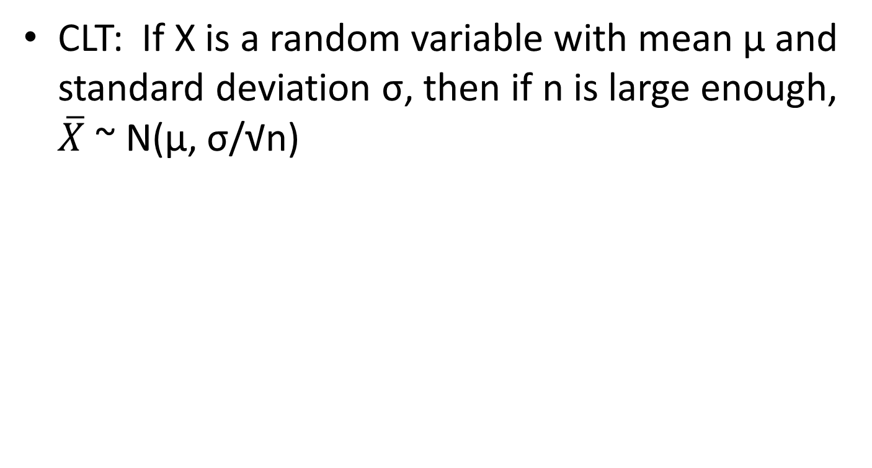
Review: Normal distribution
Notes:
CLT: Central limit theorem

Slide 5
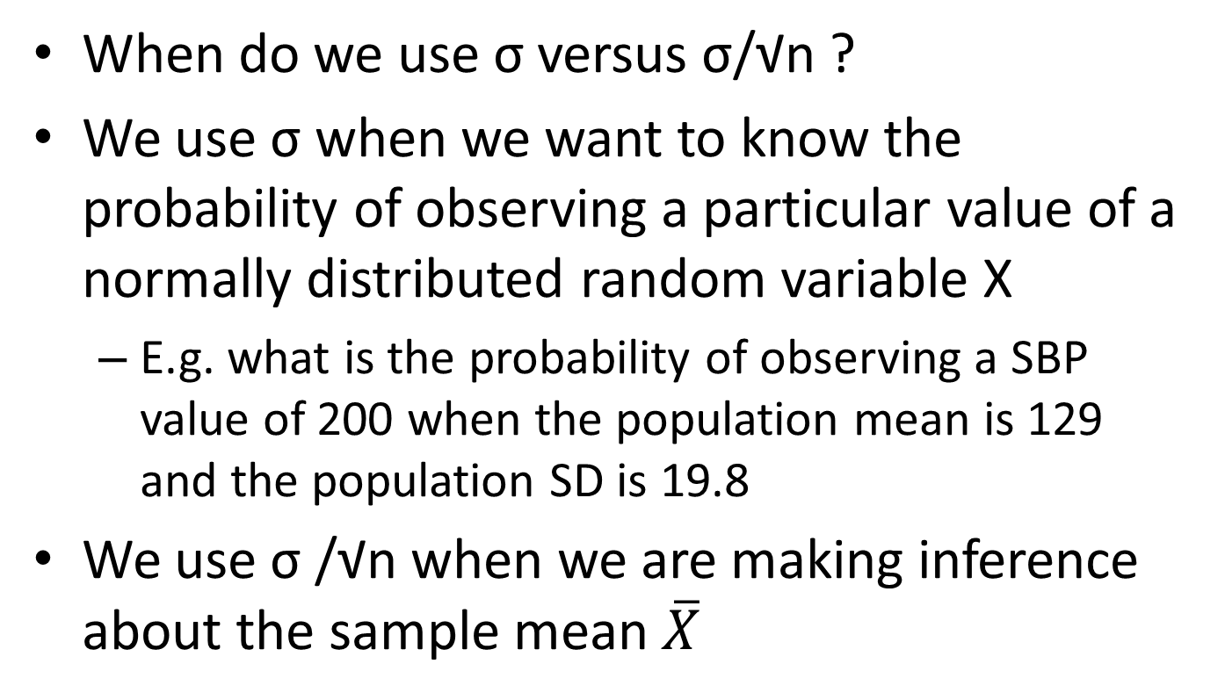
Review: Normal distribution

Slide 6
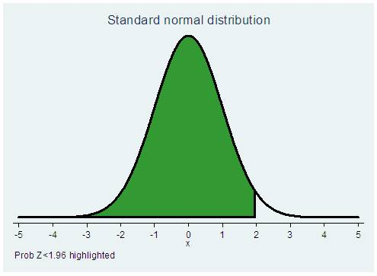
For normal distribution
  Stata calculates P(Z<z)
  If you have a z-value and you want p (PZ<z), use
  display normal(z)
  di normal(1.96)
  .9750021
  If you have a z-value and you want p [P(Z>z)], use
  display 1-normal(z)
  di 1-normal(1.96)
  .0249979
  If you have p [P(Z<z)] and you want z-value, use
    display invnormal(p)
    . di invnormal(.975)
    1.959964
  If you have p [P(Z>z)] and you want z-value, use
    display invnormal(1-p)
    di invnormal(.025)
    -1.959964
    Or use what you know about the symmetry of the distribution

Slide 7
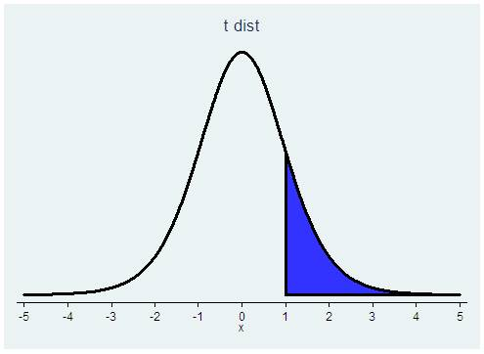
For t distribution
  Stata calculates P(T>t) for each d.f.
  If you have a t value and you want p [P(T>t)], use
  display ttail(df,t)
  di ttail(99,1.96)
  .02640356
  If you have a t value and you want p [P(T<t)], use
  display 1-ttail(df,t)
  di 1-ttail(99,1.96)
  .97359644
  If you have p [P(T>t)] and you want t-value, use
    display invttail(df,p)
    di invttail(99,.025)
    1.984217
  If you have p [P(T<t)] and you want t value, use
    display invttail(df,1-p)
    di invttail(99,.975)
    -1.984217
    Or use what you know about the symmetry of the distribution

Slide 8
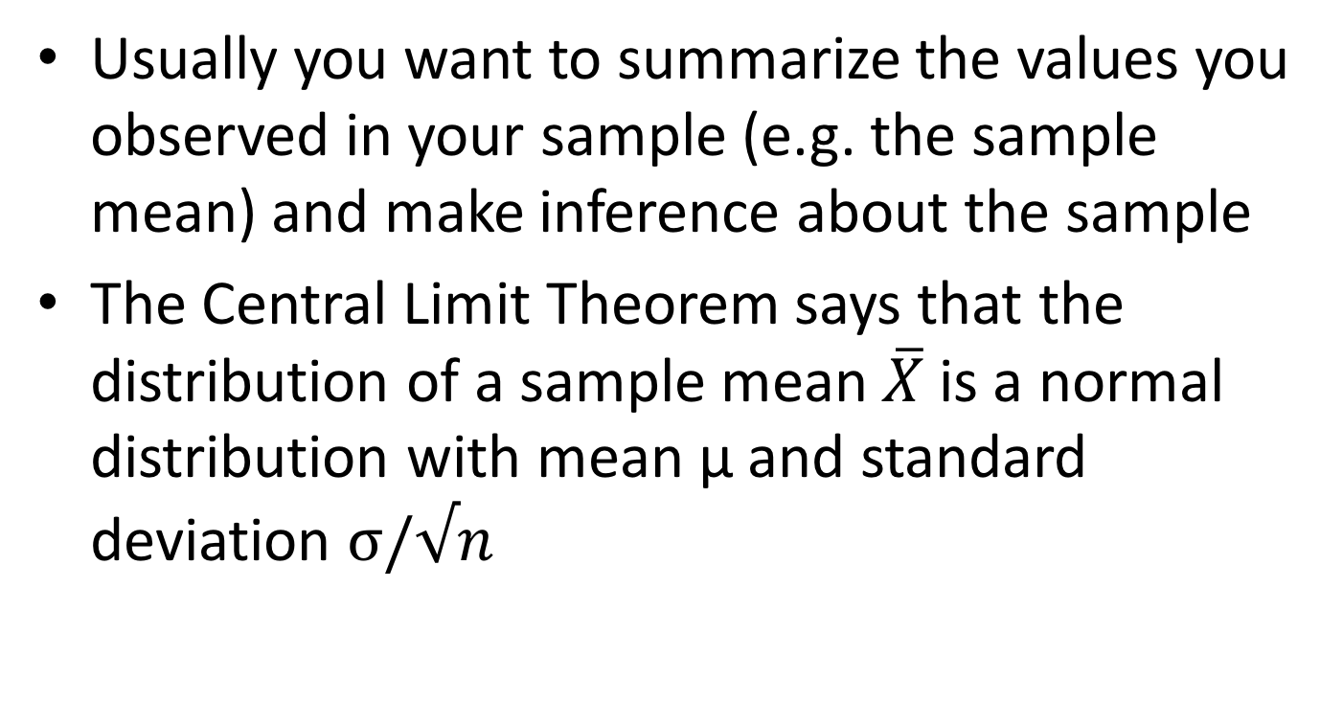
Usually you want to summarize the values you observed in your sample (e.g. the sample mean) and make inference about the sample
The Central Limit Theorem says that the distribution of a sample mean $\overline{X}$is a normal distribution with mean μ and standard deviation $σ/√n$

Slide 9
Confidence intervals
Knowing the distribution of the sample means we write down
and do the math to get
If you had drawn your sample 100 times, approximately 95 of the confidence intervals would include the true population mean µ.
  The interval is random.
These intervals can be derived for any point estimate, e.g. risk ratio, rate, etc. with known distribution.

Slide 10
The width of the confidence interval depends on the confidence level (1-⍺) and n
For confidence intervals for means, if σ is unknown, we use the t distribution and the sample standard deviation s in our computation

Slide 11
Confidence intervals for proportions
As n increases, the binomial distribution approaches the normal distribution
Also, as n increases, the distribution of an estimated proportion approaches the normal distribution
  x/n = p̂ ~ N( p, √(p(1-p)/n) )
    x/n is the proportion of successes
    p is the population proportion
    √ (p(1-p)/n) is the standard deviation of x/n if X is binomial
    So we can use the normal distribution to calculate confidence intervals for p
      p̂ - 1.96 * √ (p̂(1- p̂)/n) , p̂ + 1.96 * √ (p̂(1- p̂)/n)

Slide 12
Confidence intervals for proportions
But if n is small or p is small or both then the normal approximation is not good and the intervals using the normal approximation are not good
We need to use the binomial distribution
Confidence intervals using the binomial distribution are called exact confidence intervals
Exact confidence intervals are not symmetric around p̂ (because neither is the binomial distribution for small n or small p)

Slide 13
For p=0.05, even for large n, the distribution of X doesn’t exactly look normal
(100*.05=5)
For p=0.35, the distribution does look fairly normal at small sample sizes. N*.35>5 → n>14.3

Slide 14
Hypothesis testing
Confidence intervals are used to describe the uncertainty in a point estimate of the population mean or proportion (or some other entity)
  Although in reality they represent what you’d get if you resampled many times
Hypothesis testing is used to draw a conclusion about how an estimated quantity (e.g. mean) relates to the true population value (under certain conditions)
Remember, we are taking samples from the population and we never know the truth
Notes:
Note that hypothesis testing gives a yes/no answer which may be articificial.

Slide 15
Hypothesis testing for a mean
To conduct a hypothesis test about the mean of a population, we postulate a value for it, and call that value µ₀.
  We write this H₀ : µ = µ₀
  We call this the null hypothesis
We set an alternative hypothesis for all other values of µ
  We write this: H_{A} : µ ≠ µ₀
  We call this the alternative hypothesis

Slide 16
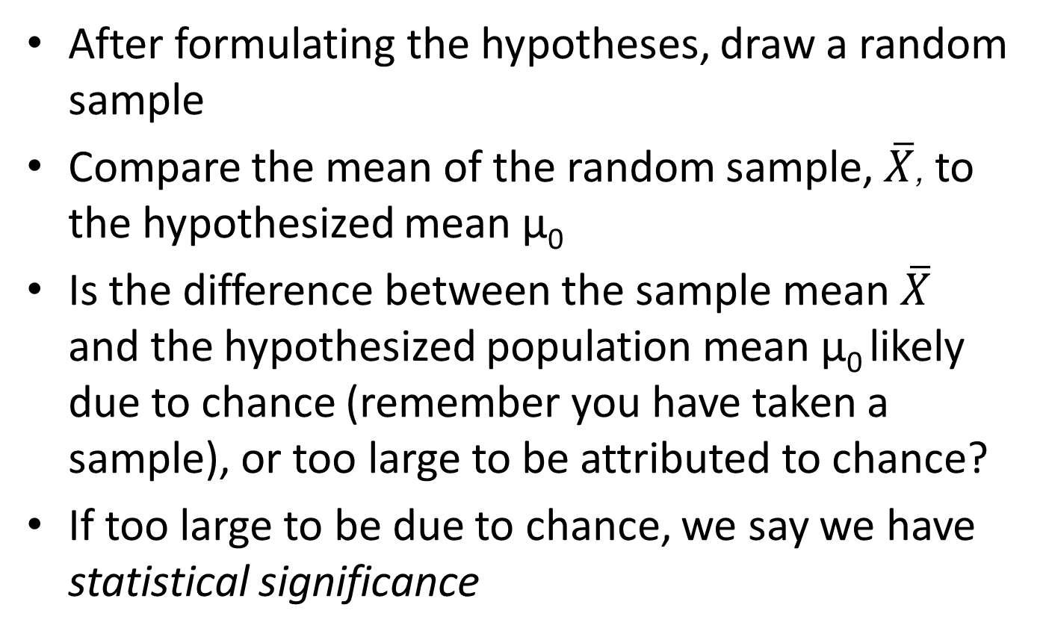
Hypothesis testing for a mean

Slide 17
Hypothesis testing for a mean
There is some probability that we will incorrectly reject the null hypothesis
  Incorrectly rejecting the null hypothesis means that we say that the evidence is against the null when the null is really true
Notes:
This is because we are taking a sample and do not know the true distribution

Slide 18
Hypothesis testing for a mean
We set the probability of incorrectly rejecting the null that we are willing to live with in advance, before collecting the data and doing the analysis
That probability is called the significance level
The significance level is denoted by ⍺, and is frequently set to 0.05.
Notes:
We realize that we are only drawing a sample. If the null is true, e.g. the population mean=0, there is still a chance that we will draw a sample that looks very different from a sample with the mean=0. This chance is what we are setting by setting alpha.

Slide 19
Hypothesis testing
Criminal trials – innocent until proven guilty
We assume the null hypothesis is true, and only reject the null if there is enough evidence that the sample did not come from the hypothesized population (e.g. that the mean is not µ₀)
In jury trials there is a chance that someone who is innocent is found guilty, but our method of innocent until proven guilty is in place to minimize this

Slide 20
Hypothesis testing
In hypothesis testing, a true null hypothesis might be mistakenly rejected (if the sample you drew very different from the null just by chance)
This mistake is called a Type I error
  The probability of a Type I error that we can live with is chosen in advance
  This probability is called the significance level, ⍺

Slide 21
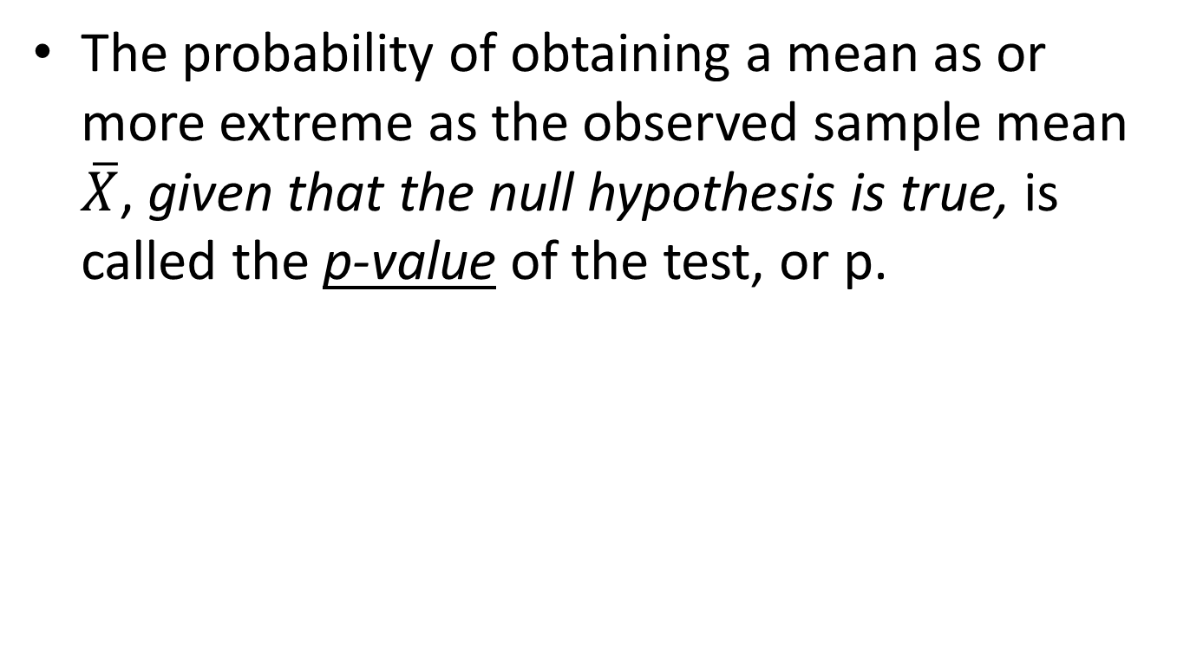
p value for testing a mean
Notes:
Note that a p-value is a conditional probability

Slide 22
Basic steps
Before the test, set the significance level, ⍺
  This is the probability of rejecting the null hypothesis when it is true P(Type I error) that you can live with
When you run the test, you get a probability of observing a sample mean as extreme as you did, given that the null hypothesis is true
  This probability is the p-value
If the p-value is less than ⍺, (e.g. ⍺ =0.05 and p=0.013), then the test is called statistically significant and the null hypothesis is rejected

Slide 23
Hypothesis testing steps
Specify the null and alternative hypothesis
Determine the compatibility of the data with the null hypothesis
Either:
  Reject the null
  OR
  Fail to reject the null. NEVER accept the null.

Slide 24
Hypothesis testing
Specify the null and alternative hypothesis
    E.g. Null: Mean CD4 cell count in population is ≥350
    Alt: ‘’ < 350
Determine the compatibility of the data with the null hypothesis
    Calculate a test statistic and compare it to its corresponding theoretical probability distribution to get the p-value
    If the test statistic is very large, then the data are very unlikely under the null hypothesis
Either:
    Reject the null if the p-value < ⍺ OR
    Fail to reject the null

Slide 25
1. State the hypotheses
In epidemiology the null hypothesis is often that there is no association between the exposure and the outcome
  E.g.,
  The difference in disease risk=0
    R_{exposed} -R_{not exposed}=0
  The ratio of risk or prevalence or etc=1
    R_{exposed} /R_{not exposed}=1
  Clinical trials: The mean value of something does not differ between two groups
The alternative hypothesis is usually an association or risk difference
  E.g.,
    R_{exposed} -R_{not exposed} ≠ 0
    R_{exposed} /R_{not} exposed ≠ 1
    The mean response in the treated group ≠ the mean response in the untreated group

Slide 26
1. State the hypotheses
H₀ (the null) and H_{A} (the alternative) must be mutually exclusive (no overlap) and include all the possibilities
The alternative is the complement of the null

Slide 27
2. Determine the compatibility with the null
We determine if there is enough evidence to reject the null hypothesis (i.e. calculate the test statistic and find the p-value)
  If the null is true, what is the probability of obtaining the sample data as extreme or more extreme?
    Calculate a test statistic
    Find the probability of the test statistic if the null is true
  This probability is call the p-value

Slide 28
3. Reject or fail to reject
If the p-value (the probability of obtaining the sample data and corresponding test statistic if the null is true) is sufficiently small (we often use 5%) then we reject the null and say the test was statistically significant.
This 5% is α, the significance level

Slide 29
3. Reject or fail to reject
If we fail to reject the null hypothesis, it does not mean that we accept it.
  We might fail to reject the null if the sample size is too small or the variability in the sample was too large
  We say we “reject the null” (if the p-value is < α) or we “fail to reject the null” (if the p-value is ≥ α)

Slide 30
Hypothesis testing
p-value, the result of your statistical test
If p< ⍺, reject the null → test is statistically significant
If p≥ ⍺, do not reject the null → test is not statistically significant
0
1
Significance level α, set a priori

Slide 31
Tests of one mean
We want to test whether a mean is equal to some hypothesized value
If we believe there might be deviations in either direction, we use a two-sided test
Two sided test:
  Null hypothesis: H₀: μ=μ₀
  Alternative hypothesis: H_{A}: μ≠μ₀

Slide 32
Tests of one mean
We want to test whether a mean is equal to some hypothesized value
If we only care about values above or below a certain value, we use a one-sided test
One sided test:
  Null hypothesis: H₀: μ≥μ₀
  Alternative hypothesis: H_{A}: μ<μ₀
or
  Null hypothesis: H₀: μ≤μ₀
  Alternative hypothesis: H_{A}: μ>μ₀

Slide 33
Lexicon
For two sided tests, people often say they are testing the hypothesis that the mean is μ₀ . When they say this they are stating the null hypothesis.
Since you know that the null is the complement of the alternative, you don’t usually state both in practicality (but we will for this class)

Slide 34
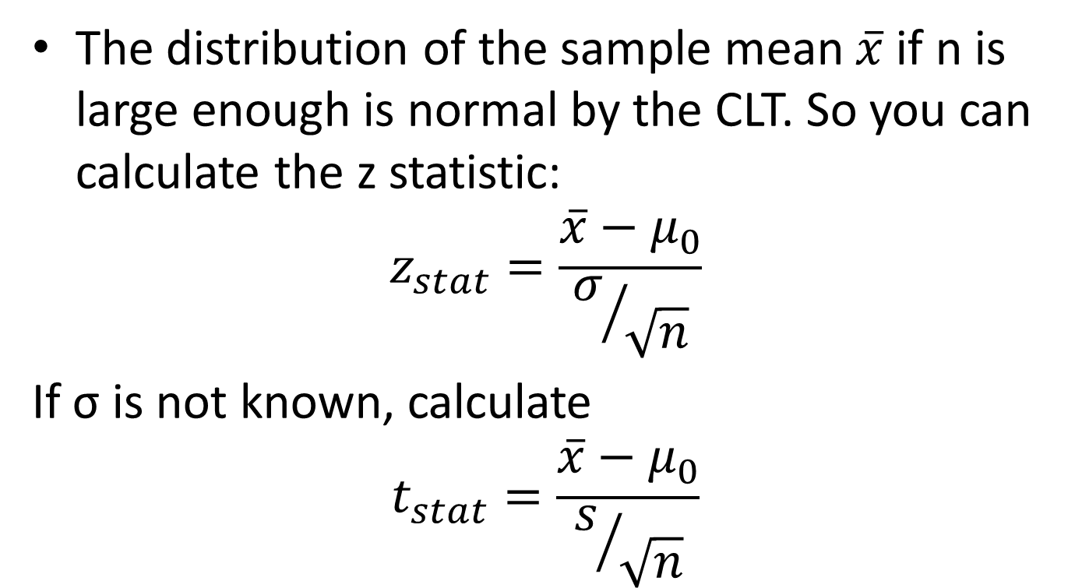
Test of one mean
The distribution of the sample mean $\overline{x}$ if n is large enough is normal by the CLT. So you can calculate the z statistic:
$$z_{stat}=\frac{\overline{x}−μ_{0}}{σ/{\sqrt{n}}}$$
If σ is not known, calculate
$$t_{stat}=\frac{\overline{x}−μ_{0}}{s/{\sqrt{n}}}$$

Slide 35
Tests of one mean
Compare the test statistic to the appropriate distribution to get the p-value
  For a one-sided test, if the alternative hypothesis is H_{A}: μ>μ₀ then the p-value is
  P(Z>z_{stat}) or P(T>t_{stat})
  For a one-sided test, if the alternative hypothesis is H_{A}: μ<μ₀ then the p-value is
  P(Z<z_{stat}) or P(T<t_{stat})

Slide 36
Tests of one mean
For a two-sided test, the p-value is
  P(Z>z_{stat})+P(Z<-z_{stat}) = 2*P(Z>z_{stat})
  OR P(T>t_{stat})+P(T<-t_{stat}) = 2*P(T>t_{stat})

Slide 37
Test of one mean, one sided
Non-pneumatic anti-shock garment for the treatment of obstetric hemorrhage in Nigeria
Mean initial blood loss 1413.1 ml; SD=491.3; n=83
Our question: Are these women sampled from a population that is hemorrhaging (>750 ml blood loss)?
Data adapted from Miller, S et al. Int J Gynecol Obstet (2009)

Slide 38
Test of one mean, one sided
The null hypothesis is they are not hemorrhaging
  H₀: μ≤750 H_{A}: μ>750 ⍺=0.05
T-statistic:
p-value: P(T>12.3) with 82 d.f.
Data adapted from Miller, S et al. Int J Gynecol Obstet (2009)

Slide 39
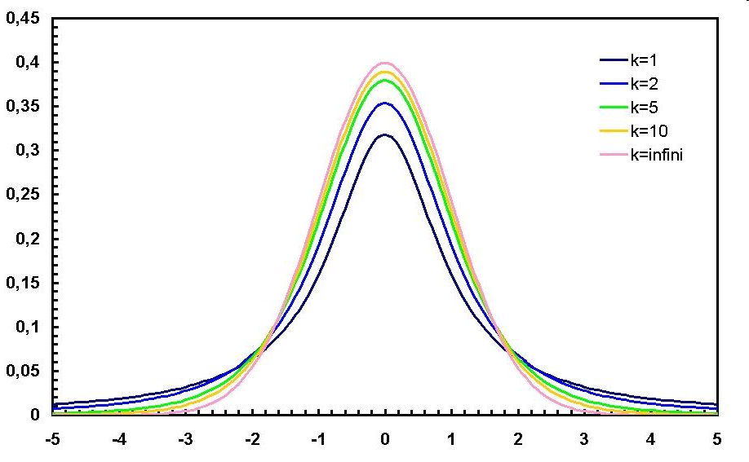
Test of one mean
12.3 is off the graph
So the probability of observing a sample mean of 1413 with n=83 and SD=431 if the true mean is <=750 is very very low

Slide 40
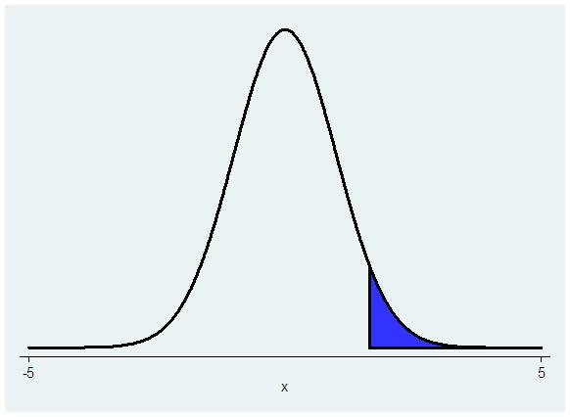
Test of one mean, one sided hypothesis, Stata
P(T>test stat)
. display ttail(82, 12.3)
1.308e-20
The p-value is <0.001, which is a lot less than 0.05, therefore we reject the null

Slide 41
Test of one mean, one sided hypothesis, Stata
Another way: Stata immediate code for ttests:
ttesti samplesize samplemean samplesd hypothesizedmean
ttesti 83 1413.1 491.3 750
One-sample t test
------------------------------------------------------------------------------
| Obs Mean Std. Err. Std. Dev. [95% Conf. Interval]
---------+--------------------------------------------------------------------
x | 83 1413.1 53.92718 491.3 1305.822 1520.378
------------------------------------------------------------------------------
mean = mean(x) t = 12.2962
Ho: mean = 750 degrees of freedom = 82
Ha: mean < 750 Ha: mean != 750 Ha: mean > 750
Pr(T < t) = 1.0000 Pr(|T| > |t|) = 0.0000 Pr(T > t) = 0.0000
→ We reject the null
Stata gives you 3 alternative hypotheses

Slide 42
Test of one mean, two sided hypothesis
Example: Do children with congenital heart disease walk at the same or a different age as compared to healthy children? Healthy children start walking at mean age of 11.4 months
  Null hypothesis: H₀: μ= 11.4 months (μ₀)
  Alternative hypothesis: H_{A}: μ≠ 11.4 months
  Significance level=0.05
  Data: Sample of children with congenital heart defects, n=9, sample mean=12.8, sample SD=2.4

Slide 43
Calculate the test statistic and its associated p value
p- value is P(T>1.75) + P(T<-1.75) = 2*P(T>1.75)
  display ttail(8,1.75)*2
  .11823278
Notes:
What do you conclude? Does this illustrate why you would not say that you accept the null?

Slide 44
Or run ttesti in Stata
** ttesti samplesize samplemean samplesd hypothesizedmean
ttesti 9 12.8 2.4 11.4
One-sample t test
------------------------------------------------------------------------------
| Obs Mean Std. Err. Std. Dev. [95% Conf. Interval]
---------+--------------------------------------------------------------------
x | 9 12.8 .8 2.4 10.9552 14.6448
------------------------------------------------------------------------------
mean = mean(x) t = 1.7500
Ho: mean = 11.4 degrees of freedom = 8
Ha: mean < 11.4 Ha: mean != 11.4 Ha: mean > 11.4
Pr(T < t) = 0.9409 Pr(|T| > |t|) = 0.1182 Pr(T > t) = 0.0591
  → Fail to reject the null

Slide 45
Test of one mean
For data already in Stata, the ttest command also works
E.g. We want to test that the mean CD4 cell count <350 among persons newly diagnosed with HIV in Uganda
  Null hypothesis: H₀: μ≥350 cells/mm³
  Alternative hypothesis (the one we are worried about – that patients come in with low CD4 cell counts):
    H_{A}: μ <350 cells/mm³
  Significance level=0.05

Slide 46
Test of one mean
Use ttest varname== hypothesized value
. ttest cd4count==350
One-sample t test
------------------------------------------------------------------------------
Variable | Obs Mean Std. Err. Std. Dev. [95% Conf. Interval]
---------+--------------------------------------------------------------------
cd4count | 999 329.2332 8.419592 266.1177 312.7111 345.7554
------------------------------------------------------------------------------
mean = mean(cd4count) t = -2.4665
Ho: mean = 350 degrees of freedom = 998
Ha: mean < 350 Ha: mean != 350 Ha: mean > 350
Pr(T < t) = 0.0069 Pr(|T| > |t|) = 0.0138 Pr(T > t) = 0.9931
→ We reject the null
Data set: vct_baseline_biostat200_v1.dta

Slide 47
Hypothesis testing – one sided vs. two sided
One sided hypothesis : e.g. H_{A}: μ>μ₀
  For a one sided hypothesis, if you know σ, you calculate P(Z>z)
  You are only looking at one tail of the distribution
  For P(Z>z) to be <0.05, the test statistic z_{stat} must be >1.645

Slide 48
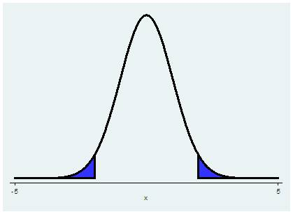
Hypothesis testing – one sided vs. two sided
Two sided hypotheses H_{A}: μ≠μ₀
  For a two sided hypothesis, you are considering the probability that μ>μ₀ or μ<μ₀ , so you calculate
  P(Z>z) or P(Z<-z) if you know σ, which is both tails of the distribution
  This is then 2*P(Z>z)
  For 2*P(Z>z) to be <0.05, the area in each tail must be <0.025, so the test statistic z_{stat} must be >1.96 or <-1.96

Slide 49
Hypothesis testing
So at the same significance level, here ⍺=0.05, a smaller test statistic, and therefore less evidence, is needed to reject the null for a one sided test as compared to a two sided test
So a two sided test is more conservative

Slide 50
Hypothesis testing
What if you ran a test and got z_{stat} =1.83? If your hypothesis was one-sided, you’d reject. If your hypothesis was two-sided, you’d fail to reject.
Therefore it is very important to specify your test a priori!

Slide 51
Hypothesis testing
For clinical trials, most people use two-sided hypotheses
  That way no one will suspect you of changing your hypothesis test after the fact
  On the other hand, does it really make sense to have an alternative hypothesis that a new treatment is either better or worse than the old one?

Slide 52
Inference on proportions
Variables that are measured as successes or failures, disease or no disease, etc., can be considered binomial random variables
  x=number of successes
  n=number of “trials”
  x/n = proportion diseased

Slide 53
Hypothesis test of a proportion
Under the CLT, the sampling distribution of an estimated proportion p̂, if n is large enough, is approximately a normal distribution with mean p and standard deviation=√(p(1-p)/n)

Slide 54
Hypothesis test of a proportion
Therefore we can test that a sample proportion is equal to, greater than, or less than some hypothesized p₀ using the z statistic

Slide 55
Hypothesis test of a proportion
Example: Micronutrient intake of black women in South Africa
Study: Pre-menopausal women randomly selected based on geographic location
Micronutrient intake was determined using a Quantitative Food Frequency Questionnaire developed for South Africans
Question: Do more than 10% of the women have the micronutrient intake of less than the RDA?
Data adapted from Hattingh Z. et al, West Indian Med J 2008: 57 (5):431

Slide 56
Hypothesis test of a proportion
Null hypothesis:
  10% or fewer of the women aged 25-34 have insufficient dietary folate levels (less than 268 µg, a cutoff based on RDA)
  H₀: p₀ ≤ 0.10
Alternative hypothesis:
  More than 10% of the women aged 25-34 have insufficient dietary folate levels
  H_{A}: p₀ > 0.10
Significance level set at = 0.05

Slide 57
Hypothesis test of a proportion
The data:
  158/279=56.6% had folate levels<268 µg
Using the normal approximation to the binomial distribution:
  z_{stat} = (.566-0.10)/√(0.10*0.90/279) =25.9
  The chance of observing a z statistic of this large (25.9) is very small (<0.05)
  → So we reject the null hypothesis

Slide 58
Hypothesis testing of a proportion
The stata command prtest or prtesti gives you a test of a proportion using the normal approximation
** prtesti samplesize observedp hypothp
. prtesti 279 .566 .1
One-sample test of proportion x: Number of obs = 279
------------------------------------------------------------------------------
Variable | Mean Std. Err. [95% Conf. Interval]
-------------+----------------------------------------------------------------
x | .566 .0296723 .5078434 .6241566
------------------------------------------------------------------------------
p = proportion(x) z = 25.9458
Ho: p = 0.1
Ha: p < 0.1 Ha: p != 0.1 Ha: p > 0.1
Pr(Z < z) = 1.0000 Pr(|Z| > |z|) = 0.0000 Pr(Z > z) = 0.0000

Slide 59
Using the binomial distribution
This is a straightforward test of the binomial distribution -- we are asking what is the probability that we observe 158 events when n=279 and the “true” proportion is 0.10
. di binomialtail(279,158,.1)
1.268e-82

Slide 60
Using the binomial distribution
The Stata command bitest or bitesti also does this
** bitesti samplesize observed_proportion hypoth_proportion
. bitesti 279 .566 .1
N Observed k Expected k Assumed p Observed p
------------------------------------------------------------
279 158 27.9 0.10000 0.56631
Pr(k >= 158) = 0.000000 (one-sided test)
Pr(k <= 158) = 1.000000 (one-sided test)
Pr(k >= 158) = 0.000000 (two-sided test)
note: lower tail of two-sided p-value is empty
Use i at the end (ttesti prtesti bitesti) when you do not have the data in stata but want to run a test

Slide 61
Hypothesis testing of a proportion example
Null hypothesis:
  Fewer than 10% of the women aged 25-34 have dietary zinc levels of less than 5 mg
  H₀: p < 0.10
Alternative hypothesis:
  10% or more of the women aged 25-34 have dietary zinc levels of less than 5 mg
  H_{A}: p ≥ 0.10
Significance level = 0.05

Slide 62
Hypothesis testing of a proportion
The data: 31/279=11.1% had zinc levels of less than 5 mg
prtesti 279 .111 .1
One-sample test of proportion x: Number of obs = 279
------------------------------------------------------------------------------
Variable | Mean Std. Err. [95% Conf. Interval]
-------------+----------------------------------------------------------------
x | .111 .0188066 .0741397 .1478603
------------------------------------------------------------------------------
p = proportion(x) z = 0.6125
Ho: p = 0.1
Ha: p < 0.1 Ha: p != 0.1 Ha: p > 0.1
Pr(Z < z) = 0.7299 Pr(|Z| > |z|) = 0.5402 Pr(Z > z) = 0.2701
Using the normal approximation, we find that the data are NOT inconsistent with the null hypothesis, therefore we fail to reject the null

Slide 63
Using the binomial distribution
. bitesti 279 .111 .1
N Observed k Expected k Assumed p Observed p
------------------------------------------------------------
279 31 27.9 0.10000 0.11111
Pr(k >= 31) = 0.295225 (one-sided test)
Pr(k <= 31) = 0.767742 (one-sided test)
Pr(k <= 24 or k >= 31) = 0.548577 (two-sided test)
Or we could have used:
. di binomialtail(279,31,.1)
.29522463
These are exact tests, rather than using the normal approximation.

Slide 64
Hypothesis testing of a proportion
Remember that if n or p are small, you may need to use an exact test
The commands in Stata to do this are
display binomialtail(n,k,p)
or
bitesti samplesize observedp hypothp

Slide 65
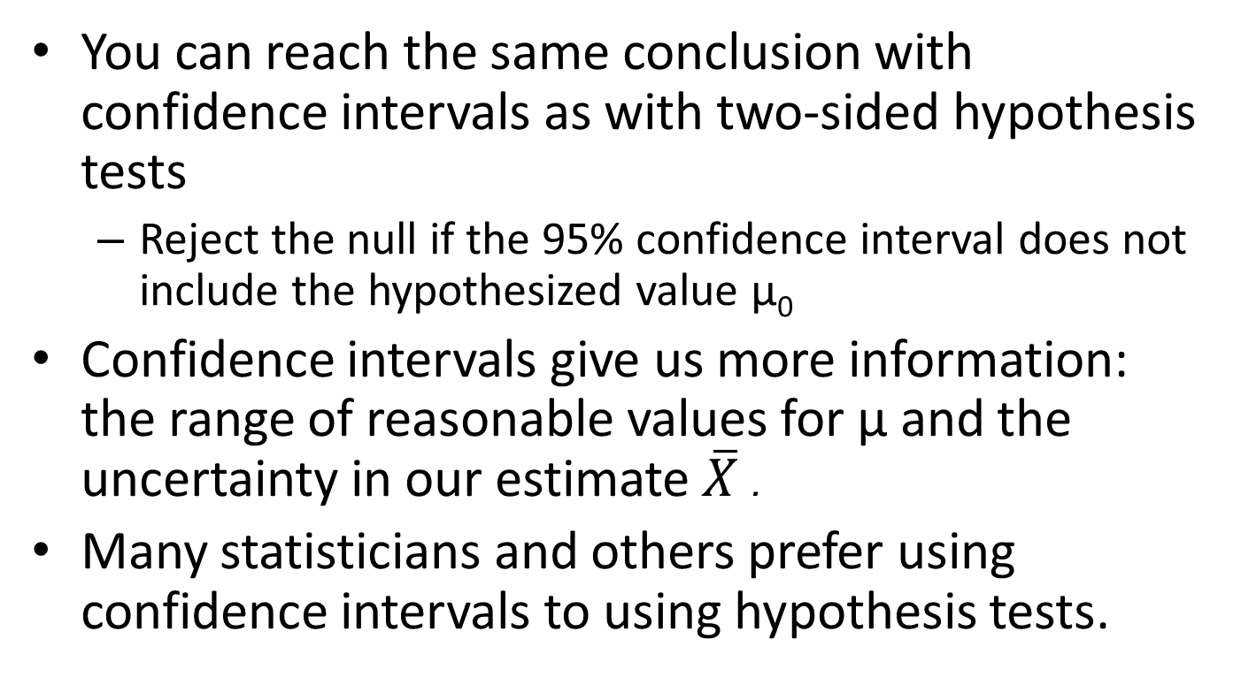
Hypothesis tests versus confidence intervals
Notes:
Hypothesis tests have an artificial cutoff for rejecting vs. failing to reject.

Slide 66
Types of error
Type I error – significance level of the test
⍺ =P(reject H₀ | H₀ is true)
Occurs when we incorrectly reject the null
We take a sample from the population, calculate the statistics, and make inference about the true population. If we did this repeatedly, we would incorrectly reject the null 5% of the time that it is true if ⍺ is set to 0.05.

Slide 67
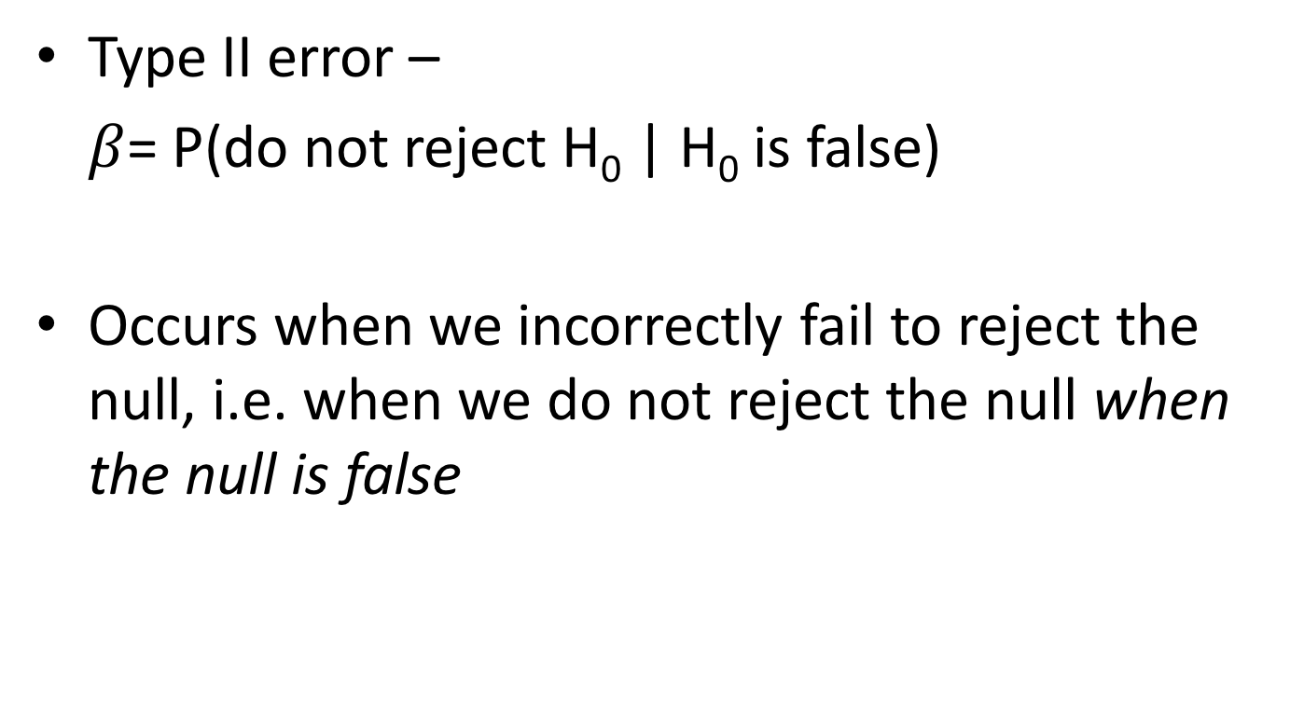
Types of error
Type II error –
$β$= P(do not reject H₀ | H₀ is false)
Occurs when we incorrectly fail to reject the null, i.e. when we do not reject the null when the null is false

Slide 68
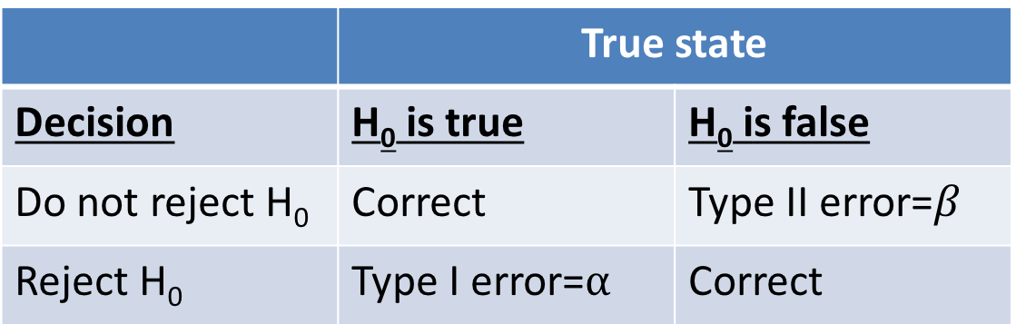
Types of error
Remember, H₀ is a statement about the population and is either true or false, but we don’t know which
We take a sample and use the information in the sample to try to determine the answer
We set our chance of a Type I error, and can design our study to minimize the chance of a Type II error
 | True state
Decision | H₀ is true | H₀ is false
Do not reject H₀ | Correct | Type II error=$β$
Reject H₀ | Type I error=⍺ | Correct

Slide 69
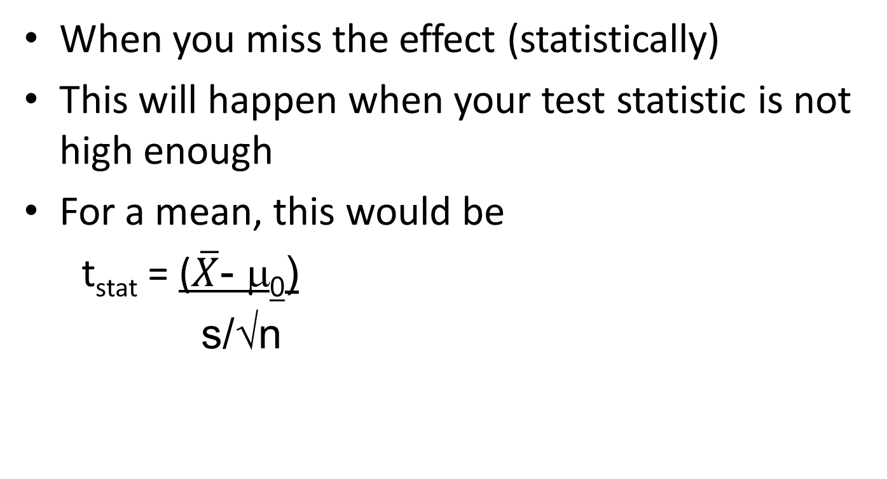
Type II error

Slide 70
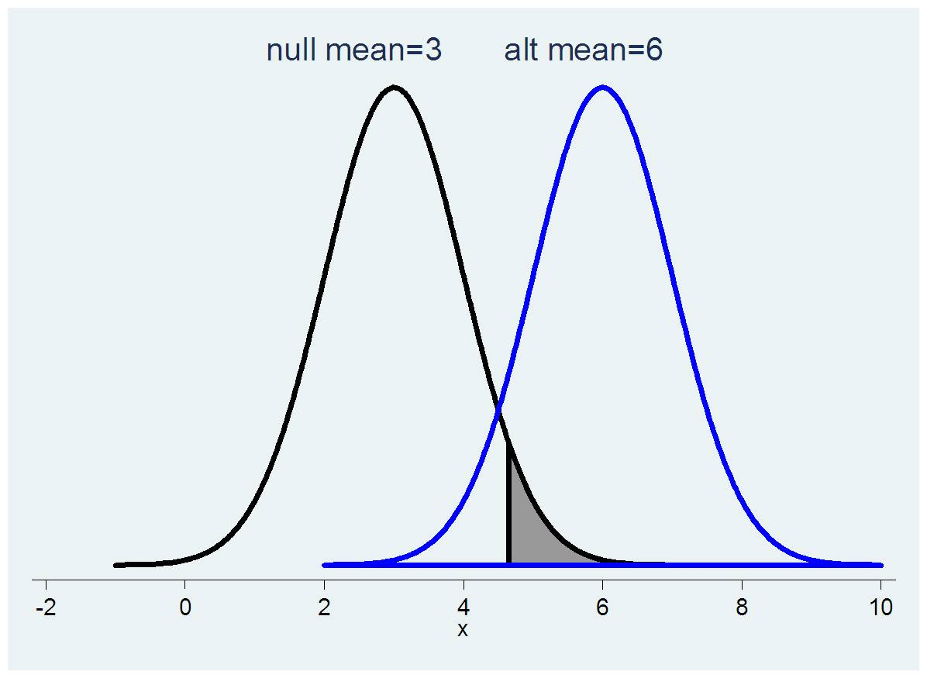
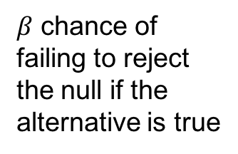
Chance of a type II error
$β$ chance of failing to reject the null if the alternative is true
Notes:
You can miss the effect when your test statistic is not high enough
The true mean might be 6 but if you get a sample with mean 4 you won’t reject the null

Slide 71
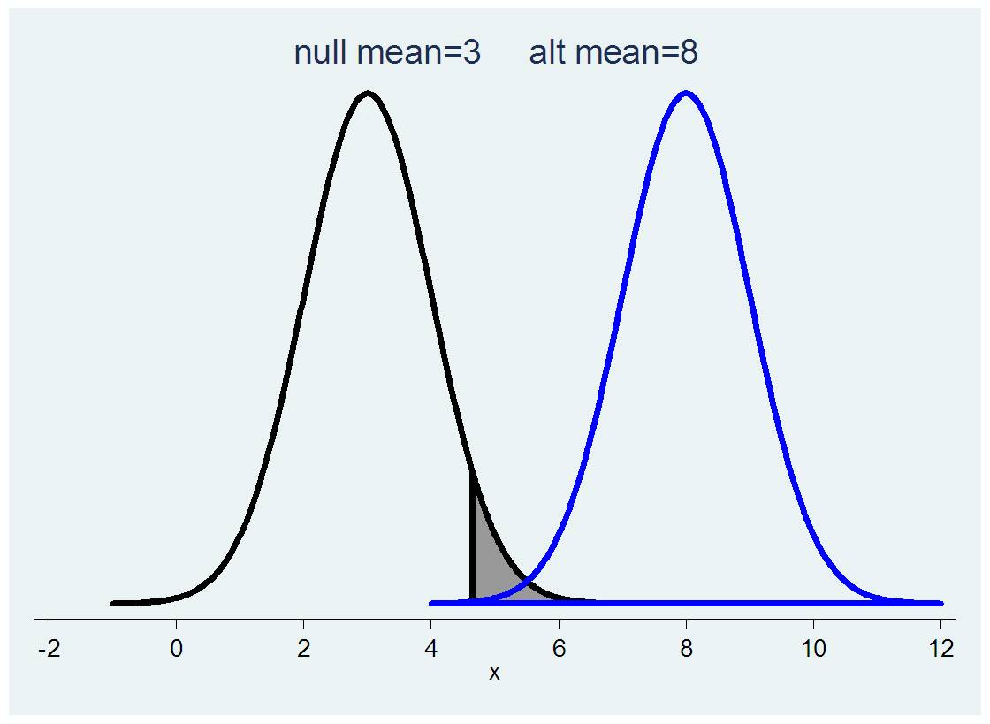
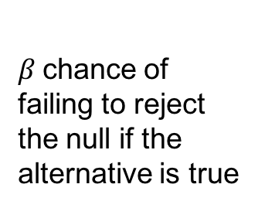
If the alternative is very different from the null, the chance of a Type II error is low
$β$chance of failing to reject the null if the alternative is true
Notes:
Here there isn’t much overlap between the null and the alternative distributions so there is less chance that you’ll get a value that lies within the acceptance range of the null if the true distribution is really the alternative. The arrow is pointing to the small part of the left tail of the distribution with mu=8 that is to the left of the grey shaded rejection area.

Slide 72
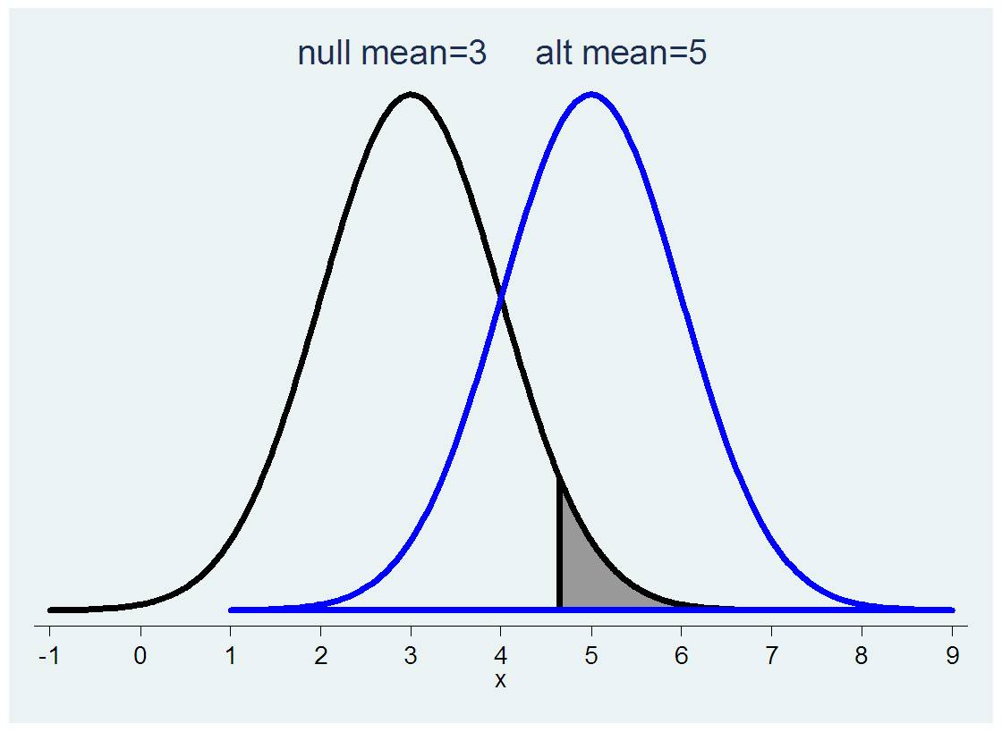
If the alternative is not very different from the null, the chance of a Type II error is high
$β$ chance of failing to reject the null if the alternative is true

Slide 73
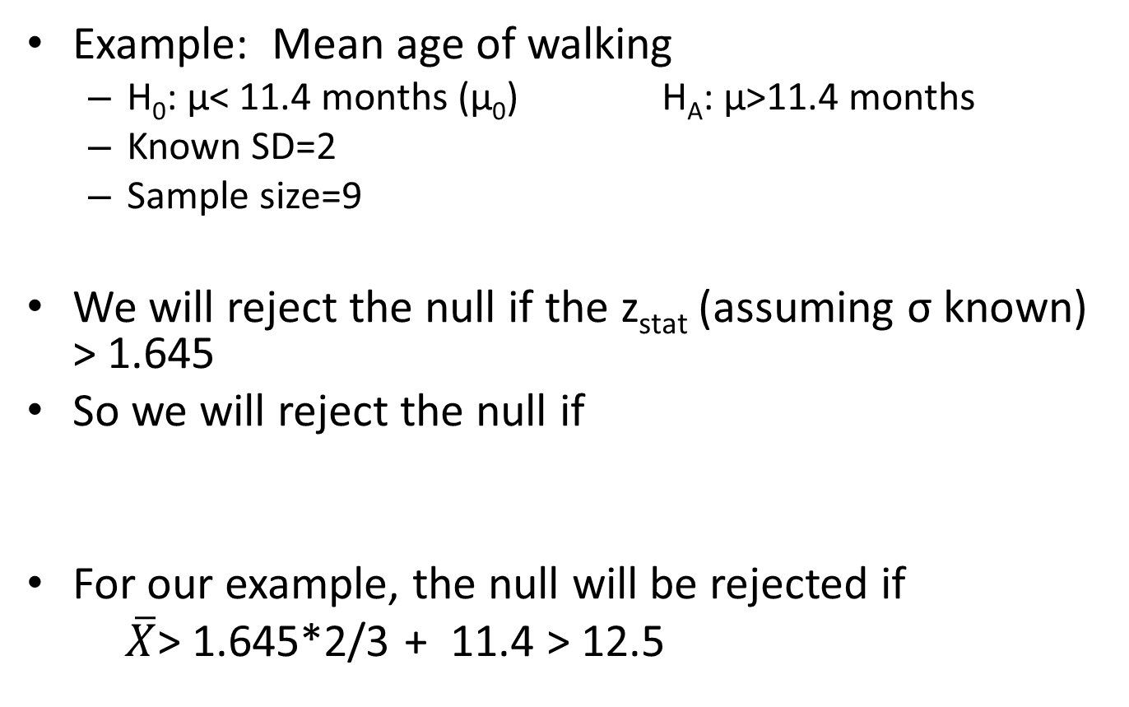

Finding $β$, P(Type II error)

Slide 74
If the true mean µ is really 14 (versus the null value of <11.4, meaning the null is false), what is the probability that the null will not be rejected?
  The probability of a Type II error?
The null will be rejected if the sample mean is >12.5, not rejected if it is ≤12.5
What is the probability of getting a sample mean of ≤12.5 if the true mean is 14? This is a z statistic.
P(Z<(12.5-14)/(2/3))
    di normal((12.5-14)/(2/3))
    .01222447
    So if the true mean is 14 and the sample size is 9, the probability of incorrectly failing to reject the null is 0.012

Slide 75
Note that this depended on this other population mean (e.g. 14)
  The chance of failing to reject the null will increase if this true population mean is closer to the null value
What is the probability of failing to reject the null if the true population mean is 13?
  P(Z<(12.5-13)/(2/3))
    di normal((12.5-13)/(2/3))
    .22662735
    So for an alternative mean that is closer to the null value, the chances of failing to reject are higher

Slide 76
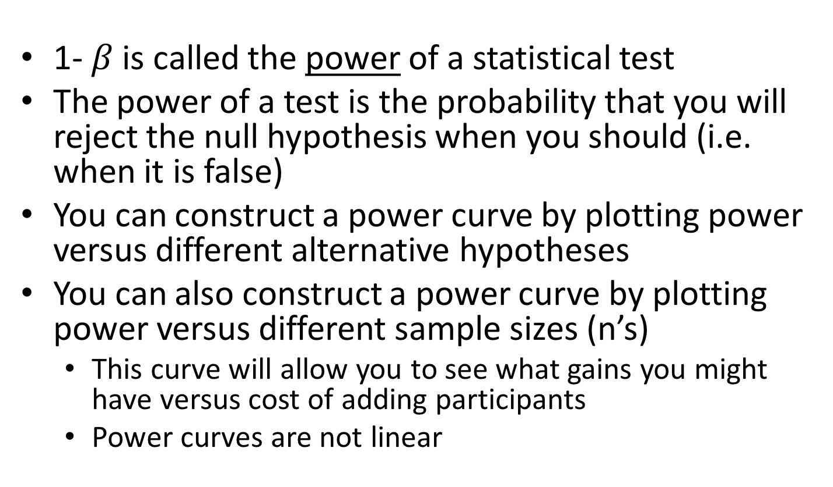
Power
1- $β$is called the power of a statistical test
The power of a test is the probability that you will reject the null hypothesis when you should (i.e. when it is false)
You can construct a power curve by plotting power versus different alternative hypotheses
You can also construct a power curve by plotting power versus different sample sizes (n’s)
  This curve will allow you to see what gains you might have versus cost of adding participants
  Power curves are not linear

Slide 77
Power
The power of a statistical test is lower for alternative values that are closer to the null value.
    When alt mean was 14, power =1-.012=.988
    When alt mean was 13, power was 1-.227=.773
The power of a statistical test can also be increased by increasing n
For a fixed n, the power of a statistical test can be increased by increasing ⍺, the probability of a Type I error

Slide 78
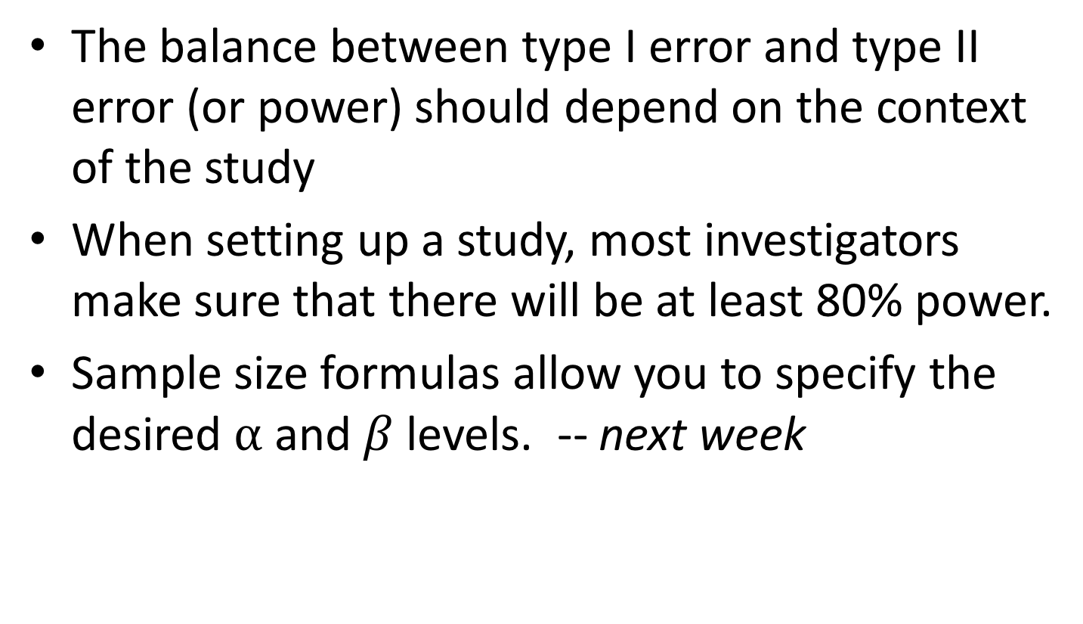
Power
The balance between type I error and type II error (or power) should depend on the context of the study
When setting up a study, most investigators make sure that there will be at least 80% power.
Sample size formulas allow you to specify the desired ⍺ and $β$ levels. -- next week

Slide 79
For next time
Read Pagano and Gauvreau
  Chapter 10 and 14 (pages 329-330) today’s material
  Pagano and Gauvreau Chapters 11-12, and 14 (pages 332-338)

